Slide 1
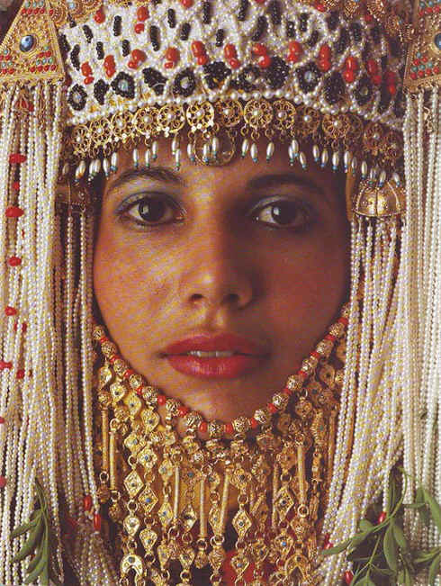
Esther
Extermination Plot Foiled
Dr. Rick Griffith • Jordan Evangelical Theological Seminary • BibleStudyDownloads.org
Notes:
To exterminate means to annihilate or destroy completely.
In Esther we see a plan to wipe out the Jews ended up being stopped.

Slide 2
Key Word
308
39
Providence
Esther
Notes:
The word providence never appears in the book itself but the reader must conclude that the events are so unlikely that God must be behind them.
Certain words and phrases that I never use: coincidence, it just so happened, fate, I thank my lucky stars, it occurred by chance, accident, etc.

Slide 3
Theme
308
Extermination Plot Foiled
Esther
Notes:
God is never mentioned in the book, so who is it that stops this plan to wipe the Jews from the face of the earth?
The fact that God is never noted only heightens the irony—surely no one else could devise such “circumstantial” events where Mordecai is in the exact place he was, or when the king could not sleep on a particular night, or when he asks that King Ahasuerus be put back to sleep with a boring reading of his reign, or the text of his life being saved in is the passage read to him, or the timing of Haman being outside his room when the king devises his plan to exalt Mordecai, or many other “it-just-so-happened” types of events that no one could plan except God. All these lead to the Jews triumphing over the threats to their very existence.

Slide 4
Key Verse
308
(Mordecai speaking) "For if you remain silent at this time, relief and deliverance for the Jews will arise from another place, but you and your father's family will perish. And who knows but that you have come to royal position for such a time as this?" (4:14).
Esther
Notes:
Here we see the perfect balance between divine sovereignty (“deliverance from another place”) and human responsibility (“for such a time as this”).
Mordechai knew that God would keep his promise to bless the world through Israel—but he also knew that God uses people in his fulfilling his plan.
Like Esther, we can either choose to rebel against God’s plan or cooperate with him. Rebellion leads to personal ruin, but obedience privileges us to actually be part of what God had designed all along!

Slide 5

Kingdom Statement
39
God's providence in averting Israel's destruction showed his rule over all nations.
Esther
Notes:
Persia’s king Xerxes thinks he is sovereign to do as he wills, but he is easily manipulated by his advisers over what to do with Vashti, over Haman’s cunning to enrich the treasury and take vengeance on the Jews, over Esther’s beauty and ability to get him to do her will, etc. The king is not as powerful as he thought, for the King of kings was above every decision.

Slide 6

Summary Statement
308
41
An extermination of the Jewish nation plotted by Haman reverts upon his own head by God's providence through Mordecai and Esther to encourage postexilic Israel of God's continued commitment to the Abrahamic Covenant.
Esther
Notes:
Province is evidence in nothing spiritual noted in the book—not God’s name(s), nor the law, nor prayer, nor priests or sacrifices or anything of a religious nature. And yet, above it all God shows clearly his unrelenting passion to fulfil the promises of land, seed, and blessing promised to Abraham (Gen 12:1-3).

Slide 7

Covenant
42b
God protected Israel from extinction (4:14; cf. Jer. 31:35-37), fulfilling his covenant promise to bring the Messiah mostly behind the scenes.
Esther
Notes:
Had Haman’s plan succeeded, the Jews would have been destroyed. There would have been no return to the land of Israel, no fulfillment of Messiah’s birth in Bethlehem (Micah 5:2), and no new covenant promised by Jeremiah 31 and Ezekiel 36.

Slide 8

Redemption
42b
All efforts to destroy God's redemptive plan by annihilating his redemptive people Israel will fail, as did Haman's.
Esther
Notes:
History has shown since the time of Esther that God is committed to save sinful humanity. The Romans tried to stamp out the Jews and Christians, but both remain today while Italy is a faint picture of the Roman Empire. Hitler sought to destroy the Jews but was himself destroyed. Even today, nations that bless Israel are themselves blessed—USA, Singapore, Jordan, etc. Likewise, countries seeking to destroy Israel are poorer, weaker, and more instable.

Slide 9

Messiah
42a
The queen’s risk of death for the Jews (4:16) and role as advocate (7:1-6) portray these roles for Christ.
Esther
Notes:
The whole book also shows how opposition against the Jews strengthened them so that the Messiah would eventually be born in Israel.

Slide 10
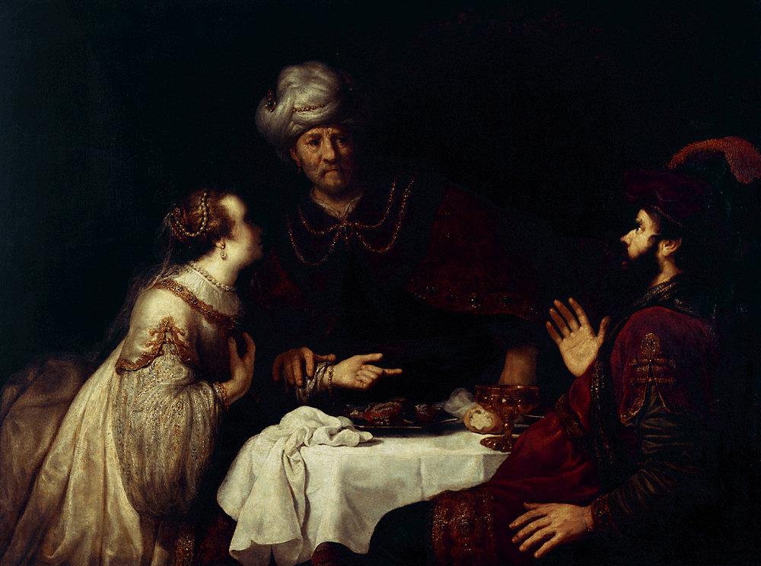
Esther
Extermination Plot Foiled |  | Principles for Growth
Plot Planned |  | Plot Foiled
Chapters 1–4 |  | Chapters 5–10
Threat |  | Triumph
Providence Prepared |  | Providence Enacted
Persecution |  | Preservation
Grave Danger |  | Great Deliverance
Feasts of Ahasuerus | Conduct 2:1-16 | Feasts of Esther & Purim | Eschatology 4:13–5:11
Esther Exalted 1:1–2:18 | Haman Plots 2:19–4:17 | Mordecai over Haman 5:1–8:2 | Mordecai over Persia 10
Persia
10 Years (483-473 BC)
308
Notes:
The turning point in the book is chapter 5. Before then, the situation keeps getting worse for the Jews, but the reversal begins in chapter 5 when the king responds favorably to Esther, leading to Haman’s downfall.

Slide 11
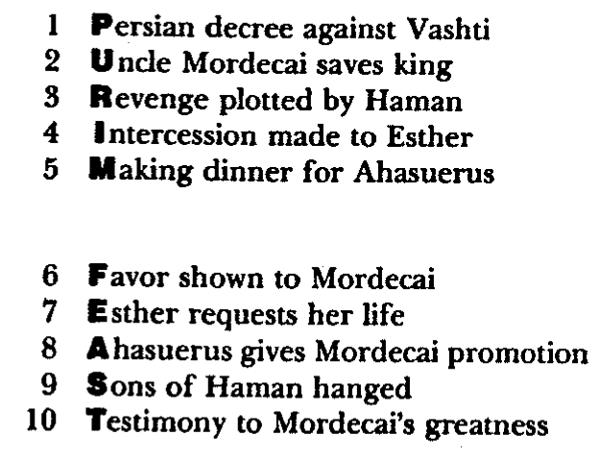
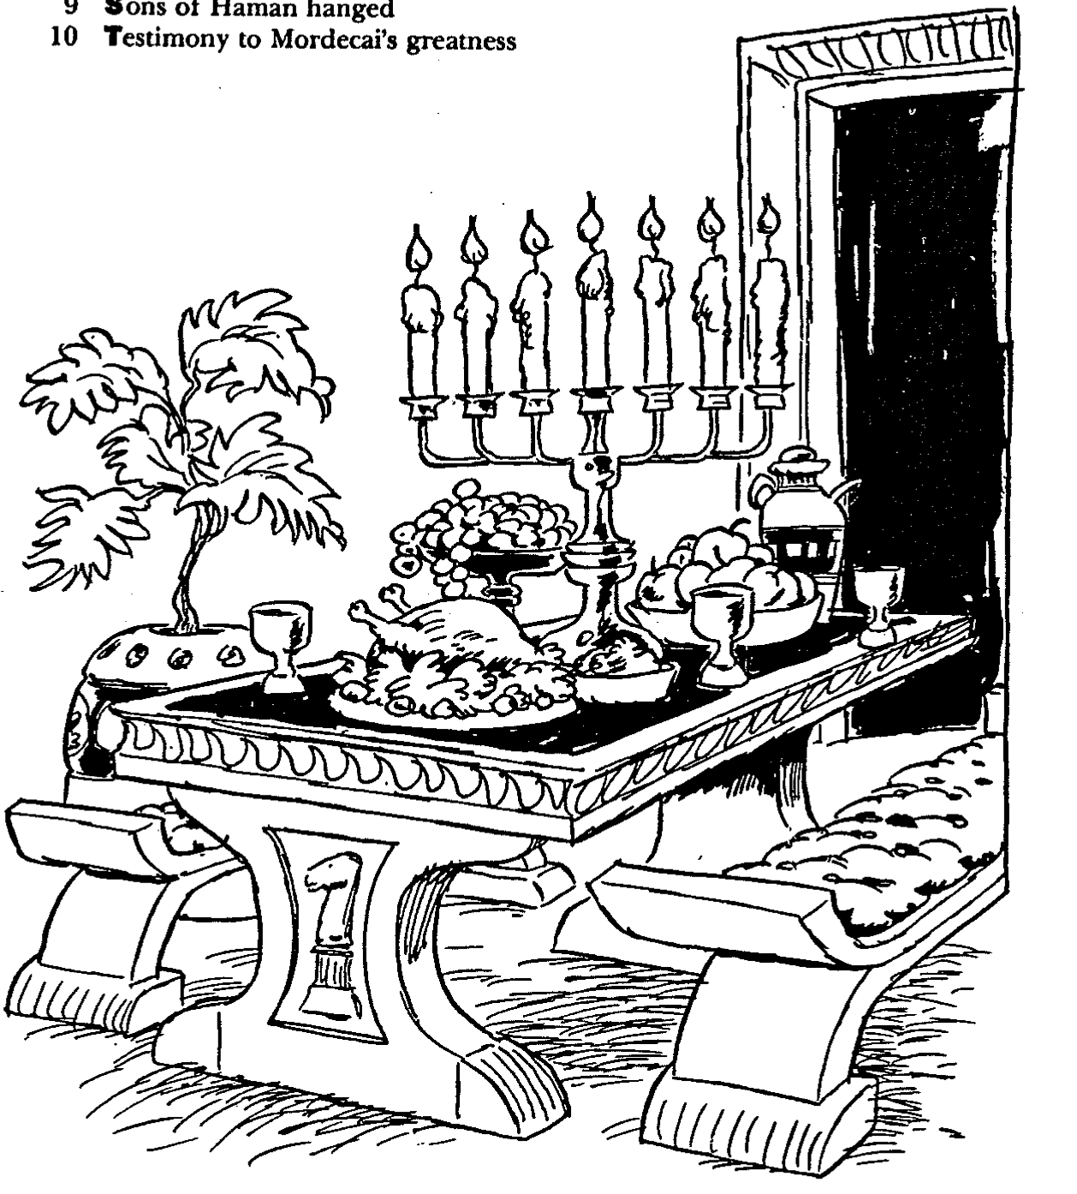
Barry Huddleston, The Acrostic Summarized Bible (Grand Rapids: Baker, 1992)
Esther
29 Genealogy of Jesus Christ
30 Opposition of King Herod
31 Spirit's descent upon Jesus
32 Power over Satan's temptations
33 Expounding Sermon on Mount
34 Lessons on proper priorities
35 Outline for personal relationships
36 Faith of the centurion
1 Persian decree against Vashti
2 Uncle Mordecai saves king
3 Revenge plotted by Haman
4 Intercession made to Esther
5 Making dinner for Ahasuerus
6 Favor shown to Mordecai
7 Esther requests her life
8 Ahasuerus gives Mordecai promotion
9 Sons of Haman hanged
10 Testimony of Mordecai’s greatness
37 Matthew's call from Jesus
38 Apostles sent to preach
39 Testimony about John's message
40 True Messiah called demonic
41 Hidden message of parables
42 Execution of the Baptist
43 Wisdom is answering Pharisees
44 Keys of the kingdom
45 Impact of Jesus' transfiguration
46 Need for true forgiveness
47 Grounds for divorce clarified
48 Opportunities in the vineyard
49 Fig tree is cursed
50 Taxes paid to Caesar
51 Hypocrisy denounced by "woes"
52 Events of second coming
53 Judgment of the nations
54 Events on Calvary's eve
55 Way of the cross
56 Savior's resurrection and commission
Notes:
The book actually has 10 feasts in 10 chapters! Even today, eating food with someone is deemed a clear testimony of fellowship. Ironically, Esther has two meals with her adversary Haman, who thought he was being honored by the queen but was in reality walking into her trap to kill him.

Slide 12
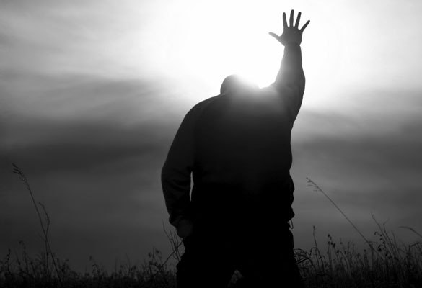
Be Committed
Esther
Dr. Rick Griffith • Crossroads International Church Singapore
CICFamily.com • BibleStudyDownloads.org
Notes:
Many examples of those committed to the Lord are in this book—Esther, Mordecai, the Jews, etc.

Slide 13

The church typically has a serious lack of commitment.
Why is that so?
Notes:
Do you think most congregations lack a zealousness for the Lord?
Why do you think? Tell your neighbor next to you.

Slide 14
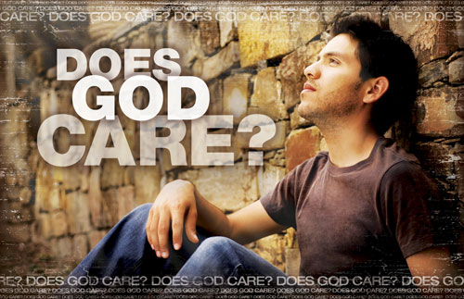
Does God Care About Those Left Behind?
Most of the Jews never returned to the land of Israel even in the Post-Exilic Period
Notes:
Does God zap us when we do not jump to serve him?
Of course not.
But does he work on even the apathetic?

Slide 15

Why should you be committed to God?
Esther
Notes:
What reasons can you give to be dedicated, loyal and devoted to the Lord?

Slide 16


The Postexilic Era
295
296
560
The Postexilic Era
Temple work
Prophets:
Haggai
Zechariah
Malachi
605
586
539
536
520
516
483-473
444-425
Others:
Zerubbabel
Esther
Ezra
Nehemiah
Persian Kings:
Cyrus
Darius
Xerxes
Artaxerxes
Notes:
The Post-Exilic Era was actually three separate periods:
(1) Temple rebuilding led by Zerubbabel, Haggai, and Zechariah in two parts under Cyrus and Darius,
(2) The saving of the nation from destruction by Esther about 30 years later under Xerxes, and
(3) The restoration of Jerusalem’s walls and gates by Nehemiah another 70 years after that under Artaxerxes.
_________
Common English slides-144
OS-00-OT Book Overviews-336
OS-15-Ezra-36
OS-16-Nehemiah-94
OS-17-Esther-16, 75

Slide 17
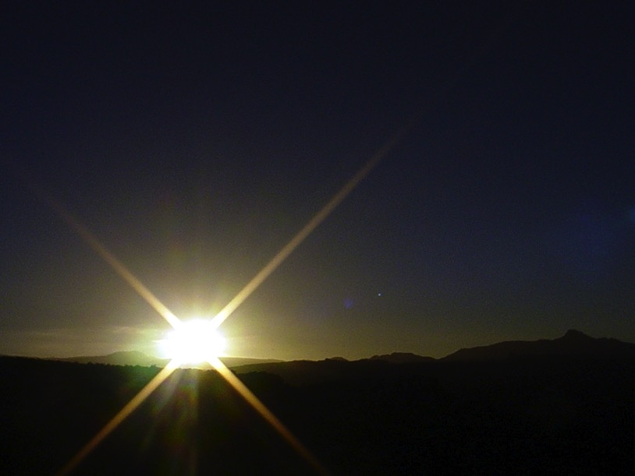


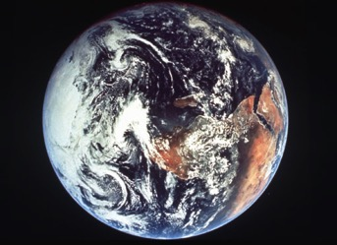
The Bible's Chiasm
446
Repeated Patterns in Reverse Order
Christ's Redemption
Christ's Rule
Man's Rule Lost at
Fall
Man's
Rule Restored at Millennium
Creation
New Creation
Notes:
We need to know who we are—more accurately, who God says we are—our future identity.
This is shown in the overall structure of the Bible in a chiasm—a literary pattern where earlier content is repeated in reverse order:
• Creation in Genesis 1–2 • is repeated In the Restored, New Creation in Rev 21–22
• Man was created to rule over the fish, birds, and land animals (Gen. 1:28) but he gave over his rule over to the god of this world, Satan (2 Cor. 4:4)
• But this rule will be restored during the 1000-year reign of the saints (Rev. 20:4-6)
• Christ is the central Person of history, • both as Lamb (Redeemer) • and as Lion (Ruler of all creation in the line of David)
________________
BE-17-Esther-76
OC-17-Genesis Authorship-14
OS-01-Genesis1-3-slide 243
OS-17-Esther-145
NS-27-Rev20-22-slide 206

Slide 18
God’s work faces threats (Esther 1–4).
Why be committed to God?
God’s work will triumph (Esther 5–10).
MAIN IDEA:
Despite Satan’s threats,
God will triumph
Notes:
Satan is always trying to push down whatever the Lord does.
But the Lord will eventually be the victor.
It’s easier to be committed to God’s plan when we know that it will ultimately succeed.
God commands our wholehearted devotion as we face many obstacles while God fulfills his plan.

Slide 19

WHAT TO DO?
308
Use your
providentially
placed position
to help
God's people
Notes:
Every believer has a strategic place to serve Christ—a different home, workplace, geographic location, gifting, passion, and background.
No one can serve Jesus in the same way you can! Fulfill God’s purposes for you!

Slide 20
Black

Slide 21

Review Quiz
REVIEW QUIZ on Ezra-Nehemiah
The book of Ezra's two main characters are __________ and _______.
The book of Nehemiah's two main characters are _____ and _________.
The book of Ezra focuses on rebuilding the _______, Nehemiah focuses on rebuilding the _____. Both deal with reforming the _________.

Slide 22
Review Quiz
REVIEW QUIZ on Ezra-Nehemiah
The book of Ezra's two main characters are Zerubbabel and Ezra.
The book of Nehemiah's two main characters are _____ and _________.
The book of Ezra focuses on rebuilding the _______, Nehemiah focuses on rebuilding the _____. Both deal with reforming the _________.

Slide 23
Review Quiz
REVIEW QUIZ on Ezra-Nehemiah
The book of Ezra's two main characters are Zerubbabel and Ezra.
The book of Nehemiah's two main characters are Ezra and Nehemiah.
The book of Ezra focuses on rebuilding the _______, Nehemiah focuses on rebuilding the _____. Both deal with reforming the _________.

Slide 24
Review Quiz
REVIEW QUIZ on Ezra-Nehemiah
The book of Ezra's two main characters are Zerubbabel and Ezra.
The book of Nehemiah's two main characters are Ezra and Nehemiah.
The book of Ezra focuses on rebuilding the Temple, Nehemiah focuses on rebuilding the walls. Both deal with reforming the people.

Slide 25
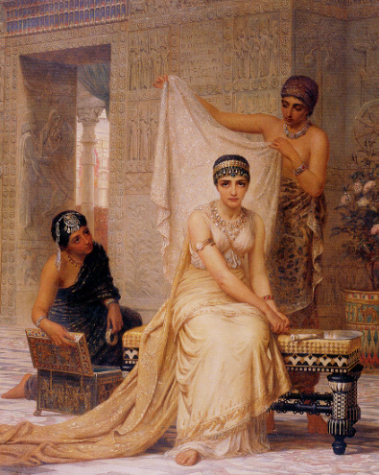
Where does Esther fit in OT history?

Slide 26

Esther
Jesus
David
Abraham
Flood
Today
Kings
Church
Tribes
3000
2000
1000
0
1000
2000
Creation
New Creation

Slide 27
Timeline
Exodus- 1 Samuel
2 Samuel – Esther
Jesus
Genesis
David
Abraham
Flood
Today
Kings
Church
Tribes
3000
2000
1000
0
1000
2000
Creation
New Creation

Slide 28
Kingdom Era
Ezra-Nehemiah
United Kingdom
1050-930
Divided Kingdom
930-722
Solitary Kingdom
722-586
Post- Exile
536-425
1100
1050
1000
950
900
850
800
7 5 0
7 0 0
650
600
550
500
450
Exile 606-536

Slide 29
Postexilic Era
Esther
United Kingdom
1050-930
Divided Kingdom
930-722
Solitary Kingdom
722-586
Post- Exile
536-425
1100
1050
1000
950
900
850
800
7 5 0
7 0 0
650
600
550
500
450
Exile 606-536

Slide 30
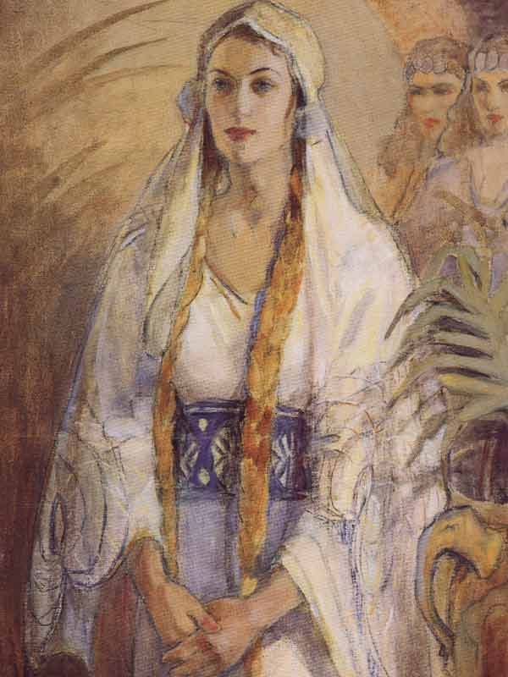
Where is Esther in the post-exilic period?

Slide 31
Chronology of the Returns
Nehemiah 444-430
Zerubbabel 537-516
Esther 483-473
Ezra 457-444
540
530
520
510
500
490
480
470
460
450
440
430
420
410
Buddha 560-477
Socrates
470-399
Confucius
551-479
Plato 427-347

Slide 32
Nebuchadnezzar's Six Deportations to Babylon
492
Size | Date | King of Judah | Number taken | Key Captives | Results/ Comments
1 Minor | 605 BC | Jehoiakim | Few (Dan 1:3) | Daniel, 3 friends & nobility & royalty | Tribute imposed. Egypt powerful.
2 Moderate | 598 BC | Jehoiakim | 3023 (Jer. 52:28) |  | Minor deportation
3 Major | 597 BC | Jehoiachin | 10,000 (2 Kings 24:14) | Jehoiachin, Ezekiel, Mordecai | Neb. deports many; installs Zedekiah
4 Minor | 587 BC | Zedekiah | 832 (Jer. 52:29) |  | Before destruction
5 Major | 586 BC | Zedekiah | ca. 10,400 (2 Kings 25:11) | Zedekiah | Jerusalem & temple destroyed
6 Minor | 582 BC |  | 745 (Jer. 52:30) |  | 4 years after Jerusalem's destruction
Notes:
Nebuchadnezzar had six deportations to Babylon. The 597 BC deportation was the third of the six and the first of 2 major deportations, with 10,000 people deported.

Slide 33
Two 70-Year Exiles
560
People Exile
605
586
539
536
516
Temple Exile
"This entire land will become a desolate wasteland. Israel and her neighboring lands will serve the king of Babylon for seventy years. ¹²Then, after the seventy years of captivity are over, I will punish the king of Babylon and his people for their sins," says the Lord. I will make the country of the Babylonians a wasteland forever"
(Jeremiah 25:11-12).
Notes:
In 539 BC under the rule of Darius, Daniel read Jeremiah 25:11-12 that limited the exile to 70 years (605-536 BC), or only three years away (9:1-2). But another way to see the 70 years is that the temple lay in ruins from 586 until 516 when the second temple was completed.
Jeremiah does not tell us the exact years that begin and end the 70-year exile.
But we can determine this in two ways—either the exile of the people beginning with Daniel’s deportation (605) to the people fully returning in 536, or the exile of the temple from its destruction in 586 to its rebuilding in 516.
_____________________
Common-320
BE-27-Daniel-89
ES-26-Restoration of Israel-186
OS-00-OT Book Overviews-295, 755
OS-12-Kings & Prophets Charts-26
OS-12-2Kings-231
OS-14-2Chron-308
OS-14-Reasons for Exile-54
OS-15-Ezra-14, 35
OS-17-Esther-33
OS-24-Jeremiah-53, 141
OS-27-Daniel-94, 284, 340, 361
OS-37-Haggai-9, 32
OS-Zechariah-15

Slide 34
Chronology of the Persian Period
313
John H. Walton, Chronological and Background Charts of the OT, 2d ed., 70
PERSIAN KING
DATES
BIBLICAL CORRELATION
GREEK CORRELATION
CYRUS
539-530
Return of Zerubbabel &
Jeshua (Ezra 1–3)
CAMBYSES
530-522
Rebuilding at Jerusalem stopped (Ezra 4)
DARIUS I
522-486
Haggai & Zechariah prophesy (520)
Temple completed (516)
(Ezra 5–6)
Greeks defeat Persians at Marathon (490)
XERXES
486-464
Story of Esther
(Esther 1–9)
Persians defeat Greeks at Thermopylae (480) but reversed at Salamis (480), Herodotus 485-425
ARTAXERXES I
464-423
Return of Ezra (458)
(Ezra 7–10)
Return of Nehemiah (445)
(Nehemiah 1–2)
Prophecy of Malachi (433)
Golden Age (461-431)
Pericles (460-429)
Athens rules

Slide 35
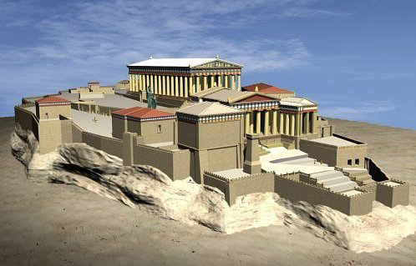
The Pinnacle of Greek History
Democracy & Building the Parthenon
Notes:
The background to Esther is the rise of democracy in Greece in the preceding century. It was based on the natural hill in Athens.

Slide 36
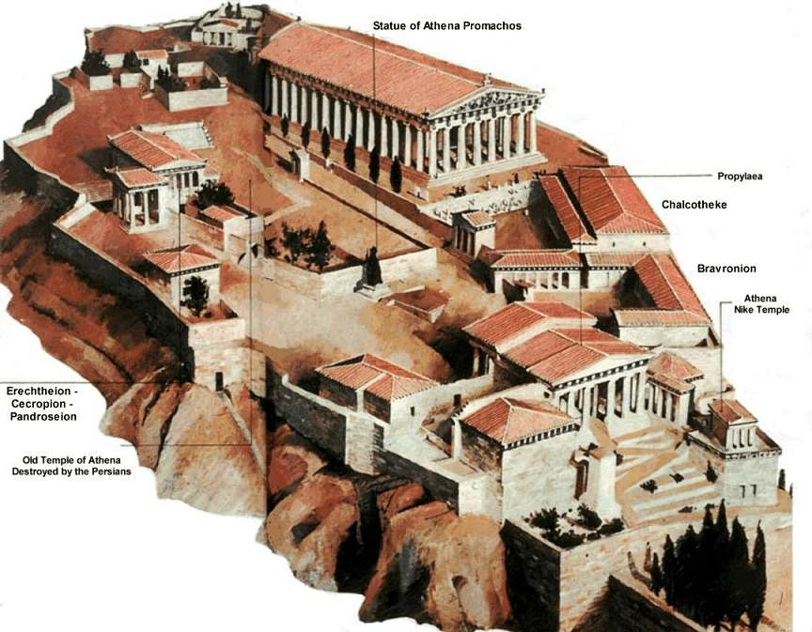
The Acropolis
Notes:
Upon this outcrop called the Acropolis was the center of Greek pagan religion that focused on the goddess Athena.

Slide 37
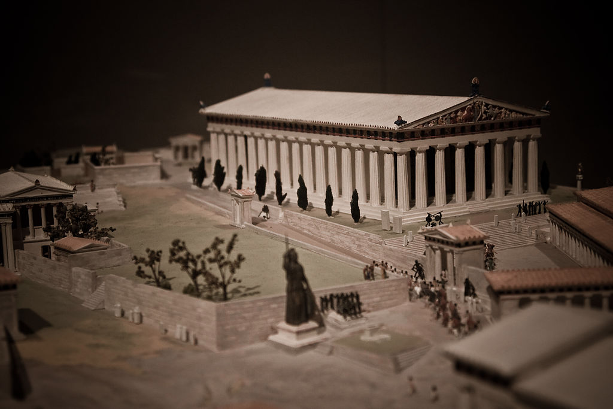
A Target for Persia…
Democracy & Building the Parthenon
Notes:
The Parthenon was considered the pinnacle of all buildings with so-called perfect proportions. This made Greece attractive to Persia so the Persians sought the wealth and influence of the Greek people and land.

Slide 38
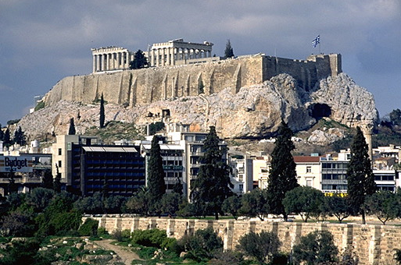
The Acropolis Today
Notes:
The Acropolis doesn’t look like much today…

Slide 39
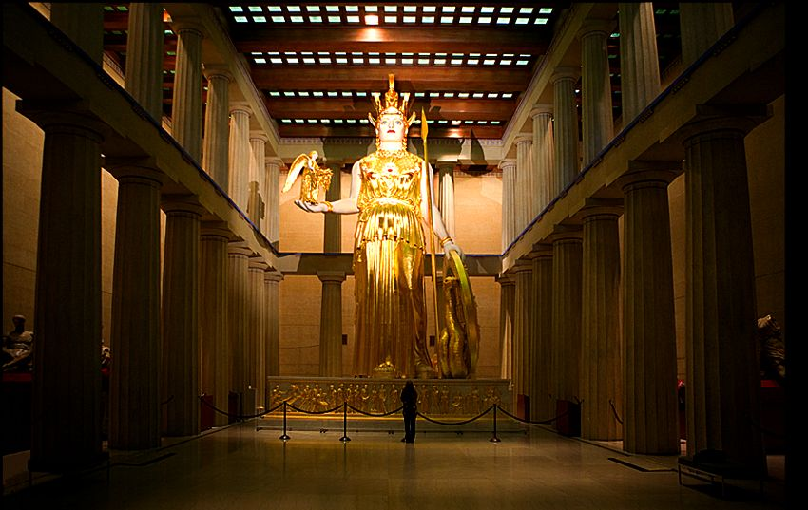
The Pinnacle of Greek History
Athena (goddess of wisdom)
inside the Parthenon
Notes:
Inside the Parthenon was a gold-plated statue of the goddess of wisdom, Athena.

Slide 40
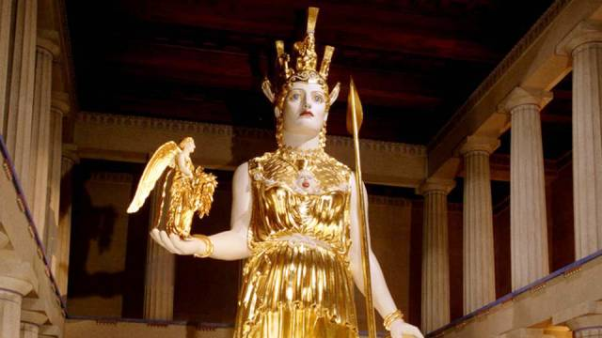
The Pinnacle of Greek History
Athena (goddess of wisdom)
inside the Parthenon
Notes:
How ironic that the builders who sought wisdom from Athena lacked the wisdom to avoid idolatry!

Slide 41
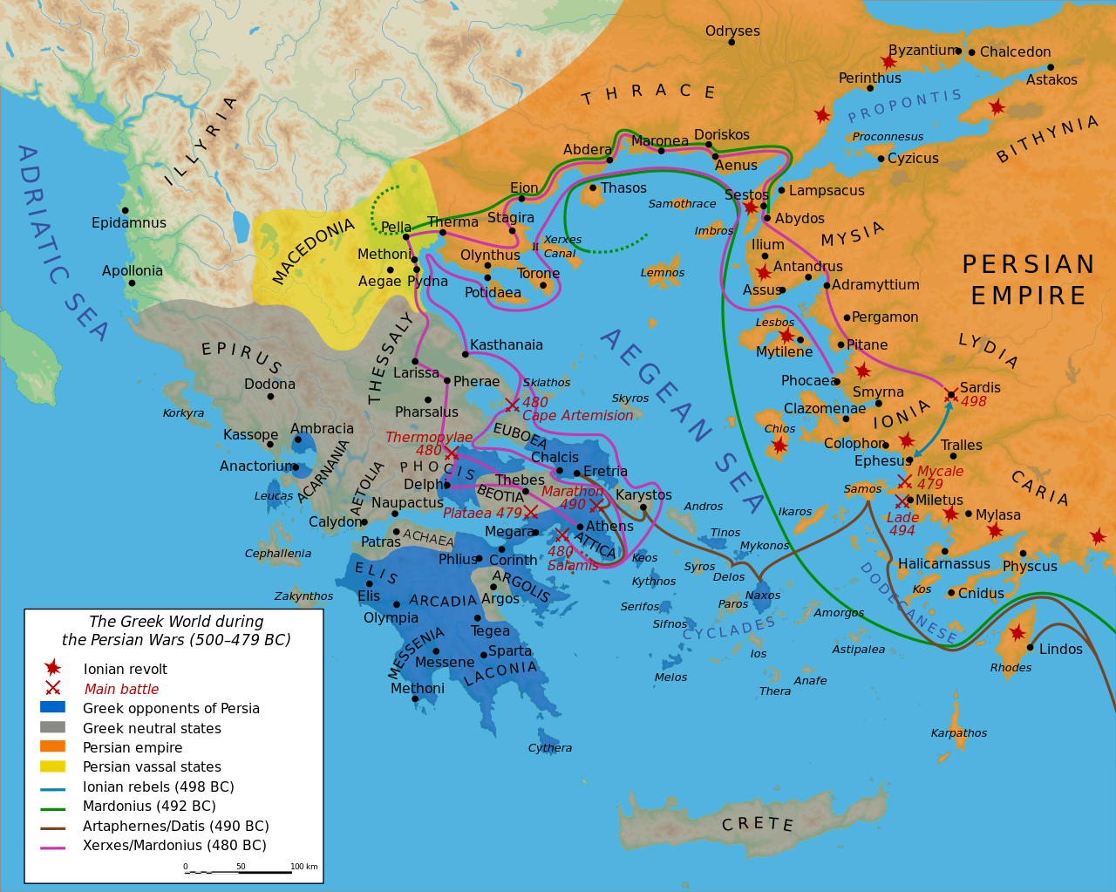
Persian Invasions of Greece (500-479 BC)
Notes:
Xerxes followed the lead of his predecessor and father, Darius I, who a decade earlier had invaded Greece and was defeated at Marathon (490 BC).
“The Battle of Marathon (Greek: Μάχη τοῦ Μαραθῶνος, Machē tou Marathōnos) took place in 490 BC, during the first Persian invasion of Greece. It was fought between the citizens of Athens, aided by Plataea, and a Persian force commanded by Datis and Artaphernes. The battle was the culmination of the first attempt by Persia, under King Darius I, to subjugate Greece. The Greek army decisively defeated the more numerous Persians, marking a turning point in the Greco-Persian Wars.
The first Persian invasion was a response to Greek involvement in the Ionian Revolt, when Athens and Eretria had sent a force to support the cities of Ionia in their attempt to overthrow Persian rule. The Athenians and Eretrians had succeeded in capturing and burning Sardis, but they were then forced to retreat with heavy losses. In response to this raid, Darius swore to burn down Athens and Eretria. According to Herodotus, Darius asked for his bow, he placed an arrow upon the string and he discharged it upwards towards heaven, and as he shot into the air he said: "Zeus, grant me to take vengeance upon the Athenians!". Also he charged one of his servants, to say to him, every day before dinner, three times: "Master, remember the Athenians."^{[3]}
At the time of the battle, Sparta and Athens were the two largest city states. Once the Ionian revolt was finally crushed by the Persian victory at the Battle of Lade in 494 BC, Darius began plans to subjugate Greece. In 490 BC, he sent a naval task force under Datis and Artaphernes across the Aegean, to subjugate the Cyclades, and then to make punitive attacks on Athens and Eretria. Reaching Euboea in mid-summer after a successful campaign in the Aegean, the Persians proceeded to besiege and capture Eretria. The Persian force then sailed for Attica, landing in the bay near the town of Marathon. The Athenians, joined by a small force from Plataea, marched to Marathon, and succeeded in blocking the two exits from the plain of Marathon. The Athenians also sent a message asking for support to the Spartans. However, at the time the Spartans were involved in a religious festival and gave this as a reason for refusing to aid the Athenians.
https://en.wikipedia.org/wiki/Battle_of_Marathon
Accessed 13 Sep 2016

Slide 42
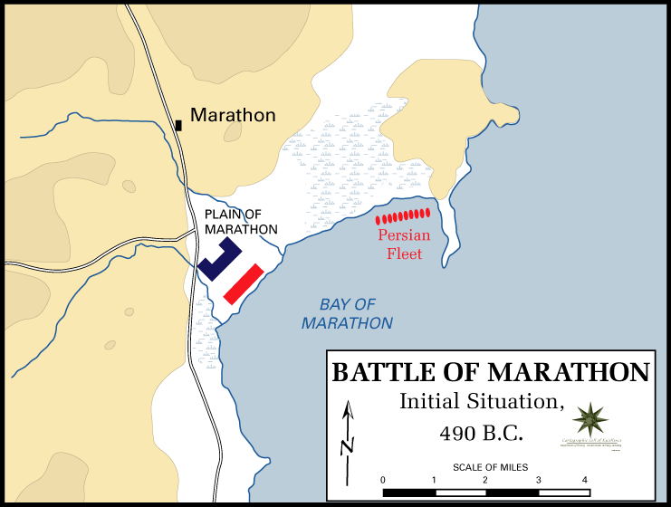
The Battle of Marathon (490 BC)
Greece defeated the Persians
Notes:
“The Battle of Marathon…
The Greeks could not hope to face the superior Persian cavalry; however, the location chosen was surrounded by marshes and mountains and so the cavalry was unable to join the main Persian army. Miltiades, the Greek general, ordered a general attack against the Persians. He reinforced his flanks, luring the Persians' best fighters into his centre.”
https://en.wikipedia.org/wiki/Battle_of_Marathon
Accessed 13 Sep 2016

Slide 43
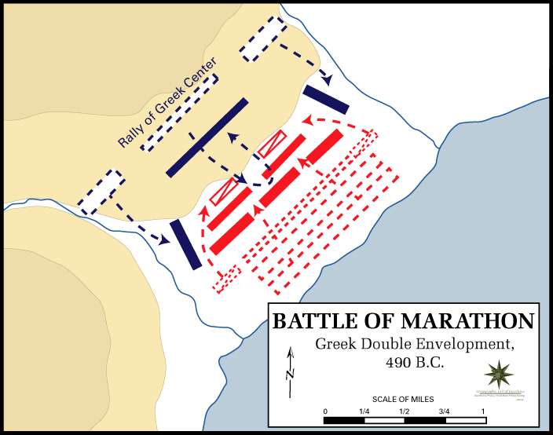
The Battle of Marathon (490 BC)
Greece defeated the Persians
Notes:
“The Battle of Marathon…
The inward wheeling flanks enveloped the Persians, routing them.”
https://en.wikipedia.org/wiki/Battle_of_Marathon
Accessed 13 Sep 2016

Slide 44
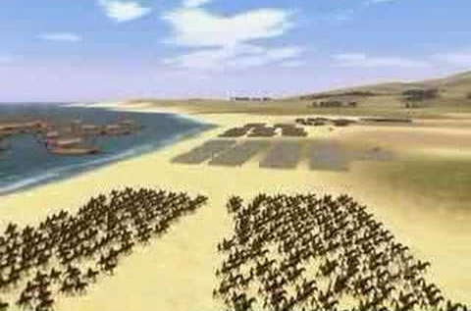
The Battle of Marathon (490 BC)
Greece defeated the Persians
Notes:
“The Battle of Marathon…
The Persian army broke in panic towards their ships, and large numbers were slaughtered. The defeat at Marathon marked the end of the first Persian invasion of Greece, and the Persian force retreated to Asia. Darius then began raising a huge new army with which he meant to completely subjugate Greece; however, in 486 BC, his Egyptian subjects revolted, indefinitely postponing any Greek expedition. After Darius died, his son Xerxes I restarted the preparations for a second invasion of Greece, which finally began in 480 BC.
https://en.wikipedia.org/wiki/Battle_of_Marathon
Accessed 13 Sep 2016

Slide 45
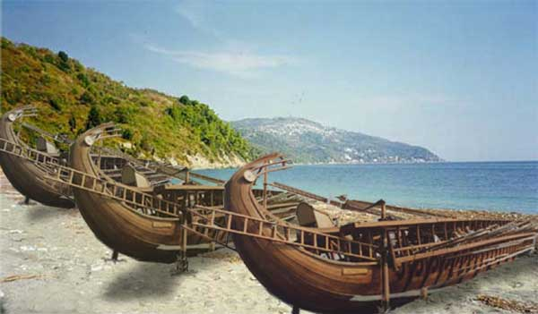
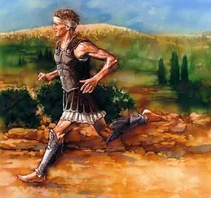
The Battle of Marathon (490 BC)
Greece defeated the Persians
Notes:
“The Battle of Marathon was a watershed in the Greco-Persian wars, showing the Greeks that the Persians could be beaten; the eventual Greek triumph in these wars can be seen to begin at Marathon. The battle also showed the Greeks that they were able to win battles without the Spartans, as they had heavily relied on Sparta previously. This win was largely due to the Athenians, and Marathon raised Greek esteem of them. Since the following two hundred years saw the rise of the Classical Greek civilization, which has been enduringly influential in western society, the Battle of Marathon is often seen as a pivotal moment in Mediterranean and European history.
The battle is perhaps now more famous as the inspiration for the marathon race. Although thought to be historically inaccurate, the legend of the Greek messenger Pheidippides running to Athens with news of the victory became the inspiration for this athletic event, introduced at the 1896 Athens Olympics, and originally run between Marathon and Athens.”
https://en.wikipedia.org/wiki/Battle_of_Marathon
Accessed 13 Sep 2016

Slide 46
Persian Invasions of Greece = Frustrated Xerxes
Greeks defeat Persians at Marathon (490)
Xerxes
7-day banquet where Queen Vashti deposed
(483)
Persians defeat Greeks at Thermopylae but reversed at Salamis
(Sept 480)
Book of Esther 483-473
490
489
488
487
486
485
484
483
482
481
480
479
478
477
Darius
522-486
Xerxes
486-464

Slide 47
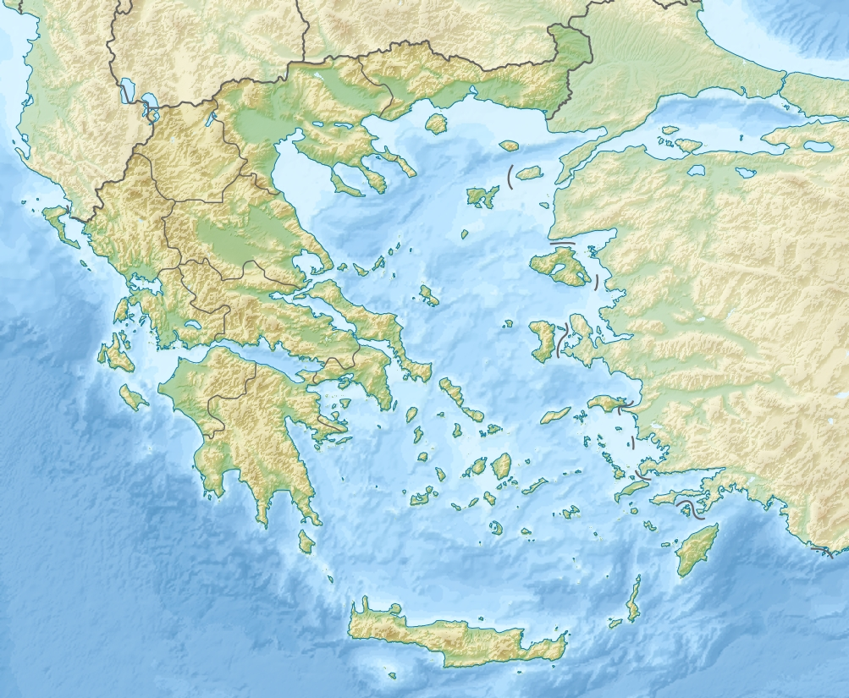
The Battle of Thermopylae
(480 BC)
Persian Victory
Thermopylae
Bay of Salamis
Greek Victory
Notes:
“The Battle of Thermopylae (/θərˈmɒpᵻliː/ thər-MOP-i-lee; Greek: Μάχη τῶν Θερμοπυλῶν, Machē tōn Thermopylōn) was fought between an alliance of Greek city-states, led by King Leonidas of Sparta, and the Persian Empire of Xerxes I over the course of three days, during the second Persian invasion of Greece. It took place simultaneously with the naval battle at Artemisium, in August or September 480 BC, at the narrow coastal pass of Thermopylae ("The Hot Gates"). The Persian invasion was a delayed response to the defeat of the first Persian invasion of Greece, which had been ended by the Athenian victory at the Battle of Marathon in 490 BC. Xerxes had amassed a huge army and navy, and set out to conquer all of Greece. The Athenian general Themistocles had proposed that the allied Greeks block the advance of the Persian army at the pass of Thermopylae, and simultaneously block the Persian navy at the Straits of Artemisium.
A Greek force of approximately 7,000 men marched north to block the pass in the middle of 480 BC. The Persian army, alleged by the ancient sources to have numbered over one million, but today considered to have been much smaller (various figures are given by scholars, ranging between about 100,000 and 150,000),^{[8][9]} arrived at the pass in late August or early September. The vastly outnumbered Greeks held off the Persians for seven days (including three of battle) before the rear-guard was annihilated in one of history's most famous last stands. During two full days of battle, the small force led by Leonidas blocked the only road by which the massive Persian army could pass. After the second day, a local resident named Ephialtes betrayed the Greeks by revealing that a small path led behind the Greek lines. Leonidas, aware that his force was being outflanked, dismissed the bulk of the Greek army and remained to guard their retreat with 300 Spartans, 700 Thespians, 400 Thebans, and perhaps a few hundred others, most of whom were killed.
At Artemisium, the Greek navy, under the command of the Athenian politician Themistocles, received news of the defeat. Since the Greek strategy required both Thermopylae and Artemisium to be held, and given their losses, it was decided to withdraw to Salamis. The Persians overran Boeotia and then captured the evacuated Athens. The Greek fleet—seeking a decisive victory over the Persian armada—attacked and defeated the invaders at the Battle of Salamis in late 480 BC. Fearful of being trapped in Europe, Xerxes withdrew with much of his army to Asia (losing most to starvation and disease), leaving Mardonius to attempt to complete the conquest of Greece. However, the following year saw a Greek army decisively defeat the Persians at the Battle of Plataea, thereby ending the Persian invasion.
Both ancient and modern writers have used the Battle of Thermopylae as an example of the power of a patriotic army defending its native soil. The performance of the defenders is also used as an example of the advantages of training, equipment, and good use of terrain as force multipliers and has become a symbol of courage against overwhelming odds.”
https://en.wikipedia.org/wiki/Battle_of_Thermopylae
Accessed 12 Sep 2016

Slide 48
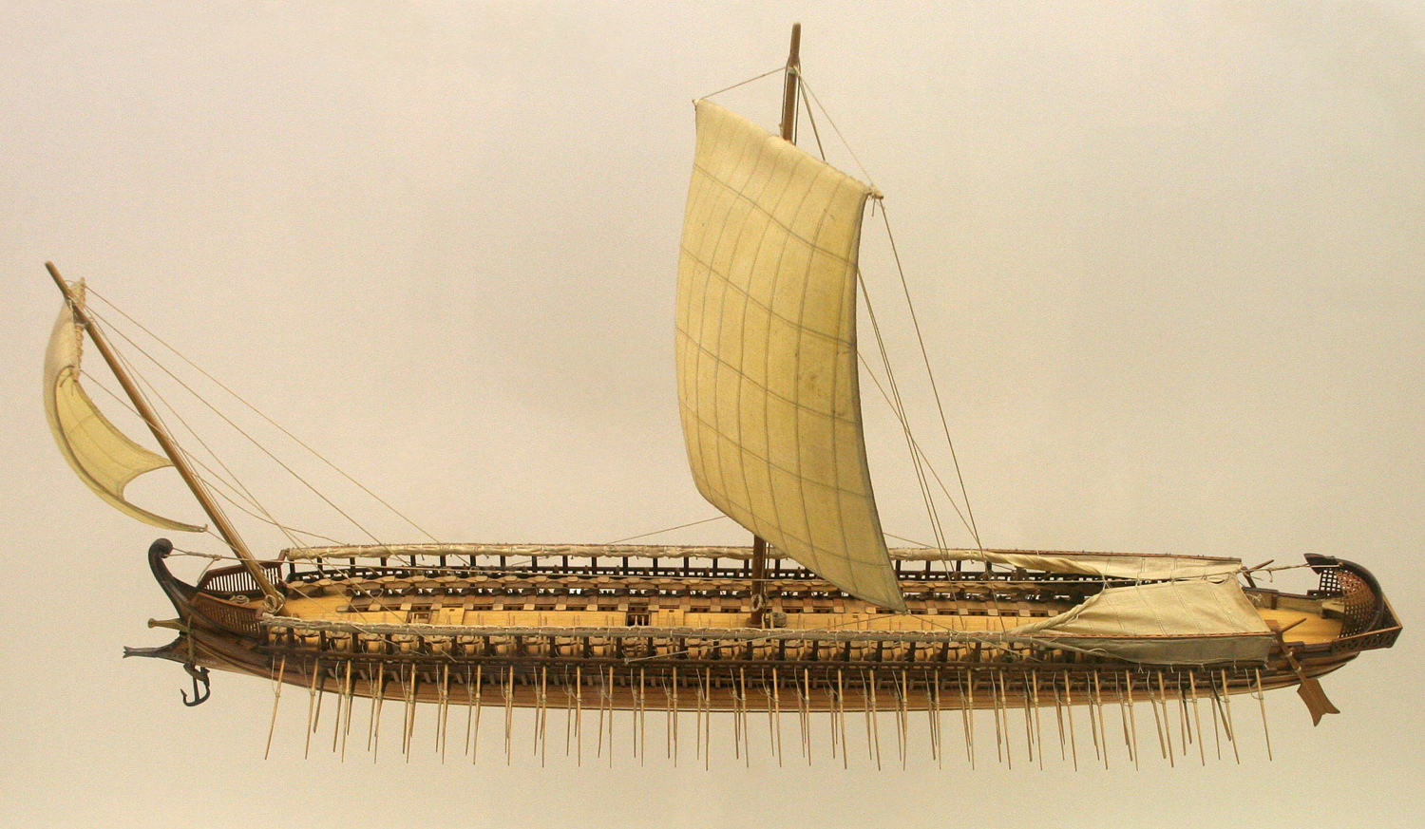
The Greek Trireme
Small but fast and deadly
Notes:
The Athenians had vast gold mines that enriched the city so that each citizen had enough money for 17 lifetimes! Persia had invaded Greece unsuccessfully in 490 BC, but the threat had not been vanquished. After much effort, the Athenians became convinced to use their resources to build many triremes, which had technological advantages over larger, heavy Persian ships.

Slide 49
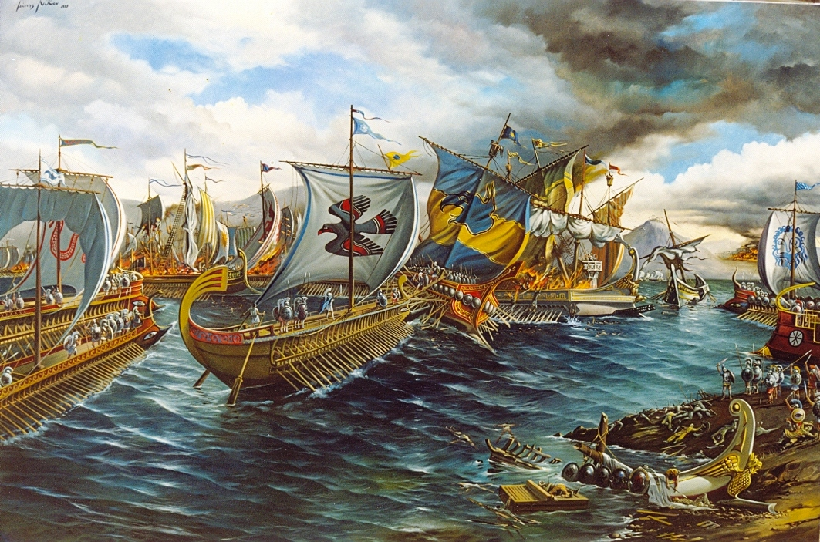
The Battle of Salamis (480 BC)
Notes:
The Greek preparation paid off. The vast Persian navy was no match for the nimble Greek ships.

Slide 50
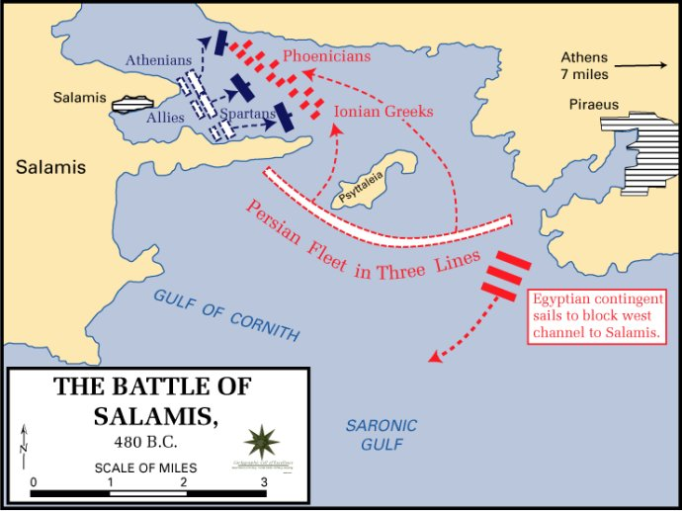
The Battle of Salamis (480 BC)
Notes:
At the Battle of Salamis, the Greeks fought valiantly to protect their homeland with the potential of getting trapped against their land.

Slide 51
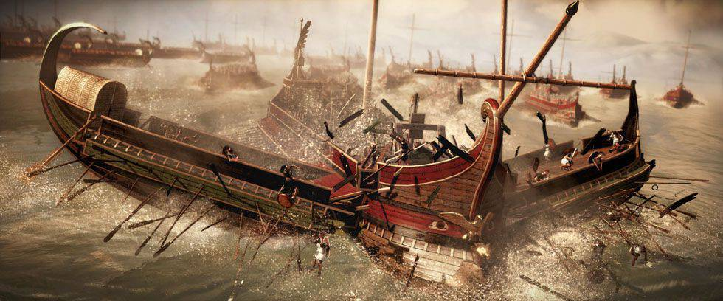
The Battle of Salamis (480 BC)
Casualties: Greeks lost 40 ships
Persians: 200-300. Victory at Salamis ended Xerxes' invasion and preserved Greek freedom
Notes:
The smaller triremes out-maneuvered the Persian vessels in a massive victory.

Slide 52
Persian Invasions of Greece = Frustrated Xerxes
Greeks defeat Persians at Marathon (490)
Xerxes
began
to
reign
at Susa
(486)
Xerxes
187 days of banquets where Queen Vashti deposed
(483)
Persians defeat Greeks at Thermopylae but reversed at Salamis
(Sept 480)
Esther became queen after a 4-year beauty contest
(Dec 480 or Jan 479)
Book of Esther 483-473
490
489
488
487
486
485
484
483
482
481
480
479
478
477
Darius
522-486
Xerxes
486-464
Notes:
The chronology shows that the defeated Xerxes returned to Susa frustrated not only with his navy losses but also before the campaign when he had also been humiliated by Vashti's public dishonor of the king.
But the beauty treatments of women continued while Xerxes was gone to Greece. These women were being prepared to compete against each other as the potential queen to replace Vashti.

Slide 53

Chart of OT Kings & Prophets
232 & 342

Slide 54
Chart of OT Postexilic Era
232 & 342

Slide 55
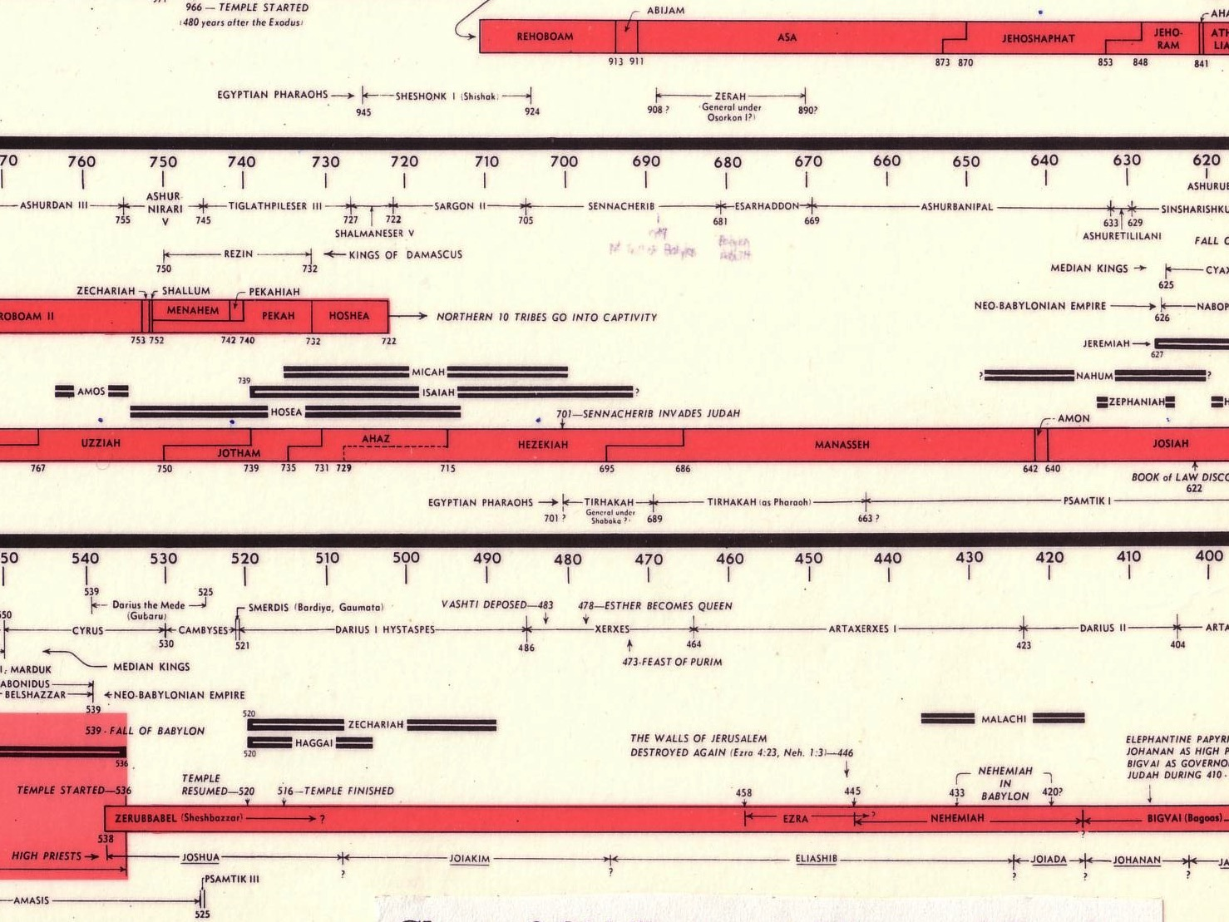
Opposition Timeline (Ezra 4; Esther 1; Neh 13)
232 342
Zerubbabel Under Cyrus
536-520 BC
Esther Under Xerxes
486 BC
Ezra Under Artaxerxes
±460 BC
Nehemiah Under Darius (internal)
±430 BC
Chart of Old Testament Kings & Prophets
John C. Whitcomb, 4th ed. (Winona Lake, IN: BMH Books, 1968), 2
Notes:
"﻿The terminology in the biblical copies of letters to and from the Persian court is directly comparable with what we find in the external, firsthand documents. Inferiors call themselves the “servant(s)” of superiors and kings; the idiom for issuing decrees (sam t’e’em) is the same; the body of the typical Official Aramaic letter begins with the phrase “Peace (sh-l-m) and much well-being I send you,” which is what is presupposed in Ezra 4:17 (lit. “Peace, etc.”), where the formula is abbreviated for brevity’s sake.39 And so on, we may also say, on this topic. The form or stage of language of Aramaic used in Ezra and Daniel is precisely that used in the Neo-Babylonian and Persian period (sixth to fourth centuries), and is currently termed Official Aramaic. In the Old Testament the sole difference is that the spelling has been consistently modernized, to bring it into line with the Aramaic otherwise in popular use among the Jews by the third century.”
K. A. Kitchen, On the Reliability of the Old Testament. Grand Rapids, MI: Eerdmans, Kindle Edition. Loc 1892 of 14432.
________
OS-37-Ezra-87
OS-38-Nehemiah-407
OS-39-Esther-54

Slide 56
Later Postexilic Era (Ezra 7–10; Neh 1–13)
232 342
Chart of Old Testament Kings & Prophets
John C. Whitcomb, 4th ed. (Winona Lake, IN: BMH Books, 1968), 2
Notes:
"﻿The terminology in the biblical copies of letters to and from the Persian court is directly comparable with what we find in the external, firsthand documents. Inferiors call themselves the “servant(s)” of superiors and kings; the idiom for issuing decrees (sam t’e’em) is the same; the body of the typical Official Aramaic letter begins with the phrase “Peace (sh-l-m) and much well-being I send you,” which is what is presupposed in Ezra 4:17 (lit. “Peace, etc.”), where the formula is abbreviated for brevity’s sake.39 And so on, we may also say, on this topic. The form or stage of language of Aramaic used in Ezra and Daniel is precisely that used in the Neo-Babylonian and Persian period (sixth to fourth centuries), and is currently termed Official Aramaic. In the Old Testament the sole difference is that the spelling has been consistently modernized, to bring it into line with the Aramaic otherwise in popular use among the Jews by the third century.”
K. A. Kitchen, On the Reliability of the Old Testament. Grand Rapids, MI: Eerdmans, Kindle Edition. Loc 1892 of 14432.
________
OS-37-Ezra-88
OS-38-Nehemiah-408
OS-39-Esther-55

Slide 57
Key Dates Related to the Book of Esther
314
Reference
Date
Event
–
486
Xerxes' reign began
1:3
483
(3rd year of Xerxes)
Xerxes 7-day banquet for his nobles & officials where Queen Vashti was deposed
–
482-479
Xerxes led disastrous campaigns against Greece, esp. at navy Battle of Salamis (480); recorded by Greek historian Herodotus (7.8)
2:16
Dec 479 or Jan 478
Esther became queen after a 4-year beauty contest
3:7
Early April 474
In the 5th year of Esther's reign, Haman & the astrologers (5:10, 14; 6:12-13) cast the pur (lot) to determine the day to exterminate the Jews 11 months later (7 March 473)
3:12
April 17, 474
(13th of Nisan)
Xerxes' 1st edict (to destroy the Jews) informed everyone of the fateful day; royal secretaries wrote it out in the various languages of the empire

Slide 58
Part 1: Feasts & Jews Threatened
A. Greatness of King Xerxes (1:1-4)
B. Feasts of King & Queens (1:5–2:18)
C. Mordecai Averts King's Death (2:21-23)
D. Promotion of Haman (3:1-6)
E. Haman's Plot & Letters (3:7-15)
F. Mordecai & Esther's Risky Appeal (4:1–5:4)
David Lang, SBC Chapel, 29 Mar 2012

Slide 59
Part 2: Mordecai Honored/Haman Hanged
G. Esther's 1st Banquet for King & Haman (5:5-8)
H. Words of Haman's Wife & Friends (5:9-14)
Focus of the Book of Esther
I. Mordecai Honored by Haman (6:1-11)
H'. Words of Haman's Wife & Friends (6:12-14)
G'. Esther's 2nd Banquet for King & Haman (7:1–8:2)
F'. Esther's Risky Appeal (8:3-7)
David Lang, SBC Chapel, 29 Mar 2012

Slide 60
Part 3: Jews Saved & Feasts
E'. Haman's Plot Foiled & Mordecai's Letters (8:8-17)
D'. Promotion of Mordecai (8:15-11)
C'. Mordecai & Esther Save Jews (9:1-19)
B'. Feasts Ordered by Mordecai & Esther (9:20-32)
A'. Greatness of Mordecai (10:1-3)
David Lang, SBC Chapel, 29 Mar 2012

Slide 61
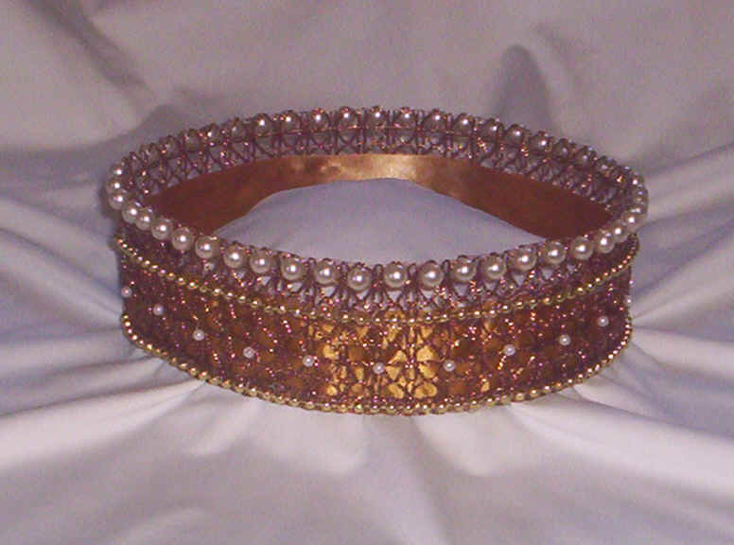
Authorship
309
External Evidence
Jewish discussions about Esther have concerned several other issues more than authorship, which remains anonymous.
Parallel passages & opinions of the Church & Synagogue on authorship have not been significant.
Internal Evidence
Since the book gives no hint who wrote it, one can only guess his identity.
The account shows such detail of Persian & Jewish life that the author must have been both Jewish & well acquainted with Persian ways.
Some suggest Ezra, Nehemiah, or Mordecai.
However, no one really knows who wrote the book.

Slide 62
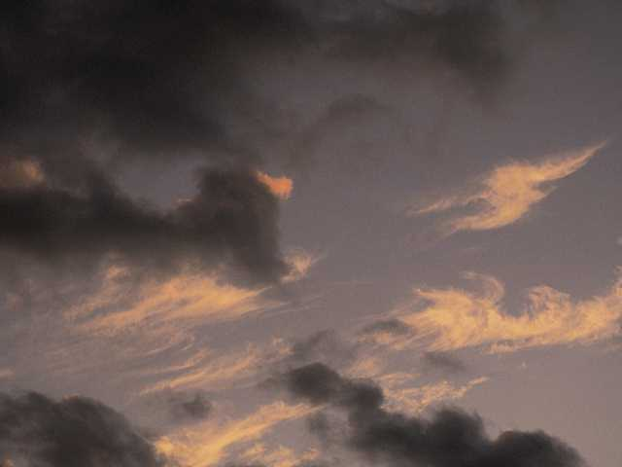
Circumstances
309
Date
Since the events of the book close at 473 BC, it is reasonable to presume a composition date shortly after this–perhaps after Xerxes' reign (ending in 464 BC) but no later than 435 BC when the palace at Susa was destroyed by fire, a significant event not mentioned in Esther.

Slide 63
Circumstances
309
Recipients
Esther's 1st readers constituted the postexilic communities during the time of Nehemiah & Malachi & the intertestamental period
These providential dealings of God on their behalf would have been a tremendous source of encouragement to both Jews in Persia as well as Jews living in Israel.

Slide 64
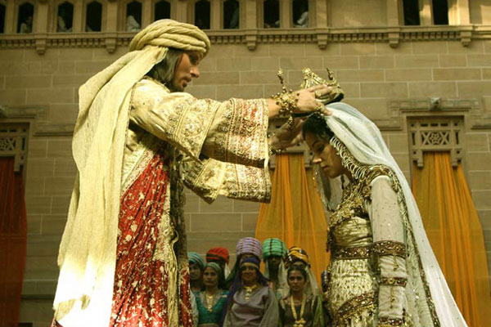
Occasion
309
The events of Esther chronicle 10 years of the 58 year gap between Ezra 6 (516 BC) & Ezra 7 (458 BC).
This story from 483-473 BC between the first return under Zerubbabel (538 BC) and the second under Ezra (458 BC).

Slide 65

Occasion
309
Without Esther the Scripture would remain silent as to the state of the majority of post-exilic Jews who chose to remain in Babylon when a small remnant of their brothers returned to the land.
The Books of Ezra & Nehemiah assert God's providential care over the small remnant that returned, while Esther reveals that God even graciously cared for these spiritually indifferent Jews whose priorities needed rearranging.

Slide 66
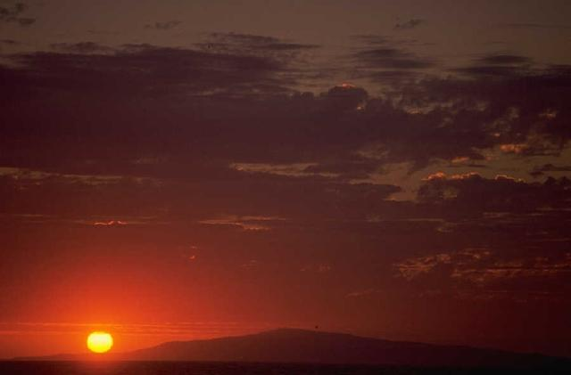
Characteristics
309
Historicity
Esther has eyewitness accounts of the Persian Empire, of which little has been verified from outside sources. Only recently has Ahasuerus been identified with Xerxes who reigned over Persia from 485-465 BC.

Slide 67
Characteristics
309
Canonicity: The usefulness of Esther has long been debated. Maimonides taught that when the Messiah comes, every book of the Jewish Scriptures would pass away but the Law & Esther, which would remain forever.
However, Martin Luther wished the book had never been written because of its many problems.
The reasons for differing opinions on the book stem from many unique characteristics:
The name of God is never mentioned in the book.
Esther is never quoted in the NT nor found in the Dead Sea Scrolls.
It never mentions the Law or sacrifices or offerings.
It never refers to prayer.
The book mentions nothing spiritual.
Its unique literary type has caused it to be placed within different sections in various collections of OT books.

Slide 68
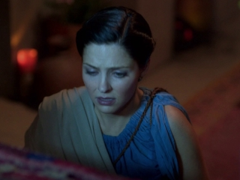
Characteristics
310
Placement:
Esther is the only OT book
on the Jews outside of the
land during the times of the
Gentiles (586 BC until the return of Christ).
This may explain why it appears as the last historical book in English Bibles, for while it precedes Nehemiah chronologically, the same conditions in the book continue during the time of the Gentiles until the deliverance of the Jews at the return of Christ.

Slide 69
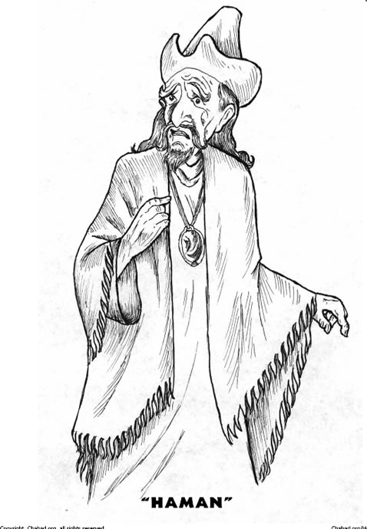
Characteristics
310
D. Lessons: The Book of Esther teaches many principles like:
Satan's purpose is to destroy the Jews by use of the nations.
God's purpose is to preserve the Jews by use of the nations.
God works in the affairs of nations to accomplish His will to preserve His people.
God works in the affairs of individuals to accomplish His will to preserve His people.

Slide 70
Interpretive Approaches
310
Response: Nothing is mentioned of the "times of the Gentiles" & the account is presented in a straightforward manner as history.
1. Prophetical–Esther predicts that the Jews will be preserved while outside of the land during the times of the Gentiles.
Historical–Esther records God's providential care of His chosen people as evidence of His commitment to the Abrahamic Covenant. The following "Argument" section will demonstrate this to be the best option.
Response: This is ambiguous & the account is presented in a straightforward manner as historical narrative.
2. Allegorical–Esther is the story of mankind.
3. Typical–Esther is a divinely intended illustration of the Christian experience in the Church Age or a type of the Millennium.
Response: While this is an ingenious view, it fails in that it reads the NT back into the OT.

Slide 71

Title
309
Esther (rTes.a,, 'ester) is a Persian name derived from the Persian word for "star." The meaning is fitting since Esther is the star of this book which bears her name. Her Hebrew name, Hadassah, means "myrtle(-tree)".
Notes:
"All the major Hebrew manuscript traditions know the book as “Esther” (Hb. estēr, probably related to Akkadian Ishtar, the goddess; ištaru, “goddess”; or Persian stâra).¹ The name is reflected in the LXX as Esthr and in the Vulgate as Esther or Hester, with other major ancient and modern versions employing variations of these spellings. The Hebrew name of the heroine for whom the book is named is Hadassah (hădassâ), the feminine form of a word meaning “myrtle tree” (Esth 2:7)."
Hb. Hebrew language
¹ C. A. Moore, Esther, AB (Garden City, NY: Doubleday, 1971), LI, 20.
LXX Septuagint
Eugene H. Merrill, “The Book of Esther,” in The World and the Word: An Introduction to the Old Testament (Nashville, TN: B&H Academic, 2011), 354.

Slide 72
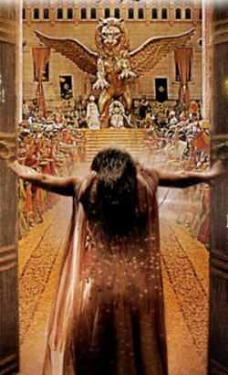
Argument
310
Esther records how a plot to exterminate the entire Jewish population is averted by God's providential workings through the godly Jewess, Queen Esther.
It cites the threat to the Jews (chs. 1–4) & the triumph of the Jews over the very ones who threatened their existence (chs. 5–10).
Chapter 9 celebrates the preservation of the nation in the Feast of Purim, which serves as an annual reminder of God's faithfulness to His people.

Slide 73

Spiritual Elements in Esther
No Law
No Sacrifices, No Temple
No Witnessing of God
No Land of Israel, No Jerusalem
No Prayer or Seeking God
No Love, No Forgiveness
No Mention of God Himself!
= No Spiritual Elements at All!

Slide 74
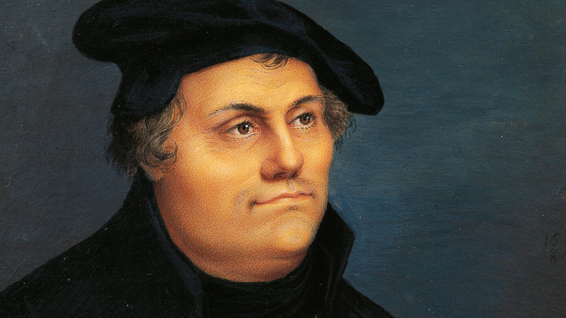
"I am so great an enemy to the second book of the Maccabees, and to Esther, that I wish they had not come to us at all, for they have too many heathen unnaturalities."
—Martin Luther
Notes:
Luther felt that Esther should not be part of the Bible due to the lack of spiritual elements in it. How do you respond to this view that was also held by many rabbis?

Slide 75
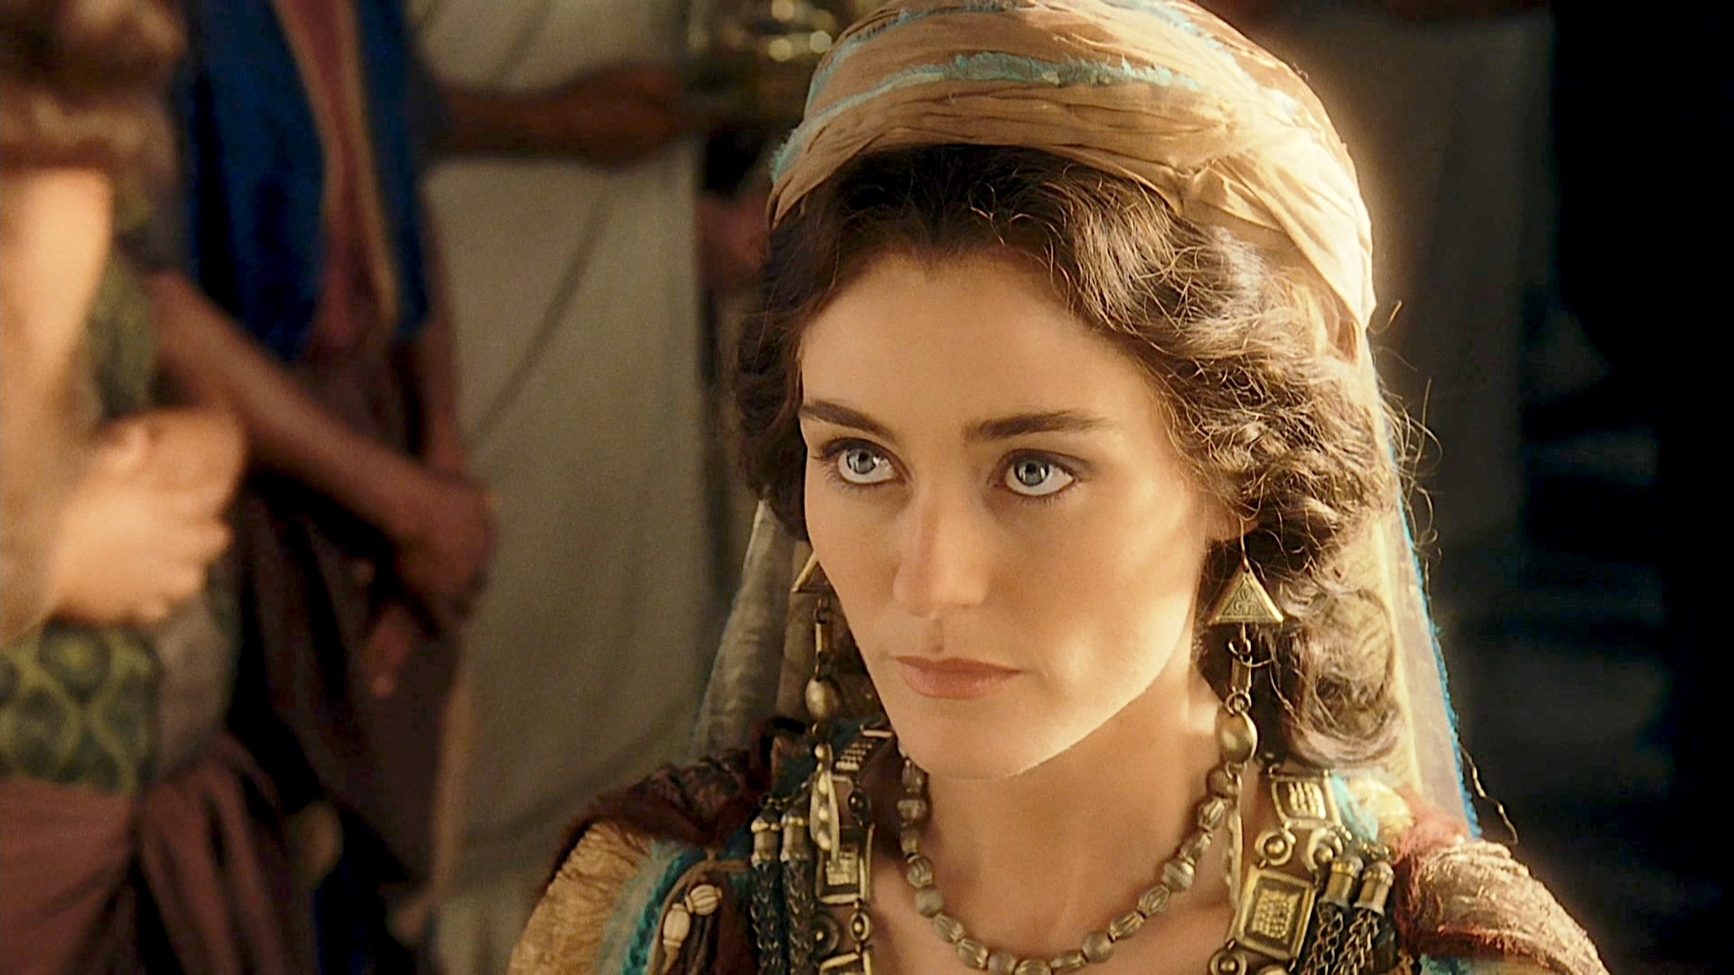
What does the lack of any spiritual elements communicate?
God is
very silent but
very present
Notes:
The fact that God is not mentioned may indicate that, although the people are not thinking in spiritual terms, God does! Each character approaches challenges with no thought of the LORD, and yet he still moves through their actions as he cannot forget his covenant with the nation.

Slide 76

Esther Crowned (2:17)
Notes:
“The king loved Esther more than all the women, and she found favor and kindness with him more than all the virgins, so that he set the royal crown on her head and made her queen instead of Vashti” (2:17 NLT).
Here again, we see God at work.

Slide 77
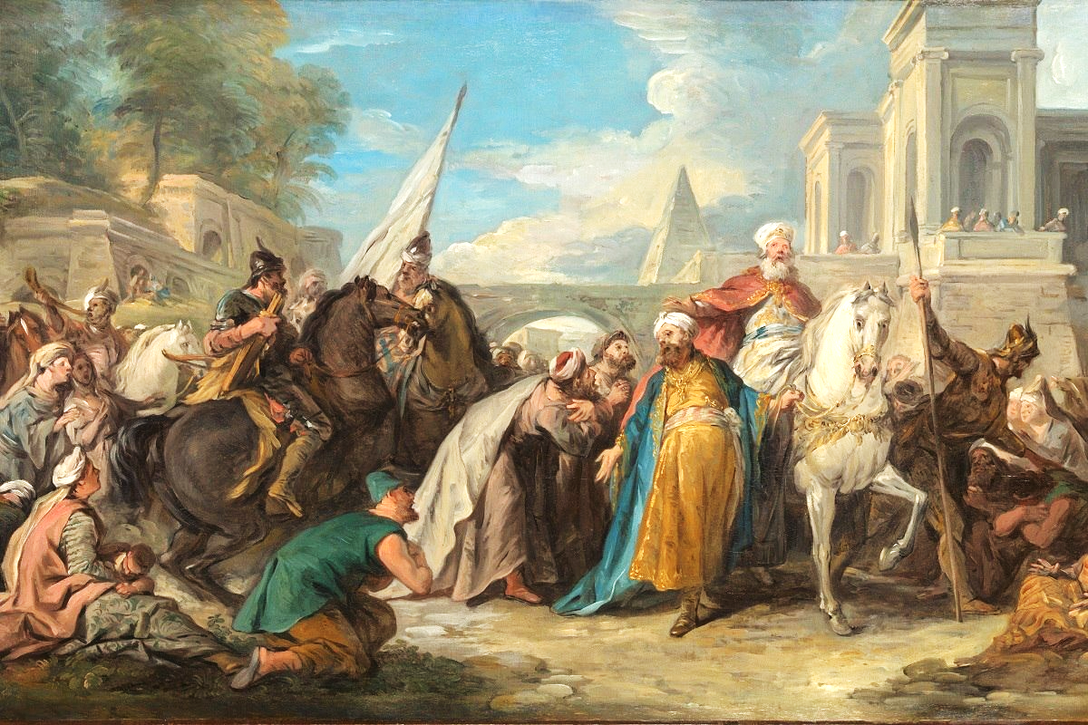
Was killing their enemies just?
“Just War Theory”
=
It is just (fair, right, allowed) to kill those who are trying to
kill you or murder others
The Megillat Esther Massacre - TheTorah.com

Slide 78
Be Committed
Esther
Dr. Rick Griffith • Crossroads International Church Singapore
CICFamily.com • BibleStudyDownloads.org

Slide 79
The church typically has a serious lack of commitment.
Why is that so?
Notes:
Why do you think? Tell your neighbor next to you.

Slide 80
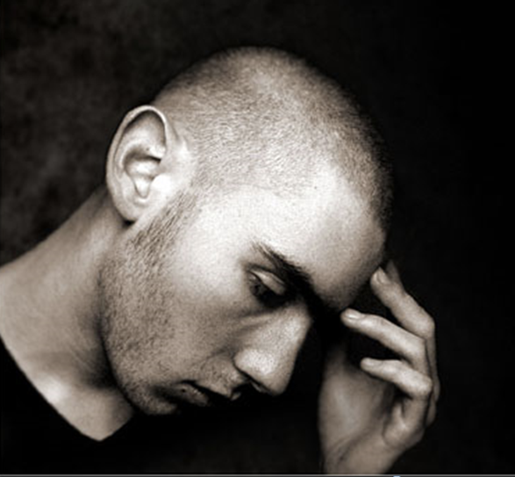
How committed are you to God’s work?
Notes:
If you were accused of being devoted to Jesus, would there be enough evidence to convict you in a court of law?

Slide 81
Why should you be committed to God?
Notes:
What reasons can you give to be dedicated, loyal and devoted to the Lord?

Slide 82

Background to Esther
NEVER GIVE UP
Notes:
Today in the book of Esther we will see that apathy can be cured.

Slide 83
The Postexilic Era
295
296
560
The Postexilic Era
Temple work
Prophets:
Haggai
Zechariah
Malachi
605
586
539
536
520
516
483-473
444-425
Others:
Zerubbabel
Esther
Ezra
Nehemiah
Persian Kings:
Cyrus
Darius
Xerxes
Artaxerxes
Notes:
The Post-Exilic Era was actually three separate periods:
(1) Temple rebuilding led by Zerubbabel, Haggai, and Zechariah in two parts under Cyrus and Darius, (2) The saving of the nation from destruction by Esther about 30 years later under Xerxes, and (3) The restoration of Jerusalem’s walls and gates by Nehemiah another 70 years after that under Artaxerxes.
_________
OS-15-Ezra-36
OS-16-Nehemiah-94
OS-17-Esther-16, 75

Slide 84
Does God Care About Those Left Behind?
Most of the Jews never returned to the land of Israel even in the Post-Exilic Period
Notes:
Why didn’t they return? What would happen to them? How would God shake them out of their lethargy?

Slide 85

The Persian Empire
Map of the Persian Empire
317
Barry J. Beitzel, Moody Atlas of Bible Lands, 150-51
Susa
The Persian Empire in the 5th century BC
extended "from India and Ethiopia" (Esther 1:1)
The boundaries of the empire that Cyrus II initiated
and Darius I consolidated stretched from Greece to India
Notes:
The Jews needed to renew their commitment to God based on his commitment to them over the ages. Yet they also needed to see God working in their lives right then as they lived outside the land of Israel.
Cyrus ruled over an absolutely ENORMOUS kingdom that eventually stretched from Greece in the west and India in the east. From his capital at Susa he had control over 127 provinces! God moved his heart to initiate a return to the land not only for the Jews but for other conquered peoples—as long as they would pray for the welfare of the king and his sons.

Slide 86
Correlation with Ezra
289
Restoring the Temple and People
Temple
Book of Esther (58 YEAR GAP)
People
Zerubbabel
Ezra
Ezra 1–6
Ezra 7–10
50,000 Return
5,000 Return
Survival
Revival
Working
Worshipping
538-516 BC (22 Years)
458-457 BC (1 Year)
External Opposition: Samaritans
Internal Opposition: Intermarriage
Return
1–2
Rebuilding
3–6
Return
7–8
Restoration
9–10
Decree
1
Returnees
2
Begins
3
Opposed
4:1–6:12
Ends
6:13-22
Qualifications
& Provisions
7
Returnees
& Protection
8
Inter- marriage
& Lament
9
Divorces
Carried Out
10

Slide 87
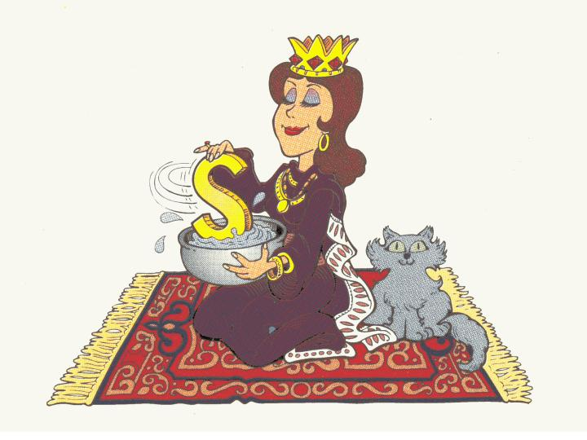
Queen of Persia
Esther:
Walk Through The Bible ©1989

Slide 88
Esther Book Chart
308
Extermination Plot Foiled
Plot Planned
Plot Foiled
Chapters 1–4
Chapters 5–10
Threat
Triumph
Providence Prepared
Providence Enacted
Persecution
Preservation
Grave Danger
Great Deliverance
Feasts of Ahasuerus
Feasts of Esther & Purim
Esther Exalted
1:1–2:18
Haman Plots
2:19–4:17
Mordecai over
Haman
5:1–8:2
Jews over Enemies
8:3–9:32
Mordecai over Persia
10
Persia
10 Years (483-473 BC)

Slide 89
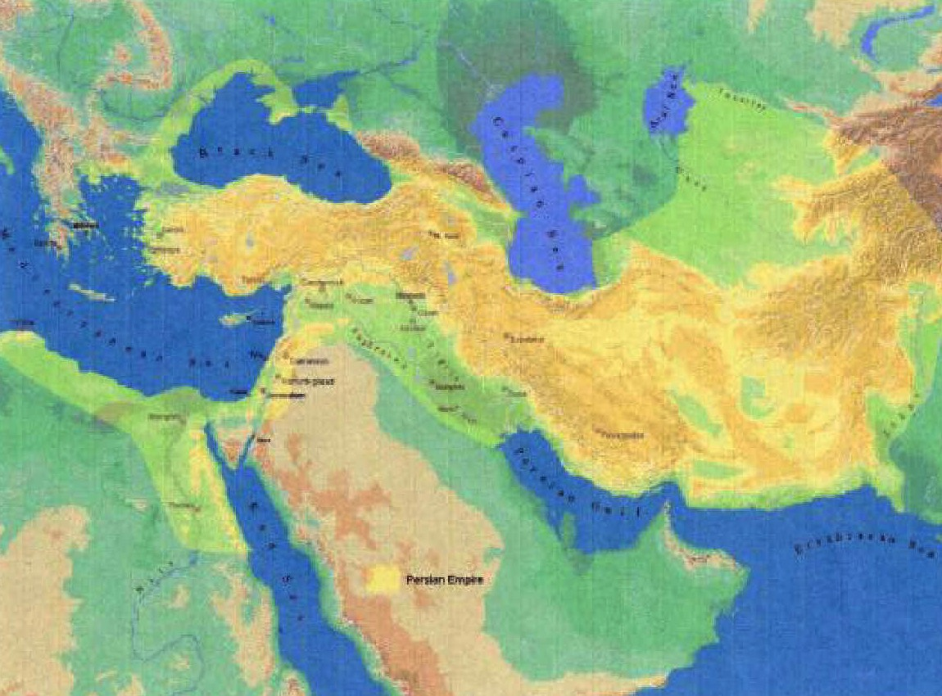
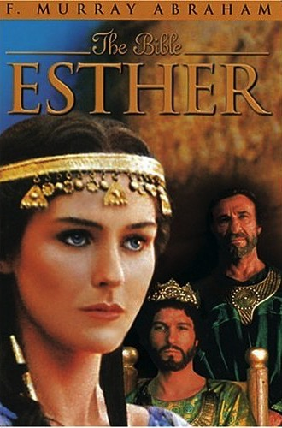
Key Word
308
Providence

Slide 90
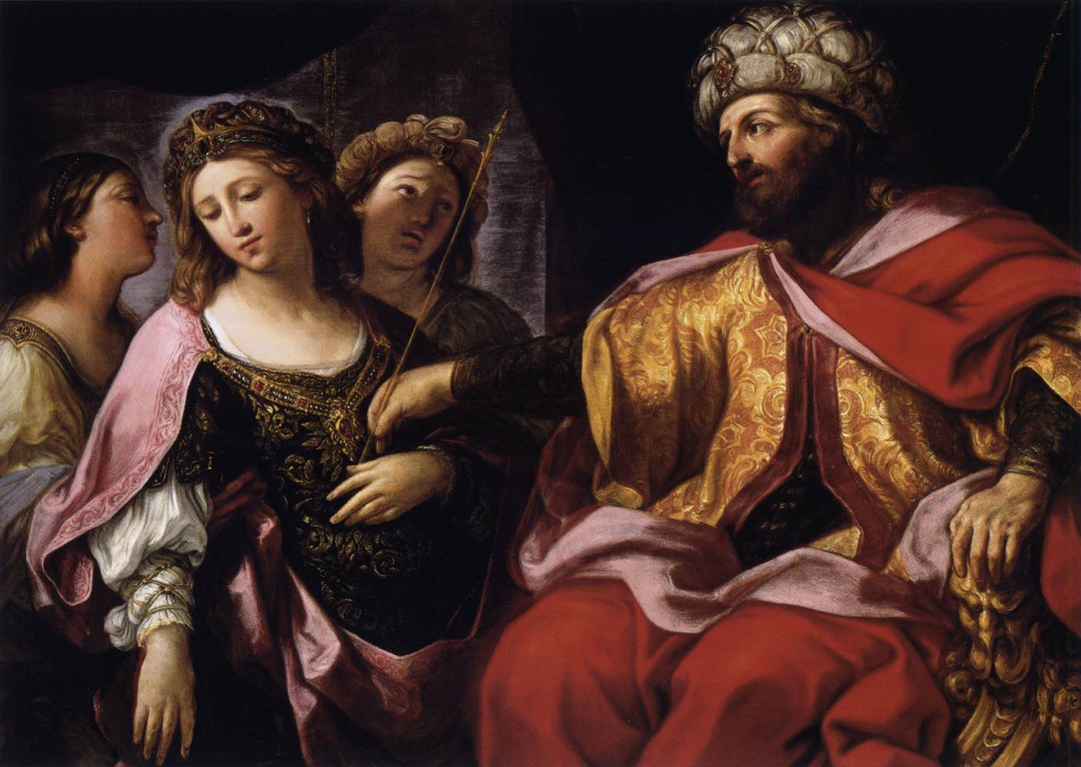
Key Verse
308
(Mordecai to Esther)
"For if you remain silent at this time, relief & deliverance for the Jews will arise from another place, but you & your father's family will perish. And who knows but that you have come to royal position for such a time as this?"
(Esther 4:14).

Slide 91
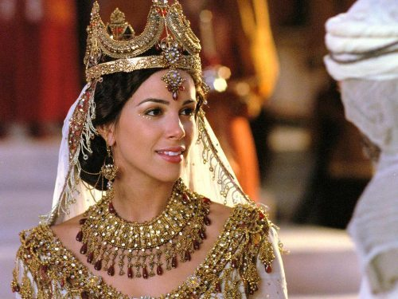
"…for such a time as this"

Slide 92
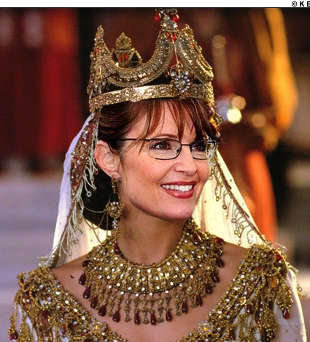
"…for such a time as this"

Slide 93
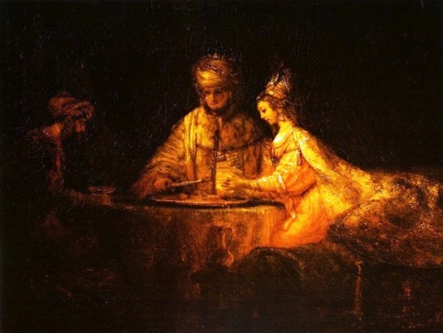
Summary Statement
308
An extermination of the Jewish nation plotted by Haman reverts upon his own head through God's providence through Mordecai & Esther to encourage postexilic Israel of God's continued commitment to the Abrahamic Covenant.

Slide 94
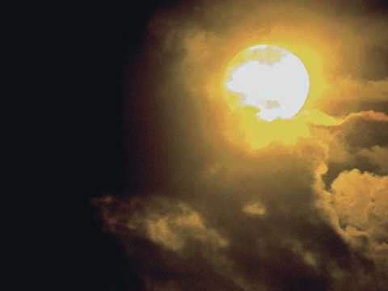
Synthesis
311
Extermination plot foiled
1–4 Plot planned—threat
5–10 Plot foiled—triumph

Slide 95
Why should you be committed to God?
2 REASONS
Notes:
What reasons can you give to be dedicated, loyal and devoted to the Lord?

Slide 96
God’s work faces threats (Esther 1–4).
Why be committed to God?
Notes:
Satan is always trying to push down whatever the Lord does.
God commands our wholehearted devotion as we face many obstacles while God fulfills his plan.

Slide 97
Slides on
Esther 1
Notes:
Threat: God strategically placed Mordecai and Esther to thwart Haman's plot to exterminate the Jews to fulfill the Abrahamic Covenant (Esther 1–4).

Slide 98
The Persian Empire
Map of the Persian Empire
317
Barry J. Beitzel, Moody Atlas of Bible Lands, 150-51
Susa
The Persian Empire in the 5th century BC
extended "from India and Ethiopia" (Esther 1:1)
The boundaries of the empire that Cyrus II initiated
and Darius I consolidated stretched from Greece to India
Notes:
Cyrus ruled over an ENORMOUS kingdom that eventually stretched from Greece in the west and India in the east. From his capital at Susa, he had control over 127 provinces! God moved his heart to initiate a return to the land not only for the Jews but for other conquered peoples—provided they would pray for the welfare of the king and his sons.
But God is bigger than Persia! Esther replaced the deposed Queen Vashti as God's intervention to save his people from annihilation as a nation (1:1–2:18).

Slide 99
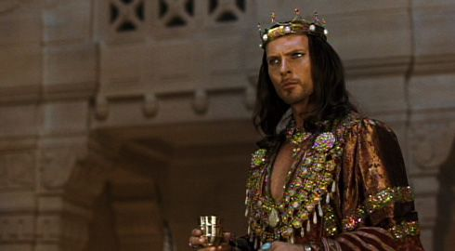
King Xerxe's Unreasonable Command to Queen Vashti
Notes:
The account begins with a very frustrated King Xerxes, or Ahasuerus.

Slide 100
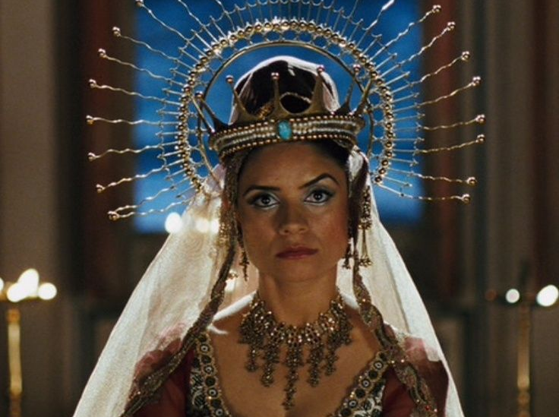
Vashti Upset
Notes:
Xerxes (Heb. Ahasuerus in the book) divorced his disobedient Queen Vashti, unaware of God’s plan for Esther to replace Vashti to preserve the Jews (Esther 1; 483 BC; 1:3).

Slide 101
Rise of Esther
  Confusion 1–2
Vashti
483
479
Mordecai's rise
Banquets
Notes:
God actually uses the confusion of the first two chapters to bring about his plan. Sound familiar?

Slide 102
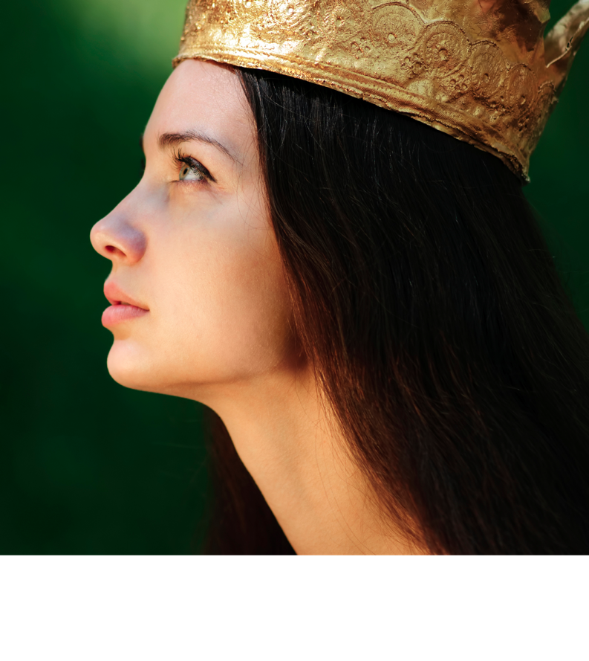
Outline
311-312
I. Haman's plot to exterminate the Jewish people becomes known to Mordecai and Esther, whom God has strategically placed, to inform Israel that apart from God it could not exist as a nation (Esther 1–4) .
Notes:
Haman’s plot to kill the Jews came just after Mordecai foiled a plot to murder the king to show God protecting Jews via Esther to uphold the Abrahamic Covenant (2:19–4:17).

Slide 103
Slides on
Esther 2
Notes:
Xerxes married Esther to replace Vashti after a divinely designed beauty contest where God controlled Xerxes' taste in women to avert a disaster for the Jews (2:1-18; 479 BC).

Slide 104


The Beauty Contest
Notes:
Actually God uses a beauty contest for his plan.
• So all the beauties are gathered.
• And they were happy about that!

Slide 105

The Beauty Contest
Notes:
OK, maybe they looked better than that…

Slide 106

Mordecai the Jew
(Esther 2:5)
Notes:
"At that time there was a Jewish man in the fortress of Susa whose name was Mordecai son of Jair. He was from the tribe of Benjamin and was a descendant of Kish and Shimei. ⁶ His family had been among those who, with King Jehoiachin of Judah, had been exiled from Jerusalem to Babylon by King Nebuchadnezzar" (2:5-6 NLT).

Slide 107

Mordecai's Young Cousin Esther (2:7)
Notes:
"This man had a very beautiful and lovely young cousin, Hadassah, who was also called Esther. When her father and mother died, Mordecai adopted her into his family and raised her as his own daughter" (2:7 NLT).

Slide 108

Mordecai Counsels Esther (2:10)
Notes:
"Esther had not told anyone of her nationality and family background, because Mordecai had directed her not to do so" (2:10 NLT).

Slide 109
Did Esther act honorably?
Notes:
Esther was written to show God's providential care in preserving Israel even though the nation was not actively concerned about returning to Jerusalem.
—————
"Esther kept her Jewish nationality a secret (cf. v. 20), not telling Hegai, her maids, or anyone else because Mordecai had told her not to. From this and other statements in the book it is clear the author was making the point that God protected and used Esther and Mordecai in spite of the fact that they were not living according to the Law commanded by God to the people of Israel. By Law Esther was not to marry a pagan (Deut. 7:1-4) or have sexual relations with a man who was not her husband (Ex. 20:14), and yet this was the purpose of her being included in the harem. Esther could be contrasted with Daniel who refused to eat the things from the king’s table (Dan. 1:5) because the food would include items considered unclean by the Jewish Law. Apparently Esther had no qualms about the food she ate (Es. 2:9). She certainly did not set herself apart as Daniel had done" (John A. Martin, "Esther," in The Bible Knowledge Commentary, 1:704).

Slide 110

All the King's Men
Notes:
Haman’s plot to kill the Jews came just after Mordecai foiled a plot to murder the king to show God protecting Jews via Esther to uphold the Abrahamic Covenant (2:19–4:17).
———————
“In those days, while Mordecai was sitting at the king’s gate, Bigthan and Teresh, two of the king’s officials from those who guarded the door, became angry and sought to lay hands on King Ahasuerus. 22 But the plot became known to Mordecai and he told Queen Esther, and Esther informed the king in Mordecai’s name. 23 Now when the plot was investigated and found to be so, they were both hanged on a gallows; and it was written in the Book of the Chronicles in the king’s presence” (2:21-23 NLT).

Slide 111

Eavesdropping
Esther
  Confusion 1–2
Vashti
483
479
Mordecai's rise
Banquets
Notes:
God informed Mordecai of a secret assassination plot that saved Xerxes' life as God’s design to later exalt Mordecai to benefit his people (2:19-23).

Slide 112
Slides on
Esther 3
Notes:
Haman’s anger at Mordecai refusing to honor him convinced Xerxes to kill all Jews from Egypt to India eleven months later for God protect them instead (Esther 3).

Slide 113

Haman the Agagite
(Esther 3:1-2)
Notes:
"Some time later King Xerxes promoted Haman son of Hammedatha the Agagite over all the other nobles, making him the most powerful official in the empire. ² All the king’s officials would bow down before Haman to show him respect whenever he passed by, for so the king had commanded. But Mordecai refused to bow down or show him respect" (3:1-2 NLT).
"Because Haman was an Agagite, some have supposed that he was descended from Agag, king of the Amalekites (1 Sam. 15:8). However, it seems unlikely that a high-ranking Persian official would be related to a west Semite who lived 600 years earlier. Archeologists have uncovered an inscription which indicates that Agag was also the name of a province in the Persian Empire. This probably explains why Haman was called an Agagite" (John A. Martin, "Esther," Bible Knowledge Commentary, 1:705).

Slide 114

No Respect (3:1-2)
Esther
Grave
Danger
  Conspiracy 3–4
  Confusion 1–2
Haman's rise & fall
Vashti
483
479
Mordecai's rise
Banquets
Fasting
Notes:
Haman was so stuck on himself that when Mordecai refused to stand in his presence, Haman decided to kill not only him, but ALL Jews throughout the 127 provinces of the empire! Talk a chip on his shoulder!

Slide 115
Slides on
Esther 4
Notes:
Mordecai convinced Esther to risk her life for the Jews by showing that God crowned her for this role even if she failed since he would still uphold the Abrahamic Covenant (Esther 4).

Slide 116
Key Verse
308
(Mordecai to Esther)
"For if you remain silent at this time, relief & deliverance for the Jews will arise from another place, but you & your father's family will perish. And who knows but that you have come to royal position for such a time as this?"
(Esther 4:14).
Notes:
Even this key verse does not say where the deliverance would come from—or who would deliver them.

Slide 117
Why should you be committed to God?
Notes:
What reasons can you give to be dedicated, loyal and devoted to the Lord?

Slide 118
God’s work faces threats (Esther 1–4).
Why be committed to God?
Notes:
Satan is always trying to push down whatever the Lord does.
God commands our wholehearted devotion as we face many obstacles while God fulfills his plan.

Slide 119

We are secure in our relationship with God—but that doesn’t mean there are no attacks!

Slide 120

We are at war.
Notes:
We are at war. The sad reality is that many of us do not realize it—so we are not committed to God as a result.

Slide 121

Crossroads
Notes:
Each of us is at a crossroads—thus our church is Crossroads International Church.
Like the Jews in the story of Esther, right now we are attacked at home, at work, and a number of other arenas.
We are challenges whether we will take God’s road at the crossroads. Too often our problem is not that we don’t know which road is God’s road. Our issue is having the courage and commitment to do it.
Why should we be committed to God?

Slide 122
God’s work faces threats (Esther 1–4).
Why be committed to God?
God’s work will triumph (Esther 5–10).
Notes:
Satan is always trying to push down whatever the Lord does.
But the Lord will eventually be the victor.
It’s easier to be committed to God’s plan when we know that it will ultimately succeed.

Slide 123
Outline
311-312
I. Haman's plot to exterminate the Jewish people becomes known to Mordecai and Esther, whom God has strategically placed, to inform Israel that apart from God it could not exist as a nation (Esther 1–4) .
II. Haman's extermination plot reverts upon his own head through God's providential workings in Mordecai and Esther to encourage postexilic Israel of God's continued commitment to the Abrahamic Covenant (Esther 5–10) .
Notes:
Triumph: God reverted Haman's massacre plot on his own head via Mordecai and Esther to fulfill the Abrahamic Covenant (Esther 5–10).

Slide 124
Slides on
Esther 5
Notes:
Mordecai overcame Haman as proof of God's faithfulness when we fear him (5:1–8:2).

Slide 125
Courage 5–7
Esther
Grave
Danger
  Conspiracy 3–4
  Confusion 1–2
  Courage 5–7
Haman's rise & fall
Vashti
483
479
Mordecai's rise
Banquets
Banquets
Fasting
Notes:
True, God is for us—but that doesn't mean it doesn't take courage on our part!

Slide 126

Esther Risked Her Life for the Jews (5:2)
Notes:
Esther had not been summoned by the king for over a month, and to come into his presence without an invitation was actually risking her very life.

Slide 127

Esther 5:1-8
Notes:
I think it is telling here that a woman is set as an example of courage. Too often it is the ladies who model courage before us men, even though God's plan is for the men to be the spiritual leaders.

Slide 128

Esther invited Haman and the king to eat (5:4)
Notes:
The king enthusiastically and curiously accepted Esther's boldness, yet Esther only invited him to a banquet to put him in the proper mood to grant her request (5:1-8).

Slide 129

Esther 5:9-14
Notes:
Yet, when Haman leaves after the meal, Mordecai refused to stand for Haman which motivated Haman to impale Mordecai.
So Haman arrogantly plotted to murder Mordecai on a 75-foot gallows as God's provision for his own death to protect the Jews (5:9-14).

Slide 130

"a sharpened pole… seventy-five feet tall”
(5:14 NLT)
"a gallows built… seventy-five feet tall”
(5:14 NIV, NAU)
Notes:
"Haman’s wife, Zeresh, and all his friends were no better than he was. They suggested that Haman have a gallows built that would be 75 feet high and that he have Mordecai hanged on it before the banquet so he would have nothing bothering him when he went to the feast. The gallows probably was an impaling stake, a common method of execution in the ancient world (cf. comments on 2:23). The purpose in suggesting such a tall stake was so it would be a lesson to all who saw it. The person on the stake would be visible from all directions, since he would be higher than all the trees. This spectacle would solemnly emphasize that Haman was in control (cf. 3:1) and that no one should try to stand in his way.
Haman undoubtedly felt that with Mordecai gone there would be no organized opposition from the Jewish camp. He would be freed from his enemy forever. Here the tension in the Haman-Mordecai conflict reached its peak. From this point on it was relieved little by little through circumstances that had already been set in motion. As the events unfold, the reader is reminded of seemingly insignificant or forgotten events that the skillful narrator had previously mentioned but had not highlighted. God was sovereignly at work behind even such a hateful act as building a gallows (cf. Acts 2:23; 4:27-28)" (John A. Martin, "Esther," Bible Knowledge Commentary, 1:708).

Slide 131
Slides on
Esther 6
Notes:
Haman honored Mordecai and returned home humiliated (Esther 6).

Slide 132

Esther 6
Notes:
I can just hear Haman announce under his voice, "This is what the king does for the one he wants to honor" and then Mordecai says, "Hey, say it a little louder!"

Slide 133

"Afterward Mordecai returned to the palace gate, but Haman hurried home dejected and completely humiliated”
(6:12 NLT)

Slide 134
Slides on
Esther 7
Notes:
Haman died on the gallows prepared for Mordecai as evidence that God protects those who fear him and punishes those who oppose him and his people (Esther 7).

Slide 135


ESTHER 7:3-4a NIV
Then Queen Esther answered,
"If I have found favor with you, O king, and if it pleases your majesty, grant me my life—this is my petition. And spare my people—this is my request. ⁴For I and my people have been sold for destruction and slaughter and annihilation."

Slide 136

"The adversary is this vile Haman" (7:6)

Slide 137

"That vile Haman…" (7:6)

Slide 138

Esther 7:8
Notes:
"In despair he fell on the couch where Queen Esther was reclining, just as the king was returning from the palace garden. The king exclaimed, “Will he even assault the queen right here in the palace, before my very eyes?” And as soon as the king spoke, his attendants covered Haman’s face, signaling his doom" (7:8 NLT).

Slide 139
"a sharpened pole… seventy-five feet tall”
(5:14 NLT)
"a gallows built… seventy-five feet tall”
(5:14 NIV, NAU)
Notes:
"Haman’s wife, Zeresh, and all his friends were no better than he was. They suggested that Haman have a gallows built that would be 75 feet high and that he have Mordecai hanged on it before the banquet so he would have nothing bothering him when he went to the feast. The gallows probably was an impaling stake, a common method of execution in the ancient world (cf. comments on 2:23). The purpose in suggesting such a tall stake was so it would be a lesson to all who saw it. The person on the stake would be visible from all directions, since he would be higher than all the trees. This spectacle would solemnly emphasize that Haman was in control (cf. 3:1) and that no one should try to stand in his way.
Haman undoubtedly felt that with Mordecai gone there would be no organized opposition from the Jewish camp. He would be freed from his enemy forever. Here the tension in the Haman-Mordecai conflict reached its peak. From this point on it was relieved little by little through circumstances that had already been set in motion. As the events unfold, the reader is reminded of seemingly insignificant or forgotten events that the skillful narrator had previously mentioned but had not highlighted. God was sovereignly at work behind even such a hateful act as building a gallows (cf. Acts 2:23; 4:27-28)" (John A. Martin, "Esther," Bible Knowledge Commentary, 1:708).

Slide 140
Slides on
Esther 8
Notes:
Mordecai was elevated to Haman's position and appointed over Haman's estate to show that those who plot evil will only prosper the righteous (8:1-2).

Slide 141
V-Day
Esther
Grave
Danger
Great Deliverance
  Conspiracy 3–4
  Vindication 8
  Confusion 1–2
  Courage 5–7
Haman's rise & fall
Jews' protection
Vashti
483
479
Mordecai's rise
473
Banquets
Feasting
Banquets
Fasting

Slide 142
Slides on
Esther 9
Notes:
Israel triumphed over its enemies and began to annually celebrate the Feast of Purim as evidence of God's faithfulness to the Abrahamic Covenant (8:3–9:32).

Slide 143
V-Day
Esther
Grave
Danger
Great Deliverance
  Conspiracy 3–4
  Vindication 8
  Confusion 1–2
  Courage 5–7
  Victory 9–10
Haman's rise & fall
Jews' protection
Vashti
483
479
Mordecai's rise
473
Banquets
Feasting
Banquets
Fasting
Notes:
God delivered the Jews in a massive slaughter of their enemies authorized by a counter-decree for their self-defense to show God upholding the Abrahamic Covenant (8:3–9:16).

Slide 144
Purim
"Purim is a minor holiday of the Jewish calendar based upon the account in the book of Esther. The holiday is preceded by the Fast of Esther, commemorating the period of assembly and fasting before the deliverance. On Purim, according to Talmudic practice, the Megillah (Scroll of Esther) is read in the synagogue, charity is distributed, gifts of food are exchanged, and a festive meal is eaten."
"Purim," in Harper's Bible Dictionary
Notes:
Xerxes allowed Esther and Mordecai’s counter-decree for Jews to defend themselves and God caused many Gentiles to become proselytes (8:3-17).

Slide 145

Proverbs 16:33 (NIV)
    "The lot is cast into the lap,
    but its every decision is from the LORD."
Notes:
The Jews slaughtered at least 75,810 enemies in two days with help from royal officials to show God's faithfulness to the Abrahamic Covenant (9:1-16; Feb-Mar 473 BC).
Mordecai and Esther authorized the Feast of Purim (plural for pur, the lot thrown by Haman) to annually celebrate God’s victory over the enemies of the Jews (9:17-32).

Slide 146

The story lives on in Jewish plays each year…
Notes:
Purim is celebrated annually by Jews where boys play the part of Mordecai and girls Esther.

Slide 147

Purim: Lots of Victory
Notes:
It is a festive time!

Slide 148
Slides on
Esther 10
Notes:
The LORD exalted Mordecai to second only to Xerxes due to his selfless concern for the Jews, which shows God's blessing on those who seek the welfare of others (Esther 10).

Slide 149
We are secure in our relationship with God—but that doesn’t mean there are no attacks!

Slide 150

We also have a future victory because God’s plan will not be thwarted.

Slide 151
Key Verse
308
(Mordecai to Esther)
"For if you remain silent at this time, relief & deliverance for the Jews will arise from another place, but you & your father's family will perish. And who knows but that you have come to royal position for such a time as this?"
(Esther 4:14).
Notes:
The key verse reminds us that, even if we have poor judgment and are not committed to God’s plan, “relief for the Jews will arise from another place” (Esther 4:14).

Slide 152

You can't thwart God’s sovereign plan. But you can be part of it.
Notes:
It is the same with us! You cannot thwart God’s sovereign plan! He is the king and will accomplish it with or without you. The real question is whether you will have that blessing to be reigning with him.

Slide 153
The Bible's Chiasm
446
Repeated Patterns in Reverse Order
Christ's Redemption
Christ's Rule
Man's Rule Lost at
Fall
Man's
Rule Restored at Millennium
Creation
New Creation
Notes:
We need to know who we are—more accurately, who God says we are—our future identity.
This is shown in the overall structure of the Bible in a chiasm—a literary pattern where earlier content is repeated in reverse order:
• Creation in Genesis 1–2 • is repeated In the Restored, New Creation in Rev 21–22
• Man was created to rule over the fish, birds, and land animals (Gen. 1:28) but he gave over his rule over to the god of this world, Satan (2 Cor. 4:4)
• But this rule will be restored during the 1000-year reign of the saints (Rev. 20:4-6)
• Christ is the central Person of history, • both as Lamb (Redeemer) • and as Lion (Ruler of all creation in the line of David)
________________
OC-17-Genesis Authorship-14
OS-01-Genesis1-3-slide 243
OS-17-Esther-17, 153
NS-27-Rev20-22-slide 206

Slide 154


Revelation 20:4-6 Diagrammed
424
^{4b}and they came to life and reigned with Christ for a thousand years.
^{4a}Then I saw thrones, and they sat on them, and judgment was given to them. And I saw the souls of those who had been beheaded because of their testimony of Jesus and because of the word of God, and those who had not worshiped the beast or his image, and had not received the mark on their forehead and on their hand…
1000 years
^{5b}This is the first resurrection. ^{6a}Blessed and holy is the one who has a part in the first resurrection; over these the second death has no power…
^{6b}but they will be priests of God and of Christ and will reign with Him for a thousand years.
^{5a}The rest of the dead did not come to life until the thousand years were completed.
Notes:
Believers will reign with Christ for 1000 years!
___________
OS-17-Esther-146
NS-27-Rev20-22-slide

Slide 155
Why should you be committed to God?
Notes:
What reasons can you give to be dedicated, loyal and devoted to the Lord?

Slide 156
God’s work faces threats (Esther 1–4).
Why be committed to God?
God’s work will triumph (Esther 5–10).
MAIN IDEA:
Despite Satan’s threats,
God will triumph
Notes:
Satan is always trying to push down whatever the Lord does.
But the Lord will eventually be the victor.
It’s easier to be committed to God’s plan when we know that it will ultimately succeed.

Slide 157
WHAT TO DO?
308
Use your
providentially
placed position
to help
God's people
Notes:
Where are you feeling crushed as if on the losing team? Plans at work, home, your future, your whatever…
You are not on the losing team! Be committed to God because you are actually on the winning side!
• Use your providentially placed position to help God's people. How? What advantages do you have that others do not? Language? Relationships? Money?

Slide 158

Esther's Tomb in Iran Today
Notes:
Just as one can visit Esther’s tomb in Iran today, who knows but that your courage could long be remembered in God’s service.

Slide 159
Black

Slide 160


OT Preaching link at BibleStudyDownloads.org
Get this presentation and script for free!

Slide 161

The Present Crisis [1844], James Russell Lowell
Truth forever on the scaffold, Wrong forever on the throne -
Yet that scaffold sways the future, and, behind the dim unknown,
Standeth God within the shadow, keeping watch above his own.

Slide 162

God Moves in a Mysterious Way
1. God moves in a mysterious way
His wonders to perform;
He plants His footsteps in the sea
And rides upon the storm.
William Cowper, 1731-1800

Slide 163

God Moves in a Mysterious Way
2. Deep in unfathomable mines
Of never-failing skill
He treasures up His bright design
And works His sovereign will.
William Cowper, 1731-1800

Slide 164

God Moves in a Mysterious Way
3. Ye fearful saints, fresh courage take;
The clouds ye so much dread
Are big with mercy and shall break
In blessings on your head.
William Cowper, 1731-1800

Slide 165

God Moves in a Mysterious Way
4. Judge not the Lord by feeble sense.
But trust Him for His grace;
Behind a frowning providence
He hides a smiling face.
William Cowper, 1731-1800

Slide 166

God Moves in a Mysterious Way
5. His purposes will ripen fast,
Unfolding every hour;
The bud may have a bitter taste,
But sweet will be the flower.
William Cowper, 1731-1800

Slide 167

God Moves in a Mysterious Way
6. Blind unbelief is sure to err
And scan His work in vain;
God is His own Interpreter,
And He will make it plain.
William Cowper, 1731-1800

Slide 168

2 Timothy 3:15 (NIV)
Esther
". . . from infancy you have known the holy Scriptures, which are able to make you wise for salvation through faith in Christ Jesus."

Slide 169

Romans 15:4 (NIV)
Esther
"For everything that was written in the past was written to teach us, so that through endurance and the encouragement of the Scriptures we might have hope."

Slide 170

1 Cor. 10:11 (NIV)
"These things happened to them as examples and were written down as warnings for us, on whom the fulfillment of the ages has come."

Slide 171
V-Day
Esther
Grave
Danger
Great Deliverance
  Conspiracy 3–4
  Vindication 8
  Confusion 1–2
  Courage 5–7
  Victory 9–10
Haman's rise & fall
Jews' protection
Vashti
483
479
Mordecai's rise
473
Banquets
Feasting
Banquets
Fasting

Slide 172
Chronology of the Persian Period
313
John H. Walton, Chronological and Background Charts of the OT, 2d ed., 70
PERSIAN KING
DATES
BIBLICAL CORRELATION
GREEK CORRELATION
CYRUS
539-530
Return of Zerubbabel &
Jeshua (Ezra 1–3)
CAMBYSES
530-522
Rebuilding at Jerusalem stopped (Ezra 4)
DARIUS I
522-486
Haggai & Zechariah prophesy (520)
Temple completed (516)
(Ezra 5–6)
Greeks defeat Persians at Marathon (490)
XERXES
486-464
Story of Esther
(Esther 1–9)
Persians defeat Greeks at Thermopylae (480) but reversed at Salamis (480), Herodotus 485-425
ARTAXERXES I
464-423
Return of Ezra (458)
(Ezra 7–10)
Return of Nehemiah (445)
(Nehemiah 1–2)
Prophecy of Malachi (433)
Golden Age (461-431)
Pericles (460-429)
Athens rules

Slide 173
Chronology of the Persian Period
313
John H. Walton, Chronological and Background Charts of the OT, 2d ed., 70
PERSIAN KING
DATES
BIBLICAL CORRELATION
GREEK CORRELATION
DARIUS II
423-404
Peloponnesian Wars
(431-404)
Athens falls (404)
Sparta rules
ARTAXERXES II
404-359
Socrates (470-399)
Plato (428-348)
Aristotle (384-322)
B S
I I
B L
L E
I N
C C
A E
L .
ARTAXERXES III
359-338
Philip II of Macedon defeats Greeks at Chaeronea in 338
ARSES
338-335
DARIUS III
335-331
Alexander the Great overthrows Persian Empire
ALEXANDER
336-323
Establishment of Greek Empire

Slide 174
Key Dates Related to the Book of Esther
314
Reference
Date
Event
–
486
Xerxes' reign began
1:3
483
(3rd year of Xerxes)
Xerxes 7-day banquet for his nobles & officials where Queen Vashti was deposed
–
482-479
Xerxes led disastrous campaigns against Greece, esp. at navy Battle of Salamis (480); recorded by Greek historian Herodotus (7.8)
2:16
Dec 479 or Jan 478
Esther became queen after a 4-year beauty contest
3:7
Early April 474
In the 5th year of Esther's reign, Haman & the astrologers (5:10, 14; 6:12-13) cast the pur (lot) to determine the day to exterminate the Jews 11 months later (7 March 473)
3:12
April 17, 474
(13th of Nisan)
Xerxes' 1st edict (to destroy the Jews) informed everyone of the fateful day, royal secretaries wrote it out in the various languages of the empire

Slide 175
Key Dates Related to the Book of Esther
314
Reference
Date
Event
8:9
June 25, 474
(23rd of Sivan)
Xerxes' 2nd edict (to protect the Jews) was sent out 2 months & 10 days after the 1st one on April 17
3:13
8:12
9:1, 17a
March 7, 473
(13th of Adar)
Rather than being destroyed on this day, Jews protected themselves by killing at least 75,810 enemies 8 months & 20 days after the counter-edict was signed
9:17b-18a
March 8, 473
(14th of Adar)
Jews feasted to celebrate their victory throughout the empire except in Susa where they killed their enemies one more day (today all Jews except in Jerusalem celebrate Purim this day, the 14th of Adar)
9:18b
March 9, 473
(15th of Adar)
Jews feasted in celebration of their victory in Susa (today Jews in Jerusalem celebrate Purim on this day, the 15th of Adar)
–
464
Palace at Susa destroyed by fire & Xerxes reign ended

Slide 176

Banquets Galore
Esther

Slide 177
Banquets in the Book of Esther
315
References
Hosts
Guests
Events
1
1:3-4
Xerxes
Nobles & Officials
Wealth of the kingdom displayed over 180 days
2
1:5-8
Xerxes
All the people
Wine flowed for everyone for 7 days
3
1:9
Vashti
Palace women
Vashti deposed for declining to attend Xerxes' banquet
4
2:18
Xerxes
Nobles & Officials
Esther introduced as the new queen
5
3:15
Xerxes
Haman
Annihilation of the Jews decreed by the king

Slide 178
Banquets in the Book of Esther
315
References
Hosts
Guests
Events
6
5:1-8
Esther
Xerxes & Haman
Xerxes kept in suspense as to Esther's request
7
7:1-10
Esther
Xerxes & Haman
Esther exposes Haman as seeking her life
8
8:17
Jews
Jews
Rejoicing over the king's edict on the Jews behalf & many Gentiles became Jews
9
9:17
Jews
Jews
Rejoicing over slaughter of 75,810 or more enemies of the Jews
10
9:18-32
Jews
Jews
Feast of Purim established to be an annual event through Mordecai's decree

Slide 179

Map of Esther's Canonical Status
Carey A. Moore, Esther, Anchor Bible, xxvi-xxvii
316

Slide 180

Xerxes depicts the universal quest of men for power and women

Slide 181

Xerxes & Women
"Herodotus, in addition to depicting Xerxes' role in the invasion of Greece, presents an unflattering portrait of the king as an impatient, hot-tempered monarch with a wandering eye for women. According to Herodotus, Xerxes not only tried to have an affair with his brother's wife, but also did have an affair with her daughter" —Edwin Yamauchi
Notes:
Edwin Yamauchi, "The Archaeological Background of Esther," BibSac 137:546 (1980): 104; cited by J. Paul Tanner, "Esther" notes, paultanner.com, page 31.2.

Slide 182

Haman reminds us how Satan has attacked Jews throughout history

Slide 183

Esther reminds us how God has protected Jews throughout history
Notes:
God has protected his people despite themselves. One noted postexilic scholar writes of Esther…
"She does not display the 'Judaism at any cost' spirit that distinguishes Daniel and even the apocryphal Judith. . . . She kept her secret for at least five years (cf. 2:16; 3;7). For the masquerade to last that long, she must have done more than eat, dress and live like a Persian. She must have worshipped like one!"
—Edwin Yamauchi, "The Archaeological Background of Esther," BibSac 137:546 (1980): 107; cited by J. Paul Tanner, "Esther" notes, paultanner.com, 31.2-31.3

Slide 184

Which side are you— opposing or protecting Israel?

Slide 185

Be on the side of God's Word.

Slide 186
Black

Slide 187
OT Survey link at BibleStudyDownloads.org
Get this presentation for free!
Notes:
OT Survey (os)

