Slide 1
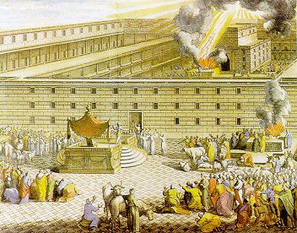
Ezra
Restoring the Temple and People
Dr. Rick Griffith • Jordan Evangelical Theological Seminary • BibleStudyDownloads.org
Notes:
The temple had been destroyed decades earlier—but this book shows us how God resolved such a situation of shame.

Slide 2
Key Word
289
39
Temple
Ezra
Notes:
We’re talking about the Second Temple Period beginning with Ezra’s book.

Slide 3
Theme
289
Restoring
the Temple and People
Ezra
Notes:
In Ezra we see the center of Israel’s worship rebuilt—that structure that also needed the Jews themselves rebuilt.

Slide 4
Key Verse
289
"… for a brief moment, the LORD our God has been gracious in leaving us a remnant and giving us a firm place in his sanctuary, and so our God gives light to our eyes and a little relief in our bondage" (9:8)
Ezra
Notes:
Once again, this book—like every book in the Bible—focuses on what GOD did. In this case, he looked past the sins of those who returned to Jerusalem because he had big plans.

Slide 5

Kingdom Statement
39
God began restoring his rule via Zerubbabel (temple: 1–6) and Ezra (people: 7–10).
Ezra
Notes:
The shame of the temple destruction cast shame on the rule of the God of the temple—but God was working to restore the honor and authority due him as King.

Slide 6

Summary Statement
289
41
The restorations of the temple and people to the land under Zerubbabel and Ezra record God's faithfulness and mercy in fulfilling His promise of restoration to encourage the remnant in true temple worship and covenant obedience.
Ezra
Notes:
Jeremiah 25:11-12 promised restoration after 70 years of exile. Now, in Ezra, we begin to see how this happened. The purpose of the narrative was to strengthen those who returned so they would obey the Lord.

Slide 7

Covenant
42b
Covenant loyalty on God's part seen in restoring the remnant to the land must be shown among the returning remnant in temple worship and holy living to keep David's line pure.
Ezra
Notes:
God had not forgotten the unconditional Abrahamic covenant promise of a land for his people. But those who returned had to do their part by rejecting intermarriage and living as his unique people.

Slide 8

Redemption
42b
Faithful to his promise to restore the nation (cf. 2 Chron. 36:22-23), God brought the exiles back to the land so that a Redeemer might be born there.
Ezra
Notes:
King Cyrus of Persia allowed the exiles to return to the land and, in this sense, was a redeemer figure to restore the nation to the land so the Redeemer would later be born in Bethlehem.
2Chr. 36:22 In the first year of King Cyrus of Persia, the LORD fulfilled the prophecy he had given through Jeremiah. He stirred the heart of Cyrus to put this proclamation in writing and to send it throughout his kingdom:
2Chr. 36:23 “This is what King Cyrus of Persia says:
“The LORD, the God of heaven, has given me all the kingdoms of the earth. He has appointed me to build him a Temple at Jerusalem, which is in Judah. Any of you who are his people may go there for this task. And may the LORD your God be with you!”

Slide 9

Messiah
42a
Zerubbabel’s role in restoring the exiles to the land prefigures the work of his Descendant who will restore his chosen ones from a life a sin.
Ezra
Notes:
Zerubbabel was in the line of David and thus became an ancestor to Jesus four centuries later. As a type of Christ, God used Zerubbabel to deliver the people from bondage. Jesus did the same to rescue us from the bondage of sin.

Slide 10
Ezra's Correlation with Esther
289
Restoring the Temple and People
Temple
Book of Esther (58 YEAR GAP)
People
Zerubbabel
Ezra
Ezra 1–6
Ezra 7–10
50,000 Return
5,000 Return
Survival
Revival
Working
Worshipping
538-516 BC (22 Years)
458-457 BC (1 Year)
External Opposition: Samaritans
Internal Opposition: Intermarriage
Return
1–2
Rebuilding
3–6
Return
7–8
Restoration
9–10
Decree
1
Returnees
2
Begins
3
Opposed
4:1–6:12
Ends
6:13-22
Qualifications
& Provisions
7
Returnees
& Protection
8
Inter- marriage
& Lament
9
Divorces
Carried Out
10
Notes:
The book records two distinct periods. Ezra the priest lived in the second era but recorded events that occurred six decades before his time. Within that time period, God rescued Jews throughout the Persian Empire through Esther (483-473 BC).

Slide 11
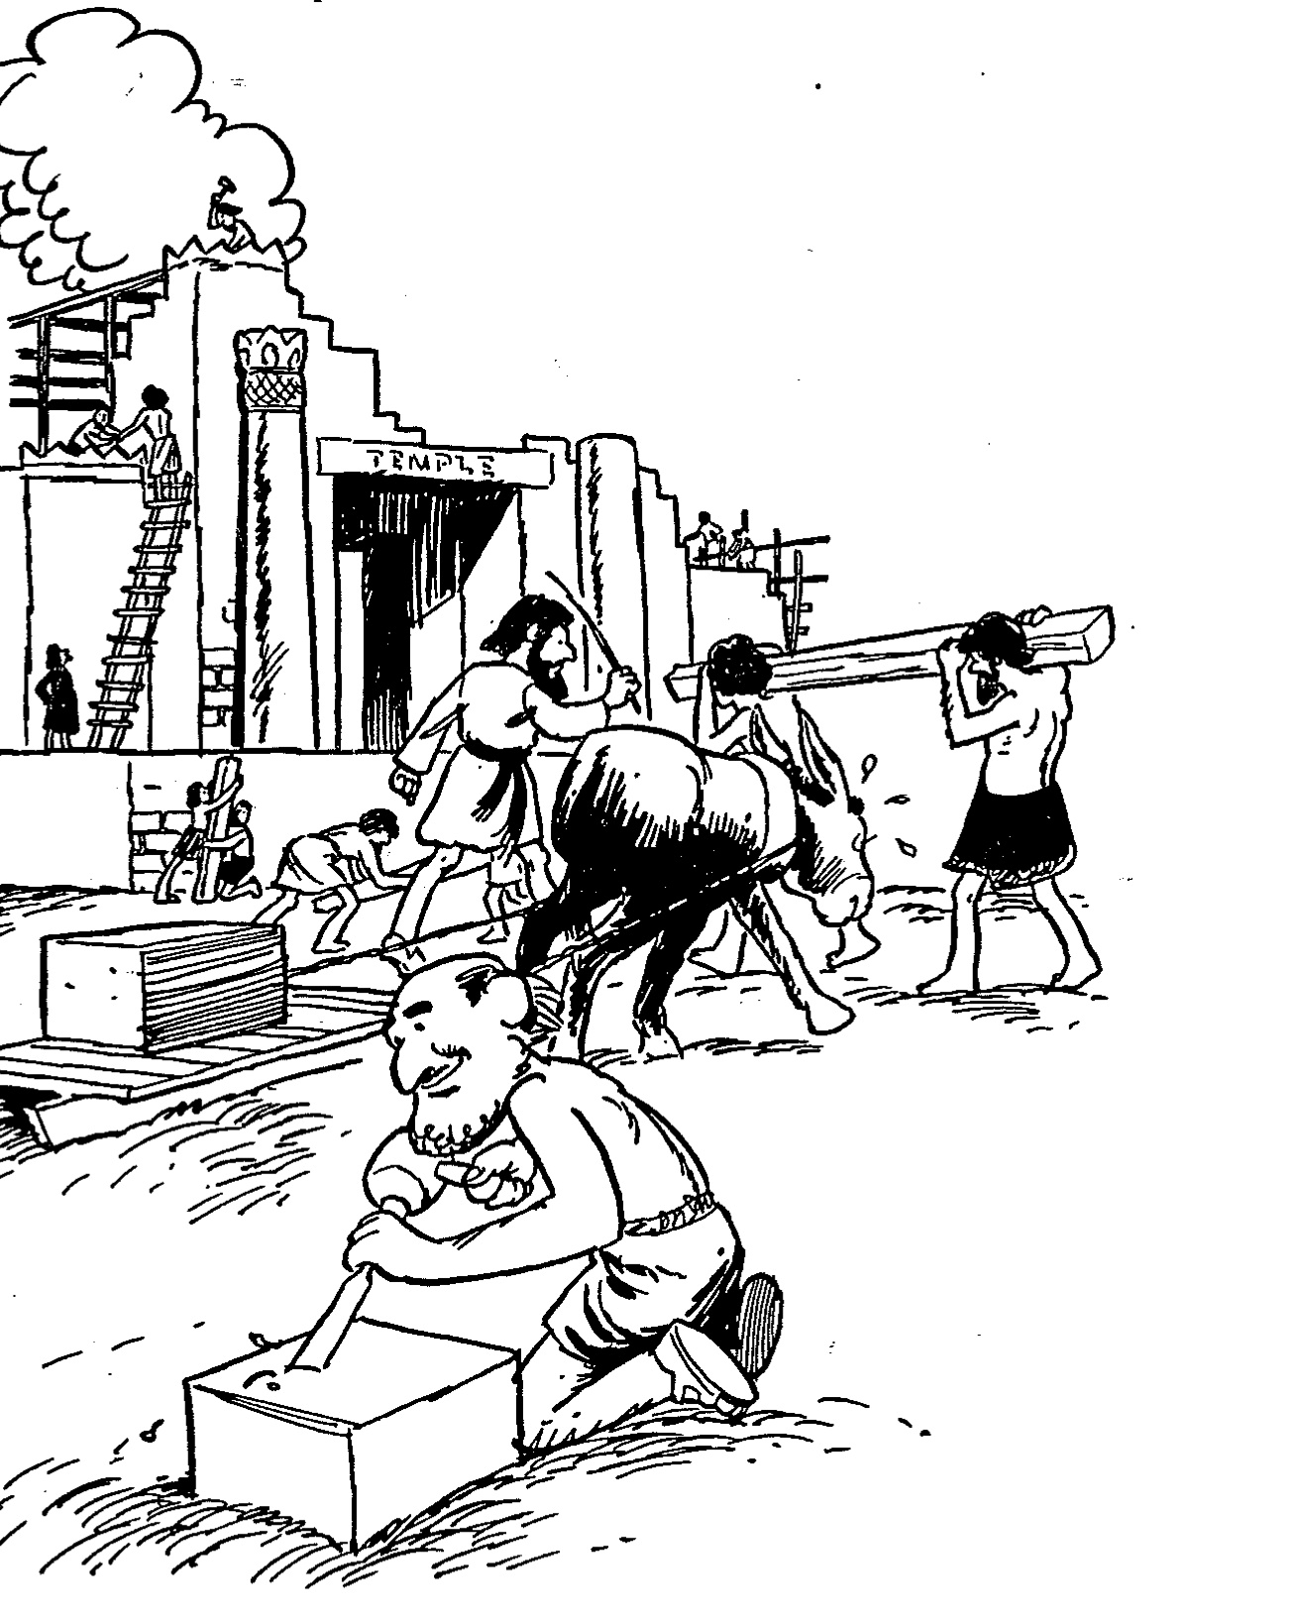
Barry Huddleston, The Acrostic Summarized Bible (Grand Rapids: Baker, 1992)
Ezra
1 Temple proclamation by Cyrus
2 Exiles return under Zerubbabel
3 Making the temple foundation
4 Postponement of the work
5 Letter written to Darius
6 Exiles finish the temple
7 Warrant authorizing Ezra's return
8 Outline of Ezra's return
9 Repentance prayer by Ezra
10 Keeping foreign wives judged
Notes:
The key concept in Ezra is the temple as no other book in the Bible gives us this history of rebuilding the temple. Of course, the people needed restoration also. It’s like our need for both hardware (buildings, spaces to live and worship) and software (people) to make the computer useful.

Slide 12

Be Worshipful
Ezra
Dr. Rick Griffith • Crossroads International Church Singapore
CICFamily.com • BibleStudyDownloads.org
Notes:
The point of Ezra is not simply to have a temple building. The people needed a common place for worship since God calls us to honor him in community.

Slide 13

Why does God restore us?
Notes:
Why are we essentially delivered from our old way of life?
God routinely delivers us even though we are at fault for neglecting him. So why does he rescue or deliver us?
There are many answers to this question but today we will look at one that we normally don't think about.

Slide 14

Two 70-Year Exiles
560
People Exile
605
586
539
536
516
Temple Exile
"This entire land will become a desolate wasteland. Israel and her neighboring lands will serve the king of Babylon for seventy years. ¹²Then, after the seventy years of captivity are over, I will punish the king of Babylon and his people for their sins," says the Lord. I will make the country of the Babylonians a wasteland forever"
(Jeremiah 25:11-12).
Notes:
In 539 BC under the rule of Darius, Daniel read Jeremiah 25:11-12 that limited the exile to 70 years (605-536 BC), or only three years away (9:1-2). But another way to see the 70 years is that the temple lay in ruins from 586 until 516 when the second temple was completed.
Jeremiah does not tell us the exact years that begin and end the 70-year exile.
But we can determine this in two ways—either the exile of the people beginning with Daniel’s deportation (605) to the people fully returning in 536, or the exile of the temple from its destruction in 586 to its rebuilding in 516.
_____________________
Common-320
BE-27-Daniel-89
ES-26-Restoration of Israel-186
OS-00-OT Book Overviews-295, 755
OS-12-Kings & Prophets Charts-26
OS-12-2Kings-231
OS-14-2Chron-308
OS-14-Reasons for Exile-54
OS-15-Ezra-14, 35
OS-17-Esther-33
OS-24-Jeremiah-53, 141
OS-27-Daniel-94, 284, 340, 361
OS-37-Haggai-9, 32
OS-Zechariah-15

Slide 15
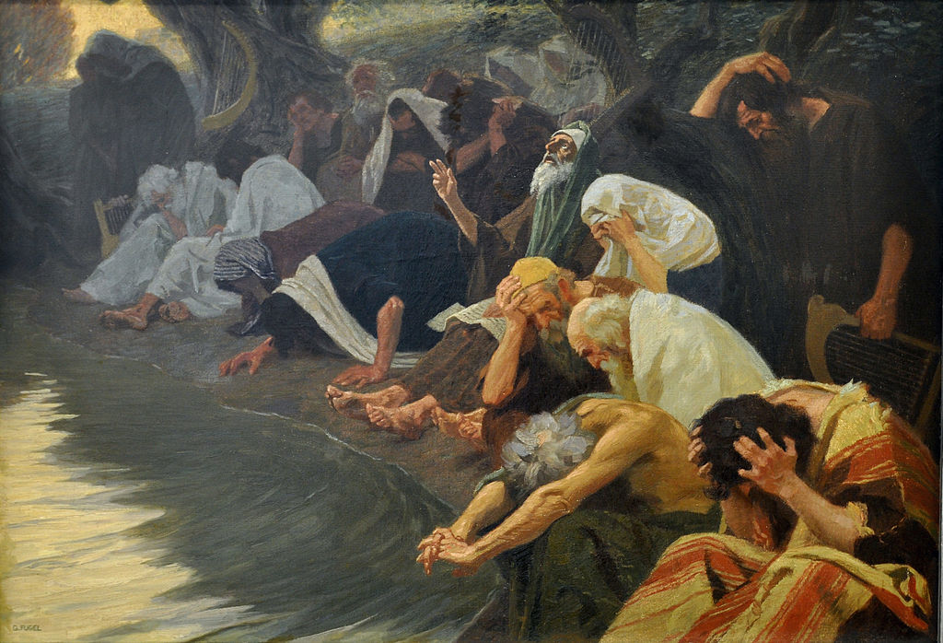
I. God delivered the Jewish exiles to worship him.
The Book of Ezra
Notes:
He brought the Jews from being kicked out of their land back to that land so they would honor him.

Slide 16
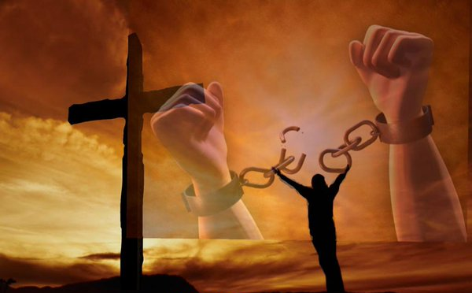
II. God delivers us from our bondage to worship him.
Ezra for Us
Notes:
The LORD has brought you from your slavery to sin into the freedom to adore him!

Slide 17

Main Idea of Ezra
God transforms
EXILES
WORSHIPPERS
INTO
Notes:
The LORD takes us in our slavery to sin and restores us to honor him.

Slide 18
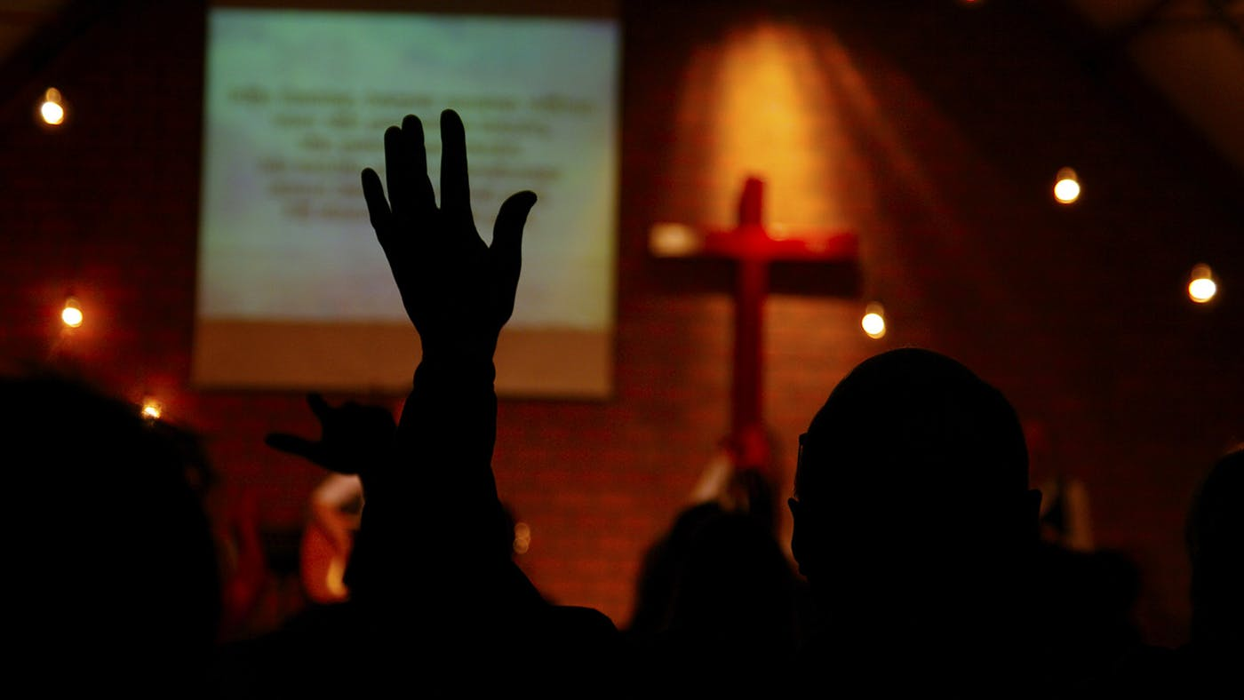
What would change in your life if your chief reason to live was to worship?
Notes:
How would your priorities change?
What would you have to give up to make God first place in your morning?
One friend taught me a great principle. He found that he always made time for breakfast, so he established a new personal rule: No Bible, no breakfast.
Maybe what would change for you is your independence. You, like me, just have to acknowledge your weakness to worship God and you need help from a friend.
As you are dependent on God, so you may need to be dependent on someone else—your own Albert—to help you be dependent on God!
Would you come early for prayer and preparation?
Would reading God’s Word daily be a delight instead of a chore?
Would you begin to lead others in worship?
Would you see your body as the new temple of the Spirit so you would take care of his temple better?

Slide 19
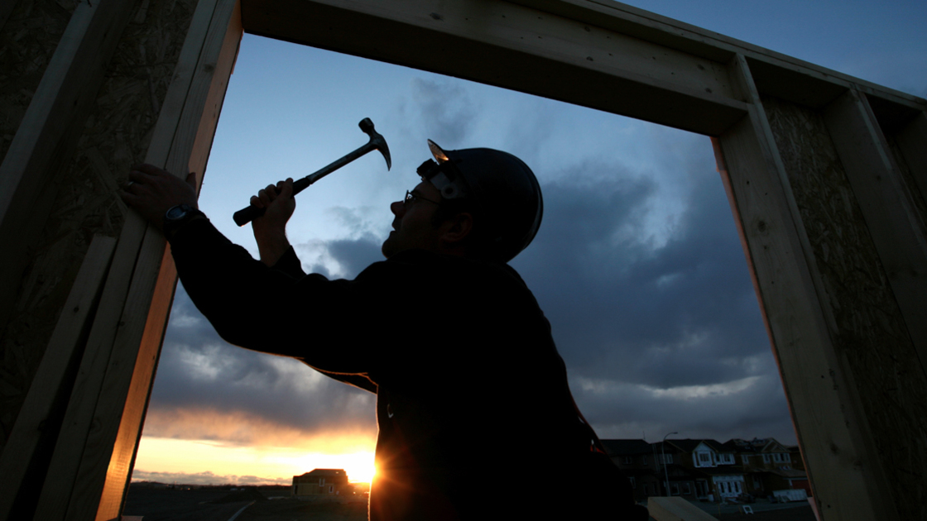
Application
289
Restoration to God for the repentant believer requires action.
Notes:
To do some rebuilding in the priority of worship, what kind of action is God calling you to take?

Slide 21
Ezra-Nehemiah
Jesus
David
Abraham
Flood
Today
Kings
Church
Tribes
3000
2000
1000
0
1000
2000
Creation
New Creation

Slide 22

Timeline
Ezra-Nehemiah
United Kingdom
1050-930
Divided Kingdom
930-722
Solitary Kingdom
722-586
Post- Exile
536-425
1100
1050
1000
950
900
850
800
7 5 0
7 0 0
650
600
550
500
450
Exile 605-536

Slide 23

Chronology of Ezra-Nehemiah
Nehemiah (444-430)
Zerubbabel (537-516)
Ezra (457-444)
540
530
520
510
500
490
480
4
7
0
4
6
0
450
440
430
420
410
Socrates 470-399
Buddha 560-477
Esther 479-473
Plato 427-347
Confucius 551-479

Slide 24
The Postexilic Period

Slide 25
The Postexilic Period

Slide 26
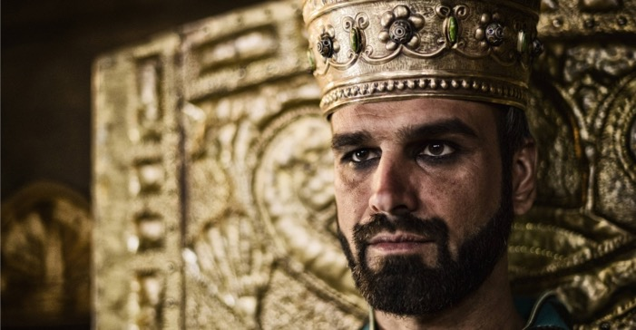
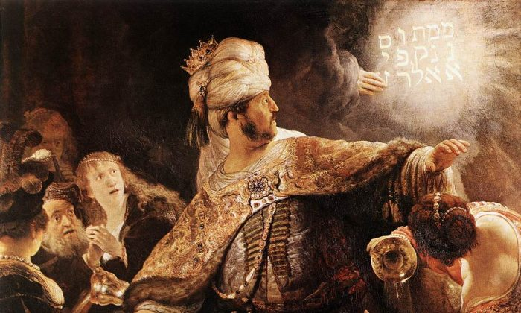
Cyrus Conquered Babylon
Belshazzar’s Feast (Daniel 5)

Slide 27



145
Fall of Babylon
BABYLON FELL (539 BC)
Cyrus entered under the water gates
Daniel 5
(Belshazzar's Feast)
Notes:
"Babylon was being besieged by the Persian army, led by Ugbaru, governor of Gutium, while Belshazzar, inside the city, was giving a great banquet for 1,000 of his nobles. Belshazzar's name means "Bel (another name for the god Marduk) has protected the king." Perhaps the banquet was given to show Belshazzar's contempt for the Persians and to allay his people's fears. Archeologists have excavated a large hall in Babylon 55 feet wide and 165 feet long that had plastered walls. Such a room would have been sufficient to house a gathering of this size. Belshazzar considered his city secure from assault because of its massive walls. Within the city were supplies that would sustain it for 20 years. Therefore the king felt he had little cause for concern."
Dwight Pentecost, “Daniel,” eds. John F. Walvoord, Roy B. Zuck and Dallas Theological Seminary, The Bible Knowledge Commentary : An Exposition of the Scriptures (Wheaton, IL: Victor Books, 1983-1985), 1:1344.
__________
Common-405
OS-23-Isaiah13-23-slide 24
OS-27-Daniel-125
OS-35-Habakkuk-169

Slide 28
Babylon's Fall (Herodotus)
544b
The History of the Persian Wars 1.191 (430 BC)
"[Cyrus] placed a portion of his army at the point where the river enters the city, and another body at the back of the place where it issues forth, with orders to march into the town by the bed of the stream, as soon as the water became shallow enough: he then himself drew off with the unwarlike portion of his host, and made for the place where Nitocris dug the basin for the river, where he did exactly what she had done formerly: he turned the Euphrates by a canal into the basin, which was then a marsh, on which the river sank to such an extent that the natural bed of the stream became fordable.
"Hereupon the Persians who had been left for the purpose at Babylon by the river-side, entered the stream, which had now sunk so as to reach about midway up a man's thigh, and thus got into the town.
Notes:
Herodotus was a reputable Greek historian who recorded the unsuccessful Persian invasion of Greece and the later fall of Babylon.
__________
OS-27-Daniel-126
OS-35-Habakkuk-170

Slide 29
Babylon's Fall (Herodotus)
544b
"Had the Babylonians been apprised of what Cyrus was about, or had they noticed their danger, they would never have allowed the Persians to enter the city, but would have destroyed them utterly; for they would have made fast all the street-gates which gave upon the river, and mounting upon the walls along both sides of the stream, would so have caught the enemy, as it were, in a trap. But, as it was, the Persians came upon them by surprise and so took the city. Owing to the vast size of the place, the inhabitants of the central parts (as the residents at Babylon declare) long after the outer portions of the town were taken, knew nothing of what had chanced, but as they were engaged in a festival, continued dancing and reveling until they learnt the capture but too certainly. Such, then, were the circumstances of the first taking of Babylon."
The History of the Persian Wars 1.191 (written over a century later in 430 BC)
Notes:
The Greek historian Herodotus describes the fall of Babylon in the same manner as does Daniel 5 with a surprise attack while the Babylonians had a party or festival.
__________
OS-27-Daniel-127
OS-35-Habakkuk-171

Slide 30
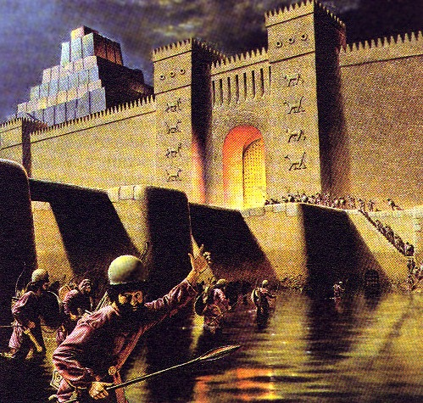
Daniel 5:30-31
“That same night Belshazzar the Chaldean king was slain. So Darius the Mede received the kingdom.”
Daniel 5:30-31
Notes:
During Belshazzar's great party, the Medes and Persians diverted the Euphrates upstream to lower the moat around Babylon. This made it easy to conquer in but a few hours!

Slide 31
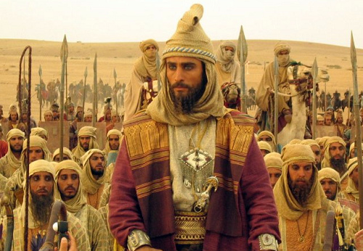
The Identifications of Darius the Mede
Stephen D. Anderson
539 BC
Notes:
Daniel was promoted to Babylon’s third position to show God's pleasure with those who accept his sovereignty (5:29).
Belshazzar lost his kingdom that night to Darius the Mede [in the reign of Cyrus the Persian, 6:28] for denying God's rule (5:30).
Stephen Anderson argues Darius the Mede as Cyaxares II and some evangelical scholars, such as Kirk MacGregor and Paul Tanner, have subsequently followed his arguments. See his article on this webpage.
تحديد هوية داريوس المادي

Slide 32
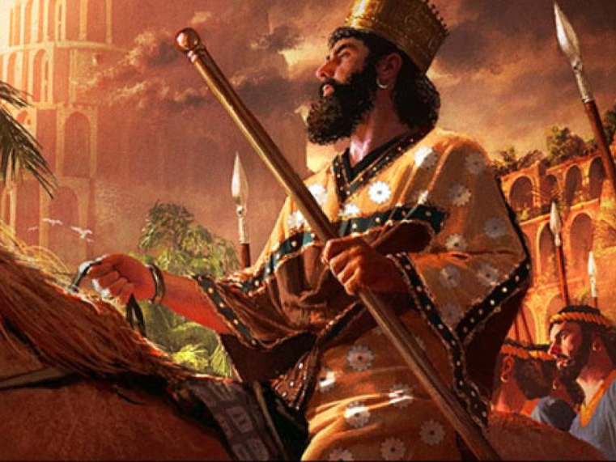
Cyrus Conquers Babylon
539 BC
Notes:
Daniel was promoted to Babylon’s third position to show God's pleasure with those who accept his sovereignty (5:29).
Belshazzar lost his kingdom that night to Darius the Mede [in the reign of Cyrus the Persian, 6:28] for denying God's rule (5:30).

Slide 33
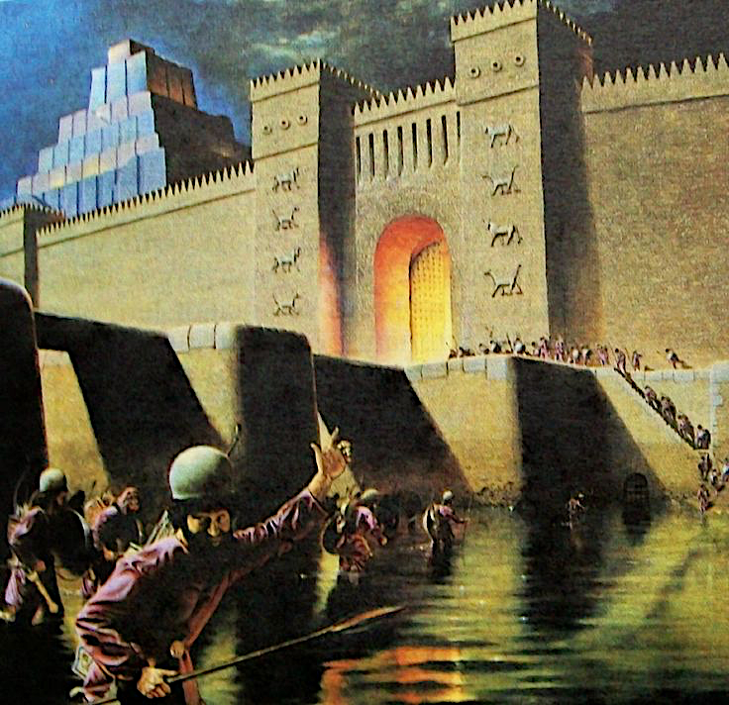
On 12 Oct 539 BC, after Cyrus' engineers diverted the waters of the Euphrates, the soldiers entered Babylon without fighting.

Slide 34
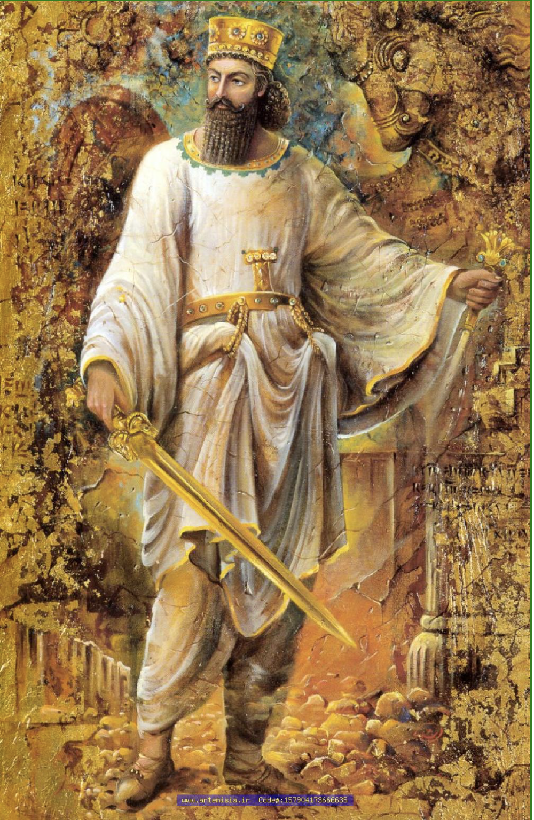
“It is I who says of Cyrus, ‘He is My shepherd! And he will perform all My desire.’ And he declares of Jerusalem, ‘She will be built,’ and of the Temple, ‘Your foundation will be laid. Thus says the LORD to Cyrus His anointed, Whom I have taken by the right hand, to subdue nations before him, and to loose the loins of kings; to open doors before him so that gates will not be shut: I will go before you and make the rough places smooth; I will shatter the doors of bronze, and cut through their iron bars. And I will give you the treasures of darkness, and hidden wealth of secret places, in order that you may know that it is I, the LORD, the God of Israel, who calls you by your name.” Isaiah 44:28–45:3
God’s Shepherd Cyrus

Slide 35
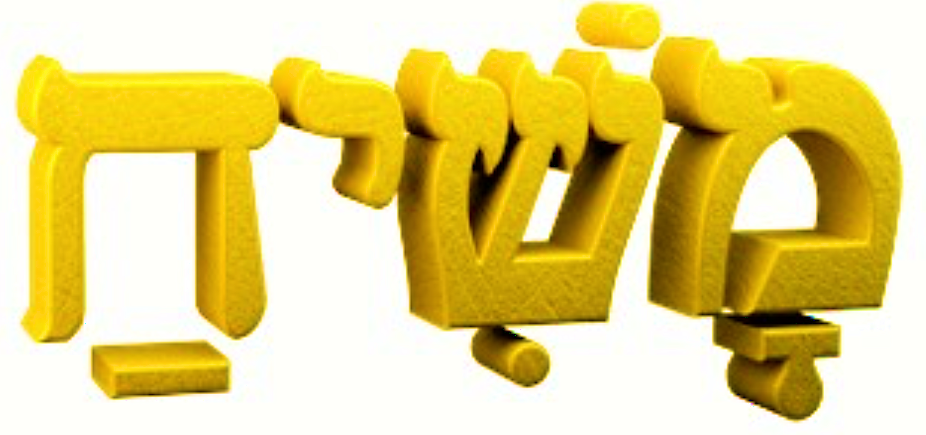
“Anointed”
Mashiach (Messiah)

Slide 36
God’s “anointed,” whether a patriarch (Ps. 105:15), priest (Lev. 4:3, 5, 16), king (1 Sam. 24:6; 2 Sam. 1:14, 16), or prophet (1 Kgs. 19:16) was a person chosen and “set apart” (the act of ”anointing” with oil) to do a special work for God. In the case of Cyrus, he was set apart to serve God’s purpose in releasing the captive Jews and returning them to Jerusalem to rebuild the Temple, as He had promised: “‘Then it will be when seventy years are completed I will punish the king of Babylon and that nation,’ declares the LORD, ‘for their iniquity, and the land of the Chaldeans; and I will make it an everlasting desolation’” (Jeremiah 25:12). God would subdue nations before Cyrus and give him the wealth of those nations in order that Cyrus would come to recognize that Israel’s God had done this for him.
The Meaning of “Anointed”

Slide 37
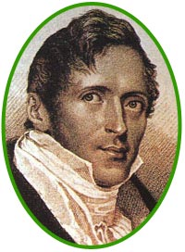
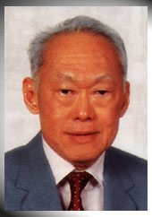
Amazing Prophecies
460
??
Stamford Raffles (1819)
Lee Kwan Yew (1959)
Did you hear that Raffles wrote 140 years before Lee Kwan Yew, "Behold, a man named Lee will arise to make Singapore its own country…"?
Notes:
Do you know why you did not hear of this prophecy? Because it never happened!
But what if it did? What if Raffles predicted the actual name of the founder of modern Singapore—and specified that he would rebuild the nation following World War II?
Wouldn’t that be amazing—perhaps even divinely inspired?

Slide 38
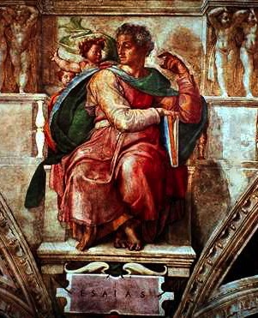
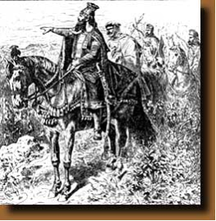
Amazing Prophecies
460
An Amazing Prophecy
41:2-3, 25
44:28
45:1-2
45:13-15
Isaiah (700 BC)
Cyrus (539 BC)
"When I say of Cyrus, 'He is my shepherd,' he will certainly do as I say.
He will command, 'Rebuild Jerusalem'; he will say, 'Restore the Temple' "
(Isa. 44:28 NLT)
Notes:
This is what God did with Isaiah’s prediction some 160 years before Cyrus the Persian sent the Jews back from Babylon and restored Jerusalem. Cyrus not only commanded the restoration of the temple in Ezra 1:2, but he funded the effort!
Isaiah notes the victories of Cyrus but not by name in 41:2, 25, but then specifically gives the name of Cyrus SIX times in his prophecy (NLT). Look these up in your Bible:
Is. 44:28 When I say of Cyrus, ‘He is my shepherd,’
he will certainly do as I say.
He will command, ‘Rebuild Jerusalem’;
he will say, ‘Restore the Temple.’”
Is. 45:1 This is what the LORD says to Cyrus, his anointed one,
whose right hand he will empower.
Before him, mighty kings will be paralyzed with fear.
Their fortress gates will be opened,
never to shut again.
2 This is what the LORD says:
“I will go before you, Cyrus,
and level the mountains.
I will smash down gates of bronze
and cut through bars of iron.
Is. 45:13 I will raise up Cyrus to fulfill my righteous purpose,
and I will guide his actions.
He will restore my city and free my captive people—
without seeking a reward!
I, the LORD of Heaven’s Armies, have spoken!”
Is. 48:14 Have any of your idols ever told you this?
Come, all of you, and listen:
The LORD has chosen Cyrus as his ally.
He will use him to put an end to the empire of Babylon
and to destroy the Babylonian armies.
Is. 48:15 “I have said it: I am calling Cyrus!
I will send him on this errand and will help him succeed.

Slide 39
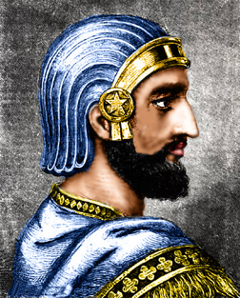
Cyrus Prophesied
“Who has stirred up this king from the east,
rightly calling him to God’s service?
Who gives this man victory over many nations
and permits him to trample their kings underfoot?
With his sword, he reduces armies to dust.
With his bow, he scatters them like chaff before the wind”
(Isaiah 41:2 NLT).

Slide 40
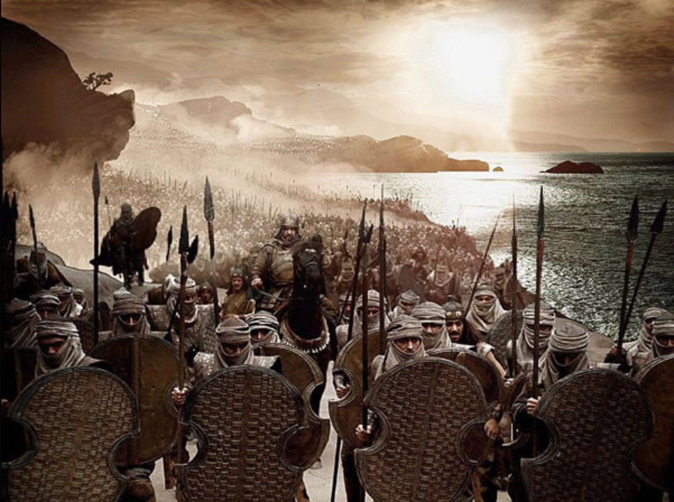
“He delivers up nations before him, and subdues kings. He makes them like dust with his sword, as the wind-driven chaff with his bow. He pursues them, passing on in safety, by a way he had not been traversing with his feet.” Isaiah 41:2b-3
Cyrus moved from country to country, conquering every king in his path. Around 550 BC he unified the Medes and Persians to defeat the powerful kingdom of Lydia (Asia Minor) in 546 BC. Turning south to Babylon, his army under the command of Darius conquered the city in 539 BC.

Slide 41
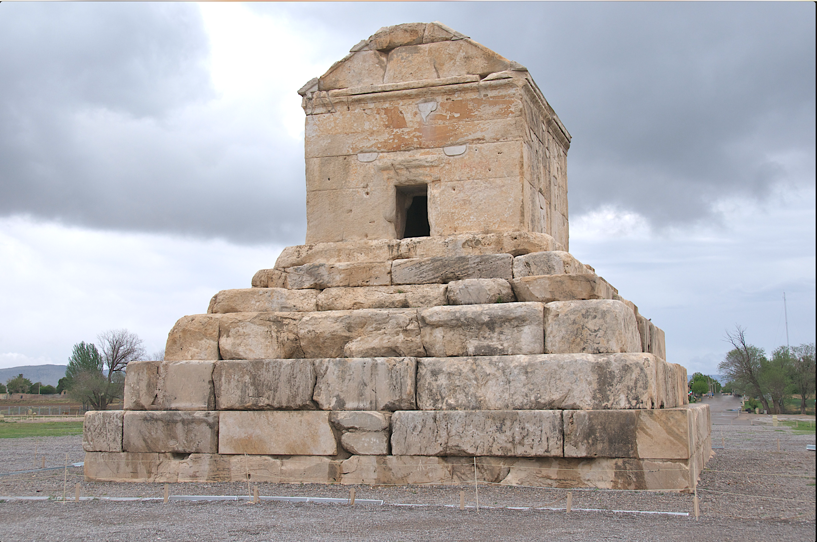
The emperor was killed in battle from a wound inflicted from a poisonous arrow during a campaign against the Massagetes of central Asia. Cyrus’ body was brought back to Pasargade in Persia; his tomb, which still exists, consists of a single chamber built on a foundation course of six steps.
The body was placed in a golden sarcophagus, and the tomb bore the inscription. He is considered as one of the most respected world leaders to date. He always fought side by side with his soldiers and never left them alone in the battlefield.
Tomb of Cyrus the Great

Slide 42
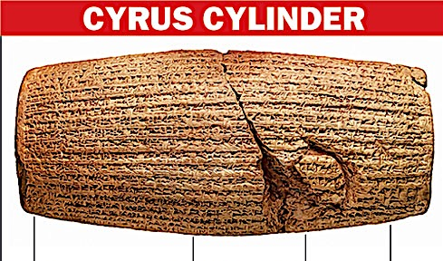
CYRUS CYLINDER
“I am Cyrus, king of the world, great king, legitimate king, king of Babylon, king of Sumer and Akkad, king of the four rims (of the earth), son of Cambyses, great king, king of Anshan, descendant of Teispes, great king, king of Anshan, family (which) always (exercised) kingship.”
What: Clay cylinder, 22.5 cm by 10 cm, inscribed with arguably the world’s first known human rights charter
Antiquity: 539 BC when Persian emperor Cyrus conquered Babylon
Contents: Freedom of worship for all, call for repatriation of deportees
Place: London Museum

Slide 43
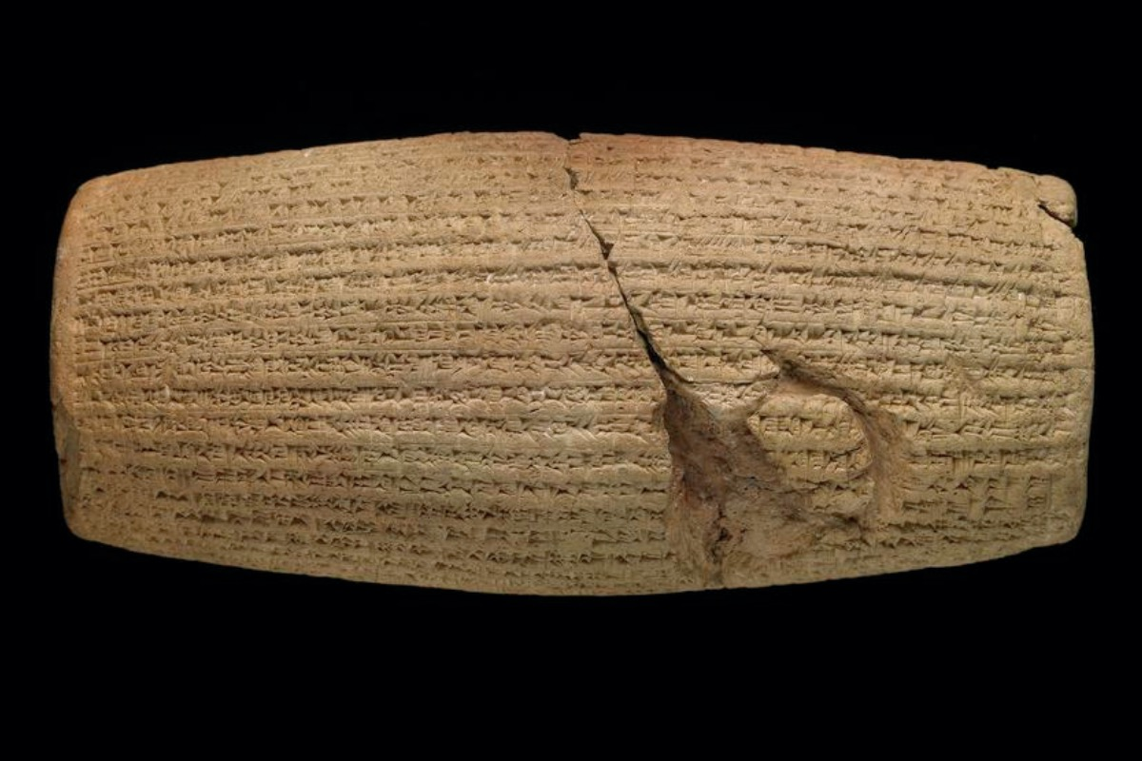

Policies of Cyrus the Great
Cyrus Cylinder
"I am Cyrus, king of the universe…"
"Nabonidus, the king who did not fear me…"
"Since the gods of foreign lands made permanent sanctuaries which are now dilapidated, I returned people to their lands and made provisions to rebuild"
Notes:
This small cylinder details the priorities of Cyrus the Great.

Slide 44
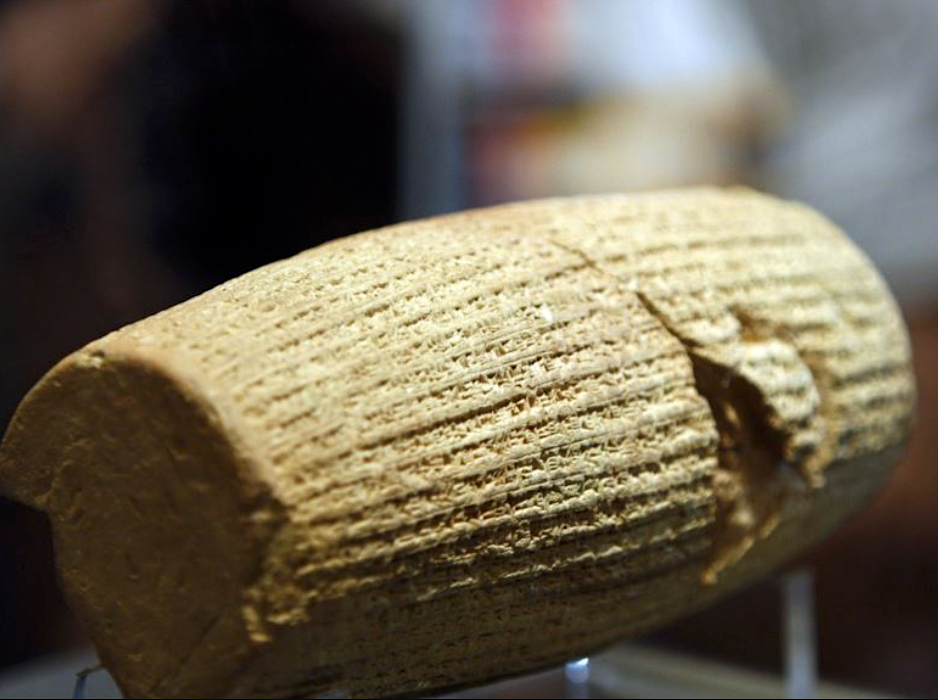
“Now that I put the crown of kingdom of Persia, Babylon, and the nations of the four directions on the head with the help of god I announce that I will respect the traditions, customs and religions of the nations of my empire and never let any of my governors and subordinates look down on or insult them until I am alive. From now on, till god grants me the kingdom favor, I will impose my monarchy on no nation. Each is free to accept it , and if any one of them rejects it, I never resolve on war to reign. Until I am the king of Persia, Babylon, and the nations of the four directions, I [will] never let anyone oppress any others, and if it occurs, I will take his or her right back and penalize the oppressor.”
“And until I am the monarch, I will never let anyone take possession of movable and landed properties of the others by force or without compensation. [While] I am alive, I [will] prevent unpaid, forced labor. Today, I announce that everyone is free to choose a religion. People are free to live in all regions and take up a job provided that they never violate other’s rights. No one [can] be penalized for his or her relatives’ faults. I prevent slavery and my governors and subordinates are obliged to prohibit exchanging men and women as slaves within their own ruling domains. Such traditions should be exterminated the world over. I implore to god to make me succeed in fulfilling my obligations to the nations of Persia, Babylon, and the ones of the four directions.”

Slide 45
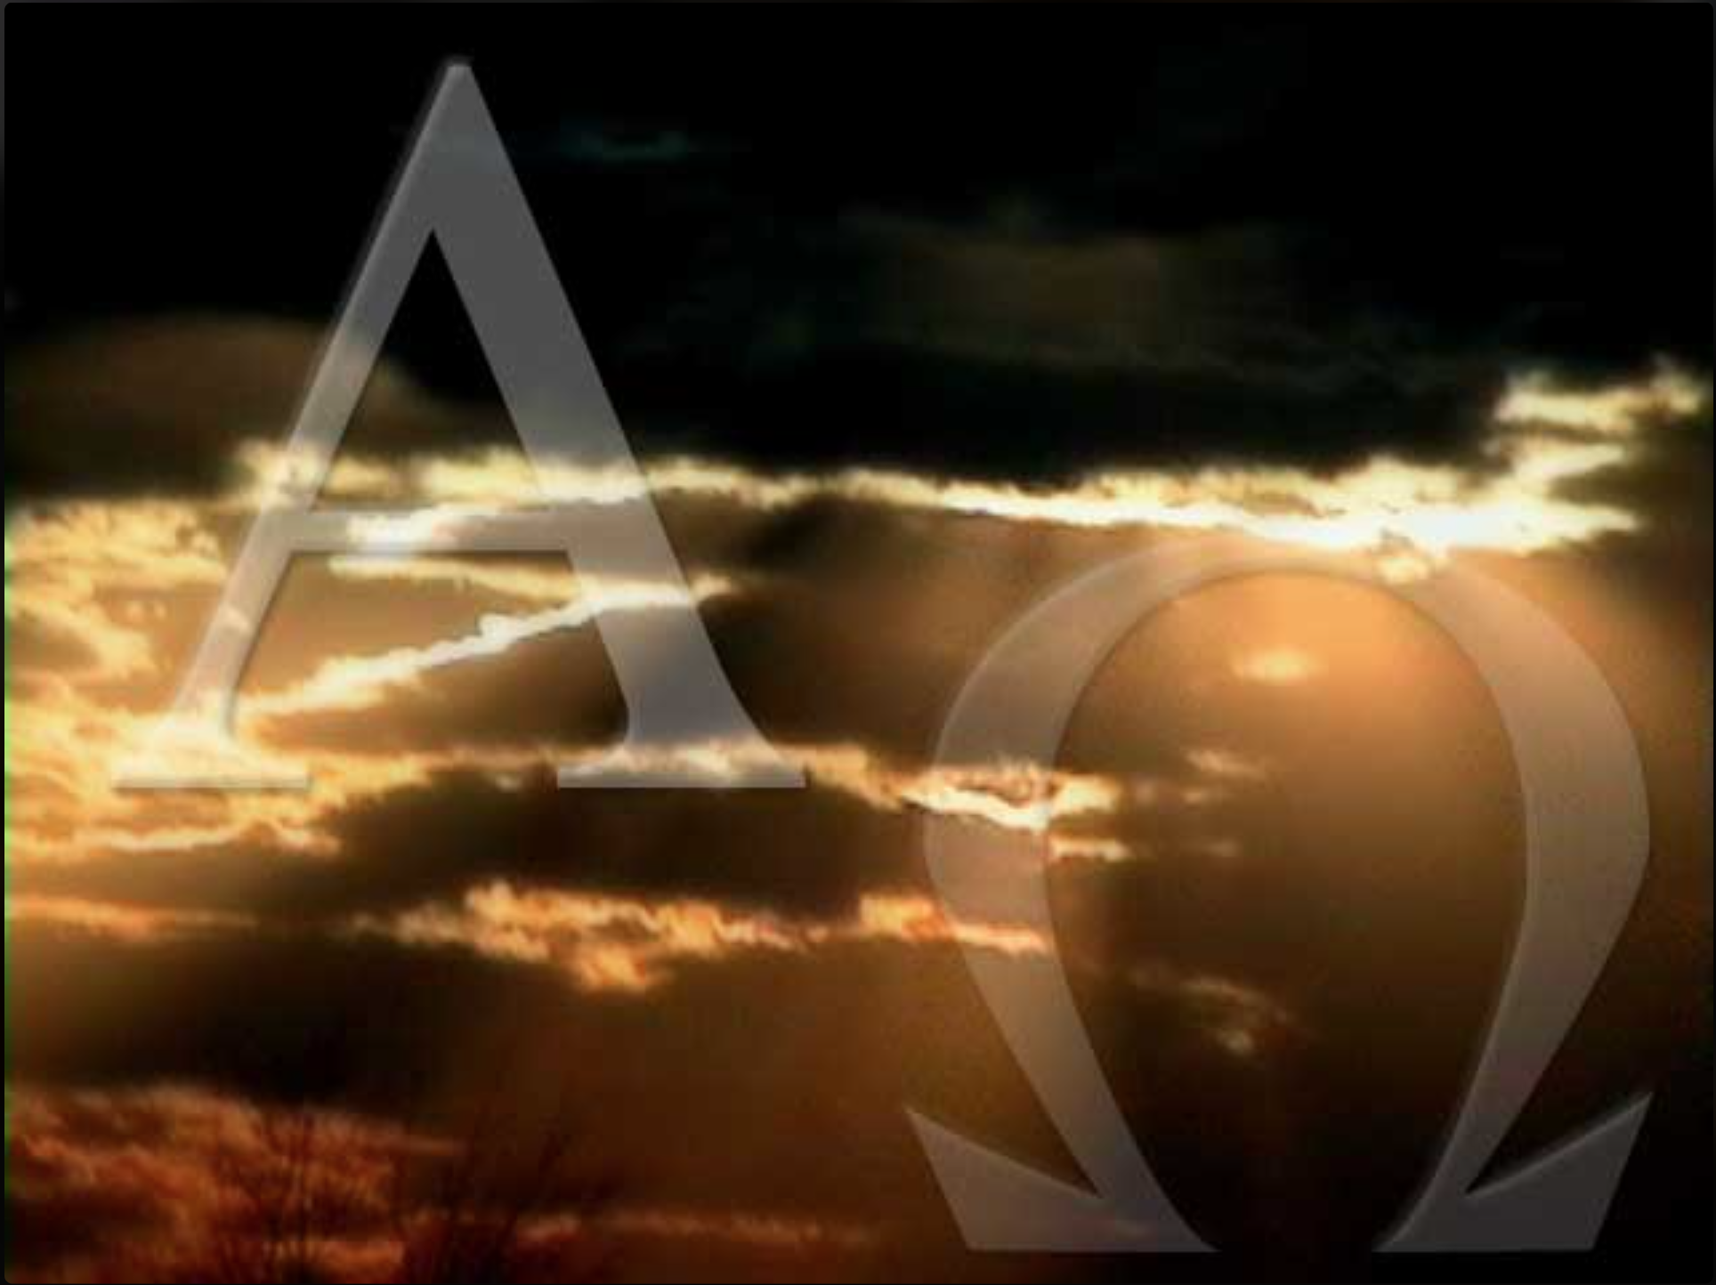
“Who has performed and accomplished it, calling forth the generations from the beginning?
The focus is on time. God is the same God to the first generations of man as the very last. He is always God for all time.
‘I, the LORD, am the first, and with the last. I am He.’”
Isaiah 41:4

Slide 46
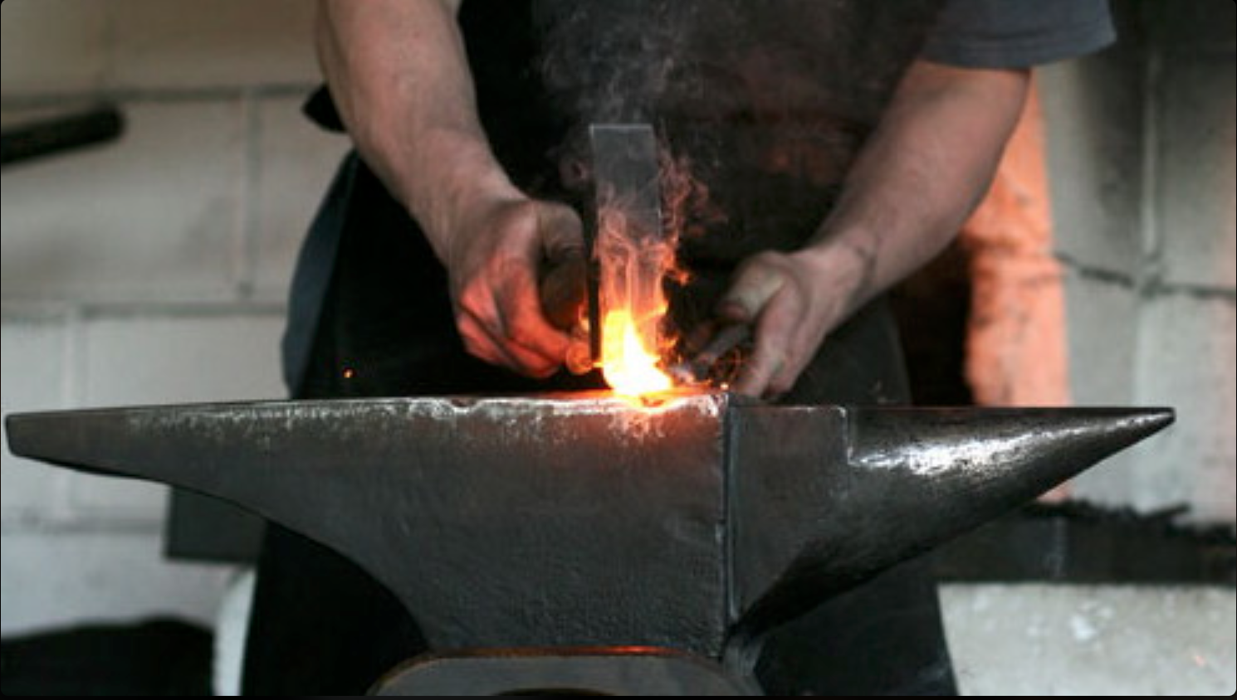
“So the craftsman encourages the smelter, and he who smooths metal with the hammer encourages him who beats the anvil, saying of the soldering, ‘It is good’; And he fastens it with nails, that it should not totter.’” Isaiah 41:7
In their desperation in wake of Cyrus’ advance, the nations made new idols in an attempt to protect them.

Slide 47
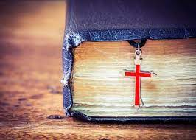
God’s Servant Israel
“But you, Israel, My servant, Jacob whom I have chosen, descendant of Abraham My friend, you whom I have taken from the ends of the earth, and called from its remotest parts, and said to you, ‘You are My servant, I have chosen you and not rejected you. ‘Do not fear, for I am with you; Do not anxiously look about you, for I am your God. I will strengthen you, surely I will help you, surely I will uphold you with My righteous right hand.’”
Isaiah 41:8–10

Slide 48
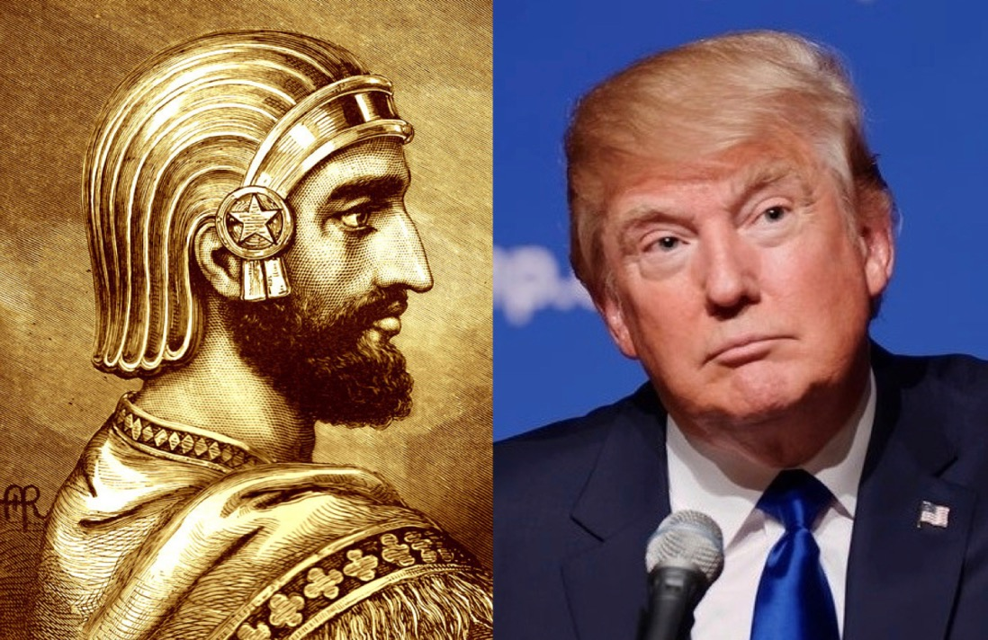
Is Trump a Cyrus?
Neither claimed to be a Jew/Christian,
but they worked tirelessly for biblical causes

Slide 49
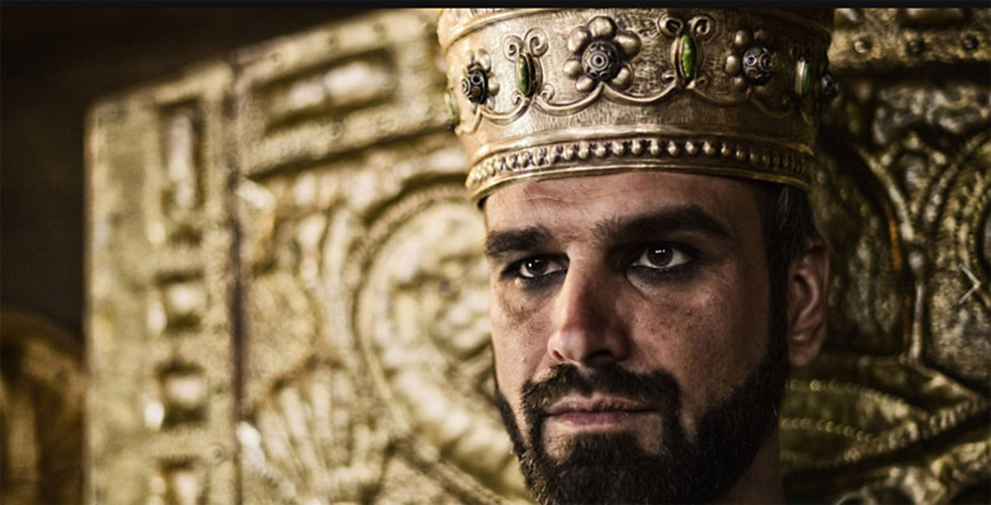
Israel the servant nation should not fear since God is sovereign over Babylon’s puny idols as he will appoint Cyrus (41:25) as the only one who knows the future.
460
Isaiah 41 Summary
Notes:
49

Slide 50

The Persian Empire
Map of the Persian Empire
317
Barry J. Beitzel, Moody Atlas of Bible Lands, 150-51
"I looked in the vision, and while I was looking I was in the citadel of Susa, which is in the province of Elam; and I looked in the vision and I myself was beside the Ulai Canal" (Dan 8:2 NAU).
^{Susa}
The Persian Empire in the 5th century BC
extended "from India and Ethiopia" (Esther 1:1)
The boundaries of the empire that Cyrus II initiated
and Darius I consolidated stretched from Greece to India
Notes:
The Jews needed to renew their commitment to God based on his commitment to them over the ages. Yet they also needed to see God working in their lives right then as they lived outside the land of Israel.
Cyrus ruled over an absolutely ENORMOUS kingdom that eventually stretched from Greece in the west and India in the east. From his capital at Susa he had control over 127 provinces! God moved his heart to initiate a return to the land not only for the Jews but for other conquered peoples—as long as they would pray for the welfare of the king and his sons.
__________________
OS-15-Ezra-50, 82
OS-27-Daniel-342

Slide 51
Be Worshipful
Ezra
Dr. Rick Griffith • Crossroads International Church Singapore
CICFamily.com • BibleStudyDownloads.org

Slide 52

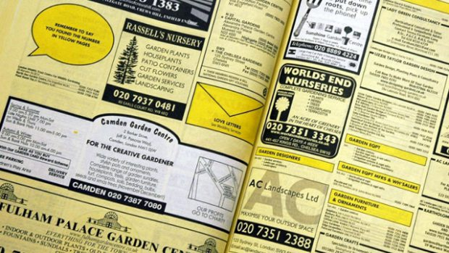
Yellow Pages
How to find a church…
Notes:
When my family moved to Singapore in 1991 for me to teach at Singapore Bible College, after securing our housing, our first item of business was to find a church.
So I did what many people did back then—"let your fingers do the walking" was the slogan of the Yellow Pages.
For those of us who have no idea what I'm talking about—and that is a lot of us since everyone in this church is younger than me—the Yellow Pages was the "go to" place before the internet.
Every business and individual had their phone number there back in the late 20th century.
• So I looked under "Churches." But I found no entries!
"Really?" I thought. "Surely the churches are in here. There are hundreds of churches in Singapore!"
So I looked up "Christian," but there was no entry there either. Then I tried "Baptist"—no go.
You are laughing, but where would you look?!
Finally, somehow, I found them under "P" alphabetically. Sure enough, the churches were all listed there in the "P" section, under "Places…of Worship"!
At that spot were listed, by religion, the Buddhist, Hindu, Muslim and Christian places of worship.
I guess what hit me most as I saw this was that these were all deemed places of worship—not places of teaching, not places of ministry, not places of gathering, not places evangelizing.
There, right there through my Yellow Pages, God spoke to me. What each religion is doing, more than anything else, is worshipping!

Slide 53




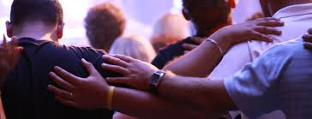
Why church?
Learn?
Sing?
Fellowship?
Serve?
Notes:
Why do we leave the world to gather in community? Why church?
• Is it to learn and teach?
• Do we gather mostly to sing?
• Is fellowship our chief reason to come together?
• Is our chief reason to gather to serve?
• Oops. That is the wrong kind of serve. I mean do we gather mainly to serve God?
What kind of service is this? It is a WORSHIP service!

Slide 54

Mei Ling
Notes:
In 2013 during a time of great loneliness after two dogs died, my brothers bought a new Shitzhu for my 82-year-old mother. Mom named the new puppy the Chinese name Mei Ling. She was really easy to care for, never messed on the carpet, and provided a lot of companionship for her.

Slide 55

Mei Ling
Notes:
"Everyone loves Mei Ling,"was the refrain as Mom brought her to the elderly home where her husband lives. My son and daughter-in-law were among those who visited.

Slide 56
Dr. Raz messed up.
My mother needed restoration.
Only God could truly restore her.
Notes:
But in a routine operation to fix Mei Ling’s ear, the vet got Mei Ling mixed up with another dog and put down Mei Ling instead.
Mom was devasted.

Slide 57

Mei Ling
Notes:
Gone was her companion of three years.

Slide 58
We all have messed up.
We all need restoration.
Only God can truly restore us.
Notes:
How have you messed up?
We have all made bad decisions that cost us money, a job, a relationship, or some other loss.
Most of all, we have messed up with God. We haven't truly followed him.

Slide 59
Why does God restore us?
Notes:
Why are we essentially delivered from our old way of life?
God routinely delivers us even though we are at fault for neglecting him. So why does he rescue or deliver us?
There are many answers to this question but today we will look at one that we normally don't think about.

Slide 60
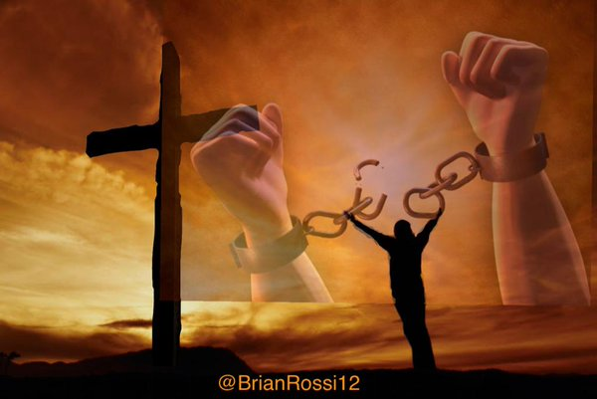
God delivers us from our bondage to worship him.
Main Idea to Apply Ezra
Notes:
The Lord frees us from our slavery for us to give him the honor that we lacked that got us into trouble in the first place.

Slide 61
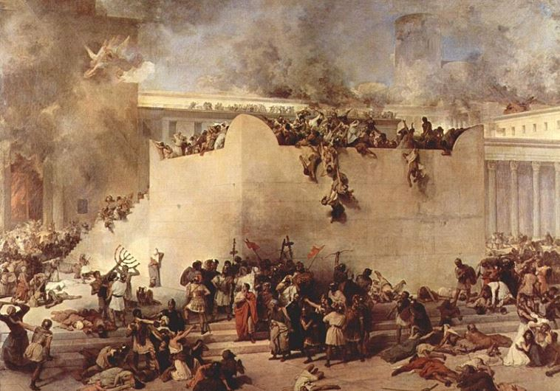
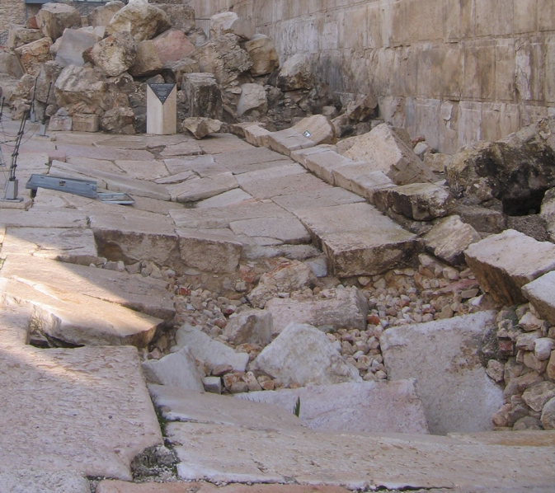
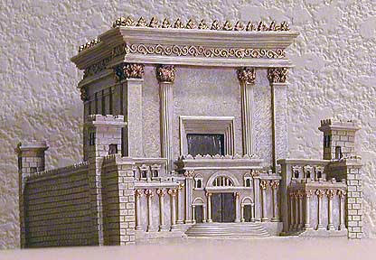
Israel messed up.
The Jews needed restoration.
Only God could restore them.
Notes:
Today we pick up the account in Scripture about 400 years before Jesus. God had disciplined the nation

Slide 62
Two 70-Year Exiles
560
People Exile
605
586
539
536
516
Temple Exile
"This entire land will become a desolate wasteland. Israel and her neighboring lands will serve the king of Babylon for seventy years. ¹²Then, after the seventy years of captivity are over, I will punish the king of Babylon and his people for their sins," says the Lord. I will make the country of the Babylonians a wasteland forever"
(Jeremiah 25:11-12).
Notes:
In 539 BC under the rule of Darius, Daniel read Jeremiah 25:11-12 that limited the exile to 70 years (605-536 BC), or only three years away (9:1-2). But another way to see the 70 years is that the temple lay in ruins from 586 until 516 when the second temple was completed.
Jeremiah does not tell us the exact years that begin and end the 70-year exile.
But we can actually determine this in two ways—either the exile of the people beginning with Daniel’s deportation (605) to the people fully returning in 536, or the exile of the temple from its destruction in 586 to its rebuilding in 516.
_____________________
Common-320
BE-27-Daniel-89
ES-26-Restoration of Israel-186
OS-00-OT Book Overviews-294, 755
OS-12-Kings & Prophets Charts-26
OS-12-2Kings-231
OS-14-2Chron-308
OS-14-Reasons for Exile-54
OS-15-Ezra-14, 35
OS-Esther
OS-24-Jeremiah-53, 141
OS-27-Daniel-94, 284, 340, 361
OS-37-Haggai-9, 32
OS-Zechariah-15

Slide 63


The Postexilic Era
295
296
560
The Postexilic Era
Temple work
Prophets:
Haggai
Zechariah
Malachi
605
586
539
536
520
516
483-473
444-425
72 years
Others:
Zerubbabel
Esther
Ezra
Nehemiah
Persian Kings:
Cyrus
Darius
Xerxes
Artaxerxes
Notes:
The Post-Exilic Era involved three separate periods:
(1) Temple rebuilding led by Zerubbabel, Haggai, and Zechariah in two parts under Cyrus and Darius,
(2) The saving of the nation from destruction by Esther about 30 years later under Xerxes, and
(3) The restoration of Jerusalem’s walls and gates by Nehemiah another 72 years after that under Artaxerxes.
_________
Common-321
BE-37-Haggai-15
BE-39-Malachi-21
OS-12-Kings & Prophets Charts-24
OS-15-Ezra-36
OS-16-Nehemiah-94, 156
OS-17-Esther-16, 75
OS-26-Ezek33-39—slide 85
OS-27-Daniel-340
OS-37-Haggai-25, 43
OS-38-Zechariah-46, 121
OS-39-Malachi-13, 56

Slide 64
JUDAH IS PRESERVED!
Isaiah 9:6-7
DRESSING
THE
STAGE
Summing up…
MS
N(A)
H
SG
C
ER
B
J
MN
DS
E
KB
WHY?
U
MS
Because Messiah was long prophesied to appear through the tribe of Judah.
PG
RS
Handbook pg. 37-38
57
8
Notes:
Summing up this time of ROYALTY…
Remember again that crucial difference when the NORTHERN and the SOUTHERN Kingdoms fell. Recall that
//// the NORTHERN Kingdom, Israel, is attacked by Assyria,
//// taken away into captivity and , through time,
//// absorbed into other societies.
But JUDAH, the SOUTHERN KINGDOM and its people…
//// conquered by Babylon under Nebuchadnezzar…
//// is taken over to Babylon for a TEMPORARY captivity. But Judah is destined to continue to play center stage in the long future history of THE LAND.
//// JUDAH IS PRESERVED and eventually returned to The Land.
////` Why?
//// Because the expected Messiah...long prophesied...was destined by the Old Testament prophets to appear through the tribal line of JUDAH.

Slide 65
2 Kings 25:21
7
CAPTIVITY
The THIRD
of
THREE
SOCIETIES
is:
CAPTIVITY
A R C
Handbook pg. 37-38
58
Notes:
And here is CAPTIVITY's file folder from the Bible File sequence ready for the four items important to this period in the life of ancient Judah.

Slide 66

Daniel 1
The Ancient City of Babylon
CAPTIVITY
Euphrates River
Hanging Gardens of Babylon
Handbook pg. 37-38
59
Notes:
Babylon -- that enormous Oriental metropolis next to the Euphrates River -- is the site of JUDAH's 70 years of captivity, shown here in an artist re-creation of the possible appearance of that incredible city. The famed Hanging Gardens of Babylon -- visible on the right -- were among the Seven Wonders of that Ancient World.

Slide 67
7
CAPTIVITY
BABYLON
PERSIAN GULF
THE STAGE OF THE ACTION
Handbook pg. 37-38
60
Notes:
Remember, also, that Babylon -- located on your map many miles upstream from the Persian Gulf – was very near the heart of today's troubled Persian Gulf region in the Middle East.

Slide 68
Jer. 29:10; Ezra 3:8; Neh. 2:5-6
7
CAPTIVITY
70 YEARS
3 TREKS
A R C
CAPTIVITY
70 Years
3 Treks
"JEWS"
"SYNAGOGUE"
Handbook pg. 37-38
61
3
Notes:
After the 70 years of Judah's exile, the Babylonian rulers allowed the captives from the SOUTHERN KINGDOM OF JUDAH to return to Jerusalem, and to rebuild their city, its walls and their Temple.
//// And it was during this time of the Babylonian Exile that the people of JUDAH came to be called Jews -- from the tribal name of JUDAH.
//// The worldwide Jewish tradition of the synagogue was also born in Babylon during Judah's Captivity or Exile.
//// The Return to The Land took place in 3 massive treks. These were difficult trips on foot from Babylon back to the Land.

Slide 69

Let's Study Through Scripture
The Bible: Book by Book
Notes:
We are in a study through the whole Bible right now, book by book. The goal is to give us a basic understanding of each book of the Bible.

Slide 70
Why does God restore us?
Why them?
Why us?
Notes:
God routinely delivers us even though we are at fault for neglecting him. So why does he rescue or deliver us?
There are many answers to this question but today we will look at one that we normally don't think about.
• Today we’ll first see why God restored the Jews—
• and then we’ll see why he delivers us.

Slide 71
I. God delivered the Jewish exiles to worship him.
The Book of Ezra
Notes:
He brought the Jews from being kicked out of their land back to that land so they would honor him.

Slide 72
Slides on
Ezra 1
Notes:
God used Zerubbabel to return 50,000 exiles to rebuild the temple to worship him (Ezra 1–6; 538 BC).
Cyrus of Persia supported all Jews in Babylon to return to Jerusalem to rebuild the temple as proof of God fulfilling his promise of restoration even through a pagan king (Ezra 1).

Slide 73
7
3 TREKS IN RETURN
A R C
CAPTIVITY
70 Years
3 Treks
THE STAGE OF THE ACTION
Handbook pg. 37-38
62
Notes:
The returning Jews moved up along the Fertile Crescent route probably near the Euphrates River....then finally turning away southward toward the Land of Israel. That route was absolutely necessary. Otherwise the returnees would be unable to survive the harsh desert conditions that lay directly westward between Babylon and Jerusalem.

Slide 74
Ezra 1 through 2
7
CAPTIVITY
70 YEARS
3 TREKS
A R C
100 YEARS / 50,000
CAPTIVITY
70 Years
3 Treks
100 Years / 50,000
Handbook pg. 37-38
63
Notes:
The THREE TREKS back to the land lasted about 100 years. During that time some 50,000 people returned.

Slide 75
Ezra 1:4
50,000 RETURNED!
BUT MANY MORE STAYED BEHIND TO FINANCE THE RETURN.
CAPTIVITY
70 Years
3 Treks
100 Years / 50,000
Handbook pg. 37-38
64
1
Notes:
Even though some 50,000 Jews left Babylon to return to the Land of their Promise…
//// …many Jews back in Babylon had been successful in business, living in their own houses. Those Jews were largely responsible for financing the trips back, and for the work of reconstruction by the returnees.

Slide 76
Jer. 29; Ezra 3; Neh. 2
7
ZERUBBABEL
CAPTIVITY
EZRA
70 YEARS
3 TREKS
A R C
100 YEARS / 50,000
Z - E - N
CAPTIVITY
NEHEMIAH
70 Years
3 Treks
100 Years / 50,000
Z - E - N
Handbook pg. 37-38
65
4
Notes:
During those difficult journeys back to Israel from Babylon, three famous names move into national leadership.
//// Remember those names by recalling the word Z-E-N...these three great men, sometimes called diplomat-priests, in order, were
//// ZERUBBABEL...
//// EZRA... and
//// NEHEMIAH.

Slide 77
Neh. 3
7
ZERUBBABEL…returns to begin rebuilding the Temple.
ZERUBBABEL
CAPTIVITY
EZRA…returns to teach the Law of the Lord.
EZRA
70 YEARS
Z-E-N
3 TREKS
100 YEARS / 50,000
Z - E - N
THREE DIPLOMAT PRIESTS
CAPTIVITY
NEHEMIAH
70 Years
NEHEMIAH…returns as the great Old Testament leader and rebuilder of the city's gates and its walls.
3 Treks
100 Years / 50,000
Z - E - N
Handbook pg. 37-38
66
3
Notes:
ZERUBBABEL is remembered because of his crucial role in beginning the rebuilding of the actual Temple structure, small though it was…
//// EZRA...the great priest who went to Jerusalem to teach the law of the Lord to the returned people...
//// While NEHEMIAH, that famed Old Testament administrator and leader, returned to rebuild the city's gates and walls. In an astonishingly short time, he and his men rebuilt Jerusalem's crucial defenses.
//// These three great men…Z-E-N….Zerubbabel, Ezra and Nehemiah…the diplomat-priests…were at the center of Judah's return, carefully guiding the development of an exiled nation now back in its homeland.

Slide 78
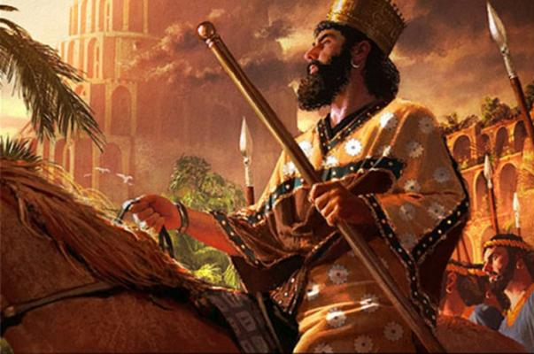
Cyrus the Great Conquers Babylon
"In the first year of King Cyrus of Persia [538 BC], the LORD fulfilled the prophecy he had given through Jeremiah [25:11-12]. He stirred the heart of Cyrus to put this proclamation in writing and to send it throughout his kingdom" (Ezra 1:1 NLT).

Slide 79
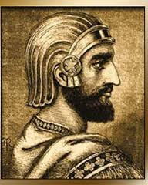
Decree of Cyrus
"This is what Cyrus king of Persia says: 'The LORD, the God of heaven, has given me all the kingdoms of the earth and he has appointed me to build a temple for him at Jerusalem in Judah. ³Any of his people among you may go up to Jerusalem in Judah and build the temple of the LORD, the God of Israel, the God who is in Jerusalem, and may their God be with them. ⁴And in any locality where survivors may now be living, the people are to provide them with silver and gold, with goods and livestock, and with freewill offerings for the temple of God in Jerusalem' " (Ezra 1:2-4 NLT).
Notes:
“﻿In terms of Persian imperial involvement with local peoples and communities, what we find in Ezra-Nehemiah (and Esther) is in harmony with what we see in the contemporary firsthand sources that we do have. The Persian kings supported local cults as a focus of local loyalties to the center; and that the local groups should invoke their deities’ blessings on their rule.”
Kitchen, K. A.. On the Reliability of the Old Testament. Wm. B. Eerdmans Publishing Co.. Kindle Edition. Loc 1884 of 14432.

Slide 80

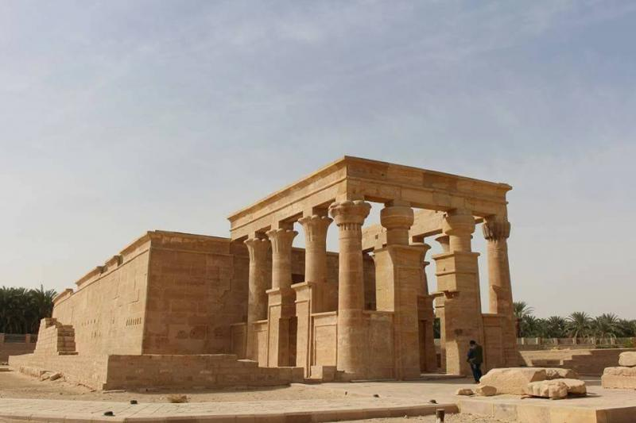
Kharga
"In Egypt, under Cambyses and especially Darius I, the Persian kings sought to patronize the local cults. For Cambyses the high dignitary Udja-Hor-resenet acted in the role of an Egyptian adviser, and enlisted his interest in the temple of the goddess Neith of Sais. Darius I in turn was served by this same dignitary, sanctioned building work on Egyptian temples, and caused to be built a whole new temple at Hibis in the Great Oasis (Kharga)."
K. A. Kitchen, On the Reliability of the Old Testament (Grand Rapids: Eerdmans), Kindle Edition loc. 1859 of 14459
Temple at Hibis in the Great Oasis (Kharga)
Notes:
“And the same applies (both religiously and politically) in the case of Darius I, who confirmed the temple-building project, with appropriate provision for the cult (Ezra 5; 6:1-12), precisely as we saw happen later at Xanthus and as is implied in what remains of the Magnesian rescript of Darius I. Likewise, in Egypt Cambyses had the temple of Neith restored and renewed its revenues and festival provision; the Hibis temple of Darius I would also have had to be granted endowments to maintain its cult.”
K. A. Kitchen, On the Reliability of the Old Testament, Eerdmans Kindle Edition.

Slide 81
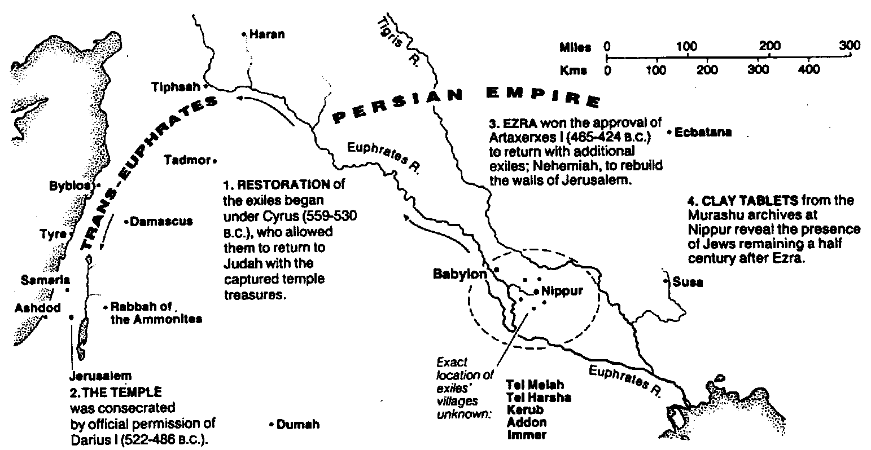
Return from Exile
The Bible Visual Resource Book, 95
298

Slide 82
The Persian Empire
Map of the Persian Empire
317
Barry J. Beitzel, Moody Atlas of Bible Lands, 150-51
"I looked in the vision, and while I was looking I was in the citadel of Susa, which is in the province of Elam; and I looked in the vision and I myself was beside the Ulai Canal" (Dan 8:2 NAU).
^{Susa}
The Persian Empire in the 5th century BC
extended "from India and Ethiopia" (Esther 1:1)
The boundaries of the empire that Cyrus II initiated
and Darius I consolidated stretched from Greece to India
Notes:
The Jews needed to renew their commitment to God based on his commitment to them over the ages. Yet they also needed to see God working in their lives right then as they lived outside the land of Israel.
Cyrus ruled over an absolutely ENORMOUS kingdom that eventually stretched from Greece in the west and India in the east. From his capital at Susa he had control over 127 provinces! God moved his heart to initiate a return to the land not only for the Jews but for other conquered peoples—as long as they would pray for the welfare of the king and his sons.
__________________
OS-15-Ezra-50, 82
OS-27-Daniel-342

Slide 83
But WHY was a return to the land of Israel so important?

Slide 84
Borders of the Land Promised to Abraham
Syria
Lebanon
Israel
Jordan
Genesis 15:18
"On that day the LORD made a covenant with Abram, saying, 'To your offspring I give this land, from the river of Egypt to the great river, the river Euphrates'" (ESV)
India
Egypt
Notes:
God’s promised land stretched northeard from the small wadi of Egypt south in the Sinai to the large Euphrates River in the far north—a HUGE piece of real estate! When today’s boundaries are placed over this land we can see the struggle modern Israel has to claim land from Egypt, Lebanon, Syria and possibly even Jordan on the other side of the Jordan River.

Slide 85
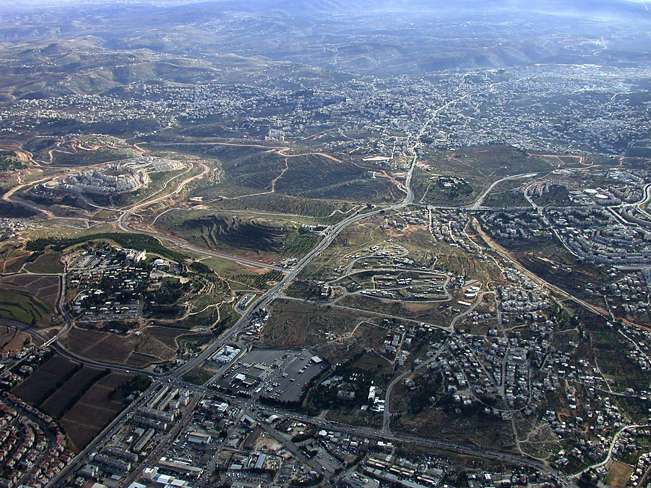
Bethlehem aerial from north
Herodium
Bethlehem
Church of Nativity
Rachel's Tomb
Har Homa
Tantur
Mar Elias
Ramat Rahel
Bethlehem aerial from north near Jerusalem
Notes:
85
Bethlehem in the Old Testament
Bethlehem was the home of Micah's Levite priest (Jud 17:1-13).
Ruth harvested in the fields of Boaz in Bethlehem.
Three generations after Ruth, David was born in Bethlehem (Ruth was David's great-grandmother).
David was anointed king in Bethlehem (1 Sam 16:1-13), but he chose not to make this city his capital.
Bethlehem was the home of Joab, Abishai, and Asahel. Asahel was buried here (2 Sam 2:32).
Bethlehem was also the home of Elhanan, one of David's mighty men (2 Sam 23:24; 1 Chr 11:26).
Rehoboam fortified Bethlehem (2 Chr 11:6).
Many Jews fled to Bethlehem after Gedaliah was killed (Jer 41:17).
The city was rebuilt after the return from Babylonian exile (Ezra 2:21; Neh 7:25).
Bethlehem was named as the place of the Messiah's birth (Micah 5:2; John 7:42).

Slide 86
Slides on
Ezra 2
Notes:
The list of returning exiles had 50,000 Jews who returned and gave freewill offerings for the temple reconstruction to show God fulfilling his promise of restoration (Ezra 2).

Slide 87
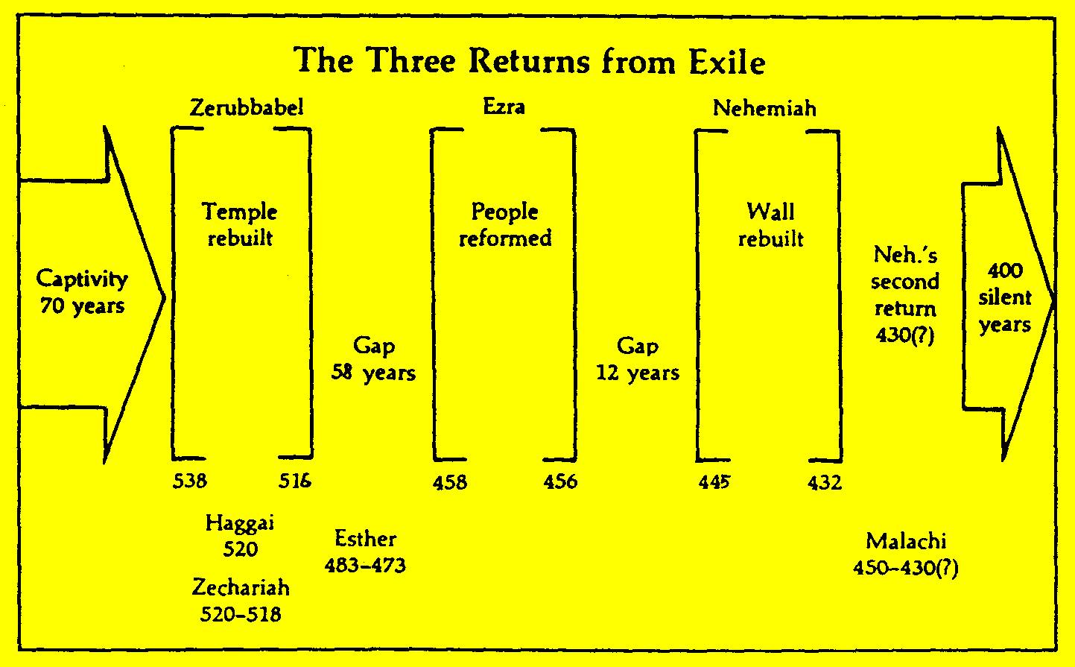
Returns from Exile
295
John H. Walton, Chronological and Background Charts of the Old Testament, 35 &
John A. Martin, "Ezra," in The Bible Knowledge Commentary, 1:652, adapted

Slide 88
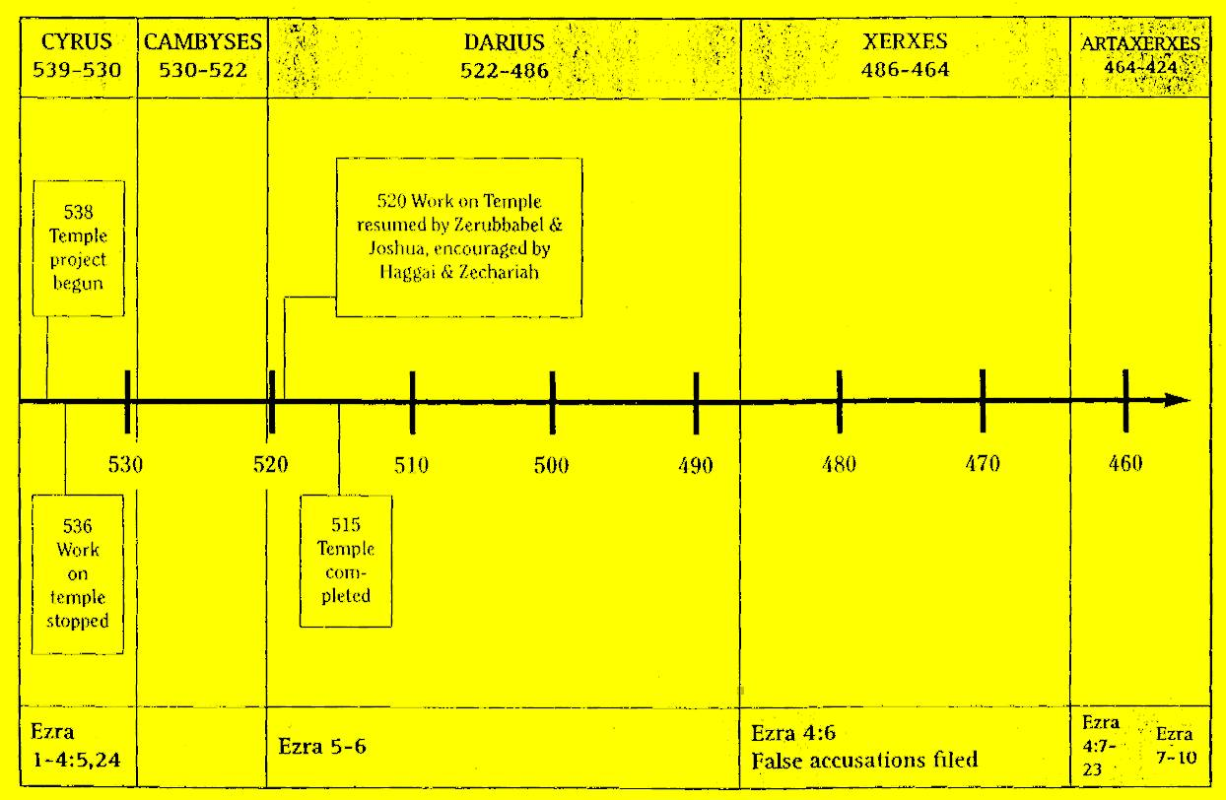
Chronological Sequence in the Book of Ezra
296
John H. Walton, Chronological and Background Charts of the OT, 2d ed., 36

Slide 89
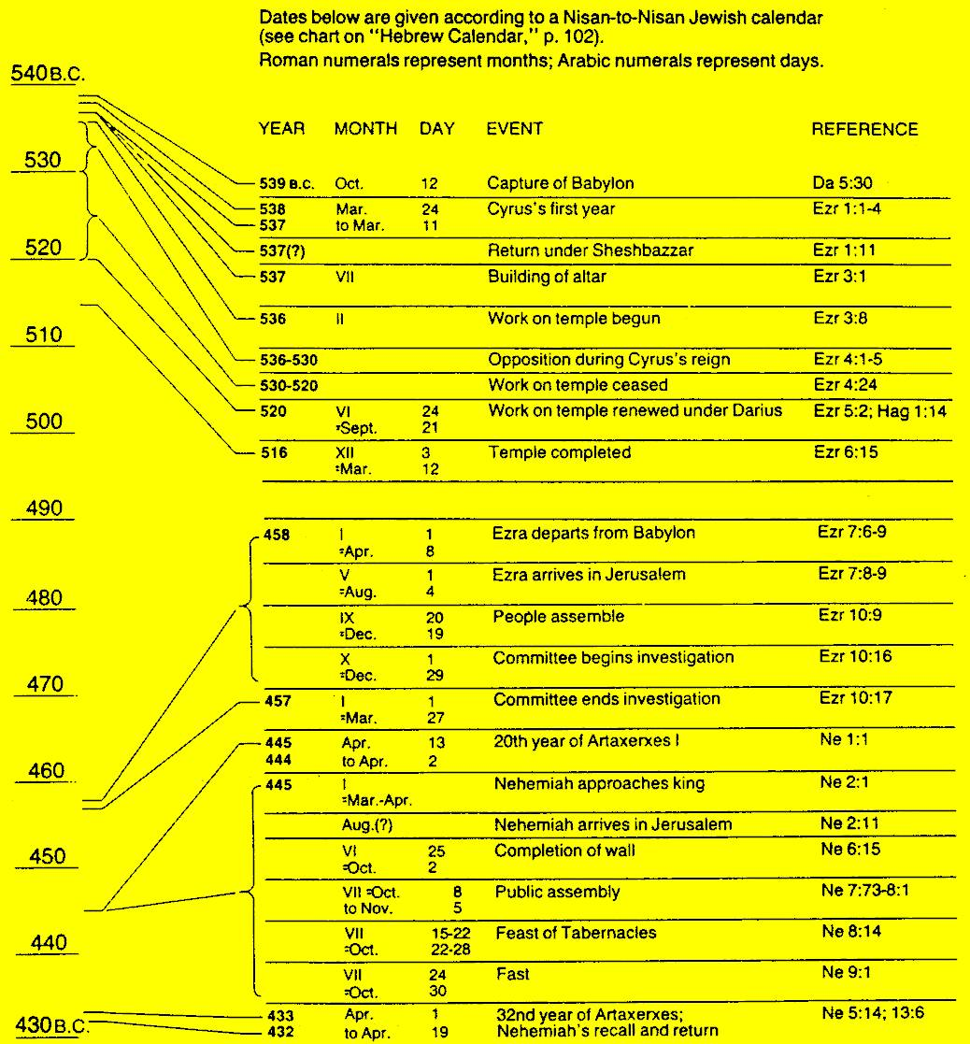
Chronology of Ezra-Nehemiah
The Bible Visual Resource Book, 93
297

Slide 90
Chronology of the Captivity
Judah's Captivity 605-536
Temple's Desolation 586-516
70 years
50 years
70 years
620
610
600
590
580
570
560
5 5 0
5 4 0
530
520
510
500
490
Judgments = 70 years
Bondage = 50 years (586-536)

Slide 91
Chronology of the Captivity
Judah's Captivity 606-536
Temple's Desolation 586-516
Ezekiel 597-572
620
610
600
590
580
570
560
5 5 0
5 4 0
530
520
510
500
490
Daniel: 606-536

Slide 92
Chronology of Ezra-Nehemiah
Ezra (457-444)
Nehemiah (444-430)
Zerubbabel (537-516)
540
530
520
510
500
490
480
4
7
0
4
6
0
450
440
430
420
410
537
457
444
430
Haggai & Zechariah 520
Esther 479-473
Malachi 432

Slide 93
Ezra's Correlation with Esther
289
Restoring the Temple and People
Temple
Book of Esther (58 YEAR GAP)
People
Zerubbabel
Ezra
Ezra 1–6
Ezra 7–10
50,000 Return
5,000 Return
Survival
Revival
Working
Worshipping
538-516 BC (22 Years)
458-457 BC (1 Year)
External Opposition: Samaritans
Internal Opposition: Intermarriage
Return
1–2
Rebuilding
3–6
Return
7–8
Restoration
9–10
Decree
1
Returnees
2
Begins
3
Opposed
4:1–6:12
Ends
6:13-22
Qualifications
& Provisions
7
Returnees
& Protection
8
Inter- marriage
& Lament
9
Divorces
Carried Out
10

Slide 94
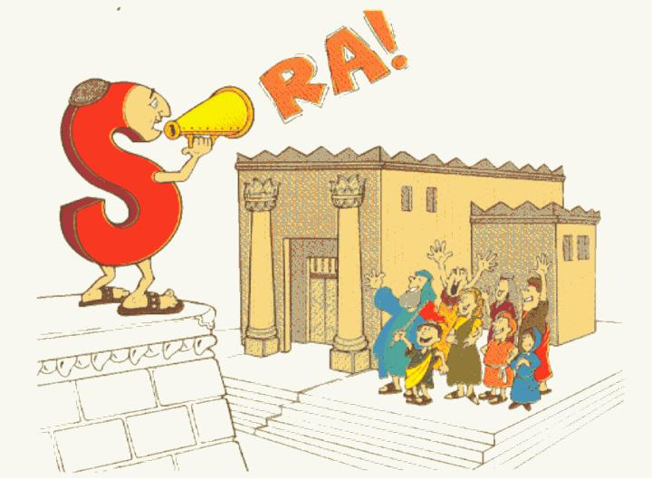
Temple/People
Ezra:
Walk Through The Bible ©1989

Slide 95
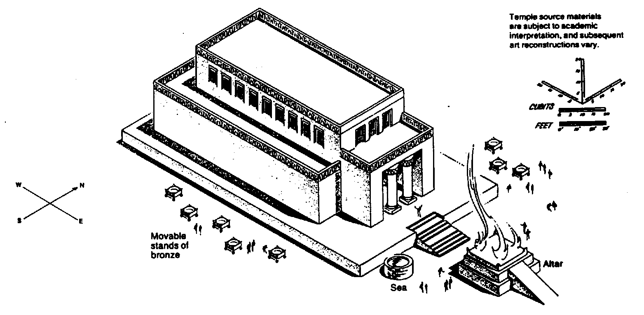
Zerubbabel's Temple
The Bible Visual Resource Book, 95
298
Key Word
Temple
Key Verse
"… for a brief moment, the LORD our God has been gracious in leaving us a remnant and giving us a firm place in his sanctuary, and so our God gives light to our eyes and a little relief in our bondage" (Ezra 9:8)

Slide 96
Title
290
Ezra & Nehemiah originally formed one book according to Josephus, Jerome, & the Talmud.
The Hebrew Bible also has the two books together under the title Ezra Nehemiah.
However, the repetition of Ezra 2 in Nehemiah 7 may indicate that the two were originally separate works.
Ezra means "help, succour, assistance" & Nehemiah means "Yahweh comforts".

Slide 97
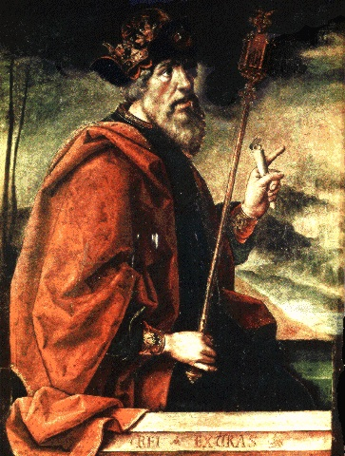
Authorship
290
External Evidence
The Jewish talmudic tradition has long held that Ezra authored this book.
Internal Evidence
In 7:27–9:15 the author refers to himself in the first person. This is significant since Ezra was not even born during the events of chapters 1–6 (538-516 BC) since he is first introduced in 7:1 (458 BC).
As in Chronicles, the book has a strong priestly emphasis, and Ezra was in direct descent from Aaron through Eleazer, Phineas, and Zadok (7:1-5).

Slide 98
Circumstances
290
Date
The events of Ezra 7–10 in which Ezra had part occurred in 458-457 BC. Also, Ezra was contemporary of Nehemiah (Neh. 8:1-9; 12:36), who arrived in Jerusalem in 444 BC. A likely date of composition may be between these 2 dates, placing the writing at approximately 450 BC.
However, the Book of Ezra itself covers 2 distinct time periods separated by 58 years. Ezra 1–6 relates the story of Zerubbabel (538-516 BC) while Ezra 7–10 is mostly an autobiographical account of Ezra that begins 6 decades later (458-457 BC).

Slide 99
Circumstances
290
Occasion
Ezra continues the account of the Jewish history recorded in 2nd Chronicles.
The Chronicles record how God was faithful in fulfilling His promise of judgment for Judah's sin;
Ezra records how God was faithful to His promise of restoration after 70 years as prophesied by Jeremiah (Jer. 25:11-12; 29:10).
Ezra's account of this restoration served to exhort the returnees to follow the LORD wholeheartedly.
Recipients
Ezra's 1st readers comprised Jews who had recently returned to Israel from Persia & the grandchildren & great-grandchildren of those who returned from Babylon a century earlier.

Slide 100
Characteristics
290-291
Ezra records the 1st events following the Babylonian Exile, but only in a selective sense as a 58 year gap separates chapters 1–6 & 7–10. The book of Esther occurs during this gap.
Ezra is one of the few books of Scripture which was originally written in 2 languages. Almost one 4th (67 of 280 verses) is written in Aramaic with the majority in Hebrew. This material (4:8–6:18; 7:12-26) is Aramaic because it mainly comprises official correspondence for which Aramaic was the standard language of the day.

Slide 101
Characteristics
290-291
C. The restoration to the land under Ezra & Nehemiah related directly to God's purposes for Israel as stated in the promise to Abraham (Gen. 12:1-3).
1) Events: The events of the restoration revolved around the three returns to the land from Babylon.
The 1st return under Zerubbabel (538 BC) involved about 50,000 Jews who came back to the land to rebuild the temple as a result of Cyrus' decree (cf. Ezra 1–6).
The 2nd return under Ezra (458 BC) brought back about 5,000 Jews during the reign of Xerxes (Ezra 7–8).
c) The 3rd return under Nehemiah (444 BC) to rebuild the Jerusalem walls revolved around Nehemiah himself, as the number of Jews with him are never recorded.

Slide 102
Characteristics
290-291
C. The restoration to the land under Ezra & Nehemiah related directly to God's purposes for Israel as stated in the promise to Abraham (Gen. 12:1-3).
2. Relationship to the Abrahamic Covenant
God promised Abraham that his descendants would occupy the land from the River of Egypt to the Euphrates (Gen. 15:18), yet Israel in Babylon was living outside of these boundaries. The nation needed to return to the land.
The Messiah had already been prophesied to be born in Bethlehem (Micah 5:2).
c) Intermarriage threatened the purity of the Davidic line to fulfill the seed promises originally given to Abraham.

Slide 103
Argument
292
The Book of Ezra concerns the temple as it continues from the end of 2 Chronicles.
Unfortunately, the remnant who returned did not convey as strong a commitment to the covenant & temple as one would expect.
Therefore, Ezra records the restoration of the temple under Zerubbabel (1–6) & the restoration of the people to their covenant obligations under Ezra (7–10) to encourage the remnant in true temple worship and covenant obedience.

Slide 104
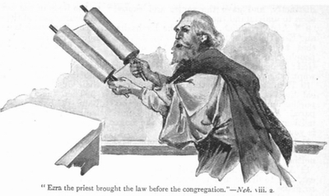
Synthesis
292
Restoring the temple and people
Partial fulfillment of land promise
1–6 Temple–Zerubbabel
7–10 People–Ezra

Slide 105
Outline
292-294
I. (Chs. 1–6) The rebuilding of the temple in the first return under Zerubbabel with 50,000 Jews encourages the remnant to worship only at the temple because of God's faithfulness in fulfilling His promise of restoration (538 BC).

Slide 106
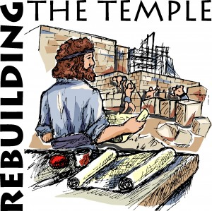
Ezra 1–6
EZRA
NEHEMIAH
  Restoring 3–6
  Returning 1–2
Rebuilding
1–6
Zerubbabel
537

Slide 107

OT Pre-exilic Prophets on Chart
232 & 342
Obadiah
Jeremiah
Jonah
Amos
Hosea
Isaiah
Micah
Nahum
Zeph
Joel
Hab
Chart of Old Testament Kings and Prophets
John C. Whitcomb, 4th rev. ed., Winona Lake, IN: BMH Books, 1962, 1968, p. 2

Slide 108
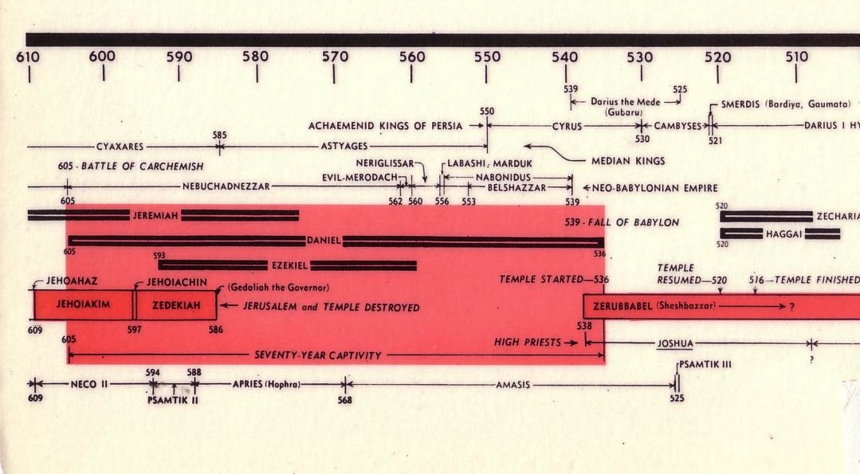
Chart of the Exile
232 & 342
The Babylonian Exile
John C. Whitcomb, 4th rev. ed., Winona Lake, IN: BMH Books, 1962, 1968

Slide 109
Chart of the Exile
232 & 342
The Babylonian Exile
John C. Whitcomb, 4th rev. ed., Winona Lake, IN: BMH Books, 1962, 1968

Slide 110
Slides on
Ezra 3
Notes:
God restored temple worship despite opposition and the idolatry that caused the exile (Ezra 3–6).
Temple rebuilding began by rebuilding the altar and foundation and resuming sacrifices as God's help to worship at the temple—not the high places (Ezra 3).

Slide 111
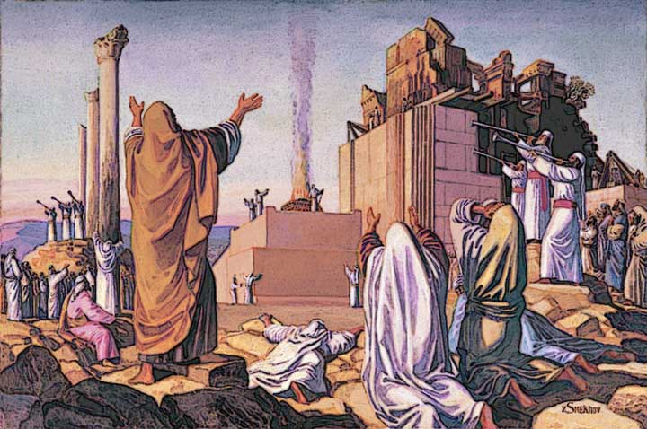
The altar was rebuilt first (Ezra 3:1-6)

Slide 112
Slides on
Ezra 4
Notes:
Enemies halted the temple rebuilding for 16 years until Zechariah and Haggai exhorted the Jews to continue until God moved the key enemy to assure their success (4:1–6:12).

Slide 113

God's work was opposed (4:1-2)

Slide 114

Opposition to Rebuilding
641
External
Notes:
However, opposition struck externally from pagans left in the land as recorded in Ezra 4.

Slide 115
The Context:
Opposition to Temple Rebuilding
536 BC: As soon as the copy of the letter of King Artaxerxes was read to Rehum and Shimshai the secretary and their associates, they went immediately to the Jews in Jerusalem and compelled them by force to stop. Thus the work on the house of God in Jerusalem came to a standstill until the second year of the reign of Darius king of Persia [520 BC].
Ezra 4:23-24 (NIV)

Slide 116
Opposition to Rebuilding
641
Internal
Notes:
Next week we will see the external threats in the book of Zechariah, but today we address the internal problems within the community itself. Often our most severe problems lie within our own midst!
These issues had already stopped the temple project for 16 years. They had started well, but made excuses and forgot God.
God hadn’t forgotten them though. He finally speaks in his land

Slide 117

Hug-I
"Temple"
Haggai
Walk Through The Bible ©1989

Slide 118

Date
641
Haggai is the most precisely dated book of the Bible, recording messages given between August and December in 520 BC

Slide 119
Dates in Haggai
Prophecy #1
Rebuilding Resumes
Prophecy #2
Prophecies #3-4
8/29
1:1
9/21
1:15
10/17
2:1
12/18
2:10, 18, 20
Aug
Sep
Oct
Nov
Dec
520 B.C.

Slide 120

"On August 29 of the second year of King Darius's reign, the LORD gave a message through the prophet Haggai to Zerubbabel son of Shealtiel, governor of Judah, and to Jeshua son of Jehozadak, the high priest" (Haggai 1:1 NLT).
Notes:
The word came to the governor.

Slide 121

Opposition Timeline (Ezra 4; Esther 1; Neh 13)
232 342
Zerubbabel Under Cyrus
536-520 BC
Esther Under Xerxes
486 BC
Ezra Under Artaxerxes
±460 BC
Nehemiah Under Darius (internal)
±430 BC
Chart of Old Testament Kings & Prophets
John C. Whitcomb, 4th ed. (Winona Lake, IN: BMH Books, 1968), 2
Notes:
"﻿The terminology in the biblical copies of letters to and from the Persian court is directly comparable with what we find in the external, firsthand documents. Inferiors call themselves the “servant(s)” of superiors and kings; the idiom for issuing decrees (sam t’e’em) is the same; the body of the typical Official Aramaic letter begins with the phrase “Peace (sh-l-m) and much well-being I send you,” which is what is presupposed in Ezra 4:17 (lit. “Peace, etc.”), where the formula is abbreviated for brevity’s sake.39 And so on, we may also say, on this topic. The form or stage of language of Aramaic used in Ezra and Daniel is precisely that used in the Neo-Babylonian and Persian period (sixth to fourth centuries), and is currently termed Official Aramaic. In the Old Testament the sole difference is that the spelling has been consistently modernized, to bring it into line with the Aramaic otherwise in popular use among the Jews by the third century.”
K. A. Kitchen, On the Reliability of the Old Testament. Grand Rapids, MI: Eerdmans, Kindle Edition. Loc 1892 of 14432.
________
Common English-168
OS-37-Ezra-87
OS-38-Nehemiah-407
OS-39-Esther-54

Slide 122
Later Postexilic Era (Ezra 7–10; Neh 1–13)
232 342
Chart of Old Testament Kings & Prophets
John C. Whitcomb, 4th ed. (Winona Lake, IN: BMH Books, 1968), 2
Notes:
"﻿The terminology in the biblical copies of letters to and from the Persian court is directly comparable with what we find in the external, firsthand documents. Inferiors call themselves the “servant(s)” of superiors and kings; the idiom for issuing decrees (sam t’e’em) is the same; the body of the typical Official Aramaic letter begins with the phrase “Peace (sh-l-m) and much well-being I send you,” which is what is presupposed in Ezra 4:17 (lit. “Peace, etc.”), where the formula is abbreviated for brevity’s sake.39 And so on, we may also say, on this topic. The form or stage of language of Aramaic used in Ezra and Daniel is precisely that used in the Neo-Babylonian and Persian period (sixth to fourth centuries), and is currently termed Official Aramaic. In the Old Testament the sole difference is that the spelling has been consistently modernized, to bring it into line with the Aramaic otherwise in popular use among the Jews by the third century.”
K. A. Kitchen, On the Reliability of the Old Testament. Grand Rapids, MI: Eerdmans, Kindle Edition. Loc 1892 of 14432.
________
Common English-169
OS-37-Ezra-88
OS-38-Nehemiah-408
OS-39-Esther-55

Slide 123
Slides on
Ezra 5

Slide 124

God's work is always opposed

Slide 125
Ezra's Correlation with Esther
289
Restoring the Temple and People
Temple
Book of Esther (58 YEAR GAP)
People
Zerubbabel
Ezra
Ezra 1–6
Ezra 7–10
50,000 Return
5,000 Return
Survival
Revival
Working
Worshipping
538-516 BC (22 Years)
458-457 BC (1 Year)
External Opposition: Samaritans
Internal Opposition: Intermarriage
Return
1–2
Rebuilding
3–6
Return
7–8
Restoration
9–10
Decree
1
Returnees
2
Begins
3
Opposed
4:1–6:12
Ends
6:13-22
Qualifications
& Provisions
7
Returnees
& Protection
8
Inter- marriage
& Lament
9
Divorces
Carried Out
10

Slide 126
Slides on
Ezra 6
Notes:
The Jews celebrated the completed temple rebuilding in 516 BC (20 years after its beginning) with a special dedication and Passover observance (6:13-22).

Slide 127

Temple Completion in 516 BC (Ezra 6:15)

Slide 128
Outline
292-294
I. Ezra 1–6: The rebuilding of the temple in the first return under Zerubbabel with 50,000 Jews encourages the remnant to worship only at the temple because of God's faithfulness in fulfilling His promise of restoration (538 BC).

Slide 129
Slides on
Ezra 7
Notes:
The second return under Ezra the priest with 5,000 Jews shows that God mercifully protects all who trust him (Ezra 7–8).

Slide 130


Which is more important?
Hardware?
Software?
Notes:
We all know that hardware without software just sits there useless.
Likewise, software without a computer to run it does no good.

Slide 131


Which is more important?
Hardware?
Software?
Rebuild Temple
Rebuild People
Notes:
In the same way, Israel needed more than simply having a temple in their midst.
They needed hearts tuned to God.

Slide 132


Which is more important?
Presence of the Spirit?
Submission to the Spirit?
Notes:
The presence of God came to Israel in the temple—and the Spirit comes into us as Christians (1 Cor 6:19)
But what good is it for us to have God's indwelling Spirit and then ignore him?

Slide 133
Outline
292-294
I. Ezra 1–6: The rebuilding of the temple in the first return under Zerubbabel with 50,000 Jews encourages the remnant to worship only at the temple because of God's faithfulness in fulfilling His promise of restoration (538 BC).
II. Ezra 7–10: The reformation of the people in the second return under Ezra with 5,000 Jews is recorded to encourage the remnant to fulfill its covenant obligations on the basis of God's mercy (458 BC).

Slide 134

"For Ezra had devoted himself to the study and observance of the Law of the LORD, and to teaching its decrees and laws in Israel"
(Ezra 7:10 NIV).
Notes:
Ezra's credentials to lead more returnees back to Jerusalem show God leading his life as priest to restore the remnant spiritually (7:1-10).
Ezra was a priest (7:1-5).
Ezra was a teacher (7:6a).
Ezra saw the hand of God on his life (7:6b-9).
Ezra prioritized the study, obedience, and teaching of the law (7:10).
God funded the return by King Artaxerxes giving money and authority to Ezra to lead and tax exemption for temple workers to show how God blesses obedience (7:11-28).

Slide 135

Ezra 7–10
EZRA
NEHEMIAH
EZRA
  Restoring 3–6
  Returning 1–2
  Returning 7–8
  Restoring 9–10
Rebuilding
1–6
Redirecting
7–10
Zerubbabel
Ezra
537
457

Slide 136
Slides on
Ezra 8
Notes:
Returnees of 18 family heads, 1496 other men, women and children, totaled about 5,000—a far smaller group than the 50,000 with Zerubbabel 80 years before (8:1-14).

Slide 137
Returns from Exile
John H. Walton, Chronological and Background Charts of the Old Testament, 35 &
John A. Martin, "Ezra," in The Bible Knowledge Commentary, 1:652, adapted
295
RETURN
FIRST
SECOND
THIRD
Reference
Ezra 1–6
Ezra 7–10
Nehemiah 1–13
Date
538 BC
458 BC
444 BC
Leaders
Sheshbazzar
Zerubbabel
Jeshua
Ezra
Nehemiah
Persian King
Cyrus
Artaxerxes
Longimanus
Artaxerxes Longimanus
Elements
Of the
Decree
As many as wished to could return.
Temple could be rebuilt, partially financed by royal treasury.
Vessels returned.
As many as wished to could return.
Finances provided by royal treasury.
Allowed to have own civil magistrates.
Allowed to rebuild the wall

Slide 138
Returns from Exile
John H. Walton, Chronological and Background Charts of the Old Testament, 35 &
John A. Martin, "Ezra," in The Bible Knowledge Commentary, 1:652, adapted
Returns from Exile
295
RETURN
FIRST
SECOND
THIRD
Number
Returning
42,360
7,337 (servants)
49,697
1,500 men
38 Levites
220 helpers
1,758 + 5000?
Unknown
Events & Problems
Temple begun; sacrifices made & Feast of Tabernacles celebrated.
Samaritans made trouble, & work ceased until 520.
Temple completed in 516.
Problems with
intermarriage
Wall rebuilt in 52 days, despite opposition from Sanballat, Tobiah, & Geshem.
Walls dedicated & Law read.

Slide 139


Leadership for Revival (Ezra 8:15-20)

Slide 140

Ezra proclaims a fast
(Ezra 8:21)
Notes:
God protected the returnees due to their spiritual preparation by adding 258 Levites as temple leaders and celebrating a fast to show his hand on all who trust him (8:15-36).

Slide 141
Slides on
Ezra 9
Notes:
God protected the messianic seed through Ezra's restoration of the people by separating from foreign wives (Ezra 9–10).
Ezra saw that leaders tempted Judah to sin by unlawful marriage to pagan wives (9:1-2; cf. Gen 24:3; 26:34-35; 28:1-8; Exod 34:16; Deut 7:1-2; 20:17-18; Judg 3:5; 1 Kings 11).

Slide 142


Internal Opposition (Ezra 9)
Notes:
Ezra lamented the intermarriage and contrasted God’s faithfulness with Israel's unfaithfulness to model repentance for the covenant people (9:3-15).

Slide 143
Zerubbabel's Temple
The Bible Visual Resource Book, 95
298
Key Word
Temple
Key Verse
"… for a brief moment, the LORD our God has been gracious in leaving us a remnant and giving us a firm place in his sanctuary, and so our God gives light to our eyes and a little relief in our bondage" (Ezra 9:8)

Slide 144

Leadership?
294
Do Ezra and Nehemiah teach us proper leadership style?
If so, then whom should you follow?
Intermarriage led Ezra to pull out his own hair (Ezra 9:13)
Intermarriage led Nehemiah to pull out others' hair (Neh. 13:25)!

Slide 145
Slides on
Ezra 10
Notes:
The initiation by the leaders that Israelites divorce their foreign wives was carried out faithfully for 113 men to exhort Israel to live according to the covenant (Ezra 10).

Slide 146

Public Confession of Sin (Ezra 10)

Slide 147
God Approved Divorce under Ezra?
294
Issue: How could God approve of divorce here when He elsewhere disapproves of it and even says clearly, "I hate divorce"
(Mal. 2:16; cf. Matt. 19:8)?
The text doesn't specifically say that God approved of divorce. One solution could have been for the 113 men to leave the community with their families. However, for the sake of argument, the other reasons below are offered…
The account serves to illustrate that maintaining the purity of the covenant people of God was more important than even keeping some individual families intact.
Although 113 men may seem to be a small number, since this included leaders of the people, the intermarriage was certainly going to spread further to all the common people as had happened in the Jewish community in Egypt & the kingdom of Israel to the north.

Slide 148

Public Confession of Sin (Ezra 10)
Notes:
After the whole nation lamented the sin of intermarriage, the leaders initiating the idea to divorce all foreign wives fulfilled their vow to do so (10:1-17).
That those who divorced pagan wives included priests, Levites, and commoners shows the great extent that this sin corrupted the holy nation (10:18-44).

Slide 149
التسلسل الزمني لعزرا - نحميا
ح ز ز
E
م ع ن
زربابل
537-516
زكريا 520-480
أستير
479-473
عزرا 457-444
نحميا
444-430
540
530
520
510
500
490
480
470
4
6
0
450
440
430
420
410
حجي
ملاخي
Notes:
What we call the Post-Exilic Period actually had three stages: (1) the rebuilding of the Temple under "HZZ," (2) the deliverance of the Jews under Esther, and (3) the restoration of Jerusalem's walls and worship under "MEN." The Hebrew canon combines Ezra-Nehemiah as a single book to depict these stages, while the book of Esther fits between Ezra 6 and Ezra 7.
________________
Common-411
BE-39-Malachi-14
OS-15-Ezra-115
OS-16-Nehemiah-406
OS-39-Malachi-49

Slide 150

This small beginning led to the first century AD restoration of Jerusalem

Slide 151
Why does God restore us?
Notes:
Why are we essentially delivered from our old way of life?
God routinely delivers us even though we are at fault for neglecting him. So why does he rescue or deliver us?

Slide 152
II. God delivers us from our bondage to worship him.
Ezra for Us
Notes:
The LORD has brought you from your slavery to sin into the freedom to adore him!

Slide 153


God knows how horrible slavery to false gods is for us.
Breaking free
Notes:
God knows how horrible slavery to false gods is for us.
Israelites even killed their children in the false worship of Molech.
Sadly, we do the same today.

Slide 154

Do you need to be restored from your slavery to sin?
“THE WORSHIP EVOLUTION”
ADAPTED FROM EDGAR WINTER
PHASE 1
True Worship,
Purity & Transparency,
Prudence & Dignity
PHASE 2
Dependence on God
& His Favor
with a Grateful Heart
PHASE 3
Disposition
& Service
PHASE 4
Independence,
Personal Interests,
& Change in Vision
PHASE 5
Indisposition,
Self-Service &
Self-Satisfaction
PHASE 6
Idolatry,
Self-Worship &
Ungrateful Heart
Notes:
That slavery is too often an idolatry when we become the focus of worship (explain devolution above)
Do you have habits that you just can’t seem to ever conquer?
Many men over the years have confessed their bondage to porn.
Women, likewise, can be enslaved to movies—or shopping—or other forms of slavery, such as romanticizing their lives.
Why does God want to restore you?

Slide 155
Why does God restore us?
Notes:
Why are we essentially delivered from our old way of life?
God routinely delivers us even though we are at fault for neglecting him. So why does he rescue or deliver us?

Slide 156
Main Idea of Ezra
God transforms
EXILES
WORSHIPPERS
INTO
Notes:
The LORD is in the business of taking people in bondage and making them into people who honor him

Slide 157
I. God delivered the Jewish exiles to worship him.
The Book of Ezra
Notes:
He brought the Jews from being kicked out of their land back to that land so they would honor him.

Slide 158
Summary Statement
289
The restorations of the temple and people to the land under Zerubbabel and Ezra record God's faithfulness and mercy in fulfilling His promise of restoration to encourage the remnant in true temple worship and covenant obedience.

Slide 159
II. God delivers us from our bondage to worship him.
Ezra for Us
Notes:
The LORD has brought you from your slavery to sin into the freedom to adore him!

Slide 160

My Journey in Worship
Notes:
I must confess that my own journey in worship was just that—a journey with its highs and lows, pitfalls and heights. I learned in college that worship is really the most important element in life, but I really struggled to get out of bed in the morning to worship God. So I shared this with my close friend Albert. He asked, "So what time do you need to get out of bed to read your Bible and pray?" I said, "Well, to leave for class at 6:45 AM but have a decent breakfast and shower before that, I need to get up at 5:30 AM to read a pray for 30 minutes."
"OK," Albert told me, "I will call you at 5:30 tomorrow morning."
Do you think I had trouble getting out of bed the next day? Not on your life! I especially knew that my parents would hear the phone and wake up, so I made sure I was at my desk and picked up the line before it could even have a full ring.
"Hey, Rick, good morning!" Albert said, "Are you at your desk meeting with God?"
"Yes," I said. "Good! Talk to you tomorrow!"
The phone call was probably the shortest call I've ever had—but also the most impactful call I've ever had.
Sure enough, Albert called the next day, and the next day, and the next day. After three weeks, I had a new habit and I told him I didn't need the calls anymore.
I went on to get my PhD in that Book, and Albert went on to lead the regional Young Life ministry.
What's the point? Worship isn't easy and doesn't come at naturally for most of us. We need help.
I have built-in help now, as Susan and I commit to pray and read God's Word together each day. Honestly, I need that kind of accountability. I suspect you do too!

Slide 161
What would change in your life if your chief reason to live were to worship?
Notes:
How would your priorities change?
What would you have to give up to give God first place in your morning?
One friend taught me a great principle. He found that he always made time for breakfast, so he established a new personal rule: No Bible, no breakfast.
Maybe what would change for you is your independence. You, like me, just have to acknowledge your weakness to worship God and you need help from a friend.
As you are dependent on God, so you may need to be dependent on someone else—your own Albert—to help you be dependent on God!
Would you come early for prayer and preparation?
Would reading God’s Word daily be a delight instead of a chore?
Would you begin to lead others in worship?
Would you see your body as the new temple of the Spirit so you would take care of his temple better?

Slide 162
Application
289
Restoration to God for the repentant believer requires action.
Notes:
To do some rebuilding in the priority of worship, what kind of action is God calling you to take?

Slide 163
Black

Slide 164


OT Preaching link at BibleStudyDownloads.org
Get this presentation and script for free!

Slide 165

Purify My Heart 1/1
PURIFY MY HEART
Brian Doerksen
CCLI Song # 426298
© 1990 Mercy / Vineyard Publishing
CIC CCLI Licence # 277507

Slide 166
Purify My Heart 1/1
Purify my heart Let me be as gold And precious silver Purify my heart Let me be as gold Pure gold.

Slide 167
Purify My Heart 1/1
Refiner's fire My heart's one desire Is to be holy Set apart for You Lord

Slide 168
Purify My Heart 1/1
I choose to be holy Set apart for You my Master Ready to do Your will.

Slide 169
Purify My Heart 1/1
Purify my heart Cleanse me from within And make me holy Purify my heart Cleanse me from my sin Deep within.

Slide 170
Purify My Heart 1/1
Refiner's fire My heart's one desire Is to be holy Set apart for You Lord

Slide 171
Purify My Heart 1/1
I choose to be holy Set apart for You my Master Ready to do Your will.

Slide 172
Purify My Heart 1/1
Refiner's fire My heart's one desire Is to be holy Set apart for You Lord

Slide 173
Purify My Heart 1/1
I choose to be holy Set apart for You my Master Ready to do Your will.

Slide 174
Purify My Heart 1/1
Ready to do Your will.

Slide 176
OT Survey link at BibleStudyDownloads.org
Get this presentation for free!
Notes:
OT Survey (os)

