Slide 1

1 Chronicles
David's Line Established
Dr. Rick Griffith • Jordan Evangelical Theological Seminary • BibleStudyDownloads.org
Notes:
Chronicles followed Kings by 100 years with the Exile separating them. Its chief purpose was to encourage the postexilic Jews that, though the kingdom was not restored, the Davidic line remained among them.

Slide 2
Key Word
262
39
Establishment
1 Chronicles
Notes:
Part 1 of the massive work we call 1 Chronicles. It highlights how God initiated his kingdom work by starting to rule through human kings.

Slide 3
Theme
262
David's Line Established
1 Chronicles
Notes:
Chief among the kings was David, with whom God made a covenant.

Slide 4
Key Verse
262
"I declare that the LORD will build a house for you: When your days are over and you go to be with your fathers, I will raise up your offspring to succeed you, one of your own sons, and I will establish his kingdom. He is the one who will build a house for me, and I will establish his throne forever. I will be his father, and he will be my son. I will never take my love away from him, as I took it away from your predecessor. I will set him over my house and my kingdom forever; his throne will be established forever" (17:10b-14).
1 Chronicles
Notes:
Note that three times God declared that he was establishing his earthly throne and kingdom through David.

Slide 5

Kingdom Statement
39
God's sovereign establishment of David's line (1–9) and David's concern for proper temple worship (10–29) reminded Israel not to repeat the idolatry of the past.
1 Chronicles
Notes:
Since God established an eternal throne through David, the proper role of Israel was to protect the true worship of God in his place of rule in Jerusalem. This explains why the Exile took place, for the temple was a place of idolatry instead of worshipping Yahweh.

Slide 6
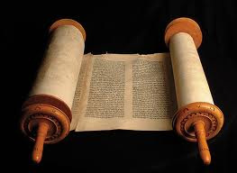
Summary Statement
262
41
The spiritual perspective on the establishment of David's kingdom is given to encourage the remnant with God's preservation of the Davidic line and to admonish them to proper temple worship—not the idolatry of the past.
1 Chronicles
Notes:
The exiles who returned to the land rebuilt the temple, but they needed to safeguard the worship there as their ancestors had not done. God declared that he established that kingdom based in Jerusalem's temple, so they should protect it from idolatry.
——————
"In light of its major themes, motifs, and emphases one can state the theology of Chronicles rather succinctly in the following terms: God, through a special covenant relationship with the Davidic dynasty, one exhibited by and centered on the temple and its cultus, will bless His elect people Israel when and as they live in obedience, and through them will extend his grace to all the world.^{25"}
²⁵ E. H. Merrill, “A Theology of Chronicles,” in A Biblical Theology of the Old Testament, ed. R. B. Zuck (Chicago: Moody, 1991), 157–87; idem, Everlasting Dominion: A Theology of the Old Testament (Nashville: B&H, 2005), 465–82; J. A. Thompson, 1, 2 Chronicles, NAC (Nashville: B&H, 1994), 32–45.
From Eugene H. Merrill, “The Books of 1 and 2 Chronicles,” in The World and the Word: An Introduction to the Old Testament (Nashville, TN: B&H Academic, 2011), 339.

Slide 7
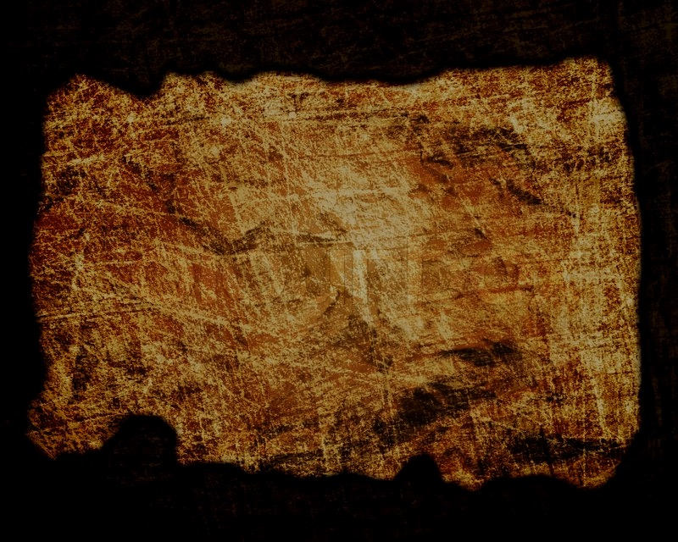
Covenant
42d
The preservation of David’s line during the exile (1–9; 17:10b-14) and his priority of worship model the remnant’s proper response to God’s covenant loyalty.
1 Chronicles
Notes:
The nation had been judged, but the descendants of David yet remained among them! This was because God's promise to David would still be fulfilled in their future.

Slide 8

Redemption
42d
Redemption from sin is rooted in the establishment of the line of Judah and David (1–9), from whom the final Redeemer will come who is worthy of worship.
1 Chronicles
Notes:
The people saw David's line primarily in a kingly sense, but this same line would provide salvation in David's descendent, the Messiah, Jesus.
_________
"The universalism of God’s salvific intentions is apparent at the very beginning with the detailed genealogies that stretch back from the Chronicler’s own time to the commencement of human history.^{26"}
²⁶ M. J. Selman, 1 Chronicles, TOTC (Downers Grove, IL: InterVarsity, 1994), 87.
— Eugene H. Merrill, “The Books of 1 and 2 Chronicles,” in The World and the Word: An Introduction to the Old Testament (Nashville, TN: B&H Academic, 2011), 339.

Slide 9
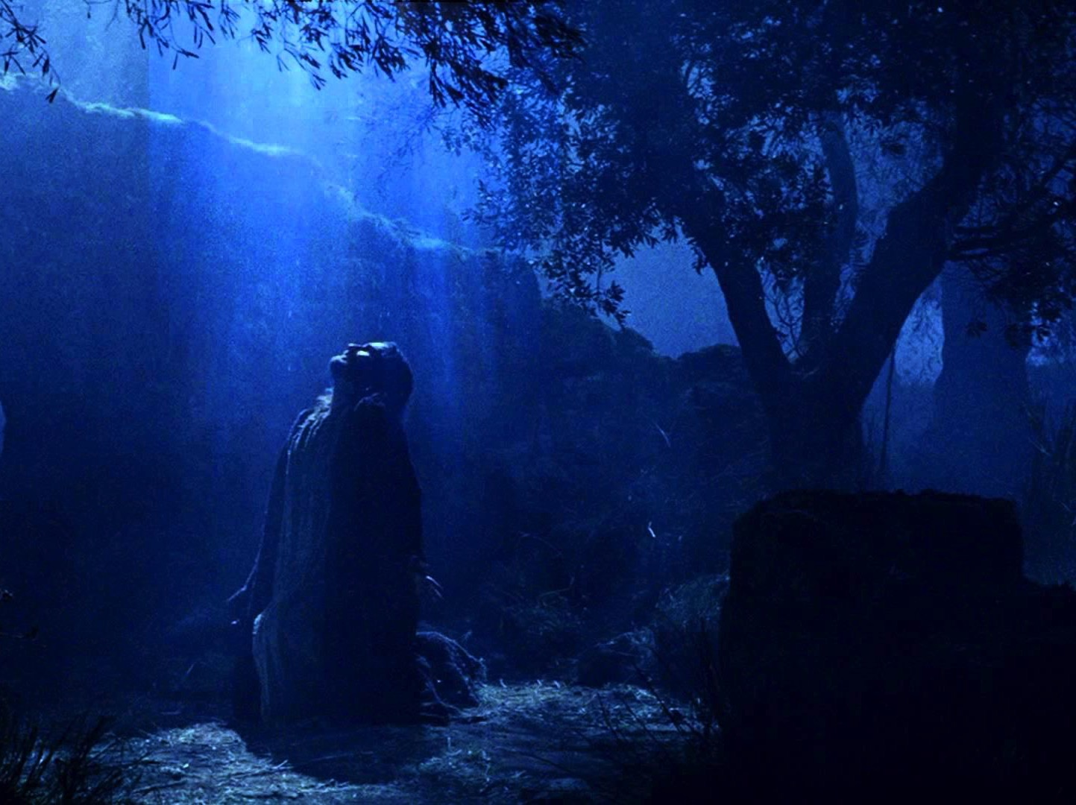
Messiah
42d
Jesus is Messiah at birth in David's unbroken lineage despite Judah’s exile (1–9) due to the unconditional promise of God to guard David’s seed forever (17:11-14; Luke 1:32-33).
1 Chronicles
Notes:
How could the Davidic line be eternal? Most probably thought that David's seed would continue to have sons who would have sons to rule. But God's plan was for the Messiah to be born and conquer death to reign forever without the need to have continuing generations to rule. The irony is that the line of David found its greatest security in One who not only never had a son, but was single!

Slide 10
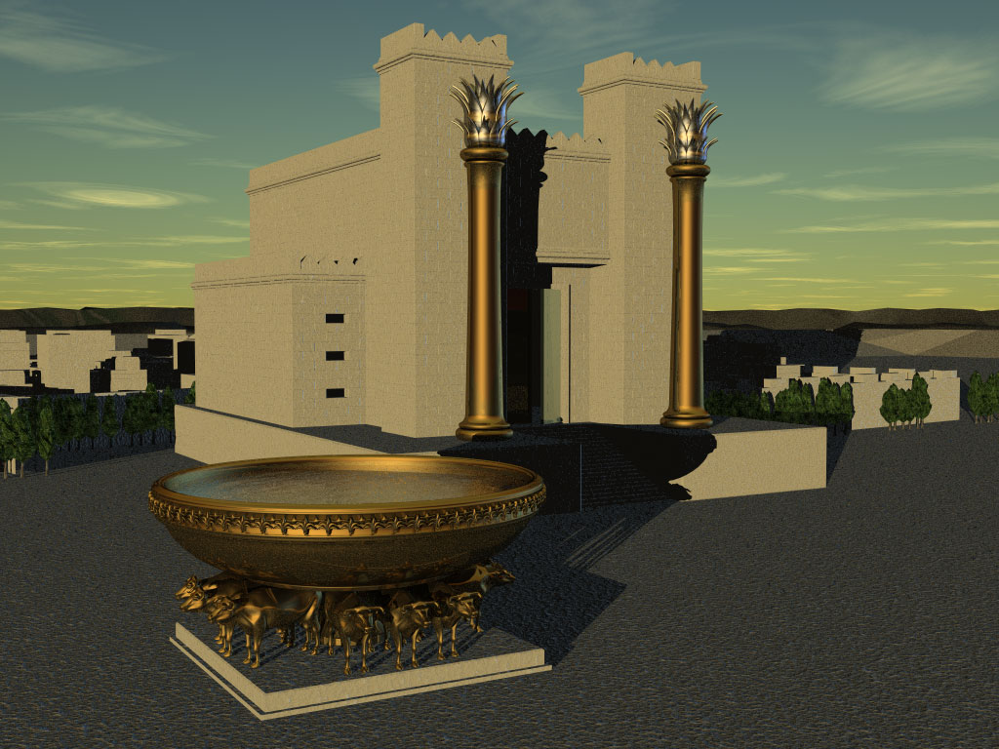
1 Chronicles
262
David's Line Established
David's Line
David's Concern (Ark / Temple)
Chapters 1–9
Chapters 10–29
Genealogy
History
Ancestry
Activity
Saul's Throne to David
David's Throne to Solomon
4143-1011 BC (3132 years)
1011-971 BC (40 years)
Davidic Line
1–3
Tribal
Lines
4–8
Priests /
Levites
9:1-34
Saul's Line
9:35-44
Accession to Throne
10–12
Respect for Ark
13–17
Military Victories
18–20
Temple Prep.
21–29
Notes:
The book of 1 Chronicles parallels 2 Samuel as both focus on the life of David.
"Chapters 1 and 9 are “foundational material”⁸ providing an inclusio around chaps. 2–8. The first of the tribes listed is Judah (2:3–4:22) and the last tribe is Benjamin (chap. 8). The southern kingdom is clearly made prominent by this arrangement. At the very center of the lists is Levi (chap. 6), the priestly tribe. Its location there also points to its theological centrality. Thus, in line with the theological importance of David’s dynasty and temple worship is the structure of the genealogical section, one that points to this assessment."
— Eugene H. Merrill, “The Books of 1 and 2 Chronicles,” in The World and the Word: An Introduction to the Old Testament (Nashville, TN: B&H Academic, 2011), 333; citing in footnote 8 the scholar S. J. DeVries, 1 and 2 Chronicles, FOTL (Grand Rapids: Eerdmans, 1989), 26.
___________
OS-00-OT Book Overviews-251
OS-12-1 Chronicles-10
OS-14-2 Chronicles-79

Slide 11
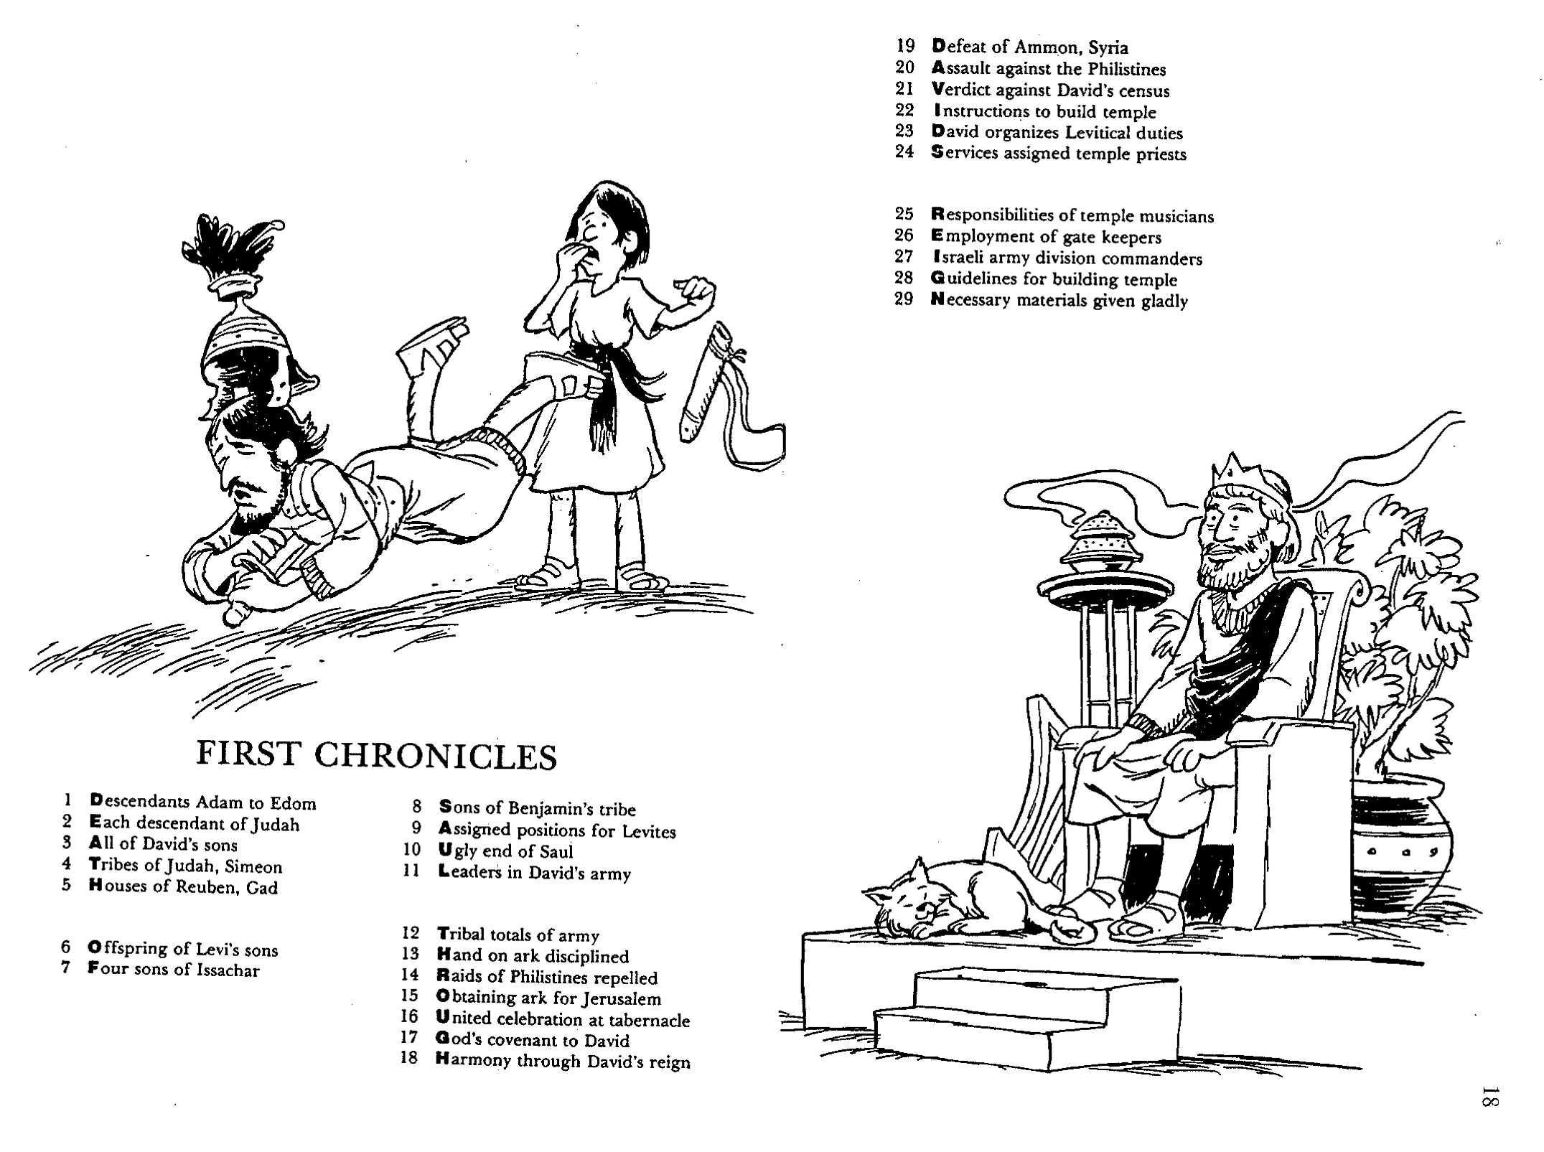
Barry Huddleston, The Acrostic Summarized Bible (Grand Rapids: Baker, 1992)
1 Inception of the world
2 Newlyweds placed in Eden
3 Temptation and man's fall
4 Hatred and first murder
5 Entire genealogy of Adam
6 Lessons on proper priorities
7 Outline for personal relationships
8 Faith of the centurion
29 Genealogy of Jesus Christ
30 Opposition of King Herod
31 Spirit's descent upon Jesus
32 Power over Satan's temptations
33 Expounding Sermon on Mount
34 Lessons on proper priorities
35 Outline for personal relationships
36 Faith of the centurion
9 Matthew's call from Jesus
10 Apostles sent to preach
11 Testimony about John's message
12 True Messiah called demonic
13 Hidden message of parables
14 Execution of the Baptist
15 Wisdom is answering Pharisees
37 Matthew's call from Jesus
38 Apostles sent to preach
39 Testimony about John's message
40 True Messiah called demonic
41 Hidden message of parables
42 Execution of the Baptist
43 Wisdom is answering Pharisees
16 Keys of the kingdom
17 Impact of Jesus' transfiguration
18 Need for true forgiveness
19 Grounds for divorce clarified
20 Opportunities in the vineyard
21 Fig tree is cursed
44 Keys of the kingdom
45 Impact of Jesus' transfiguration
46 Need for true forgiveness
47 Grounds for divorce clarified
48 Opportunities in the vineyard
49 Fig tree is cursed
First Chronicles
22 Taxes paid to Caesar
23 Hypocrisy denounced by "woes"
24 Events of second coming
25 Judgment of the nations
26 Events on Calvary's eve
27 Way of the cross
28 Savior's resurrection and commission
50 Taxes paid to Caesar
51 Hypocrisy denounced by "woes"
52 Events of second coming
53 Judgment of the nations
54 Events on Calvary's eve
55 Way of the cross
56 Savior's resurrection and commission
Notes:
Saul is noted briefly in chapter 10, but only in his death, thus paving the way for David's rule, which is the focus of 1 Chronicles.

Slide 12

Be Established
1 Chronicles
Dr. Rick Griffith • Crossroads International Church Singapore
CICFamily.com • BibleStudyDownloads.org
Notes:
We find stability in God alone, for all of man's efforts are feeble in comparison. He is the only one in whom we can be established.

Slide 13

Making Sense of Samuel, Kings, and Chronicles
220 264
1
Chronicles
2
Chronicles
Books
1
Samuel
2
Samuel
1
Kings
2
Kings
Kings
Saul
David
Solomon-Ahaziah
Ahaziah-Zedekiah
Dates
1043
1011
971 931 852
852 722 586 560
538
Kingdom
---------United-------
------------------- ---------Divided------------
Surviving
-Returned-
Notes:
The books of Samuel and Kings follow a straight chronology. But 1 Chronicles overlaps 2 Samuel with the life of David and 2 Chronicles covers the time of 1-2 Kings and even beyond it with the return from the exile.
In other words, 1 Kings and 2 Kings are parallel to 2 Chronicles: Solomon (1 Kings 1-11; 2 Chron 1-9) is followed by his descendants (1 Kings 12-25; 2 Chron 10-36). However, 2 Kings 25 ends in 560 BC while 2 Chronicles 36 goes further and ends in 538 BC.
_____________
Common-297
OS-09-1Sam-210
OS-10-2Sam-30
OS-11-1Kings-217
OS-12-2Kings-66
OS-12-Kings & Prophets Charts-3
OS-13-1Chron-13, 64
OS-14-2Chron-43

Slide 14
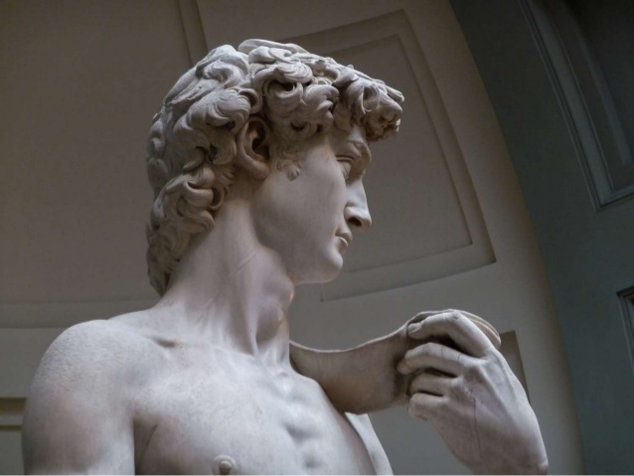
Why would God invest six books about David?
Notes:
The importance of the Davidic covenant can hardly be overstated:
• It forms the foundation of the monarchy where God promised a succession of David’s descendants
• It points to the monarchy leading to the eternal reign of Jesus

Slide 15
Two Histories of the Same Events
Earlier History Close to the Events
Time for Reflection
Later History Long After the Events
Kings
Chronicles
Notes:
• The author(s) of Kings certainly had a theology that showed the downfalls of the kingdoms due to idolatry (books of Kings).
• Theological insight typically takes time.
• But after 100 years when Chronicles was penned, the returnees could see God's faithfulness to bring this remnant back to their land. It therefore seemed appropriate to provide another account of the history of the monarchy that not only prohibits idolatry but also provides its antidote of proper temple worship in response to God's faithful restoration (=Chronicles).
"Sources
Scholars generally concede that Chronicles is a later composition than Samuel–Kings, no matter the view of the Deuteronomic history and its various redactions. If dependence can be demonstrated, Chronicles must be dependent on Samuel–Kings and not vice versa. That this is the case is apparent both from the Chronicler’s citation of texts that can only be the canonical books of Samuel and Kings (1 Chr 9:1; 29:29; 2 Chr 16:11; 20:34; 24:27; 25:26; 27:7; 28:26; 32:32; 33:18; 35:27; 36:8) and from the absence of citation the other way around, that is, Samuel-Kings citing Chronicles. Though the cited texts are seldom used verbatim in Chronicles (a common practice in the ancient world), there is no doubt that the canonical books are intended by the allusion."
— Eugene H. Merrill, “The Books of 1 and 2 Chronicles,” in The World and the Word: An Introduction to the Old Testament (Nashville, TN: B&H Academic, 2011), 337.
____________
OS-13-2Chron-15, 66

Slide 16
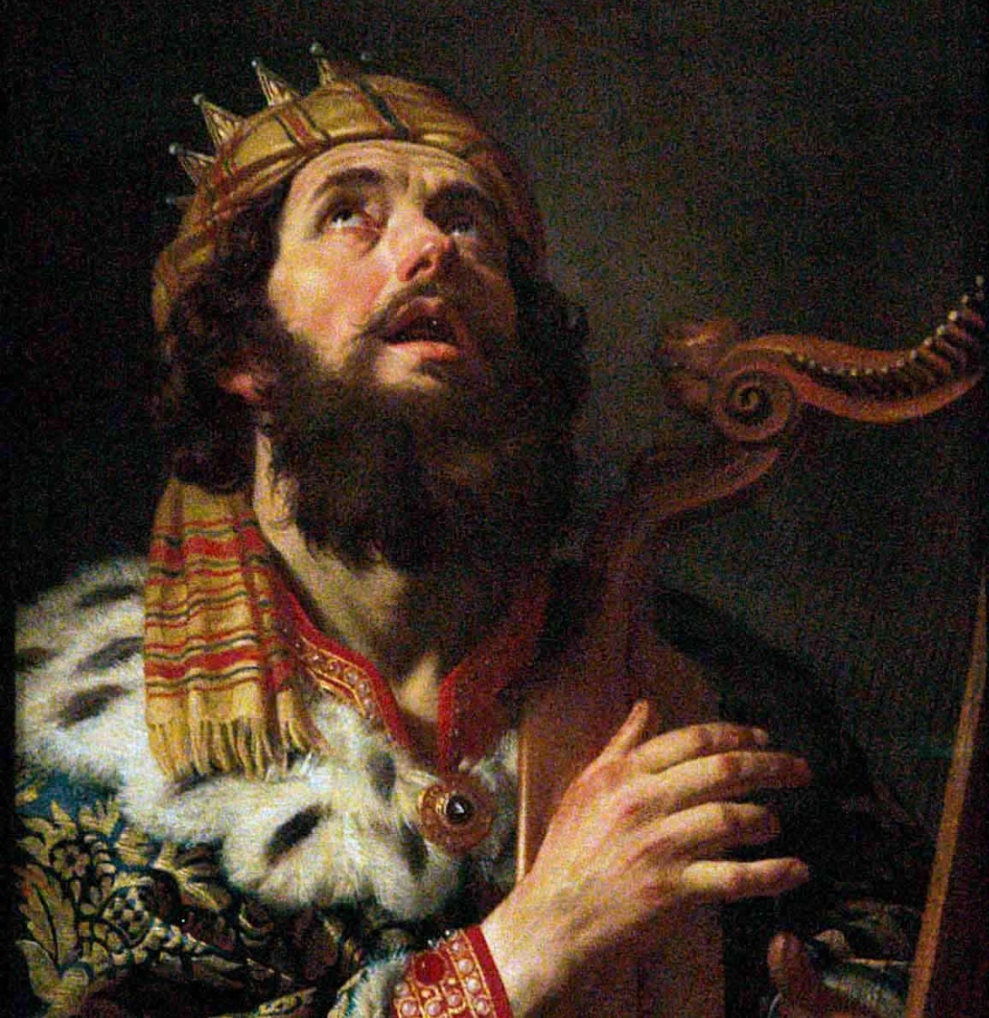
I. God established David’s kingdom to promote temple worship over idolatry.
1 Chronicles
Notes:
The LORD exalted David because David exalted God.

Slide 17

II. Be established by worshipping Jesus as David’s heir.
1 Chronicles
Notes:
Worship Christ as your firm foundation—He alone fulfills the promises to David.

Slide 18
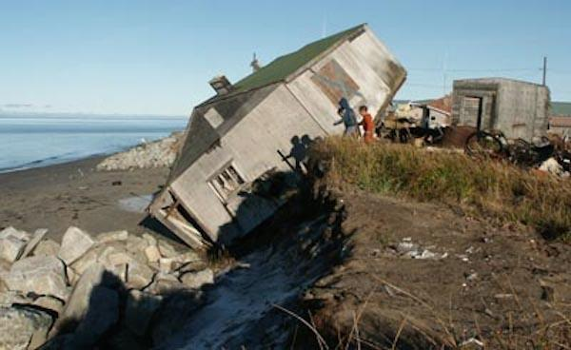
How can you be firmly established in a shaky world?
1 Chronicles
Notes:
Our world is very fragile—so how will you not lose your personal stability?

Slide 19
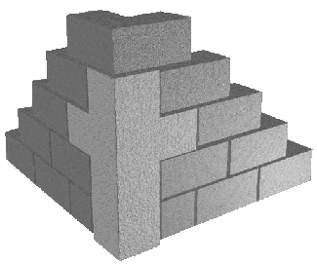
Main Idea
Be established with Christ as your foundation.
1 Chronicles
Notes:
Your personal stability in life cannot be firm without acknowledging Christ’s rule.

Slide 21

Covenants of Promise & Administration
BLESSING
Covenants of Promise
Land
Abrahamic
Amplified by
Davidic
Administrative Covenants How to experience the blessing
Mosaic Israel's terms of obedience
Superceded by
New Terms of obedience under Messiah
Adapted from Walt Russell, Playing with Fire, 121

Slide 22
Summary Statement
262
The spiritual perspective on the establishment of David's kingdom is given to encourage the remnant with God's establishment of the Davidic line and to admonish them to proper temple worship — not the idolatry of the past.

Slide 23
Application
262
Trust in God's unconditional promises.
Worship God in His way–not your own.
Ask God to enable you to see history and world events from His divine perspective.

Slide 24

Title
263
Like the Books of Samuel & Kings, the Books of Chronicles originally comprised a single scroll.
The Hebrew name ( ~yimyh yrbd Dibere Hayyamim) means "The Words (Accounts, Events) of the Days," which in modern idiom means "The Events of the Times."
The Septuagint named the book Paraleipomenon, "Of Things Omitted," referring to data lacking in Samuel and Kings. Yet this title wrongly implies that Chronicles only supplies omissions in Kings, failing to explain the parallel accounts and different emphases.
The English title "Chronicles" is perhaps the best choice. It stems from Jerome's Latin Vulgate (ca. AD 395) as he felt it chronicles the entire sacred history.
Notes:
"The Title of the Book
The title “Chronicles” in the English Bible follows Jerome’s suggestion that the work should be called chronikon, that is, a record of the passing of time from the very beginning of God’s revelation. Unfortunately the word “chronicles” now has a much narrower definition, one that suggests a seriatim collection of incidents or events with little or no comment, analysis, or interpretation. That patently fails to describe the nature of the book of Chronicles.
However, Jerome’s rendition is much superior to that of the LXX, which ignored the Hebrew title dibrê hayyāmîm (“accounts of the days,” i.e., “annals”) and instead perceived the book to be only supplementary to Samuel and Kings. Thus the Greek version coined the title Paraleipomenōn (“things left out”). Moreover, the term chronikon in its classic sense also means “annal,” so the English name, understood in this manner, is adequate.
Though Chronicles includes material missing in Samuel–Kings, it also omits other material found in the latter and repeats much more from those works. Therefore to see Chronicles as only supplemental to Samuel–Kings (a common misunderstanding to this day in some circles) is to fail to appreciate it as a significant and unique creation in its own right, one composed with clear historical and theological objectives in view.^{1"}
LXX Septuagint
¹ W. J. Dumbrell, “The Purpose of the Books of Chronicles,” JETS 27 (1984): 257–66.
From Eugene H. Merrill, “The Books of 1 and 2 Chronicles,” in The World and the Word: An Introduction to the Old Testament (Nashville, TN: B&H Academic, 2011), 330.

Slide 25
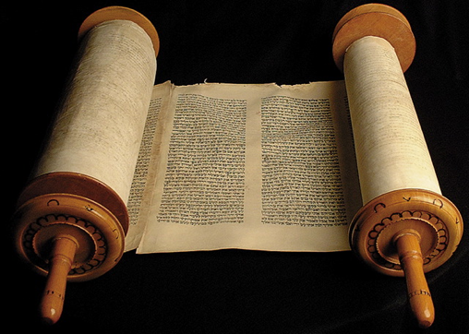
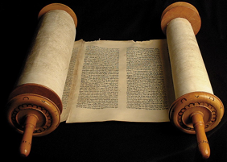
Title
263
First and Second Chronicles originally comprised only one book in the Hebrew canon called "Chronicles”
This single scroll was arbitrarily divided in the Septuagint (250 BC) since the Greek required a greater amount of scroll space.

Slide 26
Authorship
263
External Evidence
The Talmud says Ezra the priest authored the work.
Some Talmudists believe that Nehemiah wrote the genealogy (1 Chron. 1–9).
Internal Evidence
It makes sense that the book was written by a priest as it emphasizes the temple, the priesthood, & the theocratic line of David in the kingdom of Judah.
The style is very similar to the Book of Ezra & both share a priestly perspective: genealogies, temple worship, ministry of the priesthood, & obedience to the Law.
Ezra's authorship is especially supported in that Ezra 1:1-3 repeats the closing verses of 2 Chronicles 36:22-23 almost identically.

Slide 27
Date
263
References to the deportation of Judah (1 Chron. 6:15; 9:1) show that the work was compiled after 586 BC.
Chronicles was compiled long after the return from Babylon (1 Chron. 3:17-24). This text reveals that the latest person in Chronicles was Anani (v. 24) of the 8th generation from Jehoiachin (v. 17), who was taken captive to Babylon in 598 BC. Assuming 25 years for each of these 8 generations places Anani's birth ca. 425 to 400 BC.
The record of the Return (2 Chron. 36:22-23) also argues for a postexilic date.
However, Ezra authored the work & his ministry in Scripture does not stretch beyond ca. 445 (cf. Neh. 12:36).
Therefore, the best estimate of the time of the compilation is between about 450-425 BC.

Slide 28
Date
250 264
First Kings covers 120-years: from 971 BC with the crowning of Solomon to 852 BC during Ahaziah's reign. The year 931 marks the most significant date when Solomon's kingdom split into the northern nation of Israel and the southern kingdom of Judah after his death.
Jerome
1
Kingdoms
2
Kingdoms
3
Kingdoms
4
Kingdoms
Books
1
Samuel
2
Samuel
1
Kings
2
Kings
Kings
Saul
David
Solomon-Ahaziah
Ahaziah-Zedekiah
Dates
1043
1011
971 931 852
852 722 586 560
538
Kingdom
---------United-------
------------------- ---------Divided------------
Surviving
-Returned-
Notes:
Here is a thought question for small group discussion before moving to the next slide:
What elements between 2 Samuel and 1 Chronicles do you find that are the same and different? Why might these differences exist?

Slide 29
Why Two Records?
264
While Kings & Chronicles overlap in recording the kingdom era, some notable differences can be cited:
Kings
Chronicles
Kings of…
Israel & Judah
Judah (almost exclusively)
Elements
Royal / prophetic
Priestly (temple and worship)
Evaluation
Based on Mosaic Law
Based on David/worship of Yahweh
Purpose
Ethical: Judging both nations
Covenant: Blessing Judah due to David
Author
Jeremiah the prophet / priest
Ezra the priest
Faith
Man's faithlessness
God's faithfulness
Outlook
Negative: rebellion/tragedy
Positive: hope amidst apostasy/tragedy
Recipients
Exilic Jews (ca. 550 BC)
Postexilic Jews (ca. 440 BC)
Chronology
971-586 BC
1011-538 BC
Emphasis
Political: emphasizes the throne
Spiritual: emphasizes the temple
Content
Historical
Theological
Attributes
God's justice
God's grace
Protagonist
Human responsibility
Divine sovereignty
Notes:
Why do we have two different records of the divided monarchy of Israel and Judah? The book of Kings had already been written a century earlier, so why did God add the book of Chronicles 100 years later after the Exile and Return to the Land?
The acronym KEEPAFORCECAP can help recall these many issues. See the first letter of each element in the left column.
____________
"Unlike Kings, the book of Chronicles contains relatively few extended prophetic narratives such as those of Elijah and Elisha, but instead the focus is on the monarchy, especially that of Judah."
—Eugene H. Merrill, “The Books of 1 and 2 Chronicles,” in The World and the Word: An Introduction to the Old Testament (Nashville, TN: B&H Academic, 2011), 331.
__________
Common-298
OS-00-OT Book Overviews-274
OS-10-2Sam-31
OS-11-1 Kings-27
OS-12-2 Kings-67
OS-13-1 Chronicles-29, 35
OS-14-2 Chronicles-14, 42

Slide 30
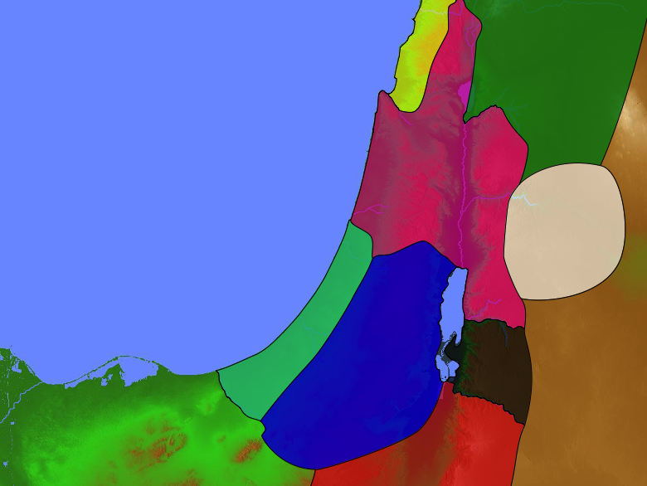
Divided Kingdom
140
Phoenicia
Aram
1 Kings 12–2 Kings 17 2 Chronicles 10–36
Israel
Ammon
Philistia
Judah
Moab
Egypt
Edom

Slide 31
Recipients
263
Using the above date of 450-425 BC for compilation, the original readers comprised Jews who had been back in the land for about a century and probably had recently experienced the reconstruction of the Jerusalem walls under Nehemiah.

Slide 32
Characteristics
263 -264
"All the books of the Bible, thus far, from Genesis to II Kings have pursued a chronological succession of events, right from Adam's creation to Judah's captivity; but now with the Chronicles we come to a writing which does not carry us forward . . . but goes back & reviews the whole story in order to derive & apply a vital lesson, namely, that the nation's response to God is the decisive factor in its history and destiny" (J. Sidlow Baxter).
Chronicles covers the same period of Jewish history begun in 2 Samuel (=1 Chron.) and stretches past 2 Kings (= 2 Chron.). This kingdom period charted appears as such:

Slide 33
Timeline of Chronicles
1–2 Chronicles
United Kingdom
1050-930
Divided Kingdom
930-722
Solitary Kingdom
722-586
Post- Exile
536-425
1100
1050
1000
950
900
850
800
7 5 0
7 0 0
650
600
550
500
450
Exile 586-536

Slide 34
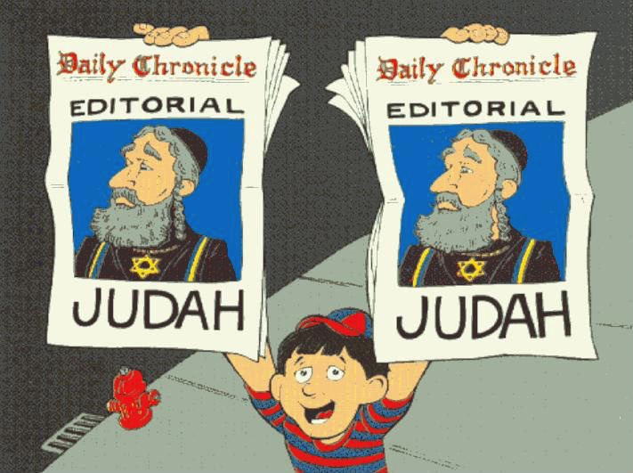
Editorial Nature of 2 Chronicles
2 Chronicles:
Editorial on Judah
Walk Through The Bible ©1989

Slide 35
Why Two Records?
264
While Kings & Chronicles overlap in kingdom era details, some notable differences can be cited:
Kings
Chronicles
Kings of…
Israel & Judah
Judah (almost exclusively)
Elements
Royal / prophetic
Priestly (temple and worship)
Evaluation
Based on Mosaic Law
Based on David/worship of Yahweh
Purpose
Ethical: Judging both nations
Covenant: Blessing Judah due to David
Author
Jeremiah the prophet / priest
Ezra the priest
Faith
Man's faithlessness
God's faithfulness
Outlook
Negative: rebellion/tragedy
Positive: hope amidst apostasy/tragedy
Recipients
Exilic Jews (ca. 550 BC)
Postexilic Jews (ca. 440 BC)
Chronology
971-586 BC
1011-538 BC
Emphasis
Political: emphasizes the throne
Spiritual: emphasizes the temple
Content
Historical
Theological
Attributes
God's justice
God's grace
Protagonist
Human responsibility
Divine sovereignty
Notes:
Why do we have two different records of the divided monarchy of Israel and Judah? The book of Kings had already been written a century earlier, so why did God add the book of Chronicles 100 years later after the Exile and Return to the Land?
____________
"Unlike Kings, the book of Chronicles contains relatively few extended prophetic narratives such as those of Elijah and Elisha, but instead the focus is on the monarchy, especially that of Judah."
—Eugene H. Merrill, “The Books of 1 and 2 Chronicles,” in The World and the Word: An Introduction to the Old Testament (Nashville, TN: B&H Academic, 2011), 331.
__________
Common-298
OS-00-OT Book Overviews-274
OS-10-2Sam-31
OS-11-1 Kings-27
OS-12-2 Kings-67
OS-13-1 Chronicles-29, 35
OS-14-2 Chronicles-14, 42

Slide 36

Characteristics
263 -264
When you add these together:
The genealogies (1 Chron. 1–9 begins 4143 BC), plus
The narrative (1 Chron. 10–2 Chron. 36 ends 538 BC),
then the original single book of Chronicles covers more time than any book of Scripture (3606 years!).
Chronicles is unique in that it contains the largest genealogy in the Bible (1 Chron. 1–9).
The Book of Chronicles appears last in the Hebrew Bible.

Slide 37
Argument
265
The central idea in Chronicles which unifies the entire account is the temple.
The author's reason for emphasizing the temple is to encourage the returned remnant with the spiritual/divine perspective that while the Davidic throne is not among them, the Davidic line & God Himself is (1 Chron. 1–9).
Therefore, the people should learn from the judgment of their ancestors' idolatry & worship Him correctly with the temple as the center of the nation's worship.

Slide 38
Synthesis
265
David's line established
1–9 Genealogy of Davidic line
10–29 David's concern for the ark / temple

Slide 39
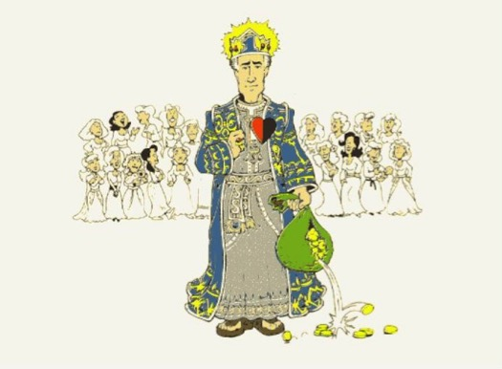
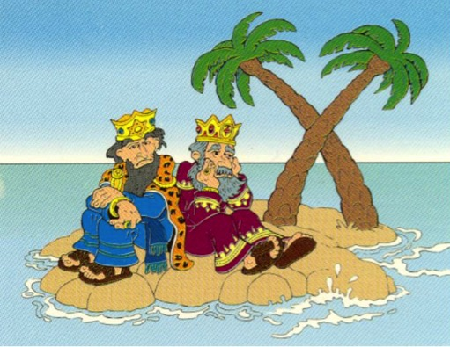
The United & Divided Kingdoms
1 Kings 1–11 United Under Solomon
1 Kings 12– 2 Kings 25 Divided Until Exile

Slide 40
Occasion
263
Kings records the history from a political / ethical standpoint, but Chronicles provides the spiritual / priestly view.
It reminded the people that David's royal line still remained to encourage the small remnant who had returned & built a meager temple compared to Solomon's (cf. Hag. 2:3).

Slide 41
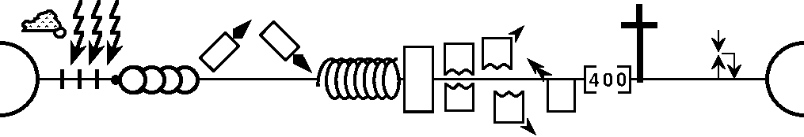
World History Detailed
--------------------------------------------------- 1 & 2 Chronicles ----------------------------------------------------------------
Genesis 1–11
Genesis
12–50
Deuteronomy
1 Samuel
Leviticus
2 Samuel
Nehemiah
Numbers
1 Kings
2 Kings
Exodus
Joshua
Judges
Ruth
Ezra
Esther
NATIONS
ISRAEL
P • G • H • R
Eternity
Flood
S • D • S
2nd Coming
Fall
Babel
1st Coming
Eternity
J (R) & I (J)
Abraham
Isaac
Joseph
Creation
Jacob
Joshua
I (A) & J (B)
Moses
Cycles
Z • E • N
1000
400
2020+
Exodus
Beginnings
Conquests
Patriarchs
Kingdom
Judges
Silent Years
Church
United Kingdom
Divided Kingdom
Restoration
Captivity
Max Anders, Dallas Theological Seminary
Notes:
OS-00-Intro & Biblical Theology-24
OS-13-1 Chron-40

Slide 42
Integration of the Old Testament
Walk Thru the OT
43
Leviticus
Deuteronomy
Ruth
1 Chronicles
2 Chronicles
Esther
Historical
Genesis | Exodus | Numbers | Joshua | Judges | 1 Samuel | 2 Samuel | 1 Kings | 2 Kings
Ezra | Nehemiah
1
2
3
4
5
6
7
8
9
10
11
Job
Psalms
Proverbs
Poetical
Ecclesiastes
Song of Songs
To Israel:
Hosea
Amos
To Judah:
Habakkuk
Isaiah
Jeremiah
Joel
Micah
Zephaniah
Lamentations
Ezekiel
Haggai
Malachi
Daniel
Zechariah
Prophetical
To Assyria:
Jonah
Nahum
To Edom:
Obadiah
Notes:
OS-00-Intro & Biblical Theology-21
OS-13-1 Chron-41
OS-23-Isaiah_60-66/Slide 94 on Supplements

Slide 43
Kingdom & Covenants Timeline
22
CH-34a
OS1-22
OS2-337
NS-9g
SA-19
34a
Dr. Rick Griffith • BibleStudyDownloads.org
22
Kingdom Teaching...
Adam rules with God (Gen. 1:26, 28; 2:19)
Satan begins rule as god of this world (Gen. 3:15;
2 Cor. 4:4)
God covenants with Abraham to reestablish man's rule via Israel as a "kingdom of priests" (Gen. 12:1-3; Exod. 19:6)
Israel's failure to witness to nations as a kingdom of priests is judged via exile under foreign rule
Israel rejects Messiah's offer of kingdom (Matt. 12:41-42; 23:37-39)
Jesus extends His kingdom in mystery form to the Church (Matt. 13)
Christ subdues Israel's enemies and nation believes (Rom. 11:26-27)
Christ rules over everything with saints (Eph. 1:9-10; Rev. 20:1-6; 22:5b)
337
9g
Fall of Man (Gen. 3)
Noahic Covenant
19
Genesis 6:18; 9:8-17
Land Covenant
ISRAEL
CHURCH
MESSIANIC KINGDOM
(National Focus)
The "New Man" (Eph. 2:15)
Millennial Eternal
land
Genesis 15:18 (cf. Deut. 30:1-10) promises:
Land from Wadi of Egypt to Euphrates River (Isa. 27:12)
Eternal possession of land (Gen. 17:8) after exile/restoration
Whole world blessed via the land (Isa. 14:1-2)
Israel judged for rejecting Messiah by dispersion away from land for 19 centuries
(AD 70–AD 1948) but now partially restored (Ezek. 37:1-7)
Full restoration (Ezek. 37:8-28) Jerusalem world capital
(Isa. 2:1-5)
New Jerusalem
(Rev. 21–22)
Davidic Covenant
Christ is Head over His Church, which is a spiritual temple (Eph. 2:19-22; 2 Cor. 6:16)
Christ reigns over the world
(Isa. 11)
with saints (Rev. 5:10; 20:4-6)
Christ hands kingdom over to Father (1
Cor. 15:24)
Genesis 12:1-3
2 Samuel 7:12-16 promises:
Sons ("house" never wiped out)
Kingdom (political dynasty)
Throne (right to rule by descendants)
Temple (son to build it)
seed
Abrahamic Covenant
New Covenant
All
things made new!
(Rev. 21:5)
All 5 elements fulfilled in national restoration (Zech. 8)
Jeremiah 31:31-34 promises:
Forgiveness
Indwelling Spirit
New heart, nature, mind
Reunification of Israel and Judah
No need for evangelism
Mosaic Law replaced with first three elements of the New Covenant (Luke 22:20; 2 Cor. 3:6)
blessing
Mosaic Covenant
Law abolished, fulfilled, and replaced at the cross (Rom. 7:1-6; 1 Cor. 9:19-21; Heb. 8:13)
10th Edition
10 Nov 2020
Temporary (Gal. 3:19) and conditional (Deut. 28) to reveal sin (Rom. 7:7) and regulate Israel (Gal. 3:23-25)
Scripture has a dual kingdom-covenant theme. Israel's role from Abraham to Christ expands to include the Church (continuity) yet the Church never replaces the nation as the "new Israel" (discontinuity). Israel will enjoy world prominence after trusting Christ at His second coming.
Notes:
All agree that a partial fulfillment of the covenant to Abraham exists now to the Church in the indwelling Holy Spirit and forgiveness of sins (Jer 31:31-34)—and the ultimate fulfillment will be in the eternal state.
The main area of disagreement relates to the time period from now to eternity. Will there be a literal land, throne, and worldwide blessing to national (ethnic) Israel before the eternal kingdom? This chart shows verses giving a resounding YES to that question in a present partial fulfillment and a future full fulfillment in the normal sense of language in the verses cited. But the messianic kingdom will be in two stages—first in a millennial fulfillment to last 1000 years, but then, after that, the eternal stage in the new Jerusalem after the destruction of our present heavens and earth (Rev 21–22). What an amazing future remains for those who trust Jesus!
____________
Common English-7
CH-02-Nature-103-p34a
OS-00-Intro & Biblical Theology-25 & 90
OS-02-Exodus-267-p22
OS-05-Deut-248-p22
OS-10-2Sam-96-p22
OS-13-1 Chron-42
OS-24-Jeremiah-174-p337
OS-23-Isaiah-97-p337
NS-09-Gal-143-p9g
NS-19-Hebrews-342-p9g
SA-08-Mosaic Law-19-p38a

Slide 44

Critical scholars point out many places where the chronologies of Kings and Chronicles do not match—and the reigns of the kings of Israel and Judah seem contradictory. So what should we do?
Oh, well… The Bible just has those contradictions?
Notes:
OS-11-1Kings-47
OS-13-1Chron-43

Slide 45
The Mystery of the Kings
70i
The total number of years of the reigns of Israel and Judah in a fixed time span were not the same
If chronology is worked according to lengths of reign, synchronisms won't fit (and vice versa)
Seeming lack of harmony between OT chronology and that of ANE
Why does it matter?
It concerns the historicity and reliability of the Bible and the accuracy of its transmission

Slide 46
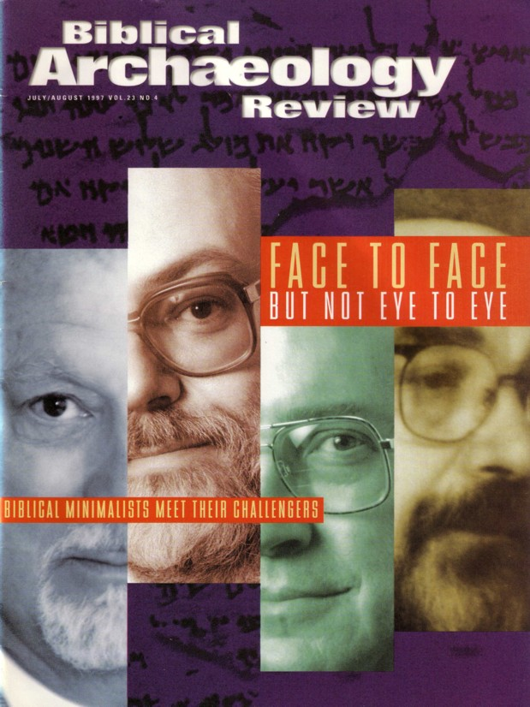
Is the Chronology of Israel's Kings Necessary?
Whether David and Solomon ever even lived was doubted by “Biblical Minimalists” in the July/Aug 1997 issue of BAR

Slide 47
Years Kings of Judah Ruled
65c
Rehoboam 17
Abijam 3
Asa 41
Jehoshaphat 25
Jehoram 8
Ahaziah 1
Athaliah 6
Joash 40
Amaziah 29
Azariah (Uzziah) 52
Jotham 18
Ahaz 19
Hezekiah 29
Manasseh 55
Amon 2
Josiah 31
Jehoahaz 3 months
Jehoiakim 11
Jehoiachin 3 months
Zedekiah 11
Total 398
Rehoboam began 931 BC
Zedekiah ended 586 BC
Total Years 345 years
Why the difference?
How can we explain this?

Slide 48
Proposed Reasons for Discrepancies
70i
Inaccurate systems used by biblical historians
Accidental errors of transmission
Largely schematic and artificial chronology
Intentional mutilation of text to cover up various facts

Slide 49
Proposed Solutions
70i
Editorial changes to the chronological data (3rd century B.C. Septuagint)
Include periods of political chaos in which no king sat on the throne
Disregard the data in the Masoretic Text and determine dates with synchronisms with ANE history
Discover original method of dating

Slide 50
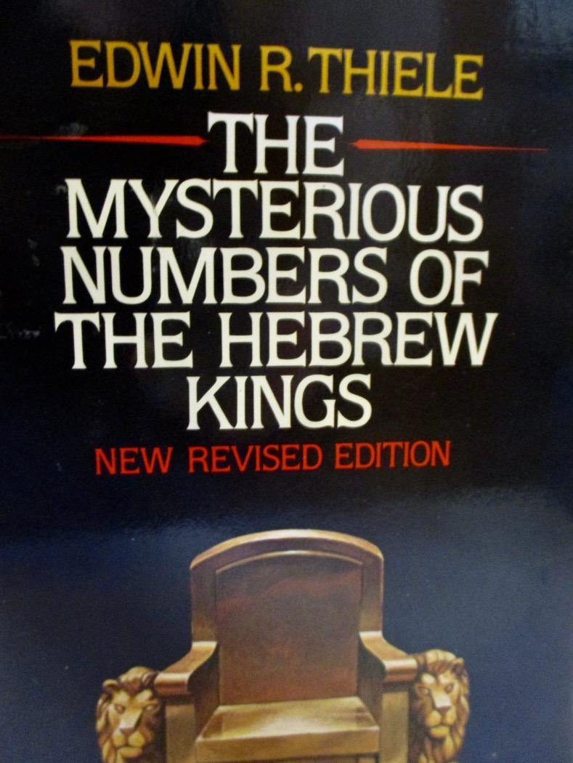
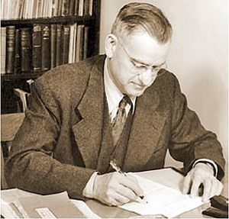
Enter stage… Seventh-Day Adventist OT scholar Edwin R. Thiele (pronounced TEE-lee)
1924-2006
Notes:
OS-11-1Kings-48
OS-13-1Chron-44

Slide 51

Hebrew Calendars
The Exodus Night:
While the Israelites were still in the land of Egypt, the LORD gave the following instructions to Moses and Aaron: ²"From now on, this month will be the first month of the year for you" (Exod. 12:1-2)
221
1 Nisan
2 Iyar
3 Sivan
4 Tammuz
5 Av
6 Elul
7 Tishri
8 Cheshvan
9 Kislev
10 Tevet
11 Shevat
12 Adar
Mar-Apr
Sacred Calendar Begins
Civil Calendar Begins
Sep-Oct
Notes:
The night of the Exodus in 1446/1445 BC was so significant that God commanded the annual calendar to begin in that month of Nisan (March-April) instead of the civil calendar used prior to that point.
But the reality is that both calendars continued to be used among Jews.

Slide 52
Hebrew Calendars
Which system did they use to determine the king's reign?
Israel began
with Nisan
& didn't count
accession year
221
1 Nisan
2 Iyar
3 Sivan
4 Tammuz
5 Av
6 Elul
7 Tishri
8 Cheshvan
9 Kislev
10 Tevet
11 Shevat
12 Adar
Mar-Apr
Did they count the accession year?
Sacred Calendar Begins
Two Key Issues:
Civil Calendar Begins
Judah began
with Tishri
& counted
accession year
What if the
king's reign
began here?
Sep-Oct
Notes:
For many centuries no one was able to decipher the chronology of the kings of Israel and Judah, as it was so complicated in many ways:
System: Israel had two calendars: a civil calendar that begins with the Feast of Trumpets in Sept (in Tishri, ironically called the 7th month!) and the sacred calendar that began in Nisan at the Exodus in March-April. But which calendar did God’s people use?
Accession: Did the author of Kings count as a full year that portion of the year left when a king was crowned? This accession year would change the dates significantly, considering that we are talking about 39 rules in both Israel and Judah.

Slide 53
Thiele's Solution
221
Different Dating Systems used by Judah and Israel
Judah | Israel
Accession-year system, beginning with Tishri (931-848) | Non-Accession year system, beginning with Nisan (931-848)
Time of alliance and intermarriage with Israel Non-Accession year system, beginning with Tishri for Judah and Nisan for Israel (848-796)
Accession-year system, beginning with Tishri for Judah and Nisan for Israel (796-586)
Notes:
Finally, in the late 20th century, Seventh-day OT scholar Edwin Thiele (pronounced TEE-lee) figured out the chronology.
a) Judah and Israel had two dating systems of accession years based on different calendars (civil v. secular). Further, this switched twice in terms of whether the accession or non-accession system was used.

Slide 54
Thiele's Solution
221
Some co-regencies in Israel and Judah
Two instances of rival reigns in Israel
Certain synchronisms in 2 Kings 17 and 18 inserted by a late hand out of harmony with original pattern of reigns
Notes:
b) Added to the above, several times a king continued to rule after his son had already been crowned, leading to a co-regency—both in Israel and in Judah.
c) Twice in Israel, two kings were vying for rule at the same time, and
d) A scholar misunderstood the above factors along the way and tried to correct the chronology in 2 Kings 17–18, but this only complicated matters. Instead, we should just accept the original text as it stands.

Slide 55
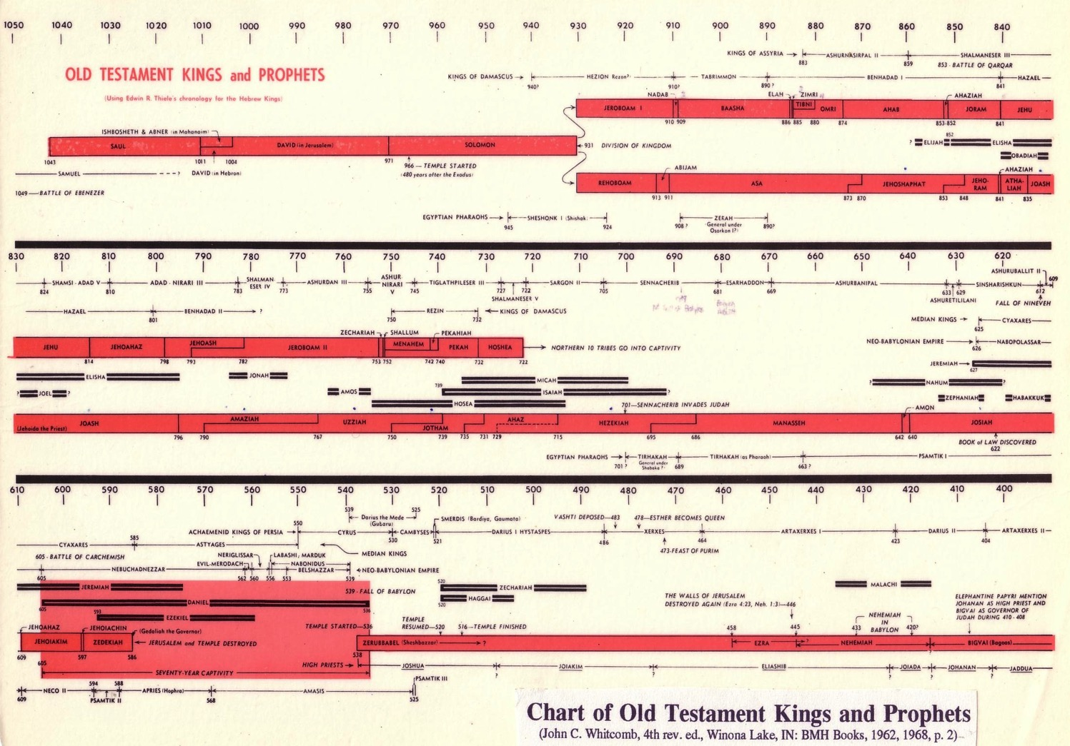
Chart of OT Kings & Prophets
232 & 342
Chart of Old Testament Kings & Prophets
John C. Whitcomb, 4th ed. (Winona Lake, IN: BMH Books, 1968), 2
Notes:
For many centuries no one was able to decipher the chronology of the kings of Israel and Judah, as it was so complicated in many ways:
System: Israel had two calendars: a civil calendar that begins with the Feast of Trumpets in Sept (in Tishri, ironically called the 7th month!) and the sacred calendar that began in Nisan at the Exodus in March-April. But which calendar did God’s people use?
Accession: Did the author of Kings count as a full year that portion of the year left when a king was crowned? This accession year would change the dates significantly, considering that we are talking about 39 rules in both Israel and Judah.
Finally, in the late 20th century, Seventh-day OT scholar Edwin Thiele (pronounced TEE-lee) figured out the chronology.
a) Judah and Israel had two dating systems of accession years based on different calendars (civil v. secular). Further, this switched twice in terms of whether the accession or non-accession system was used.
b) Added to the above, several times a king continued to rule after his son had already been crowned, leading to a co-regency—both in Israel and in Judah.
c) Twice in Israel, two kings were vying for rule at the same time, and
d) A scholar misunderstood the above factors along the way and tried to correct the chronology in 2 Kings 17–18, but this only complicated matters. Instead, we should just accept the original text as it stands.
________________
OS-11-1Kings-50
OS-12-2Kings-42
OS-13-1Chron-49
OS-14-2Chron-30

Slide 56
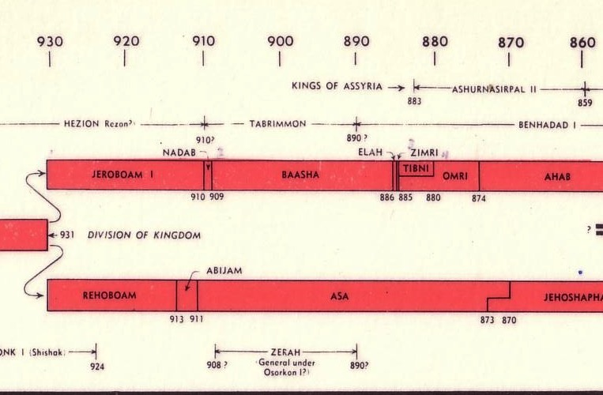

Chart of OT Kings & Prophets
232 & 342
Chart of Old Testament Kings & Prophets
John C. Whitcomb, 4th ed. (Winona Lake, IN: BMH Books, 1968), 2
Notes:
Here is the beginning of the divided kingdom where Jeroboam received the 10 northern tribes called Israel while Rehoboam continued the dynasty of David and Solomon in the southern kingdom of Judah.

Slide 57
Be Established
1 Chronicles
Dr. Rick Griffith • Crossroads International Church Singapore
CICFamily.com • BibleStudyDownloads.org

Slide 58

Let's Study Through Scripture
The Bible: Book by Book
Notes:
We are in a study through the whole Bible right now, book by book. The goal is to give us a basic understanding of each book of the Bible.

Slide 59

Oh, no… I hit the geneaologies
in my read-through-the-Bible program again…
Notes:
Most people dread the long lists in the Bible.

Slide 60
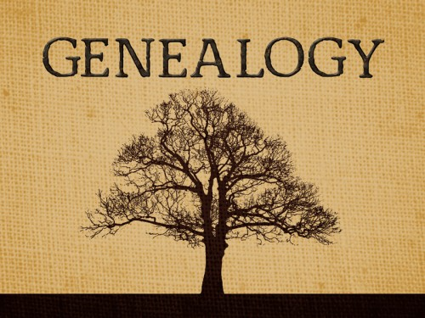
What’s the point?
GENEALOGY
Notes:
Today we see the list of hundreds of men in 1 Chronicles 1–9. Yes, there are literally NINE chapters of seemingly endless names. Why?

Slide 61

What’s the point?
Here’s a great way to catch up on your sleep?
Notes:
The nine chapters of genealogies are boring!
Some see these chapters as a sleeping pill to cure insomnia.
Besides, it is also another book about David when we’ve already read Samuel and Kings. Why Chronicles?

Slide 62
What’s the point?
GENEALOGY
The throne is empty, but David’s descendants continue
Notes:
Here is the point of these lists of names: God has been faithful to keep the line of David going even through the destruction and exile of the nation!

Slide 63
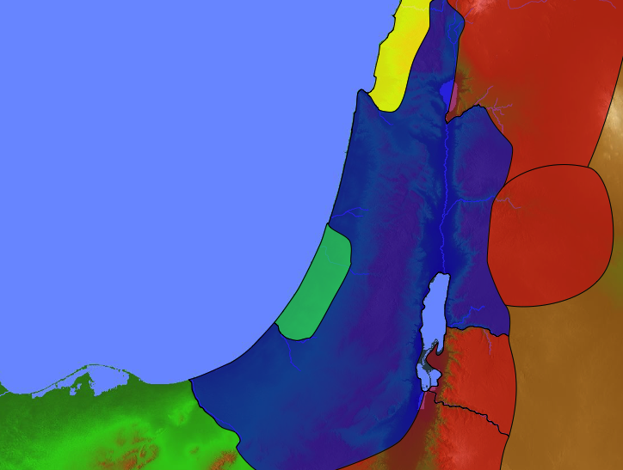
United Kingdom
140
Phoenicia
Aram
1 Samuel 8–1 Kings 11 1 Chronicles 1—2 Chronicles 9
Israel
Ammon
Philistia
Moab
Conquered kingdoms in red
Egypt
Edom
Notes:
The preceding history that the people knew about was the account in Kings—a history that had been around for 100 years. Wasn’t that enough? Well, is one gospel sufficient? God seems not to think so, for he gave us four gospels.

Slide 64
Making Sense of Samuel, Kings, and Chronicles
220 264
1
Chronicles
2
Chronicles
Books
1
Samuel
2
Samuel
1
Kings
2
Kings
Kings
Saul
David
Solomon-Ahaziah
Ahaziah-Zedekiah
Dates
1043
1011
971 931 852
852 722 586 560
538
Kingdom
---------United-------
------------------- ---------Divided------------
Surviving
-Returned-
Notes:
The books of Samuel and Kings follow a straight chronology. But 1 Chronicles overlaps 2 Samuel with the life of David and 2 Chronicles covers the time of 1-2 Kings and even beyond it with the return from the exile.
In other words, 1 Kings and 2 Kings are parallel to 2 Chronicles: Solomon (1 Kings 1-11; 2 Chron 1-9) is followed by his descendants (1 Kings 12-25; 2 Chron 10-36). However, 2 Kings 25 ends in 560 BC while 2 Chronicles 36 goes further and ends in 538 BC.
_____________
Common-297
OS-09-1Sam-210
OS-10-2Sam-30
OS-11-1Kings-217
OS-12-2Kings-66
OS-12-Kings & Prophets Charts-3
OS-13-1Chron-13, 64
OS-14-2Chron-43

Slide 65
Why would God invest six books about David?
Notes:
The importance of the Davidic covenant can hardly be overstated:
• It forms the foundation of the monarchy where God promised a succession of David’s descendants
• It points to the monarchy leading to the eternal reign of Jesus

Slide 66
Two Histories of the Same Events
Earlier History Close to the Events
Time for Reflection
Later History Long After the Events
Kings
Chronicles
Notes:
Theological insight typically takes time. The author(s) of Kings certainly had a theology that showed the downfalls of the kingdoms due to idolatry (books of Kings).
But after 100 years when Chronicles was penned, the returnees could see God's faithfulness to bring this remnant back to their land. It therefore seemed appropriate to provide another account of the history of the monarchy that not only prohibits idolatry but also provides its antidote of proper temple worship in response to God's faithful restoration (=Chronicles).
____________
OS-13-2Chron-15, 66

Slide 67
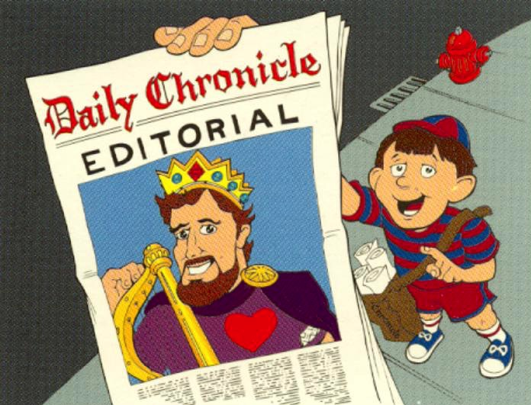
Editorial Nature of 1 Chronicles
1 Chronicles:
Editorial on David
Walk Through The Bible ©1989

Slide 68
I. God established David’s kingdom to promote temple worship over idolatry.
Notes:
The LORD exalted David because David exalted God.
Samuel notes his failures but he was still a man after God's heart.

Slide 69
Key Word
262
39
Establishment
1 Chronicles
Notes:
Part 1 of the massive work we call 1 Chronicles. It highlights how God initiated his kingdom work by starting to rule through human kings.

Slide 70
Theme
262
David's Line Established
1 Chronicles
Notes:
Chief among the kings was David, with whom God made a covenant.

Slide 71
Slides on 1 Chronicles 1

Slide 72
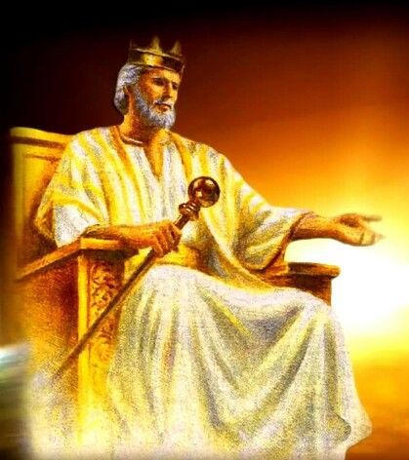
The genealogy from Adam to 450 BC showed David’s throne absent but his line still present due to God’s grace (1 Chron 1–9) .
Notes:
The returnees need to know that God is still with them and that he has promised a future king of Israel to rule over them.

Slide 73

Adam to Noah Genealogy (1 Chron. 1:1-4)
85
Adam
Seth
Enosh
Kenan
Mahalalel
Jared
Enoch
Methuselah
Lamech
= Genesis 5
Noah

Slide 74
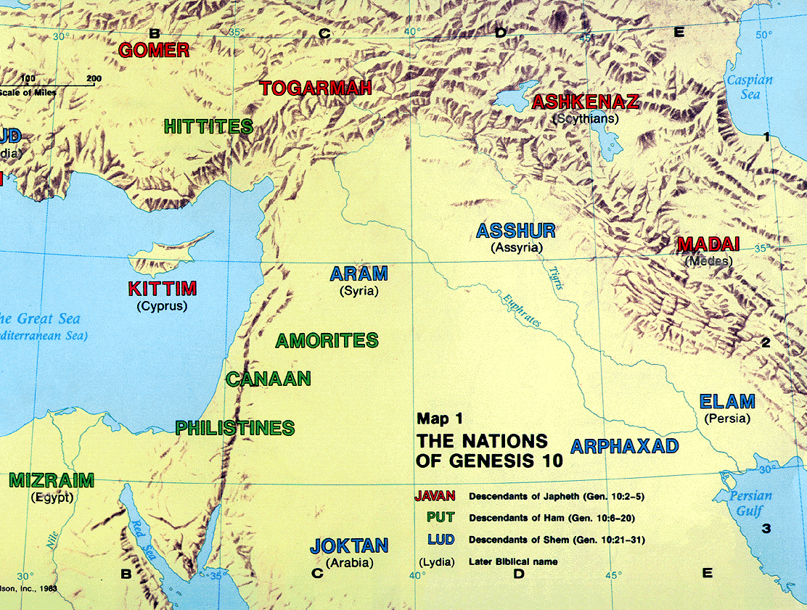
The Table of Nations
92
1 Chronicles 1:4-27
NOAH
Sino
Japheth
HAM
SHEM
Sin
Caucasians
Canaanites
Semites
Sinai
Europeans &
East Indians
Africans &
Asians
Jews &
Arabs
Genesis 10
Notes:
Noah’s three sons became three divisions of humanity in three major areas.
Asians stem from Canaanites in the city of Sin—not those who migrated south to the Sinai but those who migrated east to China. Here is why we have these terms of Sinai and East Asians called Sino.
_____________
ES-29-How the Nations Treat Israel-4
BG-03-Table of Nations-3
OS-01-Gen4-20-slide 149
OS-13-1Chron-74

Slide 75
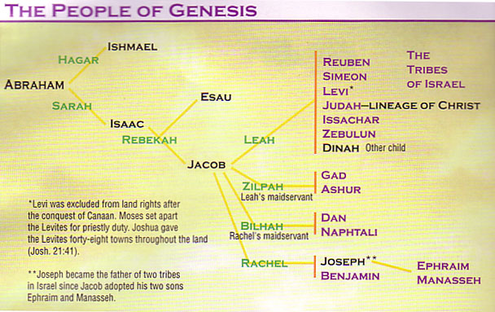
Patriarchal Family Tree (Gen. 12–50; 1 Chron. 1:28-34)
91
Ishmael
Abraham
Isaac
Jacob
* Levi was excluded from land rights after the conquest of Canaan. Moses set apart the Levites for priestly duty. Joshua gave the Levites 48 towns throughout the land (Josh 21:41)
Joseph
** Joseph became the father of two tribes in Israel since Jacob adopted his two sons Ephraim and Manasseh.

Slide 76
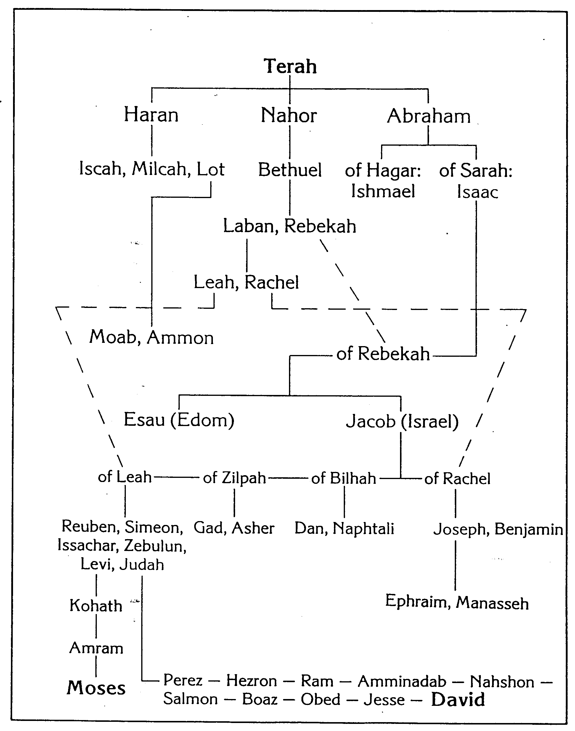
Patriarchal Family Tree
269
John H. Walton, Chronological and Background Charts of the OT

Slide 77
Eastern Tribes During Divided Kingdom
140
Phoenicia
Aram
1 Chronicles 1:35-54 (Edom)
1 Kings 12–2 Kings 17
Israel
Ammon
Philistia
Judah
Moab
Egypt
Edom

Slide 78
Slides on 1 Chronicles 2

Slide 79
Patriarchal Family Tree
Patriarchal Family Tree
91
1 Chron. 2:1-5
Terah
Haran
Nahor
Abraham
Lot
Bethuel
(of Hagar) Ishmael
(of Sarah) Isaac
Laban Rebekah
married
Esau
Jacob
Leah
Rachel
(of Leah) Reuben, Simeon, Levi, Judah, Issachar, Zebulun
(of Zilpah) Gad, Asher
(of Bilhah) Dan, Naphtali
(of Rachel) Benjamin, Joseph
Manasseh
Ephraim
Green = line of blessing with rights of firstborn even though none of these were born first (1 Chron. 5:1-2)

Slide 80
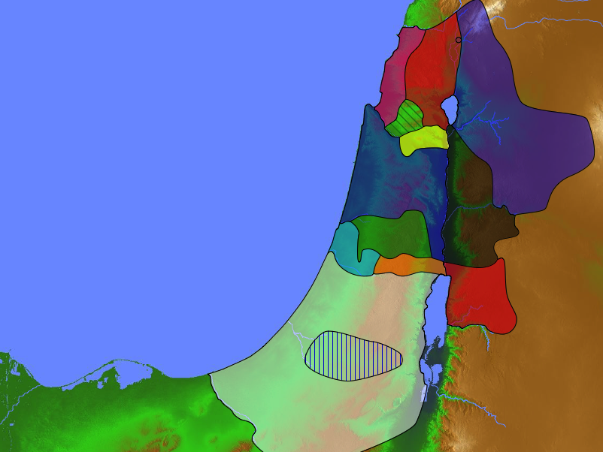
Populations by Tribe
171
Numbers 26 Joshua 13:1–19:48 1 Chronicles 2:3-55 (Judah, Hezron, Caleb, Hur)
Levi 23,000 Spread Throughout Israel
Judah 76,500

Slide 81
Slides on 1 Chronicles 3

Slide 82
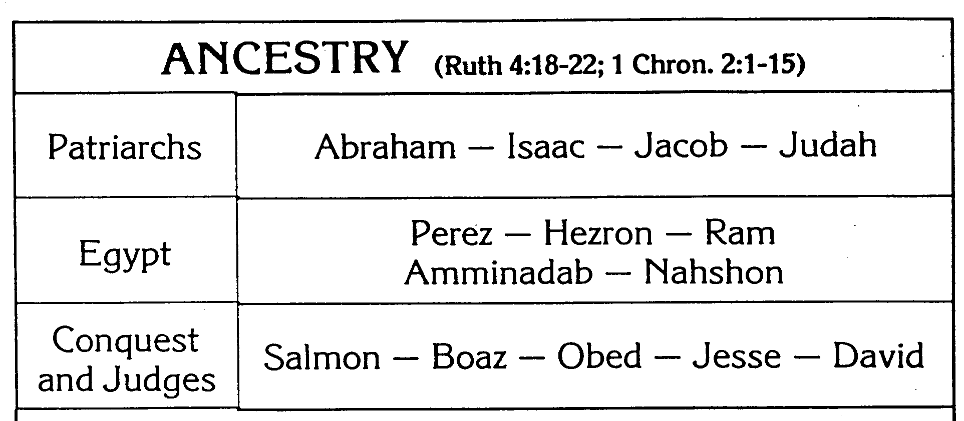
Family & Ancestry of David
270
John H. Walton, Chronological and Background Charts of the OT

Slide 83

The Lineage of David
ABRAHAM
Isaac
Jacob
Judah
Perez
Hezron
Ram
Amminadab
Nahshon
Salmon
Boaz
Obed
Jesse
DAVID

Slide 84

Messiah from Judah
Since Jacob's blessing in Genesis 49:9-10, the lion has depicted a king…
"Judah, my son, is a young lion that has finished eating its prey. Like a lion he crouches and lies down; like a lioness—who dares to rouse him?
¹⁰The scepter will not depart from Judah, nor the ruler's staff from his descendants, until the coming of the one to whom it belongs, the one whom all nations will honor" (NLT).

Slide 85

Oh, David, why so many wives?

Slide 86
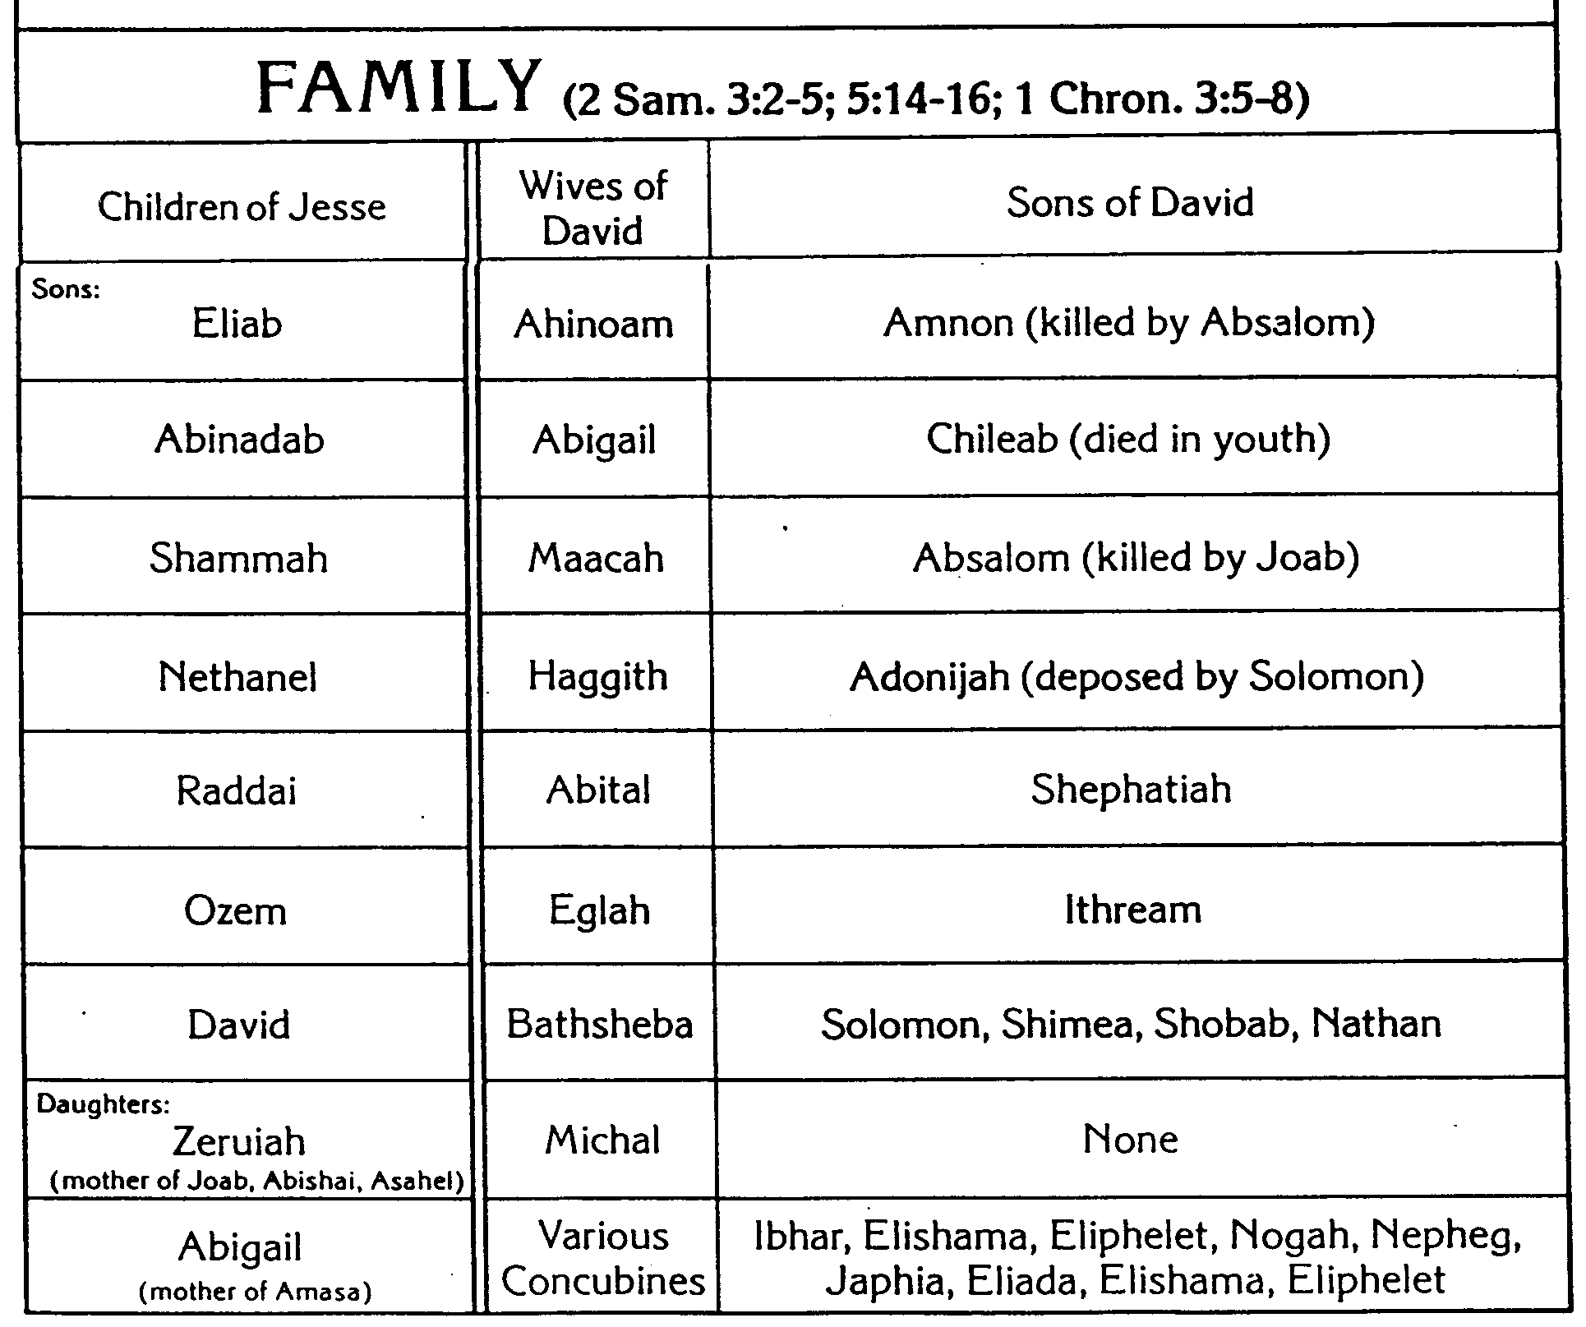
Family & Ancestry of David
270
John H. Walton, Chronological and Background Charts of the OT
FAMILY (2 Sam. 3:2-5; 5:14-16; 1 Chron. 3:5-8)
Children of Jesse
Wives of David
Sons of David

Slide 87
The Kingdom in Matthew 1
Fall of the Kingdom
Establishing the Eternal Kingdom
ABRAHAM
Solomon
Shealtiel
Isaac
Rehoboam
Zerubbabel
Jacob
Abijah
Abiud
Judah
Asa
Eliakim
Perez
Jehoshaphat
Azor
"Thus there were fourteen generations in all from Abraham to David, fourteen from David to the exile to Babylon, and fourteen from the exile to Christ."
Matthew 1:17
Ahaziah
Hezron
Jehoram
Zadok
Joash
Ram
Uzziah
Akim
Amaziah
Amminadab
Jotham
Eliud
Nahshon
Ahaz
Eleazar
Salmon
Hezekiah
Matthan
Boaz
Manasseh
Jacob
Obed
Amon
Joseph +
Mary
Rise of the Kingdom
Jesse
Josiah
KING DAVID
JECONIAH (EXILE)
JESUS CHRIST
Notes:
Matthew’s genealogy omits three kings between Jehoram and Uzziah (=Azariah), giving 14 generations in each period of the rise, fall, and preservation of the kingdom until Jesus.
The Bible has several genealogies of the Davidic line:
Perez to David (Ruth 4:18-22)
David (1000 BC) to the sons of Elionai around 400 BC (1 Chron 3:9-17)
Abraham to Jesus (Matt 1:1-17)
Adam to Jesus (Luke 3:23-38)
One difficulty concerns the son of Jehoiachin/Jeconiah/Coniah in the Davidic line. Was his son Shealtiel (Matt 1:12) or should we follow the line of Jehoiachin with his other son Pedaiah (1 Chron 3:17) or his son Rhesa (Luke 3:27), the latter not even listed among the seven sons of Jehoiachin in 1 Chron 3:17?
“2. DESCENDANTS OF SOLOMON (3:10-24)
3:10-24. This list of Solomon’s descendants is in effect a list of Judah’s kings from Solomon through Zedekiah (vv. 10-16) and their exilic and postexilic continuation (vv. 17-24). Athaliah, the queen who ruled between Ahaziah and Joash, is not mentioned (v. 11). That is because she was only a political usurper and was not in the true dynastic succession (cf. 2 Kings 11). Of the sons of Josiah, Johanan (1 Chron. 3:15) is otherwise unknown. He cannot be Jehoahaz (2 Kings 23:31) because Jehoahaz was [Vol. 1, p. 595] younger than Jehoiakim (cf. 2 Kings 23:36). This means that Shallum (1 Chron. 3:15) is identical to Jehoahaz who, though the next-to-youngest son of Josiah, preceded his brothers on the throne (cf. Jer. 22:11-12).
The remainder of the succession followed by the chronicler is Jeconiah (Heb.; cf. NIV marg. of 1 Chron. 3:16; also known as Jehoiachin; cf. v. 17 and 2 Kings 24:8, and Coniah, Jer. 22:24, marg.). Then came Pedaiah (1 Chron. 3:18), Zerubbabel (v. 19), Hananiah (v. 19), Shecaniah (v. 21), Shemaiah (v. 22), Elioenai (v. 23), and Hodaviah (v. 24).
Three difficulties here must be addressed. First, Zerubbabel (v. 19) is elsewhere called the son of Shealtiel, not the son of Pedaiah (Ezra 3:2, 8; 5:2; Neh. 12:1; Hag. 1:12, 14; 2:2, 23; Matt. 1:12; Luke 3:27). Since Shealtiel and Pedaiah were brothers (1 Chron. 3:17-18) the best solution seems to be that Shealtiel died early on and his role of dynastic succession was assumed by his younger brother Pedaiah. The second problem concerns Luke’s account of the genealogy in which he identifies Shealtiel as the son of Neri, whose descent is not from Solomon but from David’s son Nathan (Luke 3:27-31). The answer may lie in the possibility that since Jeconiah had no male heir to sit on the throne (cf. Jer. 22:30), a daughter of Jeconiah married Neri, son of Melki (Luke 3:27-28; not the Melki of Luke 3:24), of the line of Nathan. Legally Shealtiel, as grandson of Jeconiah, would continue the Davidic dynasty through Solomon, a viewpoint espoused by Matthew (Matt. 1:6-12).
The third conflict appears in Zerubbabel’s line. The chronicler lists Zerubbabel’s seven sons and one daughter (1 Chron. 3:19b-20). But none of them is mentioned in the genealogies of either Matthew or Luke. Matthew, who traces Jesus’ descent from David through Solomon, wrote that the son of Zerubbabel was Abiud (Matt. 1:13). Luke, viewing it through Nathan, said Rhesa was that son (Luke 3:27). It is entirely possible, of course, that the Shealtiel and Zerubbabel of Luke are not the same as those of 1 Chronicles and that Luke preserves a genealogy of Mary straight from David through Nathan, a line of succession that has no other connection with the chronicler’s genealogy (cf. comments on Luke 3:27). This would preclude the suggested solution to the second problem previously mentioned (and would, in fact, eliminate the problem altogether). This still leaves the variance between 1 Chronicles 3:19b-20 and Matthew 1:13. One may conjecture that Abiud is another name for one of the seven sons of Zerubbabel listed in Chronicles or that his name is missing from that list to begin with. That such a thing is possible may be seen in 1 Chronicles 3:22 where the historian wrote that Shemaiah had six sons but listed only five names” (Eugene Merrill, “1 Chronicles,” in The Bible Knowledge Commentary [Wheaton, IL: Victor, 1985], 1:594-95).
______
OS-2Sam-100
OS-13-1Chron-81
NS-01-Matt1-14—slide 161

Slide 88
An Evil End to Judah
256
1
Josiah
640-609
(31 yrs.)
2 Kings 25
1 Chronicles 3:16-24
2 Chronicles 36
Good king in white
Evil kings in yellow
3
5
2
Johanan (no rule)
Jehoiakim (Eliakim) 609-597 (11 yrs.)
Zedekiah (Mattaniah) 597-586 (11 yrs.)
Jehoahaz (Shallum) 609 (3 mos.)
4
Jehoiachin (Jeconiah/Coniah) 597 (3 mos.)
Babylon
Exiled
Notes:
OS-12-2Kings-214
OS-14-2Chron-82

Slide 89
Josiah's Sons & Prophets
232
342
Daniel
605
Ezekiel
City Fell
Jehoahaz
Josiah
Jehoiakim
Jehoiachin
Zedekiah
609
597
586
(3 mos.)
(11 yrs.)
(3 mos.)
(11 yrs.)
Jeremiah
627
Brief Puppet Kings
Notes:
OS-12-2Kings-220
OS-14-2Chron-83

Slide 90
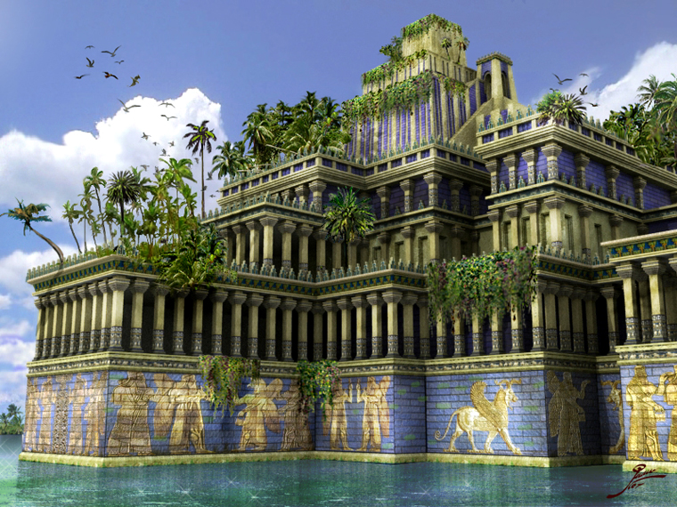
The Hanging Gardens of Babylon

Slide 91
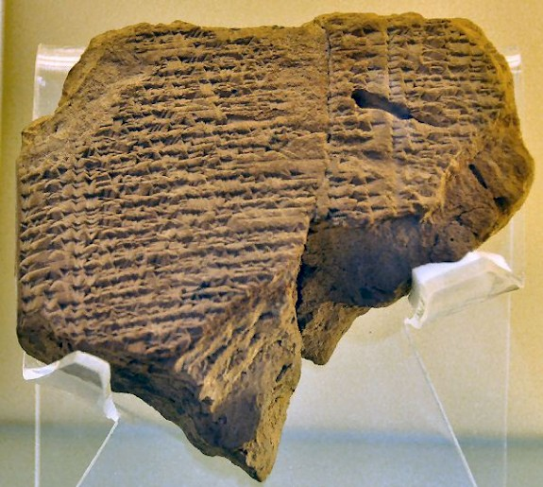
Kindness to Jehoiachin in Exile
"In the thirty-seventh year of the exile of King Jehoiachin of Judah, Evil-merodach ascended to the Babylonian throne. He was kind to Jehoiachin and released him from prison on April 2 of that year. ²⁸He spoke kindly to Jehoiachin and gave him a higher place than all the other exiled kings in Babylon. ²⁹He supplied Jehoiachin with new clothes to replace his prison garb and allowed him to dine in the king’s presence for the rest of his life. ³⁰So the king gave him a regular food allowance as long as he lived.”
—2 Kings 25:27-30 NLT
Ration Tablet Berlin Museum
Chap. 21

Slide 92
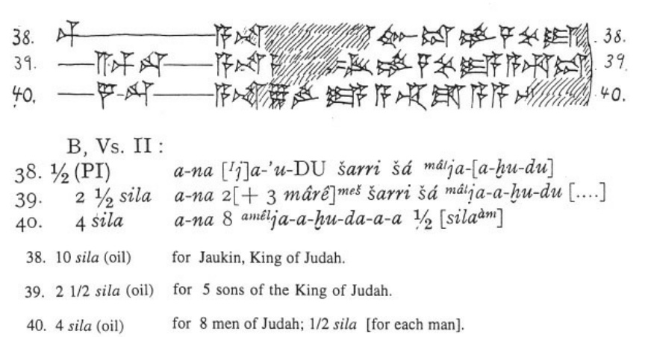
Jehoiachin’s Ration Tablet in Exile
Babylon excavation 1899-1917
10 sila (oil) for Jaukin, King of Judah.
2 ½ sila (oil) for 5 sons of the King of Judah.
4 sila (oil) for 8 men of Judah; ½ sila [for each man].
Notes:
Tablet picture above from:
“Jehoiachin in Babylonia
One of the last kings of Judah, Jehoiachin (r.598-597) was taken captive by the Babylonians (2 Kings 24.15; ABC 5) and lived in exile in the country of the conquerors. However, he was released, and a couple of cuneiform tablets from Babylonia inform us about his fate.
Cuneiform tablet, mentioning Jehoiachin The story of Jehoiachin's release can be found at the end of the Biblical book 2 Kings:
And in the thirty-seventh year of the exile of Jehoiachin king of Judah, in the twelfth month, on the twenty-seventh day of the month, Evil-merodach king of Babylon, in the year that he began to reign, graciously freed Jehoiachin king of Judah from prison; and he spoke kindly to him, and gave him a seat above the seats of the kings who were with him in Babylon. So Jehoiachin put off his prison garments. And every day of his life he dined regularly at the king's table; and for his allowance, a regular allowance was given him by the king, every day a portion, as long as he lived.^{note}
There are several possible dating systems, but the accession year of Amel-Marduk (or Evil-merodach) was 562/561, and this is more or less identical to the thirty-seventh year of the exile of Jehoiachin, which began in 596 (ABC 5 with note); the twenty-seventh day of the thirty-seventh year must be somewhere in the spring of 560. There is a small error, but it is not disastrous. We can be sure that Jehoiachin was released when Amel-Marduk became king, after his father Nebuchadnezzar had died.
Why Amel-Marduk released the former king of Judah is not known, but a recent theory is that as a crown prince, the Babylonian had fallen victim to a court intrigue and had been sent to prison. There, he may have met Jehoiachin.
According to Talmudic traditions, Jehoiachin lived in Nehardea, not far from Sippar, in the north of Babylonia. In general terms, this is confirmed by about thirty-five cuneiform texts referring to a village called âl-Jahûda ("the Judaean town") near Sippar. The prophet Ezekhiel mentions a settlement called Tell Abib near Nippur.
There are several cuneiform texts that illustrate Jehoiachin's position after his release, which were discovered by Robert Koldewey in Babylon and are collectively known as ANET³ 308.^{note} These documents, now in Berlin, are lists of deliveries of food and oil to important people, and prove that the king of Judah (who is called Ia-'-u-kin, Ia-'-kin, and Ia-ku-ú-ki-nu) received substantial rations. Here are the relevant lines:
1
... to Ia-'-u-kin, king ... to the qîpûtu-house of ... ... for Shalamiamu, the ... ... for 126 men from Tyre ... ... for Zabiruam the Ly[dian] ...
2
10 sila of oil to ... [Ia]-'-kin, king of Ia-[a-hu-du] 2½ sila of oil to the [five so]ns of the king of Ia-a-hu-du 4 sila to eight men from Ia-a-hu-da-a-a ...
3
1½ sila for three carpenters from Arvad, ½ sila each 11½ sila for eight ditto from Byblos, 1 sila each ... 3½ sila sila for seven ditto, ½ sila each ½ sila for Nabû-êtir the carpenter 10 sila to Ia-ku-ú-ki-nu, the son of the king of Ia-ku-du 2½ sila for the five sons of the king of Ia-ku-du through Qana'a
Comment
The third list is the most interesting, because it suggests that Jehoiachin had five sons, whereas the Bible says that there were seven::^{note}
The sons of Jehoiachin, the captive: Shealtiel his son, Malchiram, Pedaiah, Shenazzar, Jekamiah, Hoshama, and Nedabiah.
Perhaps two had died, or had not yet come of age. It is also possible that a mistake was made by someone who copied this verse, because the wording is a bit odd and there is a variant reading. The text, as we now have it, suggests that only Shealtiel was Jehoiachin's son, and the other names are in fact without qualification. Perhaps they are descendants of Malchiram, son of Shealtiel, and perhaps we should read:
The sons of Jehoiachin, the captive: Shealtiel his son, Malchiram his son, and Pedaiah, Shenazzar, Jekamiah, Hoshama, Nedabiah, the sons of Malchiram.
Of course, this implies that the five sons of text three are in fact five descendants, which is certainly possible, because the word "son" was frequently used in a very loose sense. This creates another problem, however: why aren't Shealtiel and Malchiram mentioned in text three? Perhaps they had become courtiers of one of the Babylonian kings, but this is just a hypothesis.
A final remark: because Jehoiachin had been king for a mere three months, he could also be described as "the son of the king of Judah" in the third text.
Literature
ANET = James K. Pritchard, Ancient Near Eastern Texts relating to the Old Testament (1969 third edition)
Diana Edelman, The Origins of the 'Second' Temple. Persian Imperial Policy and the Rebuilding of Jerusalem (2005), pp.21-22
Irving Finkel, "The Lament of Nabû-šuma-ukîn" in J. Renger (ed.), Babylon. Focus mesopotamischer Geschichte, Wiege früher Gelehrtsamkeit, Mythos in der Moderne (1999 Saaerbrücken) 323-341
This page was created in 2007; last modified on 12 October 2020.”
https://www.livius.org/articles/person/jehoiachin-in-babylonia/
——————————
White cuneiform image above from K. A. Kitchen:
﻿"From a vaulted building closely adjoining the royal palace proper came a series of cuneiform tablets dated to the tenth to thirty-fifth years of Nebuchadrezzar II (595-570), being “ration tablets” for people kept or employed in Babylon and its palace. Among the beneficiaries in receipt of oil were “Jehoiachin king of Judah” (just once, “king’s son of Judah”) and “the 5 sons of the king of Judah in the care of (their guardian?) Qenaiah” (cf. fig. 10C). Thus the exiled young king and his infant children were already on a regular allowance in Nebuchadrezzar’s time (one tablet is of Year 13, 592), but under the palace equivalent of house arrest."
Kitchen, K. A.. On the Reliability of the Old Testament . Wm. B. Eerdmans Publishing Co.. Kindle Edition. Plate X, Fig 10C

Slide 93
Grace in Exile
256
Jehoiachin (Jeconiah/Coniah) 597 (ruled 3 mos.)
Shealtiel
Pedaiah
Jekamiah
Nedabiah
Malkiram
Shenazzar
Hoshama
Zerubbabel
1 Chronicles 3:17-19
Notes:
1Chr. 3:16 The successors of Jehoiakim were his son Jehoiachin and his brother Zedekiah.ª
Descendants of Jehoiachin
1Chr. 3:17 The sons of Jehoiachin,ª who was taken prisoner by the Babylonians, were Shealtiel, 18 Malkiram, Pedaiah, Shenazzar, Jekamiah, Hoshama, and Nedabiah.
1Chr. 3:19 The sons of Pedaiah were Zerubbabel and Shimei.
The sons of Zerubbabel were Meshullam and Hananiah. (Their sister was Shelomith.) 20 His five other sons were Hashubah, Ohel, Berekiah, Hasadiah, and Jushab-hesed.
1Chr. 3:21 The sons of Hananiah were Pelatiah and Jeshaiah. Jeshaiah’s son was Rephaiah. Rephaiah’s son was Arnan. Arnan’s son was Obadiah. Obadiah’s son was Shecaniah.
1Chr. 3:22 The descendants of Shecaniah were Shemaiah and his sons, Hattush, Igal, Bariah, Neariah, and Shaphat—six in all.
1Chr. 3:23 The sons of Neariah were Elioenai, Hizkiah, and Azrikam—three in all.
1Chr. 3:24 The sons of Elioenai were Hodaviah, Eliashib, Pelaiah, Akkub, Johanan, Delaiah, and Anani—seven in all.
_____
OS-12-2Kings-231
OS-14-2Chron-82

Slide 94
The Lineage of Jehoiachin/ Jeconiah/ Coniah (1 Chron 3:17-24)
Jehoiachin
Pedaiah
+ 6 brothers
Zerubbabel
+ 1 brother (Shimei)
Hananiah
+ 6 brothers + 1 sister
Shecaniah
+ 5 brothers
Shemaiah
+ 0 brothers
Neariah
+ 5 brothers
Elioenai
+ 2 brothers
Hodaviah
+ 6 brothers
Notes:
It is difficult to tell if 3:21 mentions Hananiah’s 6 sons (Shecaniah + 5 brothers) or whether these 6 men were descendants in 6 generations. As Chronicles ends around 440-400 BC and the above has 9 generations (9 x 25 years old at son’s birth=175 years), this would already bring the account from Jehoiachin’s exile in 597 to around 422 BC (597 – 175 = 422 BC). Adding another 5 generations would bring the genealogy to about 300 BC. This is possible but unlikely and would be problematic to reconcile with the other Bible genealogies.
———————
Matthew’s genealogy omits three kings between Jehoram and Uzziah (=Azariah), giving 14 generations in each period of the rise, fall, and preservation of the kingdom until Jesus.
The Bible has several genealogies of the Davidic line:
Perez to David (Ruth 4:18-22)
David (1000 BC) to the sons of Elionai around 400 BC (1 Chron 3:9-17)
Abraham to Jesus (Matt 1:1-17)
Adam to Jesus (Luke 3:23-38)
One difficulty concerns the son of Jehoiachin/Jeconiah/Coniah in the Davidic line. Was his son Shealtiel (Matt 1:12) or should we follow the line of Jehoiachin with his other son Pedaiah (1 Chron 3:17) or his son Rhesa (Luke 3:27), the latter not even listed among the seven sons of Jehoiachin in 1 Chron 3:17?
“2. DESCENDANTS OF SOLOMON (3:10-24)
3:10-24. This list of Solomon’s descendants is in effect a list of Judah’s kings from Solomon through Zedekiah (vv. 10-16) and their exilic and postexilic continuation (vv. 17-24). Athaliah, the queen who ruled between Ahaziah and Joash, is not mentioned (v. 11). That is because she was only a political usurper and was not in the true dynastic succession (cf. 2 Kings 11). Of the sons of Josiah, Johanan (1 Chron. 3:15) is otherwise unknown. He cannot be Jehoahaz (2 Kings 23:31) because Jehoahaz was [Vol. 1, p. 595] younger than Jehoiakim (cf. 2 Kings 23:36). This means that Shallum (1 Chron. 3:15) is identical to Jehoahaz who, though the next-to-youngest son of Josiah, preceded his brothers on the throne (cf. Jer. 22:11-12).
The remainder of the succession followed by the chronicler is Jeconiah (Heb.; cf. NIV marg. of 1 Chron. 3:16; also known as Jehoiachin; cf. v. 17 and 2 Kings 24:8, and Coniah, Jer. 22:24, marg.). Then came Pedaiah (1 Chron. 3:18), Zerubbabel (v. 19), Hananiah (v. 19), Shecaniah (v. 21), Shemaiah (v. 22), Elioenai (v. 23), and Hodaviah (v. 24).
Three difficulties here must be addressed. First, Zerubbabel (v. 19) is elsewhere called the son of Shealtiel, not the son of Pedaiah (Ezra 3:2, 8; 5:2; Neh. 12:1; Hag. 1:12, 14; 2:2, 23; Matt. 1:12; Luke 3:27). Since Shealtiel and Pedaiah were brothers (1 Chron. 3:17-18) the best solution seems to be that Shealtiel died early on and his role of dynastic succession was assumed by his younger brother Pedaiah. The second problem concerns Luke’s account of the genealogy in which he identifies Shealtiel as the son of Neri, whose descent is not from Solomon but from David’s son Nathan (Luke 3:27-31). The answer may lie in the possibility that since Jeconiah had no male heir to sit on the throne (cf. Jer. 22:30), a daughter of Jeconiah married Neri, son of Melki (Luke 3:27-28; not the Melki of Luke 3:24), of the line of Nathan. Legally Shealtiel, as grandson of Jeconiah, would continue the Davidic dynasty through Solomon, a viewpoint espoused by Matthew (Matt. 1:6-12).
The third conflict appears in Zerubbabel’s line. The chronicler lists Zerubbabel’s seven sons and one daughter (1 Chron. 3:19b-20). But none of them is mentioned in the genealogies of either Matthew or Luke. Matthew, who traces Jesus’ descent from David through Solomon, wrote that the son of Zerubbabel was Abiud (Matt. 1:13). Luke, viewing it through Nathan, said Rhesa was that son (Luke 3:27). It is entirely possible, of course, that the Shealtiel and Zerubbabel of Luke are not the same as those of 1 Chronicles and that Luke preserves a genealogy of Mary straight from David through Nathan, a line of succession that has no other connection with the chronicler’s genealogy (cf. comments on Luke 3:27). This would preclude the suggested solution to the second problem previously mentioned (and would, in fact, eliminate the problem altogether). This still leaves the variance between 1 Chronicles 3:19b-20 and Matthew 1:13. One may conjecture that Abiud is another name for one of the seven sons of Zerubbabel listed in Chronicles or that his name is missing from that list to begin with. That such a thing is possible may be seen in 1 Chronicles 3:22 where the historian wrote that Shemaiah had six sons but listed only five names” (Eugene Merrill, “1 Chronicles,” in The Bible Knowledge Commentary [Wheaton, IL: Victor, 1985], 1:594-95).

Slide 95
Slides on 1 Chronicles 4

Slide 96
Populations by Tribe
171
Numbers 26 Joshua 13:1–19:48 1 Chronicles 4 (Judah & Simeon)
Judah 76,500
Simeon 22,200

Slide 97
Slides on 1 Chronicles 5

Slide 98
Patriarchal Family Tree
Patriarchal Family Tree
91
1 Chron. 2:1-5
Terah
Haran
Nahor
Abraham
Lot
Bethuel
(of Hagar) Ishmael
(of Sarah) Isaac
Laban Rebekah
married
Esau
Jacob
Leah
Rachel
(of Leah) Reuben, Simeon, Levi, Judah, Issachar, Zebulun
(of Zilpah) Gad, Asher
(of Bilhah) Dan, Naphtali
(of Rachel) Benjamin, Joseph
Manasseh
Ephraim
Green = line of blessing with rights of firstborn even though none of these were born first (1 Chron. 5:1-2)

Slide 99
Populations by Tribe
171
Numbers 26 Joshua 13:1–19:48 1 Chronicles 5 (Reuben, Gad, Manasseh)
Manasseh
Manasseh 52,700
Gad 40,500
Ephraim 32,500
Reuben 43,730

Slide 100
Patriarchal Family Tree
Kingly Line
91
Terah
Haran
Nahor
Abraham
Lot
Bethuel
(of Hagar) Ishmael
(of Sarah) Isaac
Laban Rebekah
married
Esau
Jacob
Leah
Rachel
(of Leah) Reuben, Simeon, Levi, Judah, Issachar, Zebulun
(of Zilpah) Gad, Asher
(of Bilhah) Dan, Naphtali
(of Rachel) Benjamin, Joseph
Manasseh
Ephraim
Red: Even though Judah was not the firstborn, Jacob claimed the kings of Israel would come from him.

Slide 101
Slides on 1 Chronicles 6

Slide 102
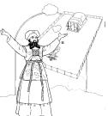
Contrasting Levites and Priests
132
Abraham
Isaac
Jacob
12 Sons: Reuben–Simeon–Levi–Judah– etc.
All other lines Aaron
Levites Priests
see p. 171a see p. 202

Slide 103
Contrasting Levites and Priests
132
Levites
Priests
Descendants of…
Levi
Aaron (also a descendant of Levi)
Population
Many (the larger group)
Few (a subset of the Levites, Josh. 21:4)
Role
Assisted priests and supervised religious activities permitted outside of the sanctuary: teaching, singing, leading worship, officials, administration, judges & gatekeepers
Mediators between God and Israel
Sacrificial Role
Didn't offer sacrifices though they did offer incense (Deut. 33:10b)
Offered sacrifices (Deut. 33:10b)
Location of Homes
Extensive–in 35 cities throughout the tribes in the central, northern, and eastern parts of Israel (Josh. 21:5-7)
Limited to 13 cities in Judah, Simeon, & Benjamin that were near the temple (Josh. 21:4, 9-13)

Slide 104
Levi's Family Tree
125
202
Levi's Family Tree
LEVI
1 Chron. 6:1-3
Gershon
Kohath
Merari
Levites
Amram
Priests
High Priest
Miriam
Aaron
Moses
Offered
Unauthorised Fire;
Killed by God
Nadab
Abihu
Eleazar
Ithamar
Adapted from Manna Bible Maps
Manna

Slide 105
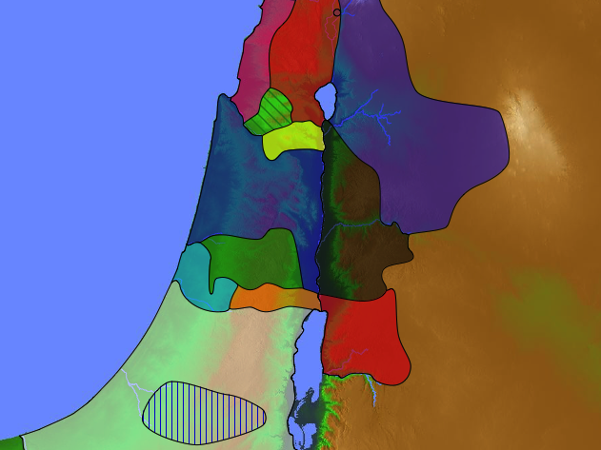
48 Levitical Cities
171a
6 Cities of Refuge
Gershon (6:62)
1 Chronicles 6:54-80
Merari (6:77)
Kohath (6:66-70)
Merari (6:63, 78-81)
Kohath (6:54-61)
Notes:
God wisely spread the instructors within Israel (Levites) among the people so they need not go to Jerusalem to learn his Word. Interspersed among them lay the six cities of refuge that guarded the people against revenge. These two systems positively provided truth (Levitical teaching) and negatively provided protection (refuge towns).
__________
Common-276
JE-10-Future Rule of Christ in Jerusalem (Is 2)-26
OS-06-Joshua-195
OS-07-Judges-56
OS-13-1Chron-105

Slide 106
Slides on 1 Chronicles 7

Slide 107
Populations by Tribe
171
Asher 53,400
Naphtali 45,400
Numbers 26 Joshua 13:1–19:48 1 Chronicles 7
Issachar 64,300
Manasseh 52,700
Ephraim 32,500
Benjamin 45,600

Slide 108
Slides on 1 Chronicles 8

Slide 109
Populations by Tribe
171
Numbers 26 Joshua 13:1–19:48 1 Chronicles 8
Benjamin 45,600

Slide 110
Slides on 1 Chronicles 9

Slide 111
Populations by Tribe
171
Asher 53,400
Naphtali 45,400
Numbers 26 Joshua 13:1–19:48 1 Chronicles 9
Zebulun 60,500
Levi 23,000 Spread Throughout Israel
Manasseh
Issachar 64,300
Manasseh 52,700
“The first of the exiles to return to their property in their former towns were priests, Levites, Temple servants, and other Israelites. ³Some of the people from the tribes of Judah, Benjamin, Ephraim, and Manasseh came and settled in Jerusalem” (1 Chron 9:2-3 NLT).
Gad 40,500
Ephraim 32,500
Dan 64,400
Benjamin 45,600
Reuben 43,730
Judah 76,500
Simeon 22,200

Slide 112
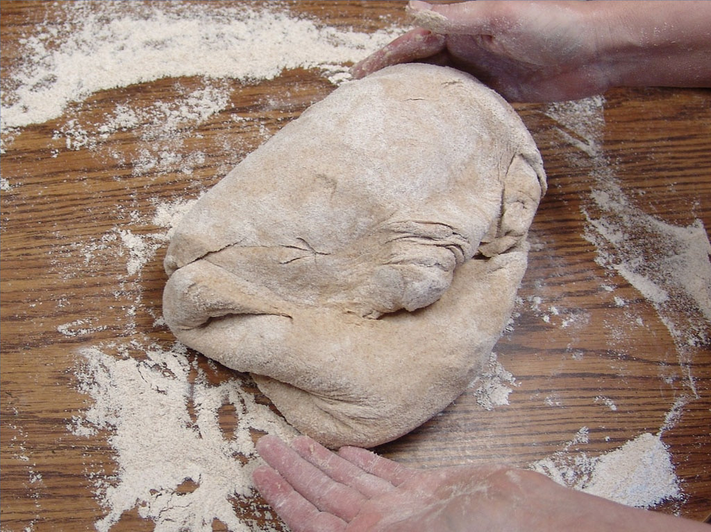

Free Bible images
THE MAKING OF SHOWBREAD
Leviticus 24:5-9; 1 Chronicles 9:32
Notes:
Lev. 24:5 “You must bake twelve flat loaves of bread from choice flour, using four quarts of flour for each loaf. ⁶ Place the bread before the LORD on the pure gold table, and arrange the loaves in two stacks, with six loaves in each stack. ⁷ Put some pure frankincense near each stack to serve as a representative offering, a special gift presented to the LORD. ⁸ Every Sabbath day, this bread must be laid out before the LORD as a gift from the Israelites; it is an ongoing expression of the eternal covenant. ⁹ The loaves of bread will belong to Aaron and his descendants, who must eat them in a sacred place, for they are most holy. It is the permanent right of the priests to claim this portion of the special gifts presented to the LORD.”
1 Chron 9:32 And some members of the clan of Kohath were in charge of preparing the bread to be set on the table each Sabbath day.

Slide 113
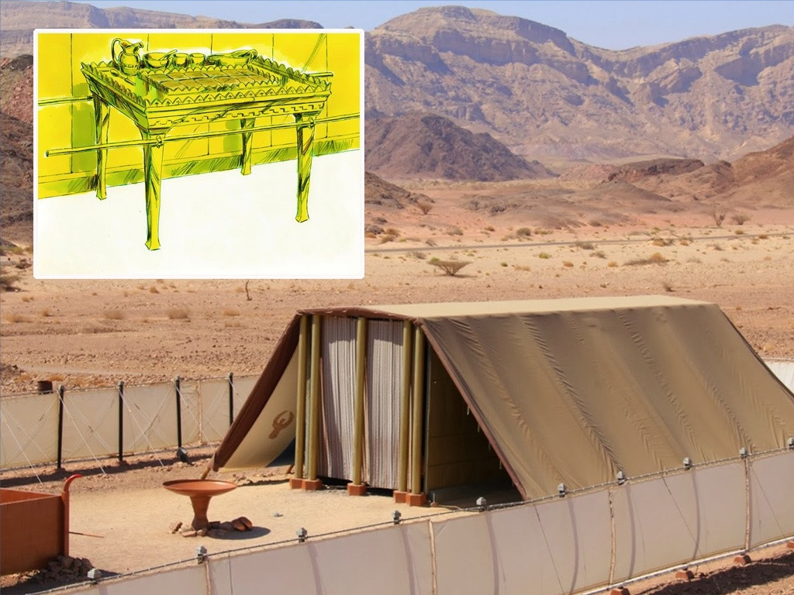

Slide 114
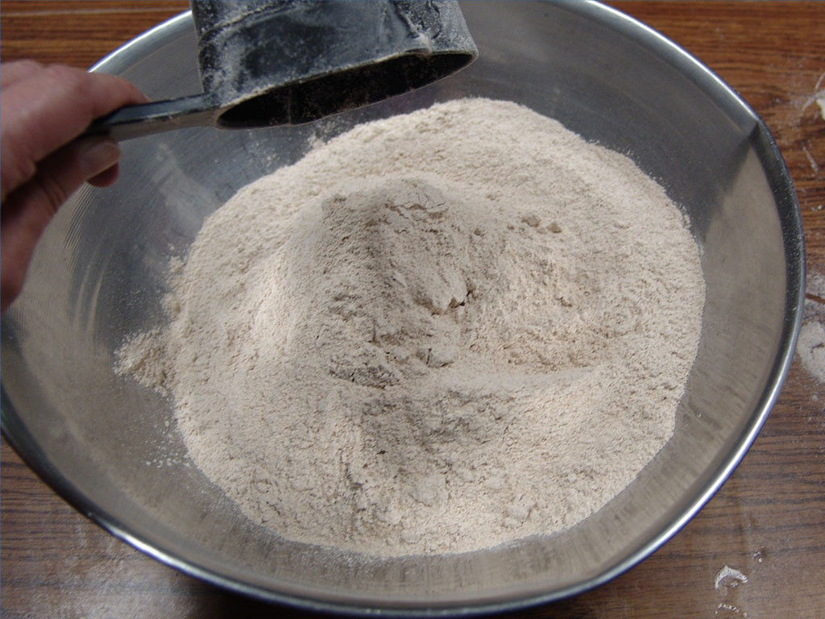

Slide 115


Slide 116
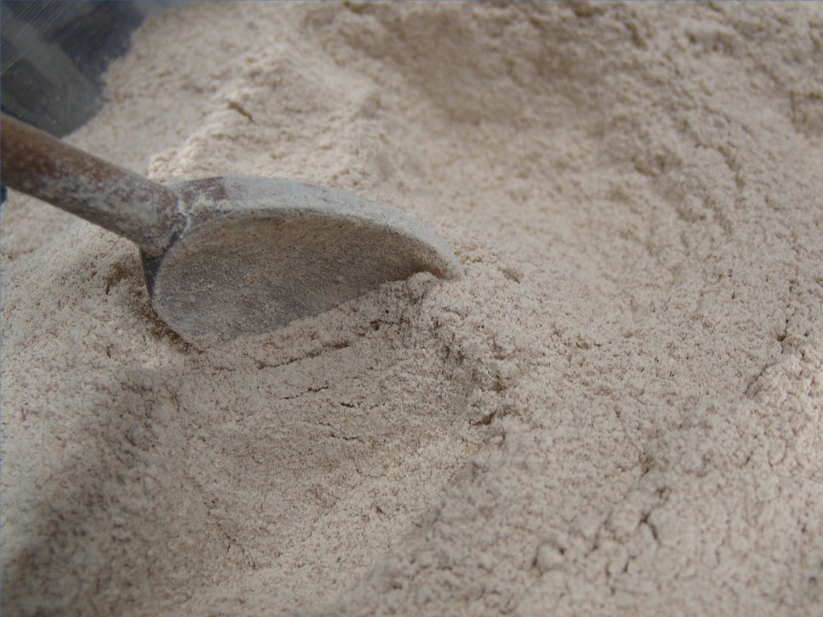

Slide 117
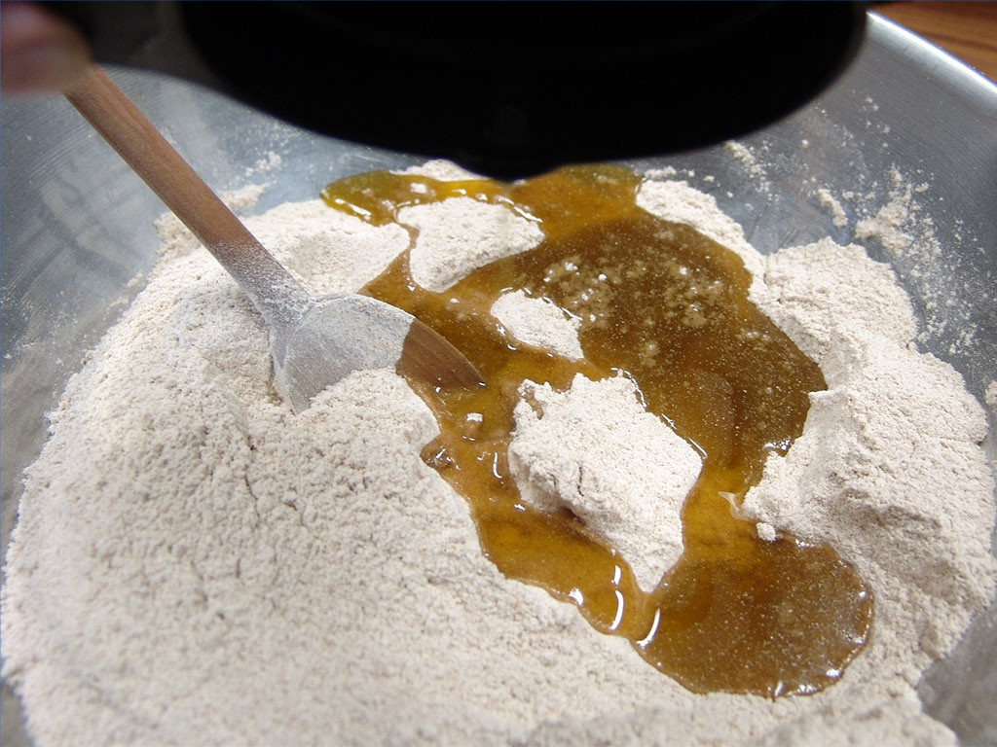

Slide 118
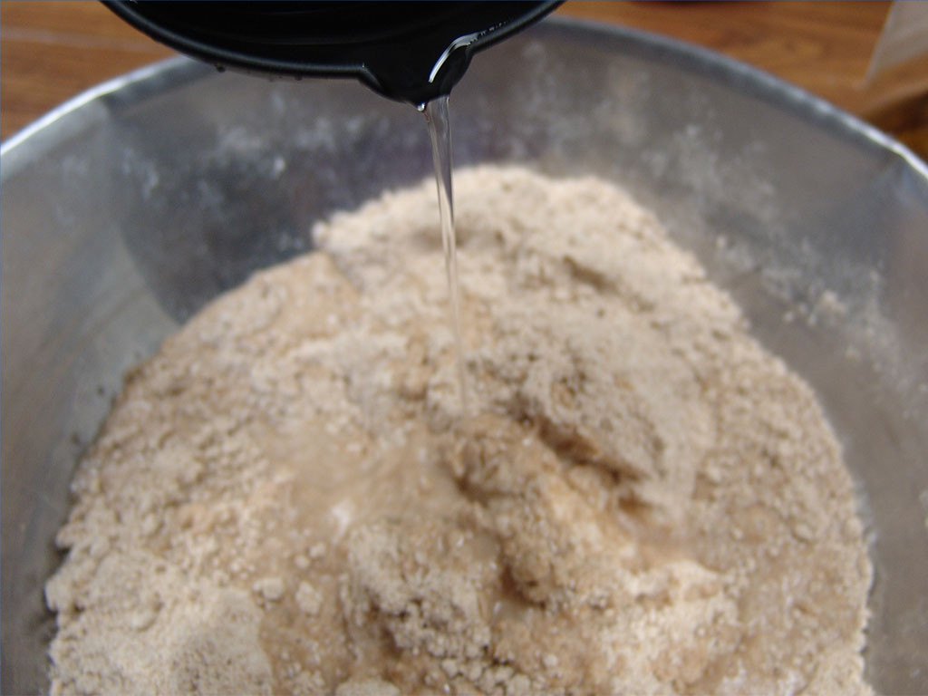

Slide 119
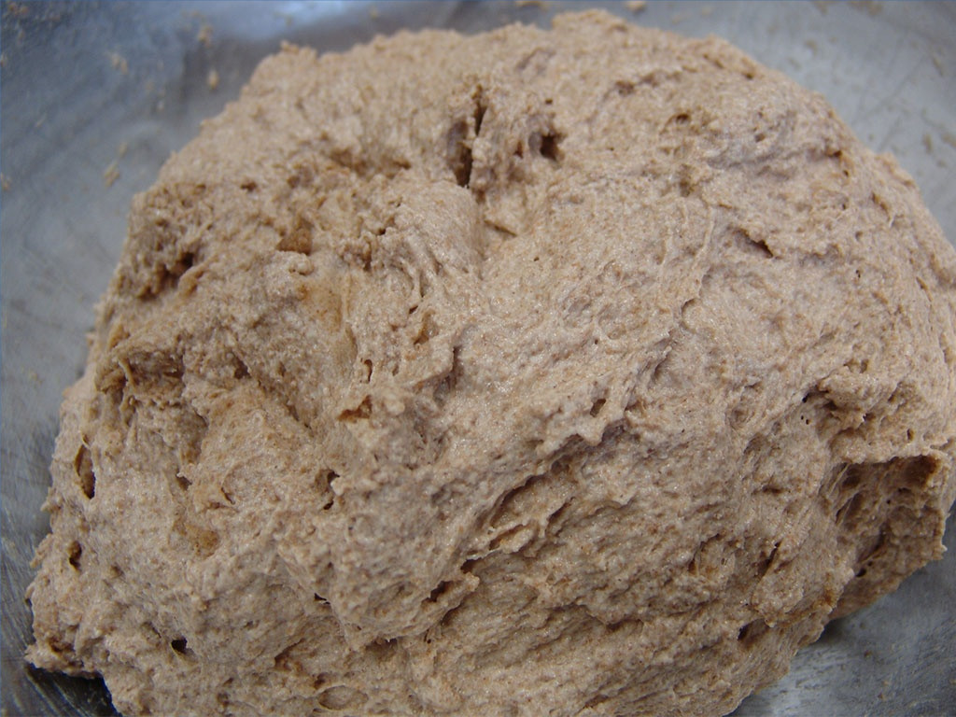

Slide 121
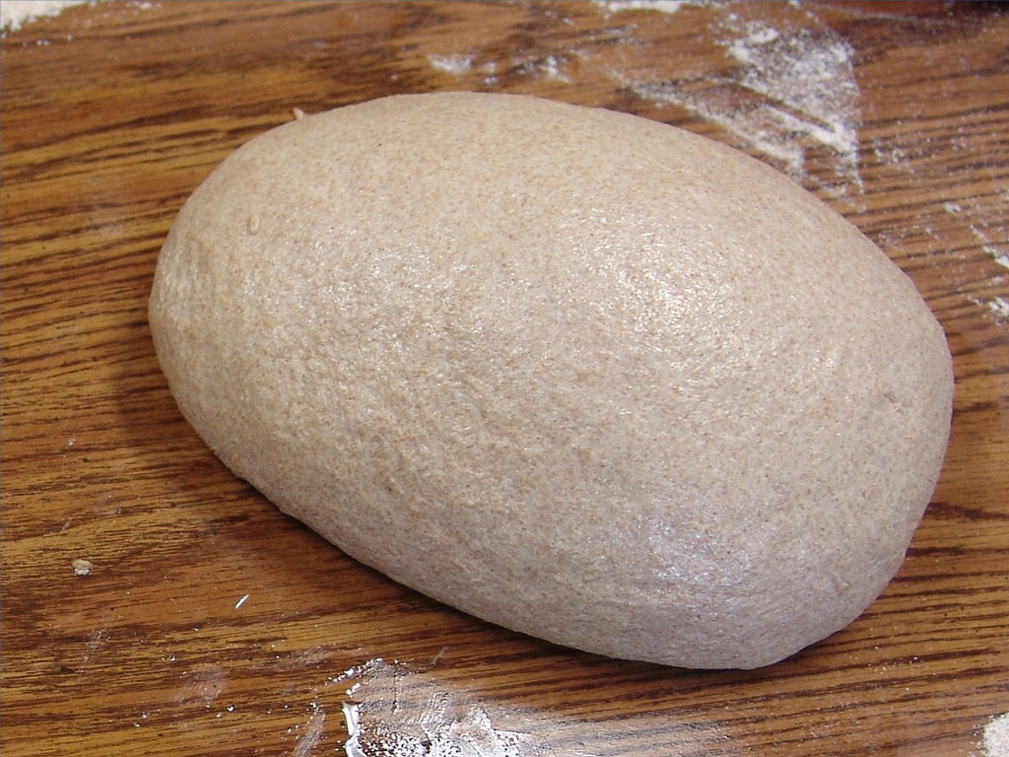

Slide 122
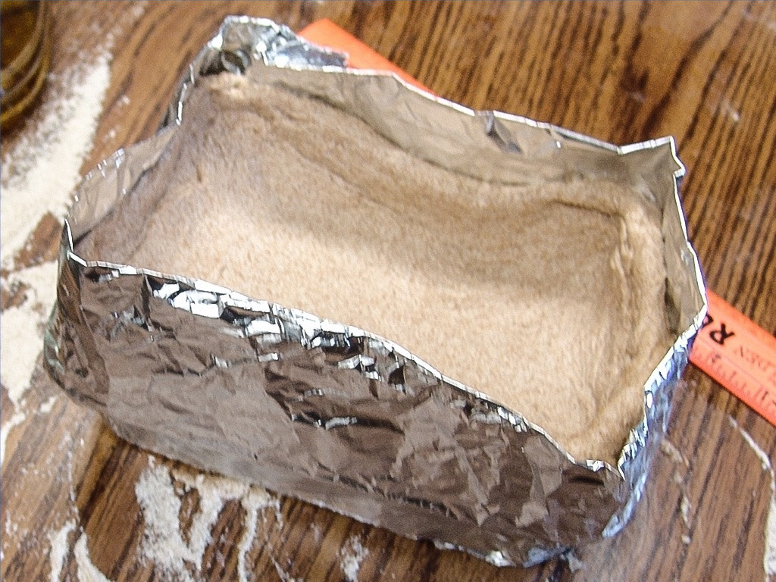

Slide 123
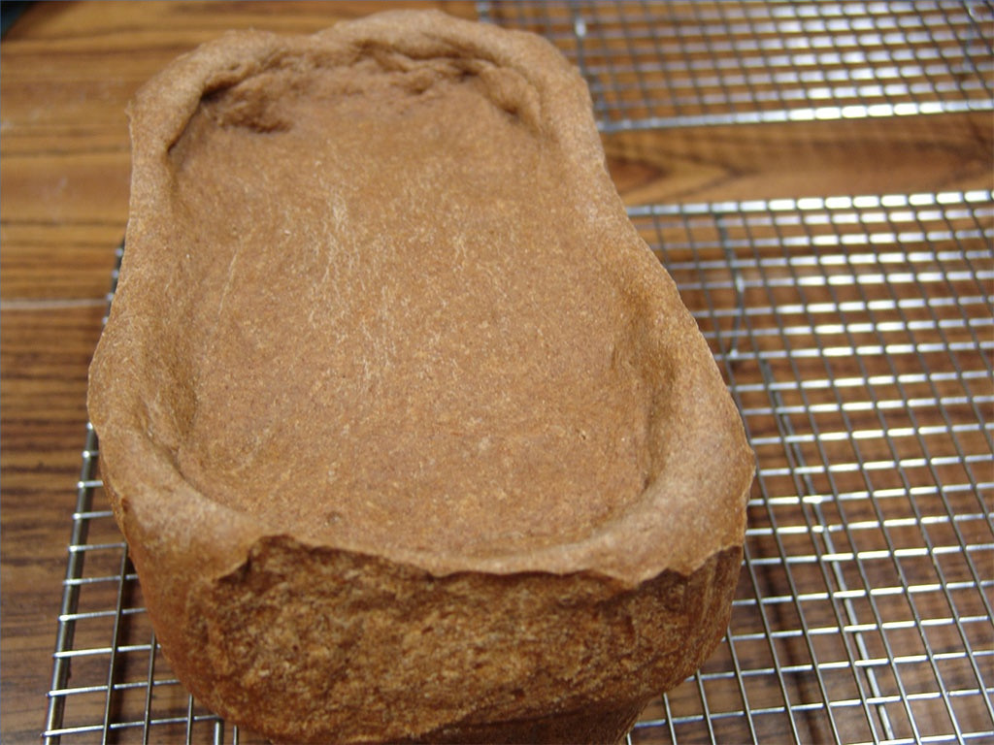

Slide 124
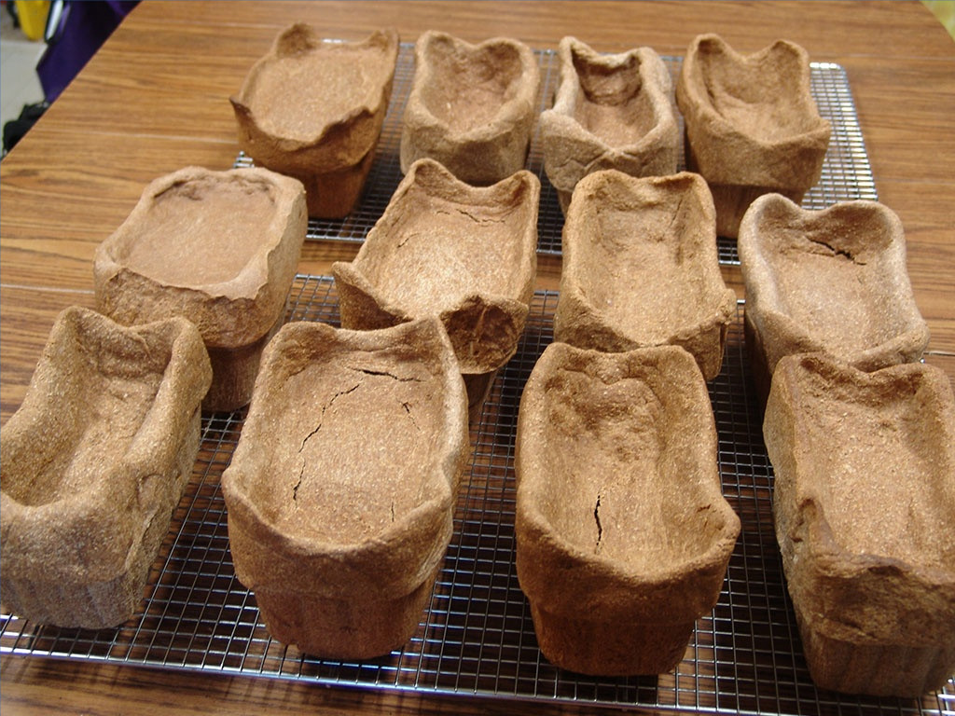

Slide 125
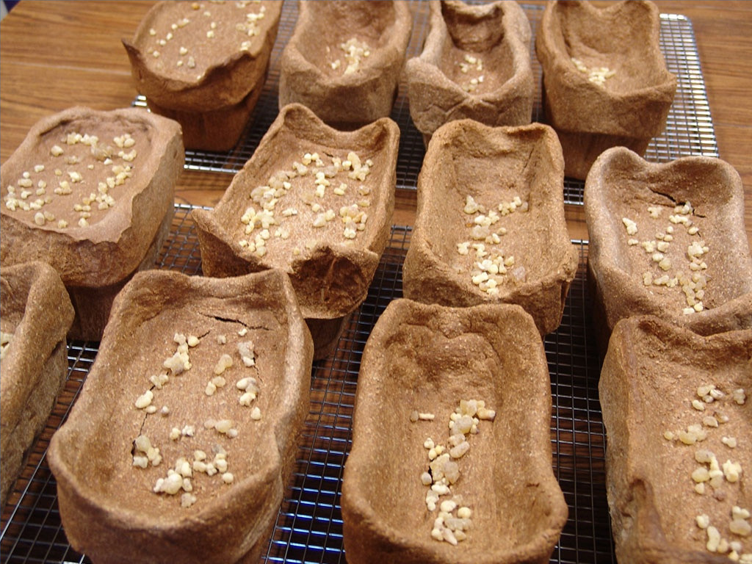

Slide 126
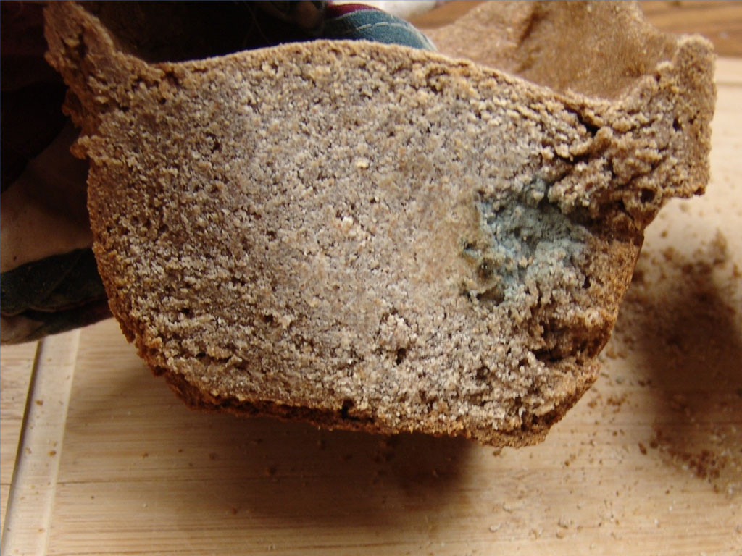

Slide 127
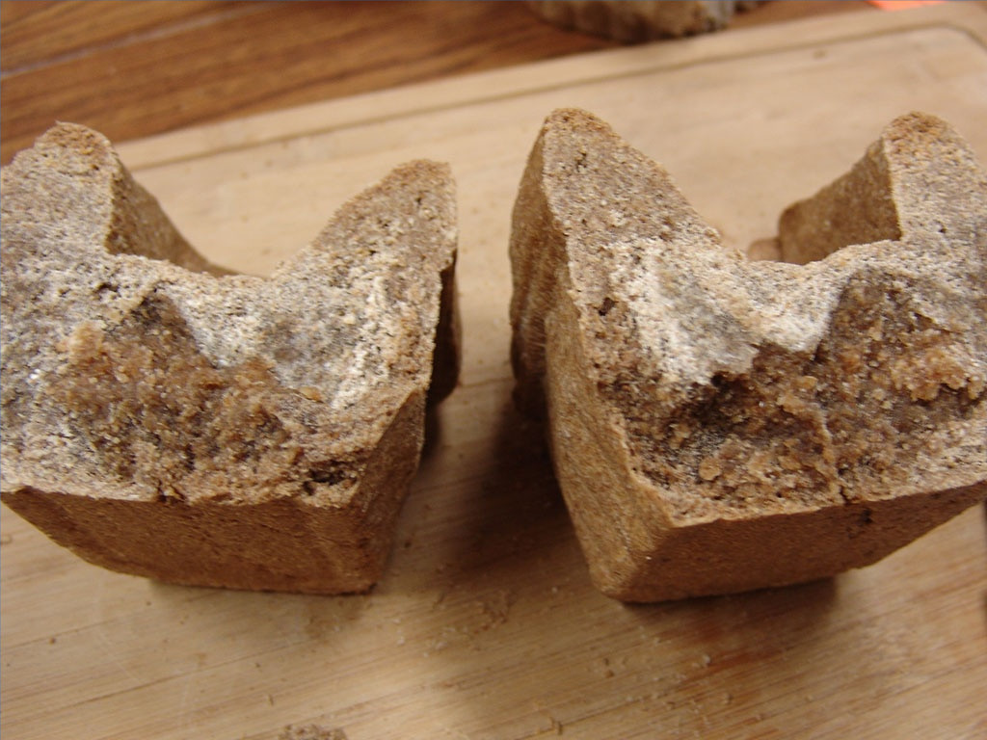

Slide 128


Slide 129


Slide 130


Slide 131


Slide 132


Slide 133


Slide 134


Slide 135


Slide 136
Why the Genealogies?
If My People
1 Chronicles
God's Sovereignty 1–9
Genealogy
Prepared
4143-1011

Slide 137

The USA began as a Christian nation
408
c

Slide 138

Plymouth Pilgrims
408
c

Slide 139

Yet they massacred the Pequot
408
c

Slide 140

The USA began as a Christian nation
408
c
The Declaration of Independence (1776) notes God 4 times
The Founding Fathers, early presidents, and the Supreme Court called the USA a “Christian nation” until 1947 (see http://www.afn.org/~govern/Christian_Nation.html)
The US sent the most missionaries in 1900s
“In God We Trust” is the national motto
The preamble of every single state among the 50 states appeals to God for help
Notes:
http://www.afn.org/~govern/Christian_Nation.html says…
WAS THE UNITED STATES FOUNDED AS A CHRISTIAN NATION?
Recently, many authors have debated whether or not the United States of America was founded as a Christian nation. I wish to provide a few historical quotes from our Founding Era that lend credence to the supposition that we indeed were founded as a Christian nation.
Granted, God is not mentioned in the Constitution, but He is mentioned in every major document leading up to the final wording of the Constitution. For example, Connecticut is still known as the "Constitution State" because its colonial constitution was used as a model for the United States Constitution. Its first words were: "For as much as it has pleased the almighty God by the wise disposition of His Divine Providence…"
Most of the fifty-five Founding Fathers who worked on the Constitution were members of orthodox Christian churches and many were even evangelical Christians. The first official act in the First Continental Congress was to open in Christian prayer, which ended in these words: "...the merits of Jesus Christ, Thy Son, our Savior. Amen". Sounds Christian to me.
Ben Franklin, at the Constitutional Convention, said: "...God governs in the affairs of men. And if a sparrow cannot fall to the ground without His notice is it probable that an empire can rise without His aid?"
John Adams stated so eloquently during this period of time that; "The general principles on which the fathers achieved Independence were ... the general principles of Christianity ... I will avow that I then believed, and now believe, that the general principles of Christianity are as eternal and immutable as the existence and attributes of God."
Later, John Quincy Adams answered the question as to why, next to Christmas, was the Fourth of July this most joyous and venerated day in the United States. He answered: "...Is it not that the Declaration of Independence first organized the social compact on the foundation of the Redeemer's mission upon earth? That it laid the cornerstone of human government upon the first precepts of Christianity?" Sounds like the founding of a Christian nation to me. John Quincy Adams went on to say that the biggest victory won in the American Revolution was that Christian principles and civil government would be tied together In what he called an "indissoluble" bond. The Founding Fathers understood that religion was inextricably part of our nation and government. The practice of the Christian religion in our government was not only welcomed but encouraged.
The intent of the First Amendment was well understood during the founding of our country. The First Amendment was not to keep religion out of government. It was to keep Government from establishing a 'National Denomination" (like the Church of England). As early as 1799 a court declared: "By our form of government the Christian religion is the established religion; and all sects and denominations of Christians are placed on the same equal footing." Even in the letter that Thomas Jefferson wrote to the Baptists of Danbury Connecticut (from which we derive the term "separation of Church and State") he made it quite clear that the wall of separation was to ensure that Government would never interfere with religious activities because religious freedom came from God, not from Government.
Even George Washington who certainly knew the intent of the Constitution and the Bill of Rights, since he presided over their formation, said in his "Farewell Address": "Of all the dispositions and habits which lead to political prosperity, religion and morality are indispensable supports. In vain would that man claim the tribute of patriotism, who should labor to subvert these great pillars." Sure doesn't sound like Washington was trying to separate religion and politics.
John Jay, the first Chief Justice of the United States Supreme Court, and one of the three men most responsible for the writing of the Constitution declared:
"Providence has given to our people the choice of their rulers, and it is their duty-as well as privilege and interest- of our Christian nation to select and prefer Christians for their rulers." Still sounds like the Founding Fathers knew this was a Christian nation.
This view, that we were a Christian nation, was hold for almost 150 years until the Everson v. Board of Education ruling in 1947. Before that momentous ruling, even the Supreme Court knew that we were a Christian nation. In 1892 the Court stated:
"No purpose of action against religion can be imputed to any legislation, state or national, because this is a religious people...This is a Christian nation." There it is again! From the Supreme Court of the United States. This court went on to cite 87 precedents (prior actions, words, and rulings) to conclude that this was a "Christian nation".
In 1854, the House Judiciary Committee said: "in this age, there is no substitute for Christianity...That was the religion of the founders of the republic, and they expected it to remain the religion of their descendants.'
It should be noted here that even as late as 1958 a dissenting judge warned in Baer v. Kolmorgen that if the court did not stop talking about the "separation of Church and State", people were going to start thinking it was part of the Constitution.
It has been demonstrated in their own words: Ben Franklin, George Washington and John Adams, to the House of Representatives and the Supreme Court, how our founding fathers felt about the mix of politics and religion.
When we read articles such as "What's God got to do with it?" (Primack, 5/4) and "The wall between state and church must not be breached" (Tager, 5/7) it just reaffirms how little, even intelligent people, understand about the founding of our great Republic. To say that this nation was not founded as a Christian nation or that the Constitution was not founded on Christian principles is totally at odds with the facts of history.
Tex Browning
Back to Citizens for Better Government Last Modified May 1, 2003

Slide 141

The USA began as a Christian nation
408
c

Slide 142


Do you trust in God?
Notes:
For over 200 years America has unashamedly declared trust in God in all forms of money--paper and coins alike. Since 1954 by law each currency and coin must say on it, "In God We Trust."

Slide 143

Do we trust in God?
Notes:
But do we really trust in God? (Click) I found it interesting that in 2007 the news broke that our new dollar coin produced in the previous month actually didn't have this phrase on the front or the back. Some have said that it didn't appear on the coin at all.

Slide 144


Does your trust in God embarrass you?
Notes:
But the phrase does appear--only it's on the side--at least on most of the 300 million coins minted! The news broke that an unknown amount of coins were missing the phrase totally. Interestingly, these coins are more valuable and at first sold for $600 on eBay. Now that we know there's as many as 100,000 of them, the price has dropped to $50. It seems that we are too embarrassed about Christ to put this phrase on the font or back anymore.

Slide 145

A Cause for Shame?
"Who, me? Well, I'm not saying that I am a Christian… but I'm not saying that I'm not…"
Notes:
That reminds me of some Christians. Ask them if they are believers and they want to know why you want to know! Worse yet, they won't admit that they trust in Christ.

Slide 146

The USA began as a Christian nation but has left its godly heritage.
408
c
OBAMA EMAIL TO CBN NEWS
"WHATEVER WE ONCE WERE, WE'RE NO LONGER JUST A CHRISTIAN NATION; WE ARE ALSO A JEWISH NATION, A MUSLIM NATION, A BUDDHIST NATION, A HINDU NATION, AND A NATION OF NON-BELIEVERS…"

Slide 147


The USA began as a Christian nation but has left its godly heritage.
408
c
"We are no longer a Christian nation."
Barack Obama

Slide 148





The Christian heritage is now hotly debated!
408
c

Slide 149
Slides on 1 Chronicles 10

Slide 150


God blessed David so Israel would imitate his passion for temple worship (1 Chron 10–29).

Slide 151
Focus on David
If My People
1 Chronicles
God's Sovereignty 1–9
David's Service 10–29
Genealogy
History
Prepared
United
4143-1011
1011–930

Slide 152

God made David king after God removed Saul as unfit for the kingship to show David as the ideal king (1 Chron 10–12).

Slide 153
Outline
266 -267
I. (Chs. 1–9) A genealogical history from Adam to many years after the return from Babylon is given to encourage the remnant of God's grace in that while the Davidic throne is absent, the Davidic line is still present with the nation.
II. (Chs. 10–29) The reign of David shows God's blessing on him in his military victories for his spiritual obedience shown in his concern for building a temple to house the ark permanently, recorded to show Israel proper worship.

Slide 154
Slides on 1 Chronicles 11

Slide 155

"The Three": Jashobeam, Eleazar, & Shammah
1 Chronicles 11:10-19; 2 Sam 23:11
Notes:
James Tissot Bible c 1899 Three of David's captains
http://www.flickriver.com/photos/tags/1chronicles/interesting/
Accessed 23 Jan 2018

Slide 156

"David's Valiant Men" by James Tissot
1 Chronicles 11:26-47
Notes:
James Tissot Bible c 1899 Three of David's captains
http://www.flickriver.com/photos/tags/1chronicles/interesting/
Accessed 23 Jan 2018

Slide 157
Slides on 1 Chronicles 12

Slide 158

The Model King
KING
DAVID
A MAN AFTER GOD’S OWN HEART
What a contrast from Saul...
Notes:
Restatement

Slide 159
Slides on 1 Chronicles 13

Slide 160

God rewarded David's respect for the ark by promising the permanent dynasty of the Davidic Covenant to show how obedience leads to blessing (1 Chron 13–17).

Slide 161
Parallels between David's and Solomon's Transfers of the Ark
275
David
(1 Chron.)
Solomon
(2 Chron.)
Ark location before transfer
Kiriath Jearim
City of David
Ark location after transfer
House of Obed near the City of David
Temple on Moriah (former threshing floor of Araunah)
Consultation with Israel's leaders & national procession
13:1-5
5:2-3
Transports the ark correctly
15:1–16:3
5:2-10
Celebration of praise at arrival
16:7-36
5:11-14
System of regular worship set up
16:4-6, 37-42
8:12-16
Divine revelation given
17:1-15
7:12-22
Prayer by the king
17:16-27
6:12-42

Slide 162
Slides on 1 Chronicles 14

Slide 163

God blessed David as king though his palace, numerous wives and children, and victories over the Philistines (1 Chron 14).

Slide 164
Slides on 1 Chronicles 15

Slide 165
Parallels between David's and Solomon's Transfers of the Ark
275
David
(1 Chron.)
Solomon
(2 Chron.)
Ark location before transfer
Kiriath Jearim
City of David
Ark location after transfer
House of Obed near the City of David
Temple on Moriah (former threshing floor of Araunah)
Consultation with Israel's leaders & national procession
13:1-5
5:2-3
Transports the ark correctly
15:1–16:3
5:2-10
Celebration of praise at arrival
16:7-36
5:11-14
System of regular worship set up
16:4-6, 37-42
8:12-16
Divine revelation given
17:1-15
7:12-22
Prayer by the king
17:16-27
6:12-42

Slide 166
Slides on 1 Chronicles 16

Slide 167
Parallels between David's and Solomon's Transfers of the Ark
275
David
(1 Chron.)
Solomon
(2 Chron.)
Ark location before transfer
Kiriath Jearim
City of David
Ark location after transfer
House of Obed near the City of David
Temple on Moriah (former threshing floor of Araunah)
Consultation with Israel's leaders & national procession
13:1-5
5:2-3
Transports the ark correctly
15:1–16:3
5:2-10
Celebration of praise at arrival
16:7-36
5:11-14
System of regular worship set up
16:4-6, 37-42
8:12-16
Divine revelation given
17:1-15
7:12-22
Prayer by the king
17:16-27
6:12-42

Slide 168
Chronicles vs. Samuel/Kings
267a
What's Missing in Chronicles
but Included in Samuel/Kings?
What's Included in Chronicles
but Missing in Samuel/Kings?
These are generally negative elements or related to Israel and royalty.
These are generally positive elements or related to Judah and the temple.
Michal despises David at ark
(2 Sam. 6:20b-23)
Levites honor God at ark
(1 Chron. 16:4-42)
Discipline aspects of the Davidic covenant (2 Sam. 7:14b)
Identification of the temple site even as God disciplines David's prideful census (1 Chron. 21:27–22:1; cp. 2 Sam. 24:25)
David's adultery with Bathsheba, murder of Uriah, & confrontation by Nathan the prophet (2 Sam. 11:2–12:25)
Divisions of Levites (1 Chron. 22–27)
David's troubles with Absalom
(2 Sam. 13–19)
David's charge to Israel & Solomon & prayer (1 Chron. 28:1–29:22a)
Sheba's rebellion put down
(2 Sam. 20)
Enterprises of Rehoboam
(2 Chron. 11:5-23)

Slide 169
Slides on 1 Chronicles 17

Slide 170
Key Verse
262
"I declare that the LORD will build a house for you: When your days are over and you go to be with your fathers, I will raise up your offspring to succeed you, one of your own sons, and I will establish his kingdom. He is the one who will build a house for me, and I will establish his throne forever. I will be his father, and he will be my son. I will never take my love away from him, as I took it away from your predecessor. I will set him over my house and my kingdom forever; his throne will be established forever" (1 Chron. 17:10b-14).
1 Chronicles

Slide 171
Parallels between David's and Solomon's Transfers of the Ark
275
David
(1 Chron.)
Solomon
(2 Chron.)
Ark location before transfer
Kiriath Jearim
City of David
Ark location after transfer
House of Obed near the City of David
Temple on Moriah (former threshing floor of Araunah)
Consultation with Israel's leaders & national procession
13:1-5
5:2-3
Transports the ark correctly
15:1–16:3
5:2-10
Celebration of praise at arrival
16:7-36
5:11-14
System of regular worship set up
16:4-6, 37-42
8:12-16
Divine revelation given
17:1-15
7:12-22
Prayer by the king
17:16-27
6:12-42

Slide 172
Slides on 1 Chronicles 18

Slide 173
David's New Vassal States
Zobah
140
Phoenicia
Aram
2 Samuel 10
God rewarded David with victory over the Philistines and other nations to show him as a righteous king to whom God had promised an eternal dynasty (1 Chron 18–20).
Israel
Philistia
Moab
Egypt
Edom

Slide 174
Slides on 1 Chronicles 19

Slide 175
Victory over Aram & Ammon
Zobah
140
Phoenicia
Aram
1 Chronicles 19
Israel
Ammon
Philistia
Moab
Egypt
Edom

Slide 176
Slides on 1 Chronicles 20

Slide 177

"During another battle with the Philistines, Elhanan son of Jair killed Lahmi, the brother of Goliath of Gath. The handle of Lahmi’s spear was as thick as a weaver’s beam!" (2 Sam 21:19; cf. 1 Chron 20:5 NLT).

Slide 178

"In another battle with the Philistines at Gath, they encountered a huge man with six fingers on each hand and six toes on each foot, twenty-four in all, who was also a descendant of the giants. But when he defied and taunted Israel, he was killed by Jonathan, the son of David’s brother Shimea" (2 Samuel 21:20; cf. 1 Chron 20:6-7 NLT).
Notes:
In this photo taken Wednesday Aug. 24, 2011, Yoandri Hernandez Garrido, 37
There be GIANTS!
Posted on October 6, 2015 by TheMeltingThought
https://themeltingthought2000.wordpress.com/2015/10/06/there-be-giants/
Accessed 21 Jan 2018

Slide 179
Slides on 1 Chronicles 21

Slide 180

God blessed David’s worship by selecting the temple site, organizing the materials and leaders, and commissioning the work to encourage temple worship (1 Chron 21–29).

Slide 181

Temple Site
Website

Slide 182

Floor of Araunah
1 Chronicles 21:15, 18
Website

Slide 183

Temple Site (1 Chron 21)
Dome of the Rock (For Antonia)
Threshing Floor
Website

Slide 184

Temple Site
Website

Slide 185
Samuel/Kings vs. Chronicles
267a
The execution of the Saulites
(1 Sam. 21:1-14)
Abijam of Judah defeats Jeroboam of Israel by honoring temple (2 Chron. 13:3-21)
Adonijah's rebellion against his father David (1 Kings 1)
Revivals under 6 kings of Judah, all "sons" of David
David's charge to Solomon to avenge his opposers (1 Kings 2:1–9)
David's charge to Solomon to build the temple (1 Chron. 22:2-19)
Negative information on the kings of Israel (e.g., 1 Kings 13:1–14:20 on Jeroboam; 1 Kings 15:25–21:29 on others)
Positive details about kings of Judah: Asa (1 Chron. 14:6–15:15), Jehoshaphat (2 Chron. 17:1-19), Hezekiah (2 Chron. 32:27-30), etc.
Stories of Elijah (1 Kings 15:25–21:29) and Elisha (2 Kings 2:1–8:15; 13:14-25) since they ministered primarily in Israel
God's discipline by plague and enemy invasions upon Joram of Judah for his evil ways (1 Chron. 21:11-20)
Negative events after Judah's fall
(2 Kings 25)
Renewal of Passover (2 Chron. 30) & other reforms of worship (2 Chron. 31)
The 2 falls of Israel (2 Kings 17:1-41 & 17:5-6; 18:9-12)
The end of Judah's exile (2 Chron. 36:22-23)

Slide 186
Samuel/Kings vs. Chronicles
267a
What's Missing in Chronicles
but Included in Samuel/Kings?
What's Included in Chronicles
but Missing in Samuel/Kings?
These are generally negative elements or related to Israel and royalty.
These are generally positive elements or related to Judah and the temple.
Michal despises David at ark
(2 Sam. 6:20b-23)
Levites honor God at ark
(1 Chron. 16:4-42)
Discipline aspects of the Davidic covenant (2 Sam. 7:14b)
Identification of the temple site even as God disciplines David's prideful census (1 Chron. 21:27–22:1; cp. 2 Sam. 24:25)
David's adultery with Bathsheba, murder of Uriah, & confrontation by Nathan the prophet (2 Sam. 11:2–12:25)
Divisions of Levites (1 Chron. 22–27)
David's troubles with Absalom
(2 Sam. 13–19)
David's charge to Israel & Solomon & prayer (1 Chron. 28:1–29:22a)
Sheba's rebellion put down
(2 Sam. 20)
Enterprises of Rehoboam
(2 Chron. 11:5-23)

Slide 187
Slides on 1 Chronicles 22

Slide 188

David & Solomon

Slide 189
Samuel/Kings vs. Chronicles
267a
The execution of the Saulites
(1 Sam. 21:1-14)
Abijam of Judah defeats Jeroboam of Israel by honoring temple (2 Chron. 13:3-21)
Adonijah's rebellion against his father David (1 Kings 1)
Revivals under 6 kings of Judah, all "sons" of David
David's charge to Solomon to avenge his opposers (1 Kings 2:1–9)
David's charge to Solomon to build the temple (1 Chron. 22:2-19)
Negative information on the kings of Israel (e.g., 1 Kings 13:1–14:20 on Jeroboam; 1 Kings 15:25–21:29 on others)
Positive details about kings of Judah: Asa (1 Chron. 14:6–15:15), Jehoshaphat (2 Chron. 17:1-19), Hezekiah (2 Chron. 32:27-30), etc.
Stories of Elijah (1 Kings 15:25–21:29) and Elisha (2 Kings 2:1–8:15; 13:14-25) since they ministered primarily in Israel
God's discipline by plague and enemy invasions upon Joram of Judah for his evil ways (1 Chron. 21:11-20)
Negative events after Judah's fall
(2 Kings 25)
Renewal of Passover (2 Chron. 30) & other reforms of worship (2 Chron. 31)
The 2 falls of Israel (2 Kings 17:1-41 & 17:5-6; 18:9-12)
The end of Judah's exile (2 Chron. 36:22-23)

Slide 190
Slides on 1 Chronicles 23

Slide 191
Samuel/Kings vs. Chronicles
267a
What's Missing in Chronicles
but Included in Samuel/Kings?
What's Included in Chronicles
but Missing in Samuel/Kings?
These are generally negative elements or related to Israel and royalty.
These are generally positive elements or related to Judah and the temple.
Michal despises David at ark
(2 Sam. 6:20b-23)
Levites honor God at ark
(1 Chron. 16:4-42)
Discipline aspects of the Davidic covenant (2 Sam. 7:14b)
Identification of the temple site even as God disciplines David's prideful census (1 Chron. 21:27–22:1; cp. 2 Sam. 24:25)
David's adultery with Bathsheba, murder of Uriah, & confrontation by Nathan the prophet (2 Sam. 11:2–12:25)
Divisions of Levites (1 Chron. 22–27)
David's troubles with Absalom
(2 Sam. 13–19)
David's charge to Israel & Solomon & prayer (1 Chron. 28:1–29:22a)
Sheba's rebellion put down
(2 Sam. 20)
Enterprises of Rehoboam
(2 Chron. 11:5-23)

Slide 192
Slides on 1 Chronicles 24

Slide 193

The priests became 24 divisions to offer sacrifices before the LORD in two-week rotations each year
1 Chronicles 24
Notes:
This 48-week pattern of priestly divisions lasted past the birth of Christ where Zechariah served in the eighth division of Abijah (Luke 1).

Slide 194
Slides on 1 Chronicles 25

Slide 195

David organized the musicians
1 Chronicles 25
Notes:
Those who played the harp and lyre and other instruments—including the singers—also served at the temple in a pattern organized by David prior to the temple construction.

Slide 196

The musicians were organized into instrumentalists and singers to offer praise to the LORD in the ministry of prophesying (1 Chron 25).
Notes:
Here prophesying is used in a general sense of leading the people into worship under the teaching of the Word of God.
1Chr. 25:1 NLT David and the army commanders then appointed men from the families of Asaph, Heman, and Jeduthun to proclaim God’s messages to the accompaniment of lyres, harps, and cymbals. Here is a list of their names and their work.

Slide 197
Slides on 1 Chronicles 26

Slide 198

The temple officers were organized into gatekeepers, treasurers, and administrators for smooth functioning of the temple (1 Chron 26).
Notes:
David appointed leaders in each of these areas so that Solomon would already have this system in place once the temple was finished.

Slide 199
Slides on 1 Chronicles 27

Slide 200
Samuel/Kings vs. Chronicles
267a
What's Missing in Chronicles
but Included in Samuel/Kings?
What's Included in Chronicles
but Missing in Samuel/Kings?
These are generally negative elements or related to Israel and royalty.
These are generally positive elements or related to Judah and the temple.
Michal despises David at ark
(2 Sam. 6:20b-23)
Levites honor God at ark
(1 Chron. 16:4-42)
Discipline aspects of the Davidic covenant (2 Sam. 7:14b)
Identification of the temple site even as God disciplines David's prideful census (1 Chron. 21:27–22:1; cp. 2 Sam. 24:25)
David's adultery with Bathsheba, murder of Uriah, & confrontation by Nathan the prophet (2 Sam. 11:2–12:25)
Divisions of Levites (1 Chron. 22–27)
David's troubles with Absalom
(2 Sam. 13–19)
David's charge to Israel & Solomon & prayer (1 Chron. 28:1–29:22a)
Sheba's rebellion put down
(2 Sam. 20)
Enterprises of Rehoboam
(2 Chron. 11:5-23)

Slide 201
Slides on 1 Chronicles 28

Slide 202

"Then David gave Solomon the plans for the Temple and its surroundings, including the entry room, the storerooms, the upstairs rooms, the inner rooms, and the inner sanctuary—which was the place of atonement. ¹²David also gave Solomon all the plans he had in mind for the courtyards of the Lord’s Temple, the outside rooms, the treasuries, and the rooms for the gifts dedicated to the LORD" (28:11-12)
Notes:
David's temple plans included not just the main building and the systems of priests and Levites to serve there, but also where items would be located among its many rooms.

Slide 203

David commissioned Israel and Solomon to follow God’s design for the temple building and service by Levites and priests (1 Chron 28).
The Choristers, by James Tissot, 1896-1900
Notes:
Singing was a noble business!

Slide 204
Slides on 1 Chronicles 29

Slide 205
1 Chronicles
262
David's Line Established
David's Line
David's Concern (Ark / Temple)
Chapters 1–9
Chapters 10–29
Genealogy
History
Ancestry
Activity
Saul's Throne to David
David's Throne to Solomon
4143-1011 BC (3132 years)
1011-971 BC (40 years)
Davidic Line
1–3
Tribal
Lines
4–8
Priests /
Levites
9:1-34
Saul's Line
9:35-44
Accession to Throne
10–12
Respect for Ark
13–17
Military Victories
18–20
Temple Prep.
21–29
Notes:
Note that 1 Kings and 2 Kings are parallel to 2 Chronicles: Solomon (1 Kings 1-11; 2 Chron 1-9) is followed by his descendants (1 Kings 12-25; 2 Chron 10-36). However, 2 Kings 25 ends in 560 BC while 2 Chronicles 36 goes further and ends in 538 BC.
___________
OS-00-OT Book Overviews-251
OS-12-1 Chronicles-10, 181
OS-14-2 Chronicles-79

Slide 206
Summary Statement
262
The spiritual perspective on the establishment of David's kingdom is given to encourage the remnant with God's establishment of the Davidic line and to admonish them to proper temple worship — not the idolatry of the past.

Slide 207
I. God established David’s kingdom to promote temple worship over idolatry.
Notes:
The LORD exalted David because David exalted God.

Slide 208
II. Be established by worshipping Jesus as David’s heir.
Notes:
Worship Christ as your firm foundation—He alone fulfills the promises to David.
Christ is the best foundation for worship you can have since he alone fulfills God’s promises to David.

Slide 209

That temple was glorious
Notes:
This sanctuary served as the religious and administrative center of the nation for centuries.

Slide 210

But what about that temple?
Notes:
What view should we have of the temple?

Slide 211

Even the temple rebuilt near the time of Chronicles was later destroyed—so what about temple worship now?
Notes:
The second temple was destroyed by the Romans even as the Babylonians ruined the first temple, so, why would it be so important in the present age?

Slide 212


Matthew 21:12-17
Mark 11:15-19
Luke 19:45-48
John 2:13-24
THE EASTER STORY
CLEANSING THE TEMPLE
Free Bible images

Slide 213

It was nearly time for the Jewish Passover celebration, so Jesus went to Jerusalem.

Slide 214

In the Temple area he saw merchants selling cattle, sheep, and doves for sacrifices.

Slide 215

He also saw dealers at tables exchanging foreign money.

Slide 216


Slide 217

Jesus made a whip from some ropes and chased them all out of the Temple.

Slide 218
He drove out the sheep and cattle, scattered the money changers’ coins over the floor

Slide 219

and turned over their tables.

Slide 220

Then, going over to the people who sold doves, he told them...

Slide 221

“Get these things out of here. Stop turning my Father’s house into a marketplace!”

Slide 222

Then his disciples remembered this prophecy from the Scriptures: “Passion for God’s house will consume me.”

Slide 223


Slide 224

But the Jewish leaders demanded, “What are you doing? If God gave you authority to do this, show us a miraculous sign to prove it.”

Slide 225

“All right,” Jesus replied. “Destroy this temple, and in three days I will raise it up.”

Slide 226

“What!” they exclaimed. “It has taken forty-six years to build this Temple, and you can rebuild it in three days?”

Slide 227

But when Jesus said “this temple,” he meant his own body.

Slide 228

After he was raised from the dead, his disciples remembered he had said this, and they believed both the Scriptures and what Jesus had said.

Slide 229

THE WORD IN PICTURES
Free Bible images

Slide 230

Used with Permission
THE GOSPEL ——OF—— MATTHEW
THE GOSPEL ——OF—— MARK
THE GOSPEL ——OF—— LUKE
THE GOSPEL ——OF—— JOHN
Due to the Lumo Project producing its own publishing material we regret to inform you that we cannot license our photos to other clients outside of freebibleimages.org.
These images are not licensed for reuse in video, epublishing or other media. Downloaded pictures and files cannot be redistributed through any other website than freebibleimages.org or used in any context where the accompanying message is undermining of the Christian faith and gospel.
Photos can only be used on educational presentations, blogs and social media, all of which should be accompanied with reference to www.LumoProject.com.
Picture courtesy of BBM © All Rights Reserved.
www.bigbookmedia.com

Slide 231

"Don’t you realize that your body is the temple of the Holy Spirit, who lives in you and was given to you by God? You do not belong to yourself, ²⁰ for God bought you with a high price. So you must honor God with your body" (1 Cor 6:19-20 NLT).

Slide 232
How can you be firmly established in a shaky world?
Notes:
The world system is falling apart. How do you get your life on solid ground?

Slide 233
Main Idea
Be established with Christ as your foundation.
Notes:
Your personal stability in life cannot be firm without acknowledging Christ’s rule.

Slide 234
I. God established David’s kingdom to promote temple worship over idolatry.
Notes:
The LORD exalted David because David exalted God.

Slide 235
II. Be established by worshipping Jesus as David’s heir.
Notes:
Worship Christ as your firm foundation—He alone fulfills the promises to David.
Christ is the best foundation for worship you can have since he alone fulfills God’s promises to David.

Slide 236
1 Corinthians 3:11
"For no one can lay any foundation other than the one we already have—Jesus Christ."

Slide 237

How's yours?
Firm
FOUNDATION
Notes:
Everyone needs a solid basis on which to live.

Slide 238

Firm Foundation

Slide 239

Firm Foundation

Slide 240

Be Established

Slide 241

Firm Foundation

Slide 242

Firm Foundation

Slide 243

Be Established

Slide 244

GOD'S WORD
A FIRM FOUNDATION

Slide 245

Build on Your Foundation
Notes:
Restatement

Slide 246

How Firm a Foundation
Unknown
CCLI Song # 107816
© Words: Public Domain
Music: Public Domain
CCLI License # 277507

Slide 247
How firm a foundation ye saints of the Lord
Is laid for your faith in His excellent word
What more can He say
than to you He hath said
To you who for refuge to Jesus have fled?

Slide 248
Fear not I am with thee, O be not dismayed
For I am thy God, I will still give thee aid
I'll strengthen thee, help thee
And cause thee to stand
Upheld by My gracious omnipotent hand

Slide 249
In every condition, in sickness, in health
In poverty's vale or abounding in wealth
At home and abroad on the land on the sea
As thy days may demand shall thy strength ever be

Slide 250
When through the deep waters
He calls thee to go
The rivers of grief shall not thee overflow
For He will be with thee, in trouble to bless
And sanctify to thee thy deepest distress

Slide 251
When through fiery trials thy pathway shall lie
My grace all-sufficient shall be thy supply
The flames shall not hurt thee, I only design
Thy dross to consume and thy gold to refine

Slide 252
The soul that on Jesus hath leaned for repose
I will not, I will not, desert to its foes
That soul though all hell should endeavor to shake
I'll never, no never, no never forsake

Slide 253
Black

Slide 254


OT Preaching link at BibleStudyDownloads.org
Get this presentation and script for free!

Slide 255
OT Kings (Animated)
232 & 342
Jeroboam
Nadab
Baasha
Zimri
Ahab
Joram
JNBEZOAAJJ
Elah
Omri
Ahaziah
Jehu
Jehoram
Jehoshaphat
Rehoboam
Asa
Abijam
Ahaziah
Athaliah
Joash
RAAJJAAJ
U Has Ash 2
ZS MPPH
Jeroboam II
Jehu
Zechariah
Jehoahaz
Jehoash
Shallum
Menahem
Pekahiah
Pekah
Hoshea
Ahaz
Joash
Amaziah
Uzziah
Jotham
Hezekiah
Manasseh
Amon
Josiah
JAU JAH MAJ
19 Kings of Israel (all bad)
Black/Blue = 9 dynasties in Israel
Has Kim's Chin Zed
12 Bad Kings of Judah
One Dynasty
Jehoiachin
Jehoiakim
Zedekiah
Jehoahaz
8 Good Kings of Judah
Chart of Old Testament Kings & Prophets
John C. Whitcomb, 4th ed. (Winona Lake, IN: BMH Books, 1968), 2
Notes:
Here you see all 19 kings of Israel and all 20 kings of Judah—laid out with animation and with the memory devices to help you recall their names. Try to guess their names before you advance the animation.
Think of the first letter of each king and note the memory device JNBEZOAAJJ. The shift between black and blue names show when the dynasty changed in Israel.
RAAJJAAJ does the same for Judah but here all are in the same dynasty of David, so the colors indicate bad and good kings.
UHasAsh2 are not all capitals but indicate only a new kings at the capital letter. The difficulty here is 4 kings whose names all begin with "J" so the memory device shows the end of their names.
ZS MPPH give us the final 6 kings of Israel. The rest of the chart thus indicates only Judah.
JAU JAH MAJ provides another silly pneumonic ending in the last of the good kings of Judah called Josiah.
Has Kim's Chin Zed is another strange clue that we are looking at the end of three kings whose names once again all begin with "J" (not unusual since each was named after Jehovah).
Of course, the final king must have a name ending with "Z" so we can wrap this up alphabetically :-) !
———————
Common English Slides-131
OS-00-OT Book Overviews-234
OS-11-1 Kings-182
OS-12-2 Kings-slides 44 and 45 identical but 44 has no animation
OS-13-1 Chronicles-231
OS-14-2 Chronicles-39

Slide 256
Placing the Prophets
342
Placing the Prophets
Key Dates
931
Obadiah
722
Jonah
Amos
Hosea
Isaiah
Micah
Nahum
Zephaniah
Jeremiah
Lamentations
Joel
Daniel
Haggai
Habakkuk
Ezekiel
Zechariah
Malachi
586
Notes:
Common English Slides-133
OS-11-1 Kings-186
OS-12-2 Kings-51
OS-13-1 Chron-232
OS-14-2 Chron-40

Slide 257
Samuel/Kings vs. Chronicles
267a
The execution of the Saulites
(1 Sam. 21:1-14)
Abijam of Judah defeats Jeroboam of Israel by honoring temple (2 Chron. 13:3-21)
Adonijah's rebellion against his father David (1 Kings 1)
Revivals under 6 kings of Judah, all "sons" of David
David's charge to Solomon to avenge his opposers (1 Kings 2:1–9)
David's charge to Solomon to build the temple (1 Chron. 22:2-19)
Negative information on the kings of Israel (e.g., 1 Kings 13:1–14:20 on Jeroboam; 1 Kings 15:25–21:29 on others)
Positive details about kings of Judah: Asa (1 Chron. 14:6–15:15), Jehoshaphat (2 Chron. 17:1-19), Hezekiah (2 Chron. 32:27-30), etc.
Stories of Elijah (1 Kings 15:25–21:29) and Elisha (2 Kings 2:1–8:15; 13:14-25) since they ministered primarily in Israel
God's discipline by plague and enemy invasions upon Joram of Judah for his evil ways (1 Chron. 21:11-20)
Negative events after Judah's fall
(2 Kings 25)
Renewal of Passover (2 Chron. 30) & other reforms of worship (2 Chron. 31)
The 2 falls of Israel (2 Kings 17:1-41 & 17:5-6; 18:9-12)
The end of Judah's exile (2 Chron. 36:22-23)

Slide 258
2 Chronicles
David's Line Preserved
271
Solomon
Davidic Dynasty
Chapters 1–9
Chapters 10–36
Temple Constructed
Temple Destroyed
Royalty
Ruins
40 Years
393 Years
971-931 BC
931-538 BC
Wealth & Wisdom
1
Temple Construction
2–7
Successes
& Death
8–9
Kingdom Divides via Rehoboam
10–12
7 Bad,
8 Good Kings
13–35
4 Bad Kings then Judah Falls
36
1 Kings 1–11
1 Kings 12–22
2 Kings 1–25
Notes:
Note that 1 Kings and 2 Kings are parallel to 2 Chronicles: Solomon (1 Kings 1-11; 2 Chron 1-9) is followed by his descendants (1 Kings 12-25; 2 Chron 10-36). However, 2 Kings 25 ends in 560 BC while 2 Chronicles 36 goes further and ends in 538 BC.
___________
OS-00-OT Book Overviews-271
OS-12-1 Chronicles-234
OS-14-2 Chronicles-10

Slide 260
OT Survey link at BibleStudyDownloads.org
Get this presentation for free!
Notes:
OT Survey (os)

