Slide 1
THE DAVIDIC COVENANT
The Revelation of the Kingdom of God
Dr. Rick Griffith • Jordan Evangelical Theological Seminary • BibleStudyDownloads.org

Slide 2
Who to Celebrate?

Slide 3
In your small group…
Matthew presents Christ as King of Israel. Do you think Christians today have a hard time thinking of Christ as King?
Why or why not?
Notes:
Many of us come from democracies where we elect leaders and then proceed to tear them down afterward. This anti-authority view too often can be applied to Jesus himself. Jesus is not up for election. He is the King of kings and Lord of lords. We should embrace this reality no matter what type of earthly government we have over us.
________
OS-10-Davidic Covenant-03
NS-01-Matt1-14-slides 13, 60

Slide 4
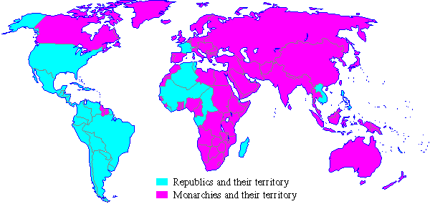
Monarchies in 1900
Republics and their territory
Monarchies and their territory
Notes:
A quick look at the world map a century ago shows that most of the world was ruled by kings in 1900.
________
Common-495
OS-09-1 Samuel-93
OS-10-Davidic Covenant-04
NS-01-Matt1-14-slide 61

Slide 5
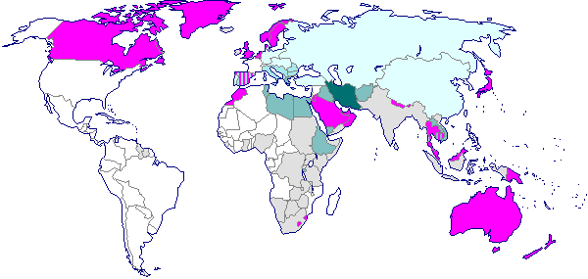
Monarchies in 2000
Monarchies Abolished:
1900-1925
1925-1950
1950-1975
1975-2000
Still Monarchies
Colonies Which Became Republics Upon Independence
Notes:
However, a century later, few monarchies are left. Even Britain, Japan, Canada, Australia and perhaps Scandinavian countries are not monarchies in the practical sense.
________
Common-496
OS-09-1 Sam-94
OS-10-Davidic Covenant-05
NS-01-Matt1-14-slide 62

Slide 6
The Demise of Monarchies
Monarchies in 1900
Monarchies in 2000
Republics and their territory
Monarchies and their territory
Monarchies Abolished:
1900-1925
1925-1950
1950-1975
1975-2000
Still Monarchies
Colonies Which Became Republics Upon Independence
Notes:
Do you see the vast difference between the two world maps? I wonder if the demise of monarchies affects the way we look at Jesus in terms of him being king.
________
Common-497
OS-09-1 Sam-95
OS-10-Davidic Covenant-06
NS-01-Matt1-14-slide 63

Slide 7
The First Presleyterian Church of Elvis the Divine
The Rev. Mort Fandu, dressed in Elvis clothing, raises a compass to show the direction of Las Vegas during a ceremony to worship Elvis at Packer Memorial Church at Lehigh University in Bethlehem. Pa.
Notes:
________
OS-10-Davidic Covenant-07
NS-01-Matt1-14-slide 64

Slide 8
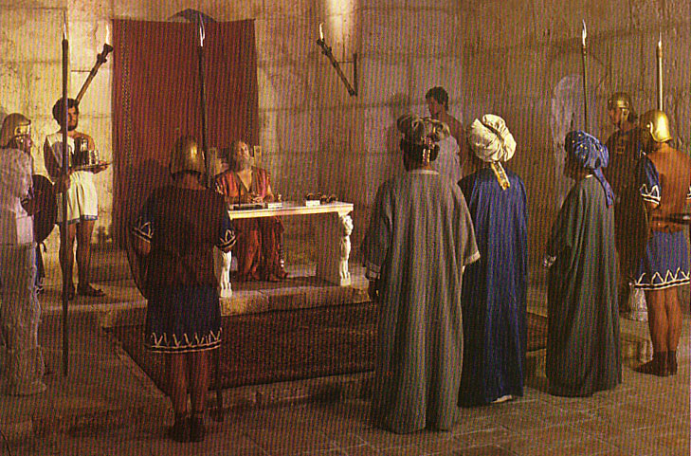
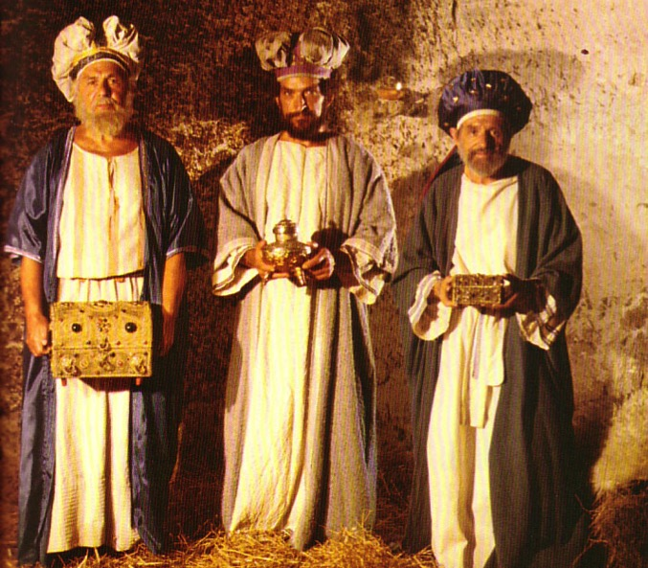
What Kind of Kingdom Did Isaiah (and Matthew) Envision?
78b
Political
Physical
Emotional
Intellectual
Spiritual
Notes:
________
OS-10-Davidic Covenant-08
NS-01-Matt1-14-slide 88

Slide 9
Universal Kingdom
(everything inside and outside the circle)
461a
Living Beings
All People
(saved and unsaved all in the box)
Spiritual
Kingdom
(saved
people)
Unsaved Before Christ
Saints prior to Moses
Theocracy & Monarchy
(OT Saints under Law in Israel)
Kingdom of Darkness
(shaded area of all ages with unsaved people and demons)‏
Present
Unbelievers
Church
Angels
& Animals
Tribulation
Unbelievers
Tribulation
Believers
Isaiah’s focus
Millennial
Unbelievers
Millennial
Believers
The Kingdom Diagrammed
Second Death
(Hell)
Eternal Life
(Heaven)‏
Mystery Form
of the Kingdom
Millennial Kingdom
Notes:
9
The Bible uses the word "kingdom" in many ways, so we must see the context of each passage.
______________
Common-327
OS-10-Davidic_Covenant-09
OS-23-Isaiah1-12-slide 47
NS-01-Matt1-14-slide 100

Slide 10
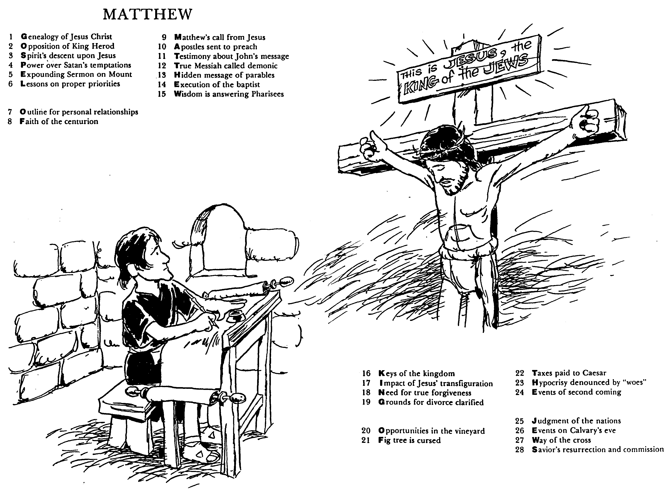
The Acrostic Bible by Barry Huddleston
Matthew
1 Genealogy of Jesus Christ
2 Opposition of King Herod
3 Spirit's descent upon Jesus
4 Power over Satan's temptations
5 Expounding Sermon on Mount
6 Lessons on proper priorities
7 Outline for personal relationships
8 Faith of the centurion
9 Matthew's call from Jesus
10 Apostles sent to preach
11 Testimony about John's message
12 True Messiah called demonic
13 Hidden message of parables
14 Execution of the Baptist
15 Wisdom is answering Pharisees
16 Keys of the kingdom
17 Impact of Jesus' transfiguration
18 Need for true forgiveness
19 Grounds for divorce clarified
20 Opportunities in the vineyard
21 Fig tree is cursed
22 Taxes paid to Caesar
23 Hypocrisy denounced by "woes"
24 Events of second coming
25 Judgment of the nations
26 Events on Calvary's eve
27 Way of the cross
28 Savior's resurrection and commission
Notes:
Note that 28 phrases of four words each appear here, each of which summarizes the respective chapter in Matthew. But if you read downward, then you will also see Matthew's theme in an acrostic: GOSPEL OF MATTHEW KING OF THE JEWS. Huddleston does this for every book of the Bible in this amazing book!
Barry Huddleston wrote The Acrostic Bible in 1990. It appears to have been out of print until 2019 when only old and original editions were sold at https://www.thriftbooks.com/w/the-acrostic-summarized-bible_barry-huddleston/23524258/item/41736967/?utm_source=google&utm_medium=cpc&utm_campaign=shopping_new_condition_books_high&utm_adgroup=&utm_term=&utm_content=545821544816&gclid=Cj0KCQjw7uSkBhDGARIsAMCZNJvxaNAaz_hKVxynKPUYZXHNPYgJZEDBA0odsszrUVIPeoRFXfoHcyQaAk-ZEALw_wcB#idiq=41736967&edition=56990115
Format: Paperback
Language: English
ISBN:1532680384
ISBN13:9781532680380
Release Date: August 2019
Publisher: Wipf & Stock Publishers
Length:96 Pages
Weight:0.31 lbs.
Dimensions:0.2" x 6.0" x 9.0"
_______
Amazon Product details
Original Edition
Publisher ‏ : ‎ Baker Pub Group (January 1, 1990)
Language ‏ : ‎ English
ISBN-10 ‏ : ‎ 0801043514
ISBN-13 ‏ : ‎ 978-0801043512
Item Weight ‏ : ‎ 6.4 ounces
Dimensions ‏ : ‎ 6 x 0.25 x 9 inches
Best Sellers Rank: #4,419,728 in Books (See Top 100 in Books)
Customer Reviews: 5.0 5.0 out of 5 stars 4 ratings
________
OS-10-Davidic Covenant-10
NS-01-Matt1-14-slides 11, 102

Slide 11
The Big Question
What is God's primary purpose for the world as revealed in Scripture?

Slide 12
The Big Idea
God desires to glorify Himself
by establishing His Kingdom
on earth through human representation

Slide 13
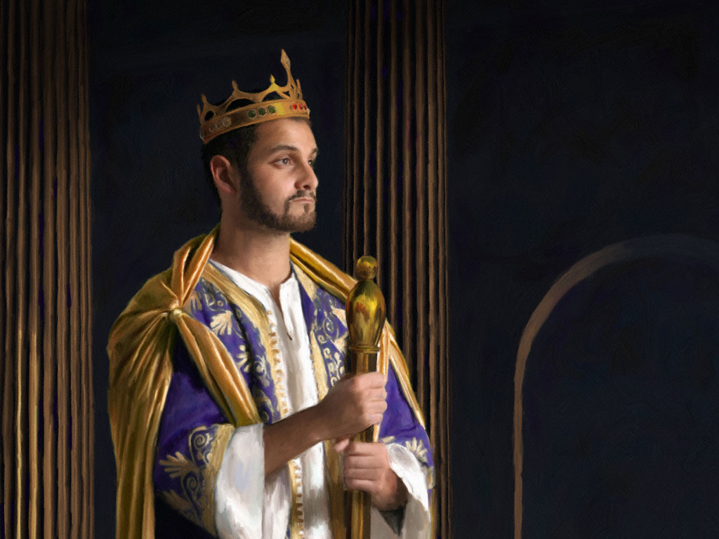
KEY VERSE: 2 Samuel 7:12-13
209
"For when you (David) die, I will raise up one of your descendants, and I will make his kingdom strong. He is the one who will build a house—a temple—for my name. And I will establish the throne of his kingdom forever."
Notes:
The Davidic covenant is an eternal promise from God.
______________
Common-283
OS-10-2 Samuel-86
OS-10-Davidic Covenant-13
NS-01-Matt1-14-slide 131
NS-03-Luke1-12-slide 197

Slide 14
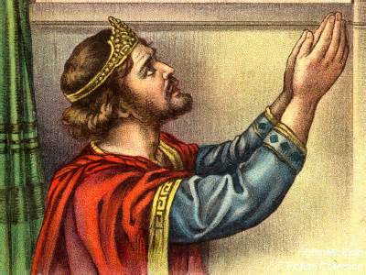
COVENANT KINDNESS TOWARDS DAVID'S DYNASTY
209
Notes:
God has the right to choose which people He wants to use to bless the rest. He chose to raise up David's line to bless the rest of us! Let's look deeper now to see how he has done it and will do it.
___________________
OS-10-Davidic Covenant-14
OS-10-2Samuel-78

Slide 15
Covenants of Promise
BLESSING
Walt Russell, Playing with Fire, p. 121
Amplified by
Abrahamic
Davidic
Administrative Covenants How to experience the blessing
Mosaic Israel's terms of obedience
Superseded by
New Terms of obedience under Messiah
Walt Russell, Playing with Fire
Notes:
Walt Russell groups the covenants into covenants of promise as opposed to administrative ones. However, the new covenant has many promises also (Jer 31:31-34; Ezek 36). Also, the place where they will be fulfilled must be included, so the land aspect is missing. Nevertheless, this diagram clearly shows that the new covenant replaces the old covenant of Moses.
_______
Common-172
OS-10-Davidic Covenant-15
OS-10-2Sam-79
OS-29-Joel-123

Slide 16
Covenants of Promise
BLESSING
Walt Russell, Playing with Fire, p. 121
Amplified by
Abrahamic
Davidic
2 Samuel 7:12-16
Administrative Covenants How to experience the blessing
Mosaic Israel's terms of obedience
Superceded by
New Terms of obedience under Messiah

Slide 17
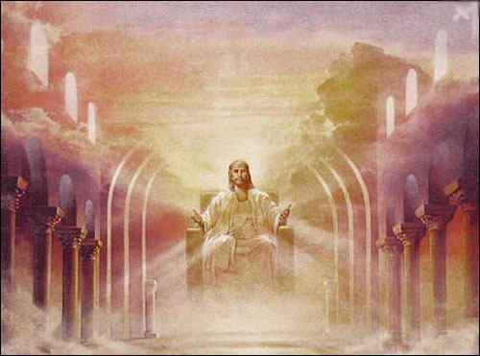
Promises of the Davidic Covenant
22
What did God promise David in 2 Samuel 7:12-16?
New Dynasty (2 Sam 7)
Notes:
With your study partner(s), list as many promises as you can that God gave to David in these five verses.
___________________
OS-10-Davidic Covenant-04
OS-10-2Samuel-87
NS-01-Matt1-14-slide 158

Slide 18
Promises of the Davidic Covenant
22
What did God promise David in 2 Samuel 7:12-16?
Sons: "house" never wiped out
Kingdom: political dynasty (each Jerusalem king will be one of his direct descendants)
Throne: As an eternal covenant (v. 16), the right to rule will remain with his family forever
Temple: Solomon will build it
Discipline: God will punish disobedient kings but still unconditionally keep these promises
New Dynasty (2 Sam 7)
Notes:
Here is one way to sum up God's promises to David.
___________________
OS-10-Davidic Covenant-18
OS-10-2Samuel-97
NS-01-Matt1-14-slide 160

Slide 19
God is King
In the beginning God…
Genesis 1:1
The fool has said in his heart, "There is no God."
Psalm 14:1
Before the mountains were born or you brought forth the earth and the world, from everlasting to everlasting you are God.
Psalm 90:2
The LORD reigns…Your throne was established long ago;
you are from all eternity.
Psalm 93:1-2
For the LORD is the great God, the great King above all gods.
Psalm 95:3
Notes:
• From the first verse of the Bible, it is obvious that God is King. Like a king, he speaks laws into existence. He also did not create any other gods such as the sun or moon, for these are but objects of creation.
• The Bible does not seek to prove God's existence, for this is not needed. It is so obvious that he exists that only a fool claims that there is no God (Ps 14:1).
• Moses recognized God's eternality in Psalm 90:2.
• Since he is king and he is also eternal, his reign is also eternal (Ps 93:1-2).
• There exists no other god, but there are so-called gods that people worship, yet God is greater than all of them.

Slide 20
God is Creator
The World is His Kingdom
"You are worthy, our Lord and God, to receive glory and honour and power, for you created all things, and by your will they were created and have their being."
Revelation 4:11
Notes:
God deserves worship since this earth is made by him.

Slide 21
The Kingdom is Established
So God created man in his own image, in the image of God he created him; male and female he created them. God blessed them…
Genesis 1:27-28
The LORD God took the man and put him in the Garden of Eden to work it and take care of it.
Genesis 2:15
And the LORD God commanded the man, "You are free to eat from any tree in the garden; but you must not eat from the tree of the knowledge of good and evil, for when you eat of it you will surely die."
Genesis 2:16-17
Notes:
Like a king, God also can delegate rule, for only one who has authority can share it with someone else.
• So God decided to share this rule with both men and women.
• He also gave his a small realm to rule in comparison to his gigantic rule over all the universe. Adam and Eve had a garden over which to rule.
• But they were not robots without free will, so he gave them the option to continue ruling in obedience or to forfeit this rule in disobedience with death as a result.

Slide 22
The Fall
When the woman saw that the fruit of the tree was good for food and pleasing to the eye, and also desirable for gaining wisdom, she took some and ate it. She also gave some to her husband, who was with her, and he ate it.
Genesis 3:6
Notes:
Where did sin begin?
Too often we suppose it began in Eden. But it would not have come to Eden if it had not begun in heaven first.
Satan tempted Eve to think that life would improve by disobeying God, so she ate after being deceived.
Adam was not deceived, though.

Slide 23
The Kingdom is Ruined
So the LORD God banished him from the Garden of Eden to work the ground from which he had been taken.
After he drove the man out, he placed on the east side of the Garden of Eden cherubim and a flaming sword flashing back and forth to guard the way to the tree of life.
Genesis 3:23-24

Slide 24
God's Plan
And I will put enmity between you [Satan] and the woman, and between your offspring [demons] and hers [Jesus]; he will crush your head [resurrection], and you will strike his heal [Calvary].
Genesis 3:15
Promise
War
Satan
Notes:
God warned Satan that war would occur between Satan and humans. Satan would appear to defeat Jesus at the cross, but Eve's descendant (Jesus) would eventually defeat him at his resurrection.

Slide 25
How is God accomplishing His plan?
It is revealed in stages throughout the Bible by COVENANT rather than all at one time.
Notes:
God is far more patient than us.
He has been working throughout the ages to fulfill his promise.

Slide 26
What is a Covenant ?
Promise between 2 or more parties by which either of the parties pledges himself to the other.
The covenants we are going to study between God and humans are all UNILATERAL.
God made promises that He would do something, and there was nothing required by the humans involved.

Slide 27
The Kingdom is Promised Abrahamic Covenant
Genesis 17:6-7
I will make you exceedingly fruitful, and I will make you into nations and KINGS shall come from you. And I will establish my covenant between me and you and your OFFSPRING after you throughout their generations for an EVERLASTING covenant, to be God to you and to your offspring after you.
Promise
Land
A
B
R
A
H
A
M
Seed
Blessing
Genesis 12:1-3

Slide 28
How does the Abrahamic Covenant relate to David?

Slide 29
Kingdom & Covenants Timeline
22
CH-34a
OS1-22
OS2-337
NS-9g
SA-19
34a
Dr. Rick Griffith • BibleStudyDownloads.org
22
Kingdom Teaching...
Adam rules with God (Gen. 1:26, 28; 2:19)
Satan begins rule as god of this world (Gen. 3:15;
2 Cor. 4:4)
God covenants with Abraham to reestablish man's rule via Israel as a "kingdom of priests" (Gen. 12:1-3; Exod. 19:6)
Israel's failure to witness to nations as a kingdom of priests is judged via exile under foreign rule
Israel rejects Messiah's offer of kingdom (Matt. 12:41-42; 23:37-39)
Jesus extends His kingdom in mystery form to the Church (Matt. 13)
Christ subdues Israel's enemies and nation believes (Rom. 11:26-27)
Christ rules over everything with saints (Eph. 1:9-10; Rev. 20:1-6; 22:5b)
337
9g
Fall of Man (Gen. 3)
Noahic Covenant
19
Genesis 6:18; 9:8-17
Land Covenant
ISRAEL
CHURCH
MESSIANIC KINGDOM
(National Focus)
The "New Man" (Eph. 2:15)
Millennial Eternal
land
Genesis 15:18 (cf. Deut. 30:1-10) promises:
Land from Wadi of Egypt to Euphrates River (Isa. 27:12)
Eternal possession of land (Gen. 17:8) after exile/restoration
Whole world blessed via the land (Isa. 14:1-2)
Israel judged for rejecting Messiah by dispersion away from land for 19 centuries
(AD 70–AD 1948) but now partially restored (Ezek. 37:1-7)
Full restoration (Ezek. 37:8-28) Jerusalem world capital
(Isa. 2:1-5)
New Jerusalem
(Rev. 21–22)
Davidic Covenant
Christ is Head over his Church, which is a spiritual temple (Eph. 2:19-22; 2 Cor. 6:16)
Christ reigns over the world
(Isa. 11)
with saints (Rev. 5:10; 20:4-6)
Christ hands kingdom over to Father (1
Cor. 15:24)
Genesis 12:1-3
2 Samuel 7:12-16 promises:
Sons ("house" never wiped out)
Kingdom (political dynasty)
Throne (right to rule by descendants)
Temple (son to build it)
seed
Abrahamic Covenant
New Covenant
All
things made new!
(Rev. 21:5)
All 5 elements fulfilled in national restoration (Zech. 8)
Jeremiah 31:31-34 promises:
Forgiveness
Indwelling Spirit
New heart, nature, mind
Reunification of Israel and Judah
No need for evangelism
Mosaic Law is replaced with first three elements of the New Covenant (Luke 22:20; 2 Cor. 3:6)
blessing
Mosaic Covenant
Law abolished, fulfilled, and replaced at the cross (Rom. 7:1-6; 1 Cor. 9:19-21; Heb. 8:13)
12th Edition
5 March 2023
Temporary (Gal. 3:19) and conditional (Deut. 28) to reveal sin (Rom. 7:7) and regulate Israel (Gal. 3:23-25)
Scripture has a dual kingdom-covenant theme. Israel's role from Abraham to Christ expands to include the Church (continuity) yet the Church never replaces the nation as the "new Israel" (discontinuity). Israel will enjoy world prominence after trusting Christ at His second coming.
Notes:
This complicated chart combines the two themes of Kingdom and Covenants. God's kingdom rule extends to humanity across the ages at the top. But the major part shows the unfolding of the Abrahamic Covenant in its land, Davidic, and New Covenant promises—partially fulfilled in the present, but fully completed in the Messianic Kingdom. This will happen in the Millennial Age and especially in the Eternal State.
• This chart also shows that the Old (Mosaic) Covenant was replaced by the New Covenant.
All agree that a partial fulfillment of the covenant to Abraham exists now to the Church in the indwelling Holy Spirit and forgiveness of sins (Jer 31:31-34)—and the ultimate fulfillment will be in the eternal state.
The main area of disagreement relates to the time period from now to eternity. Will there be a literal land, throne, and worldwide blessing to national (ethnic) Israel before the eternal kingdom? This chart shows verses giving a resounding YES to that question in a present partial fulfillment and a future full fulfillment in the normal sense of language in the verses cited. But the messianic kingdom will be in two stages—first in a millennial fulfillment to last 1000 years, but then, after that, the eternal stage in the new Jerusalem after the destruction of our present heavens and earth (Rev 21–22). What an amazing future remains for those who trust Jesus!
____________
Common-151
BT-01-OT Biblical Theology-25
CH-02-Nature-103-p34a
OC-10-Chronology-42
OS-00-Intro & Biblical Theology-40 & 103
OS-02-Exodus-267-p22
OS-05-Deut-279, 300
OS-10-2Sam-96-p22
OS-10-Davidic Covenant-29
OS-12-Kings & Prophets Charts-25
OS-13-1 Chron-46
OS-17-Kingdom & Covenants Timeline-01
OS-23-Isaiah-97-p337
OS-24-Jeremiah-174-p337
OS-23-Isaiah-97-p337
OS-28-Hosea-49
OS-31-Obadiah-164
05-Acts1-2-slide 45
NS-09-Gal-143-p9g
NS-19-Hebrews-342-p9g
NS-27-Rev20-22-slide 189
SA-08-Mosaic Law-19-p38a

Slide 30
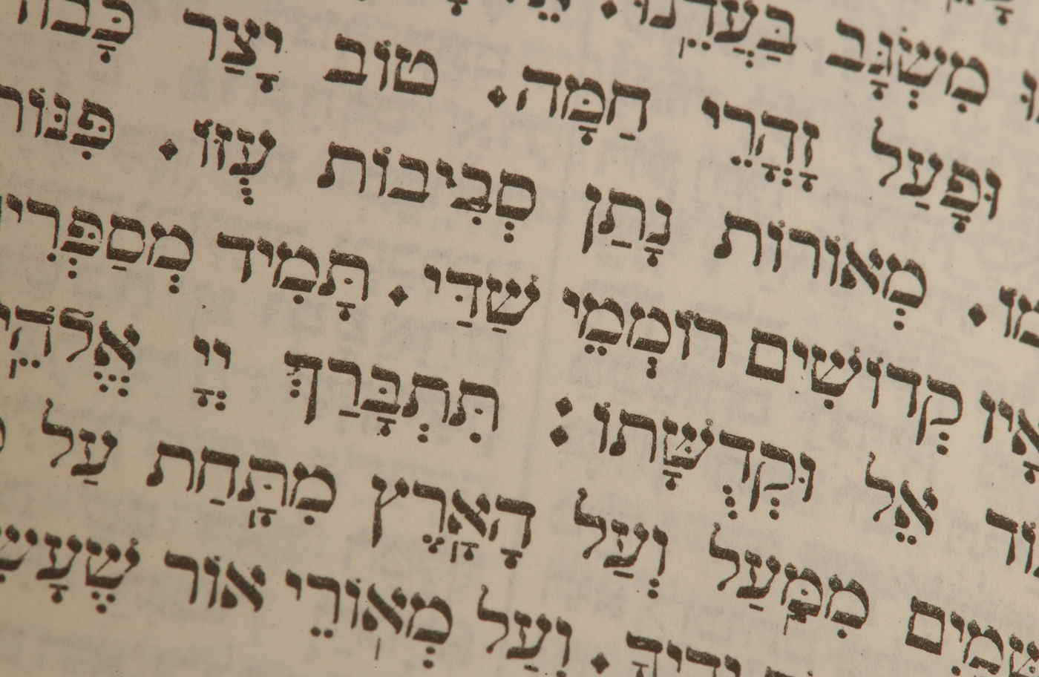
The Promised Seed
David met the lineage requirements of Judah's line (Genesis 49:10; Numbers 24:17).
Notes:
Jacob predicted that "the scepter would not depart from Judah" (Gen 49:10), so the kingly line would come from Judah and never be transferred to any other line.
___________________
OS-10-Davidic Covenant-30
OS-10-2Samuel-81

Slide 31
The Lineage of David
ABRAHAM
Isaac
Jacob
Judah
Perez
Hezron
Ram
Amminadab
Nahshon
Salmon
Boaz
Obed
Jesse
DAVID
Notes:
This line of direct descent from Abraham through Judah to David made David a unique man, for only one in 12 Israelites came from the tribe of Judah, and very few from Judah were born and lived in the tiny village of Bethlehem.
___________________
OS-10-Davidic Covenant-31
OS-10-2Samuel-82

Slide 32
The Rise of the Kingdom
All the tribes of Israel came to David at Hebron and said, "….the LORD said to you, 'You shall shepherd my people Israel, and you shall become their ruler.' …and they anointed David king over Israel.
2 Samuel 5:1-3
D
A
V
I
D

Slide 33
The Ark is brought to Jerusalem
So David and all the house of Israel brought up the ark of the LORD with shouting and with the sound of the trumpet…
King David leaping and dancing before the LORD...
They brought in the ark of the LORD and set it in its place inside the tent which David had pitched for it.
2 Samuel 6:15-17

Slide 34
David wanted to build a temple
WHEN KING David dwelt in his house and the Lord had given him rest from all his surrounding enemies, the king said to Nathan the prophet, "See now, I dwell in a house of cedar, but the ark of God dwells within curtains."
2 Samuel 7:1-2

Slide 35
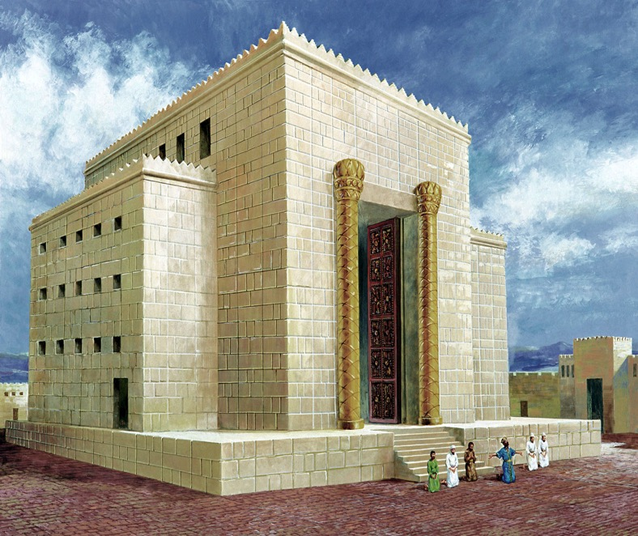
David's House: "I want to build a house for you…"
D
A
V
I
D
Notes:
David envisioned building the temple.
___________________
OS-10-Davidic Covenant-35
OS-10-2Samuel-84

Slide 36
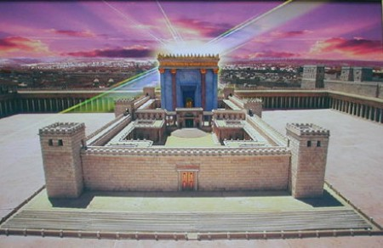
But who would build the Temple ?
God's House: "I want to build a house for you…"
Notes:
It was not immediately clear to David who would build the temple.
___________________
OS-10-Davidic Covenant-36
OS-10-2Samuel-85

Slide 37
Davidic Covenant
2 Samuel 7:12-16
"And when your days are fulfilled and you sleep with your fathers, I will set up after you YOUR OFFSPRING who shall be born to you, and I will establish HIS KINGDOM.
He shall build a house for My Name [and My Presence], and I will establish the THRONE of HIS KINGDOM FOREVER. I will be his Father, and he shall be My son. When he commits iniquity, I will chasten him with the rod of men and with the stripes of the sons of men.
But My mercy and loving-kindness SHALL NOT DEPART from him, as I took [them] from Saul, whom I took away from before you.
And your house and your kingdom shall be made sure forever before you; YOUR THRONE shall be ESTABLISHED FOREVER."
Notes:
Verse 15 notes the discipline aspect of the covenant, but this does NOT make the overall covenant conditional as the next verse clarifies.
___________________
OS-10-Davidic Covenant-37
OS-10-2Samuel-88

Slide 38
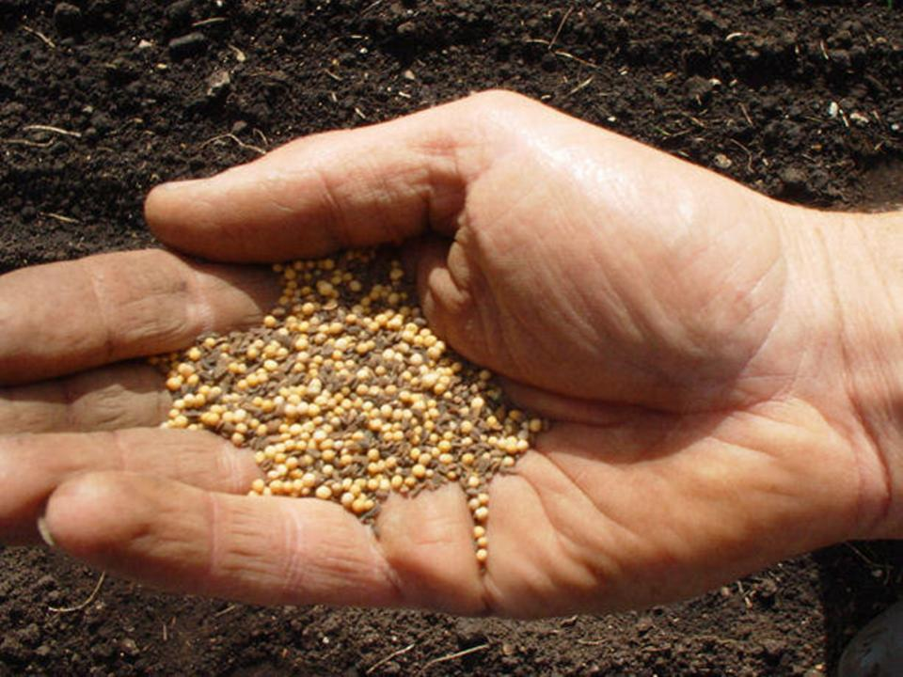
The Davidic Covenant is…
a continuation of the seed aspect of the
Abrahamic Covenant and the promise
that kings would come from Abraham
(Genesis 17:6-7)
Notes:
God promised kings among Abraham's descendants, so this indicates monarchy as God's ultimate political structure—not democracy, not a republic, or any other political system.
___________________
OS-10-Davidic Covenant-38
OS-10-2Samuel-89

Slide 39
Davidic Covenant
Nathan's original oracle does not include the word "covenant" but David describes it as an "eternal covenant" (2 Samuel 23:5) and this "covenant" is celebrated in the Psalms (Psalm 89:4-29; 132:12).

Slide 40
Davidic Covenant
Promises of the covenant:
1. Sons (descendants)
2. Throne (right to rule)
3. Kingdom (country or land)

Slide 41
Sons
God promised that this son of David would be His own son, the son of God (Psalm 2:7).
God promised not only that the son of David would be His son, but that this son would build a "house," a Temple to the heavenly Father's name. That promise was partially fulfilled when David's son, Solomon, built the glorious Temple in Jerusalem.

Slide 42
Throne
This looks back to the Abraham Covenant in which God said that "kings would come from his descendants" (Gen 17:6)
Davidic descendants would always be available to sit on the royal throne.

Slide 43
Kingdom
A King will come from the line of David whose kingdom will ultimately be eternal.
His kingdom would extend over all nations (Psalm 2:8; 72:8, 11).

Slide 44
The Kingdom is foreshadowed
You have established your people Israel as your very own for ever, and you, O LORD, have become their God…
for you, O Sovereign LORD, have spoken, and with your blessing the house of your servant will be blessed forever.
2 Samuel 7:24, 29b

Slide 45
The Kingdom is foreshadowed
God's people
The people of Judah and Israel were as numerous as the sand on the seashore.
1 Kings 4:20
God's rule in God's place
Solomon ruled over all the kingdoms from the River to the land of the Philistines, as far as the border of Egypt.
1 Kings 4:21

Slide 46
The Kingdom is foreshadowed
God's blessing
During Solomon's lifetime Judah and Israel, from Dan to Beersheba, lived in safety, each man under his own vine and fig tree.
1 Kings 4:25
God keeps his promises
Praise be to the LORD, who has given rest to his people Israel just as he promised. Not one word has failed of all the good promises he gave through his servant Moses.
1 Kings 8:56

Slide 47
The Kingdom is foreshadowed
The LORD has kept the promise he made: I have succeeded David my father and now I sit on the throne of Israel, just as the LORD promised, and I have built the temple for the Name of the LORD, the God of Israel. I have provided a place there for the ark, in which is the covenant of the LORD that he made with our fathers when he brought
them out of Egypt.
1 Kings 8:20-21

Slide 48
The Kingdom Declines
The Israelites persisted in all the sins of Jeroboam and did not turn away from them until the LORD removed them from his presence, as he had warned through all his servants the prophets. So the people of Israel were taken from their homeland into exile in Assyria, and they are still there.
2 Kings 17:22-23

Slide 49
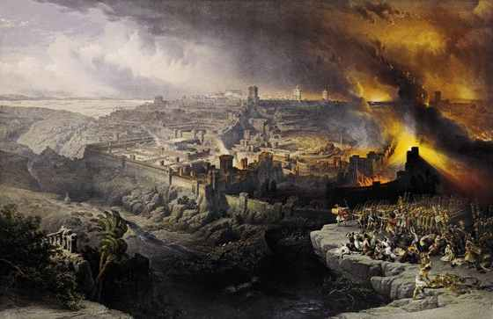
Jerusalem Burned
It was because of the LORD's anger that all this happened to Jerusalem and Judah, and in the end he thrust them from his presence.
2 Kings 24:20

Slide 50
A Promise of Eternal Kingdom
Behold, the days are coming, says the LORD, when I will raise up to David a righteous Branch (Sprout), and He will reign as King and do wisely and will execute justice and righteousness in the land. In His days Judah shall be saved and Israel shall dwell safely: and this is His name by which He shall be called: The LORD Our Righteousness.
Jeremiah 23:5-6

Slide 51
Still Waiting
I will give you a new heart and put a new spirit in you; I will remove from you your heart of stone and give you a heart of flesh.
And I will put my Spirit in you and move you to follow my decrees and be careful to keep
my laws. You will live in the land I gave your forefathers; you will be my people, and I will be your God.
Ezekiel 36:26-28
?
'See, I will send my messenger, who will prepare the way before me. Then suddenly the Lord you are seeking will come to his temple; the messenger of the covenant, whom you desire, will come,' says the Lord Almighty.
Malachi 3:1

Slide 52
How does the Davidic Covenant relate to Jesus?

Slide 53
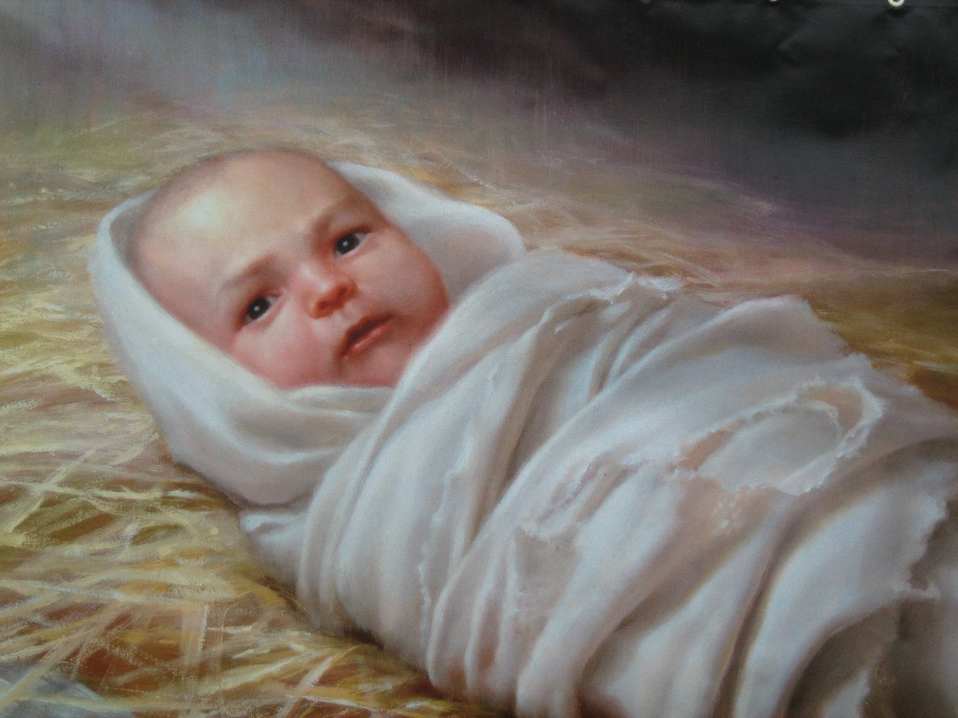
What would be the Messiah's lineage?
Notes:
___________________
OS-10-Davidic Covenant-53
OS-10-2Samuel-99
NS-01-Matt1-14-slide 161

Slide 54
The Kingdom in Matthew 1
Fall of the Kingdom
Establishing the Eternal Kingdom
ABRAHAM
Solomon
Shealtiel
Isaac
Rehoboam
Zerubbabel
Jacob
Abijah
Abiud
Judah
Asa
Eliakim
Perez
Jehoshaphat
Azor
"Thus there were fourteen generations in all from Abraham to David, fourteen from David to the exile to Babylon, and fourteen from the exile to Christ."
Matthew 1:17
Ahaziah
Hezron
Jehoram
Zadok
Joash
Ram
Uzziah
Akim
Amaziah
Amminadab
Jotham
Eliud
Nahshon
Ahaz
Eleazar
Salmon
Hezekiah
Matthan
Boaz
Manasseh
Jacob
Obed
Amon
Joseph +
Mary
Rise of the Kingdom
Jesse
Josiah
KING DAVID
JECONIAH (EXILE)
JESUS CHRIST
Notes:
Matthew’s genealogy omits three kings between Jehoram and Uzziah (=Azariah), giving 14 generations in each period of the rise, fall, and preservation of the kingdom until Jesus.
The Bible has several genealogies of the Davidic line:
Perez to David (Ruth 4:18-22)
David (1000 BC) to the sons of Elionai around 400 BC (1 Chron 3:9-17)
Abraham to Jesus (Matt 1:1-17)
Adam to Jesus (Luke 3:23-38)
One difficulty concerns the son of Jehoiachin/Jeconiah/Coniah in the Davidic line. Was his son Shealtiel (Matt 1:12) or should we follow the line of Jehoiachin with his other son Pedaiah (1 Chron 3:17) or his son Rhesa (Luke 3:27), the latter not even listed among the seven sons of Jehoiachin in 1 Chron 3:17?
“2. DESCENDANTS OF SOLOMON (3:10-24)
3:10-24. This list of Solomon’s descendants is in effect a list of Judah’s kings from Solomon through Zedekiah (vv. 10-16) and their exilic and postexilic continuation (vv. 17-24). Athaliah, the queen who ruled between Ahaziah and Joash, is not mentioned (v. 11). That is because she was only a political usurper and was not in the true dynastic succession (cf. 2 Kings 11). Of the sons of Josiah, Johanan (1 Chron. 3:15) is otherwise unknown. He cannot be Jehoahaz (2 Kings 23:31) because Jehoahaz was [Vol. 1, p. 595] younger than Jehoiakim (cf. 2 Kings 23:36). This means that Shallum (1 Chron. 3:15) is identical to Jehoahaz who, though the next-to-youngest son of Josiah, preceded his brothers on the throne (cf. Jer. 22:11-12).
The remainder of the succession followed by the chronicler is Jeconiah (Heb.; cf. NIV marg. of 1 Chron. 3:16; also known as Jehoiachin; cf. v. 17 and 2 Kings 24:8, and Coniah, Jer. 22:24, marg.). Then came Pedaiah (1 Chron. 3:18), Zerubbabel (v. 19), Hananiah (v. 19), Shecaniah (v. 21), Shemaiah (v. 22), Elioenai (v. 23), and Hodaviah (v. 24).
Three difficulties here must be addressed. First, Zerubbabel (v. 19) is elsewhere called the son of Shealtiel, not the son of Pedaiah (Ezra 3:2, 8; 5:2; Neh. 12:1; Hag. 1:12, 14; 2:2, 23; Matt. 1:12; Luke 3:27). Since Shealtiel and Pedaiah were brothers (1 Chron. 3:17-18) the best solution seems to be that Shealtiel died early on and his role of dynastic succession was assumed by his younger brother Pedaiah. The second problem concerns Luke’s account of the genealogy in which he identifies Shealtiel as the son of Neri, whose descent is not from Solomon but from David’s son Nathan (Luke 3:27-31). The answer may lie in the possibility that since Jeconiah had no male heir to sit on the throne (cf. Jer. 22:30), a daughter of Jeconiah married Neri, son of Melki (Luke 3:27-28; not the Melki of Luke 3:24), of the line of Nathan. Legally Shealtiel, as grandson of Jeconiah, would continue the Davidic dynasty through Solomon, a viewpoint espoused by Matthew (Matt. 1:6-12).
The third conflict appears in Zerubbabel’s line. The chronicler lists Zerubbabel’s seven sons and one daughter (1 Chron. 3:19b-20). But none of them is mentioned in the genealogies of either Matthew or Luke. Matthew, who traces Jesus’ descent from David through Solomon, wrote that the son of Zerubbabel was Abiud (Matt. 1:13). Luke, viewing it through Nathan, said Rhesa was that son (Luke 3:27). It is entirely possible, of course, that the Shealtiel and Zerubbabel of Luke are not the same as those of 1 Chronicles and that Luke preserves a genealogy of Mary straight from David through Nathan, a line of succession that has no other connection with the chronicler’s genealogy (cf. comments on Luke 3:27). This would preclude the suggested solution to the second problem previously mentioned (and would, in fact, eliminate the problem altogether). This still leaves the variance between 1 Chronicles 3:19b-20 and Matthew 1:13. One may conjecture that Abiud is another name for one of the seven sons of Zerubbabel listed in Chronicles or that his name is missing from that list to begin with. That such a thing is possible may be seen in 1 Chronicles 3:22 where the historian wrote that Shemaiah had six sons but listed only five names” (Eugene Merrill, “1 Chronicles,” in The Bible Knowledge Commentary [Wheaton, IL: Victor, 1985], 1:594-95).
______
OS-10-2Sam-100
OS-10-Davidic Covenant-54
OS-13-1Chron-81
NS-01-Matt1-14—slide 161

Slide 55
Jesus is the Promised Son Of David
Nine times Jesus is called "son of David" in Matthew (compared to twice in Mark and Luke and none in John). David is referred to 59 times in the New Testament (NIV).
Jesus' birthplace, Bethlehem, is recalled as "the city of David" (Matt. 2:1; 1 Sam. 20:6)
Notes:
All Christians agree that the Davidic Covenant finds its fulfillment in Jesus, though how and when this happens is debated.
___________________
OS-10-Davidic Covenant-54
OS-10-2Samuel-95
NS-01-Matt1-14-slide 163

Slide 56
Jesus is the Promised Son of David
We see this foreshadowed in the story about Mary and Joseph finding Jesus in the Temple. What does Jesus tell them? Like a dutiful son of David, he replies: "Did you not know that I must be in My Father's house?"
(Luke 2:49)

Slide 57
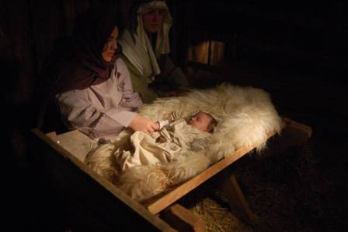
Jesus is the Promised Son of David
Luke tells us that Joseph and Mary went to "the city of David that is called Bethlehem, because he [Joseph] was of the house and family of David" (Luke 2:4).
Like the Davidic Messiah, Jesus is called God's "beloved son" at His baptism (Matthew 3:17; Psalm 2:7).

Slide 58
Jesus is the Promised Son of David
Matthew 3:17
And a voice from heaven said, "This is my Son, whom I love; with him I am well pleased."

Slide 59
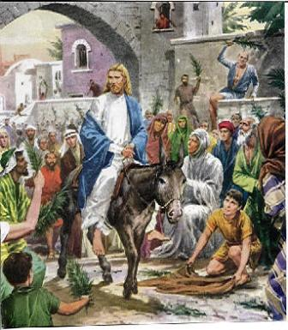
The Son of David .
Matt. 21:7-9
… The crowds that went ahead of him and those that followed shouted, 'Hosanna to the SON OF DAVID! Blessed is he who comes in the name of the Lord! Hosanna in the highest!"
Zechariah 9:9 notes that He will enter Jerusalem as a KING, riding on a donkey. "Rejoice greatly, O Daughter of Jerusalem! See, your KING comes to you, righteous and having salvation, gentle and riding on a donkey"

Slide 60
The Coming Kingdom of God
Then he said to his disciples, "The time is coming when you will long to see one of the days of the Son of Man, but you will not see it. Men will tell you, 'There he is!' or 'Here he is!' Do not go running off after them. For the Son of Man in his day will be like the lightning, which flashes and lights up the sky from one end to the other. But first he must suffer many things and be rejected by this generation.
Luke 17:22-25

Slide 61
King of Kings
Jesus said, "My kingdom is not of this world. If it were, my servants would fight to prevent my arrest by the Jews. But now my kingdom is from another place."
"You are a king, then!" said Pilate.
Jesus answered, "You are right in saying I am a king. In fact, for this reason I was born, and for this I came into the world, to testify to the truth. Everyone on the side of truth listens to me."
John 18:36-37

Slide 62
Acts 1:9, 11
He was taken up before their very eyes, and a cloud hid him from their sight.
"Men of Galilee," they said, "Why do you stand here looking into the sky? This same Jesus, who has been taken from you into heaven, will come back in the same way you have seen him go into heaven."
Acts 1:9, 11

Slide 63
The Kingdom is at Hand
"Exalted to the right hand of God, he has received from the Father the promised Holy Spirit and has poured out what you now see and hear. Therefore let all Israel be assured of this: God has made this Jesus, whom you crucified, both Lord and Christ."
Acts 2:33, 36
Heaven
J
E
S
U
S
J
E
S
U
S
Disciples

Slide 64
God's Presence with His People
For we are the temple of the living God. As God has said, "I will live with them and walk among them, and
I will be their God, and they will be my people."
2 Corinthians 6:16b

Slide 65
The King is in Heaven
J
E
S
U
S
And if I go and prepare a place for you, I will come back and take you to be with me that you also may be where I am.
John 14:3

Slide 66
The Return of the King
"Behold, I am coming soon! My reward is with me, and I will give to everyone according to what he has done.
I am the Alpha and the Omega, the First and the Last, the Beginning and the End.
...
I am the Root and the Offspring of David, and the bright Morning Star."
Rev. 22:12-13, 16

Slide 67
A Literal Kingdom for David's Line
218c
Ordinary language for "kingdom" is used
Prophets interpreted the kingdom literally
Israel interpreted the kingdom literally
586 BC kingdom overthrown is the same kind
The Davidic Covenant relates only to Israel
David saw the covenant applying only to Israel
Portions have been fulfilled literally
David's throne is not related to Christ's present session in heaven
John, Jesus, the 12, and the 70 all offered Israel a literal kingdom (Matt. 3:11; 4;17; 10:7; Luke 10:1, 9)
…so Jesus will reign in the future
Notes:
Knowing the nature of the kingdom first will help us discern when it will take place. If it is only a spiritual kingdom, then we will be led to think that it occurs now, though only partially since most people still do not submit to the Lord. But if it both a spiritual and political kingdom, then it obviously is future, for it should be evident to all that Jesus is not exercising his political rule on this rebellious planet. These factors lead
______________
Common-494
OS-10-Davidic Covenant-67
OS-10-2Samuel-102
NS-01-Matt1-14—slide 165

Slide 68
Revelation of the Kingdom of God
Eden The Kingdom is established
Christ's Second Coming The Kingdom is consummated
Christ's First Coming The Kingdom is "at hand"
The Fall
King David The Kingdom is foreshadowed
Abraham The Kingdom is promised
Original Pattern
First Phase
Second Phase
Third Phase
Final Phase
Kingdom handed to Satan 2 Cor 4:14

Slide 69
Conclusion #1
The Davidic Covenant promised David an eternal throne.
The Messiah, the Eternal King, will reign on David's throne "forever"
(2 Sam 7: 13, 16; 1 Kings 2:45; 9:5; 1 Chron. 22:10; 28:4-7; Jer. 30:9; Ezek. 34:23-25; 37:24-28; Hosea 3:5; Ezek. 34:23-25; 37:24-28; 43:6-9; Dan. 3:5; Amos 9:11-12).

Slide 70
Conclusion #2
Beginning with David's son Solomon, the kings from David's family did indeed rule, yet most were spiritual and moral failures.
But there was a promise that "one," the ultimate son of David, the Anointed One or Messiah, would someday come and bring in worldwide peace from His throne in Jerusalem.

Slide 71
Conclusion #3
Jesus was the Promised King, the long-awaited Messiah, the Son of David, who came to restore the everlasting Kingdom promised by God to David (Isaiah 9:6-7; Luke 1: 31-33).
Christ is building a spiritual temple in the hearts of all who believe through the Holy Spirit (Eph. 2).

Slide 72
Conclusion(1)
Isaiah 9:6-7
He will reign on DAVID'S THRONE FOREVER. "For to us a child is born, to us A SON is given. ... And he will be called Wonderful Counselor, Mighty God, Everlasting Father, Prince of Peace. ... He will rule on DAVID'S THRONE and over HIS KINGDOM, establishing and upholding it with justice and righteousness from that time on and FOREVER"
Luke 1:31-33
And listen! You will become pregnant and will give birth to A SON, and you shall call His name JESUS. He will be great (eminent) and will be called the SON of the Most High; and the Lord God will give to Him the THRONE of His forefather DAVID, And He will reign over the HOUSE OF JACOB throughout the ages; and of His reign there will be NO END.

Slide 73
Applications
Praise God for:
His wisdom in establishing His plans
His faithfulness
His unconditional love
God is sovereign over the human race
God's will is not man's will
God chooses to dwell in our hearts

Slide 74
Issues Relating to the Davidic Covenant

Slide 75
Eschatological Questions
Has the Church replaced Israel as the people of God?
If so, what then happens to Israel?
What about all those land promises God made to Israel?
Does Israel have a future or has the Church replaced Israel?
Will Israel be reestablished and restored under her Messiah?
Are all the promises given in the covenants fulfilled or are we still waiting for them to be fulfilled?
Is the kingdom present or future—or both?

Slide 76
Two Major Views
Issues
Covenant Theology
Dispensationalism
DAVIDIC THRONE
Christ is the fulfillment of the Davidic promise and is reigning at the right hand of God now (Acts 2:30-36; 13:32-33; Psalm 2)
Christ is seated at the right hand of God, but His Davidic rule will not begin until He sits down on a literal throne in a literal Jerusalem on a literal earth (Luke 1:31-33)
THE RELATIONSHIP BETWEEN ISRAEL
AND THE CHURCH
The Church is the new Israel. All promises are realized in the church (Gal. 3:28-29; Eph. 2:11)
The Church has not replaced Israel. Israel will always have a future (Jeremiah 23:5-8; 31:35-40)

Slide 77
What We All Can Agree Upon
We realize:
Jesus really is the fulfillment of OT prophecy.
He really is who He claimed to be.
His Kingdom will reign and all who believe will be with HIM forever.
God is infinite and we are finite so we can't always explain all the details of how God does things.
May God be praised!

Slide 78
What is your response ?

Slide 79
Kingdom & Covenants Timeline
22
CH-34a
OS1-22
OS2-337
NS-9g
SA-19
34a
Dr. Rick Griffith • BibleStudyDownloads.org
22
Kingdom Teaching...
Adam rules with God (Gen. 1:26, 28; 2:19)
Satan begins rule as god of this world (Gen. 3:15;
2 Cor. 4:4)
God covenants with Abraham to reestablish man's rule via Israel as a "kingdom of priests" (Gen. 12:1-3; Exod. 19:6)
Israel's failure to witness to nations as a kingdom of priests is judged via exile under foreign rule
Israel rejects Messiah's offer of kingdom (Matt. 12:41-42; 23:37-39)
Jesus extends His kingdom in mystery form to the Church (Matt. 13)
Christ subdues Israel's enemies and nation believes (Rom. 11:26-27)
Christ rules over everything with saints (Eph. 1:9-10; Rev. 20:1-6; 22:5b)
337
9g
Fall of Man (Gen. 3)
Noahic Covenant
19
Genesis 6:18; 9:8-17
Land Covenant
ISRAEL
CHURCH
MESSIANIC KINGDOM
(National Focus)
The "New Man" (Eph. 2:15)
Millennial Eternal
land
Genesis 15:18 (cf. Deut. 30:1-10) promises:
Land from Wadi of Egypt to Euphrates River (Isa. 27:12)
Eternal possession of land (Gen. 17:8) after exile/restoration
Whole world blessed via the land (Isa. 14:1-2)
Israel judged for rejecting Messiah by dispersion away from land for 19 centuries
(AD 70–AD 1948) but now partially restored (Ezek. 37:1-7)
Full restoration (Ezek. 37:8-28) Jerusalem world capital
(Isa. 2:1-5)
New Jerusalem
(Rev. 21–22)
Davidic Covenant
Christ is Head over his Church, which is a spiritual temple (Eph. 2:19-22; 2 Cor. 6:16)
Christ reigns over the world
(Isa. 11)
with saints (Rev. 5:10; 20:4-6)
Christ hands kingdom over to Father (1
Cor. 15:24)
Genesis 12:1-3
2 Samuel 7:12-16 promises:
Sons ("house" never wiped out)
Kingdom (political dynasty)
Throne (right to rule by descendants)
Temple (son to build it)
seed
Abrahamic Covenant
New Covenant
All
things made new!
(Rev. 21:5)
All 5 elements fulfilled in national restoration (Zech. 8)
Jeremiah 31:31-34 promises:
Forgiveness
Indwelling Spirit
New heart, nature, mind
Reunification of Israel and Judah
No need for evangelism
Mosaic Law is replaced with first three elements of the New Covenant (Luke 22:20; 2 Cor. 3:6)
blessing
Mosaic Covenant
Law abolished, fulfilled, and replaced at the cross (Rom. 7:1-6; 1 Cor. 9:19-21; Heb. 8:13)
12th Edition
5 March 2023
Temporary (Gal. 3:19) and conditional (Deut. 28) to reveal sin (Rom. 7:7) and regulate Israel (Gal. 3:23-25)
Scripture has a dual kingdom-covenant theme. Israel's role from Abraham to Christ expands to include the Church (continuity) yet the Church never replaces the nation as the "new Israel" (discontinuity). Israel will enjoy world prominence after trusting Christ at His second coming.
Notes:
This complicated chart combines the two themes of Kingdom and Covenants. God's kingdom rule extends to humanity across the ages at the top. But the major part shows the unfolding of the Abrahamic Covenant in its land, Davidic, and New Covenant promises—partially fulfilled in the present, but fully completed in the Messianic Kingdom. This will happen in the Millennial Age and especially in the Eternal State.
• This chart also shows that the Old (Mosaic) Covenant was replaced by the New Covenant.
All agree that a partial fulfillment of the covenant to Abraham exists now to the Church in the indwelling Holy Spirit and forgiveness of sins (Jer 31:31-34)—and the ultimate fulfillment will be in the eternal state.
The main area of disagreement relates to the time period from now to eternity. Will there be a literal land, throne, and worldwide blessing to national (ethnic) Israel before the eternal kingdom? This chart shows verses giving a resounding YES to that question in a present partial fulfillment and a future full fulfillment in the normal sense of language in the verses cited. But the messianic kingdom will be in two stages—first in a millennial fulfillment to last 1000 years, but then, after that, the eternal stage in the new Jerusalem after the destruction of our present heavens and earth (Rev 21–22). What an amazing future remains for those who trust Jesus!
____________
Common-151
BT-01-OT Biblical Theology-25
CH-02-Nature-103-p34a
OC-10-Chronology-42
OS-00-Intro & Biblical Theology-40 & 103
OS-02-Exodus-267-p22
OS-05-Deut-279, 300
OS-10-2Sam-96-p22
OS-10-Davidic Covenant-29, 79
OS-12-Kings & Prophets Charts-25
OS-13-1 Chron-46
OS-17-Kingdom & Covenants Timeline-01
OS-23-Isaiah-97-p337
OS-24-Jeremiah-174-p337
OS-23-Isaiah-97-p337
OS-28-Hosea-49
OS-31-Obadiah-164
05-Acts1-2-slide 45
NS-09-Gal-143-p9g
NS-19-Hebrews-342-p9g
NS-27-Rev20-22-slide 189
SA-08-Mosaic Law-19-p38a

Slide 81
OT Survey link at BibleStudyDownloads.org
Get this presentation for free!

