Slide 1
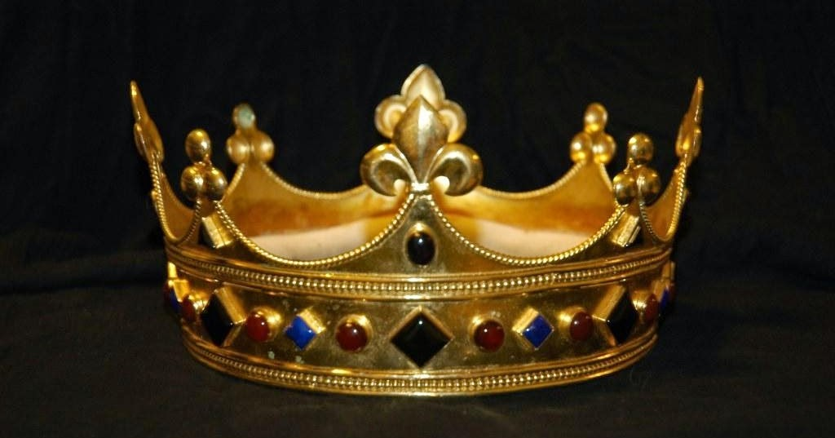
2 Samuel
Dr. Rick Griffith • Jordan Evangelical Theological Seminary • BibleStudyDownloads.org
Notes:
In 2 Samuel, we finally arrive at King David to which 1 Samuel was pointing.

Slide 2
Key Word
209
39
Covenant
2 Samuel
Notes:
We have already seen God's promises to people in earlier books:
Genesis 9 had the covenant with Noah
Exodus 19–24 showed Israel agreeing to God establish the Mosaic covenant
Deuteronomy 30: 1-10 promises the land covenant
Now we see another unconditional promise from God.

Slide 3
Theme
209
God's Covenant
Kindness to David
2 Samuel
Notes:
David receives undeserved favor from God's own good will in 2 Samuel.

Slide 4
Key Verse
209
"For when you (David) die, I will raise up one of your descendants, and I will make his kingdom strong. He is the one who will build a house—a temple—for my name. And I will establish the throne of his kingdom forever" (7:12-13)
2 Samuel
Notes:
The key concern of any king in ancient and modern days is for the next generation—thus the need for sons.
God assured David of not simply one generation after him to build a temple—but actually and eternal dynasty of kings!

Slide 5

Kingdom Statement
39
God delegated His rule to David and his seed by covenant (1–10) and protected his dynasty despite punishing David's sin and the rivals to the throne (11–24).
2 Samuel
Notes:
The Davidic covenant is an unconditional covenant, but this does not mean that it has no conditional element.
It is unconditional in the sense that all kings of Jerusalem into eternity would be related to David.
But it also included discipline. This is best explained in the contrast that God gives in 2 Samuel 7:14-16 (NIV)…
"I will be his father, and he will be my son. When he does wrong, I will punish him with the rod of men, with floggings inflicted by men. 15 But my love will never be taken away from him, as I took it away from Saul, whom I removed from before you. 16 Your house and your kingdom will endure forever before me; your throne will be established forever."

Slide 6

Summary Statement
209
41
God establishes David as king and protects his dynasty despite punishing David's sin and the rivals to the throne to show His justice and faithfulness to fulfill His purposes through His covenant kindness shown to David and his seed.
2 Samuel
Notes:
David makes many mistakes in 2 Samuel, but none of them can undo God's promise of an eternal throne.
David does not try to protect his throne by force but finds God's protection until he lives to a ripe, old age.

Slide 7

Covenant
42c
God restored Israel’s unity in the Davidic covenant (7:12-16) that promised an eternal seed, throne, and kingdom and was not conditioned even on David’s fidelity (11–24).
2 Samuel
Notes:
Chapter 11 records David's horrendous sins of adultery with Bathsheba and murder of Uriah. This sets in order God's discipline but never threatens God's promise of and eternal throne for David's family.

Slide 8

Redemption
42c
Israel's faith in David as redeeming shepherd-ruler (5:2) typifies the redemption faith of other covenant people in the eternal Ruler from David's line who will secure eternal salvation for man.
2 Samuel
Notes:
A responsible shepherd sacrificially guards the flock from enemies and feeds the flock to sustain these helpless sheep. As David protected Israel and fed the people with God's Word, so Jesus protects believers from Satan and instructs us through his Word.
2Sam. 5:1 Then all the tribes of Israel went to David at Hebron and told him, “We are your own flesh and blood. ² In the past, when Saul was our king, you were the one who really led the forces of Israel. And the LORD told you, ‘You will be the shepherd of my people Israel. You will be Israel’s leader.’”

Slide 9

Messiah
42c
David portrays Jesus Christ as the divinely chosen king who will maintain a righteous and eternal reign (cf. Matt. 12:23; 21:15; Luke 1:32, 69; Rev. 5:5).
2 Samuel
Notes:
The key OT trait prophesied of Messiah is his kingship. In the OT, this begins with David and eventually leads to Jesus Christ 1000 year later.

Slide 10
2 Samuel Book Chart
209
GOD'S COVENANT KINDNESS TO DAVID
ESTABLISMENT |  | SIN |  | CONSEQUENCES |  | APPENDIX
TRIUMPH |  | TRANSGRESSION |  | TROUBLES |  | TRIBUTE
OBEDIENCE |  | DISOBEDIENCE |  | JUDGMENT |  | SUMMARY
Chapters 1–10 |  | Chapter 11 |  | Chapters 12–20 |  | Chapters 21–24
Faith | Blessing | Adultery | Murder | Family | Politics | Humility | Pride
1–4 | 5–10 | 11:1–5 | 11:6-27 | 12–14 | 14–20 | 21–23 | 24
OVER JUDAH | O V E R A L L I S R A E L
HEB-RON | FROM J E R U S A L E M
7 years (1011–1004) | 33 years (1004–971 BC)
Notes:
The turning point of the book is chapter 11. After this, David experiences the results of his sins in his family and kingdom.

Slide 11
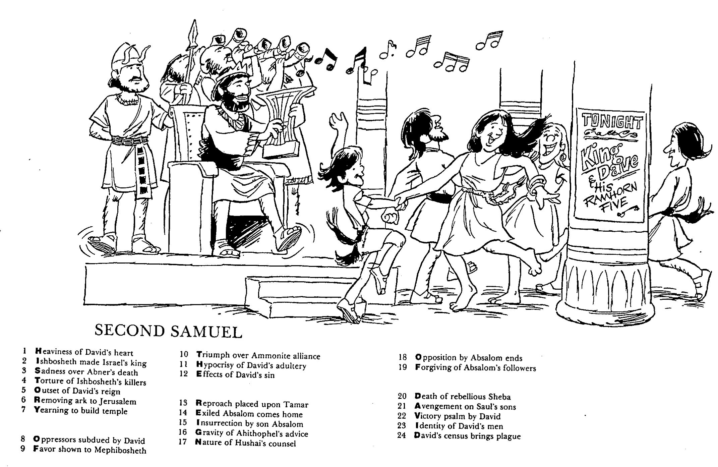
Barry Huddleston, The Acrostic Summarized Bible (Grand Rapids: Baker, 1992)
1 Inception of the world
2 Newlyweds placed in Eden
3 Temptation and man's fall
4 Hatred and first murder
5 Entire genealogy of Adam
6 Lessons on proper priorities
7 Outline for personal relationships
8 Faith of the centurion
Second Samuel
29 Genealogy of Jesus Christ
30 Opposition of King Herod
31 Spirit's descent upon Jesus
32 Power over Satan's temptations
33 Expounding Sermon on Mount
34 Lessons on proper priorities
35 Outline for personal relationships
36 Faith of the centurion
9 Matthew's call from Jesus
10 Apostles sent to preach
11 Testimony about John's message
12 True Messiah called demonic
13 Hidden message of parables
14 Execution of the Baptist
15 Wisdom is answering Pharisees
37 Matthew's call from Jesus
38 Apostles sent to preach
39 Testimony about John's message
40 True Messiah called demonic
41 Hidden message of parables
42 Execution of the Baptist
43 Wisdom is answering Pharisees
16 Keys of the kingdom
17 Impact of Jesus' transfiguration
18 Need for true forgiveness
19 Grounds for divorce clarified
20 Opportunities in the vineyard
21 Fig tree is cursed
44 Keys of the kingdom
45 Impact of Jesus' transfiguration
46 Need for true forgiveness
47 Grounds for divorce clarified
48 Opportunities in the vineyard
49 Fig tree is cursed
22 Taxes paid to Caesar
23 Hypocrisy denounced by "woes"
24 Events of second coming
25 Judgment of the nations
26 Events on Calvary's eve
27 Way of the cross
28 Savior's resurrection and commission
50 Taxes paid to Caesar
51 Hypocrisy denounced by "woes"
52 Events of second coming
53 Judgment of the nations
54 Events on Calvary's eve
55 Way of the cross
56 Savior's resurrection and commission
Notes:
This drawing emphasizes the joy of David's initial reign up through chapter 10. The sad reality of 2 Samuel 11 brought much turmoil to his life afterwards, but God kept his covenant promises throughout David's reign.

Slide 12

Be Kind
2 Samuel
Dr. Rick Griffith • Crossroads International Church Singapore
CICFamily.com • BibleStudyDownloads.org
Notes:
The world certainly needs more kindness, which is one of God's key attributes and one of the most prominent in the book of 2 Samuel.

Slide 13

Kindness is needed.
2 Samuel
Notes:
Everyone has experienced rejection of some sort. Haven't you?

Slide 14
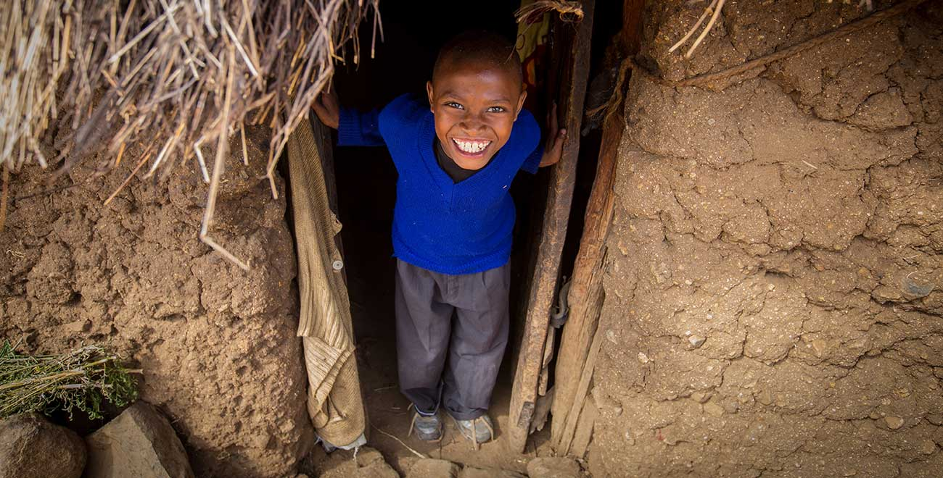
How does God model kindness to us so we can be kind to others?
2 Samuel
Notes:
What examples of benevolence does the Lord show that we should imitate?

Slide 15

I. God’s kindness gives us leaders (1–10).
2 Samuel
Notes:
The LORD grants us his divinely appointed authorities to follow.

Slide 16
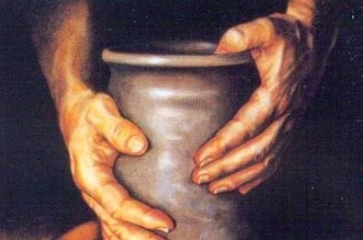
II. God’s kindness gives us discipline (11–24).
2 Samuel
Notes:
The LORD blesses us with inconveniences to turn us back to him.

Slide 17
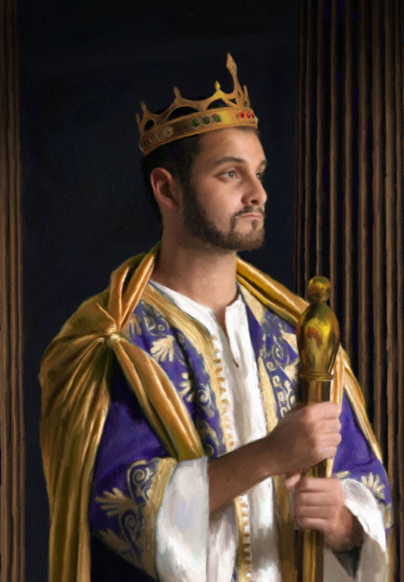
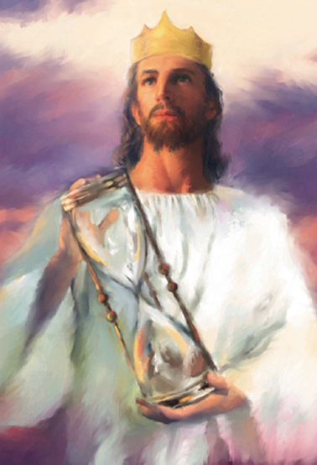
III. David pictures Jesus.
2 Samuel
Notes:
The rule of David pictures the rule of Jesus, who will sit on the throne of David in Jerusalem after his return.

Slide 18
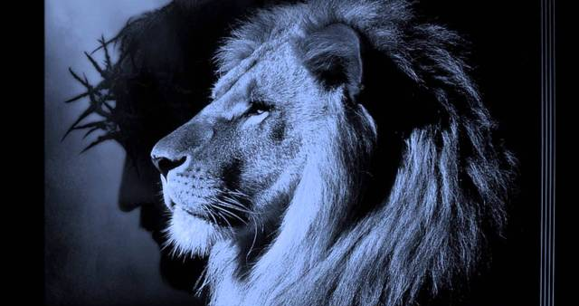
Main Idea
God will rule the world through David’s Descendent,
Jesus.
2 Samuel
Notes:
God has always been sovereign over the world. He has even set up kings and put down kings, as noted in the book of Daniel. He has not yet ruled on an earthly throne through the One who took on flesh in the lineage of David. But he will certainly do it!

Slide 19
How do you respond to God’s kindness in Jesus?
Trust Jesus as your Savior and coming King
Show God’s kindness to others
2 Samuel
Notes:
Kindness is meant to be shared, so first accept God's kindness offered to you in Jesus, the ultimate descendant of David promised in 2 Samuel 7 who will reign in the days ahead.
But then, as a recipient of God's kindness, live for others. Do what you do TODAY to lift other people up rather live for your own pursuits.

Slide 21
Theology of Ruth
193
Judges
Ruth
Samuel
Bethlehem
David
Boaz
Bethlehemites
Idolatry (17–18)
Concubine (19)
Gibeah
Murder (19–20)
Saul
Monarchy
Needed
Monarchy
Prepared
Monarchy
Established
Adapted from Thomas L. Constable, "A Theology of Joshua, Ruth, and Judges,"
in A Biblical Theology of the OT, ed. Roy B. Zuck, 95-96, 117

Slide 22

Introduction
210
Title
"Samuel" comes from Hebrew word Semuel which means "name of El (God)" or "his name is El (God)."
He is the first key figure of the Book of Samuel, though he is not in this latter half called "2 Samuel."
Authors
Probably written by Nathan and Gad (1 Chron. 29:29).
No strong internal evidence indicates an author.
Date
Samuel died in 1015 BC
The final work was between 931-722 BC

Slide 23
Timeline
1-2 SAMUEL
Jesus
David
Abraham
Flood
Today
Kings
Church
Tribes
3000
2000
1000
0
1000
2000
Creation
New Creation

Slide 24

Chronology
1 Samuel
2 Samuel
Samuel's Life
Saul
David
Solomon
Judges
1105
1043
1015
1125
1100
1075
1050
1025
1000
9 7 5
950
130 years

Slide 25
Dates for Saul
1 Samuel
2 Samuel
Samuel
1105
Saul
1080Birth
1050
King
1010
Death
1125
1100
1075
1050
1025
1000
9 7 5
950
130 years

Slide 26
Dates for David
Saul
1 Samuel
2 Samuel
Samuel
1024
Anointed
David
1100
1040
Birth
1010
King
970
Death
1125
1100
1075
1050
1025
1000
9 7 5
950
130 years

Slide 27
Leadership Overlaps
1 Samuel
2 Samuel
Samuel
Saul
David
1100
970
1125
1100
1075
1050
1025
1000
9 7 5
950
130 years
Rick Griffith, ThM, PhD

Slide 28
Judges to Monarchy Dates
1375 Judges begin to rule
1050 Saul becomes king
1010 Saul dies; David is king over Judah
1003 David becomes king over all Israel
997? David and Bathsheba sin
991 Solomon born
980? David's census
970 David dies; Solomon made king
930 The kingdom is divided
Life Application Bible, NIV

Slide 29
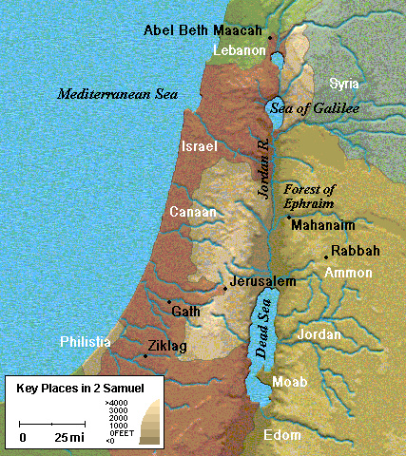
Key Places in 2 Samuel
Life Application Bible, NIV

Slide 30

Making Sense of Samuel, Kings, and Chronicles
264
1
Chronicles
2
Chronicles
Books
1
Samuel
2
Samuel
1
Kings
2
Kings
Kings
Saul
David
Solomon-Ahaziah
Ahaziah-Zedekiah
Dates
1043
1011
971 931 852
852 722 586 560
538
Kingdom
---------United-------
------------------- ---------Divided------------
Surviving
-Returned-

Slide 31

Why Two Records?
264
While Kings & Chronicles overlap in kingdom era details, some notable differences can be cited:
Kings
Chronicles
Kings of…
Israel & Judah
Judah (almost exclusively)
Elements
Royal / prophetic
Priestly (temple and worship)
Evaluation
Based on Mosaic Law
Based on David/worship of Yahweh
Purpose
Ethical: Judging both nations
Covenant: Blessing Judah due to David
Author
Jeremiah the prophet / priest
Ezra the priest
Faith
Man's faithlessness
God's faithfulness
Outlook
Negative: rebellion/tragedy
Positive: hope amidst apostasy/tragedy
Recipients
Exilic Jews (ca. 550 BC)
Postexilic Jews (ca. 440 BC)
Chronology
971-586 BC
1011-538 BC
Emphasis
Political: emphasizes the throne
Spiritual: emphasizes the temple
Content
Historical
Theological
Attributes
God's justice
God's grace
Protagonist
Human responsibility
Divine sovereignty

Slide 32

Be Kind
2 Samuel
Dr. Rick Griffith • Crossroads International Church Singapore
CICFamily.com • BibleStudyDownloads.org

Slide 33
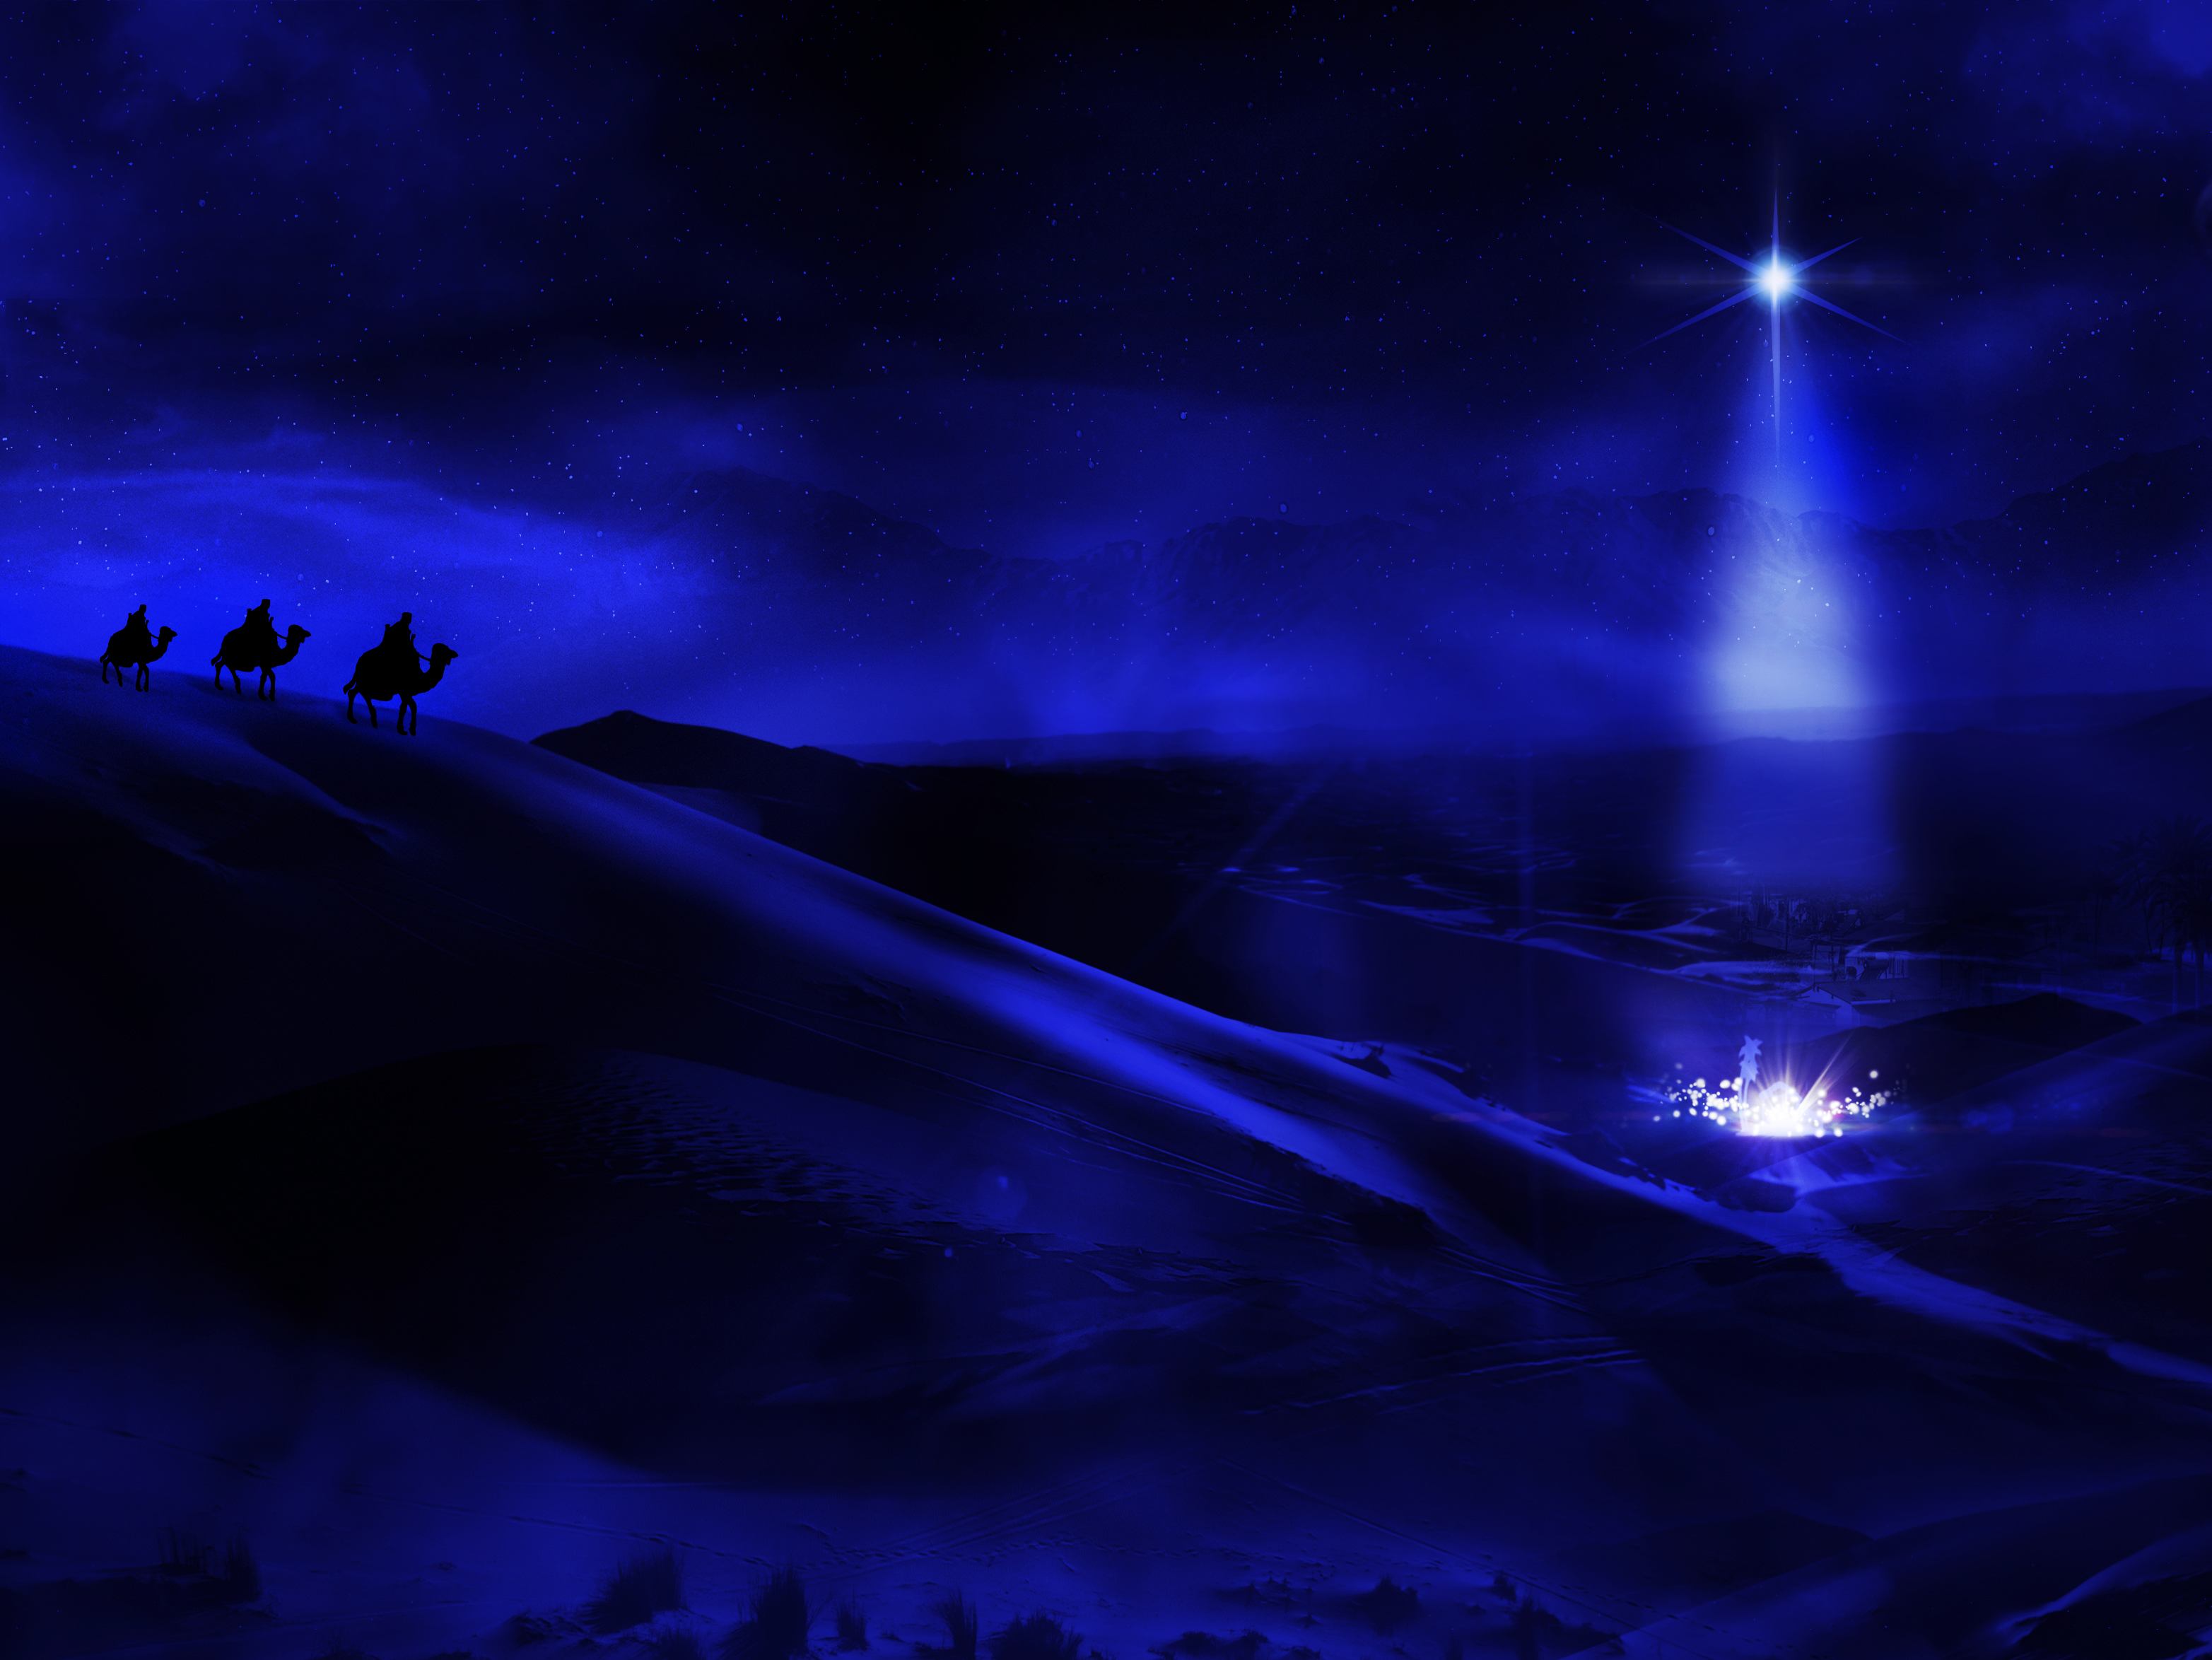
Welcome!
Notes:
Welcome to our service today!

Slide 34
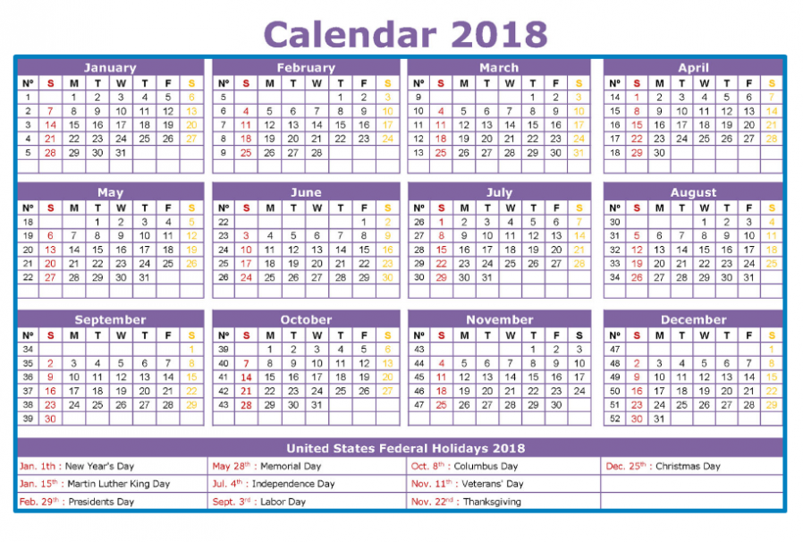
Annual Calendar
Notes:
One of my good friends wrote this week, “Isn't December a strange month? Well, at least I think it is. Doesn't it seem like more people die in December than any other time of year? According to an article in Consumer News (2013)…

Slide 35

The Most Deaths: Dec 25
Notes:
"Christmas Day actually does have more deaths than any other day of the year. Wow. How strange that what should be the most joyful of all days would also be the saddest for many. One theory is that the expectation of joy and cheer exaggerates the reality of darkness and depression for those who feel they have little reason to celebrate. May it not be so for those who have made the Babe of Bethlehem's manger the Source of their salvation. May we also be reminded that, in the midst of our great joy others around us may be suffering; let's be His arms and hands to them.”—Dr. Joe Hale, NICS

Slide 36
Kindness is needed.
Notes:
People need kindness.

Slide 37
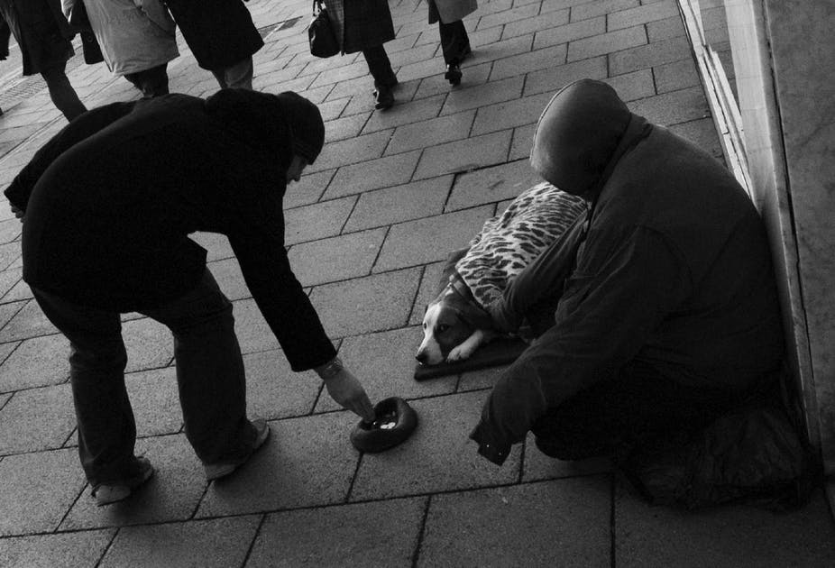
Kindness
Notes:
How are you doing at showing kindness when others are sad?

Slide 38
How does God model kindness to us so we can be kind to others?
Notes:
He shows it to us in the Christmas story probably more than anywhere else in Scripture with the exception of the death of Christ.

Slide 39

Background
Notes:
We last studied 1 Samuel where we saw three key transitions—

Slide 40
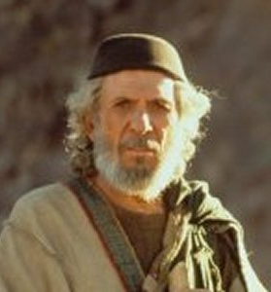
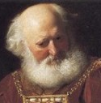
Transition #1
196
1 Samuel 1–7
Eli
Samuel
Notes:
The first transition of national leadership from Eli to Samuel marked the end of judges with Samuel as the last judge (1 Sam 1–7).

Slide 41
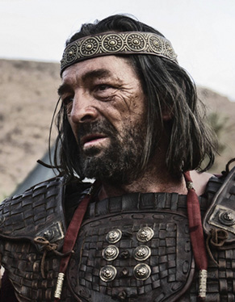
Transition #2
196
1 Samuel 8–15
Samuel
Saul
Notes:
The second transition of national leadership from Samuel to Saul marked the start of the monarchy due to Israel's evil motives (1 Sam 8–12).

Slide 42

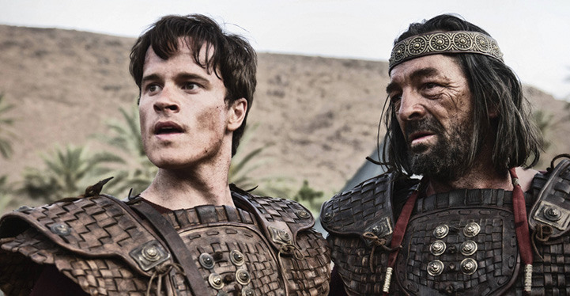
Transition #3 from Saul to David
Transition #3
198
1 Samuel 16–31
Saul
David
Notes:
The third transition from Saul to David marked the quick end of the kingship in the line of Benjamin to the line of Judah as David is anointed king (2 Sam 16–31). By the time we get to 2 Samuel, Saul has just died but David hasn’t been crowned king yet

Slide 43

How will David respond?
Notes:
Saul dies a tragic death in the final chapter of 1 Samuel, so what will David do? Will he rejoice that his enemy who pursued him for ten years finally meets his end? Saul is now out of the way—so how will David respond?

Slide 44
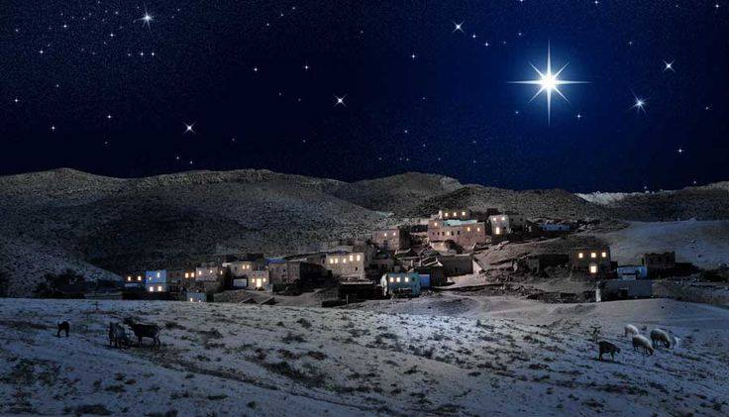
Bethlehem
Bethlehem plays a much larger role in the New Testament as the birthplace of Jesus
Zondervan Atlas
Notes:
How God works in the story of 2 Samuel is the prequel to the Christmas story.

Slide 45

The Star in the East
Notes:
A millennium after David lived, wise men in the east would see a star above David's city.

Slide 46

Follow the Star
Notes:
They would conclude that God was telling them to follow that star to worship David's descendent who would also be the king od the Jews.

Slide 47
How does God model kindness to us so we can be kind to others?
2 ways
Notes:
What examples of benevolence does the Lord show that we should imitate?

Slide 48

Let's Study Through Scripture
The Bible: Book by Book
Notes:
We are in a study through the whole Bible right now, book by book. The goal is to give us a basic understanding of each book of the Bible.

Slide 49
How does God model kindness to us so we can be kind to others?
Notes:
What examples of benevolence does the Lord show that we should imitate?

Slide 50

I. God’s kindness gives us leaders (2 Sam 1–10).
Notes:
The LORD grants us his divinely appointed authorities to follow.

Slide 51
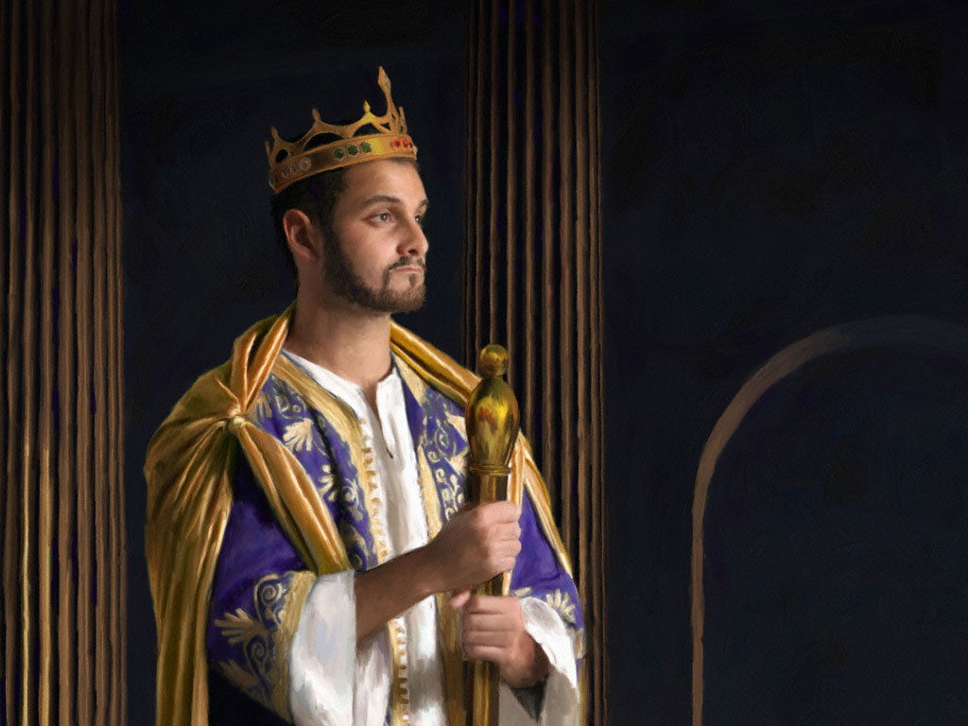
God led Israel by establishing David as king over a renewed, perpetual kingdom
(2 Sam 1–10).
Notes:
The LORD directed his covenant nation through David’s monarchy that would last forever!

Slide 52
Slides on
2 Samuel 1
Notes:
David reigned over Judah at Hebron after Saul's death and trusted God to prepare the entire kingdom without force (2 Sam 1–4).

Slide 53
2 Samuel 1–10 Chart
209
E S T A B L I S H M E N T
T R I U M P H
O B E D I E N C E
CHAPTERS 1–10
F A I T H | B L E S S I N G
1–4 | 5–10
Over Judah | Over All Israel
From HEBRON | From JERUSALEM
7 Yrs. (1011–1004 BC) | 7 Yrs.? (1004–997? BC)
Notes:
David's rule over Judah at Hebron is a test of faith because he refuses to seize the kingdom by force (2 Sam 1–4).

Slide 54
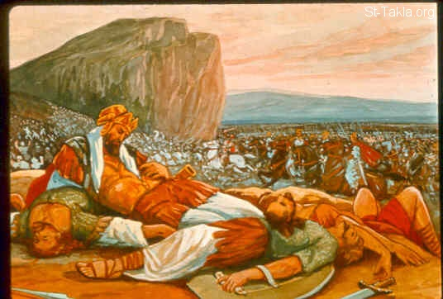
Saul died with his sons Jonathan, Abinadab, and Malkishua (1 Sam. 31:2)
200
Notes:
Saul is out of the way now, but will David change his leadership style to become one who seizes power?

Slide 55
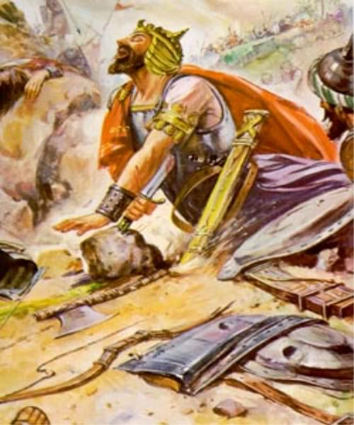
Saul killed himself
(1 Sam. 31:4) but an Amalekite lied by saying he did it instead (2 Sam. 1:10)
200
Notes:
Actually, the messenger of Saul's death lies to David by saying that he killed Saul. David then kills the messenger to show that he would not grasp for power by worldly means!

Slide 56
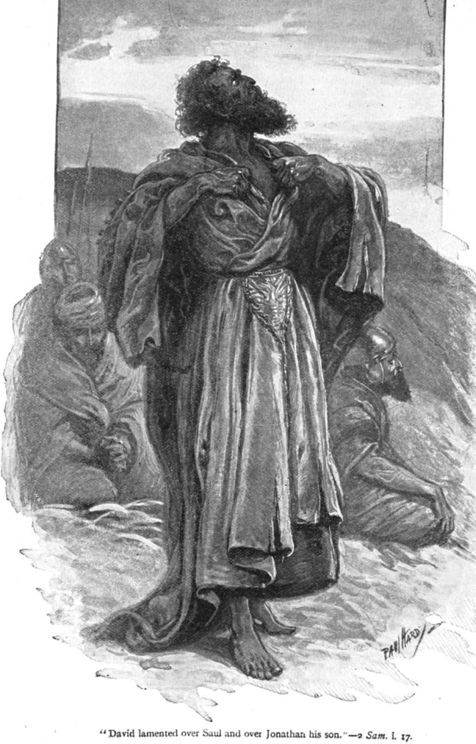
Grief over Saul (1:17)
David lamented over the deaths of Saul and Jonathan
(2 Samuel 1:17)

Slide 57
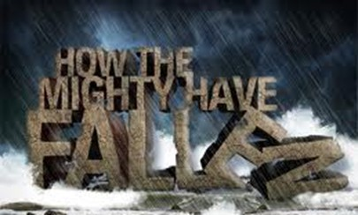
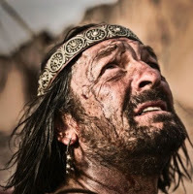
David laments the death of Saul and his sons (2 Sam. 1:17-27)
HOW THE MIGHTY HAVE FALLEN
200

Slide 58
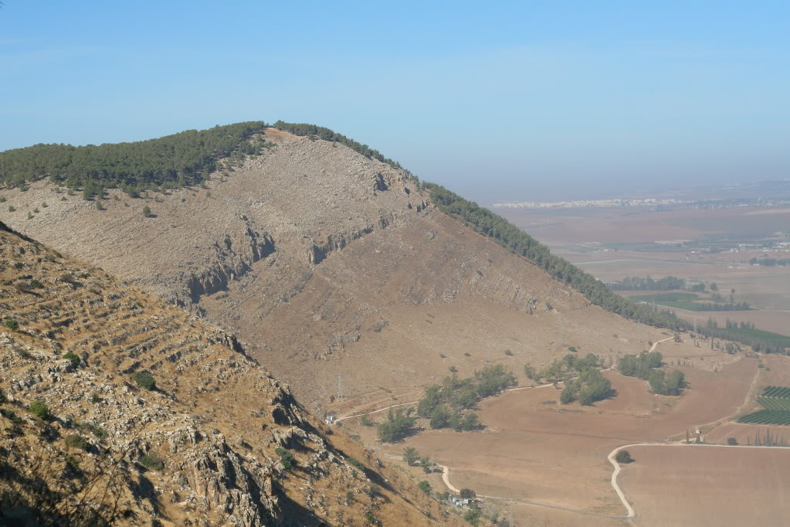
Mount Gilboa today
"O mountains of Gilboa, let there be no dew or rain upon you, nor fruitful fields producing offerings of grain. For there the shield of the mighty heroes was defiled; the shield of Saul will no longer be anointed with oil"
(2 Sam. 1:21 NLT).
Notes:
David even places a curse on the place of Saul's death in northern Israel at Mount Gilboa. To this day it has little or no vegetation!
"Most of east side of Mt. Gilboa looks barren, although modern foresting added green colors to some parts of this side of the mountain"
("Saul's Shoulder," http://www.biblewalks.com/Sites/SaulShoulder.html accessed 23 Dec 2017).

Slide 59
Slides on
2 Samuel 2

Slide 60
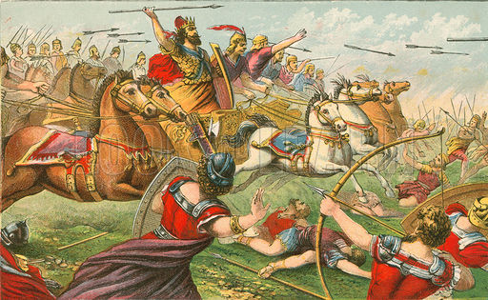
David defeats Abner
Field of Swords
2 Samuel 2:15-17
Notes:
David became king of Judah at Hebron, but Saul's commander Abner crowned Saul's son Ish-Bosheth king over Judah against God's purposes (2:1-11).

Slide 61
Slides on
2 Samuel 3
Notes:
David refused to take the kingdom by force but trusted God to judge rivals to his throne (2:12–4:12).

Slide 62
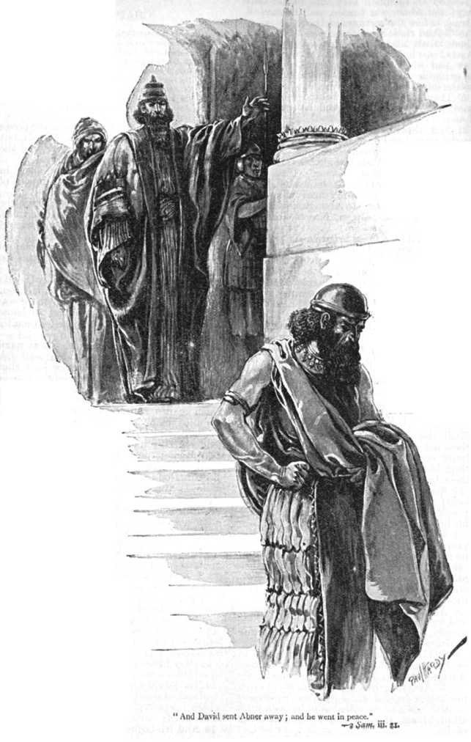
Abner sent away (3:21)
David sent Abner away in peace
(2 Sam. 3:21)
Notes:
Abner initially fought David's commander Joab but then defected to David's side and Joab killed him to remove a potential rival to the throne (2:12–3:39).

Slide 63
Slides on
2 Samuel 4

Slide 64
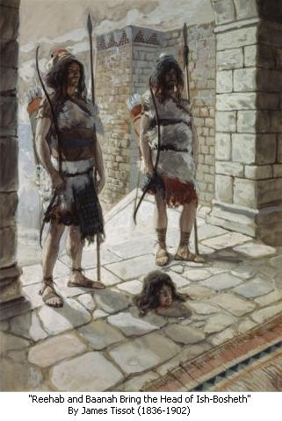
David killed
Ish-Bosheth’s murderers to punish seizing his kingdom for him by force (2 Sam 4).
200

Slide 65
Slides on
2 Samuel 5
Notes:
David reigned over all Israel at Jerusalem and renewed the kingdom as evidence of God's blessing on him and his dynasty (2 Sam 5–10).

Slide 66
Chapters 5–10 shows David over all Israel at Jerusalem with new…
NEW!
211
5 Capital (Jerusalem)
6 Worship center (Ark moved)
7 Dynasty (Davidic Covenant)
8 Boundary (Kingdom Expansion)
9 Son (Mephibosheth)
10 Vassals (Ammon and Syria)
Notes:
The key word of chapters 5–10 is NEW!

Slide 67

David: Hebron to Jerusalem
171
Asher
Naphtali
Zebulun
Manasseh
Issachar
2 Samuel 5
Manasseh
Gad
Ephraim
Dan
Benjamin
Jerusalem
Reuben
Judah
Hebron
Simeon

Slide 68
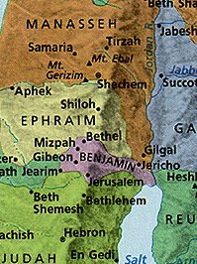
Central Location
Jerusalem was in Benjamin next to Judah but close to the northern tribes
Jerusalem
Notes:
68
Some say Jerusalem was in the "navel" of Israel, meaning the center!

Slide 69
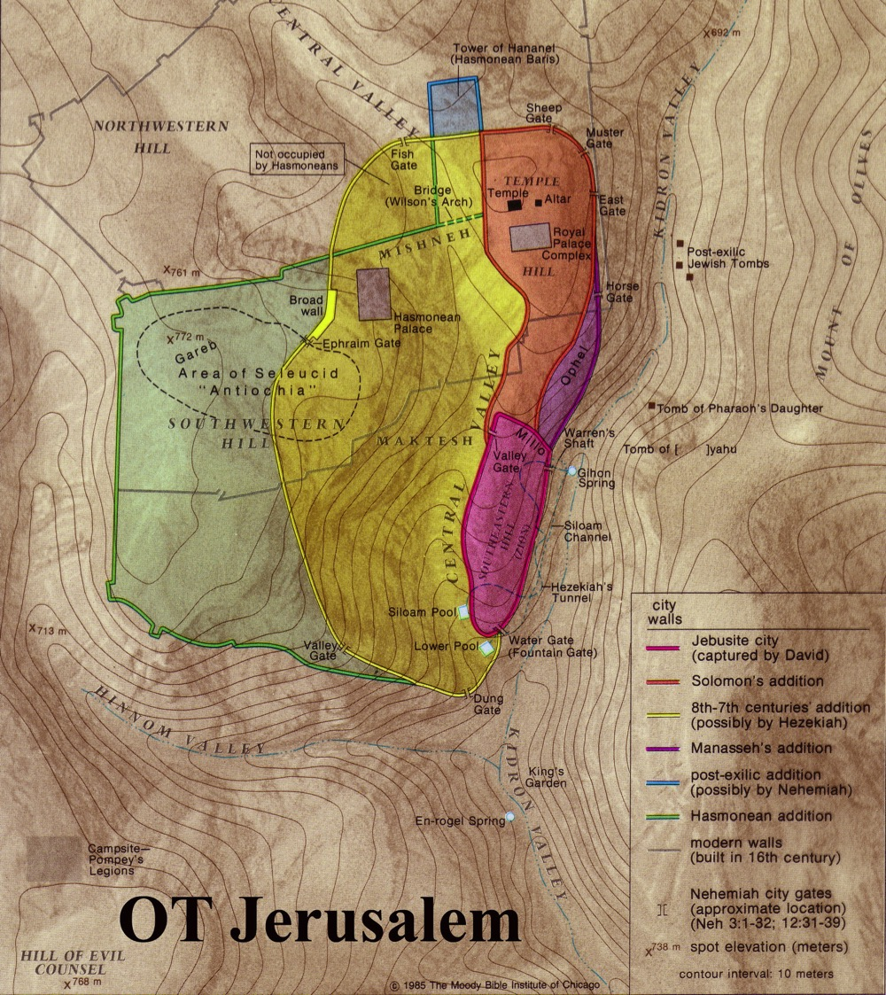
Jerusalem was a Border City
The OT border between Benjamin and Judah ran just south of the city
Benjamin
Judah

Slide 70
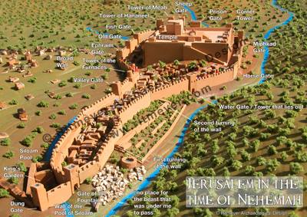
Jerusalem had room to expand to the north for a temple
Chapter 5

Slide 71
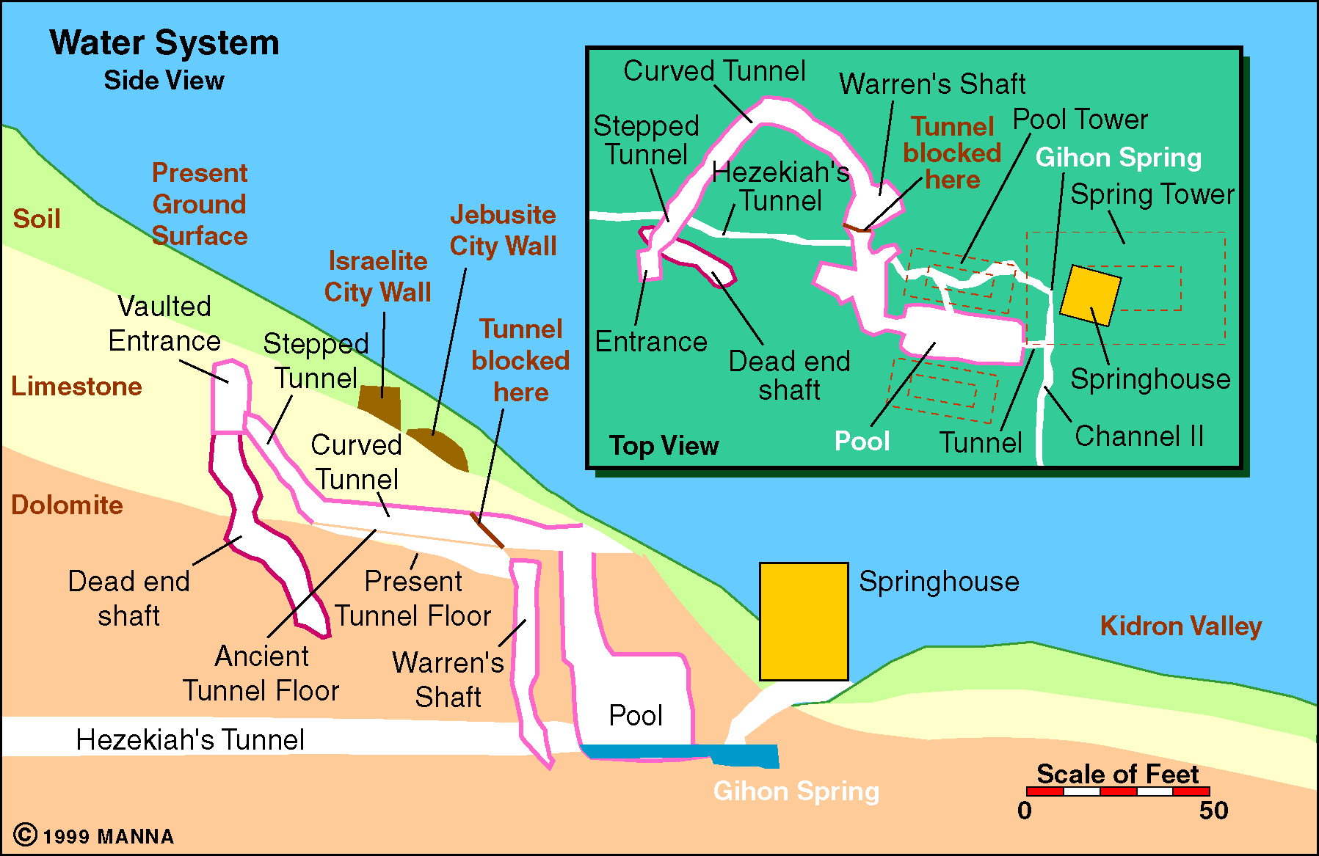
Jerusalem Water System
215
New Capital
(2 Sam 5)
Gihon Spring

Slide 72
Slides on
2 Samuel 6

Slide 73
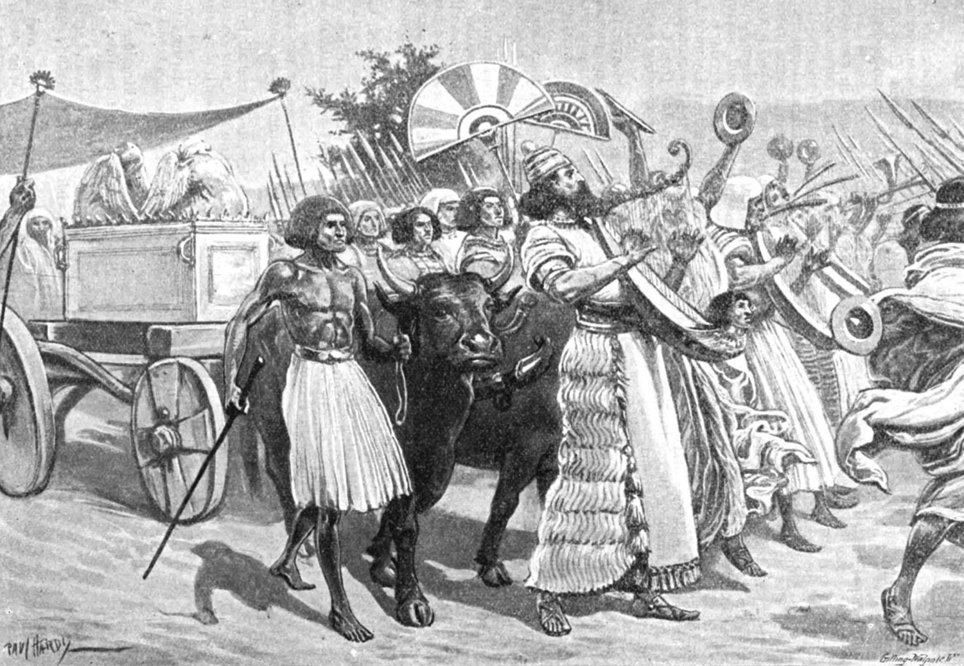
King David brought the Ark to Jerusalem
(2 Samuel 6:5-15)
New Worship Center
(2 Sam 6)

Slide 74
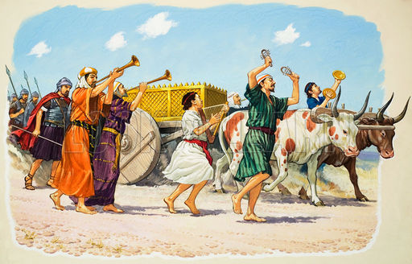
David and the ark (2 Samuel 6)
200

Slide 75
Slides on
2 Samuel 7

Slide 76
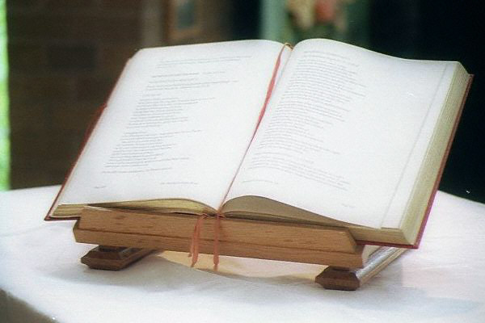
KEY WORD
209
KEY WORD:
COVENANT
New Dynasty
(2 Sam 7)

Slide 77
KEY VERSE
209
2 Samuel 7:12-16
New Dynasty
(2 Sam 7)

Slide 78
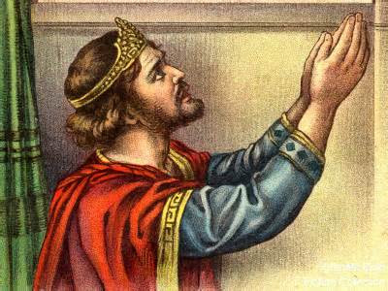
COVENANT KINDNESS TOWARDS
DAVID'S DYNASTY
209
Notes:
God has the right to choose which people He wants to use to bless the rest. He chose to raise up David's line to bless the rest of us! Let's look deeper now to see how he has done it and will do it.l
___________________
OS-10-Davidic Covenant-14
OS-10-2Samuel-78

Slide 79
Covenants of Promise
BLESSING
Walt Russell, Playing with Fire, p. 121
Amplified by
Abrahamic
Davidic
Administrative Covenants
How to experience the blessing
Mosaic Israel's terms of obedience
Superseded by
New Terms of obedience under Messiah
Walt Russell, Playing with Fire
Notes:
OS-12-2Sam-79
OS-29-Joel-123

Slide 80
Covenants of Promise
BLESSING
Walt Russell, Playing with Fire, p. 121
Amplified by
Abrahamic
Davidic
2 Samuel 7:12-16
Administrative Covenants
How to experience the blessing
Mosaic Israel's terms of obedience
Superceded by
New Terms of obedience under Messiah
Walt Russell, Playing with Fire

Slide 81
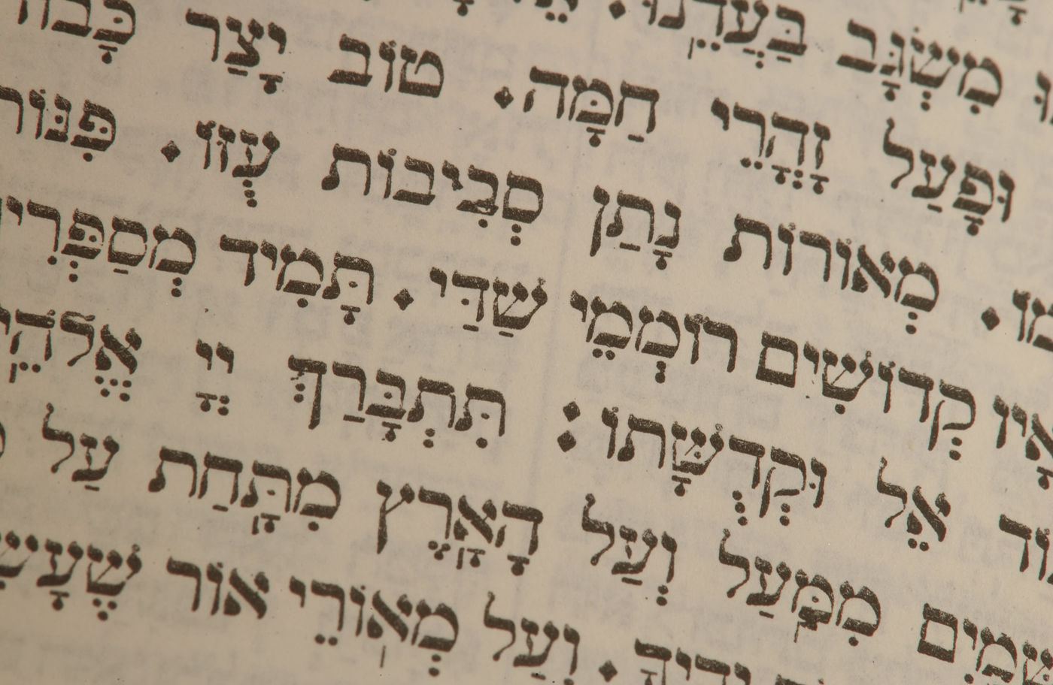
The Promised Seed
David met the lineage requirements of Judah's line (Genesis 49:10; Numbers 24:17)
Notes:
Jacob predicted that "the scepter would not depart from Judah" (Gen 49:10), so the kingly line would come from Judah and never be transferred to any other line.
___________________
OS-10-Davidic Covenant-30
OS-10-2Samuel-81

Slide 82

The Lineage of
David
ABRAHAM
Isaac
Jacob
Judah
Perez
Hezron
Ram
Amminadab
Nahshon
Salmon
Boaz
Obed
Jesse
DAVID

Slide 83
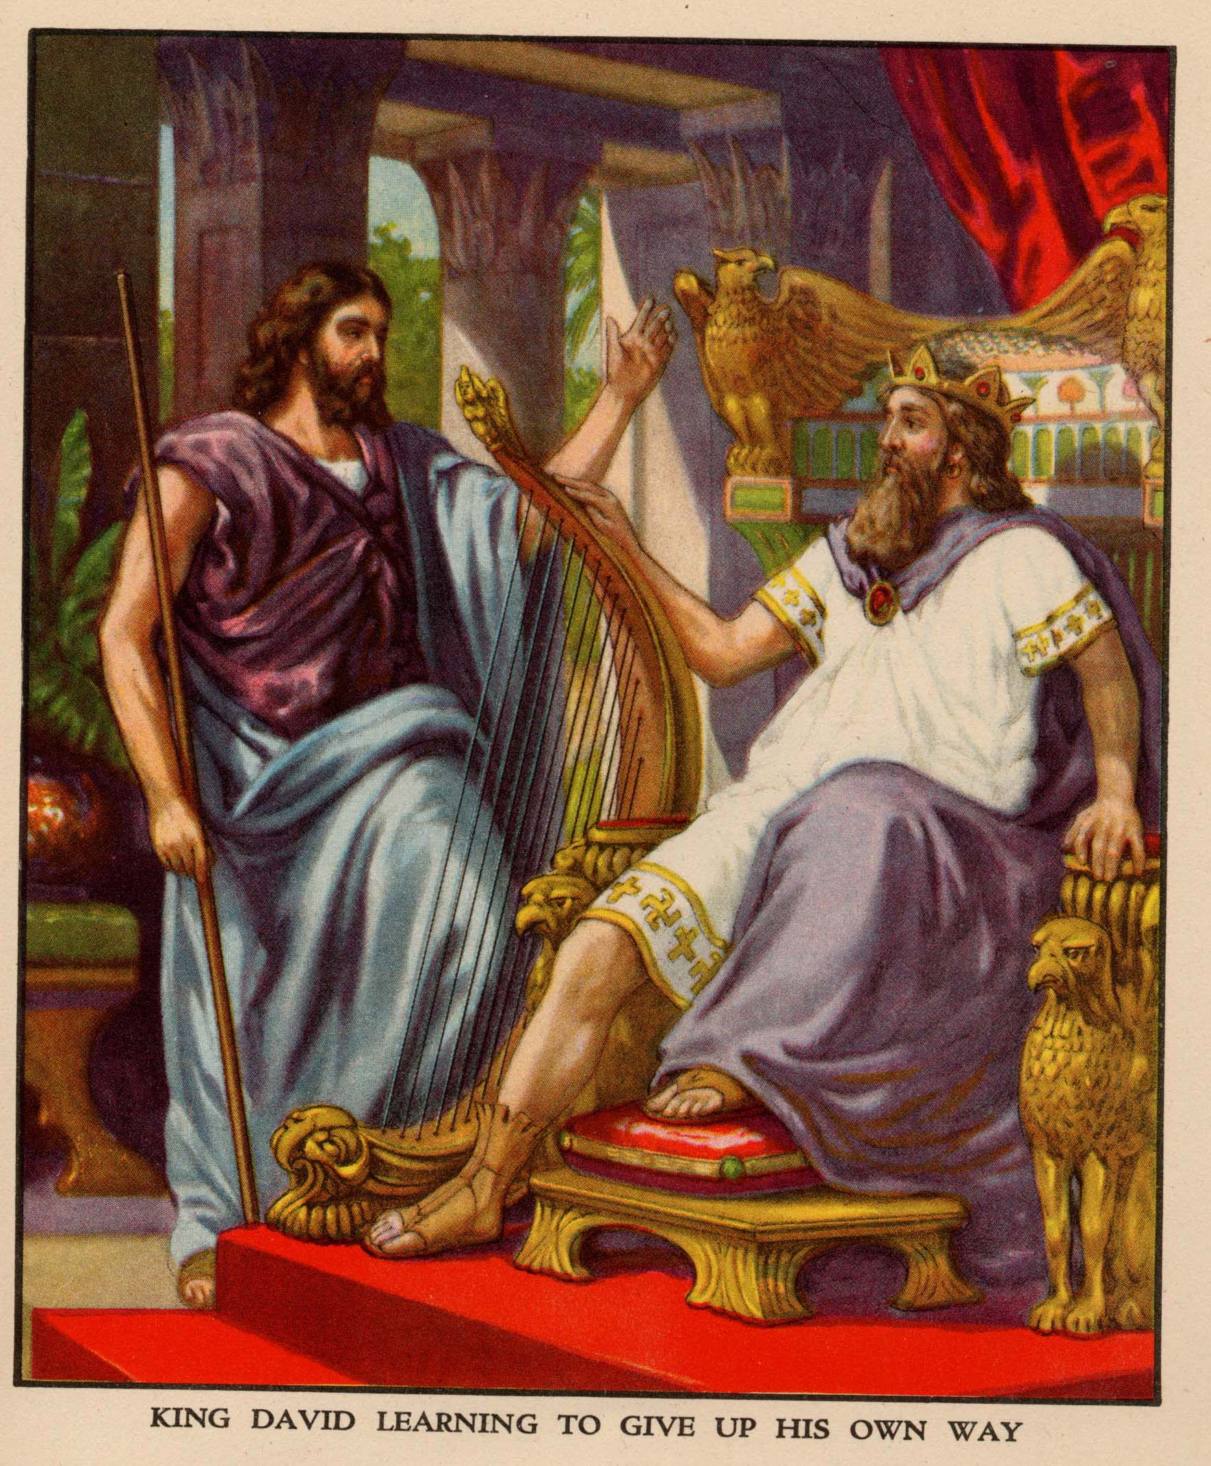
Nathan related God's promise to David (2 Sam. 7)

Slide 84
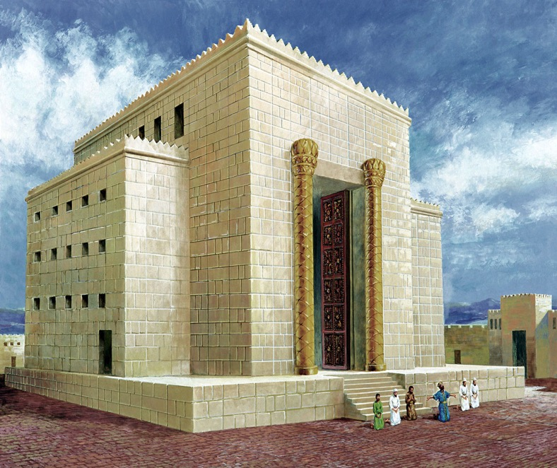


David's House:
"I want to build a house for you…"
D
A
V
I
D
Notes:
David envisioned building the temple.
___________________
OS-10-Davidic Covenant-35
OS-10-2Samuel-84

Slide 85
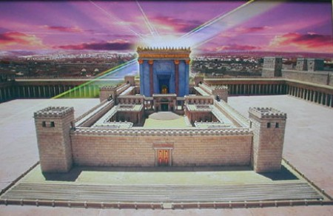
But who would build the Temple ?
God's House:
"I want to build a house for you…"
Notes:
It was not immediately clear to David who would build the temple.
___________________
OS-10-Davidic Covenant-36
OS-10-2Samuel-85

Slide 86
KEY VERSE:
2 Samuel 7:12-13
209
"For when you (David) die, I will raise up one of your descendants, and I will make his kingdom strong. He is the one who will build a house—a temple—for my name. And I will establish the throne of his kingdom forever."
Notes:
The Davidic covenant is an eternal promise from God.
______________
Common-283
OS-10-2 Samuel-86
NS-01-Matt1-14-slide 131
NS-03-Luke1-12-slide 197

Slide 87

Promises of the Davidic Covenant
22
What did God promise David in 2 Samuel 7:12-16?
New Dynasty
(2 Sam 7)
Notes:
With your study partner(s), list as many promises as you can that God gave to David in these five verses.
___________________
OS-10-Davidic Covenant-04
OS-10-2Samuel-87
NS-01-Matt1-14-slide 158

Slide 88
Davidic Covenant
2 Samuel 7:12-16
"And when your days are fulfilled and you sleep with your fathers, I will set up after you YOUR OFFSPRING who shall be born to you, and I will establish HIS KINGDOM.
He shall build a house for My Name [and My Presence], and I will establish the THRONE of HIS KINGDOM FOREVER.
I will be his Father, and he shall be My son. When he commits iniquity, I will chasten him with the rod of men and with the stripes of the sons of men.
But My mercy and loving-kindness SHALL NOT DEPART from him, as I took [them] from Saul, whom I took away from before you.
And your house and your kingdom shall be made sure forever before you; YOUR THRONE shall be ESTABLISHED FOREVER."

Slide 89
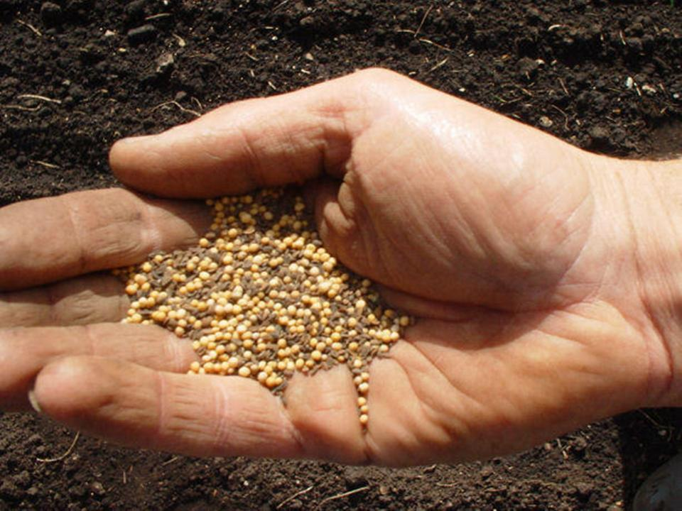
The Davidic Covenant is…
a continuation of the seed aspect of the
Abrahamic Covenant and the promise
that kings would come from Abraham
(Genesis 17:6-7)

Slide 90
The Three Basic Elements
7
Genesis 12
The Lord had said to Abram,
"Leave your country, your people and your father's household, and go to the land I will show you.
1
A LAND
A SEED
"I will make you into a great nation
and I will bless you;
I will make your name great,
and you will be a blessing.
2
ABRAHAM
The CALL
I will bless those who bless you,
and whoever curses you I will curse;
and all peoples on earth
will be blessed through you."
L - S - B
3
A BLESSING
Handbook pg. 19-24
14
2
Notes:
God appeared to Abram with a threefold promise:
God told this nomad who grew up in the city of Ur that he would provide for him and his descendants a land to live,
God promised this 75-year-old man with a barren wife of decades that he would father an entire nation to come from that barren wife Sarah, and
God assured that the nation that came from him would bless all peoples—especially fulfilled through Jesus, who came 2000 years later to die for the whole world.
_________
Common-163
BB-3B-Abraham-Joseph-18
OS-01-Gen4-20-slide 215
OS-10-2Samuel-90

Slide 91
The Elements Expanded
60
7
Abrahamic Covenant
Gen. 12:1-3
LAND SEED BLESSING
ABRAHAM
The CALL
L - S - B
12:1
12:2
12:3
"L-S-B"
Handbook pg. 19-24
15

Slide 92
The Abrahamic Covenant
("The Call")
Genesis 12:1-3
Three Overriding Characteristics!
ABRAHAM
LAND
SEED
BLESSING
The CALL
L - S - B
• LITERAL
• ETERNAL
• UNCONDITIONAL
17
3
Notes:
Now...to the basic outline of the promise...L-S-B-...for LAND, SEED, and BLESSING...we can also add these basic concepts...three additional ideas that describe the characteristics of that Abrahamic Promise...
//// First…that great promise was -- and is -- LITERAL in that the words mean exactly what they say.
//// It is also ETERNAL, an unending arrangement, guaranteed by the maker of the contract, God Himself. And finally...
//// It is UNCONDITIONAL...indicating that no matter what Abraham or his descendants might do in the future, God would, in time…REPEAT: IN TIME…fulfill every element of His promises.
As we move farther through this story, we'll come to see how the entire Bible is built on that set of unconditional and foundational promises.... soon to become a legal contract between God and his friend, Abraham.
_________
Common-285
BB-3B-Abraham-Joseph-20
OS-10-2Samuel-92

Slide 93
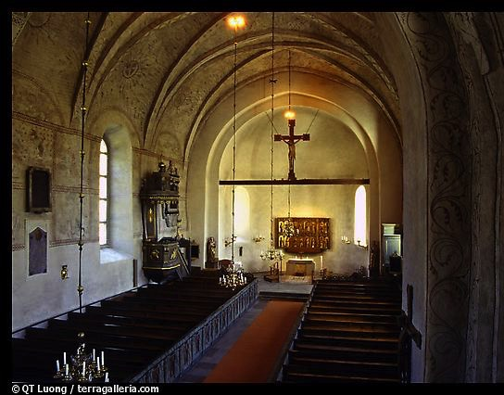
Types of Unconditional Covenants
60
Abrahamic
Land
Davidic
New
Land | Seed | Blessing
Physical | Political | Spiritual
Deut. 30 | 2 Sam. 7 | Jer. 31
Notes:
The three key provisions of the Genesis 12:1-3 Abrahamic Covenant are later amplified in three other covenants in the OT. All will be fulfilled when Christ returns to reign on this earth:
Israel will finally live in the land that God gave as an eternal possession (Genesis 17:8),
Messiah’s rule will finally provide the world with righteous leadership (Isaiah 11),
The blessing to Israel will include many Gentiles among them (Ezek 47-48).
We have already seen how the Abrahamic Covenant is fleshed out further in three other OT covenants.
Covenant is also prominent in the very names of the Old Testament (Old Covenant) and New Testament (New Covenant).
We don’t have these major divisions of the Bible called the Old Kingdom and New Kingdom—or Old Worship and New Worship—or some other designation that highlights a different theme.
_________
Common-171
OS-00-Intro & Biblical Theology-54
OS-01-Gen4-20-slide 219
OS-10-2Sam-93
OS-29-Joel-122

Slide 94

How does the Davidic Covenant relate to Jesus?

Slide 95
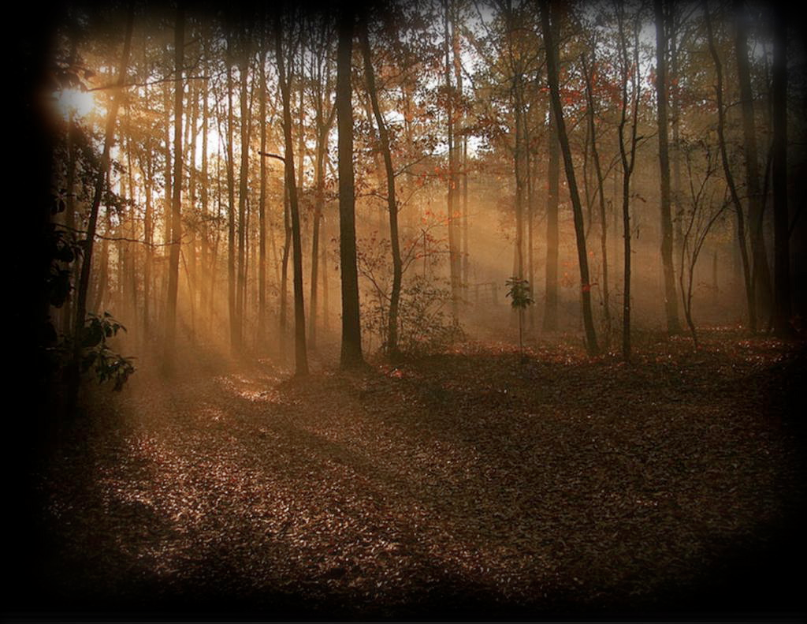
Jesus is the Promised
Son Of David
Nine times Jesus is called "son of David" in Matthew (compared to twice in Mark and Luke and none in John). David is referred to 59 times in the New Testament (NIV).
Jesus' birthplace, Bethlehem, is recalled as "the city of David" (Matt. 2:1; 1 Sam. 20:6)
Notes:
All Christians agree that the Davidic Covenant finds its fulfillment in Jesus, though how and when this happens is debated.
___________________
OS-10-Davidic Covenant-54
OS-10-2Samuel-95
NS-01-Matt1-14-slide 163

Slide 96
Kingdom & Covenants Timeline
22
CH-34a
OS1-22
OS2-337
NS-9g
SA-19
34a
Dr. Rick Griffith • BibleStudyDownloads.org
22
Kingdom Teaching...
Adam rules with God (Gen. 1:26, 28; 2:19)
Satan begins rule as god of this world (Gen. 3:15;
2 Cor. 4:4)
God covenants with Abraham to reestablish man's rule via Israel as a "kingdom of priests" (Gen. 12:1-3; Exod. 19:6)
Israel's failure to witness to nations as a kingdom of priests is judged via exile under foreign rule
Israel rejects Messiah's offer of kingdom (Matt. 12:41-42; 23:37-39)
Jesus extends His kingdom in mystery form to the Church (Matt. 13)
Christ subdues Israel's enemies and nation believes (Rom. 11:26-27)
Christ rules over everything with saints (Eph. 1:9-10; Rev. 20:1-6; 22:5b)
337
9g
Fall of Man (Gen. 3)
Noahic Covenant
19
Genesis 6:18; 9:8-17
Land Covenant
ISRAEL
CHURCH
MESSIANIC KINGDOM
(National Focus)
The "New Man" (Eph. 2:15)
Millennial Eternal
land
Genesis 15:18 (cf. Deut. 30:1-10) promises:
Land from Wadi of Egypt to Euphrates River (Isa. 27:12)
Eternal possession of land (Gen. 17:8) after exile/restoration
Whole world blessed via the land (Isa. 14:1-2)
Israel judged for rejecting Messiah by dispersion away from land for 19 centuries
(AD 70–AD 1948) but now partially restored (Ezek. 37:1-7)
Full restoration (Ezek. 37:8-28) Jerusalem world capital
(Isa. 2:1-5)
New Jerusalem
(Rev. 21–22)
Davidic Covenant
Christ is Head over His Church, which is a spiritual temple (Eph. 2:19-22; 2 Cor. 6:16)
Christ reigns over the world
(Isa. 11)
with saints (Rev. 5:10; 20:4-6)
Christ hands kingdom over to Father (1
Cor. 15:24)
Genesis 12:1-3
2 Samuel 7:12-16 promises:
Sons ("house" never wiped out)
Kingdom (political dynasty)
Throne (right to rule by descendants)
Temple (son to build it)
seed
Abrahamic Covenant
New Covenant
All
things made new!
(Rev. 21:5)
All 5 elements fulfilled in national restoration (Zech. 8)
Jeremiah 31:31-34 promises:
Forgiveness
Indwelling Spirit
New heart, nature, mind
Reunification of Israel and Judah
No need for evangelism
Mosaic Law replaced with first three elements of the New Covenant (Luke 22:20; 2 Cor. 3:6)
blessing
Mosaic Covenant
Law abolished, fulfilled, and replaced at the cross (Rom. 7:1-6;
1 Cor. 9:19-21; Heb. 8:13)
10th Edition
10 Nov 2020
Temporary (Gal. 3:19) and conditional (Deut. 28) to reveal sin (Rom. 7:7) and regulate Israel (Gal. 3:23-25)
Scripture has a dual kingdom-covenant theme. Israel's role from Abraham to Christ expands to include the Church (continuity) yet the Church never replaces the nation as the "new Israel" (discontinuity). Israel will enjoy world prominence after trusting Christ at His second coming.
Notes:
All agree that a partial fulfillment of the covenant to Abraham exists now to the Church in the indwelling Holy Spirit and forgiveness of sins (Jer 31:31-34)—and the ultimate fulfillment will be in the eternal state.
The main area of disagreement relates to the time period from now to eternity. Will there be a literal land, throne, and worldwide blessing to national (ethnic) Israel before the eternal kingdom? This chart shows verses giving a resounding YES to that question in a present partial fulfillment and a future full fulfillment in the normal sense of language in the verses cited. But the messianic kingdom will be in two stages—first in a millennial fulfillment to last 1000 years, but then, after that, the eternal stage in the new Jerusalem after the destruction of our present heavens and earth (Rev 21–22). What an amazing future remains for those who trust Jesus!
____________
Common English-7
CH-02-Nature-103-p34a
OS-02-Exodus-267-p22
OS-05-Deut-248-p22
OS-10-2Sam-96-p22
OS-24-Jeremiah-174-p337
OS-23-Isaiah-97-p337
NS-09-Gal-125-p9g
NS-19-Hebrews-319-p9g
SA-08-Mosaic Law-19-p38a

Slide 97
Promises of the Davidic Covenant
22
What did God promise David in 2 Samuel 7:12-16?
Sons: "house" never wiped out
Kingdom: political dynasty (each Jerusalem king will be one of his direct descendants)
Throne: As an eternal covenant (v. 16), the right to rule will remain with his family forever
Temple: Solomon will build it
Discipline: God will punish disobedient kings but still unconditionally keep these promises
New Dynasty
(2 Sam 7)
Notes:
Here is one way to sum up God's promises to David.
___________________
OS-10-Davidic Covenant-18
OS-10-2Samuel-97
NS-01-Matt1-14-slide 160

Slide 98

Christ Descended from Judah
"Judah, my son, is a young lion that has finished eating its prey. Like a lion he crouches and lies down; like a lioness—who dares to rouse him?
¹⁰The scepter will not depart from Judah, nor the ruler's staff from his descendants, until the coming of the one to whom it belongs, the one whom all nations will honor" (NLT).
Since Jacob's blessing in Genesis 49:9-10, the lion has depicted a king…
Notes:
God showed Jacob nearly 2000 years before the birth of Jesus that the Messiah would come from Judah in the south of Israel. Royalty in the image of a lion, a scepter, and a ruler's staff all point to Jesus, who will receive worldwide honor and worship.
____________
Common-177
OS-01-Gen37-50-slide 275
OS-10-2Sam-98
NS-01-Matt1-14-slide 71

Slide 99
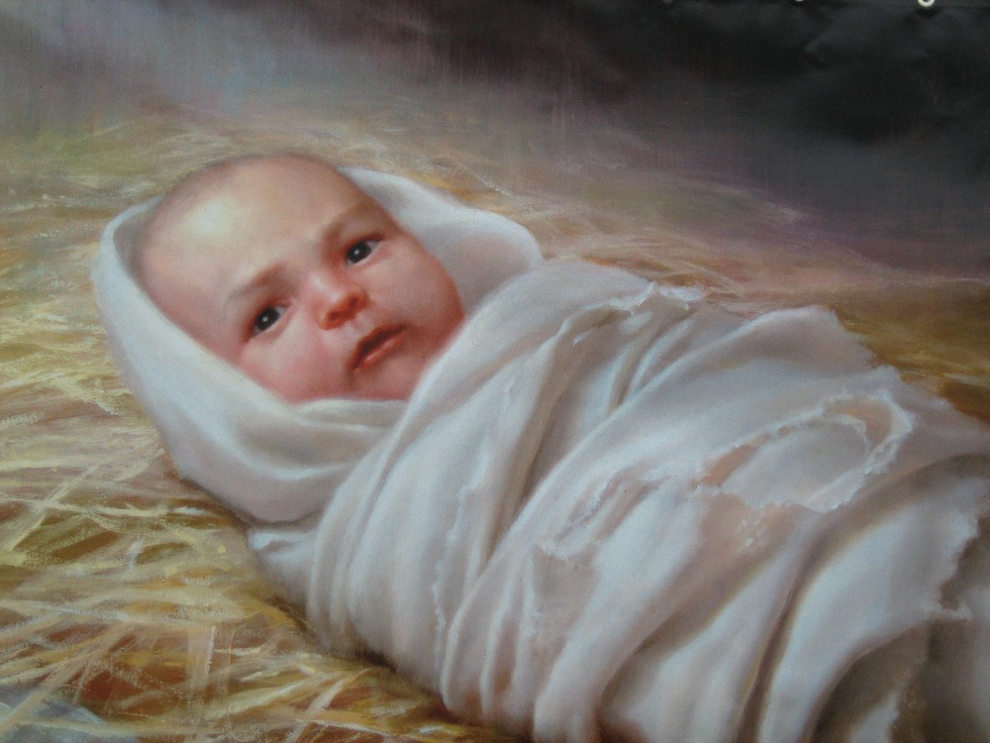
What would be the Messiah's lineage?
Notes:
___________________
OS-10-Davidic Covenant-53
OS-10-2Samuel-99
NS-01-Matt1-14-slide 161

Slide 100
The Kingdom in Matthew 1
Fall of the Kingdom
Establishing the Eternal Kingdom
ABRAHAM
Solomon
Shealtiel
Isaac
Rehoboam
Zerubbabel
Jacob
Abijah
Abiud
Judah
Asa
Eliakim
Perez
Jehoshaphat
Azor
"Thus there were fourteen generations in all from Abraham to David, fourteen from David to the exile to Babylon, and fourteen from the exile to Christ."
Matthew 1:17
Ahaziah
Hezron
Jehoram
Zadok
Joash
Ram
Uzziah
Akim
Amaziah
Amminadab
Jotham
Eliud
Nahshon
Ahaz
Eleazar
Salmon
Hezekiah
Matthan
Boaz
Manasseh
Jacob
Obed
Amon
Joseph +
Mary
Rise of the Kingdom
Jesse
Josiah
KING DAVID
JECONIAH (EXILE)
JESUS CHRIST
Notes:
Matthew’s genealogy omits three kings between Jehoram and Uzziah (=Azariah), giving 14 generations in each period of the rise, fall, and preservation of the kingdom until Jesus.
The Bible has several genealogies of the Davidic line:
Perez to David (Ruth 4:18-22)
David (1000 BC) to the sons of Elionai around 400 BC (1 Chron 3:9-17)
Abraham to Jesus (Matt 1:1-17)
Adam to Jesus (Luke 3:23-38)
One difficulty concerns the son of Jehoiachin/Jeconiah/Coniah in the Davidic line. Was his son Shealtiel (Matt 1:12) or should we follow the line of Jehoiachin with his other son Pedaiah (1 Chron 3:17) or his son Rhesa (Luke 3:27), the latter not even listed among the seven sons of Jehoiachin in 1 Chron 3:17?
“2. DESCENDANTS OF SOLOMON (3:10-24)
3:10-24. This list of Solomon’s descendants is in effect a list of Judah’s kings from Solomon through Zedekiah (vv. 10-16) and their exilic and postexilic continuation (vv. 17-24). Athaliah, the queen who ruled between Ahaziah and Joash, is not mentioned (v. 11). That is because she was only a political usurper and was not in the true dynastic succession (cf. 2 Kings 11). Of the sons of Josiah, Johanan (1 Chron. 3:15) is otherwise unknown. He cannot be Jehoahaz (2 Kings 23:31) because Jehoahaz was [Vol. 1, p. 595] younger than Jehoiakim (cf. 2 Kings 23:36). This means that Shallum (1 Chron. 3:15) is identical to Jehoahaz who, though the next-to-youngest son of Josiah, preceded his brothers on the throne (cf. Jer. 22:11-12).
The remainder of the succession followed by the chronicler is Jeconiah (Heb.; cf. NIV marg. of 1 Chron. 3:16; also known as Jehoiachin; cf. v. 17 and 2 Kings 24:8, and Coniah, Jer. 22:24, marg.). Then came Pedaiah (1 Chron. 3:18), Zerubbabel (v. 19), Hananiah (v. 19), Shecaniah (v. 21), Shemaiah (v. 22), Elioenai (v. 23), and Hodaviah (v. 24).
Three difficulties here must be addressed. First, Zerubbabel (v. 19) is elsewhere called the son of Shealtiel, not the son of Pedaiah (Ezra 3:2, 8; 5:2; Neh. 12:1; Hag. 1:12, 14; 2:2, 23; Matt. 1:12; Luke 3:27). Since Shealtiel and Pedaiah were brothers (1 Chron. 3:17-18) the best solution seems to be that Shealtiel died early on and his role of dynastic succession was assumed by his younger brother Pedaiah. The second problem concerns Luke’s account of the genealogy in which he identifies Shealtiel as the son of Neri, whose descent is not from Solomon but from David’s son Nathan (Luke 3:27-31). The answer may lie in the possibility that since Jeconiah had no male heir to sit on the throne (cf. Jer. 22:30), a daughter of Jeconiah married Neri, son of Melki (Luke 3:27-28; not the Melki of Luke 3:24), of the line of Nathan. Legally Shealtiel, as grandson of Jeconiah, would continue the Davidic dynasty through Solomon, a viewpoint espoused by Matthew (Matt. 1:6-12).
The third conflict appears in Zerubbabel’s line. The chronicler lists Zerubbabel’s seven sons and one daughter (1 Chron. 3:19b-20). But none of them is mentioned in the genealogies of either Matthew or Luke. Matthew, who traces Jesus’ descent from David through Solomon, wrote that the son of Zerubbabel was Abiud (Matt. 1:13). Luke, viewing it through Nathan, said Rhesa was that son (Luke 3:27). It is entirely possible, of course, that the Shealtiel and Zerubbabel of Luke are not the same as those of 1 Chronicles and that Luke preserves a genealogy of Mary straight from David through Nathan, a line of succession that has no other connection with the chronicler’s genealogy (cf. comments on Luke 3:27). This would preclude the suggested solution to the second problem previously mentioned (and would, in fact, eliminate the problem altogether). This still leaves the variance between 1 Chronicles 3:19b-20 and Matthew 1:13. One may conjecture that Abiud is another name for one of the seven sons of Zerubbabel listed in Chronicles or that his name is missing from that list to begin with. That such a thing is possible may be seen in 1 Chronicles 3:22 where the historian wrote that Shemaiah had six sons but listed only five names” (Eugene Merrill, “1 Chronicles,” in The Bible Knowledge Commentary [Wheaton, IL: Victor, 1985], 1:594-95).
______
Common-284
OS-10-2Sam-100
OS-13-1Chron-81
NS-01-Matt1-14—slide 161

Slide 101
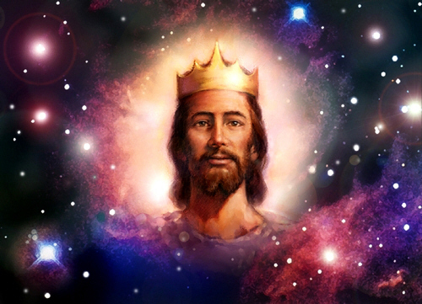
Matthew says Jesus is King!

Slide 102
A Literal Kingdom for David's Line
218c
Ordinary language for "kingdom" is used
Prophets interpreted the kingdom literally
Israel interpreted the kingdom literally
586 BC kingdom overthrown is the same kind
The Davidic Covenant relates only to Israel
David saw the covenant applying only to Israel
Portions have been fulfilled literally
David's throne is not related to Christ's present session in heaven
John, Jesus, the 12, and the 70 all offered Israel a literal kingdom (Matt. 3:11; 4;17; 10:7; Luke 10:1, 9)
…so Jesus will reign in the future
Notes:
Knowing the nature of the kingdom first will help us discern when it will take place. If it is only a spiritual kingdom, then we will be led to think that it occurs now, though only partially since most people still do not submit to the Lord. But if it both a spiritual and political kingdom, then it obviously is future, for it should be evident to all that Jesus is not exercising his political rule on this rebellious planet. These factors lead
______________
Common-494
OS-10-Davidic Covenant-67
OS-10-2Samuel-102
NS-01-Matt1-14—slide 165

Slide 103
Slides on
2 Samuel 8

Slide 104
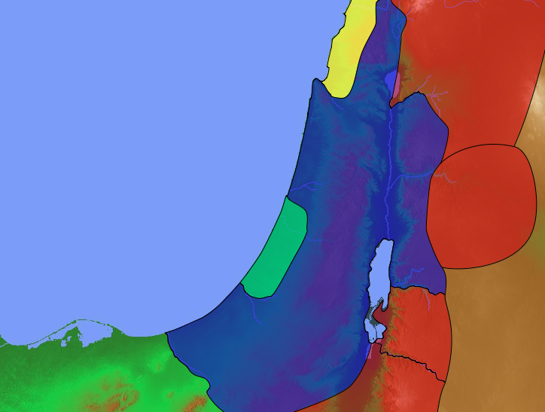
David's Victories
Zobah
140
Phoenicia
Aram
2 Samuel 8
Israel
Ammon
Philistia
Moab
Egypt
Edom
Notes:
David expanded the kingdom with a new boundary through military victories in the north and south as God's fulfillment of his promise to give Israel rest from its enemies (2 Sam 8).

Slide 105
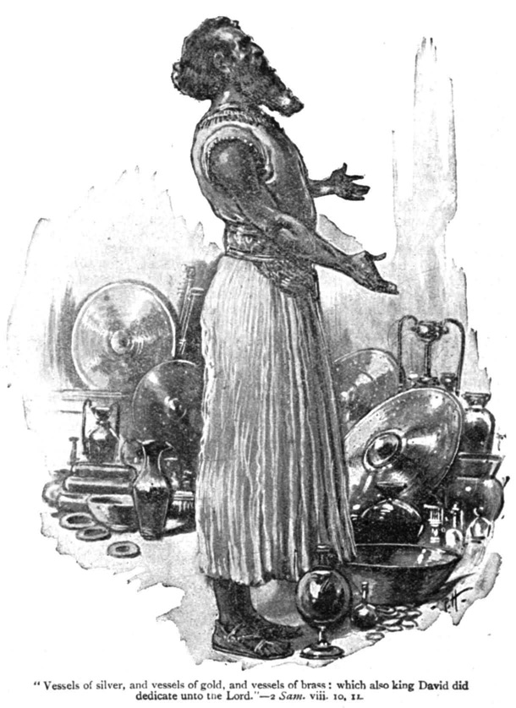
New Boundary
(2 Sam 8)
"King David dedicated all these gifts to the LORD, along with the silver and gold he had set apart from the other nations he had subdued"
(2 Samuel 8:11)

Slide 106
Slides on
2 Samuel 9
Notes:
David honored Jonathan's son Mephibosheth as a new son to show loyalty to Saul (2 Sam 9).

Slide 107
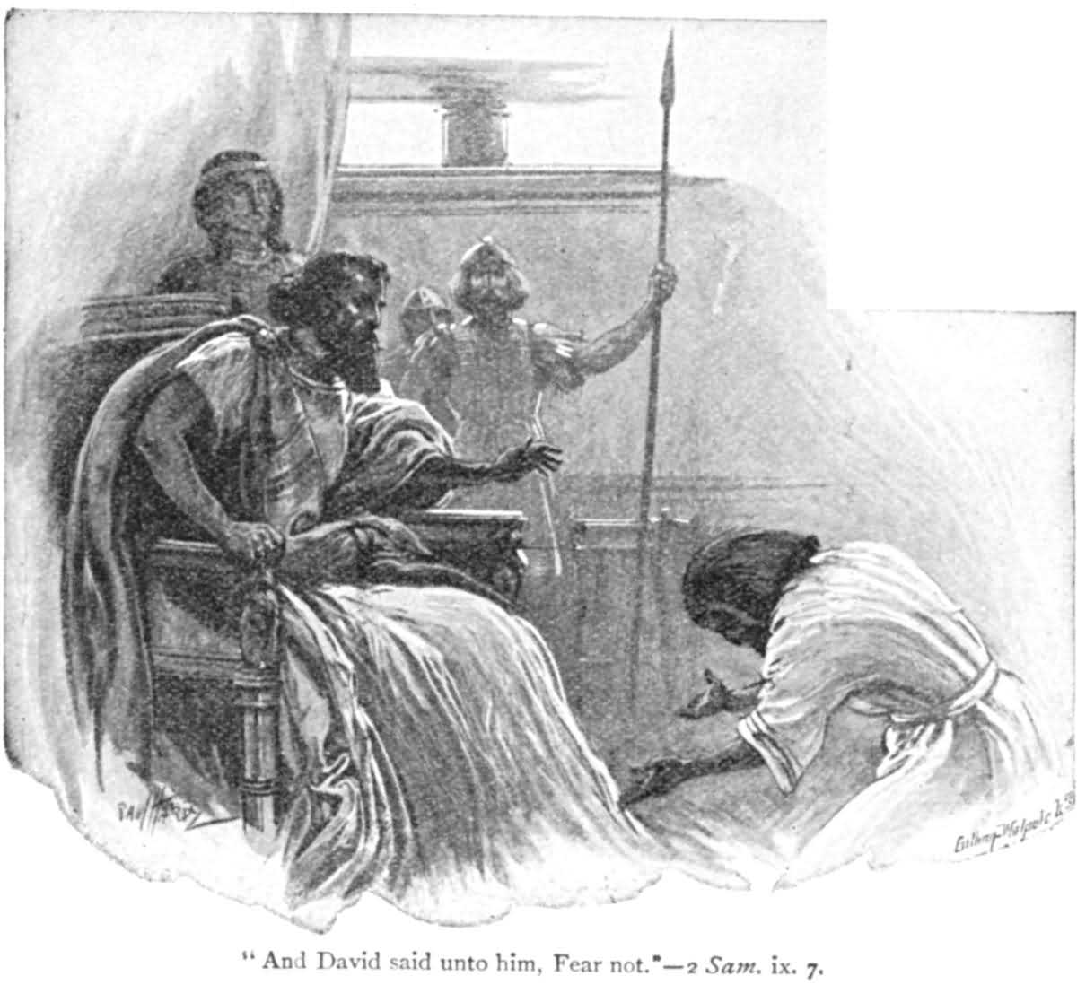
New Son
(2 Sam 9)
But David said, "Don't be afraid!" (to Mephibosheth, Jonathan's son)
2 Samuel 9:7

Slide 108
Slides on
2 Samuel 10
Notes:
David’s victory over ungrateful Ammon and Syria acquired them as new vassals (2 Sam 10).

Slide 109
David's New Vassal States
Zobah
140
Phoenicia
Aram
2 Samuel 10
Israel
Ammon
Philistia
Moab
Egypt
Edom

Slide 110
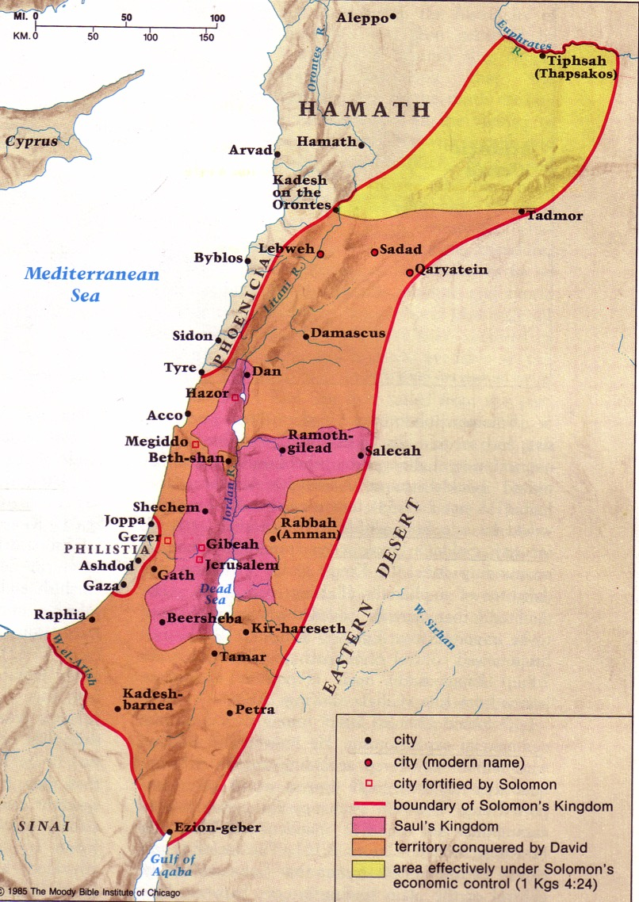
David's Conquests
209
Moody Atlas of Bible Lands, 121
New Vassals
(2 Sam 10)

Slide 111
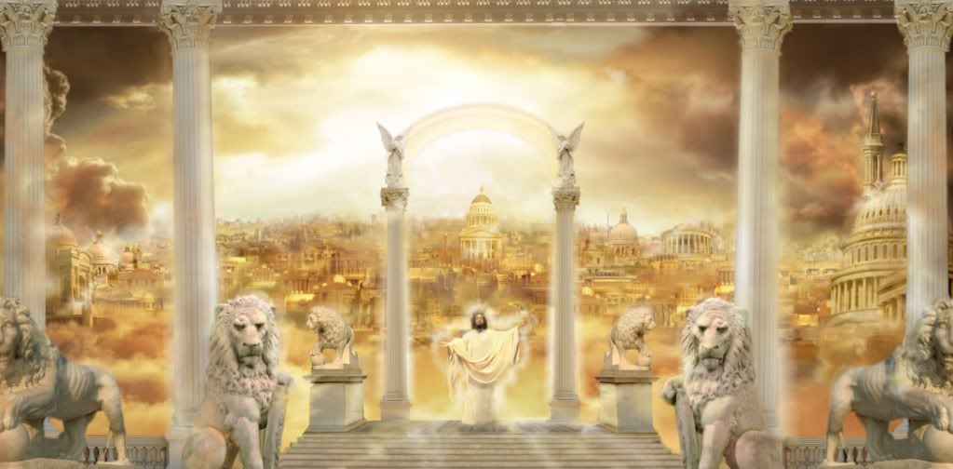
God is kind to give us Jesus as King.
Notes:
The LORD shows us his compassion in placing the crown on Jesus.

Slide 112

We Want Democracy.
Demos ("people") + kratos ("to rule")
Notes:
Our human tendency is to like to be in control.
We like to elect our leaders because we feel that we can do the best job in directing our lives.
But how are we doing at being in control? Just look at the world we live in where we seize control! If you haven’t noticed, it’s a mess.

Slide 113
We prefer democracy but God mandates kingship
Notes:
We are far better to see that God shows his kindness to us when he gives the leader we really need in Christ.

Slide 114
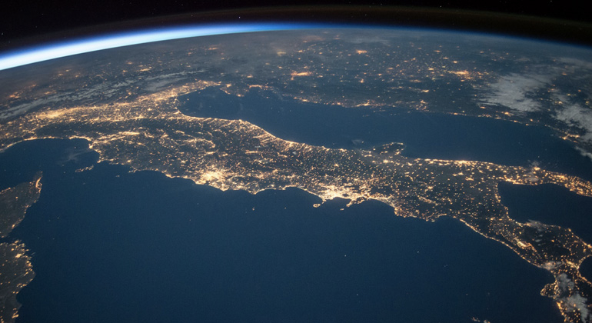
Rule from Rome?
Notes:
How are we doing with rule from Rome now like there was in the first century?

Slide 115
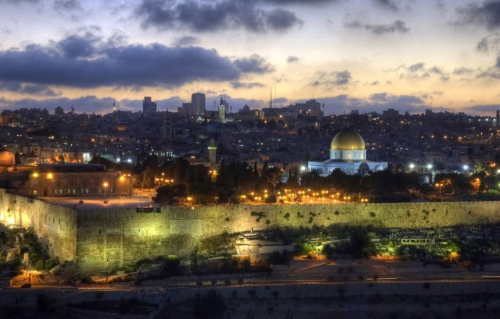
Jerusalem
Notes:
Matthew 2 shows us that the Jews were more disturbed at the birth of Jesus than they were with Herod’s rule!

Slide 116

1000 Years!
MILLENNIAL REIGN OF CHRIST
Notes:
Yet Jesus is the Prince of Peace to those who believe: “Peace on earth to all with whom he is pleased.” He will rule in peace for 1000 years over those who believe!

Slide 117
How does God model kindness to us so we can be kind to others?
2 ways
Notes:
In what ways does the Lord exemplify compassion to us so we can pass this compassion on?

Slide 118
I. God’s kindness gives us leaders (2 Sam 1–10).
Notes:
The LORD grants us his divinely appointed authorities to follow.

Slide 119
II. God’s kindness gives us discipline (2 Sam 11–24).
Notes:
The LORD blesses us with inconveniences to turn us back to him.

Slide 120
Slides on
2 Samuel 11

Slide 121

When life is "too good" then watch out…

Slide 122

Chapter 11 = Bankruptcy
Bankruptcy

Slide 123

209
Bankruptcy
S I N
T R A N S G R E S S I O N
D I S O B E D I E N C E
CHAPTER 11
ADULTERY |  | MURDER
1–5 |  | 6–27
OVER ALL ISRAEL
From JERUSALEM
33 Yrs. (1004–971 BC)

Slide 124

An idle mind…
…leads to…
an idol mind…
"In the spring when kings go out to war…" (11:1)

Slide 125


Bath for Bathsheba

Slide 126

The inevitable conclusion

Slide 127

Uriah the Hittite and his wicked king, David

Slide 128

Uriah was killed along with several other Israelite soldiers
(2 Sam. 11:17)

Slide 129

Amman Citadel northern wall from west
Amman Citadel Northern Wall from West
Notes:
The wall overlooking the area of Uriah’s attack is part of an Islamic palace complex (credit: Dr Todd Bolen, BiblePlaces.com).

Slide 130

Amman Citadel northern end view to nw
Amman Citadel Northern End View to NW
Notes:
The acropolis is surrounded by deep wadis (valleys) on three sides. The north side was not so protected and thus was the most vulnerable to attack. It is likely that David’s men concentrated their campaign against the city at this point, and perhaps it was here that Uriah was killed at David’s order (credit: Dr Todd Bolen, BiblePlaces.com).

Slide 131

The Heartache David Caused
Bathsheba Mourns Her Husband

Slide 132
209
S I N
T R A N S G R E S S I O N
D I S O B E D I E N C E
CHAPTER 11
ADULTERY | WICKED INTENTION | MURDER
1-5 | 8, 10, 13 | 6-27
OVER ALL I S R A E L
From JERUSALEM
33 Yrs. (1004–971 BC)

Slide 133
Slides on
2 Samuel 12

Slide 134

"You are the man!"
Nathan rebukes David for his sins
(12:1-12)

Slide 135

Bathsheba's baby dies

Slide 136

Their baby dies
God judges David's family
(12:1-12)

Slide 137
209
CONSEQUENCES
TROUBLES
JUDGMENTS
CHAPTERS 12–20
FAMILY | POLITICS
12–14 | 15–20
OVER ALL ISRAEL
From JERUSALEM
33 yrs. (1004–971 BC)

Slide 138

Descendants of David
Lineage of David

Slide 139

FAMILY TROUBLES
SON of ADULTERY dies… (12:15-23)
STILL, GRACE of GOD…
David's second son from Bathsheba is
named SOLOMON alias Jedidiah–
"beloved of the LORD"—because the LORD loved him
(12:24-25)

Slide 140
Slides on
2 Samuel 13

Slide 141

Amnon
Family troubles continued with David's son Amnon

Slide 142

Amnon & Tamar
David was judged through the rape of his daughter via his son

Slide 143

But Amnon's half-brother Absalom was full brother to Tamar

Slide 144

Absalom killed Amnon two years later

Slide 145

David mourns Amnon’s death
(2 Samuel 13:37)

Slide 146
213
FAMILY TROUBLES
SON of ADULTERY dies… (12:15-23)
STILL, GRACE of GOD…
David's second son from Bathsheba is
named SOLOMON alias Jedidiah–
"beloved of the LORD"—because the LORD loved him
(12:24-25)
INCEST in David's house…
AMNON rapes TAMAR (13:1-20)
MURDER: ABSALOM murders AMNON
(13:21-36)
Bruce Wilkinson and Kenneth Boa, Talk Thru The Bible

Slide 147
Slides on
2 Samuel 14

Slide 148

The Wise Woman of Tekoa (2 Samuel 14)

Slide 149
Slides on
2 Samuel 15

Slide 150

213
POLITICAL TROUBLES
(2 Samuel 15–20)
ABSALOM
SHEBA
ADONIJAH, later in Solomon's era
Notes:
David's political troubles from Absalom and Sheba's rebellions actually removed Absalom as a rival to David’s throne (2 Sam 15–20).

Slide 151


ABSALOM, David's handsome and
likeable son… still rebels against him.
Notes:
Absalom rivaled his father's throne but David refused to protect his kingdom by force, resulting in Absalom's death and the protection of David’s dynasty (2 Sam 15–18).

Slide 152

What kind of king will David become when he later has the same power as Saul? How will he respond to the third king, Absalom?
199
A TALE OF
THREE KINGS
A study in brokeness

Slide 153


"David and Zadok were alone once more. 'And now, what will you do, David? In your youth, you spoke no word against an unworthy king. What will you do now with an equally unworthy youth?' 'As I said,' replied David, 'These are the times I hate the most, Zadok. Nonetheless, against all reason, I judge my own heart first and rule against its interests.
I will do what I did under Saul.
I will leave the destiny of the kingdom in God's hands alone. Perhaps he is finished with me. Perhaps I have sinned too greatly and am no longer worthy to lead. Only God knows if that is true, and it seems he will not tell."
—Gene Edwards, A Tale of Three Kings, 93

Slide 154

Tyndale's Life Application Bible, NIV
Notes:
Absalom won over many in Israel to become king, forcing David from Jerusalem into exile since he was unwilling to protect his kingdom by force (15:1–16:14).

Slide 155

David had to flee to the wilderness to avoid war between him and Absalom. He wept in the Kidron Valley.
2 Samuel 15

Slide 156
Slides on
2 Samuel 16

Slide 157

Shimei opposed David by throwing stones at him. However, David refused to punish Shimei (2 Samuel 16:5-14).

Slide 158
Slides on
2 Samuel 17

Slide 159

Ahithophel gives Absalom good advice to pursue David at once (2 Sam 17:1-4)

Slide 160

Hushai gives Absalom bad advice to pursue David later (2 Sam 17:5-14)

Slide 161
Slides on
2 Samuel 18

Slide 162

A bad hair day for Absalom (18:9)

Slide 163

"'Enough of this nonsense,'
Joab said. Then he took three daggers and plunged them into Absalom's heart as he dangled from the oak still alive."
2 Samuel 18:14

Slide 164

2 Sam. 18:33
"The king was overcome with emotion. He went up to his room over the gateway and burst into tears. And as he went, he cried, 'O my son Absalom! My son, my son Absalom! If only I could have died instead of you! O Absalom, my son, my son.'"

Slide 165
Slides on
2 Samuel 19

Slide 166

Divided Kingdom
140
Phoenicia
Aram
2 Samuel 19
David returned to a restored kingdom in Jerusalem but the north-south division persisted.
Israel
Ammon
Philistia
Judah
Moab
Egypt
Edom
Notes:
_______
Common-289
OS-10-2 Samuel-166

Slide 167

Misplaced Grief
Joab rebukes David for his poor leadership (19:5-7)

Slide 168
Slides on
2 Samuel 20

Slide 169
DAVID'S FINAL YEARS
214
An appendix in chapters 21–24
of David's final years provides additional accounts of his failures and successes as indication of God's continued blessing upon his line while still punishing sin.

Slide 170
Slides on
2 Samuel 21

Slide 171
Appendix Chart
209
A P P E N D I X
T R I B U T E
S U M M A R Y
CHAPTERS 21–24
H U M I L I T Y | P R I D E
21–23 | 24
OVER ALL I S R A E L
From JERUSALEM
33 Yrs. (1004–971 BC)
Notes:
An appendix of David's failures and successes in his final years proves God blessed his line while punishing sin (2 Sam 21–24).

Slide 172

"During another battle with the Philistines, Elhanan son of Jair killed Lahmi, the brother of Goliath of Gath. The handle of Lahmi’s spear was as thick as a weaver’s beam!"
(2 Sam 21:19; cf. 1 Chron 20:5 NLT).

Slide 173

"In another battle with the Philistines at Gath, they encountered a huge man with six fingers on each hand and six toes on each foot, twenty-four in all, who was also a descendant of the giants. But when he defied and taunted Israel, he was killed by Jonathan, the son of David’s brother Shimea"
(2 Samuel 21:20; cf. 1 Chron 20:6-7 NLT).
Notes:
In this photo taken Wednesday Aug. 24, 2011, is Yoandri Hernandez Garrido, 37
There be GIANTS!
Posted on October 6, 2015 by TheMeltingThought
https://themeltingthought2000.wordpress.com/2015/10/06/there-be-giants/
Accessed 21 Jan 2018

Slide 174
Slides on
2 Samuel 22

Slide 175

David kept the humility of his youth.
The result was that many risked their lives for him.

Slide 176
Slides on
2 Samuel 23

Slide 177

"David's Mighty Men"
By James Tissot (1836-1902)

Slide 178

2 Samuel 23:8-11
David's Mighty Men

Slide 179

"David remarked longingly to his men, 'Oh, how I would love some of that good water from the well by the gate in Bethlehem.' ¹⁶ So the Three broke through the Philistine lines, drew some water from the well by the gate in Bethlehem, and brought it back to David. But he refused to drink it. Instead, he poured it out as an offering to the LORD"
(2 Samuel 23:15-16 NLT)
198

Slide 180
Slides on
2 Samuel 24

Slide 181

Araunah's Threshing Floor
(2 Sam 24:18-19)
Notes:
"After David’s sin in the the matter of taking a census of the people of Israel, and his acknowledgment of the sin, he was told by Gad to build an altar (2 Samuel 24:1-10). The instructions are specific.
And Gad came that day to David and said to him, “Go up, raise an altar to the LORD on the threshing floor of Araunah the Jebusite.” So David went up at Gad’s word, as the LORD commanded. (2 Samuel 24:18-19 ESV)
Araunah was gracious in his offer to allow David to take any of his property needed — the oxen, the threshing sledge, and the yokes of the oxen for the wood. He said, “All this, O king, Araunah gives to the king.”
David’s reply is one of those memorable statements of Scripture.
But the king said to Araunah, “No, but I will buy it from you for a price. I will not offer burnt offerings to the LORD my God that cost me nothing.” So David bought the threshing floor and the oxen for fifty shekels of silver. (2 Samuel 24:24 ESV)
Artist Balage Balogh has provided us a beautiful illustration of the threshing floor of Araunah [above] on what we later know to be Mount Moriah. See more of his work at Archaeology Illustrated.
It is generally understood that this is the place where Abraham came to offer Isaac, in the mount of the LORD three days from Beersheba (Genesis 22:4, 14). It is where Solomon began to build the temple in 966 B.C.
Then Solomon began to build the house of the LORD in Jerusalem on Mount Moriah, where the LORD had appeared to David his father, at the place that David had appointed, on the threshing floor of Ornan the Jebusite. (2 Chronicles 3:1 ESV)."
Araunah’s threshing floor
Posted on August 18, 2010 | 4 Comments
Ferrel Jenkins
https://ferrelljenkins.wordpress.com/2010/08/18/araunahs-threshing-floor/
Accessed 24 Dec 2017

Slide 182

Old City aerial from north
2 Sam. 24:18-24; 2 Chron. 3:1
The Temple Mount: Jerusalem's Global Focal Point
9.7.03d.
©2006 TBBMI
27
Notes:
Flying closer, you would see on that Temple Mount the golden-roofed Islamic Dome of the Rock. Also known as Mount Moriah and Mount Zion, this site marks the location of the First Temple of King David and the later Second Temple – built by King Herod the Great -- around which Our Lord ministered to the multitudes. To the far left are the Mount of Olives and the Garden of Gethsemane.

Slide 183



2 Sam. 24:18-24; 2 Chron. 3:1
Ancient Threshing Floor
Araunah's threshing floor…
David bought it…
To build the FIRST Temple to the Lord!
On Mount Moriah!
28
5
©2006 TBBMI
9.7.03d.
Notes:
And the Temple Mount itself…47 acres of unending international intrigue, strife and dispute…currently controlled by local Moslem authorities. The octagonal Dome of the Rock has occupied this site for 1,400 years! Now…
//// Imagine this place without the Dome of the Rock…3,000 years ago, on the top of Mount Moriah…the same Moriah where Abraham had taken Isaac for sacrifice a thousand years earlier than that.
//// In David's time, it had become a threshing floor owned by a man named Araunah.
//// David bought that threshing floor from Araunah – similar to this one – on which to build a great worship center…because ever since the time of Moses…
//// …the old tabernacle, housing the sacred Ark of the Covenant, had existed in the fierce winds of the desert. David wanted to see the Furniture of the Lord protected in a fine building…
//// …such as a great Temple to the Lord there on Mount Moriah.

Slide 184


King David planned it.
1 Kings 5:5
ROYALTY
S - D - S
But…his son Solomon was to build it!
Handbook pg. 32-37
29
1
Notes:
So David planned the Temple and brought supplies into town to build it. However, God did not allow David to erect it because he had spilled human blood.
//// It then became an assignment from God that David's son, Solomon, should build the First Temple.

Slide 185

Israel's "First" Temple
1 Kings 5:5
ROYALTY
S - D - S
Handbook pg. 32-37
30
Notes:
Of course, we have no picture of that Temple. However, this painting shows us its probable grandeur and beauty.

Slide 186

Dome of the Rock
(Original Site of Solomon's Temple)
Notes:
"The temple was destroyed by the Babylonians in 586 B.C., but rebuilt under the leadership of Joshua and Zerubbabel after the return from Babylonian exile (520-516 B.C.). Herod the Great basically built a new temple during his reign.
The Romans destroyed Jerusalem, including the temple, in A.D. 70. Centuries later, between 687 and 691, the Qubbet es Sakhra, (Dome of the Rock) was built on the orders of the Ommayad caliph, Abd el Malik. The building has been restored numerous times, but “the monument has preserved its original majestic proportions and harmonious design” (The Middle East, Hachette, 1966).
The association of this site with both Abraham and David ties together two of the great texts of the Old Testament (Genesis 12; 2 Samuel 7) and makes it especially significant for those who believe the Bible."
Araunah’s threshing floor
Posted on August 18, 2010 | 4 Comments
Ferrel Jenkins
https://ferrelljenkins.wordpress.com/2010/08/18/araunahs-threshing-floor/
Accessed 24 Dec 2017

Slide 187

God also shows his kindness to us in his discipline.
Notes:
We seem to understand horizontal discipline better than vertical discipline.
We can see how valuable it is for a mother or father to discipline their children—that’s a horizontal discipline on a human level.
However, we seem to struggle with giving this same privilege to the God who knows best how to discipline us!

Slide 188
Jesus is central to history despite God's discipline
New Heaven and New Earth
Saints Reign with Christ Forever
Edenic Paradise
Immorality
Pre-Flood World
Longevity
Babylon
Kingdom of Nimrod
Patriarchal Age
Law and Prophets
Church Age
World Missions
Tribulation
Kingdom of Antichrist
Millennium
Longevity
Creation
Fall
Flood
Dispersion
Jesus
Rapture
Second Coming
Final Judgment
Notes:
Yet Jesus is central to history despite God's discipline. After creating the world and Eden where people were immortal, God disciplined man in the fall but humans still had longevity of life before the Flood. That longevity will return in the Millennium after the Second Coming of Christ where God's Final Judgment will occur, restoring man's rule in the New Heaven and New Earth. In the middle are kingdoms opposing God—the Kingdom of Nimrod reappearing as the Kingdom of Antichrist in the Tribulation. Even more central is God's judgment at Babel dispersing people, but God's kindness will undo that dispersion in his regathering all who believe in him at the Rapture! At the very heart of history is Jesus, though, preceded by the prophecies of the patriarchs, Law, and prophets and fulfilled in our Church age where we proclaim him among the nations!
_____________
Jesus at the Centre of History
Mike Gascoigne
Copyright 2005
http://annomundi.com/bible/jesus_centre_of_history.htm#
Accessed 24 Dec 2017
"After the Fall, things got worse and worse. Jesus came to turn history around, so that the end-time events resemble the events of the ancient world, but in reverse order. For believers, things get better and better, but for unbelievers, it continues to get worse and worse.
For a printable version of this time chart in landscape orientation, see the Acrobat PDF file (120K).
The Ancient World
In the beginning, God created a perfect world where there was no death, destruction, or suffering. The first two occupants, Adam and Eve, were to live forever, but only if they were obedient to God. They disobeyed and lost their immortality, but they still lived for a long time, and so did their descendants, almost up to a thousand years. However, successive generations fell into great levels of decadence, with increasing violence, until God destroyed all air-breathing life in a great Flood, except for Noah, his wife, his three sons and their wives, and the animals they brought with them into the Ark. After the Flood, the lifespans of successive generations became shorter and shorter, until they reached the levels they are now, where hardly anyone reaches the age of 100. The shortened lifespan could be the result of exposure to radiation from space, after the collapse of the water vapour canopy, if this is a correct interpretation of the physical causes of the Flood. Alternatively, it could be the consequence of the genetic bottleneck that occurred when the population of the world was reduced to only eight people, and then they began to multiply again.
The salutary lesson of the Flood seems to have been lost on the descendants of Noah, who continued to invent new forms of rebellion. They were supposed to multiply and disperse and re-populate the earth, but they remained in Babylon under the dictatorship of Nimrod, and they built a tower as a centre of idolatrous worship. There were some who instigated the rebellion and others who reluctantly endured it, but their personal preferences counted for little because they were under a dictatorship and there was no-one who could stand up to Nimrod. Then the Lord intervened and scattered them, confusing their languages so that they couldn't understand each other, and the dispersal from Babylon became the starting point for the history of the nations as we know them today.
The story so far is covered in the first eleven chapters of Genesis, although the supporters of the rebellion were still at war with the surrounding nations during the time of Abraham, when there was the battle of four kings against five (Gen. 14:1-9). This continuing warfare is thought by mythographers (1) to be the historical basis of the Titanic wars of Greek mythology.
From the Patriarchs to the Present Time
Most of the Bible, from Genesis 12 onwards, is about the central portion of the time chart which includes Abraham and the patriarchs of Israel, the law and the prophets, the coming of Jesus and the establishment of the early church with the objective to follow the Great Commission to preach the Gospel to all the world. Since that time, the church has followed its Commission with a greater or lesser degree of enthusiasm, and there is a history that leaves much to be desired, but the eventual result is that the Commission has been largely fulfilled, and the Gospel is known with a greater or lesser degree of understanding all over the world. This would have been achieved earlier if the message had not been distorted into all sorts of social and political variants during a long period known as the "dark ages", when the Bible was available only to the privileged clergy and was hidden from the common people. The process of restoration began with the Renaissance and the invention of the printing press, and the Greek New Testament of Erasmus which was distributed to people all over Europe who had sufficient education to read it. Then the Bible, both Old and New Testaments, was translated into English, German and many other languages spoken by the common people, an event that was opposed by the established church and created many martyrs. Nevertheless, the Reformation had become unstoppable and led to a period of world mission, with the result that there is hardly a place in the world where the name of Christ is not known, and the Bible is either found on the open market or is obstructed by governments who fear it. It's hard to obstruct the Gospel these days, because people in the remotest areas of the world can hear it preached on short-wave radio. They can also read the Bible on the Internet, where the infrastructure exists, and it's becoming increasingly difficult for obstructive governments to make excuses to their people, and deny the Internet to those who need it for business purposes. The Gospel is available almost everywhere to people who want to find it, and the enthusiasm is often greatest in the places where it has been obstructed. Jesus didn't say that everybody has to believe the Gospel before he returns. He only said it has to be preached everywhere, and to a large extent, this has been done, so what happens next?
The End Times
Jesus is at the centre of history, and the work of salvation is much more than what is anticipated by many Christians who believe that their personal destiny is in a place called "heaven". They only have a vague idea about what happens there, and they possibly imagine that they will sit on a cloud playing a harp for all eternity. They don't make any serious attempt to find out what the Bible teaches about life after death, and instead they tend to emphasise the work of Christ in their lives here and now, as their previously messed up lives are sorted out by their faith in Christ.
The term "heaven", in its most general sense in the New Testament, refers to the spiritual state of the believer who dwells in the presence of God. Our actual destination is not in an ethereal vapour-like space in the clouds, but right here on earth. But it won't be the earth as it is now. Instead it will be a new creation, known as the New Heaven and New Earth, with the perfect conditions of Eden fully restored, and with no possibility of getting it messed up because there will be no Devil.
The New Heaven and New Earth will not come into existence all at once. Instead, history will be rolled back in stages. There will be a world dictator known as the Antichrist, the New Testament version of Nimrod. But before he begins his reign, there will be the sudden disappearance of Christians from the earth, an event that Jesus compared with the Flood:
But as the days of Noe were, so shall also the coming of the Son of man be. For as in the days that were before the flood they were eating and drinking, marrying and giving in marriage, until the day that Noe entered into the ark, and knew not until the flood came, and took them all away; so shall also the coming of the Son of man be. (Matt. 24:37-39)
The Rapture can be identified in the book of Revelation by the complete absence of the church after the letters to the seven churches are completed in Chapter three. Then in Chapters 4 and 5 there is the vision of heaven and the book with seven seals that only Christ can open. The end-time events, whether good or evil, can only happen by divine permission, and in Chapter 6 we see the four horsemen of the Apocalypse being released upon the world. The first is the Antichrist, riding a white horse, and he is followed by his three companions representing war, famine and death. From that point onwards, the book of Revelation is primarily concerned with the tribulation period until the true Christ appears, riding a white horse in Chapter 19.
There are disagreements among theologians about the order of events, with some saying that the rapture comes before the tribulation, and others saying it comes afterwards, and others saying it comes in the middle of the tribulation. My reasons for a pre-tribulation rapture are given in my book Impossible Theology: The Christian Evolutionist Dilemma, but for the purpose of this discussion it is sufficient to have the rapture and tribulation as related events occurring within the same general time period.
In the ancient world there was the Flood followed by Nimrod's rebellion, and in the end-time events we have the rapture and the reign of Antichrist. The rebellion of Nimrod came to an end when God scattered the people and confused their languages. The reign of Antichrist will come to an end when Christ returns with his raptured saints and establishes his millennial kingdom.
During the millennium there will be a state of near-perfect conditions, where Satan is bound and evil is restrained. Nature will be at peace, and people will live for a long time.
The wolf will live with the lamb, and the leopard will lie down with the young goat; The calf, the young lion, and the fattened calf together; and a little child will lead them. The cow and the bear will graze. Their young ones will lie down together. The lion will eat straw like the ox. The nursing child will play near a cobra’s hole, and the weaned child will put his hand on the viper’s den. They will not hurt nor destroy in all my holy mountain; for the earth will be full of the knowledge of Yahweh, as the waters cover the sea. (Isaiah 11:6-9, World English Bible (2)).
There shall be no more thence an infant of days, nor an old man that hath not filled his days: for the child shall die an hundred years old; but the sinner being an hundred years old shall be accursed. (Isaiah 65:20).
These conditions can be compared with the pre-Flood world, where people lived for almost a thousand years, and as far as we can tell, both humans and animals were vegetarian. All living creatures were originally given a vegetarian diet:
God created man in his own image... God said, "Behold, I have given you every herb yielding seed, which is on the surface of all the earth, and every tree, which bears fruit yielding seed. It will be your food. To every animal of the earth, and to every bird of the sky, and to everything that creeps on the earth, in which there is life, I have given every green herb for food;" and it was so. (Gen. 1:27-30, World English Bible).
It isn't clear at what point the animals became carniverous, but humans were not specifically permitted to eat meat until after the Flood:
And God blessed Noah and his sons, and said unto them, Be fruitful, and multiply, and replenish the earth. And the fear of you and the dread of you shall be upon every beast of the earth, and upon every fowl of the air, upon all that moveth upon the earth, and upon all the fishes of the sea; into your hand are they delivered. Every moving thing that liveth shall be meat for you; even as the green herb have I given you all things. But flesh with the life thereof, which is the blood thereof, shall ye not eat. (Gen. 9:1-4).
This passage marks a change in the behaviour of animals, as they began to live in fear of man and his newly aquired carniverous diet. The reasons for the change of diet are not given, but it was probably because of the changed climate of the world, where protein-rich vegetables were no longer available in abundance. In that case, there would be sufficient reason for some of the animals also to become carniverous, and if this is the point where they abandoned their vegetarian diet, it means there was peace among the animals during the entire pre-Flood period.
Taking all this together, we have peace among the animals, and great longevity among humans, so that the pre-Flood period can be compared with the millennium. Christ comes and overthrows the Antichrist, establishing his millennial kingdom and restoring the world to the pre-Flood conditions, but the work of restoration is not yet finished.
At the end of the millennium, Satan is loosed from his pit and leads the nations in rebellion against Christ and his saints, but is defeated and thrown into the lake of fire, and then there is the resurrection of unbelievers for the Final Judgement (Rev. 20:7-15).
At this point the problem of sin has been finally dealt with, and it is time to create a New Heaven and New Earth, and a New Jerusalem where there is the Tree of Life. The conditions of Eden are fully restored and the saints will live there with Christ for ever. (Rev. 21 and 22).
The entire scenario shows the justice and mercy of God, who created the world in a state of perfection, but with the opportunity for evil to proliferate. He then deals with Satan and his followers, the perpetrators of evil, in the presence of all the angels, and restores the world to its perfect state. This time there will be no Satan to mess it up, and the perfect world will continue for ever.
So we see that the hope of the believer is not to sit on a cloud for all eternity playing a harp, a prospect that seems utterly unappealing. The purpose of the resurrection is to return us to this world and see it restored to perfection. Christ is at the centre of history, and his crucifixion and resurrection marks the point where the errors of history are rolled backwards, in the reverse order in which they occurred. We are presently in a transition period known as the "Church Age", where the Gospel is to be preached to all the world, and then Christ will return, and we have to be ready because he will come at a time when we do not expect him.
Notes and References
1. See for example: Bryant, J., A New System or an Analysis of Ancient Mythology, 3rd edition, 1807. The war at the time of Abraham is described in vol.6, pp.189-208, Some Farther Account of the Arabians who Resided in Egypt. This section is only in the 6-volume edition, not the earlier 3-volume edition published in 1776. Mythography is the practice of relating mythology to real historical events, and is sometimes known as Euhemerism, based on the philosopher Euhemerus who believed that all the gods were deified kings.
2. I have used the World English Bible on some occasions where the antiquated language of the King James Authorised Version might not make sense to modern readers."

Slide 189

III. David pictures Jesus.
Notes:
So God’s kindness gives us leaders and discipline as he did for Israel regarding David. But how does all this kindness to David and from David relate to Jesus? Well, connecting the dots between the OT and NT, we see that…
[God’s kindness to David recalls God’s kindness to us through Jesus.]
[Many qualities of David are also true of Jesus.]

Slide 190

David to Jesus
  Both came from the line of Judah (Gen 49:10).
  Both were born in Bethlehem (1 Sam 15; Matt 2:1).
  Both came from humble roots—a shepherd and carpenter.
  Both protected others from evil with courage but also with the heart of a shepherd.
  Both were appointed to rule Israel without seeking it.
  Both were exalted to rule the whole world.
  Both start in Bethlehem and end in Jerusalem.
  Both have had to wait a long time after their anointing before ruling.
Notes:
Jesus parallels David in many remarkable ways!

Slide 191

Micah 4:6-7 NLT
"In that coming day,” says the LORD, “I will gather together those who are lame, those who have been exiles, and those whom I have filled with grief. ⁷Those who are weak will survive as a remnant; those who were exiles will become a strong nation. Then I, the LORD, will rule from Jerusalem [Hebrew Mount Zion] as their king forever."

Slide 192
Micah 4:8 NLT
"As for you, Jerusalem, the citadel of God’s people, your royal might and power will come back to you again. The kingship will be restored to my precious Jerusalem."

Slide 193
How does God model kindness to us so we can be kind to others?
Notes:
In what ways does the Lord exemplify compassion to us so we can pass this compassion on?

Slide 194
Main Idea
God will rule the world through David’s Descendent,
Jesus.
2 Samuel
Notes:
God has always been sovereign over the world. He has even set up kings and put down kings, as noted in the book of Daniel. He has not yet ruled on an earthly throne through the One who took on flesh in the lineage of David. But he will certainly do it!

Slide 195
I. God’s kindness gives us leaders (2 Sam 1–10).
Notes:
The LORD grants us his divinely appointed authorities to follow.

Slide 196
II. God’s kindness gives us discipline (2 Sam 11–24).
Notes:
The LORD blesses us with inconveniences to turn us back to him.

Slide 197
III. David pictures Jesus.
Notes:
[God’s kindness to David recalls God’s kindness to us through Jesus.]
[Many qualities of David are also true of Jesus.]

Slide 198
How do you respond to God’s kindness in Jesus?
Trust Jesus as your Savior and coming King
Show God’s kindness to others
2 Samuel
Notes:
Kindness is meant to be shared, so first accept God's kindness offered to you in Jesus, the ultimate descendant of David promised in 2 Samuel 7 who will reign in the days ahead.
But then, as a recipient of God's kindness, live for others. Do what you do TODAY to lift other people up rather live for your own pursuits.

Slide 199

Bethlehem Baptist Church and Pastor Khoury were told in 2012 that the Palestinian Authority no longer considers them legitimate and will no longer accept any paperwork from them, such as baptismal or wedding certificates
Notes:
Even in Bethlehem itself, a Baptist church that backs Israel is troubled by the Palestinian Authority.
The First Baptist Church in Bethlehem
"…was told that the Palestinian Authority no longer considers them legitimate and will no longer accept any paperwork from them, such as baptismal or wedding certificates. Obviously, this remains a matter of grave concern, and appears to be a serious infringement of religious freedom…." (Rabbi Russ Resnik March 15, 2012, at 11:21 pm)
Pastor Khoury faced Sharia Laws, for supporting the "little Satan" (Israel) and not living in submission to Islam.
14 March 2012
https://ivarfjeld.com/2012/03/14/baptist-church-that-backs-israel-shuttered-by-palestinian-authority/

Slide 200

Kindness
Notes:
The kindness of this man moved him to rescue the kittens that their mother swimming behind him could not save.

Slide 201

Kindness
Notes:
Show compassion over competition.

Slide 202

Kindness
Notes:
Sometimes we show kindness simply by listening and praying for someone.

Slide 203

There is no exercise better for the heart than reaching down and lifting people up.
—John Holmes
Notes:
Better to exercise your heart for others than for yourself!

Slide 204

Be kind.
Notes:
Let your heart show in your hands.

Slide 205

Joy to the World!
Debby Kerner Rettino | Ernie Rettino |
George Frideric Handel | Isaac Watts
CCLI Song # 4556318
© Words: Public Domain
Music: 1982, 1988 Rettino/Kerner Publishing
CIC CCLI Licence # 277507
Notes:
Did you know that “Joy to the World” was not written as a Christmas carol? In its original form, it had nothing to do with Christmas. It wasn’t even written to be a song.
“Joy to the world” is perhaps an unlikely popular Christmas hymn. First of all, it is based on a psalm, and, second, it celebrates Christ’s second coming much more than the first. This favorite Christmas hymn is the result of a collaboration of at least three people and draws its initial inspiration not from the Christmas narrative in Luke 2, but from Psalm 98.
___________
Text of:
History of Hymns: “Joy to the World”
by C. Michael Hawn
https://www.umcdiscipleship.org/resources/history-of-hymns-joy-to-the-world
Accessed 24 Dec 2017
___
First paragraph above from:
A Brief History of "Joy to the World"
December 21, 2015 by: Greg Forster
https://www.crossway.org/articles/a-brief-history-of-joy-to-the-world/
The following slides from Hawn's work above

Slide 206

Joy to the world! the Lord is come;
let earth receive her King;
let ev’ry heart prepare Him room,
and heav’n and nature sing,
and heav’n and nature sing,
and heav’n and heav’n and nature sing.
Isaac Watts (1674-1748)
Notes:
The first collaborator was the English poet and dissenting clergyman, Isaac Watts (1674-1748)…
A comparison between Watts’s psalm paraphrase and the original verses in the King James translation of Psalm 98:4-9 demonstrates considerable freedom:
“Make a joyful noise unto the Lord, all the earth: make a loud noise, and rejoice, and sing praise. Sing unto the Lord with the harp; with the harp, and the voice of a psalm. With trumpets and sound of cornet make a joyful noise before the Lord, the King. Let the sea roar, and the fullness thereof; the world, and they that dwell therein. Let the floods clap their hands…

Slide 207
Joy to the earth! the Savior reigns;
let men their songs employ;
while fields and floods,
rocks, hills, and plains
repeat the sounding joy,
repeat the sounding joy,
repeat, repeat the sounding joy.
Notes:
"…let the hills be joyful together…” (KJV)

Slide 208
No more let sins and sorrows grow,
nor thorns infest the ground;
he comes to make His blessings flow
far as the curse is found,
far as the curse is found,
far as, far as the curse is found.
Notes:
Curiously, stanza three is the exception. It is not based on Psalm 98 and is sometimes omitted:
No more let sins and sorrows grow,
Nor thorns infest the ground;
He comes to make his blessings flow
Far as the curse is found.
The “curse” is a reference to Genesis 3:17 when God says to Adam following the eating of the apple from the tree, “Thou shalt not eat of it: cursed is the ground for thy sake; in sorrow shalt thou eat of it all the days of thy life.” (KJV) As a part of “five-point Calvinism,” the “total depravity of man”, the curse is a significant part of classic Reformed theology, Isaac Watts’ theological perspective.
______________

Slide 209
He rules the world with truth and grace,
and makes the nations prove
the glories of His righteousness
and wonders of His love,
and wonders of His love,
and wonders, wonders of His love.
Notes:
"…let the hills be joyful together. Before the Lord; for he cometh to judge the earth: with righteousness shall he judge the world, and the people with equity.” (KJV)

Slide 211


OT Preaching • BibleStudyDownloads.org
Get this presentation and script for free!
Notes:
OT Survey (os)

Slide 212
DAVID'S ACCOMPLISHMENTS
GREAT KING
MAN OF ACTION
POET
TENDER LOVER
GENEROUS FOE
STERN DISPENSER OF JUSTICE
LOYAL FRIEND
ALL THAT MEN FIND WHOLESOME AND ADMIRABLE IN MEN
SUBMITTED TO THE WILL OF GOD WHO MADE HIM AND SHAPED HIM FOR HIS DESTINY…

Slide 213
2 Samuel Book Chart
209
GOD'S COVENANT KINDNESS TO DAVID
ESTABLISMENT |  | S I N |  | CONSEQUENCES |  | APPENDIX
TRIUMPH |  | TRANSGRESSION |  | TROUBLES |  | TRIBUTE
OBEDIENCE |  | DISOBEDIENCE |  | JUDGMENT |  | SUMMARY
Chapters 1 - 10 |  | Chapter 11 |  | Chapters 12 - 20 |  | Chapters 21 -24
Faith | Blessing | Adultery | Murder | Family | Politics | Humility | Pride
1–4 | 5–10 | 11:1–5 | 11:6-27 | 12–14 | 14–20 | 21–23 | 24
OVER JUDAH | O V E R A L L I S R A E L
HEB-RON | FROM J E R U S A L E M
7 yrs (1011–1004) | 33 yrs (1004–971 BC)

Slide 214

THE GENTLE SHEPHERD

Slide 215







NATIONAL HERO

Slide 216



GREAT KING!
GREAT ARTIST!

Slide 217

PEEPING TOM, ADULTERER, MURDERER…

Slide 218

WHAT CAN WE LEARN FROM DAVID?
"GOD BLESSES THE OBEDIENT
AND
JUDGES THE DISOBEDIENT!"

Slide 219
SIN IS A VERY DANGEROUS THING TO TOLERATE. ONCE TOLERATED, WE ARE SURELY ON THE WAY TO DO IT.
DAVID WAS A GREAT MAN, HIS LOYALITY AND ZEAL TO GOD WE CAN'T QUESTION, BUT STILL… HE FELL…
What starts with the E Y E
If unchecked enters the T H O U G H T S / M I N D
Without a reversal, sin is as good as D O N E…
IT CAN BE WORSE… CORRUPTING OUR H E A R T AND BECOMING OUR H A B I T…
WORST OF ALL… IT CAN BECOME OUR C H A R A C T E R !

Slide 220
GRACE is SUFFICIENT
DAVID HAD A SINCERE AND PURE HEART FOR GOD. THAT'S WHY HE WAS ABLE TO SENSE HIS FAILURE AND QUICKLY REPENT AND FIX EACH FAILURE…
SO… THE LAST QUIZ FOR US…
1. ARE WE SENSITIVE ENOUGH LIKE DAVID?
2. DO WE ALSO HAVE A SINCERE AND PURE HEART FOR GOD LIKE HIM?
TAKE HOME THE ANSWER IN YOUR HEART AND ANSWER IT EVERY DAY IN YOUR LIFE…

Slide 221
Date
250
264
First Kings covers 120-years: from 971 BC with the crowning of Solomon to 852 BC during Ahaziah's reign. The year 931 marks the most significant date when Solomon's kingdom split into the northern nation of Israel and the southern kingdom of Judah after his death.
Jerome
1
Kingdoms
2
Kingdoms
3
Kingdoms
4
Kingdoms
Books
1
Samuel
2
Samuel
1
Kings
2
Kings
Kings
Saul
David
Solomon-Ahaziah
Ahaziah-Zedekiah
Dates
1043
1011
971 931 852
852 722 586 560
538
Kingdom
---------United-------
------------------- ---------Divided------------
Surviving
-Returned-
Notes:
The 4th century Christian exegete Jerome who wrote the Latin Vulgate noted the connection between Samuel and Kings by combining them into four segments that all spoke of kingship, starting with Saul and ending with Zedekiah. Thus, he named them 1 Kingdoms, 2 Kingdoms, 3 Kingdoms, and 4 Kingdoms.
_____________
Common-296
OS-09-1Sam-216
OS-10-2Sam-221
OS-11-1Kings-26
OS-12-2Kings-14, 65, 102
OS-13-1Chron-221
OS-14-2Chron-39

Slide 222
OT Survey link at BibleStudyDownloads.org
Get this presentation for free!
Notes:
OT Survey (os)

