Slide 1

1 Samuel
1 Samuel
Dr. Rick Griffith • Jordan Evangelical Theological Seminary • BibleStudyDownloads.org
Notes:
Q: Why have a picture of Jesus as the title slide for 1 Samuel when he isn't in this book?
A: The book introduces us to David for the first time, beginning the reign that culminates in Jesus.

Slide 2
Key Word
194
39
Transition
1 Samuel
Notes:
The book has three major transitions, but the keyword appears in the singular here since they all point to one major transition. What is it?

Slide 3
Theme
194
Degenerate Theocracy
to Davidic Monarchy
1 Samuel
Notes:
What is the difference between a theocracy and a monarchy? Don't both have human leaders?
We don't think of Moses and Joshua as kings, so what is the difference between them and kings such as Saul and David? Both led the entire nation, so why don't we refer to "King Moses" or "King Joshua"?
Answer: Kings had succession by genealogical line with the concern for their sons taking their role in the next generation. What other distinctions of a monarchy?

Slide 4
Key Verse
194
"[The people] said to [Samuel], 'You are old and your sons do not walk in your ways; now appoint a king to lead us, such as all the other nations have'"
(8:5).
1 Samuel
Notes:
What motive was revealed by the people? Is this any different from our motives today?

Slide 5

Kingdom Statement
39
The transition from a degenerate theocracy under Eli and Samuel (1–7) to a monarchy under Saul and David (8–31) shows how God's sovereignty was delegated to the divinely elected Davidic kings who were to rule justly.
1 Samuel
Notes:
Notice that this statement teaches that monarchy was ultimately God's idea, even though 1 Samuel presents it in a negative light. But does chapter 8 present monarchy itself negatively—or was it specifically the kingdom of Saul that was viewed as a rejection of God?

Slide 6

Summary Statement
194
41
The reason God transitioned Israel from a degenerate theocracy under Eli and Samuel to a monarchy under Saul and David was to show that he delegated his rule to Davidic kings for them to rule justly.
1 Samuel
Notes:
This statement is very similar to the kingdom statement but is worded in a question/answer format. Why this transition? Because it shows that it was God's plan all along to bring his Son into the world via the line of David.

Slide 7

Covenant
42c
God used Samuel to replace corrupt yet anointed priests with godly leadership in the anointed David to fulfill His covenant promise to provide kings from Abraham’s line
(cf. Gen. 17:6).
1 Samuel
Notes:
The Abrahamic promise includes kings to come from Abraham, but it does not reveal which descendants would bring this about. We find later in Genesis 49:10 that Judah would lead the nation with kings, but only in 1 Samuel do we discover that this covenant promise goes through David.

Slide 8

Redemption
42c
God’s commitment to save the nation from her carnal choice of Saul to God’s choice of David shows his concern to carry out his redemptive plan despite man’s sin.
1 Samuel
Notes:
God's salvation plan would stem from the line of David, despite his faults. His seed would lead us to Jesus, whose very name means "salvation."

Slide 9

Messiah
42c
Samuel’s willing transfer of his tri-office of prophet-priest-judge to David’s kingship pictures the authority of Christ in these various dimensions.
1 Samuel
Notes:
Jesus is also a Prophet, Priest (in the order of Melchizedek), and King, so Samuel in effect is a type of Christ.
But David also typifies Jesus as the kingdom led by David eventually led to the rule of Jesus Christ.
In fact, David was anointed king but had to wait years before he could rule. The same is true of Jesus.

Slide 10
Book Chart
Degenerate Theocracy to Davidic Monarchy
Theocracy Ended |  | Monarchy Established
Decline of Judges |  | Rise of Kings
Chapters 1–7 |  | Chapters 8–31
Samuel: "Heavenly King" |  | Saul: "Earthly King"
Eli | Samuel | Saul |  | David
Man After Man's Heart | Man After God's Heart | Man After Man's Heart |  | Man After God's Heart
Paralysis | Prayer | Panic |  | Patience
Transition #1 Eli to Samuel (1–3) | Samuel & Ark’s Wanderings (4–7) | Transition #2 Samuel to Saul (8–12) | Saul Rejected (13–15) | Transition #3 Saul to David (16–31)
c. 94 Years
Birth of Samuel (1105 BC) to Death of Saul (1011 BC)
203
1 Samuel:
194
Notes:
The three minor transitions between persons point to the ultimate transition of political structures from theocracy to monarchy. This makes 1 Samuel 8 the hinge chapter between the two.

Slide 11
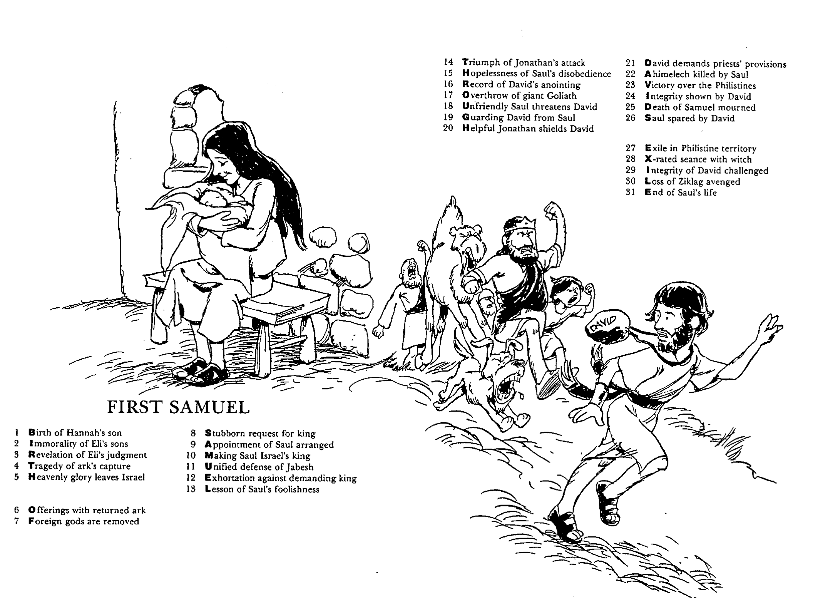
Barry Huddleston, The Acrostic Summarized Bible (Grand Rapids: Baker, 1992)
1 Inception of the world
2 Newlyweds placed in Eden
3 Temptation and man's fall
4 Hatred and first murder
5 Entire genealogy of Adam
6 Lessons on proper priorities
7 Outline for personal relationships
8 Faith of the centurion
First Samuel
29 Genealogy of Jesus Christ
30 Opposition of King Herod
31 Spirit's descent upon Jesus
32 Power over Satan's temptations
33 Expounding Sermon on Mount
34 Lessons on proper priorities
35 Outline for personal relationships
36 Faith of the centurion
9 Matthew's call from Jesus
10 Apostles sent to preach
11 Testimony about John's message
12 True Messiah called demonic
13 Hidden message of parables
14 Execution of the Baptist
15 Wisdom is answering Pharisees
37 Matthew's call from Jesus
38 Apostles sent to preach
39 Testimony about John's message
40 True Messiah called demonic
41 Hidden message of parables
42 Execution of the Baptist
43 Wisdom is answering Pharisees
16 Keys of the kingdom
17 Impact of Jesus' transfiguration
18 Need for true forgiveness
19 Grounds for divorce clarified
20 Opportunities in the vineyard
21 Fig tree is cursed
44 Keys of the kingdom
45 Impact of Jesus' transfiguration
46 Need for true forgiveness
47 Grounds for divorce clarified
48 Opportunities in the vineyard
49 Fig tree is cursed
22 Taxes paid to Caesar
23 Hypocrisy denounced by "woes"
24 Events of second coming
25 Judgment of the nations
26 Events on Calvary's eve
27 Way of the cross
28 Savior's resurrection and commission
50 Taxes paid to Caesar
51 Hypocrisy denounced by "woes"
52 Events of second coming
53 Judgment of the nations
54 Events on Calvary's eve
55 Way of the cross
56 Savior's resurrection and commission
Notes:
Huddleston's The Acrostic Summarized Bible depicts the theme of every biblical book in a vertical acrostic with that book’s theme in as many letters as there exist chapters in the book. Each chapter is summed up in four words where the first word doubles as part of the vertical acrostic for the entire book.
Here he depicts the theme of 1 Samuel chronologically from Samuel to David as the bookends of this account.

Slide 12

Be
Changed
1 Samuel
Dr. Rick Griffith • Crossroads International Church Singapore
CICFamily.com • BibleStudyDownloads.org
Notes:
Dr Rick's sermon covering this entire book is on the Bible Exposition link: https://biblestudydownloads.org/resource/bible-exposition/
It is also available in Arabic.
The idea is to look at how 1 Samuel is to apply to our lives. Since God causes transitions, we must be ready to be transformed by them.

Slide 13

Change
1 Samuel
Do you like it?
Notes:
Do you like change? If so, raise your hand!
Most people don't like change. Studies show that very few—even as low as 2%—are eager for change as "early adopters."

Slide 14

What changes are you experiencing right now?
Why?
1 Samuel
Notes:
Share in your small group the changes going on in your life right now, perhaps in these areas:
• Job?
• Body?
• Relationships?
• Something else?
• Why are you experiencing these changes right now?
If we are honest, we really don’t understand why change happens.
Is God causing it—or are you causing the change? I can comprehend why some of us initiate change, but…

Slide 15
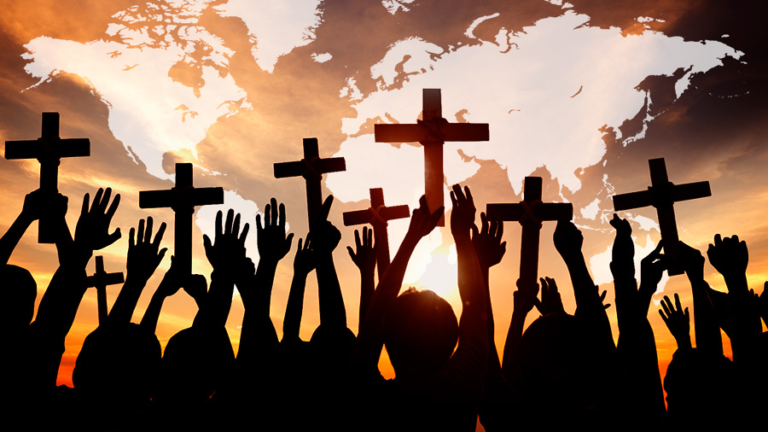
Why does God cause change?
1 Samuel
Notes:
What reasons would the LORD have to make us have to adjust to new environments over and over?

Slide 16
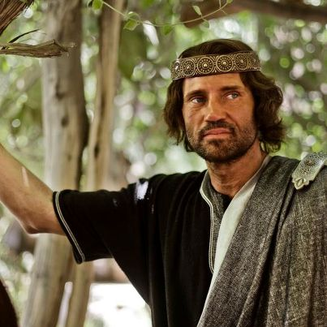
I. God had always planned to rule through Davidic kings.
Exegetical Idea of 1 Samuel
Notes:
The LORD even used Israel’s sin to bring in the monarchy under David.

Slide 17

The Theology of Judges-Ruth-Samuel
193
Judges
Ruth
Samuel
Bethlehem
David
Boaz
Bethlehemites
Idolatry (17–18)
Concubine (19)
Gibeah
Murder (19–20)
Saul
Monarchy
Needed
Monarchy
Prepared
Monarchy
Established
Adapted from Thomas L. Constable, "A Theology of Joshua, Ruth, and Judges,"
in A Biblical Theology of the OT, ed. Roy B. Zuck, 95-96, 117
Notes:
The theology of Judges-Ruth-Samuel is fascinating. It shows that God can use any circumstance and any person for His kingdom purpose and His glory.
• The book of Judges shows a dismal scene where a king was needed for the nation.
• Bethlehem appears in two disgraceful scenes:
• A Levite from Bethlehem is involved in ungodly priestly duties and even colludes with the tribe of Dan to steal an idol for their migration north (Judges 17–18). Another Levite with a concubine from Bethlehem (again) encounters a group of Benjaminite men in Gibeah who rape his concubine (Judges 19) and ultimately lead to her disgraceful death.
• In retaliation, the town of Gibeah comes into focus. It is no better than Bethlehem.
• Here in Gibeah the tribe of Benjamin was nearly wiped out, except for 600 men (Judges 20).
• In spite of extreme moral darkness and sin, God was preparing the monarchy.
• He even established that monarchy through the wicked Benjamites through the wicked city of Gibeah.
• How?
God chose the Benjaminite Saul as the first anointed king of Israel (1 Sam 8), though he was from the smallest of the tribes.
• However, Saul’s sad end brings even more shame on Gibeah.
• That preparation of the monarchy finds its true fulfilment in the city of Bethlehem, for in Ruth we see that both Boaz and the Bethlehemites act honourably in the midst of national apostasy. So God can use the same, shameful city of Bethlehem to raise a kinsmen-redeemer through Boaz. Ruth was a woman from Moab, a nation worshipping pagan gods. But through God’s plan and provision, the line of David was established and ultimately the Messiah Jesus Christ himself was born through the line.
• This birth was in the obscure city of Bethlehem, where David raises the status of this town to an amazing height. It is raised to an even higher status than given by David when we get to the NT and see that David’s descendant, Jesus, is not only born into his line but is born in the exact city of David, Bethlehem (Matt 2).
Therefore, the theology of Ruth is that God’s grace can transform the ordinary and obscure to extraordinary and world renown.
________
Common-282
OS-00-OT_Book_Overviews-178
OS-07-Judges-208
OS-08-Ruth-74
OS-09-1 Sam-17, 22, 48
OS-10-2 Sam-21

Slide 18
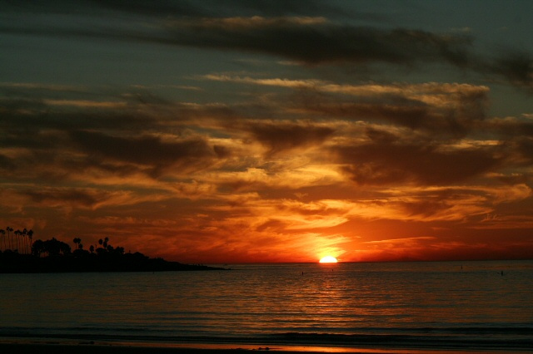
II. God initiates change to fulfill his plans for us.
Main Idea of 1 Samuel
Notes:
The LORD alters our lives to focus on his purposes.

Slide 19

If nothing ever changed, there'd be no butterflies.
—Unknown
1 Samuel
Notes:
Be open to God initiating any change he wants in your life. As someone said, “If nothing ever changed, there’d be no butterflies.” Be that butterfly.

Slide 20
Black

Slide 21
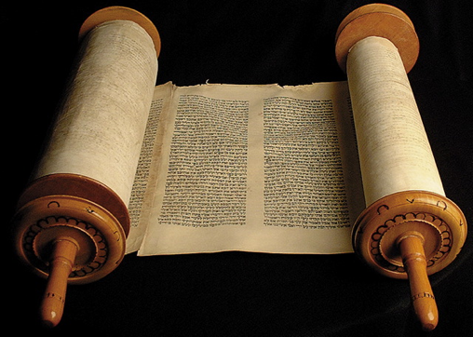
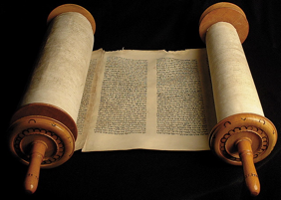
Title
198
First and Second Samuel originally comprised only one book in the Hebrew canon called "Samuel" after the author up to chapter 25.
This single scroll was arbitrarily divided in the Septuagint (250 BC) since the Greek required a greater amount of scroll space.

Slide 22
The Theology of Judges-Ruth-Samuel
193
Judges
Ruth
Samuel
Bethlehem
David
Boaz
Bethlehemites
Idolatry (17–18)
Concubine (19)
Gibeah
Murder (19–20)
Saul
Monarchy
Needed
Monarchy
Prepared
Monarchy
Established
Adapted from Thomas L. Constable, "A Theology of Joshua, Ruth, and Judges,"
in A Biblical Theology of the OT, ed. Roy B. Zuck, 95-96, 117
Notes:
The theology of Judges-Ruth-Samuel is fascinating. It shows that God can use any circumstance and any person for His kingdom purpose and His glory.
• The book of Judges shows a dismal scene where a king was needed for the nation.
• Bethlehem appears in two disgraceful scenes:
• A Levite from Bethlehem is involved in ungodly priestly duties and even colludes with the tribe of Dan to steal an idol for their migration north (Judges 17–18). Another Levite with a concubine from Bethlehem (again) encounters a group of Benjaminite men in Gibeah who rape his concubine (Judges 19) and ultimately lead to her disgraceful death.
• In retaliation, the town of Gibeah comes into focus. It is no better than Bethlehem.
• Here in Gibeah the tribe of Benjamin was nearly wiped out, except for 600 men (Judges 20).
• In spite of extreme moral darkness and sin, God was preparing the monarchy.
• He even established that monarchy through the wicked Benjamites through the wicked city of Gibeah.
• How?
God chose the Benjaminite Saul as the first anointed king of Israel (1 Sam 8), though he was from the smallest of the tribes.
• However, Saul’s sad end brings even more shame on Gibeah.
• That preparation of the monarchy finds its true fulfilment in the city of Bethlehem, for in Ruth we see that both Boaz and the Bethlehemites act honourably in the midst of national apostasy. So God can use the same, shameful city of Bethlehem to raise a kinsmen-redeemer through Boaz. Ruth was a woman from Moab, a nation worshipping pagan gods. But through God’s plan and provision, the line of David was established and ultimately the Messiah Jesus Christ himself was born through the line.
• This birth was in the obscure city of Bethlehem, where David raises the status of this town to an amazing height. It is raised to an even higher status than given by David when we get to the NT and see that David’s descendant, Jesus, is not only born into his line but is born in the exact city of David, Bethlehem (Matt 2).
Therefore, the theology of Ruth is that God’s grace can transform the ordinary and obscure to extraordinary and world renown.
________
Common-282
OS-00-OT_Book_Overviews-178
OS-07-Judges-208
OS-08-Ruth-74
OS-09-1 Sam-17, 22, 48
OS-10-2 Sam-21

Slide 23

The Keys
194
The
to 1 Samuel

Slide 24


Keys to…
194
1 Samuel
1 Samuel
word
Transition
verse
8:5
characters
Samuel, Saul, David
place
Israel
authors
Samuel, Nathan, Gad

Slide 25

Key Verse
Key Verse
194
1 Sam. 8:5
Let's read it
Was it a good idea for Israel to ask for a king?
Why or why not?
  Premature
  Wrong motive

Slide 26

How long it covers
How long it covers
194
94 years
From 1105 B.C --- 1011 B.C.
Begins: Birth of Samuel
Ends: Death of Saul

Slide 27

Purpose of this Book
196
Purpose of this Book
Theocracy
Monarchy
GOD AS
Man as
Notes:
The book of 1 Samuel gives the transitions necessary for that change to come about from a theocracy to a monarchy focused on David.

Slide 28
Forming the Message Statement
41
✚
Subject
(Theme)
✚
Purpose
(Reason)
What the book says
Why it says it
The narrow lineage of Israel from Creation to Joseph
informs Israel it began by God's election for rule and unconditional promise for blessings through Abraham in contrast to the Canaanites
Notes:
Most Bible outlines tell us only the content of a passage without sharing any theological design.
They also rarely share why this particular text is in the Bible.
So this course seeks to concisely state both the theological intent and why it is important.
For example, as background to Genesis, Israel in the wilderness was between two idolatrous peoples—Egypt was behind them for the past 400 years (but still too much part of their worldview), and Canaan was ahead in their near future. Both Egypt and Canaan worshipped many gods, so Israel needed to see how their God and history were unique in contrast.
____________
BT-01-Common-45
OS-01-Gen1-3-slide 53
OS-09-1Sam-28
PR-09-Exegetical Idea Part 2—slide 7

Slide 29
Genesis
Summary Statement
56
63
41
The narrow lineage of Israel from Creation to Joseph informs Israel it began by God's election for rule and unconditional promise for blessings through Abraham in contrast to the Canaanites
Notes:
So what better way to show their identity but by writing a theological history of where they came from? That’s what we have in the pages of Genesis: The narrow lineage of Israel from Creation to Joseph informs Israel it began by God's election for rule and unconditional promise for blessings through Abraham in contrast to the Canaanites.
Note that this statement gives both the WHAT (The narrow lineage of Israel from Creation to Joseph)
as well as the WHY (informs Israel it began by God's election for rule and unconditional promise for blessings through Abraham in contrast to the Canaanites).
Together, these parts reveal that Genesis was written to give a theological history for Israel’s task at hand to defeat the Canaanites.

Slide 30
Summary Statement
194
41
The reason God transitioned Israel from a degenerate theocracy under Eli and Samuel to a monarchy under Saul and David was to show that he delegated his rule to Davidic kings for them to rule justly.
1 Samuel

Slide 31
Now You Write Your Own Summary Statement
Sum up 1 Samuel 1–7 in one sentence with both the subject (content/theme/what the chapters say) plus the purpose (reason/significance/why it says it)
1 Samuel 1–7
Notes:
The reason God prepared Israel for a king in the transfer of leadership from Eli to Samuel was because the nation did not know God's character (1 Sam 1–7).

Slide 32
PaulTanner.org (JETS)

Slide 33
Be
Changed
1 Samuel
Dr. Rick Griffith • Crossroads International Church Singapore
CICFamily.com • BibleStudyDownloads.org

Slide 34
Change
Do you like it?
Notes:
Do you like change?

Slide 35
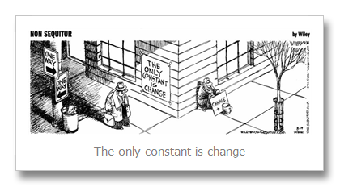
The only constant is change.
Notes:
Whether you like change or not, change is inevitable.

Slide 36
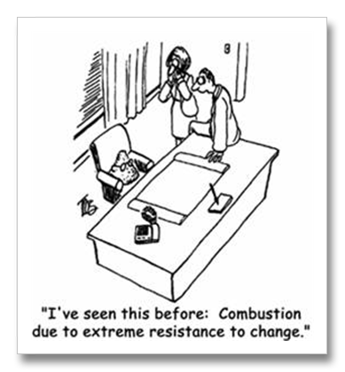
I've seen this before: Combustion due to extreme resistance to change.
Notes:
Some like it while others hate it, so some of us are early adopters while others are laggards. The majority tolerates it.

Slide 37
What changes are you experiencing right now?
Why?
Notes:
Job?
Body?
Relationships?
Something else?
• Why are you experiencing these changes right now?
If we are honest, we really don’t understand why change happens.
Is God causing it—or are you causing the change? I can comprehend why some of us initiate change, but…

Slide 38
Why does God cause change?
Notes:
What reasons would the LORD have to make us have to adjust to new environments over and over?

Slide 39

Let's Study Through Scripture
The Bible: Book by Book
Notes:
We are in a study through the whole Bible right now, book by book. The goal is to give us a basic understanding of each book of the Bible.

Slide 40
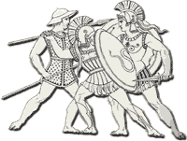
Morality & Politics
195
Poor moral values during Judges era
Weak & vulnerable to enemy attacks
Notes:
Judges had led Israel for 350 years with the only constant being change itself. Judge after judge came and left the scene, some good and some bad. Few agreed that the situation was sustainable. Change needed to happen because each person did what was right in his own eyes with enemies at the door.

Slide 41
Key Word
194
39
Transition
1 Samuel
Notes:
Too often we think of the period of the judges as limited only to the book of Judges. Yet it also includes Ruth and 1 Samuel 1–7, where Samuel himself was the final judge.

Slide 42
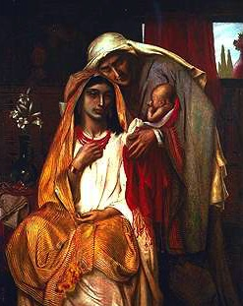
Genealogy of Perez
1. 2. 3. 4. 5. 6. 7. 8. 9. 10.
Perez Hezron Ram Amminadab Nahshon Salmon Boaz Obed Jesse David
Simeon Solomon's The Book of Ruth
Ruth 4:18-22
Notes:
If we keep reading right from the end of Ruth, we see Ruth concluding with its final word, “David.” We are left with the amazing realization that the whole story of Ruth was about David’s great-grandmother!

Slide 43
Theme
194
Degenerate Theocracy
to Davidic Monarchy
1 Samuel
Notes:
In 1 Samuel we will see why David was the climax of Ruth. All along, God’s plan was to delegate his authority to David and his descendants.

Slide 44
Purpose of this Book
196
Purpose of this Book
Theocracy
Monarchy
GOD AS
Man as
Notes:
The book of 1 Samuel gives the transitions necessary for that change to come about from a theocracy to a monarchy focused on David.

Slide 45
Change
FOR ISRAEL
FOR
US
1 Samuel
Notes:
Today we will see what God was doing in changing Israel’s situation and then see why change occurs for us today.

Slide 46
Why does God cause change?
Notes:
What reasons would the LORD have to make us have to adjust to new environments over and over?

Slide 47
I. God had always planned to rule through Davidic kings.
Exegetical Idea of 1 Samuel
Notes:
The LORD even used Israel’s sin to bring in the monarchy under David.

Slide 48
The Theology of Judges-Ruth-Samuel
193
Judges
Ruth
Samuel
Bethlehem
David
Boaz
Bethlehemites
Idolatry (17–18)
Concubine (19)
Gibeah
Murder (19–20)
Saul
Monarchy
Needed
Monarchy
Prepared
Monarchy
Established
Adapted from Thomas L. Constable, "A Theology of Joshua, Ruth, and Judges,"
in A Biblical Theology of the OT, ed. Roy B. Zuck, 95-96, 117
Notes:
The theology of Judges-Ruth-Samuel is fascinating. It shows that God can use any circumstance and any person for His kingdom purpose and His glory.
• The book of Judges shows a dismal scene where a king was needed for the nation.
• Bethlehem appears in two disgraceful scenes:
• A Levite from Bethlehem is involved in ungodly priestly duties and even colludes with the tribe of Dan to steal an idol for their migration north (Judges 17–18). Another Levite with a concubine from Bethlehem (again) encounters a group of Benjaminite men in Gibeah who rape his concubine (Judges 19) and ultimately lead to her disgraceful death.
• In retaliation, the town of Gibeah comes into focus. It is no better than Bethlehem.
• Here in Gibeah the tribe of Benjamin was nearly wiped out, except for 600 men (Judges 20).
• In spite of extreme moral darkness and sin, God was preparing the monarchy.
• He even established that monarchy through the wicked Benjamites through the wicked city of Gibeah.
• How?
God chose the Benjaminite Saul as the first anointed king of Israel (1 Sam 8), though he was from the smallest of the tribes.
• However, Saul’s sad end brings even more shame on Gibeah.
• That preparation of the monarchy finds its true fulfilment in the city of Bethlehem, for in Ruth we see that both Boaz and the Bethlehemites act honourably in the midst of national apostasy. So God can use the same, shameful city of Bethlehem to raise a kinsmen-redeemer through Boaz. Ruth was a woman from Moab, a nation worshipping pagan gods. But through God’s plan and provision, the line of David was established and ultimately the Messiah Jesus Christ himself was born through the line.
• This birth was in the obscure city of Bethlehem, where David raises the status of this town to an amazing height. It is raised to an even higher status than given by David when we get to the NT and see that David’s descendant, Jesus, is not only born into his line but is born in the exact city of David, Bethlehem (Matt 2).
Therefore, the theology of Ruth is that God’s grace can transform the ordinary and obscure to extraordinary and world renown.
________
Common-282
OS-00-OT_Book_Overviews-178
OS-07-Judges-208
OS-08-Ruth-74
OS-09-1 Sam-17, 22, 48
OS-10-2 Sam-21

Slide 49
Slides on
1 Samuel 1
Notes:
Israel’s first national leadership transition from Eli to Samuel came by Samuel's birth, call, and acceptance over Eli's wicked house to prepare for the prophesied monarchy (1 Sam 1–3).

Slide 50
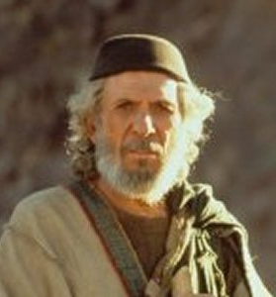
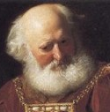
Transition #1
196
1 Samuel
Eli
Samuel
Notes:
The first transition of national leadership from Eli to Samuel marked the end of judges with Samuel as the last judge (1 Sam 1–7).

Slide 51
Book Chart
Degenerate Theocracy to Davidic Monarchy
Theocracy Ended |  | Monarchy Established
Decline of Judges |  | Rise of Kings
Chapters 1–7 |  | Chapters 8–31
Samuel: "Heavenly King" |  | Saul: "Earthly King"
Eli | Samuel | Saul |  | David
Man After Man's Heart | Man After God's Heart | Man After Man's Heart |  | Man After God's Heart
Paralysis | Prayer | Panic |  | Patience
Transition #1 Eli to Samuel (1–3) | Samuel & Ark’s Wanderings (4–7) | Transition #2 Samuel to Saul (8–12) | Saul Rejected (13–15) | Transition #3 Saul to David (16–31)
c. 94 Years
Birth of Samul (1105 BC) to Death of Saul (1011 BC)
203
1 Samuel:
194

Slide 52
Samuel's Birth
197
Samuel was born about 1100 BC.
His father was Elkanah. He was an Ephraimite.
Elkanah had two wives. One was named Hannah.
The two wives did not see eye to eye because Hannah was childless.
1 Sam 1

Slide 53
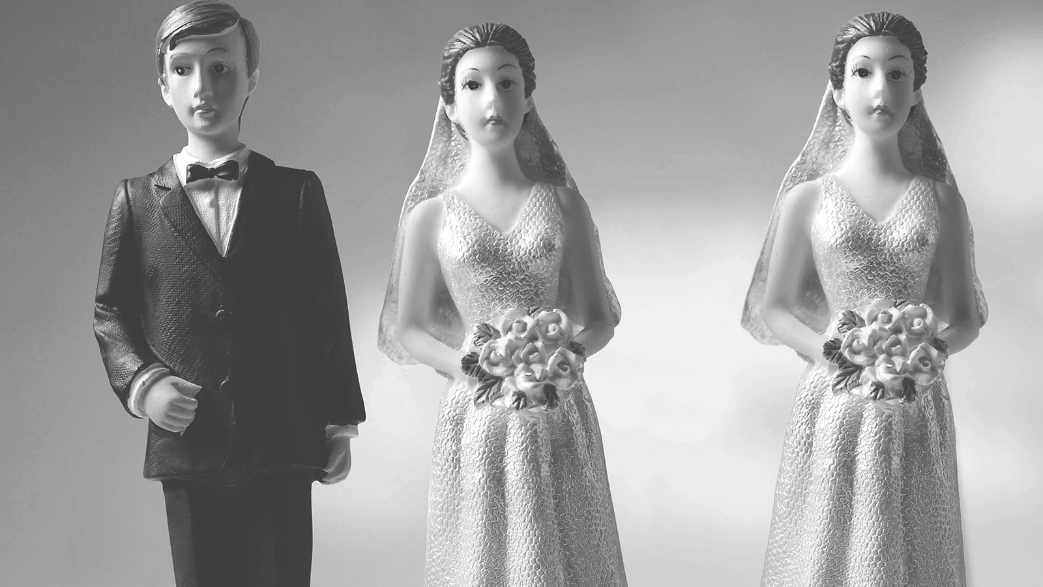
One wife is enough!
197

Slide 54

Barrenness in a Mother’s World
197

Slide 55
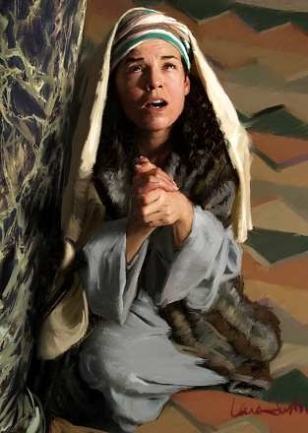
Hannah Prays for a Son
197

Slide 56
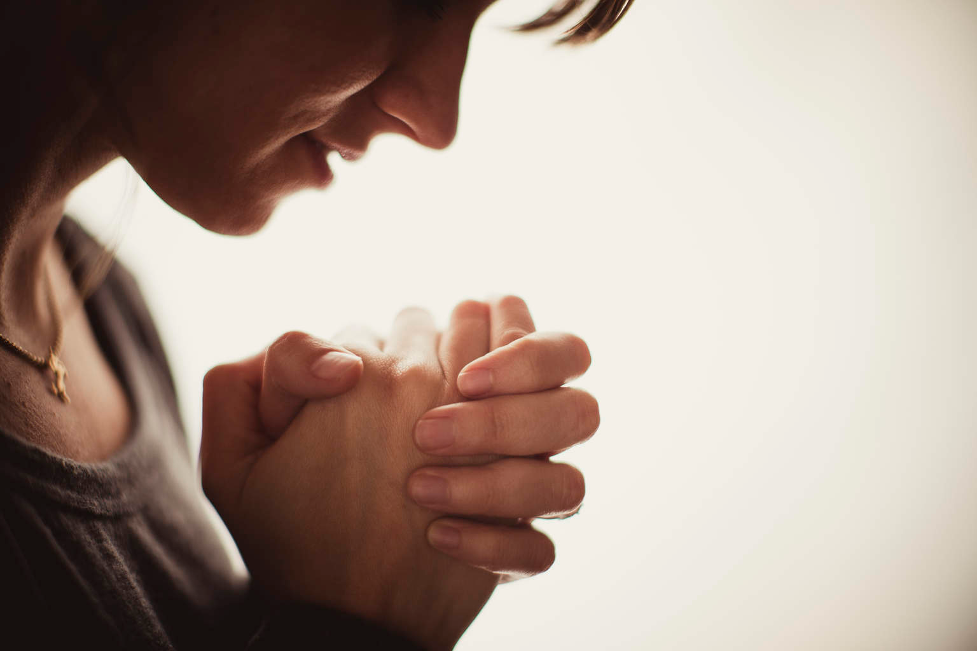
God knows our heart's prayers
197

Slide 57
Slides on
1 Samuel 2
Notes:
Hannah's prophetic prayer praised God's attributes and his future provision of kings (2:1-11).

Slide 58
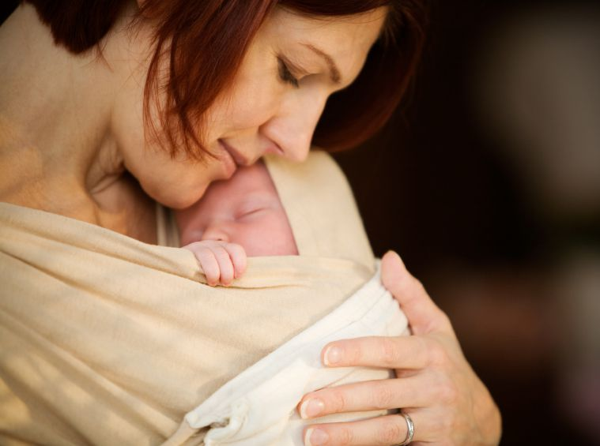
God Answers
197

Slide 59

Children are a Blessing
197

Slide 60
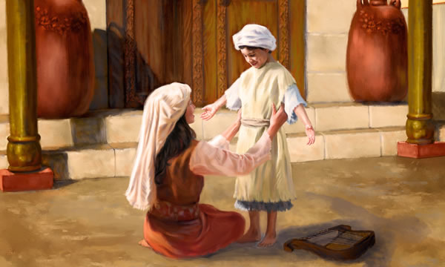
Hannah Cares for Samuel
197

Slide 61
Biographical Contrast by Interchange (1 Sam 1–12)
201
1:1–2:11
2:18-21
2:26
3:1-4:1a
7:3–12:25
Samuel
But Samuel
Samuel
Samuel
Samuel
Eli's Sons
Eli & Sons
Eli & Sons
Eli & Sons (Plus Results)
2:12-17
2:22-25
2:27-36
4:1b–7:2
Donald K. Campbell, Dallas Seminary handout

Slide 62

Samuel's Dedication
197
Hannah prayed earnestly for a child, and God honored her.
God gave her a son and she named him Samuel.
She dedicated Samuel to the LORD for service in the tabernacle.
He was born to a Levite home.
He was called an Ephraimite because he stayed in the hill region of Ephraim.
1 Sam 2

Slide 63
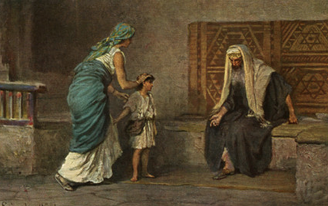
Hannah brings Samuel to Eli
197

Slide 64
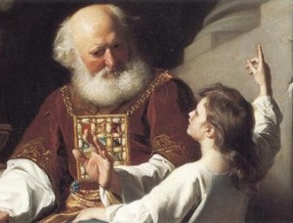
Eli & Samuel
197

Slide 65
Slides on
1 Samuel 3
Notes:
Samuel's call by the LORD and acceptance by the people verified the leadership transition from Eli to Samuel (1 Sam 3).

Slide 66
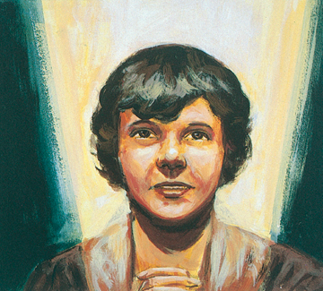
The Boy Samuel
197

Slide 67

Samuel's Call
197
God called Samuel in the night when he was lying down in the temple.
God called him thrice.
Samuel responded on the third time.
1 Sam 3

Slide 68

The Boy Samuel
197

Slide 69
Slides on
1 Samuel 4
Notes:
Israel showed its need for Samuel's leadership in their ignorance of the character of God evident in their superstitious use of the ark to fight the Philistines (1 Sam 4–7).

Slide 70
Book Chart
Degenerate Theocracy to Davidic Monarchy
Theocracy Ended |  | Monarchy Established
Decline of Judges |  | Rise of Kings
Chapters 1–7 |  | Chapters 8–31
Samuel: "Heavenly King" |  | Saul: "Earthly King"
Eli | Samuel | Saul |  | David
Man After Man's Heart | Man After God's Heart | Man After Man's Heart |  | Man After God's Heart
Paralysis | Prayer | Panic |  | Patience
Transition #1 Eli to Samuel (1–3) | Samuel & Ark’s Wanderings (4–7) | Transition #2 Samuel to Saul (8–12) | Saul Rejected (13–15) | Transition #3 Saul to David (16–31)
c. 94 Years
Birth of Samul (1105 BC) to Death of Saul (1011 BC)
203
1 Samuel:
194

Slide 71
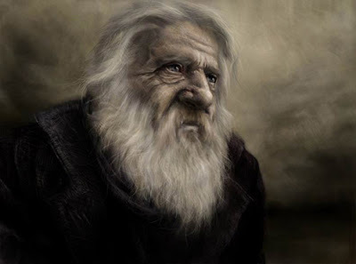
"And Samuel's word came to all Israel"
(1 Samuel 4:1 NIV)
197
Notes:
The Philistine capture of the ark and deaths of Eli and his sons fulfilled the LORD's prophecy against Eli and showed their need for a new leader due to confusion over God's omnipresence (1 Sam 4).

Slide 72
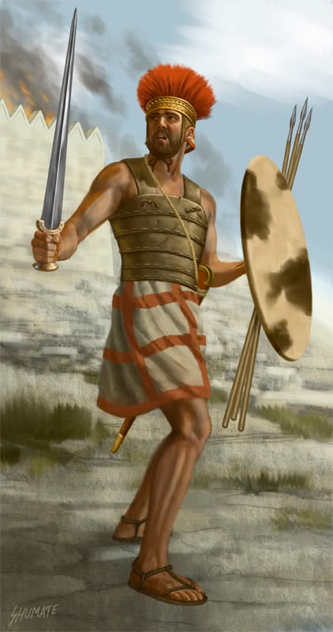
A Rough Start as Judge
197
The Philistines defeat Israel
They capture the Ark of the Covenant too
1 Sam 4

Slide 73
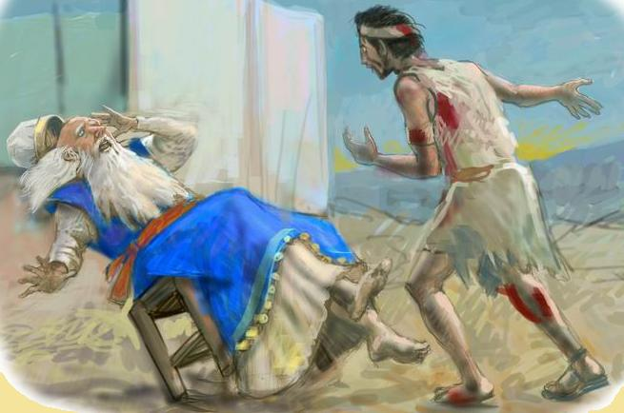
News Brought to Eli (1 Sam 4:18)
197

Slide 74
Slides on
1 Samuel 5
Notes:
The ark’s superiority over Dagan in the Philistine camp showed God's omnipotence over all gods and grace even in Israel’s disobedience (1 Sam 5).

Slide 75
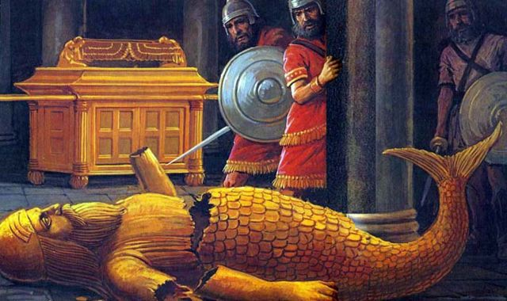
Dagan Shamed at Ashdod
(1 Samuel 5:4)
197

Slide 76
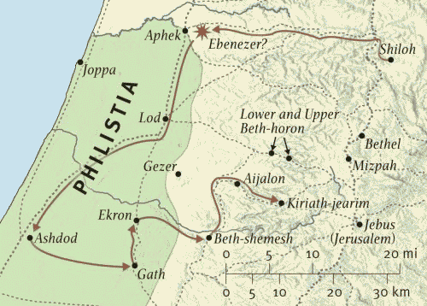
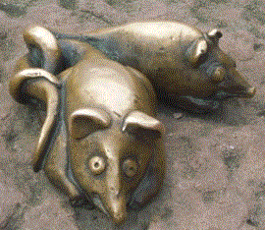
Route of the Ark (1 Samuel 5)
197

Slide 77
Slides on
1 Samuel 6

Slide 78

What should Israel's next move be to protect the Ark of God?
197

Slide 79
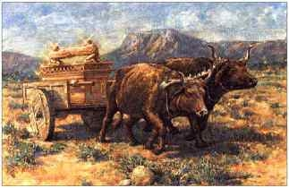
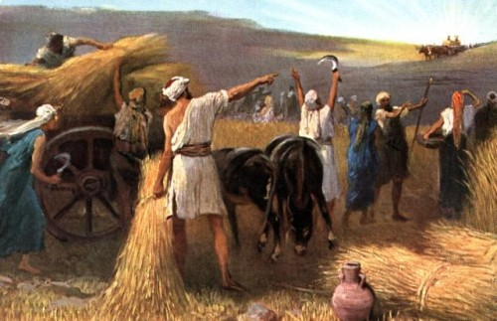
The Ark Returned
197
The Ark was returned to the Israelites at Beth Shemesh.
The Ark was restored to Kiriath Jearim
1 Sam 6

Slide 80
Slides on
1 Samuel 7

Slide 81
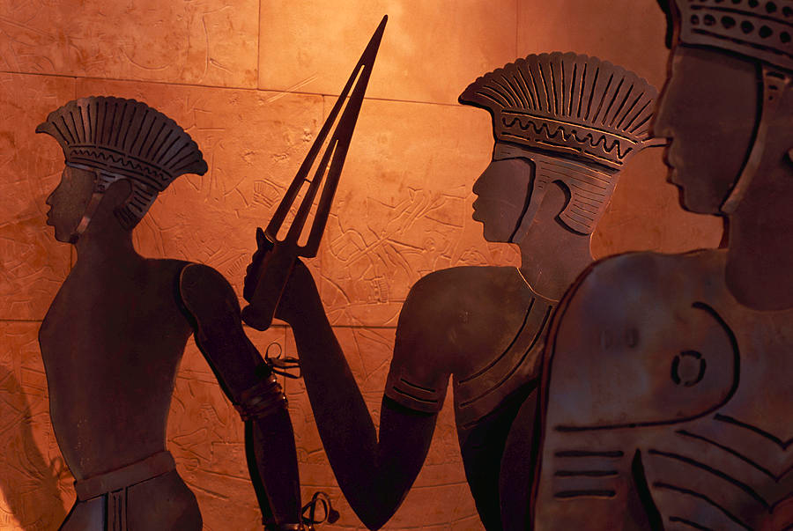
Samuel Subdues the Philistines at Mizpah (1 Samuel 7:2-17)
197

Slide 82
Transition #1
196
1 Samuel
Eli
Samuel
Notes:
The first transition of national leadership from Eli to Samuel marked the end of judges with Samuel as the last judge (1 Sam 1–7).

Slide 83
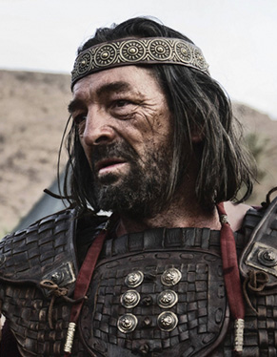
Transition #2
196
1 Samuel
Samuel
Saul
Notes:
The second transition of national leadership from Samuel to Saul marked the start of the monarchy due to Israel's evil motives (1 Sam 8–12).

Slide 84
Slides on
1 Samuel 8

Slide 85
Key Verse
Key Verse
194
1 Sam. 8:5
Let's read it
Was it a good idea for Israel to ask for a king?
Why or why not?
  Premature
  Wrong motive

Slide 86
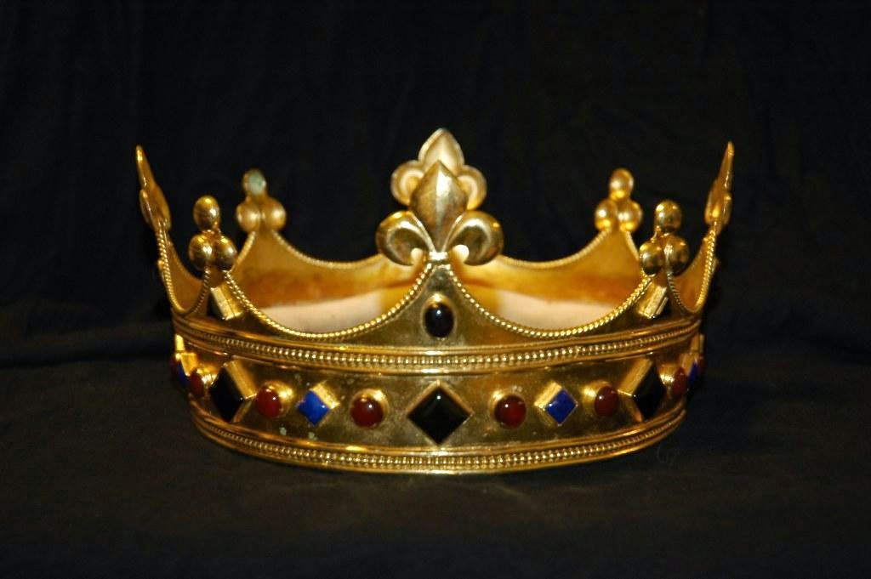
Who deserved the crown?
197

Slide 87

Matthew: Christ as King
"Judah, my son, is a young lion that has finished eating its prey. Like a lion he crouches and lies down; like a lioness—who dares to rouse him?
¹⁰The scepter will not depart from Judah, nor the ruler's staff from his descendants, until the coming of the one to whom it belongs, the one whom all nations will honor" (NLT).
Since Jacob's blessing in Genesis 49:9-10, the lion has depicted a king…

Slide 88
What would the king do to the people?
197
Standing army (8:12a)
Conscripted farmers (8:12b)
Forced makers of weapons (8:12c)
Daughters as bakers, launderers, oil workers, and perfumers in the palace (8:13)
Notes:
“﻿(ii) Saul (a) Nature of Levantine Kingship The changeover from the rule of largely local chiefs to a centralized authority having power over them was a momentous one. In 1 Sam. 8 the prophet Samuel outlined what the practical cost of the rule by monarchy would be. His somber picture has often been treated by Old Testament scholars as an artificial retrojection from the bad days of the subsequent monarchy, put into the prophet’s mouth by a late antimonarchical propagandist. For this purely theoretical view there exists no external supporting evidence. Rather, the evidence we do have points in diametrically the opposite direction — that Samuel’s sentiments were a realistic assessment of what traditional Levantine kingship meant in practice.18 Comparison with the data from the courts of such kingdoms shows clear similarities with Samuel’s warnings. (1) The Hebrews would see their sons impressed into a standing army, serving in the chariotry and as commanders (by fifties and thousands) of companies and divisions of soldiers. With this has been compared the service of maryannu, chariot warriors at Alalakh and later in Ugarit. At Ugarit conscription of the male inhabitants of local villages for military service, particularly as archers, is well attested (as well as for marine service).19 (2) With 1 Sam. 8:12b, royal conscription for work on the land, one may compare the situation in Ugarit, where citizens in their villages were conscripted for this and other work, including on the royal estate (dimtu/gt).20 (3) With 8:12c, on people having to make (or produce) weapons (including for chariots) and equipment, we again may compare usage at Ugarit. There the required delivery of bronze vessels and of lances is mentioned.21 (4) 8:13 continues with such a king taking on people’s daughters to be perfumers, cooks, and bakers — probably to be understood as for royal service in the palace. This compares with bakers, launderers, oil workers, and perfumers in the palace records at Ugarit, and (several centuries before) with women bakers and confectioners, etc., among 400 women in the palace at Mari.22 (5) In 8:14 Samuel warns of royal confiscation of choice land, vineyards and olive groves, to distribute to the king’s officers. In the Canaanite and Levantine world the king often had considerable rights of disposal over the terrain in his realm, and could freely transfer land and title to it, as the Ugarit archives clearly illustrate.23 (6) Further, 8:15, 17a attributes to the king the levying of a tithe of crops (grain, vintage) to supply his officers, and of livestock. The exercise of the royal tithe (crops, vintage, cattle) is again well attested at Ugarit, both in practice and by mention of special exemptions.24 (7) And (8:16) the king can take over servants and livestock, or (8:17b) impress citizens into service.25 In the light of these extensive and well-attested usages, at Mari, Alalakh, and especially Ugarit (which fell in approximately 1175, barely 130 years before Saul’s time), there is no need whatever to defer these usages as attested in 1 Sam. 8 to any period after the eleventh century — they have ancient and enduring roots.
Kenneth Kitchen. On the Reliability of the Old Testament (Eerdmans). Kindle Edition. Loc 2204-2230 of 14432

Slide 89
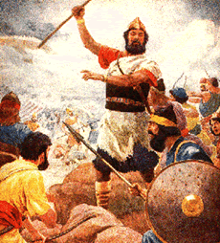
Warnings for Kings (1400 BC)
"You are about to enter the land the LORD your God is giving you. When you take it over and settle there, you may think, 'We should select a king to rule over us like the other nations around us.' ¹⁵ If this happens, be sure to select as king the man the LORD your God chooses. You must appoint a fellow Israelite; he may not be a foreigner"
(Deut. 17:14-15 NLT).

Slide 90
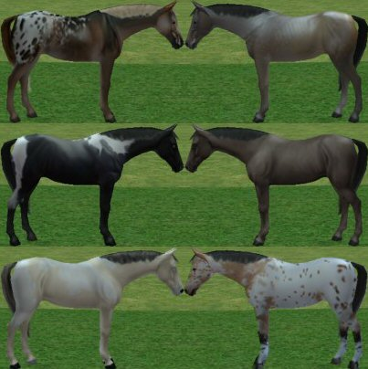
Warnings for Kings (1400 BC)
"The king must not build up a large stable of horses for himself or send his people to Egypt to buy horses, for the LORD has told you, 'You must never return to Egypt'"
(Deut. 17:16 NLT).

Slide 91
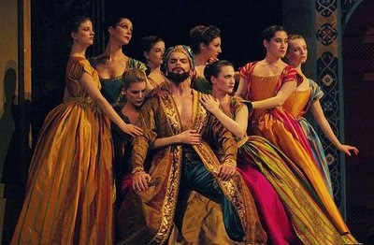
Warnings for Kings (1400 BC)
"The king must not take many wives for himself, because they will turn his heart away from the LORD"
(Deut. 17:17a NLT).

Slide 92
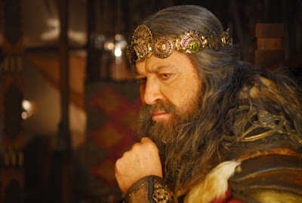
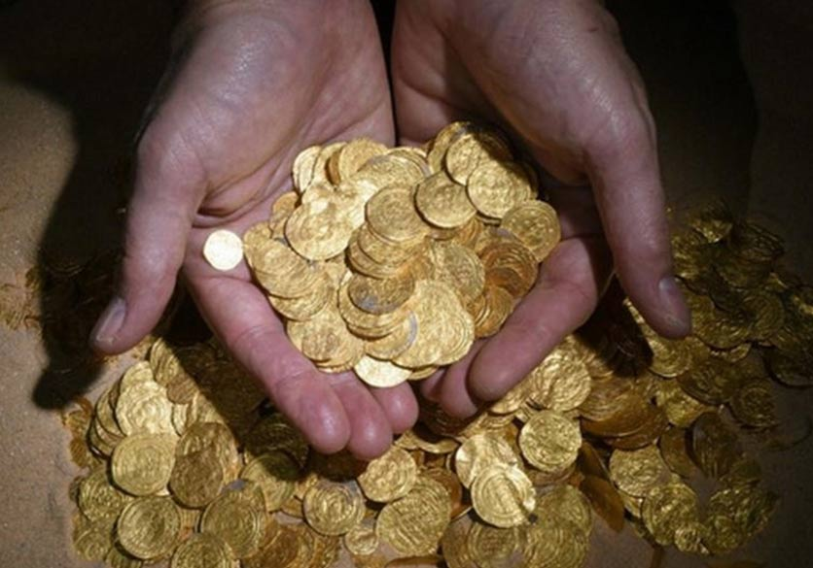
Warnings for Kings (1400 BC)
"And he must not accumulate large amounts of wealth in silver and gold for himself"
(Deut. 17:17b NLT).

Slide 93
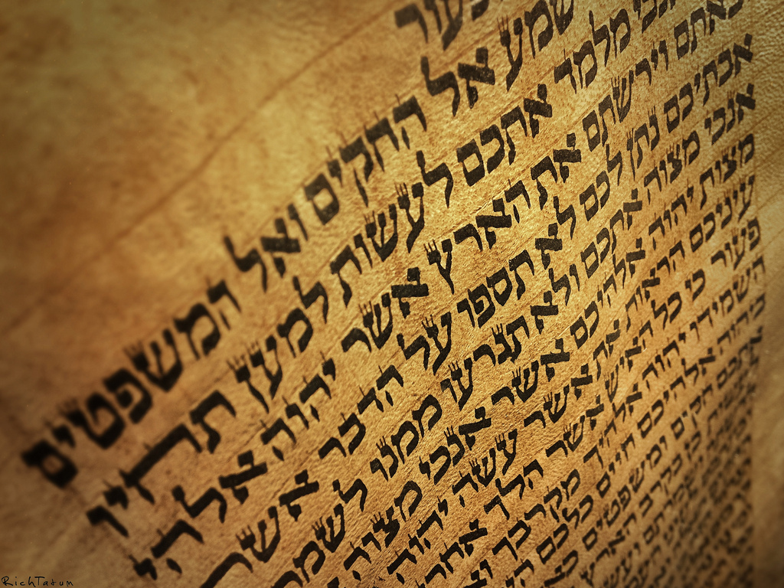
Warnings for Kings (1400 BC)
"When he sits on the throne as king, he must copy for himself this body of instruction on a scroll in the presence of the Levitical priests.
¹⁹He must always keep that copy with him and read it daily as long as he lives. That way he will learn to fear the LORD his God by obeying all the terms of these instructions and decrees"
(Deut. 17:18-19 NLT).

Slide 94
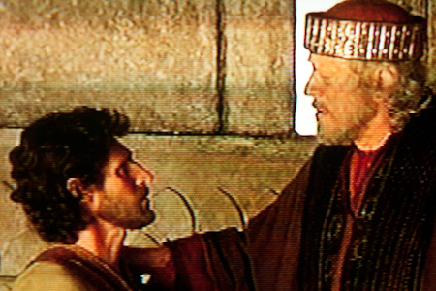
Warnings for Kings (1400 BC)
"This regular reading will prevent him from becoming proud and acting as if he is above his fellow citizens. It will also prevent him from turning away from these commands in the smallest way"
"And it will ensure that he and his descendants will reign for many generations in Israel"
(Deut. 17:20 NLT).

Slide 95
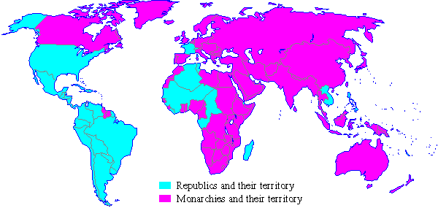
Monarchies in 1900
Republics and their territory
Monarchies and their territory
Notes:
A quick look at the world map a century ago shows that most of the world was ruled by kings in 1900.
________
Common-495
OS-09-1 Samuel-95
OS-10-Davidic Covenant-04
NS-01-Matt1-14-slide 61

Slide 96
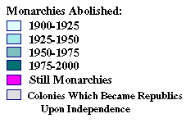
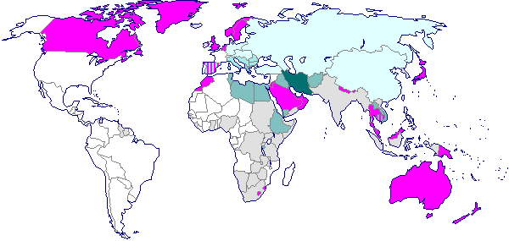
Monarchies in 2000
Monarchies Abolished:
1900-1925
1925-1950
1950-1975
1975-2000
Still Monarchies
Colonies Which Became Republics Upon Independence
Notes:
However, a century later, few monarchies are left. Even Britain, Japan, Canada, Australia and perhaps Scandinavian countries are not monarchies in the practical sense.
________
Common-496
OS-09-1 Sam-96
OS-10-Davidic Covenant-05
NS-01-Matt1-14-slide 62

Slide 97
The Demise of Monarchies
Monarchies in 1900
Monarchies in 2000
Republics and their territory
Monarchies and their territory
Monarchies Abolished:
1900-1925
1925-1950
1950-1975
1975-2000
Still Monarchies
Colonies Which Became Republics Upon Independence
Notes:
Do you see the vast difference between the two world maps? I wonder if the demise of monarchies affects the way we look at Jesus in terms of him being king.
________
Common-497
OS-09-1 Sam-97
OS-10-Davidic Covenant-06
NS-01-Matt1-14-slide 63

Slide 98
The Eternal Davidic Ruler
KING OF KINGS

Slide 99
Book Chart
Degenerate Theocracy to Davidic Monarchy
Theocracy Ended |  | Monarchy Established
Decline of Judges |  | Rise of Kings
Chapters 1–7 |  | Chapters 8–31
Samuel: "Heavenly King" |  | Saul: "Earthly King"
Eli | Samuel | Saul |  | David
Man After Man's Heart | Man After God's Heart | Man After Man's Heart |  | Man After God's Heart
Paralysis | Prayer | Panic |  | Patience
Transition #1 Eli to Samuel (1–3) | Samuel & Ark’s Wanderings (4–7) | Transition #2 Samuel to Saul (8–12) | Saul Rejected (13–15) | Transition #3 Saul to David (16–31)
c. 94 Years
Birth of Samul (1105 BC) to Death of Saul (1011 BC)
203
1 Samuel:
194

Slide 100
Slides on
1 Samuel 9
Notes:
Samuel privately anointed Saul as king to prepare him for public coronation (9:1–10:16).

Slide 101
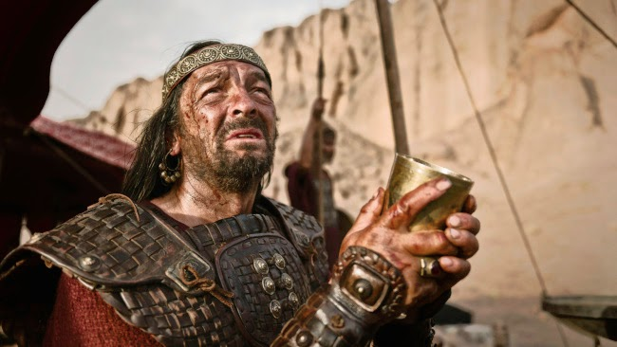
What kind of man was Saul?
198

Slide 102
Slides on
1 Samuel 10
Notes:
Samuel publicly made Saul king as an official declaration of God's displeasure with the nation's decision (10:17-27).

Slide 103
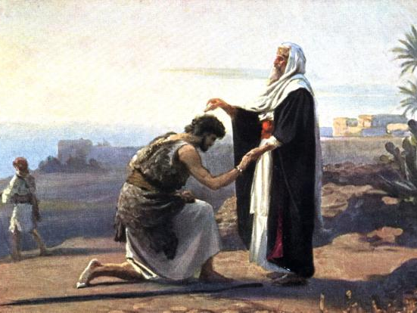
Saul Anointed King
198
1 Samuel 10:1
Notes:
The anointing started very private but then ended up before the entire nation!

Slide 104
Slides on
1 Samuel 11
Notes:
Saul's rescue of Jabesh Gilead and confirmation at Gilgal confirmed him as king in Israel’s eyes (1 Sam 11).

Slide 105
"When Saul heard their words, the Spirit of the God came upon him in power, and he burned with anger."
1 Sam. 11:6

Slide 106
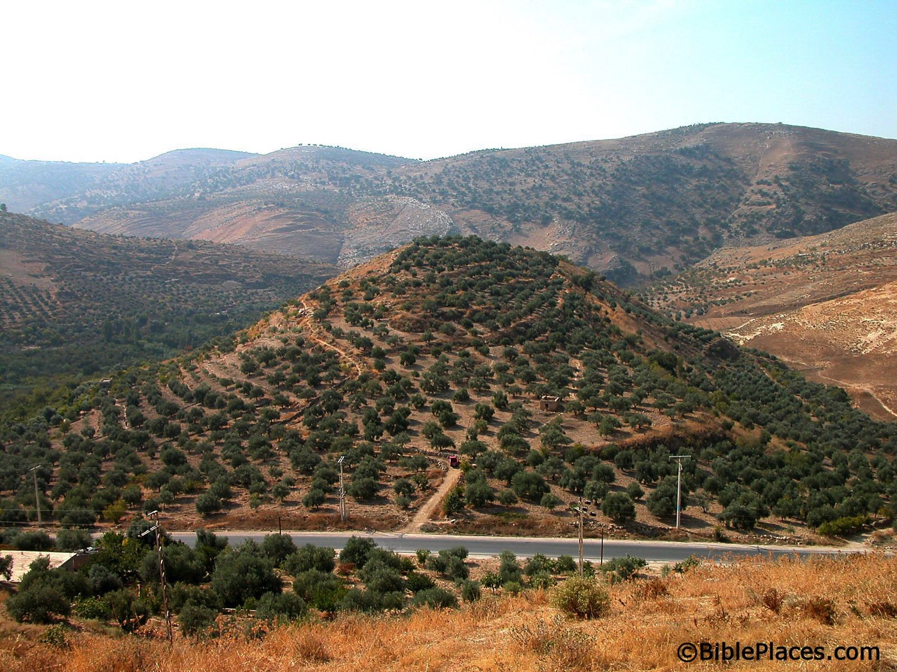
A Great Start as King
198
Tell of Jabesh Gilead (now an olive orchard, never excavated)
Saul led Israelites to victory at Jabesh Gilead (1 Sam 11)

Slide 107
Slides on
1 Samuel 12
Notes:
In Samuel’s retirement speech as judge (but not prophet), he reminded Israel of their sin of asking for a king to motivate them to live based on the Mosaic covenant (1 Sam 12).

Slide 108
The Beginning of…
198
1 Sam 12

Slide 109
Slides on
1 Samuel 13
Notes:
Saul's impatience and fear of the Philistines by having priests offer sacrifices before the required seven days results in Samuel hinting at the LORD had already appointed a godly king (13:1-22).

Slide 110
Book Chart
Degenerate Theocracy to Davidic Monarchy
Theocracy Ended |  | Monarchy Established
Decline of Judges |  | Rise of Kings
Chapters 1–7 |  | Chapters 8–31
Samuel: "Heavenly King" |  | Saul: "Earthly King"
Eli | Samuel | Saul |  | David
Man After Man's Heart | Man After God's Heart | Man After Man's Heart |  | Man After God's Heart
Paralysis | Prayer | Panic |  | Patience
Transition #1 Eli to Samuel (1–3) | Samuel & Ark’s Wanderings (4–7) | Transition #2 Samuel to Saul (8–12) | Saul Rejected (13–15) | Transition #3 Saul to David (16–31)
c. 94 Years
Birth of Samul (1105 BC) to Death of Saul (1011 BC)
203
1 Samuel:
194

Slide 111
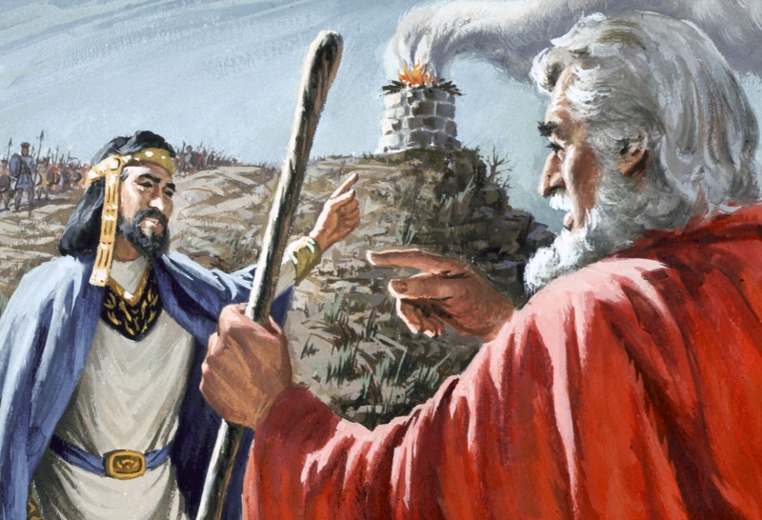
Saul's excuses (1 Samuel 13)
198

Slide 112
Slides on
1 Samuel 14
Notes:
Saul's rashness by preventing his men from food and leading them to eat blood unlawfully shamed him in his vow to kill the "disobedient" Jonathan and showed his godless rule (13:23–14:52).

Slide 113
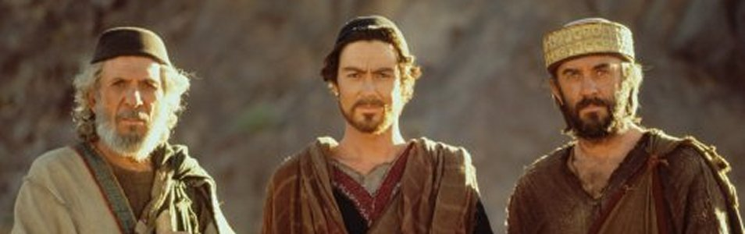
Samuel, David & Saul
198
Notes:
Saul's rashness by preventing his men from food and leading them to eat blood unlawfully shamed him in his vow to kill the "disobedient" Jonathan and showed his godless rule (13:23–14:52).

Slide 114
Slides on
1 Samuel 15
Notes:
Saul's disobedience by not completely destroying the Amalekites was his last act of disobedience before the LORD rejected him as king to show Israel's need for a righteous king (1 Sam 15).

Slide 115

Saul's Refusal to Destroy the Amalekites (1 Sam. 15)
198
1 Sam 15

Slide 116

God's Sorrow Over Saul
198
God is unchangeable.
So why then did He "repent" or "grieve over" the fact that
He made Saul king?
(1 Sam. 15:35)

Slide 117
Transition #1
196
1 Samuel 1–7
Eli
Samuel
Notes:
The first transition of national leadership from Eli to Samuel marked the end of judges with Samuel as the last judge (1 Sam 1–7).

Slide 118
Transition #2
196
1 Samuel 8–15
Samuel
Saul
Notes:
The second transition of national leadership from Samuel to Saul marked the start of the monarchy due to Israel's evil motives (1 Sam 8–12).

Slide 119

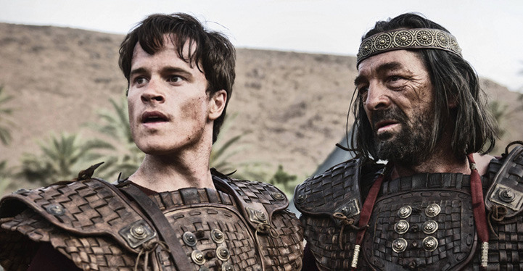
Transition #3 from Saul to David
Transition #3
198
1 Samuel 16–31
Saul
David

Slide 120
Slides on
1 Samuel 16
Notes:
Saul and David were friends while David rose as his musician and warrior (1 Sam 16–17).

Slide 121
Book Chart
Degenerate Theocracy to Davidic Monarchy
Theocracy Ended |  | Monarchy Established
Decline of Judges |  | Rise of Kings
Chapters 1–7 |  | Chapters 8–31
Samuel: "Heavenly King" |  | Saul: "Earthly King"
Eli | Samuel | Saul |  | David
Man After Man's Heart | Man After God's Heart | Man After Man's Heart |  | Man After God's Heart
Paralysis | Prayer | Panic |  | Patience
Transition #1 Eli to Samuel (1–3) | Samuel & Ark’s Wanderings (4–7) | Transition #2 Samuel to Saul (8–12) | Saul Rejected (13–15) | Transition #3 Saul to David (16–31)
c. 94 Years
Birth of Samul (1105 BC) to Death of Saul (1011 BC)
203
1 Samuel:
194

Slide 122
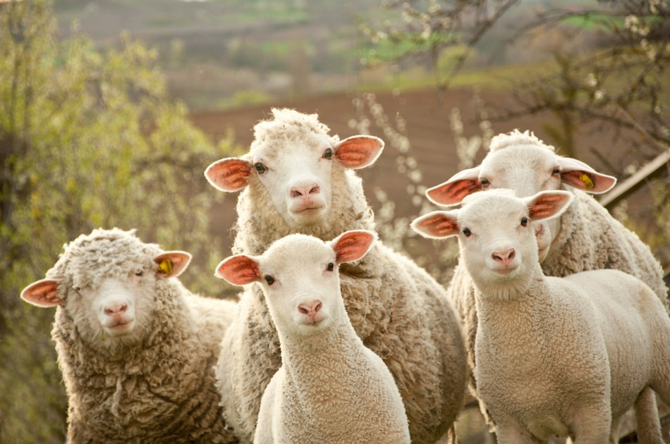
David's Sheep
198
Notes:
Hidden valleys are where shepherds are turned into kings.
What you do in secret is the most important things about you.
David cared for sheep when no one but God was looking.

Slide 123
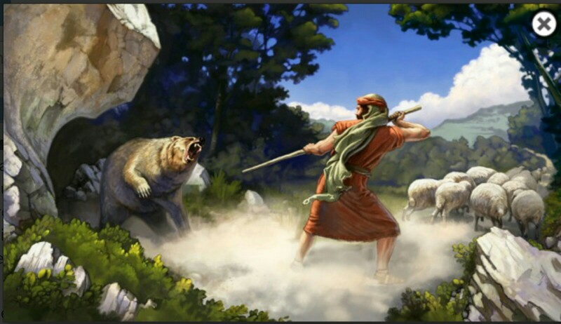
David's Courage
198
Notes:
David's care for the sheep was tested by a lion and a bear and who-knows what else?

Slide 124
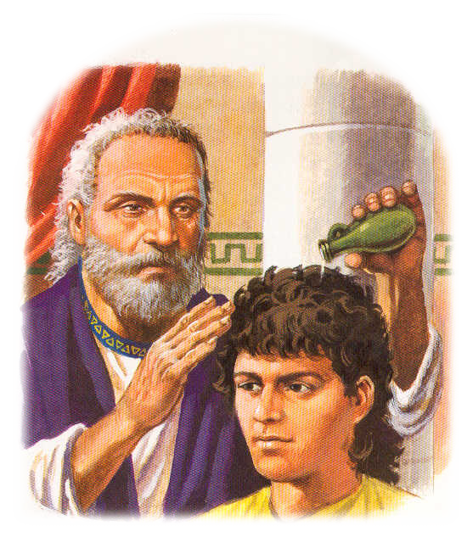
Samuel Anointed David
198
1 Sam 16

Slide 125

Samuel Anointed David
198
1 Sam 16
Notes:
In a rather humorous account where David wasn't even invited to his family feast, God passed by his handsome brothers because God doesn't look at the outside. Even Samuel was initially fooled by David's ruddy appearance.

Slide 126

Who was David?
198
David
Youngest son of Jesse
Handsome, strong, courageous
Shepherd tending his father's sheep
Strong arms, excellent harpist
1 Sam 16

Slide 127

God's Work in David
1 Sam 16
198
David
Chosen by the LORD
Anointed as Israel's 2nd king
Spirit of God came upon Him with power

Slide 128

Bethlehem
Bethlehem: David was anointed king by Samuel here (1 Sam 16:13,15)
Zondervan Atlas

Slide 129

Bethlehem
Bethlehem plays a much larger role in the New Testament as the birthplace of Jesus
Zondervan Atlas

Slide 130
David & Saul
198
Notes:
Bethlehem took an even higher status as King David’s hometown (1 Sam 16:1; 17:58). After defeating Goliath, “Tell me about your father, young man,” Saul said. And David replied, “His name is Jesse, and we live in Bethlehem.”

Slide 131

David in the King's Court
198
The Spirit of God left King Saul
An evil spirit tormented him
David rescued him by playing harp to relieve the king
1 Sam 16

Slide 132
Slides on
1 Samuel 17
Notes:
David's victory over Goliath won Saul's approval as one of his warriors (1 Sam 17).

Slide 133

David's Enemy

Slide 134

David's Courage

Slide 135

First Victory!
198
David Over Goliath
David won with only a sling & stone
Read: 1 Sam. 17:45-47
The LORD was with David
1 Sam. 17

Slide 136

David Beheads Goliath
(1 Sam 17:57)

Slide 137

Result: Philistines Flee
198
1 Sam 17

Slide 138

Saul initially trusted David
198

Slide 139
Slides on
1 Samuel 18
Notes:
Saul and David were enemies when Saul exiled him and attempted to kill him, thus teaching him valuable lessons that would enable him to rule righteously (1 Sam 18–27).
Saul attempted to kill David out of jealousy over God's blessing on his life as a carnal response to God’s revealed will (18:10–20:42).

Slide 140

Jonathan & David
(1 Sam 18:1)
Notes:
"While still holding the dripping head of Goliath, David appears before Saul, who asks about his family. In the king's tent at that time is Saul's son and heir, Jonathan. He is probably a decade older than David, but there is an instant bond between the two.
David's Bond with Jonathan (18:1)
"After David had finished talking with Saul, Jonathan became one in spirit with David, and he loved him as himself." (18:1)
3. Jonathan's Friendship, Saul's Jealousy (1 Samuel 18-20)
by Dr. Ralph F. Wilson
Audio (29:42)
http://www.jesuswalk.com/david/03_david_jonathan.htm
Accessed 11 Nov 2017
_________
Picture by James J. Tissot, detail of 'Friendship of David and Jonathan' (1896-1902) gouache on board, Jewish Museum, New York. David is on the left, Jonathan on the right.

Slide 141

Saul's Jealousy of David
David's prestige
Saul's jealousy
So Saul tried to kill David
The LORD was with David but had left Saul
1 Sam. 18–19

Slide 142

Saul distrusted David
198

Slide 143

Paranoia
198

Slide 144

David the Refugee
198
Was loved by his wife Michal
She deceived her father (Saul) to help David flee and escape from being killed by her father
1 Sam. 18–19
Notes:
OT verses on Michal:
1Sam. 14:49 Saul’s sons included Jonathan, Ishbosheth, and Malkishua. He also had two daughters: Merab, who was older, and Michal.
1Sam. 18:20 In the meantime, Saul’s daughter Michal had fallen in love with David, and Saul was delighted when he heard about it.
1Sam. 18:27 he and his men went out and killed 200 Philistines. Then David fulfilled the king’s requirement by presenting all their foreskins to him. So Saul gave his daughter Michal to David to be his wife.
1Sam. 18:28 When Saul realized that the LORD was with David and how much his daughter Michal loved him,
1Sam. 19:11 Then Saul sent troops to watch David’s house. They were told to kill David when he came out the next morning. But Michal, David’s wife, warned him, “If you don’t escape tonight, you will be dead by morning.”
1Sam. 19:17 “Why have you betrayed me like this and let my enemy escape?” Saul demanded of Michal.
“I had to,” Michal replied. “He threatened to kill me if I didn’t help him.”
1Sam. 25:44 Saul, meanwhile, had given his daughter Michal, David’s wife, to a man from Gallim named Palti son of Laish.
2Sam. 3:13 “All right,” David replied, “but I will not negotiate with you unless you bring back my wife Michal, Saul’s daughter, when you come.”
2Sam. 3:14 David then sent this message to Ishbosheth, Saul’s son: “Give me back my wife Michal, for I bought her with the livesª of 100 Philistines.”
2Sam. 3:15 So Ishbosheth took Michal away from her husband, Palti son of Laish.
2Sam. 6:16 But as the Ark of the LORD entered the City of David, Michal, the daughter of Saul, looked down from her window. When she saw King David leaping and dancing before the LORD, she was filled with contempt for him.
2Sam. 6:20 When David returned home to bless his own family, Michal, the daughter of Saul, came out to meet him. She said in disgust, “How distinguished the king of Israel looked today, shamelessly exposing himself to the servant girls like any vulgar person might do!”
2Sam. 6:21 David retorted to Michal, “I was dancing before the LORD, who chose me above your father and all his family! He appointed me as the leader of Israel, the people of the LORD, so I celebrate before the LORD.
2Sam. 6:23 So Michal, the daughter of Saul, remained childless throughout her entire life.
1Chr. 15:29 But as the Ark of the LORD’s Covenant entered the City of David, Michal, the daughter of Saul, looked down from her window. When she saw King David skipping about and laughing with joy, she was filled with contempt for him.

Slide 145

David the Refugee
198
Was loved by his wife Michal
She deceived her father (Saul) to help David flee and escape from being killed by her father
1 Sam. 18–19
Notes:
OT verses on Michal:
1Sam. 14:49 Saul’s sons included Jonathan, Ishbosheth, and Malkishua. He also had two daughters: Merab, who was older, and Michal.
1Sam. 18:20 In the meantime, Saul’s daughter Michal had fallen in love with David, and Saul was delighted when he heard about it.
1Sam. 18:27 he and his men went out and killed 200 Philistines. Then David fulfilled the king’s requirement by presenting all their foreskins to him. So Saul gave his daughter Michal to David to be his wife.
1Sam. 18:28 When Saul realized that the LORD was with David and how much his daughter Michal loved him,
1Sam. 19:11 Then Saul sent troops to watch David’s house. They were told to kill David when he came out the next morning. But Michal, David’s wife, warned him, “If you don’t escape tonight, you will be dead by morning.”
1Sam. 19:17 “Why have you betrayed me like this and let my enemy escape?” Saul demanded of Michal.
“I had to,” Michal replied. “He threatened to kill me if I didn’t help him.”
1Sam. 25:44 Saul, meanwhile, had given his daughter Michal, David’s wife, to a man from Gallim named Palti son of Laish.
2Sam. 3:13 “All right,” David replied, “but I will not negotiate with you unless you bring back my wife Michal, Saul’s daughter, when you come.”
2Sam. 3:14 David then sent this message to Ishbosheth, Saul’s son: “Give me back my wife Michal, for I bought her with the livesª of 100 Philistines.”
2Sam. 3:15 So Ishbosheth took Michal away from her husband, Palti son of Laish.
2Sam. 6:16 But as the Ark of the LORD entered the City of David, Michal, the daughter of Saul, looked down from her window. When she saw King David leaping and dancing before the LORD, she was filled with contempt for him.
2Sam. 6:20 When David returned home to bless his own family, Michal, the daughter of Saul, came out to meet him. She said in disgust, “How distinguished the king of Israel looked today, shamelessly exposing himself to the servant girls like any vulgar person might do!”
2Sam. 6:21 David retorted to Michal, “I was dancing before the LORD, who chose me above your father and all his family! He appointed me as the leader of Israel, the people of the LORD, so I celebrate before the LORD.
2Sam. 6:23 So Michal, the daughter of Saul, remained childless throughout her entire life.
1Chr. 15:29 But as the Ark of the LORD’s Covenant entered the City of David, Michal, the daughter of Saul, looked down from her window. When she saw King David skipping about and laughing with joy, she was filled with contempt for him.

Slide 146
Slides on
Psalm 59
For the choir director: A psalm of David, regarding the time Saul sent soldiers to watch David’s house in order to kill him. To be sung to the tune “Do Not Destroy!”

Slide 147
Psalm 59:1-3
Rescue me from my enemies, O God.
Protect me from those who have come to destroy me.
² Rescue me from these criminals;
save me from these murderers.
³ They have set an ambush for me.
Fierce enemies are out there waiting, LORD,
though I have not sinned or offended them.

Slide 148
Slides on
1 Samuel 19
Notes:
Saul attempted to kill David out of jealousy over God's blessing on his life as a carnal response to God’s revealed will (18:10–20:42).

Slide 149


David the Fugitive
198
Notes:
Saul tried to kill David by throwing a spear at him (18:10-16).
Saul tried to kill David by tricking him to fight the Philistines (18:17-30).
Saul tried to kill David by commanding his servants to kill David (19:1-7).
Saul tried to kill David by throwing a spear at him again (19:8-10).
Saul tried to kill David by sending messengers to kill him (19:11-17).
Saul tried to kill David by seeking his life at Samuel's house (19:18-24).

Slide 150
Slides on
1 Samuel 20
Notes:
Saul tried to kill David by commanding Jonathan to betray him (1 Sam 20).

Slide 151
Gone were the harp days
198

Slide 152

Best Friends: David and Jonathan
198
Final Parting
1 Sam 20

Slide 153
Slides on
1 Samuel 21

Slide 154

The priest Ahimelech gave Goliath's sword and consecrated bread to David and his men (1 Samuel 21:6, 9)
198
Notes:
At Nob, David ate the consecrated bread and learned the concession that the Law permitted—that life is more holy than bread (21:1-9; cf. Matt. 12:7-8).
At Gath, David feigned insanity before Achish and learned not to go to his enemies for protection (21:10-15).

Slide 155

Doeg the Edomite & Saul (21:7)
198
Notes:
Unfortunately, a traitor is in his midst.

Slide 156
Slides on
Psalm 52
For the choir director: A psalm of David, regarding the time Doeg the Edomite said to Saul, “David has gone to see Ahimelech.”

Slide 157
Rebuke
Why do you boast of evil, you mighty man? Why do you boast all day long, you who are a disgrace in the eyes of God? Your tongue plots destruction; it is like a sharpened razor, you who practice deceit. You love evil rather than good, falsehood rather than speaking the truth.
Psalm 52:1-3

Slide 158
Slides on
Psalm 34
A psalm of David, regarding the time he pretended to be insane in front of Abimelech, who sent him away.
Notes:
At Gath, David feigned insanity before Achish and learned not to go to his enemies for protection (1 Sam 21:10-15).
1Sam. 21:10 So David escaped from Saul and went to King Achish of Gath. ¹¹ But the officers of Achish were unhappy about his being there. “Isn’t this David, the king of the land?” they asked. “Isn’t he the one the people honor with dances, singing,
‘Saul has killed his thousands,
and David his ten thousands’?”
1Sam. 21:12 David heard these comments and was very afraid of what King Achish of Gath might do to him. ¹³ So he pretended to be insane, scratching on doors and drooling down his beard.
1Sam. 21:14 Finally, King Achish said to his men, “Must you bring me a madman? ¹⁵ We already have enough of them around here! Why should I let someone like this be my guest?”

Slide 159

390
P 13
Psalm 34:3
“Glorify the LORD with me; let us exalt his name together.”

Slide 160

Psalm 34
¹ I will extol the LORD at all times;
his praise will always be on my lips.
² I will glory in the LORD;
let the afflicted hear and rejoice.
³ Glorify the LORD with me;
let us exalt his name together.
⁴ I sought the LORD, and he answered me;
he delivered me from all my fears.

Slide 161
⁵ Those who look to him are radiant;
their faces are never covered with shame.
⁶ This poor man called,
and the LORD heard him;
he saved him out of all his troubles.
⁷ The angel of the LORD encamps around those who fear him,
and he delivers them.
⁸ Taste and see that the LORD is good;
blessed is the one who takes refuge in him.
⁹ Fear the LORD, you his holy people,
for those who fear him lack nothing.

Slide 162
¹⁰ The lions may grow weak and hungry,
but those who seek the LORD
lack no good thing.
¹¹ Come, my children, listen to me;
I will teach you the fear of the LORD.
¹² Whoever of you loves life
and desires to see many good days,
¹³ keep your tongue from evil
and your lips from telling lies.
¹⁴ Turn from evil and do good;
seek peace and pursue it.

Slide 163
¹⁵ The eyes of the LORD are on the righteous,
and his ears are attentive to their cry;
¹⁶ but the face of the LORD
is against those who do evil,
to blot out their name from the earth.
¹⁷ The righteous cry out,
and the LORD hears them;
he delivers them from all their troubles.
¹⁸ The LORD is close to the brokenhearted
and saves those who are crushed in spirit.

Slide 164
¹⁹ The righteous person may have many troubles,
but the LORD delivers him from them all;
²⁰ he protects all his bones,
not one of them will be broken.
²¹ Evil will slay the wicked;
the foes of the righteous will be condemned.
²² The LORD will rescue his servants;
no one who takes refuge in him will be condemned.

Slide 165

"The LORD is near the brokenhearted
and saves the crushed in spirit.”
Psalm 34:18

Slide 166
Slides on
Psalm 56
For the choir director: A psalm of David, regarding the time the Philistines seized him in Gath. To be sung to the tune “Dove on Distant Oaks.”

Slide 167
Psalm 56:1-4 NLT
O God, have mercy on me,
for people are hounding me.
My foes attack me all day long.
² I am constantly hounded by those who slander me, and many are boldly attacking me.
³ But when I am afraid,
I will put my trust in you.
⁴ I praise God for what he has promised.
I trust in God, so why should I be afraid?
What can mere mortals do to me?

Slide 168
Slides on
1 Samuel 22
Notes:
At the cave of Adullam, David gathered 400 "down-and-outers" and learned compassionate leadership (22:1-2).
At Mizpah, David left his parents at Moab—kin of his great-grandmother Ruth—and learned the need to care for his family (22:3-4).

Slide 169

Saul killed the priests at Nob
(1 Sam 22)
198
Notes:
At Hereth, David learned of Saul's slaughter of 85 priests and all of Nob because Abimelech helped David and this taught him of the perils of jealousy (22:5-23).

Slide 170
Slides on
1 Samuel 23
Notes:
At Keilah, David delivered the town from both the Philistines and Saul, which instructed him to consult the LORD in decision-making (23:1-12).
At Horesh in the Ziph desert, Jonathan encouraged David but Ziphites betrayed his spot to Saul, which taught David to find strength in God when betrayed (23:13-23).
In the Maon desert, David barely escaped Saul, who broke his pursuit to rout the invading Philistines, which taught David that his life is in God's hands (23:24-28)

Slide 171
Slides on
Psalm 54
For the choir director; on stringed instruments. A Maskil of David, when the Ziphites came and said to Saul, “Is not David hiding himself among us?”
Notes:
At Horesh in the Ziph desert, Jonathan encouraged David but Ziphites betrayed his spot to Saul, which taught David to find strength in God when betrayed (1 Sam 23:13-23).

Slide 172

Psalm 54:1-3 NLT
Come with great power, O God, and rescue me!
Defend me with your might.
² Listen to my prayer, O God.
Pay attention to my plea.
³ For strangers are attacking me;
violent people are trying to kill me.
They care nothing for God.
Interlude

Slide 173

En Gedi Refuge
199
Above En Gedi, looking up the canyon from west to the east with the Dead Sea in back, here David found refuge from Saul (1 Sam. 23:29; 24:1)
Zondervan Atlas
Notes:
At En Gedi’s cave, David spared Saul due to his authority as God's chosen king, which taught him to use his future kingly authority only for godly ends (23:29–24:22).

Slide 174
Slides on
1 Samuel 24

Slide 175

David Spared Saul's Life
199
Called Saul
"the LORD's anointed"
(7x in chaps. 24 & 26)
David respected God's appointed king
David spared Saul's life even though Saul was trying to kill him
1 Sam. 24 & 26
Notes:
At En Gedi’s cave, David spared Saul due to his authority as God's chosen king, which taught him to use his future kingly authority only for godly ends (23:29–24:22).

Slide 176
Slides on
Psalm 142

Slide 177

For the LORD said, “I will also banish Judah from my presence just as I have banished Israel. And I will reject my chosen city of Jerusalem and the Temple where my name was to be honored”
(NLT).
A psalm of David, regarding his experience in the cave. A prayer.
Psalm 142 (NLT)

Slide 178
For the LORD said, “I will also banish Judah from my presence just as I have banished Israel. And I will reject my chosen city of Jerusalem and the Temple where my name was to be honored”
(NLT).
I cry out to the LORD;
I plead for the LORD’s mercy.
² I pour out my complaints before him and tell him all my troubles.
³ When I am overwhelmed,
you alone know the way I should turn. Wherever I go, my enemies have set traps for me.
Psalm 142 (NLT)

Slide 179
For the LORD said, “I will also banish Judah from my presence just as I have banished Israel. And I will reject my chosen city of Jerusalem and the Temple where my name was to be honored”
(NLT).
I look for someone to come and help me, but no one gives me a passing thought! No one will help me; no one cares a bit what happens to me.
⁵ Then I pray to you, O LORD. I say, “You are my place of refuge. You are all I really want in life.”
Psalm 142 (NLT)

Slide 180
For the LORD said, “I will also banish Judah from my presence just as I have banished Israel. And I will reject my chosen city of Jerusalem and the Temple where my name was to be honored”
(NLT).
⁶ “Hear my cry, for I am very low.
Rescue me from my persecutors,
for they are too strong for me.
⁷ Bring me out of prison
so I can thank you.
The godly will crowd around me,
for you are good to me.”
Psalm 142 (NLT)

Slide 181
Slides on
1 Samuel 25
Notes:
In the Maon desert, David learned not to act rashly like Saul through Nabal's wife Abigail, who honored David as God’s anointed and soon married him (1 Sam 25).

Slide 182
Samuel Died
199
1 Sam. 25

Slide 183

Expecting Reward (1 Sam 25)
198
Notes:
In the Maon desert, David learned not to act rashly like Saul through Nabal's wife Abigail, who honored David as God’s anointed and soon married him (1 Sam 25).

Slide 184

Abigail, Nabal & David (1 Sam 25)
198
Notes:
In the Maon desert, David learned not to act rashly like Saul through Nabal's wife Abigail, who honored David as God’s anointed and soon married him (1 Sam 25).

Slide 185
Slides on
1 Samuel 26
Notes:
On the Hakilah hill, David again spared Saul's life as God's chosen king, again showing David to use his future kingly authority for godly purposes (1 Sam 26).

Slide 186

David spares Saul’s life (26:5)
198
Notes:
On the Hakilah hill, David again spared Saul's life as God's chosen king, again showing David to use his future kingly authority for godly purposes (1 Sam 26).

Slide 187
Slides on
1 Samuel 27
Notes:
At Gath and Ziklag, David developed his leadership and combat skills by carrying out raids against peoples south of the Philistines (1 Sam 27).

Slide 188


A Tale of Three Kings
198
The Three Kings:
Saul
David
Absalom
A TALE OF
THREE KINGS
A study in brokeness
Notes:
Application: When an oppressive superior mistreats you (like Saul mistreated David), how do you respond? If you do not learn submission and brokenness, eventually when you get into a position of authority, you too could become a “Saul” who grasps for power! Learn the lesson of David. As we will see in 2 Samuel, David eventually had plenty of opportunities to imitate Saul—especially when his son Absalom claimed to be the rightful “third king” after Saul and David. This decision of David not to become a Saul is well said in this modern classic for those in ministry transition: Gene Edwards, A Tale of Three Kings: A Study in Brokenness (Wheaton, IL: Tyndale, 1980, 1982). It’s a fast-moving, stirring, and biblical account of only 98 pages.

Slide 189

David exults in God alone
198

Slide 190
Slides on
1 Samuel 28

Slide 191

Philistines and Saul Assemble for Battle at Mt. Gilboa
1 Samuel 28–29
200

Slide 192

Saul's Final Decline!
199
Philistines set up camp and Saul was afraid
Inquired of the LORD how to deal with the Philistine army
- What did the LORD say?
Reply
1 Sam. 28

Slide 193

Saul Consulted a Medium
199
Succumbed to
idol worship
Disobeyed the LORD!
1 Sam. 28

Slide 194

The witch of Endor was a fake
198

Slide 195
Slides on
1 Samuel 29

Slide 196

David Enlisted by Achish & Rejected
140
Phoenicia
Aram
1 Samuel 29
Gilboa
Israel
Ammon
Philistia
Moab
Egypt
Edom

Slide 197

David Pretended to Befriend Philistines
200
What about David?
Found strength in the LORD and continued to pursue and obey the LORD in his undertaking
1 Sam. 29

Slide 198
Slides on
1 Samuel 30

Slide 199
David Pursues the Amalekites
140
Phoenicia
Aram
1 Samuel 30
Gilboa
Israel
Ammon
Philistia
Moab
Ziklag
Egypt
Amalekites
Edom

Slide 200
Slides on
1 Samuel 31

Slide 201



Saul's Tragic End
200
Philistines killed Saul's sons
Saul took his own life
1 Sam. 31

Slide 202

Saul died with his sons Jonathan, Abinadab, and Malkishua (1 Sam. 31:2)
200

Slide 203

Saul killed himself
(1 Sam. 31:4) but an Amalekite lied by saying he did it instead (2 Sam. 1:10)
200

Slide 204
Saul's Body
After Saul's death men from Jabesh Gilead courageously took his body off the wall of Beth Shan
200
Tell of Jabesh Gilead (now an olive orchard, never excavated)

Slide 205
Lessons in Patience
198
David's Life
King of All Israel
Saul Dies
Running from Saul
Anointed King
Goliath
7 ½ Years
wilderness years
10 Years
Does NOT Seize the Throne
Accepts Partial Kingship (Judah alone)
Does NOT Kill Saul

Slide 206
II. God initiates change to fulfill his plans for us.
Main Idea of 1 Samuel
Notes:
The LORD alters our lives to focus on his purposes.

Slide 207

Sometimes change comes though our desire to be like the world
Notes:
I don’t see the world trying to be like the church much, but I do see the church trying to be like the world in many ways—dress, authority, morality, technology, etc.
Our “been there, done that” types of regrets in our lives cause us to change.
We can learn from the mistakes of others since none of us will live long enough to make all the mistakes ourselves.

Slide 208
The better way to change is for us to let God lead us
CAUTION
GOD AT WORK

Slide 209
"The world has yet to see what God can do through one man who is totally yielded to him"
—Dwight L. Moody—
Notes:
If you gave complete control of your life to God, what would change?
Would you still have the same habits?
Would you still have the same job?
Where would you live?
What would you be doing?

Slide 210
Why does God cause change?
Notes:
Restatement

Slide 211
I. God had always planned to rule through Davidic kings.
Exegetical Idea of 1 Samuel
Notes:
The LORD even used Israel’s sin to bring in the monarchy under David.

Slide 212
II. God initiates change to fulfill his plans for us.
Main Idea of 1 Samuel
Notes:
The LORD alters our lives to focus on his purposes.

Slide 213
Be
Changed
1 Samuel
Dr. Rick Griffith • Crossroads International Church Singapore
CICFamily.com • BibleStudyDownloads.org
Notes:
So what should we do (Exhortation)?
Be changed! (Notice the title of this sermon.)

Slide 214
Change
"THE CIRCUMSTANCES
WE ASK GOD
TO CHANGE ARE OFTEN
THE CIRCUMSTANCES GOD
IS USING
TO CHANGE US"
—MAX LUCADO,
I AM WONDERFULLY & FEARFULLY MADE
Notes:
Do you fear change? Then change your view of change! Max Lucado said, “The circumstances we ask God to change are often the circumstances God is using to change us.”

Slide 215

If nothing ever changed, there'd be no butterflies.
—Unknown
Notes:
Be open to God initiating any change he wants in your life. As someone said, “If nothing ever changed, there’d be no butterflies.” Be that butterfly.

Slide 216

LORD
I come to
YOU
————————
Let my
HEART be changed
Notes:
Are you willing for God to make whatever change in your life that he wants? Then tell him. Tell him that you want “The Power of Your Love” as the song says.

Slide 217
Black

Slide 218


OT Preaching link at BibleStudyDownloads.org
Get this presentation and script for free!

Slide 219
1 Samuel at a Glance
Theocracy | Transition from Samuel to Saul | Monarchy | Transition from Saul to David
Samuel's Birth & Calling | Samuel's Ministry & Saul's Anointing as king of Israel | Rise of Saul & Fall of Saul Rise of David | Saul's Death
Man after God's Heart | Saul: Man after Man's Heart David: Man after God's Heart |  | Saul: Man after Man's Heart David: Man after God's Heart
Chapters 1–3 | Chapters 4–7 | Chapters 8–30 | Chapter 31
194

Slide 220

Application
208
START
RIGHT
FINISH
WELL
Be a man after GOD'S heart through obedience

Slide 221
Review of Saul
208
How did He start?
Saul
Physically (9:2):
He was young
He was impressive
He was tall
Q: Advantages or Disadvantages?
A: Advantages!

Slide 222
Review of Saul
208
How did He start?
Saul
Physically (9:2):
He was young
He was impressive
He was tall
Q: How did he respond when Samuel said that he'd lead Israel?
A: Felt inadequate despite his advantages!!!

Slide 223
Saul's Start
208
How He Started
Saul
Flying Colours, Flying Start!
Felt unworthy of the honour, fearful of the position
Successfully routed enemy and saved the city… Kingship was confirmed!

Slide 224

Saul's Failures
208
How He Continued
Saul
Incident 1:
He did not wait for Samuel but went ahead to offer sacrifices to the Lord.
Read: 13:12
Disregarded God
Feared men

Slide 225
Saul's Failures
208
How He Continued
Saul
Incident 2:
God promised Saul victory but after the battle Saul took the spoils for himself
His Defense:
Read: 15:13-15
pushed the blame onsoldiers
failed to obey God again (15:20)
sought honour from man (15:24, 25, 30)

Slide 226
Consistent Character Flaws
208
Consistent Character Flaws
Saul
Failed to obey the LORD's commands
2. Unduly concerned about what the people wanted
Rejected by the Lord (1 Sam 15:23)

Slide 227
Review of David
208
How He Started
David
Physically (16:12):
ruddy
fine appearance
handsome features
Q: Advantages or Disadvantages?
A: Advantages

Slide 228
David's Start
208
How He Started
David
Flying Colours, Flying Start!
Spiritually?
Let's Read: 16:12b-13
Chosen by the Lord
Spirit of the Lord came upon David in power
Anointed by the Lord

Slide 229
David's Successes
208
How He Continued
David
Inquired of the Lord
1 Sam. 23:2
1 Sam. 23:4
1 Sam. 30:8
Read 30:8
The Lord answered David's inquiries and he obeyed the Lord

Slide 230
David's Successes
208
How He Continued
David
Spared his Enemy's Life
1 Sam. 24:7-8
1 Sam. 26:9-10
David respected Saul's anointment
David obeyed the Lord's command (Deut. 1:17) and left the judgment of Saul to God

Slide 231

God's View of Sacrifices
194
TO OBEY IS BETTER THAN SACRIFICE
1 Samuel 15:22

Slide 232

Today's Context
Today's Context
194
God does not want us to make sacrifices for him if we are not obeying his commands. For example:
A church leader gives his time to serve on several ministries in the church, but is not showing love to his wife and his children at home.
A missionary conducts weekly discipleship classes but does not forgive someone who hurt her.

Slide 233

Why Obedience is Vital
God said to tell you his law is not to be voted on. Just do it!
194
Why our Obedience
is important to God
God cherishes our relationship more than anything else.
He does not want us to be busy doing things when our relationship with him is not right.

Slide 234
Started Right
Summary on Saul
208
Humble
+
Felt unworthy
of honour
+
Afraid to take up king's responsibility
Pride
+
Concern with honour
+
Ego Problem
Finished Wrong
Personal
Downfall
A man after man's heart

Slide 235
Finished Well?
<to be continued ☺…. in 2 Samuel>
208
Continued Well
Summary on David
David
Rise of David
Started Right
Anointed by the Lord
Continuously obeyed the Lord
A man after GOD's heart

Slide 236
Application
208
RIGHT
START
WELL
FINISH
A man after GOD's heart through Obedience

Slide 237


208
Review
Who remembers the three transitions that we have studied today?

Slide 238
Keys to the Book
1 Samuel
194
1 Samuel
key word
Transition
key verse
1 Samuel 8:5
key application
Start Right, Finish Well:
A man after God's heart through Obedience

Slide 239

Date
250
264
First Kings covers 120 years from 971 BC with the crowning of Solomon to 852 BC during Ahaziah's reign. The year 931 marks the most significant date when Solomon's kingdom split into the northern nation of Israel and the southern kingdom of Judah after his death.
Jerome
1
Kingdoms
2
Kingdoms
3
Kingdoms
4
Kingdoms
Books
1
Samuel
2
Samuel
1
Kings
2
Kings
Kings
Saul
David
Solomon-Ahaziah
Ahaziah-Zedekiah
Dates
1043
1011
971 931 852
852 722 586 560
538
Kingdom
---------United-------
------------------- ---------Divided------------
Surviving
-Returned-
Notes:
The 4th century Christian exegete Jerome who wrote the Latin Vulgate noted the connection between Samuel and Kings by combining them into four segments that all spoke of kingship, starting with Saul and ending with Zedekiah. Thus, he named them 1 Kingdoms, 2 Kingdoms, 3 Kingdoms, and 4 Kingdoms.
_____________
OS-09-1Sam-216
OS-11-1Kings-26
OS-12-2Kings-14, 65, 102

Slide 240
Making Sense of Samuel, Kings, and Chronicles
220
264
1
Chronicles
2
Chronicles
Books
1
Samuel
2
Samuel
1
Kings
2
Kings
Kings
Saul
David
Solomon-Ahaziah
Ahaziah-Zedekiah
Dates
1043
1011
971 931 852
852 722 586 560
538
Kingdom
---------United-------
------------------- ---------Divided------------
Surviving
-Returned-
Notes:
The books of Samuel and Kings follow a straight chronology. But 1 Chronicles overlaps 2 Samuel with the life of David and 2 Chronicles covers the time of 1-2 Kings and even beyond it with the return from the exile.
_____________
OS-09-1Sam-210
OS-11-1Kings-217
OS-12-2Kings-66

Slide 241
Black

Slide 242
OT Survey link at BibleStudyDownloads.org
Get this presentation for free!
Notes:
OT Survey (os)

