Slide 1
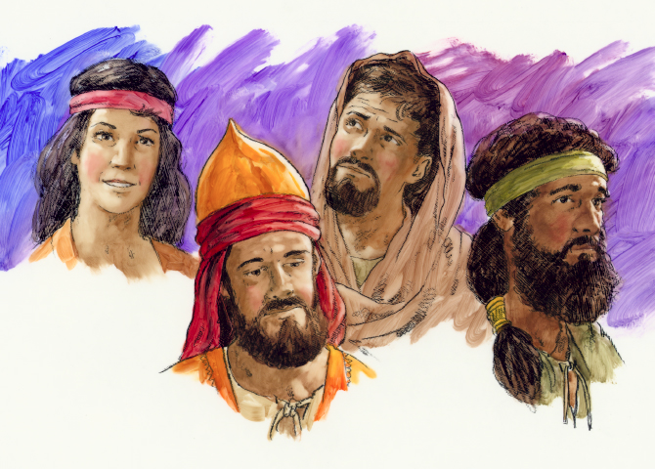
Judges
Dr. Rick Griffith • Jordan Evangelical Theological Seminary • BibleStudyDownloads.org
Notes:
Typically, we think of judges today as those who interpret the law, period. But this book has a broader view of these individuals who: (1) fought for justice, and then (2) maintained that justice.

Slide 2
Key Word
172
39
Failure
Judges
Notes:
In the book of Judges, we see the opposite idea of Joshua, where we saw only success. In Joshua, although Israel had some failures, these were remedied by repentance and action. But in Judges, failure is the norm.

Slide 3
Theme
172
Failure Under
the Theocracy
Judges
Notes:
I used to say that the theme was "failure of the theocracy." However, that looked like God failed. Instead, this books shows that Israel failed to submit to God's Word and God's rule.

Slide 4
Key Verse
172
"In those days Israel had no king;
everyone did as he saw fit
(what was right in his own eyes)"
(17:6; 21:25)
Judges
Notes:
Today we call this "doing your own thing" relativism. But notice the reason for such relativism—the lack
__
"THE THEOLOGY OF THE BOOK
Political Leadership
When the Lord raised up judges, He did not give up His position as the supreme judge (Gen 18:25), a fact observed by Jephthah (Judg 11:27). Yahweh is the divine warrior on whom all of Israel’s battles depend. He delivered the nation when they were under foreign oppression just as He did in the exodus.³⁸ Moreover, the spiritual decline and chaos demonstrated by many of the judges shows the need for another judge who would come and “judge Your people with righteousness” (Ps 72:2; see also Isa 11:4).
That future leader will emerge from the tribe of Judah, which already held a place of prominence in the book of Judges as the first tribe to encounter the Canaanites (Judg 1:2), and later the Benjamites (20:18), and the tribe to produce the first effective judge (3:7–11). The future leader of Israel would thus emerge from Judah (1:2–20) and not Benjamin (i.e., Saul).³⁹ The tribe of Benjamin was the first tribe that failed to complete the conquest (1:21). Gibeah in Benjamin, the hometown of King Saul, was compared to Sodom and Gomorrah, and the immorality of the tribe of Benjamin led to an internecine war with the rest of the nation.⁴⁰
The future king from Judah will be a king, not a judge (17:6; 18:1; 19:1; 21:25). This king will be a covenant-keeper, who will read the Law (Deut 17:14–20) and promote the acknowledgement of God (4:9, 32–40).⁴¹ The remaining pages of the OT anticipate the coming of this national leader, who will lead His people and serve as a faithful king."
³⁸ The root zʿ q, “to cry out,” occurs in Exod 2:23 as in Judg 3:9, 15; 6:6–7; 10:10.
³⁹ While David and Saul are never mentioned in the book of Judges, their character and behavior are exhibited by their respective tribes, Judah and Benjamin. This indicates that David would have the character to be an effective God-fearing leader. See J. A. Groves, “Judges,” in Theological Interpretation of the Old Testament, ed. K. J. Vanhoozer (Grand Rapids: Baker Academic, 2008), 96.
⁴⁰ For the many terminological parallels between the Gibeah incident (Judges 19) and Sodom and Gomorrah (Genesis 19) see Block, Judges, Ruth, 533–34.
⁴¹ Groves, “Judges,” 96.
Mark F. Rooker, “The Book of Judges,” in The World and the Word: An Introduction to the Old Testament (Nashville, TN: B&H Academic, 2011), 297–298.
of an earthly king.

Slide 5

Kingdom Statement
39
Israel failed to implement God's direct rule over the nation, showing the need for a righteous king to lead the nation under a monarchy (21:25).
Judges
Notes:
The point of Judges is that when people reject God, they need a human ruler who represents him well. Israelites doing what was right in their own eyes could be remedied by a righteous king who modeled the rule of God.

Slide 6

Summary Statement
172
41
Israel's failure under the theocracy due to faithless disobedience is contrasted with God's merciful care in disciplining and delivering Israel through judges to exhort submission to its new, divinely appointed kings in a righteous monarchy
Judges
Notes:
This book is obviously written during the monarchy, showing the need for this system of government. Judges were but temporary and local leaders, but submission to the righteous Davidic king would be God's long-term solution—and it still is his solution today as we look forward to the reign of Christ.

Slide 7

Covenant
42b
Israel’s repeated faithlessness to the Mosaic Covenant caused cycles of sin yet not destruction due to God’s faithfulness to the Abrahamic Covenant.
Judges
Notes:
Discipline was needed, but the destruction of the nation was impossible. God cannot betray his own promises.

Slide 8

Redemption
42b
God faithfully provided redeemers for Israel (2:18) who served as forerunners of the redemption in Christ, who also will judge the unrighteous and deliver His children (Rom. 10:13).
Judges
Notes:
The common element between the judges and Jesus is deliverance or salvation from what destroys us—which is ultimately sin that ruins us.

Slide 9

Messiah
42a
Judges raised up by God typify Jesus Christ, the Final Deliverer, Judge, and Ruler not of a single locale but of the entire world.
Judges
Notes:
The judges point to the kings and the kings point us finally to Jesus.

Slide 10
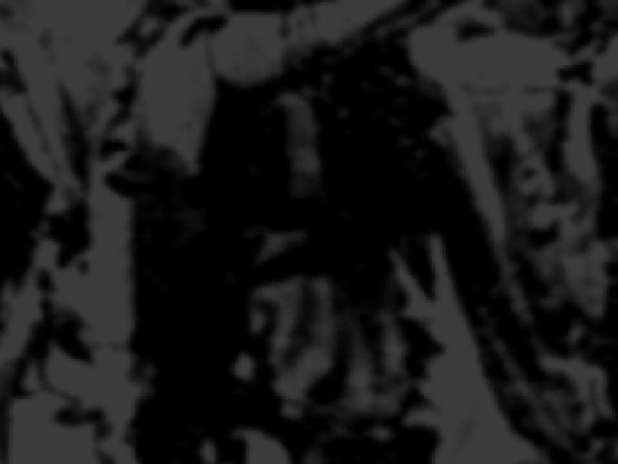
Judges
172
Failure Under the Theocracy
Incomplete
Occupation
Deliverance by Judges
Need
for Monarchy
1:1–2:5
2:6–16:31
17–21
Deterioration
Discipline
Depravity
Causes
Of the Cycles
Curse
Of the Cycles
Conditions
Of the Cycles
Living with
the Canaanites
War with
the Canaanites
Living Like
the Canaanites
Military
Disobedience
1
Spiritual
Disobedience
2:1-5
Intro
2:6–3:6
South
3:7-31
East
10:3–
12:7
North
12:8-15
West
13:1–
16:31
Religious
Depravity
17–18
Moral
Depravity
19–21
North
4:1–5:31
Central
6:1–10:2
Canaan
c. 341 Years (1390-1049 BC)
Notes:
The outline is essentially an introduction, process, and result. These are not chronological, though, as chapters 17–21 fit within the cycles of the middle section. However, they do show how repeated patterns of sin spiral out of control.
__________
"Within the main section (3:7–16:31) the narratives have been arranged geographically by tribes, ranging from Judah in the south (Othniel, 3:9) to Benjamin (Ehud, 3:15), to Ephraim in the center (Deborah, 4:5), and then to Manasseh (Gideon, 6:15), Gilead (Jephthah, 11:1) and finally to Dan in the north (Samson, 13:2). This corresponds to the order the tribes are presented in the prologue (1:1–36).²⁴ Virtually every tribe contributed a judge at some point in this period, and no tribe contributed more than one. As for the seven major judges of this section the important judge Gideon occupies the central position:
A Othniel (3:7–11)
B Ehud (3:12–31)
C Deborah, Barak, Jael (chaps. 4–5)
D Gideon (6:1–8:32)
C¹ Abimelech (8:33–10:5)
B¹ Jephthah (10:6–12:15)
A¹ Samson (chaps. 13–16)
While Gideon is the only judge who opposed idolatry, the moral decline in Gideon’s own life is a reflection of the nation’s spiritual decline as a whole. After the 40 years of peace following Gideon’s victory, no more periods of peace are mentioned in the rest of the book (3:11, 30; 4:17; 6:23–24). From the time of Gideon to the rest of the book the Israelites were increasingly engaged in internal conflict.^{25"}
²⁴ W. Dumbrell, “In Those Days There Was No King In Israel,” JSOT 25 (1983): 25; D. M. Gunn, “Joshua and Judges,” in The Literary Guide to the Bible, ed. R. Alter and F. Kermode (Cambridge: Harvard University Press, 1987), 105; Block, Judges, Ruth, 59.
²⁵ For helpful discussion see J. R. Vannoy, “Judges, Theology of,” NIDOTTE, ed. W. VanGemeren (Grand Rapids: Zondervan, 1997), 4:830.
Mark F. Rooker, “The Book of Judges,” in The World and the Word: An Introduction to the Old Testament (Nashville, TN: B&H Academic, 2011), 293–294.

Slide 11
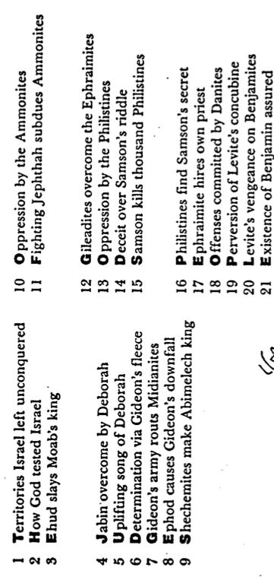
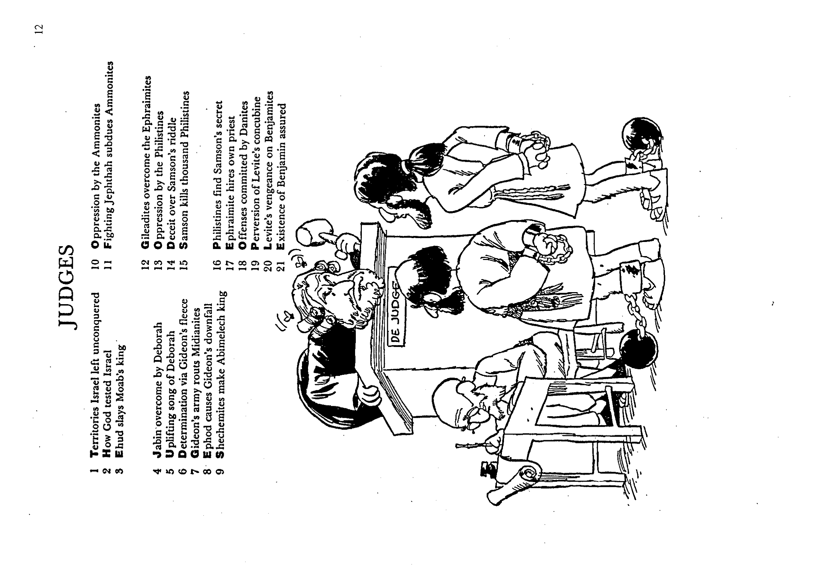
Barry Huddleston, The Acrostic Summarized Bible (Grand Rapids: Baker, 1992)
1 Inception of the world
2 Newlyweds placed in Eden
3 Temptation and man's fall
4 Hatred and first murder
5 Entire genealogy of Adam
6 Lessons on proper priorities
7 Outline for personal relationships
8 Faith of the centurion
Judges
29 Genealogy of Jesus Christ
30 Opposition of King Herod
31 Spirit's descent upon Jesus
32 Power over Satan's temptations
33 Expounding Sermon on Mount
34 Lessons on proper priorities
35 Outline for personal relationships
36 Faith of the centurion
9 Matthew's call from Jesus
10 Apostles sent to preach
11 Testimony about John's message
12 True Messiah called demonic
13 Hidden message of parables
14 Execution of the Baptist
15 Wisdom is answering Pharisees
37 Matthew's call from Jesus
38 Apostles sent to preach
39 Testimony about John's message
40 True Messiah called demonic
41 Hidden message of parables
42 Execution of the Baptist
43 Wisdom is answering Pharisees
16 Keys of the kingdom
17 Impact of Jesus' transfiguration
18 Need for true forgiveness
19 Grounds for divorce clarified
20 Opportunities in the vineyard
21 Fig tree is cursed
44 Keys of the kingdom
45 Impact of Jesus' transfiguration
46 Need for true forgiveness
47 Grounds for divorce clarified
48 Opportunities in the vineyard
49 Fig tree is cursed
22 Taxes paid to Caesar
23 Hypocrisy denounced by "woes"
24 Events of second coming
25 Judgment of the nations
26 Events on Calvary's eve
27 Way of the cross
28 Savior's resurrection and commission
50 Taxes paid to Caesar
51 Hypocrisy denounced by "woes"
52 Events of second coming
53 Judgment of the nations
54 Events on Calvary's eve
55 Way of the cross
56 Savior's resurrection and commission
Notes:
This picture is a bit misleading as the book depicts judges in a more holistic role—not just making pronouncements but actually delivering and leading the people.
_______
"PURPOSE OF THE BOOK
The reason the book of Judges was written can be determined from the two major refrains of the book: “The Israelites did what was evil in the Lord’s sight” (Judg 2:11; 3:7, 12; 4:1; 6:1; 10:6; 13:1) and “In those days there was no king in Israel; everyone did whatever he wanted” (17:6; 21:25). Taking these two statements together shows that the book is concerned with describing Israel’s relationship to God between the period of Joshua and the monarchy. It shows the outworking of Israel’s covenant relationship with God where obedience to the Law resulted in blessing and peace, whereas disobedience led to hardship and oppression. The overall effect would be a call to Israel to return to her God from her idolatrous ways as her position as a holy nation was in jeopardy.¹⁹ Focusing primarily on the second refrain, many argue that the purpose of the book is to demonstrate that a centralized kingship was necessary for the well-being of the covenant community.²⁰ Boling maintains that the structure of the work, which he argues focuses on the abortive attempt to establish the monarchy at Shechem, supports this theme.^{21"}
¹⁹ See Block, Joshua, Ruth, 58; House, Old Testament Theology, 225.
²⁰ E.g., Harrison, Introduction to the Old Testament, 692; R. Rendtorff, The Old Testament Introduction, trans. J. Bowden (Philadelphia: Fortress, 1986), 169.
²¹ R. Boling, “Judges, Book of,” in ADB, 3:1110.
Mark F. Rooker, “The Book of Judges,” in The World and the Word: An Introduction to the Old Testament (Nashville, TN: B&H Academic, 2011), 292.

Slide 12
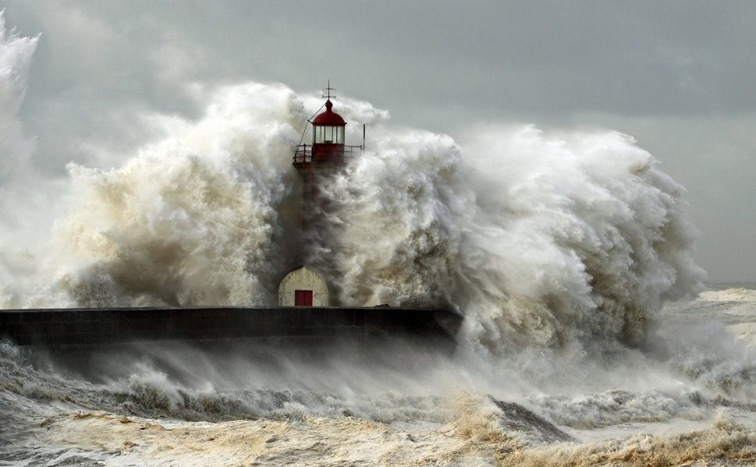
Be Steadfast
Judges
Dr. Rick Griffith • Crossroads International Church Singapore
CICFamily.com • BibleStudyDownloads.org
Notes:
We have a need for consistency in our lives—but what are the reasons we should be consistent? The Book of Judges answers that question.

Slide 13
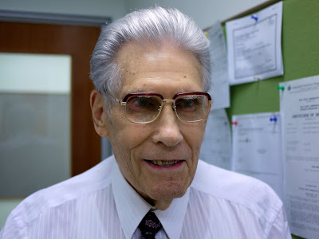
Dr E N Poulson
1 April 1925—13 October 2017
Notes:
A full 64 years later, he was still ministering in Singapore until the Lord called him home on 13 October 2017.
Dr. P, as he was affectionately known, established the School of Theology (English) at Singapore Bible College in 1958—the year I was born!

Slide 14
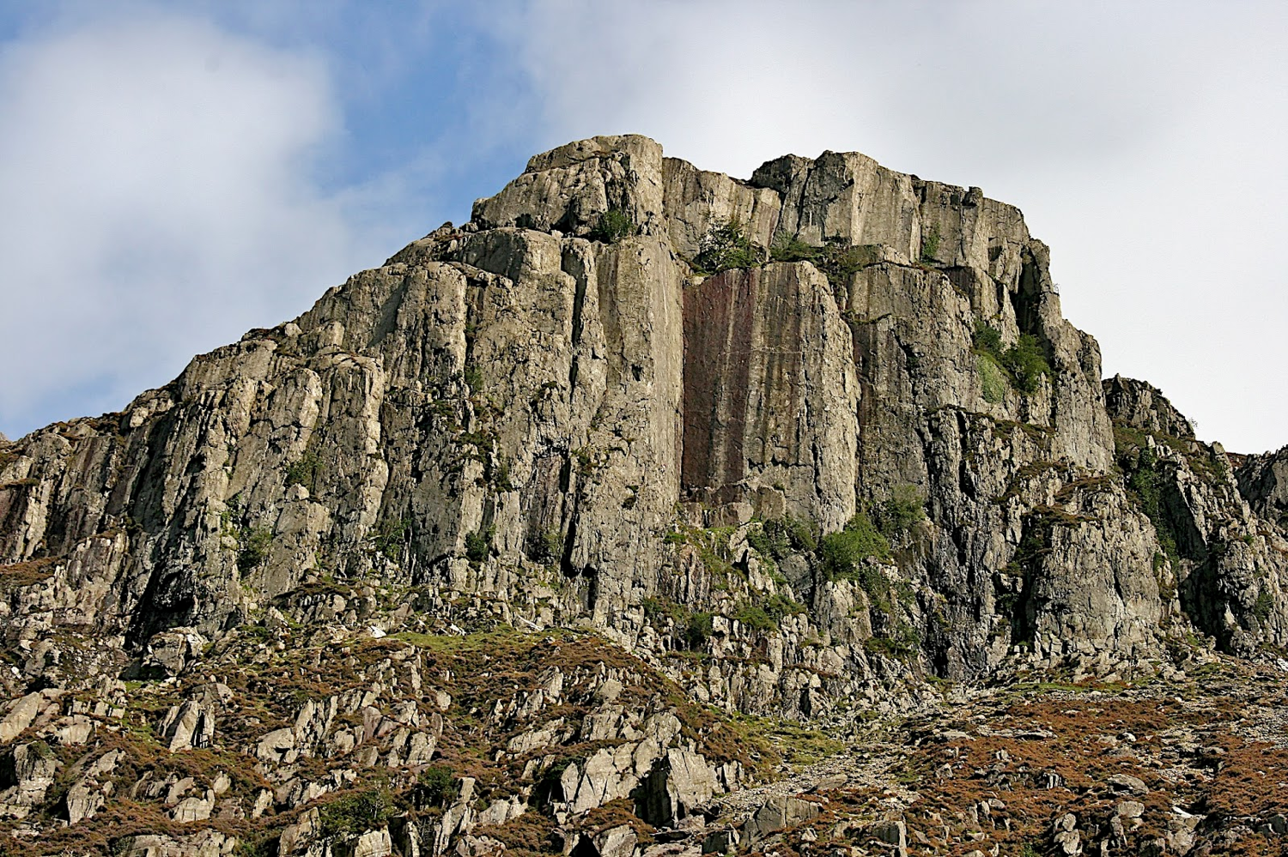
Why must you be steadfast in having God as your king?
3 reasons
Notes:
Today we will see three reasons to place God as king.

Slide 15
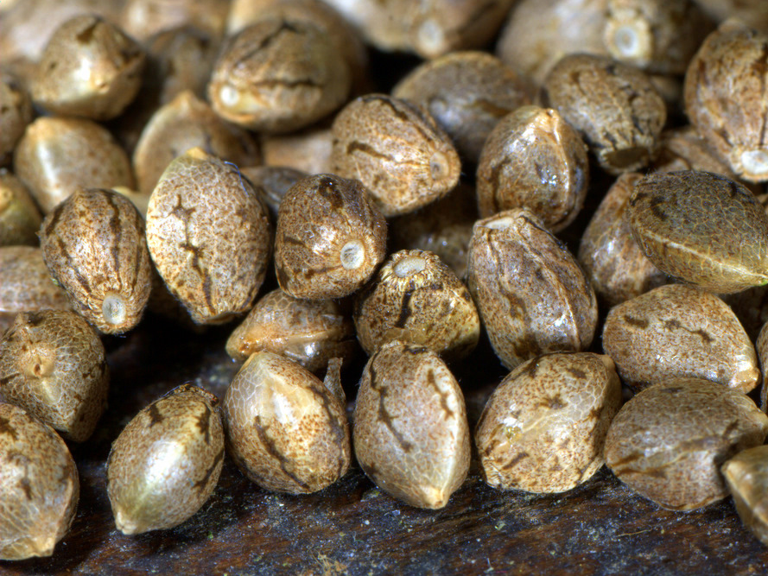
I. Incomplete obedience plants the seeds for failure (1–2).
Notes:
Rejecting God as the king leads to our downfall.

Slide 16

II. Relativism leads to cycles of sin (3–16).
Notes:
We go in circles when we follow our rules instead of God’s absolute standards.

Slide 17
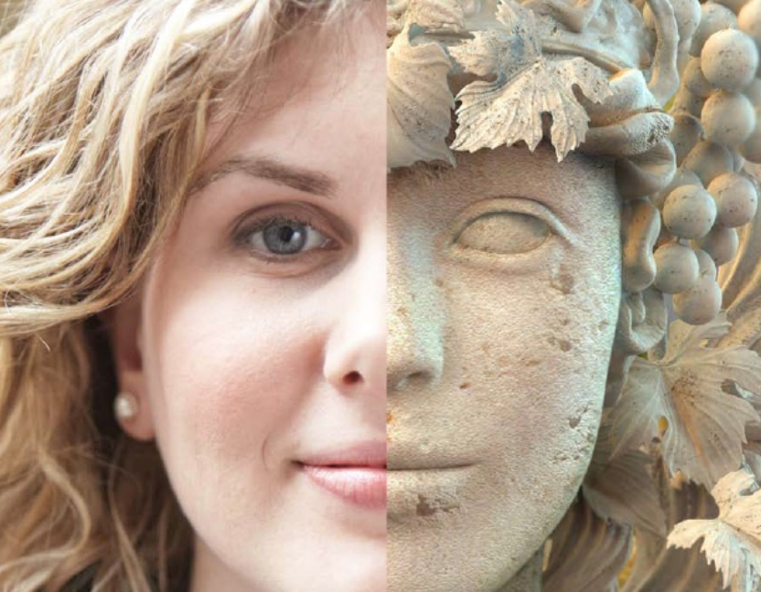
III. Relativism leads to idolatry (17–21).
Notes:
Whims instead of wisdom worships a different god.

Slide 18
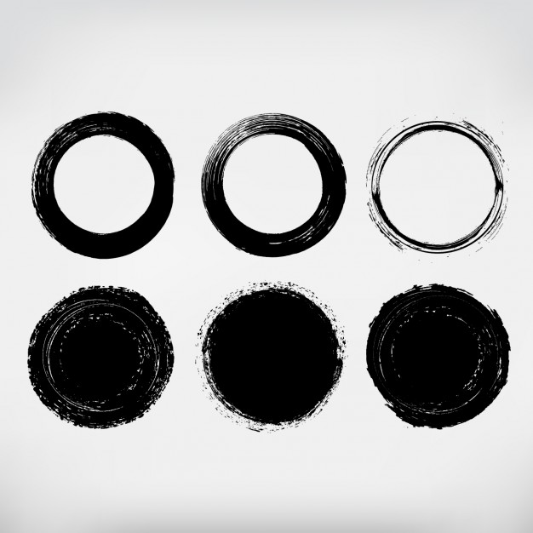
Main Idea
Make God king
—not relativism and the idolatry of sin cycles
Judges
Notes:
Be steadfast with God as king so you don’t have to fail over and over (restatement).

Slide 19

Discussion Question:
How is Our Day Like the Judges Period?
Relativism: "Save the whales" but kill humans
Secularism: "I don't let my religion affect my politics"
Promiscuity: "What that leader does in his bedroom is his business and not mine"
Notes:
Before animating the three reasons above, first, let the learners consider in small groups how people do "what is right in their own eyes" today.

Slide 21
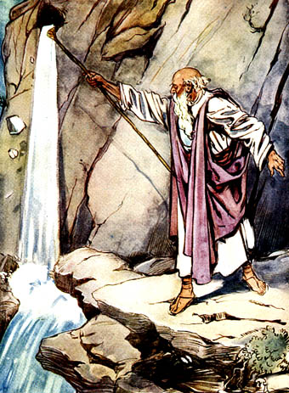
Birth of a People
Exodus
Leviticus
Numbers
Joshua
Them
Formation
Sanctification
Preparation
Occupation
Us
Salvation
Instruction
Walk
Rest
Notes:
OTS Exodus 02.30
OTS Leviticus 03.23
OTS Numbers 04.23
OTS Joshua 06.06
OTS Judges 07.02

Slide 22
Who were these judges?
173
The name Judges (shaphat)
—Those who "act as law giver, judge, governor" (BDB 1047b 1b)
—Those who liberate or deliver people first before ruling
Notes:
The latter role is the focus of the book of Judges.
"THE ROLE OF THE JUDGES
A casual reading of the book of Judges reveals that the main characters of the book, the judges, were not engaged primarily in legal disputes but rather functioned more like military leaders.¹⁵ Moreover, Judg 2:16, the introductory summation to the period, explicitly states that the judges saved (yāšaʿ ) the Israelites from the foreign oppressors that had been sent by God to afflict the Israelites for their disobedience.¹⁶ The view that the judges were actually deliverers is also apparent in what might be considered the conclusion of the period of the judges when Samuel stated that the judges had been sent by the Lord to deliver the Israelites (1 Sam 12:10–11).¹⁷ The Hebrew word šôpēṭ (“judge”) is thus broader than the normal English meaning, as indicated for example by its parallel occurrence with mlk (“king”) in Isa 33:22. The broader usage is borne out by the cognate uses of the root špṭ in Akkadian, Ugaritic, and Phoenician.^{18"}
¹⁵ Only in the case of Deborah is their mention of anything like a judicial decision or arbitration (4:4–5).
¹⁶ The root yāšaʿ is used in various contexts in reference to Othniel (3:9), Ehud (3:15), Shamgar (3:31), Gideon (6:15; 8:22), Tola (10:1), Jephthah (12:3), and Samson (13:5).
¹⁷ See P. House, Old Testament Theology (Downers Grove, IL: InterVarsity, 1998), 221–22.
¹⁸ See Block, Judges, Ruth, 24–25 for a fuller discussion.
Mark F. Rooker, “The Book of Judges,” in The World and the Word: An Introduction to the Old Testament (Nashville, TN: B&H Academic, 2011), 291–292.

Slide 23
Authorship & Date
173
Probably Samuel
Between coronation of Saul (1043 BC) & David's conquest of Jerusalem (1004 BC)
Notes:
"According to Jewish tradition Samuel was largely responsible for the composition of the book of Judges. While this remains a possibility, most scholars have abandoned this view.⁶ A more attractive option is the one that sees the book as composed early in the time of the monarchy as the author either combined or utilized the earlier sources and traditions about individual judges.⁷
Several factors favor a date of composition early in the history of Israel. According to Judg 1:21 the Jebusites were still living in Jerusalem when Judges was written. These circumstances describe a historical reality before David’s capture of the city in 2 Sam 5:6–10. In Judg 1:29 it is reported that the Canaanites occupied Gezer. This set of circumstances reflects a time before the city was given as a gift to Solomon by Pharaoh (970 BC; 1 Kgs 9:16). Also Sidon is mentioned before Tyre in Judges 3:3, indicating that it was the superior Phoenician port. It is virtually universally accepted however that beginning in the twelfth century BC. Tyre became the superior Phoenician port. These facts, along with passages such as Judg 18:1 and 19:1 which suggest that there was not yet a king in Israel, may all indicate that the book was written early in the Israelite monarchy. Critical to the discussion of the time of composition of the book is the editorial reference in Judg 18:30 that the descendants of Jonathan, the grandson of Moses,⁸ served as priests to the Danites “until the day of the captivity of the land” (NASB). The latter phrase has been taken to refer to the defeat of the northern kingdom in 722 BC, the captivity of the southern kingdom in 586 BC, or the fall of Shiloh in 1 Sam 4:10–11. All of these suggestions are defensible. However, the latter has contextual support as the statement “all the time that the house of God was at Shiloh” (until c. 1104 BC)⁹ in the following verse (Judg 18:31) might be viewed as parallel and thus explanatory to the phrase “until the day of the captivity of the land.”
Possibly, however, the narratives of individual judges may have had a prior independent existence. These written sources would have been produced shortly after the events they describe, and were later joined together by the author. Even critics concede that the written source documents for the book of Judges would have been composed before the period of David and Solomon.¹⁰ It seems that the contents of the book were known to other biblical writers at a very early period (1 Sam 12:9–11; 2 Sam 11:21; Pss 68:8–15; 83; Isa 9:3; Hos 9:9; 10:1)."
⁶ E.g., G. L. Archer argues that either Samuel or one of his disciples was responsible for the compiling the contents of the book (A Survey of Old Testament Introduction, 3rd ed. [Chicago: Moody, 1994], 303).
⁷ R. K. Harrison, Introduction to the Old Testament (Grand Rapids: Eerdmans, 1969), 690.
⁸ Some textual evidence suggests that the name is Manasseh rather than Moses.
NASB New American Standard Bible
⁹ E. Merrill, Kingdom of Priests (Grand Rapids: Baker, 1987), 176.
¹⁰ E.g., Sellin and Fohrer, Introduction to the Old Testament, 208.
Mark F. Rooker, “The Book of Judges,” in The World and the Word: An Introduction to the Old Testament (Nashville, TN: B&H Academic, 2011), 289–290.

Slide 24

Relativism

Slide 25
Deuteronomy 7:1-4
"When the LORD your God brings you into the land you are entering to possess and drives out before you many nations – the Hittites, Girgashites, Amorites, Canaanites, Perizzites, Hivites, and Jebusites, seven nations larger and stronger than you – and when the LORD your God has delivered them over to you and you have defeated them, then
you must destroy them totally."

Slide 26
Deuteronomy 7:1-4
"Make no treaty with them, and show them no mercy. Do not intermarry with them. Do not give your daughters to their sons or take their daughters for your sons, for they will turn your sons away from following me to serve other gods, and the LORD's anger will burn against you and
will quickly destroy you."

Slide 27
Keys
172
Key Word:
Failure
Key Verse:
Judges 17:6; 21:25
"In those days Israel had no king;
everyone did as he saw fit (what was right in his own eyes)"

Slide 28
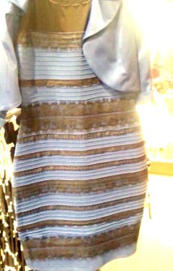
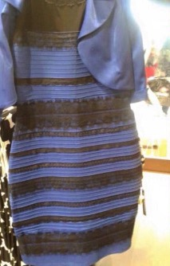
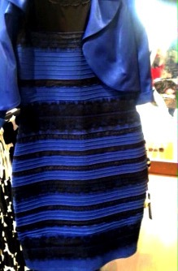
What color is this wedding dress?
White & Gold?
Or…
Blue & Black?
"The original image is in the middle. At left, white-balanced as if the dress is white-gold. At right, white-balanced to blue-black."
Notes:
RELATIVISM even applies to the color of a dress
Ambiguous Wedding Dress Color Causes Internet Stir
Scripture: Judges 17:6; Proverbs 12:15; Proverbs 14:12; Proverbs 16:25
Source: "THE SCIENCE OF WHY NO ONE AGREES ON THE COLOR OF THIS DRESS" by Adam Rogers for Science on Wired.com, 2/26/15 at:
http://www.wired.com/2015/02/science-one-agrees-color-dress/
Contributor: Illustration Exchange
Visit the source
There's no doubt you saw it AND that you had an opinion on it—the viral pic of a wedding dress—is it white and gold or blue and black? That question taunted the internet and social media for days.
It all began when a mother-of-the-bride sent a pic to the bride and groom of the dress she planned to wear to her daughter's wedding. They were confounded. The bride saw the dress as white and gold; the groom saw it as blue and black. Before the feud could threaten their upcoming nuptials, they posted the pic to Facebook and solicited the opinions of their friends to end the debate.
Alas, it only ignited even greater debate. Within hours, the pic had gone viral and, it seemed, the entire world was debating the issue. People standing in the same room, at the same time, saw the dress as different colors. What's more, some saw the dress as white and gold one minute, then as blue and black the next.
Color perception experts soon began weighing in on the phenomenon.
Adam Rogers, writing for SCIENCE on Wired.com, explains it this way:
Light enters the eye through the lens—different wavelengths corresponding to different colors. The light hits the retina in the back of the eye where pigments fire up neural connections to the visual cortex, the part of the brain that processes those signals into an image. Critically, though, that first burst of light is made of whatever wavelengths are illuminating the world, reflecting off whatever you're looking at. Without you having to worry about it, your brain figures out what color light is bouncing off the thing your eyes are looking at, and essentially subtracts that color from the "real" color of the object. "Our visual system is supposed to throw away information about the illuminant and extract information about the actual reflectance," says Jay Neitz, a neuroscientist at the University of Washington. "But I've studied individual differences in color vision for 30 years, and this is one of the biggest individual differences I've ever seen." (Neitz sees white-and-gold.)
In other words, our brains recognize that the shading of the light that is illuminating an object can alter the "real" appearance of that object, so our brains have been programmed to filter out the illumination and focus primarily on the light waves reflecting off the object itself. As keen a computer as our brain is, it is not always able to make that distinction.
Scientists and graphic designers have both since taken long looks at the dress, both in photos and in real life. Their conclusion? The dress is indeed blue and black, not white and gold. While the context of the illuminating light (at the time the photo was taken) created a nearly perfectly ambiguous image, diagnostics of the RGB values (the color saturations of the dress itself) were able to conclusively determine its true color.
Application:
So, the confusion over the color of the mother-of-the-bride dress is the result of "a nearly perfectly ambiguous image."
Perfect ambiguity--sounds like the moral state of the world we live in today! What is white or black--blue or gold? Right and wrong have become confused by the spiritual context of our age.
Just as the light that illuminates an object can alter the appearance of that object, so the opinions and influences of the world can alter our perceptions and cloud our discernment. Yet even as there is a right answer to the true colors of a dress, there is a right answer to the question of what is morally right or wrong.
So often, finding the truth is simply a matter of filtering out the extraneous, competing waves of worldly opinion that would blind us to the genuine reflection of God's truth.
"All the people did whatever seemed right in their own eyes" (Judges 17:6, NLT).
"The way of a fool is right in his own eyes, but a wise man is he who listens to counsel" (Proverbs 12:15, NASB).
"There is a way which seems right to a man, but its end is the way of death," (Proverbs 14:12, NASB; cf. Proverbs 16:25 et al).
____________
"The original image is in the middle. At left, white-balanced as if the dress is white-gold. At right, white-balanced to blue-black."
http://www.wired.com/2015/02/science-one-agrees-color-dress/

Slide 29
Be Steadfast
Judges
Dr. Rick Griffith • Crossroads International Church Singapore
CICFamily.com • BibleStudyDownloads.org
Notes:
Sadly, many today do not hold firm to the end.

Slide 30
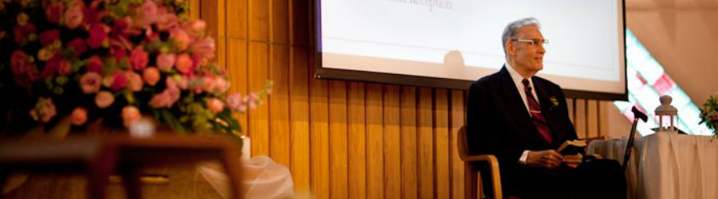
Dr E N Poulson
Arrived in Singapore 17 March 1953
Notes:
Our world tempts us to trust anything or anyone but God. Yet God provides rare examples of those who are steadfast in their faith. Dr. E. N. Poulson was such an example.
He arrived in Singapore from the USA on 17 March 1953 as a missionary to Indonesia. The plan was to apply for his visa from Singapore, then invest his life in Indonesia.

Slide 31
Dr E N Poulson
1 April 1925—13 October 2017
Notes:
A full 64 years later, he was still ministering in Singapore until the Lord called him home on 13 October 2017.
Dr. P, as he was affectionately known, established the School of Theology (English) at Singapore Bible College in 1958—the year I was born!

Slide 32
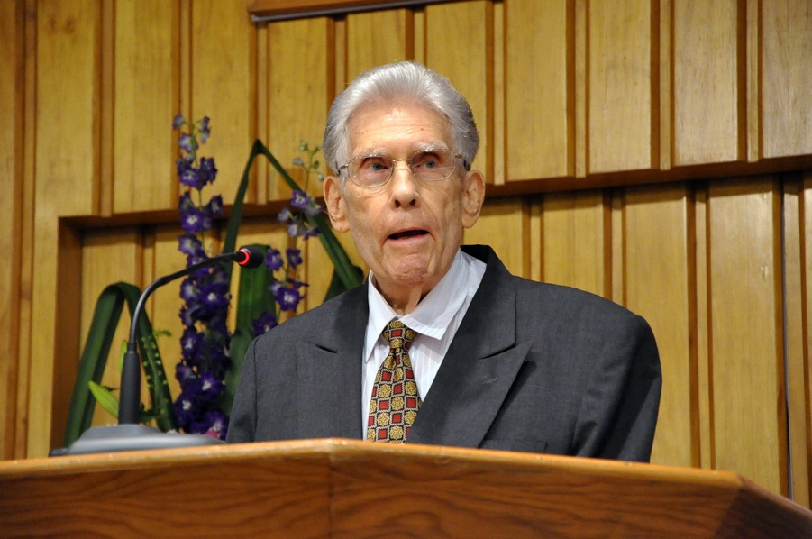
Dr E N Poulson
Notes:
He actually served for 5 years at SBC before that, ironically, teaching the Chinese how to speak Indonesian. Such is the way God works. He brought an Ang Mo (white) to Singapore to teach them the indigenous language of the island!
Dr. P served at SBC until 1988—a full 36 years. I often told him that one of my life goals was to beat his 36 years of service to the college. That would have happened if I could serve 37 years until age 70, but I fell short at 30 years.

Slide 33
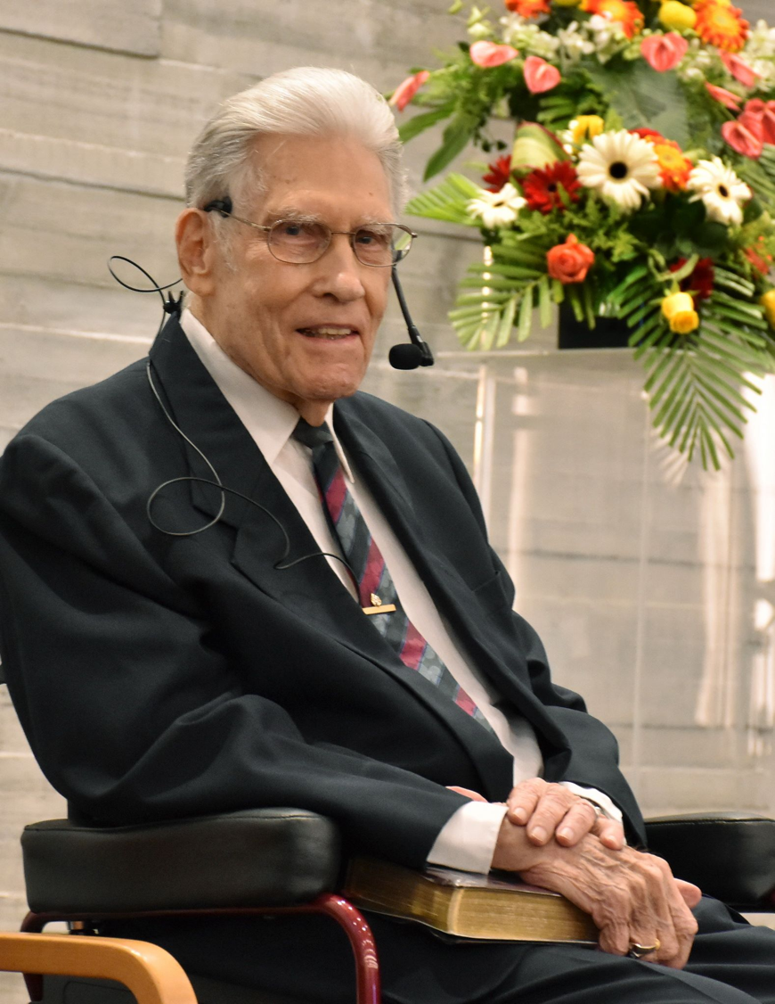
Dr E N Poulson
Notes:
He never intended to retire, so he never did. He taught a Tuesday night Bible Study to SS teachers at Grace Baptist all the way until three days before his home going.

Slide 34
Steadfast.
Notes:
Dr. P mentored me as my pastor at GBC for our first ten years in Singapore, but stayed in touch the 17 years since then. He was a model to me of one whose goal was to “be steadfast” in putting his trust in the Lord.

Slide 35
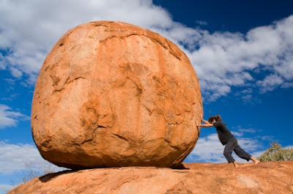
Where are you putting your trust? Do you have an immovable trust in God?
Notes:
How much money do you need to feel secure? One SBC student about 20 years ago said she was called to mission but needed to build up her bank account first. My colleague asked her how much she felt she needed in the bank before she left. With a straight face she noted, “Just 1$ million.”
Does your self worth come from your occupation, social standing, or national identity?
Do you place faith in scientists, philosophers, media personalities, or wealthy people—or in God?
Who is the real king or boss in your life that is worth your trust? I suggest that you be steadfast to trust God above all else.

Slide 36
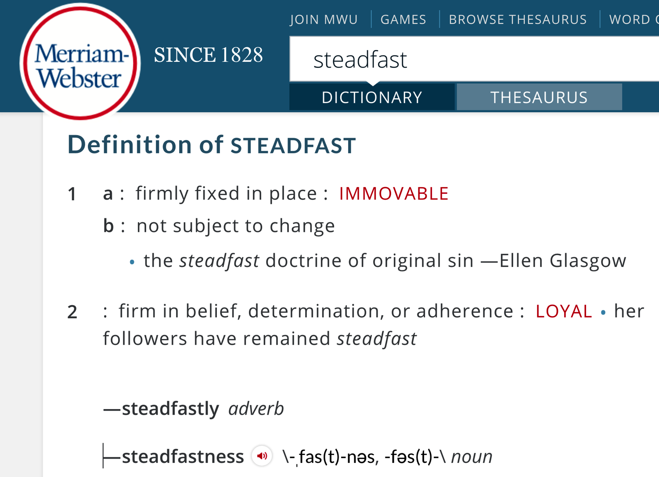
Defining "Steadfast"
1 a :firmly fixed in place :immovable
b :not subject to change the steadfast doctrine of original sin
—Ellen Glasgow
2 :firm in belief, determination, or adherence :loyal her followers have remained steadfast
Notes:
Being “steadfast” means to be immovable from your place.

Slide 37
Why must you be steadfast in having God as your king?
Notes:
What is so bad about having relative standards?

Slide 38
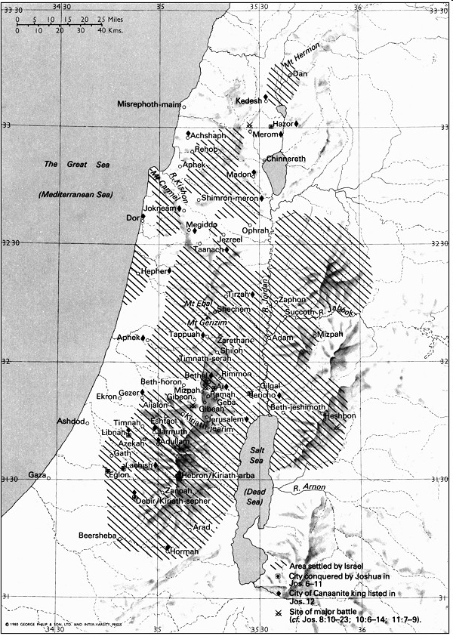
Land Settled under Joshua
181
New Bible Atlas
Notes:
The Israelites struggled to be steadfast, and today we will see why they trusted idols instead of trusting God.
Israel had completed the conquest and settled the majority of Canaan, and then Joshua died (book of Joshua).

Slide 39
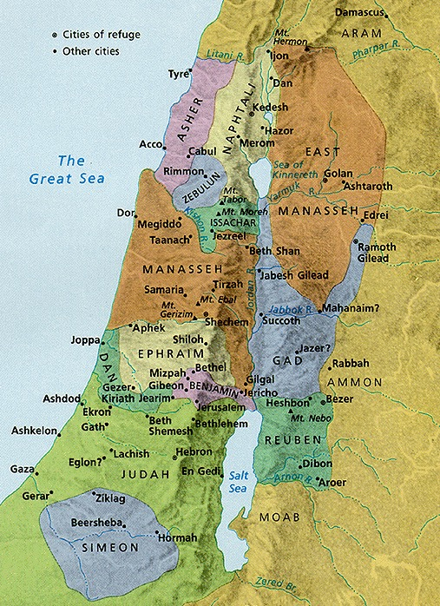
Settlements v. Allotments
171
New Bible Atlas
The Conquest
and
settlement
under Joshua
Notes:
God had kept his promise to give them every place where they set foot—yet still, much of the land was still not clear.
The unsubdued land sadly placed pagan influences close to each tribe—but in the case of the coastal tribe of Dan (a huge tribe of 64,400), it took most of their territory, which led them to migrate to the far north.
__________
Common-280
OS-05-Deut-309
OS-06-Joshua-188
OS-07-Judges-39

Slide 40

The Word Available to Them
5 Books of Moses + Joshua
Notes:
By this time in the OT story, they have two written sources of God’s will—the Books of Moses and the Book of Joshua. Now, what would they do with them?

Slide 41

48 Levitical Cities
171a
6 Cities of Refuge
Notes:
The Levites were spread throughout the land to provide teachers close to each of the tribes—now would they teach the people the truth of God’s Word?

Slide 42
Book Chart
172
Failure Under the Theocracy
Incomplete
Occupation
Need
for Monarchy
Deliverance by Judges
1:1–2:5
2:6–16:31
17–21
Deterioration
Discipline
Depravity
Causes
Of the Cycles
Curse
Of the Cycles
Conditions
Of the Cycles
Living with
the Canaanites
War with
the Canaanites
Living Like
the Canaanites
Canaan
c. 341 Years (1390-1049 BC)

Slide 43
Why must you be steadfast in having God as your king?
3 reasons
Notes:
Today we will see three reasons to place God as king.

Slide 44
I. Incomplete obedience plants the seeds for failure (1–2).
Notes:
Rejecting God as the king leads to our downfall.

Slide 45
Israel's incomplete occupation of Canaan led to the need for judges (1:1–2:5).

Slide 46
Judges
Dr. Rick Griffith, Singapore Bible College
BibleStudyDownloads.org

Slide 47
Barry Huddleston, The Acrostic Summarized Bible (Grand Rapids: Baker, 1992)
1 Inception of the world
2 Newlyweds placed in Eden
3 Temptation and man's fall
4 Hatred and first murder
5 Entire genealogy of Adam
6 Lessons on proper priorities
7 Outline for personal relationships
8 Faith of the centurion
Judges
29 Genealogy of Jesus Christ
30 Opposition of King Herod
31 Spirit's descent upon Jesus
32 Power over Satan's temptations
33 Expounding Sermon on Mount
34 Lessons on proper priorities
35 Outline for personal relationships
36 Faith of the centurion
9 Matthew's call from Jesus
10 Apostles sent to preach
11 Testimony about John's message
12 True Messiah called demonic
13 Hidden message of parables
14 Execution of the Baptist
15 Wisdom is answering Pharisees
37 Matthew's call from Jesus
38 Apostles sent to preach
39 Testimony about John's message
40 True Messiah called demonic
41 Hidden message of parables
42 Execution of the Baptist
43 Wisdom is answering Pharisees
16 Keys of the kingdom
17 Impact of Jesus' transfiguration
18 Need for true forgiveness
19 Grounds for divorce clarified
20 Opportunities in the vineyard
21 Fig tree is cursed
44 Keys of the kingdom
45 Impact of Jesus' transfiguration
46 Need for true forgiveness
47 Grounds for divorce clarified
48 Opportunities in the vineyard
49 Fig tree is cursed
22 Taxes paid to Caesar
23 Hypocrisy denounced by "woes"
24 Events of second coming
25 Judgment of the nations
26 Events on Calvary's eve
27 Way of the cross
28 Savior's resurrection and commission
50 Taxes paid to Caesar
51 Hypocrisy denounced by "woes"
52 Events of second coming
53 Judgment of the nations
54 Events on Calvary's eve
55 Way of the cross
56 Savior's resurrection and commission

Slide 48
Slides on
Judges 1

Slide 49
Chapter 1
172
Failure Under the Theocracy
Incomplete
Occupation
Need
for Monarchy
Deliverance by Judges
1:1–2:5
2:6–16:31
17–21
Deterioration
Discipline
Depravity
Causes
Of the Cycles
Curse
Of the Cycles
Conditions
Of the Cycles
Living with
the Canaanites
War with
the Canaanites
Living Like
the Canaanites
Military
Disobedience
1
Canaan
c. 341 Years (1390-1049 BC)
Notes:
Several tribes refused to trust God to finish the job of clearing their allotment of the idolatrous pagan peoples, thinking that they were too strong with iron chariots or simply becoming complacent and apathetic to allow their co-existence.

Slide 50

Populations by Tribe
171
Asher
53,400
Naphtali
45,400
Numbers 26
Joshua 13:1–19:48
Zebulun
60,500
Manasseh
Issachar
64,300
Manasseh
52,700
Levi
23,000
Spread Throughout Israel
Gad
40,500
Ephraim
32,500
Dan
64,400
Benjamin
45,600
Reuben
43,730
Judah
76,500
Simeon
22,200
Notes:
Small groups: Make as many observations as you can in your small group. What do you see here?
Class discussion: What did you notice about the populations?
Do God's allotments look fair to you? These land areas are obviously not all the same size.
• For example, why did Manasseh get two huge land areas on both sides of the Jordan River? This is because Joseph became the firstborn son with the double blessing as noted in 1 Chron 5:1 NLT: "The oldest son of Israel was Reuben. But since he dishonored his father by sleeping with one of his father’s concubines, his birthright was given to the sons of his brother Joseph. For this reason, Reuben is not listed in the genealogical records as the firstborn son. ² The descendants of Judah became the most powerful tribe and provided a ruler for the nation, but the birthright belonged to Joseph."
• Judah had the largest population but Manasseh had the largest land area. So, the most populous tribe (Judah) got a lot of land, but the southern part was the Negev, or desert area. God did not give the reason.
• Why did Zebulun and Issachar have larger populations but smaller land areas? This may seem unfair until you see that these two tribes had the best farm land in Israel, the flat and fertile Jezreel Plain or Plain of Megiddo.
• Dan had a huge population for the coastal plain but couldn't drive out the Canaanites so migrated north. Dan was the third largest tribe that God gave the plain of Sharon to farm and live in—yet the people crowded into the nearby hills instead of taking the land that God gave them. Judges 17–18 reveals their carnal plan to steal land from Laish instead of conquering their land allotted by God.
• Levi and Simeon were both the smallest tribes and spread out due to their ancestor's slaughter at Shechem (Gen 34).
• Simeon was the only tribe totally enclosed within another tribe (an "island" within Judah).
Many other observations can be made, but all should be viewed in light of God's sovereign choice!
__________
Common Arabic-201
Common English-160
OS-00-Intro-50
OS-00-Book Overviews-119
OS-04-Numbers-228
OS-05-Deuteronomy-313
OS-06-Joshua-18, 184
OS-07-Judges-50
OS-26-Ezek40-48-slide 162

Slide 51
Grades for the Tribes of Israel
171
Asher
F
Naphtali
D
Judges 1:1-35
Zebulun
D
Manasseh
Issachar
D
Manasseh
Levites
Spread Throughout Israel
Gad
F
A
Ephraim
Dan
F
F
Benjamin
Reuben
Judah
F
F
A
Simeon
A
Notes:
The tribes did well on their "midterm exam" by defeating 31 kings throughout the land (Joshua 12), but on their "final exam" where they needed to finish the job tribe-by-tribe had mixed results as many of them failed."
_______
"The survey of the victories and defeats of seven tribes in Judges 1 begins with victory but quickly moves to defeat. The tribal episodes are arranged in a south-to-north direction, foreshadowing the orientation of the Judges cycle in Judg 3:7–16:31.²⁷
²⁷ W. J. Dumbrell, The Faith of Israel: A Theological Survey of the Old Testament, 2nd ed. (Grand Rapids: Baker, 2002), 76.
Mark F. Rooker, “The Book of Judges,” in The World and the Word: An Introduction to the Old Testament (Nashville, TN: B&H Academic, 2011), 294.

Slide 52
Key Word
172
39
Failure
Judges
Notes:
In the book of Judges, we see the opposite idea of Joshua, where we saw only success. In Joshua, although Israel had some failures, these were remedied by repentance and action. But in Judges, failure is the norm.

Slide 53
Theme
172
Failure Under
the Theocracy
Judges
Notes:
I used to say that the theme was "failure of the theocracy." However, that looked like God failed. Instead, this books shows that Israel failed to submit to God's Word and God's rule.

Slide 54
Key Verse
172
"In those days Israel had no king;
everyone did as he saw fit
(what was right in his own eyes)"
(17:6; 21:25)
Judges
Notes:
Today we call this "doing your own thing" relativism. But notice the reason for such relativism—the lack of an earthly king.

Slide 55
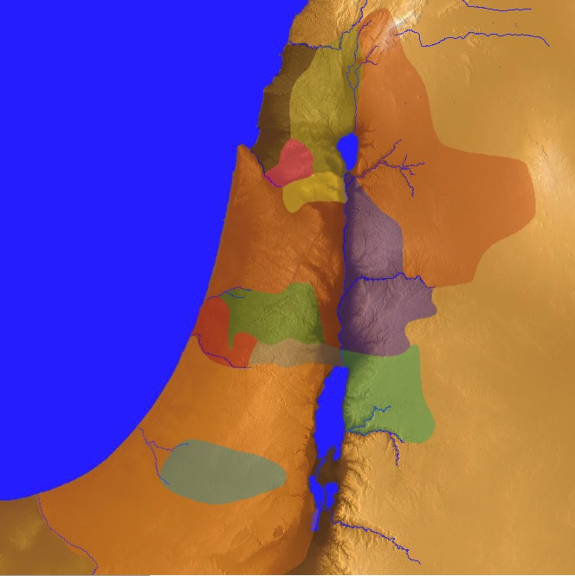
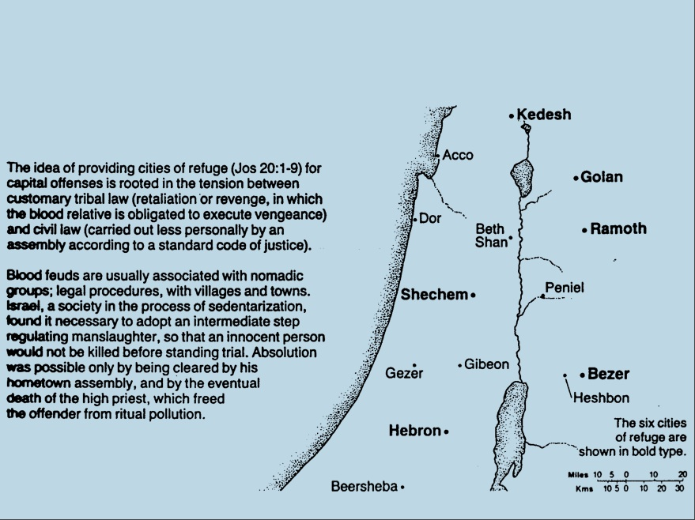
Cities of Refuge
Israel lived in a nomadic culture of personal vengeance by family members against the offending family (blood feuds).
Yet the nation was not ready for legal procedures by an objective village assembly (civil law).
Therefore, God instituted an intermediate step of six nearby cities where one who accidentally killed someone could flee.
142
Kedesh
Golan
Ramoth
Shechem
Bezer
Hebron
Numbers 35; Josh. 20:1-9
Notes:
"The idea of providing cities of refuge (Josh. 20:1-9) for capital offenses is rooted in the tension between customary tribal law (retaliation or revenge, in which the blood relative is obligated to execute vengeance) and civil law (carried out less personally by an assembly according to a standard code of justice)" (The Bible Visual Resource Book, 35).
__________
OS-04-Numbers-245
OS-06-Joshua-193
OS-07-Judges-55

Slide 56
48 Levitical Cities
171a
6 Cities of Refuge
Notes:
God wisely spread the instructors within Israel (Levites) among the people so they need not go to Jerusalem to learn his Word. Interspersed among them lay the six cities of refuge that guarded the people against revenge. These two systems positively provided truth (Levitical teaching) and negatively provided protection (refuge towns).
__________
OS-06-Joshua-195
OS-07-Judges-56

Slide 57
Land Settled under Joshua
181
New Bible Atlas
Notes:
What do you notice about which lands were conquered?
• They subdued the hill country which led to the isolation of the people.
• They could not conquer the flat, coastal trade routes—but this protected them from the pagan influences marching through the land.
• Philistines maintained control of the western plains, so their enemies had the easiest lands to farm. This led Israel to rely on the milk (herding goats) more than the honey (cultivating bees from crops) in their "land of milk and honey" (eastern shepherding over western farming).
__________
Common-279
OS-07-Judges-57

Slide 58
Settlements v. Allotments
171
New Bible Atlas
The Conquest
and
settlement
under Joshua
Notes:
The unsubdued land sadly placed pagan influences close to each tribe—but in the case of the coastal tribe of Dan (a huge tribe of 64,400), it took most of their territory, which led them to migrate to the far north.
__________
OS-05-Deut-309
OS-06-Joshua-188
OS-07-Judges-58

Slide 59
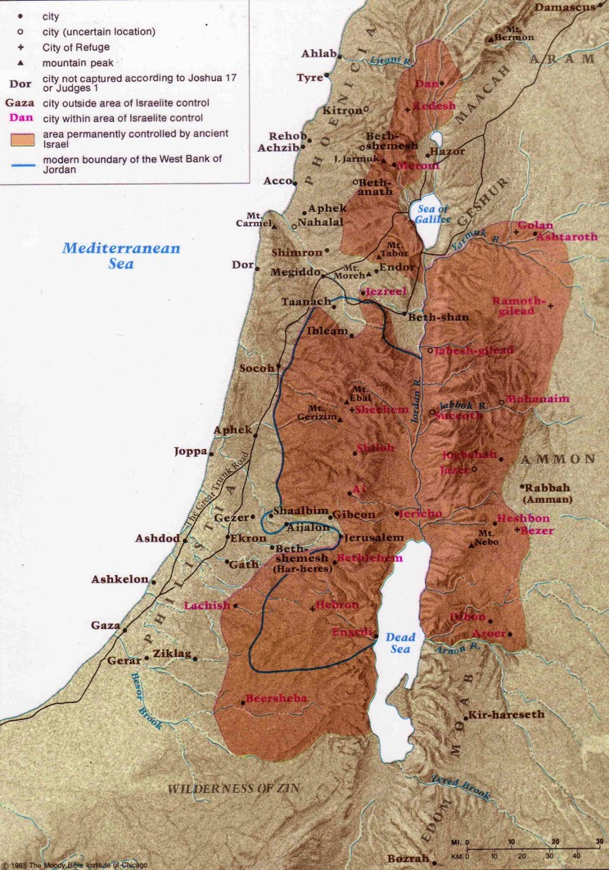
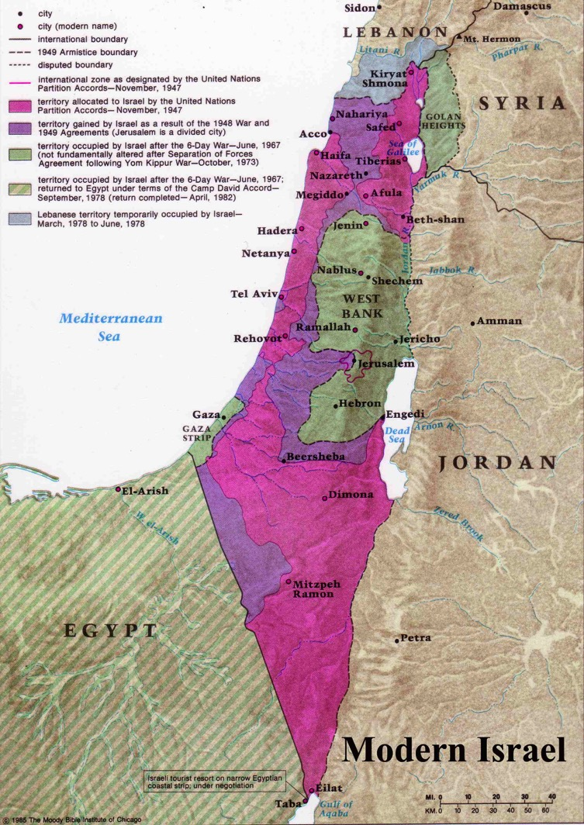
Israel of 1400 BC is today's West Bank!
Israel allotted by the UN is what they rarely conquered in Bible times!
Notes:
In 1947, the UN allocated to the soon-formed state of Israel a portion of land that was extremely difficult to defend. It was essentially divided in half with most of it in the southern desert. But Israel's victories against later attacks by surrounding nations yielded a more sustainable territory. But, even with the West Bank (called Samaria by the Jews), the land controlled by the Arab peoples is EIGHTY (80) times the size of Israel!
__________
Common-281
OS-06-Joshua-189
OS-07-Judges-59

Slide 60
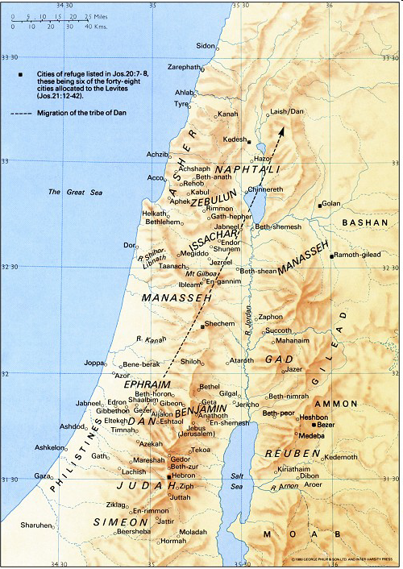
Hometowns of the Judges
Shamgar
New Bible Atlas
Samson
Elon
Jair
Barak
Gideon
Jephthah
Tola
Abimelech
Ehud
Deborah
Izban
Othniel
Abdon
The Moody Atlas of Bible Lands, map 34

Slide 61
Slides on
Judges 2

Slide 62
2:1-5
172
Failure Under the Theocracy
Incomplete
Occupation
Need
for Monarchy
Deliverance by Judges
1:1–2:5
2:6–16:31
17–21
Deterioration
Discipline
Depravity
Causes
Of the Cycles
Curse
Of the Cycles
Conditions
Of the Cycles
Living with
the Canaanites
War with
the Canaanites
Living Like
the Canaanites
Military
Disobedience
1
Spiritual
Disobedience
2:1-5
Canaan
c. 341 Years (1390-1049 BC)

Slide 63
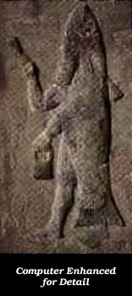
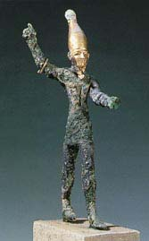
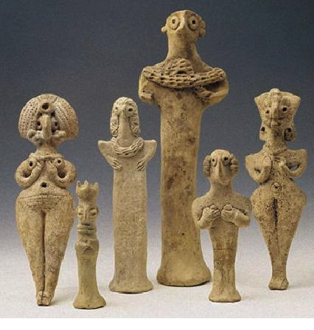
False Gods of the Land
A
S
T
H
A
R
O
T
H
DAGON
BAAL

Slide 64
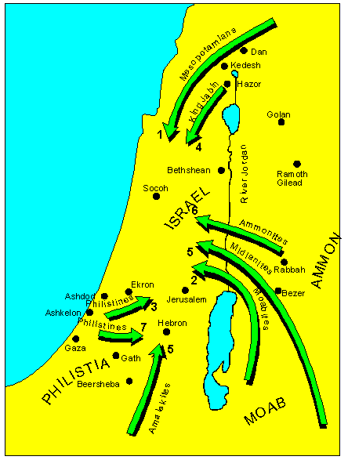
The Consequence of Breaking the Mosaic Covenant
Israel was invaded by enemies that the LORD raised up against them.
+Taken from Nelsons 3D-M Jenkins, S. 1997, c1985. Nelson's 3-D Bible map book (electronic ed.). Thomas Nelson: Nashville

Slide 65
Disobeying the LORD as king leads to trouble.
Notes:
Incomplete obedience shows that we trust something other than God.
God then seeks to earn our trust by allowing difficulty in our lives.

Slide 66

Relativism
Notes:
Relativism comes from relative, as opposed to absolute. All of us believe that some things are relative since different situations would make an action right in some circumstances but wrong in others. For example, we do not say "I love you" to all people! But relativism means the belief that nothing is absolute. No one actually believes this, since we all balance our checkbooks the same way and do not create money in the bank simply by thought. There is an absolute balance in every bank account—even for the person who says he believes in relativism. But this person says that nothing is absolutely right or wrong as everything depends upon circumstances.

Slide 67
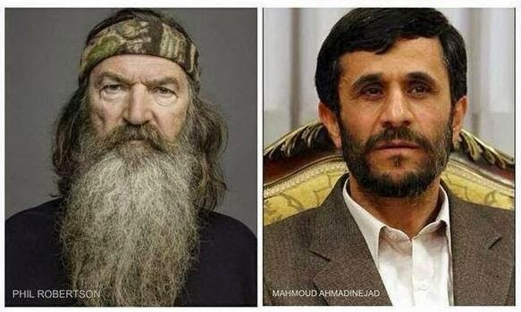
Relativism
SAYS GAYS NEED TO ACCEPT JESUS CHRIST TO GET TO HEAVEN
ORDERS GAYS HANGED, BEHEADED, STONED & BURNED ALIVE
LIBERALS DEMAND HE BE CENSORED
INVITED TO SPEAK AT COLUMBIA UNIV., USA
Notes:
The relativist picks and chooses which beliefs to emphasize as important. Of course, we all do this, but the relativist is less consistent.

Slide 68

RELATIVISM
Because there absolutely are no absolutes.
Notes:
Relativism is a self-defeating system because it posits a claim that contradicts its tenants.

Slide 69
Why must you be steadfast in having God as your king?
3 reasons
Notes:
In the book of Judges, we see three reasons to place God as king.

Slide 70
I. Incomplete obedience plants the seeds for failure (1–2).
Notes:
Rejecting God as the king leads to our downfall.

Slide 71
II. Relativism leads to cycles of sin (3–16).
Notes:
We go in circles when we follow our rules instead of God’s absolute standards.

Slide 72
Judges tried to stop Israel’s cycles of sin to show that God’s absolute standards were better than Israel’s relative standards (2:6–16:31).

Slide 73

The Cycle Repeated in Judges
174
1 Sin
2 Servitude
5 Silence
3 Supplication
4 Salvation
Notes:
The introduction previews God's repeated provision of judges even though Israel broke the covenant after Joshua’s death (2:6–3:6).

Slide 74
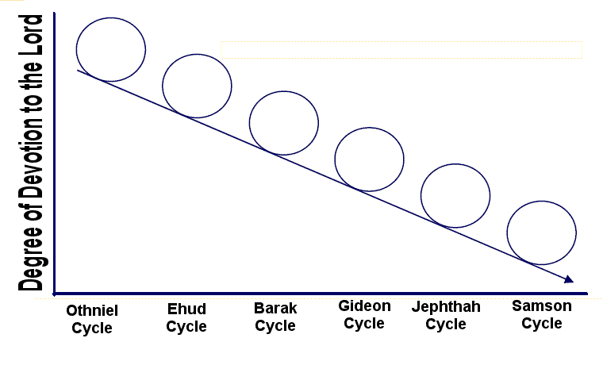
Downward Spiral of the Cycles
Degree of Devotion to the Lord
Othniel
Cycle
Ehud
Cycle
Barak
Cycle
Gideon
Cycle
Jephthah
Cycle
Samson
Cycle

Slide 75
The Mystery of the Judges
174
We define the era of the Judges as starting with the leadership of Moses and finishing with the crowning of Saul
  480 (from Exodus to Solomon's temple; 1 Kings 6:1)
  - 40 (Saul's rule Acts 13:11)
  - 40 (David's rule 1 Kings 2:11) = 400 years
When the number of years that the Judges and Israel's enemies rule are added up, it significantly exceeds the expected value of 400 years: 510+ years

Slide 76

How Can We Fit in the Judges?
174
480 yrs
1446
360 yrs
966
Wanderings 40 yrs
410 yrs
David 40 yrs
Saul 40 yrs
?
1700
1600
1500
1400
1300
1200
1100
1000
900

Slide 77
Years the Judges Ruled
174
Cycle | Oppressor | Location in Israel | Years of Oppression | Deliverer | Years of Peace
1 (3:7-11) | Mesopotamians | South | 8 | Othniel | 40
2 (3:12-30) | Moabites | Southeast | 18 | Ehud | 80
Parenthesis (3:31) | Philistines | Southwest | — | Shamgar | —
3 (Judges 4–5) | Canaanites | North | 20 | Deborah & Barak | 40
4 (6:1–8:32) | Midianites | Northcentral (Ophrah) | 7 | Gideon | 40
5 (8:33–9:57) | Abimelech | Central | 3 | Unnamed Woman | —
Parenthesis (10:1-2) | — | Central (Shamir) | — | Tola | 23
Parenthesis (10:3-5) | — | East (Komon, Gilead) | — | Jair | 22
6 (10:6–12:7) | Ammonites | East (Zaphon, Gilead) | 18 | Jephthah | 6
Parenthesis (12:8-10) | — | Southeast (Bethlehem) | — | Izban | 7
Parenthesis (12:11-12) | — | Northwest | — | Elon | 10
Parenthesis (12:13-15) | — | Central (Pirathon) | — | Abdon | 8
7 (Judges 13–16) | Philistines | Southwest (Zorah) | 40 | Samson | 20
1381 BC Mesopotamian rule began
Oppression
Peace
114
296
Total
Total
332
410
1049 BC Samson died
Notes:
OS-07-Judges-77, 90, 181

Slide 78
Possible Solutions
174
Include the years of oppression by Israel's enemies within the periods of leadership of the Judges
Overlap the leaderships of the Judges

Slide 79
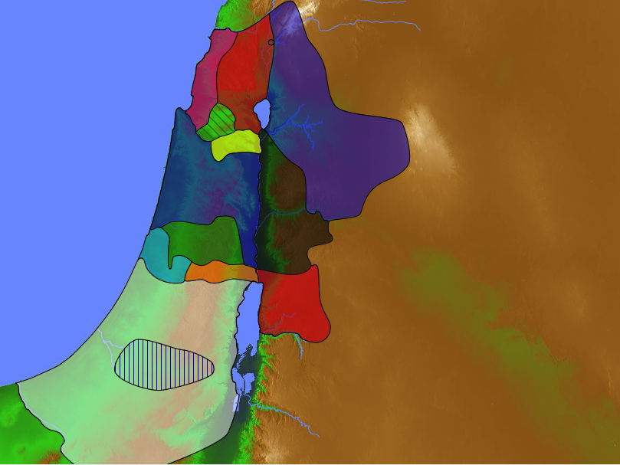
Where were the judges from?
Naphtali
180a
Asher
Shamgar
Zebulun
Elon
Barak
Manasseh
Issachar
Gideon
Jair
Tola
Manasseh
Abdon
Jephthah
Abimelech
Gad
Deborah
Ephraim
Dan
Ehud
Benjamin
Samson
Reuben
Izban
Judah
Othniel
Simeon

Slide 80
What Do We Think?
174
It is clear from the Bible that the period of the Judges spans 400 years.
Closer study reveals that there are some overlaps. For example, the judges Jephthah to Samson obviously overlapped with the 40 years of Philistine oppression and the years of priestly service of Eli and Samuel.

Slide 81
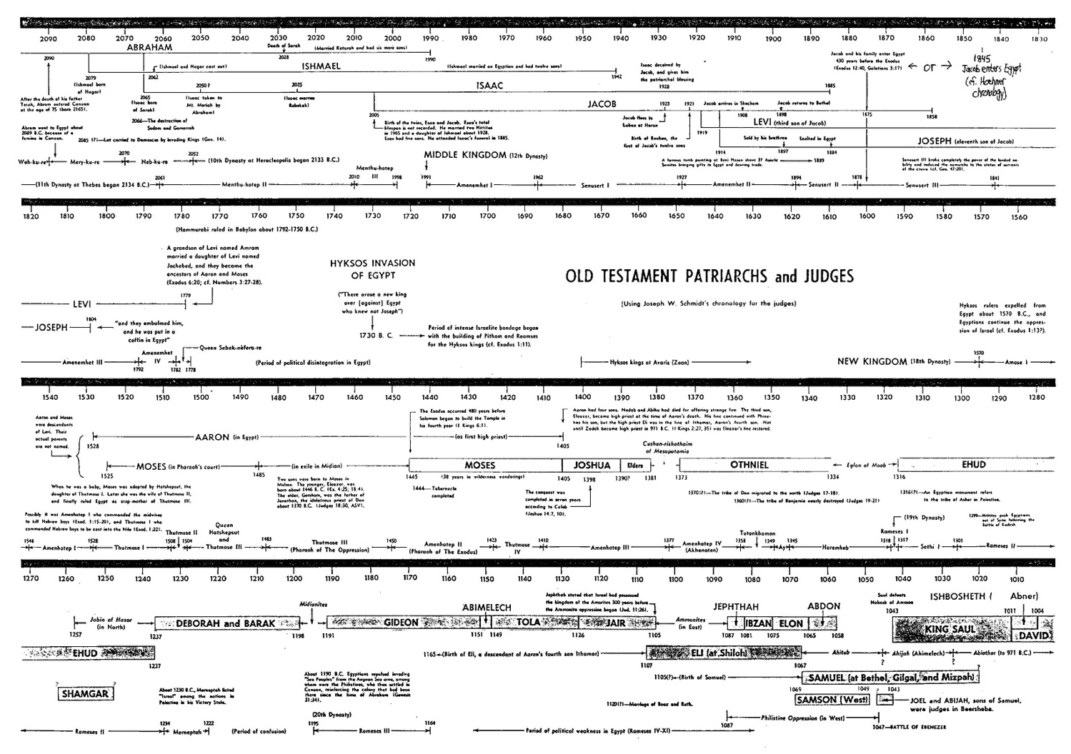
Old Testament Patriarchs & Judges
96
Note the Overlaps!

Slide 82
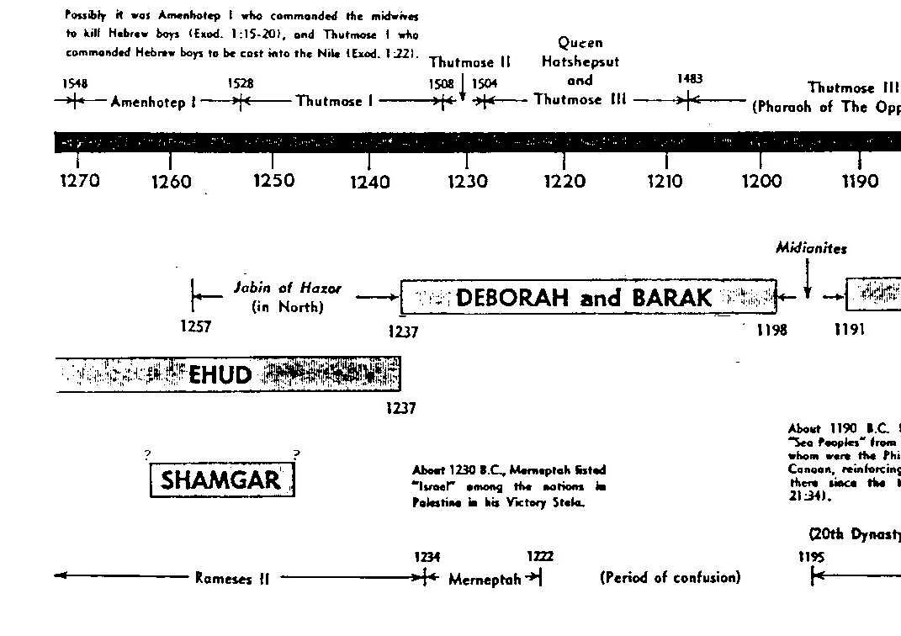
Old Testament Patriarchs & Judges
96
Note the Overlaps!

Slide 83
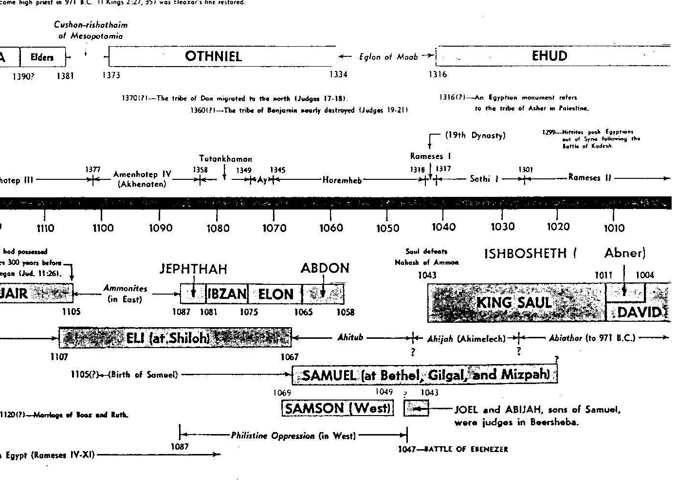
Old Testament Patriarchs & Judges
96
Note the Overlaps!
Notes:
We know that Samuel and Saul lived at the same time, but this was also likely the same period when Samson and Abdon both ruled Israel in different places.
__________
OS-07-Judges-83
OS-08-Ruth-20

Slide 84
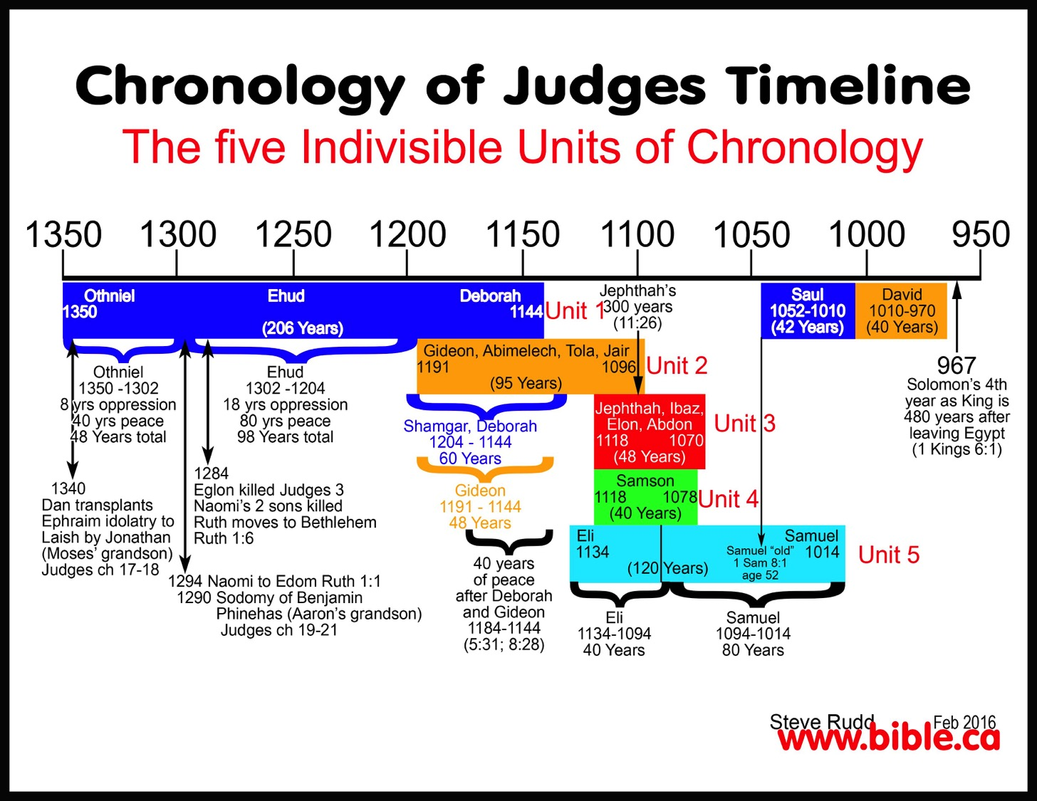
Chronological Overlaps
Chronology of Judges Timeline
The Five Indivisible Units of Chronology

Slide 85
Conclusions from Findings
174
There is not enough biblical information to determine the exact number of years that each judge ruled alone
The years that Israel fell under enemy rule are not always mentioned
Nevertheless, the Bible is accurate in its historical information

Slide 86
Slides on
Judges 3

Slide 87
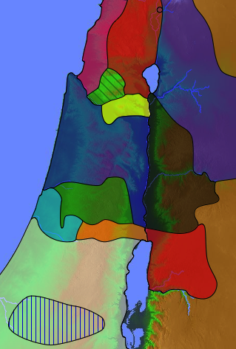
Enemies in Canaan During the Judges (3:5)
Sidonians
Mesopo
tamians
181
Phoenicians
Amorites
Canaanites
A m o r i t e s
Ammonites
Perizzites
Hivites
Jebusites
Philistines
Moabites
Amalekites
Edomites

Slide 88

"The Arameans and Philistines who settled in Canaan adopted the practices of the Canaanites; similarly the Amorites accepted much of the Sumerian religion as their own when they moved into Mesopotamia. Among all those peoples, however, the Hebrews took an independent course. Their God was the unique and cosmic deity who demanded exclusive allegiance. Such a concept ran against the grain of all the religions of the day."
WALTER A. ELWELL
Notes:
Walter A. Elwell and Barry J. Beitzel, Baker Encyclopedia of the Bible (Grand Rapids, MI: Baker, 1988), 410.

Slide 89
Southern Campaign (3:7-31)
172
Failure Under the Theocracy
Incomplete
Occupation
Need
for Monarchy
Deliverance by Judges
1:1–2:5
2:6–16:31
17–21
Deterioration
Discipline
Depravity
Causes
Of the Cycles
Curse
Of the Cycles
Conditions
Of the Cycles
Living with
the Canaanites
War with
the Canaanites
Living Like
the Canaanites
Military
Disobedience
1
Spiritual
Disobedience
2:1-5
Intro
2:6-3:6
South
3:7-31
Canaan
c. 341 Years (1390-1049 BC)

Slide 90
Judges of Israel
174
Cycle | Oppressor | Location in Israel | Years of Oppression | Deliverer | Years of Peace
1 (3:7-11) | Mesopotamians | South | 8 | Othniel | 40
2 (3:12-30) | Moabites | Southeast | 18 | Ehud | 80
Parenthesis (3:31) | Philistines | Southwest | — | Shamgar | —
3 (Judges 4–5) | Canaanites | North | 20 | Deborah & Barak | 40
4 (6:1–8:32) | Midianites | Northcentral (Ophrah) | 7 | Gideon | 40
5 (8:33–9:57) | Abimelech | Central | 3 | Unnamed Woman | —
Parenthesis (10:1-2) | — | Central (Shamir) | — | Tola | 23
Parenthesis (10:3-5) | — | East (Komon, Gilead) | — | Jair | 22
6 (10:6–12:7) | Ammonites | East (Zaphon, Gilead) | 18 | Jephthah | 6
Parenthesis (12:8-10) | — | Southeast (Bethlehem) | — | Izban | 7
Parenthesis (12:11-12) | — | Northwest | — | Elon | 10
Parenthesis (12:13-15) | — | Central (Pirathon) | — | Abdon | 8
7 (Judges 13–16) | Philistines | Southwest (Zorah) | 40 | Samson | 20
Peace 5x
Peace 4x
Peace 2x
Peace 6x
Oppression 3x
Oppression 2x
Notes:
OS-07-Judges-77
Adapted OS-07-Judges-90, 181

Slide 91
Where did Othniel judge
(3:7-11)?
Naphtali
Cushan-Rishathaim
180a
Asher
Zebulun
Manasseh
Issachar
All
Israel
Manasseh
Gad
Ephraim
Dan
Benjamin
Reuben
Judah
Othniel
Simeon
Notes:
"The first judge, Othniel, is the only judge who is mentioned prior to his becoming a judge. He captured Debir (Kiriah-sepher) and was given his niece Achsah (Caleb’s daughter) as a wife (1:12–13). Othniel was from the tribe of Judah, and he was one of the few exemplary judges (3:7–11). God raised up Othniel to deliver the Israelites form Cushan-rishathaim, king of Mesopotamia. This account uniquely contains all the components in the cycle of the judges: sin (3:7), God’s wrath (3:8), foreign oppressor (3:8), God’s mercy (3:9), deliverance/rest (3:10–11), and renewed sin (3:12)."
Mark F. Rooker, “The Book of Judges,” in The World and the Word: An Introduction to the Old Testament (Nashville, TN: B&H Academic, 2011), 295.

Slide 92
Othniel
176
Othniel – (tribe of Judah), Caleb's nephew
Location
Southern Israel
Sin
Did evil in the eyes of the Lord
Served the Baals and Asherahs(3:7)
Servitude
Mesopotamians
Eight years(3:8)
Supplication
Cried out to the LORD (3:9)
Silence
Peace for 40 years (3:11)
The first judge and probably the finest
Empowered by the Spirit of the Lord (3:10a)
3. From reputable line and related to Caleb

Slide 93
Where did Ehud judge (3:12-30)?
Naphtali
180a
Asher
Zebulun
Manasseh
Issachar
Manasseh
Gad
Ehud
Ephraim
Dan
Benjamin
Reuben
Judah
Simeon
Moab

Slide 94
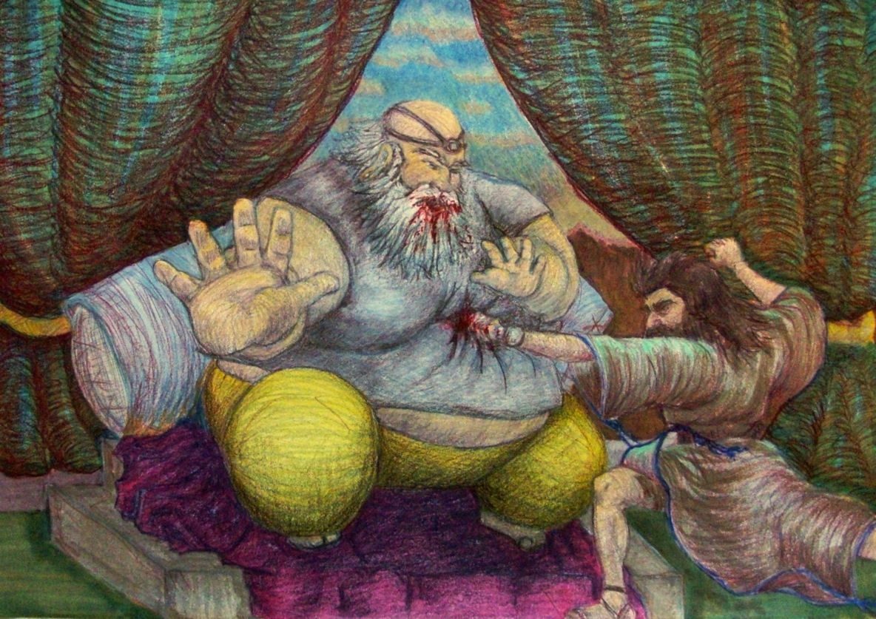
Ehud
Notes:
"The second judge, Ehud, defeated the Moabites by secretly stabbing Moab’s obese king Eglon³⁰ in Eglon’s chambers (3:15–30). The text specifies that Ehud was left-handed (3:15). Since most people were right-handed, the assumption may be that if a search for a weapon was made the left side was probably not searched as carefully as the right.
³⁰ The name Eglon sounds like the Hebrew word for calf (ʿegel), suggesting that he would be slaughtered like a sacrificial calf."
Mark F. Rooker, “The Book of Judges,” in The World and the Word: An Introduction to the Old Testament (Nashville, TN: B&H Academic, 2011), 295.

Slide 95
Ehud
176
Ehud (tribe of Benjamin), left-handed
Location
South-eastern Israel
Sin
Israel did evil (3:12a)
Moab
Eighteen years (3:14)
Servitude
Supplication
Cried out to the LORD (3:15)
Silence
Peace for 80 years (3:30)
Left-handed, element of surprise
Unexpected deliverer because:
a. Israel saw him as a tribute bearer, not a likely hero
b. Eglon saw a deformed, weak & unlikely assassin
3. Ehud's message for Eglon is the "sword"
Shamgar (son of Anath) killed 600 with an ox goad and was a deliverer for SW Israel during Ehud's lifetime.

Slide 96
Where did Shamgar judge (3:30)?
Naphtali
180a
Asher
Shamgar
"After Ehud, Shamgar son of Anath rescued Israel. He once killed 600 Philistines with an ox goad"
(3:31 NLT).
Zebulun
Manasseh
Issachar
Manasseh
Gad
Ephraim
Dan
Benjamin
Reuben
Judah
Simeon

Slide 97
Slides on
Judges 4

Slide 98
Northern Campaign (4:1–5:31)
176
Failure Under the Theocracy
Incomplete
Occupation
Need
for Monarchy
Deliverance by Judges
1:1–2:5
2:6–16:31
17–21
Deterioration
Discipline
Depravity
Causes
Of the Cycles
Curse
Of the Cycles
Conditions
Of the Cycles
Living with
the Canaanites
War with
the Canaanites
Living Like
the Canaanites
Military
Disobedience
1
Spiritual
Disobedience
2:1-5
Intro
2:6-3:6
South
3:7-31
North
4:1-5:31
Canaan
c. 341 Years (1390-1049 BC)

Slide 99
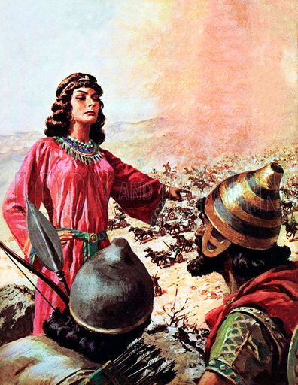
Deborah & Barak

Slide 100
Where did Deborah & Barak judge?
Naphtali
180a
Asher
Zebulun
Manasseh
Barak
Issachar
Manasseh
Gad
Ephraim
Deborah
Dan
Benjamin
Reuben
Judah
Simeon

Slide 101
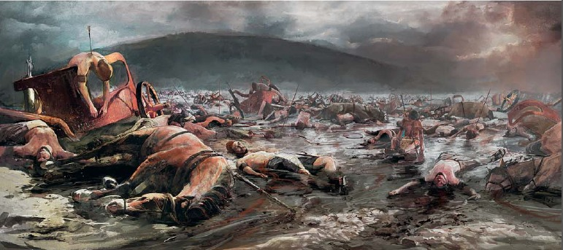
10,000 Israelite men defeated 900 Canaanite chariots (Judges 4:3, 6)

Slide 102
Slides on
Judges 5

Slide 103
Deborah & Barak
176
Deborah (prophetess, wife of Lappidoth)
Barak (son of Abinoam of Kedesh)
Location
Northern Israel
Sin
-Did evil in the eyes of the Lord (4:1)
-Canaanites (4:2)
-Twenty years (4:3)
Servitude
Supplication
-Cried to the Lord (4:3b)
Silence
-Peace for 40 years (5:31b)
1. Deborah conveyed the Lord's command to Barak
2. Barak would go only if Deborah went too.
3. Was Barak a coward? See Heb 11:32 "...about Gideon, Barak, Samson, Jephthah...who through faith conquered kingdoms...." can depict Barak's humble acceptance and dependence on God acting thru Deborah.
"...the Lord will hand Sisera over to a woman" (4:9b).
- Jael, wife of Heber the Kenite killed Sisera

Slide 104
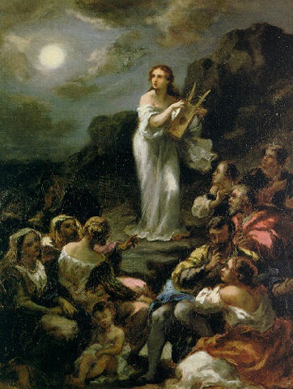
Deborah's Song (Judges 5)

Slide 105
Slides on
Judges 6

Slide 106
Central Judges (6:1–10:2)
172
Failure Under the Theocracy
Incomplete
Occupation
Need
for Monarchy
Deliverance by Judges
1:1–2:5
2:6–16:31
17–21
Deterioration
Discipline
Depravity
Causes
Of the Cycles
Curse
Of the Cycles
Conditions
Of the Cycles
Living with
the Canaanites
War with
the Canaanites
Living Like
the Canaanites
Military
Disobedience
1
Spiritual
Disobedience
2:1-5
Intro
2:6-3:6
South
3:7-31
North
4:1-5:31
Central
6:1-10:2
Canaan
c. 341 Years (1390-1049 BC)

Slide 107
Where did Gideon judge?
Naphtali
180a
Asher
Zebulun
Manasseh
Issachar
Gideon
Manasseh
Gad
Ephraim
Dan
Benjamin
Reuben
Judah
Simeon

Slide 108
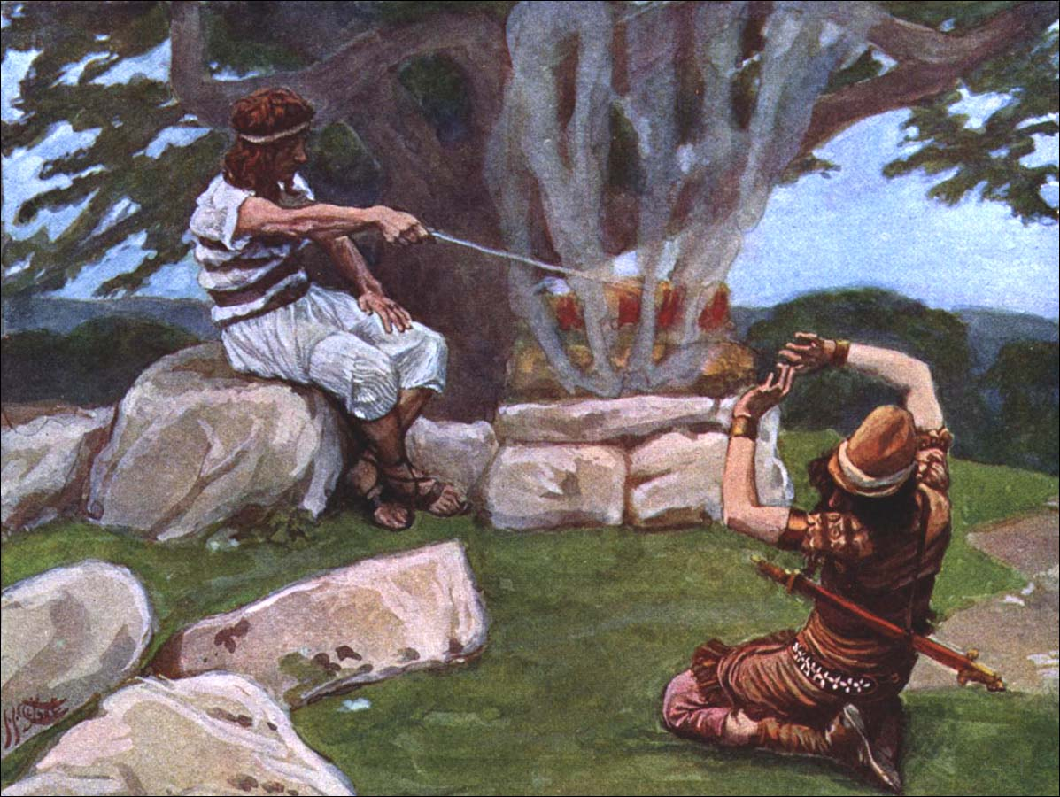
God Called Gideon

Slide 109
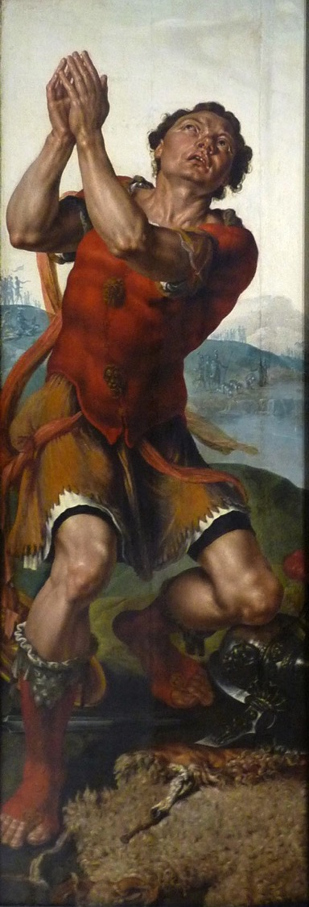
"Gideon thanks God for the miracle of the dew"
Painting by Maarten van Heemskerck (Musée des Beaux-Arts de Strasbourg) in AD 1550

Slide 110
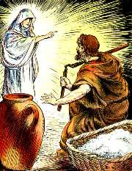
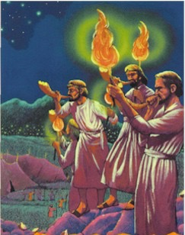
Gideon
Son of Joash
(Manasseh)
Notes:
"The Gideon account played an important role in the author’s purpose. Unique to this period is what approaches a revival of religious faith in Yahweh as Gideon pulled down the altar of Baal and cut down the Asherah (6:28). The eradication of pagan idols constituted what the nation was to have been doing all along (Deut 7:5), so only here were the people obedient to the command given by Moses and Joshua to the people."
Mark F. Rooker, “The Book of Judges,” in The World and the Word: An Introduction to the Old Testament (Nashville, TN: B&H Academic, 2011), 295.

Slide 111
Gideon Part 1
177
Gideon (tribe of Manasseh)
(Also known as "Jerubbaal," the great Baal fighter)
Location
North-central (Ophrah)
Sin
Did evil in the eyes of the Lord (6:1a)
Servitude
Midianites, (6:1), Amalekites, & other eastern peoples (6:3b) for seven years (6:1)
Supplication
Cried out to the Lord (6:6b)
Silence
Peace for 40 years
1. In the book of Judges, the Gideon narrative marks a turning point as the 'quality' of the judges began to get worse.
2. Gideon was called while he threshed in shame
He was tested for obedience in destroying Baal's altar (6:25-26)
4. He was empowered for service (6:34).
5. He asked for two confirmations—is that a faith problem?
Notes:
"Also, unlike the other Judges’ narratives here is a lengthy description of how the Israelites were to overcome the Midianites (Judg 7:1–18). And yet, in the end Gideon proved not to be a good example for the nation, for he led the nation into idolatry, fashioning a golden ephod from the people’s gold (8:24–27)—“a situation too much like the golden calf incident for theological comfort.”³² Like Aaron, who collected jewelry to erect a gold calf (Exod 32:1–4), Gideon took gold earrings to make an ephod. Accumulating gold for this undertaking ran counter to the Mosaic law, which stated that the king was not to amass gold for himself (Deut 17:17).³³ From this point on in the narrative the Israelites became adversarial to fellow Israelites (Judg 9:5, 34–54; 12:1–6; 15:9–13).
³² P. House, Old Testament Theology (Downers Grove, IL: InterVarsity, 1998), 219.
³³ The people seem to have been requesting that Gideon be king (Judg 8:22–23)."
Mark F. Rooker, “The Book of Judges,” in The World and the Word: An Introduction to the Old Testament (Nashville, TN: B&H Academic, 2011), 295.

Slide 112
Slides on
Judges 7

Slide 113
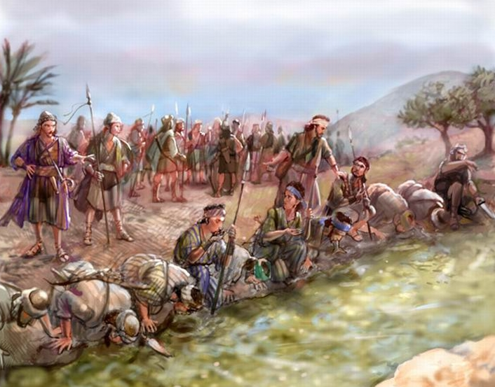
Gideon Trimmed Down His Troops (7:1-8a)

Slide 114
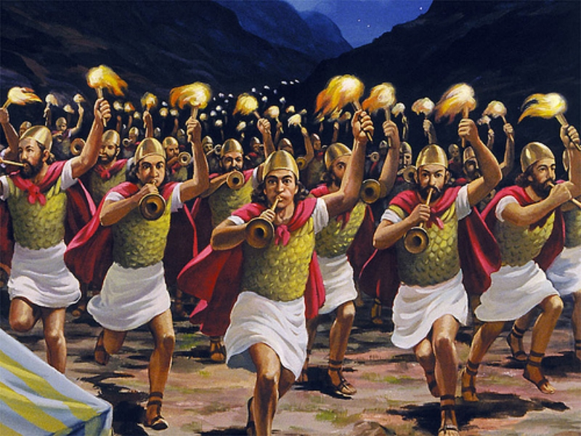
Gideon Defeated the Midianites (7:17-21)

Slide 115
Slides on
Judges 8

Slide 116
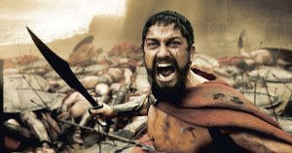
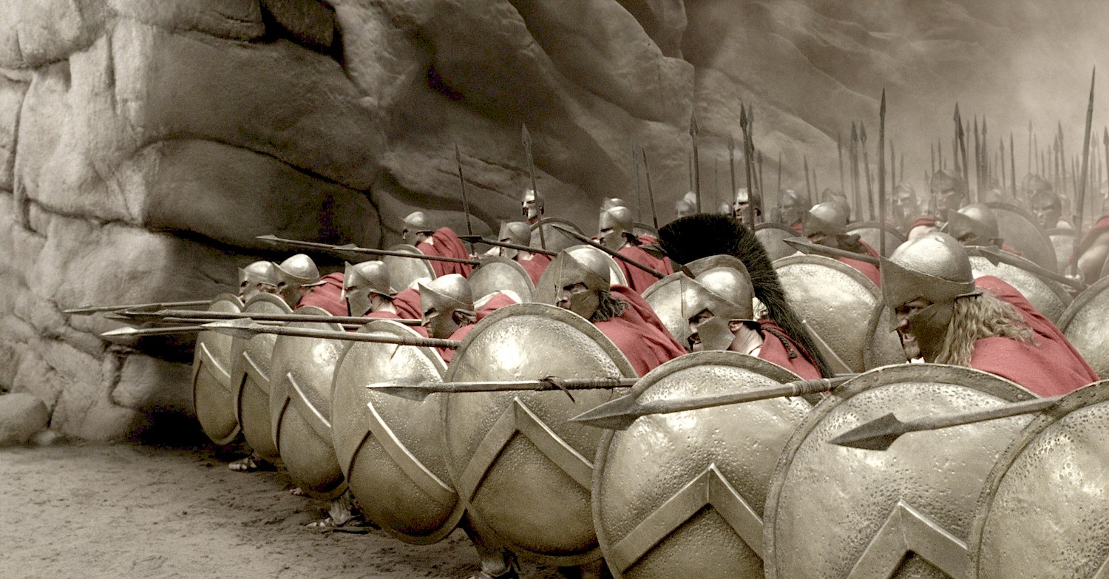
"You will break the oppressor's rod, just as you did when you destroyed the army of Midian"
(Isa. 9:4b NLT)
Gideon

Slide 117
Gideon Part 2
177
Gideon (tribe of Manasseh)
(Also known as "Jerubbaal," the great Baal fighter)
Location
North-central (Ophrah)
Sin
Did evil in the eyes of the Lord (6:1a)
Servitude
Midianites, (6:1), Amalekites, & other eastern peoples (6:3b) for seven years (6:1)
Supplication
Cried out to the Lord (6:6b)
Silence
Peace for 40 years
After reducing Gideon's army of 32,000 to 300, the Lord gave him confirmation from the enemy's camp.
Hebrews 11:32 "...about Gideon, Barak, Samson, Jephthah...who through faith conquered kingdoms...." shows he is a hero of faith due to his obedience to God's calling in spite of humanly impossible odds.
He foolishly made a golden ephod which the people worshipped.
His son by a concubine, Abimelech, killed seventy of his sons except the youngest, Jotham.

Slide 118
Slides on
Judges 9

Slide 119
Where did Abimelech judge?
Naphtali
180a
Asher
Zebulun
Manasseh
Issachar
Manasseh
Abimelech
Gad
Ephraim
Dan
Benjamin
Reuben
Judah
Simeon

Slide 120
Slides on
Judges 10

Slide 121
Eastern Campaign (10:3–12:7)
172
Failure Under the Theocracy
Incomplete
Occupation
Need
for Monarchy
Deliverance by Judges
1:1–2:5
2:6–16:31
17–21
Deterioration
Discipline
Depravity
Causes
Of the Cycles
Curse
Of the Cycles
Conditions
Of the Cycles
Living with
the Canaanites
War with
the Canaanites
Living Like
the Canaanites
Military
Disobedience
1
Spiritual
Disobedience
2:1-5
Intro
2:6-3:6
South
3:7-31
East
10:3-
12:7
North
4:1-5:31
Central
6:1-10:2
Canaan
c. 341 Years (1390-1049 BC)

Slide 122
Where did Tola judge?
Naphtali
180a
Asher
Zebulun
Manasseh
Issachar
Manasseh
Tola
Gad
Ephraim
Dan
Benjamin
Reuben
Judah
Simeon
Notes:
Judg. 10:1 After Abimelech died, Tola son of Puah, son of Dodo, was the next person to rescue Israel. He was from the tribe of Issachar but lived in the town of Shamir in the hill country of Ephraim. ² He judged Israel for twenty-three years. When he died, he was buried in Shamir.

Slide 123
Where did Jair judge?
Naphtali
180a
Asher
Zebulun
Manasseh
Issachar
Jair
Manasseh
Gad
Ephraim
Dan
Benjamin
Reuben
Judah
Simeon
Notes:
Judg. 10:3 After Tola died, Jair from Gilead judged Israel for twenty-two years. ⁴ His thirty sons rode around on thirty donkeys, and they owned thirty towns in the land of Gilead, which are still called the Towns of Jair. ⁵ When Jair died, he was buried in Kamon.

Slide 124
Where did Jephthah judge?
Naphtali
180a
Asher
Zebulun
Manasseh
Issachar
Manasseh
Gad
Jephthah
Ephraim
Dan
Ammonites
Benjamin
Reuben
Judah
Simeon

Slide 125

Gods of the Nations
Sidon
140
(Baal & Ashtoreth)
Aram
Judges 10:6 NLT
"…They served the images of Baal and Ashtoreth, and the gods of Aram, Sidon, Moab, Ammon, and Philistia…"
(10:6).
Israel
Ammon
Philistia
Moab
Egypt
Edom
Notes:
While Jezebel brought Baal worship into Israel during her husband Ahab's reign, it already had a history of influencing the people long before during the time of the Judges.
______________
BB-02-Map-49
OS-07-Judges-125

Slide 126

Twin Invasions
(Judges 10:8)
"Philistines and the Ammonites…began to oppress them that year. For eighteen years they oppressed all the Israelites east of the Jordan River in the land of the Amorites (that is, in Gilead)" (NLT).
171
Zebulun
Issachar
Manasseh
Manasseh
Gilead
Ammon
Ephraim
Philistines
Benjamin
Judah
Reuben
Notes:
Interestingly, Israel served the god of Philistia, so the Lord persecuted them with the Philistines!
——————————
BB-02-Map-50
OS-07-Judges-126

Slide 127
Eastern Invasions
(Judges 10:9)
171
Zebulun
"The Ammonites also crossed to the west side of the Jordan and attacked Judah, Benjamin, and Ephraim. The Israelites were in great distress" (NLT).
Issachar
Manasseh
Manasseh
Gilead
Ammon
Ephraim
Philistines
Benjamin
Judah
Reuben
Notes:
Judg. 10:6 Again the Israelites did evil in the LORD’s sight. They served the images of Baal and Ashtoreth, and the gods of Aram, Sidon, Moab, Ammon, and Philistia. They abandoned the LORD and no longer served him at all. ⁷ So the LORD burned with anger against Israel, and he turned them over to the Philistines and the Ammonites, ⁸ who began to oppress them that year. For eighteen years they oppressed all the Israelites east of the Jordan River in the land of the Amorites (that is, in Gilead).
——————————
BB-02-Map-51
OS-07-Judges-127

Slide 128

Jepththah's Victory (10:17–12:6)

Slide 129
Slides on
Judges 11

Slide 130
An Early Exodus (1446)
FOR
1 Kings 6:1
480 years from Exodus to the building of Solomon's Temple (966)
Judges 11:26 Jephthah assigns 300 years between his day (c.1100) and the Conquest
Exodus 1446 BC
+ 480 yrs
Temple = 966 BC
+ 4 yrs
Reign Began = 970/71

Slide 131
Jephthah versus Ammonites
70a, 70g
Manasseh
Gilead
Gad
Ammonites
Reuben
Jephthah 1100 BC
+ 300 yrs
Conquest =
1400 BC

Slide 132
An Early Exodus (1446)
70g
FOR
1 Kings 6:1
480 years from Exodus to the building of Solomon's Temple (966)
Judges 11:26 Jephthah assigns 300 years between his day (c.1100) and the Conquest
AGAINST
a) 480 means 12 generations. Actual no. of yrs is 12 x 25 = 300
b) The text is corrupt
c) Historian had inaccurate facts
This was a generalization or an inaccurate guess as he had no access to historical records

Slide 133

Jepththah's Daughter Greets Him (11:34)

Slide 134

Did Jephthah really kill his daughter?

Slide 135
Views on Jephthah's Daughter (Judg. 12)
183
DEDICATED | SACRIFICED
Being a judge, Jephthah must have been God-fearing, so he would not have violated God's law | 1. Promise of a simple animal sacrifice would hardly be a convincing vow in this situation
2. The Spirit of the Lord comes on Jephthah; he is noted in Heb. 11 so he would not have violated Law | 2. The mention of something coming out of the house implies that human sacrifice was intended
3. Daughter bewails her virginity and 11:39 makes comment that "she knew not a man" | 3. The burnt offering ('olah) involves death in all 286 OT occurrences
Adapted from John H. Walton, Chronological and Background Charts of the OT, 2d ed., 104

Slide 136
Views on Jephthah's Daughter (Judg. 12)
183
DEDICATED | SACRIFICED
4. Evidence of women in service of tabernacle—Ex. 38:8; 1 Sam. 2:22 | 4. If it was frequent practice to have women enter tabernacle service, why the commendation?
5. Human sacrifice would have been clearly understood as a violation of God's Law, and public opinion would have disallowed it even if Jephthah wanted to proceed | 5. Human sacrifice is seen as a last ditch effort in battle (2 Kings 3:27)
Adapted from John H. Walton, Chronological and Background Charts of the OT, 2d ed., 104

Slide 137
Views on Jephthah's Daughter (Judg. 12)
183
DEDICATED | SACRIFICED
6. Lev. 27:1-8 allows for redemption of humans vowed for sacrifice | 6. The conjunction in 11:31 is one of apposition: "will be the Lord's, that is, I will sacrifice it as a burnt offering"
7. The conjunction in 11:31 should be rendered "or," showing Jephthah considered various situations | 7. There is little evidence of Jephthah's spirituality or knowledge of the Law
Adapted from John H. Walton, Chronological and Background Charts of the OT, 2d ed., 104

Slide 138
Jephthah Part 1
178
Jephthah (the Gileadite)
Location
East (Zaphon, Gilead)
Sin
Did evil in the eyes of the Lord (10:6a)
Served gods of many nations
Philistines and Ammonites (10:7)
Eighteen years (10:8)
Servitude
Supplication
Cried out to the Lord (10:10)
Repented and got rid of foreign gods (10:16)
Silence
Six years (12:7a)
1. The Spirit of the Lord came upon Jephthah when he went against the Ammonites (11:29) and the Lord gave him victory.
2. He made an unnecessary vow and the text points towards its
fulfilment in sacrificing his daughter.

Slide 139
Jephthah Part 2
178
Jephthah (the Gileadite)
Location
East (Zaphon, Gilead)
Sin
Did evil in the eyes of the Lord (10:6a)
Served gods of many nations
Philistines and Ammonites (10:7)
Eighteen years (10:8)
Servitude
Supplication
Cried out to the Lord (10:10)
Silence
Six years (12:7a)
3. Hebrews 11:32-33 "...about Gideon, Barak, Samson, Jephthah, ...who through faith conquered kingdoms...." notes his feats positively
4. Though a prohibited act, his ultimate sacrifice of his daughter shows him to be a man of his word; Although foolish and stubborn, he still mentioned "the Lord, God of Israel" in his message to the Ammonite king (11:13-27).
5. His background and deeds show the influence of the surrounding nations on his behaviour (e.g. the sacrifice of his daughter).

Slide 140
Slides on
Judges 12

Slide 141
Northern Campaign (12:8-15)
172
Failure Under the Theocracy
Incomplete
Occupation
Need
for Monarchy
Deliverance by Judges
1:1–2:5
2:6–16:31
17–21
Deterioration
Discipline
Depravity
Causes
Of the Cycles
Curse
Of the Cycles
Conditions
Of the Cycles
Living with
the Canaanites
War with
the Canaanites
Living Like
the Canaanites
Military
Disobedience
1
Spiritual
Disobedience
2:1-5
Intro
2:6-3:6
South
3:7-31
East
10:3-
12:7
North
12:8-
12:15
North
4:1-5:31
Central
6:1-10:2
Canaan
c. 341 Years (1390-1049 BC)

Slide 142
Where did Izban judge?
Naphtali
180a
Asher
Zebulun
Manasseh
Issachar
Manasseh
Gad
Ephraim
Dan
Benjamin
Izban
Reuben
Judah
Simeon

Slide 143
Where did Elon judge?
Naphtali
171
Asher
Zebulun
Manasseh
Elon
Issachar
Manasseh
Gad
Ephraim
Dan
Benjamin
Reuben
Judah
Simeon

Slide 144
Where did Abdon judge?
Naphtali
180a
Asher
Zebulun
Manasseh
Issachar
Manasseh
Abdon
Gad
Ephraim
Dan
Benjamin
Reuben
Judah
Simeon

Slide 145
Slides on
Judges 13

Slide 146
The Samson Cycle
174
1 Sin
"Again the Israelites did evil in the LORD's sight…" (13:1a).

Slide 147
The Samson Cycle
174
1 Sin
2 Servitude
"…so the LORD handed them over to the Philistines, who oppressed them for forty years" (13:1b).

Slide 148
The Samson Cycle
174
1 Sin
2 Servitude
3 Supplication
Supplication Absent: No mention is made of the nation crying out to the LORD for deliverance from its enemy.

Slide 149

"Then the LORD said to Moses, 'Give the following instructions to the people of Israel.
²"If any of the people, either men or women, take the special vow of a Nazirite, setting themselves apart to the Lord in a special way, ³they must give up wine and other alcoholic drinks. They must not use vinegar made from wine or from other alcoholic drinks, they must not drink fresh grape juice, and they must not eat grapes or raisins"'"
(Num 6:1-3 NLT).

Slide 150

"As long as they are bound by their Nazirite vow, they are not allowed to eat or drink anything that comes from a grapevine—not even the grape seeds or skins"
(Num 6:4 NLT).

Slide 151
"They must never cut their hair throughout the time of their vow, for they are holy and set apart to the LORD. Until the time of their vow has been fulfilled, they must let their hair grow long. ⁶And they must not go near a dead body during the entire period of their vow to the LORD'"
(Num 6:5-6 NLT).

Slide 152
The Samson Cycle
174
1 Sin
2 Servitude
Samson delivers southwestern Israel from the Philistines as God's merciful provision for the nation (13:2–16:31).
3 Supplication
4 Salvation

Slide 153

Samson: A "Sun" in Darkness
"Samson" means "Sun"

Slide 154
Western Campaign (13–16)
172
Failure Under the Theocracy
Incomplete
Occupation
Need
for Monarchy
Deliverance by Judges
1:1–2:5
2:6–16:31
17–21
Deterioration
Discipline
Depravity
Causes
Of the Cycles
Curse
Of the Cycles
Conditions
Of the Cycles
Living with
the Canaanites
War with
the Canaanites
Living Like
the Canaanites
Military
Disobedience
1
Spiritual
Disobedience
2:1-5
Intro
2:6-3:6
South
3:7-31
East
10:3-
12:7
North
12:8-
12:15
West
13:1-
16:31
North
4:1-5:31
Central
6:1-10:2
Canaan
c. 341 Years (1390-1049 BC)

Slide 155
Where did Samson judge?
Naphtali
180a
Asher
Zebulun
Manasseh
Issachar
Manasseh
Gad
Ephraim
Dan
Samson
Benjamin
Reuben
Judah
Simeon
Notes:
"The last of the major judges is Samson, who perhaps even more than Gideon is a portrait of the nation in miniature as he blatantly violated God’s instructions. In contrast with the other judges Samson’s dealings with the Philistines seem to almost be of a personal nature rather than having anything to do with his tribe or Israel at large."
Mark F. Rooker, “The Book of Judges,” in The World and the Word: An Introduction to the Old Testament (Nashville, TN: B&H Academic, 2011), 296.

Slide 156
Slides on
Judges 14

Slide 157

"One day when Samson was in Timnah, one of the Philistine women caught his eye. ²When he returned home, he told his father and mother, 'A young Philistine woman in Timnah caught my eye.
I want to marry her. Get her for me'"
(Judges 14:1-2 NLT).
Notes:
"One of the ways the Israelites were to prevent the emergence of idolatry in the land was by avoiding mixed marriages (3:6; Exod 34:16; Deut 7:3). Samson, however, was involved with at least two relationships with foreign women (Judg 14:1–20; 16:1). In doing so he stands in contrast to Othniel, the first judge who displayed virtue and courage in his marriage to Achsah (1:12–15). This contrast illustrates the moral and spiritual decline of the judges themselves. The moral and spiritual decline of the judges seems to reach its climax with Samson. Samson demonstrates one who “did whatever he wanted” (17:6; 21:25)."
Mark F. Rooker, “The Book of Judges,” in The World and the Word: An Introduction to the Old Testament (Nashville, TN: B&H Academic, 2011), 296.

Slide 158

"As Samson and his parents were going down to Timnah, a young lion suddenly attacked Samson near the vineyards of Timnah. ⁶At that moment the Spirit of the LORD came powerfully upon him, and he ripped the lion's jaws apart with his bare hands. He did it as easily as if it were a young goat. But he didn't tell his father or mother about it"
(Judges 14:5-6 NLT).

Slide 159
Slides on
Judges 15

Slide 160

Samson & the Foxes
(Judges 15)
Notes:
Chapter 15 NLT
Samson’s Vengeance on the Philistines
Later on, during the wheat harvest, Samson took a young goat as a present to his wife. He said, “I’m going into my wife’s room to sleep with her,” but her father wouldn’t let him in.
2 “I truly thought you must hate her,” her father explained, “so I gave her in marriage to your best man. But look, her younger sister is even more beautiful than she is. Marry her instead.”
3 Samson said, “This time I cannot be blamed for everything I am going to do to you Philistines.” 4 Then he went out and caught 300 foxes. He tied their tails together in pairs, and he fastened a torch to each pair of tails. 5 Then he lit the torches and let the foxes run through the grain fields of the Philistines. He burned all their grain to the ground, including the sheaves and the uncut grain. He also destroyed their vineyards and olive groves.
6 “Who did this?” the Philistines demanded.
“Samson,” was the reply, “because his father-in-law from Timnah gave Samson’s wife to be married to his best man.” So the Philistines went and got the woman and her father and burned them to death.

Slide 161

"Samson said, 'This time I cannot be blamed for everything I am going to do to you Philistines.' ⁴Then he went out and caught 300 foxes. He tied their tails together in pairs, and he fastened a torch to each pair of tails. ⁵Then he lit the torches and let the foxes run through the grain fields of the Philistines. He burned all their grain to the ground, including the sheaves and the uncut grain. He also destroyed their vineyards and olive groves"
(Judges 15:3-5 NLT).

Slide 162

Samson's Jawbone Revenge (15:15-16)
Notes:
"The prologue of the book announced that God raised up the judges and was with them (2:18). But things had become so perverse by Samson’s day that he did not realize that the Lord had departed from him (Judg 16:20). Samson was also the only judge who was a Nazirite, but he seems to have violated Nazirite vows by having contact with the dead, cutting his hair, and perhaps drinking wine (Num 6:1–21)."
Mark F. Rooker, “The Book of Judges,” in The World and the Word: An Introduction to the Old Testament (Nashville, TN: B&H Academic, 2011), 296.

Slide 163
Samson Part 1
178
Samson (tribe of Dan), a Nazirite by birth
Location
Southwest (Zorah)
Sin
Does evil in the eyes of the LORD (13:1)
Servitude
Philistines (13:1)
Forty years
Supplication
No mention
Silence
No mention
He led Israel twenty years
1. Record of the Lord's Spirit working in him:(1)13:25
(2)14:6 (3)14:19 (4)15:14.
2. He loved women (esp. Philistines), contributing to his fall.
3. His life-style was not reflective of a Nazirite:
-getting near the carcass of the lion,
-participation in intermarriage with other nations.

Slide 164
Samson Part 2
178
Samson (tribe of Dan), a Nazirite by birth
Location
Southwest (Zorah)
Sin
Does evil in the eyes of the LORD (13:1)
Servitude
Philistines (13:1)
Forty years
Supplication
No mention
Silence
No mention
He led Israel 20 years
4. Disclosing and having his hair cut denounced his union with God and so his strength departed. Prayer restored it as strength was not in his hair per se but in the presence of God.
Samson's prayers: (1) 15:18 because was thirsty (2) 16:28 asking God for his strength.
6. He killed more when he died than while he lived (16:30).
Hebrews 11:32-33 shows Samson as a hero of faith who acted against all odds and depended on God.

Slide 165
Slides on
Judges 16

Slide 166

"But Samson stayed in bed only until midnight. Then he got up, took hold of the doors of the town gate, including the two posts, and lifted them up, bar and all. He put them on his shoulders and carried them all the way to the top of the hill across from Hebron"
(Judges 16:3 NLT).

Slide 167

Samson & Delilah

Slide 168

Samson

Slide 169

What was his weakness?
The Story of Samson
Her?
Hair?
Heart?
"Samson… the he man with a she weakness"
-Chuck Swindoll

Slide 170

Samson's Haircut

Slide 171

Samson's
Eyes Cut

Slide 172

Samson's Death

Slide 173
The Samson Cycle
174
"Samson had judged Israel for twenty years" (16:21) but no mention is made of the nation experiencing peace after Samson's 20-year rule.
1 Sin
2 Servitude
5 Silence
3 Supplication
4 Salvation

Slide 174
We go in circles when we make up the rules.
Notes:
Repeated cycles tell us that the only thing we learn from history is that we don’t learn from history.
Is your commitment to Christ cyclical?
How can you stop the cycles? Go back to the Source daily.

Slide 175

Moral Relativism
Notes:
Repeated cycles tell us that the only thing we learn from history is that we don’t learn from history.

Slide 176

Relativism
Notes:
Is your commitment to Christ cyclical?

Slide 177

Band-Aids on a Gunshot Wound
Lessons from Judges
Notes:
When someone gets a wound from a gun, it is very serious and requires immediate surgery to prevent bleeding and later infection. How silly to simply place a small adhesive strip over it such as a Band-Aid rather than carefully taking the bullet out, but this is candid way that we often view sin today. We have serious problem with sin, but we typically lack a serious solution, thinking that a simple prayer or confession would heal the issue. Of course, this only gives time for an infection to occur, so that a serious problem gets even more problematic. How can you stop the cycles? Go back to the Source daily.

Slide 178
Why must you be steadfast in having God as your king?
3 reasons
Notes:
Today we will see three reasons to place God as king.

Slide 179
I. Incomplete obedience plants the seeds for failure (1–2).
Notes:
Rejecting God as the king leads to our downfall.

Slide 180
II. Relativism leads to cycles of sin (3–16).
Notes:
We go in circles when we follow our rules instead of God’s absolute standards.

Slide 181
III. Relativism leads to idolatry (17–21).
Notes:
Whims instead of wisdom worships a different god.

Slide 182
Israel's religious and moral failures showed they needed a righteous king instead of their relativism (Judges 17–21).

Slide 183
Downward Spiral of the Cycles
Degree of Devotion to the Lord
Othniel
Cycle
Ehud
Cycle
Barak
Cycle
Gideon
Cycle
Jephthah
Cycle
Samson
Cycle

Slide 184
Judges of Israel
174
Cycle | Oppressor | Location in Israel | Years of Oppression | Deliverer | Years of Peace
1 (3:7-11) | Mesopotamians | South | 8 | Othniel | 40
2 (3:12-30) | Moabites | Southeast | 18 | Ehud | 80
Parenthesis (3:31) | Philistines | Southwest | — | Shamgar | —
3 (Judges 4–5) | Canaanites | North | 20 | Deborah & Barak | 40
4 (6:1–8:32) | Midianites | Northcentral (Ophrah) | 7 | Gideon | 40
5 (8:33–9:57) | Abimelech | Central | 3 | Unnamed Woman | —
Parenthesis (10:1-2) | — | Central (Shamir) | — | Tola | 23
Parenthesis (10:3-5) | — | East (Komon, Gilead) | — | Jair | 22
6 (10:6–12:7) | Ammonites | East (Zaphon, Gilead) | 18 | Jephthah | 6
Parenthesis (12:8-10) | — | Southeast (Bethlehem) | — | Izban | 7
Parenthesis (12:11-12) | — | Northwest | — | Elon | 10
Parenthesis (12:13-15) | — | Central (Pirathon) | — | Abdon | 8
7 (Judges 13–16) | Philistines | Southwest (Zorah) | 40 | Samson | 20
Peace 5x
Peace 4x
Peace 2x
Peace 6x
Oppression 3x
Oppression 2x
Notes:
OS-07-Judges-77
Adapted OS-07-Judges-90, 181

Slide 185
Where were the judges from?
Naphtali
180a
Asher
Shamgar
Zebulun
Elon
Barak
Manasseh
Issachar
Gideon
Jair
Tola
Manasseh
Abdon
Jephthah
Abimelech
Gad
Deborah
Ephraim
Dan
Ehud
Benjamin
Samson
Reuben
Izban
Judah
Othniel
Simeon

Slide 186
Slides on
Judges 17

Slide 187
Depravity (17–21)
172
Failure Under the Theocracy
Incomplete
Occupation
Deliverance by Judges
Need
for Monarchy
1:1–2:5
2:6–16:31
17–21
Deterioration
Discipline
Depravity
Causes
Of the Cycles
Curse
Of the Cycles
Conditions
Of the Cycles
Living with
the Canaanites
War with
the Canaanites
Living Like
the Canaanites
Military
Disobedience
1
Spiritual
Disobedience
2:1-5
Intro
2:6-3:6
South
3:7-31
East
10:3-
12:7
North
12:8-
12:15
West
13:1-
16:31
Religious
Depravity
17-18
Moral
Depravity
19-21
North
4:1-5:31
Central
6:1-10:2
Canaan
c. 341 Years (1390-1049 BC)
Notes:
Does false worship lead to immorality—or does lack of morals lead to idolatry?
"The period of the Judges began with Israel fighting enemies it should have annihilated, continued with Israel engaged with foreign enemies because of her apostasy, and concluded with Israel fighting among themselves.³⁵ The spiritual condition of the inhabitants of the land at the end of the book is no different from the pagan inhabitants the Israelites were to remove from the land at the beginning of the book.
³⁵ D. M. Howard Jr., An Introduction to the Old Testament Historical Books (Chicago: Moody, 1993), 99. The fact that the first episode of the appendix deals with the tribe of Dan forms a connection to Samson, the last mentioned judge, who was from the tribe of Dan."
Mark F. Rooker, “The Book of Judges,” in The World and the Word: An Introduction to the Old Testament (Nashville, TN: B&H Academic, 2011), 296.

Slide 188
Religious Failure (17–18)
Personal apostasy of Micah (ch. 17)
- Idolatry
- Hiring a Levite pagan priest
Notes:
"The first epilogue records the migration of the tribe of Dan and Micah’s idolatry (chaps. 17–18), while the second epilogue reports the rape of a Levite’s concubine and the near annihilation of an Israelite tribe as a result of intertribal warfare (chaps. 19–21). Several events illustrate the depth to which Israel has departed from the commandments of the Mosaic law. The sins include theft (17:1–2), idolatry (17:5), immorality (19:2), homosexuality (19:22), and abduction (21:23). Micah assumed he would receive God’s blessing because he procured a Levite to preside over the worship of his manufactured idol (17:13). The accounts in the epilogue illustrate in a more graphic way Israel’s tendency toward idolatry and scandal that was seen earlier in the book."
Mark F. Rooker, “The Book of Judges,” in The World and the Word: An Introduction to the Old Testament (Nashville, TN: B&H Academic, 2011), 296–297.

Slide 189

The Golden Calf
Notes:
What's the deal with all these calves? Today many societies know much stronger animals such as the elephant, but the bull or ox were the strongest of animals in the Ancient Near East.
We see Israel making a golden calf even at Sinai (Exodus 32). Gold would, of course, last much longer than an idol carved out of wood—but both required skilled craftsmen. We do not know if Micah's silver image and idol (Judges 17:4-5) and carved image (Judges 18:30) depicted a calf or some other animal, but the strength of the calf certainly makes it a good candidate.

Slide 190

Hiring the Levite Pagan Priest
(Judges 17)
Naphtali
Asher
180a
Zebulun
Issachar
Manasseh
Manasseh
Ephraim
Gad
Benjamin
Reuben
Bethlehem
Judah
Simeon
Notes:
Bethlehem appears in a really bad light in Judges.
Judg. 17:7 One day a young Levite, who had been living in Bethlehem in Judah, arrived in that area [of Ephraim]. 8 He had left Bethlehem in search of another place to live, and as he traveled, he came to the hill country of Ephraim. He happened to stop at Micah’s house as he was traveling through. 9 “Where are you from?” Micah asked him. He replied, “I am a Levite from Bethlehem in Judah, and I am looking for a place to live.”
10 “Stay here with me,” Micah said, “and you can be a father and priest to me. I will give you ten pieces of silver a year, plus a change of clothes and your food.” 11 The Levite agreed to this, and the young man became like one of Micah’s sons.
Judg. 17:12 So Micah installed the Levite as his personal priest, and he lived in Micah’s house. 13 “I know the Lord will bless me now,” Micah said, “because I have a Levite serving as my priest.”
So Bethlehem becomes the town where not only a Levite unlawfully acts as a priest, but a pagan priest at that!

Slide 191
Slides on
Judges 18

Slide 192
Religious Failure (17–18)
Personal apostasy of Micah (ch. 17)
- Idolatry
- Hiring a Levite pagan priest from Bethlehem
Tribal apostasy (ch. 18)
- Levite blesses the selfish, faithless migration plan of the tribe of Dan
- Syncretism

Slide 193

Migration of the Tribe of Dan
(Judges 18)
Naphtali
Dan
Asher
180a
Zebulun
Issachar
Manasseh
Manasseh
Gad
Ephraim
Dan
Benjamin
Reuben
Judah
Simeon
Notes:
This pagan Bethlehem priest then amazingly blesses the godless plan of the people of Dan to murder a peaceful town in the far north.

Slide 194

Who was this Levite?
Moses
Judges 18:30-31 (NLT)
"Then they set up the carved image, and they appointed Jonathan son of Gershom, son of Moses, as their priest. This family continued as priests for the tribe of Dan until the Exile. ³¹ So Micah’s carved image was worshiped by the tribe of Dan as long as the Tabernacle of God remained at Shiloh."
Gershom
Jonathan
Notes:
But the Masoretic Text (MT) does not read "Moses" as but "Manasseh" instead. See the center of the image above where the Hebrew letter nun (pronounced "noon") is raised above the other letters by a scribe to show that it should be read "Manasseh" to protect the reputation of Moses. Against this is the fact that Moses did have a son named Gershom whereas this was not the case with Manasseh, who had seven sons but none named Gershom.
Josh. 17:1 The next allotment of land was given to the half-tribe of Manasseh, the descendants of Joseph’s older son. Makir, the firstborn son of Manasseh, was the father of Gilead. Because his descendants were experienced soldiers, the regions of Gilead and Bashan on the east side of the Jordan had already been given to them. ² So the allotment on the west side of the Jordan was for the remaining families within the clans of the tribe of Manasseh: Abiezer, Helek, Asriel, Shechem, Hepher, and Shemida. These clans represent the male descendants of Manasseh son of Joseph.
See the verses at the bottom of this note.
________
"18:28b-31. The Danites rebuilt the city and named it Dan after their tribal forefather. More significantly (and sadly), they established a tribal center of idolatrous worship under the priesthood of Jonathan son of Gershom (cf. Ex. 2:22) which extended through his descendants until the time of the captivity of the land. Many scholars refer this to either the Assyrian captivity of Israel in 722 B.C. (2 Kings 17:6) or the captivity of the Galilean population under Tiglath-Pileser III in 733-732 B.C. (2 Kings 15:29). However, an early monarchial date of the authorship of Judges suggests that the statement refers to an earlier unknown captivity (some have suggested the Philistine capture of the ark; cf. 1 Sam. 4:11). For Moses the Hebrew text has inserted a superlinear n [Hebrew letter nun] into the name of Moses… to make it read “Manasseh”…
This was apparently a pious scribe’s attempt to relieve Moses’ grandson, Jonathan, of involvement with idolatry. The reference to the house of God ... in Shiloh (modern Seilun 19 miles north of Jerusalem) implies that the worship at the Danite shrine opposed the true worship of the Lord at Shiloh (cf. Josh. 18:1). This false worship in Dan was a forerunner of that of Jeroboam I who later established a Northern Kingdom shrine at Dan (cf. 1 Kings 12:28-31)" (F. Duane Lindsey, "Judges," in The Bible Knowledge Commentary, eds. John F. Walvoord and Roy B. Zuck [Wheaton: Victor Books, 1985), 1:410).
____________
Is it really difficult to believe that the grandson of Moses could be led into apostasy? Scripture records that it happened even one generation after Joshua (Judg. 2:10 "After that generation died, another generation grew up who did not acknowledge the LORD or remember the mighty things he had done for Israel").
So it certainly could happen two generations later. In fact, siblings and friends within the same generation too often witness one or both of them being caught up in false teaching or idolatry.
____________
Image Above:
Description The Raised Nun in Judges 18:30. From the middle column of the reverse of (extant) folio 33 of the Aleppo Codex.
Source https://archive.org/details/Aleppo_Codex
Date circa 920 AD
Author Shlomo ben Buya'a
https://en.wikipedia.org/wiki/File:Raised_Nun_in_Judges_18.30.jpg
————————
Ex. 2:22 Later she gave birth to a son, and Moses named him Gershom,ª for he explained, “I have been a foreigner in a foreign land.”
Ex. 18:3 (Moses’ first son was named Gershom,ª for Moses had said when the boy was born, “I have been a foreigner in a foreign land.”
Judg. 18:30 Then they set up the carved image, and they appointed Jonathan son of Gershom, son of Moses,ª as their priest. This family continued as priests for the tribe of Dan until the Exile.
1Chr. 23:15 The sons of Moses were Gershom and Eliezer.
1Chr. 26:24 From the clan of Amram, Shebuel was a descendant of Gershom son of Moses. He was the chief officer of the treasuries.

Slide 195


Early Divided Kingdom
1 Kings 12:1–16:28
Altar of Jonathan (grandson of Moses) in 1340 BC (Judges 18:30)
Jeroboam set up his golden calf on the very same altar in 931 BC (1 Kings 12:26-33)!
The Israelite Kingdom Began Under Jeroboam
(1 Kings 12:25–14:20)
Tel Dan
Notes:
When we get to the end of Judges 18, we see in 18:30 that the Bethlehem Levite this whole story is about is none other than the grandson of Moses himself! Only two generations away, and a leader of apostasy! His descendants continued the false worship at that exact spot another 600 years until the Danites were exiled by Assyria in 722 BC!
• In fact, 400 years after Jonathan, the godless Jeroboam of Israel began his rival kingdom in the north and rallied his people in the heresy started by Jonathan, grandson of Moses.
• Jeroboam up a golden calf idol on the VERY SAME ALTAR as this Bethlehem Levite from centuries earlier. You can visit it today.

Slide 196

Inventing Paganism...
Dan
Jeroboam set up calf idols at Bethel and Dan (1 Kings 12:26-33)
Bethel
Jerusalem

Slide 197

Early Divided Kingdom
1 Kings 12:1–16:28
Jeroboam's altar like this in Bethel split in half (1 Kings 13:1-5, 31-32)
Tel Dan
Notes:
1Kings 13:1 At the LORD’s command, a man of God from Judah went to Bethel, arriving there just as Jeroboam was approaching the altar to burn incense. 2 Then at the LORD’s command, he shouted, “O altar, altar! This is what the LORD says: A child named Josiah will be born into the dynasty of David. On you he will sacrifice the priests from the pagan shrines who come here to burn incense, and human bones will be burned on you.” 3 That same day the man of God gave a sign to prove his message. He said, “The LORD has promised to give this sign: This altar will split apart, and its ashes will be poured out on the ground.”
1Kings 13:4 When King Jeroboam heard the man of God speaking against the altar at Bethel, he pointed at him and shouted, “Seize that man!” But instantly the king’s hand became paralyzed in that position, and he couldn’t pull it back. 5 At the same time a wide crack appeared in the altar, and the ashes poured out, just as the man of God had predicted in his message from the LORD.
1Kings 13:31 Afterward the prophet said to his sons, “When I die, bury me in the grave where the man of God is buried. Lay my bones beside his bones. 32 For the message the LORD told him to proclaim against the altar in Bethel and against the pagan shrines in the towns of Samaria will certainly come true.”

Slide 198
Cause & Effect
Religious Failure
Moral Failure
17–18
19–21

Slide 199
Slides on
Judges 19

Slide 200

Concubine Killed (Judges 19–21)
Notes:
Picture Source: https://newgracebaptistchurch.wordpress.com/2018/08/20/the-levite-and-his-concubine-judges-19-21/

Slide 201


**** Gibeah Gazette ****
THE MOST OUTRAGEOUS STORY IN THE BIBLE
CONCUBINE KILLED & CUT INTO 12 PIECES (JUDG. 19:1-30)
"Now in those days Israel had no king. There was a man from the tribe of Levi living in a remote area of the hill country of Ephraim. One day he brought home a woman from Bethlehem in Judah to be his concubine."
JUDGES: UNFAITHFUL PEOPLE… FAITHFUL GOD
Notes:
"Within this final section the young Levite who journeyed to the hill country of Ephraim (17:7–8) is counterbalanced by the Levite who traveled in the hill country of Ephraim to Bethlehem (chap. 19). There his concubine was raped and killed, stated in language remarkably similar to the account of Sodom and Gomorrah in Genesis 19. In both accounts men of the city surrounded the home of the guest, called for the visitors to come out to engage in homosexual relations, and were offered virgin daughters as a consolation.³⁶ Comparing the activity of the Israelites to the sin of Sodom and Gomorrah, the paradigm of abominable behavior in the OT, shows how low Israelites have stooped in their conduct.
³⁶ See Block, Judges, Ruth, 533–34.
OT Old Testament"
Mark F. Rooker, “The Book of Judges,” in The World and the Word: An Introduction to the Old Testament (Nashville, TN: B&H Academic, 2011), 297.

Slide 202

A Levite & His Concubine
(Judges 19)
Naphtali
Asher
180a
Zebulun
Issachar
Manasseh
Manasseh
Ephraim
Gad
Gibeah
Benjamin
Reuben
Bethlehem
Judah
Simeon
Notes:
• A man from Ephraim traveled to Bethlehem, got a concubine…
• and brought her back north.
• However, she was unfaithful to him and went back south to Bethlehem.
• he pursued her and then brought her to Gibeah where the men of the town raped her.

Slide 203

Moral Failure (19–21)
Benjamites in Gibeah rape and kill a Levite's concubine (19)
Notes:
The raped and abused Bethlehem woman died at the hands of the men of Gibeah, so the Levite cut her body into 12 pieces.

Slide 204
Concubine
Parts Sent to All Israel
(Judges 19:29-30)
Naphtali
Asher
180a
Zebulun
Issachar
Manasseh
Manasseh
Ephraim
Gad
Gibeah
Benjamin
Reuben
Judah
Simeon
Notes:
He sent parts of her body to all the remaining 11 tribes of Israel.

Slide 205
Slides on
Judges 20

Slide 206
Moral Failure (19–21)
Benjamites in Gibeah rape and kill a Levite's concubine (19)
- 400,000 warriors of other 11 tribes destroy 26,100 Benjamites, including women and children (20).
Notes:
The entire country of Israel against the tiny tribe of Benjamin led to the slaughter of the Benjamites.

Slide 207
Near Destruction of the Tribe of Benjamin
171
Asher
53,400
Naphtali
45,400
Judges 20
Zebulun
60,500
Manasseh
Issachar
64,300
Manasseh
52,700
Levi
23,000
Spread Throughout Israel
Gad
40,500
Ephraim
32,500
Dan
64,400
Benjamin
45,600
Reuben
43,730
Judah
76,500
Simeon
22,200
Numbers 26 Populations
Notes:
Benjamin had over 45,000 men centuries earlier upon entering the land.
• But the combined forces of Israel nearly wiped them out.

Slide 208
Slides on
Judges 21

Slide 209
Moral Failure (19–21)
Benjamites in Gibeah rape and kill a Levite's concubine (19)
- 400,000 warriors of other 11 tribes destroy 26,100 Benjamites, including women and children (20).
- Benjamites kill everyone in Jabesh Gilead except 400 virgins and steal another 200 virgins at Shiloh as wives for the remaining 600 Benjamites to preserve their line (21).
Notes:
Only 600 men of Benjamin were left! The other tribes then asked, “What have we done?” and concocted a plan to steal wives for them.

Slide 210

The Last Verse is the Key Verse
"In those days Israel had no king. Everyone did as he saw fit"
(Judges 21:25).

Slide 211
The Theology of Judges-Ruth-Samuel
193
Judges
Ruth
Samuel
Bethlehem
David
Boaz
Bethlehemites
Idolatry (17-18)
Concubine (19)
Gibeah
Murder (19-20)
Saul
Monarchy
Needed
Monarchy
Prepared
Monarchy
Established
Adapted from Thomas L. Constable, "A Theology of Joshua, Ruth, and Judges,"
in A Biblical Theology of the OT, ed. Roy B. Zuck, 95-96, 117
Notes:
The theology of Judges-Ruth-Samuel is fascinating. It shows that God can use any circumstance and any person for His kingdom purpose and His glory.
• The book of Judges shows a dismal scene where a king was needed for the nation.
• Bethlehem appears in two disgraceful scenes:
• A Levite from Bethlehem is involved in ungodly priestly duties and even colludes with the tribe of Dan to steal an idol for their migration north (Judges 17-18). Another Levite with a concubine from Bethlehem (again) encounters a group of Benjaminite men in Gibeah who assault his concubine (Judges 19) and ultimately lead to her disgraceful death.
• In retaliation, the town of Gibeah comes into focus. It is no better than Bethlehem.
• Here in Gibeah the tribe of Benjamin was nearly wiped out, except for 600 men (Judges 20).
• In spite of extreme moral darkness and sin, God was preparing the monarchy.
• He even established that monarchy through the wicked Benjamites through the wicked city of Gibeah.
• How?
God chose the Benjaminite Saul as the first anointed king of Israel (1 Sam 8), though he was from the smallest of the tribes.
• However, Saul’s sad end brings even more shame on Gibeah.
• That preparation of the monarchy finds its true fulfilment in the city of Bethlehem, for in Ruth we see that both Boaz and the Bethlehemites act honourably in the midst of national apostasy. So God can use the same, shameful city of Bethlehem to raise a kinsmen-redeemer through Boaz. Ruth was a woman from Moab, a nation worshipping pagan gods. But through God’s plan and provision, the line of David was established and ultimately the Messiah Jesus Christ himself was born through the line.
• This birth was in the obscure city of Bethlehem, where David raises the status of this town to an amazing height. It is raised to an even higher status than given by David when we get to the NT and see that David’s descendant, Jesus, is not only born into his line but is born in the exact city of David, Bethlehem (Matt 2).
Therefore, the theology of Ruth is that God’s grace can transform the ordinary and obscure to extraordinary and world renown.
________
Common-282
OS-07-Judges-208
OS-08-Ruth-72
OS-09-1 Sam-17, 22, 43

Slide 212
Be guided by wisdom instead of whims that worship a different god.
Notes:
Replacing God’s wisdom with personal whims is idolatry.
There exist several reasons idols appeal to people.
Jesus said that no one could serve two masters.

Slide 213
Apostasy's Bitter Fruits
political disintegration
tribal hostility
social chaos
increased immorality
disregard of the law
anarchy

Slide 214

Defining Idolatry
IDOLATRY
MAKING A GOOD THING THE ULTIMATE THING.
Notes:
Replacing God’s wisdom with personal whims is idolatry. That means “making a good thing the ultimate thing.”

Slide 215

Defining Idolatry
Notes:
It applies, for example, to making sex the most important thing in your life.

Slide 216

Defining Idolatry
Notes:
Interestingly, that can even apply to marriage. Jesus said that no one could serve two masters—God and money—but he also said that we need to love him even more than our spouse!

Slide 217
Why must you be steadfast in having God as your king?
Notes:
Today we will see three reasons to place God as king.

Slide 218
Main Idea
Make God king
—not relativism and the idolatry of sin cycles
Judges
Notes:
Be steadfast with God as king so you don’t have to fail over and over (restatement).

Slide 219
I. Incomplete obedience plants the seeds for failure (1–2).
Notes:
Rejecting God as the king leads to our downfall.

Slide 220
II. Relativism leads to cycles of sin (3–16).
Notes:
We go in circles when we follow our rules instead of God’s absolute standards.

Slide 221
III. Relativism leads to idolatry (17–21).
Notes:
Whims instead of wisdom worships a different god.

Slide 222
Discussion Question:
How is Our Day Like the Judges Period?
Relativism: "Save the whales" but kill humans
Secularism: "I don't let my religion affect my politics"
Promiscuity: "What that leader does in his bedroom is his business and not mine"

Slide 223

Relativism
This pamphlet is blank.
We're atheists.
Notes:
Relativism is seen in atheism where anything can be written on their pamphlets.

Slide 224

Applications
172
Rejecting God's lordship (incomplete obedience) plants the seeds for failure (1–2).
Personal relative standards instead of God's absolute standards lead to cycles of sin (3–16).
Replacing God's wisdom with personal whims leads to idolatry (17–21).

Slide 225

Be Steadfast.

Slide 226

Think about it.
Who is the real boss of your life?
How can you enthrone God as your true king?

Slide 227

Therefore, my beloved brothers,
be steadfast,
immovable,
always abounding in the work of the Lord,
knowing that in the Lord your labour is not in vain.
1 Corinthians 15:58

Slide 229


OT Survey link at BibleStudyDownloads.org
Get this presentation for free!
Notes:
OT Survey (os)

