Slide 1
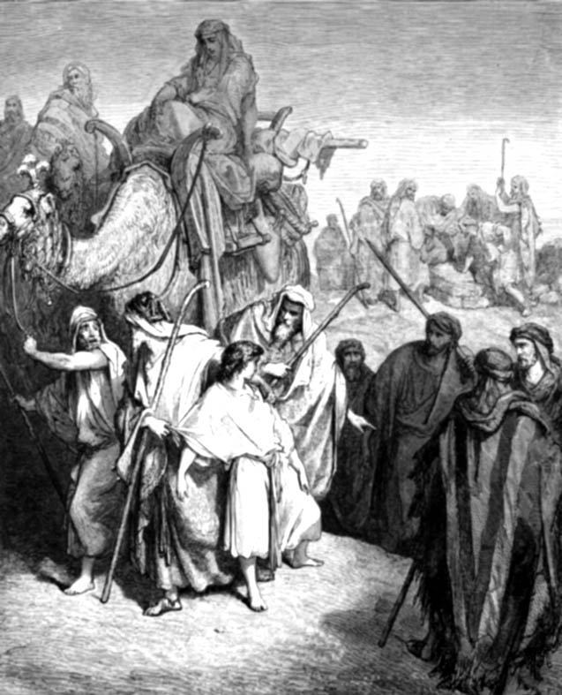
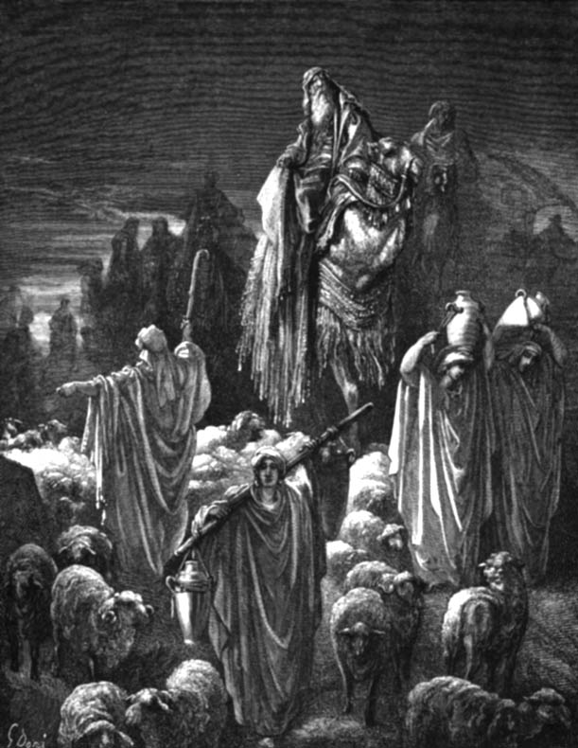
The Date of
The Exodus
By
Chiam Cheng Kiat
Djenny Ruswandi
Adapted by Dr. Rick Griffith
Jordan Evangelical Theological Seminary • BibleStudyDownloads.org

Slide 2
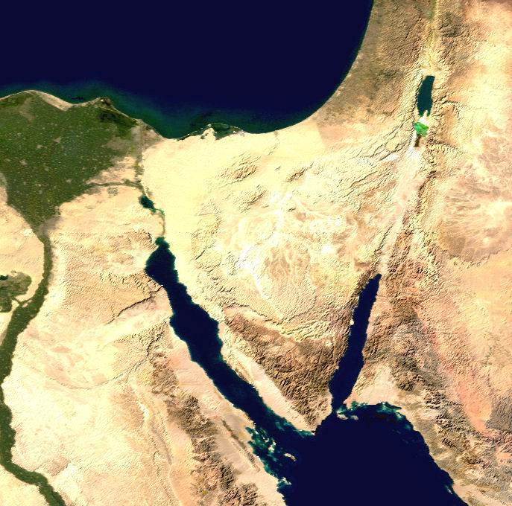
Route of the Exodus
Canaan
107
Goshen
Nile River
Mt. Sinai
Egypt
Midian
Notes:
BE-02-Exodus-58
OB-02-Exodus Date-2
OC-02-Exodus Date-2
OS-02-Exodus-124
NB-14 Religion 5 Passover & Lord's Supper-113

Slide 3

Crossing the Sea of Reeds
Yam Suph (Exod. 13:18; cf. 10:19) means "Sea of Reeds" but was erroneously translated as "Red Sea" in the LXX.
Amenophis II

Slide 4
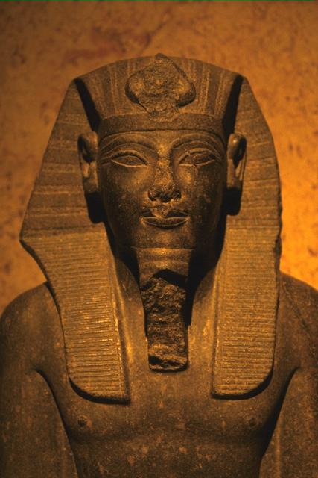
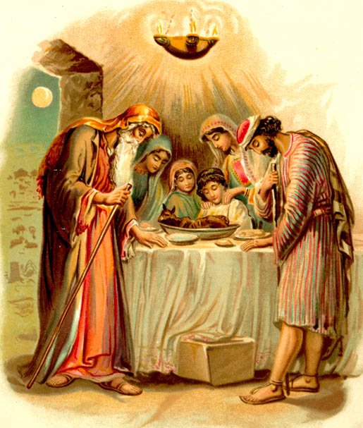

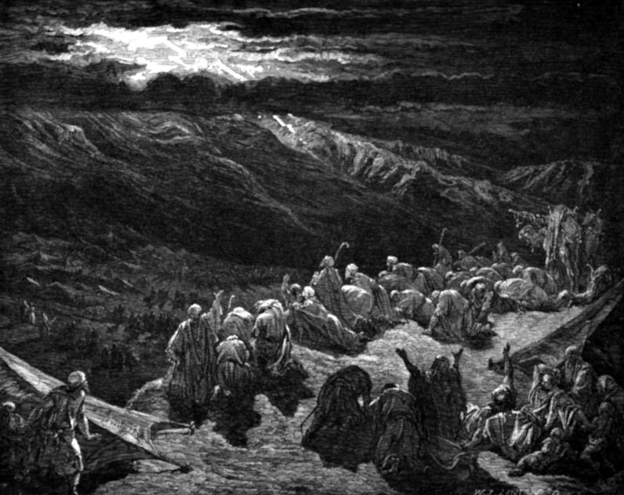
Traditional History of Egypt
OTB 73
3100-2686 Proto-Dynastic
2686-2181 Old Kingdom
2181-1991 First Intermediate
1991-1786 Middle Kingdom
1786-1558 Second Intermediate
1558-1085 New Kingdom
1098- 332 Late Dynastic
332- Alexander the Great
Pyramids
Abraham
Joseph
Moses
Notes:
The majority view on Egypt’s chronology puts the rulers back to 3100 BC, which is long before the Genesis date of the Flood at 2487 (see OT Survey notes, p. 86). Obviously the Bible and the Egyptologists cannot both be correct. This traditional view also puts the pyramids prior to Abraham, though the Bible never mentions the pyramids. Moses is typically seen as living around 1250 BC.
https://portal.tiu.edu/uportal/teds/otdept/jhoffmeier

Slide 5
Two Theories on the Date of the Exodus
Late Date Theory
(the 13th century)
Early Date Theory
(the 15th century)

Slide 6

Timeline of Proposed Exodus Dates
Abraham (2166-1991)
Joseph (1915-1805)
1445
1290
2000
1900
1800
1700
1600
1500
1400
1300
1200

Slide 7
Early Exodus Timeline
Abraham (2166-1991)
1445
1290
Joseph (1915-1805)
Moses (1525-1405)
2000
1900
1800
1700
1600
1500
1400
1300
1200

Slide 8
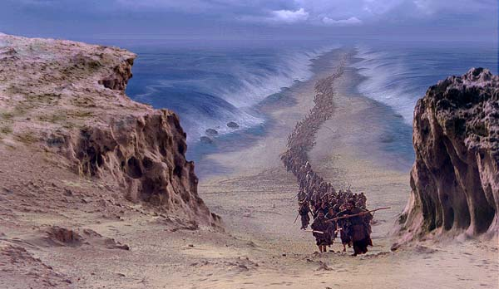
Why should we know about the date of the Exodus?
?

Slide 9
The Mystery of the Exodus
109
When did it happen? 1446 or 1266?
Why does it matter?
  It is the most important historical event in Israel's past, when it truly began to be a nation
  It stands at the centre of Israel's faith
  Many dates before and after depend on this date
  The choice of date reflects our belief (or lack thereof) in the historicity and accuracy of the Bible and thus has an impact on our faith

Slide 10
Arguments for the Late Date
Historical Arguments
Archaeological Arguments
Biblical Arguments

Slide 11
Historical Arguments for the Late Date
The civilizations of Edom, Ammon, and Moab were not in existence in the 15th century. Thus the Exodus must be dated to the 13th century.

Slide 12
Historical Arguments for the Late Date
The City of Raamses (Exod. 1:11) was founded by Seti I (1318-1304) and completed by Rameses II (1304-1237)

Slide 13
A Late Exodus (1266-1299)
110
FOR
Ex. 1:11 The Israelites built the city of Rameses. It must have been in honour of Rameses II (c.1290)
Thutmose III was not known as a great builder and therefore does not fit into the historical picture
AGAINST
The name 'Rameses' was used much earlier than 13th century. The city was being built before Moses' birth (before Rameses II)
He is known to have had some building projects in the delta region

Slide 14
Historical Arguments for the Late Date
Thutmose IV was not the legal heir to the Egyptian throne, but that in no way proves that the legal heir had died in the tenth plague.

Slide 15
Historical Arguments for the Late Date
His father, Thutmose III (1504-1450), was not noted as a great builder.

Slide 16
Historical Arguments for the Late Date
The 300-year figure cited by Jephthah is merely an exaggerated generalization, since he had no access to historical records.

Slide 17
Historical Arguments for the Late Date
The 430 years of Exodus 12:40 from the late date for the Exodus places Jacob's entrance into Egypt in the Hyksos period (1730-1570). This period of foreign domination in Egypt is a more likely time for Israel's entrance into Egypt.

Slide 18
Arguments for the Late Date
Historical Arguments
Archeological Arguments
Biblical Arguments

Slide 19
Archeological Arguments for a Late Date
The Menerptah Stela (1220 B.C.)
The name “Israel” does not occur in any other historical record or documents before 1220.
The Amarna Tablet (1400 B.C.)
The name of “Habiru” cannot be identified with the Hebrews. “Habiru“ were a diverse people, native Canaanites.
Archeological evidences
Lachish, Bethel, Debir, etc. support a 13th century date for the Exodus.

Slide 20
A Late Exodus (1266-1299)
70h
FOR
There is no evidence of widespread destruction in Canaan in the early 14th century. These cities of Canaan stood.
Archeological evidence shows that Bethel, Lachish and Debir in Palestine fell as a result of a violent attack between 1250 and 1200. It must have been the Israelite conquest.
AGAINST
Israelites did not cause material destruction during the Conquest, except Jericho, Ai and Hazor (Josh. 24:13)
The destruction might have been caused by Egyptian conquests (Pharaoh Merneptah)

Slide 21
Arguments for the Late Date
Historical Arguments
Archeological Arguments
Biblical Arguments

Slide 22
Biblical Arguments for the Late Date
The Old Testament
1 Kings 6:1
Exodus 2:23

Slide 23
The Old Testament
The OT does not mention the Palestinian invasions of Seti I (1318-1304 B.C.) or Rameses II (1304-1237 B.C.), very likely because Israel was not yet in the land of Palestine.

Slide 24
Small Group Discussion
How does 1 Kings 6:1 help date the Exodus?
How does Judges 11:26 help date the Exodus?
(Solomon began to reign in 971 BC.)
(Jephthah lived around 1100 BC.)

Slide 25
1 Kings 6:1
"In the four hundred and eightieth year after the Israelites had come out of Egypt, in the fourth year of Solomon's reign over Israel, in the month of Ziv, the second month, he began to build the temple of the Lord."
The 480 years is a symbolic figure for 12 generations. Because a generation is about 25 years, the actual figure should be 300 years.
966/ 960/ 957 B.C.
300/ 300/ 300 years
1266/1260/1257 B.C.

Slide 26
An Early Exodus (1446)
109
FOR
1 Kings 6:1
480 years from Exodus to the building of Solomon's Temple (966)
Judges 11:26 Jephthah assigns 300 years between his day (c.1100) and the Conquest
Exodus 1446 BC
+ 480 yrs
Temple = 966 BC
+ 4 yrs
Reign Began = 970/71

Slide 27
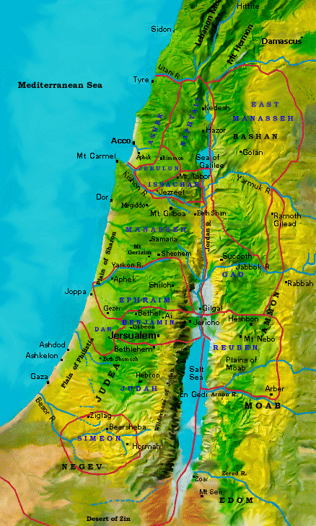
Jephthah versus Ammonites
109
Manasseh
Gilead
Ammonites
Gad
Jephthah 1100 BC
Reuben
+ 300 yrs
Conquest =
1400 BC

Slide 28
An Early Exodus (1446)
109
FOR
The length of time assigned to the judges in the Bible cannot be squeezed into the 150 years required by a late Exodus, even with overlaps
Thutmose IV (Pharaoh after 1446 Exodus) was not the eldest son, who was possibly killed in the 10th plague
AGAINST
With overlaps and a symbolic understanding of time spans, it can be fitted in
There are many other possible explanations for his eldest son not ruling

Slide 29
Exodus 2:23
During that long period, the king of Egypt died. The Israelites groaned in their slavery and cried out, and their cry for help because of their slavery went up to God.
The 40 years Moses spent with the Midianites is not a chronological figure, but a symbolic figure indicating a long period of time.

Slide 30
Two Theories of the Date of the Exodus
Late Date Theory
(the 13th century date)
Early Date Theory
(the 15th century date)

Slide 31
Egyptian Sojourn Chronologies Contrasted
400 YEAR SOJOURN
430 YEAR SOJOURN
215 YEAR SOJOURN
LATE
EXODUS
CRITICAL
108
The Patriarchs
2135-1774
Canaan Sojourn
1875-1845
Migration to Egypt
1845
The Patriarchs
2166-1805
Canaan Sojourn
2090-1876
Migration to Egypt
1876
2100
2000
The Patriarchs
1952-1589
Canaan Sojourn
1875-1660
Migration to Egypt
1660
The Patriarchs
1950-1650
Canaan Sojourn
?-1650
Migration to Egypt
1650
1900
Egyptian Sojourn
1875-1446
Slavery
1730 or 1580
Egyptian Sojourn
1845-1445
Slavery
1730?
1800
1700
Egyptian Sojourn
1660-1446
Slavery
1580
Egyptian Sojourn
1650-1230
Slavery
1580
1600
EXODUS
1500
The Patriarchs
1500-1300
Gradual Migration to Egypt
EXODUS
EXODUS
Wandering
1445-1405
Conquest and Judges
1405-1050
Wandering
1446-1405
Conquest and Judges
1406-1050
Wandering
1446-1405
Conquest and Judges
1406-1050
1400
1300
Egyptian Sojourn
1350-1230
EXODUS
1200
(No Wandering)
Conquest and Judges
1230-1025
(No Exodus or
40 Yr. Wandering)
Migration, Conquest and Judges
1230-1025
Adapted (column 1 added) from John H. Walton, Chronological and Background Charts of the OT, 2d ed., 99
1100
United Kingdom
1050-931
United Kingdom
1050-931
United Kingdom
1050-931
1000
United Kingdom
1025-931
United Kingdom
1025-931
900
Notes:
Three evangelical views all subscribe to the Earl Exodus, but they differ on the length of Israel’s slavery.
The Late Exodus view is held by liberal scholarship and some evangelicals such as Kenneth Kitchen.
Note that critical scholarship doesn’t believe there ever was an actual Exodus. These scholars believe the Exodus story arose much later as a myth to unite the nation.

Slide 32
Arguments for the Early Date
Biblical Arguments
Archaeological Arguments
Historical Arguments

Slide 33
Biblical Arguments for the Early Date
1 Kings 6:1
Judges 11:26
Exodus 2:23

Slide 34
1 Kings 6:1
"In the four hundred and eightieth year after the Israelites had come out of Egypt, in the fourth year of Solomon's reign over Israel, in the month of Ziv, the second month, he began to build the temple of the Lord."

Slide 35
1 Kings 6:1
The Exodus occurred 480 years before the 4th year of Solomon's reign
966/ 960/ 957 B.C.
480/ 480/ 480 years
1446/1440/1437 B.C.

Slide 36
An Early Exodus (1446)
109
FOR
1 Kings 6:1
480 years from Exodus to the building of Solomon's Temple (966)
Judges 11:26 Jephthah assigns 300 years between his day (c.1100) and the Conquest
AGAINST
a) 480 means 12 generations. Actual no. of yrs is 12 x 25 = 300
b) The text is corrupt
c) Historian had inaccurate facts
This was a generalization or an inaccurate guess as he had no access to historical records

Slide 37
Judges 11:26
"For three hundred years Israel occupied Heshbon, Aroer, the surrounding settlements and all the towns along the Arnon. Why didn't you retake them during that time?"

Slide 38
Judges 11:26
Israel in Canaan 300 years before Jephthah
Jephthah dated --- 1100 B.C.
300
Joshua Conquest --- 1400 B.C.
Add 40 yrs in desert 40
Exodus dated 1440 B.C.

Slide 39
Exodus 2:23
"During that long period, the king of Egypt died. The Israelites groaned in their slavery and cried out, and their cry for help because of their slavery went up to God."

Slide 40
Exodus 2:23
Moses lived in exile in Midian 40 years. The only pharaohs who ruled 40 years or more:
1. Thutmose III (1504-1450)
2. Rameses II (1290-1224)

Slide 41
Arguments for the Early Date
Biblical Arguments
Archaeological Arguments
Historical Arguments

Slide 42
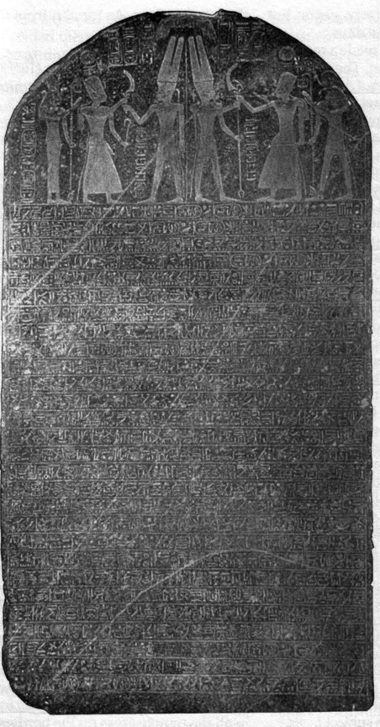
Merneptah Stela
109
Lists Israel in Canaan as a people group in the 13th century
This is the first mention of the name "Israel" outside the Bible
Ancient Egypt, 1208 BC
Arnold/Beyer, 160

Slide 43

An Early Exodus (1446)
109
FOR
The Merneptah Stela identifies Israel as a people group (not city state or foreign nation) c.1231. If Israel had left Egypt in 1266, they would still have been wandering in the wilderness then
AGAINST
This is not the same Israel of the Exodus
Israel might have left in 1300 and would have been a settled nation for 20 years
"Canaan is captive with all woe . . . Israel is wasted, bare of seed"
Merneptah Stela, Readings from the ANE, 160

Slide 44
Archeological Arguments for an Early Date
The Menerptah Stela (1220 B.C.)
Israel was already a nation.
The Amarna Tablets (1440 B.C.)
The “Habiru” that caused chaos was likely the Hebrews.
The Dream Stela of Thutmose IV
Shows Thutmose IV was not the legal heir to Pharaoh. Why not? The legal heir died in the 10th plague.
Jericho and Hazor Evidences

Slide 45
Arguments for the Early Date
Biblical Arguments
Archeological Arguments
Historical Arguments

Slide 46
Historical Arguments for the Early Date
The length of the Period of Judges
Early Date – 250 years
Late Date – 180 years (unlikely)
The Reign of the Pharaoh during the Entrance of Jacob was Sesostris/Senusert III (1878-43 B.C.), not the Hyksos dynasty (1674-1567 B.C)

Slide 47
Egyptian Sojourn Chronologies Contrasted
400 YEAR SOJOURN
430 YEAR SOJOURN
215 YEAR SOJOURN
LATE
EXODUS
CRITICAL
108
The Patriarchs
2135-1774
Canaan Sojourn
1875-1845
Migration to Egypt
1845
The Patriarchs
2166-1805
Canaan Sojourn
2090-1876
Migration to Egypt
1876
2100
2000
The Patriarchs
1952-1589
Canaan Sojourn
1875-1660
Migration to Egypt
1660
The Patriarchs
1950-1650
Canaan Sojourn
?-1650
Migration to Egypt
1650
1900
Egyptian Sojourn
1875-1446
Slavery
1730 or 1580
Egyptian Sojourn
1845-1445
Slavery
1730?
1800
1700
Egyptian Sojourn
1660-1446
Slavery
1580
Egyptian Sojourn
1650-1230
Slavery
1580
1600
EXODUS
1500
The Patriarchs
1500-1300
Gradual Migration to Egypt
EXODUS
EXODUS
Wandering
1445-1405
Conquest and Judges
1405-1050
Wandering
1446-1405
Conquest and Judges
1406-1050
Wandering
1446-1405
Conquest and Judges
1406-1050
1400
1300
Egyptian Sojourn
1350-1230
EXODUS
1200
(No Wandering)
Conquest and Judges
1230-1025
(No Exodus or
40 Yr. Wandering)
Migration, Conquest and Judges
1230-1025
Adapted (column 1 added) from John H. Walton, Chronological and Background Charts of the OT, 2d ed., 99
1100
United Kingdom
1050-931
United Kingdom
1050-931
United Kingdom
1050-931
1000
United Kingdom
1025-931
United Kingdom
1025-931
900
Notes:
Three evangelical views all subscribe to the Earl Exodus, but they differ on the length of Israel’s slavery.
The Late Exodus view is held by liberal scholarship and some evangelicals such as Kenneth Kitchen.
Note that critical scholarship doesn’t believe there ever was an actual Exodus. These scholars believe the Exodus story arose much later as a myth to unite the nation.

Slide 48
Egyptian Sojourn Chronologies Evaluated
View
400 YEAR SOJOURN
430 YEAR SOJOURN
215 YEAR SOJOURN
LATE EXODUS
CRITICAL
108a
CRITICAL
Exodus
Early
Early
Early
Late
Gradual Migration
Egyptian Sojourn
400
430
215
420
120
Years of Freedom
Unspecified
295 or 145
80
70
120
Years of Slavery
<400
135 or 285
135
350
none (a myth)
Exod. 12:40 Text
LXX &
Samaritan Pentateuch
MT
LXX & Samaritan Pentateuch
MT
Unimportant
Popularity
Few
Most common
Common
Few Evangelicals
Many Liberals
Many Liberals
Support:
• Gen. 15:13 (sojourn 400 yrs)
• Acts 13:19-20 "about 450 years" =
400 + 40 + 7
= 447 yrs.
• Exod. 12:40 "children of Israel" points to Gen. 35:10 (1875 BC) to begin 430 years since this is when nation called "Israel"
• Follows MT of Exod. 12:40
• Scripture sometimes uses round numbers
(See the next few pages for more early date arguments)
• Follows MT of Exod. 12:40
• The new king of Exod. 1 was a native Egyptian who followed the Hyksos
• Their later date for Abr. Cov. (1875 BC) to Jacob entering Egypt (1660 BC) is 215 yrs.
• Archaeology supports the destruction of some Canaanite cities in the 13th century
(See the next few pages for more late date arguments)
• The city of Rameses (Exod. 1:11) must have been built after Rameses II (1300 BC) since it was named after him
These views are listed in order from the best to the worst perspective, in my opinion.
Notes:
Each view has its strengths and weaknesses, so the student should evaluate all the arguments for each and make an informed decision whether I am correct to hold to the 400-year sojourn.

Slide 49
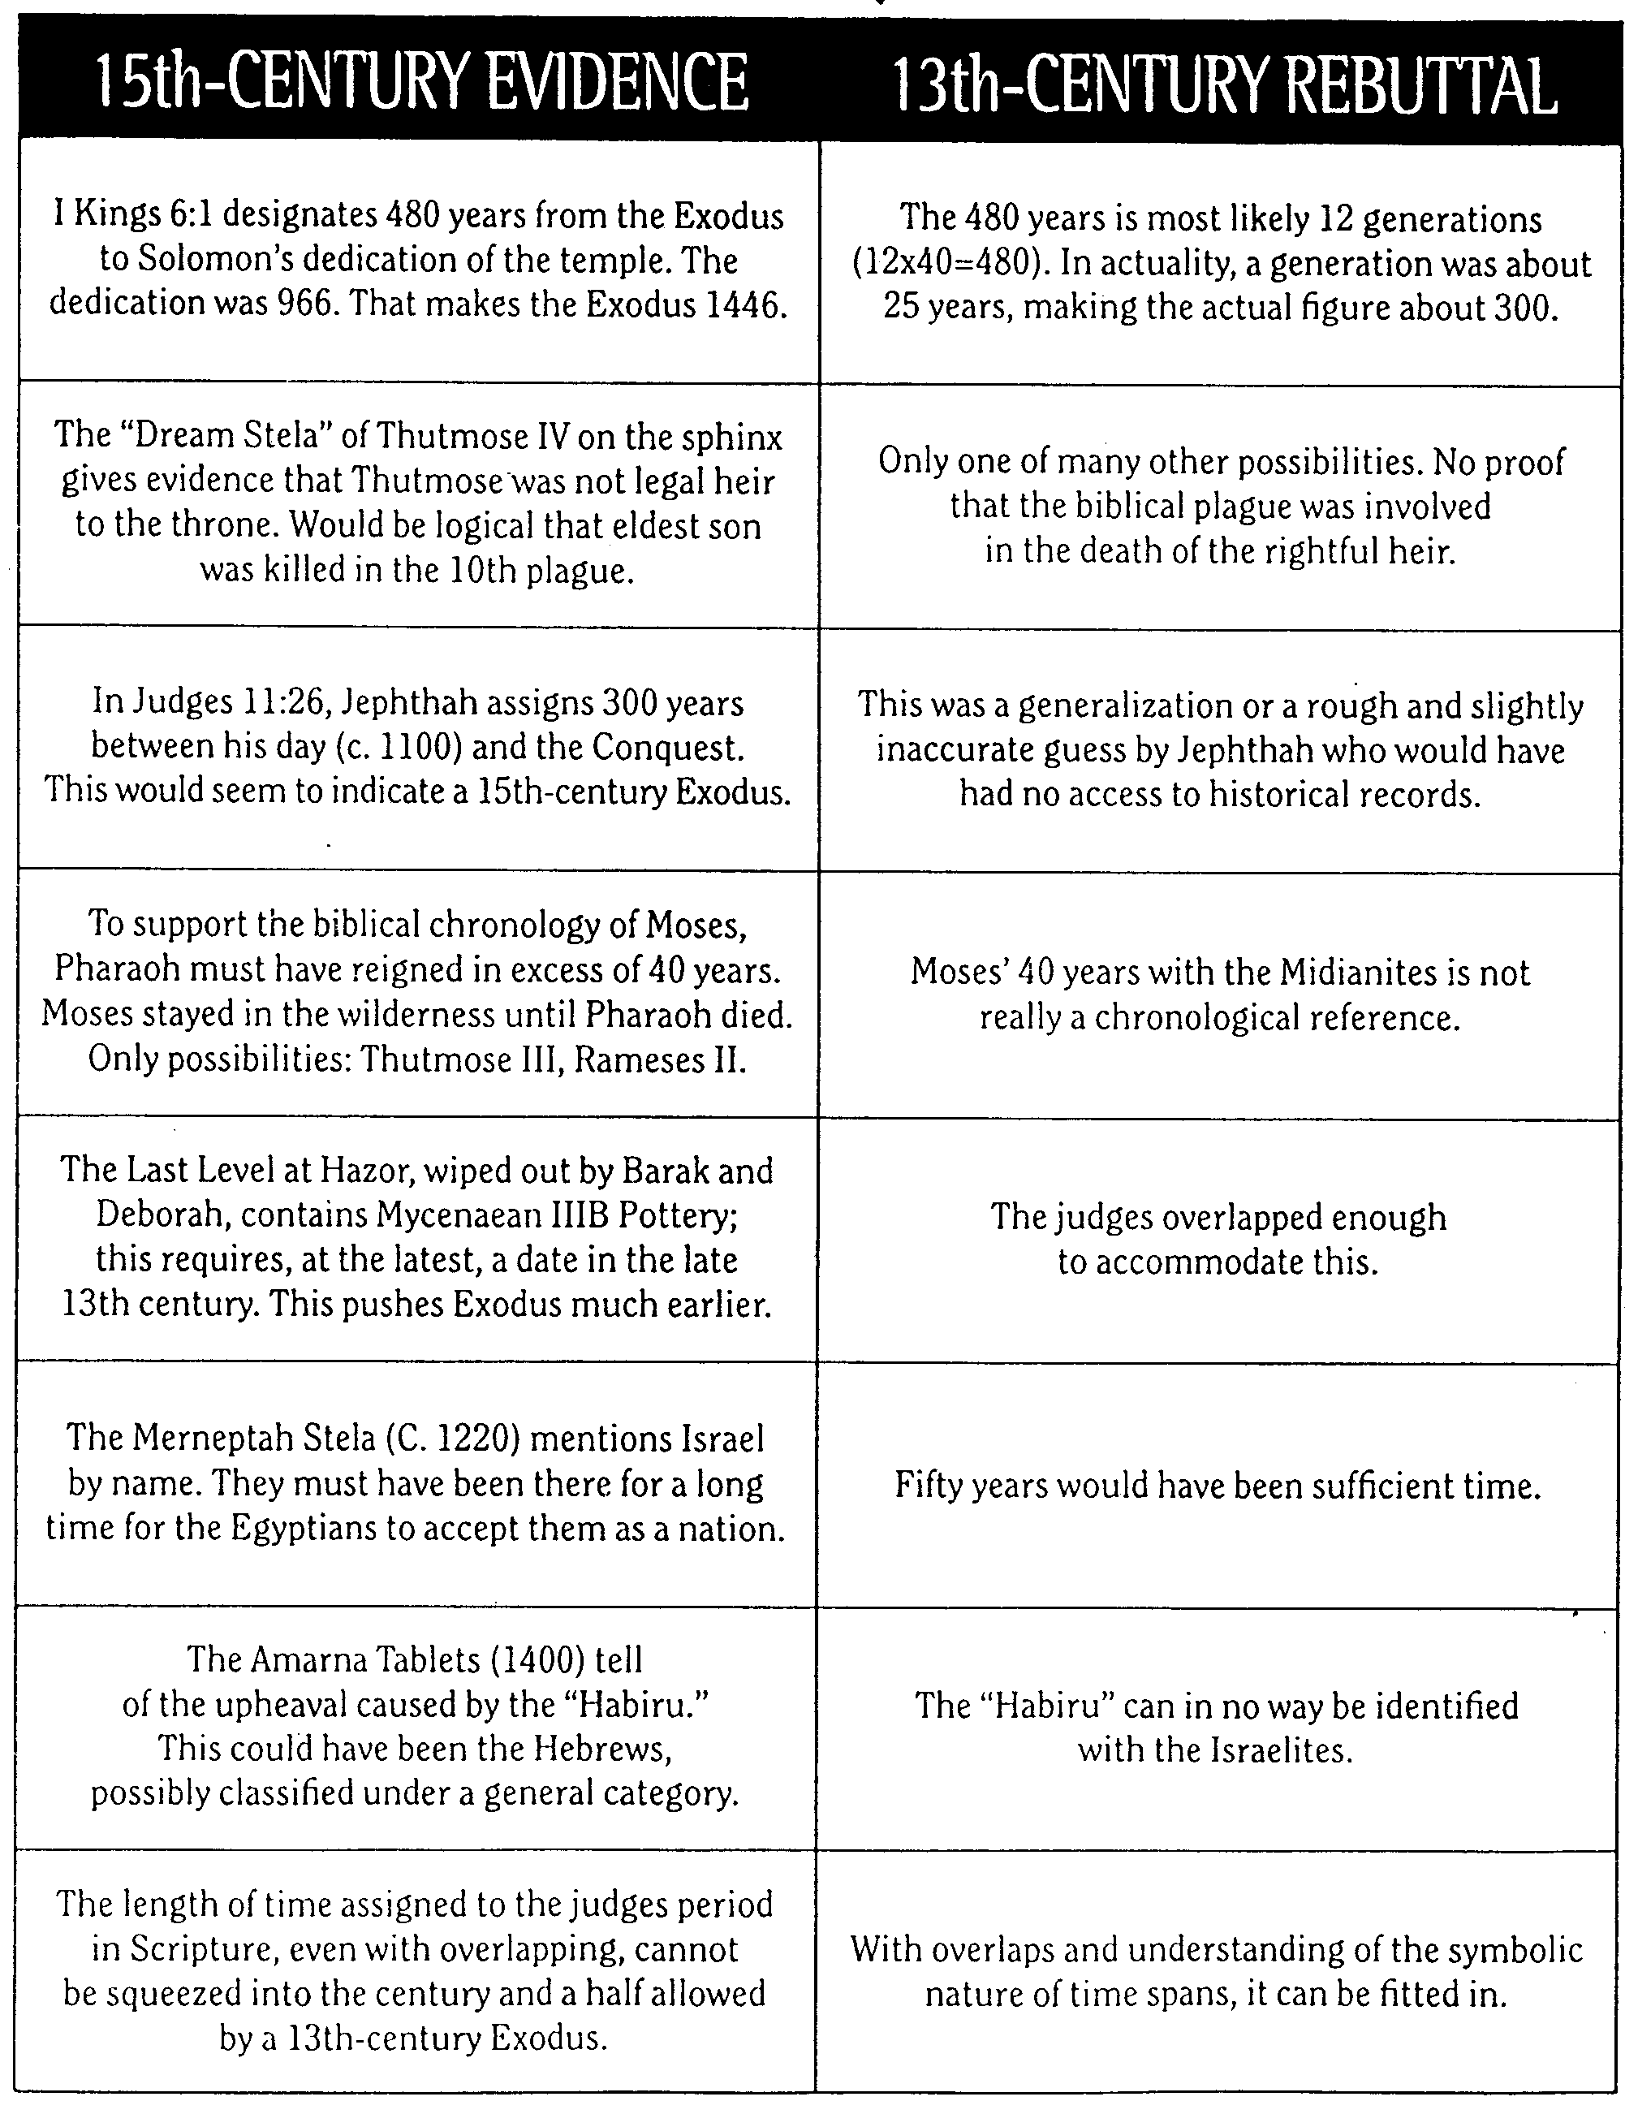
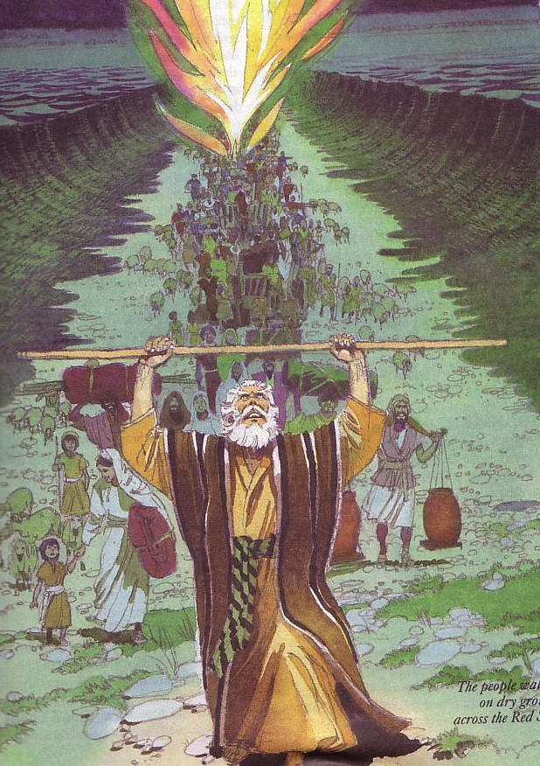
Early Date Evidence
109
John H. Walton, Chronological and Background Charts of the OT,
2d ed., 102-3

Slide 50
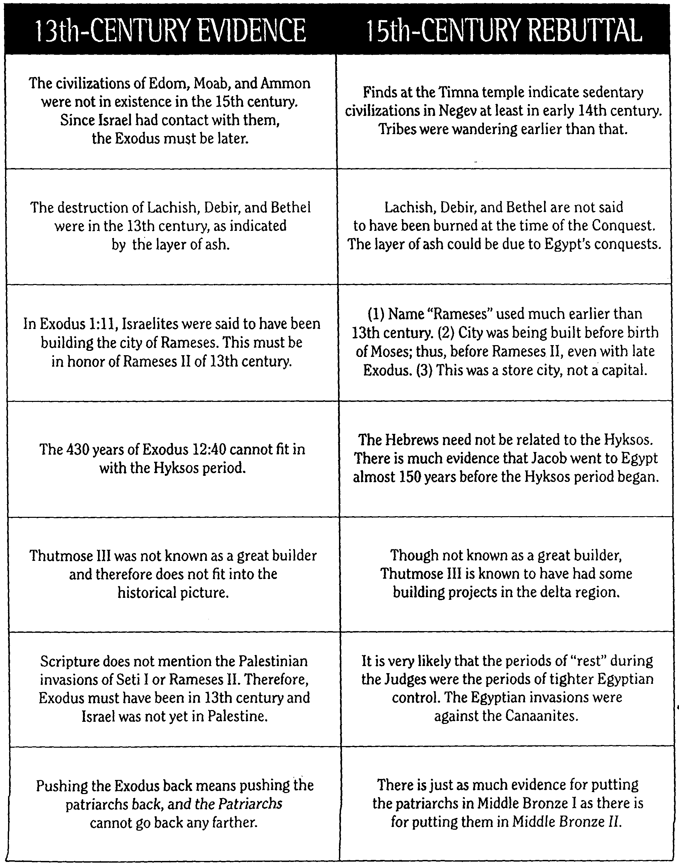
Early Date Responses
十三世纪的证据 | 十五世纪证据
以东，莫阿布，和阿蒙的文明是在15世纪后。以色列与他们接触，所以外流必须在后。 | 以东，莫阿布，和阿蒙的文明是在15世纪后。以色列与他们接触，所以外流必须在后。
。销毁Lachish ， Debir和贝瑟尔是在13世纪，如一层灰。 | Lachish ， Debir和贝瑟尔不说，被烧毁的时候，征服。层灰的原因可能是埃及的征服。
在Exod.埃及记 1：11，犹太人被说已经建立了城市拉美西斯。这必须是13世纪为纪念拉美西斯二世建立的。 | 1 。名称"拉美西斯"使用更早超过13世纪。 2 。市正在建立Exod.生前摩西;从而在拉美西斯二世，即使后期外流。 3 。 这是一储蒇城市，而不是首都。
430多年的Exod.埃及记12:40不能配合Hyksos期 | 希伯来人不必与hyksos有关。有大量证据雅各前往埃及将近150年前开始的Hyksos时期。
图特摩斯三世不是一个伟大的建设者，因此不适合的历史图片。 | 虽然不知道是一个伟大的建设者，图特摩斯三世是众所周知的已经取得了一些建设项目中的三角洲地区。
圣经没有提到巴勒斯坦入侵塞蒂本人或拉美西斯二世。因此，Exod.埃及记必须是在13世纪和以色列还没有在巴勒斯坦。 | 士师时期"休息"期间同于埃及时期的严格控制。埃及入侵反对迦南人。
推进Exod.走回到手段推动始祖回来，始祖不能回去任何更远。 | 有一样的证据，把始祖青铜我中有把他们在中东铜牌二。
110
John H. Walton, Chronological and Background Charts of the OT,
2d ed., 102-3

Slide 51
Conclusion
“After examining the biblical, historical, and archeological evidence, we can see that both the 1446 [early] date and the 1290 [late] date can be supported by impressive arguments, but at this point in the debate the case for the 1446 B.C. Exodus appears to be the stronger one.”
Herbert Wolf, An Introduction to the Old Testament Pentateuch, 148.

Slide 52
Application
Inerrancy
- The Biblical Historicity
- Jewish Festivals and Tradition
God's Faithfulness
Parallel to NT experience in Christ

Slide 53
Additional Information
Source: John D. Currid, A Study Commentary on Exodus (Darlington, England: Evangelical Press, 2000)
Currid subscribes to 13th Century B.C.
Peaceful Migration Theory (to Canaan)
Rural Canaanites

Slide 54
Currid subscribes to 13th Century B.C.
John D. Currid, A Study Commentary on Exodus (Darlington, England: Evangelical Press, 2000), 27
The Egyptian monument first mentioning Israel is a stele of Pharaoh Merneptah (1224-1214 B.C.)
Historical Setting – The 13th Century was a period of upheaval, conducive to Israel's escape from Egypt and conquest of Canaan
God is not in the picture

Slide 55
Peaceful Migration Theory I originated by M. Noth and A. Alt,
John D. Currid, A Study Commentary on Exodus (Darlington, England: Evangelical Press, 2000), 29
“…the increase of settlement in Palestine was due to gradual infiltration of Hebrews into Palestine and a gradual subsistence shift from semi-nomadism to agriculture… no invasion, only a peaceful penetration from outside to inside Palestine.”
This contradicts Genesis 46:31-34, where Israelites settled Palestine as shepherds and were despised in Egypt.

Slide 56
Peaceful Migration Theory II by G. Mendenhall in 1962
John D. Currid, A Study Commentary on Exodus (Darlington, England: Evangelical Press, 2000), 29
“…there occurred a withdrawal by a faction of Palestinian society, namely the peasantry. This peasantry later came to develop into the Hebrews. The catalyst for their moving out of the Canaanite cities was a revolt, or at least a dissatisfaction with the ruling people.”
Hebrews were not an evolution from such peasantry. Genesis 45:17-20 says Pharaoh invited Joseph’s family into Egypt.

Slide 57
Rural Canaanites recently by Finkelstein
John D. Currid, A Study Commentary on Exodus (Darlington, England: Evangelical Press, 2000), 30
“… he believes the change may simply be a shift in the subsistence patterns of the Canaanites. These Canaanites gave up their urban environment and moved out to pastoral villages. Much later, these Canaanites became Israelites.”
Israelites were not an evolution from Canaanites.

Slide 58
Questions & Answers

Slide 59
Black

Slide 60


OT Survey link at BibleStudyDownloads.org
Get this presentation for free!
Notes:
OT Survey (os)

