Slide 1
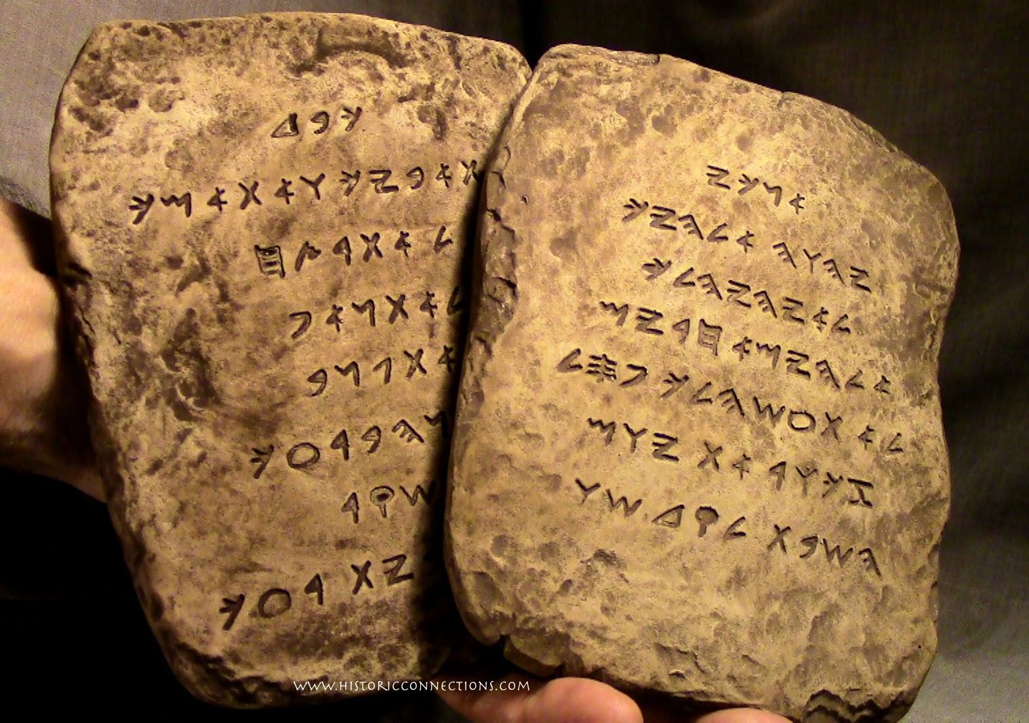
Genesis Authorship
Who Wrote the Pentateuch?
Dr. Rick Griffith • Jordan Evangelical Theological Seminary
BibleStudyDownloads.org

Slide 2
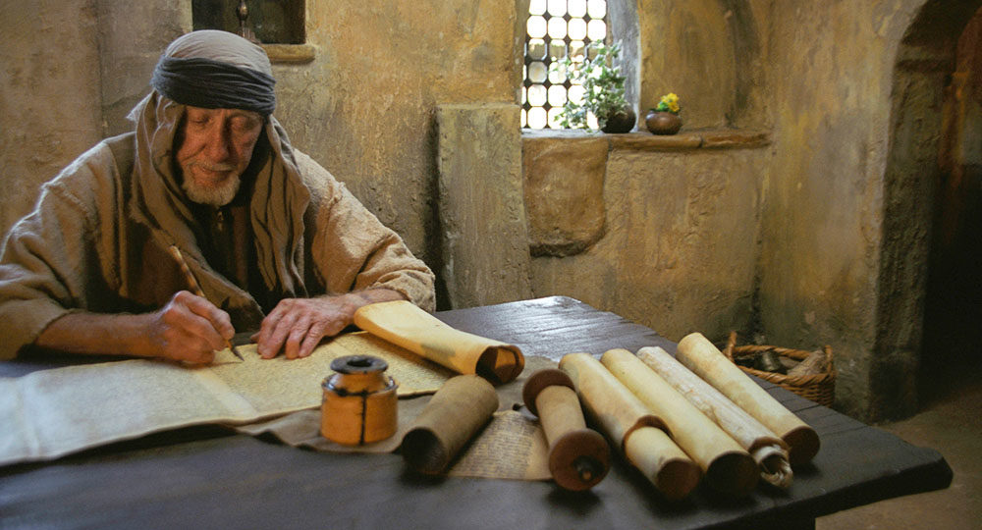
Did Moses wrote Genesis—and the entire Pentateuch?
Critical OT scholarship says no.
Notes:
If we say that the Jewish tradition has argued for Mosaic authorship over the centuries, how would we respond?
Is tradition a fool-proof response?
Are there any Jewish traditions that we do NOT follow? (Most of us do not think as they did that Song of Songs depicts God’s love for Israel.)

Slide 3
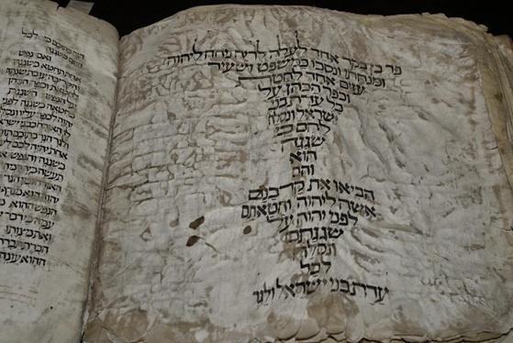
Why do they attack Genesis?
Answer:
It teaches many vital truths!

Slide 4

"In the beginning"

Slide 5
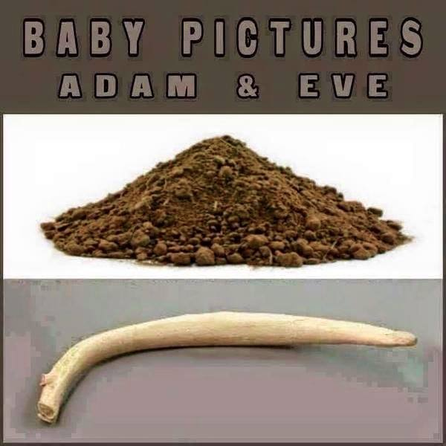
Baby Pictures of Adam & Eve
Notes:
Do you recognize these? Do you know what these are? They are baby pictures!
One woman noted, "Sure God created man before woman, but then again you always make a rough draft before creating the final masterpiece."
(http://cher-homespun.blogspot.sg/2011/06/firewater-friday-sure-god-created-man.html accessed 15 August 2015)

Slide 6
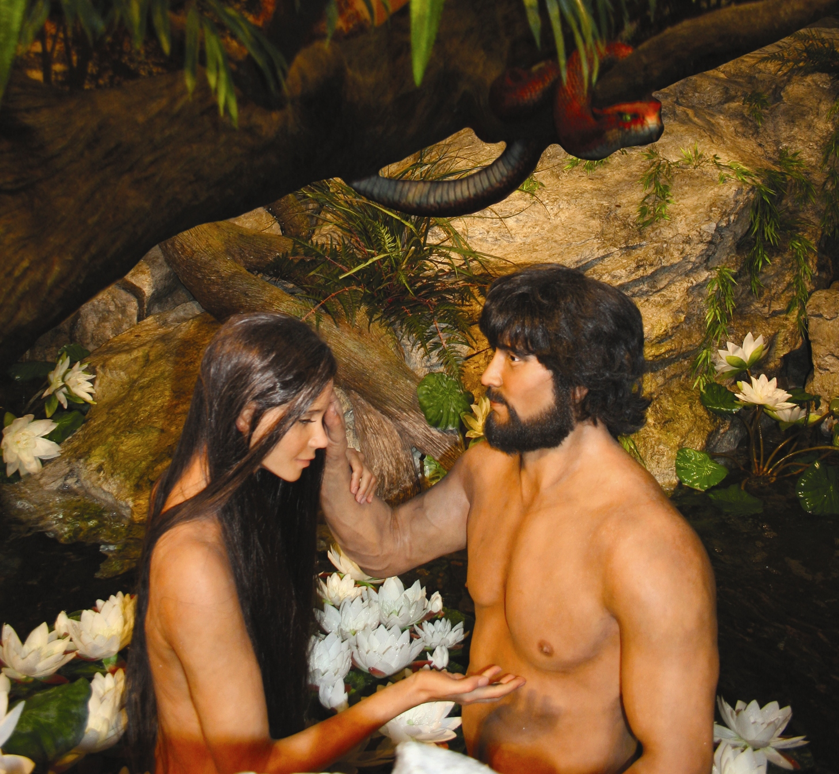
Adam & Eve with the Serpent
Notes:
6

Slide 7

Is Genesis 1–11 Real History?
58
Myths don't teach "deep truths" better than history
A non-historical approach is very subjective
They have vital information otherwise not known
They fit into the book's argument emphasizing election
Events are presented as historical
Science confirms the Genesis 1–11 historical record
Christ affirmed their historicity
Notes:
I believe we have genuine history in the first 11 chapters of the Bible. Why? Seven reasons…
_______
See “What does the original Hebrew text reveal about Genesis 1-11? - Dr. Steve Boyd”
https://www.youtube.com/watch?v=3txmpHQJ520
———————
OC-17-Genesis Authorship-7
OS-01-Gen4-20-slide 23

Slide 8
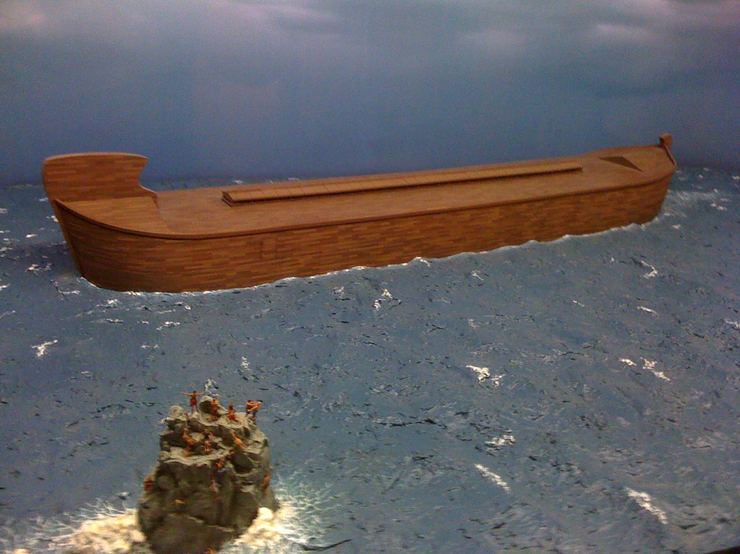
The Ark
Notes:
Noah’s descendants led to his grandson Canaan after the Flood to affirm both God's righteous judgment due to man's sin and his gracious redemption in electing people with whom he can fellowship (6:9–9:29).

Slide 9
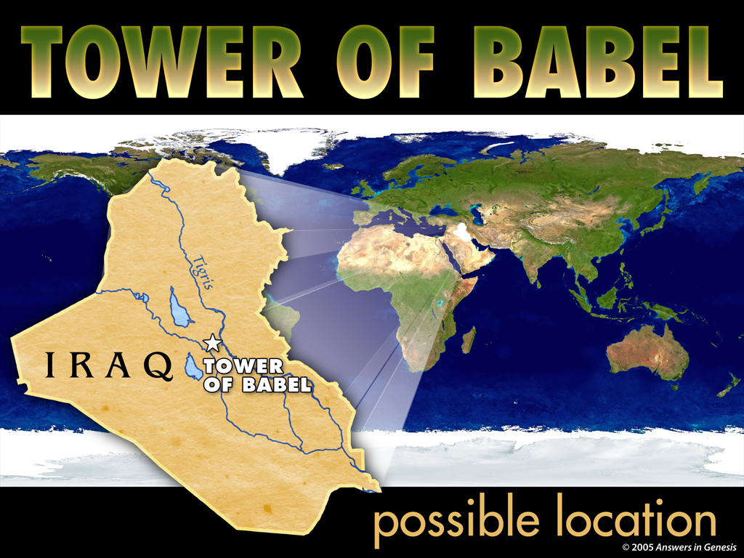
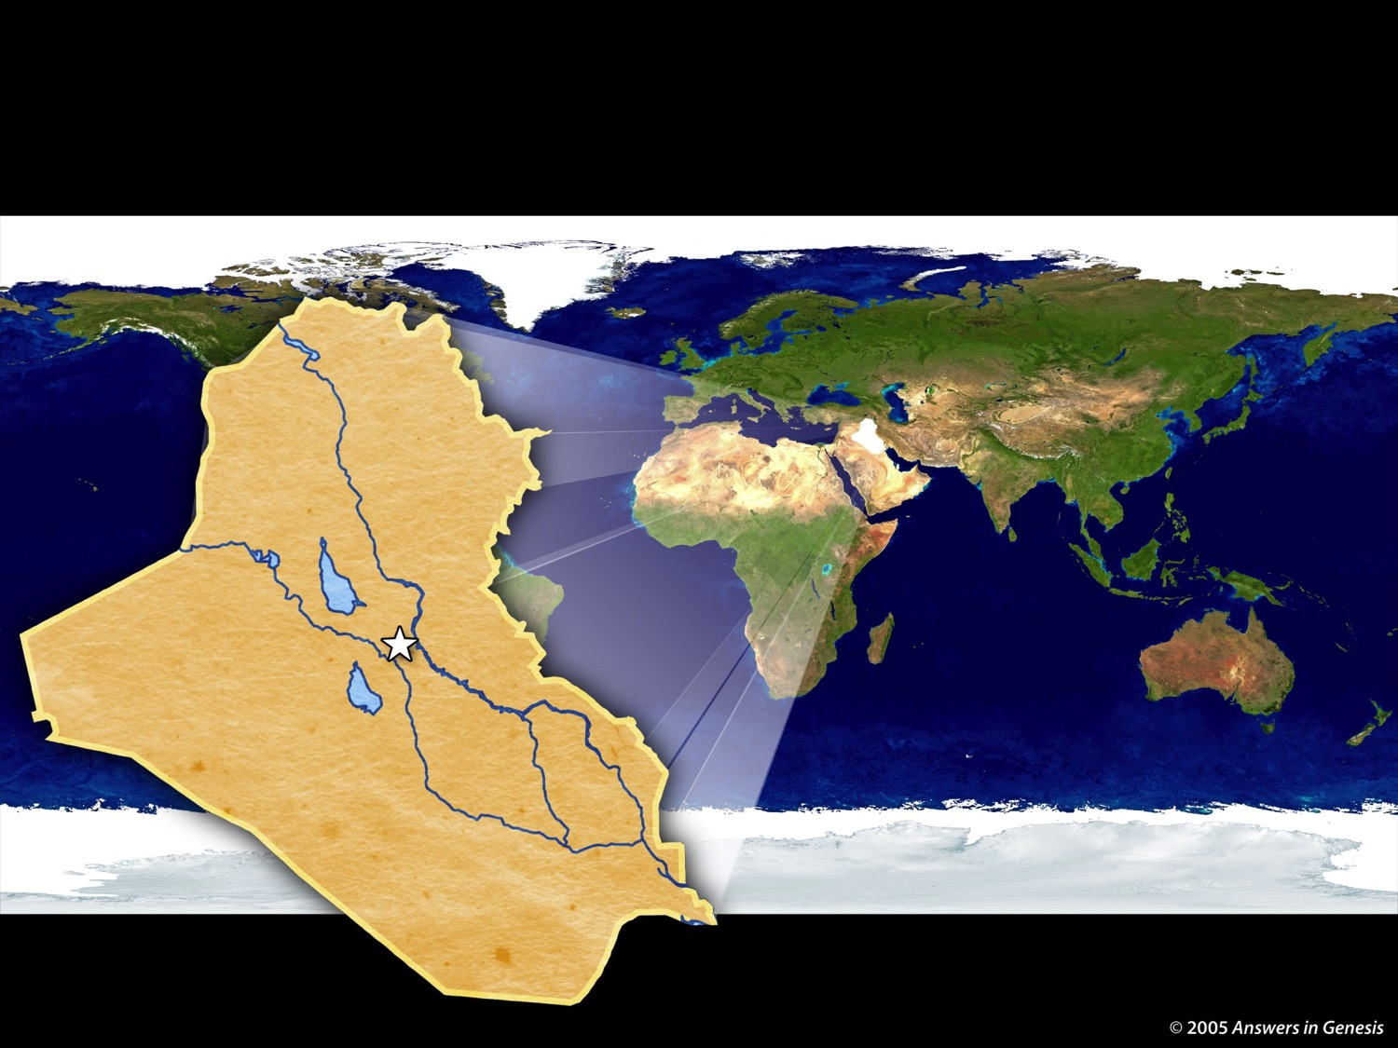
4-07 Tower of Babel Map 02277
TOWER OF BABEL
IRAQ
Tower
of Babel
possible location
Notes:
9
9
Our confusion of languages stems from the city of Babylon where people proudly sought to reach God by their own efforts. God judged them by giving them different languages.

Slide 10

Hello
أهلا
Arabic
Notes:
10
Why do we have so many ways that we greet people today?

Slide 11
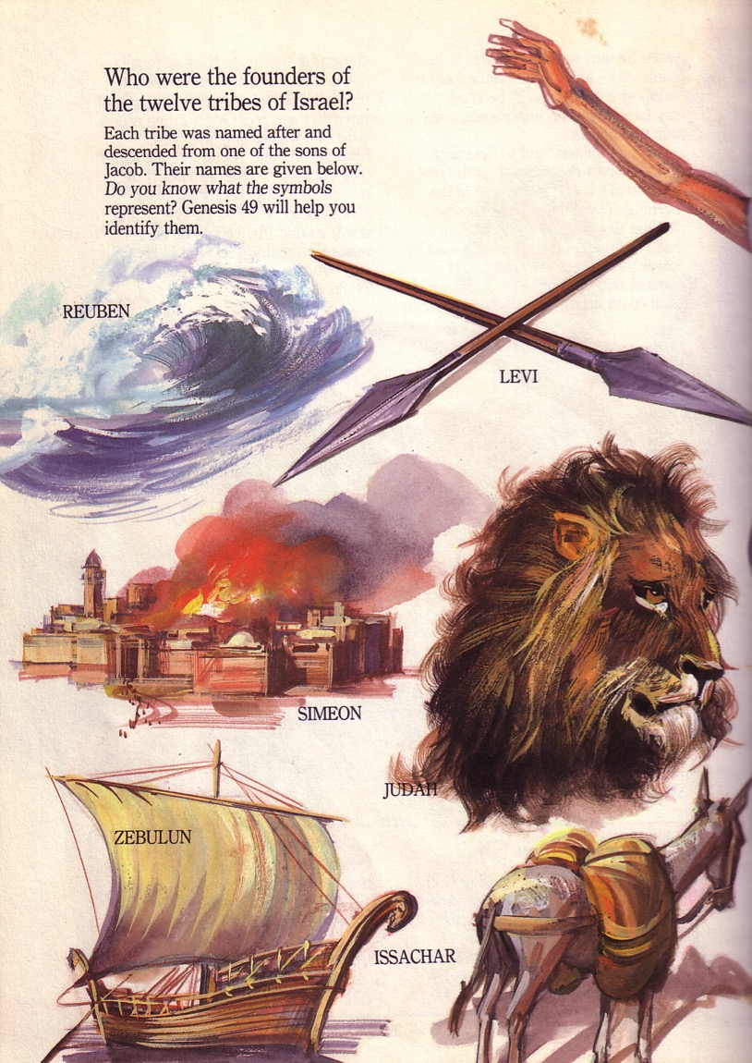
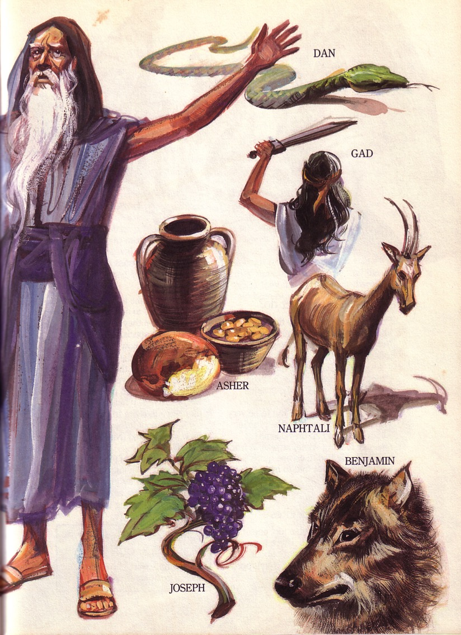
Jacob's Blessing His 12 Sons Was Prophetic (Gen. 49)

Slide 12

Christ Descended from Judah
"Judah, my son, is a young lion that has finished eating its prey. Like a lion he crouches and lies down; like a lioness—who dares to rouse him?
¹⁰The scepter will not depart from Judah, nor the ruler's staff from his descendants, until the coming of the one to whom it belongs, the one whom all nations will honor" (NLT).
Since Jacob's blessing in Genesis 49:9-10, the lion has depicted a king…

Slide 13

God promised believers like us blessings of the Abrahamic Covenant.

Slide 14
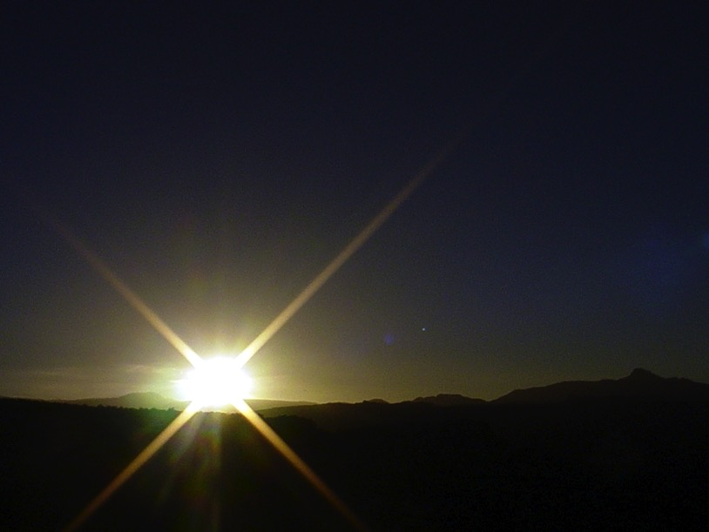
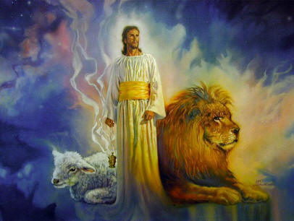
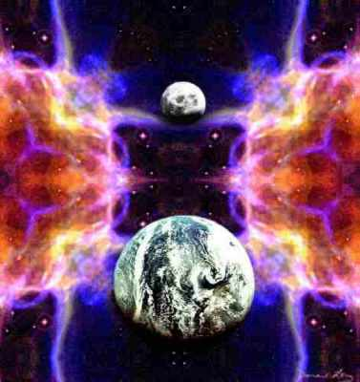
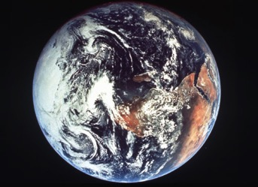
The Bible's Chiasm
446
Repeated Patterns in Reverse Order
Christ's Redemption
Christ's Rule
Man's Rule Lost at Fall
Man's Rule Restored at Millennium
Creation
New Creation
Notes:
We need to know who we are—more accurately, who God says we are—our future identity.
Creation in Genesis 1–2 is repeated In the Restored, New Creation in Rev 21–22
Man was created to rule over the fish, birds, and land animals (Gen. 1:28) but he gave over his rule over to the god of this world, Satan (2 Cor. 4:4)
However, this rule is restored during the 1000-year reign of the saints (Rev. 20:4-6)
But Christ is the central Person of history: both as Lamb (Redeemer) and as Lion (Ruler of all creation in the line of David)

Slide 15
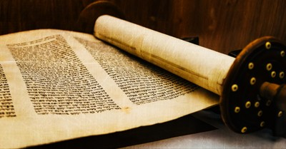
Support for Mosaic Authorship
External
External
Internal
External
External
External

Slide 16
Support for Mosaic Authorship
External
External
External
External
External

Slide 17
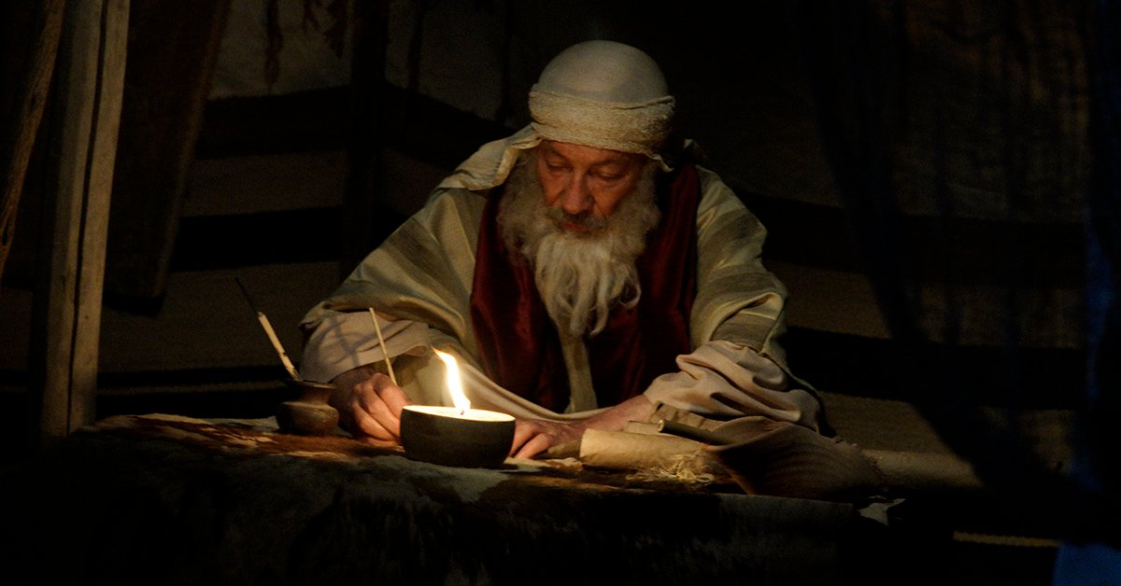
"After the victory, the LORD instructed Moses, 'Write this down on a scroll as a permanent reminder, and read it aloud to Joshua: I will erase the memory of Amalek from under heaven'" (Exodus 17:14 NLT).
Notes:
Although Genesis does not directly specify its author, the other four books of the Pentateuch affirm Mosaic authorship (cf. Exod. 17:14; 24:4, 7; 34:27; Lev. 1:1-2; Num. 33:2; Deut. 1:1; 31:9).

Slide 18
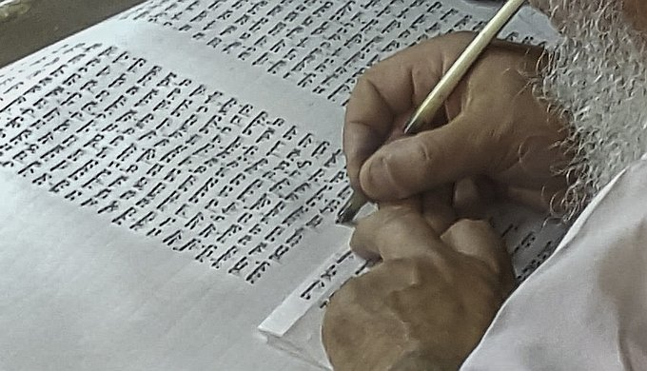
Tradition Supports Moses
Early church
Jerusalem Talmud
Josephus
Except some early Christian theologians

Slide 19
Support for Mosaic Authorship
Internal

Slide 20
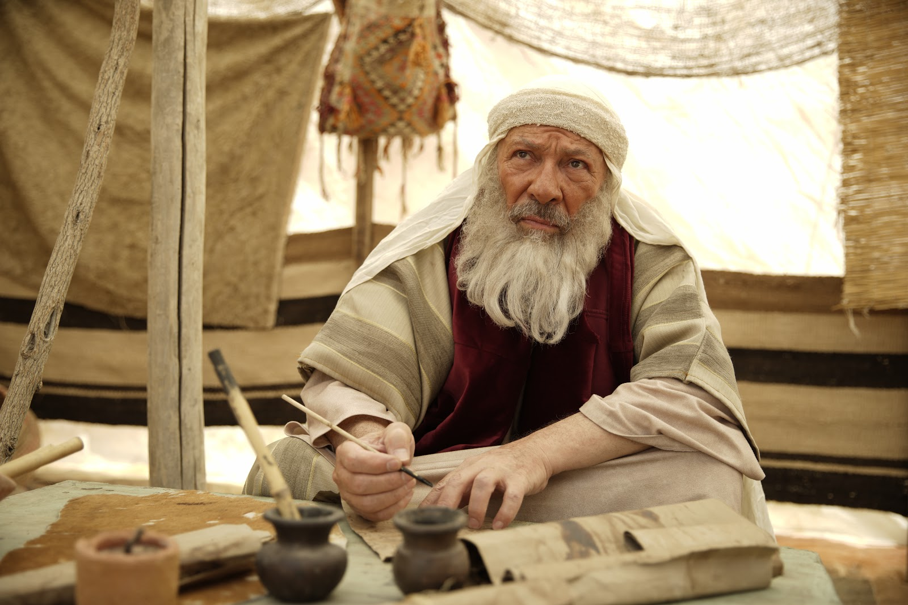
Qualifications of Moses

Slide 21
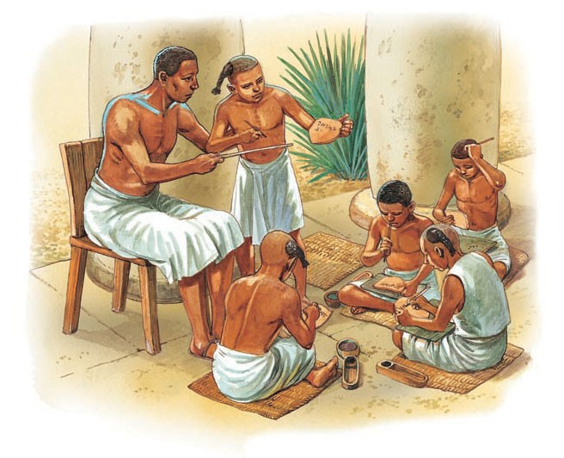
"Moses was educated in all the wisdom of the Egyptians" (Acts 7:22 NLT).

Slide 22
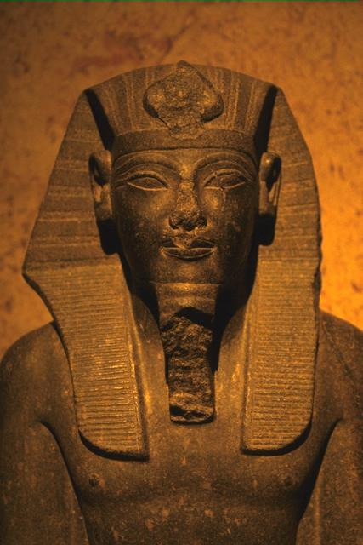
2. Moses to Pre-Kingdom (Egyptians)
155
158
Acts 7:22 Moses was educated in all the wisdom of the Egyptians and was powerful in speech and action.
Education in Ancient Egypt
1. Schools for priests connected with temple and taught magic, medicine and religion.
2. The royal court equipped young men for positions of authority (incl. Moses)
3. Schools sponsored by the royal court trained people for smooth running of government.
4. Subjects taught included arithmetic, geography, poetry and astronomy.

Slide 23
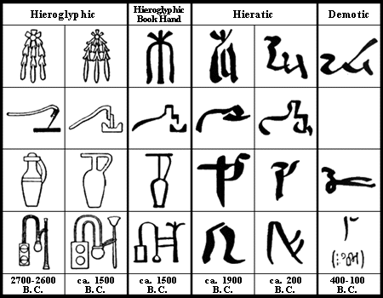
Education in the Time of Moses
155
Moses learned Egyptian hieroglyphics and Canaanite Script in his training.
He was able to record the laws and commandments of God for the people of Israel.
During the wilderness wanderings, no formal system of education existed.
Families were responsible for passing down the trade and skills of their livelihood and the teaching of the laws.

Slide 24
Egyptian Hieroglyphics

Slide 25
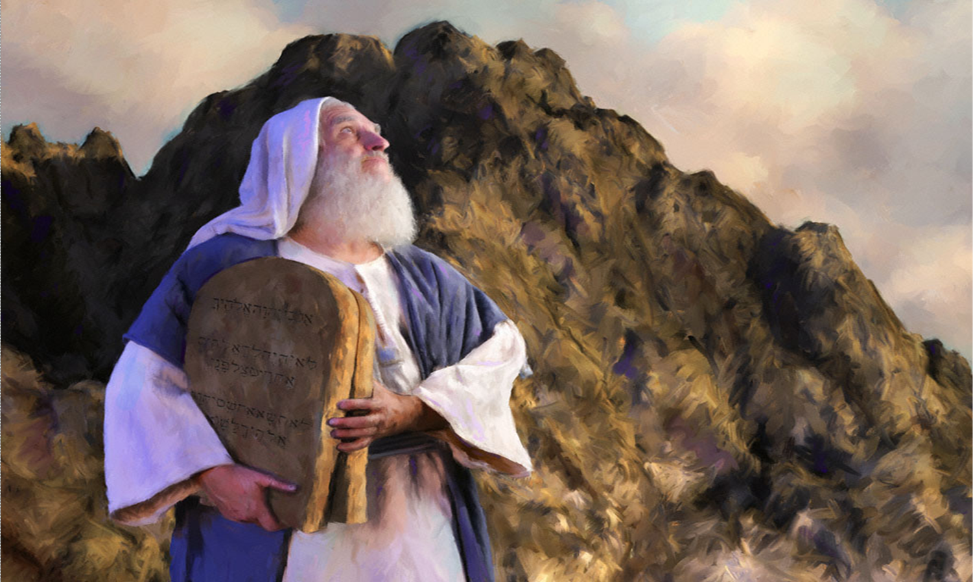
Qualifications of Moses
"We have the witness of the incidental allusions to contemporary events or current issues, to social or political conditions, or to matters of climate or geography. When all such factors are fairly and properly weighed, they lead to this conclusion: the author of these books and his readers must originally have lived in Egypt.”
Gleason Archer, Encyclopedia of Bible Difficulties, 46

Slide 26
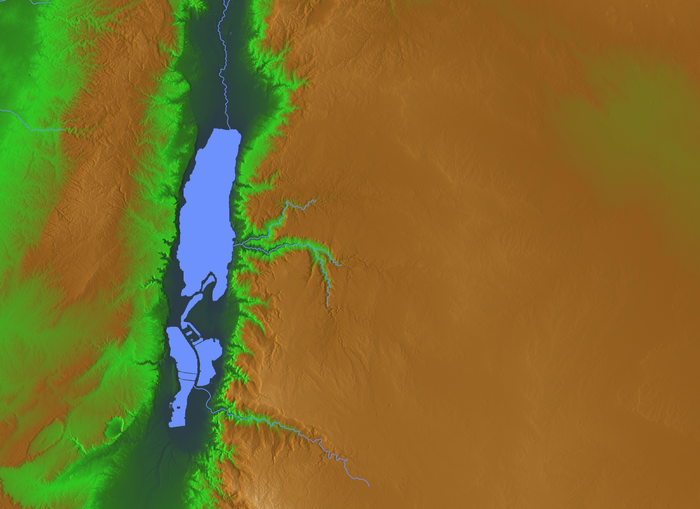
The Choice
Abram & Lot
"Lot took a long look at the fertile plains of the Jordan Valley in the direction of Zoar. The whole area was well watered everywhere, like the garden of the LORD or the beautiful land of Egypt. (This was before the LORD destroyed Sodom and Gomorrah.)" (Gen 13:10 NLT).
• Gomorrah?
• Sodom?
• Zoar
Notes:
Abram gave Lot the choice where to live. As godless people today take the most beautiful places, so it was then.
• From his northly position, Lot looked south all the way to Zoar and saw lush land.
• He chose to live in Sodom—the city from which he could manage his rural flocks.
• Gomorrah lay close by as well—another godless city of sexual perversion.
• For Lot, the choice was easy—so he moved into the fertile plain—though his should was vexed on how he could impact them:
2Pet. 2:7 But God also rescued Lot out of Sodom because he was a righteous man who was sick of the shameful immorality of the wicked people around him. ⁸ Yes, Lot was a righteous man who was tormented in his soul by the wickedness he saw and heard day after day.
• Abram, on the other hand, chose the rocky hill country.

Slide 27
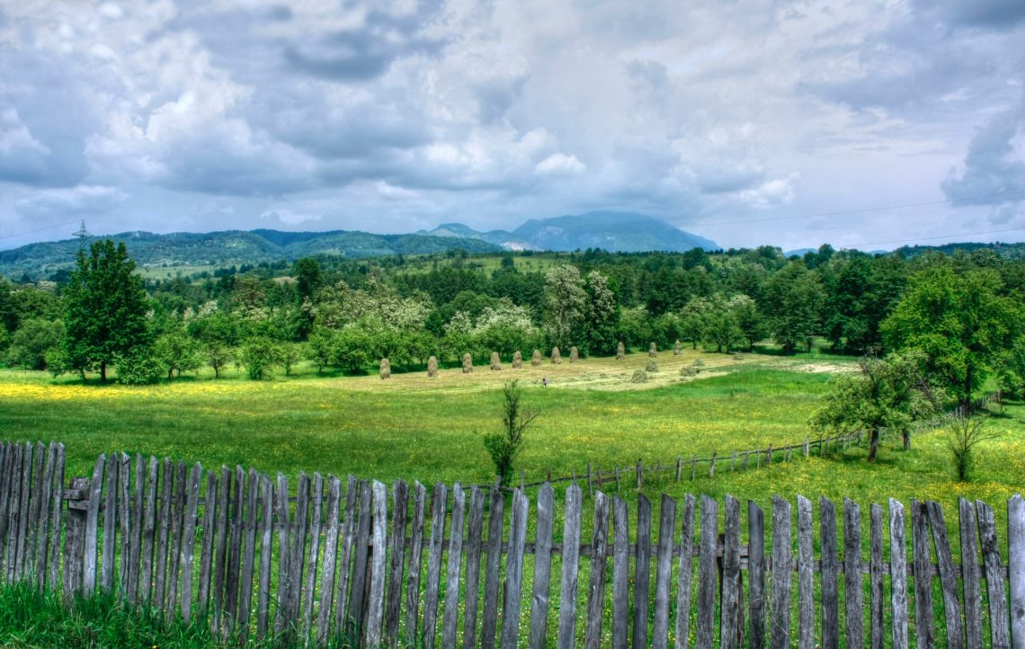
"Lot took a long look at the fertile plains of the Jordan Valley in the direction of Zoar. The whole area was well watered everywhere, like the garden of the LORD or the beautiful land of Egypt. (This was before the LORD destroyed Sodom and Gomorrah.)" (Gen 13:10 NLT).
Notes:
The above description of the Jordan Valley makes sense only to those familiar with Egypt, which limits the original audience to the Exodus generation. This, then, strongly argues for Moses as the author of Genesis.
Similarly, Genesis 41:45 uses the Egyptian spelling (John Davis, A Survey of OT Introduction, 102).

Slide 28
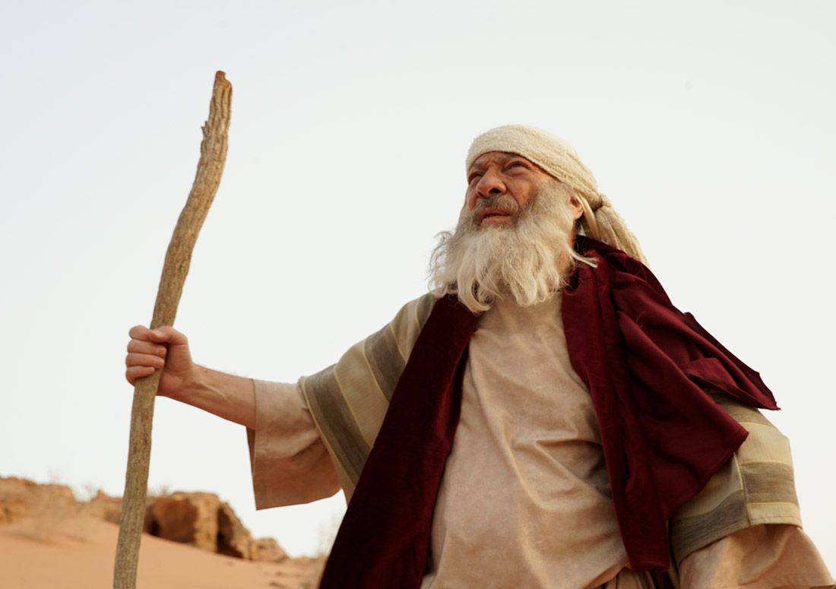
The JEDP Attack on Mosaic Authorship

Slide 29

Genesis Authorship
57
Traditional View: Moses
Critical View: JEDP
J
Jehovah
(LORD)
850 BC
E
Elohim
(God)
750 BC
D
Deuteronomistic
School
550 BC
P
Priestly
Code
450 BC
"Documentary Hypothesis"
Notes:
Since the late 1700s, liberal scholars have often taught that Moses did NOT write Genesis in 1500 BC. Instead, they theorize that Genesis was written gradually in four major stages much later by groups that emphasized the two key names “YHWH” and “God,” followed by others who wrote the book of Deuteronomy, and finally priests finished the book by adding more elements of interest to them, such as sacrifices and passages noting priestly matters.
This JEDP view is VERY speculative and its supporters argue amongst themselves as to which parts of Genesis belong to which stage. Many evangelical scholars have refuted this “Documentary Hypothesis” so many times that even many liberal scholars doubt it today.

Slide 30
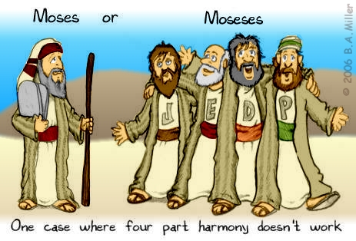
Moses? or Moseses?
One case where four part harmony doesn’t work

Slide 31

JEDP Formulation
OTS 57 Pent 23
Southern
Traditions
Northern
Traditions
J
850 BC
E
750 BC
JE
650 BC
Josiah's Reform Book
D
621 BC
JED
550 BC
Exilic Priestly Materials
P
450 BC
JEDP
400 BC
Encountering the OT, 70

Slide 32

Some Terms...
Lower Criticism: Constructive textual studies.
Higher Criticism: Attacks the inspiration and authenticity of the Scriptures.
Interpretive Problems: Honest differences of opinion exist as to possible answers to problems of scriptural interpretation.

Slide 33
WHO WROTE THE PENTATEUCH?
Some still claim it was…
The Documentary Hypothesis

Slide 34
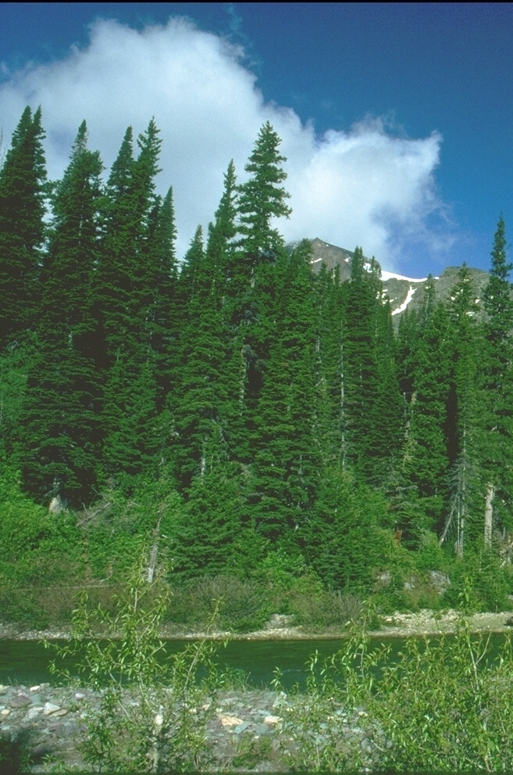
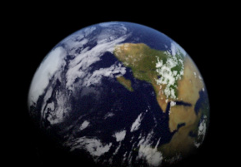
Two Accounts of Creation
Genesis 1
Genesis 2
Use of "God" (Elohim)
Days 1-6
Creation of Everything
"In the beginning…"
Use of "LORD" (Yahweh)
Day 6 alone
Creation of Adam & Eve
"These are the (toledot) generations…" (11x)
Notes:
But the Bible has a much greater view of man. Last week we saw Genesis 1 showed God creating everything in the beginning.
The next chapter zeros in on day 6 where Adam and Eve were created.

Slide 35
Definitions
Document
J
E
J-E
D
P
Jehovah/Yahweh
Elohim
Combined edition
Deuteronomic
Priestly

Slide 36
Contents
Document
J
E
J-E
D
P
Genesis 2
Genesis 1
Genesis-Numbers
Deuteronomy-Kings
Genesis-Numbers

Slide 37
Dates
Document
J
E
J-E
D
P
850 B.C.
750 B.C.
650 B.C.
621 B.C.
570-445 B.C.

Slide 38
Origins
Document
J
E
J-E
D
P
S. Kingdom
N. Kingdom
Unknown redactor
Hilkiah the High Priest
Ezra

Slide 39
Themes
Document
J
E
J-E
D
P
Personal biography, vivid delineation of character, portrays God in human terms

Slide 40
Themes
Document
J
E
J-E
D
P
Objective, deals with concrete particulars such as ritual and sacrifice

Slide 41
Themes
Document
J
E
J-E
D
P
Reflects Josiah's reform efforts to centralize worship in the temple in Jerusalem

Slide 42
Themes
Document
J
E
J-E
D
P
Origins and institutions of the theocracy, genealogies, rituals and sacrifices

Slide 43

The "Sources" of Genesis 6–9
6:5-8
6:9-22
7:1-5
7:6
7:7-8
7:9
J
P
J
P
J
P
7:10
7:11
7:12
7:13-16a
7:16b-17
7:18-21
J
P
J
P
J
P

Slide 44
The "Sources" of Genesis 6–9
7:22-23
7:24-8:2a
8:2b-3a
8:3b-5
8:6-12
8:13a
J
P
J
P
J
P
8:13b
8:14-19
8:20-22
9:1-17
J
P
J
P

Slide 45
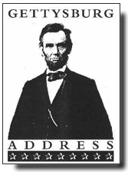
The "Documents" of the Gettysburg Address
THE STIFF-COLLAR COMMENTARY
Applying the insights of higher criticism to the Gettysburg Address, given by Abraham Lincoln on November 19, 1863 at the dedication of the battlefield cemetery.
Rev. LeRoy Koopman, Christianity Today, 1965
Notes:
Here is a bit of a joke on the JEDP idea, as if such ridiculous theories were applied to a writing of our modern times. Enjoy the fun!
Another parody on JEDP was made on the “Jack and Jill” nursery rhyme by Gleason Archer, I believe, but I cannot find it anymore! It hilariously looks at the “sources” for the story.

Slide 46
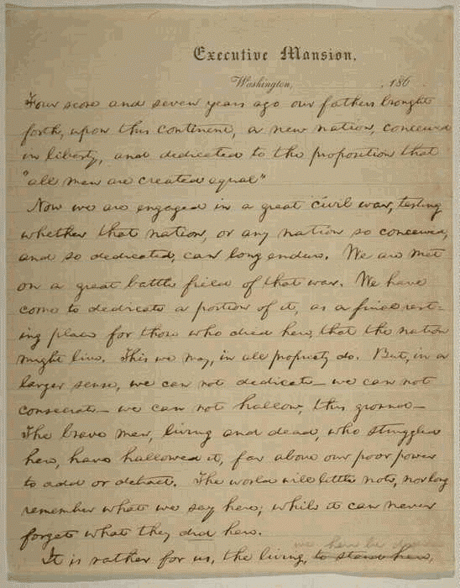
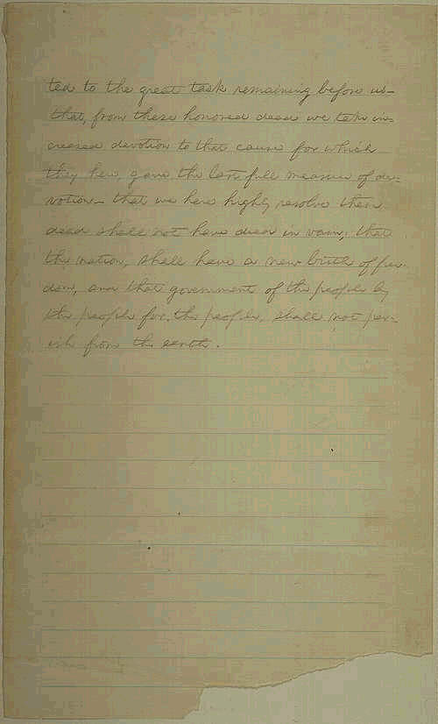
The "Documents" of Gettysburg 2
Four score and seven years ago
This phrase is the work of E, an English professor and friend of Lincoln who had a propensity for utilizing ornate language. Lincoln, simple and uneducated man that he was, would have said, "eighty-seven."

Slide 47
The "Documents" of Gettysburg 3
our fathers brought forth on this continent a new nation, conceived in liberty
"Fathers" is a faulty translation of the original "forefathers." The use of "conceived" points to redactor M, presumably Mary Todd Lincoln, who proofread his speech and added her female bias.

Slide 48
The "Documents" of Gettysburg 4
and dedicated to the proposition that all men are created equal.
"Proposition" - by M. Use of "created" indicates a third author, p¹, a priest accompanying Lincoln on the train to Gettysburg. Since Lincoln was only a layman, it was natural that he should seek clerical help in adding theological terminology. A second priest, p², also added a few glosses.

Slide 49
The "Documents" of Gettysburg 5
Now we are engaged in a great civil war, testing whether that nation
"That nation” — some scholars see here the work of one foreign-born (C?). An American would have said "this nation."

Slide 50
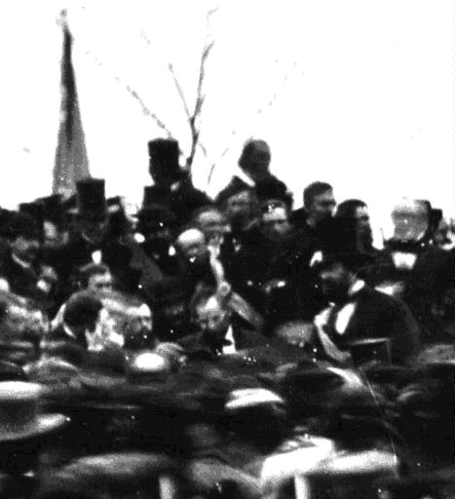
The "Documents" of Gettysburg 6
or any nation so conceived and so dedicated can long endure.
"Conceived" -- M's favorite interjection.

Slide 51
JEDP Problems
OTS 57 Pent 23
Violates internal self-claims of Pentateuch
Anti-supernatural bias
Based on inaccurate 19th century evolution
Lack of unanimity among scholars
Subjective with circular reasoning
No manuscript evidence
Ignores ANE archaeological evidence
Rejects NT evidence
Encountering the OT, 70

Slide 52

Editorial Activity
Notes:
The NT affirms that the Pentateuch was written by Moses. But this does not mean that there existed no updating of the text to make it more understandable to those who read it later.

Slide 53
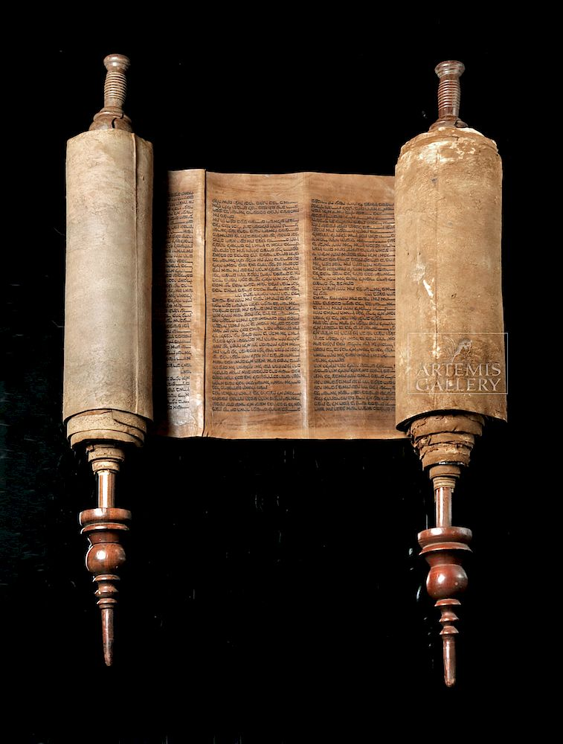
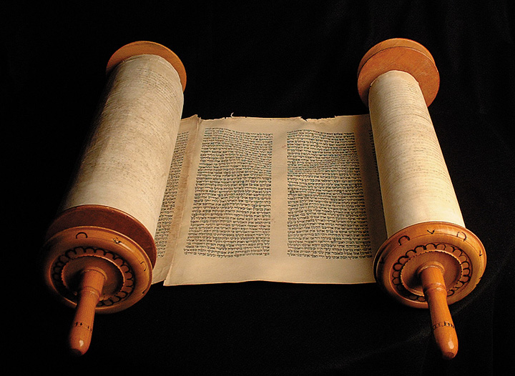
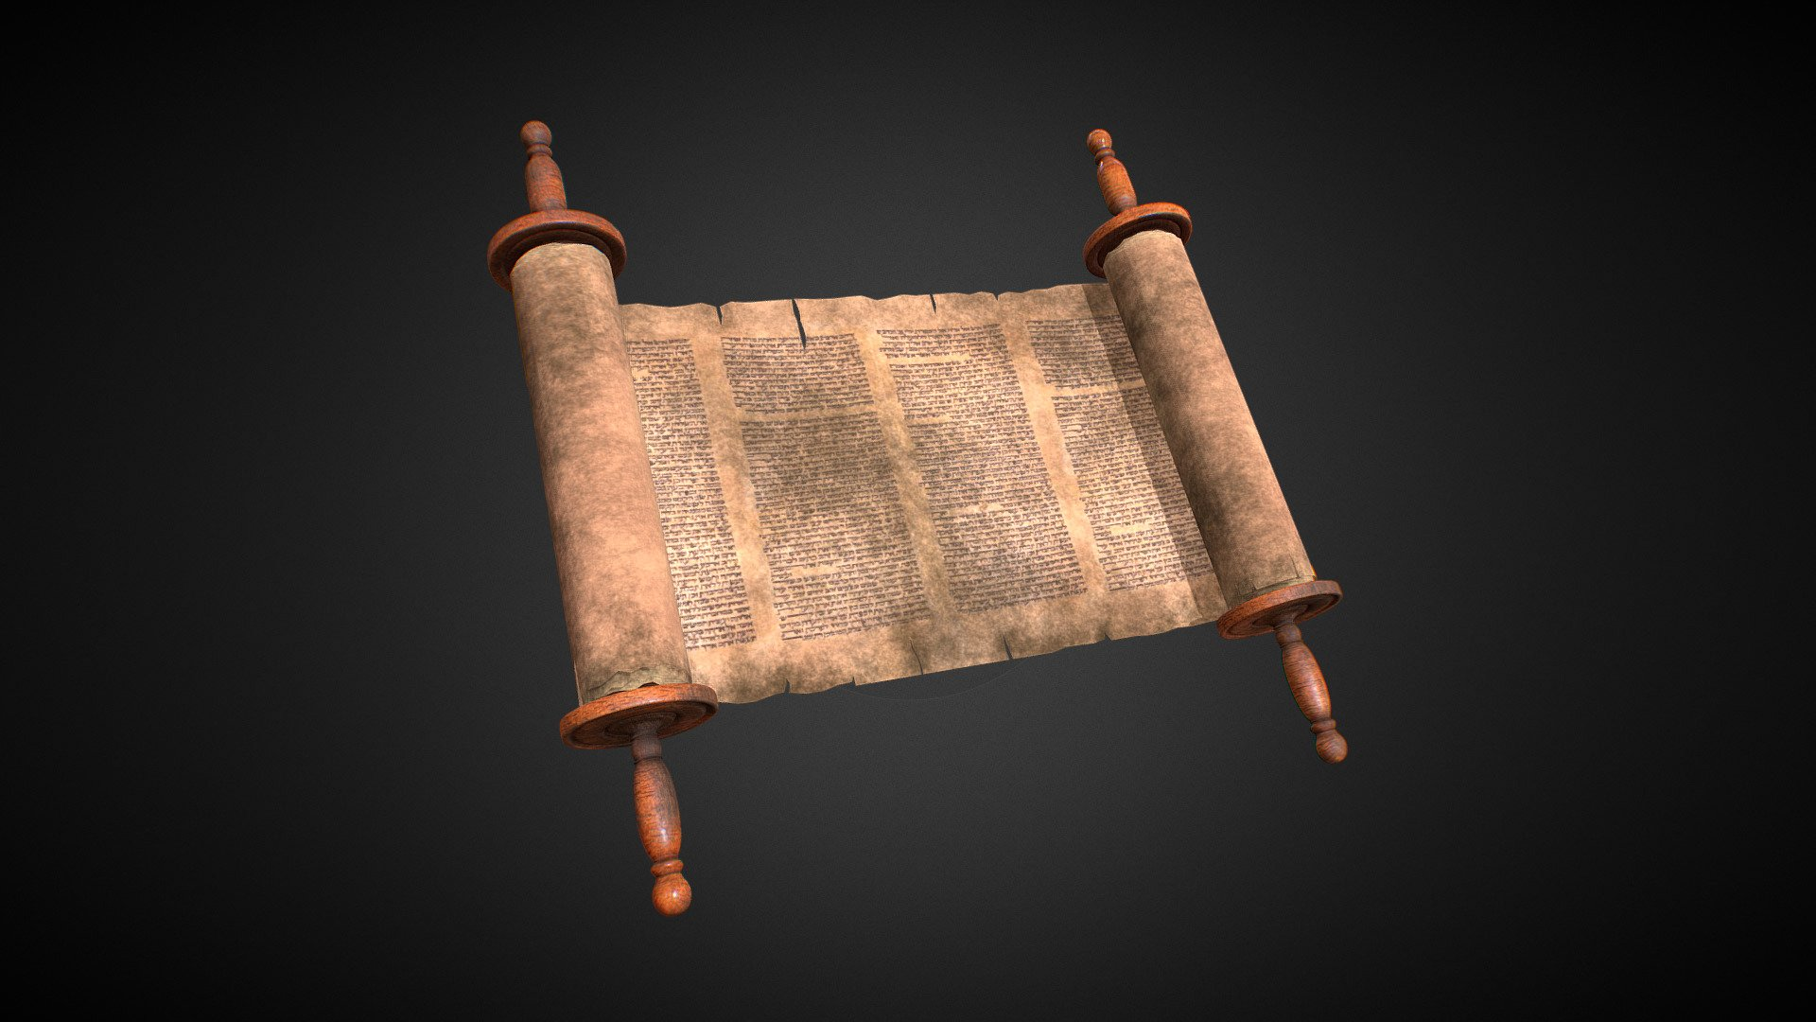
Hebrew Consistency
Why does the whole OT show a consistent use of Hebrew so that the Pentateuch does not look like it was written 1000 years before Malachi?
Pentateuch
1400 BC
Poetics
1000 BC
Malachi
400 BC
Notes:
The OT does have vocabulary development, such as the use of the term “the Jews” only used in the post-exilic era—where also “Yahweh” is not used.
But there still appears to be a smoothing of language?

Slide 54
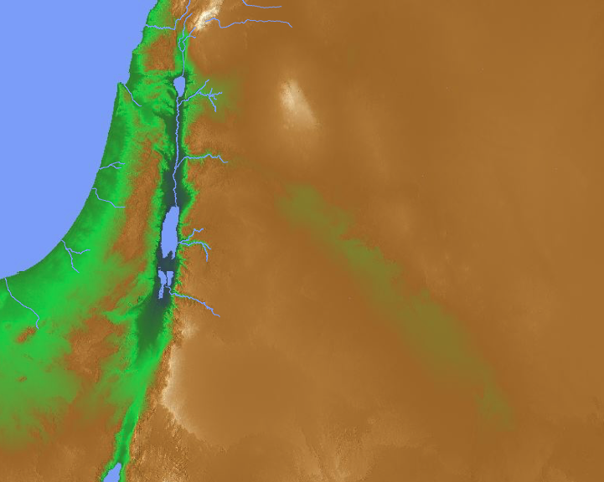
Dan
The Land of Canaan (2000 BC)
5 Kings
Salem
Abraham
Mamre
Sodom
“When Abram heard that his relative had been taken captive, he called out the 318 trained men born in his household and went in pursuit as far as Dan” (Genesis 14:14 NIV).
Kadesh
El Paran
Notes:
Basically, we have four eastern kings against five Jordanian kings (1-7).
They fought at the south end of the Dead Sea, near Sodom where Lot lived.
The five Jordanian kings lost the battle and Lot was carried far north (8-12).
Then Abraham rescued Lot, the goods, women and captives at Dan and Hobah (13-16).
How could Abraham defeat these four powerful kings with only 318 men (14-16)?
Humanly speaking, he had his allies Aner, Eshcol, and Mamre (14:13, 24)—plus he had the advantage of a surprise night attack. However, Abraham was quick to give God the full credit as he agreed with Melchizedek's praise to God for granting him the victory (14:20).
“When Abram heard that his relative had been taken captive, he called out the 318 trained men born in his household and went in pursuit as far as Dan” (Gen 14:14 NIV).
Of course, it was not called Dan until over 500 years later, but this is an example of an inspired updating of the book of Genesis to make it clear where Abram met them. "Dan was then named Leshem (Josh. 19:47) or Laish (Judges 18:29)” (Ross, “Genesis,” in BKC, 1:53).
_____________
OS-01-Gen4-20-slide 244
OC-17-Gen Author-30

Slide 55
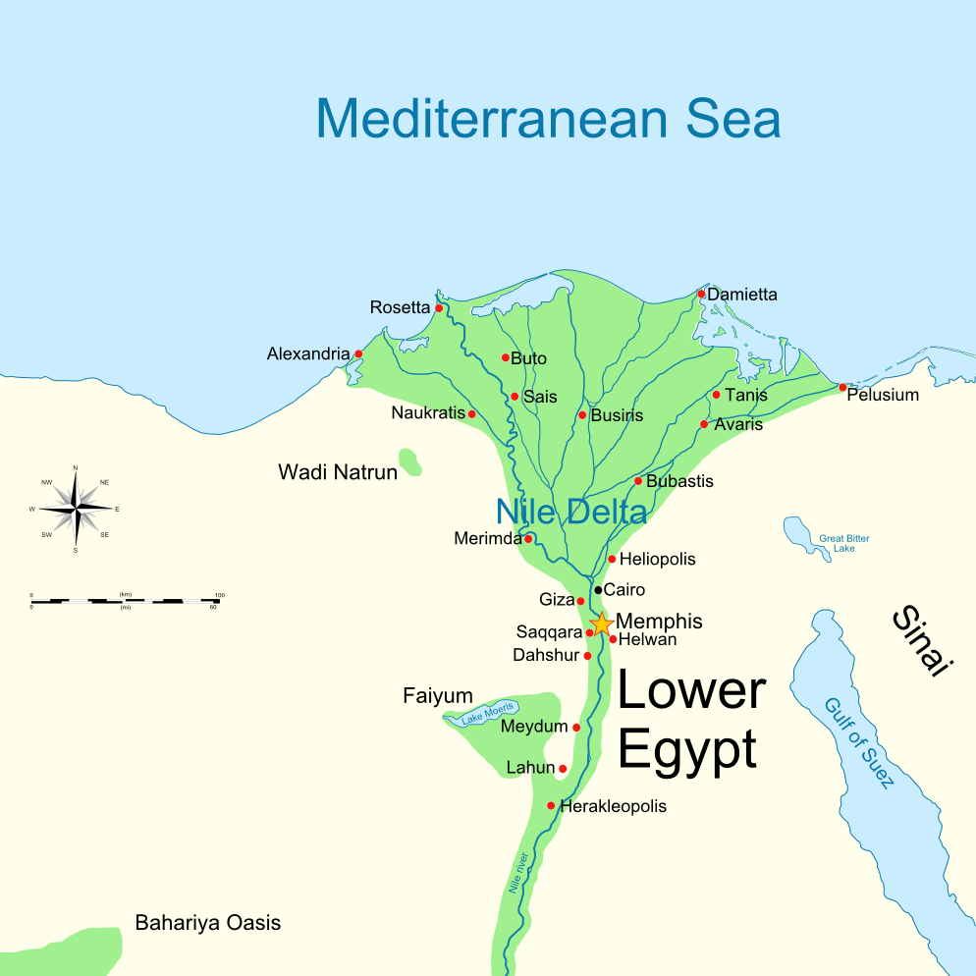
City of Avaris
“Egyptians… forced them to build the cities of Pithom and Rameses as supply centers for the king” (Exod 1:11).
Notes:
The enslaved Israelites built the city of Rameses (Exod 1:11), but Rameses did not live until more than a century later. Probably the best explanation of this is that they built the city of Avaris, upon which the city of Rameses was later built. This is akin to someone in 200 BC writing that the Greeks lived in the Hellenistic city Philadelphia but a later hand changing it to Amman to prevent confusion by those who do not know that the modern Amman used to be called Philadelphia.
__________________
OC-17-Genesis Authorship-55
02-Exodus-137 on Exodus 12

Slide 56
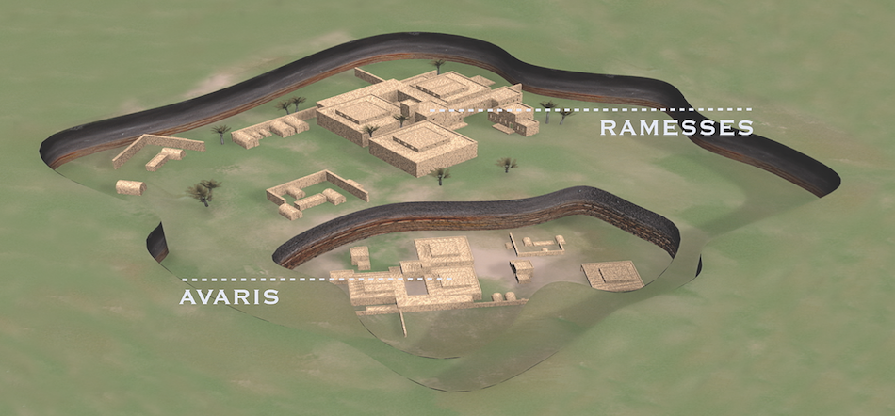
City of Avaris
Beneath Rameses
"Patterns of Evidence" is a film by Timothy Mahoney (Thinking Man Films, 2015) that presents amazing archaeological evidence for the Early Exodus discovered by Dr. David Rohl, an agnostic Egyptologist.
Notes:
In reality, Israelites built Avaris. However, someone under the inspiration of the Holy Spirit changed Avaris to Rameses in order to prevent confusion about the name of the city.
__________________
OC-17-Genesis Authorship-56
02-Exodus-138 on Exodus 12

Slide 57
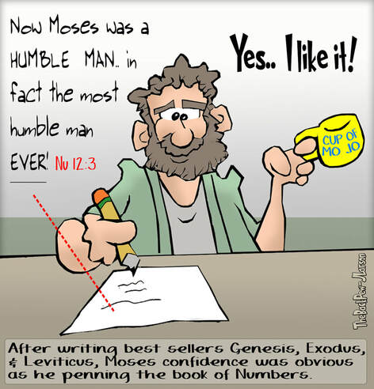
Now Moses was very humble— more humble than any other person on earth. —Numbers 12:3
Yes… I like it!
After writing best sellers Genesis, Exodus, & Leviticus, Moses’s confidence was obvious as he penned the book of Numbers.

Slide 58
Unlikely Statements
Numbers 12:3 has an interesting parenthesis:
“(Now Moses was very humble— more humble than any other person on earth.)”
How would you explain this as written by Moses?
This seems to be an addition since for Moses to say it would be self-contradictory.

Slide 59
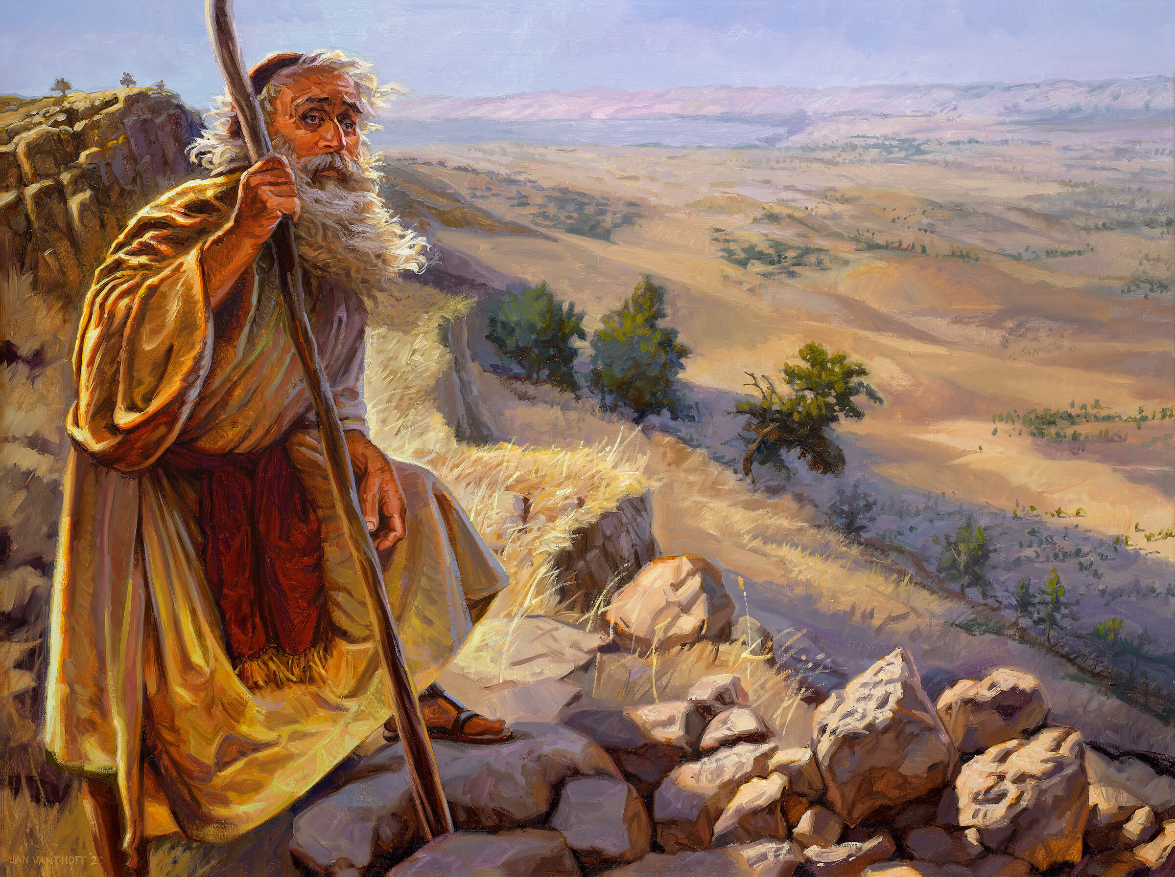
The Death of Moses (Deut 34:1, 5)
"Then Moses went up to Mount Nebo from the plains of Moab and climbed Pisgah Peak, which is across from Jericho. And the LORD showed him the whole land… So Moses, the servant of the LORD, died there in the land of Moab, just as the LORD had said."
Notes:
Who wrote this—did Moses? Not unless he wrote it prophetically and the ink on Deuteronomy was hardly dry before his final mountain climbing!
The Hebrew tradition is that Joshua penned this final chapter of Deuteronomy.

Slide 60
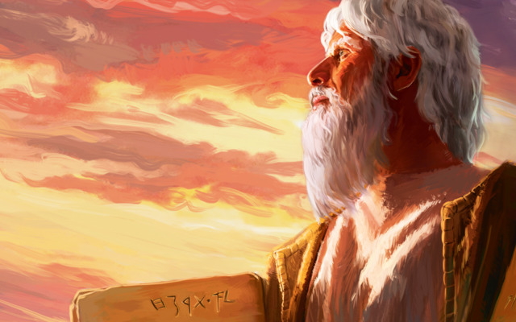
Conclusion
While others may have done some editorial work under the inspiration of the Holy Spirit, no substantial evidence exists that Moses did not compose the Pentateuch. To think otherwise is to contradict the clear testimony of both tradition and Scripture.

Slide 61

Supplements

Slide 62
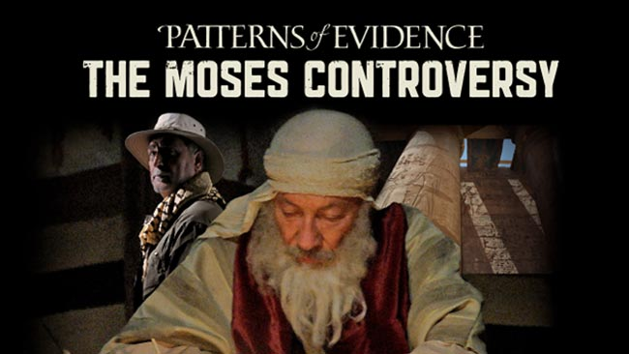
A recent movie supporting authorship by Moses…

Slide 63
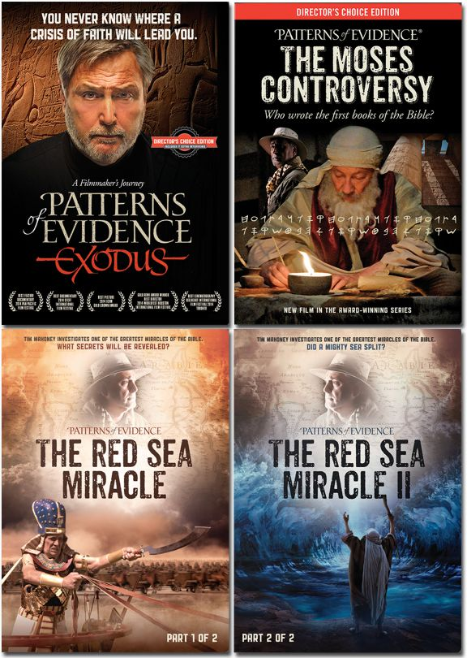
Recent Movies Supporting Moses

Slide 64
Problems of the Documentary Hypothesis
57
1. Anti-supernaturalism bias
2. Circular reasoning: posits its conclusion
"There can be no such thing as supernatural revelation; therefore, the Bible is not a supernatural revelation."

Slide 65
Problems of the Documentary Hypothesis
57
3. Subjectivity in applying the theory results in conflicting explanations
4. Ignores stylistic variation within an author

Slide 66
Evidence for Mosaic Authorship
57
The author of Genesis and Exodus shows a thorough acquaintance with Egypt.
Eyewitness details are included in the exodus account.
There is a unity of arrangement underlying the entire Pentateuch.
Gleason Archer, A Survey of Old Testament Introduction

Slide 67
Evidence for Mosaic Authorship
57
The Pentateuch itself testifies to Moses as the author (Exodus 17:14; 24:4; Deut. 31:9).
Other OT books refer to Moses as the author (Josh. 1:7-8; Neh. 1:7-8)
The NT identifies Moses as the author (John 5:46-47; Rom. 10:5)
Gleason Archer, A Survey of Old Testament Introduction

Slide 68
Black

Slide 69


Critical Studies of the OT link at BibleStudyDownloads.org
Get this presentation and script for free!

