Slide 1
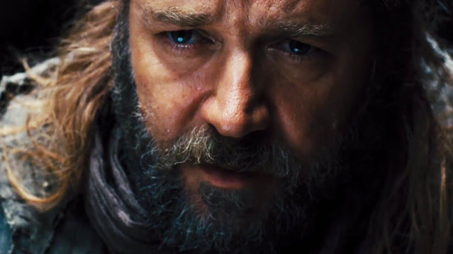
Noah: Blockbuster or Bible?
Genesis 6–9
Dr. Rick Griffith • Singapore Bible College • BibleStudyDownloads.org

Slide 2
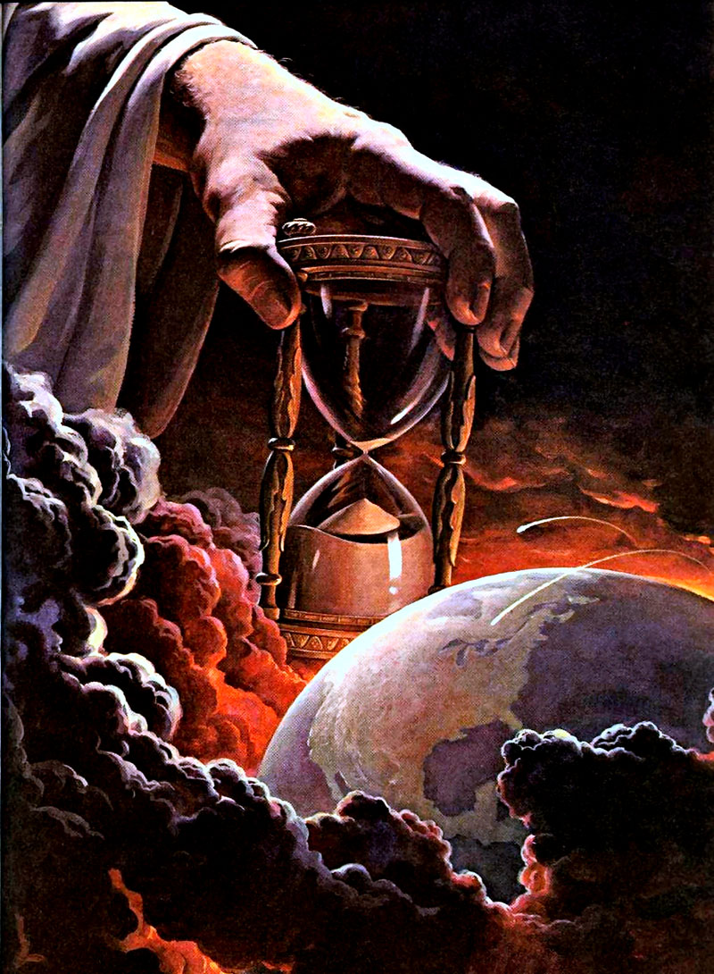
What right does God have to judge?

Slide 3
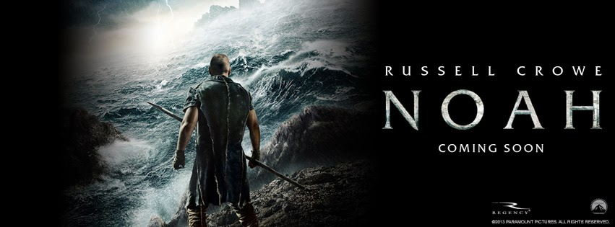

Noah
Shadowed

Slide 4

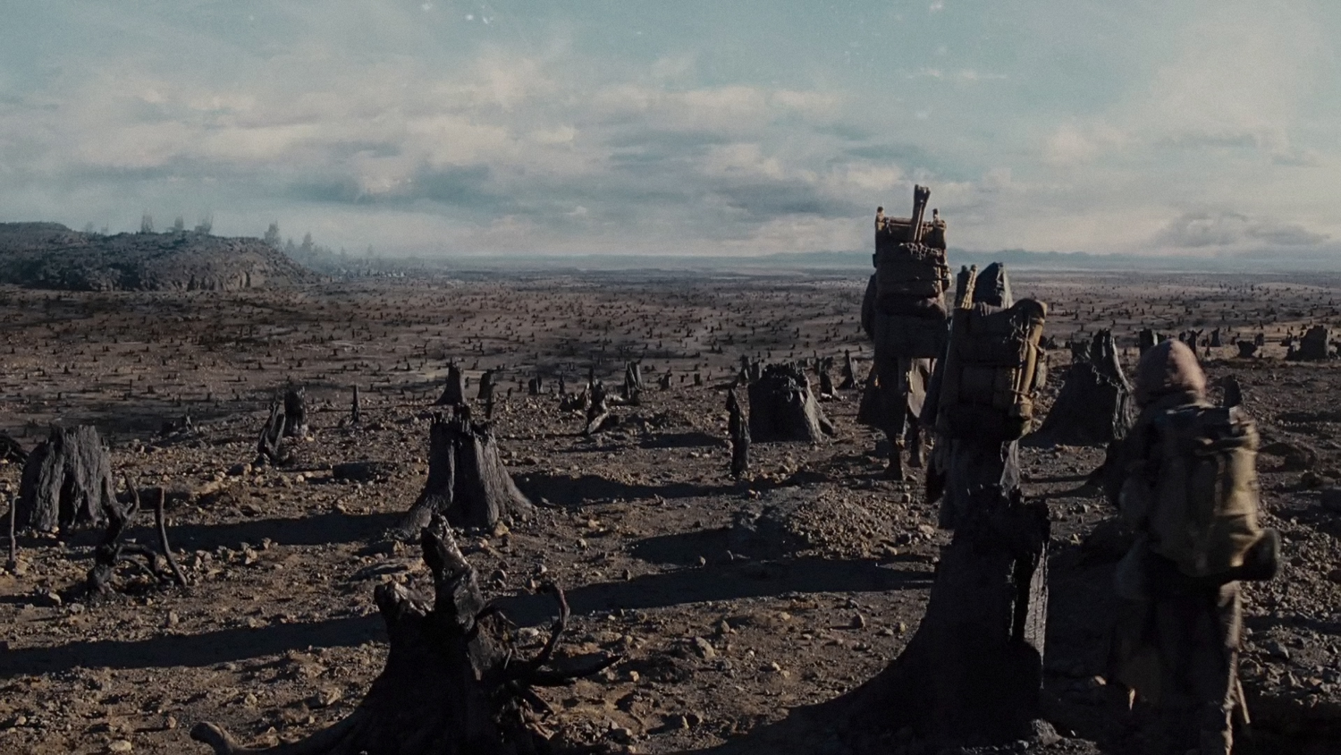
Noah
The earth must be destroyed due to man not taking care of the environment!

Slide 5
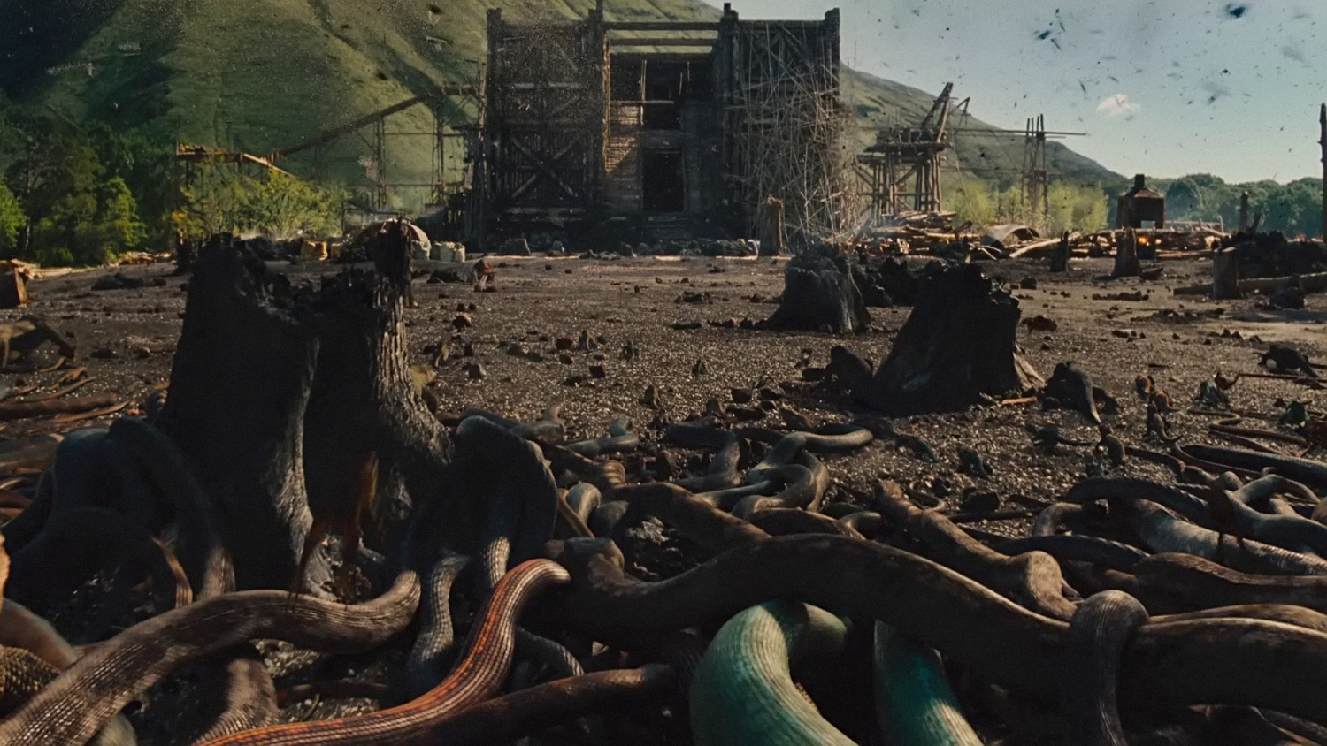
Noah
Snake infestation

Slide 6
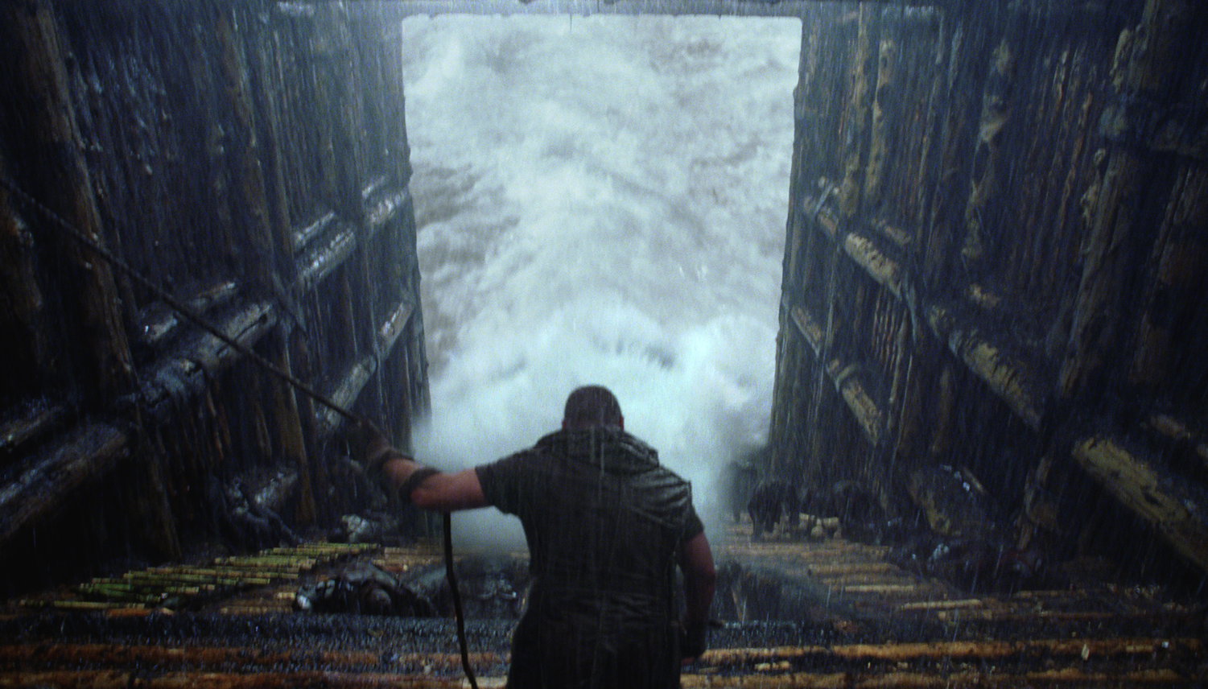
Noah
Who closed the door seven days before the Flood?

Slide 7
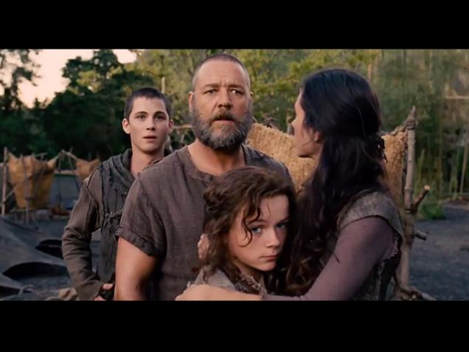
Noah
Where's Ham, Shem & Japheth?

Slide 8
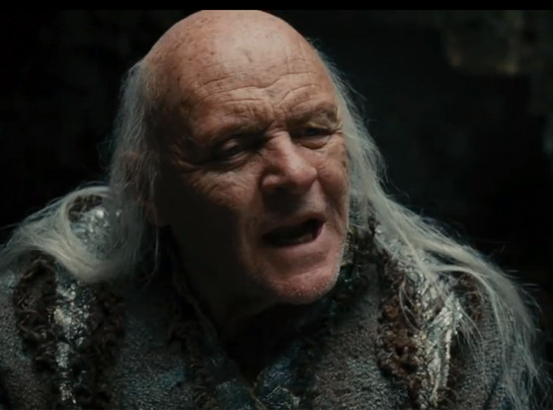
Noah
Methuselah is deemed to be a "witch doctor"!

Slide 9
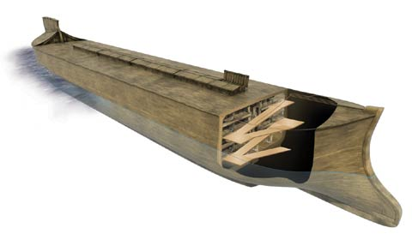
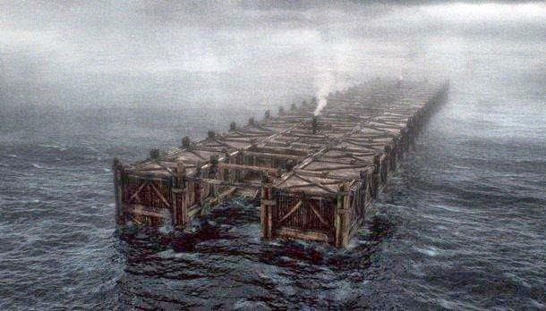
Noah
A more realistic ark
The crude ark

Slide 10
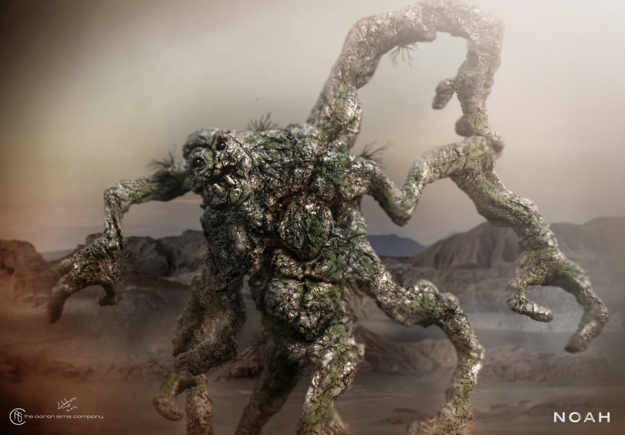
Noah
"This is the film that will introduce most of the country to the Watchers: fallen angels who, according to Aronofsky's version, have been encrusted in stone and, with a little persuading, help Noah construct the ark (for giants with gobs of rock for hands, they are extraordinarily dexterous). The Watchers are a very ancient tradition, going back over two thousand years in Jewish and Christian interpretation. But they don't go as far back as Genesis."
Notes:
Joel Baden, ‘Noah’: The Bible vs. the Blockbuster at http://www.thedailybeast.com/articles/2014/03/30/what-noah-gets-right.html accessed 2 Jan 2015

Slide 11
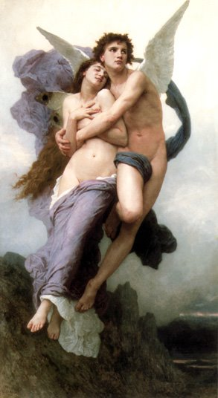
1 Enoch 6
¹It happened after the sons of men had multiplied in those days, that daughters were born to them, elegant and beautiful.
²And when the angels,* the sons of heaven, beheld them, they became enamoured of them, saying to each other, "Come, let us select for ourselves wives from the progeny of men, and let us beget children."
³Then their leader Samyaza said to them, "I fear that perhaps you will not consent that this deed should be done, and I alone will become
*An Aramaic text reads "Watchers" here (J.T. Milik, Aramaic Fragments of Qumran Cave 4 [Oxford: Clarendon Press, 1976], p. 167).
Notes:
http://www.johnpratt.com/items/docs/enoch.html#06 translated from Ethiopic by Richard Laurence, London, 1883
Edited into modern English at points from Charlesworth, 1:15

Slide 12
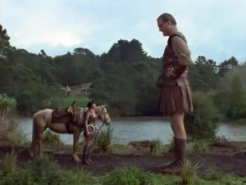
1 Enoch 6
(responsible) for this great sin.
⁴But they responded to him, "Let us all swear an oath and bind everyone among us by a curse not to abandon this suggestion but to do the deed." Then they swore all together and bound one another by (the curse).
⁵Their whole number was two hundred, who descended upon Ardis, which is the top of mount Armon.
Notes:
http://www.johnpratt.com/items/docs/enoch.html#06 translated from Ethiopic by Richard Laurence, London, 1883
Edited into modern English at points from Charlesworth, 1:15

Slide 13
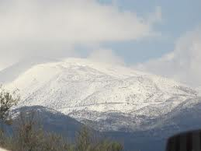

1 Enoch 6
⁶And they called the mount Armon,* for they swore and bound one another by a curse.
⁷These are the names of their chiefs: Samyaza, who was their leader, Urakabarameel, Akibeel, Tamiel, Ramuel, Danel, Azkeel, Saraknyal, Asael, Armers, Batraal, Anane, Zavebe, Samsaveel, Ertael, Turel, Yomyael, Arazyal. ⁸These were the prefects of the two hundred angels, and the remainder were all with them.
* Mt Armon, or Mt. Hermon, derives its name from the Hebrew word herem,
a curse (Charles, p. 63).
Notes:
http://www.johnpratt.com/items/docs/enoch.html#06 translated from Ethiopic by Richard Laurence, London, 1883
Edited into modern English at points from Charlesworth, 1:15

Slide 14
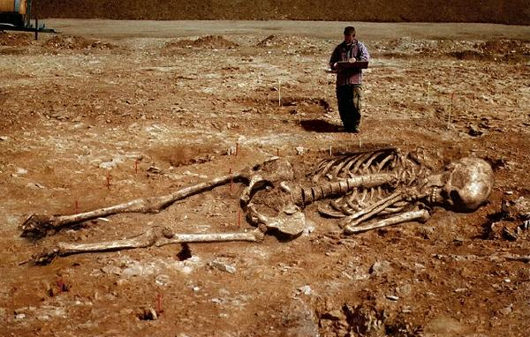
1 Enoch 7
¹Then they took wives, each choosing for himself; whom they began to approach, and with whom they cohabited; teaching them sorcery, incantations, and the dividing of roots and trees.
²And the women conceiving brought forth giants* whose heights were three hundred cubits [137 meters]
* The Greek texts vary considerably from the Ethiopic text here. One Greek manuscript adds to this section, "And they [the women] bore to them [the Watchers] three races: First, the great giants. The giants brought forth [some say "slew"] the Naphelim, and the Naphelim brought forth [or "slew"] the Elioud. And they existed, increasing in power according to their greatness." See the account in the Book of Jubilees.
Notes:
http://www.johnpratt.com/items/docs/enoch.html#06 translated from Ethiopic by Richard Laurence, London, 1883
Edited into modern English at points from Charlesworth, 1:15

Slide 15
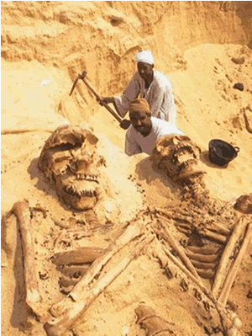
1 Enoch 7
³These (giants) consumed the produce of all the people until the people detested feeding them.
⁴So the giants turned against (the people) in order to eat them.
Notes:
Image from:
Forbidden Gates
Part 17
By Thomas R. Horn
November 11, 2010
NewsWithViews.com
http://www.newswithviews.com/Horn/thomas153.htm
The Spirit Behind Transhumanism
English theologian George Hawkins Pember, in his 1876 masterpiece, Earth's Earliest Ages, analyzed the prophecy of Jesus Christ that says the end times would be a repeat of "the days of Noah." Pember outlined
the seven great causes of the antediluvian destruction and documented their developmental beginnings in his lifetime. The seventh and most fearful sign, Pember wrote, would be the return of the spirits of Nephilim, "the appearance upon earth of beings from the Principality of the Air, and their unlawful intercourse with the human race."
Jesus Himself, in answering His disciples concerning the signs of His coming and of the end of the world, said it would be "as the days of [Noah] were" (Matthew 24:37). The implication is, just as it was before the Flood when the spirits of Nephilim were powerful upon earth (Genesis 6:4), mankind would experience an end-times renaissance of the influence of these entities. From Scripture we are made to understand the purpose of this latter-day wave of supernaturalism includes deception (2 Timothy 3:13), and the effect upon mankind would be so successful that heresy and delusion would become firmly entrenched—even within institutionalized Christianity. In writing of this scenario, Paul prophesied to Timothy that "in the latter times, some shall depart from the faith, giving heed to seducing spirits, and doctrines of devils" (1 Timothy 4:1).
Based on contemporary developments, the foretold increase in demonism and its influence within secular and religious society is rapidly unfolding this century—abruptly, dramatically, and suspiciously. In a recent edition of Prophecy in the News magazine, biblical scholar Gary Stearman agreed, stating in disturbing language how the manifestation of these powers are quickening now because the world is under conditions "in which the influence of God's Holy Spirit is diminishing." This is apparent not only in metaphysics, but within science and technology, where genetic engineering and transhumanist aspirations seem literally hell-bent on repeating what the Watchers did in giving birth to the spirits of Nephilim as in the days of Noah.
The First Time Nephilim Appeared on Earth
As far back as the beginning of time and within every major culture of the ancient world, the astonishingly consistent story is told of "gods" who descended from heaven and materialized in bodies of flesh. From Rome to Greece—and before that, to Egypt, Persia, Assyria, Babylonia, and Sumer—the earliest records of civilization tell of the era when powerful beings known to the Hebrews as "Watchers" and in the book of Genesis as the b'nai ha Elohim ("sons of God") mingled themselves with humans, giving birth to part-celestial, part-terrestrial hybrids known as "Nephilim." The Bible says this happened when men began to increase on earth and daughters were born to them. When the sons of God saw the women's beauty, they took wives from among them to sire their unusual offspring. In Genesis 6:4, we read the following account: "There were giants [Nephilim] in the earth in those days; and also after that, when the sons of God came in unto the daughters of men, and they bare children to them, the same became mighty men which were of old, men of renown."
When this Scripture is compared with other ancient texts, including Enoch, Jubilees, Baruch, Genesis Apocryphon, Philo, Josephus, Jasher, and others, it unfolds to some that the giants of the Old Testament such as Goliath were the part-human, part-animal, part-angelic offspring of a supernatural interruption into the divine order and natural development of the species. The apocryphal Book of Enoch gives a name to the angels involved in this cosmic conspiracy, calling them "Watchers." We read:
And I Enoch was blessing the Lord of majesty and the King of the ages, and lo! the Watchers called me—Enoch the scribe—and said to me: "Enoch, thou scribe of righteousness, go, declare to the Watchers of the heaven who have left the high heaven, the holy eternal place, and have defiled themselves with women, and have done as the children of earth do, and have taken unto themselves wives: Ye have wrought great destruction on the earth: And ye shall have no peace nor forgiveness of sin: and inasmuch as they delight themselves in their children [the Nephilim], The murder of their beloved ones shall they see, and over the destruction of their children shall they lament, and shall make supplication unto eternity, but mercy and peace shall ye not attain." (1 Enoch 10:3–8)
According to Enoch, two hundred of these powerful angels departed "high heaven" and used women (among other dna providers) to extend their progeny into mankind's plane of existence. The Interlinear Hebrew Bible (ihn) offers an interesting interpretation of Genesis 6:2 in this regard. Where the King James Version of the Bible says, "The sons of God saw the daughters of men that they [were] fair," the ihn interprets this as, "The [b'nai ha Elohim] saw the daughters of Adam, that they were fit extensions" (emphasis added). The term "fit extensions" seems applicable when the whole of the ancient record is understood to mean that the Watchers wanted to leave their proper sphere of existence in order to enter earth's three-dimensional reality. They viewed women—or at least their genetic material—as part of the formula for accomplishing this task. Departing the proper habitation that God had assigned them was grievous to the Lord and led to divine penalization. Jude described it this way: The "angels which kept not their first estate, but left their own habitation, He hath reserved in everlasting chains under darkness unto the judgment of the great day" (Jude 6).
Besides apocryphal, pseudepigraphic, and Jewish traditions related to the legend of the Watchers and the "mighty men" born of their union with humans, mythologized accounts tell the stories of "gods" using humans and animals to produce heroes or demigods (half-gods). When the ancient Greek version of the Hebrew Old Testament (the LXX or Septuagint) was made, the word "Nephilim"—referring to the part-human offspring of the Watchers—was translated gegenes, a word implying "earth born." This same terminology was used to describe the Greek Titans and other legendary heroes of part-celestial and part-terrestrial origin, such as Hercules (born of Zeus and the mortal Alcmena), Achilles (the Trojan hero son of Thetis and Peleus), and Gilgamesh (the two-thirds god and one-third human child of Lugalbanda and Ninsun). These demigods were likewise accompanied in texts and idol representation by half-animal and half-human creatures like centaurs (the part-human, part-horse offspring of Apollo's son, Centaurus), chimeras, furies, satyrs, gorgons, nymphs, Minotaurs, and other genetic aberrations. All of this seems to indicate that the Watchers not only modified human dna during the construction of Nephilim, but that of animals as well, a point the Book of Enoch supports, saying in the seventh chapter that the fallen angels "sinned" against animals as well as humans.
Other books such as Jubilees add that this interspecies mingling eventually resulted in mutations among normal humans and animals whose "flesh" (genetic makeup) was "corrupted" by the activity, presumably through crossbreeding (see 5:1–5; 7:21–25). Even the Old Testament contains reference to the genetic mutations that developed among humans following this time frame, including "men" of unusual size, physical strength, six fingers, six toes, animal appetite for blood, and even lion-like features (2 Samuel 21:20, 23:20). But of all the ancient records, the most telling extrabiblical script is from the Book of Jasher, a mostly forgotten text referred to in the Bible in Joshua 10:13 and 2 Samuel 1:18. Jasher records the familiar story of the fall of the Watchers, then adds an exceptional detail that none of the other texts is as unequivocal about, something that can only be understood in modern language to mean advanced biotechnology, genetic engineering, or "transgenic modification" of species. After the Watchers had instructed humans "in the secrets of heaven," note what Jasher says occurred: "[Then] the sons of men [began teaching] the mixture of animals of one species with the other, in order therewith to provoke the Lord" (4:18).
The phrase "the mixture of animals of one species with the other" does not mean Watchers had taught men hybridization, as this would not have "provoked the Lord." God made like animals of different breeds capable of reproducing. For example, horses can propagate with other mammals of the equidae classification (the taxonomic "horse family"), including donkeys and zebras. It would not have "provoked the Lord" for this type of animal breeding to have taken place, as God Himself made the animals able to do this.
If, on the other hand, the Watchers were crossing species boundaries by mixing incompatible animals of one species with the other, such as pig dna with humans like science is doing today, this would have been a different matter and may cast light on the numerous ancient stories of mythical beings of variant-species manufacturing that fit perfectly within the records of what the Watchers were accomplishing. Understandably, this kind of chimera-making would have "provoked the Lord," and raises the serious question of why the Watchers would have risked eternal damnation by tinkering with God's creation in this way. Yahweh had placed boundaries between the species and strictly ordered that "each kind" reproduce only after its "own kind." Was the motive of the Watchers to break these rules simply the desire to rebel, to assault God's creative genius through biologically altering what He had made? Or was something of deeper significance behind the activity? We'll talk about this in the next entry, but the following quotes provide a hint:
It would be nice to be an artilect, a god, a supremely powerful omnipotent being. I could be such a creature [soon.] It's possible. It's not an unattainable dream.... All I can do here is attempt to convey some measure of the strength of "religious" feeling that I and other[s] will make public this century. —Prof. Hugo de Garis, artificial brain designer
All of the boundaries are up for grabs. All of the boundaries that have defined us as human beings, boundaries between a human being and an animal and between a human being and a super human being or a god. —Prof. Leon R. Kass, former chairman, President's Council on Bioethics
A non-human race once lived upon earth. They came to be called the Rephaim [Nephilim]. They were genetic monsters, mutants whose end is darkness, just as was their society upon earth. Will JCVI's [J. Craig Venter Institute, which created the entirely new life form nicknamed "Synthia"] work result in another such atrocity? —Gary Stearman, Bible scholar
http://arcticcompass.blogspot.sg/2010/08/new-paradigm-integration-of-human.html

Slide 16
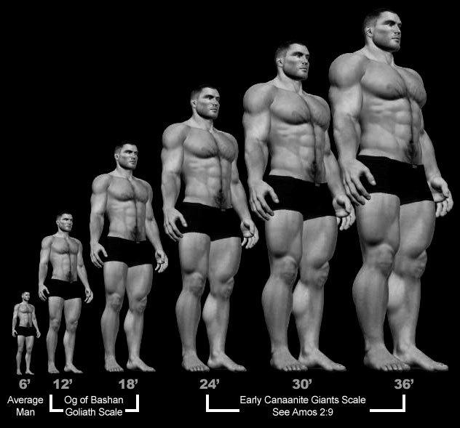
1 Enoch 7
⁵And they began to sin against birds, wild beasts, reptiles, and fish. And their flesh was devoured the one by the other,* and they drank blood.
⁶And then the earth brought an accusation against the oppressors.
* Or, "one another's flesh." R.H. Charles notes that this phrase may refer to the destruction of one class of giants by another (Charles, 65).
Notes:
http://www.johnpratt.com/items/docs/enoch.html#06 translated from Ethiopic by Richard Laurence, London, 1883
Edited into modern English at points from Charlesworth, 1:15

Slide 17
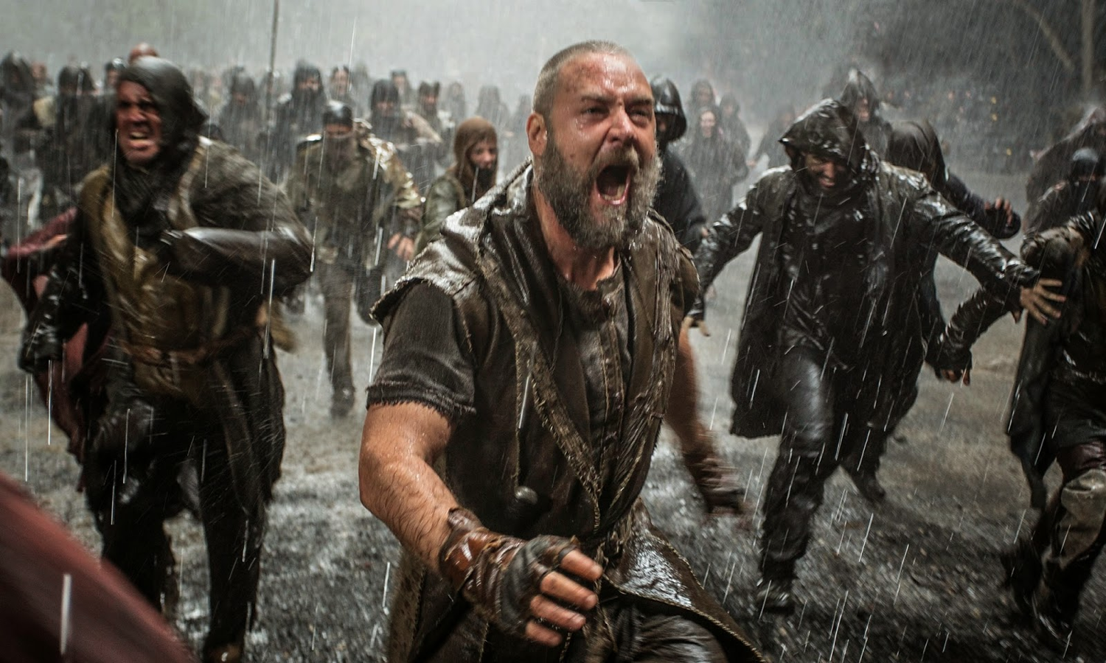
Noah
Violence

Slide 18

Noah
Noah versus Tubal-Cain?

Slide 19
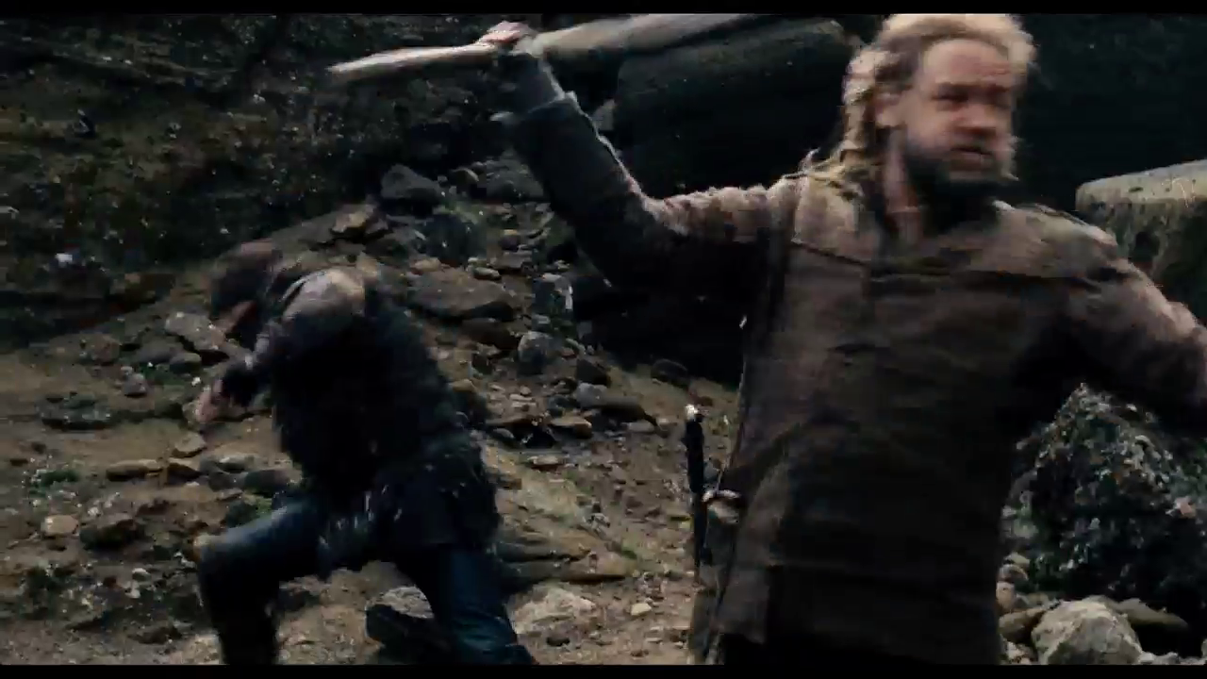
Noah
Shadowed

Slide 20
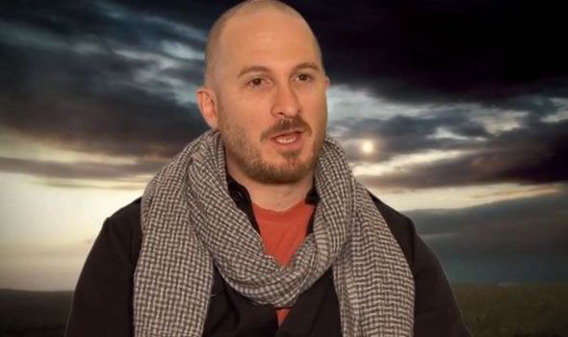
Atheist Producer Darren Aronofsky
"least biblical biblical film ever made."
Notes:
"Russell Crowe hits 'Noah' critics: 'Bordering on absolute stupidity'". The Washington Times. March 27, 2014. Retrieved March 27, 2014; cited at Wikipedia, "Noah (movie)."

Slide 21
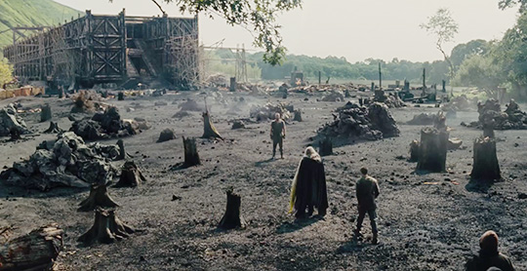
Noah
Noah was "the first environmentalist"
—Aronofsky

Slide 22
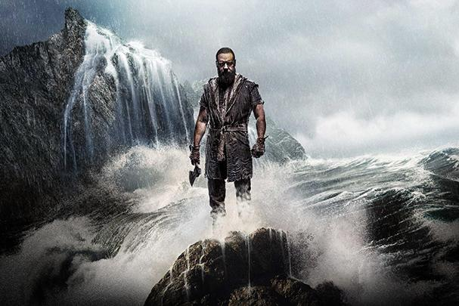
Noah
Should Christians see it?

Slide 23
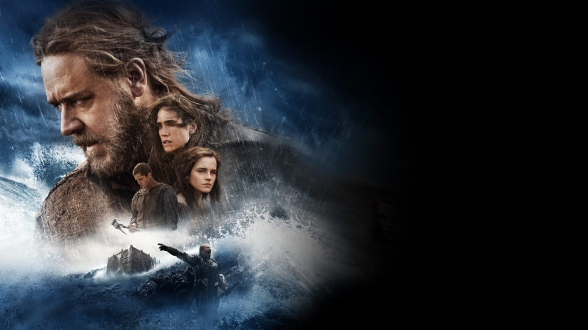
Praise of "Noah"
"The YouVersion Bible App team noted that during the three-day weekend of 'Noah's' release, the Biblical account of Noah was read or listened to 389,794 times, or about 129,931 times per day."
"It was the 'highest number of people exploring that passage that they've ever experienced,' according to the Charisma News."
Bill Hitchcock at http://www.refiningtruth.com/noah-genesis-6-facts/
Notes:
http://www.refiningtruth.com/noah-genesis-6-facts/

Slide 24
Praise of "Noah"
"The American Bible Society reportedly discovered that 87 percent of respondents to a poll on the subject said they were reading the account of Noah in Genesis because of the film."
"In the days after Noah hit theaters, people opening the Noah story in Genesis 6 increased about 300% in US & 245% globally on @YouVersion," reported YouVersion on Twitter on Tuesday.
H/T Breaking Christian News; cited by Bill Hitchcock at http://www.refiningtruth.com/noah-genesis-6-facts/
Notes:
http://www.refiningtruth.com/noah-genesis-6-facts/

Slide 25

Praise of "Noah"
Focus on the Family president Jim Daly stated that: "[Noah] is a creative interpretation of the scriptural account that allows us to imagine the deep struggles Noah may have wrestled with as he answered God's call on his life. This cinematic vision of Noah's story gives Christians a great opportunity to engage our culture with the biblical Noah, and to have conversations with friends and family about matters of eternal significance."
https://en.wikipedia.org/wiki/Noah_%282014_film%29#Test_screenings
Notes:
http://www.refiningtruth.com/noah-genesis-6-facts/

Slide 26

Praise of "Noah"
The Biologos Foundation stated that they "saw the importance of stories as explanations—my favorite part of the whole movie was when Noah retold the Genesis creation accounts to his sons, and we saw the evolutionary creation of the world up to some mysterious Adam and Eve figures."
https://en.wikipedia.org/wiki/Noah_%282014_film%29#Test_screenings
Notes:
Stump, Jim (April 2, 2014). "The Noah Movie". The Biologos Foundation. Retrieved April 2, 2014. "And we saw the importance of stories as explanations—my favorite part of the whole movie was when Noah retold the Genesis creation accounts to his sons, and we saw the evolutionary creation of the world up to some mysterious Adam and Eve figures."

Slide 27

Criticism of "Noah"
Ken Ham (Answers in Genesis):
"Except for some of the names…hardly any remnant of the Bible's account of the flood in Genesis 6–9 is recognizable in the movie. Yes, there is an ark in the film that is true to the massive biblical proportions, but it did not look seaworthy. There were many animals that came to Noah and went aboard the ark, but there were far too many creatures crammed inside, certainly many more than were needed."
http://time.com/42274/ken-ham-the-unbiblical-noah-is-a-fable-of-a-film/

Slide 28
Criticism of "Noah"
Ken Ham (Answers in Genesis):
"Also, while the extreme wickedness of man was depicted, the real sin displayed in the film was the people's destruction of the earth. Lost within the film's extreme environmentalist message is that the actual sins of the preflood people were rebellion against God and man's inhumanity to man."
http://time.com/42274/ken-ham-the-unbiblical-noah-is-a-fable-of-a-film/

Slide 29
Criticism of "Noah"
Ken Ham (Answers in Genesis):
"Ultimately, there is barely a hint of biblical fidelity in this film. It is an unbiblical, pagan film from its start. It opens, 'In the beginning there was nothing.' The Bible opens, 'In the beginning God.' That difference helps sum up the problem I have with the film. The Bible is about the true God of creation; the movie does not present the true God of the Bible."
http://time.com/42274/ken-ham-the-unbiblical-noah-is-a-fable-of-a-film/

Slide 30

Ray Comfort's "Noah"
http://www.noahthemovie.com/

Slide 31
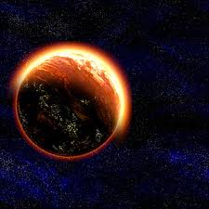
Does God have the right to judge the world?
Why?

Slide 32
Chart of Gen. 6–9
56
Primeval History
Creation 1–2
Flood 6–9
Fall 3–5
EVENTS 1–11
Human Race

Slide 33

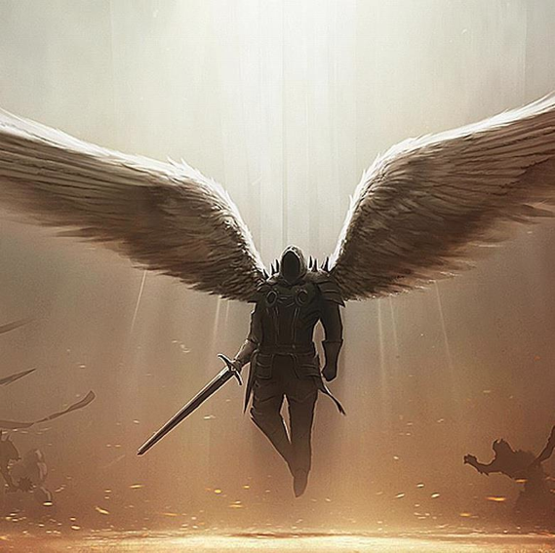
The "Sons of God" Immorality & Giants Led to the Flood (Gen. 6:1-4)
83
Who were these who impregnated women?
Demons (Angels)?
Rulers?
Demon-possessed rulers?
Sethites?
Cainites?
Lesser deities?
Godly men?

Slide 34

Questions on Genesis 6:1-4
Who were "the sons of God" (6:2)?
Who were "the daughters of men"
(6:2)?
Did man's 120-year limit (v. 3) indicate "grace years" until the Flood or individual longevity?
Were Nephilim giants born of the "sons of God" and "daughters of men" (v. 4)?
Does the Nephilim "on the earth in those days—and also afterward…" show they couldn't have been offspring of the "sons of God"?
How could the Nephilim be in Canaan in 1400 BC if they were destroyed in the Flood (Deut. 13:33)?

Slide 35
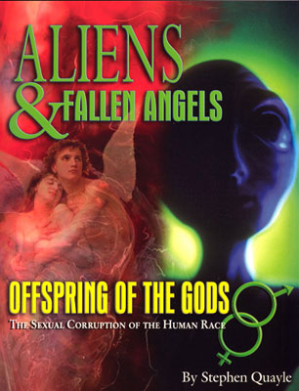
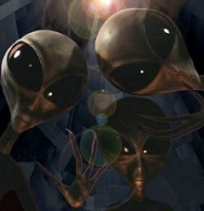
Were the "Sons of God" Angels?
83
www.alienresistance.com

Slide 36
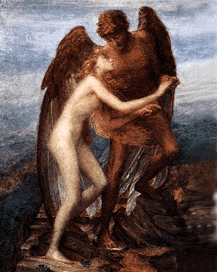
Support for the Angel View
83
Phrase refers only to angels elsewhere (Job 1:6; 2:1; 38:7; cf. Ps. 29:1)
Explains God and men contrast & overstepping natural bounds
Oldest view
(1 Enoch, etc.)
NT support
(2 Pet. 2:4; Jude 6-7)
Explains power of Nephilim offspring

Slide 37
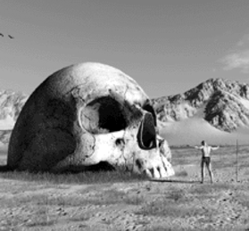
Critiquing the Angel View
83
"God" can denote human judges (Ps. 82:1, 6-7)
—but not "sons of God"
"At the resurrection people will neither marry nor be given in marriage; they will be like the angels in heaven" (Matt. 22:30)
—but does future celibacy imply past celibacy?
Punishing humans for the sin of angels seems unfair
—but Jude 6 says some angels are bound
NT support debatable
Mythological tone
Angels not in context

Slide 38
Godly Line of Seth View
Key Points
But . . .
Elohim ("God") does at times refer to men
Worldly Cainites contrast with Godly Sethites in Gen. 4
The line of blessing was to be kept pure
Luther & Calvin supported this view
This is not the normal usage
"Daughters of men" is general and without an evil sense
No evidence shows these lines separate
Their support is late and irrelevant
Men in v. 1 must align with men in v. 2

Slide 39
The Dynasty-Ruler View
Support
Problems
Elohim ("God") at times denotes judges (Exod. 21:6; 22:8-9, 28; Ps. 82:1, 6-7)
God-king relationship noted as "father" to "son" (2 Sam. 7:14)
True, but judges are not in the context so "sons of God" as angels is better
True, but Gen. 6 says nothing about kings
A group of kings is never called "sons of God" in OT or ANE

Slide 40

God Despises Human Pride
Notes:
www.schambach.org/

Slide 41
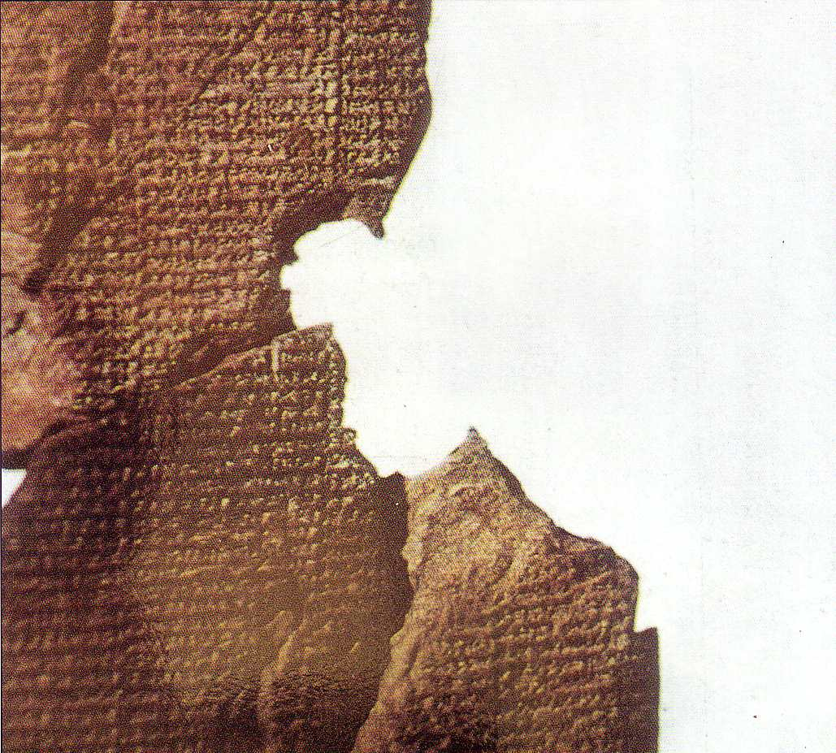
Little Deities View Has Pagan Notions
Atrahasis Epic
Genesis
Anu, the high god
Man too noisy for gods
Atrahasis built boat
Pitch used
Animals caught
Rained 7 days
Regretted Flood
(Arnold/Beyer, 21-31)
Yahweh, the only God
Man too sinful
Noah built boat
Pitch used
God brought animals
Rained 40 days
Rainbow promise
(Genesis 6–9)

Slide 42
Noah
Noah was "the first environmentalist"
—Aronofsky

Slide 43
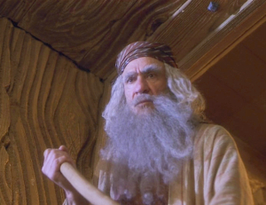

Christians & the Environment
Biblical Noah
God angry at environmental sins
Murder, adultery, idolatry
A flawed savior
Models our Savior

Slide 44
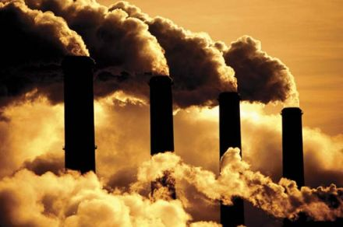
Is global warming due to man?
No.

Slide 45
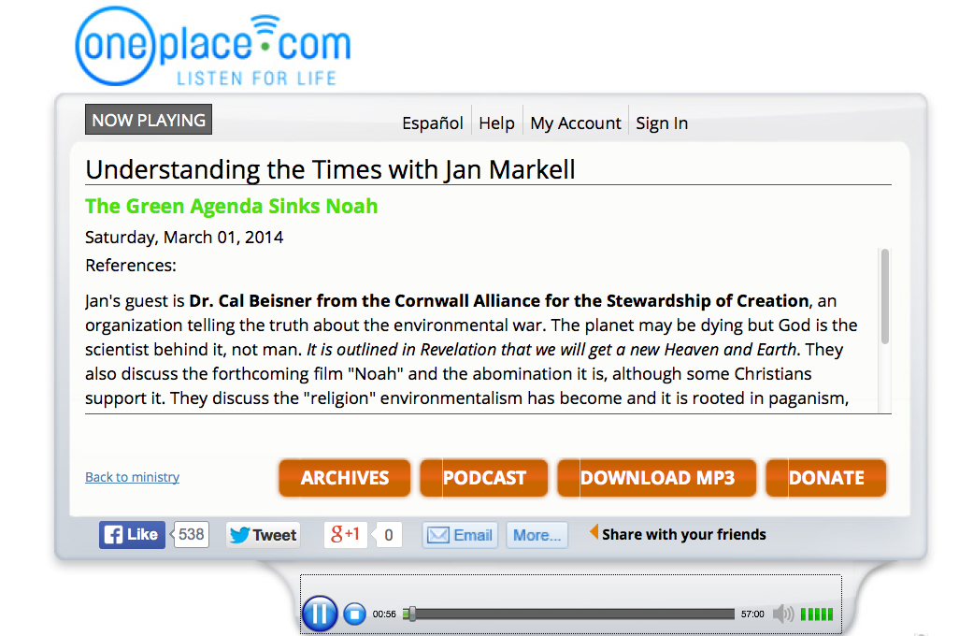
Is global warming due to man?
No.

Slide 46
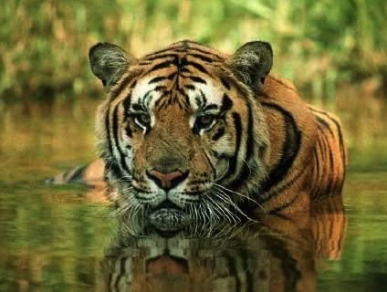
Animals
God's Creation…Day 6
448
"Then God said, 'Let the earth bring forth living creatures after their kind: cattle and creeping things and beasts of the earth after their kind'; and it was so. God made the beasts of the earth after their kind, and the cattle after their kind, and everything that creeps on the ground after its kind; and God saw that it was good" (Gen. 1:24-25).

Slide 47

Man
God's Creation…Day 6
448
"Then God said, 'Let Us make man in Our image, according to Our likeness; and let them rule over the fish of the sea and over the birds of the sky and over the cattle and over all the earth, and over every creeping thing that creeps on the earth'" (Gen. 1:26).

Slide 48

Woman
God's Creation…Day 6
"So God created man in his own image
in the image of God he created him
male and female he created them" (Gen. 1:27).

Slide 49

Mandate
448
and over the birds of the air
"And God blessed them, and God said to them, 'Be fruitful and multiply, and fill the earth and subdue it;
and have dominion over the fish of the sea
and over every living thing that
moves upon the earth'" (Gen. 1:28 NLT).

Slide 50
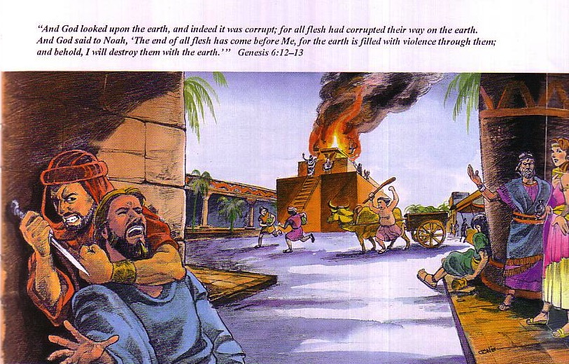
Need for a new start…
65
God saw how corrupt the earth had become, for all the people on earth had corrupted their ways. ¹³So God said to Noah, "I am going to put an end to all people, for the earth is filled with violence because of them. I am surely going to destroy both them and the earth" (Gen. 6:12-13).

Slide 51
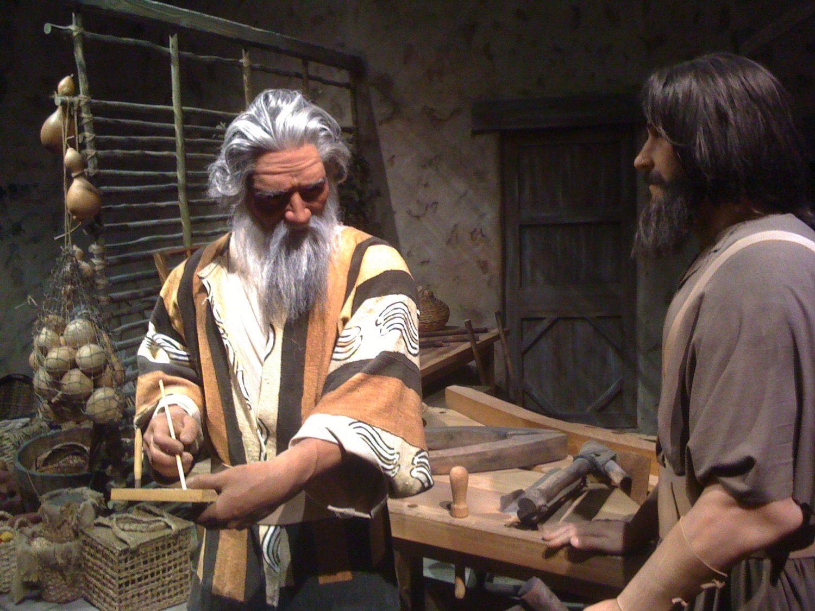
Noah & His Son

Slide 52
"By Faith…" (Hebrews 11)
"It was by faith that Noah built a large boat to save his family from the flood. He obeyed God, who warned him about things that had never happened before. By his faith Noah condemned the rest of the world, and he received the righteousness that comes by faith" (Heb. 11:5 NLT)

Slide 53
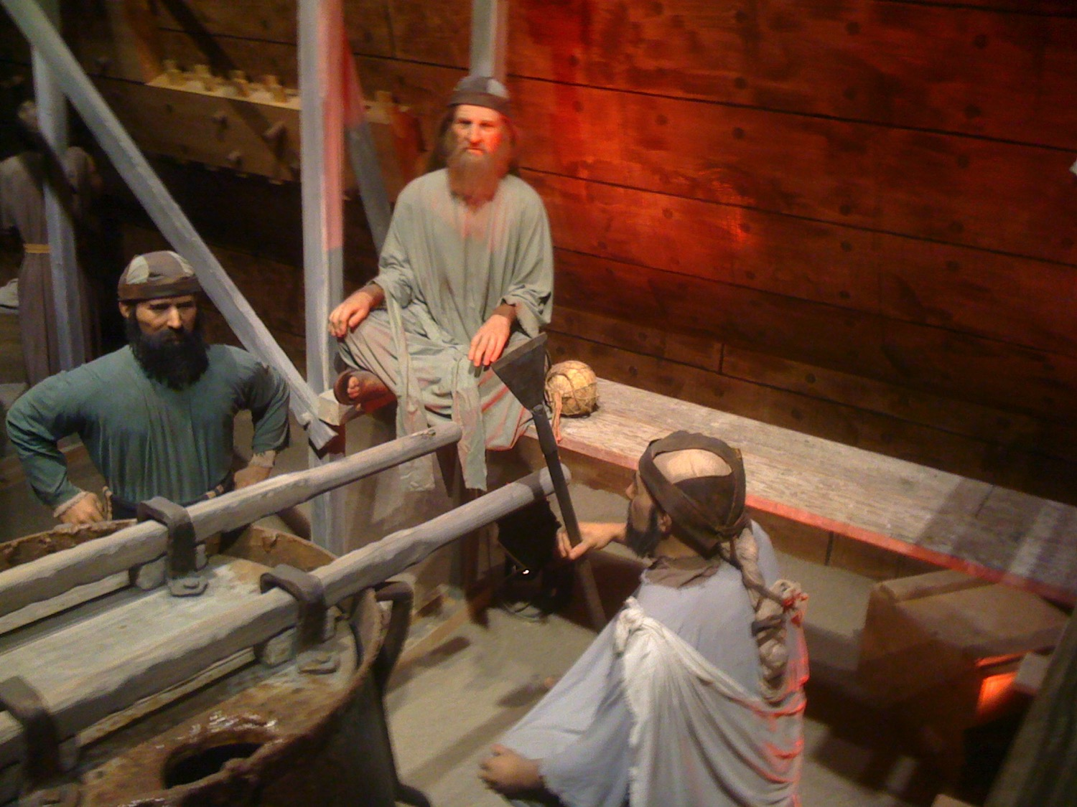
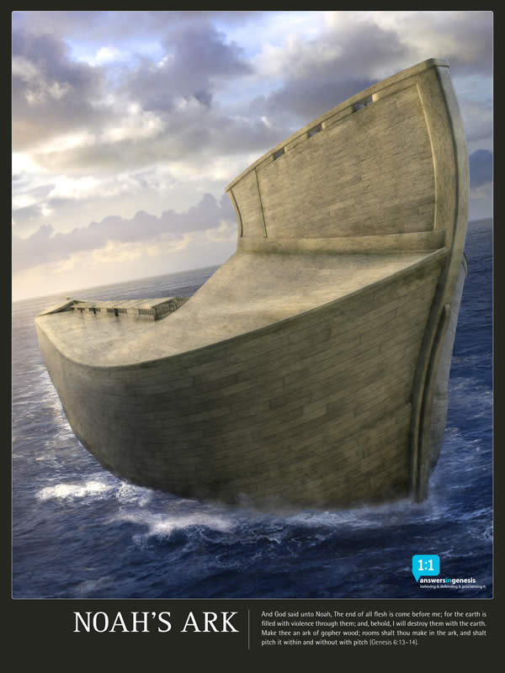
Noah & His Son

Slide 54
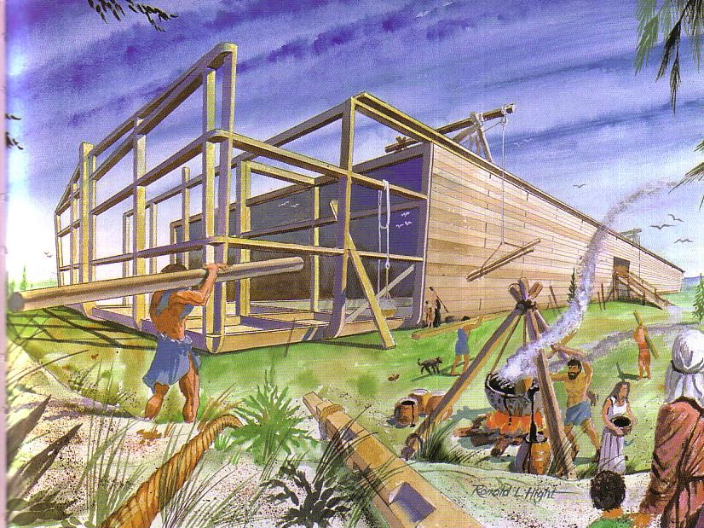
Building the Ark
65

Slide 55
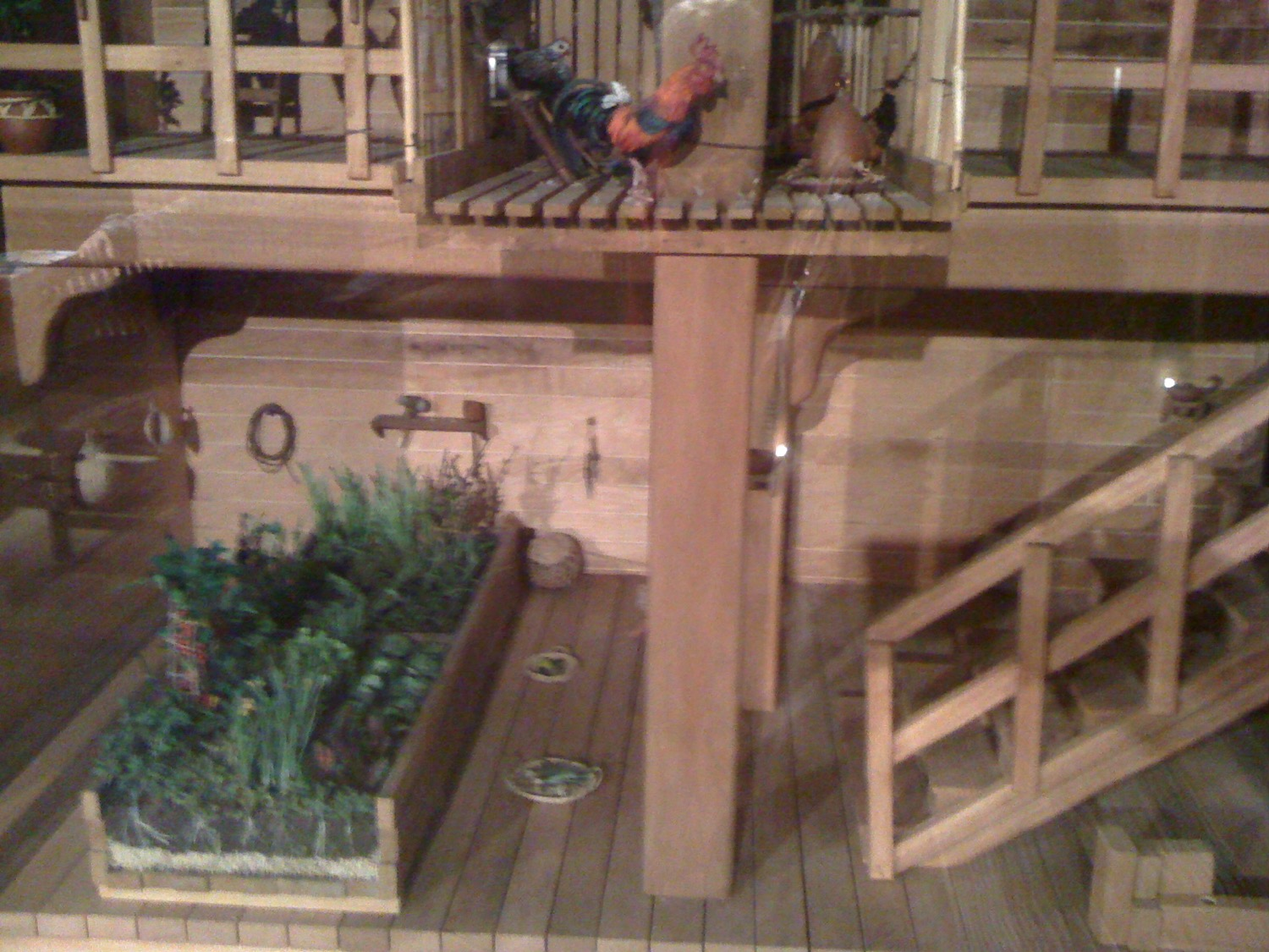
Food in the Ark

Slide 56
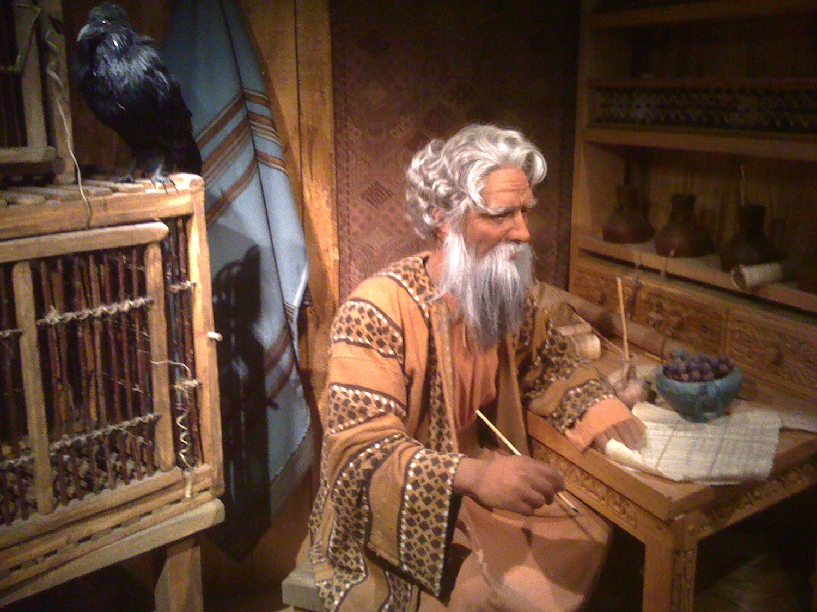
Noah & His Study

Slide 57


Cubit Diagram Sample
This is a sample page from "The World of the Bible" a PowerPoint Sunday School Series from eBibleteacher.com
B
I
B
L
E
Finger
18 Inches
= 1 Cubit
Span
Handbreadth
Length Measurement
© EBibleTeacher.com
INDEX
Notes:
The new "World of the Bible" series has over 450 slides and covers Bible lands, people, time, measurements and culture.
The ancient Bible people used measurements that could be easily reproduced. The cubit was simply the measurement from your elbow to the end of your fingers. Cubits are known to have varied from 16 to 19 inches. In the case of dispute, the king's arm was used to determine the standard cubit.
Like the cubit, spans, handbreadth and fingers were also easily determined. Even today, some people still use these measurements such as in measuring horses.

Slide 58
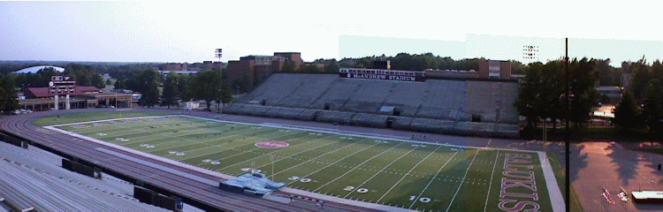
Noah's Ark Size
The ark was 300 cubits long (450 feet), 50 cubits wide (75 feet) and 30 cubits tall (45 feet) Gen 6:15
INDEX

Slide 59
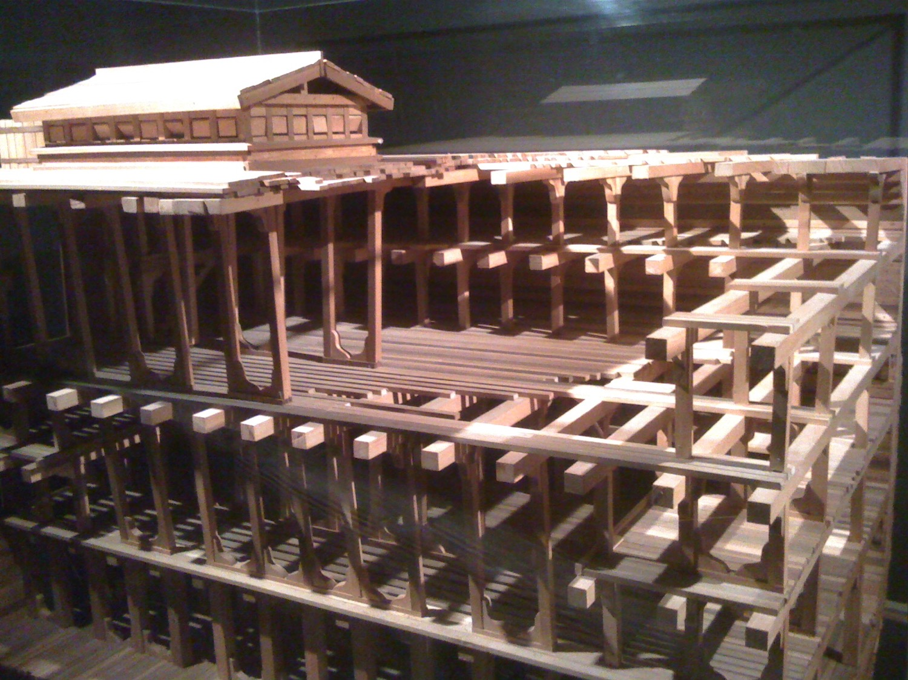
The Ark

Slide 60
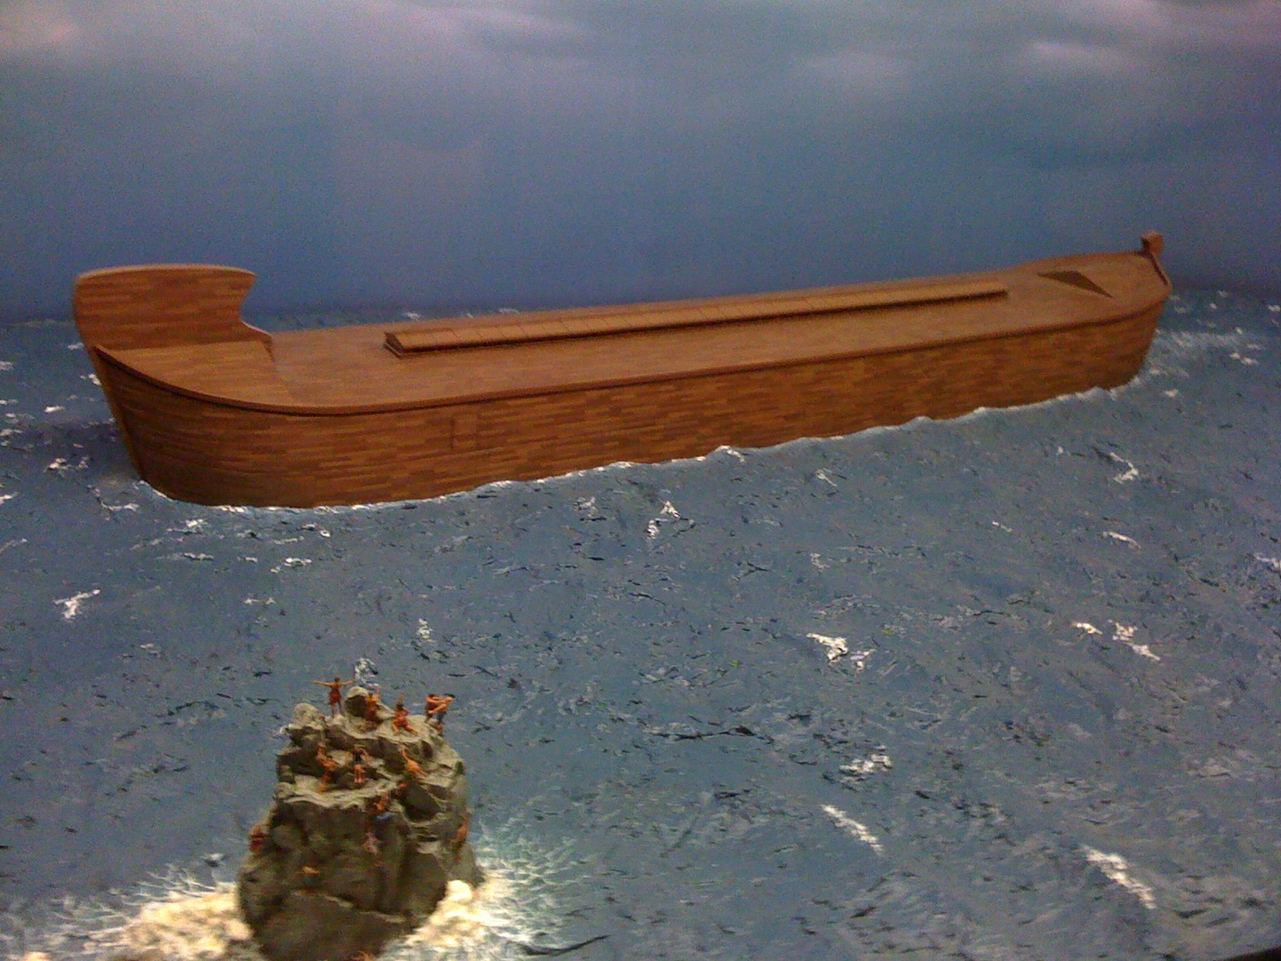
The Ark

Slide 61
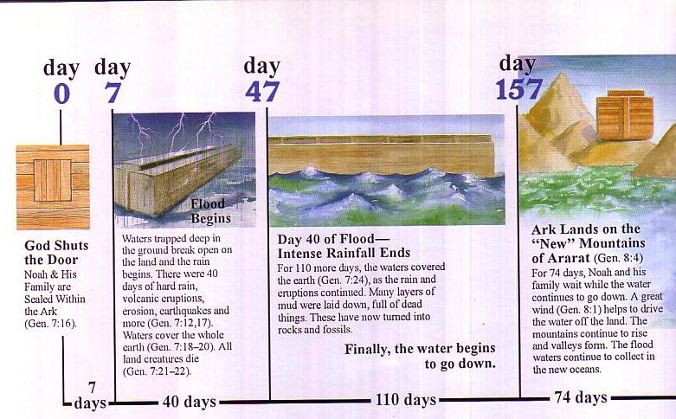
Flood Chronology

Slide 62
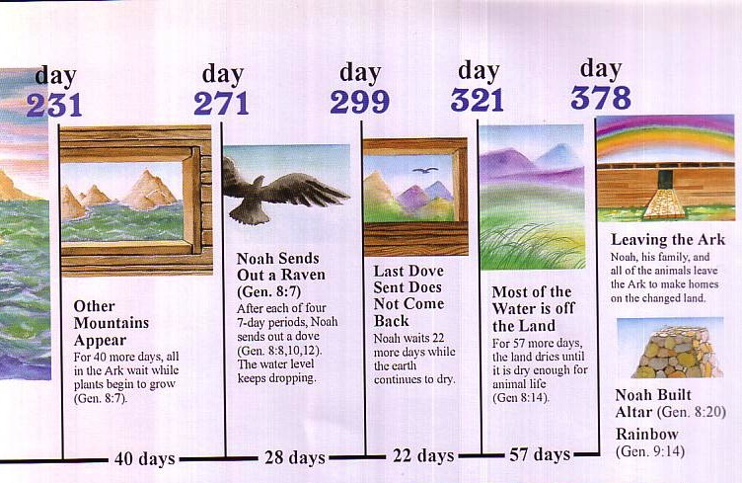
Flood Chronology

Slide 63
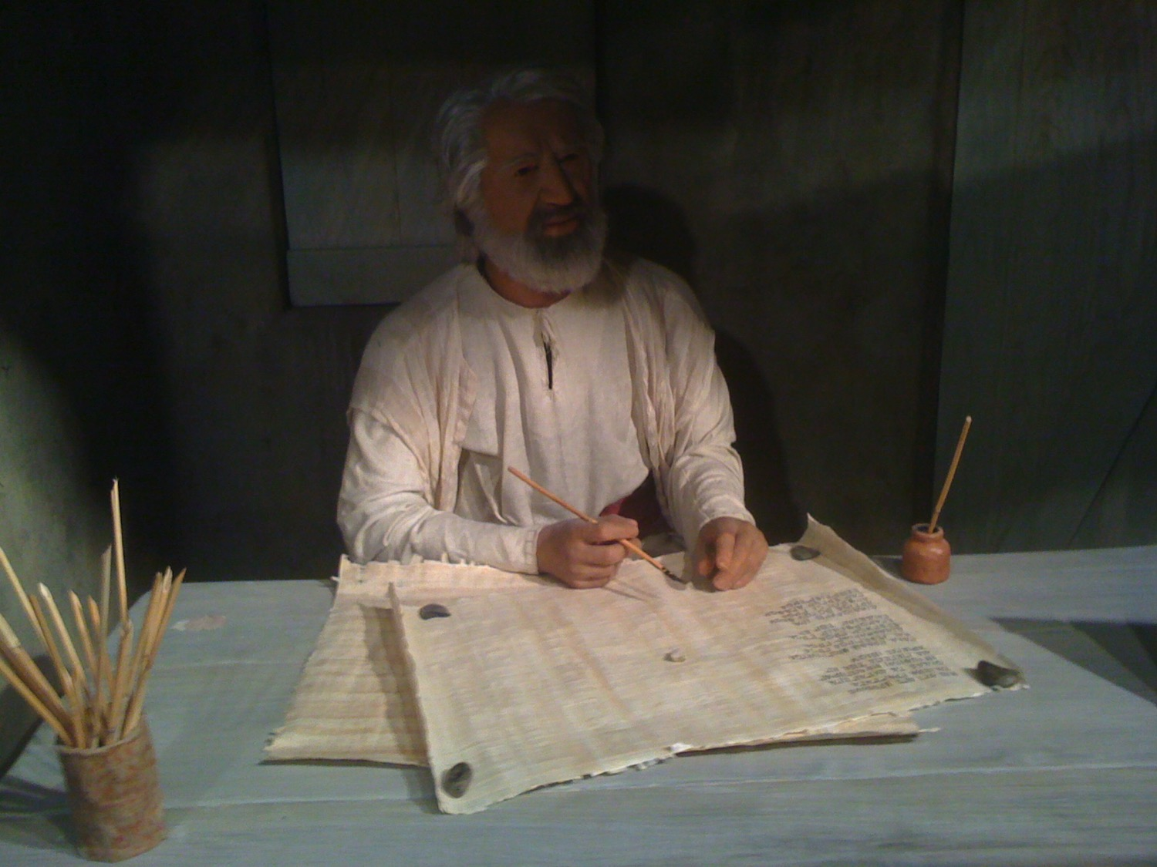
Flood Chiasm
7 days of waiting for flood (7:4)
7 days of waiting for flood (7:10)
40 days of flood (7:17a)
150 days of water triumphing (7:24)
God remembered Noah (8:1)
150 days of water waning (8:3)
40 days of waiting (8:6)
7 days of waiting (8:10)
7 days of waiting (8:12)
– Gordon Wenham, Genesis 1–15, Word Biblical Commentary (Dallas: Word Books, 1994)

Slide 64
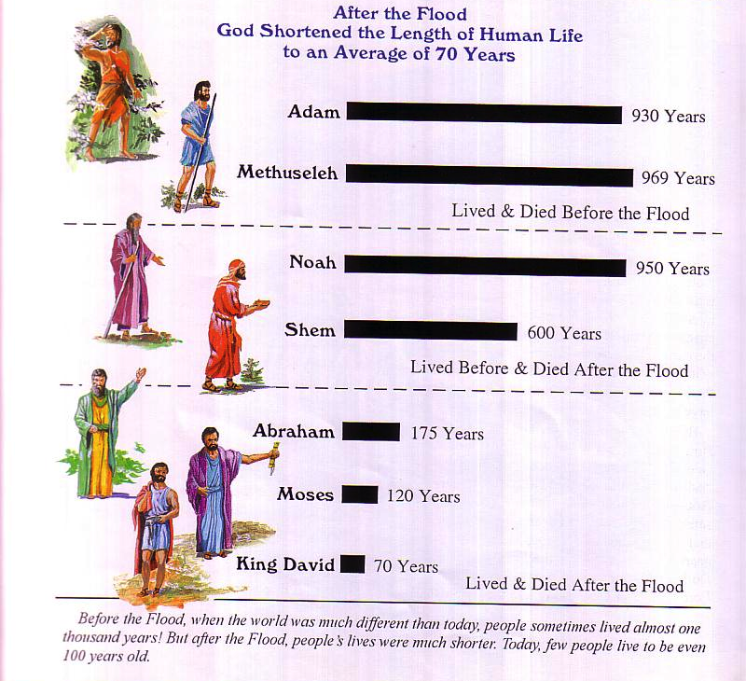

The Flood explains why life spans shortened
90

Slide 65
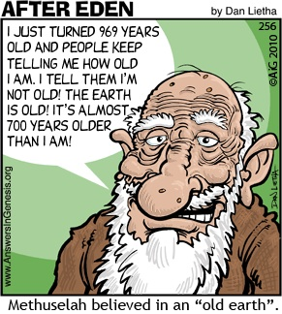
Methuselah
90
I JUST TURNED 969 YEARS OLD AND PEOPLE KEEP TELLING ME HOW OLD I AM. I TELL THEM I'M NOT OLD! THE
EARTH IS OLD! IT'S ALMOST 700 YEARS OLDER THAN
I AM!
Methuselah believed in an "Old Earth."

Slide 66
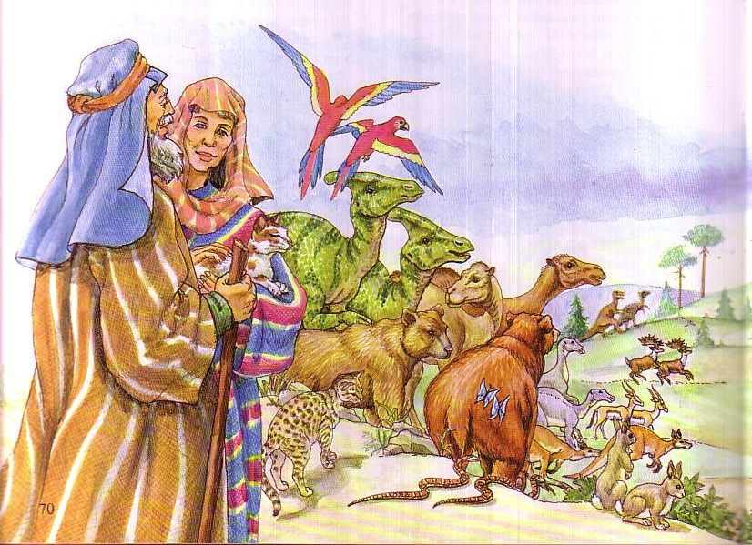

Genesis 6:19 NIV
You are to bring into the ark two of all living creatures, male and female, to keep them alive with you.

Slide 67

Noah's Character
"And the LORD said, 'I will wipe this human race I have created from the face of the earth. Yes, and I will destroy every living thing—all the people, the large animals, the small animals that scurry along the ground, and even the birds of the sky. I am sorry I ever made them. ⁸But Noah found favor with the LORD" (6:7-8 NLT).

Slide 68

Noah Wasn't Perfect
"Ham, the father of Canaan, saw that his father was naked and went outside and told his brothers. ²³Then Shem and Japheth took a robe, held it over their shoulders, and backed into the tent to cover their father. As they did this, they looked the other way so they would not see him naked" (9:22-23 NLT).

Slide 69

Noah Wasn't Perfect
"When Noah woke up from his stupor, he learned what Ham, his youngest son, had done. ²⁵Then he cursed Canaan, the son of Ham:
'May Canaan be cursed!
May he be the lowest of servants to his relatives'" (9:24-25 NLT).

Slide 70

Does it really matter if there really was a universal Flood?
77j
Genesis 7–8

Slide 71

Dr. Hugh Ross: A Mid-East Flood Advocate
77i
http://www.reasons.org/exploring-extent-flood-what-bible-says-part-two
"The Genesis Flood may well have extended beyond Mesopotamia. Most of the place names recorded in Genesis 2–8 are associated with locations within Mesopotamia, but some are not. The notable exceptions are the Pishon and Gihon rivers, which flowed from the southern part of the Arabian Peninsula. It seems possible that the Genesis Flood inundated not only all of Mesopotamia but also the entire Persian Gulf region and much of southern Arabia as well."
Notes:
http://www.reasons.org/interpreting-genesis/noahs-flood/exploring-extent-flood-part-one

Slide 72
Dr. Hugh Ross: A Mid-East Flood Advocate
77i
http://www.reasons.org/exploring-extent-flood-what-bible-says-part-two
Why does Ross advocate a limited flood?
Presupposition of old earth
Meaning of "world" in other OT passages
Notes:
http://www.reasons.org/interpreting-genesis/noahs-flood/exploring-extent-flood-part-one

Slide 73

But why not a local flood?
77j
If the Flood was local, why did Noah have to build an ark? He could have walked to the other side of the mountains and missed it.
If the Flood was local, why did God send the animals to the ark so they could escape death? There would have been other animals to reproduce that kind if these particular ones had died.
Ken Ham & Terry Mortenson, "What's Wrong with Progressive Creationism?"
in The New Answers Book 2 [http://www.answersingenesis.org/articles/nab2/whats-wrong-with-progressive-creation]

Slide 74

But why not a local flood?
77j
If the Flood was local, why was the ark big enough to hold all the different kinds of vertebrate land animals? If only Mesopotamian animals were aboard, the ark could have been much smaller.
If the Flood was local, why would birds have been sent on board? These could simply have winged across to a nearby mountain range.
Ken Ham & Terry Mortenson, "What's Wrong with Progressive Creationism?"
in The New Answers Book 2 [http://www.answersingenesis.org/articles/nab2/whats-wrong-with-progressive-creation]

Slide 75

But why not a local flood?
77j
If the Flood was local, how could the waters rise to 15 cubits (8 meters) above the mountains (Genesis 7:20)? Water seeks its own level. It couldn't rise to cover the local mountains while leaving the rest of the world untouched.
Ken Ham & Terry Mortenson, "What's Wrong with Progressive Creationism?"
in The New Answers Book 2 [http://www.answersingenesis.org/articles/nab2/whats-wrong-with-progressive-creation]

Slide 76

How high was the water?
77j
¹⁸ The waters rose and increased greatly on the earth, and the ark floated on the surface of the water. ¹⁹ They rose greatly on the earth, and all the high mountains under the entire heavens were covered. ²⁰ The waters rose and covered the mountains to a depth of more than twenty feet (Gen. 7:18-20).

Slide 77
But why not a local flood?
77j
If the Flood was local, people who did not happen to be living in the vicinity would not be affected by it. They would have escaped God's judgment on sin. If this had happened, what did Christ mean when He likened the coming judgment of all men to the judgment of "all" men in the days of Noah (Matthew 24:37–39)? A partial judgment in Noah's day means a partial judgment to come.
Ken Ham & Terry Mortenson, "What's Wrong with Progressive Creationism?"
in The New Answers Book 2 [http://www.answersingenesis.org/articles/nab2/whats-wrong-with-progressive-creation]

Slide 78

CW-Local Flood 1 01129
77j
LOOK AT THAT BEAUTIFUL RAINBOW! IT'S A PROMISE FROM GOD THAT HE'LL NEVER* AGAIN FLOOD THE ENTIRE EARTH AS HE DID IN NOAH'S DAY!
HE TOLD YOU IT WAS JUST A "LOCALIZED" FLOOD?
THAT'S WHAT HE SAID!
MY CHRISTIAN COLLEGE PROFESSOR SAID THAT NOAH'S FLOOD DIDN'T COVER THE ENTIRE EARTH.

Slide 79

CW-Local Flood 2 01130
SO HE BELIEVES THAT GOD PROMISED TO NEVER AGAIN SEND A "LOCALIZED" FLOOD?

Slide 80

A local flood?
77j
If the Flood was local, God HAS repeatedly broken His promise never to send such a flood again!
Notes:
http://www.answersingenesis.org/Home/Area/overheads/archive/oh20030829_191_scrn.jpg

Slide 81

Rodinia––The World That Perished
The transformation of Adam's world into today's world

Slide 82

THE WORLD THAT PERISHED
The transformation of Adam's world into today's world

Slide 83

Flood Significance
God's righteous judgment
God's gracious redemption
Water baptism (1 Pet. 3:20-21)
^{NLT} 1 Peter 3:20 those who disobeyed God long ago when God waited patiently while Noah was building his boat. Only eight people were saved from drowning in that terrible flood. ²¹And this is a picture of baptism. . .

Slide 84




Flood Legends
83c
270 Flood Legends
Hawaii
Babylonia
Mexico
Common Elements:
universal flood
boat saved
family passengers
China

Slide 85

Scoffers Believe in Uniformitarianism
"First of all, you must understand that in the last days scoffers will come, scoffing and following their own evil desires. They will say, 'Where is this "coming" he promised? Ever since our fathers died, everything goes on as it has since the beginning of creation.'
2 Peter 3:3-4 (NIV)

Slide 86
Scoffers Doubt the Flood
"But they deliberately forget that long ago by God's word the heavens existed and the earth was formed out of water and by water. By these waters also the world of that time was deluged and destroyed. By the same word the present heavens and earth are reserved for fire, being kept for the day of judgment and destruction of ungodly men."
2 Peter 3:5-7 (NIV)

Slide 87

Why Not Dinosaurs on Noah's Ark?

Slide 88

Dinosaurs Lived Recently
Behemoth--giant vegetarian
(Job 40:15-24)
Leviathan--ferocious meat eater (Job 41)
British King Morvidus was killed by a monster by being "gulped down… as a big fish swallows a little one" (336 BC)
A monster was killed in 1693 in Bedd-yr-Afanc, England
Monsters have been reported in nearly 200 places in England alone
Notes:
Bill Cooper, After the Flood (Chicester, England: New Wine, 1995), 131.

Slide 89



Beowulf & the Creatures of Denmark
Danish poem extols Beowulf (AD 495-583)--later king for 50 years
The monster Grendel ("grinder, destroyer") preyed on Danes 12 years (AD 503-515)
This hero cleared monstrous animals from the sea lanes between Denmark and Sweden
He then pulled out Grendel's small arm, who retreated to his cave and bled to death
DENMARK

Slide 90


Japanese Fisherman's Dead Monster
(The Times 21 July 1977)
Two tons & ten meters long
Caught at 330 meters deep ocean near Christchurch
Plesiosaurus: huge, small-headed reptiles with long neck and four fins
Photographed and sketched by marine biologist Michihiko Yano
Captain threw it back into sea for fear of contaminating his fish.
Soon after BBC reported it to be a shark (30 July 1977)!
Enlarge and read this!
Duane T. Gish, Dinosaurs by Design (4730 Barnes Road, Colorado Springs, CO: Master Books and Creation-Life Publishers, 1992), 86
Notes:
Duane T. Gish, Dinosaurs by Design, 4730 Barnes Road, Colorado Springs, CO: Master Books and Creation-Life Publishers, 1992, 86

Slide 91

Is This a Shark?!
Bill Cooper, After the Flood, 140

Slide 92

Noah's Ark Mt. Ararat
A view from space of snow-covered Mt. Ararat and Little Ararat--inactive volcanoes located in eastern Turkey. Mount Ararat rises over 3 miles above sea level. This mountain is the traditional resting place of Noah's ark.
Mt. Ararat
NASA Photo
© EBibleTeacher.com
INDEX
Notes:
The picture shows a satellite view of snow covered Mt. Ararat and Little Ararat. These mountains are inactive volcanoes located in eastern Turkey. Mt. Ararat rises over 3 miles above sea level. This mountain is the traditional resting place of the Ark. You can see the lava flow fields to the south part of the mountain peak. Below the lava field you can see green fields.

Slide 93

Worship & the Rainbow

Slide 94

To see "Noah" or not to see?
Key Verse
“Anyone who runs ahead and does not continue in the teaching of Christ does not have God; whoever continues in the teaching has both the Father and the Son. If anyone comes to you and does not bring this teaching, do not take him into your home or welcome him. Anyone who welcomes him shares in his wicked work”
(2 John 9-11).

Slide 95

How do Christians aid heresy?
297
Encouraging itinerate heretics
Giving money to cults (radio, TV, etc.)
Buying heretical books
Attending movies that violate Scripture
Accepting literature from false evangelists

Slide 96

"Then I saw a new heaven and a new earth, for the old heaven and the old earth had disappeared" (21:1a NLT).
449

Slide 97

A Literal New Heaven & New Earth!
447

Slide 98


The Consummation of All Things
448
Genesis 1–3
Revelation 20–22
"In the beginning God created the heavens and the earth" (1:1)
"Then I saw a new heaven and a new earth" (21:1)
Notes:
The first three chapters of Scripture have many parallels in the last three chapters.

Slide 99

"'Yes! I am coming soon!'
Amen! Come, Lord Jesus!
The grace of the Lord Jesus be with God's people. Amen"
(22:20-21 NIV).

Slide 100
Black

Slide 101


OT Survey link at BibleStudyDownloads.org
Get this presentation for free!
Notes:
OT Survey (os)

