Slide 1
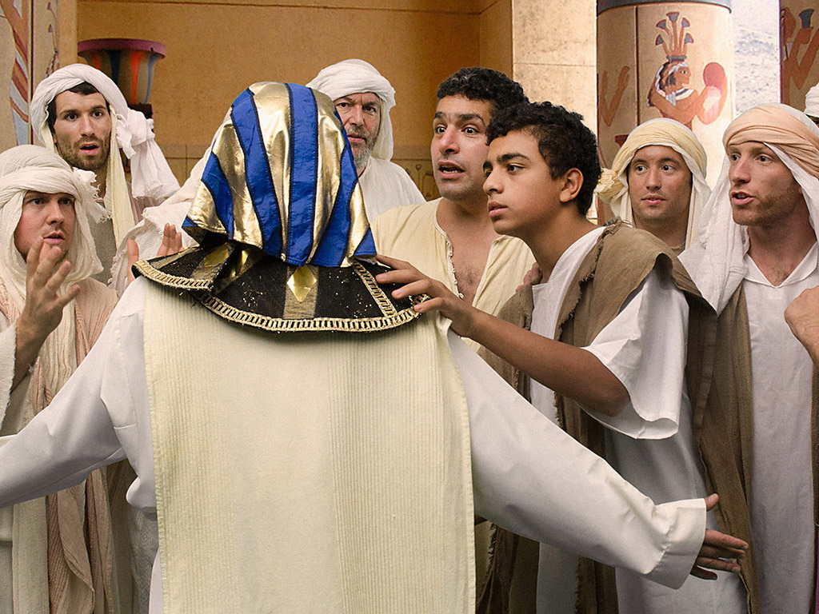
Genesis 37–50
Dr. Rick Griffith • Jordan Evangelical Theological Seminary • BibleStudyDownloads.org

Slide 2
Keyword
56
39
Election
Genesis
Notes:
The keyword for Genesis is election—God chose people to rule with him and he does the same for us.
___________
Common-49
OS-01-Gen1-3-slide 2

Slide 3
Theme
56
Origin in
Election and Promise
Genesis
Notes:
Genesis shows Israel’s beginnings as a chosen people with the promise of land, many descendants from Abraham in a nation, and blessings that impact all nations.
___________
Common-50
OS-01-Gen1-3-slide 3

Slide 4
Key Verse
56
"I will bless you… and all peoples on earth will be blessed through you"
(12:1-3)
Genesis
Notes:
God promised to bless the entire world through Abraham. There is a corollary curse for those who curse Abraham's line through Jacob.
___________
Common-51
OS-01-Gen1-3-slide 4

Slide 5
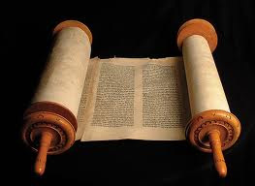
Summary Statement
56
63
41
The narrow lineage of Israel from Creation to Joseph informs Israel it began with both God's election for rule and unconditional promise for blessings through Abraham in contrast to the Canaanites
Genesis
Notes:
A line of blessing started with Adam and ended with Joseph due to the LORD choosing their descendants to reign and God’s unilateral promise to eventually benefit all peoples through Abraham, which was unique to Israel.

Slide 6

Kingdom Statement
39
God created a perfect kingdom (1–2), but man gave up his rule to Satan (3), so God elected a seed to produce a ruler (4–11) to bless all nations in Abraham (12–50).
Genesis
Notes:
The LORD made humans to reign (1–2) but the devil stole this right (3), so God chose a line of blessing (4–11) leading to Abraham’s descendants to result in a ruler to benefits all peoples (12–50).

Slide 7
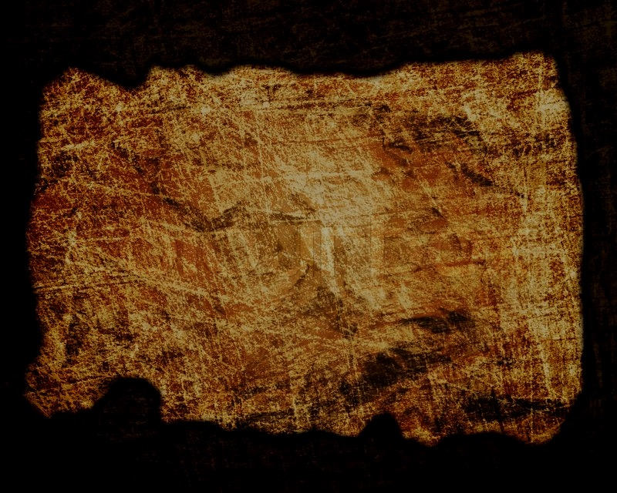
Covenant
42a
God narrowed man’s line from Adam through Seth to Abram (1–11) to establish the Abrahamic Covenant with unconditional promises of Canaan, eternal rule, and blessing to his descendants (12–50).
Genesis
Notes:
All humanity focused from Seth to Abraham (1–11) so that through Abraham the focus will broaden to bless all people once again through Israel (12–50).
___________
Common-53
OS-01-Gen1-3-slide 7

Slide 8

Redemption
42a
Redemption is needed due to man’s sin (3:1-7), but as God redeemed Adam and Eve with a sacrificial animal (3:21), so a Redeemer from Eve will finally defeat Satan (3:15), typified in Joseph (45:7).
Genesis
Notes:
There was no need of salvation until Adam and Eve sinned (3:1-7), but God covered them with animal skins by the death of an animal (3:21) that typified the Saviour over the devil (3:15), who is also pictured in Joseph’s redemption of Jacob’s family by bringing them to Egypt (45:7).

Slide 9
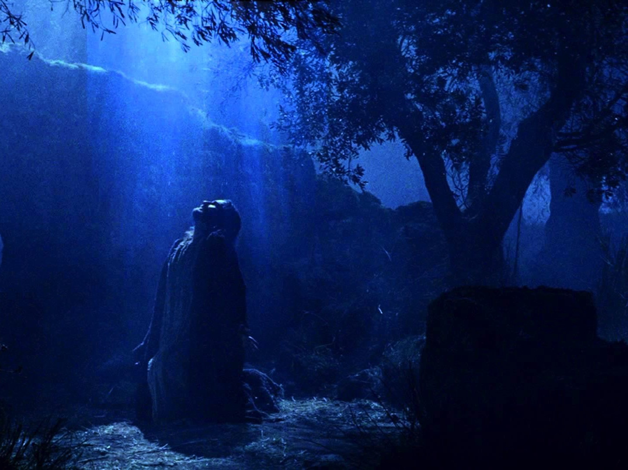
Messiah
42a
Jesus created the earth (1:26) and will defeat Satan (3:15), after descending from the line of Abraham (12:1-3) so that he might rule in the line of Judah (49:10).
Genesis
Notes:
Christ is intimated in the “Us” who created man (1:26) and pictured in the victor over the serpent (3:15), who will be the descendant of Abraham to bless all the world by offering salvation (12:1-3) as the prophesied King from Judah’s line (49:10).

Slide 10

Genesis
56
Origin in Election and Promise
Creation | Fall | Fall | Flood | Flood |  | Babel | Jacob | Abraham |  | Isaac | Jacob | Joseph | Joseph | Isaac
Primeval Events |  |  |  |  |  |  |  | Patriarchal Characters
1:1–11:26 |  |  |  |  |  |  |  | 11:27–50:26
God’s Election |  |  |  |  |  |  |  | God’s Promise
Adam and Descendants |  |  |  |  |  |  |  | Abraham and Descendants
1/5 of the Book |  |  |  |  |  |  |  | 4/5 of the Book
Mesopotamia |  |  |  |  |  |  |  | Canaan |  |  |  | Egypt
2083 Years (4143-2060 BC) |  |  |  |  |  |  |  | 215 Years (2060-1845 BC) |  |  |  | 71 Years (1845-1774 BC)
The tôledôt of… | Heavens & Earth |  | Adam | Noah | Sons of Noah | Sons of Noah | Shem | Terah | Ishmael | Ishmael | Isaac |  | Esau | Jacob
Creation | Post-Creation |  | Sons of Adam | Noah | Sons of Noah | Sons of Noah | Sons of Shem | Abraham & Isaac | Sons of Ishmael | Sons of Ishmael | Jacob |  | Sons of Esau | Joseph
1:1–2:3 | 2:4–4:26 |  | 5:1–6:8 | 6:9–9:29 | 10:1–11:9 | 10:1–11:9 | 11:10-26 | 11:27–25:11 | 25:12-18 | 25:12-18 | 25:19–35:29 |  | 36:1–37:1 | 37:2–50:26
Covers 2369 Years of History
Written During Wilderness Wanderings (c. 1405 BC)
Notes:
Genesis 1–11 shows Israel’s origin in election and pivots in Genesis 12 to show the nation originated in God’s promise to Abraham to bless all peoples. This chart combines both the Hebrew division into 11 toledot (generations) with the more simple two-fold division around chapter 12.

Slide 11
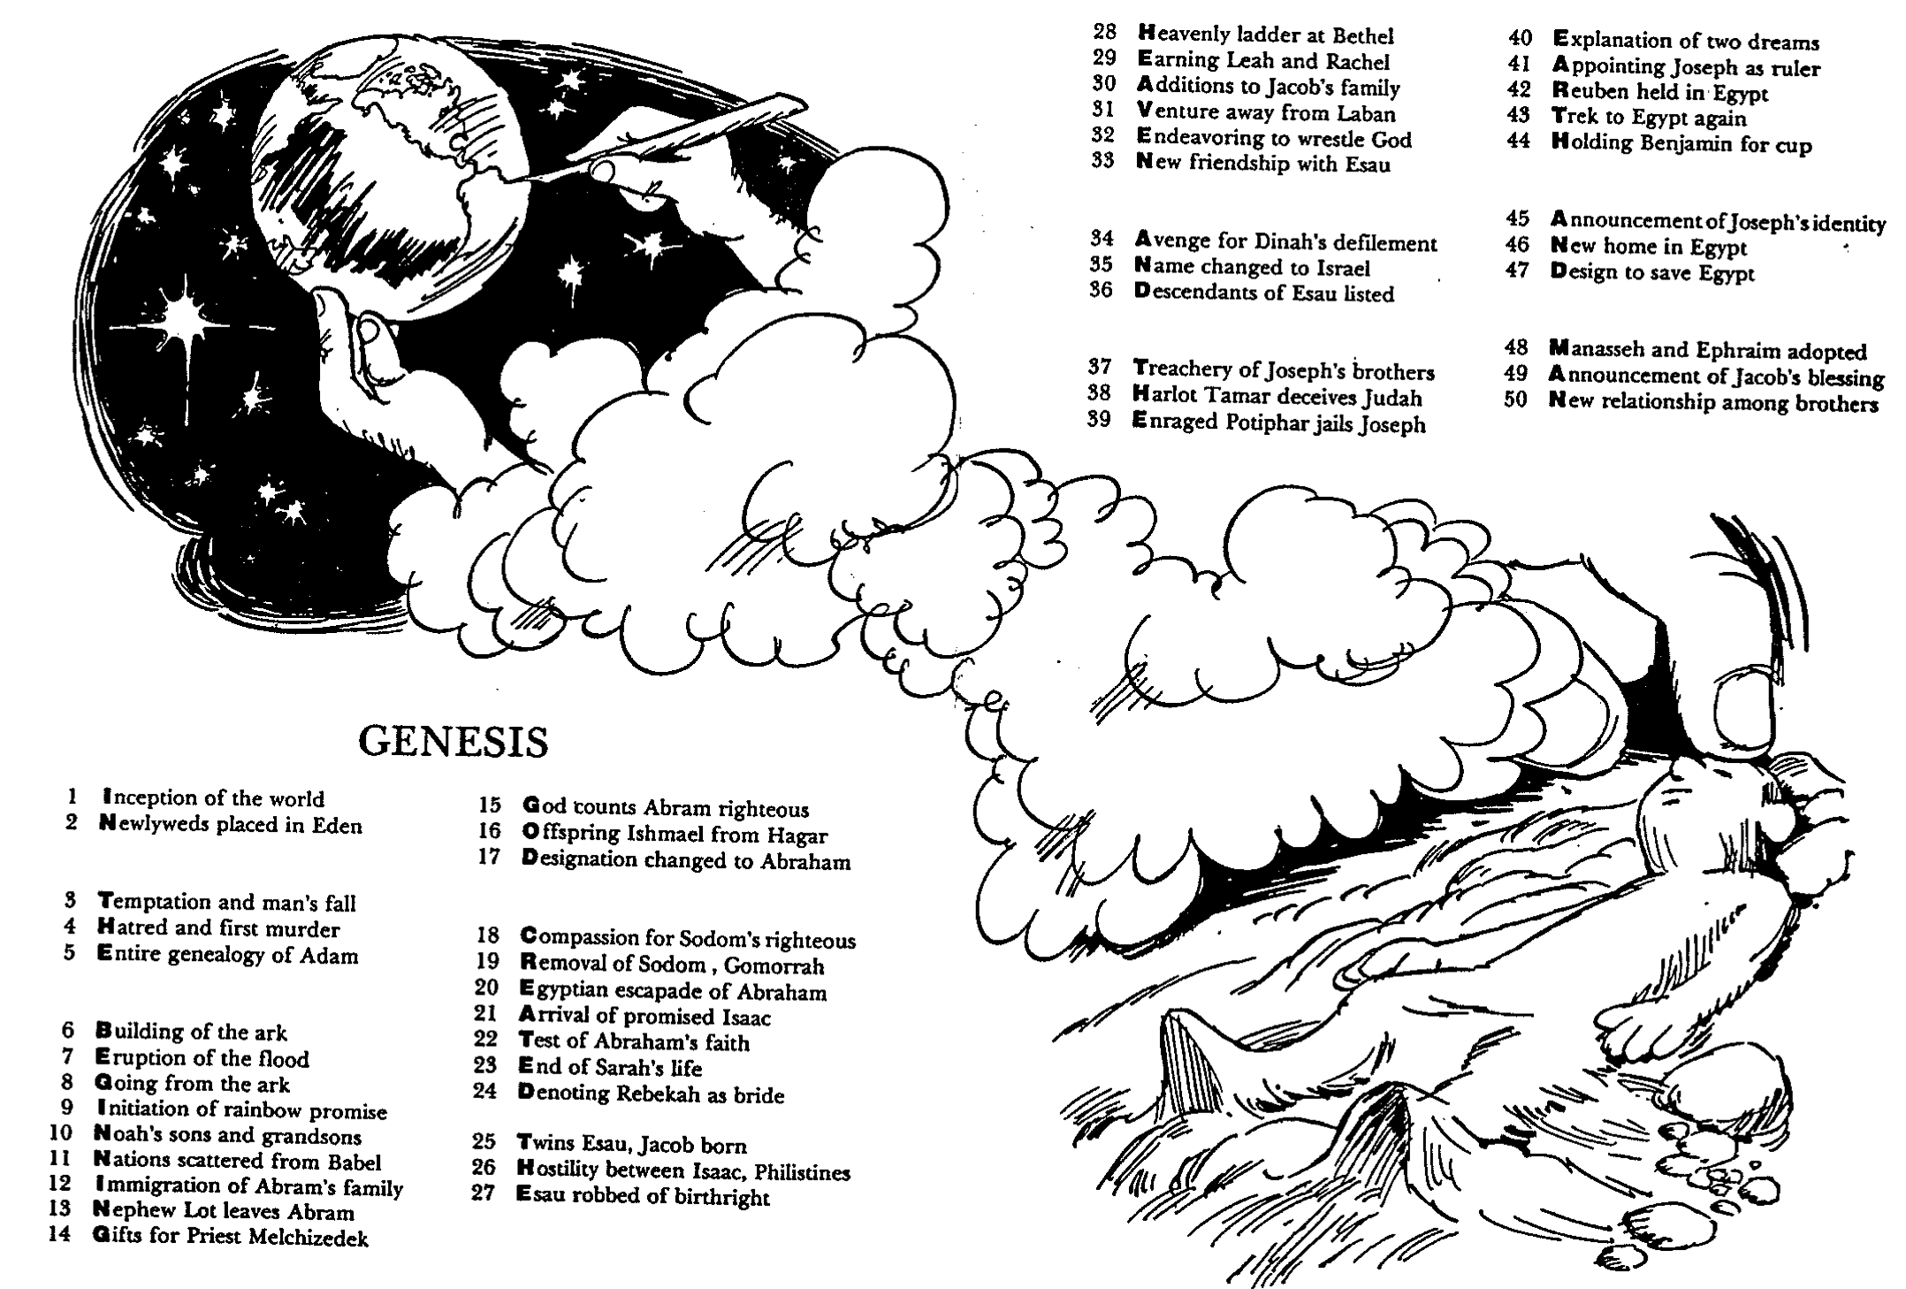
Barry Huddleston, The Acrostic Summarized Bible (Grand Rapids: Baker, 1992)
1 Inception of the world
2 Newlyweds placed in Eden
3 Temptation and man's fall
4 Hatred and first murder
5 Entire genealogy of Adam
6 Lessons on proper priorities
7 Outline for personal relationships
8 Faith of the centurion
29 Genealogy of Jesus Christ
30 Opposition of King Herod
31 Spirit's descent upon Jesus
32 Power over Satan's temptations
33 Expounding Sermon on Mount
34 Lessons on proper priorities
35 Outline for personal relationships
36 Faith of the centurion
9 Matthew's call from Jesus
10 Apostles sent to preach
11 Testimony about John's message
12 True Messiah called demonic
13 Hidden message of parables
14 Execution of the Baptist
15 Wisdom is answering Pharisees
37 Matthew's call from Jesus
38 Apostles sent to preach
39 Testimony about John's message
40 True Messiah called demonic
41 Hidden message of parables
42 Execution of the Baptist
43 Wisdom is answering Pharisees
Genesis
16 Keys of the kingdom
17 Impact of Jesus' transfiguration
18 Need for true forgiveness
19 Grounds for divorce clarified
20 Opportunities in the vineyard
21 Fig tree is cursed
44 Keys of the kingdom
45 Impact of Jesus' transfiguration
46 Need for true forgiveness
47 Grounds for divorce clarified
48 Opportunities in the vineyard
49 Fig tree is cursed
22 Taxes paid to Caesar
23 Hypocrisy denounced by "woes"
24 Events of second coming
25 Judgment of the nations
26 Events on Calvary's eve
27 Way of the cross
28 Savior's resurrection and commission
50 Taxes paid to Caesar
51 Hypocrisy denounced by "woes"
52 Events of second coming
53 Judgment of the nations
54 Events on Calvary's eve
55 Way of the cross
56 Savior's resurrection and commission
Notes:
Genesis depicts how “in the beginning God created the heaven and the earth and man,” though this actually only summarizes Genesis 1.
The Acrostic Summarized Bible depicts the theme of every biblical book in a vertical acrostic with that books’ theme in as many letters as there exist chapters in the book. Each chapter is summed up in four words where the first word doubles as part of the vertical acrostic for the entire book.

Slide 12

BE
FAITHFUL
Genesis
Dr. Rick Griffith, Crossroads International Church Singapore
CICFamily.com • BibleStudyDownloads.org
Notes:
The natural outworking of God choosing us for salvation and fulfilling his promise to bless us is to respond in faithfulness to him—to be reliable, dependable, and devoted to him.

Slide 13

Let's Study Through Scripture
The Bible: Book by Book
Notes:
This preaching series looks at each book in the Bible in a single sermon—66 messages that each cover an overview of an entire book.
I have taught through the Bible 37 times but never preached through it. Therefore, as I just finished 12 messages on the Minor Prophets, so now I will preach the other 54 books in the coming year until we learn all 66 books.
I encourage you to read through the Bible during this series, one book at a time.

Slide 14

A World of Idols
Notes:
In our hostile world full of idols, God says to be faithful to him as you face your future.
Persecution of Christians has been at its height the past century. More believers died in the 20th century than in the previous 19 centuries combined!
The media marginalizes the Christian viewpoint. One Supreme Court decision was thrown out because the Bible was used as evidence!

Slide 15


How can you be faithful to God in a world of idols?
IDOLS
of the
HEART
Notes:
In our hostile world of idols, God says to be faithful to him as you face your future. Christians have been persecuted more than ever in the past century. More believers were martyred in the 20th century than in the previous 19 centuries combined!
_________
“Son of man, these leaders have set up idols in their hearts. They have embraced things that will make them fall into sin. Why should I listen to their requests? ⁴ Tell them, ‘This is what the Sovereign LORD says: The people of Israel have set up idols in their hearts and fallen into sin, and then they go to a prophet asking for a message. So I, the LORD, will give them the kind of answer their great idolatry deserves. ⁵ I will do this to capture the minds and hearts of all my people who have turned from me to worship their detestable idols.’” (Ezekiel 14:3-6 NLT).

Slide 16

I. Grasp that the King chose you to rule.
Genesis 1–11
Notes:
We must know our amazing identity as God's elect people.

Slide 17

II. Grasp that the King promised you blessings.
Genesis 12–50
Notes:
We must know that being God's elect people guarantees incredible benefits.

Slide 18

Main Idea
Live out God's choice of you and promises for blessing
Genesis
Notes:
Make your life one that faithfully applies your election by God and his commitment to benefit you though Abraham.

Slide 19

What or who are you trusting to save you from your sin?
Genesis
Notes:
Whatever you trust has to be reliable!
Trust Christ to save you from your sin.

Slide 21
Slides on
Genesis 37

Slide 22
Youthful Indiscretion
Genesis 37:1-11

Slide 23
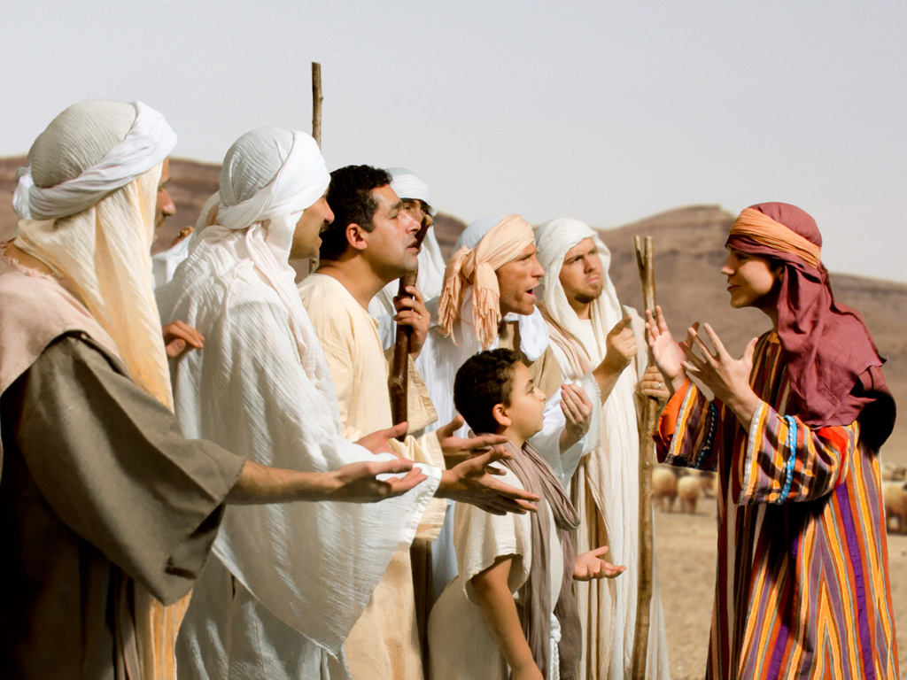
JOSEPH THE DREAMER
Genesis 37:1-10
Free
Bible
images

Slide 24
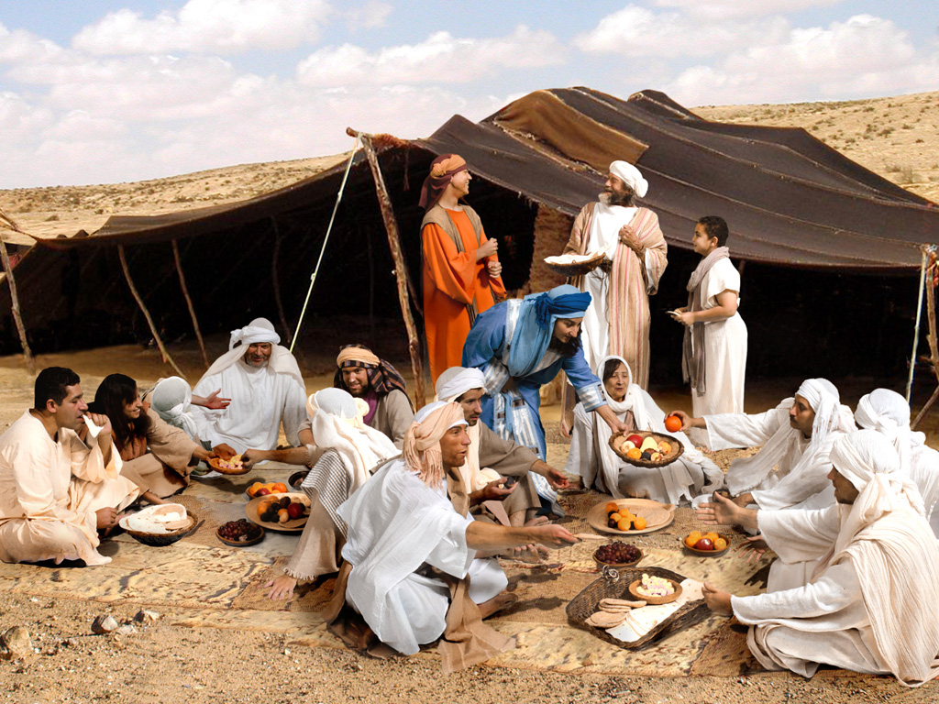

Slide 25
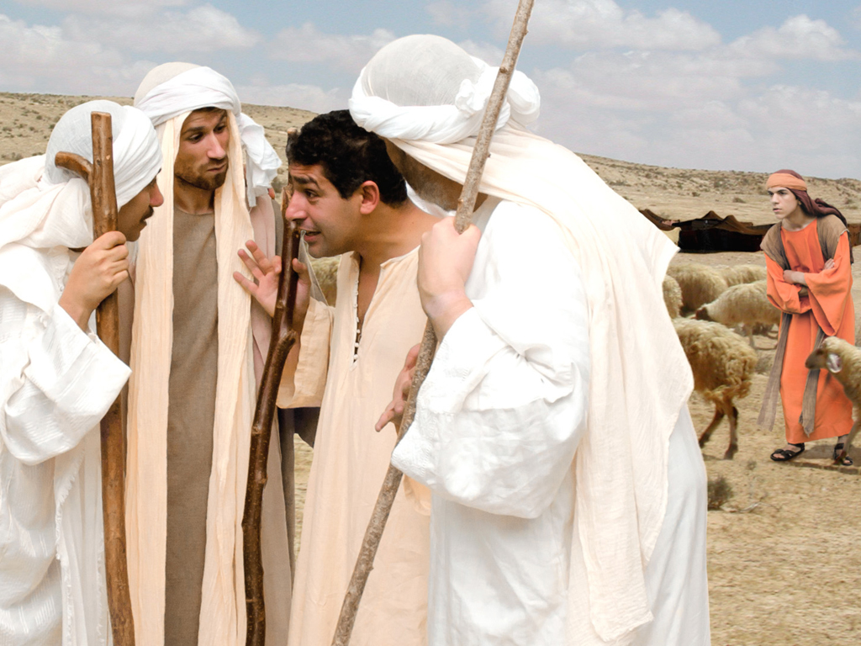

Slide 26
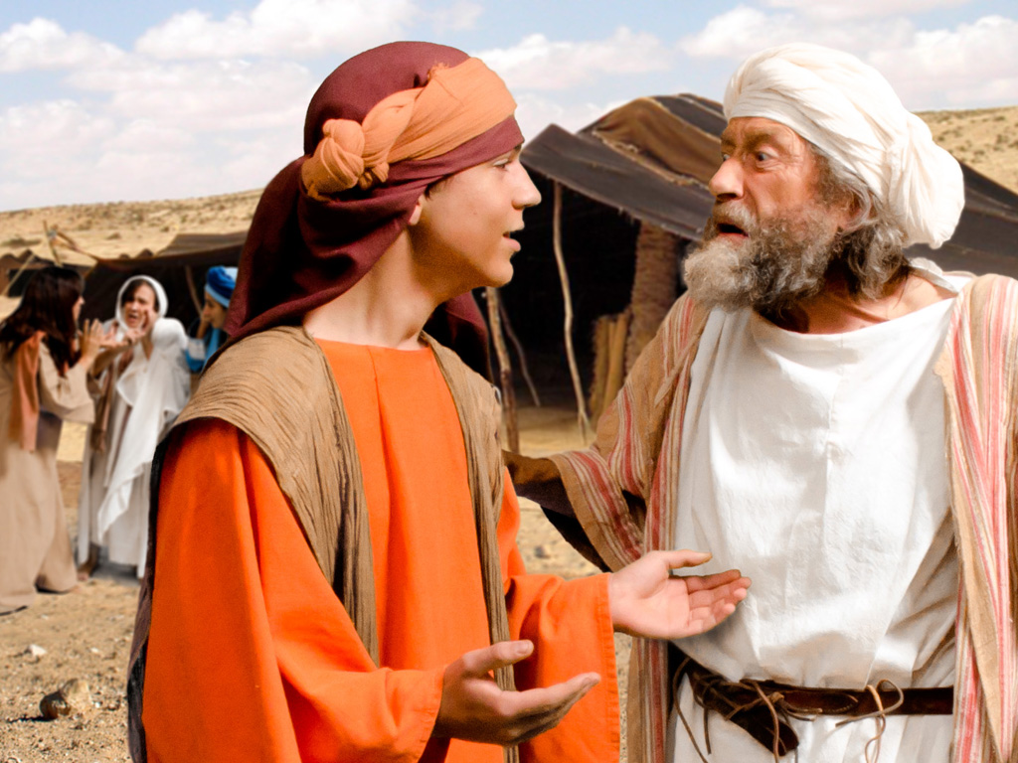

Slide 27
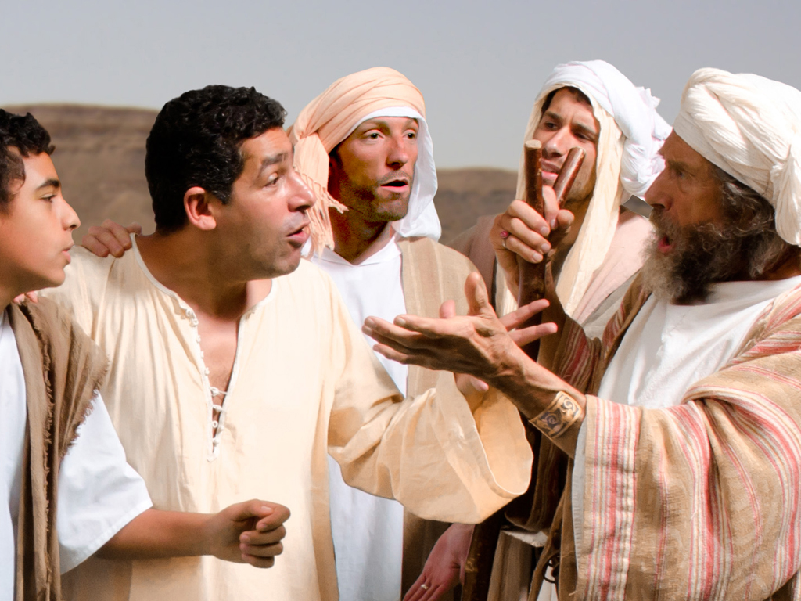

Slide 28
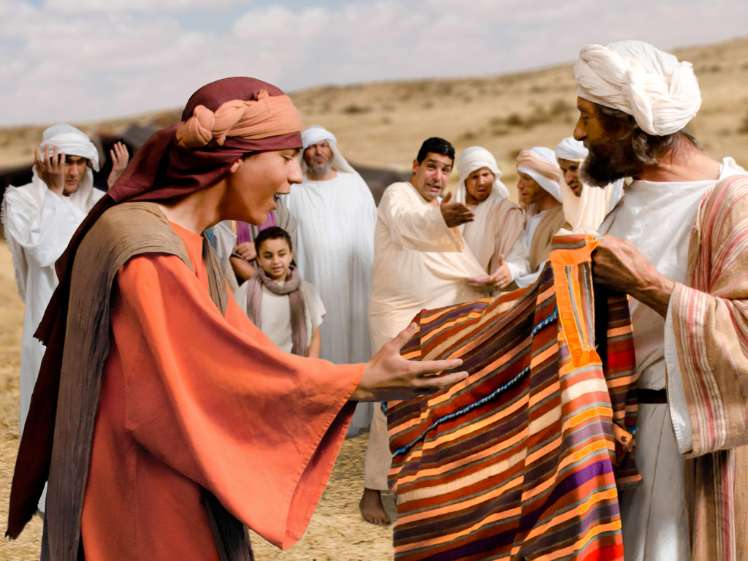

Slide 29
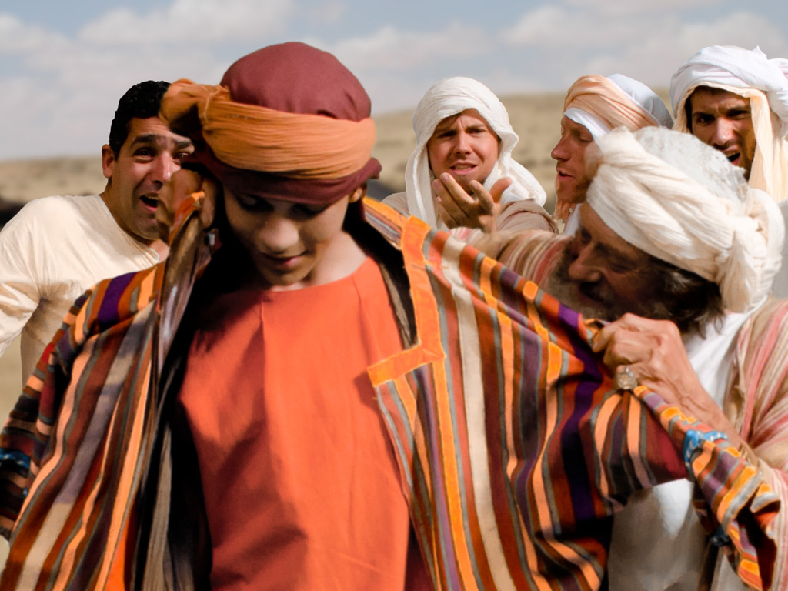

Slide 30
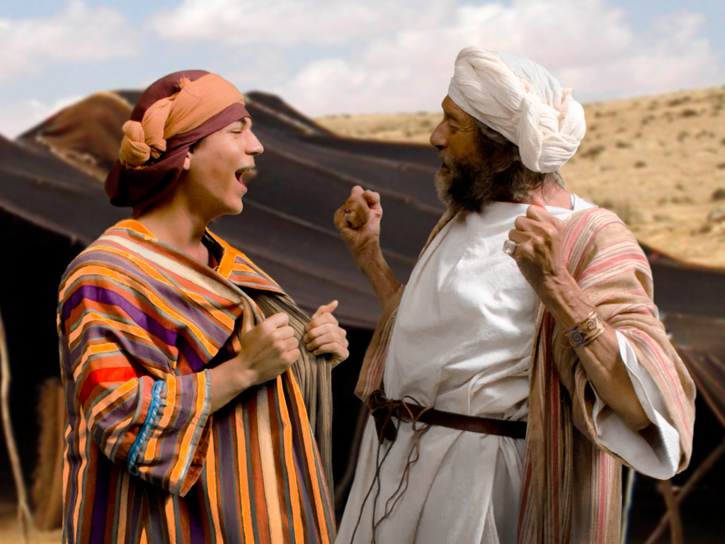

Slide 31
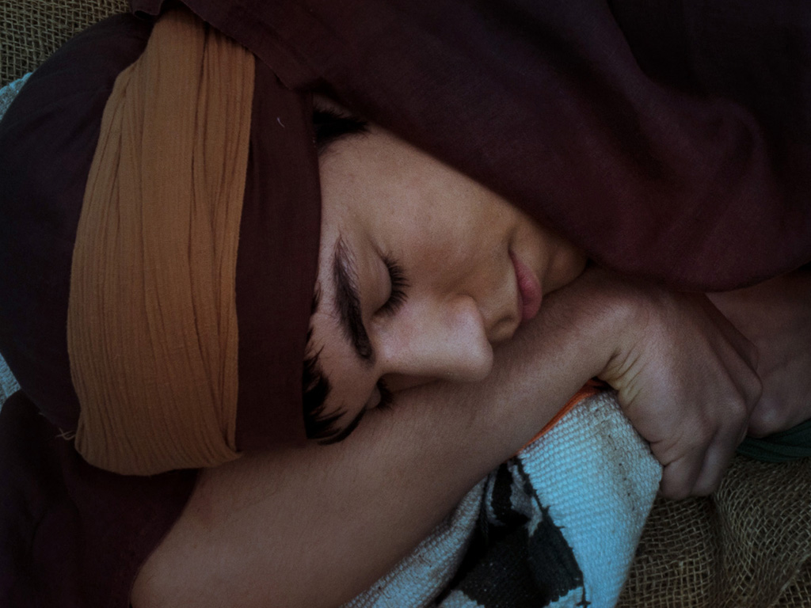

Slide 32
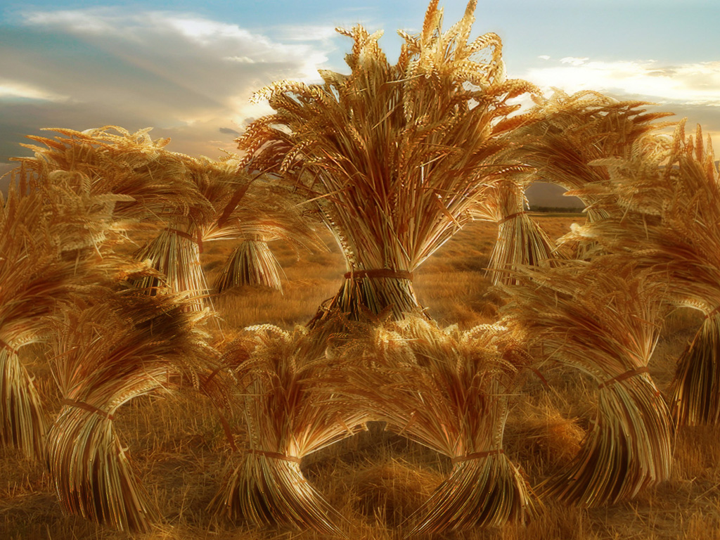

Slide 34
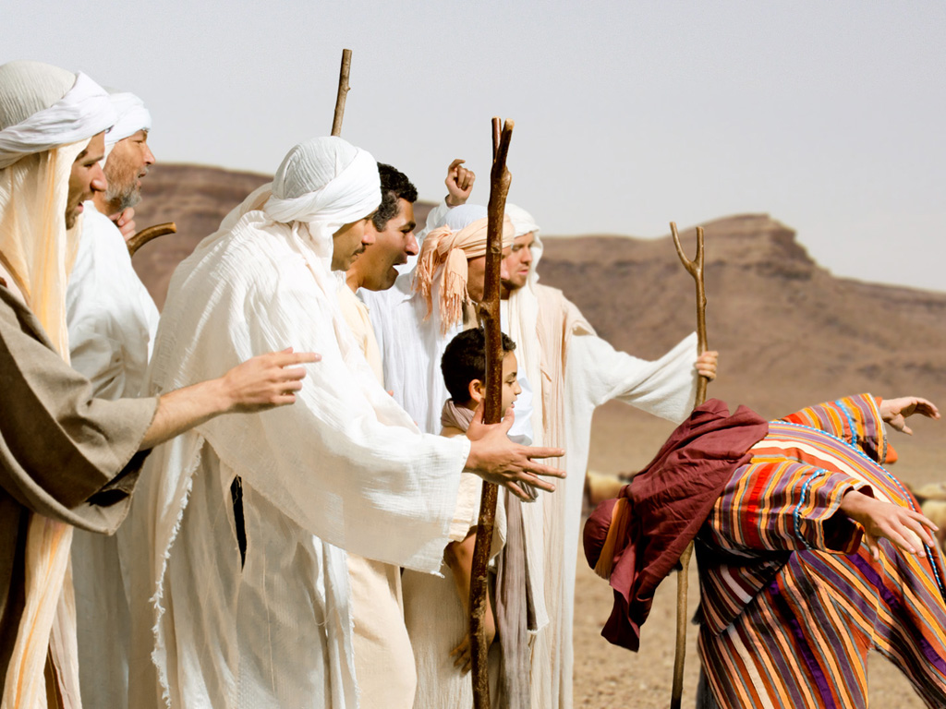

Slide 35
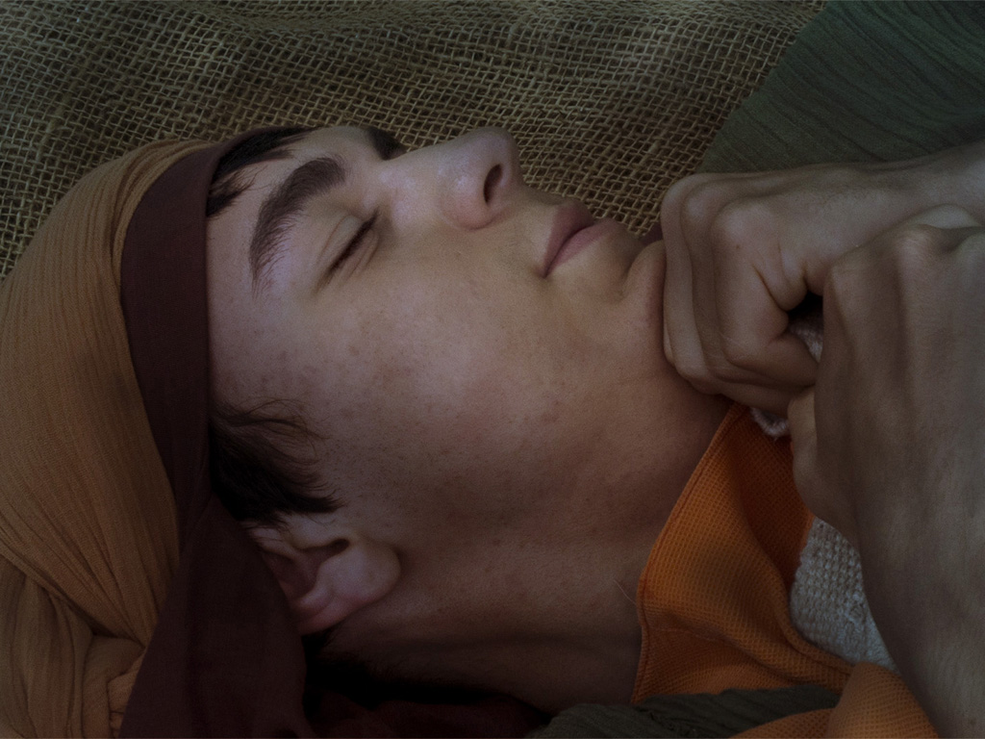

Slide 36
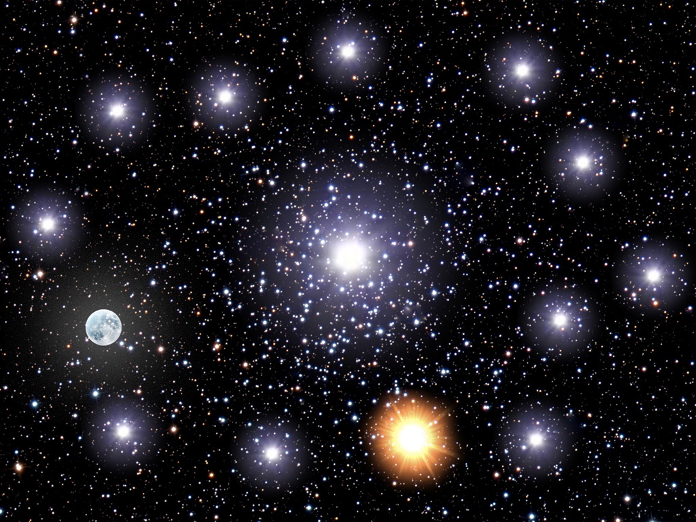

Slide 37
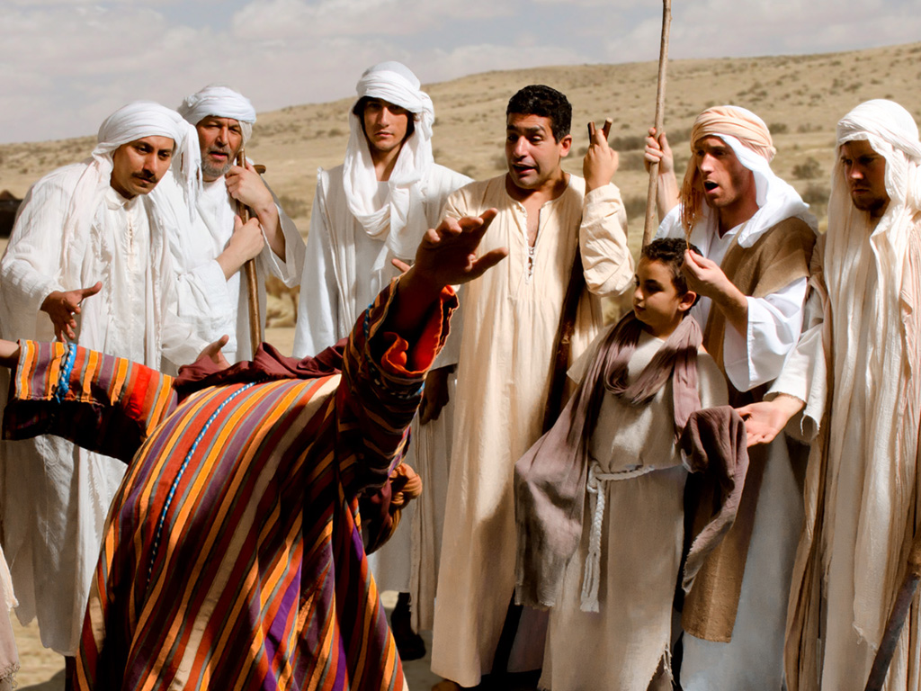

Slide 38
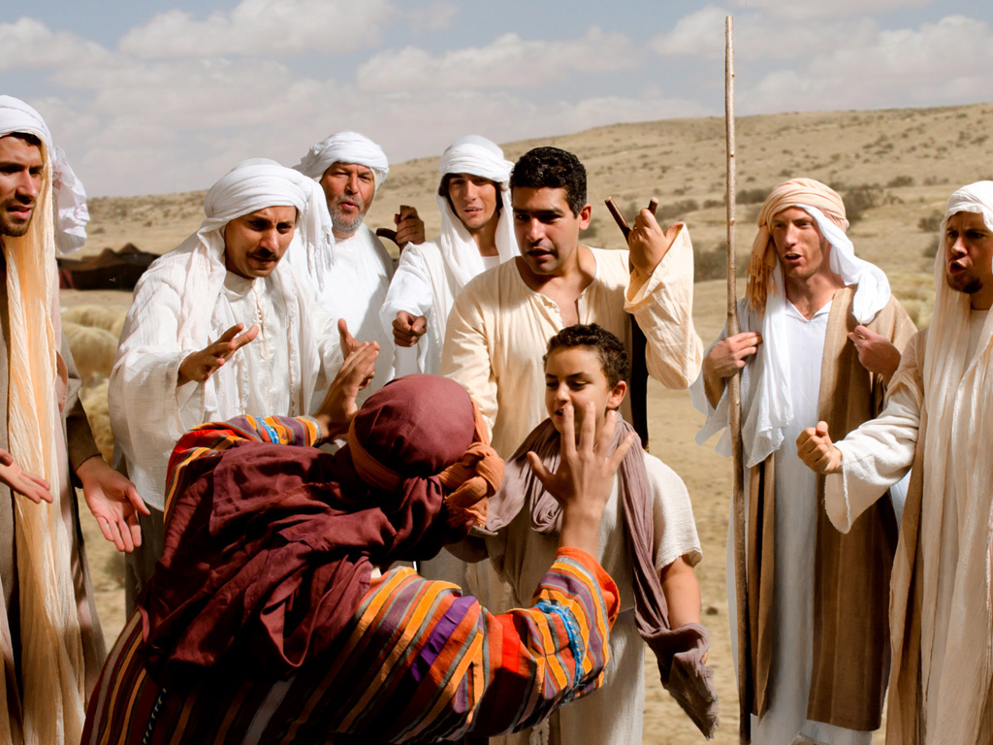

Slide 39
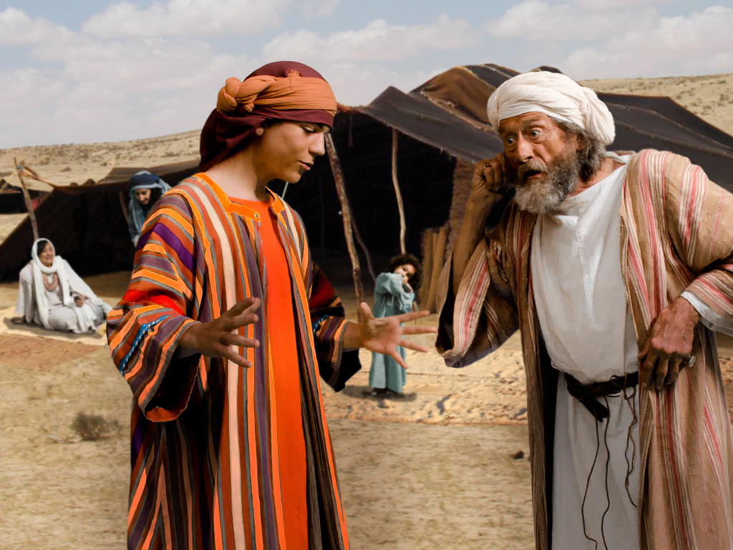

Slide 40
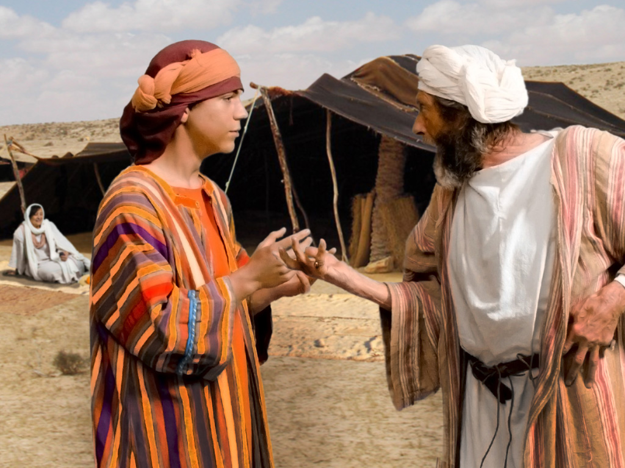

Slide 41
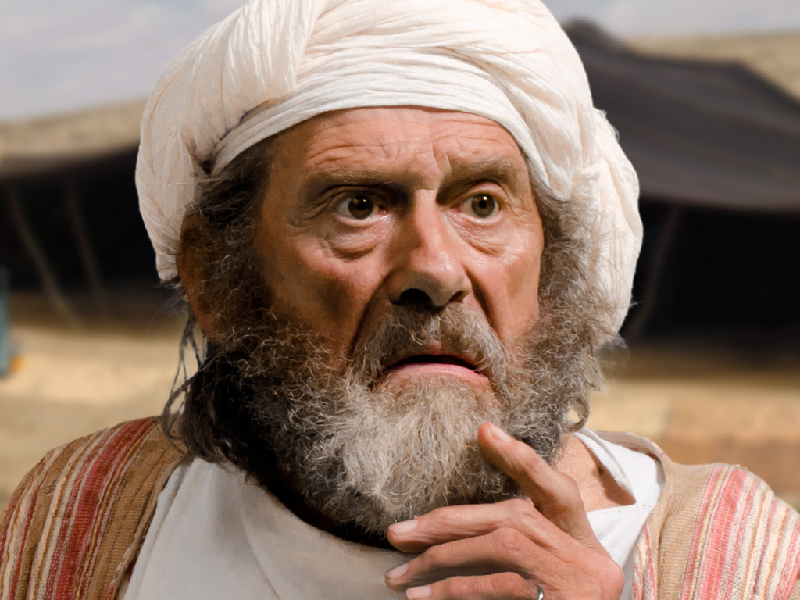

Slide 42

THE WORD IN PICTURES
Free
Bible
images

Slide 43


Slide 44
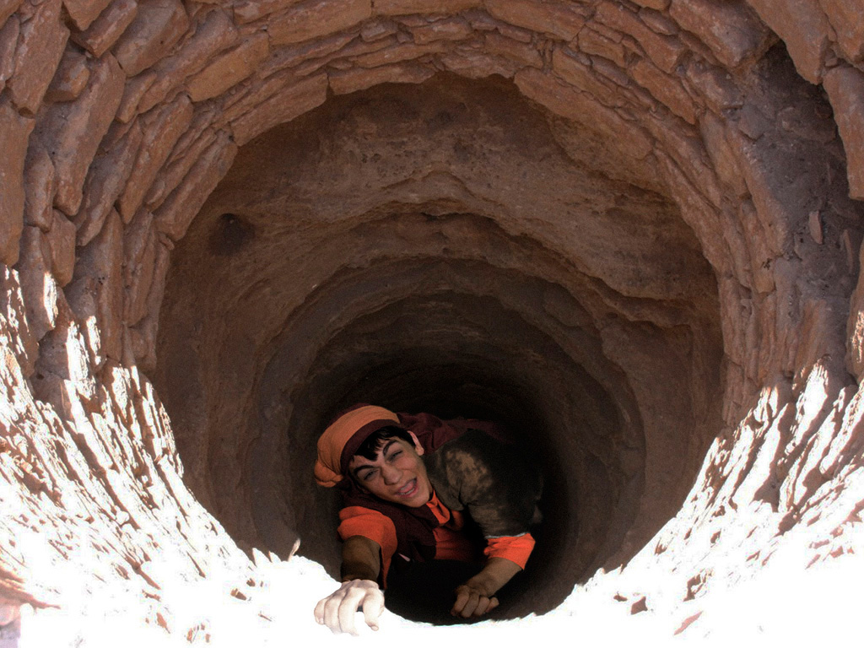
JOSEPH SOLD AS SLAVE
Genesis 37:12-36
Free
Bible
images

Slide 45
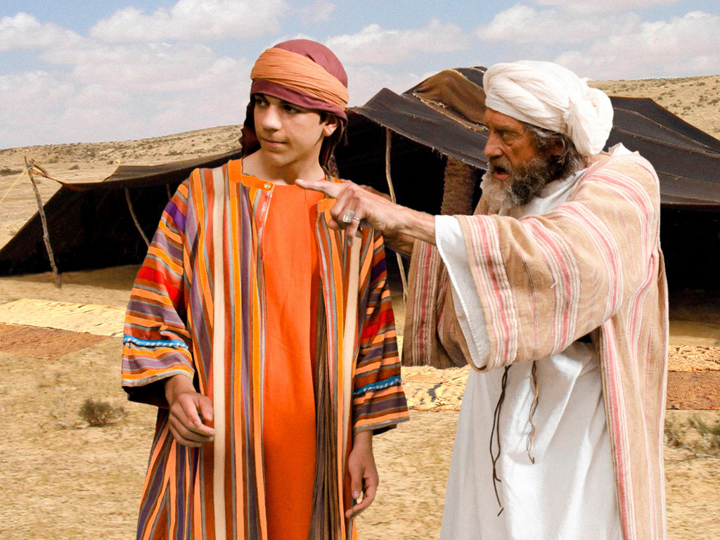

Slide 46
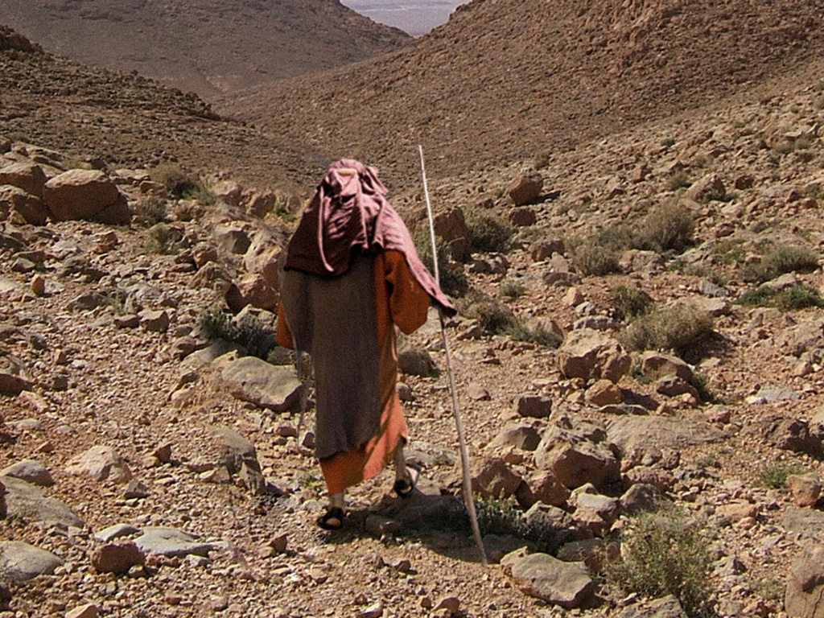

Slide 47
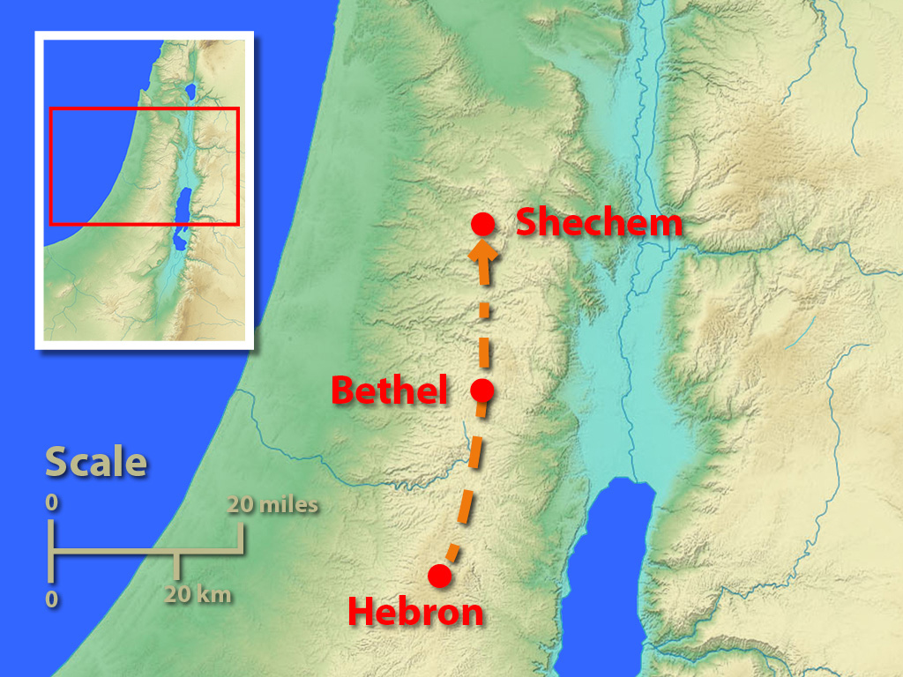

Slide 48
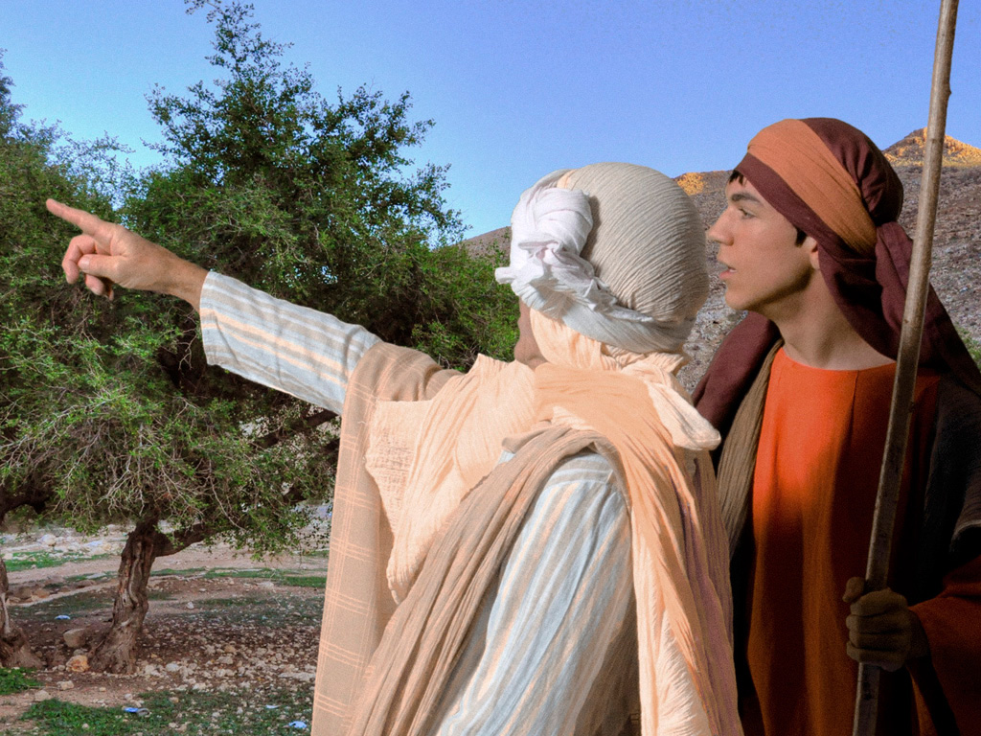

Slide 49
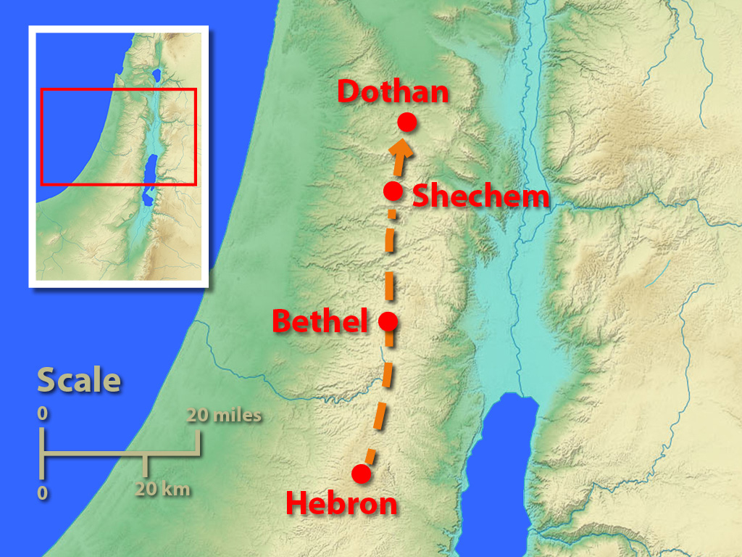

Slide 50
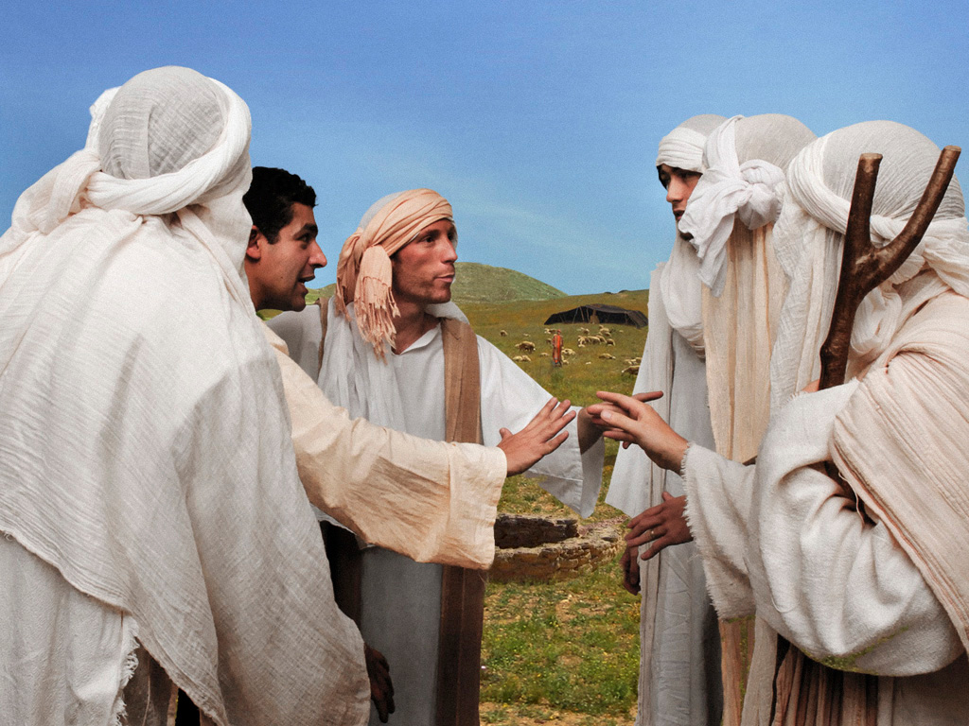

Slide 51
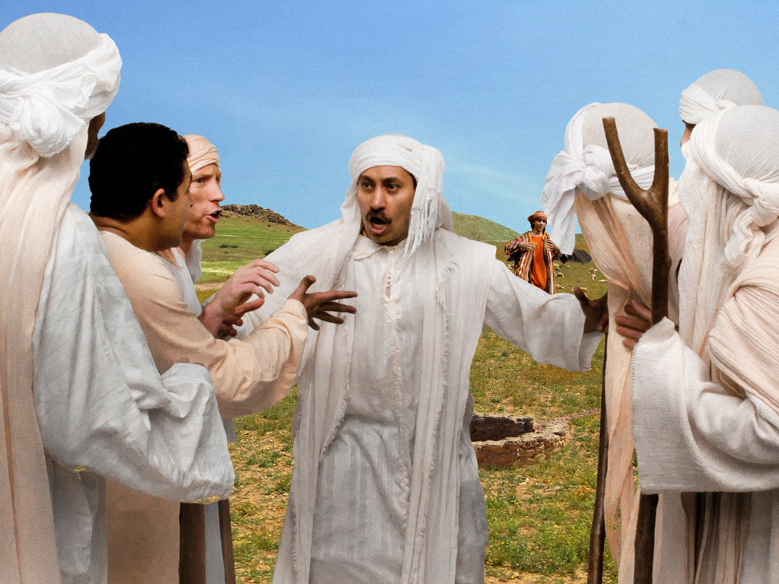

Slide 52
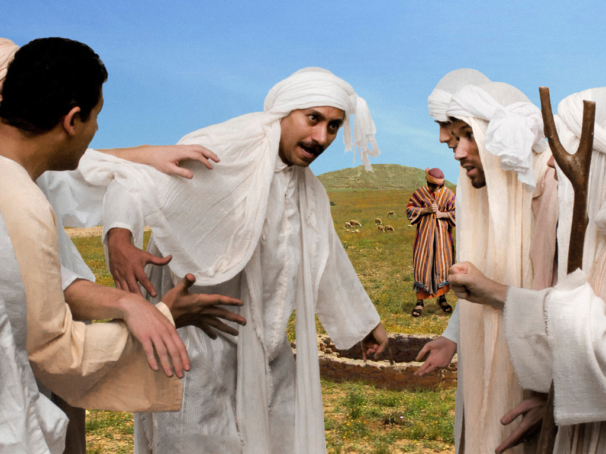

Slide 53
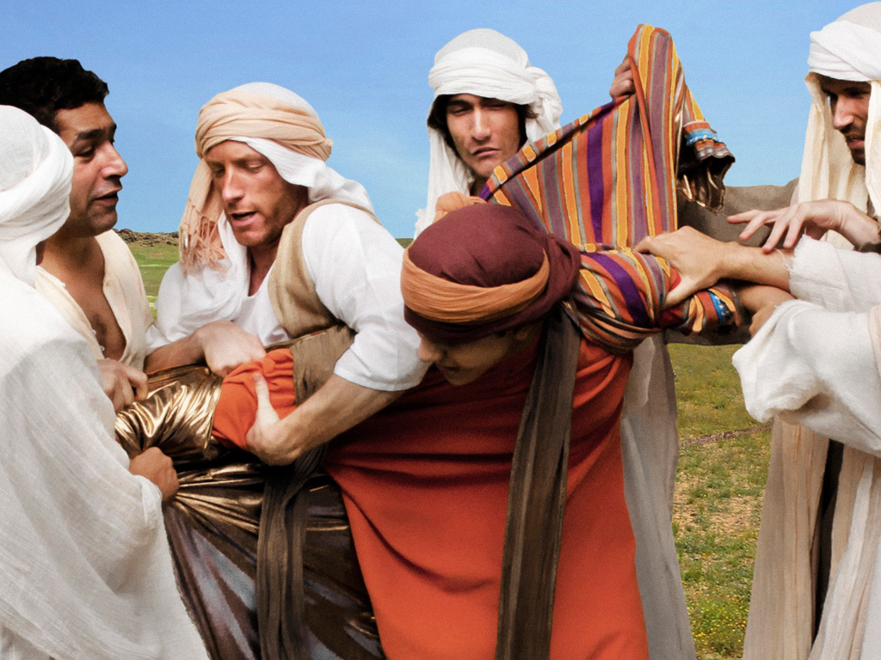

Slide 54
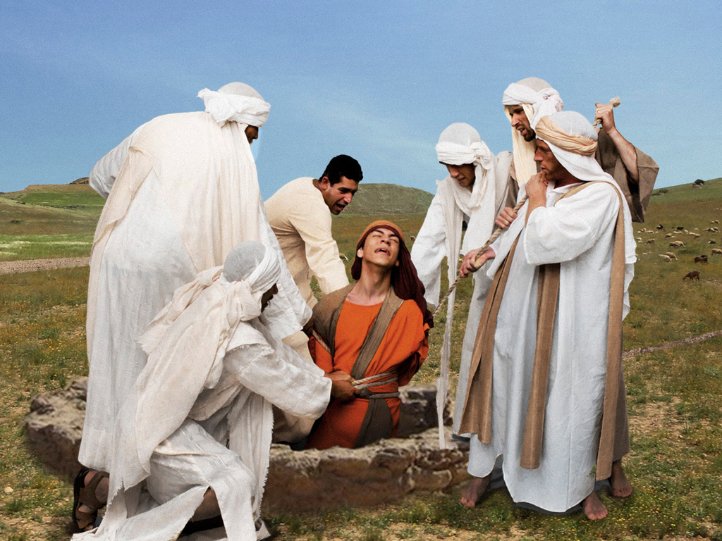

Slide 56
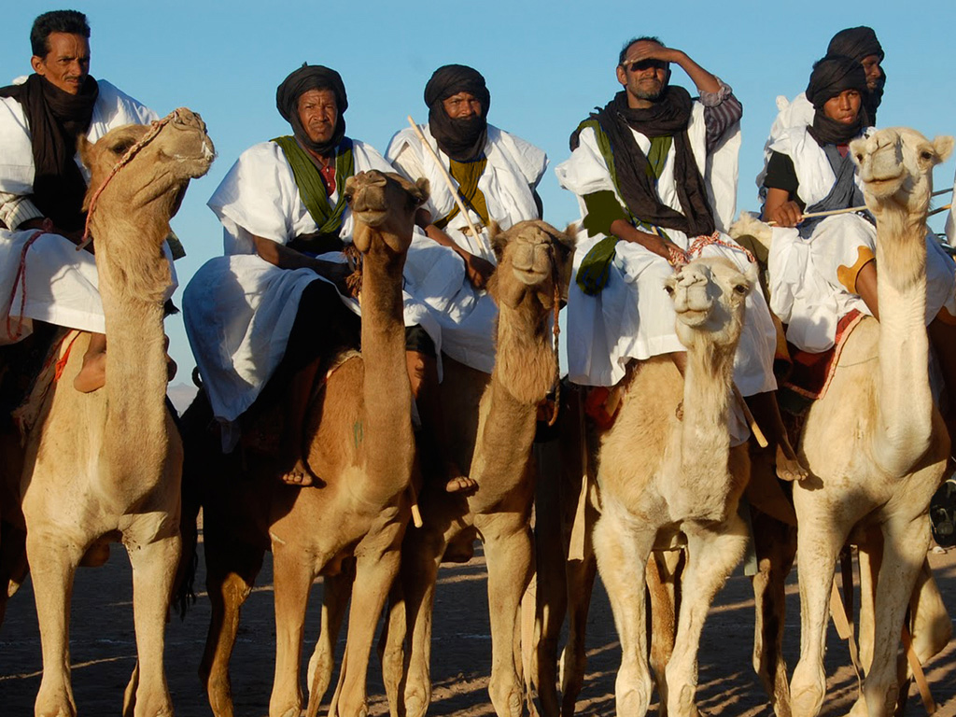

Slide 57
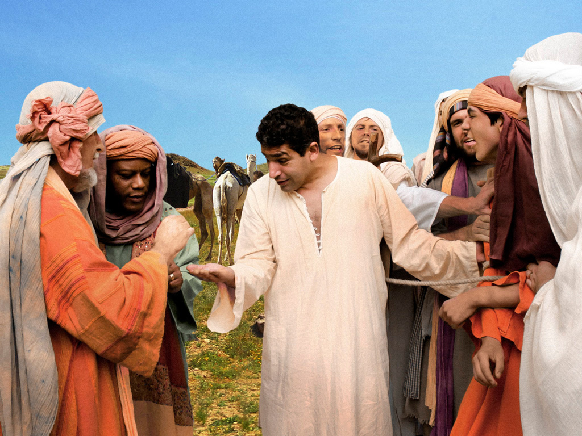

Slide 58
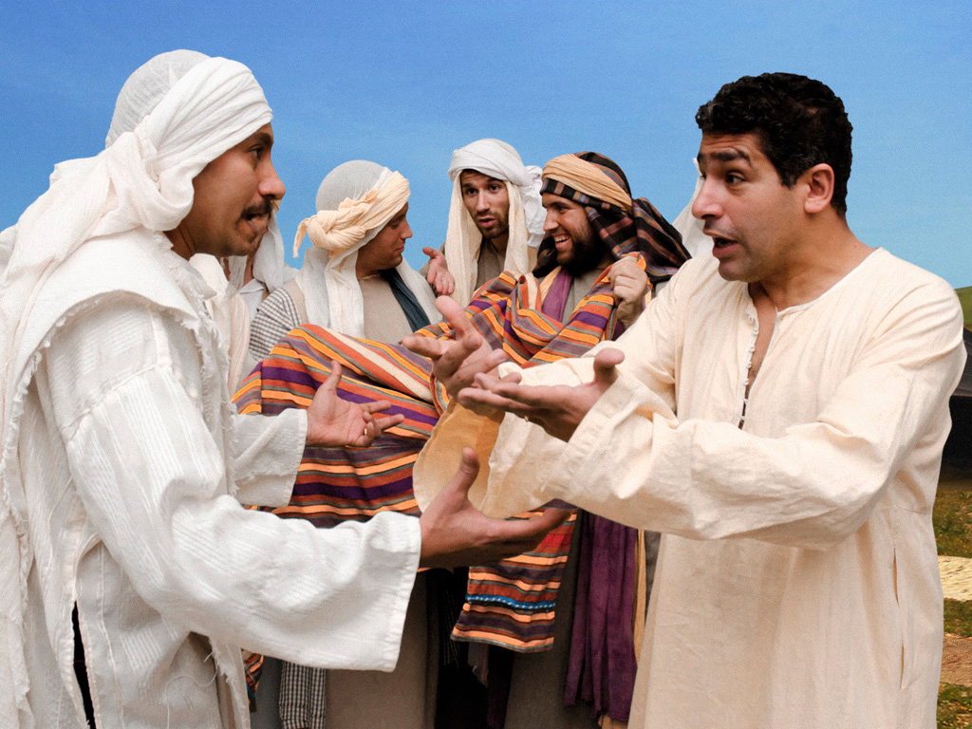

Slide 59
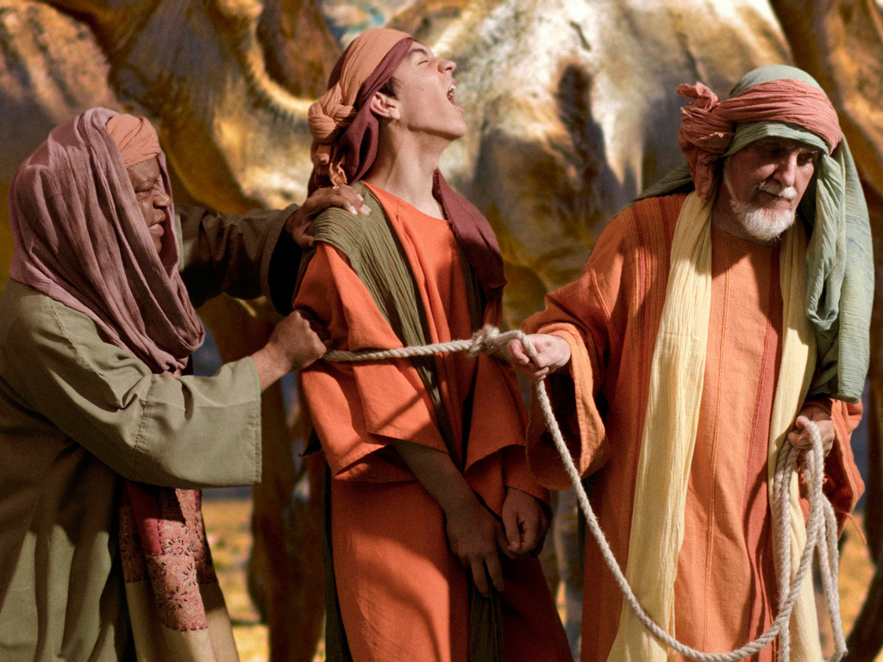

Slide 60
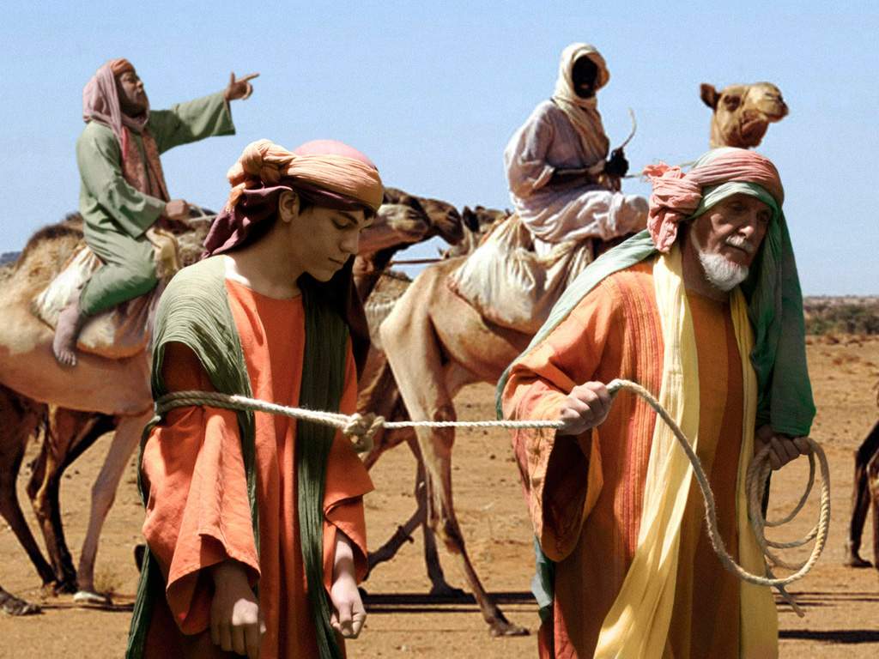

Slide 61
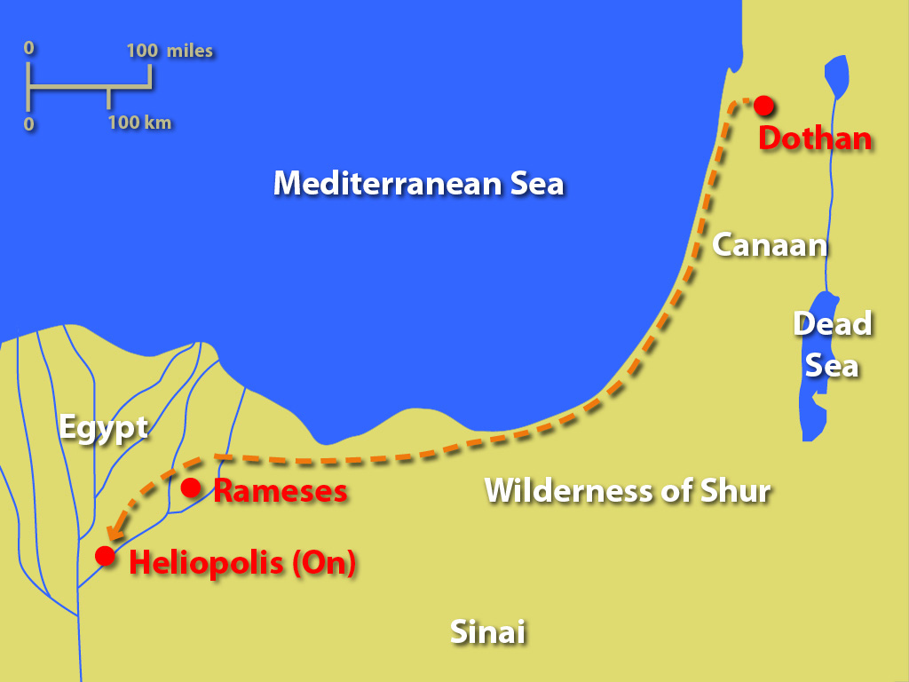

Slide 62
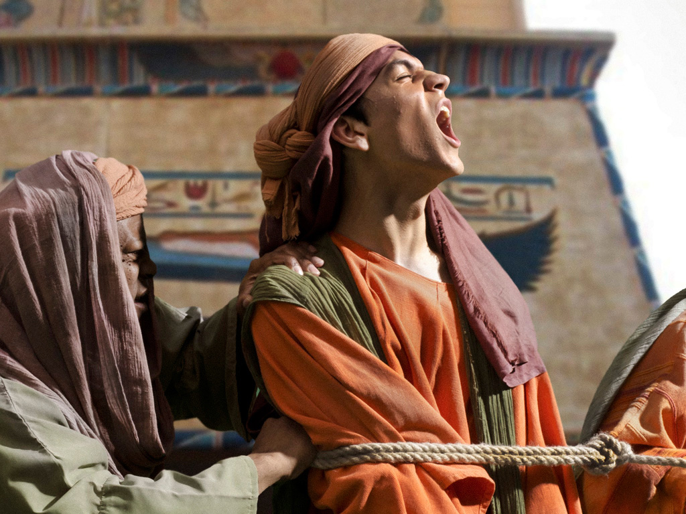

Slide 63
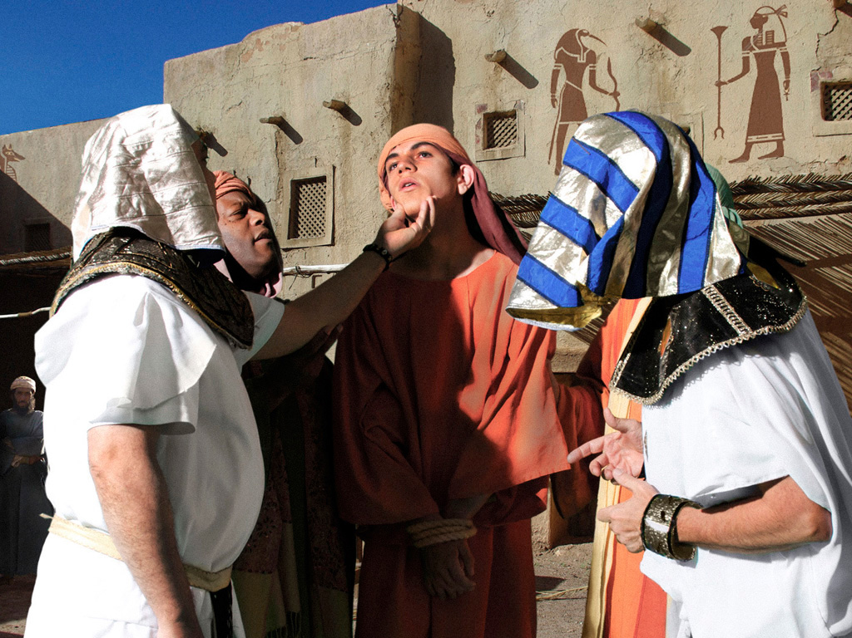

Slide 64
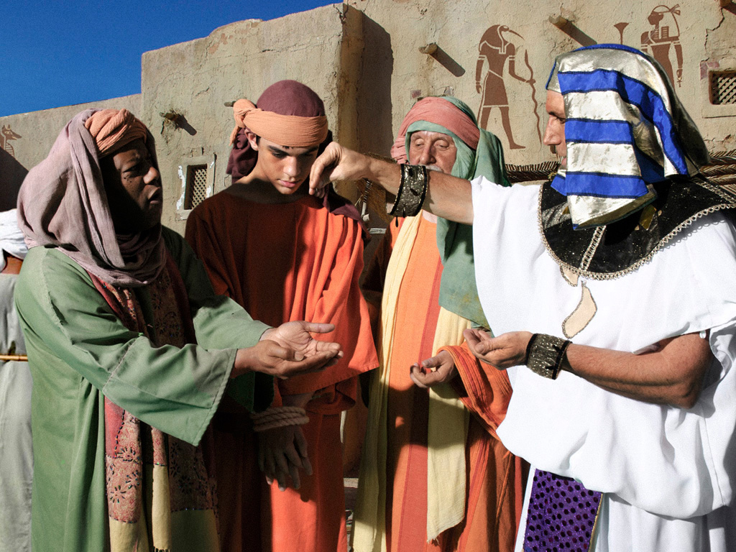

Slide 65
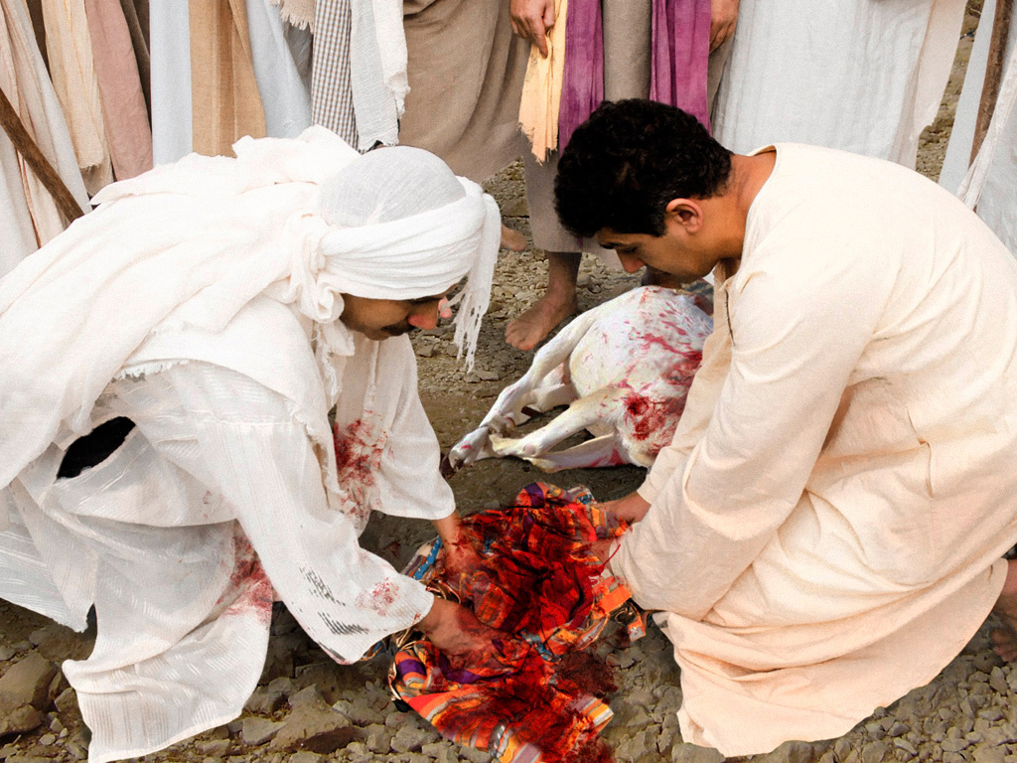

Slide 66
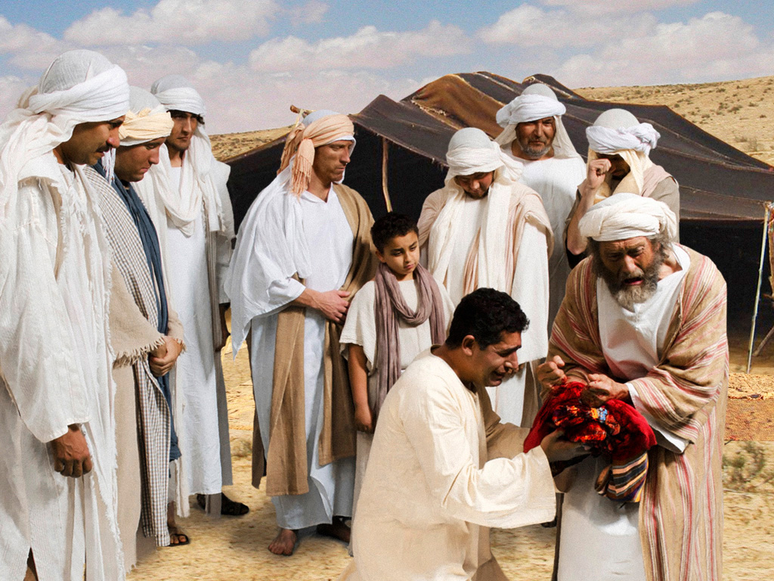

Slide 67
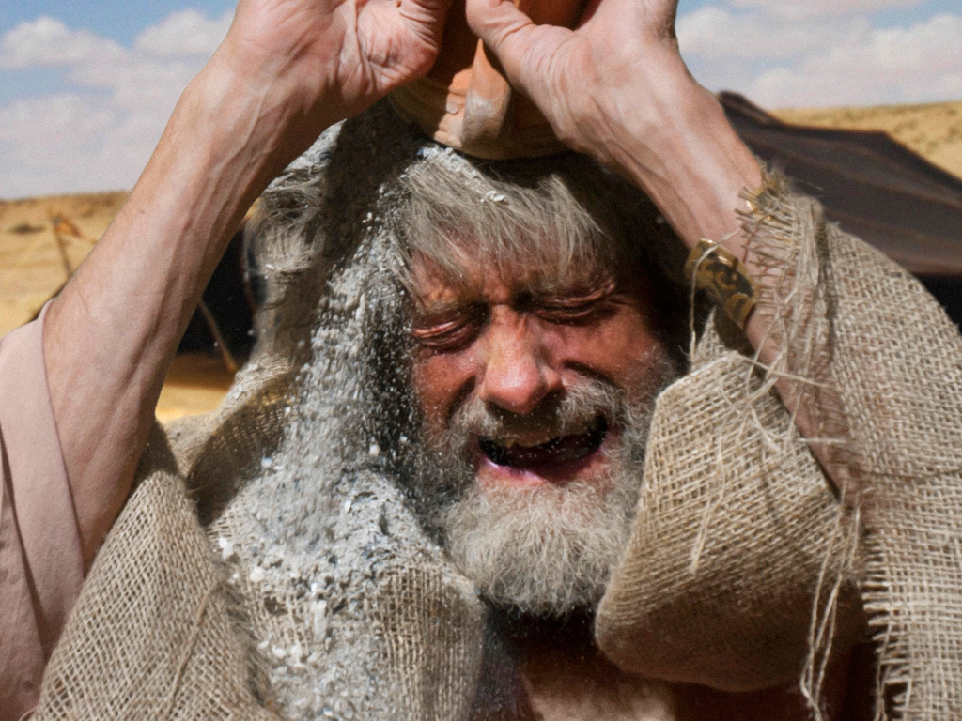

Slide 68
THE WORD IN PICTURES
Free
Bible
images

Slide 69
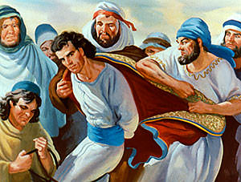
Joseph a Type of Christ
97b
Notes:
“Joseph—a Type of Christ
"By faith Joseph, when he died, made mention of the departing of the children of Israel; and gave commandment concerning His bones." Hebrews 11:22
Jacob had twelve sons. Joseph was his eleventh son, born to Jacob in his old age. Jacob loved Joseph more than all his children. This caused the older brothers to hate Joseph.
Once, when the older brothers were far away tending sheep, Jacob sent Joseph to see how they were. When the brothers saw Joseph coming, they conspired to kill him. One brother, Judah, did not want Joseph to be killed. He persuaded the others to sell him as a slave to a caravan of traders going to Egypt. The brothers told their father that wild beasts had killed Joseph.
Through no fault of his own, Joseph ended up as a slave in the house of Potiphar, a wealthy Egyptian man. But God was with Joseph.”
_________
Lesson 9: Jesus Christ is “Lord of All”
http://ubdavid.org/youth-world/winners1/winners1_09.html
Accessed 5 Feb 2016

Slide 70
From Palace to Prison
Genesis 37–40

Slide 71
Slides on
Genesis 38

Slide 72
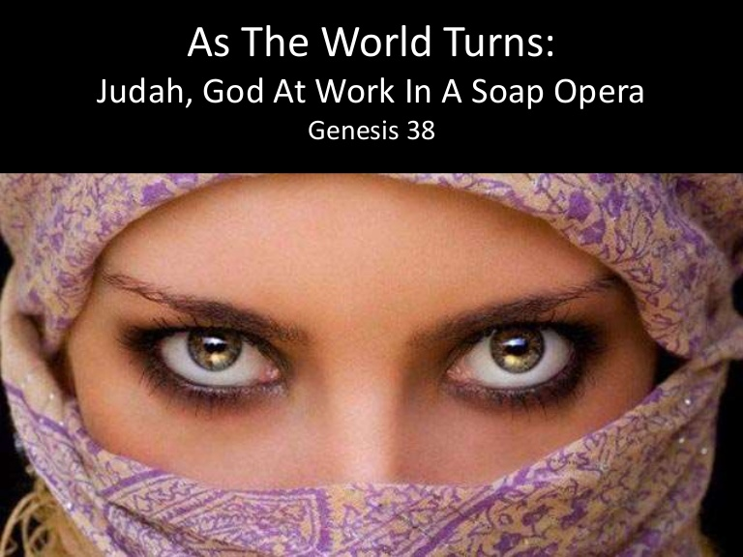
Judah the Creep (Tamar the Innocent)
God was at work even through the immorality of Abraham's descendants
—Genesis 38—

Slide 73
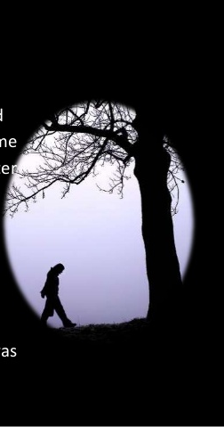
Judah the Creep (Tamar the Innocent)
About this time, Judah left home and moved to Adullam, where he stayed with a man named Hirah. ²There he saw a Canaanite woman, the daughter of Shua, and he married her. When he slept with her, ³she became pregnant and gave birth to a son, and he named the boy Er. ⁴Then she became pregnant again and gave birth to another son, and she named him Onan. ⁵And when she gave birth to a third son, she named him Shelah. At the time of Shelah’s birth, they were living at Kezib.
Genesis 38

Slide 74
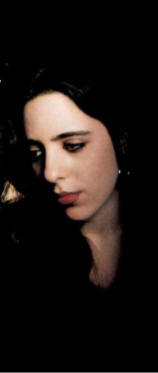
Judah the Creep (Tamar the Innocent)
⁶In the course of time, Judah arranged for his firstborn son, Er, to marry a young woman named Tamar. ⁷But Er was a wicked man in the LORD’s sight, so the LORD took his life. ⁸Then Judah said to Er’s brother Onan, “Go and marry Tamar, as our law requires of the brother of a man who has died. You must produce an heir for your brother.”
⁹But Onan was not willing to have a child who would not be his own heir. So whenever he had intercourse with his brother’s wife, he spilled the semen on the ground. This prevented her from having a child who would belong to his brother. ¹⁰But the LORD considered it evil for Onan to deny a child to his dead brother. So the LORD took Onan’s life, too.
Gen 38

Slide 75

Judah the Creep (Tamar the Innocent)
¹⁵Judah noticed her and thought she was a prostitute, since she had covered her face.
¹⁶So he stopped and propositioned her. “Let me have sex with you,” he said, not realizing that she was his own daughter-in-law. “How much will you pay to have sex with me?” Tamar asked.
¹⁷“I’ll send you a young goat from my flock,” Judah promised. “But what will you give me to guarantee that you will send the goat?” she asked. ¹⁸“What kind of guarantee do you want?” he replied. She answered, “Leave me your identification seal and its cord and the walking stick you are carrying.” So Judah gave them to her. Then he had intercourse with her, and she became pregnant.¹⁹Afterward she went back home, took off her veil, and put on her widow’s clothing as usual.
Genesis 38

Slide 76

Judah the Creep (Tamar the Innocent)
²⁴About three months later, Judah was told, “Tamar, your daughter-in-law, has acted like a prostitute. And now, because of this, she’s pregnant.” “Bring her out, and let her be burned!” Judah demanded. ²⁵But as they were taking her out to kill her, she sent this message to her father-in-law: “The man who owns these things made me pregnant. Look closely. Whose seal and cord and walking stick are these?” ²⁶Judah recognized them immediately and said, “She is more righteous than I am, because I didn’t arrange for her to marry my son Shelah.” And Judah never slept with Tamar again.

Slide 77

Judah the Creep (Tamar the Innocent)
Genesis 38
²⁷When the time came for Tamar to give birth, it was discovered that she was carrying twins. ²⁸ While she was in labor, one of the babies reached out his hand. The midwife grabbed it and tied a scarlet string around the child’s wrist, announcing, “This one came out first.” ²⁹ But then he pulled back his hand, and out came his brother! “What!” the midwife exclaimed. “How did you break out first?” So he was named Perez. ³⁰ Then the baby with the scarlet string on his wrist was born, and he was named Zerah.

Slide 78
Slides on
Genesis 39

Slide 79

JOSEPH AND POTIPHAR'S WIFE
Free
Bible
images
Genesis 39

Slide 80


Slide 81


Slide 82


Slide 83


Slide 84


Slide 85


Slide 86


Slide 87


Slide 88


Slide 89


Slide 90


Slide 91


Slide 92


Slide 93

“How could I sin against God?"
(Gen. 39:9)
Notes:
As Joseph had his coat taken from him in innocence, so Jesus offered his coat to those who crucified him.
“Potiphar's wife was a wicked woman who tried to seduce Joseph. When he fled from her presence, she was furious. She lied to her husband and told him that Joseph had tried to force her to have sex with him. Although Joseph was innocent, he was sent to prison and put in chains. But God was with him.
Sometime later, Pharaoh, king of Egypt, had a dream that troubled him. His wise men could not tell him the meaning of the dream. The chief butler told Pharaoh that Joseph could interpret his dream. Pharaoh immediately called for Joseph.”
_________
Lesson 9: Jesus Christ is “Lord of All”
http://ubdavid.org/youth-world/winners1/winners1_09.html
Accessed 5 Feb 2016

Slide 94


Slide 95


Slide 96


Slide 98


Slide 99


Slide 100


Slide 101


Slide 102


Slide 103


Slide 104
THE WORD IN PICTURES
Free
Bible
images

Slide 105


Slide 106

Joseph Works for Potiphar
Genesis 39:1-23

Slide 107

Notes:
Joseph was brought down to Egypt by the Ishmaelite traders to be sold as a slave.

Slide 108

Notes:
An Egyptian named Potiphar, an official of Pharaoh and the captain of the guard, purchased him from the Ishmaelites.

Slide 109

Notes:
Joseph was taken to Potiphar’s house and set to work as a slave. The Lord was with Joseph. He was successful as he served his Egyptian master.

Slide 110

Notes:
Potiphar observed that the Lord was with Joseph. Everything he did was successful. So, he promoted Joseph to become his personal attendant and overseer of his household. Joseph was now in charge of everything Potiphar owned. The Lord continued to bless everything Joseph did indoors and outdoors.

Slide 111

Notes:
Now Joseph was well built and good-looking. Potiphar’s wife took notice of Joseph and said, ‘Come to bed with me.’ But he refused, saying, ’Look, my master has trusted me to look after everything that he owns. There is no one greater in this household than I am. He has withheld nothing from me except you because you are his wife. So how could I do such a great evil and sin against God?’

Slide 112

Notes:
She continued to speak to Joseph day after day, but he did not respond to her invitations to go to bed with her.

Slide 113

Notes:
One day Joseph went into the house to do his work when none of the household servants were in the house.

Slide 114

Notes:
Potiphar’s wife grabbed Joseph by his outer garment, saying, ‘Come to bed with me!’

Slide 115

Notes:
Joseph struggled out of her grasp and left his outer garment in her hand to run outside. Potiphar’s wife called for her household servants and said to them, ‘See, my husband brought in a Hebrew slave to humiliate us. He tried to go to bed with me, but I screamed loudly. When he heard me raise my voice he left his outer garment beside me and ran outside.’

Slide 116

Notes:
When Potiphar heard his wife say, ‘This is the way your slave treated me,’ he was furious.

Slide 117

Notes:
Potiphar took Joseph and threw him into the prison where the king’s prisoners were confined. But in prison the Lord was with Joseph and showed him kindness.

Slide 118


Slide 119

Joseph Interprets Dreams While in Prison
Genesis 39:21–40:23

Slide 120

Notes:
Joseph was unfairly put in prison but the Lord was with him and showed him kindness. The Lord granted him favour in the sight of the prison warden.

Slide 121

Notes:
The warden put all the prisoners under Joseph’s care. He was now in charge of whatever the prisoners were doing. The warden did not concern himself with anything in Joseph’s care because the Lord was with Joseph and whatever he did was successful.

Slide 122

Notes:
At that time the cupbearer to Pharaoh, the king of Egypt offended his master and was put in the same prison as Joseph.

Slide 123

Notes:
Pharaoh’s baker also enraged him …

Slide 124

Notes:
… and he was imprisoned also. The captain of the guard appointed Joseph to be their attendant, and he served them both.

Slide 125

Notes:
One night, while in prison, the cupbearer and the baker both had dreams. Each man’s dream had its own meaning. When Joseph came to them in the morning, he saw that they were looking depressed and asked, ‘Why do you look so sad today?’
They told him, ‘We both had dreams, but there is no one to interpret them.
Joseph responded, ‘Don’t interpretations belong to God? Tell them to me.’

Slide 126

Notes:
So the chief cupbearer told his dream to Joseph: ‘In my dream, there was a vine in front of me. On the vine there were three branches. As it budded, its blossoms opened and its clusters ripened into grapes. Now Pharaoh’s cup was in my hand, so I took the grapes, squeezed them into his cup, and put the cup in Pharaoh’s hand.’

Slide 127

Notes:
‘This is its meaning,’ Joseph said to him. ‘The three branches represent three days. In three more days Pharaoh will reinstate you and restore you to your office. You will put Pharaoh’s cup in his hand, just as you did before when you were cupbearer. But remember me when it goes well for you. Make mention of me to Pharaoh and bring me out of this prison, for I really was kidnapped from the land of the Hebrews and I am in prison having done nothing wrong.”

Slide 128

Notes:
When the chief baker saw that the interpretation of the first dream was favourable, he said to Joseph, ‘I also appeared in my dream and there were three baskets of white bread on my head. In the top basket there were baked goods of every kind for Pharaoh, but the birds were eating them from the basket that was on my head.’

Slide 129

Notes:
Joseph replied, ‘This is its meaning: The three baskets represent three days. In three more days Pharaoh will execute you and impale you on a pole. Then the birds will eat your flesh.’

Slide 130

Notes:
On the third day it was Pharaoh’s birthday, so he gave a feast for all his servants.

Slide 131

Notes:
He released his chief cupbearer from prison.

Slide 132

Notes:
Pharaoh restored the chief cupbearer to his former position just as Joseph had said.

Slide 133

Notes:
That same day, the baker was taken out of prison and executed.

Slide 134

Notes:
The chief cupbearer did not remember Joseph—he forgot all about him. So Joseph remained a prisoner for a further two years.

Slide 136

Free
Bible
images
JOSEPH, THE BAKER, AND THE CUPBEARER
Genesis 39:20–40:23

Slide 137


Slide 138


Slide 139
Slides on
Genesis 40

Slide 140


Slide 141


Slide 142


Slide 143


Slide 144


Slide 145


Slide 146


Slide 147


Slide 148


Slide 149


Slide 151


Slide 152


Slide 153


Slide 154


Slide 155


Slide 156


Slide 157


Slide 158


Slide 159


Slide 160


Slide 161


Slide 162


Slide 163


Slide 164


Slide 165


Slide 166


Slide 167


Slide 168

Joseph in Prison (Genesis 40)

Slide 169

Joseph in Prison (Genesis 40)

Slide 170

Joseph in Prison (Genesis 40)

Slide 171
Slides on
Genesis 41

Slide 172
Joseph's Exaltation
Genesis 41–50

Slide 173

Genesis 41
Free
Bible
images
JOSEPH INTERPRETS PHARAOH’S DREAMS

Slide 174


Slide 175


Slide 176


Slide 177


Slide 178


Slide 179


Slide 180


Slide 181


Slide 182


Slide 183


Slide 184


Slide 185


Slide 186


Slide 187


Slide 188


Slide 189


Slide 190


Slide 191


Slide 192


Slide 194


Slide 195


Slide 196


Slide 197


Slide 199
Slides on
Genesis 42

Slide 200

Free
Bible
images
JOSEPH'S BROTHERS VISIT EGYPT
Genesis 42

Slide 201


Slide 202


Slide 203


Slide 204


Slide 205


Slide 206


Slide 207


Slide 208


Slide 209


Slide 210


Slide 212


Slide 213


Slide 214


Slide 215


Slide 216


Slide 217


Slide 218


Slide 219


Slide 220


Slide 221


Slide 222


Slide 223


Slide 224


Slide 225


Slide 226


Slide 227
THE WORD IN PICTURES
Free
Bible
images

Slide 228
Slides on
Genesis 43

Slide 229

Joseph Tests His Brothers
(Genesis 42–43)

Slide 230

Joseph Tests His Brothers
(Genesis 42-43)

Slide 231
Free
Bible
images
Genesis 43:1–45:15
JOSEPH'S BROTHERS RETURN TO EGYPT

Slide 232


Slide 233


Slide 234


Slide 235


Slide 236


Slide 237


Slide 238


Slide 239


Slide 240


Slide 241


Slide 242


Slide 243


Slide 244


Slide 245


Slide 246


Slide 247


Slide 248


Slide 249
Slides on
Genesis 44

Slide 250


Slide 251


Slide 252


Slide 253


Slide 254

Joseph's Cup (Genesis 44:17)

Slide 255


Slide 256


Slide 257

Joseph is Reunited with His Brothers
Genesis 43:1–44:15

Slide 258

Notes:
After Joseph’s brothers had eaten a meal at his house, Joseph told his chief steward, ‘Fill the men’s sacks with as much food as they can carry, and put each man’s silver in the mouth of his sack. Then put my cup, the silver one, in the mouth of the youngest one’s sack.’

Slide 259

Notes:
As morning dawned, the men were sent on their way with their donkeys. They had not gone far from the city when Joseph said to his steward, ‘Go after those men. When you catch up with them search their sacks and say to them, ‘Why have you repaid good with evil? The silver cup belonging to my Master is missing. This is a wicked thing you have done.’

Slide 260

Notes:
The servant caught up with the brothers. Each of them quickly lowered his sack to the ground and opened it. Then the steward proceeded to search, beginning with the oldest and ending with the youngest. And the silver cup was found in Benjamin’s sack.

Slide 261

Notes:
They all loaded their donkeys and returned to the city.

Slide 262

Notes:
Joseph was still in the house when Judah and his brothers came in, and they threw themselves to the ground before him. Joseph said to them, ‘What is this you have done?’

Slide 263

Notes:
Judah replied. ‘What can we say? How can we prove our innocence? God has uncovered your servants’ guilt. We are now your slaves.’

Slide 264

Notes:
But Joseph said, ‘Far be it from me to do such a thing! Only the man who was found to have the cup will become my slave. The rest of you, go back to your father in peace.’
Judah went up to Joseph and started pleading, ‘We cannot return to our father without Benjamin. Rebekah, his wife, bore him two sons. One of them is dead and if any harms come to the other my father will die in misery. Please take me as your slave. How can I go back to my father if the boy is not with me?’

Slide 265

Notes:
Then Joseph could no longer control himself and asked all his attendants to leave.
Joseph said to his brothers, ‘I am Joseph! Is my father still living?’
His brothers were speechless and terrified.

Slide 266

Notes:
Then Joseph said to his brothers, ‘Come close to me.’ When they had done so, he said, ‘I am your brother Joseph, the one you sold into Egypt! And now, do not be distressed and do not be angry with yourselves for selling me here, because it was to save lives that God sent me ahead of you.’

Slide 267

Notes:
‘For two years now there has been famine in the land, and for the next five years there will famine. But God sent me ahead of you to save your lives by a great deliverance.’

Slide 268

Notes:
‘So then, it was not you who sent me here, but God. He appointed me in charge of Pharaoh’s entire household and ruler of all Egypt.’

Slide 269

Notes:
‘Tell my father about all the honour awarded me in Egypt and about everything you have seen. And bring my father down here quickly.’

Slide 270

Notes:
Joseph threw his arms around his brother Benjamin and wept, and Benjamin embraced him, weeping. He kissed all his brothers and wept over them. Afterward his brothers talked with him.

Slide 271


Slide 272
Slides on
Genesis 45

Slide 273

"I am Joseph!
Is my father still alive?"
(Gen. 45:3)

Slide 274


Slide 275


Slide 277


Slide 278


Slide 279
THE WORD IN PICTURES
Free
Bible
images

Slide 280

Genesis 45:16–46:34
JOSEPH IS REUNITED WITH JACOB
Free
Bible
images

Slide 281


Slide 282


Slide 283


Slide 284


Slide 285


Slide 286


Slide 287


Slide 288


Slide 289
Slides on
Genesis 46

Slide 290

Jacob & the Family Move to Egypt
(Genesis 46)

Slide 291


Slide 292


Slide 293


Slide 294


Slide 295


Slide 296


Slide 298


Slide 299


Slide 300


Slide 301
THE WORD IN PICTURES
Free
Bible
images

Slide 302
Slides on
Genesis 47

Slide 303

Joseph a Type of Christ
97b
Jesus Christ
GOD'S
SON
"LORD OF ALL"!
Jesus Christ, now in the highest place in Heaven
Jesus, God's Son
Born as a tiny baby
Jesus
Rose from the dead
Went back to Heaven
Jesus
Served people
Jesus
Died on the cross for our sins
Notes:
As Joseph humbled himself, so Jesus did the same.
As Joseph was exalted, so was Jesus.
_________
Lesson 9: Jesus Christ is “Lord of All”
http://ubdavid.org/youth-world/winners1/winners1_09.html
Accessed 5 Feb 2016

Slide 304

City of Avaris

Slide 305

City of Avaris
Beneath Rameses
"Patterns of Evidence" is a film by Timothy Mahoney (Thinking Man Films, 2015) that presents amazing archaeological evidence for the Early Exodus discovered by Dr. David Rohl, an agnostic Egyptologist.

Slide 306

City of Avaris
It's been said THE EXODUS is not a historical event, that the Hebrews were never there in the number described, and yet the city of Avaris in the Egyptian Delta grew with great speed to be one of the biggest in the ancient world, with a large Semitic speaking population, right around the time the Bible places Israel in Egypt.
COINCIDENCE?
Notes:
Translate the text on the right and then drag it over the English above.

Slide 307

This palace with 12 columns lay directly before 12 tombs behind it
Notes:
The 12 pillars in front of the heart of the palace (Copyright 2014, Patterns of Evidence, LLC.)
“The palace had other interesting aspects; it initially contained 12 pillars at its entrance and had 12 primary tombs behind it. These fit the 12 sons of Jacob (who was also named Israel) who were the heads of the 12 tribes of Israel. The primary tomb of the Semitic official was in the shape of pyramid, something unique at this time for a foreigner – again fitting the great rewards and honor given by Pharaoh to Joseph.”
From the article:
12 Tribes Of Israel on a Seal From Egypt?
Steve Law
September 14, 2018
https://patternsofevidence.com/2018/09/14/12-tribes-of-israel-on-a-seal-from-egypt/
Accessed 30 Jan 2021

Slide 308

12 Tribes of Israel on a Seal from Avaris, Egypt?
Notes:
The 12 pillars in front of the heart of the palace (Copyright 2014, Patterns of Evidence, LLC.)
“The palace had other interesting aspects; it initially contained 12 pillars at its entrance and had 12 primary tombs behind it. These fit the 12 sons of Jacob (who was also named Israel) who were the heads of the 12 tribes of Israel. The primary tomb of the Semitic official was in the shape of pyramid, something unique at this time for a foreigner – again fitting the great rewards and honor given by Pharaoh to Joseph.”
From the article:
12 Tribes Of Israel on a Seal From Egypt?
Steve Law
September 14, 2018
https://patternsofevidence.com/2018/09/14/12-tribes-of-israel-on-a-seal-from-egypt/
Accessed 30 Jan 2021

Slide 309

Was this the palace of Joseph?
There was uncovered in Avaris an Egyptian palace, but its occupant wasn't Egyptian. It obviously belonged to some high official who was very important. When somebody gets a palace like this given to them, it means they have been honored for what they've done for the state.
Notes:
Translate the text on the right and then drag it over the English above.

Slide 310

12 Tombs Found Together

Slide 311

Is the pyramid Joseph's tomb?
Under the city of Rameses (Exod. 1:11) was a tomb occupant with a coat of many colors
It was a pyramid with 11 other tombs
No bones are left

Slide 312

Is the pyramid Joseph's tomb?
Under the city of Rameses (Exod. 1:11) was a tomb occupant with a coat of many colors
It was a pyramid with 11 other tombs
No bones are left

Slide 313

Statue of Joseph?
Notes:
Statue of the high Semitic official found in the shrine of the pyramid tomb and a digital reconstruction. (Copyright 2014, Patterns of Evidence, LLC.)
“In a shrine in front of the pyramid tomb, the remains of a colossal statue of the Semitic ruler were found – and he was depicted as wearing a multi-color coat. The bones of the person buried here were found to be missing. This again fits the promise made by Joseph’s family that they would take his bones with them when the left Egypt to return to the Promised Land..”
From the article:
12 Tribes Of Israel on a Seal From Egypt?
Steve Law
September 14, 2018
https://patternsofevidence.com/2018/09/14/12-tribes-of-israel-on-a-seal-from-egypt/
Accessed 30 Jan 2021

Slide 314

Is this Joseph’s statue?
Under the city of Rameses (Exod. 1:11) was a tomb occupant with a coat of many colors
It was a pyramid with 11 other tombs
No bones are left

Slide 315
Slides on
Genesis 48

Slide 316

Ephraim & Manasseh

Slide 317
Slides on
Genesis 49

Slide 318


Jacob's Blessing His 12 Sons Was Prophetic
(Gen. 49)
Notes:
Jacob was brutally honest about the character of his sons before he died.
____________
Common-175
OS-01-Gen37-50-slide 273

Slide 319


Blessing Judah & the Lesser Tribes
Jacob's Blessing His 12 Sons Was Prophetic
(Gen. 49)
Zebulun
Issachar
Levi
Reuben
Judah
Simeon
Notes:
The descendants of Simeon and Levi would be scattered due to their treachery at Shechem (Gen 34). Although the firstborn, Reuben would live outside the western land of Canaan.
____________
Common-176
OS-01-Gen37-50-slide 274

Slide 320

Christ Descended from Judah
"Judah, my son, is a young lion that has finished eating its prey. Like a lion he crouches and lies down; like a lioness—who dares to rouse him?
¹⁰The scepter will not depart from Judah, nor the ruler's staff from his descendants, until the coming of the one to whom it belongs, the one whom all nations will honor" (NLT).
Since Jacob's blessing in Genesis 49:9-10, the lion has depicted a king…
Notes:
God showed Jacob nearly 2000 years before the birth of Jesus that the Messiah would come from Judah in the south of Israel. Royalty in the image of a lion, a scepter, and a ruler's staff all point to Jesus, who will receive worldwide honor and worship.
____________
Common-177
OS-01-Gen37-50-slide 275
NS-01-Matt1-14-slide 71

Slide 321

Blessing All the Tribes
Naphtali
Asher
Manasseh
Zebulun
Issachar
Manasseh
Ephraim
Gad
Dan
Benjamin
Levi
Judah
Reuben
Simeon
Notes:
Joseph's tribes of Ephraim and Manasseh would receive the double portion of the firstborn.
____________
Common-178
OS-01-Gen37-50-slide 276

Slide 322

Tribal Boundaries of Israel
Naphtali
171
Asher
Zebulun
Manasseh
Issachar
Joshua 13:1–19:48
Manasseh
Gad
Ephraim
Dan
Ammon
Benjamin
Reuben
Judah
Simeon
Moab
Eastern tribes
Firstborn double portion & kingly tribe
Seven tribal allotments by lot
Neighboring nations related by blood
Edom
Notes:
____________
Common-179
OS-01-Gen37-50-slide 277

Slide 323


Tribal Redistribution
Dan
146
147
Asher
After Conquest
(Josh. 13)
Millennial Israel
(Ezek. 47-48)
Naphtali
Manasseh
Ephraim
Reuben
Judah
Leaders & Temple
Benjamin
Simeon
Millennial Jerusalem in Ezekiel 47 retains its central location but is south (not north) of Judah
Issachar
Zebulun
Gad
Notes:
Ezekiel 47–48 shows that, in the millennium, the 12 tribal allotments under Joshua will all lie on the west side of the Jordan River.
____________
Common-180
OS-01-Gen37-50-slide 278
OS-26-Ezek43-48-slide

Slide 324
Slides on
Genesis 50

Slide 325
Joseph Knew God's Sovereign Purpose
You intended to harm me,
but God intended it for good to accomplish what is now being done, the saving of many lives.
Genesis 50:20 (NIV)

Slide 326
Patriarchal Family Tree
Patriarchal Family Tree
91
Terah
Haran
Nahor
Abraham
Lot
Bethuel
(of Hagar) Ishmael
(of Sarah) Isaac
Laban Rebekah
married
Esau
Jacob
Leah
Rachel
(of Leah) Reuben, Simeon, Levi,
Judah, Issachar, Zebulun
(of Zilpah) Gad,
Asher
(of Bilhah) Dan, Naphtali
(of Rachel)
Benjamin, Joseph
Manasseh
Ephraim
Green = line of blessing with rights of firstborn even though none of these were born first (1 Chron. 5:1-2)
Notes:
Note that Isaac married into his family but Rebekah was a generation younger as he married his second cousin Rebekah.
Leah was not the favorite wife but God helped compensate for this by giving her 6 of Jacob’s 12 sons.
The tribes of Zilpah and Bilhah’s sons never became significant in Israel.
The line of blessing followed the younger sons, showing that God does not follow man’s ways of favoring the oldest sons.
Finally, since Levi received no inheritance of land, the double blessing went to Joseph (the 11th youngest son) when Jacob adopted as his own sons his grandsons—the sons of Joseph, Manasseh and Ephraim.
God’s ways are not our ways!
—————————
Common-181
OS-01-Gen21-36-slide 78
OS-01-Gen37-50-slide 281
OS-02-Exodus-29
OS-04-Numbers-72, 213

Slide 327
Patriarchal Family Tree
Kingly Line
91
Terah
Haran
Nahor
Abraham
Lot
Bethuel
(of Hagar) Ishmael
(of Sarah) Isaac
Laban Rebekah
married
Esau
Jacob
Leah
Rachel
(of Leah) Reuben, Simeon, Levi,
Judah, Issachar, Zebulun
(of Zilpah) Gad, Asher
(of Bilhah) Dan, Naphtali
(of Rachel)
Benjamin, Joseph
Manasseh
Ephraim
Red: Even though Judah was not the firstborn, Jacob claimed the kings of Israel would come from him.
Notes:
____
Common-182

Slide 328

Joseph's Death
(the last verse of Genesis)
"So Joseph died at the age of a hundred and ten. And after they embalmed him, he was placed in a coffin in Egypt"
(50:26).
But what about God's promise of a land?

Slide 329

Key Word for Genesis:
56
Election
19
©2003 TBBMI
7.5.03a.

Slide 330

God promised believers like us blessings of the Abrahamic Covenant.

Slide 331
Main Idea of Genesis
Live out God's choice of you and promises for blessing

Slide 332

How should you respond to God's election and promise?

Slide 333
Black

Slide 334

OT Preaching at BibleStudyDownloads.org
Get this presentation for free!

Slide 335
Chart of Entire Book
56
Primeval History
Patriarchal History
Isaac 25:19–26:35
Abraham 12–25:18
Nations 10–11
Joseph 37–50
Creation 1–2
Jacob 27–36
Flood 6–9
Fall 3–5
EVENTS 1–11
PEOPLE 12–50
Human Race
Hebrew Race

Slide 336
Theology in Genesis
The study of . . .
Theology: Cosmogony: Anthropology: Sociology: Hamartiology: Ethnology: Soteriology:
God
The universe
Humanity
Society
Sin
Races
Salvation

Slide 337
Questions Answered in Genesis
Genesis
Beginnings
Where did we come from?
Why is there evil in the world?
Is there hope?

Slide 338
Genesis Teaches Us Wisdom
“. . . from infancy you have known the holy Scriptures, which are able to make you wise for salvation through faith in Christ Jesus.”
2 Timothy 3:15 (NIV)

Slide 339
Genesis Gives Us Hope
“For everything that was written in the past was written to teach us, so that through endurance and the encouragement of the Scriptures we might have hope.”
Romans 15:4 (NIV)

Slide 340
Genesis Warns Us
“These things happened to them as examples and were written down as warnings for us, on whom the fulfillment of the ages has come.”
1 Corinthians 10:11 (NIV)

Slide 341
Chart of Entire Book
56
Primeval History
Patriarchal History
Isaac 25:19–26:35
Abraham 12–25:18
Nations 10–11
Joseph 37–50
Creation 1–2
Jacob 27–36
Flood 6–9
Fall 3–5
EVENTS 1–11
PEOPLE 12–50
Human Race
Hebrew Race

Slide 342
The First Half
56
Primeval History
Patriarchal History
Isaac 25:19–26:35
Abraham 12–25:18
Nations 10–11
Joseph 37–50
Creation 1–2
Jacob 27–36
Flood 6–9
Fall 3–5
EVENTS 1–11
PEOPLE 12–50
Human Race
Hebrew Race

Slide 343
A Balanced Theme
56
Primeval History
Patriarchal History
Divine Sovereignty
Isaac 25:19–26:35
Abraham 12–25:18
Nations 10–11
Joseph 37–50
Creation 1–2
Jacob 27–36
Flood 6–9
Human Responsibility
Fall 3–5
Christ: The Seed
EVENTS 1–11
PEOPLE 12–50
Introduction
Plot
Genesis 3:15

Slide 344

Trust & Obey
TRUST
and
OBEY
for there's no other way

Slide 345

The Christian OT
HOW?
Old Testament
Genesis - Malachi
History (17)
Poetry (5)
Prophecy (17) Major Minor
English

Slide 346
The Hebrew OT
51
HOW?
Old Testament
Genesis - Chronicles
Law (5)
Prophets (8) Former Latter
Writings (11)
Masoretic

Slide 347


The Same Old Testament. . . Just a Different Order!
Jewish:
Law
Prophets
Writings
(24 books)
Christian:
Law
History
Prophets
(39 books)

Slide 348

Mesopotamia
27
Tigris
Assyria
Euphrates
Babylon
Persia
Chaldea
Persian Gulf

Slide 349
Black

Slide 350
OT Survey link at BibleStudyDownloads.org
Get this presentation for free!

