Slide 1
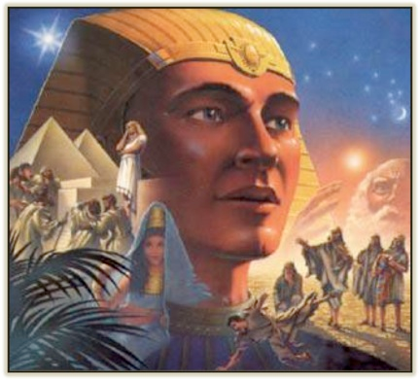
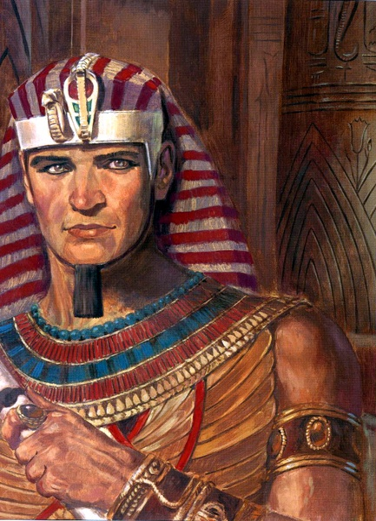
Genesis 21–36
Dr. Rick Griffith • Jordan Evangelical Theological Seminary • BibleStudyDownloads.org

Slide 2
Keyword
56
39
Election
Genesis
Notes:
The keyword for Genesis is election—God chose people to rule with him and he does the same for us.
___________
Common-49
OS-01-Gen1-3-slide 2

Slide 3
Theme
56
Origin in
Election and Promise
Genesis
Notes:
Genesis shows Israel’s beginnings as a chosen people with the promise of land, many descendants from Abraham in a nation, and blessings that impact all nations.
___________
Common-50
OS-01-Gen1-3-slide 3

Slide 4
Key Verse
56
"I will bless you… and all peoples on earth will be blessed through you"
(12:1-3)
Genesis
Notes:
God promised to bless the entire world through Abraham. There is a corollary curse for those who curse Abraham's line through Jacob.
___________
Common-51
OS-01-Gen1-3-slide 4

Slide 5

Summary Statement
56
63
41
The narrow lineage of Israel from Creation to Joseph informs Israel it began with both God's election for rule and unconditional promise for blessings through Abraham in contrast to the Canaanites
Genesis
Notes:
A line of blessing started with Adam and ended with Joseph due to the LORD choosing their descendants to reign and God’s unilateral promise to eventually benefit all peoples through Abraham, which was unique to Israel.

Slide 6

Kingdom Statement
39
God created a perfect kingdom (1–2), but man gave up his rule to Satan (3), so God elected a seed to produce a ruler (4–11) to bless all nations in Abraham (12–50).
Genesis
Notes:
The LORD made humans to reign (1–2) but the devil stole this right (3), so God chose a line of blessing (4–11) leading to Abraham’s descendants to result in a ruler to benefits all peoples (12–50).

Slide 7

Covenant
42a
God narrowed man’s line from Adam through Seth to Abram (1–11) to establish the Abrahamic Covenant with unconditional promises of Canaan, eternal rule, and blessing to his descendants (12–50).
Genesis
Notes:
All humanity focused from Seth to Abraham (1–11) so that through Abraham the focus will broaden to bless all people once again through Israel (12–50).
___________
Common-53
OS-01-Gen1-3-slide 7

Slide 8

Redemption
42a
Redemption is needed due to man’s sin (3:1-7), but as God redeemed Adam and Eve with a sacrificial animal (3:21), so a Redeemer from Eve will finally defeat Satan (3:15), typified in Joseph (45:7).
Genesis
Notes:
There was no need of salvation until Adam and Eve sinned (3:1-7), but God covered them with animal skins by the death of an animal (3:21) that typified the Saviour over the devil (3:15), who is also pictured in Joseph’s redemption of Jacob’s family by bringing them to Egypt (45:7).

Slide 9

Messiah
42a
Jesus created the earth (1:26) and will defeat Satan (3:15), after descending from the line of Abraham (12:1-3) so that he might rule in the line of Judah (49:10).
Genesis
Notes:
Christ is intimated in the “Us” who created man (1:26) and pictured in the victor over the serpent (3:15), who will be the descendant of Abraham to bless all the world by offering salvation (12:1-3) as the prophesied King from Judah’s line (49:10).

Slide 10
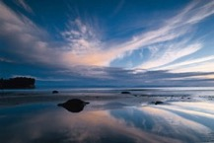
Genesis
56
Origin in Election and Promise
Creation | Fall | Fall | Flood | Flood |  | Babel | Jacob | Abraham |  | Isaac | Jacob | Joseph | Joseph | Isaac
Primeval Events |  |  |  |  |  |  |  | Patriarchal Characters
1:1–11:26 |  |  |  |  |  |  |  | 11:27–50:26
God’s Election |  |  |  |  |  |  |  | God’s Promise
Adam and Descendants |  |  |  |  |  |  |  | Abraham and Descendants
1/5 of the Book |  |  |  |  |  |  |  | 4/5 of the Book
Mesopotamia |  |  |  |  |  |  |  | Canaan |  |  |  | Egypt
2083 Years (4143-2060 BC) |  |  |  |  |  |  |  | 215 Years (2060-1845 BC) |  |  |  | 71 Years (1845-1774 BC)
The tôledôt of… | Heavens & Earth |  | Adam | Noah | Sons of Noah | Sons of Noah | Shem | Terah | Ishmael | Ishmael | Isaac |  | Esau | Jacob
Creation | Post-Creation |  | Sons of Adam | Noah | Sons of Noah | Sons of Noah | Sons of Shem | Abraham & Isaac | Sons of Ishmael | Sons of Ishmael | Jacob |  | Sons of Esau | Joseph
1:1–2:3 | 2:4–4:26 |  | 5:1–6:8 | 6:9–9:29 | 10:1–11:9 | 10:1–11:9 | 11:10-26 | 11:27–25:11 | 25:12-18 | 25:12-18 | 25:19–35:29 |  | 36:1–37:1 | 37:2–50:26
Covers 2369 Years of History
Written During Wilderness Wanderings (c. 1405 BC)
Notes:
Genesis 1–11 shows Israel’s origin in election and pivots in Genesis 12 to show the nation originated in God’s promise to Abraham to bless all peoples. This chart combines both the Hebrew division into 11 toledot (generations) with the more simple two-fold division around chapter 12.

Slide 11
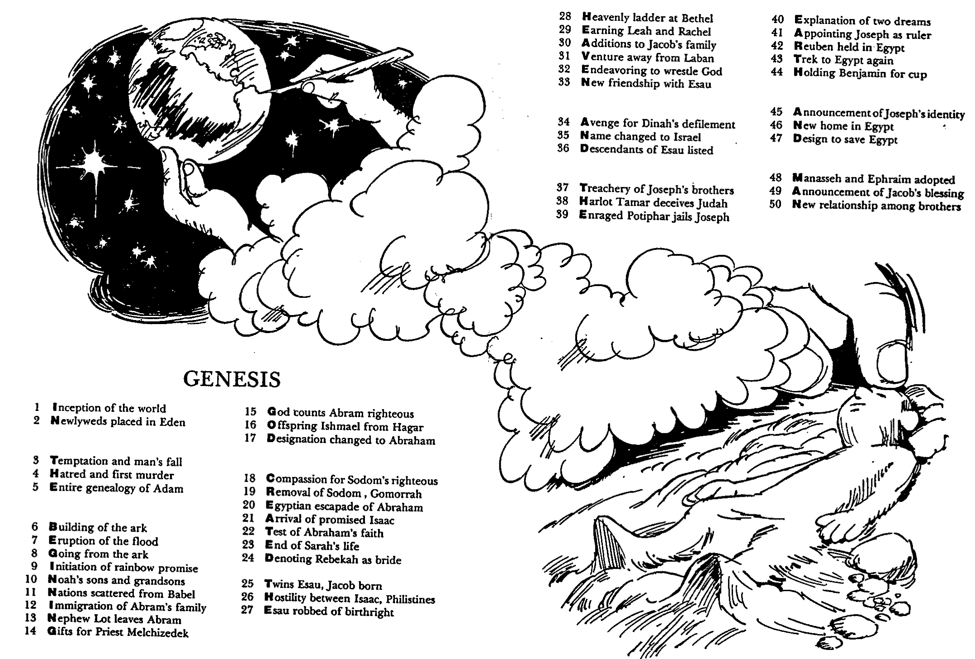
Barry Huddleston, The Acrostic Summarized Bible (Grand Rapids: Baker, 1992)
1 Inception of the world
2 Newlyweds placed in Eden
3 Temptation and man's fall
4 Hatred and first murder
5 Entire genealogy of Adam
6 Lessons on proper priorities
7 Outline for personal relationships
8 Faith of the centurion
29 Genealogy of Jesus Christ
30 Opposition of King Herod
31 Spirit's descent upon Jesus
32 Power over Satan's temptations
33 Expounding Sermon on Mount
34 Lessons on proper priorities
35 Outline for personal relationships
36 Faith of the centurion
9 Matthew's call from Jesus
10 Apostles sent to preach
11 Testimony about John's message
12 True Messiah called demonic
13 Hidden message of parables
14 Execution of the Baptist
15 Wisdom is answering Pharisees
37 Matthew's call from Jesus
38 Apostles sent to preach
39 Testimony about John's message
40 True Messiah called demonic
41 Hidden message of parables
42 Execution of the Baptist
43 Wisdom is answering Pharisees
Genesis
16 Keys of the kingdom
17 Impact of Jesus' transfiguration
18 Need for true forgiveness
19 Grounds for divorce clarified
20 Opportunities in the vineyard
21 Fig tree is cursed
44 Keys of the kingdom
45 Impact of Jesus' transfiguration
46 Need for true forgiveness
47 Grounds for divorce clarified
48 Opportunities in the vineyard
49 Fig tree is cursed
22 Taxes paid to Caesar
23 Hypocrisy denounced by "woes"
24 Events of second coming
25 Judgment of the nations
26 Events on Calvary's eve
27 Way of the cross
28 Savior's resurrection and commission
50 Taxes paid to Caesar
51 Hypocrisy denounced by "woes"
52 Events of second coming
53 Judgment of the nations
54 Events on Calvary's eve
55 Way of the cross
56 Savior's resurrection and commission
Notes:
Genesis depicts how “in the beginning God created the heaven and the earth and man,” though this actually only summarizes Genesis 1.
The Acrostic Summarized Bible depicts the theme of every biblical book in a vertical acrostic with that books’ theme in as many letters as there exist chapters in the book. Each chapter is summed up in four words where the first word doubles as part of the vertical acrostic for the entire book.

Slide 12

BE
FAITHFUL
Genesis
Dr. Rick Griffith, Crossroads International Church Singapore
CICFamily.com • BibleStudyDownloads.org
Notes:
The natural outworking of God choosing us for salvation and fulfilling his promise to bless us is to respond in faithfulness to him—to be reliable, dependable, and devoted to him.

Slide 13

Let's Study Through Scripture
The Bible: Book by Book
Notes:
This preaching series looks at each book in the Bible in a single sermon—66 messages that each cover an overview of an entire book.
I have taught through the Bible 37 times but never preached through it. Therefore, as I just finished 12 messages on the Minor Prophets, so now I will preach the other 54 books in the coming year until we learn all 66 books.
I encourage you to read through the Bible during this series, one book at a time.

Slide 14

A World of Idols
Notes:
In our hostile world full of idols, God says to be faithful to him as you face your future.
Persecution of Christians has been at its height the past century. More believers died in the 20th century than in the previous 19 centuries combined!
The media marginalizes the Christian viewpoint. One Supreme Court decision was thrown out because the Bible was used as evidence!

Slide 15


How can you be faithful to God in a world of idols?
IDOLS
of the
HEART
Notes:
In our hostile world of idols, God says to be faithful to him as you face your future. Christians have been persecuted more than ever in the past century. More believers were martyred in the 20th century than in the previous 19 centuries combined!
_________
“Son of man, these leaders have set up idols in their hearts. They have embraced things that will make them fall into sin. Why should I listen to their requests? ⁴ Tell them, ‘This is what the Sovereign LORD says: The people of Israel have set up idols in their hearts and fallen into sin, and then they go to a prophet asking for a message. So I, the LORD, will give them the kind of answer their great idolatry deserves. ⁵ I will do this to capture the minds and hearts of all my people who have turned from me to worship their detestable idols.’” (Ezekiel 14:3-6 NLT).

Slide 16

I. Grasp that the King chose you to rule.
Genesis 1–11
Notes:
We must know our amazing identity as God's elect people.

Slide 17

II. Grasp that the King promised you blessings.
Genesis 12–50
Notes:
We must know that being God's elect people guarantees incredible benefits.

Slide 18

Main Idea
Live out God's choice of you and promises for blessing
Genesis
Notes:
Make your life one that faithfully applies your election by God and his commitment to benefit you though Abraham.

Slide 19

What or who are you trusting to save you from your sin?
Genesis
Notes:
Whatever you trust has to be reliable!
Trust Christ to save you from your sin.

Slide 21
Slides on
Genesis 21

Slide 22
Patriarchal Family Tree
Patriarchal Family Tree
91
Terah
Haran
Nahor
Abraham
Lot
Bethuel
(of Hagar) Ishmael
(of Sarah) Isaac
Notes:
Abram’s seeking to secure God's promise of children through a carnal plan that complicates his life is recorded to encourage Israel not to try to accomplish God's will through plans contrary to His will (Gen 16).
——————
Though a man of great faith, Abraham did not have a perfect faith. He wavered and followed Sarah’s advice to bear Ishmael from the slave woman, Hagar. Only 14 years later did he trust God to bring forth Isaac.

Slide 23
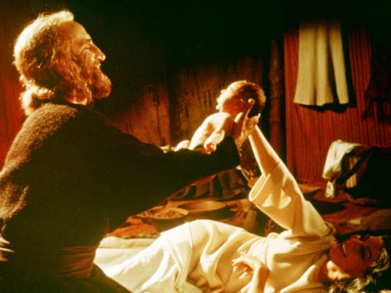
Birth of Isaac

Slide 24
Slides on
Genesis 22

Slide 25

Abraham's Ultimate Test (Genesis 22)

Slide 26
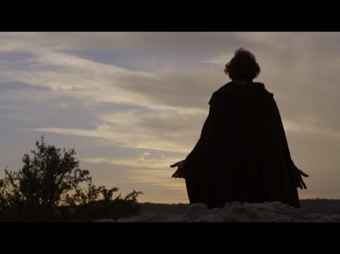
Genesis 22
Why did God ask Abraham to sacrifice Isaac?

Slide 27
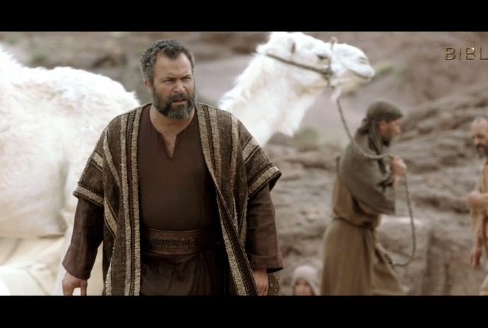
Genesis 22
Why did God ask Abraham to sacrifice Isaac?

Slide 28
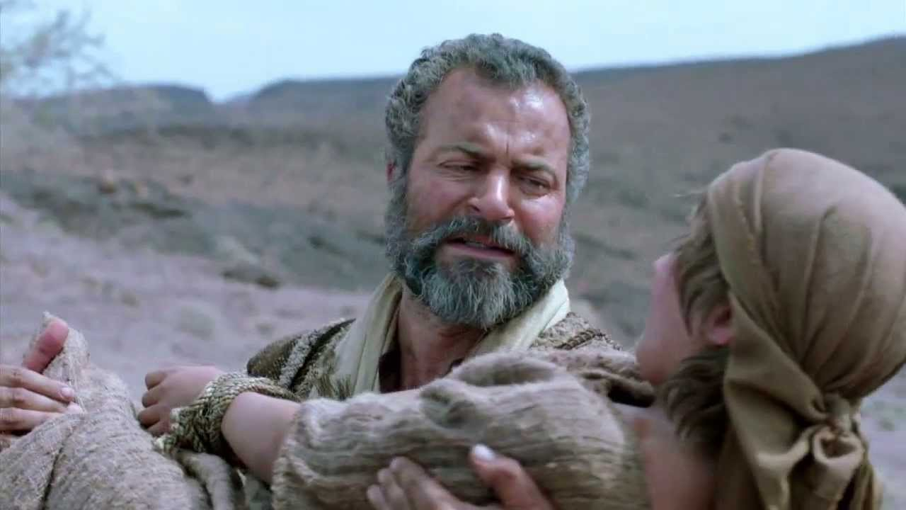
Genesis 22
Why did God ask Abraham to sacrifice Isaac?

Slide 29
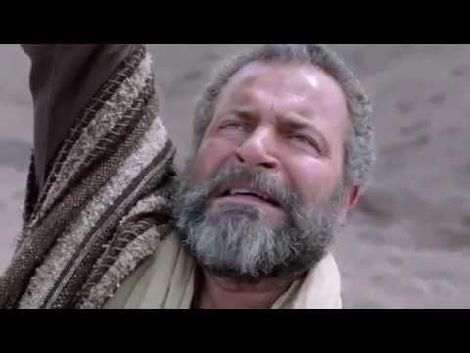
Genesis 22
Why did God ask Abraham to sacrifice Isaac?

Slide 30
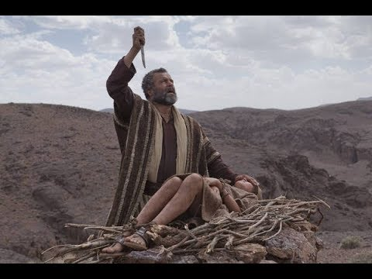
Genesis 22
Why did God ask Abraham to sacrifice Isaac?

Slide 31
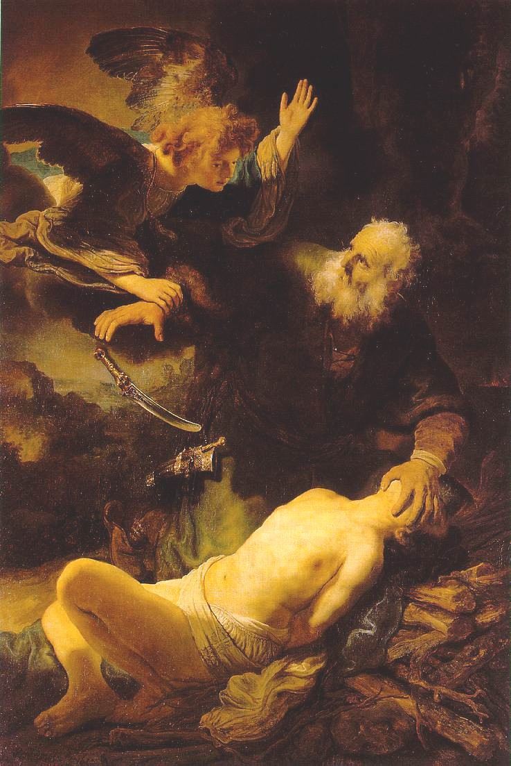
The Near Sacrifice of Isaac
(Genesis 22)
God tests the faithfulness of believers by asking them to surrender to him the best they have (1-2).
Faithful believers are willing to surrender the best they have to God, trusting that the Lord will provide (3-10).
Faithful believers receive God's provision for worship (11-14).
Faithful believers enjoy the assurance of God's blessing (15-18).
Allen P. Ross, Creation & Blessing, 396-401

Slide 32
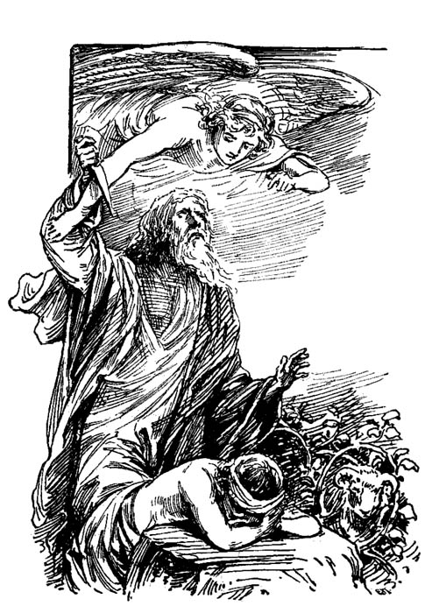
Galatians 3:29 (NIV)
“If you belong to Christ, then you are Abraham's seed, and heirs according to the promise.”

Slide 33
Slides on
Genesis 23

Slide 34
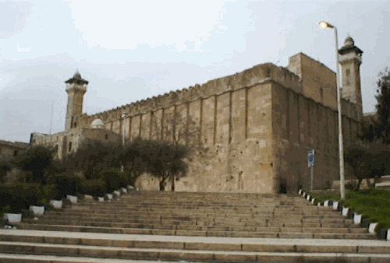
The Burial of Sarah (Genesis 23)
Why did Moses write an entire chapter on Sarah's death?
This monument marks the cave of Machpelah where Abraham, Sarah, Isaac, Jacob, and Leah are buried. (Rachel was buried near Bethlehem where she died.)

Slide 35
Patriarchal Family Tree
Patriarchal Family Tree
91
Terah
Haran
Nahor
Abraham
Lot
Bethuel
(of Hagar) Ishmael
(of Sarah) Isaac
Laban Rebekah
married

Slide 36
Slides on
Genesis 24

Slide 37
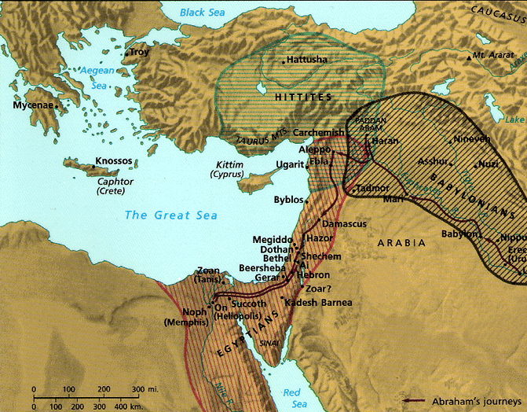
Securing a Bride for Isaac (Gen. 24)
Thought Question:
Why did Abraham send his servant to Haran to get a wife for Isaac?
Land of Rebekah
Land of Isaac

Slide 38
Isaac's Life
56
Primeval History
Patriarchal History
Isaac 25:19–26:35
Abraham 12–25:18
Nations 10–11
Creation 1–2
Flood 6–9
Fall 3–5
EVENTS 1–11
PEOPLE 12–50
Human Race
Hebrew Race

Slide 39
Slides on
Genesis 25

Slide 40
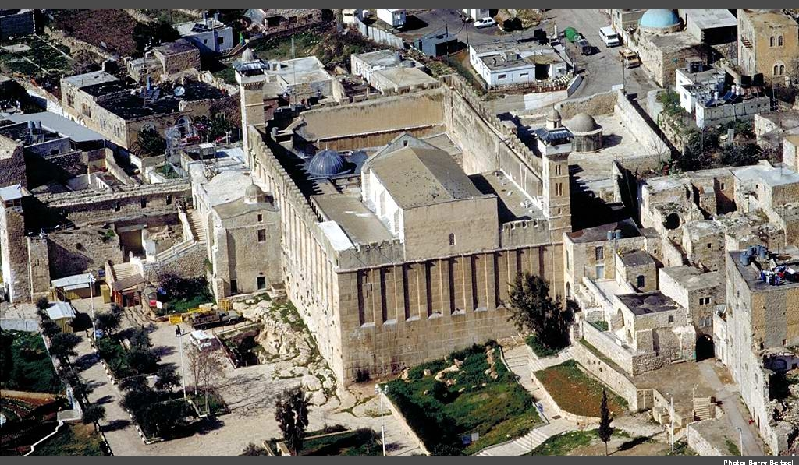
Abraham was Buried with Sarah in the Cave of Machpelah
Genesis 1-2

Slide 41
Abraham's Descendants
91
Wives in pink
Abraham
Sarah
Hagar
Keturah
Israelites
Ishmaelites
Midianites
Genesis 25:12-18
Arabs
Notes:
Abraham

Slide 42
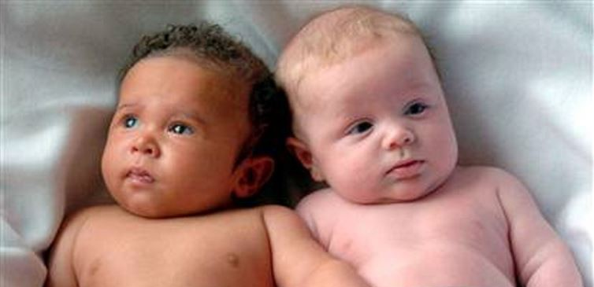
Esau & Jacob are born but God reaffirms once again that the older Esau will serve the younger Jacob
Genesis 25:19-34

Slide 43
Slides on
Genesis 26

Slide 44
Patriarchal Family Tree
Patriarchal Family Tree
91
Terah
Haran
Nahor
Abraham
Lot
Bethuel
(of Hagar) Ishmael
(of Sarah) Isaac
Laban Rebekah
married
Esau
Jacob

Slide 45

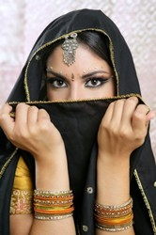
Abimelech, Rebekah & Isaac
Genesis 26

Slide 46
Slides on
Genesis 27

Slide 47
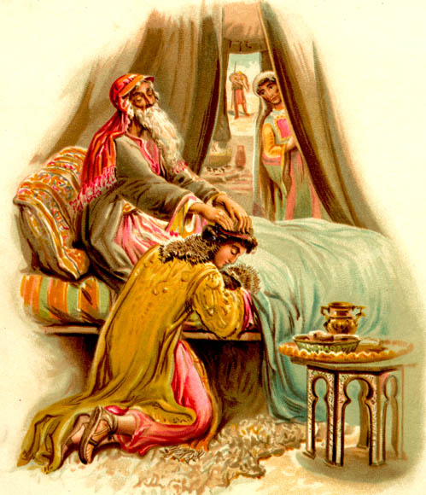
Genesis 27:1-40
God chose Jacob,
not Esau
Notes:
Isaac opposed God's declaration of firstborn rights to Jacob, but God overruled him. Even if Jacob had not deceived his father for the blessing, God's sovereign plan would still have prevailed.
_________
Common-173
OS-01-Gen21-36-slide 47
OS-39-Malachi-41

Slide 48
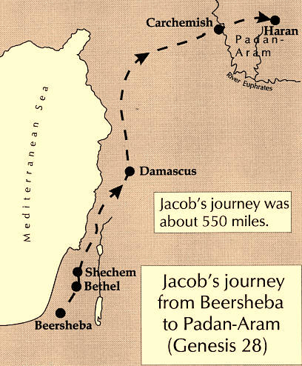
Jacob's Journey to Paddan Aram
2. During his flight, Jacob meets God in Bethel. God promises,
"I am with you and will watch over you wherever you go, and I will bring you back to this land. I will not leave you until I have done what I have promised you"
(Gen. 28:15).
1. Jacob steals the blessing from Esau. Esau vows to kill him. Jacob runs for his life and heads for Paddan Aram
(Gen. 27:43, 28:5, 10).

Slide 49
Slides on
Genesis 28

Slide 50
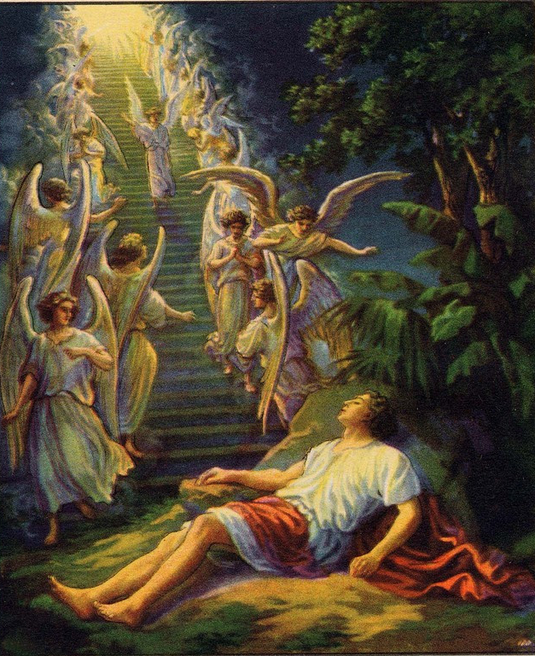
Jacob's Ladder (Gen. 28:10-22)

Slide 51
Jacob Arrives at Paddan Aram (Gen. 27–29)
3. Jacob arrives from Beersheba in Canaan at the home of Laban (Rebekah's brother) at Haran in Paddan Aram (Gen. 29).
2. During his flight, Jacob meets God in Bethel. God promises, "I am with you and will watch over you wherever you go, and I will bring you back to this land. I will not leave you until I have done what I have promised you" (Gen. 28:15).
1. Jacob steals the blessing from Esau. Esau vows to kill him. Jacob runs for his life and heads for Paddan Aram (Gen. 27:43, 28:5, 10).

Slide 52
Slides on
Genesis 29

Slide 53

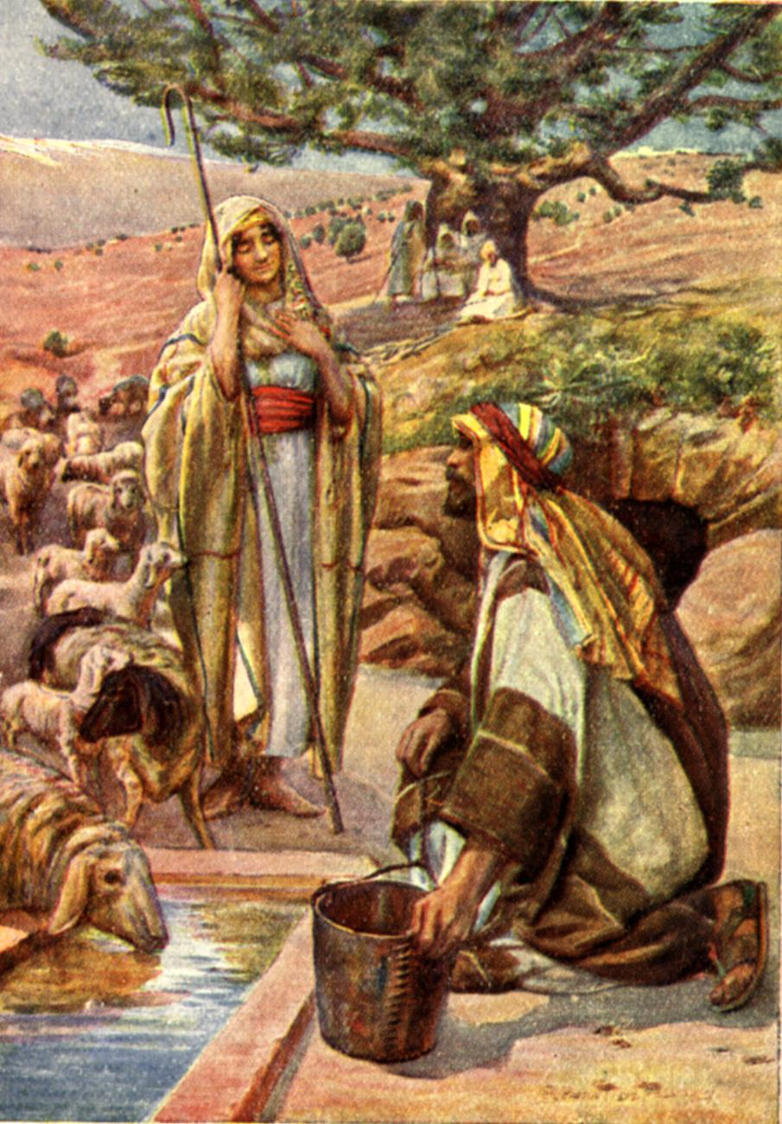
Jacob Meets Rachel
Genesis 29:1-30

Slide 54

(Genesis 29:31–30:24)
Warning: This Section (sex-shun?) is Rated R
Adapted from David Turner • bibleguy.org (used with permission)
Notes:
This popular American TV series focuses on the antics of four desperate women.

Slide 55

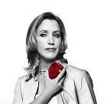

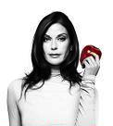
Desperate for What?
Gabrielle Solis – Came from poverty. Successful model. Desperate for materialistic wealth and the Hollywood lifestyle.
Lynette Scavo – She has found it easier to be successful in business than to be a successful housewife. Desperate for order and success at home.
Bree Van de Kamp - a White Anglo-Saxon Protestant (Presbyterian), conservative Republican, desperate for perfectionist control of life.
Susan Mayer/Delfino – clumsy at most things, especially relationships. Single mom desperate for a man.
Note the fruit – Wanting something they do not have.
If I only had ________, life would be better.

Slide 56

Jacob’s Desperate Housewives
Genesis 29:31–30:24
Notes:
There were four of them too!

Slide 57
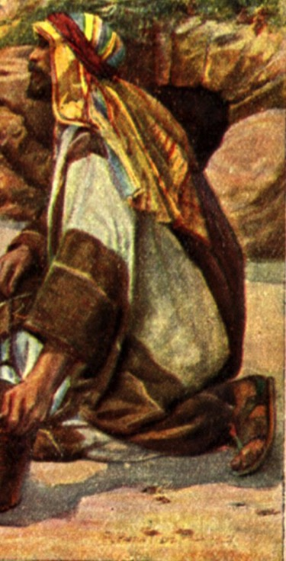
Jacob was desperate
Desperate for the inheritance
  He deceived to get it and got none of it.
Desperate for his father's blessing
  He received it through deception but alienated family for it.
Desperate for a wife
  He received two of them, more than he bargained for.
Desperate for possessions
  He received them but at a cost.

Slide 58
Jacob's Desperate Wives
Leah – Desperate for Love
  Had children but never gained love from it
Rachel – Desperate for Children
  Had love but was desperate for children
Jacob's frustration – He couldn't satisfy what they were desperate to receive. A husband seldom can.

Slide 59

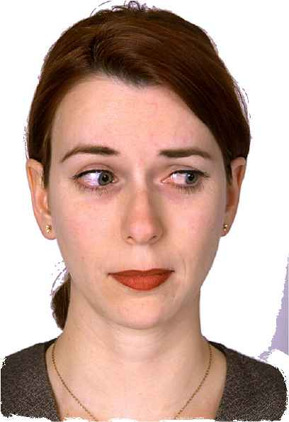
Are you desperate?
Men – what are you so desperate for that you put others in a desperate mode?
Women –
  What are you desperate for that causes you to lose site of the blessings you already have?
  What expectations do you put on others that they can't possibly meet?

Slide 60
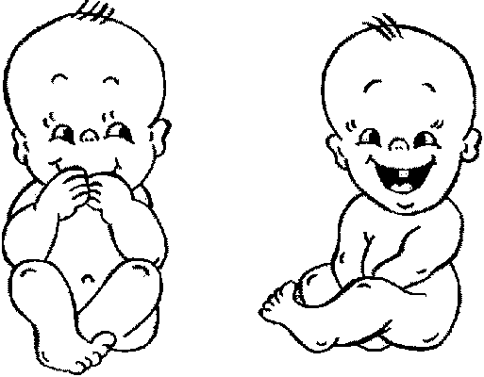
Leah was Desperate for Love
Genesis 29:31–32 (NET)
³¹ When the Lord saw that Leah was unloved, he enabled her to become pregnant while Rachel remained childless. ³² So Leah became pregnant and gave birth to a son. She named him Reuben, for she said, “The Lord has looked with pity on my oppressed condition. Surely my husband will love me now.”
Leah was jealous of Jacob's love for Rachel.
Since Jacob wouldn't bless Leah with love, God blessed her with children.
Reuben – “Look, a son”
She thought having children would cause her husband to love her.
How often do couples make the mistake of thinking having a child will increase their love or help a troubled marriage?

Slide 61
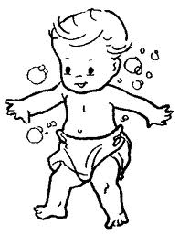
If one won't get love, maybe three?
Genesis 29:33–34
³³ She became pregnant again and had another son. She said, “Because the Lord heard that I was unloved, he gave me this one too.” So she named him Simeon. ³⁴ She became pregnant again and had another son. She said, “Now this time my husband will show me affection, because I have given birth to three sons for him.” That is why he was named Levi.
Second son, Simeon – “hearing”
Third son, Levi – sounds like the Hebrew word “to join”
“Show me affection” – lit. “to be joined”
If one wouldn't make him love her, surely three would.

Slide 62
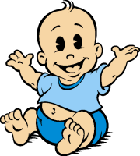
Momentary joy during desperation
Genesis 29:35
³⁵ She became pregnant again and had another son. She said, “This time I will praise the Lord.” That is why she named him Judah. Then she stopped having children.
For a moment Leah places her thought away from her desperation of the love of husband and honors God.
Judah – “he will be praised”

Slide 63
Slides on
Genesis 30

Slide 64
Rachel Desperate for Children
Genesis 30:1–2
¹ When Rachel saw that she could not give Jacob children, she became jealous of her sister. She said to Jacob, “Give me children or I'll die!” ² Jacob became furious with Rachel and exclaimed, “Am I in the place of God, who has kept you from having children?”
She had Jacob's love, but was jealous of Leah for having children.
Desperation causes irrational thinking.
  She expected Jacob to fix it.
“furious” – lit. “his nostrils burned”
Jacob showed his frustration:
“Do you think I'm God?”

Slide 65

Desperation leads to desperate solutions
Genesis 30:3–4
³ [Rachel] replied, “Here is my servant Bilhah! Have sexual relations with her so that she can bear children for me and I can have a family through her.” ⁴ So Rachel gave him her servant Bilhah as a wife, and Jacob had marital relations with her.
Sarah's desperation for children led to the birth of Ishmael.
Jacob's desperation for the blessing caused deception.
Now Rachel's desperation causes her to turn to a surrogate.
“bear children for me” – lit. “bear children upon my knees”

Slide 66
Desperation leads to an irrational view of judgment
Genesis 30:5–6
⁵ Bilhah became pregnant and gave Jacob a son. ⁶ Then Rachel said, “God has vindicated me. He has responded to my prayer and given me a son.” That is why she named him Dan.
Dan – “judged, vindicated” she viewed his birth as God righting the wrong of her not having children.

Slide 67
Jealousy and competition feed the desperation
Genesis 30:7–8
⁷ Bilhah, Rachel's servant, became pregnant again and gave Jacob another son. ⁸ Then Rachel said, “I have fought a desperate struggle with my sister, but I have won.” So she named him Naphtali.
Naphtali – “my struggle”
Why is she so desperate to have children? She is in competition with her sister.

Slide 68

Desperation leads to copying the competition
Genesis 30:9–11
⁹ When Leah saw that she had stopped having children, she gave her servant Zilpah to Jacob as a wife. ¹⁰ Soon Leah's servant Zilpah gave Jacob a son. ¹¹ Leah said, “How fortunate!” So she named him Gad.
Gad – “good fortune”

Slide 69
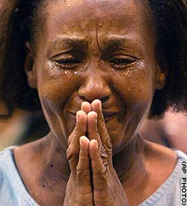
Will Leah ever be Happy?
Genesis 30:12–13
¹² Then Leah's servant Zilpah gave Jacob another son. ¹³ Leah said, “How happy I am, for women will call me happy!” So she named him Asher.
Asher – “happy one”

Slide 70
Desperation leads to myth and/or medication
Genesis 30:12–15
¹⁴ At the time of the wheat harvest Reuben went out and found some mandrake plants in a field and brought them to his mother Leah. Rachel said to Leah, “Give me some of your son's mandrakes.” ¹⁵ But Leah replied, “Wasn't it enough that you've taken away my husband? Would you take away my son's mandrakes too?” “All right,” Rachel said, “he may sleep with you tonight in exchange for your son's mandrakes.”
Mandrakes – from Hebrew word meaning “love plant” were viewed as a type of aphrodisiac.
Rachel wanted them for obvious reasons.
Rachel has authority in the relationship regarding Jacob.
Leah views Rachel as having stole her husband from her.
The relationship has deteriorated to purchasing Jacob's bed.

Slide 71
Desperation misinterprets God's grace
Genesis 30:16–18
¹⁶ When Jacob came in from the fields that evening, Leah went out to meet him and said, “You must sleep with me because I have paid for your services with my son's mandrakes.” So he had marital relations with her that night. ¹⁷God paid attention to Leah; she became pregnant and gave Jacob a son for the fifth time. ¹⁸ Then Leah said, “God has granted me a reward because I gave my servant to my husband as a wife.” So she named him Issachar.
So desperate Leah meets him in the field.
Jacob has become a passive instrument for baby making in this relationship. She paid for his services.
Irony – Rachel wanted the aphrodisiac, but it was Leah that received what Rachel was after.
Issachar – appears to mean “man of reward.” She thought God rewarded her because she gave her servant to Jacob.

Slide 72
Leah's desperation changes
Genesis 30:19–21
¹⁹ Leah became pregnant again and gave Jacob a son for the sixth time. ²⁰ Then Leah said, “God has given me a good gift. Now my husband will honor me because I have given him six sons.” So she named him Zebulun. ²¹ After that she gave birth to a daughter and named her Dinah.
Zebulun – “honor”
She no longer uses the word love. Now, Jacob will honor me.
Dinah – “Justice” the only daughter mentioned.

Slide 73
A child doesn't end the desperation
Genesis 30:22–24
²² Then God took note of Rachel. He paid attention to her and enabled her to become pregnant. ²³ She became pregnant and gave birth to a son. Then she said, “God has taken away my shame.” ²⁴ She named him Joseph, saying, “May the Lord give me yet another son.”
God answers Rachel and gives her a child.
Her shame is removed
But, she is desperate for another child.
Joseph means “may he add” but sounds like a Hebrew verb meaning “taken away”

Slide 74

Genesis 29–30 Lessons
It is not wrong to desire love, children, a good home, prosperity, etc.
Desperation for what we don't have can lead us into wrong attitudes and actions.
Desperation can lead to jealousy and hatred.
A spouse can seldom provide all we are desperate to receive.

Slide 75
Challenge: Look at your heart
Is there something you're desperate for that leads you to jealousy, hate, a competitive spirit, ungratefulness for what you have, or actions inconsistent with God's will?
How are we really different from Jacob, Leah, or Rachel?

Slide 76
Be Content
Philippians 4:11-13 (NET)
¹¹ I am not saying this because I am in need, for I have learned to be content in any circumstance. ¹² I have experienced times of need and times of abundance. In any and every circumstance I have learned the secret of contentment, whether I go satisfied or hungry, have plenty or nothing. ¹³ I am able to do all things through the one who strengthens me.

Slide 77
Slides on
Genesis 31

Slide 78
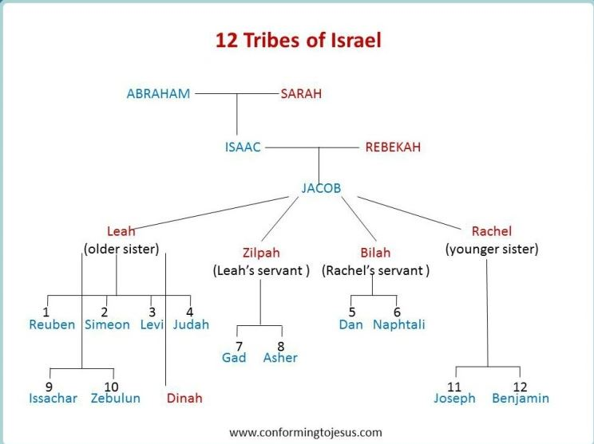
Patriarchal Family Tree
Patriarchal Family Tree
91
Terah
Haran
Nahor
Abraham
Lot
Bethuel
(of Hagar) Ishmael
(of Sarah) Isaac
Laban Rebekah
married
Esau
Jacob
Leah
Rachel
(of Leah) Reuben, Simeon, Levi,
Judah, Issachar, Zebulun
(of Zilpah) Gad,
Asher
(of Bilhah) Dan, Naphtali
(of Rachel)
Benjamin, Joseph
Manasseh
Ephraim
Green = line of blessing with rights of firstborn even though none of these were born first (1 Chron. 5:1-2)

Slide 79
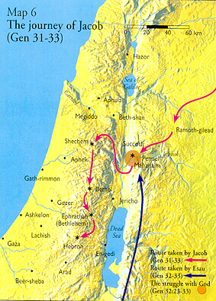
Jacob's Work & Return (Gen 29–32)
4. Jacob works 20 years for Laban, marries his 2 daughters, Rachel and Leah, and prospers (Gen. 29:30).
5. Then the Lord says to Jacob, "Go back to the land of your fathers and to your relatives and I will be with you" (Gen. 31:3).
6. Jacob flees from Laban with his family and his rightful possessions. Laban confronts Jacob at Mizpah and they agree to separate (Gen. 31:48-49).
Mizpah
7. Jacob meets angels of God. He affirms God is with him by naming the place Mahanaim, or "camp of God" (Gen. 32:1).

Slide 80
Slides on
Genesis 32

Slide 81
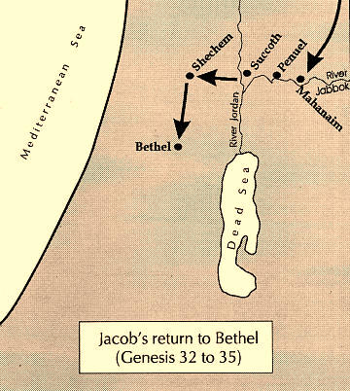
God Meets Jacob (Gen. 32)
8. Jacob prepares to meet Esau. God meets Jacob at Peniel. Jacob wrestles with God all night long. God changes his name to Israel, "because you have struggled with God and with men and have overcome" (Gen. 32:28).
God Meets Jacob

Slide 82
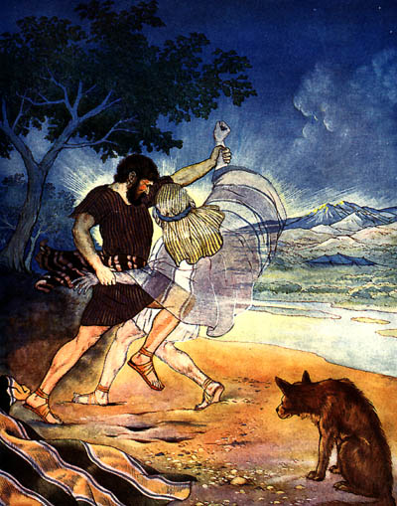
Jacob Wrestles with God
Genesis 32:22-32

Slide 83
Jacob Names Peniel
8. Jacob prepares to meet Esau. God meets Jacob at Peniel. Jacob wrestles with God all night long. God changes his name to Israel, "because you have struggled with God and with men and have overcome" (Gen. 32:28).
9. Jacob called the place Peniel, saying, "It is because I saw God face to face,and yet my life was spared"
(Gen. 32:30).
10. Now, onto Genesis 33...
Jacob finally meets Esau.

Slide 84
Slides on
Genesis 33

Slide 85
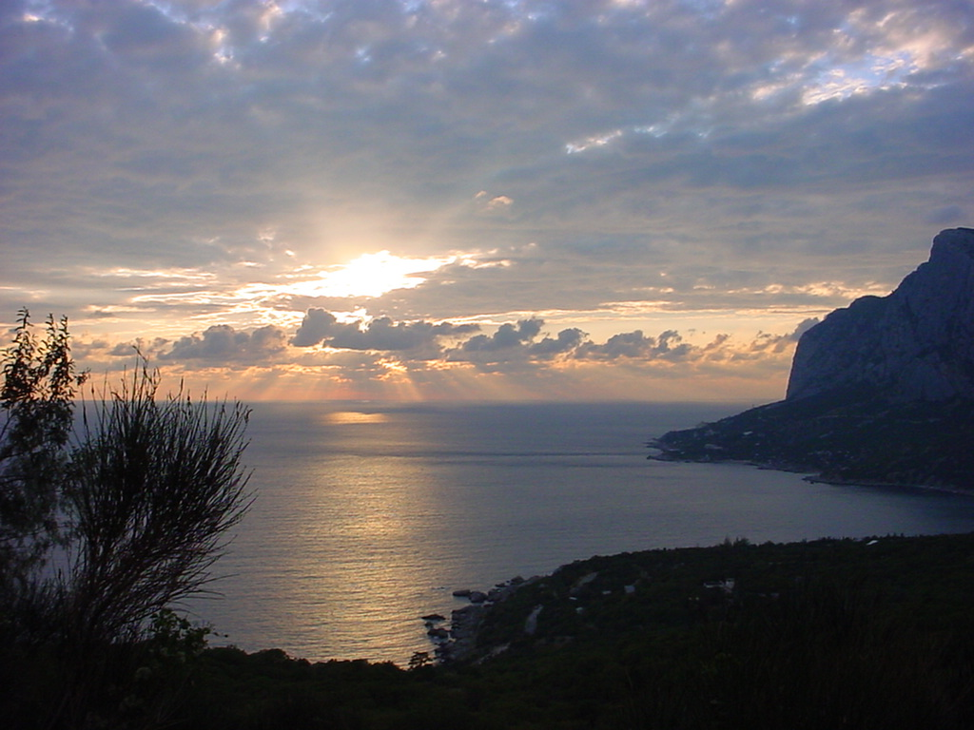
Jacob: From Deceiver to Believer (Gen. 33)
God's choice of Jacob finally wins over him without manipulation on Jacob's part.

Slide 86
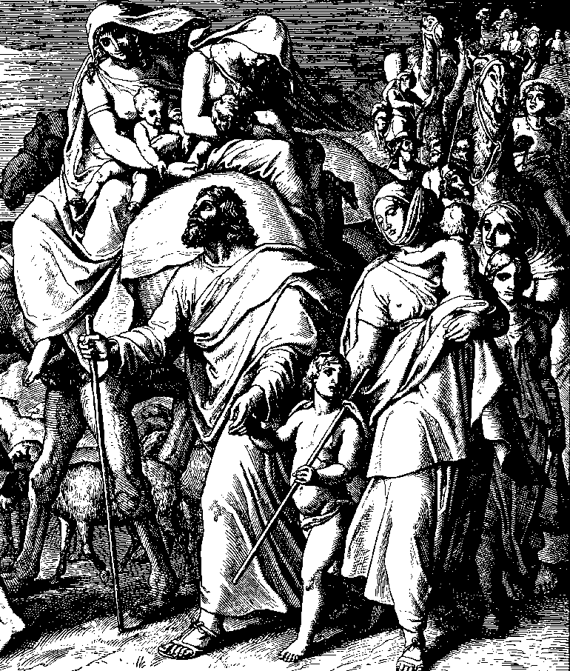
Preparing and Meeting
THE PREPARATION
Jacob sees Esau and army (33:1).
The previous day, Jacob was gripped with fear and sent his livestock ahead while he stayed behind (32:20).
After having received the blessing of God (32:29), Jacob divides his family into groups and goes ahead of them (33:3)
THE MEETING
Jacob bows down to the ground seven times.(33:3)
Cultural significance: deep humility in deference to Esau.

Slide 87
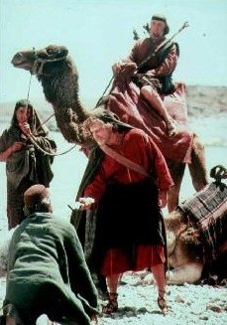
An Unexpected Reunion
AN UNEXPECTED REUNION
Joyful reunion and reconciliation
Esau ran to meet Jacob, fell on his neck and kissed him.
Both wept (33:4)
(20 years earlier, Esau had vowed to kill Jacob in 27:41)

Slide 88
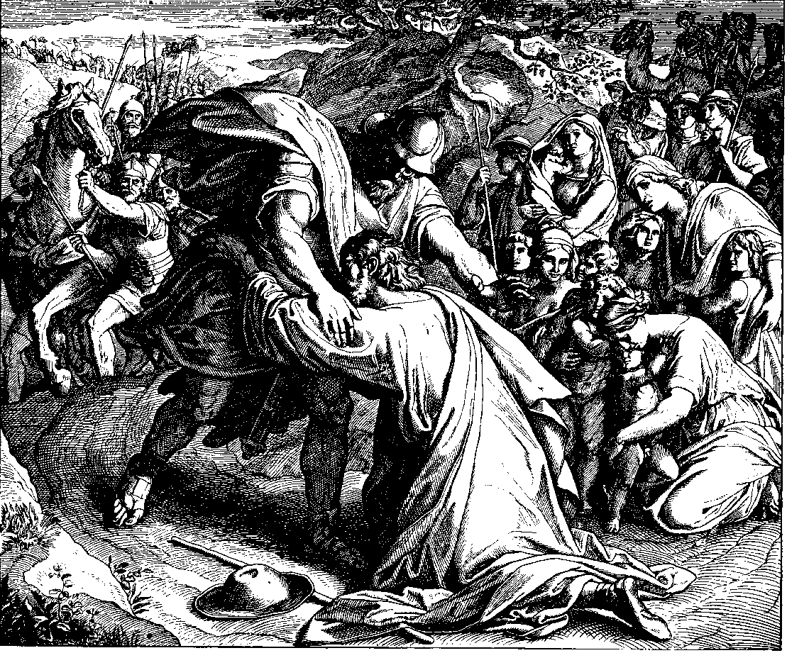
Meeting Jacob's Family
MEETING JACOB'S FAMILY (33:5-7)
- Jacob introduces his family to Esau.
- Jacob acknowledges God for the children He has so graciously given him.

Slide 89
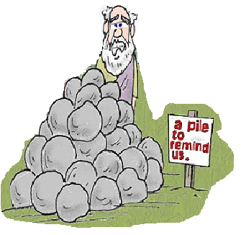
Jacob Builds Shechem Altar
JACOB BUILDS SHECHEM ALTAR
Calls altar El Elohe Israel – meaning "God, the God of Israel," or "mighty is the God of Israel."
Significance of the Altar
Jacob used his new name, "Israel."
In the centre of an idolatrous land, he established a new centre of worship of the true God.

Slide 90
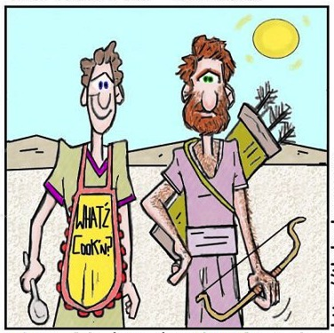
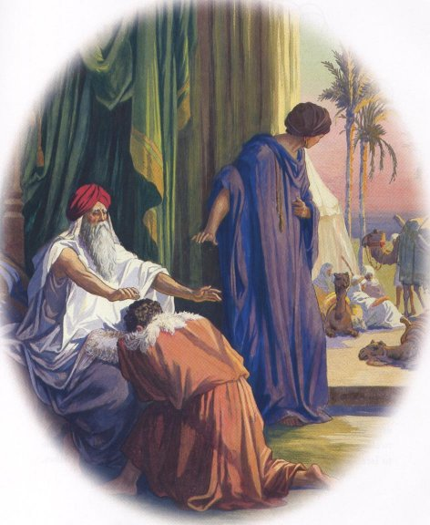
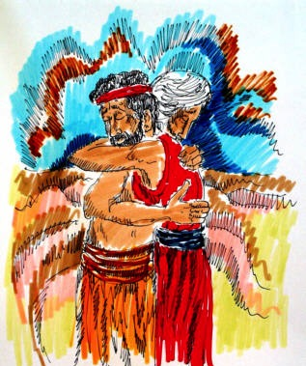
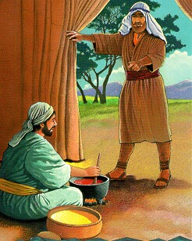
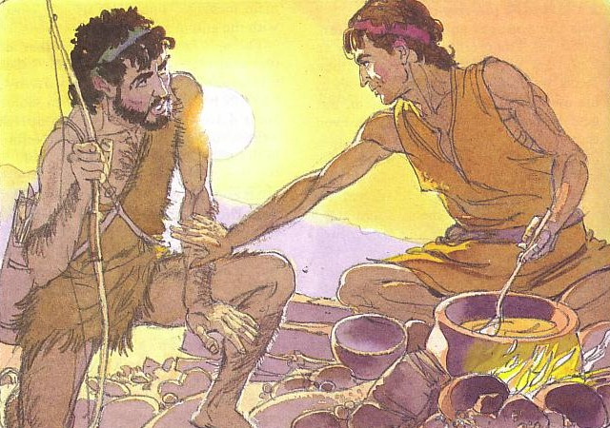
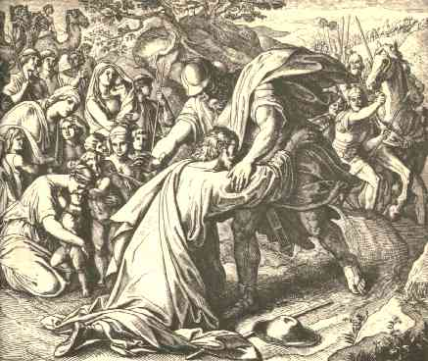
Jacob Reconciles with Esau

Slide 91
Slides on
Genesis 34
Notes:
Jacob returns to Canaan and the promised seed is endangered in the land but protected by the hand of God to remind Israel that God keeps His promises (Gen 33–35)

Slide 92

Dinah Violated at Shechem
Brothers Revenge
Genesis 33:18–34:31
Notes:
Jacob’s sons avert marrying the women at Shechem but threaten the promise to Abraham’s descendants by tempting the people of the land to wipe them out for slaughtering the men of Shechem.

Slide 93

Dinah Violated at Shechem
We don't talk about that in church
Genesis 34
Notes:
We typically don’t talk about rape and murder in church—but the Bible gives a very real view of these flawed people through whom God worked—just like us!

Slide 94
Slides on
Genesis 35

Slide 95
Joseph's Life
56
Primeval History
Patriarchal History
Isaac 25:19–26:35
Abraham 12–25:18
Nations 10–11
Joseph 37–50
Creation 1–2
Jacob 27–36
Flood 6–9
Fall 3–5
EVENTS 1–11
PEOPLE 12–50
Human Race
Hebrew Race

Slide 96
Slides on
Genesis 36

Slide 97


Geographical Setting
444
598d
Jacob
Israel
Esau
Edom
Notes:
God blessed both Jacob and Esau to become fathers of the respective nations of Israel and Edom.
____________
Common-174
OS-01-Gen21-36-slide 97
OS-31-Obadiah-75

Slide 98
Esau's Descendants (Genesis 36)
Family of Abraham
Terah
?
Haran
Nahor
Sarai
ABRAM
Hagar
Lot
Milcah
Bethuel
Ishmael (1)
ISAAC (2)
Daughter 1
Daughter 2
Ishmaelites
(12 tribes/Arabs)
Laban
Rebekah
Moabites
Ammonites
JACOB (2)
Esau (1)
Leah
(+Zilpah)
Rachel
(+Bilhah)
Edomites
ISRAELITES
(12 tribes/Jews)
KEY: Blue = Men, Red = Women, Blue-Gray = Reference to Esau, Dashes = Spouses, Arrows = Children

Slide 99
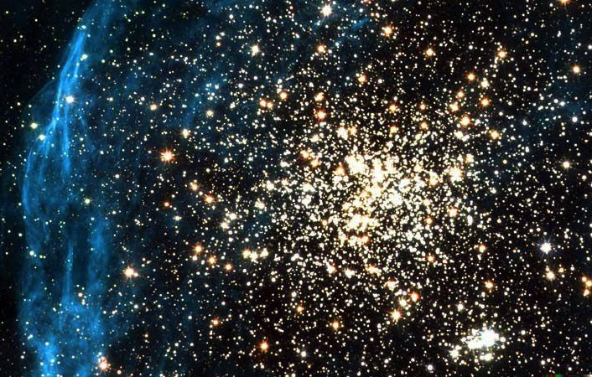
Key Word for Genesis:
56
Election
19
©2003 TBBMI
7.5.03a.
Notes:
Election is seen in the last section of Genesis too—Joseph makes his brothers swear to return his bones to Canaan when the family returns home as a sign of his faith in the promise of God, then he dies (50:22-26).

Slide 100

God promised believers like us blessings of the Abrahamic Covenant.

Slide 101
Main Idea of Genesis
Live out God's choice of you and promises for blessing

Slide 102

How should you respond to God's election and promise?

Slide 103
Black

Slide 104

OT Preaching at BibleStudyDownloads.org
Get this presentation for free!

Slide 105
Chart of Entire Book
56
Primeval History
Patriarchal History
Isaac 25:19–26:35
Abraham 12–25:18
Nations 10–11
Joseph 37–50
Creation 1–2
Jacob 27–36
Flood 6–9
Fall 3–5
EVENTS 1–11
PEOPLE 12–50
Human Race
Hebrew Race

Slide 106
Theology in Genesis
The study of . . .
Theology: Cosmogony: Anthropology: Sociology: Hamartiology: Ethnology: Soteriology:
God
The universe
Humanity
Society
Sin
Races
Salvation

Slide 107
Questions Answered in Genesis
Genesis
Beginnings
Where did we come from?
Why is there evil in the world?
Is there hope?

Slide 108
Genesis Teaches Us Wisdom
“. . . from infancy you have known the holy Scriptures, which are able to make you wise for salvation through faith in Christ Jesus.”
2 Timothy 3:15 (NIV)

Slide 109
Genesis Gives Us Hope
“For everything that was written in the past was written to teach us, so that through endurance and the encouragement of the Scriptures we might have hope.”
Romans 15:4 (NIV)

Slide 110
Genesis Warns Us
“These things happened to them as examples and were written down as warnings for us, on whom the fulfillment of the ages has come.”
1 Corinthians 10:11 (NIV)

Slide 111
Chart of Entire Book
56
Primeval History
Patriarchal History
Isaac 25:19–26:35
Abraham 12–25:18
Nations 10–11
Joseph 37–50
Creation 1–2
Jacob 27–36
Flood 6–9
Fall 3–5
EVENTS 1–11
PEOPLE 12–50
Human Race
Hebrew Race

Slide 112
The First Half
56
Primeval History
Patriarchal History
Isaac 25:19–26:35
Abraham 12–25:18
Nations 10–11
Joseph 37–50
Creation 1–2
Jacob 27–36
Flood 6–9
Fall 3–5
EVENTS 1–11
PEOPLE 12–50
Human Race
Hebrew Race

Slide 113
A Balanced Theme
56
Primeval History
Patriarchal History
Divine Sovereignty
Isaac 25:19–26:35
Abraham 12–25:18
Nations 10–11
Joseph 37–50
Creation 1–2
Jacob 27–36
Flood 6–9
Human Responsibility
Fall 3–5
Christ: The Seed
EVENTS 1–11
PEOPLE 12–50
Introduction
Plot
Genesis 3:15

Slide 114
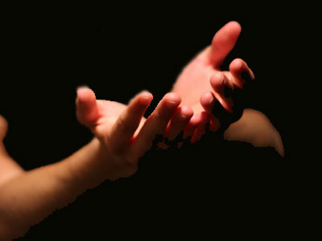
Trust & Obey
TRUST
and
OBEY
for there's no other way

Slide 115

The Christian OT
HOW?
Old Testament
Genesis - Malachi
History (17)
Poetry (5)
Prophecy (17) Major Minor
English

Slide 116
The Hebrew OT
51
HOW?
Old Testament
Genesis - Chronicles
Law (5)
Prophets (8) Former Latter
Writings (11)
Masoretic

Slide 117


The Same Old Testament. . . Just a Different Order!
Jewish:
Law
Prophets
Writings
(24 books)
Christian:
Law
History
Prophets
(39 books)

Slide 118
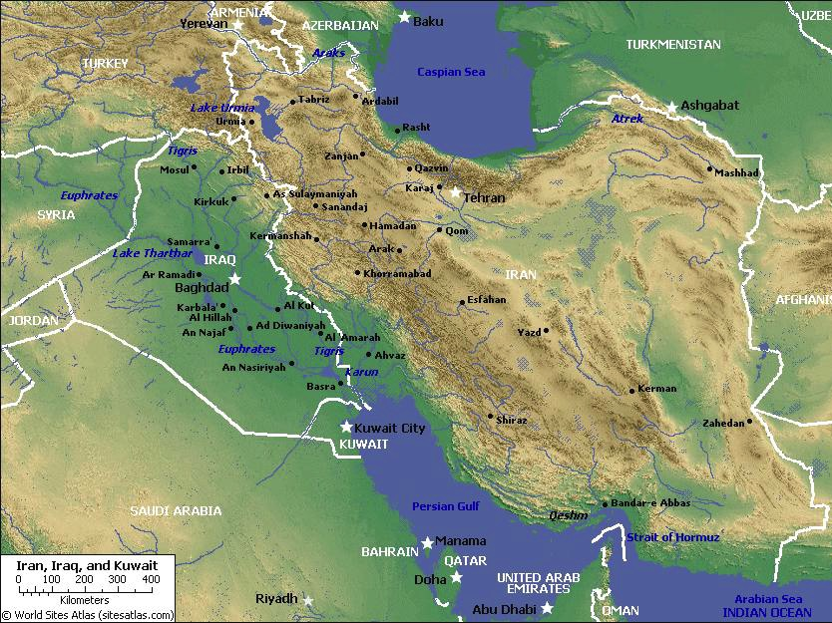
Mesopotamia
27
Tigris
Assyria
Euphrates
Babylon
Persia
Chaldea
Persian Gulf

Slide 119
Black

Slide 120
OT Survey link at BibleStudyDownloads.org
Get this presentation for free!

