Slide 1
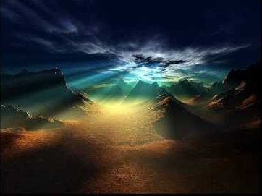
Genesis 1–3
God’s election and promise
Dr. Rick Griffith • Jordan Evangelical Theological Seminary • BibleStudyDownloads.org

Slide 2
Keyword
56
39
Election
Genesis
Notes:
The keyword for Genesis is election—God chose people to rule with him and he does the same for us.
___________
Common-49
OS-01-Gen1-3-slide 2

Slide 3
Theme
56
Origin in
Election and Promise
Genesis
Notes:
Genesis shows Israel’s beginnings as a chosen people with the promise of land, many descendants from Abraham in a nation, and blessings that impact all nations.
___________
Common-50
OS-01-Gen1-3-slide 3

Slide 4
Key Verse
56
"I will bless you… and all peoples on earth will be blessed through you"
(12:1-3)
Genesis
Notes:
God promised to bless the entire world through Abraham. There is a corollary curse for those who curse Abraham's line through Jacob.
___________
Common-51
OS-01-Gen1-3-slide 4

Slide 5
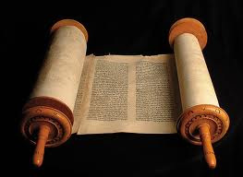
Summary Statement
56
63
41
The narrow lineage of Israel from Creation to Joseph informs Israel it began with both God's election for rule and unconditional promise for blessings through Abraham in contrast to the Canaanites
Genesis
Notes:
A line of blessing started with Adam and ended with Joseph due to the LORD choosing their descendants to reign and God’s unilateral promise to eventually benefit all peoples through Abraham, which was unique to Israel.

Slide 6

Kingdom Statement
39
God created a perfect kingdom (1–2), but man gave up his rule to Satan (3), so God elected a seed to produce a ruler (4–11) to bless all nations in Abraham (12–50).
Genesis
Notes:
The LORD made humans to reign (1–2) but the devil stole this right (3), so God chose a line of blessing (4–11) leading to Abraham’s descendants to result in a ruler to benefits all peoples (12–50).

Slide 7

Covenant
42a
God narrowed man’s line from Adam through Seth to Abram (1–11) to establish the Abrahamic Covenant with unconditional promises of Canaan, eternal rule, and blessing to his descendants (12–50).
Genesis
Notes:
All humanity focused from Seth to Abraham (1–11) so that through Abraham the focus will broaden to bless all people once again through Israel (12–50).
___________
Common-53
OS-01-Gen1-3-slide 7

Slide 8

Redemption
42a
Redemption is needed due to man’s sin (3:1-7), but as God redeemed Adam and Eve with a sacrificial animal (3:21), so a Redeemer from Eve will finally defeat Satan (3:15), typified in Joseph (45:7).
Genesis
Notes:
There was no need of salvation until Adam and Eve sinned (3:1-7), but God covered them with animal skins by the death of an animal (3:21) that typified the Saviour over the devil (3:15), who is also pictured in Joseph’s redemption of Jacob’s family by bringing them to Egypt (45:7).

Slide 9
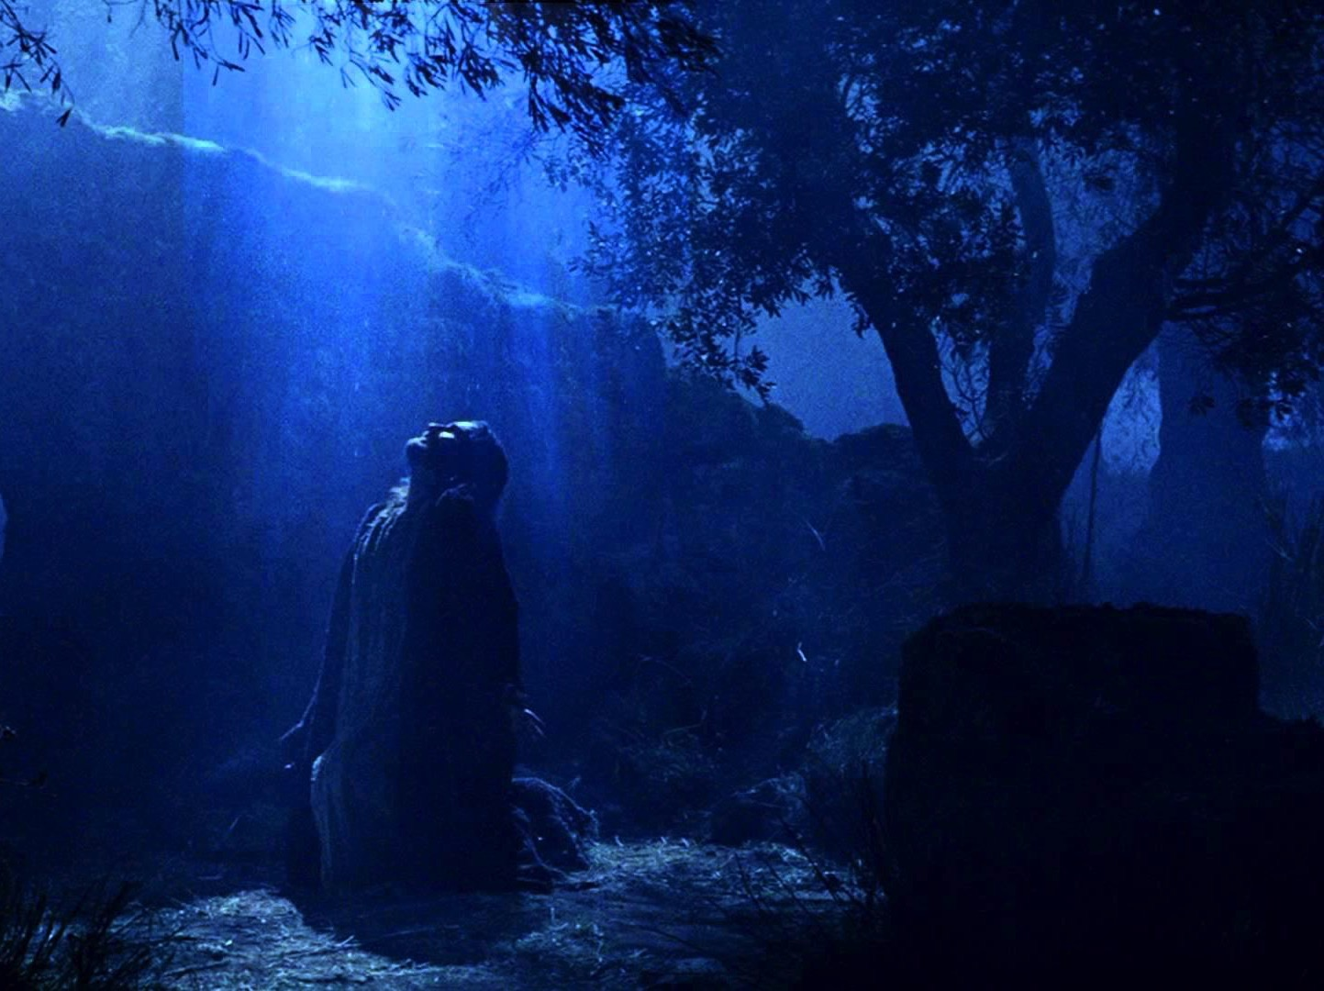
Messiah
42a
Jesus created the earth (1:26) and will defeat Satan (3:15), after descending from the line of Abraham (12:1-3) so that he might rule in the line of Judah (49:10).
Genesis
Notes:
Christ is intimated in the “Us” who created man (1:26) and pictured in the victor over the serpent (3:15), who will be the descendant of Abraham to bless all the world by offering salvation (12:1-3) as the prophesied King from Judah’s line (49:10).

Slide 10
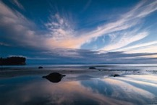
Genesis
56
Origin in Election and Promise
Creation | Fall | Fall | Flood | Flood |  | Babel | Jacob | Abraham |  | Isaac | Jacob | Joseph | Joseph | Isaac
Primeval Events |  |  |  |  |  |  |  | Patriarchal Characters
1:1–11:26 |  |  |  |  |  |  |  | 11:27–50:26
God’s Election |  |  |  |  |  |  |  | God’s Promise
Adam and Descendants |  |  |  |  |  |  |  | Abraham and Descendants
1/5 of the Book |  |  |  |  |  |  |  | 4/5 of the Book
Mesopotamia |  |  |  |  |  |  |  | Canaan |  |  |  | Egypt
2083 Years (4143-2060 BC) |  |  |  |  |  |  |  | 215 Years (2060-1845 BC) |  |  |  | 71 Years (1845-1774 BC)
The tôledôt of… | Heavens & Earth |  | Adam | Noah | Sons of Noah | Sons of Noah | Shem | Terah | Ishmael | Ishmael | Isaac |  | Esau | Jacob
Creation | Post-Creation |  | Sons of Adam | Noah | Sons of Noah | Sons of Noah | Sons of Shem | Abraham & Isaac | Sons of Ishmael | Sons of Ishmael | Jacob |  | Sons of Esau | Joseph
1:1–2:3 | 2:4–4:26 |  | 5:1–6:8 | 6:9–9:29 | 10:1–11:9 | 10:1–11:9 | 11:10-26 | 11:27–25:11 | 25:12-18 | 25:12-18 | 25:19–35:29 |  | 36:1–37:1 | 37:2–50:26
Covers 2369 Years of History
Written During Wilderness Wanderings (c. 1405 BC)
Notes:
Genesis 1–11 shows Israel’s origin in election and pivots in Genesis 12 to show the nation originated in God’s promise to Abraham to bless all peoples. This chart combines both the Hebrew division into 11 toledot (generations) with the more simple two-fold division around chapter 12.

Slide 11
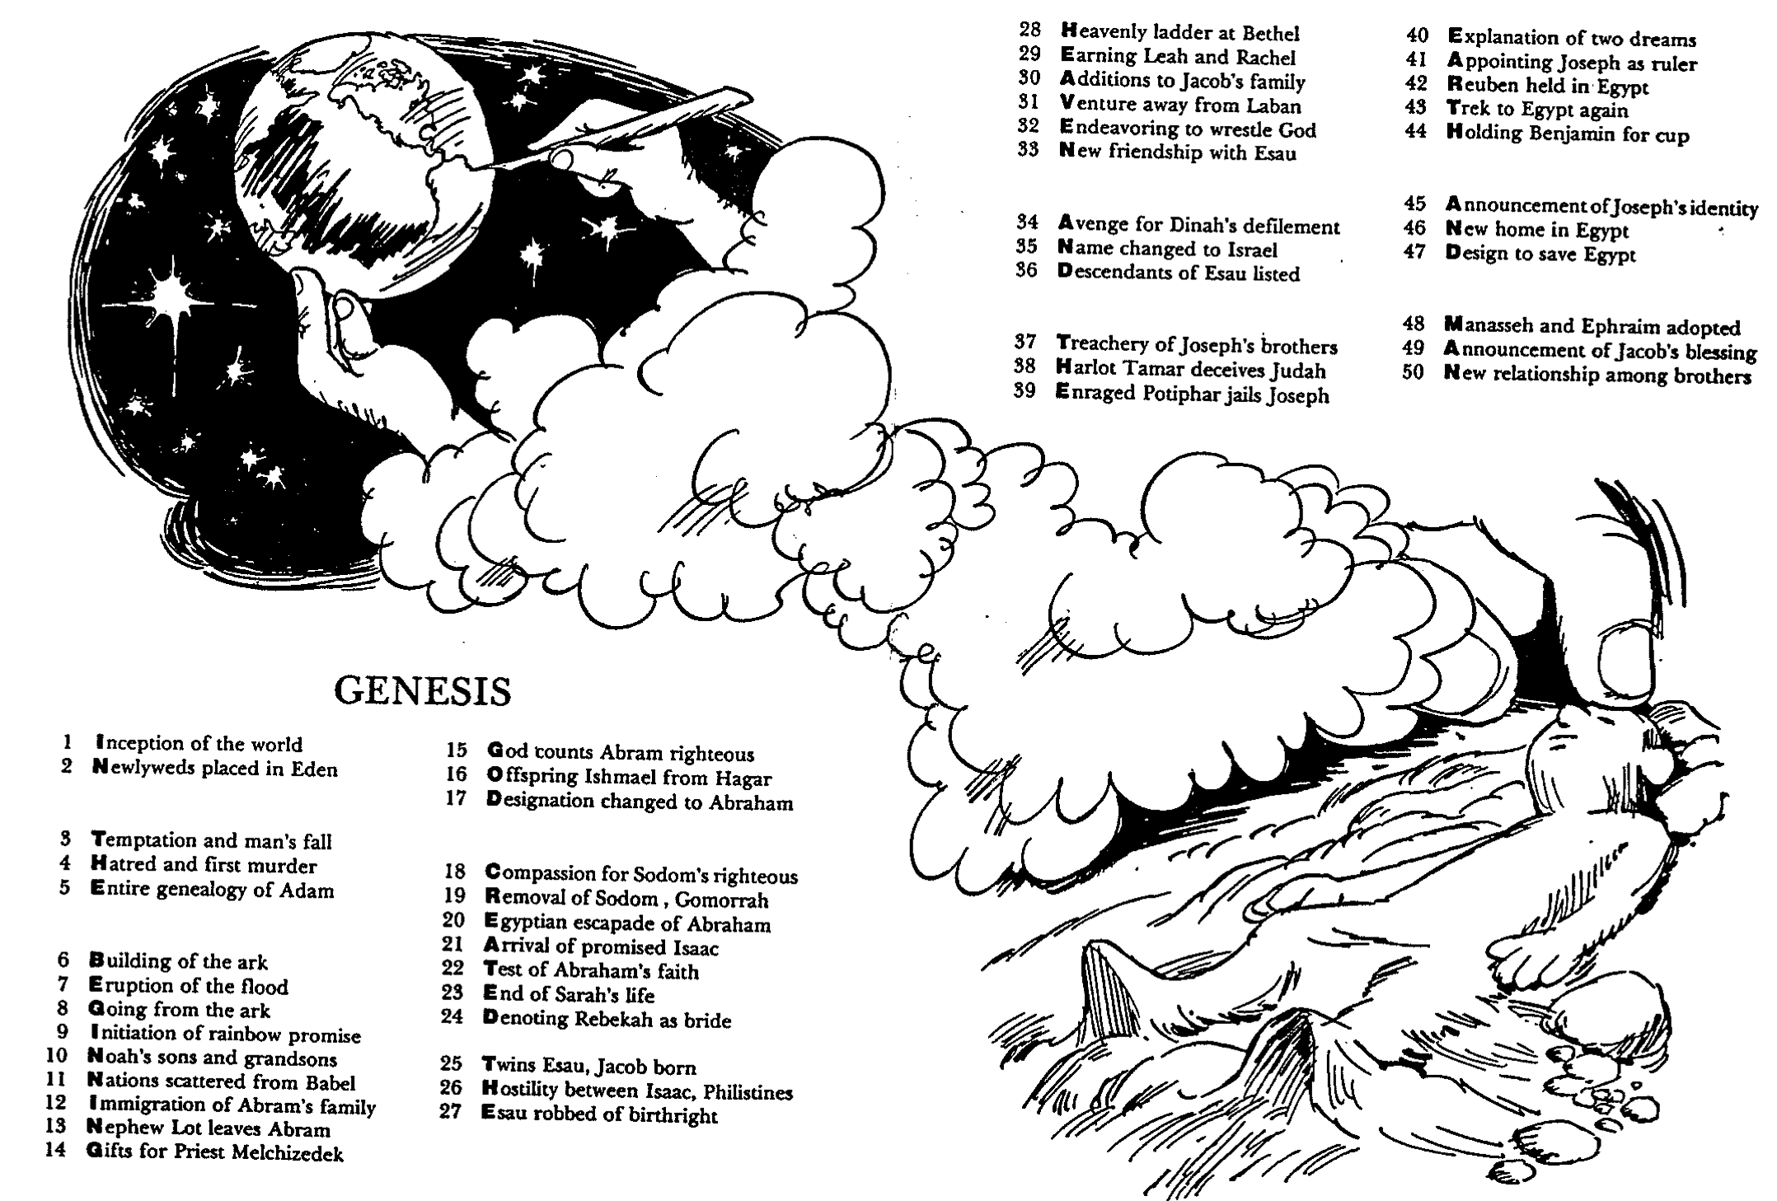
Barry Huddleston, The Acrostic Summarized Bible (Grand Rapids: Baker, 1992)
1 Inception of the world
2 Newlyweds placed in Eden
3 Temptation and man's fall
4 Hatred and first murder
5 Entire genealogy of Adam
6 Lessons on proper priorities
7 Outline for personal relationships
8 Faith of the centurion
29 Genealogy of Jesus Christ
30 Opposition of King Herod
31 Spirit's descent upon Jesus
32 Power over Satan's temptations
33 Expounding Sermon on Mount
34 Lessons on proper priorities
35 Outline for personal relationships
36 Faith of the centurion
9 Matthew's call from Jesus
10 Apostles sent to preach
11 Testimony about John's message
12 True Messiah called demonic
13 Hidden message of parables
14 Execution of the Baptist
15 Wisdom is answering Pharisees
37 Matthew's call from Jesus
38 Apostles sent to preach
39 Testimony about John's message
40 True Messiah called demonic
41 Hidden message of parables
42 Execution of the Baptist
43 Wisdom is answering Pharisees
Genesis
16 Keys of the kingdom
17 Impact of Jesus' transfiguration
18 Need for true forgiveness
19 Grounds for divorce clarified
20 Opportunities in the vineyard
21 Fig tree is cursed
44 Keys of the kingdom
45 Impact of Jesus' transfiguration
46 Need for true forgiveness
47 Grounds for divorce clarified
48 Opportunities in the vineyard
49 Fig tree is cursed
22 Taxes paid to Caesar
23 Hypocrisy denounced by "woes"
24 Events of second coming
25 Judgment of the nations
26 Events on Calvary's eve
27 Way of the cross
28 Savior's resurrection and commission
50 Taxes paid to Caesar
51 Hypocrisy denounced by "woes"
52 Events of second coming
53 Judgment of the nations
54 Events on Calvary's eve
55 Way of the cross
56 Savior's resurrection and commission
Notes:
Genesis depicts how “in the beginning God created the heaven and the earth and man,” though this actually only summarizes Genesis 1.
The Acrostic Summarized Bible depicts the theme of every biblical book in a vertical acrostic with that books’ theme in as many letters as there exist chapters in the book. Each chapter is summed up in four words where the first word doubles as part of the vertical acrostic for the entire book.

Slide 12

BE
FAITHFUL
Genesis
Dr. Rick Griffith, Crossroads International Church Singapore
CICFamily.com • BibleStudyDownloads.org
Notes:
The natural outworking of God choosing us for salvation and fulfilling his promise to bless us is to respond in faithfulness to him—to be reliable, dependable, and devoted to him.

Slide 13

Let's Study Through Scripture
The Bible: Book by Book
Notes:
This preaching series looks at each book in the Bible in a single sermon—66 messages that each cover an overview of an entire book.
I have taught through the Bible 37 times but never preached through it. Therefore, as I just finished 12 messages on the Minor Prophets, so now I will preach the other 54 books in the coming year until we learn all 66 books.
I encourage you to read through the Bible during this series, one book at a time.

Slide 14

A World of Idols
Notes:
In our hostile world full of idols, God says to be faithful to him as you face your future.
Persecution of Christians has been at its height the past century. More believers died in the 20th century than in the previous 19 centuries combined!
The media marginalizes the Christian viewpoint. One Supreme Court decision was thrown out because the Bible was used as evidence!

Slide 15


How can you be faithful to God in a world of idols?
IDOLS
of the
HEART
Notes:
In our hostile world of idols, God says to be faithful to him as you face your future. Christians have been persecuted more than ever in the past century. More believers were martyred in the 20th century than in the previous 19 centuries combined!
_________
“Son of man, these leaders have set up idols in their hearts. They have embraced things that will make them fall into sin. Why should I listen to their requests? ⁴ Tell them, ‘This is what the Sovereign LORD says: The people of Israel have set up idols in their hearts and fallen into sin, and then they go to a prophet asking for a message. So I, the LORD, will give them the kind of answer their great idolatry deserves. ⁵ I will do this to capture the minds and hearts of all my people who have turned from me to worship their detestable idols.’” (Ezekiel 14:3-6 NLT).

Slide 16

I. Grasp that the King chose you to rule.
Genesis 1–11
Notes:
We must know our amazing identity as God's elect people.

Slide 17

II. Grasp that the King promised you blessings.
Genesis 12–50
Notes:
We must know that being God's elect people guarantees incredible benefits.

Slide 18

Main Idea
Live out God's choice of you and promises for blessing
Genesis
Notes:
Make your life one that faithfully applies your election by God and his commitment to benefit you though Abraham.

Slide 19

What or who are you trusting to save you from your sin?
Genesis
Notes:
Whatever you trust has to be reliable!
Trust Christ to save you from your sin.

Slide 21
Then…
God is Creator.
“We are endowed by our Creator with certain unalienable rights…”
(US Declaration of Independence)
Now…
We are creators.
Most movies:
“Created by…
[script writer’s name].”

Slide 22
BE
FAITHFUL
Genesis
Dr. Rick Griffith, Crossroads International Church Singapore
CICFamily.com • BibleStudyDownloads.org
Notes:
The natural outworking of God choosing us for salvation and fulfilling his promise to bless us is to respond in faithfulness to him—to be reliable, dependable, and devoted to him.

Slide 23
A World of Idols
Notes:
In our hostile world full of idols, God says to be faithful to him as you face your future.
Persecution of Christians has been at its height the past century. More believers died in the 20th century than in the previous 19 centuries combined!
The media marginalizes the Christian viewpoint. One Supreme Court decision was thrown out because the Bible was used as evidence!

Slide 24
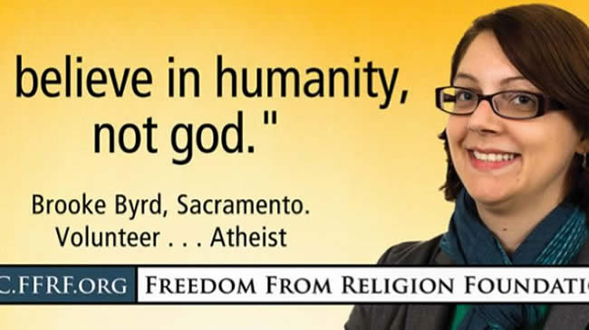
"Believe in humanity, not god."
Notes:
The atheists in particular have become more emboldened to tell us to abandon our faith.

Slide 25
How can you be faithful to God in a world of idols?
IDOLS
of the
HEART
Notes:
“Son of man, these leaders have set up idols in their hearts. They have embraced things that will make them fall into sin. Why should I listen to their requests? ⁴ Tell them, ‘This is what the Sovereign LORD says: The people of Israel have set up idols in their hearts and fallen into sin, and then they go to a prophet asking for a message. So I, the LORD, will give them the kind of answer their great idolatry deserves. ⁵ I will do this to capture the minds and hearts of all my people who have turned from me to worship their detestable idols.’” (Ezekiel 14:3-6 NLT).

Slide 26
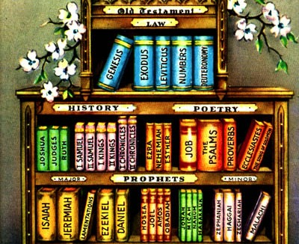
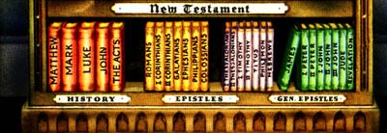
How can you remember all these books?
Notes:
But how well do you know God’s Word?
You can’t be faithful to what you don’t know, so you must grow in the God of the Word and the Word of God.
Like many believers, I lament that we don’t know the Bible as well as past generations. This week only three of my 46 students could even list the books of the OT.
Yet part of the blame is on us Bible teachers—pastors, SS teachers, professors, parents, and other teachers have not systematically taught through Scripture. od’s Word to help defeat the idols of our day?

Slide 27
Let's Study Through Scripture
The Bible: Book by Book
Notes:
This preaching series looks at each book in the Bible in a single sermon—66 messages that each cover an overview of an entire book.
I have taught through the Bible 37 times but never preached through it. Therefore, as I just finished 12 messages on the Minor Prophets, so now I will preach the other 54 books in the coming year until we learn all 66 books.
I encourage you to read through the Bible during this series, one book at a time.

Slide 28
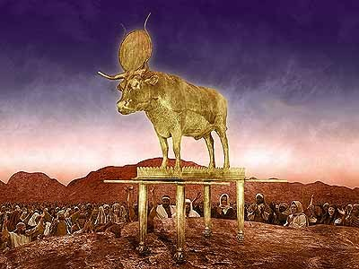
Where was Israel?
Notes:
As we approach Genesis, where was Israel geographically? Where did the first readers receive the book of Genesis? God needed to prepare Israel to be faithful before facing Canaan’s idolatry—thus he had Moses write Genesis in the wilderness before the Conquest to instruct them.

Slide 29
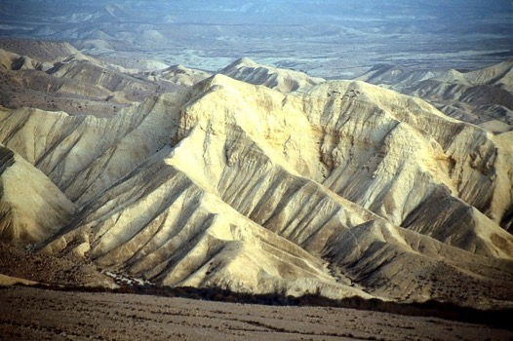
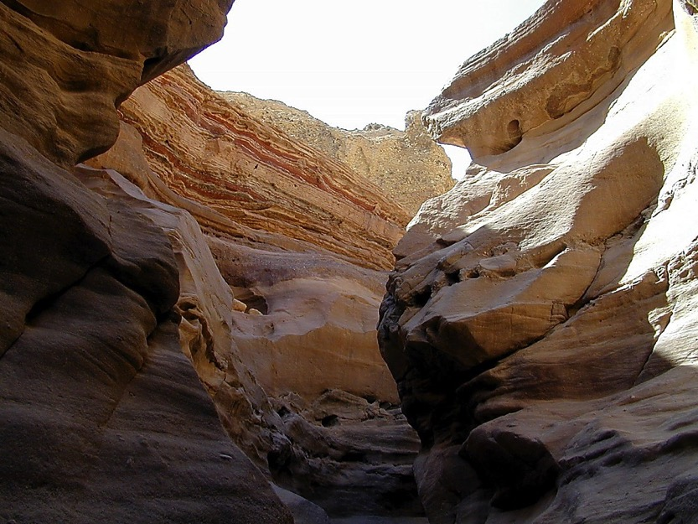
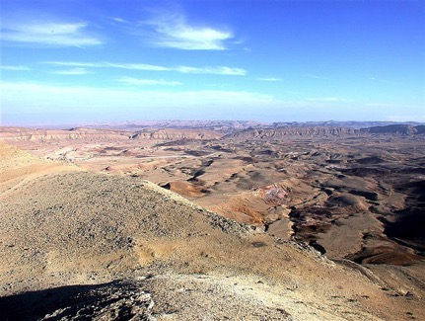
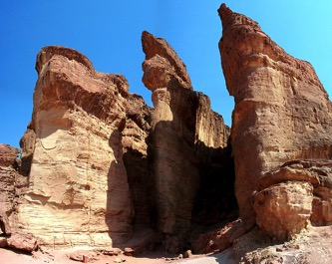
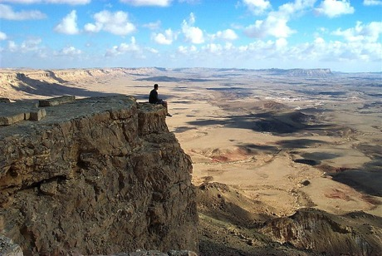
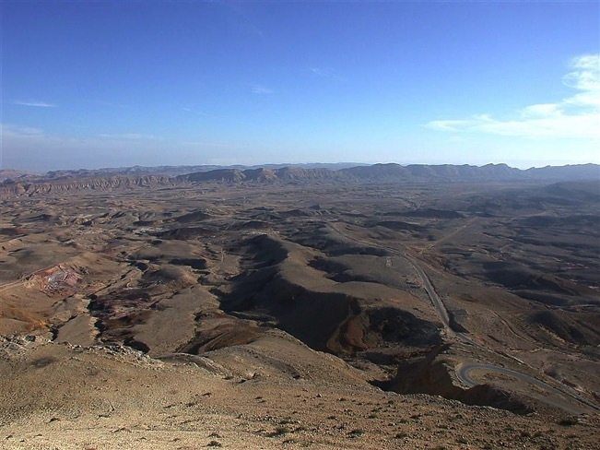
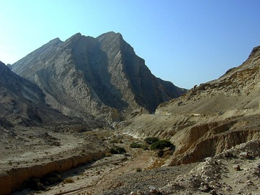
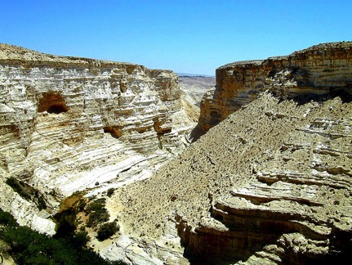
YOU MEAN… 40 YEARS?
OUT HERE?
Num. 32:13
DRESSING
THE
STAGE
YOU MEAN…
40 YEARS?
OUT HERE?
YOU MEAN…
40 YEARS?
OUT HERE?
MOSES
Exodus
Sinai
M - C - C
Kadesh Barnea
40
40
Handbook pg. 26-29
23
Notes:
Israel has just had 400 years in Egypt. We pick up the account where they had gotten out of Egypt, but Egypt hadn’t gotten out of them. They need a fresh look at who they are after generation of slavery in a foreign land.
_________
OS-Gen1-3-slide 29
OS-05-Deuteronomy-80

Slide 30
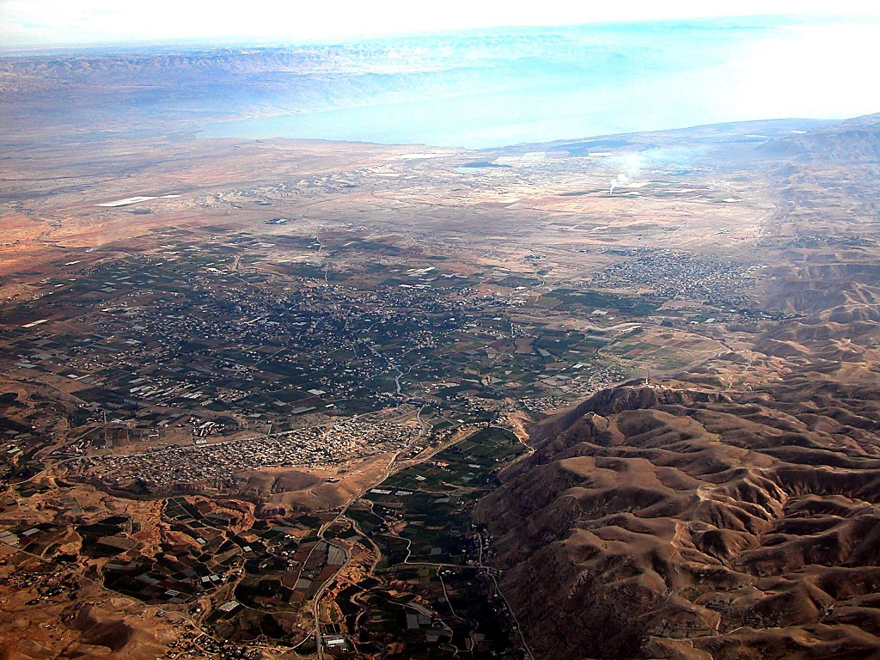
Jericho
DEAD SEA
JORDAN RIVER
MODERN JERICHO
JOSHUA
Jericho/Ai
ANCIENT JERICHO
From Jericho...
Looking East Across the Jordan River
Handbook pg. 26-29
42
Notes:
God told Moses that he will die in the wilderness—so how could Moses best prepare the nation to enter the land of Canaan?

Slide 31

Israel needed to know, "Who is their God"?
56
Notes:
They need to be taught who God is and how they are a nation chosen by the Sovereign Lord of all creation.
Then they will see that Canaan’s giants and walled cities are puny in comparison to their great God

Slide 32
Summary Statement
56
63
41
The narrow lineage of Israel from Creation to Joseph informs Israel it began with both God's election for rule and unconditional promise for blessings through Abraham in contrast to the Canaanites
Genesis
Notes:
A line of blessing started with Adam and ended with Joseph due to the LORD choosing their descendants to reign and God’s unilateral promise to eventually benefit all peoples through Abraham, which was unique to Israel.

Slide 33
Key Word
56
39
Election
Genesis
Notes:
The key word for Genesis is election—God chose them to rule with him and he does the same for us.

Slide 34
Genesis
56
Origin in Election and Promise
Creation | Fall | Fall | Flood | Flood |  | Babel | Jacob | Abraham |  | Isaac | Jacob | Joseph | Joseph | Isaac
Primeval Events |  |  |  |  |  |  |  | Patriarchal Characters
1:1–11:26 |  |  |  |  |  |  |  | 11:27–50:26
God’s Election |  |  |  |  |  |  |  | God’s Promise
Adam and Descendants |  |  |  |  |  |  |  | Abraham and Descendants
1/5 of the Book |  |  |  |  |  |  |  | 4/5 of the Book
Mesopotamia |  |  |  |  |  |  |  | Canaan |  |  |  | Egypt
2083 Years (4143-2060 BC) |  |  |  |  |  |  |  | 215 Years (2060-1845 BC) |  |  |  | 71 Years (1845-1774 BC)
The tôledôt of… | Heavens & Earth |  | Adam | Noah | Sons of Noah | Sons of Noah | Shem | Terah | Ishmael | Ishmael | Isaac |  | Esau | Jacob
Creation | Post-Creation |  | Sons of Adam | Noah | Sons of Noah | Sons of Noah | Sons of Shem | Abraham & Isaac | Sons of Ishmael | Sons of Ishmael | Jacob |  | Sons of Esau | Joseph
1:1–2:3 | 2:4–4:26 |  | 5:1–6:8 | 6:9–9:29 | 10:1–11:9 | 10:1–11:9 | 11:10-26 | 11:27–25:11 | 25:12-18 | 25:12-18 | 25:19–35:29 |  | 36:1–37:1 | 37:2–50:26
Covers 2369 Years of History
Written During Wilderness Wanderings (c. 1405 BC)
Notes:
Genesis 1–11 shows Israel’s origin in election and pivots in Genesis 12 to show the nation originated in God’s promise to Abraham to bless all peoples.

Slide 35
How can you be faithful to God in a world of idols?
IDOLS
of the
HEART
2 ways
Notes:
Today in Genesis we will see two ways to be faithful to God in a world of idols.
(What is the first way to be faithful to God in a world of idols?)

Slide 36
I. Grasp that the King chose you to rule (Gen 1-11).
Notes:
We must know our amazing identity as God's elect people.

Slide 37
Slides on
Genesis 1

Slide 38
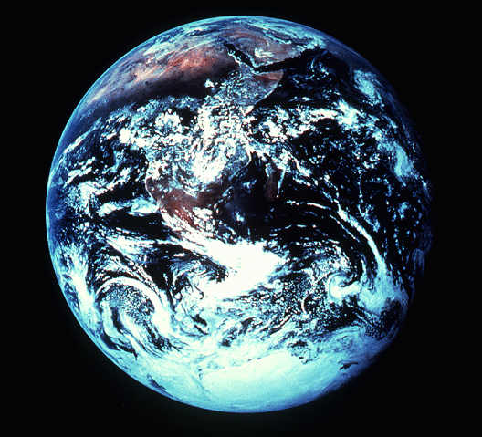
"In the beginning"
An Introduction to Genesis

Slide 39
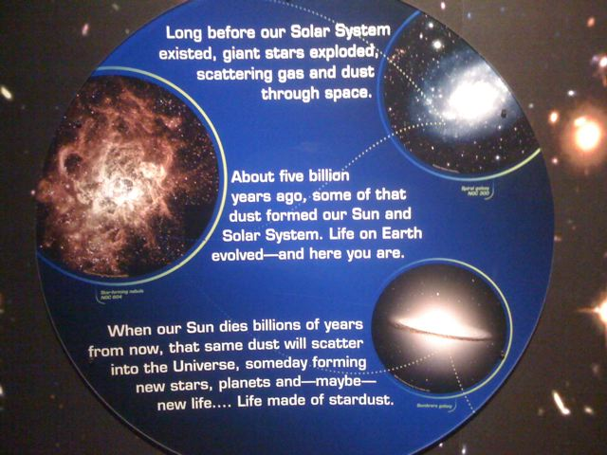
Worldly View of Origins
Text to translate & paste at left
Text to translate & paste at left
Text to translate & paste at left
Notes:
I took these pictures from the Chabot Space & Science Center in Oakland, California in July 2009. What creativity! What ignorance!

Slide 40
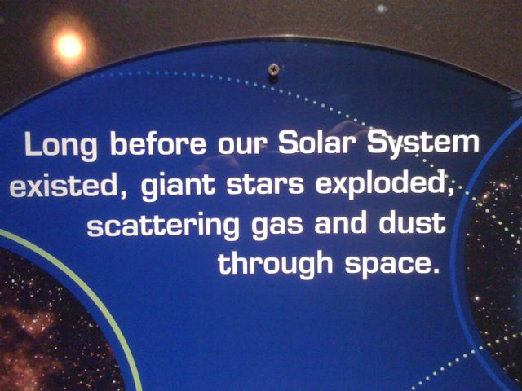
Worldly View of Origins
Text to translate & paste at left

Slide 41
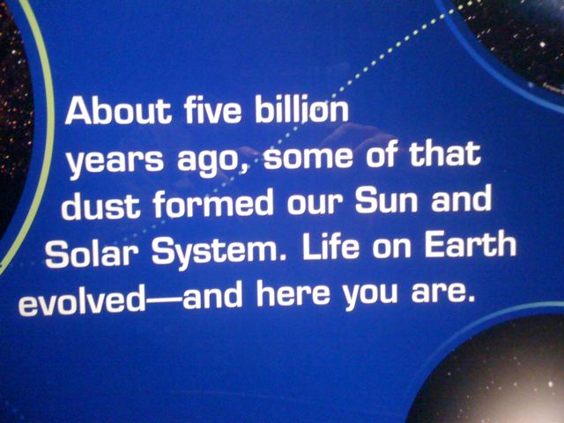
Worldly View of Origins
Text to translate & paste at left

Slide 42
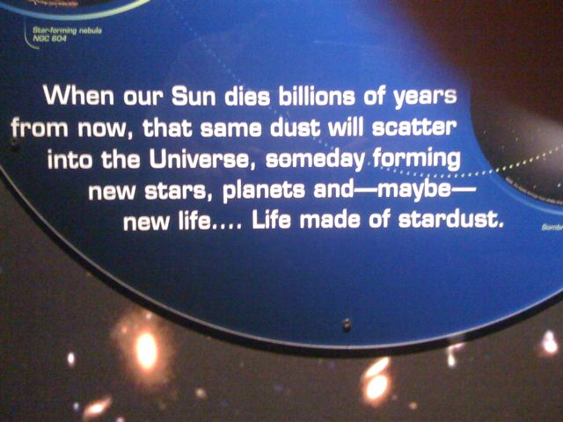
Worldly View of Origins
Text to translate & paste at left

Slide 43
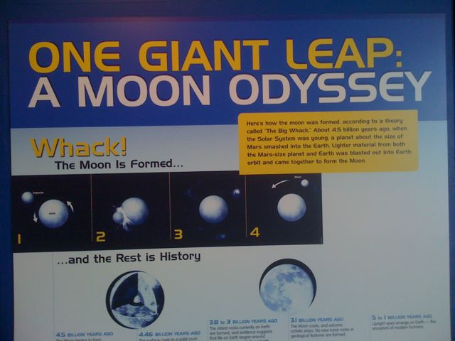
Worldly View of Origins
ONE GIANT LEAP:
A MOON ODYSSEY
Whack!
The Moon is Formed…
…and the Rest is History

Slide 44
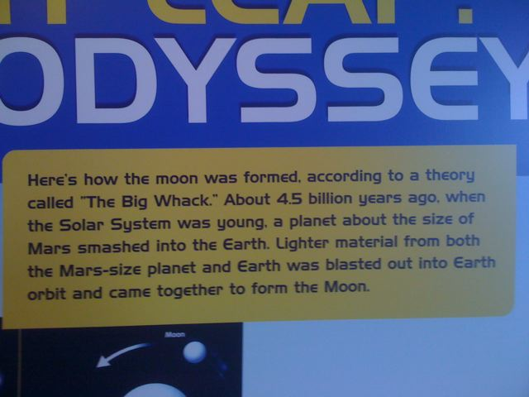
Worldly View of Origins
Text to translate & paste at left

Slide 45
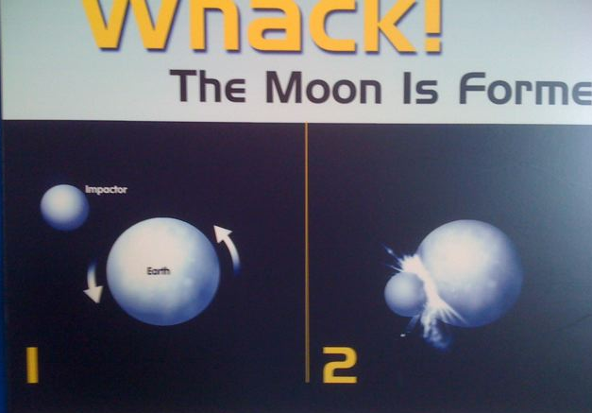
Worldly View of Origins
Whack!
The Impacter hit the Earth
Impacter
Earth

Slide 46
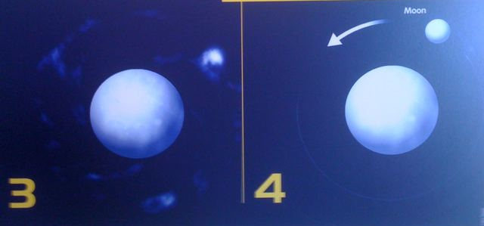
The Moon formed from the Earth
Moon

Slide 47
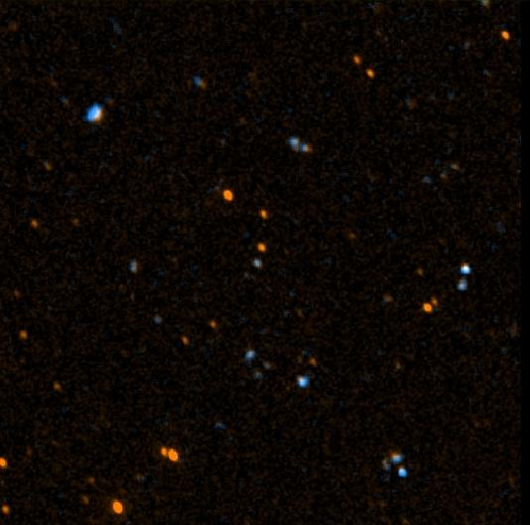


Title
57
Hebrew:
tyvarb
bereshith
In the beginning
Greek:
ge,nesij
genesis
Origin, source, birth
Notes:
Genesis provides a more believable origin for our universe.
The Hebrew name for the book is from the first word, saying that God started it all.
The Greek name is more descriptive from the word for “origin.”

Slide 48
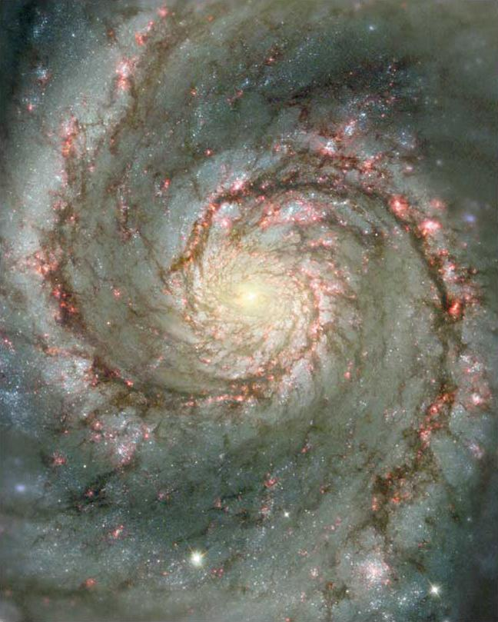
Questions We All Must Answer
Genesis = "Beginnings"
Origin: Where did we come from?
Purpose: Why am I here? Is there meaning?
Morality: Why is there evil in the world?
Destiny: Where am I going? Is there hope?
Notes:
All individuals want answers to these four basic issues—no matter their culture, language, education, ethnicity, time period, etc.

Slide 49

"Big N-ings"
58
Walk Through The Bible ©1989
Notes:
In baseball, when a team scores many runs in one of the 9 innings when they are at ball, it is called a “big inning.” In English, this provides a play-on-words where the “N” is larger than the other letters in the word “GeNesis.” This may help you recall a key concept in this book that reveals the “big starts” for many things today that we take for granted: the universe, the earth, the sun, moon, male and female, marriage, children, and so on. The origin for them all is in Genesis.

Slide 50

Authorship of Genesis
57
57
Traditional View: Moses
Critical View: JEDP
J
Jehovah
(LORD)
850 BC
E
Elohim
(God)
750 BC
D
Deuteronomistic
School
550 BC
P
Priestly
Code
450 BC
"Documentary Hypothesis"
Notes:
Since the late 1700s, liberal scholars have often taught that Moses did NOT write Genesis in 1500 BC. Instead, they theorize that Genesis was written gradually in four major stages much later by groups that emphasized the two key names “YHWH” and “God,” followed by others who wrote the book of Deuteronomy, and finally priests finished the book by adding more elements of interest to them, such as sacrifices and passages noting priestly matters.
This JEDP view is VERY speculative and its supporters argue amongst themselves as to which parts of Genesis belong to which stage. Many evangelical scholars have refuted this “Documentary Hypothesis” so many times that even many liberal scholars doubt it today.

Slide 51
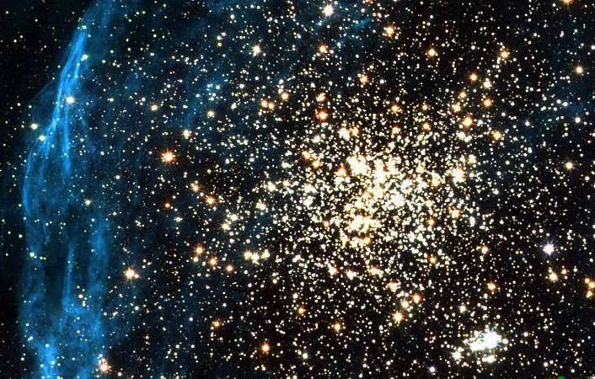
Key Word for Genesis:
56
Election
©2003 TBBMI
7.5.03a.
19
Notes:
Genesis is an Elect History: God chose people to rule with him that led to Abraham (1:1–11:26).

Slide 52
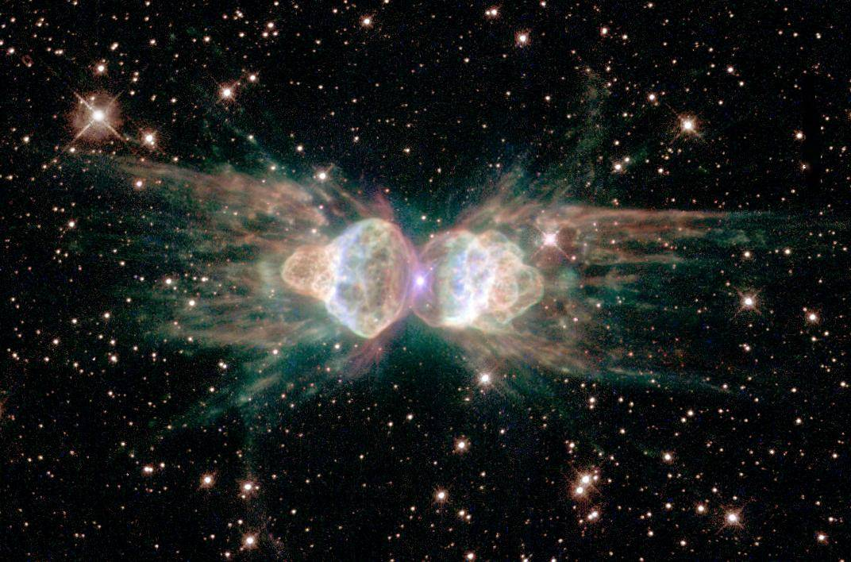
Support for Election as the Key Theme
Election
59-62
71b
God's sovereignty and desire to share this rule with man (1:26) is totally his choice alone
The eleven-section structure narrows down the chosen seed with which God can fellowship
The overall design shifts from God choosing Adam & his seed (1–11) to Abraham & his seed (12–50)
Repeated election of the younger over the older shows God's choices are superior to man's
Notes:
Election of God’s choice permeates Genesis in at least 4 ways…

Slide 53
God chose the older son to serve the younger!
Election
62
Older serves the | Younger | References
Nahor | Abraham | 11:27-28
Ishmael | Isaac | 21:10-12
Esau | Jacob | 25:29-34; 27:27-29, 38-40
Reuben, etc. (10 older brothers) | Joseph | 37:5-11
Manasseh | Ephraim | 48:13-14, 17-20
Reuben, Simeon, Levi (all 3 are older brothers) | Judah | 49:8-12
©2003 TBBMI
7.5.03a.
20
Notes:
Repeated election of the younger over the older shows God‘s choices are superior to man’s. In fact, nearly every man God chose was NOT the older son…

Slide 54
Forming the Message Statement
41
✚
Subject
(Theme)
✚
Purpose
(Reason)
What the book says
Why it says it
The narrow lineage of Israel from Creation to Joseph
informs Israel it began by God's election for rule and unconditional promise for blessings through Abraham in contrast to the Canaanites
Notes:
Most Bible outlines tell us only the content of a passage without sharing any theological design.
They also rarely share why this particular text is in the Bible.
So this course seeks to concisely state both the theological intent and why it is important.
For example, as background to Genesis, Israel in the wilderness was between two idolatrous peoples—Egypt was behind them for the past 400 years (but still too much part of their worldview), and Canaan was ahead in their near future. Both Egypt and Canaan worshipped many gods, so Israel needed to see how their God and history were unique in contrast.

Slide 55
Summary Statement
56
63
41
The narrow lineage of Israel from Creation to Joseph informs Israel it began with both God's election for rule and unconditional promise for blessings through Abraham in contrast to the Canaanites
Genesis
Notes:
A line of blessing started with Adam and ended with Joseph due to the LORD choosing their descendants to reign and God’s unilateral promise to eventually benefit all peoples through Abraham, which was unique to Israel.

Slide 56

A Cyclical View of History
58
WHO?
God
Church
Nations
Apostles
Patriarchs
Tribes
Savior
Israel
Prophets
Priests
Kings
Judges
Notes:
The Bible starts with God in the first verse and then ends with God in the exhortation for Jesus to return in Rev 22.

Slide 57
Genesis in the Cyclical View of History
58
GENESIS
God
Church
Nations
Apostles
Patriarchs
Tribes
Savior
Israel
Prophets
Priests
Kings
Judges
Notes:
Genesis covers the first three major movements of the Bible as it ends with a family led by the patriarch Jacob, who dies in the final chapter.

Slide 58
Timeline
58
GENESIS = 2369 years
Jesus
David
Abraham
Flood
Today
Kings
Church
Tribes
3000
2000
1000
AD
1000
2000
Creation
New Creation
Notes:
A normal reading of the genealogies of Genesis 5 and 11 shows that the book of Genesis covers and amazing 2369 years, ending around 2000 BC.

Slide 59
Chart of Gen 1–11
56
Primeval History
EVENTS 1–11
2083 years
286 years
Notes:
Genesis quickly moves through the major time period of over 2000 years in only 11 chapters.
This leaves room for the more detailed history of the patriarchs, who received God’s promise upon which Israel rested.

Slide 60
Chart of Gen 1–2
56
Primeval History
Creation 1–2
EVENTS 1–11
Human Race
Notes:
In contrast to the fast-moving Genesis 1–11 section, the first six days of this 2083-year period is written with great detail.

Slide 61

IN THE BEGINNING
God
created
the heavens and the earth
Genesis 1:1
Notes:
The Bible does not start with any effort to prove God’s existence. Rather, it simply tells us what he did to start life as we know it. Some believe verse 1 to be a title for what follows, but this sentence should actually be taken at face value in terms of what God did on Day 1. He made the earth that still needed more forming (see 1:2), and he made outer space, though it still needed the sun, moon, and stars, which would fill it on Day 4.

Slide 62

Days of Creation
33
Void
Formless
Forming
Filling
Day 4: Sun, moon & stars arranged
Day 1: Light
Day 2: Water & air separated
Day 5: Fish & fowl
Day 3: Land & sea separated
Day 6: Animals & man
Genesis 1:3-31
Notes:
There is no accident or evolution of trial-and-error in Genesis 1—God carefully made everything by his choice. As expected, he formed the world for three days before he filled it.

Slide 63
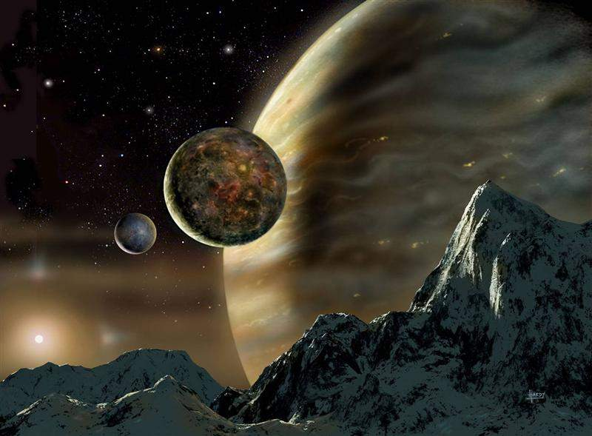
Creation in Six Days
Notes:
Ask anyone to read Genesis 1. Then ask, “How long does this chapter say it took God to make the world?” I suggest that 99% will say, “Six days. I don’t believe it was that quick, but the chapter says it took six days.”
The text is clear. There is no ambiguity about how long it took. Our problem is not an unclear narrative. Our problem is reading things into the passage that are not there—time gaps, figurative language, etc.
So let’s read it.

Slide 64
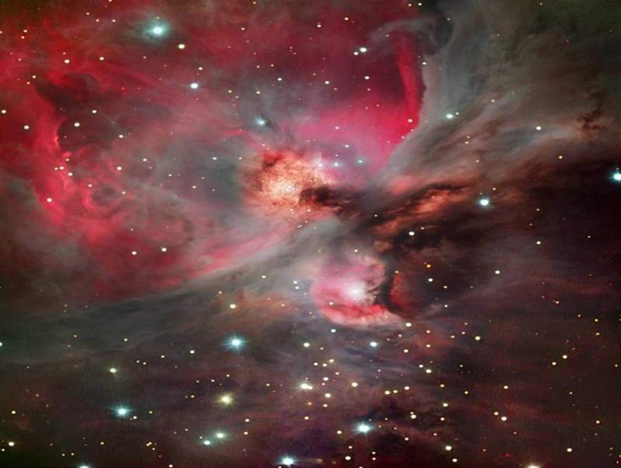
Day 1
God's Creation…Day 1
In the beginning God created
the heavens and the earth (1).

Slide 65
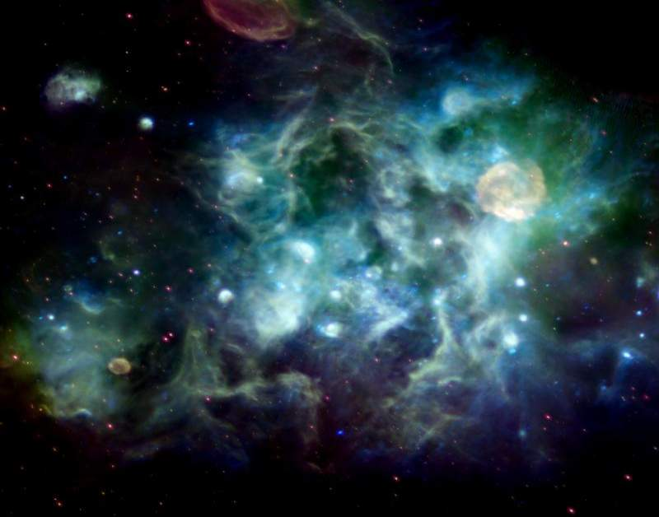
Formless & Void
God's Creation…Day 1
The earth was formless and void, and darkness was over the surface of the deep, and the Spirit of God was moving over the surface of the waters (2).

Slide 66
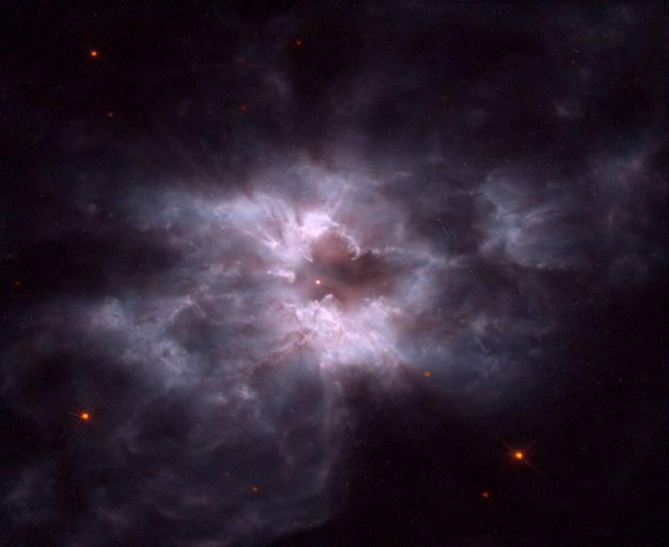
Light
God's Creation…Day 1
Then God said, "Let there be light"; and there was light. God saw that the light was good, and he separated the light from the darkness (3-4).

Slide 67
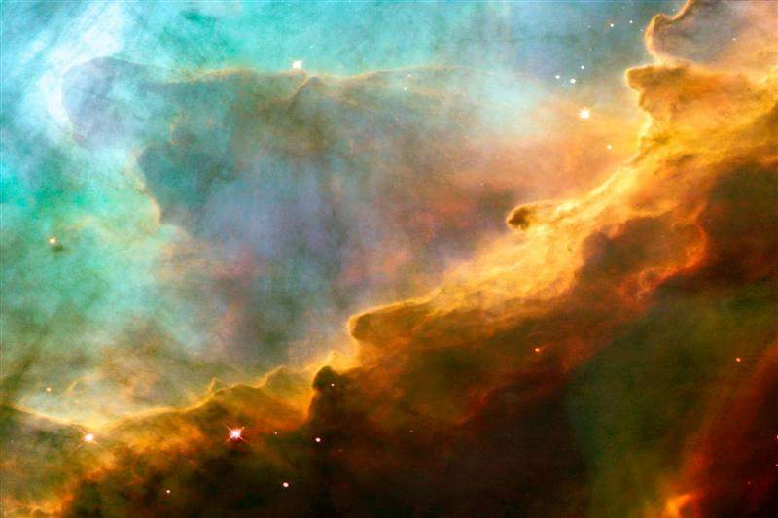
First Day
God's Creation…Day 1
God called the light day, and the darkness He called night. And there was evening and there was morning, one day (5).

Slide 68
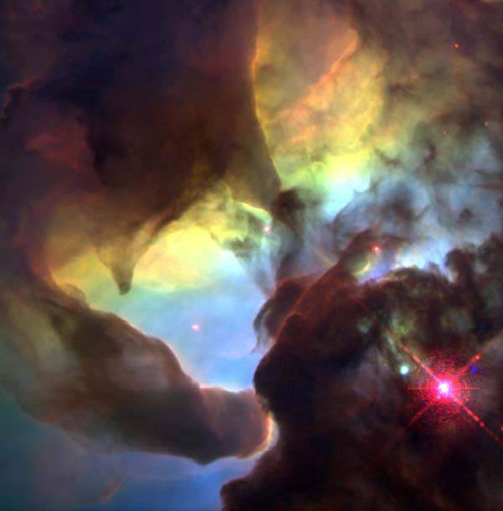
Day 2
God's Creation…Day 2
Then God said, "Let there be an expanse in the midst of the waters, and let it separate the waters from the waters" (6).

Slide 69
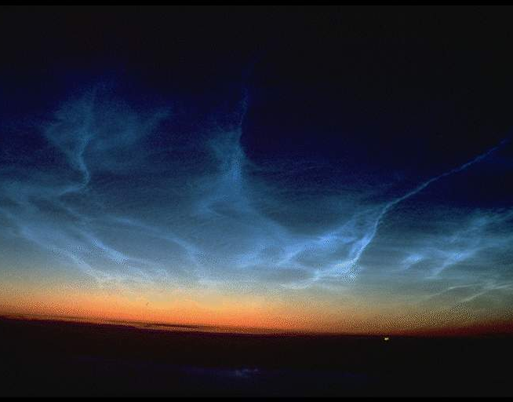
Expanse
God's Creation…Day 2
God made the expanse, and separated the waters which were below the expanse from the waters which were
above the expanse; and it was so (7).

Slide 70

Sky
God's Creation…Day 2
God called the expanse heaven (NIV "sky," 8a).

Slide 71
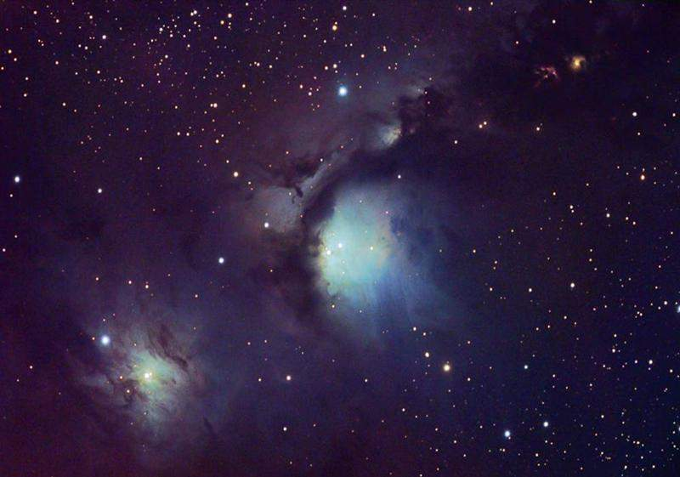
Second Day
God's Creation…Day 2
And there was evening and morning, a second day (8b).

Slide 72
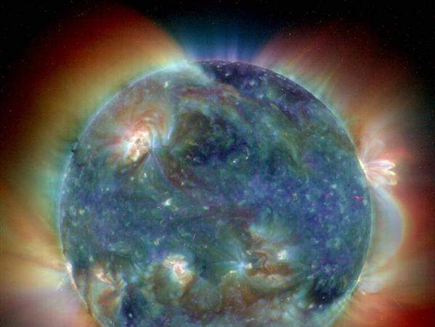
Day 3
God's Creation…Day 3
Then God said, "Let the waters below the heavens be gathered into one place, and let the dry land appear"; and it was so (9).

Slide 73
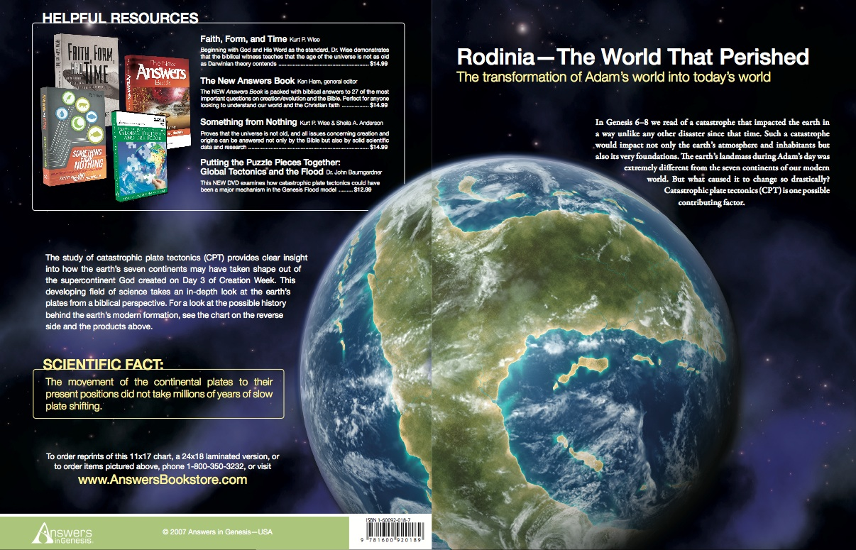
Rodinia––The World That Perished
The transformation of Adam's world into today's world
Notes:
God initially made the world as a single land mass that creationists call Rodinia.
____________
OS-01-Gen1-3—slide 73
OS-23-Isaiah13-23—slide 75

Slide 74
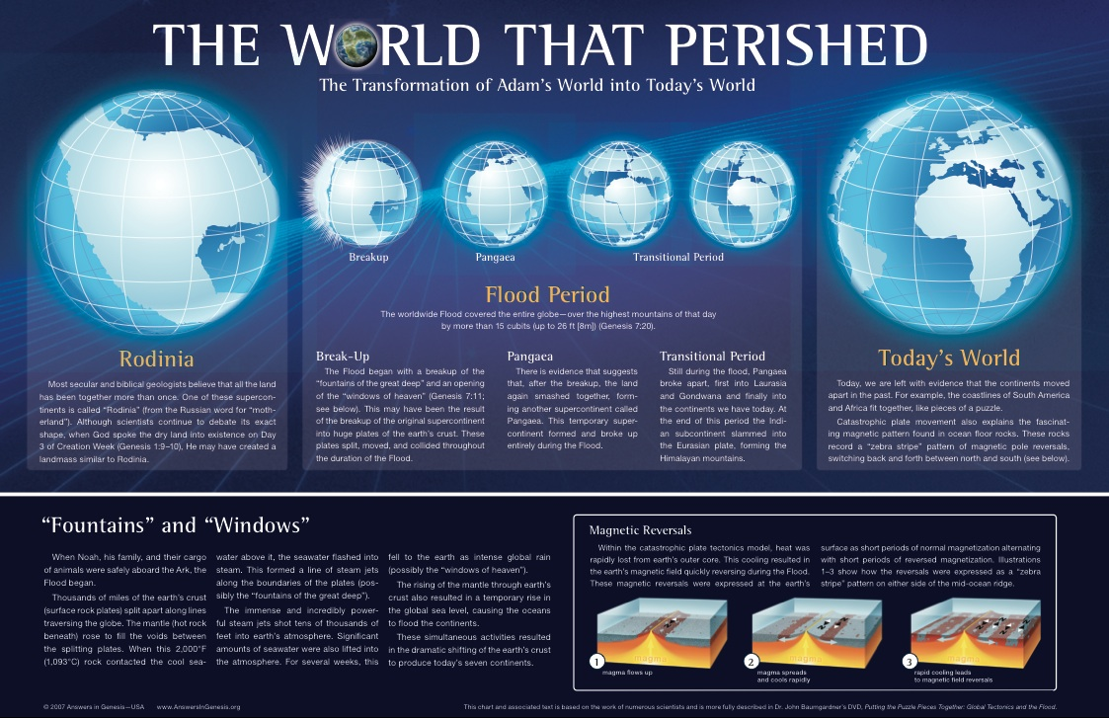
THE WORLD THAT PERISHED
The transformation of Adam's world into today's world
Notes:
Most geologists—both believers and unbelievers—recognize that Rodinia broke apart. Evolutionists believe it took place only a centimeter per year, which is the present rate or continental shift. But there is no reason that it could not have occurred at a much faster rate during Noah's Flood, which required about a 12-miles-per-hour shift from a single land mass into the continents of today.
____________
OS-01-Gen1-3—slide 77
OS-23-Isaiah13-23—slide 76

Slide 75
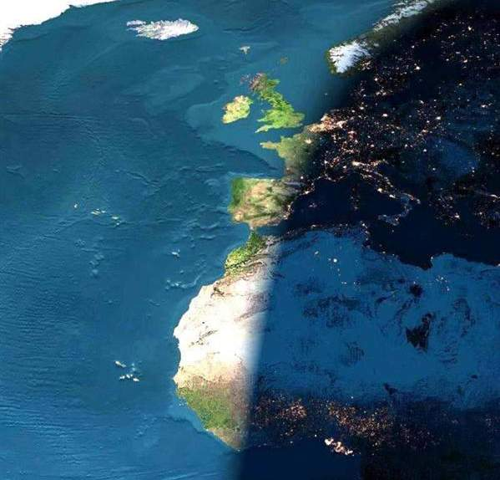
Land & Seas
God's Creation…Day 3
God called the dry land earth, and the gathering of the waters He called seas; and God saw that it was good (10).

Slide 76
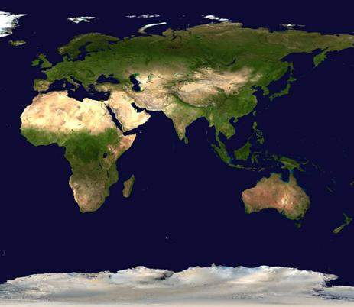
Vegetation
God's Creation…Day 3
Then God said, "Let the earth sprout vegetation: plants yielding seed, and fruit trees on the earth bearing fruit after their kind with seed in them," and it was so. The earth brought forth vegetation, plants yielding seed after their kind, and trees bearing fruit with seed in them, after their kind; and God saw that it was good (11-12).

Slide 77
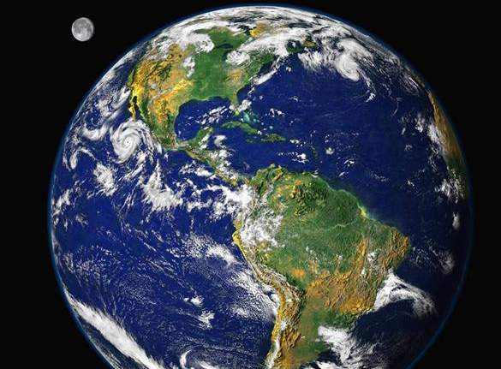
Third Day
God's Creation…Day 3
There was evening and there was morning, a third day (13).

Slide 78
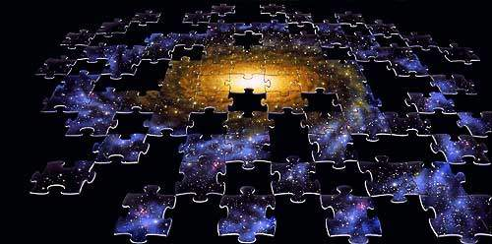
Day 4
God's Creation…Day 4
Then God said, "Let there be lights in the expanse of the heavens to separate the day from the night, and let them be for signs and for seasons and for days and years (14);

Slide 79
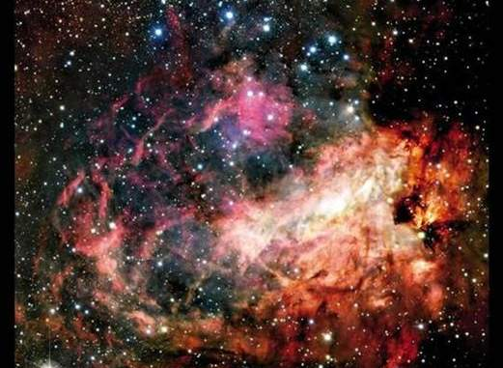
Sun & Moon
God's Creation…Day 4
And let them be for lights in the expanse of the heavens to give light on the earth"; and it was so (15).

Slide 80
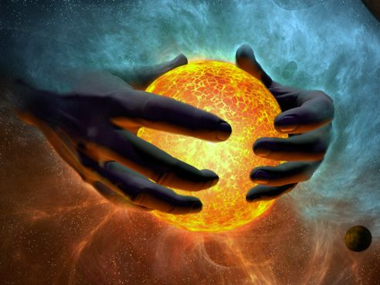
Sun
God's Creation…Day 4
God made the two great lights,
the greater light to govern the day (16a)…

Slide 81
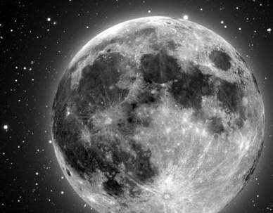
Moon
God's Creation…Day 4
…and the lesser light to govern the night (16b)…

Slide 82
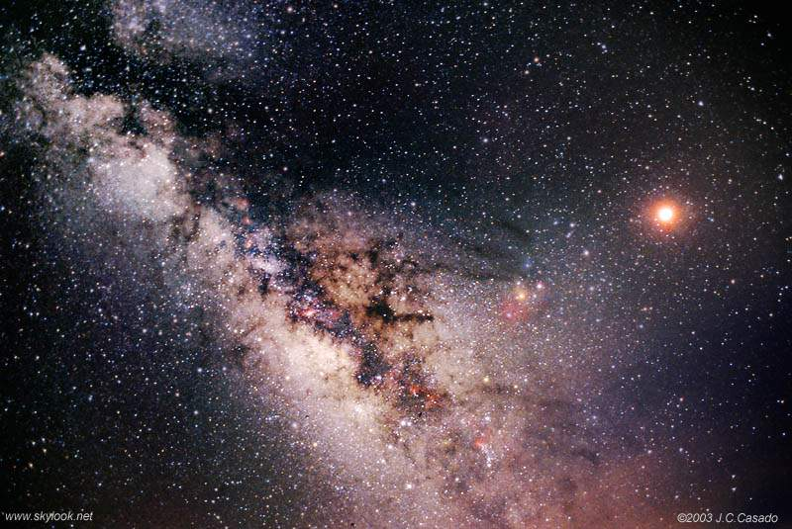
Stars
God's Creation…Day 4
He made the stars also (16c).

Slide 83

Fourth Day
God's Creation…Day 4
God placed them in the expanse of the heavens to give light on the earth, and to govern the day and the night, and to separate the light from the darkness; and God saw that it was good. There was evening and there was morning, a fourth day (17-19).

Slide 84

Day 5
God's Creation…Day 5
Then God said,
"Let the waters teem with swarms of living creatures…" (20a)

Slide 85

Birds
God's Creation…Day 5
"…and let birds fly above the earth in the open expanse of the heavens" (20b).

Slide 86

Whales
God's Creation…Day 5
God created the great sea monsters and every living creature that moves, with which the waters swarmed after their kind (21a)…

Slide 87

Penguins
God's Creation…Day 5
…and every winged bird after its kind; and God saw that it was good (21b).

Slide 88

Multiply
God's Creation…Day 5
God blessed them saying, "Be fruitful and multiply, and fill the waters in the seas, and let the birds multiply on the earth" (22).

Slide 89

Fifth Day
God's Creation…Day 5
There was evening and there was morning, a fifth day (23).

Slide 90

Animals
God's Creation…Day 6
448
"Then God said, 'Let the earth bring forth living creatures after their kind: cattle and creeping things and beasts of the earth after their kind'; and it was so. God made the beasts of the earth after their kind, and the cattle after their kind, and everything that creeps on the ground after its kind; and God saw that it was good" (Gen. 1:24-25).

Slide 91

Man
God's Creation…Day 6
448
"Then God said, 'Let Us make man in Our image, according to Our likeness; and let them rule over the fish of the sea and over the birds of the sky and over the cattle and over all the earth, and over every creeping thing that creeps on the earth'" (Gen. 1:26).

Slide 92

Woman
God's Creation…Day 6
"So God created man in his own image
in the image of God he created him
male and female he created them" (Gen. 1:27).

Slide 93

Mandate
448
and over the birds of the air
"And God blessed them, and God said to them, 'Be fruitful and multiply, and fill the earth and subdue it;
and have dominion over the fish of the sea
and over every living thing that
moves upon the earth'" (Gen. 1:28 NLT).

Slide 94

Food
Then God said, "Look, I have given you every green plant yielding seed that is on the surface of all the earth, and every tree which has fruit yielding seed; it shall be food for you" (29)

Slide 95

Food
"and to every beast of the earth and to every bird of the sky and to every thing that moves on the earth which has life,
I have given every green plant for food"; and it was so (30).

Slide 96

Sixth Day
God's Creation…Day 6
God saw all that He had made, and it was very good.
And there was evening and there was morning, the sixth day (31).

Slide 97
An All-Encompassing Theme
33
Genesis 1:26-28
"Then God said, 'Let us make man in our image, in our likeness, and let them rule over the fish … birds … livestock … all the earth, and over all the creatures that move along the ground…' God blessed them and said to them, 'Be fruitful and increase in number; fill the earth and subdue it. Rule over the fish of the sea and the birds of the air and over every living creature that moves on the ground.'"
Revelation 22:5
"There will be no more night. They will not need the light of a lamp or the light of the sun, for the Lord God will give them light. And they will reign for ever and ever."
The Bible's Theme: God extends His rule to man
Command
Covenants
Fulfillment
Notes:
The Kingdom theme goes from the first to the last chapters of the Bible.
• God created us to rule creation
• and we will do that even in the new Jerusalem!
• This means that the overall theme of the Bible is that God shares his rule with us!
• Then God's command
• will finally be fulfilled.
• And the covenants will be his vehicle to accomplish this rule.
God chose believers like us to rule the world!
Throughout Scripture, we see the Kingdom of God as the primary theme from the first to the last chapter. But we also see God establishing covenants, or promises, alongside his kingdom rule to enable us to see our eventual rule with him accomplished.
__________
Common Slides Arabic-51
Common English-85
BT-01-OT Biblical Theology-24
OS-00-Intro-89
OS-01-Gen1-3-slide 100
OS-23-Isaiah_49-66/Slide 105 on Supplements
NS-05-Acts1-2-slide 45
NS-22-Rev20-22-slide

Slide 98

The Kingdom in Genesis 1
71a
• Uncreated God (1:1)
• Creation by Word alone (1:4)
• Creation with ease
• Sun and moon [gods] created (1:16)
• Shared rule with man (1:26)

Slide 99

Where Does the Idea of Covenant Come From?
Genesis 1:1–2:3
"A Great King in authority over lesser rulers, with a historical background of doing good to them, with commands and with blessings, but also a curse in case of disobedience. These facts about the Genesis creation account are the stuff of covenant, and primordially so."
Jeffrey J. Niehaus, "Covenant: An Idea in the Mind of God," JETS 52 (2009): 61
Notes:
Cited by David Andrew Dean, "Covenant, Conditionality, and Consequence: New Terminology and a Case Study in the Abrahamic Covenant," JETS 57 (June 2014): 281.
Dean is professor of Systematic Theology and Bible Exposition at Yan Fook Bible Institute, 16/F1, Yan Fook Centre, 789 Cheung Sha Wan Road, Kowloon, Hong Kong.

Slide 100
Kingdom & Covenants Timeline
22
CH-34a
OS1-22
OS2-337
NS-9g
SA-19
34a
Dr. Rick Griffith • BibleStudyDownloads.org
22
Kingdom Teaching...
Adam rules with God (Gen. 1:26, 28; 2:19)
Satan begins rule as god of this world (Gen. 3:15;
2 Cor. 4:4)
God covenants with Abraham to reestablish man's rule via Israel as a "kingdom of priests" (Gen. 12:1-3; Exod. 19:6)
Israel's failure to witness to nations as a kingdom of priests is judged via exile under foreign rule
Israel rejects Messiah's offer of kingdom (Matt. 12:41-42; 23:37-39)
Jesus extends His kingdom in mystery form to the Church (Matt. 13)
Christ subdues Israel's enemies and nation believes (Rom. 11:26-27)
Christ rules over everything with saints (Eph. 1:9-10; Rev. 20:1-6; 22:5b)
337
9g
Fall of Man (Gen. 3)
Noahic Covenant
19
Genesis 6:18; 9:8-17
Land Covenant
ISRAEL
CHURCH
MESSIANIC KINGDOM
(National Focus)
The "New Man" (Eph. 2:15)
Millennial Eternal
land
Genesis 15:18 (cf. Deut. 30:1-10) promises:
Land from Wadi of Egypt to Euphrates River (Isa. 27:12)
Eternal possession of land (Gen. 17:8) after exile/restoration
Whole world blessed via the land (Isa. 14:1-2)
Israel judged for rejecting Messiah by dispersion away from land for 19 centuries
(AD 70–AD 1948) but now partially restored (Ezek. 37:1-7)
Full restoration (Ezek. 37:8-28) Jerusalem world capital
(Isa. 2:1-5)
New Jerusalem
(Rev. 21–22)
Davidic Covenant
Christ is Head over His Church, which is a spiritual temple (Eph. 2:19-22; 2 Cor. 6:16)
Christ reigns over the world
(Isa. 11)
with saints (Rev. 5:10; 20:4-6)
Christ hands kingdom over to Father (1
Cor. 15:24)
Genesis 12:1-3
2 Samuel 7:12-16 promises:
Sons ("house" never wiped out)
Kingdom (political dynasty)
Throne (right to rule by descendants)
Temple (son to build it)
seed
Abrahamic Covenant
New Covenant
All
things made new!
(Rev. 21:5)
All 5 elements fulfilled in national restoration (Zech. 8)
Jeremiah 31:31-34 promises:
Forgiveness
Indwelling Spirit
New heart, nature, mind
Reunification of Israel and Judah
No need for evangelism
Mosaic Law replaced with first three elements of the New Covenant (Luke 22:20; 2 Cor. 3:6)
blessing
Mosaic Covenant
Law abolished, fulfilled, and replaced at the cross (Rom. 7:1-6;
1 Cor. 9:19-21; Heb. 8:13)
11th Edition
29 Jan 2023
Temporary (Gal. 3:19) and conditional (Deut. 28) to reveal sin (Rom. 7:7) and regulate Israel (Gal. 3:23-25)
Scripture has a dual kingdom-covenant theme. Israel's role from Abraham to Christ expands to include the Church (continuity) yet the Church never replaces the nation as the "new Israel" (discontinuity). Israel will enjoy world prominence after trusting Christ at His second coming.
Notes:
This complicated chart combines the two themes of Kingdom and Covenants. God's kingdom rule extends to humanity across the ages at the top. But the major part shows the unfolding of the Abrahamic Covenant in its land, Davidic, and New Covenant promises—partially fulfilled in the present, but fully completed in the Messianic Kingdom. This will happen in the Millennial Age and especially in the Eternal State.
• This chart also shows that the Old (Mosaic) Covenant was replaced by the New Covenant.
All agree that a partial fulfillment of the covenant to Abraham exists now to the Church in the indwelling Holy Spirit and forgiveness of sins (Jer 31:31-34)—and the ultimate fulfillment will be in the eternal state.
The main area of disagreement relates to the time period from now to eternity. Will there be a literal land, throne, and worldwide blessing to national (ethnic) Israel before the eternal kingdom? This chart shows verses giving a resounding YES to that question in a present partial fulfillment and a future full fulfillment in the normal sense of language in the verses cited. But the messianic kingdom will be in two stages—first in a millennial fulfillment to last 1000 years, but then, after that, the eternal stage in the new Jerusalem after the destruction of our present heavens and earth (Rev 21–22). What an amazing future remains for those who trust Jesus!
____________
Common English-84
BT-01-OT Biblical Theology-25
CH-02-Nature-103-p34a
OC-10-Chronology-42
OS-00-Intro & Biblical Theology-25 & 90
OS-02-Exodus-267-p22
OS-05-Deut-279, 300
OS-10-2Sam-96-p22
OS-12-Kings & Prophets Charts-25
OS-13-1 Chron-46
OS-23-Isaiah-97-p337
OS-24-Jeremiah-174-p337
OS-23-Isaiah-97-p337
OS-28-Hosea-49
OS-31-Obadiah-164
05-Acts1-2-slide 45
NS-09-Gal-143-p9g
NS-19-Hebrews-342-p9g
SA-08-Mosaic Law-19-p38a

Slide 101

My View of the OT's Theme
33
The Old Testament narrates
God's restoring man to participate in His kingdom rule for His own glory
mandated in Eden but lost in the Fall
and accomplished by redeeming man
through Israel as a kingdom of priests
and ultimately through the Messiah,
who will reign as Savior and King
to fulfill the Abrahamic Covenant
Notes:
• The OT is a story more than a poetic description.
• This part in yellow italics is the main part of the main theme!
• Most descriptions of the overall theme lack kingdom ideas. But this one includes the problem
• the solution (redemption)
• the covenant nation of Israel
• the Messiah as King
• (not just Savior),
• and the Abrahamic Covenant.
__________
Common English-86
BT-01-OT Biblical Theology-26
OS-00-Intro-91
OS-23-Isaiah_49-66/Slide 106 on Supplements

Slide 102
Days of Creation
33
Void
Formless
Forming
Filling
Day 4: Sun, moon & stars arranged
Day 1: Light
Day 2: Water & air separated
Day 5: Fish & fowl
Day 3: Land & sea separated
Day 6: Animals & man
Genesis 1:3-31
Notes:
There is no accident or evolution of trial-and-error in Genesis 1—God carefully made everything by his choice. As expected, he formed the world for three days before he filled it.

Slide 103

Day 7
God's Creation…Day 7
So the creation of the heavens and the earth and everything in them was completed (2:1).

Slide 104

Day 7
God's Creation…Day 7
By the seventh day God completed His work which He had done, and He rested on the seventh day from all His work which He had done (2:2).

Slide 105

Sabbath
God's Creation…Day 7
Then God blessed the seventh day and sanctified it, because in it He rested from all His work which God had created and made (2:3).

Slide 106
Creation Theories
71
24-Hour Day
1 day = literal 24 hours
Day-Age
1 day = indefinite era
Literary
7 days = symbolic
Prior Creation
Creation | Gap | Re-Creation
1:1 1:2–2:3
Two-Phase
Creation | Gap | Creation
1:1–2:3 2:4-25
Genesis 1

Slide 107

How Big is the God of Creation?
An Amazing Comparison
Earth
Venus
Mars
Mercury
Pluto

Slide 108

Our 9 Planets
Jupiter
Saturn
Uranus
Neptune
Earth
Pluto

Slide 109

Our Sun is Huge!
Sun
Earth
Jupiter
Pluto

Slide 110
If you think our own solar system is amazing, beyond our sun it's an even bigger universe.

Slide 111

Jupiter is about 1 pixel in size and Earth is invisible at this scale!
Sun
Sirius
Pollux
Jupiter is about 1 pixel in size
Arcturus
Earth is invisible at this scale

Slide 112

Antares is the 15th brightest star in the sky.
It is more than 1000 light years away.
Betelgeuse
Antares
Sun (1 pixel)
Sirius
Jupiter is invisible at this scale
Pollux
Arcturus
Rigel
Aldebaran

Slide 113

This Hubble Telescope ultra deep field infrared views countless entire galaxies billions of light-years away.

Slide 114

Here is a close up of one of the darkest regions of the previous photo

Slide 115
Humbling, isn't it?
And yet, Father God knows how many hairs are on your head, and not even a single sparrow dies apart from his will
(Matthew 10:29-31)

Slide 116
And yet, you are more precious to Father God than many sparrows.

Slide 117

Jesus is the source of all things existing today

Slide 118

Jesus also sustains his creation

Slide 119

Christ in Colossians
"Christ is the visible image of the invisible God. He existed before anything was created and is supreme over all creation" (Col. 1:15).

Slide 120

Col. 1:16-17
"for through him God created everything in the heavenly realms
and on earth.
He made the things we can see
and the things we can't see—
such as thrones, kingdoms, rulers, and authorities in the unseen world.
Everything was created
through him and for him.
¹⁷ He existed before anything else, and he holds all creation together"
(Col. 1:16-17 NLT).

Slide 121

Jesus weeps over His creation
"He came into the very world he created, but the world didn't recognize him. ¹¹He came to his own people, and even they rejected him" (John 1:10-11 NLT)

Slide 122

The Best Commentary on Genesis
Creation
&Blessing
Very Readable
Exegetical Outlines
Sermon Outlines
Theology of Genesis
Evangelical

Slide 123

"Now the earth was formless and empty, darkness was over the surface of the deep…"
"…and the Spirit of God was hovering over the waters."
Genesis 1:2 NIV

Slide 124
"Earth was a soup of nothingness, a bottomless emptiness, an inky blackness."
"God's Spirit brooded like a bird above the watery abyss."
Genesis 1:2 The Message
Notes:
The ANE myths all have the gods come out of the creation but Genesis stands out by saying that God’s Spirit was above it all.

Slide 125
How Does 1:1 Relate to 1:2-3?
34
Original Creation (Traditional View)
Leupold, Keil, Cassuto, Young, Ryrie, Griffith, Tanner, Rooker
1- Creation out of nothing of the original mass on Day 1
"In the beginning God created the heavens and the earth" (1:1)
2- Three disjunctive, parallel clauses describe the condition of the earth immediately after the creation of the universe.
"Now the earth was formless and empty, darkness was over the surface of the deep, and the Spirit of God was hovering over the waters" (1:2 NIV)
3- An independent, narrative sentence shows the manner in which God worked—by His Word.
"And God said, 'Let there be light,' and there was light" (1:3)
Allen Ross, Creation & Blessing, 718
Notes:
Tanner calls this the "Initial Chaos Theory."
The three clauses are neutral (not negative) and circumstantial—not sequential" "The independent clause makes a statement [v. 1] and the following circumstantial clause [v. 2] describes parenthetically an element in the main clause" (Tanner, 5, quoting Mark Rooker, "Genesis 1:1-3: Creation or Re-Creation?" BibSac 149:596 [Oct-Dec]: 416).
This view sees verse 3 as continuing Day 1 rather than starting it. Exodus 20:11 supports this, as it puts 1:1-2 with Day 1: “For in six days the Lord made the heavens, the earth, the sea, and everything in them; but on the seventh day he rested. That is why the Lord blessed the Sabbath day and set it apart as holy” (NLT).
Exodus 31:17 supports this as well: “[The Sabbath] is a permanent sign of my covenant with the people of Israel. For in six days the Lord made heaven and earth, but on the seventh day he stopped working and was refreshed.’”
The Qumran practice of leaving space after each day supports 1:1-3 as part of Day 1 since 4QGenesisB has 1:1-5 all as one unit. Thus, these five verses were to be read as one unit.
The Book of Jubilees 2:1-24 reworks Genesis 1 by retelling the story in seven works of creation: water, abysses, light, etc. where
Haggadah Talmud also includes 1:1-3 as part of Day 1.
Was “formless and void” a negative statement indicating chaos? Some Egyptians used it in this manner, and the Babylonian Tiamat saw demons in the desert where it was “formless.” However, Jer. 4:23 “I looked at the earth, and it was empty and formless. I looked at the heavens, and there was no light” seems to indicate the negative sense.
Separation of the heaven and earth was a common motif in the ANE. See Gilgamesh and Enuma Anu Enlil and the Egyptian Memphite Theology.
But wouldn’t this make God create the heavens twice—here and on day 2? No, as it is used in a different sense in these places. Nathan Chambers (ETS presentation, 21 Nov 2019) sees this as referring theologically to God’s dwelling place, which also was created, so he says that it means that God created his own throne room on Day 1. This is a minor view, though.
A bipartite cosmology (heaven and earth) seems to be taught here, but later it shows that he actually created a tripartite universe: heaven, earth, and sea (cf. Exodus 20:11). This shows that 1:1 is not simply a heading for the narrative, as it is bipartite rather than tripartite.
The "earth" is 1:1 referred to the present sky, earth, and sea but all messed up. Verse 10 is the dry earth and verse 28 refers to rule over the dry earth also. This makes 1:2 include everything in the realm for humanity. God's dwelling place (1:1a) was finished but man's dwelling place was inhabitable.
This view is consistent with Greg Beale's heavenly temple view as the Holy of Holies (=God's dwelling place) is complete but man lives in a world that needed forming.
Why does Genesis start like this with a simple declaration?
1. Genesis 1 starts the biblical narrative with original creation that God made from nothing rather than a drama within existing matter. God did not have to fight any other gods to create.
2. This shows the initial act of creation, showing the story in historically relevant terms. If God created everything instantaneously, there would be no story to tell as it would be as if he snapped his fingers rather than over six days. It implies a wildness to creation, though, as God must overcome it.
3. God is transcendent over creation, but he is not opposed to creaturely agency. Instead, he makes use of means. He does not work through mediation, though the earth responds by making plants appear.
_______________________
OS-01-Gen1-3-Slide124
OB-22-Creation-43

Slide 126
Gap Theory (or Ruin/Reconstruction)
34
How Does 1:1 Relate to 1:2-3?
Pember, Hengstenburg, Scofield Reference Bible (1st ed.)
1- An independent narrative of the original, perfect creation
"In the beginning God created the heavens and the earth" (1:1)
Satan's fall
2- Satan fell between 1:1 and 1:2, followed by God's judgment which put the earth into a chaotic state
"Now the earth became formless and empty, darkness was over the surface of the deep, and the Spirit of God was hovering over the waters" (1:2 NIV margin)
3- An independent, narrative sentence describes the first step to reconstruct & reform the judged earth
"And God said, 'Let there be light,' and there was light" (1:3)
Allen Ross, Creation & Blessing, 718-19, 721
Notes:
OS-01-Gen1-3-Slide125
OB-22-Creation-44

Slide 127
Gap Theory (or Ruin/Reconstruction)
34
How Does 1:1 Relate to 1:2-3?
Pember, Hengstenburg, Scofield Reference Bible (1st ed.)
1- An independent narrative of the original, perfect creation
"In the beginning God created the heavens and the earth" (1:1)
Satan's fall
2- Satan fell between 1:1 and 1:2, followed by God's judgment which put the earth into a chaotic state
"Now the earth became formless and empty, darkness was over the surface of the deep, and the Spirit of God was hovering over the waters" (1:2 NIV margin)
—an improbable translation of the Hebrew disjunctive
3- An independent, narrative sentence describes the first step to reconstruct & reform the judged earth
"And God said, 'Let there be light,' and there was light" (1:3)
Allen Ross, Creation & Blessing, 718-19, 721
Notes:
OS-01-Gen1-3-Slide125
OB-22-Creation-44

Slide 128
Relative Beginning (5 variations)
How Does 1:1 Relate to 1:2-3?
34
Rashi/NEB, Speiser, Unger, Young, von Rad/Waltke/Ross
Satan's fall
1- Relative clause (dependent or temporal to 1:2) or title
"When God began to create the heavens and the earth" (1:1)
2- Three circumstantial clauses with negative, disjunctive sense describe the condition of the earth when God spoke.
"Now the earth was formless and empty, darkness was over the surface of the deep, and the Spirit of God was hovering over the waters" (1:2)
3- An independent, narrative sentence shows the manner in which God recreated/refashioned the earth into its present state (not creation out of nothing) after divine judgment.
"And God said, 'Let there be light,' and there was light" (1:3)
Allen Ross, Creation & Blessing, 719-20
Notes:
Prov 8:22-31 sees the creation as ex nihilo as it is a commentary on Genesis 1.
________________
OS-01-Gen1-3-Slide126
OB-22-Creation-45

Slide 129
Relative Beginning (5 variations)
How Does 1:1 Relate to 1:2-3?
34
Rashi/NEB, Speiser, Unger, Young, von Rad/Waltke/Ross
Satan's fall
1- Relative clause (dependent or temporal to 1:2) or title
"When God began to create the heavens and the earth" (1:1)
Implications:
"For the initial creation, or original creation, one has to look elsewhere in the Bible"
"This view in no wise teaches evolution or allows for it… It simply recognizes that 'beginnings' with God are not necessarily absolute beginnings" (Ross, 723)
2- Three circumstantial clauses with negative, disjunctive sense describe the condition of the earth when God spoke.
"Now the earth was formless and empty, darkness was over the surface of the deep, and the Spirit of God was hovering over the waters" (1:2)
3- An independent, narrative sentence shows the manner in which God recreated/refashioned the earth into its present state (not creation out of nothing) after divine judgment.
"And God said, 'Let there be light,' and there was light" (1:3)
Allen Ross, Creation & Blessing, 719-20
Notes:
Prov 8:22-31 sees the creation as ex nihilo as it is a commentary on Genesis 1.
________________
OS-01-Gen1-3-Slide126
OB-22-Creation-45

Slide 130

Water Vapor Canopy Theory
64
First proposed by Isaac Newton Vail in 1874
Support sought in "Let there be an expanse between the waters to separate water from water" (Gen. 1:6)
Provided enough water for universal flood (Gen. 7:11)
Enabled long pre-flood life spans (reduced radiation)
Held by young earth advocates
Hotly contested!

Slide 131

Evangelicals Differ
34
70d
Reasons to Believe
Hugh Ross
Walt Brown
Old Earth
Progressive Creation
Mid-East Flood
Rain waters
reasons.org
godandscience.org
creationscience.com
Institute for Creation Research
Henry/John Morris, Duane Gish
Joseph Dillow, Ken Ham
Young Earth
24-hour Creation Days
Universal Flood
Vapor canopy
answersingenesis.org
genesispark.org
icr.org critiques Ross at:
icr.org/pubs/imp/imp-217.htm

Slide 132


GOD: I just created a
24-hour period of alternating lightness and darkness on earth…
ANGEL:
What are you going to do now?
GOD:
Call it
a day.
Notes:
BE-01-Gen-Be Faithful-22
OP-01-Gen-Be Faithful-22
CR-41-Theistic Evolution-27
OB-41-Theistic Evolution-27
OS-01-Gen1-3-Slide 132

Slide 133
Why 24 Hours?
70b
Instantaneous creation
"By the word of the LORD were the heavens made, their starry host by the breath of his mouth" (Ps. 33:6)
"There is certainly no thought here of delay, or a trial-and-error process, or a gradual, step-by-step fulfillment"
– John Whitcomb, The Early Earth, 24

Slide 134
Why 24 Hours?
70b
Instantaneous creation (Ps. 33:6)
"evening and morning"

Slide 135

Dan. 8:26 alone (besides Gen 1) has "evening & morning"
––with a literal view
"The vision of the evenings and mornings which has been told is true; But keep the vision secret, for it pertains to many days in the future" (NASB).

Slide 136
Why 24 Hours?
Instantaneous creation (Ps. 33:6)
"evening and morning"
Numerical adjective ("second…")
In Hebrew, when "day" (yom) is preceded by a numerical adjective, "day" is always literal!

Slide 137

Numbers 7:12
"Now the one who presented his offering on the first day was Nahshon…"

Slide 138
Why 24 Hours?
Instantaneous creation (Ps. 33:6)
"evening and morning"
Numerical adjective ("second…")
Pattern for work & rest

Slide 139

We get our 7-day week from Genesis 1

Slide 140

Four Ways to Call Parts of a Day
Noon
DAY
Start of Jewish Day
Sunrise
Sunset
Start of Roman Day
24 Hour
AM/PM
Roman
Jewish
NIGHT
Midnight
Notes:
• The 24 Hour rendering numbers each hour consecutively
• AM/PM divides the 24 hour day in half into ante (before) the middle (noon) and post (after) the middle (noon), abbreviated AM and PM, respectively
• Romans began the day at midnight, dividing the night into 4 watches of 3 hours each that went from 7 PM to 7 AM
• Jews began the day at 7 PM, dividing the night into 3 watches of 4 hours each that went from 7 PM to 7 AM
OB-29-Theistic Evolution-35
OB-41-Theistic Evolution-35
OS-01-Gen 1-3-137

Slide 141


When to Start the Day…
6
PM
12
AM
6
AM
12
PM
6
PM
12
AM
6
AM
12
PM
6
PM
Roman
Day 1
Day 2
Jewish
Day 1
Day 2
There was evening…
…and morning…
There was evening…
…and morning…
…one day.
…the
second day.
Notes:
Our "day" today beginning at midnight came from the Romans hundreds of years after the Jewish reckoning from evening to evening that is used in Genesis 1.

Slide 142
Why 24 Hours?
Instantaneous creation (Ps. 33:6)
"evening and morning"
Numerical adjective ("second…")
Pattern for work & rest
Sun & moon not until day 4

Slide 143

Romans 1:20
161
Since the start of creation…
people have seen God
= literal 24-hour days
"For since the creation of the world God's invisible qualities—his eternal power and divine nature—have been clearly seen, being understood from what has been made, so that men are without excuse" (NIV).
Notes:
People have seen God’s invisible attributes since the BEGINNING of creation—not thousands or millions of years later!
How? The creation week was a normal work week for God of only six 24-hour days.

Slide 144


Creation or Evolution?
74
Notes:
Do you believe in creation…
• or evolution from ape-men?
• Is your ancestor the “Big Daddy” ape-man or not?

Slide 145

Did dinosaurs come before man?
Dinosaurs ^{by} Design
80
Yes. God created dinosaurs earlier on the sixth day of creation!

Slide 146



Evolution relies on a theory of transitional forms which would have been easy prey!
75
Evolutionary Fairy Tales

Slide 147

Narrative Parallels to Genesis
79f
Memphite Theology
Enuma Elish
Atrahasis Epic
Gilgamesh Epic
Creation
Creation
Creation & Flood
Flood

Slide 148

Marduk Kills Tiamat
79f
Notes:
“Marduk Fights Tiamat
In the Babylonian epic of creation [Enuma Elish], Tiamat, chaos monster and primordial goddess of the ocean, mates with Abzu, god of fresh water. She gives birth to the first generation of gods, then attacks them and is killed by the storm-God Marduk. His name is mentioned in scripture and is also part of the name of the Babylonian ruler Merodach-Baladan, ‘Marduk has given me an heir,’ and Esther’s cousin Mordecai. Esth 2:5, Jer 50:2, Isa 39:1.”
Richard Myers, Images from Helps to Study the Bible (Bellingham, WA: Logos Bible Software, 2012).

Slide 149

Expelled Movie Clip

Slide 150

The Evolution of Man
人类进化史
软塌塌的无脊椎胶质
早期灵长类
直立人
软塌塌的无脊椎胶质
新石器时代智人
进化智人
77d
The Evolution of Man
SOFT, GLOB-LIKE LUMP OF SPINELESS MUSH
EARLY PRIMATE
HOMO ERECTUS
NEOLITHIC HOMO-SAPIEN
EVOLVED HOMO-SAPIEN
SOFT, GLOB-LIKE LUMP
OF
SPINELESS MUSH

Slide 151





Big Bang and Bible order compared
Big Bang
Stars
Sun
Molten
Earth
First
Oceans
15 Billion
Years Ago
10 Billion
Years Ago
5 Billion
Years Ago
4.5 Billion
Years Ago
3.8 Billion
Years Ago

Slide 152



Big Bang and Bible order compared
Big Bang
Stars
Sun
Molten
Earth
First
Oceans
15 Billion
Years Ago
10 Billion
Years Ago
5 Billion
Years Ago
4.5 Billion
Years Ago
3.8 Billion
Years Ago
Water Covered
Earth
Dry Land
and Plants
Sun, Moon,
and Stars
Days 1-2
Day 3
Day 4

Slide 153
Day | Biblical Creation | Points of Conflict | Big Bang Evolution | Sequence
1 | Earth |  | Light | 1
1 | Darkness |  | Darkness | 2
1 | Water |  | Stars | 3
1 | Light |  | Water | 4
2 | Oceans |  | Solar system | 5
3 | Dry land |  | Earth | 6
3 | First life (vegetation) |  | Dry land | 7
3 | Trees |  | Oceans | 8
4 | Solar system |  | First life (single cellular) | 9
4 | Stars |  | Fish | 10
5 | Fish |  | Trees | 11
5 | Birds |  | Insects | 12
6 | Mammals |  | Reptiles | 13
6 | Reptiles |  | Birds | 14
6 | Insects |  | Mammals | 15
6 | Man |  | Man | 16
Adapted from Dr. John Hartnett (Associate Professor, Physicist, Cosmologist at The University of Adelaide) at http://johnhartnett.org/

Slide 154



Who believes what?
Creationists (55%)
Theistic Evolutionists (32%)
Darwinists (13%)
(the view that leading scientists and educators accept)
2005 CBS News/New York Times Poll
Notes:
"In a recent survey of beliefs about origins, a 2005 CBS News/New York Times Poll of 885 persons found 55 percent of the general public were creationists, 32 percent were theistic evolutionists, and only 13 percent were orthodox Darwinists (the view that leading scientists and educators accept)." (Theistic Evolution and the Creation-Evolution Controversy (#393) by Jerry Bergman, PhD at http://www.icr.org/article/2701/). Jerry Bergman is on the Biology faculty at Northwest State College in Ohio

Slide 155

Did life originate as an accident?
"There are only two possible explanations as to how life arose: Spontaneous generation arising to evolution or a supernatural creative act of God…. There is no other possibility. Spontaneous generation was scientifically disproved 120 years ago by Louis Pasteur and others, but that just leaves us with only one other possibility… that life came as an act of supernatural creation by God, but I can't accept that philosophy because I do not want to believe in God. Therefore, I choose to believe that which I know is scientifically impossible, spontaneous generation leading to evolution."
Dr. George Wald
Professor Emeritus of Biology, Harvard
Nobel Prize winner in Biology, 1971
Notes:
George Wald, "Origin, Lie and Evolution," Scientific American (1978); cited by Joe White and Nicholas Comninellis, Darwin's Demise (Green Forest, AR: Master Books, 2001), 46.

Slide 156

AiG Web Address 00439

Slide 157
Slides on
Genesis 2
Notes:
Do you see any sign of death in Genesis 1 or Genesis 2? Neither do I—because you cannot find it there.

Slide 158

Summary
God's Creation…Day 7
Thus the heavens and the earth were completed,
and all their hosts (2:1)

Slide 159
Day 7
God's Creation…Day 7
By the seventh day God completed His work which He had done, and He rested on the seventh day from all His work which He had done (2:2).

Slide 160
Sabbath
God's Creation…Day 7
Then God blessed the seventh day and sanctified it, because in it He rested from all His work which God had created and made (2:3).

Slide 161
The Eschatological Significance of the Sabbath
23
529
NS 266k
A visual summary of the ThD dissertation by Richard James Griffith, Dallas Theological Seminary, 1990
Christ’s Second Coming in
2 Phases
Pre-Fall
Pre-Mosaic
Mosaic
Church
Tribulation
Millennial Kingdom
Eternity
Creation
Fall of Man
Mount Sinai
Death of Christ
Rapture
Revelation
Rev 20:1-6
Eternity
6 Days
(Work)
Gen 1
7th Day
(Rest)
Gen 2:1-3
Law Instituted
Exod 20
Law Abolished
Rom 7:1-6
Gal 3:19, 23-29
1 Cor 9:20
2 Cor 3:6-11
Daniel’s 70th Week of 70-Week Prophecy
Dan 9:27
Some Aspects of Law Reinstituted
Ezek 40–48
God’s Work
Work of Creation
Gen 1
Work of Sustaining
John 5:17
Work of Recreation
Rev 21–22
Israel Repeatedly Rejected God’s Offer of the Promised Land Rest…
God’s Rest
Not Resting
Rests from Creative Activity
Gen 2:2-3
Rest Stops by Sin
Rest Linked to Canaan
Gen 12:1-3; 15:18;
Deut 30:1-10
Rejected in Wilderness
Gen 14:23;
Heb 3:9
Rejected in David’s Time
Ps 95:7b-11
Rejected in Messiah
Matt 23:37-39
Rejected in Peter’s Sermon
Acts 3:19-20
Rest Accepted & Reinstituted
Heb 3:7–4:11
Israel’s Sabbath
No Sabbath for Mankind
Israel’s Sabbath Anticipated
Gen 2:3
Sabbath Instituted
Exod 16
Neh 9:13-14
Sign of Mosaic Covenant
Exod 31:13, 17;
Ezek 20:12, 20
Sabbath Abolished
Col 2:16-17
Gal 4:9-10
Rom 14:5
Hos 2:11
Lord’s Day Instituted
Acts 20:7
1 Cor 16:1-2
Rev 1:10
Sabbath Reinstituted
Matt 24:20
Sabbath Reinstituted
Ezek 46:1
Isa 66:23
Transition Begins
Transition Completed
Israel’s National History
Nation Established at Mt Sinai
Exod 19
69 Weeks
（483 years）
444 BC-AD 33
Dan 9:25
Nation Set Aside in
Church Age Gap: “Times of the Gentiles”
Dan 9:26
Luke 21:24
1 Week
(7 Years)
AD ??
Dan 9:27
Nation Repents, Believes in Messiah, Re-established
Ezek 36–39
Kingdom Typology
Kingdom Language
Gen 1
Abrahamic & Land Covenants
Gen 12:1-3; 15:18
Deut 30:1-10
Sabbath Looks Back at Creation & Redemption
Exod 20:8-11
Deut 5:12-15
Sabbath Looks Forward & Typifies Kingdom
Heb 4:9
Lev 23:1-3
Sabbath Typifies in a Dual Sense
Notes:
God worked in six 24-hour days to create the earth, but his rest on Day 7 had no "evening and morning," so he continues to rest from his creative (but not his sustaining) work. Humans entered that rest until the Fall, but since then have repeatedly rejected his offers to enter that rest. Then rest is located in Canaan, so the seventh day Sabbath looked back to creation in Exodus 20 and to redemption from Egypt in Deut 5. Yet Israel repeatedly rejected full entrance into God's Canaan rest—even unto today—through unbelief. But Hebrews 4:9 promises future Canaan rest for all who believe. The Sabbath thus looks forward to the 100-year Canaan rest in a typological sense.
________
OB-25-Feasts-80
OS-00-Intro-41
OS-01-Gen1-3-slide 157
OS-02-Exodus-320
OS-26-Ezek 40-48-slide 23
NS-19-Hebrews-175

Slide 162

Two Accounts of Creation
Genesis 1
Genesis 2
Use of "God" (Elohim)
Days 1-6
Creation of Everything
"In the beginning…"
Use of "LORD" (Yahweh)
Day 6 alone
Creation of Adam & Eve
"These are the (toledot) generations…" (11x)
Notes:
But the Bible has a much greater view of man. Last week we saw Genesis 1 showed God creating everything in the beginning.
The next chapter zeros in on day 6 where Adam and Eve were created.

Slide 163

Two Suggested Locations of Eden
21
Barry Beitzel, Moody Atlas of Bible Lands, 75
Genesis 2:10-14
Eden
Mt Ararat
Tigris
Euphrates
Gihon?
(Ethiopia)
Pishon?
(Saudi Arabia)
Notes:
We don't know the exact location of Eden as it was destroyed later in the Flood.
——————
OS-01-Gen1-3-slide158
OS-01-Gen4-20-slide 119
OS-23_Isaiah13-23-slide 73

Slide 164

Mesopotamian Cush First Noted in Genesis 2
457
Eden
Pishon
Gihon
Havilah?
Cush?
“A river flowed from the land of Eden, watering the garden and then dividing into four branches. ¹¹The first branch, called the Pishon, flowed around the entire land of Havilah, where gold is found. ¹²The gold of that land is exceptionally pure; aromatic resin and onyx stone are also found there. ¹³The second branch, called the Gihon, flowed around the entire land of Cush” (Genesis 2:10-13 NLT)
Egypt
Sudan
Notes:
Ancient Cush overlapped present Libya, Egypt, and Sudan as seen on the next slide.
————
Cush in the OT (NLT version):
Gen. 2:13 The second branch, called the Gihon, flowed around the entire land of Cush.
Gen. 10:6 The descendants of Ham were Cush, Mizraim, Put, and Canaan.
Gen. 10:7 The descendants of Cush were Seba, Havilah, Sabtah, Raamah, and Sabteca. The descendants of Raamah were Sheba and Dedan.
Gen. 10:8 Cush was also the ancestor of Nimrod, who was the first heroic warrior on earth.
1Chr. 1:8 The descendants of Ham were Cush, Mizraim,ª Put, and Canaan.
1Chr. 1:9 The descendants of Cush were Seba, Havilah, Sabtah, Raamah, and Sabteca. The descendants of Raamah were Sheba and Dedan. ¹⁰ Cush was also the ancestor of Nimrod, who was the first heroic warrior on earth.
Psa. 7:0 A psalmª of David, which he sang to the LORD concerning Cush of the tribe of Benjamin.
——————
OS-01-Gen1-3-slide 159
OS-01-Gen4-20-slide 121
OS-23_Isaiah13-23-slide 73

Slide 165

Correct Location of Cush
Cush
This is not the Cush of Genesis but a later settlement between Egypt and Sudan as part of Nubia stretching from Aswan, Egypt to Khartoum, Sudan
http://arab-israelites.tripod.com/cush2.htm
Notes:
We often think of ancient Cush as covering modern Ethiopia, but this map says otherwise as it does not even include a part of Ethiopia.
——————
BG-02-Eden&ANE-6
OS-01-Gen1-3-slide160
OS-01-Gen4-20-slide 121
OS-23_Isaiah13-23-slide 76

Slide 166
Rodinia––The World That Perished
The transformation of Adam's world into today's world
Notes:
Creationists and evolutionists alike agree that the world originally was a single continent. Genesis 1:9-10 supports this idea, “Then God said, ‘Let the waters beneath the sky flow together into one place, so dry ground may appear.’ And that is what happened. ¹⁰ God called the dry ground ‘land’ and the waters ‘seas.’ And God saw that it was good.”
——————
OS-01-Gen1-3-slide166
OS-01-Gen4-20-slide 122
OS-23_Isaiah13-23-slide 77

Slide 167
THE WORLD THAT PERISHED
The transformation of Adam's world into today's world
Notes:
This slide from Answers in Genesis shows the original Rodinia breaking up into Pangaea and then transitioning into our continental configuration today. This process took about a year.

Slide 168

Atrahasis Epic
"Let the birth-goddess create offspring, and let man bear the toil of the gods… create humanity that he may bear the yoke… let Nintu mix clay, that god and man may be thoroughly mixed in the clay, let there be a spirit from the god's flesh"
(Arnold/Beyer, Readings from the ANE, 24)
35
Akkadian 1650 BC
Creation & flood stories
Man created to help overworked gods
Man made from clay
Notes:
Pagan teachings at that time said that the gods created man as their slaves to do the work they didn't want to do!

Slide 169

Jesus formed Adam from the dust (John 1:3; Gen. 2:7).

Slide 170

What Kind of Eternal Life?
"If we're supposed to have eternal life, how come we were created biodegradable?"

Slide 171

Genesis 2:7 NAS
"Then the LORD God formed man from the dust of the ground, and breathed into his nostrils the breath of life; and man became a living being
(ESV: creature)."
Notes:
NAS, NIV, NKJV, HCSB: "living being"
KJV "living soul"

Slide 172


Gen. 2:22 NAS
"The LORD God fashioned into a woman the rib which He had taken from the man, and brought her to the man."
Genesis 2:22
Notes:
My definition of woman = the very best "spare rib" the world has ever known!
Eve was also a miraculous creation of God from Adam.

Slide 173

Jesus Created Adam and Eve (John 1:3;
Gen. 2:21-23)

Slide 174

What are these?
Notes:
Do you recognize these? Do you know what these are? They are baby pictures!
One woman noted, "Sure God created man before woman, but then again you always make a rough draft before creating the final masterpiece."
(http://cher-homespun.blogspot.sg/2011/06/firewater-friday-sure-god-created-man.html accessed 15 August 2015)

Slide 175
Baby Pictures of Adam & Eve
Notes:
Do you recognize these? Do you know what these are? They are baby pictures!
One woman noted, "Sure God created man before woman, but then again you always make a rough draft before creating the final masterpiece."
(http://cher-homespun.blogspot.sg/2011/06/firewater-friday-sure-god-created-man.html accessed 15 August 2015)

Slide 176

Adam & Eve with the Serpent
Notes:
176

Slide 177

The Image of God
35
What is it?
Humans are distinct from animals:
The right to rule creation (1:26)
Dignity of humankind (9:6)
Able to relate to God (2:16ff.)
Notes:
God made man in his own image: (1) to rule creation, (2) with dignity, and (3) able to relate to him.

Slide 178


Gen 3:20 & 1 Cor 15:45 NAS
Genesis 3:20
"Now the man called his wife's name Eve, because she was the mother of all the living."
Garden
Dust
Breath
Enclosure
Person
Person
1 Corinthians 15:45
"So also it is written, 'The first man, Adam, became a living soul.…'"

Slide 179
The Image of God
Ancient kings placed images (statues) of themselves in the remotest parts of their empires to represent their sovereignty—and so did God!
KNOW
LOVE
Mind
Emotions
Man rules with God
Will
OBEY
Genesis 1:27
Notes:
Ancient kings placed images (statues) of themselves in the remotest parts of their empires to represent their sovereignty—and so did God! He gave us a mind, emotions and will so could know, love, and obey him.

Slide 180

Creation Going into Genesis 3
35
Monotheism
Sovereign God
All is "Good"
Man without sin
No pain or evil
Fellowship with God
Notes:
Going into Genesis 3 we have one, sovereign God who made everything good. Man has no sin, pain or evil and lives in complete fellowship with God.
Baldung Grien, Hans: Adam 1520-23; Wood, 208 x 83.5 cm; Museum of Fine Arts, Buda
www.ibiblio.org/wm/ paint/auth/baldung/adam-eve/

Slide 181

Life started great for animals

Slide 182

Life started great for animals

Slide 183

Life started great for people

Slide 184

Life started great for people

Slide 185

But God needed to include the tree

Slide 186

Genesis 2:16-17 (NLT)
"But the LORD God warned him, 'You may freely eat the fruit of every tree in the garden ¹⁷ —except the tree of the knowledge of good and evil. If you eat its fruit, you are sure to die.'"

Slide 187

Satan fell very soon after the 7th day of history
1. Ezek. 28 shows Satan was in his
unfallen, perfect state in Eden.
2. Everything was "very good" at the end of the 6th day—including angels.
3. God sanctified the 7th day, so how could Satan have fallen that day?
4. Once Satan fell, he would have immediately launched an attack on God.
5. The Fall came soon after the 7th day as Adam and Eve apparently had no sex until after the Fall.
Terry Mortenson, 10 Oct 2014 email, adapted
Notes:
"On Satan's fall, I submit it had to be very soon after the 7th day of history but obviously before the temptation of Eve, for several reasons:
1. No Scripture says explicitly when Satan fell but Ezek. 28 (which most Bible scholars think refers to the fall of Satan) indicates that Satan was in his unfallen, perfect state in Eden, the garden of God.
2. God called everything He had made "very good" at the end of the 6th day. Angels are created beings so they must have all been very good at that time. I don't see how Satan in his rebellious state could be roaming the earth in Genesis 1 and God would call creation "very good."
3. God sanctified the 7th day, so I don't see how Satan could have fallen that day.
4. Once Satan fell, he would have immediately launched an attack on God by tempting God's highest creation to rebel. So I think the fall was just before the temptation of Eve. Bishop Ussher makes the suggestion that since the Day of Atonement was on the 10th day of the month, that is possibly because God made coats of skin for Adam and Eve (implying the first blood sacrifice as a covering for sin) on the 10th day of history.
5. I don't think the Fall of Adam and Eve was too long after the 7th day because they had apparently not had sexual relations until after the Fall and there is no reason that they would have waiting a long time to have children. So I think the temptation and Fall of man was sometime in the 8th-10th days of history."
Terry Mortenson, 10 Oct 2014 email, adapted
My summation of the above:
Satan fell very soon after the 7th day of history:
1. Ezek. 28 shows Satan was in his unfallen, perfect state in Eden
2. Everything was "very good" at the end of the 6th day—including angels
3. God sanctified the 7th day, so how could Satan have fallen that day?
4. Once Satan fell, he would have immediately launched an attack on God
5. The Fall came soon after the 7th day as they apparently had no sex until after the Fall
So I think the temptation and Fall of man was sometime in the 8th-10th days of history.

Slide 188


Genesis 3
What we
did wrong
What God did right
Notes:
I told you when I started that we would see both what went wrong and how our problem is met with God's solution.

Slide 189

I. We trust ourselves instead of God.
Praying won't help.
Doing will.
Notes:
We need to be saved from our independence that leads to sin [restated].

Slide 190

We try to live without God (3:1-7).

Slide 191

"The serpent was the shrewdest of all the wild animals the LORD God had made. One day he asked the woman, 'Did God really say you must not eat the fruit from any of the trees in the garden?'" (3:1 NLT).
Notes:
Notice how Satan came in disguise to tempt Eve to doubt God's word.

Slide 192

"'Of course we may eat fruit from the trees in the garden,' the woman replied. ³'It's only the fruit from the tree in the middle of the garden that we are not allowed to eat. God said, 'You must not eat it or even touch it; if you do, you will die'" (3:2-3 NLT).
Notes:
Eve really didn't believe God's word in that she tried to defend what God said by adding to it!

Slide 193

"We can't even touch it!"
(Legalism)
Eve doubted God's word as a disgruntled legalist (3:1-3).
Notes:
Eve really didn't believe God's word in that she tried to defend what God said by adding to it!

Slide 194

Small Group Question:
What is our basic problem as humans?
What does the main group that you minister to think is our key struggle? Buddhists, Hindus, secularists, etc. will have different answers.
How do you respond to their answer?
Notes:
OS-01-Gen1-3—Slide 181
SA-02-Creation-15

Slide 195

Hippocrates
A wise man should consider that health is the greatest of human blessings, and learn how by his own thought to derive benefit from his illnesses.
Notes:
OS-01-Gen1-3—Slide 182
SA-02-Creation-16

Slide 196

Buddhism
The secret to living well and longer is: eat half, walk double, laugh triple, and love without measure.
Chinese Proverb
Notes:
OS-01-Gen1-3—Slide 183
SA-02-Creation-17

Slide 197

Who Needs Christ During Christmas? Nobody.
Notes:
Satan still tries to make think we don't need God today.

Slide 198

"God free, happy, and inspired by wonder."
“God free, happy, and inspired by wonder.”
Will Scharff, Sacramento
Technology Analyst…Atheist
FREEDOM FROM RELIGION FOUNDATION
Notes:
Note how those who deny God’s existence are portrayed as happier!

Slide 199
"Believe in humanity, not god."
Brooke Byrd, Sacramento.
Volunteer…Atheist
FREEDOM FROM RELIGION FOUNDATION
Notes:
The atheists in particular have become more emboldened to tell us to abandon our faith.

Slide 200

We Trust Strangers, Even When It Doesn't Make Sense to Do So
Alice Park
May 16, 2014
Paper Boat Creative
—Getty Images
Notes:
We Trust Strangers, Even When It Doesn't Make Sense to Do So
Alice Park @aliceparkny
May 16, 2014
There's a reason why those bank scams on the internet continue to flourish. Because we feel guilty if we don't trust people
Relationships, businesses, governments—almost every interaction people have is built on trust. eBay can't survive without it. But why do we put so much faith in others? What makes us so sure that the person who puts a mint condition baby carriage up for sale a) Actually owns the carriage, b) Isn't lying when he says it's in mint condition, and c) will send the said carriage when you pay him?
David Dunning, a psychology professor at Cornell University and his colleagues, say that all rational behavior theories predict that people shouldn't trust complete strangers. We have no way of knowing that the other person will do what he promises in any transaction, because we know nothing about that person. Any rational model of behavior predicts that the other person will renege on any promise as soon as it's in his best interest to do so. Survival of the fittest and all.
But in a series of trust experiments with 645 undergraduates, the scientists found that 62% would give away a small sum of money even if their two options were that the other person would keep it all, or, if the person decided to return it, that both would get back a larger amount. If the students were actually calculating the odds of getting their money back or increasing it, only 20% would have taken the gamble.
What does that tell us about ourselves? That we're more of a society than we thought. Most of the participants talked about politeness and rudeness as motivating them to trust their fellow study subject, even if it meant potentially getting exploited by them. "Their behavior was a comment on the other person's character," says Dunning. By not giving up the money, in other words, the volunteers were concerned that they would be implying that the other subject was untrustworthy and a crook, because by keeping the money, they had decided it wasn't going to be returned. "People feel a social duty to respect the other person," says Dunning.
How does he know that the first person wasn't simply acting out of greed over potentially quadrupling their payoff? Through other variations of this game, in which participants chose between trusting a stranger to return the money or a coin flip that would decide, people did not take such gambles on getting their money back if they were told the coin flip would determine whether they got their money back. "That tells us that people are responding to issues in the other person's character," says Dunning. "The signal they are sending is that 'I respect your character.' As soon as you take out that issue, people gamble at the rate that would be consistent with greed."
You can interpret that as either being a sign of solidarity, an inexplicable sense of belonging to and being a member of a community in which everyone treats everyone with respect, or you can view it in a slightly more cynical way – that people trust others because they think they have to, and are guilted into acting in the more magnanimous way. Different people may justify their behavior in different ways, says Dunning. That's because although most people will act in the more generous, way that shows respect and trust for their fellow man, that doesn't mean that they believe internally that everyone is trustworthy. "The situation causes internal conflict," he says. "We get 30% to 40% of people saying something like the odds are that I am going to get screwed, or not get the money back, but they still give up the $5 to the other person."
That strength of community norms, or an obligation to act in ways that may be counter to their internal beliefs, is something that Dunning hopes to explore further. Does it come from an even deeper faith in the goodness of the world and an optimism that people are good and nice to each other? Perhaps. For now, it's enough to know that even strangers tend to trust one another – even if it's driven by a sense of obligation.
MORE: Faith in Humanity: 10 Studies to Restore Your Hope for the Future

Slide 201

The Confrontation

Slide 202
"We can't even touch it!"
(Legalism)
Eve doubted God's word as a disgruntled legalist (3:1-3).

Slide 203

"I want to be like God!"
(Pride)
Eve doubted God's goodness as if he jealously held her back
(Genesis 3:4-5).

Slide 204

"'You won't die!' the serpent replied to the woman. ⁵'God knows that your eyes will be opened as soon as you eat it, and you will be like God, knowing both good and evil'" (3:4-5 NLT).
Notes:
"The serpent then challenged God's judgment by claiming 'you will not surely die' and promised instead sophistication (that their eyes will be opened) and spiritual advancement (that they will be like God)" (Gordon Wenham, "Genesis," New Bible Commentary)

Slide 205

Dear Christians, I share my toys. Why won't you share the season? Happy holidays for all!
Notes:
Today we also doubt God's goodness by saying God holds us back. One atheist billboard states, "Dear Christians, I share my toys. Why won't you share the season? Happy holidays for all!" Do you see the assumption here? Christians want God's goodness only for them—so we don't believe God is good to share with all!

Slide 206

Dear Santa, All I want for Christmas is skip church! I'm too old for fairy tales.
Notes:
Another writes, "Dear Santa, All I want for Christmas is to skip church! I'm too old for fairy tales." Some see the biblical story of the Fall as a fairy tale so that we don't want to be exposed to why God says death exists in our world. Ironic isn't? She writes to the fairy tale Santa and says she doesn't want to believe in God!

Slide 207

Convincing Dialogue
You will NOT surely die. When you eat of the fruit, your eyes will be open and you will be like GOD, knowing good and evil.
Notes:
We need to get back to the real story of how sin entered our world.

Slide 208
Convincing Dialogue
Your transparent appeal to our pride and naïveté is no match for the security and joy we have here in God's presence.

Slide 209
Convincing Dialogue
It's organic, rich in antioxidants, and now available in convenient
GO-PACKS.
We'll take two.

Slide 210

"The LORD God commanded the man, saying, 'From any tree of the garden you may eat freely; ¹⁷but from the tree of the knowledge of good and evil you shall not eat, for in the day that you eat from it you will surely die'" (Genesis 2:16-17 NAU).

Slide 211

"The LORD God commanded the man, saying, 'From any tree of the garden you may eat freely; ¹⁷but from the tree of the knowledge of good and evil you shall not eat, for in the day that you eat from it you will surely die'" (Genesis 2:16-17 NAU).
Notes:
God gave humans a free will by providing the Tree of the Knowledge of Good and Evil. Without it, Adam would have had no choice but to obey God like a robot programmed to obey the maker.

Slide 212

"The woman was convinced. She saw that the tree was beautiful and its fruit looked delicious, and she wanted the wisdom it would give her. So she took some of the fruit and ate it. Then she gave some to her husband, who was with her, and he ate it, too'" (3:6 NLT).
Notes:
Eve's bodily cravings, greed and pride motivated her and Adam to sin by eating the fruit (3:6).

Slide 213

Yielding to Temptation
64
DOUBT
DENIAL
Mind
Emotions
Satan rules against God
Will
DISOBEY
Genesis 3
Notes:
God had given her a mind (but she used it to doubt), emotions (but she used them to deny what she knew was wrong), and a will—but she used her will to disobey the clear will of God. Why? [Eve felt God was unfair by not letting her be God (3:4-5).]

Slide 214

"She gave some to her husband who was with her" (3:6b NLT).
Notes:
Sadly, Adam was right there with her—but instead of leading and protecting her, Adam left Eve alone to face the enemy—and he also ate with her. Some leader!

Slide 215

Our Problem: Evil
The Chinese pictograph for "evil" reflects Genesis 3.
It has the green symbol for "garden" placed under a "great expanse" in blue. In the garden are two trees in black and a child is playing there. Right next to this child is a small mark that stands for "whisperer."

Slide 216


The Things of the World
Comparing Some Key Texts
World
(1 John 2:15-16)
Sources of Temptation
Eve
(Gen. 3)
Christ
(Matt. 4; Luke 4)
"Cravings of sinful man"
Ungodly bodily desires
• sex outside marriage
• gluttony
• etc.
"Good for food"
Stones to bread
"Lust of the eyes"
Greed, coveting
(10th commandment)
"Pleasing to the eye"
Possess all kingdoms
"Boasting of what he has and does"
Pride & boasting of:
• occupation
• position
• worldly advantages
• etc.
"Desirable for gaining wisdom"
Acclaim by men
("throw yourself from the temple")
Notes:
The same three motivations for Eve to sin faced Jesus in the wilderness and are listed by John's epistle as basic sources of temptation.

Slide 217

The Blame Game
Notes:
What, then, were the results of this first sin of man? One might call it "The Blame Game"!

Slide 218


The Blame Game
Notes:
God asked Adam what he had done.
Adam blamed Eve (and God): "The woman YOU gave me…" (3:12)
God then asked Eve what she had done.
Eve blamed Satan: "The serpent deceived me…" (3:13)
The only one who didn't blame someone else was the serpent!

Slide 219
The Sad Results
Our independence brings blame, shame and pain
(3:7-13, 17-19).

Slide 220

"At that moment their eyes were opened, and they suddenly felt shame at their nakedness. So they sewed fig leaves together to cover themselves" (3:7 NLT).
Notes:
Adam and Eve felt deep shame (3:7-13).

Slide 221

What Resulted from the Fall (3:7-24)?
Shame
For both Adam and Eve (7-13)
For the serpent (14-15)
For Eve (16)
For Adam (17-18)
For Humanity (19)
Defeat
Pain
Toil

Slide 222

"And to the man he said, 'Since you listened to your wife and ate from the tree whose fruit I commanded you not to eat, the ground is cursed because of you. All your life you will struggle to scratch a living from it. ¹⁸It will grow thorns and thistles for you, though you will eat of its grains'" (3:17-18 NLT).
Ground was cursed (Gen. 3:17-18)

Slide 223

"By the sweat of your brow will you have food to eat until you return to the ground from which you were made. For you were made from dust, and to dust you will return" (3:19 NLT).
Adam & Eve began to die spiritually
Notes:
Adam's physical death did not come for another 930 years (Gen. 5:5), but his spiritual separation (death) came immediately upon sinning against God.

Slide 224

Adam died
Adam did not die for another 930 years (Gen. 5:5), but he did die
Notes:
Adam's physical death did not come for another 930 years (Gen. 5:5), but his spiritual separation (death) came immediately upon sinning against God.

Slide 225
What Resulted from the Fall (3:7-24)?
Shame
For both Adam and Eve (7-13)
For the serpent (14-15)
For Eve (16)
For Adam (17-18)
For Humanity (19)
Defeat
Pain
Toil
Death

Slide 226

Results of Sin
Shame: "At that moment their eyes were opened, and they suddenly felt shame at their nakedness. So they sewed fig leaves together to cover themselves"
(Gen. 3:7 NLT)
Separation from God: Adam hid in the Garden (Gen. 3:8)
Death: "In the day you eat from it,
you shall die" (Gen. 2:17 NAU)
Notes:
To sum up, sin resulted in shame, separation from God, and death.

Slide 227

When did death come into the world?
Notes:
Here is one of the most vital questions you can ask.

Slide 228


Did death exist before sin?
What do you think?
VERY GOOD
What does it mean that creation was "very good" if death existed then?
Notes:
So did death exist before sin? What do you think? God said that his creation up to this time was "very good." What does it mean that creation was "very good" if death existed then?

Slide 229

Two Histories of Death
How long has death existed (Rom. 5:12)?
Beginning
Death is an enemy
Future
Man's sin brought Death
DEATH will be done away with
ONLY THOUSANDS OF YEARS
God's Word
NO DEATH
NO DEATH
Death is temporary
Notes:
Only two options exist, either
God’s Word that teaches no death in the creation and therefore no death in the future, or…
Man’s opinion that death has always existed and always will exist.
Each believer must answer which of these two theologies he will follow.
_____________
Common-48
AP-02-Engaging Athiests-86
CR-29-Theistic Evolution-71
OS-01-Gen1-3-slide219
06-Romans_5-8_slide 26

Slide 230
Two Histories of Death
How long has death existed (Rom. 5:12)?
Beginning
Death is an enemy
Future
Man's sin brought Death
DEATH will be done away with
ONLY THOUSANDS OF YEARS
God's Word
NO DEATH
NO DEATH
Death is temporary
Man's Opinion
MILLIONS AND MILLIONS OF YEARS
Life and death have always been together
Death is a permanent part of history
As long as there is life, there will be death
Notes:
Only two options exist, either
God’s Word that teaches no death in the creation and therefore no death in the future, or…
Man’s opinion that death has always existed and always will exist.
Each believer must answer which of these two theologies he will follow.
_____________
Common-48
AP-02-Engaging Athiests-86
CR-29-Theistic Evolution-71
OS-01-Gen1-3-slide219
06-Romans_5-8_slide 26

Slide 231


Fossils on Garden of Eden
GARDEN OF EDEN
PAIN
FOSSIL
RECORD
DEATH
Noah's
Flood
KILLING
DISEASE
STRUGGLE
SUFFERING
EXTINCTION
Notes:
The Bible says that it all started good, but the fossil record shows horrible things that came out of the Flood.

Slide 232

Romans 5:12 (NAU)
"Therefore, just as through one man sin entered into the world, and death through sin, and so death spread to all men, because all sinned"
Notes:
Death started with Adam—not just death for humans, but death itself for all creatures.

Slide 233
Romans 5:12 (NLT)
"When Adam sinned, sin entered the world. Adam's sin brought death, so death spread to everyone, for everyone sinned"
Notes:
The NLT renders this…

Slide 234

I. We trust ourselves instead of God.
Lead with your heart.
Not with your Bible.
Notes:
So why do we die? Because since the beginning we have trusted ourselves instead of God.
______________
Slide 223 duplicated as slide 247

Slide 235

Millions of Americans are living happily without religion. CFI. LivingWithoutReligion.org
Millions of Americans are living happily without religion.
Notes:
One billboard is quite blatant about our rejection of God …
____________
The Center for Inquiry is an organization of humanists, skeptics, freethinkers, and atheists all working together at the public policy and grassroots levels to advance science and secularism.

Slide 236

You KNOW it's a Myth. This Season, Celebrate REASON!
Notes:
Another claims, "You KNOW it's a Myth. This Season, Celebrate REASON!"

Slide 237

We need a Savior
Notes:
So we have a huge problem—we did in Genesis 3 and we still do today—we trust in ourselves in prideful sin. Does God have a solution? Yes!

Slide 238

II. Jesus saves us from sin's penalty.
Notes:
Even Genesis 3 says that God provides Christ as our Savior from the cost of our independence

Slide 239

"When the cool evening breezes were blowing, the man and his wife heard the LORD God walking about in the garden. So they hid from the LORD God among the trees. ⁹Then the LORD God called to the man, 'Where are you?'" (3:8-9 NLT).
Notes:
God went looking for Adam—not Adam looking for God (3:8-11).

Slide 240
"He replied, 'I heard you walking in the garden, so I hid. I was afraid because I was naked.' "
¹¹'Who told you that you were naked?" the LORD God asked. 'Have you eaten from the tree whose fruit I commanded you not to eat?'"
(3:10-11 NLT).
Notes:
Notice how Adam did not answer God’s question. Sin is like that—it motivates us to only talk about the actions of others rather than take responsibility for our own actions.

Slide 241


Who likes stepping on snakes?

Slide 242

Genesis 3:14 (NLT)
"Then the LORD God said to the serpent, 'Because you have done this, you are cursed more than all animals, domestic and wild. You will crawl on your belly, groveling in the dust as long as you live."
Serpent cursed (Gen. 3:14)
Notes:
242

Slide 243

Genesis 3:15 (NLT)
"And I will cause hostility between you [Satan] and the woman [Eve], and between your offspring [satanic forces] and her offspring [Cain to Christ]. He [Christ] will strike your head [Calvary], and you will strike his heel [cripple mankind]."
Notes:
243
This is what God said to Satan…
God promised a Savior to defeat Satan (3:14-15).
We have hated snakes since this day!
More seriously, God promised that one of Eve's descendants would strike the mortal blow to Satan. Jesus did this at the cross!

Slide 244

Eve judged greatly: increased pain in childbirth (Gen. 3:16)

Slide 245

"Then the man—Adam—named his wife Eve [Heb. living, life], because she would be the mother of all who live"
(3:20 NLT).
Notes:
God gave Adam hope for the future by naming Eve (3:20).

Slide 246

Genesis 3:21
Redemption through a sacrifice gave them animal skin coverings
Notes:
246
God killed animals to clothe Adam and Eve with reminders of redemption (3:21).
Here we see the first experience of death in the Bible—for without the shedding of blood, there is no forgiveness.

Slide 247

Leaves to Leather
(3:21)
Redemption Foretold Again
Notes:
I call this God's "leaves to leather" plan. He takes our temporary covering and gives something lasting. Redemption!

Slide 248

Adam & Eve Banished
Notes:
But why were Adam and Eve banished from the garden? God's grace!
God prevented them from forever living in sin (3:22-24).

Slide 249


"Then the LORD God said, 'Look, the human beings have become like us, knowing both good and evil. What if they reach out, take fruit from the tree of life, and eat it? Then they will live forever!'" (3:22 NLT).
Notes:
They hadn't eaten from the tree of life that would have made them live forever.

Slide 250

EXILED

Slide 251

"So the LORD God banished them from the Garden of Eden, and he sent Adam out to cultivate the ground from which he had been made"
(3:23 NLT).
Notes:
So God prevented them from ever being able to eat from that second tree.

Slide 252

"After sending them out, the LORD God stationed mighty cherubim to the east of the Garden of Eden. And he placed a flaming sword that flashed back and forth to guard the way to the tree of life"
(3:24 NLT).
Notes:
Until the Flood destroyed Eden, God assured that they would not forever live in sin by returning to the tree of life.

Slide 253


What other results came from the Fall besides those in Genesis 3?

Slide 254




The Bible's Chiasm
446
Repeated Patterns in Reverse Order
Christ's Redemption
Christ's Rule
Man's Rule Lost at
Fall
Man's
Rule Restored at Millennium
Creation
New Creation
Notes:
We need to know who we are—more accurately, who God says we are—our future identity.
This is shown in the overall structure of the Bible in a chiasm—a literary pattern where earlier content is repeated in reverse order:
• Creation in Genesis 1–2 • is repeated In the Restored, New Creation in Rev 21–22
• Man was created to rule over the fish, birds, and land animals (Gen. 1:28) but he gave over his rule over to the god of this world, Satan (2 Cor. 4:4)
• But this rule will be restored during the 1000-year reign of the saints (Rev. 20:4-6)
• Christ is the central Person of history, • both as Lamb (Redeemer) • and as Lion (Ruler of all creation in the line of David)
________________
OS-01-Genesis1-3-slide 243
OS-17-Esther-145
NS-27-Rev20-22-slide 206
OC-17-Genesis Authorship-14

Slide 255

DID GOD GIVE US A SAVIOR?
WHY?
Notes:
So why did God give us a Savior? He sent Christ because…

Slide 256
Jesus saves us from sin's penalty.
Main Idea
Notes:
Even Genesis 3 says that God provides Christ as our Savior from the cost of our independence

Slide 257

Significant Gifts:
Frankincense
Gold
Ruling King
Myrrh
Redeeming Savior
Notes:
This is the point of the magi giving Christ the gift of myrrh—pointing to his death for all.

Slide 258
Genesis 3
What we
did wrong
What God did right
Notes:
Genesis 3 tells what went wrong and how our problem is met with God's solution.

Slide 259
I. We trust ourselves instead of God.
Lead with your heart.
Not with your Bible.
Notes:
So why do we die? Because since the beginning we have trusted ourselves instead of God.
______________
Slide 223 duplicated as slide 247

Slide 260
II. Jesus saves us from sin's penalty.

Slide 261

Keep the MERRY!
Dump the MYTH!
Notes:
Atheists say, "Keep the MERRY!" and "Dump the MYTH!" But God's love is no myth!
In reality, atheists cling to the myth of Santa and reject the reality of the historical Jesus.
What if atheists do not believe in God?

Slide 262

What if God does not believe in atheists?
Notes:
The more significant question was posed by one church sign: "What is God doesn't believe in atheists?"

Slide 263

We need Christ!
If our greatest need had been information,
God would have sent us an educator.
If our greatest need had been technology,
God would have sent us a scientist.
If our greatest need had been money,
God would have sent us an economist.
If our greatest need had been pleasure,
God would have sent us an entertainer.
But our greatest need was forgiveness,
so God sent us a Saviour.
Notes:
One poet wrote…

Slide 264

We need a RISEN Savior
Notes:
More than that, we need a risen Savior to change our lives.

Slide 265
What or who are you trusting to save you from your sin?
Notes:
Whatever you trust has to be reliable!
Trust Christ to save you from your sin.

Slide 266

OT Survey link at BibleStudyDownloads.org
Download the PowerPoint for this presentation for free!
Notes:
OS OT Survey—English

