Slide 1
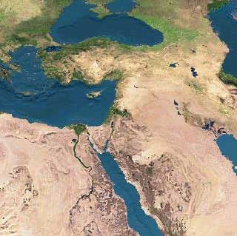
The Pentateuch
MS
SG
ER
DS
Five Books That Changed the World
PG
RS
Dr. Rick Griffith • Jordan Evangelical Theological Seminary • BibleStudyDownloads.org

Slide 2

Where Do Events Fit?
Prophets
Church
Nations
Judges
Israel
Tribes
Apostles
Savior
Patriarchs
Priests
Kings
God

Slide 3
The Pentateuch is Foundational
Pentateuch
God
Church
Nations
Apostles
Patriarchs
Tribes
Savior
Israel
Prophets
Priests
Kings
Judges

Slide 4
A Timeline of History
New Creation
Creation
Jesus
David
Abraham
Flood
Today
Kings
Church
Tribes
3000
2000
1000
0
1000
2000

Slide 5
Abraham to Moses Timeline
EXODUS
Abraham (2166-1991)
1445
1290
Joseph (1915-1805)
Moses (1525-1405)
2000
1900
1800
1700
1600
1500
1400
1300
1200

Slide 6
What About Geography?

Slide 7
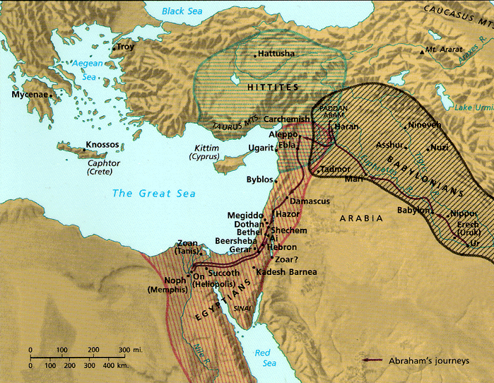
Geography of the Pentateuch
28
Thought Question:
What were the major geographical movements of the Pentateuch? Where did each book begin?
Genesis
Deuteronomy
Exodus
Numbers
Leviticus

Slide 8

Names for the Pentateuch
54
Penta + teuch = five scrolls
The Law
Book(s) of the Law
Book(s) of Moses
Torah ("instruction, teaching")
Names: the first word of each "book"

Slide 9
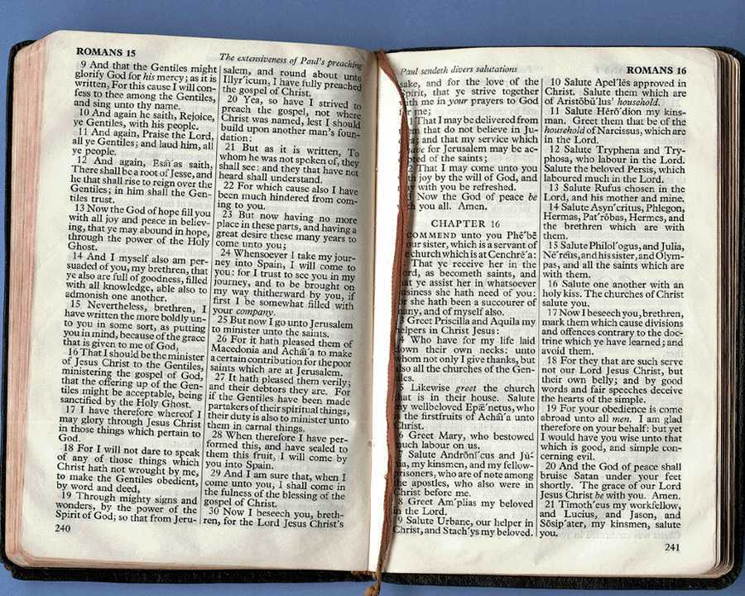
Divisions in Christian OT
HOW?
Old Testament
Genesis - Malachi
History (17)
Poetry (5)
Prophecy (17) Major Minor
English
Notes:
Our threefold division of the OT into history, poetry and prophecy hides the foundational nature of the Pentateuch.

Slide 10
Divisions in Hebrew OT
51
HOW?
Old Testament
Genesis - Chronicles
Law (5)
Prophets (8) Former Latter
Writings (11)
Masoretic
Notes:
The Jewish threefold division better shows how important these first five books are.

Slide 11

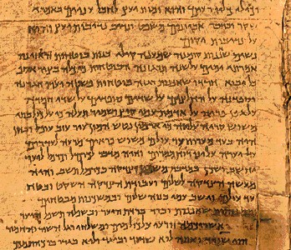
It's better to give the Law a classification of its own…
Jewish:
Law
Prophets
Writings
(24 books)
Christian:
Law
History
Poetry
Prophets
(39 books)

Slide 12
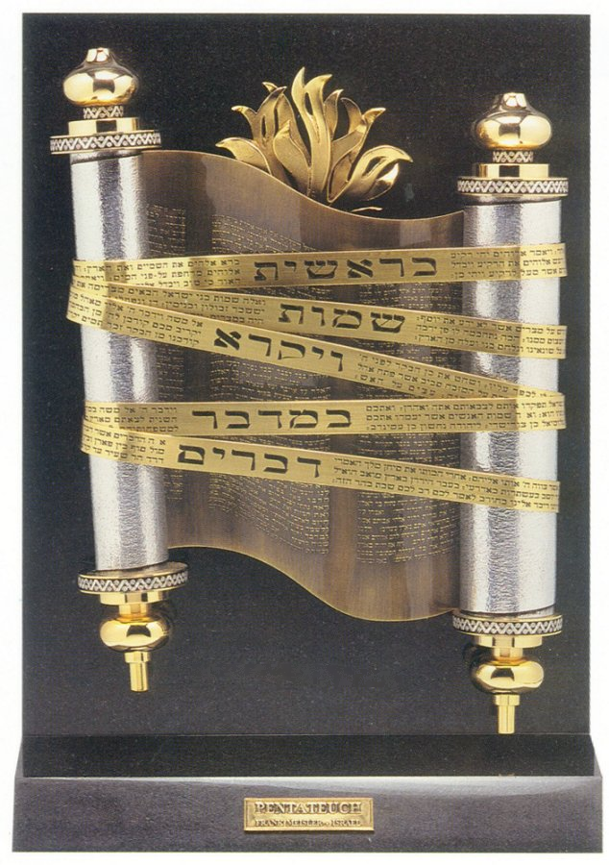
Pentateuch Theology
Themes about God, man, redemption, etc.

Slide 13
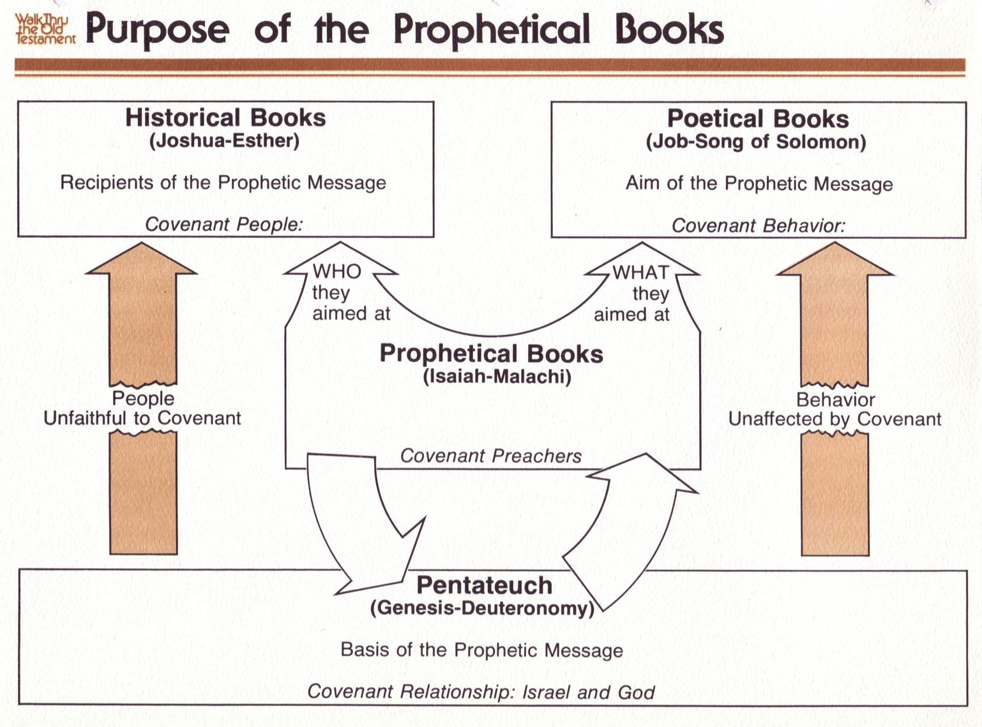
The Pentateuch Foundation
440
OTS 53a, 440
Pent 23
Historical Books
(Joshua-Esther)
Recipients of the Prophetic Message
Covenant People
Poetical Books
(Job-Song of Solomon)
Aim of the Prophetic Message
Covenant Behavior
WHO they aimed at
WHAT
they aimed at
Prophetical Books
(Isaiah-Malachi)
Deliverers of the Prophetic Message
Covenant Preachers
People
Unfaithful to Covenant
Behavior
Unaffected by Covenant
Abrahamic Covenant
Pentateuch
(Genesis-Deuteronomy)
Basis of the Prophetic Message
Covenant Relationship: Israel & God
Mosaic Covenant
Genesis 12:1-3; 15:18
Deut. 28; Lev. 26
Unconditional
Conditional
Blessing
Judgment
Adapted from Walk Thru the Bible

Slide 14

The Lord Reigns
The Lord reigns, the Lord reigns,
the Lord reigns, let the earth rejoice
let the earth rejoice
let the earth rejoice
Let the people be glad;
that our God reigns.
(repeat)

Slide 15
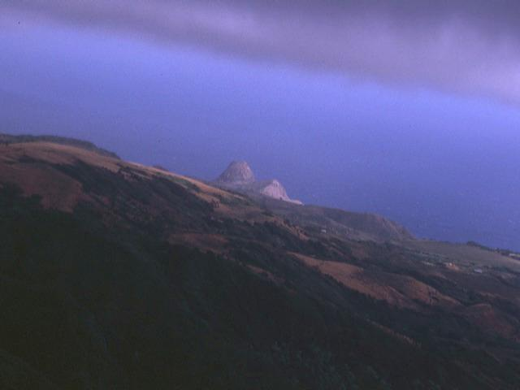
The Lord Reigns 2 of 3
The heavens declare His righteousness
The people see His glory
For You, O Lord, are exalted
over all the earth
over all the earth.

Slide 16
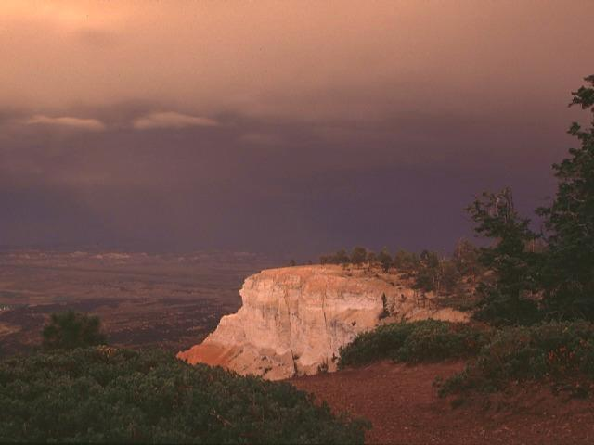
The Lord Reigns 3 of 3
The Lord reigns, the Lord reigns,
the Lord reigns, let the earth rejoice
let the earth rejoice
let the earth rejoice
Let the people be glad;
that our God reigns,
our God reigns,
our God reigns,
our God reigns.

Slide 17
An All-Encompassing Theme
OTS 33
Genesis 1:26-28
"Then God said, 'Let us make man in our image, in our likeness, and let them rule over the fish … birds … livestock … all the earth, and over all the creatures that move along the ground…' God blessed them and said to them, 'Be fruitful and increase in number; fill the earth and subdue it. Rule over the fish of the sea and the birds of the air and over every living creature that moves on the ground.'"
Revelation 22:5
"There will be no more night. They will not need the light of a lamp or the light of the sun, for the Lord God will give them light. And they will reign for ever and ever."
The Bible's Theme: God extends His rule to man
Command
Covenants
Fulfillment

Slide 18
Kingdom & Covenants Timeline
22
CH-34a
OS1-22
OS2-337
NS-9g
SA-19
34a
Dr. Rick Griffith • BibleStudyDownloads.org
22
Kingdom Teaching...
Adam rules with God (Gen. 1:26, 28; 2:19)
Satan begins rule as god of this world (Gen. 3:15;
2 Cor. 4:4)
God covenants with Abraham to reestablish man's rule via Israel as a "kingdom of priests" (Gen. 12:1-3; Exod. 19:6)
Israel's failure to witness to nations as a kingdom of priests is judged via exile under foreign rule
Israel rejects Messiah's offer of kingdom (Matt. 12:41-42; 23:37-39)
Jesus extends His kingdom in mystery form to the Church (Matt. 13)
Christ subdues Israel's enemies and nation believes (Rom. 11:26-27)
Christ rules over everything with saints (Eph. 1:9-10; Rev. 20:1-6; 22:5b)
337
9g
Fall of Man (Gen. 3)
Noahic Covenant
19
Genesis 6:18; 9:8-17
Land Covenant
ISRAEL
CHURCH
MESSIANIC KINGDOM
(National Focus)
The "New Man" (Eph. 2:15)
Millennial Eternal
land
Genesis 15:18 (cf. Deut. 30:1-10) promises:
Land from Wadi of Egypt to Euphrates River (Isa. 27:12)
Eternal possession of land (Gen. 17:8) after exile/restoration
Whole world blessed via the land (Isa. 14:1-2)
Israel judged for rejecting Messiah by dispersion away from land for 19 centuries
(AD 70–AD 1948) but now partially restored (Ezek. 37:1-7)
Full restoration (Ezek. 37:8-28) Jerusalem world capital
(Isa. 2:1-5)
New Jerusalem
(Rev. 21–22)
Davidic Covenant
Christ is Head over his Church, which is a spiritual temple (Eph. 2:19-22; 2 Cor. 6:16)
Christ reigns over the world
(Isa. 11)
with saints (Rev. 5:10; 20:4-6)
Christ hands kingdom over to Father (1
Cor. 15:24)
Genesis 12:1-3
2 Samuel 7:12-16 promises:
Sons ("house" never wiped out)
Kingdom (political dynasty)
Throne (right to rule by descendants)
Temple (son to build it)
seed
Abrahamic Covenant
New Covenant
All
things made new!
(Rev. 21:5)
All 5 elements fulfilled in national restoration (Zech. 8)
Jeremiah 31:31-34 promises:
Forgiveness
Indwelling Spirit
New heart, nature, mind
Reunification of Israel and Judah
No need for evangelism
Mosaic Law is replaced with first three elements of the New Covenant (Luke 22:20; 2 Cor. 3:6)
blessing
Mosaic Covenant
Law abolished, fulfilled, and replaced at the cross (Rom. 7:1-6;
1 Cor. 9:19-21; Heb. 8:13)
12th Edition
5 March 2023
Temporary (Gal. 3:19) and conditional (Deut. 28) to reveal sin (Rom. 7:7) and regulate Israel (Gal. 3:23-25)
Scripture has a dual kingdom-covenant theme. Israel's role from Abraham to Christ expands to include the Church (continuity) yet the Church never replaces the nation as the "new Israel" (discontinuity). Israel will enjoy world prominence after trusting Christ at His second coming.
Notes:
This complicated chart combines the two themes of Kingdom and Covenants. God's kingdom rule extends to humanity across the ages at the top. Also, God's covenant (promise) to Noah still applies today never to flood the entire earth. But the major part shows the unfolding of the Abrahamic Covenant in its land, Davidic, and New Covenant promises—partially fulfilled in the present, but fully completed in the Messianic Kingdom. This will happen in the Millennial Age and especially in the Eternal State.
• This chart also shows that the Old (Mosaic) Covenant was replaced by the New Covenant because believers have died to the Law (Rom 7:1-6).
All agree that a partial fulfillment of the covenant to Abraham exists now to the Church in the indwelling Holy Spirit and forgiveness of sins (Jer 31:31-34)—and the ultimate fulfillment will be in the eternal state.
The main area of disagreement relates to the time period from now to eternity. Will there be a literal land, throne, and worldwide blessing to national (ethnic) Israel before the eternal kingdom? This chart shows verses answering YES to that question in a present partial fulfillment and a future full fulfillment in the normal sense of language in the verses cited. But the messianic kingdom will be in two stages—first in a millennial fulfillment to last 1000 years, but then, after that, the eternal stage in the new Jerusalem after the destruction of our present heavens and earth (Rev 21–22). What an amazing future remains for those who trust Jesus!
____________
Common Slides-168
BT-01-OT Biblical Theology-25
CH-02-Nature-103-p34a
ES-13-Tribulation-23
ES-27-Kingdom_&_Covenants_Timeline-1
CH-02-Nature-103-p34a
OC-10-Chronology-42
OS-00-Intro & Biblical Theology-25 & 90
OS-00-Pentateuch-18
OS-02-Exodus-267-p22
OS-05-Deut-279, 300
OS-10-2Sam-96-p22
OS-12-Kings & Prophets Charts-25
OS-13-1 Chron-46
OS-23-Isaiah-97-p337
OS-24-Jeremiah-174-p337
OS-23-Isaiah-97-p337
OS-28-Hosea-49
OS-31-Obadiah-164
OS-38-Zechariah-220
05-Acts1-2-slide 45
NS-09-Gal-143-p9g
NS-19-Hebrews-342-p9g
SA-08-Mosaic Law-19-p38a

Slide 19
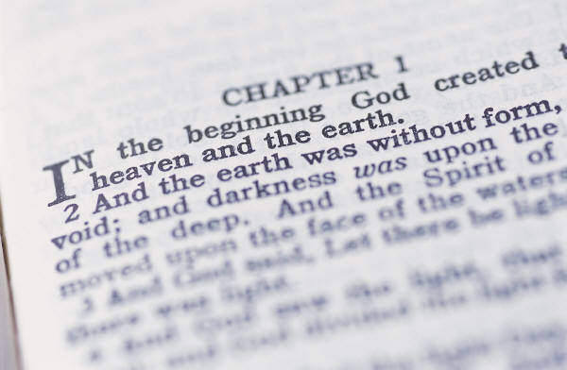
My View of the OT's Theme
OTS 33
The Old Testament narrates
God's restoring man to participate in His kingdom rule for His own glory
mandated in Eden but lost in the Fall
and accomplished by redeeming man
through Israel as a kingdom of priests
and ultimately through the Messiah,
who will reign as Saviour and King
to fulfill the Abrahamic Covenant

Slide 20
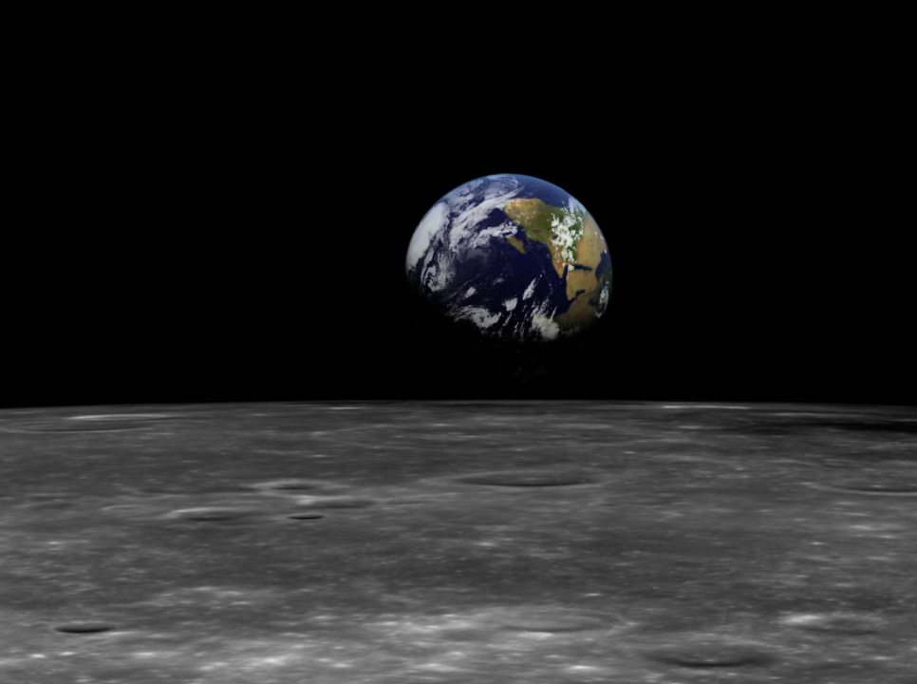
The Kingdom in Genesis 1
OTS 71a
Pent 23
Uncreated God (1:1)
Creation by Word alone (1:4)
Creation with ease
Sun and moon [gods] created (1:16)
Shared rule with man (1:26)

Slide 21

Pentateuch Authorship
OTS 57
Pent 23
Traditional View: Moses
Critical View: JEDP
J
Jehovah
(LORD)
850 BC
E
Elohim
(God)
750 BC
D
Deuteronomistic
School
550 BC
P
Priestly
Code
450 BC

Slide 22

JEDP Formulation
OTS 57
Pent 23
Southern
Traditions
Northern
Traditions
J
850 BC
E
750 BC
JE
650 BC
Josiah's Reform Book
D
621 BC
JED
550 BC
Exilic Priestly Materials
P
450 BC
JEDP
400 BC
Encountering the OT, 70

Slide 23
JEDP Problems
OTS 57
Pent 23
Violates internal self-claims of Pentateuch
Ignores ANE archaeological evidence
Based on inaccurate 19th-century evolution
Too subjective
Rejects NT evidence
Encountering the OT, 70

Slide 24

Some Terms...
Lower Criticism: Constructive textual studies
Higher Criticism: Attacks the inspiration and authenticity of the Scriptures.
Interpretive Problems: Honest differences of opinion exist as to possible answers to problems of scriptural interpretation.

Slide 25
WHO WROTE THE PENTATEUCH?
Some still claim it was…
The Documentary Hypothesis

Slide 26
Definitions
Document
J
E
J-E
D
P
Jehovah/Yahweh
Elohim
Combined edition
Deuteronomic
Priestly

Slide 27
Contents
Document
J
E
J-E
D
P
Genesis 2
Genesis 1
Genesis-Numbers
Deuteronomy-Kings
Genesis-Numbers

Slide 28
Dates
Document
J
E
J-E
D
P
850 B.C.
750 B.C.
650 B.C.
621 B.C.
570-445 B.C.

Slide 29
Origins
Document
J
E
J-E
D
P
S. Kingdom
N. Kingdom
Unknown redactor
Hilkiah the High Priest
Ezra

Slide 30
Themes
Document
J
E
J-E
D
P
Personal biography, vivid delineation of character, portrays God in human terms

Slide 31
Themes
Document
J
E
J-E
D
P
Objective, deals with concrete particulars such as ritual and sacrifice

Slide 32
Themes
Document
J
E
J-E
D
P
Reflects Josiah's reform efforts to centralize worship in the temple in Jerusalem

Slide 33
Themes
Document
J
E
J-E
D
P
Origins and institutions of the theocracy, genealogies, rituals and sacrifices

Slide 34

The "Sources" of Genesis 6–9
6:5-8
6:9-22
7:1-5
7:6
7:7-8
7:9
J
P
J
P
J
P
7:10
7:11
7:12
7:13-16a
7:16b-17
7:18-21
J
P
J
P
J
P

Slide 35
The "Sources" of Genesis 6–9
7:22-23
7:24-8:2a
8:2b-3a
8:3b-5
8:6-12
8:13a
J
P
J
P
J
P
8:13b
8:14-19
8:20-22
9:1-17
J
P
J
P

Slide 36
Problems of the Documentary Hypothesis
57
1. Anti-supernaturalism bias
2. Circular reasoning: posits its conclusion
"There can be no such thing as supernatural revelation; therefore, the Bible is not a supernatural revelation."

Slide 37
Problems of the Documentary Hypothesis
57
3. Subjectivity in applying the theory results in conflicting explanations
4. Ignores stylistic variation within an author

Slide 38
Evidence for Mosaic Authorship
57
The author of Genesis and Exodus shows a thorough acquaintance with Egypt.
Eyewitness details are included in the exodus account.
There is a unity of arrangement underlying the entire Pentateuch.
Gleason Archer, A Survey of Old Testament Introduction

Slide 39
Evidence for Mosaic Authorship
57
The Pentateuch itself testifies to Moses as the author (Exodus 17:14; 24:4; Deut. 31:9).
Other OT books refer to Moses as the author (Josh. 1:7-8)
The NT identifies Moses as the author (John 5:46-47; Rom. 10:5)
Gleason Archer, A Survey of Old Testament Introduction

Slide 40
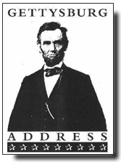
The "Documents" of the Gettysburg Address
THE STIFF-COLLAR COMMENTARY
Applying the insights of higher criticism to the Gettysburg Address, given by Abraham Lincoln on November 19, 1863 at the dedication of the battlefield cemetery.
Rev. LeRoy Koopman, Christianity Today, 1965
Notes:
Here is a bit of a joke on the JEDP idea, as if such ridiculous theories were applied to a writing of our modern times. Enjoy the fun!

Slide 41
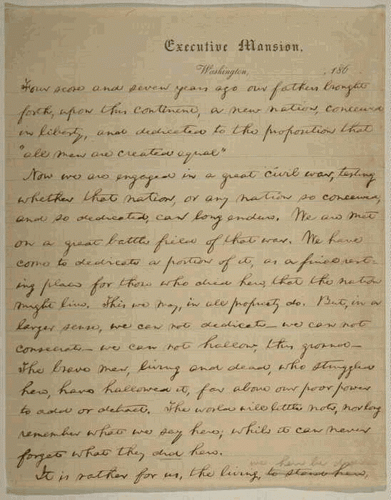
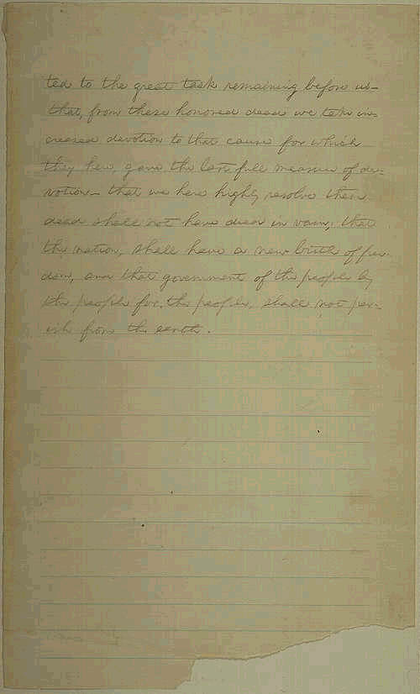
The "Documents" of Gettysburg 2
Four score and seven years ago
This phrase is the work of E, an English professor and friend of Lincoln who had a propensity for utilizing ornate language. Lincoln, simple and uneducated man that he was, would have said, "eighty-seven."

Slide 42
The "Documents" of Gettysburg 3
our fathers brought forth on this continent a new nation, conceived in liberty
"Fathers" is a faulty translation of the original "forefathers." The use of "conceived" points to redactor M, presumably Mary Todd Lincoln, who proofread his speech and added her female bias.

Slide 43
The "Documents" of Gettysburg 4
and dedicated to the proposition that all men are created equal.
"Proposition" - by M. Use of "created" indicates a third author, p¹, a priest accompanying Lincoln on the train to Gettysburg. Since Lincoln was only a layman, it was natural that he should seek clerical help in adding theological terminology. A second priest, p², also added a few glosses.

Slide 44
The "Documents" of Gettysburg 5
Now we are engaged in a great civil war, testing whether that nation
"That nation” — some scholars see here the work of one foreign-born (C?). An American would have said "this nation."

Slide 45
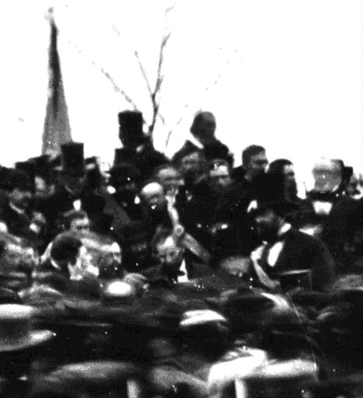
The "Documents" of Gettysburg 6
or any nation so conceived and so dedicated can long endure.
"Conceived" -- M's favorite interjection.

Slide 46
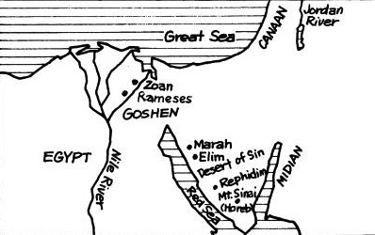
2 Timothy 3:15 (NIV)
Deuteronomy
“. . . from infancy you have known the holy Scriptures, which are able to make you wise for salvation through faith in Christ Jesus.”

Slide 47
Romans 15:4 (NIV)
Deuteronomy
“For everything that was written in the past was written to teach us, so that through endurance and the encouragement of the Scriptures we might have hope.”

Slide 48
Black

Slide 49


OT Survey link at BibleStudyDownloads.org
Get this presentation for free!
Notes:
OT Survey (os)

