Slide 1
Old Testament Survey
Syllabus
BibleStudyDownloads.org
Dr. Rick Griffith
Jordan Evangelical Theological Seminary

Slide 2

Introduce Yourself!
Name
Country
Family
Church
Class Goal
Name
Country
Programme
Family
Church
Ministry Goal
$20 each for Notes

Slide 3


Our People
Susan teaches church women
Notes:
I also lead the woman's Precept Bible study at our church

Slide 4
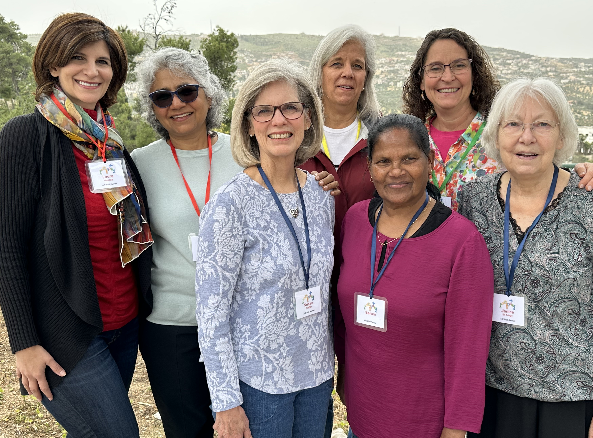
WOW Women’s Ministry
Women on Wednesday

Slide 5
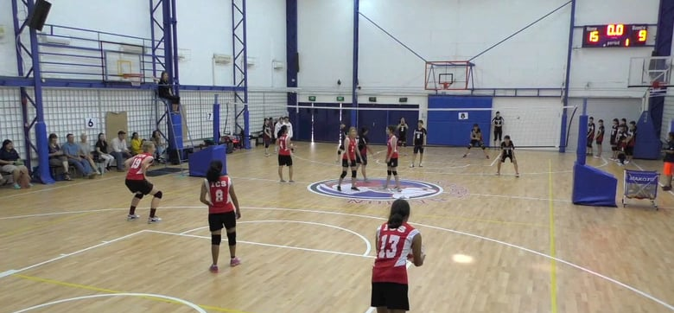
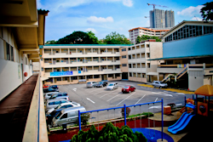
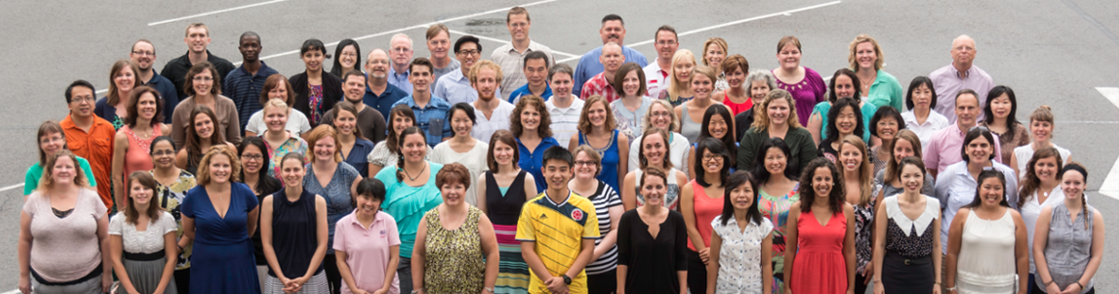
International Community School
(est. 1993)

Slide 6

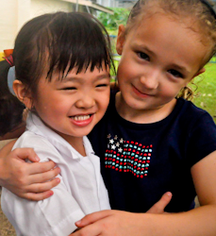


ICS now has 400 students!
UK
SWEDEN
KOREA
SWITZERLAND
JAPAN
ITALY
USA
THAILAND
INDIA
MEXICO
ICS
VENUZELA
INDONESIA
BRAZIL
SOUTH AFRICA
AUSTRALIAN

Slide 7
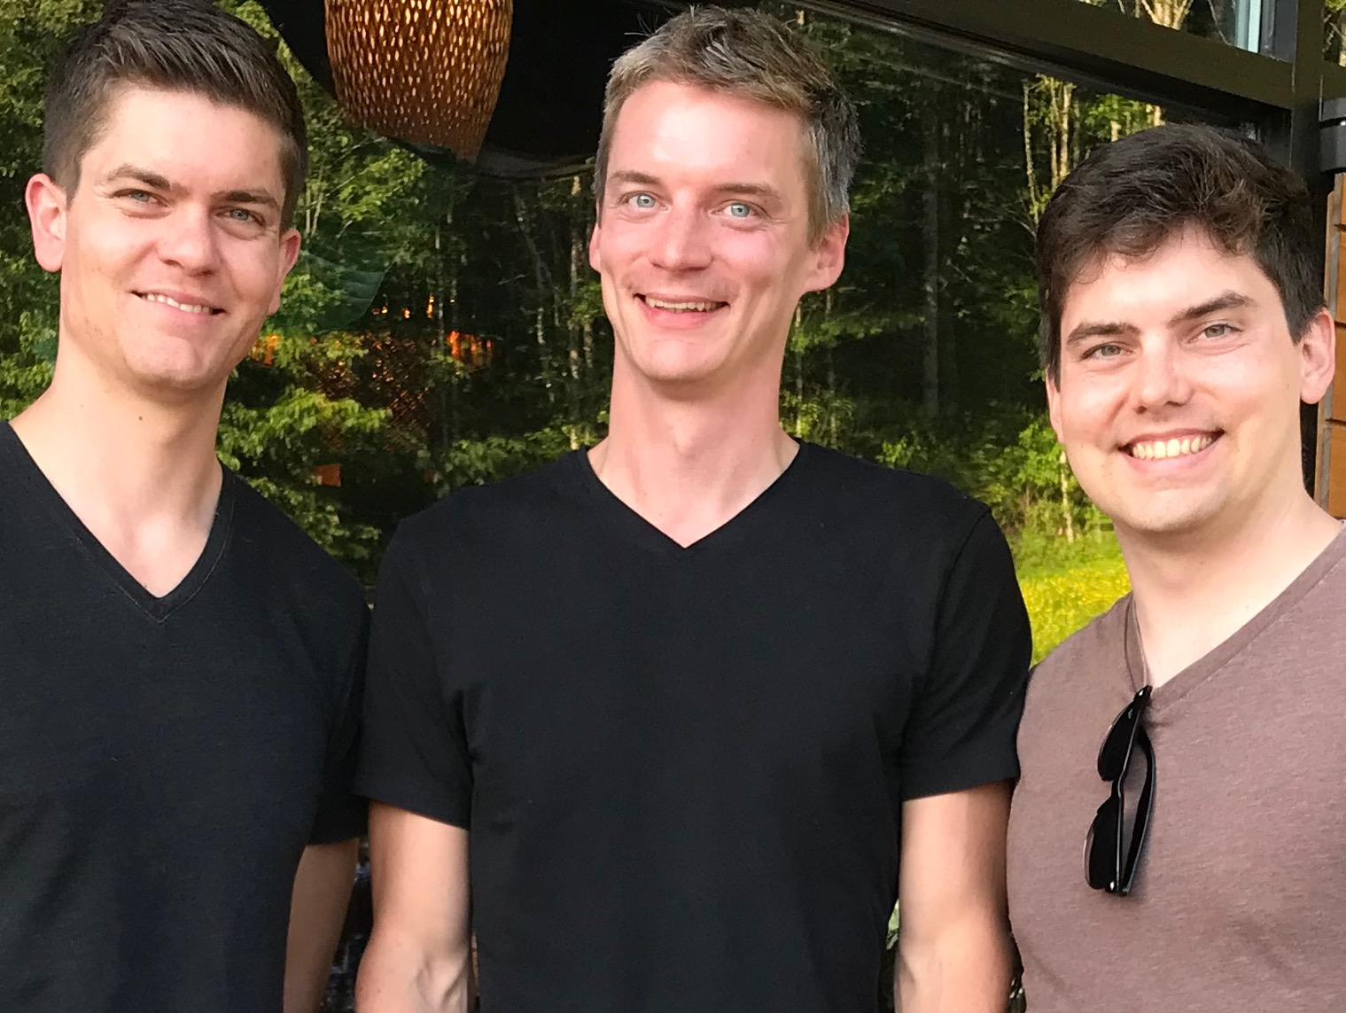
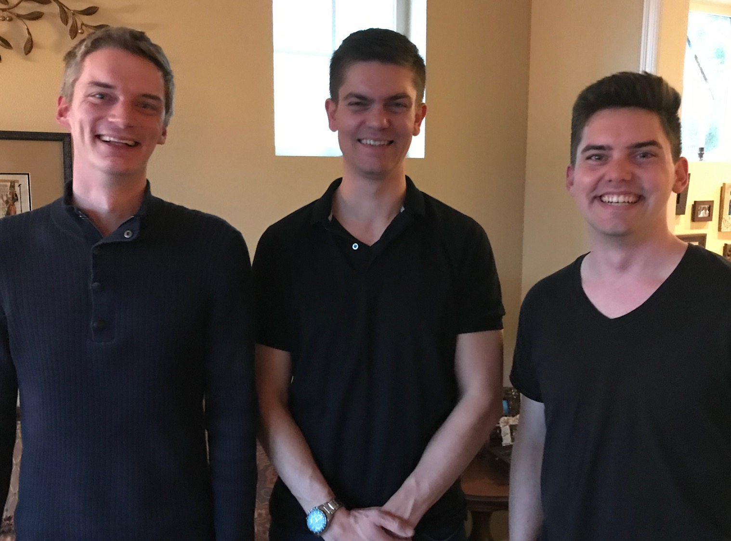
Our Three Sons

Slide 8
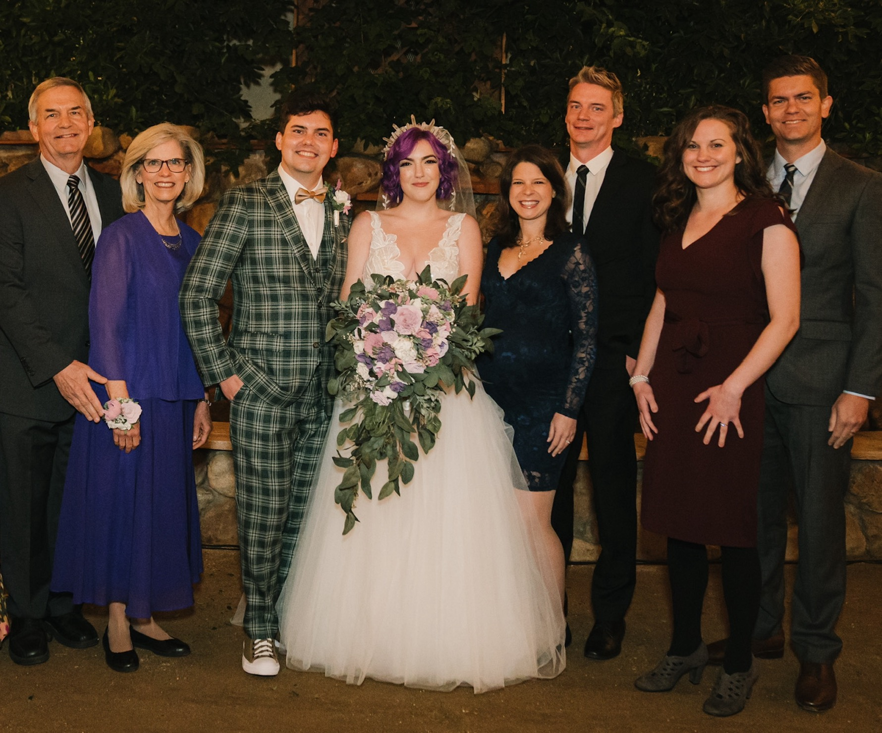
The Griffiths
28 Nov 2019
2022
Rick & Susan
John
& Chloe
(30)
Kurt
& Cara (36)
Stephen & Katie (33)

Slide 9
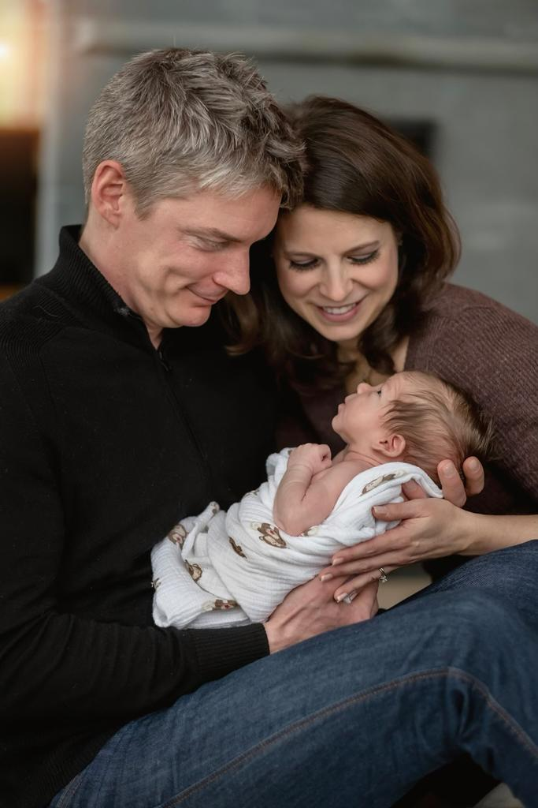
Kurt (35) & Cara own their HR consulting business near Seattle
Notes:
Kurt and his wife Cara are in Seattle

Slide 10
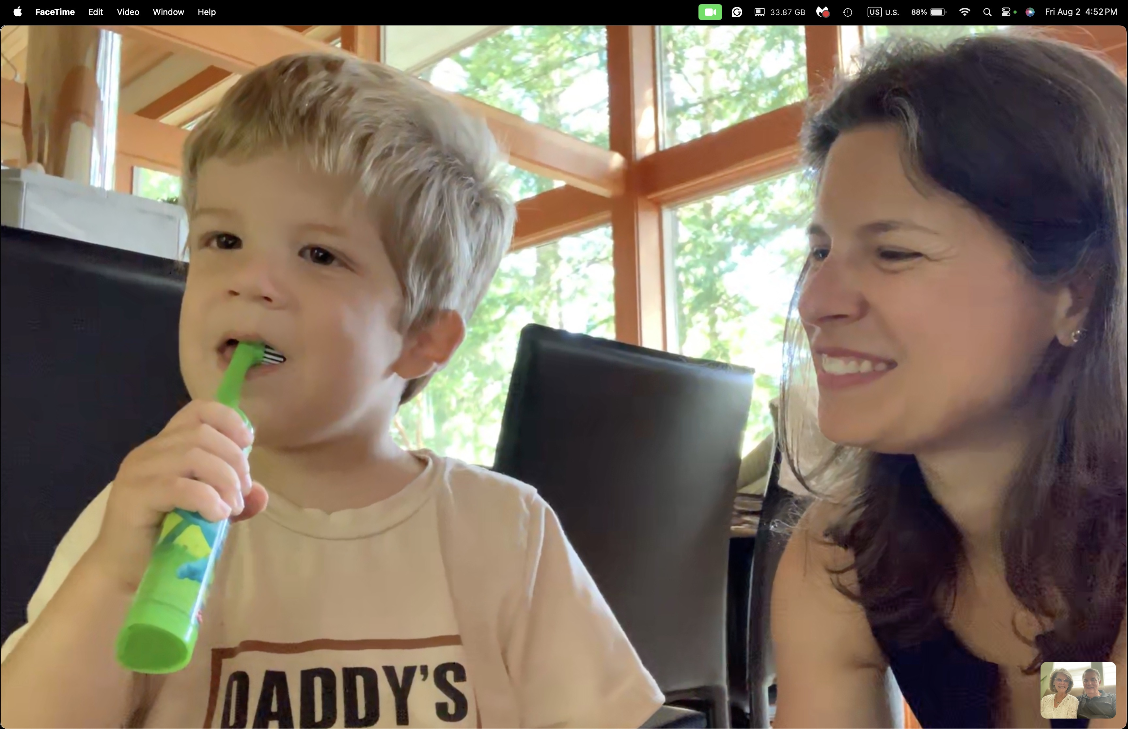
20-month-old grandson Kadon

Slide 11
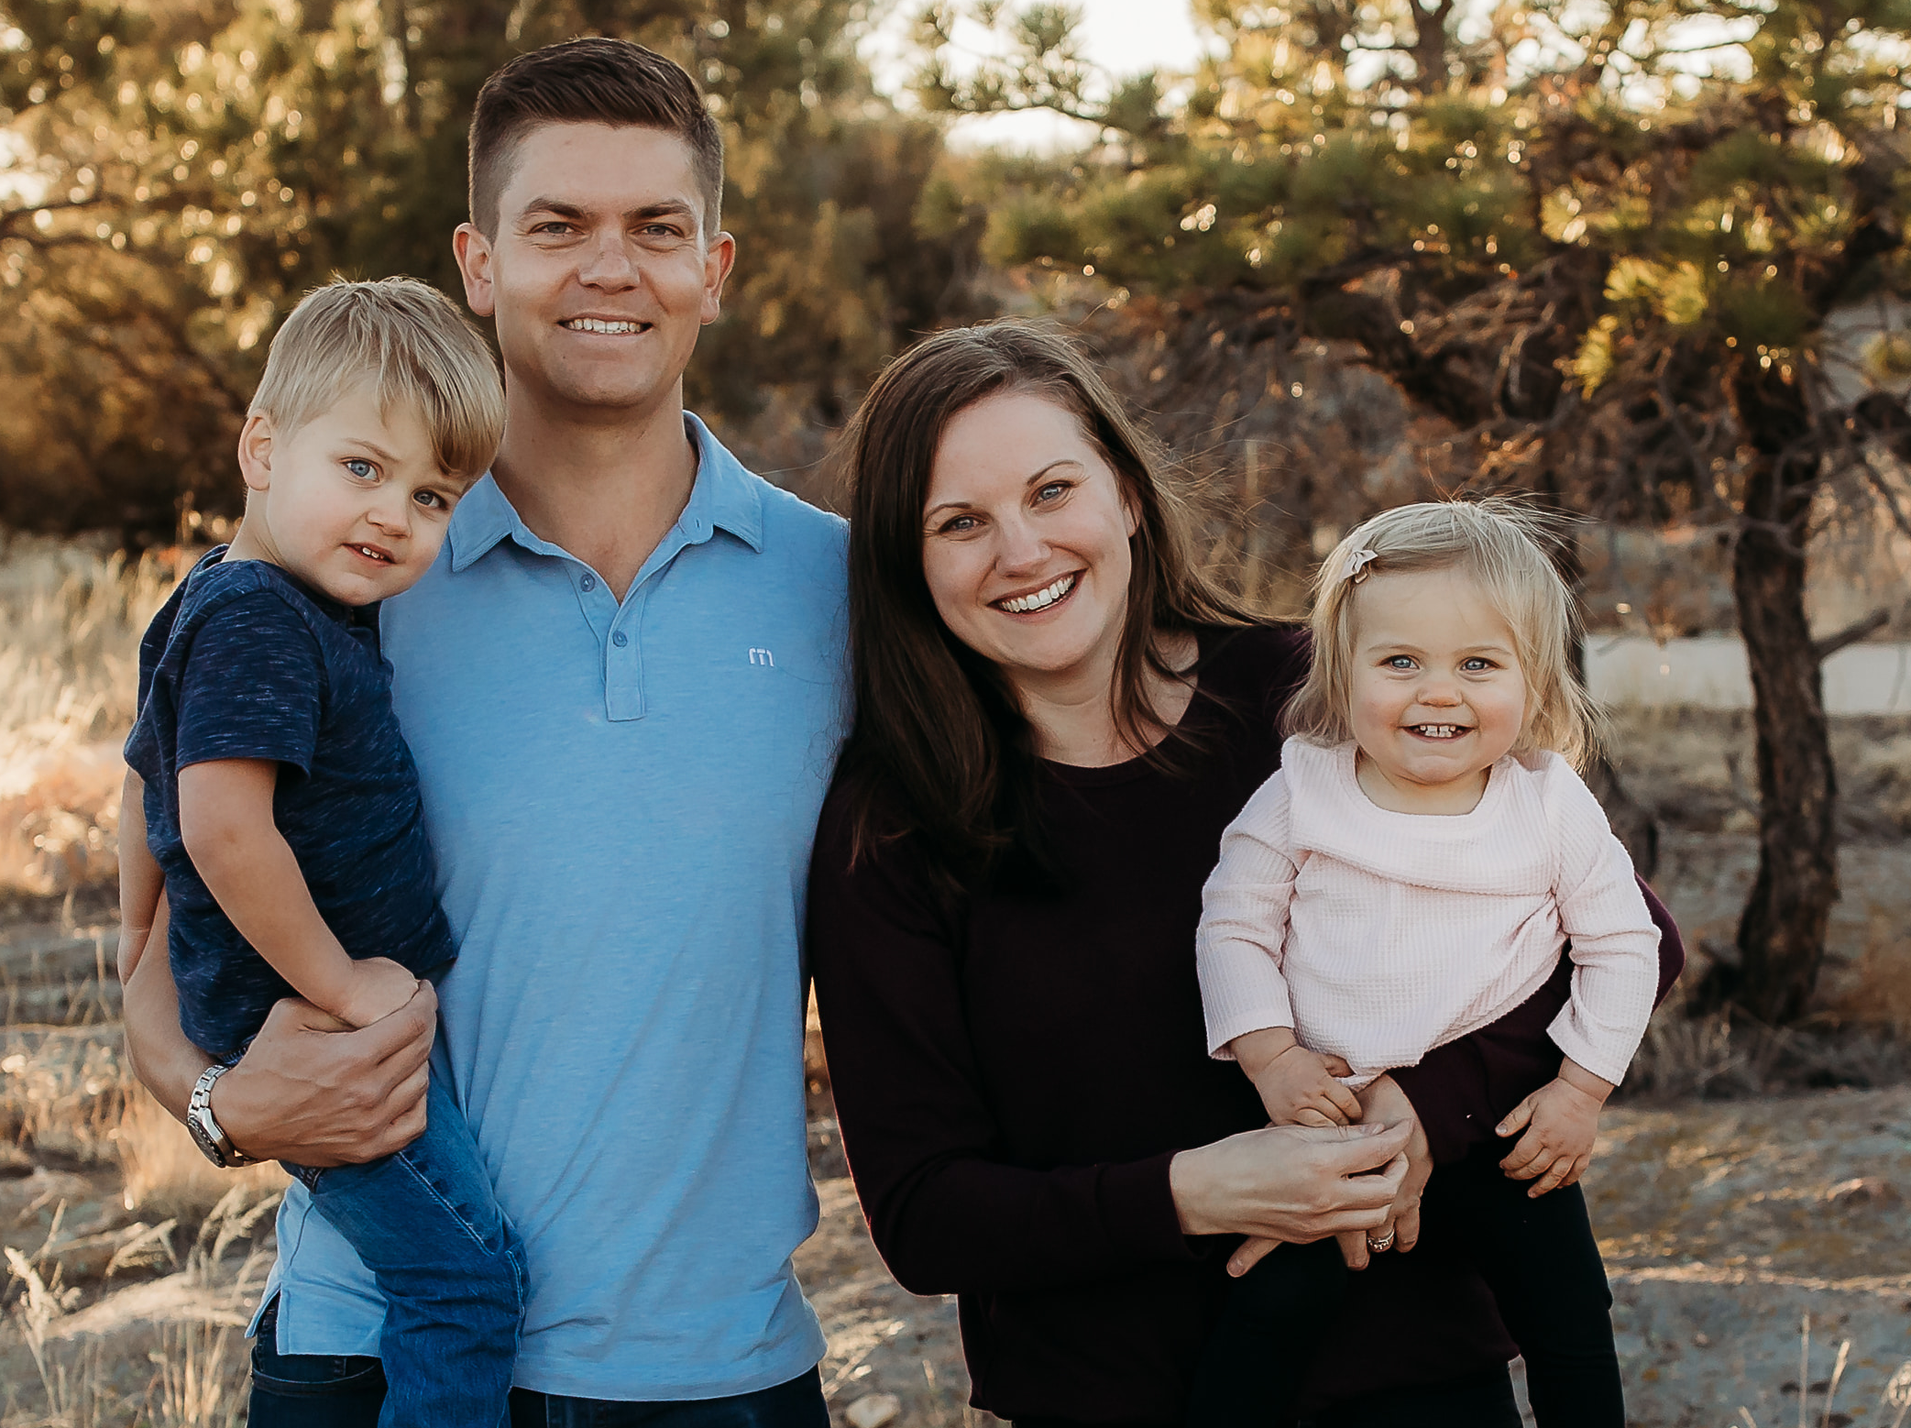
Stephen, Katie, Jesse & Norah in Denver
Notes:
Our granddaughter joined the family on 31 July 2021 but why would God take us now? I don’t know.

Slide 12
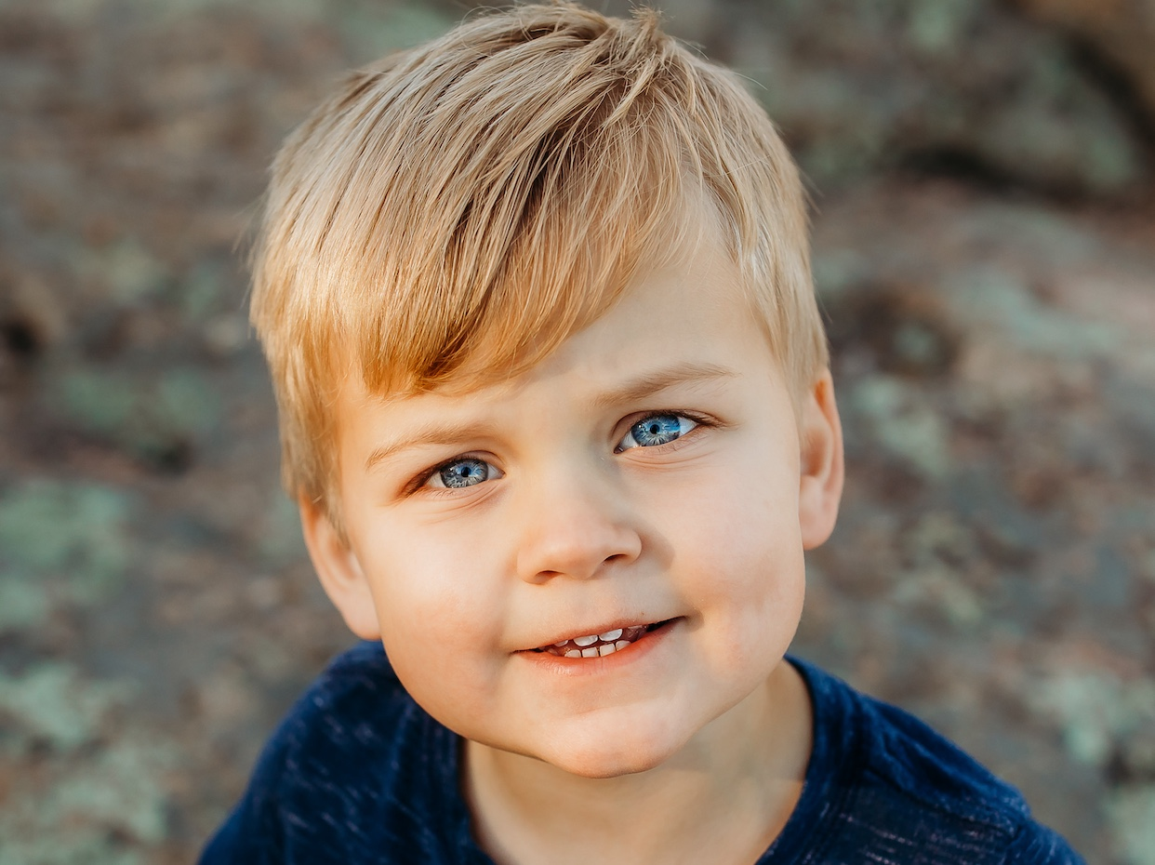
4-year-old grandson Jesse

Slide 13
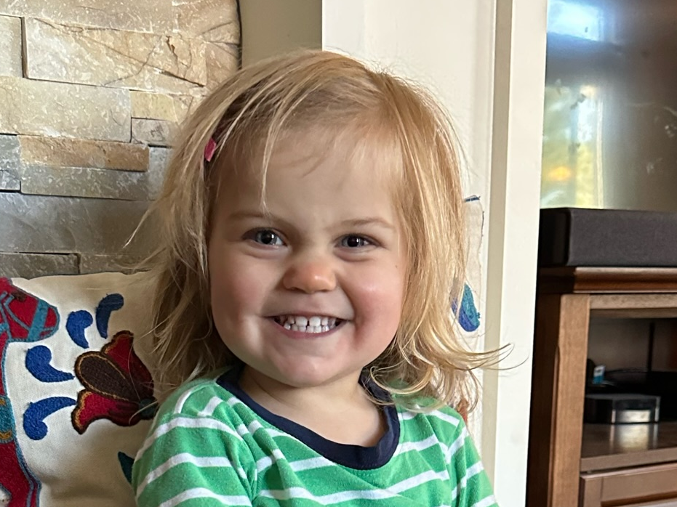
2-year-old granddaughter Norah

Slide 14
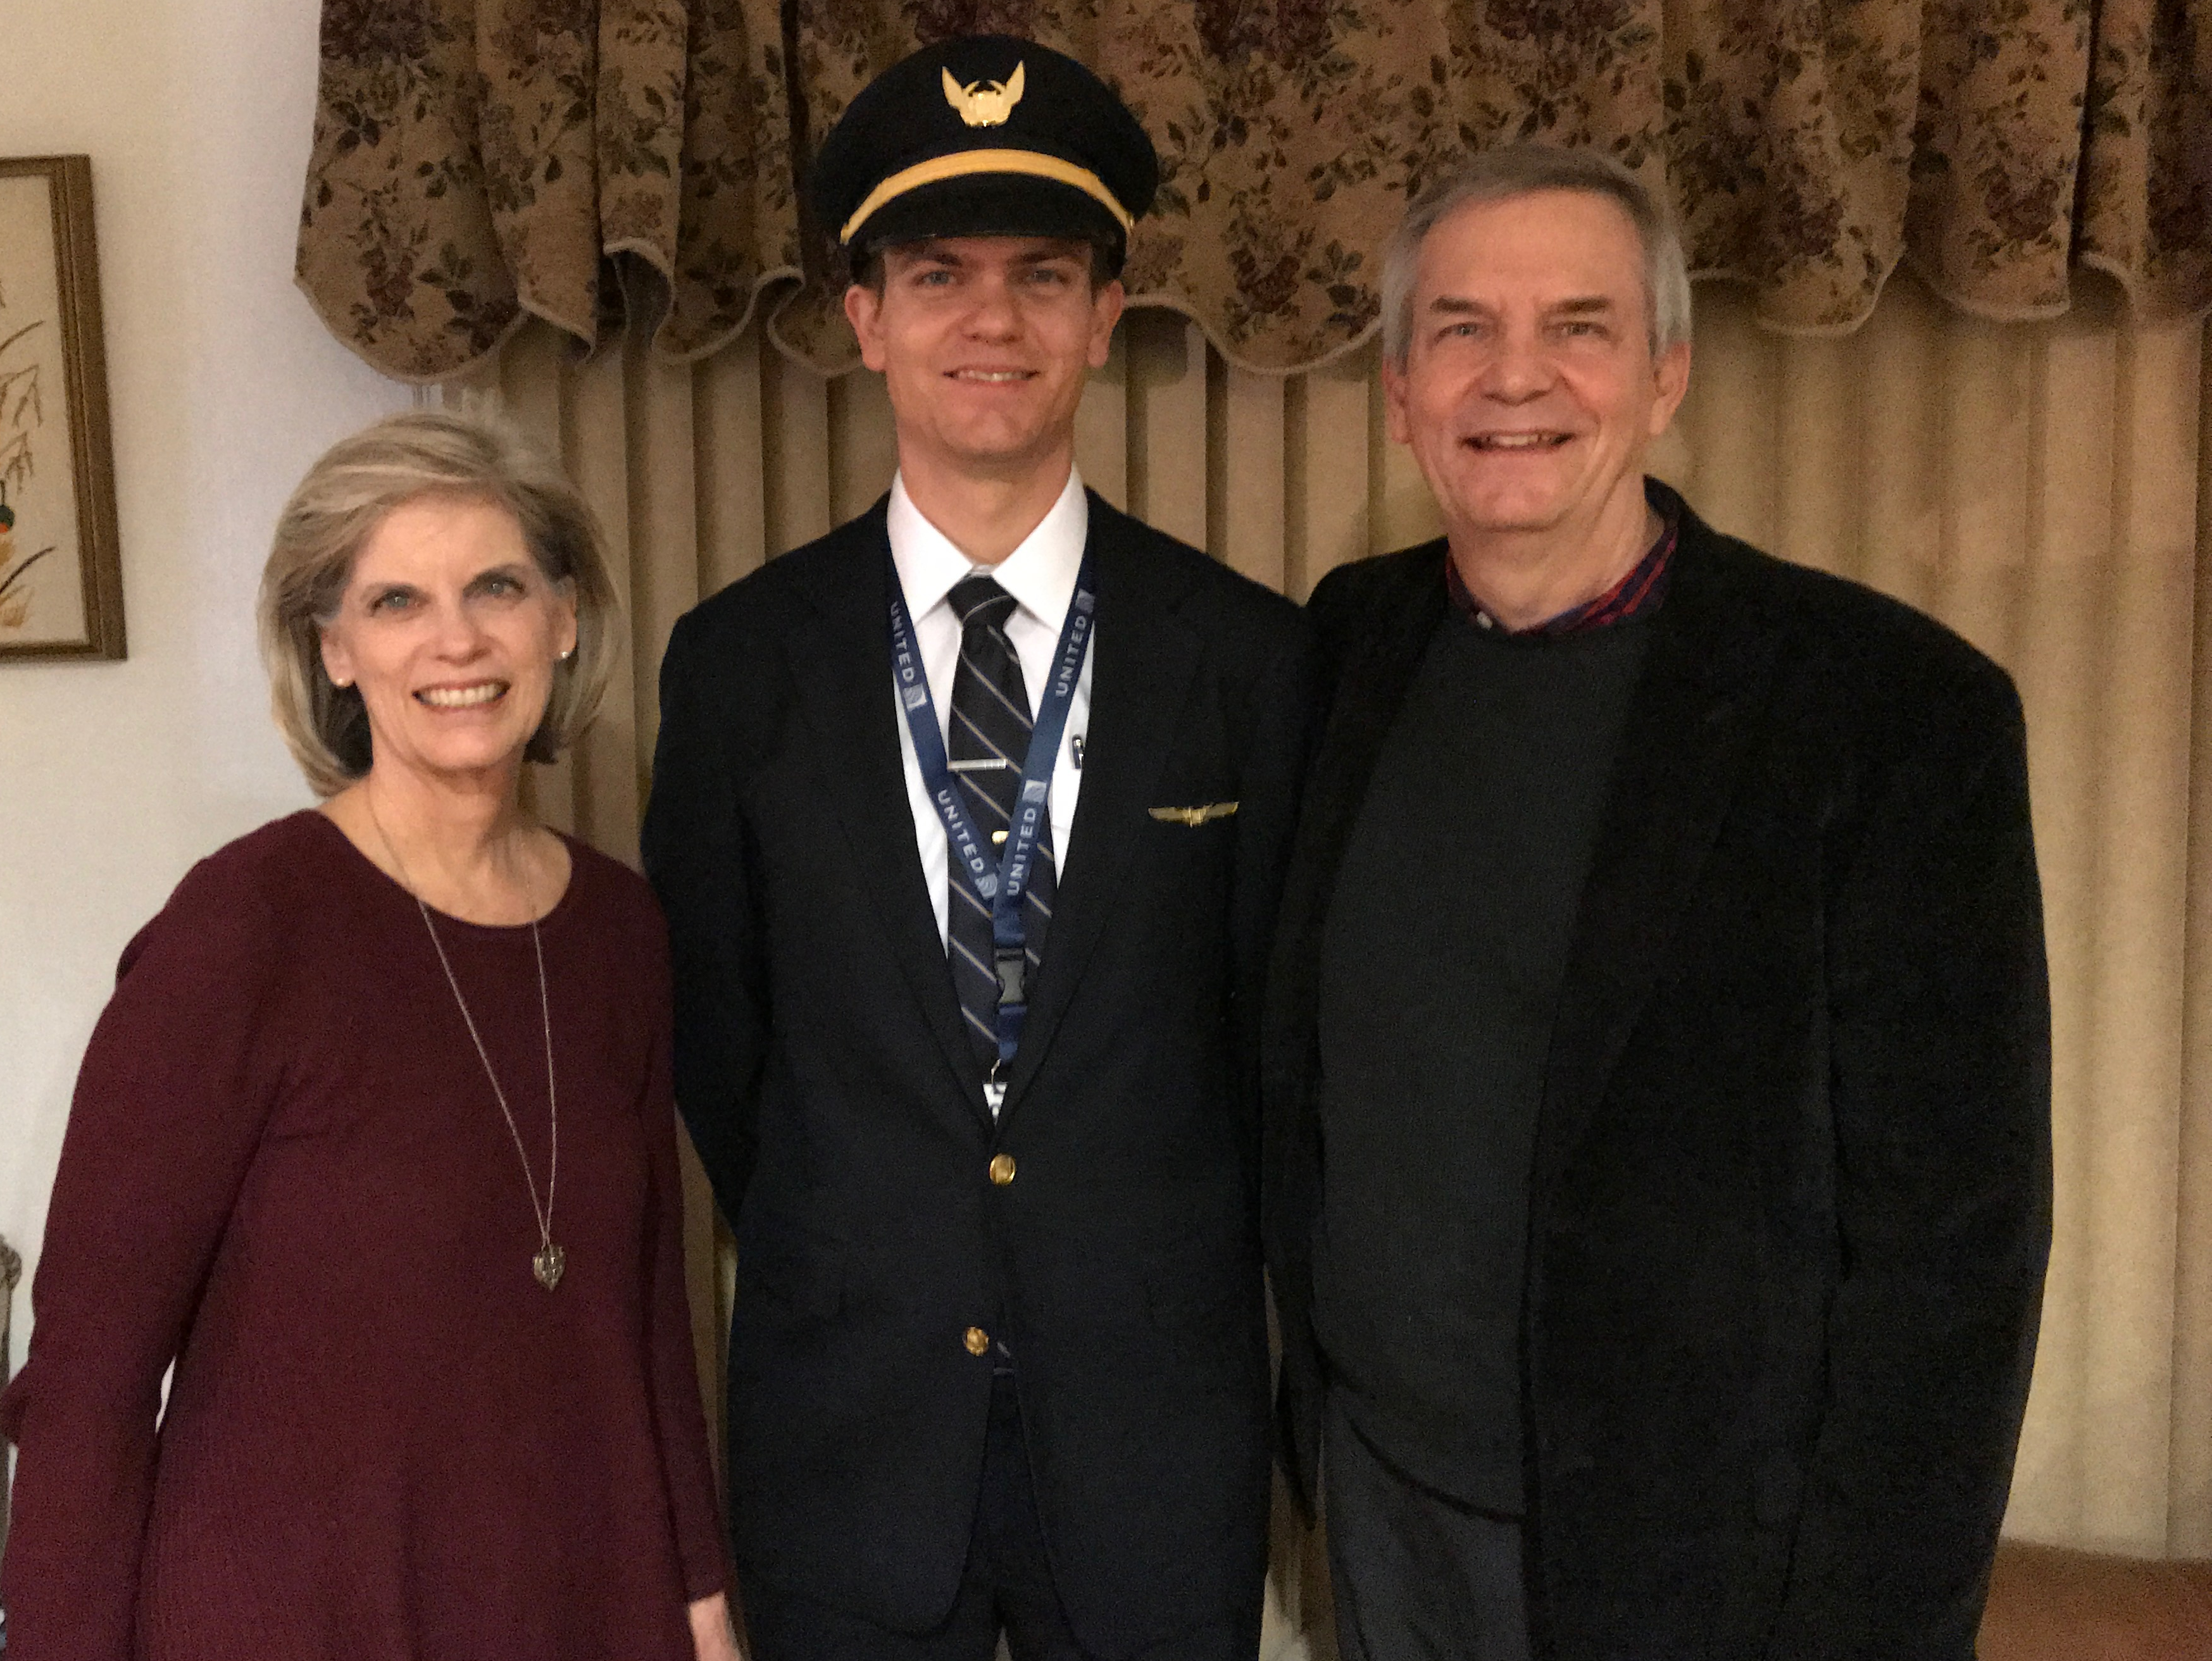
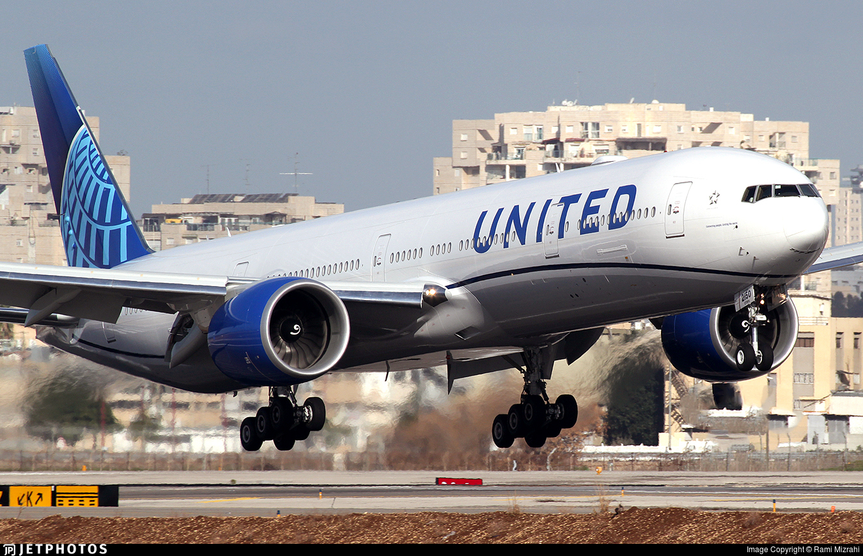
Stephen (33) trains United B777 pilots in Denver
6
Notes:
Stephen and his wife Katie in Boise

Slide 15
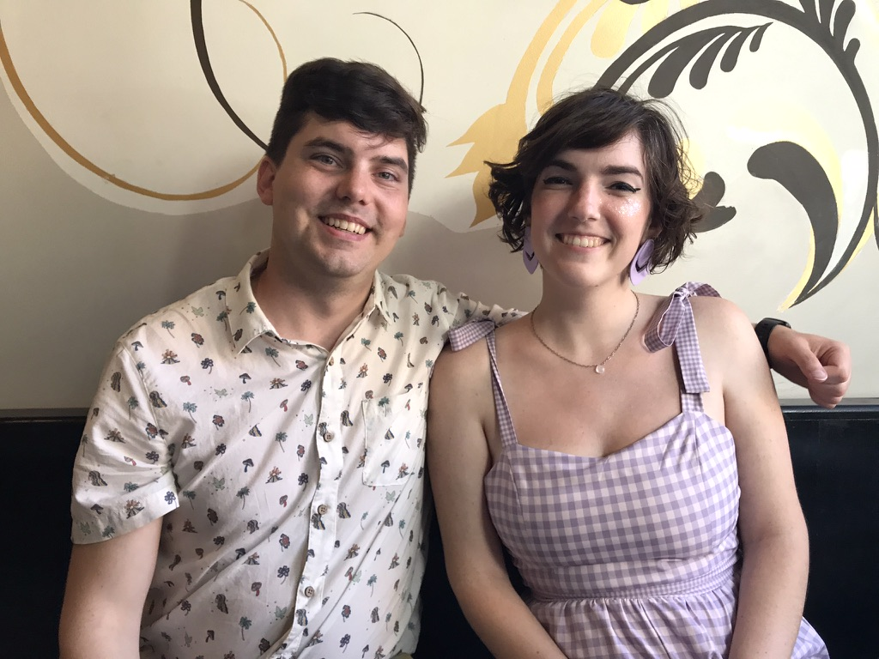
John (30) and his wife Chloe live in Pasadena, California
8
Notes:
John and his wife Chloe met at ESRI—Environmental Systems Research Institute—doing web design and graphics for this digital software company.

Slide 16

Our Mission Organization…

Slide 17
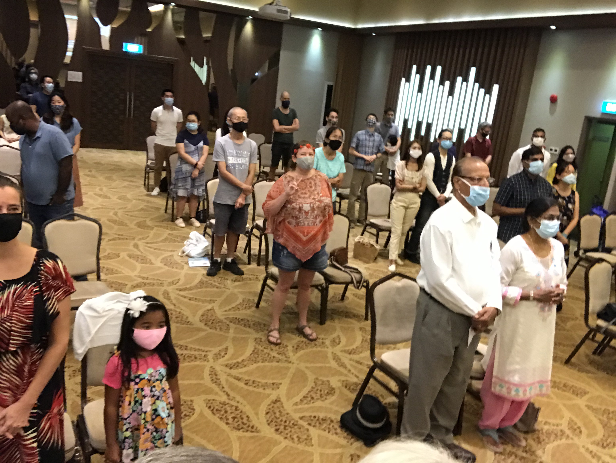
Our People
9
June 2021
90 people from 16 nations

Slide 18


Crossroads People • June 2021
UK
UNITED KINGDOM
RUSSIA
NETHERLANDS
MONGOLIA
ITALY
FRANCE
KOREA
HONG KONG
LEBANON
EGYPT
JAPAN
CHINA
MYANMAR
GERMANY
TAIWAN
CANADA
INDIA
USA
THAILAND
ETHIOPIA
MALAYSIA
ZIMBABWE
SOUTH AFRICA
PHILIPPINES
SINGAPORE
INDONESIA
CIC
AUSTRALIA
NEW ZEALAND
KENYA
Notes:
We actually have about 20% Indian at CIC, thanks to St. Thomas, who overcame his initial reluctance to witness for Jesus in India.
Our June 2021 church of 90 people stem from 16 different countries around the world: Australia (David & Fiona), China (Jianji), Egypt (Tamara), France (Valentin), Korea (Grace Kim), India (Cynthia), Indonesia (Rena), Kenya (Jacqueline Ngare), Nepal (Joshua Limbu), Netherlands (Toes), Singapore (Albina), South Africa (Melody Hertenberger), Taiwan (Maple), Thailand (Mae), UK (James & Gabi), USA (Jim & Jacqui).
This does not include people who have recently attended only once:
Nor does it include missionaries living back in their countries but still are members of CIC: Maple (Taiwan), Budmaa (Mongolia)
Previous: Canada (Gloria Lee), Ethiopia (Lele), Malaysia (Aston, Naomi), Netherlands (Dies & Desiree), Philippines (Micah), South Africa (Melody),

Slide 19

Our People
Preaching through Scripture
Notes:
RICK: Yes, we helped start Crossroads International Church in 2006 and I serve as the pastor-teacher.

Slide 20
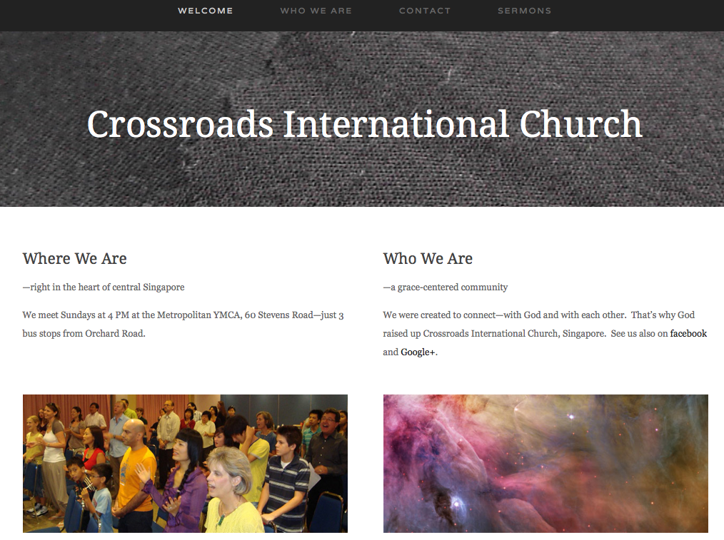
www.cicfamily.com

Slide 21
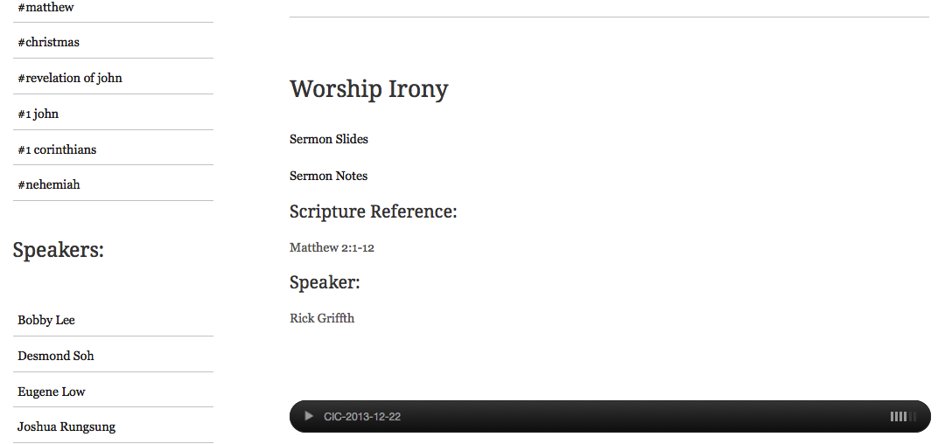
www.cicfamily.com

Slide 22

Our People
SBC students serve at church
Notes:
One special joy is mentoring my students who serve with us at church and led ministries to youth, children, home groups, and the worship team.

Slide 23
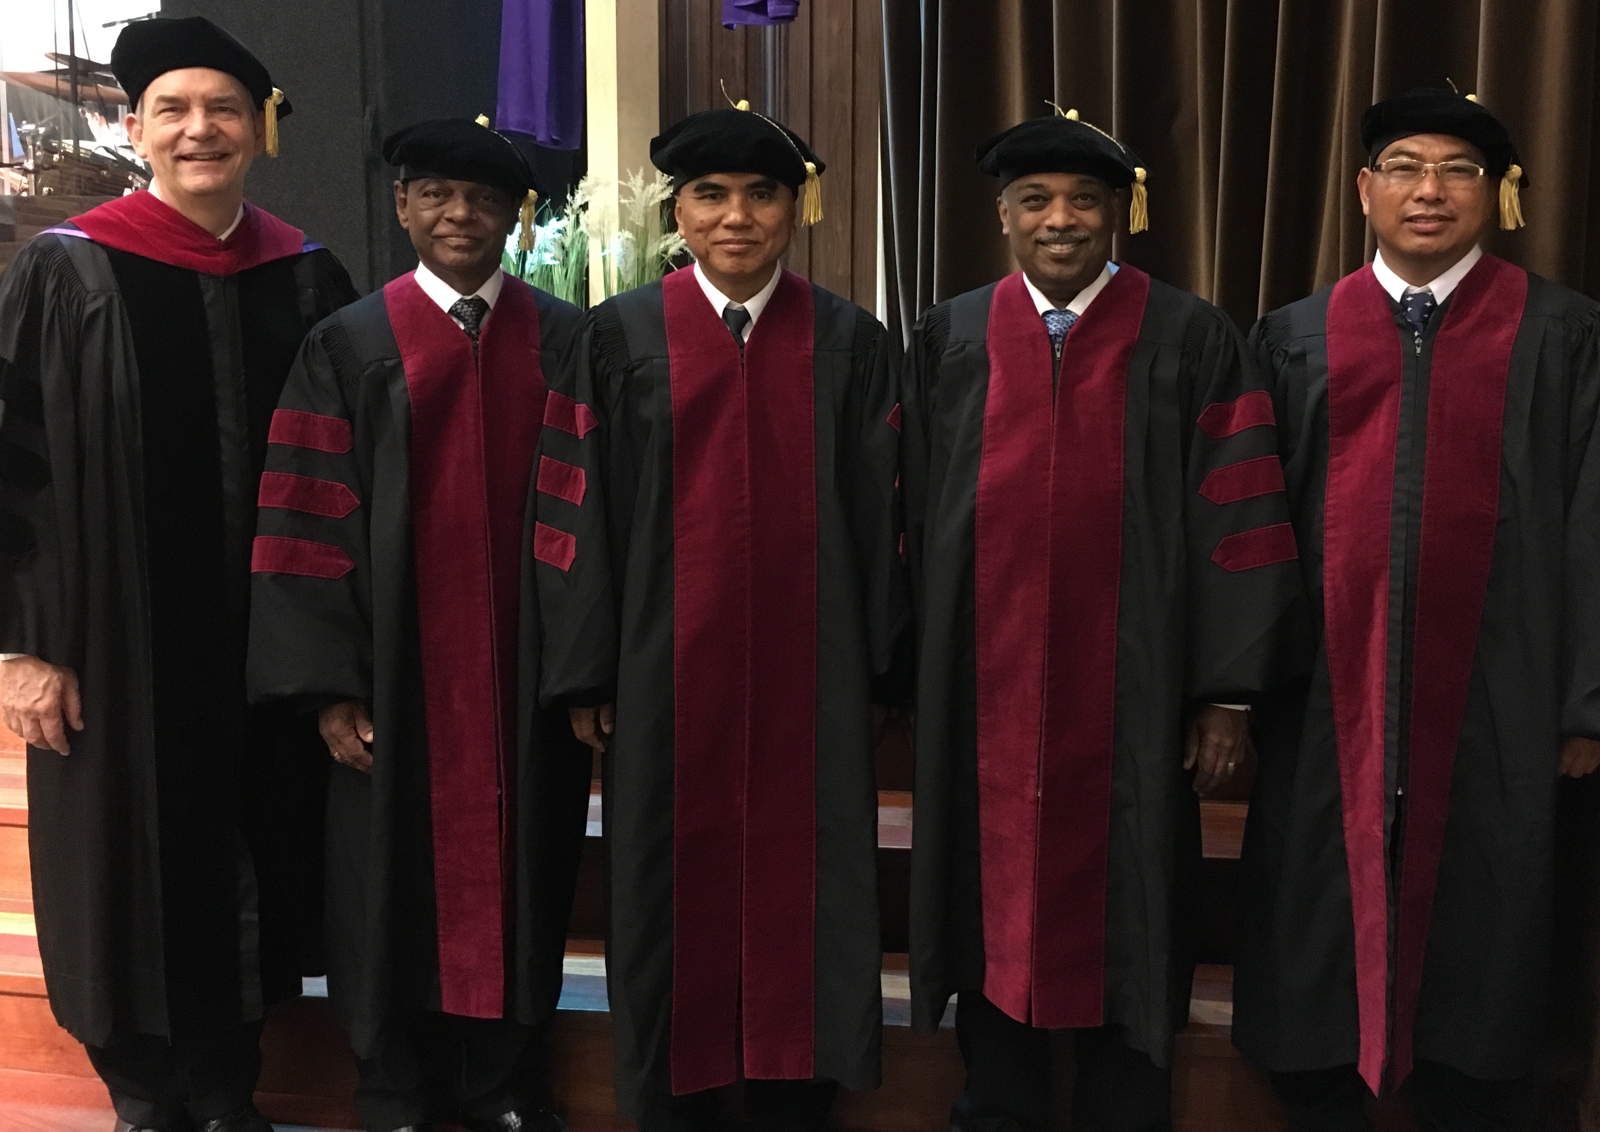
I directed the SBC Doctor of Ministry studies (DMin) 2009-2021
Notes:
I also directed the doctoral program at SBC that trains about 50 seminary professors and pastors throughout Asia in English and Chinese. Generally each year about 4 of them received their Doctor of Ministry degree.

Slide 24
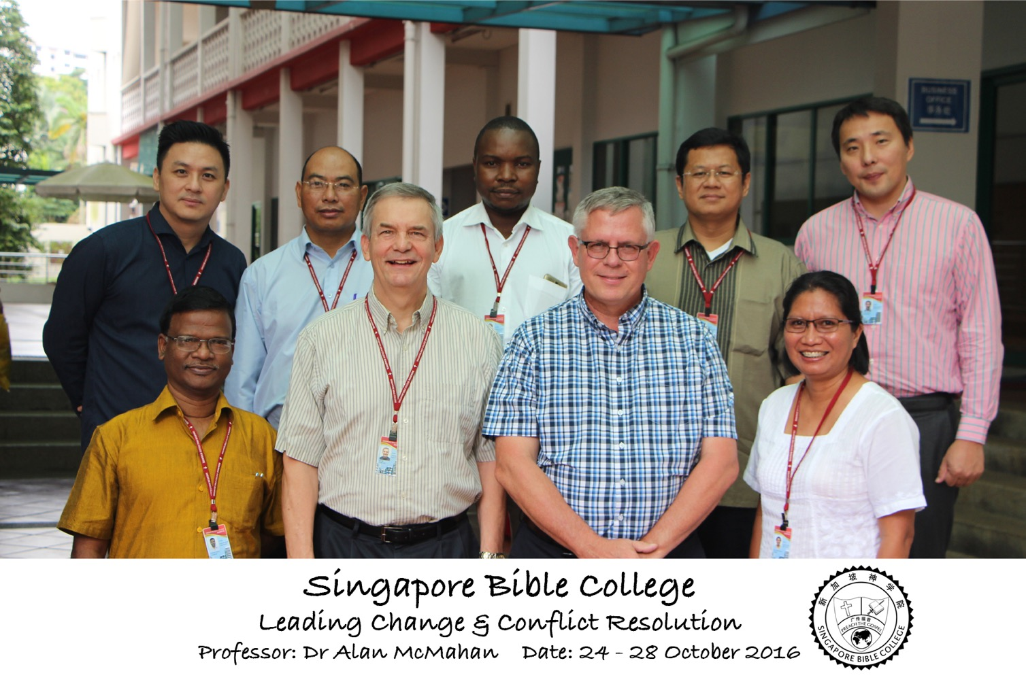
Leading Change & Conflict Resolution
(Dr. Alan McMahan Oct 2016)

Slide 25

What's this course about?
1
A general overview of the message of each
Old Testament book, including:
Backgrounds (author, date, origin, recipients, occasion, characteristics, and argument) of each OT book.
The general content of the OT books, including a key word for each book.
The relevance of each OT book to Arab culture and world mission.

Slide 26
What's this course about?
1
A general overview of the message of each
Old Testament book, including:
A general biblical theology of the Old Testament.
Backgrounds on foreign countries that affected Israel.
A general chronology of the history of Israel with corresponding key dates.

Slide 27

How most people see the Bible…
Prophets
Church
Nations
Judges
Israel
Tribes
Apostles
Patriarchs
Savior
Priests
Kings
God

Slide 28
How we will see the Bible!
God
Church
Nations
Apostles
Patriarchs
Tribes
Savior
Israel
Prophets
Priests
Kings
Judges

Slide 29
Timeline of History
WHEN?
New Creation
Creation
Jesus
David
Abraham
Flood
Today
Kings
Church
Tribes
3000
2000
1000
1
1000
2000

Slide 30
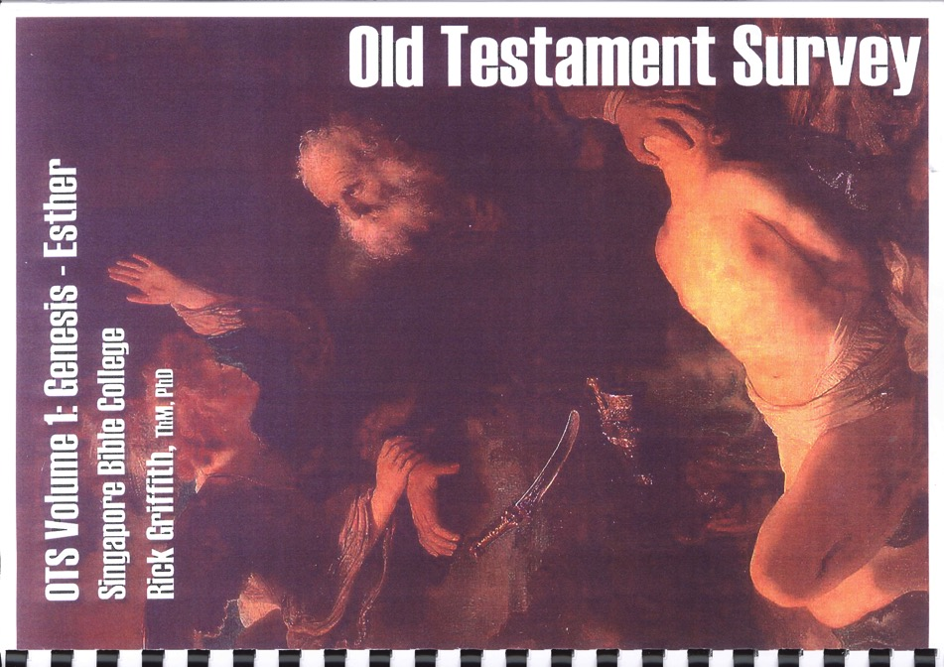
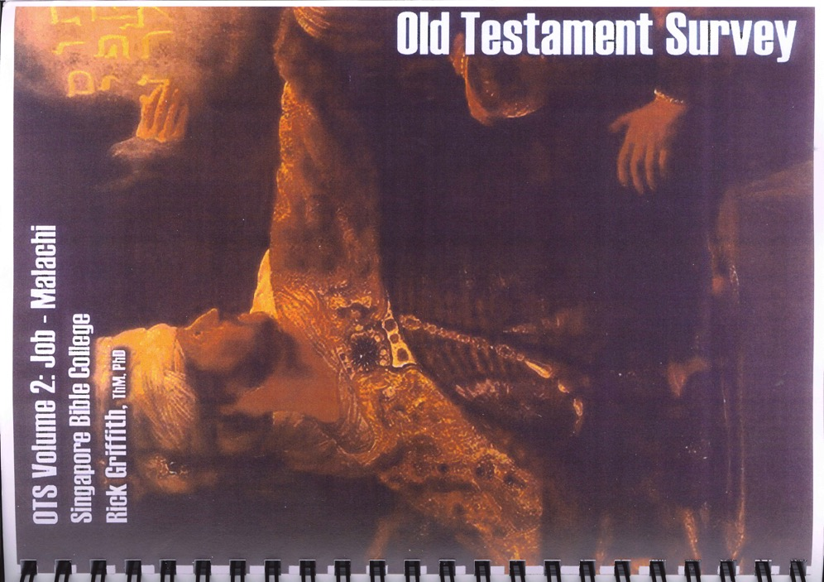
Course Notes
OT Intro I
(Vol. 1:
Genesis-Esther)
OT Intro II
(Vol. 2:
Job-Malachi)

Slide 31
BCM Course Grading

Slide 32

NTI MBS Grading
3
 | BTh/DipTh | GDCS • MA • MDiv • MMin
Readings | 33% | 33%
Paper | 33% | 33%
Final Exam | 33% | 33%
Total | 100% | 100%
Attendance | 90+% | 90+%

Slide 33
CCTE Readings
Read the notes only
The weekly quiz of 11 questions covers only part of the reading.

Slide 34

CCTE Course Requirements
22
Average of
5 grades
Reading
(5 Weeks)
page 22
Assessments
(5 Quizzes)

Slide 35
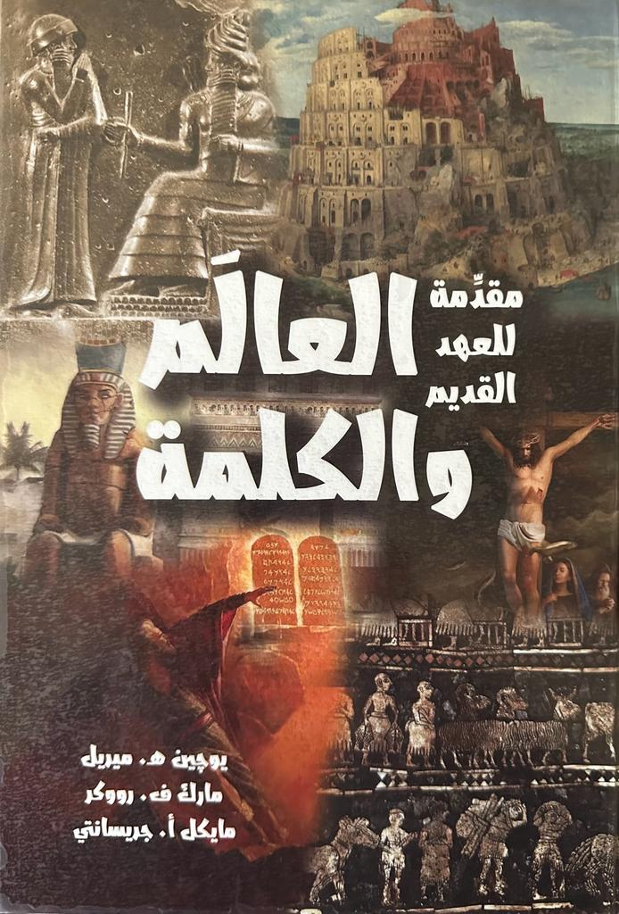
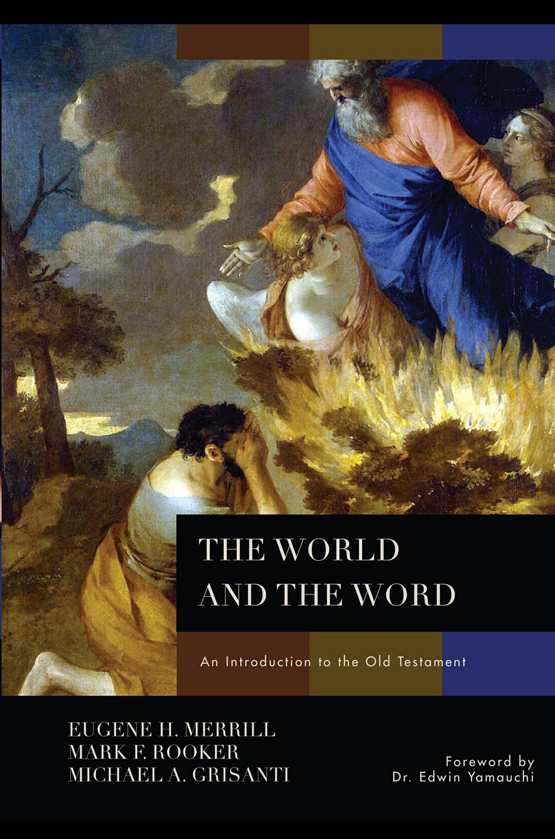
Our Texts

Slide 36
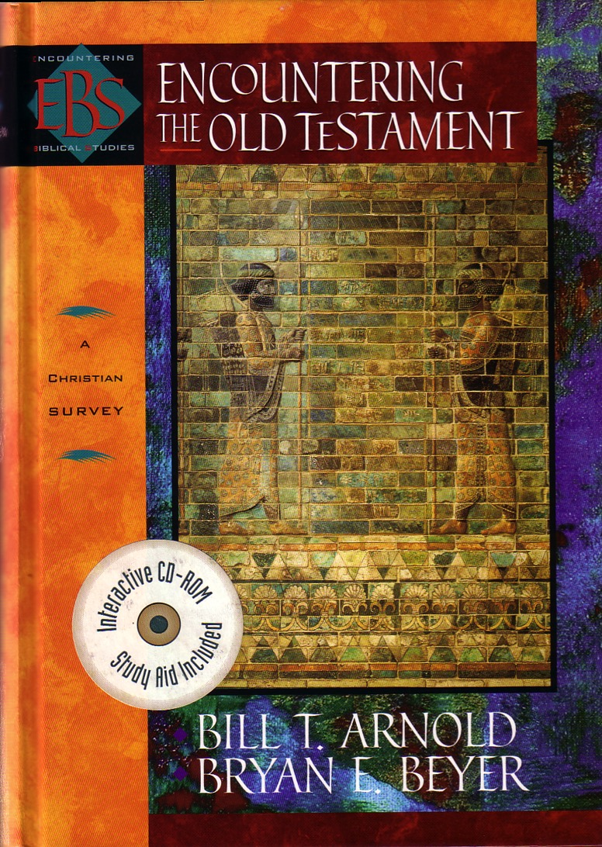
Main Text for Day Students
Survey

Slide 37
Grading
4
 | BCM | MPrep • GDIS • GDCS • MA • MCM • GDC • MAC
Readings | 33% | 25%
Project | - | 25%
Midterm Exam | 33% | 25%
Final Exam | 33% | 25%
Total | 100% | 100%
Attendance | 90+% | 90+%

Slide 38
Grad Student Grading
4
Average of
4 grades
IBS Study
(date p. 7)
Midterm
Project
Final

Slide 39
PowerPoint Presentation Grade Sheet
11
The Introduction, Body, Conclusion, and Miscellaneous concern the presentation content (70% of the grade). The form grade (the other 30%) concerns how you present your material.
1 2 3 4 5
Poor Minimal Average Good Excellent
Introduction
Attention (focuses listener's need on the theme)
Procedure for addressing the text/topic introduced
Body
Overall content (charts, other good info.)
Individual work (not excessive quotations)
Key passages/issues addressed well
Problem Texts (fair to views, own view supported)
Interpretation of passages accurate (exegesis)

Slide 40
PowerPoint Presentation Grade Sheet
11
The Introduction, Body, Conclusion, and Miscellaneous concern the presentation content (70% of the grade). The form grade (the other 30%) concerns how you present your material.
1 2 3 4 5
Poor Minimal Average Good Excellent
Conclusion
Solution given to issue raised in introduction
Main points reviewed and/or restated
Application (exhorts life change in specific areas)
Miscellaneous
(Applies to the whole presentation)
Depth leaves no key questions unanswered
Interesting in voice, illustrations, presence
Theological content shows insight
Handouts attractive with sources for further study

Slide 41
PowerPoint Presentation Grade Sheet
11
The Introduction, Body, Conclusion, and Miscellaneous concern the presentation content (70% of the grade). The form grade (the other 30%) concerns how you present your material.
1 2 3 4 5
Poor Minimal Average Good Excellent
Form
Format (slides attractive, clear, 20+ point font size)
Many Good Pictures/Visuals (not too much text)
Spelling and typographical errors, punctuation
Grammar (agreement of subject/verb and tenses)
Length is 10 minutes w/o unnecessary info.
Digital Readable PPT & MS Word File Submitted

Slide 42
Grad Student Grading
4
Average of
4 grades
Readings
Paper
Project
Exams

Slide 43

Internet Advantages
2
Interest
Better Learning
Equipping Others
Saves Time

Slide 44
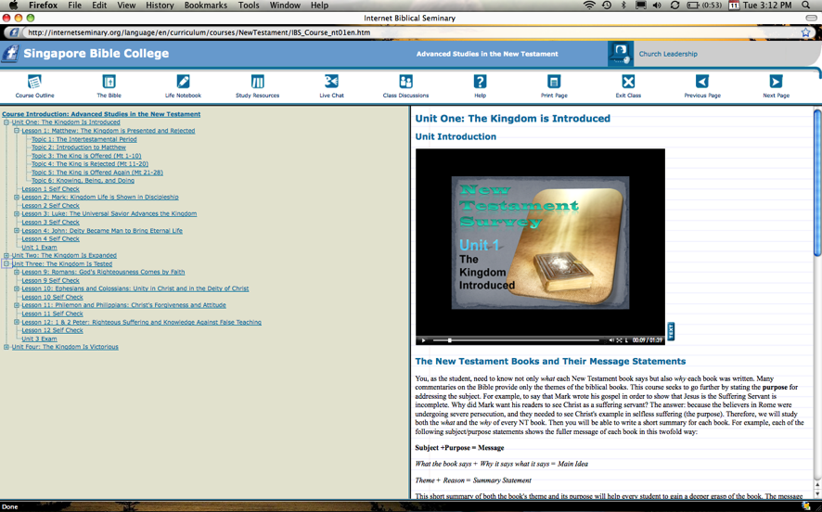
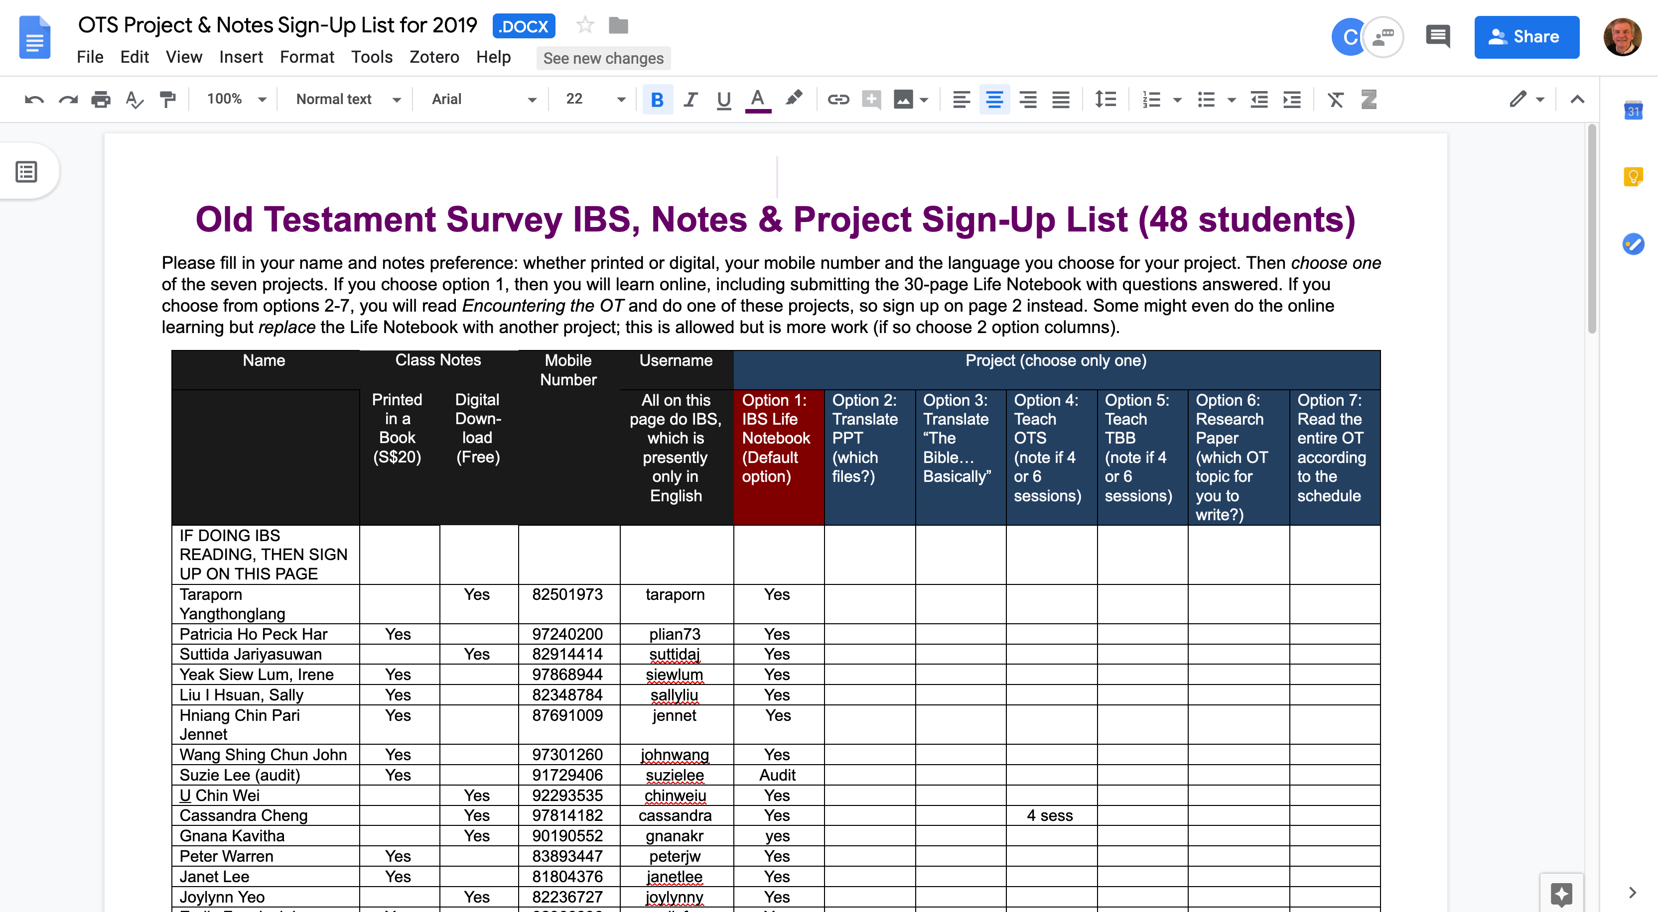
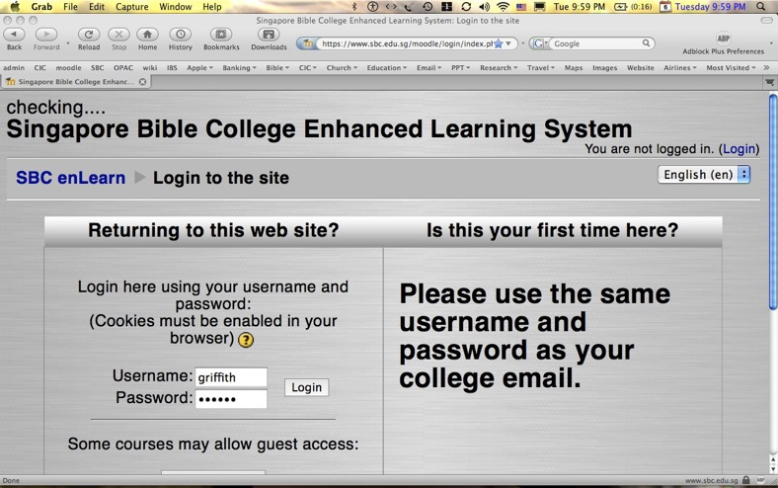

Our Four Websites
Google Drive
(Sign Ups)
Internet Biblical Seminary
(Reading)
SBC Moodle
(Exams)
BibleStudyDownloads.org
(Downloads)

Slide 45


All Exams are Closed Book!

Slide 46
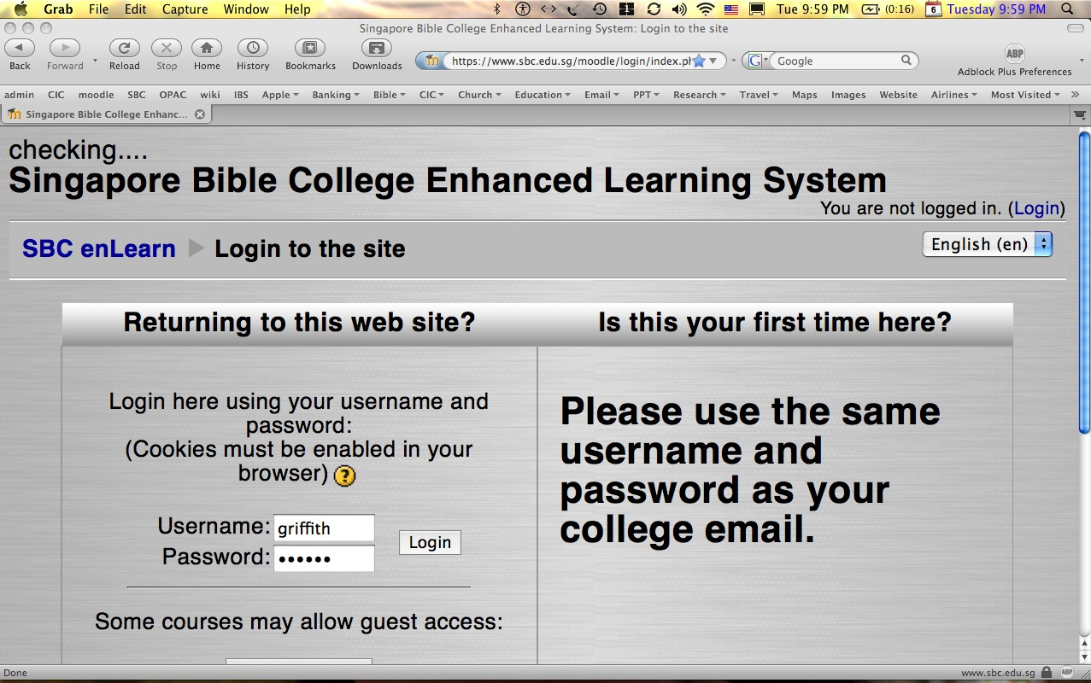
How to Get on Moodle…
1
Log on at sbc.edu.sg/moodle/login/index.php
Type your normal SBC username
Type normal SBC password
Click on the OT Survey course (or CCTE OT Survey course for CCTE)
Take your exam or post a message

Slide 47
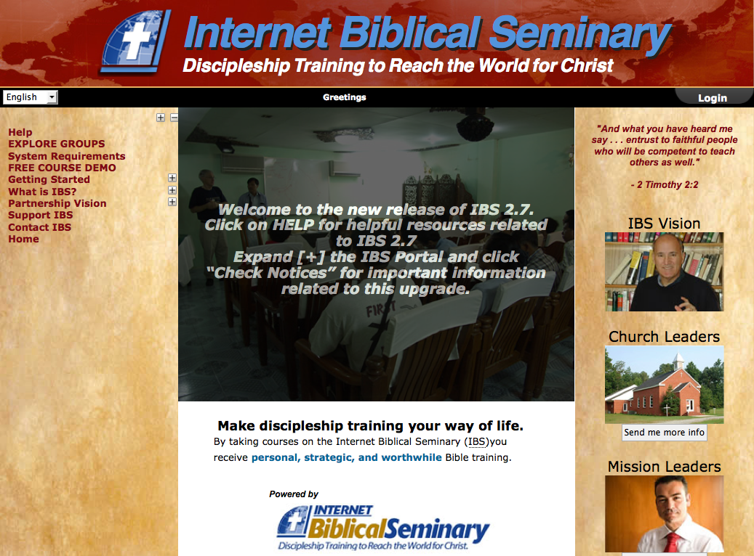
How to Get on IBS…
2
Go to internetseminary.org
Type your normal SBC username
Type 123456 for initial password
Click on the SBC option
Students > Learn > Enter My Classes
Select Advanced Studies in the OT 1

Slide 48
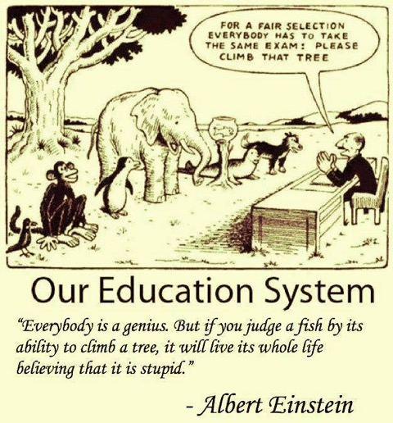
Our Education System

Slide 49
A Proposition
You know best how you learn—not me.

Slide 50
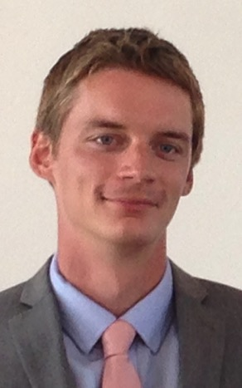
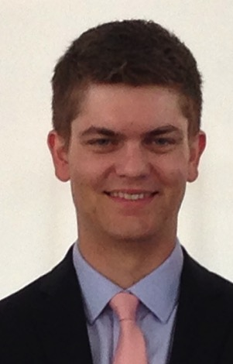
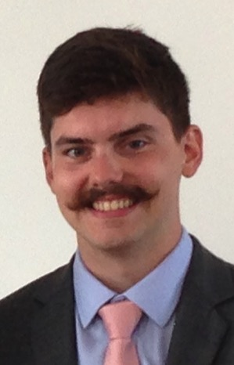
3 Sons, 3 Learning Styles
Kinesthetic
(hands)
Auditory
(ears)
Visual
(eyes)

Slide 51
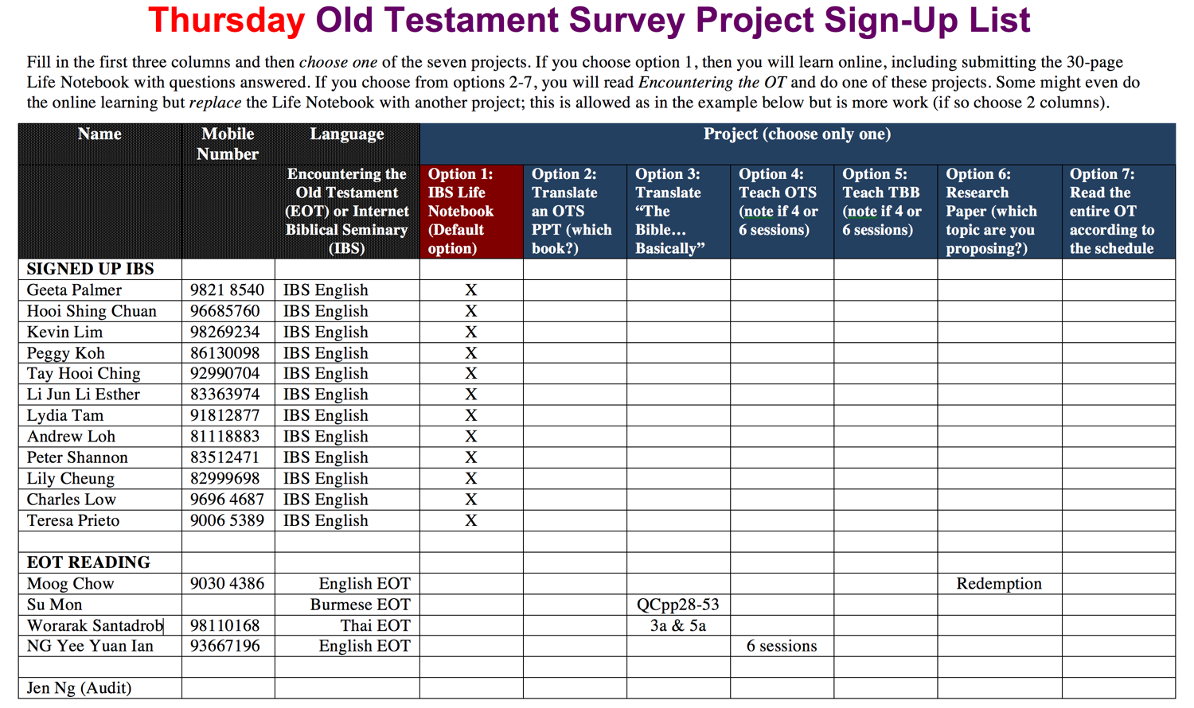
OTS Project Sign Up List

Slide 52
Another Proposition
Teachers teach
how they learn

Slide 53
How Do You Learn?
Kinesthetic
(hands)
Auditory
(ears)
Visual
(eyes)
Listen & Read
Doing
Seeing

Slide 54
How Do You Teach?
Kinesthetic
(hands)
Auditory
(ears)
Visual
(eyes)
Listen & Read
Doing
Lecture
Projects
Seeing
PowerPoint

Slide 55
A Problem
Teachers have less time to prepare but listeners demand higher quality visuals!

Slide 56
A Solution
Let's work hard on fewer visuals then share them with other teachers

Slide 57
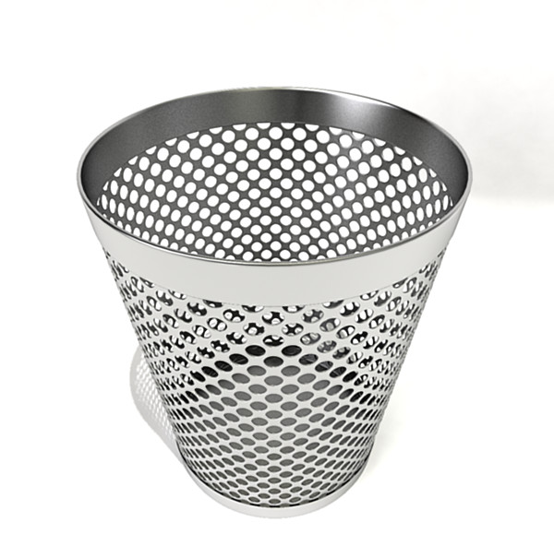
Assignment File System
Notes:
Too often students simply look at the grade on their research paper and toss it into this type of file system. There must be a better way!

Slide 58

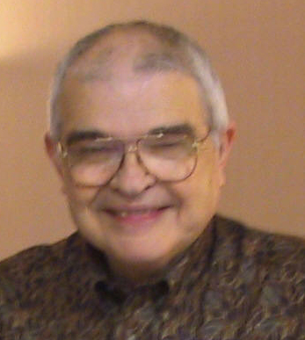
Dr John Fryman
Dr John Fryman
A Presentation of The Bible…Basically Ministries International Inc. Fort Worth, Texas
©2004 TBBMI
8.0.01.
04
Notes:
Dr. Fyman invested 30 years of his life to develop "The Bible…Basically," a 10-hour seminar that brings audiences through the whole Bible SIX times!

Slide 59
الكتاب المقدَّس
بصورةٍ أساسيَّة (TBB)
إعداد د. جون فرايمان، تكساس – الولايات المتَّحدة الأميركيَّة
جرى تدريسها بواسطة د. ريك غريفيث - مؤسَّسة الدراسات اللاهوتيَّة الأردنيَّة
جميع الملفات متاحةُ بلغاتٍ عدَّة للتنزيل مجَّانًا على الموقع الإلكترونيّ:
BibleStudyDownloads.org
©2006 TBBMI
Notes:
______________
Common-07

Slide 60

English

Slide 61

Burmese
Lai S
iangtho…Abulpi
A Presentation of The Bible…Basically Ministries International Inc. Fort Worth, Texas
www.biblebasically.com
©2004 TBBMI
8.0.01.
04

Slide 62


French
LA BIBLE…
EN BASE
Une Présentation du Ministère Internationale de La Bible… En Base Inc. Fort Worth, Texas
www.biblebasically.com
©2006 TBBMI
8.0.01.
04
©2004 TBBMI
9.6.01.

Slide 63

Japanese
バイブル ベイシックミニストリーズ
インスティチュート
A Presentation of The Bible…Basically Ministries International Inc. Fort Worth, Texas
www.biblebasically.com
©2004 TBBMI
8.0.01.
04
Notes:
Japanese title slide

Slide 64

Khmer (Cambodian)
mUldæanRKwH>>>
énRBHKm<IIr
karbgðaj[sÁal;nUvRBHKm<Ir>>> EdlCamUldæanRKw³ kñúg B½n§kic©shKmnGnþrCati GayGinsIu.
Fort Worth, Texas
www.biblebasically.com
©2004 TBBMI
8.0.01.
04

Slide 65
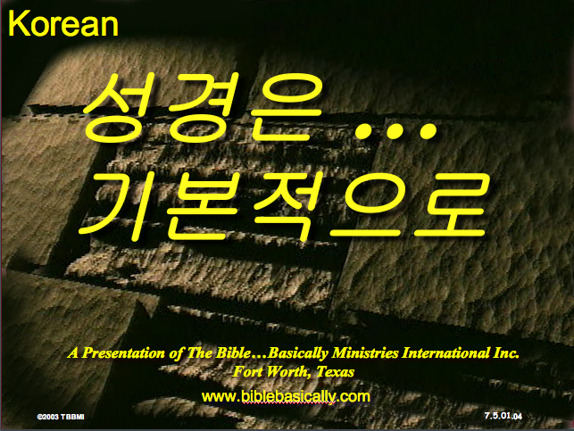
Korean
성경은 …
기본적으로
A Presentation of The Bible…Basically Ministries International Inc. Fort Worth, Texas
www.biblebasically.com
7.5.01.
©2003 TBBMI
04

Slide 66

Malay
Alkitab…
Dasar
Presentasi dari The Bible…Basically Ministries International Inc. Fort Worth, Texas
www.biblebasically.com
©2004 TBBMI
8.0.01.
04

Slide 67

Mao (India)
Bible…
Amolo Leino
Bible…Ngashankakhuina Ministries International Inc. pashina semkashok Fort Worth, Texas
www.biblebasically.com
©2004 TBBMI
8.0.01.
04

Slide 68
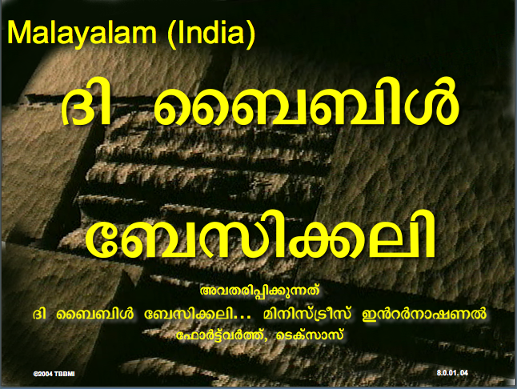
Malayalam (India)
Æß èÌÌßZ
çÌØßAÜß
¥ÕÄøßMßAáKÄí Æß èÌÌßZ çÌØßAÜß… ÎßÈßØíd¿àØí §aVÈÞ×ÃW çËÞVGíÕVJí, æ¿µíØÞØí
©2004 TBBMI
8.0.01.
04

Slide 69
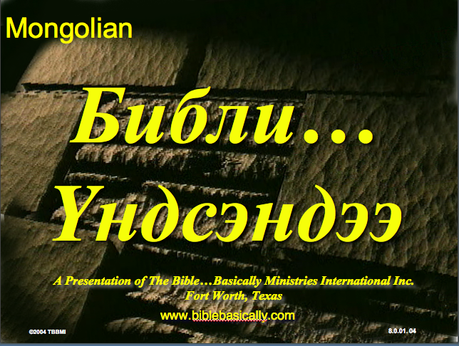
Mongolian
Библи…
Үндсэндээ
A Presentation of The Bible…Basically Ministries International Inc. Fort Worth, Texas
www.biblebasically.com
©2004 TBBMI
8.0.01.
04

Slide 70

Nepali
afOan======
cfwf/e[\t
A Presentation of The Bible…Basically Ministries International Inc. Fort Worth, Texas
www.biblebasically.com
8.0.01.
©2004 TBBMI
04

Slide 71

Swahili (Kenya)
biblia kwa ujumla
A Presentation of The Bible…Basically Ministries International Inc. Fort Worth, Texas
www.biblebasically.com
8.0.01.
©2003 TBBMI
04

Slide 72

Tagalog (Philippines)
Ang Biblia . . . Pinasimple
A Presentation of The Bible…Basically Ministries International Inc. Fort Worth, Texas
www.biblebasically.com
©2004 TBBMI
8.0.01.
04
Notes:
PLEASE PUT THE TITLE AND SUBTITLES INTO YOUR NATIONAL LANGUAGE AND LEAVE THE WEBSITE UNCHANGED

Slide 73

Tangkhul (India)
Bible…
Ngashankakhui
Bible…Ngashankakhuina Ministries International Inc. pashina semkashok Fort Worth, Texas
www.biblebasically.com
©2004 TBBMI
8.0.01.
04

Slide 74

Tamil (Sri Lanka/India)
jpUkiwapd;…
mbg;gil
A Presentation of The Bible…Basically Ministries International Inc. Fort Worth, Texas
www.biblebasically.com
©2004 TBBMI
8.0.01.
04

Slide 75
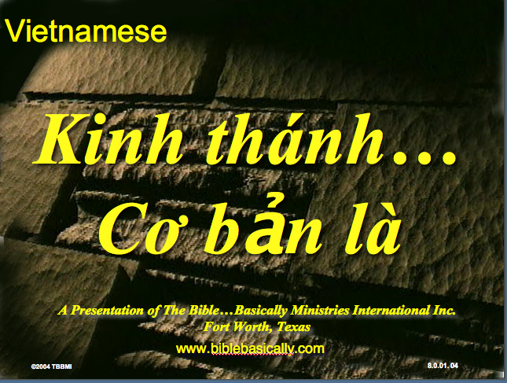
Vietnamese
Kinh thánh…
Cơ bản là
A Presentation of The Bible…Basically Ministries International Inc. Fort Worth, Texas
www.biblebasically.com
©2004 TBBMI
8.0.01.
04

Slide 76


Bahasa Indonesia
Presentasi dari The Bible…Basically Ministries International Inc. Fort Worth, Texas
www.biblebasically.com
7.5.01.
©2003 TBBMI
04

Slide 77
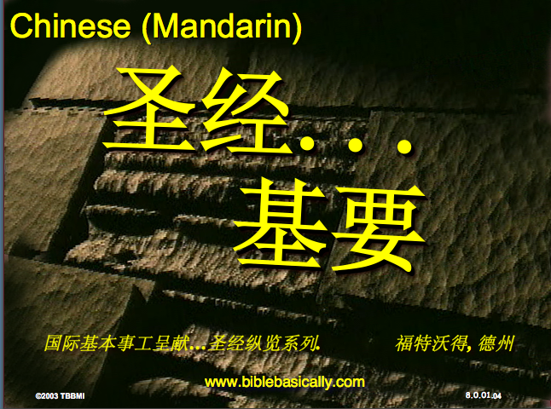
Chinese (Mandarin)
圣经...
基要
国际基本事工呈献…圣经纵览系列. 福特沃得, 德州
www.biblebasically.com
8.0.01.
©2003 TBBMI
04

Slide 78
PowerPoint (945 slides)
Student Workbook (100 pages)
Teacher Script (400 pages)
TBB Materials
Completed in
Arabic • English • Chinese • Hindi • Indonesian • Korean • Malay • Mongolian • Russian • Spanish
A Presentation of The Bible…Basically Ministries International Inc. Fort Worth, Texas
www.biblebasically.com
©2004 TBBMI
8.0.01.
04

Slide 79
YOUR
BIBLE FILE
7
C
7
S
J
Handbook pg. 8-14
39
Notes:
Now let's think again about a filing cabinet. This will be YOUR BIBLE FILE! Here is a look ahead to where we are going in this study.

Slide 80
10 File Folders
7
1
2
3
C
4
5
6
7
7
8
S
9
10
J
Handbook pg. 8-14
41
Notes:
As a starting point, begin thinking about 10 file folders in a filing cabinet.
You are going to organize your own Bible File into a collection of these ten mental file folders.
Very soon you'll be applying labels to each of those 10 file folders. So…now to begin…and…

Slide 81
Opening Up
"Your Bible File"
7
7
7
7
7
7
7
7
C
7
J
C
S
J
C
S
J
C
S
J
S
Handbook pg. 8-14
4
42
Notes:
We begin right here...with the single number…. 7.
That's our mental anchor point. Simply the number 7 with that all-important dash through the stem.
//// Next step...surround that number with three alphabet letters. Set them firmly in place in your mind:
C 7 S J
Repeat the letter group aloud several times as you embed it in your mind... Because this is the very core of the Bible's organization and time-line flow:
//// "C 7 S J....
//// C 7 S J....
//// C 7 S J...etc."

Slide 82
Opening Up
"Your Bible File"
7
7
= 4+3
Handbook pg. 8-14
2
43
Notes:
Now...about that European style '7'.
//// You'll remember that it has a dash through its stem... That's an important reminder — a mind clue. Keep it mentally handy. That small dash divides the length of the 7's stem into two parts. So, ask yourself the question: "What two numbers does 7 easily split into?"
//// One possible answer…and the right one…is: 4 and 3.

Slide 83
C 4 3 S J
7
Opening Up
"Your Bible File"
C 4 3 S J
C 4 3 S J
Handbook pg. 8-14
1
44
Notes:
So, in the C 7 S J formula, by changing the 7 to a 4 and a 3, we have
C 4 3 S J.
As before, repeat that changed sequence aloud several times to help it hold tightly in your mind for easy recall.
//// C 4 3 S J.

Slide 84
5 Key Words or Phrases:
7
C = CREATION
4 = PEOPLE
3 = SOCIETIES
S = SILENCE
J = JESUS
Handbook pg. 8-14
5
45
Notes:
Now, based on C 4 3 S J, we enlarge that idea into five key words or phrases. They will become the foundation of your mental Bible File. Here they are…say them aloud…
//// C = CREATION
//// 4 = 4 PEOPLE
//// 3 = 3 SOCIETIES
//// S = SILENCE
//// J = JESUS.
And that's an organizational plan for the entire Bible! Those five words and phrases create an abbreviated outline map of the entire Bible's basic design.

Slide 85
5 Key Words or Phrases:
7
C = CREATION
4 = PEOPLE
3 = SOCIETIES
S = SILENCE
J = JESUS
Handbook pg. 8-14
6
46
Notes:
Once again...aloud…
//// C = CREATION
//// 4 = 4 PEOPLE
//// 3 = 3 SOCIETIES
//// S = SILENCE
//// J = JESUS.
We will now go back through the phrases, expanding them still farther.
//// CREATION,
of course, remains at the top of the list naturally…because the Bible story itself begins right there.

Slide 86
5 Key Words or Phrases:
7
C = CREATION
4 = PEOPLE
3 = SOCIETIES
S = SILENCE
J = JESUS
Handbook pg. 8-14
47
Notes:
We then take the next phrase from the list:
4 PEOPLE.

Slide 87
THE 4 PEOPLE ARE:
7
ABRAHAM
JOSEPH
MOSES
JOSHUA
Handbook pg. 8-14
5
48
Notes:
Let's break apart "4 PEOPLE" into 4 specific people, in this order:
//// ABRAHAM
//// JOSEPH
//// MOSES
//// JOSHUA
It's helpful to remember the word order by repeating several times the first-letter order of the words:
//// "A-J-M-J ... A-J-M-J ... etc."

Slide 88
A Judge Must Judge
7
A
JUDGE
MUST
JUDGE!
Handbook pg. 8-14
49
Notes:
How can you remember the order of those letters and the names?
This simple sentence..."A JUDGE MUST JUDGE." The first letters of each word: AJMJ and then you have it.

Slide 89
THE 4 PEOPLE ARE:
7
A BRAHAM
A
J OSEPH
JUDGE
M OSES
MUST
J OSHUA
JUDGE
Handbook pg. 8-14
8
50
Notes:
Just remember to repeat the four names aloud to yourself several times until you feel the rhythm of the words:
//// "ABRAHAM,
//// JOSEPH,
//// MOSES and
//// JOSHUA."
And here again is that mental tool…
//// A
//// JUDGE
//// MUST
//// JUDGE.

Slide 90
Creation to Joshua
7
CREATION
ABRAHAM
JOSEPH
MOSES
JOSHUA
Handbook pg. 8-14
5
51
Notes:
So, from the top of the list we now can say:
//// CREATION
//// ABRAHAM
//// JOSEPH
//// MOSES
//// JOSHUA
This step completes the main FOUR PEOPLE of your new Bible File. Of course, there are dozens of other Biblical characters, but these are the only ones we are using to build the Bible File right now. Repeat the four names aloud several times until they are firmly set mentally.

Slide 91
5 Key Words or Phrases:
7
C = CREATION
4 = PEOPLE
3 = SOCIETIES
S = SILENCE
J = JESUS
Handbook pg. 8-14
52
Notes:
The next phrase of that beginning list is:
3 SOCIETIES.

Slide 92
A R C
7
Handbook pg. 8-14
2
53
Notes:
Another memory tool now…what do you call
//// that red section of the perimeter of a circle?
//// It's called an "arc," spelled A-R-C. Those letters, then, remind you of the first letters of 3 KINDS OF SOCIETIES.

Slide 93
THE 3 SOCIETIES ARE:
7
ANARCHY
ROYALTY
CAPTIVITY
Handbook pg. 8-14
6
54
Notes:
The three societies are…
//// ANARCHY
//// ROYALTY
//// CAPTIVITY.
As before, please repeat that word order several times.
ANARCHY, ROYALTY, CAPTIVITY...
ANARCHY, ROYALTY, CAPTIVITY.
And the mental tool here:
//// A
//// R
//// C.

Slide 94
OT Review
7
CREATION
ABRAHAM
JOSEPH
MOSES
JOSHUA
ANARCHY
ROYALTY
CAPTIVITY
Handbook pg. 8-14
55
Notes:
Now we add the 3 SOCIETIES group to the others, and we have:
CREATION
ABRAHAM
JOSEPH
MOSES
JOSHUA
ANARCHY
ROYALTY
CAPTIVITY

Slide 95
To Review…
7
7
TO REVIEW...
C 7 S J
C 4 3 S J
Handbook pg. 8-14
3
56
Notes:
To review the entire sequence so far…
Beginning with the single number
//// 7....
leading to…
//// C 7 S J...
which becomes...
//// C 4 3 S J.
These numbers and letters are then used to develop a mental list of TEN WORDS that will form a dependable mental outline of the entirety of Scripture.

Slide 96
The Basics
7
CREATION
4 PEOPLE
3 SOCIETIES
SILENCE
JESUS
Handbook pg. 8-14
57
Notes:
C 4 3 S J is then expanded into:
CREATION
4 PEOPLE
3 SOCIETIES
SILENCE
JESUS.

Slide 97
The Last Two Folders
7
CREATION
ABRAHAM
JOSEPH
MOSES
JOSHUA
ANARCHY
ROYALTY
CAPTIVITY
SILENCE
JESUS
Handbook pg. 8-14
2
58
Notes:
Then further expanded into:
CREATION
ABRAHAM
JOSEPH
MOSES
JOSHUA
ANARCHY
ROYALTY
CAPTIVITY.
Finally, now, we add: //// SILENCEand//// JESUS.

Slide 98
Your New Mental "Bible File”
CREATION
CREATION
ABRAHAM
ABRAHAM
ABRAHAM
ABRAHAM
JOSEPH
ABRAHAM
MOSES
JOSEPH
JOSHUA
ANARCHY
MOSES
ROYALTY
CAPTIVITY
JOSHUA
SILENCE
JESUS
ANARCHY
ROYALTY
CAPTIVITY
SILENCE
JESUS
Handbook pg. 8-14
59
11
Notes:
Now it's time mentally to apply those ten words as labels to ten mental folders in your new Bible File –
//// right up there in your head. That mental picture might look something like this. And there they are...
//// CREATION//// ABRAHAM//// JOSEPH//// MOSES//// JOSHUA//// ANARCHY//// ROYALTY//// CAPTIVITY//// SILENCE…and…//// JESUS.
Now it's organized in a neat and orderly package in your mind --- ready for recall and use as you need it. Now just a few more
examples to drive home the point...

Slide 99
Membuka
“Arsip Alkitab Anda”
7
7
7
7
7
7
C S Y
C S Y
C S Y
C S Y
Buku Panduan hlm. 8-14
40
4

Slide 100
Membuka
“Arsip Alkitab Anda”
7
7
= 4+3
Buku Panduan hlm. 8-14
41
2

Slide 101
Membuka
“Arsip Alkitab Anda”
7
C 4 3 S Y
C 4 3 S Y
Buku Panduan hlm. 8-14
42
1

Slide 102
5 Kata Kunci atau Ungkapan:
7
C = CIPTAAN
4 = TOKOH
3 = KOMUNITAS
S = SENYAP
Y = YESUS
Buku Panduan hlm. 8-14
43
5

Slide 103
5 Kata Kunci atau Ungkapan:
7
C = CIPTAAN
4 = TOKOH
3 = KOMUNITAS
S = SENYAP
Y = YESUS
Buku Panduan hlm. 8-14
45

Slide 104
4 TOKOH tsb adalah:
7
A BRAHAM
Y USUF
M USA
Y OSUA
Buku Panduan hlm. 8-14
46
5

Slide 105
AYMY
7
ANUGERAH
YANG
MENAKJUBKAN
YA !
Buku Panduan hlm. 8-14
47

Slide 106
5 Kata Kunci atau Ungkapan:
7
C = CIPTAAN
4 = ORANG
3 = KOMUNITAS
S = SENYAP
Y = YESUS
Buku Panduan hlm. 8-14
50

Slide 107

KAKAP
7
K
A
K
A
P
Buku Panduan hlm. 8-14
53
2
Notes:
Alat pengingat yang lainnya adalah …
//// Ini ikan apa?
//// Benar, ikan “KAKAP”
//// Kita lihat disini ada 2 huruf K, kita mau buang 1 huruf K-nya
//// Huruf A juga ada 2, kita buang lagi huruf A yang double
//// Sekarang yang tersisa adalah A-K-P
//// Ikan KAKAP-nya tidak dibutuhkan lagi, kita kembali ke laut saja..
Sisa tiga huruf ini A-K-P, huruf-huruf ini akan membantu anda mengingatkan huruf pertama pada tiga 3 MACAM KOMUNITAS.

Slide 108
KE 3 KOMUNITAS ADALAH:
7
A NARKI
K ERAJAAN
P EMBUANGAN
Buku Panduan hlm. 8-14
52
6

Slide 109

Two Saturdays, 24 & 31 August
9 am-1 pm at SBC

Slide 110

SINGAPORE BIBLE COLLEGE
Notes:
I served as a seminary professor from 1991 to 2021 with 30 other faculty at Singapore's largest training seminary called Singapore Bible College

Slide 111
SBC Courses I Teach
(English • Bahasa • Chinese)
Survey • The Bible…Basically
OT NT Bible Study
Backgrounds • Research & Writing
OT NT Geography
Theology • Creation • Jesus
Church • Spirit • Salvation • Future
Preaching
Homiletics 1 Homiletics 2
Notes:
I get to teach these leaders every book of the Bible in survey courses, plus backgrounds to both the OT and NT, three areas of theology, and how to preach.

Slide 112
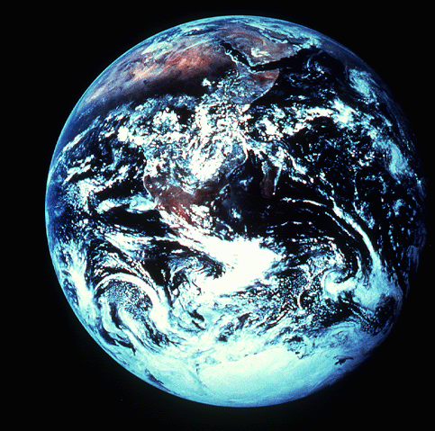
“in the beginning”
Gen. 1:1
An Introduction to Genesis

Slide 113
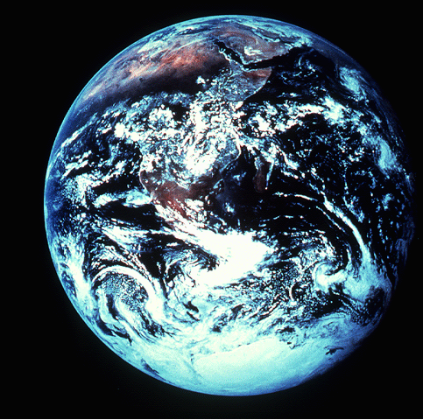
“pada mulanya”
Gen. 1:1
Pengenalan kitab Kejadian

Slide 114
“起初”
Gen. 1:1
创世记导论

Slide 115

Days of Creation
33
Void
Formless
Forming
Filling
Day 4: Sun, moon & stars arranged
Day 1: Light
Day 2: Water & air separated
Day 5: Fish & fowl
Day 3: Land & sea separated
Day 6: Animals & man
Genesis 1:3-31

Slide 116
Days of Creation in Bahasa Indonesian
Hari-hari penciptaan
64
Kosong
Tidak berbentuk
Dibentuk
Diisi
Hari 4: Matahari, bulan & bintang diatur
Hari 1: Terang
Hari 2: Air & udara dipisahkan
Day 5: Ikan & unggas
Day 3: Darat & laut dipisahkan
Day 6: Binatang & manusia
Kejadian 1:3-31

Slide 117
六天的创造
空虚
64
充满
混沌
形成
第四天: 太阳，月亮与众星摆列在天
第一天: 光
第二天:
水与空气分开
第五天: 鱼与雀鸟
第三天:
旱地与海分开
第六天: 动物与人
创世记 1:3-31

Slide 118


Preaching (Homiletics) link at BibleStudyDownloads.org
Get thousands of PPT for free!
Notes:
Preaching (pr)
Homiletics

Slide 119

BibleStudyDownloads.org
7
Notes:
My SBC teaching has resulted in Bible teaching and study materials—mostly PowerPoint—in 49 languages! All a teacher needs to do is to click on a file and it downloads for free to teach any book of the Bible and many other subjects.

Slide 120
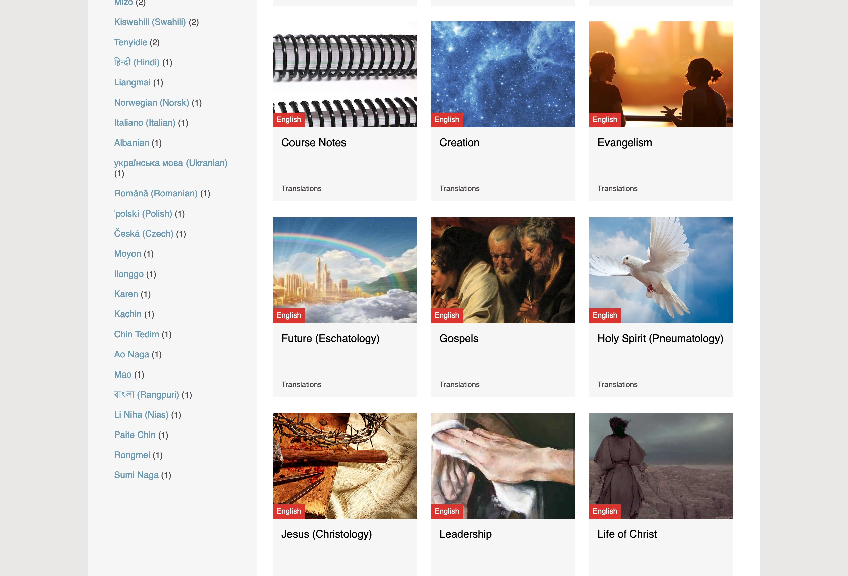
BibleStudyDownloads.org
7
Notes:
My SBC teaching has resulted in Bible teaching and study materials—mostly PowerPoint—in 49 languages! All a teacher needs to do is to click on a file and it downloads for free to teach any book of the Bible and many other subjects.

Slide 121
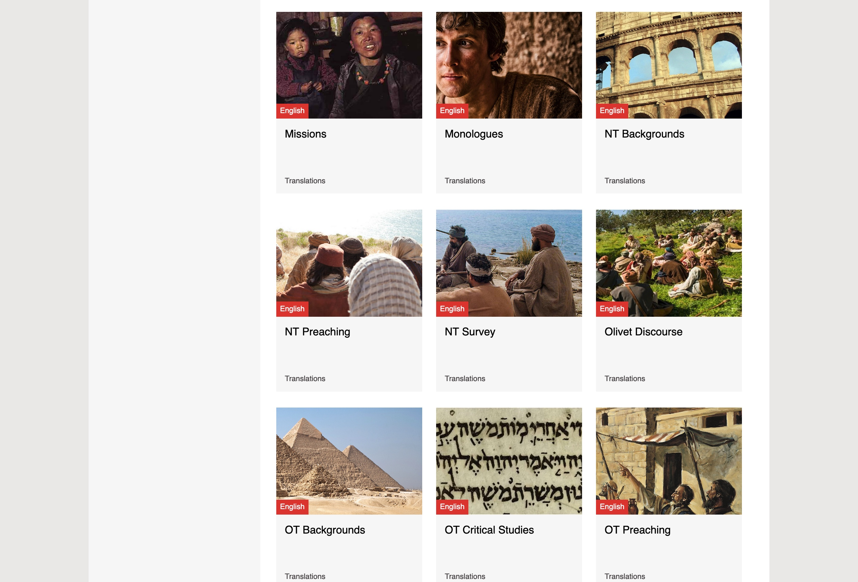
BibleStudyDownloads.org
7
Notes:
My SBC teaching has resulted in Bible teaching and study materials—mostly PowerPoint—in 49 languages! All a teacher needs to do is to click on a file and it downloads for free to teach any book of the Bible and many other subjects.

Slide 122
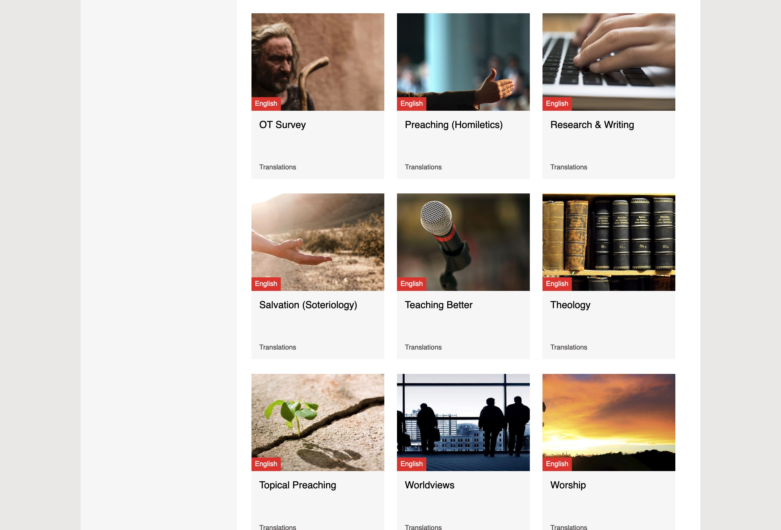
BibleStudyDownloads.org
7
Notes:
My SBC teaching has resulted in Bible teaching and study materials—mostly PowerPoint—in 49 languages! All a teacher needs to do is to click on a file and it downloads for free to teach any book of the Bible and many other subjects.

Slide 123
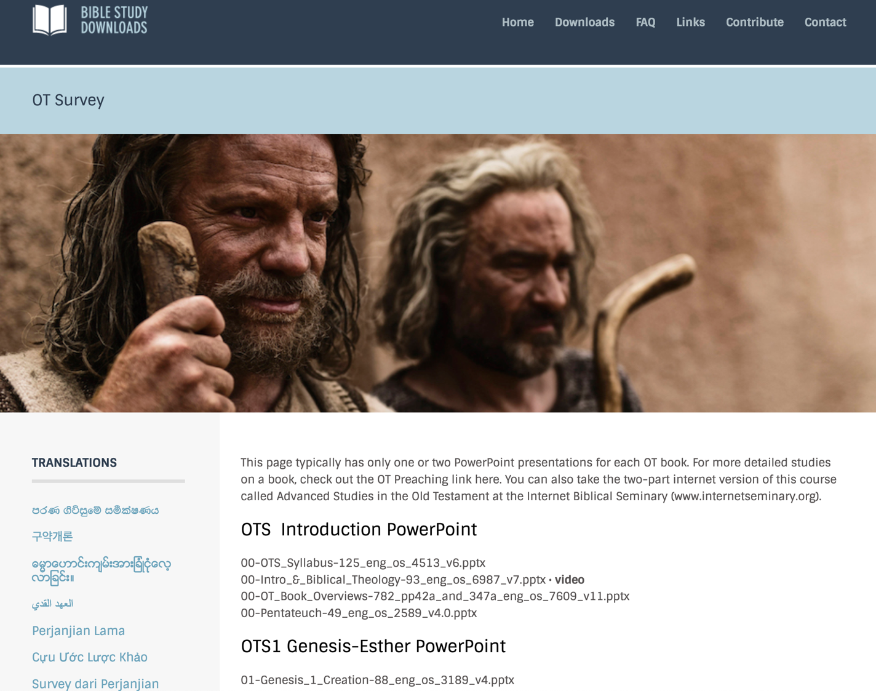
BibleStudyDownloads.org
7
English
Notes:
My SBC teaching has resulted in Bible teaching and study materials—mostly PowerPoint—in 54 languages! All a teacher needs to do is to click on a file and it downloads for free to teach any book of the Bible and many other subjects.

Slide 124
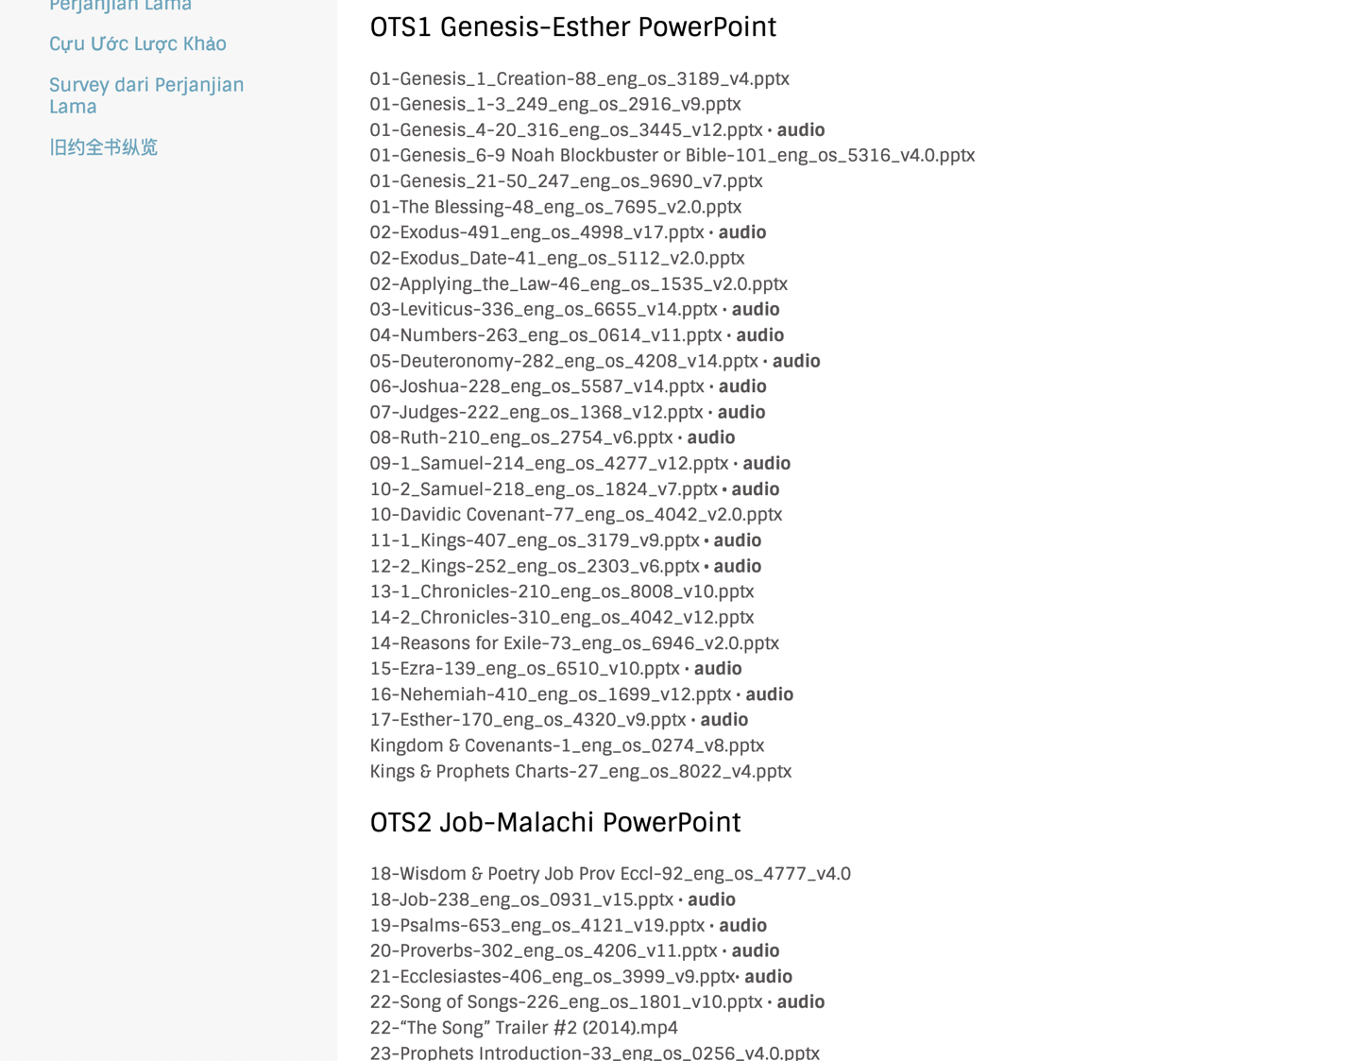
BibleStudyDownloads.org
7
Notes:
My SBC teaching has resulted in Bible teaching and study materials—mostly PowerPoint—in 49 languages! All a teacher needs to do is to click on a file and it downloads for free to teach any book of the Bible and many other subjects.

Slide 125

BibleStudyDownloads.org
7
Notes:
Here are 9 languages featured.

Slide 126

Chinese
7
Notes:
Chinese downloads include more than 37,000 slides as of Jan 2020.

Slide 127

Indonesian
7
Notes:
Indonesian downloads include more than 14,000 slides as of Jan 2020.

Slide 128


Vietnamese
7
Notes:
Vietnamese downloads include more than 8,000 slides as of Jan 2020.

Slide 129

Arabic العربية
7
Notes:
Arabic downloads include more than 1100 slides as of August 2021.

Slide 130
Black

Slide 131
Black

Slide 132
Black

Slide 133
Black

Slide 134
Black

Slide 135
OT Survey link at BibleStudyDownloads.org
Get this presentation for free!
Notes:
OT Survey (os)

