Slide 1
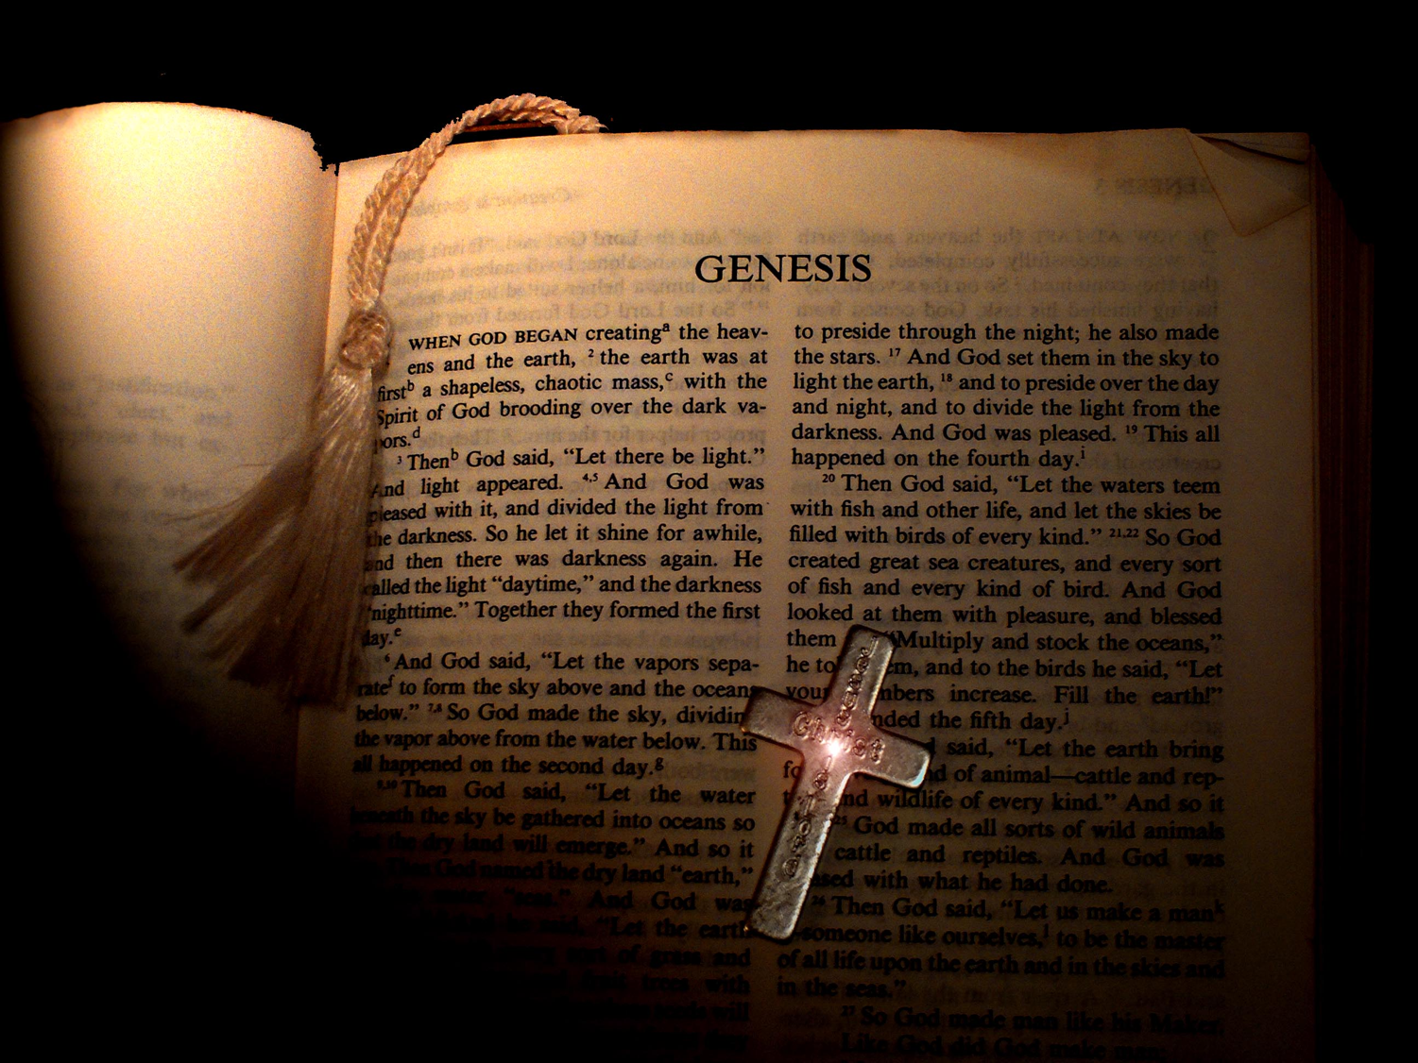
Introduction to the
Old Testament
Dr. Rick Griffith • Jordan Evangelical Theological Seminary • BibleStudyDownloads.org

Slide 2
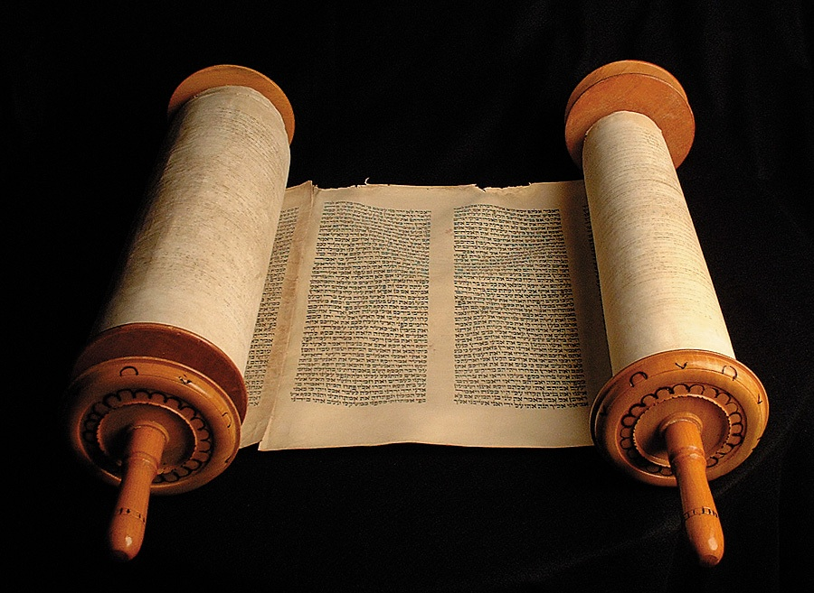
How Well Do You Know Your
Old Testament?
Take out a blank piece of paper
(or use a blank page in your notes or call up a blank screen on your computer)
List the OT books in order

Slide 3

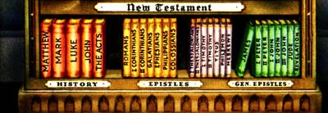
How can you remember all these books?

Slide 4












Books of the Bible
Books of the Bible
GENESIS
EXODUS
JOSHUA
JUDGES
RUTH
1 SAMUEL
2 SAMUEL
1 KINGS
2 KINGS
1 CHRON
2 CHRON
EZRA
NEHEMIAH
LEVITICUS
ESTHER
NUMBERS
DEUTERONOMY
LAW
HISTORY
Old
Testament
JOB
PSALMS
ISAIAH
JEREMIAH
LAMEN-TATIONS
EZEKIEL
DANIEL
PROVERBS
POETRY
MAJOR PROPHETS
SONG OF SOLOMON
HOSEA
JOEL
AMOS
OBADIAH
JONAH
MICAH
NAHUM
HABAKKUK
ZEPHANIAH
HAGGAI
ZECHARIAH
MALACHI
ECCLESIASTES
POETRY
MINOR PROPHETS
MATTHEW
New
Testament
MARK
ACTS
HEBREWS
JAMES
1 PETER
2 PETER
1 JOHN
2 JOHN
JUDE
REVELATION
1 COR
2 THESS
PHILEMON
3 JOHN
ROMANS
1 TIMOTHY
2 COR
1 THESS
PHILIPPIANS
2 TIMOTHY
EPHESIANS
LUKE
GALATIANS
COLOSSIANS
TITUS
JOHN
GOSPELS
HISTORY
PAULINE EPISTLES
GENERAL EPISTLES

Slide 5
OT Bookshelf
Old Testament
Genesis - Malachi
Law (5)
History (12)
Poetry (5)
Prophecy (17)
Major 5 Minor 12

Slide 6



THE "OPENED BIBLE"
(Yes, it is an ORGANIZED book!)
THE BIBLE… BASICALLY
®
PART SIX
By Dr. John Fryman
9.65.06.
©2006 TBBMI
02
Notes:
YES…IT IS AN ORGANIZED BOOK! So let's take a big step forward in this expanding view of -- as we said – "the basic document of our faith." This is Part SIX of THE BIBLE...BASICALLY, the part we call The OPENED Bible.

Slide 7

NOW…
LET'S SLICE AND DICE...
9.65.06.
©2006 TBBMI
03
Notes:
We're going to slice and dice the Word-- as a published book, just as we know books today -- developing some of its distinct parts and divisions.
Today's Bibles are very different from the Scriptures of our ancient ancestors. But the eternal message is the same, all across the millennia.

Slide 8

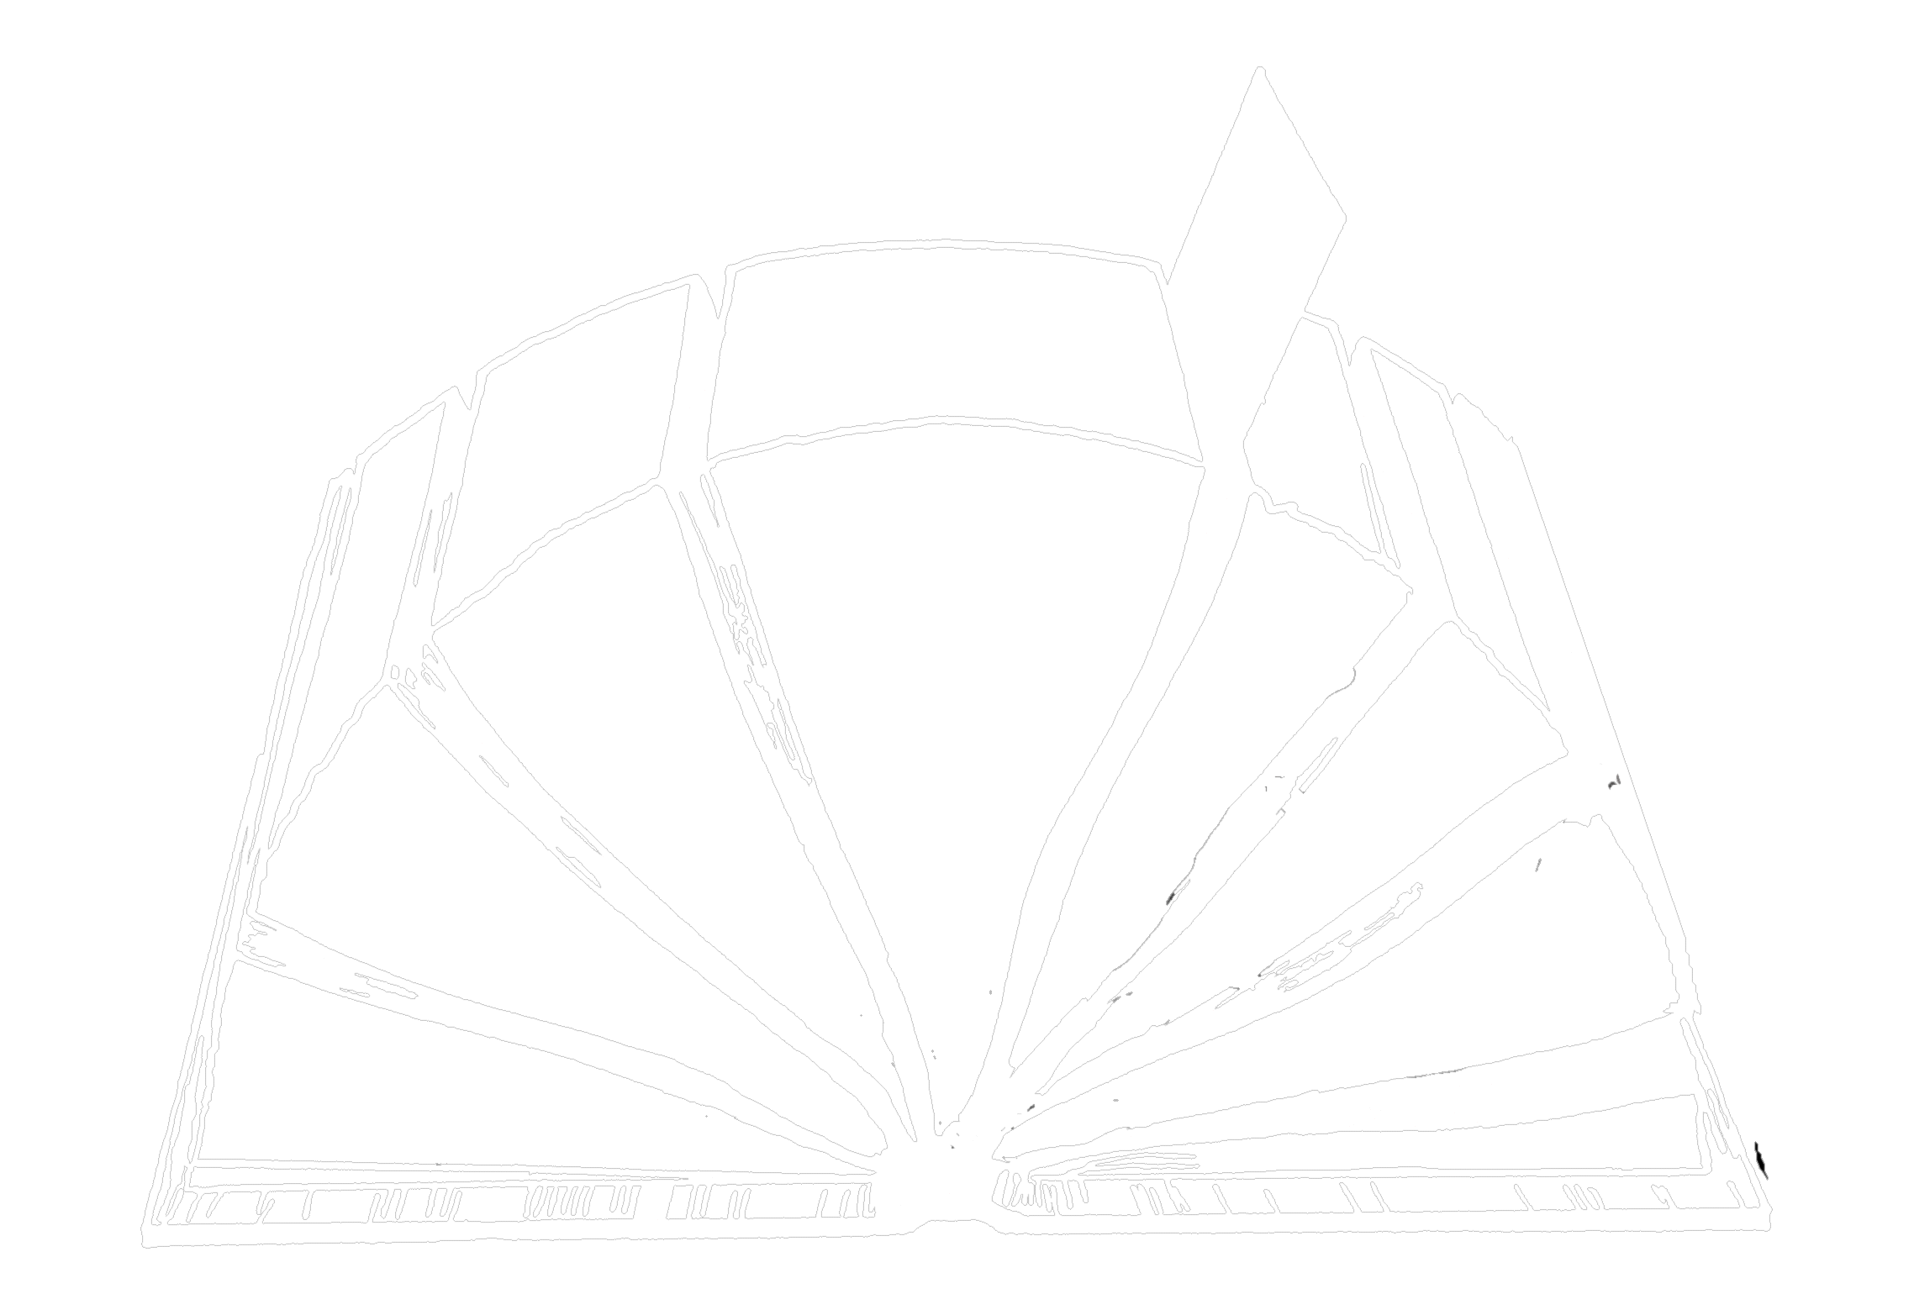
THE "OPENED"
BIBLE
THE PARTS
and
THE PIECES
Organized...Progressive...Timeless
A Ministry of ScriptureTechnologies International
9.65.06.
2
©2006 TBBMI
04
Notes:
We call this section, THE OPENED BIBLE….because…
//// We are going to explore its parts and its pieces.
And by now, you are probably beginning to develop your own mental Bible File.
So…the ideas presented next will further show you that the
//// Word of God is an organized, progressive structure, timeless in its spiritual value…containing an incomparable collection of literature on which you can place your complete faith and confidence -- in its writers, its message of salvation, and its proven spiritual directions for every human life on our planet.

Slide 9
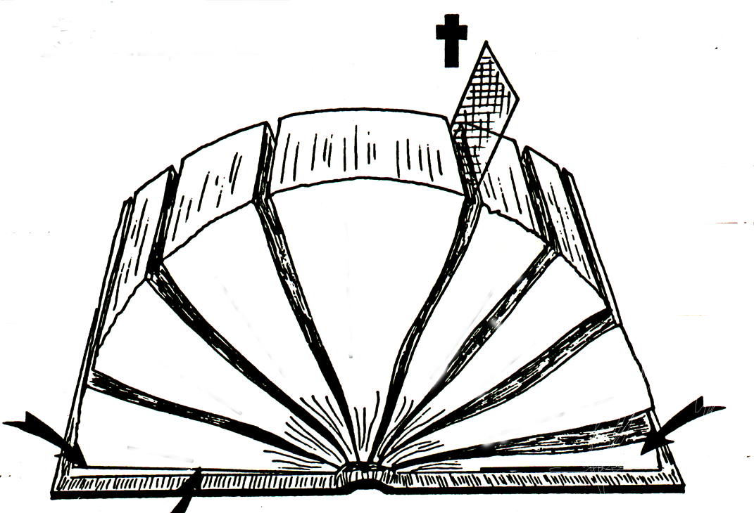
50a
A
B
" "
" "
D(OT)
C
ONE THEME:
D(NT)
E(OT)
" "
E(NT)
" "
F(OT)
F(NT)
4
3
5
/
/
G(OT)
6
G(NT)
2
STUDY HELP #18
7
1
8
H(OT)
2
1
H(NT)
I(OT)
J
The "Opened" Bible
06-06
©2006 TBBMI
©2006 TBBMI
06-
9.65.06.
05
©TBBBI
Notes:
With Study Help #18… called the OPENED BIBLE,…you'll be able to fill it in as we work forward. Stop to study it for a moment and you'll find a number of blank lines and letters. They will guide you through this next section. Ready? Let's begin.

Slide 10
50a
THE OLDER STORY
THE NEWER STORY
4
3
5
6
2
4
4
7
1
8
06
5
Notes:
We start by spreading open the pages of the Bible in this sketch,
separating it out into eight sections...
//// with a division marker right in the middle...
//// …with four sections on one side and four on the other. And of course, it is probably obvious to you
//// …that a division marker lies at the intersection of these two major Biblical sections. It identifies the most significant event in the history of our planet – the Cross of Calvary and the sacrifice of Our Lord.
//// The four sections to the left of the marker make up what we'll call, for now, THE OLDER STORY…
//// those to the right, THE NEWER STORY.

Slide 11
50a
THE OLDER STORY
THE NEWER STORY
4
3
5
6
2
7
1
8
07
Notes:
Now we'll number each of the sections in order...from SECTION ONE on the left, across and over to SECTION EIGHT on the right.

Slide 12
50a
THE OLDER STORY
THE NEWER STORY
4
3
5
6
2
7
1
8
08
4
Notes:
We'll uncover some interesting parallels between the varied sections of the Book. We will, for instance, link together sections
//// 1 and 5,
//// 2 and 6,
//// 3 and 7, and
//// 4 and 8.

Slide 13
50a
THE OLDER STORY
THE NEWER STORY
4
3
5
GOSPELS
6
2
7
1
LAW
8
THE BEGINNING DOCUMENTATION
09
3
Notes:
Look first at sections 1 and section 5. Think about them as serving a parallel purpose in term of the Bible's story line development. If you are using the Study Help #18 sheet, you can fill in each location as we go.
//// Across the centuries these two sections of Scripture have come to be known as THE LAW in the Old Testament
//// and THE GOSPELS in the New. Think about these two sections, linked here by a blue line as fulfilling somewhat parallel functions in the organization of the Bible. Because, it's from these beginning sections of the Old and the New that
//// all the events of the rest of each testament unfold...as we'll see right now. OK...
HERE WE HAVE "THE BEGINNING DOCUMENTATION" for each part of your Bible. Following these beginning documents…the Law in the Old and the Gospels in the New. Let's unpack the other sections.

Slide 14
50a
THE OLDER STORY
THE NEWER STORY
4
What follows? A body of writing!
3
What follows? A body of writing!
5
GOSPELS
6
2
ACTS
7
HISTORY
1
LAW
8
10
4
Notes:
Here are the next linked parallel sections, 2 and 6.
These sections we call HISTORY in the Old and
//// the ACTS in the New. In other words,
//// these two biblical sections reveal the result of circumstances set up in that beginning documentation...sections 1 and 5. So, then, if we have Law and Histories in the Old, and Gospels and Acts in the New…
//// …what follows next? Inevitably, a body of writings develops out of every significant historical epoch and its unique culture.

Slide 15
50a
THE OLDER STORY
THE NEWER STORY
4
3
5
GOSPELS
6
2
POETRY
ACTS
7
HISTORY
1
EPISTLES
LAW
8
11
3
Notes:
So…here we'll link together sections 3 in the Old and 7 in the New.
//// These are traditionally called POETRY in the Old
//// and THE EPISTLES in the New.
//// In both cases, the resulting writings were produced in response to circumstances recounted in the earlier two sections of each testament…with some prophetic characteristics

Slide 16
50a
THE OLDER STORY
THE NEWER STORY
4
3
5
GOSPELS
6
2
PROPHETS
POETRY
ACTS
7
HISTORY
EPISTLES
1
LAW
8
REVELATION
12
2
Notes:
And finally...sections 4 and 8...the parts of our Bible that, as a type of literature, are virtually unknown in other religious documents outside the Judeo-Christian tradition.
//// These sections are THE PROPHETS in the Old Testament and
//// the Book of REVELATION in the New. We will expand a little on all of this as we move along.

Slide 17
50a
THE OLDER STORY
THE NEWER STORY
4
3
5
GOSPELS
6
2
PROPHETS
POETRY
ACTS
7
HISTORY
EPISTLES
1
LAW
8
REVELATION
13
4
Notes:
Some new ideas may be coming into focus now. From this high level view, "the foundational document of our faith" is organized very clearly in a general progression of subjects that makes sense and shows order…when we look at it in this way.
//// In each section we have the beginning documentation...
//// …out of which falls a history of resulting events...
//// …which in turn produces a body of preserved writing...
//// …culminating in two sections of prophetical writing that look far beyond our times toward an outworking of titanic future events.

Slide 18
Parallel OT & NT Structure
34
Foundation
Past
Present
Future
OT
Torah
History
Wisdom
Prophecy
NT
Gospels
Acts
Epistles
Revelation
Erich Zenger, Einleitung in das Alte Testament (Stuttgart: W. Kohlehammer, 1995), 34; cited in Gregory Goswell, "Two Testaments in Parallel: The Influence of the Old Testament on the Structuring of the New Testament Canon," JETS 56 (2013): 461.
Notes:
OS-00-Intro & Biblical Theology-17
OS-23-Isaiah_60-66/Slide 92 on Supplements

Slide 19
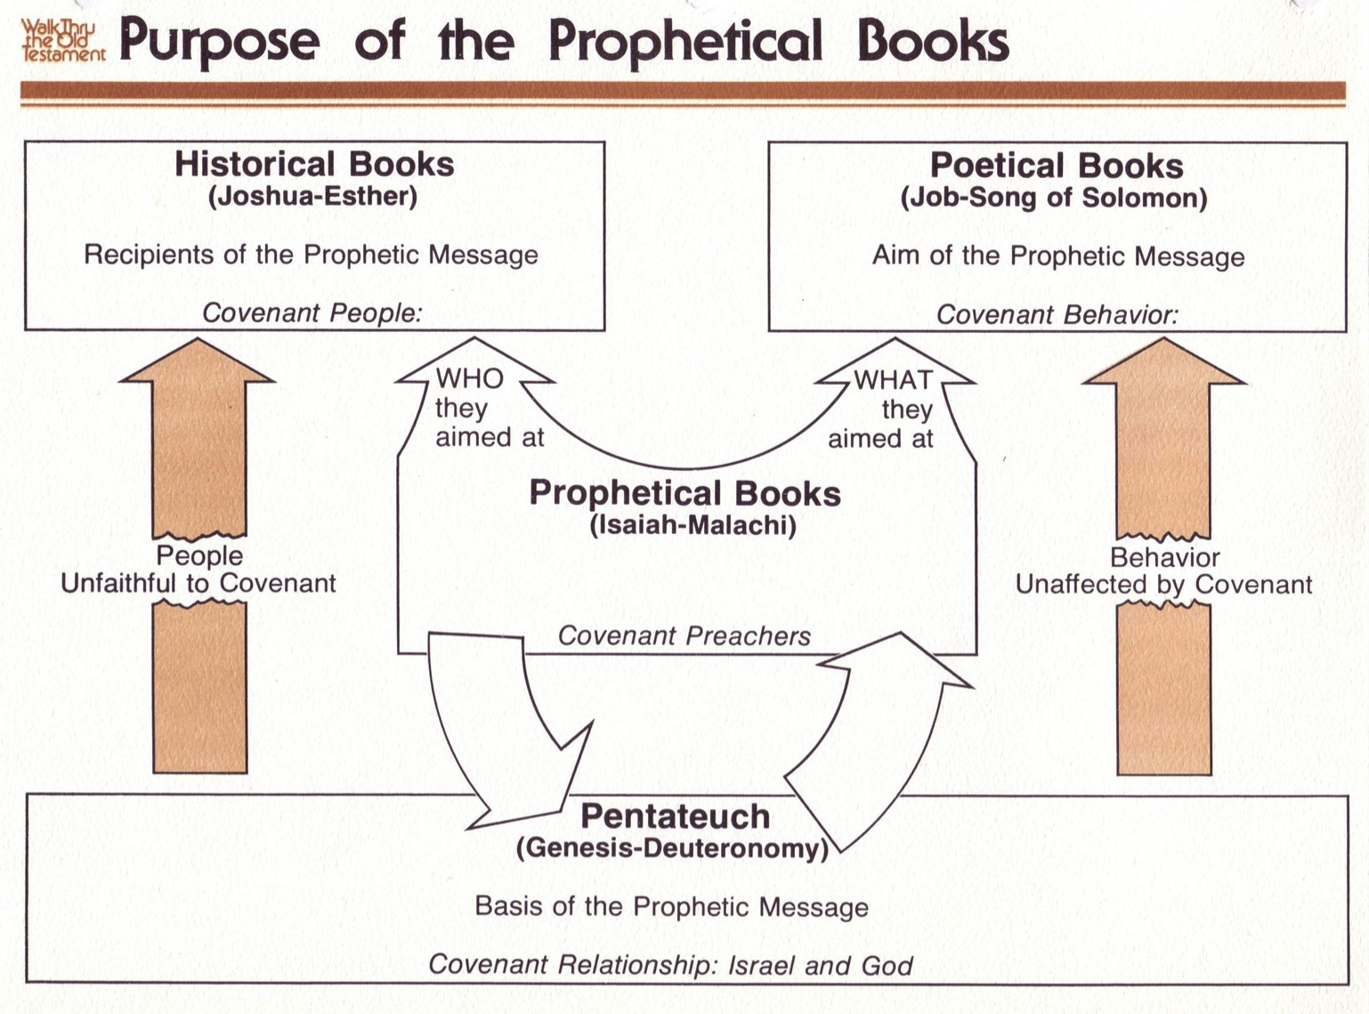
Purpose of the Prophetic Books
50b440
Historical Books
(Joshua-Esther)
Recipients of the Prophetic Message
Covenant People
Poetical Books
(Job-Song of Solomon)
Aim of the Prophetic Message
Covenant Behavior
WHO they aimed at
WHAT they aimed at
Prophetical Books
(Isaiah-Malachi)
Covenant Preachers
People
Unfaithful to Covenant
Behavior
Unaffected by Covenant
FORTHTELLING
FORETELLING
Mosaic Covenant
Pentateuch
(Genesis-Deuteronomy)
Basis of the Prophetic Message
Covenant Relationship: Israel & God
Abrahamic Covenant
Deut. 28; Lev. 26
Gen. 12:1-3; 15:18
Conditional
Unconditional
Judgment
Blessing
Notes:
The OT prophets are typically not taught in most churches and yet play a crucial role in the OT to link the Historical, Poetic, and Pentateuch sections. These covenant preachers fit into the end of OT chronology and thus look back at both the Abrahamic and Mosaic covenants in their blessing and judgment aspects, respectively. This includes both the forth-telling role to warn Israel of the conditions of the Mosaic requirements (Lev 26; Deut 28), as well as the foretelling role to remind the nation of unconditional blessings of the Abrahamic promises (Gen 12 & 15).
———————————————————
Common-326
00-Intro & Biblical Theology-slide 19
00_OT Book Overviews-453
23-Prophets Intro-27
23-Isaiah_1-12-Slide 13
28-Hosea-54
31-Obadiah-26

Slide 20

Structure of the Old Testament
Walk Thru the OT
36
( )
( )
( )
History
17
Poetry
5
Prophecy
17
5
Genesis
Exodus
Leviticus
Numbers
Deuteronomy
Joshua
Judges
Ruth
1 Samuel
2 Samuel
1 Kings
2 Kings
1 Chronicles
2 Chronicles
Ezra
Nehemiah
Esther
Job
Psalms
Proverbs
Ecclesiastes
Song of Solomon
Isaiah
Jeremiah
Lamentations
Ezekiel
Daniel
Hosea
Joel
Amos
Obadiah
Jonah
Micah
Nahum
Habakkuk
Zephaniah
Haggai
Zechariah
Malachi
Major
( )
Exodus
Exile
( )
Law
5
Pre-Exilic
History
Pre-Exilic
Prophets
12
Number of books in the OT:
3 + 9
39
27
Minor
Number of books in the NT:
( )
3 x 9
( )
66
Narrative
Number of books in the Bible:
Exile
Exile
Post-Exilic
History
Post-Exilic
Prophets
12
Events
Experience
Expectation
Actions
Axioms
Alarms
What people did
What people felt
What people should do
Notes:
The Christian arrangement of the OT shows many parallels in structure. The 17 historical books parallel the 17 prophetical books, and both sections are divided after the first 5 books, which is itself parallel to the 5 poetic books. Even the titles of these 5 books in English become longer from Job to Song of Solomon. In the history and prophecy sections, the exile took place prior to the last three books. Finally, subdivisions associated with the second books in the history and prophecy sections (Exodus and Jeremiah) show how Jews were kicked out of Egypt and Israel, respectively. As for remembering the number of OT books, think 3+9, and the NT, 3x9.
________________
Common Slides-123
OS-00-Intro & Biblical Theology-19
OS-23-Isaiah_60-66/Slide 93 on Supplements

Slide 21
Integration of the Old Testament
Walk Thru the OT
43
Leviticus
Deuteronomy
Ruth
1 Chronicles
2 Chronicles
Esther
Historical
Genesis | Exodus | Numbers | Joshua | Judges | 1 Samuel | 2 Samuel | 1 Kings | 2 Kings
Ezra | Nehemiah
1
2
3
4
5
6
7
8
9
10
11
Psalm 137 Psalms Psalm 90
Job
Psalms
Proverbs
Poetical
Ecclesiastes
Song of Songs
To Israel:
Hosea
Amos
To Judah:
Habakkuk
Isaiah
Jeremiah
Joel
Micah
Zephaniah
Lamentations
Ezekiel
Haggai
Malachi
Daniel
Zechariah
Prophetical
To Assyria:
Jonah
Nahum
To Edom:
Obadiah
Notes:
The OT Historical Books fall into 11 periods with 6 other historical books supplementing them but not bringing the chronology forward.
The Poetic Books stretch from Job through Solomon's time, probably ending in Ecclesiastes.
Then the Prophetic Books cluster later in the OT era during the divided monarchy to the end of the OT.
• The Book of Psalms has incredible breadth, stretching over 1000 years from Psalm 90 by Moses who wrote Genesis to Psalms 137 in the Post Exilic era.
______
Common-125
OS-00-Intro & Biblical Theology-21
OS-03-Numbers-50
OS-13-1 Chron-47
OS-19-Psalms-126
OS-23-Isaiah_24-39/Slide 262 on Supplements
OS-23-Isaiah_49-59/Slide 168 on Isaiah 169
OS-23-Isaiah_60-66/Slide 99 on Supplements
OS-39-Malachi-50

Slide 22
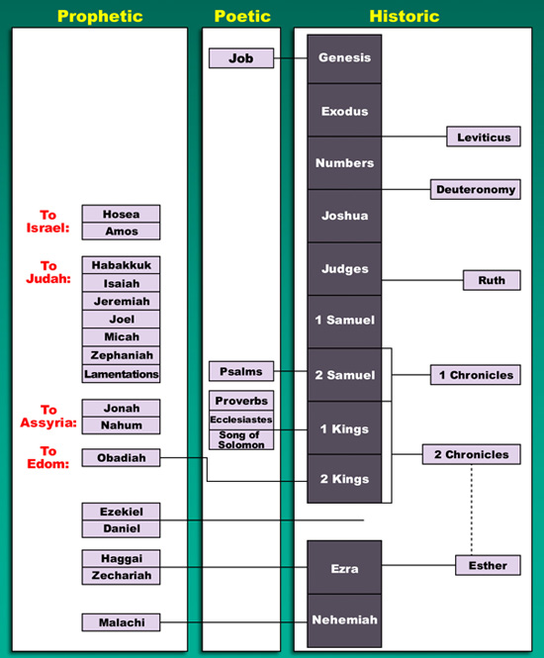
The Old Testament
Prophetic
Poetic
Historic
43
Genesis
Job
Exodus
Numbers
Leviticus
Joshua
Deuteronomy
To
Israel:
Hosea
Amos
To Judah:
Habakkuk
Judges
Isaiah
Ruth
Jeremiah
1 Samuel
Joel
Micah
Zephaniah
2 Samuel
Lamentations
Psalms
1 Chronicles
To
Assyria:
Jonah
Proverbs
1 Kings
Nahum
Ecclesiastes
To
Edom:
Song of Songs
2 Chronicles
Obadiah
2 Kings
Ezekiel
Daniel
Haggai
Ezra
Zechariah
Esther
Nehemiah
Malachi

Slide 23
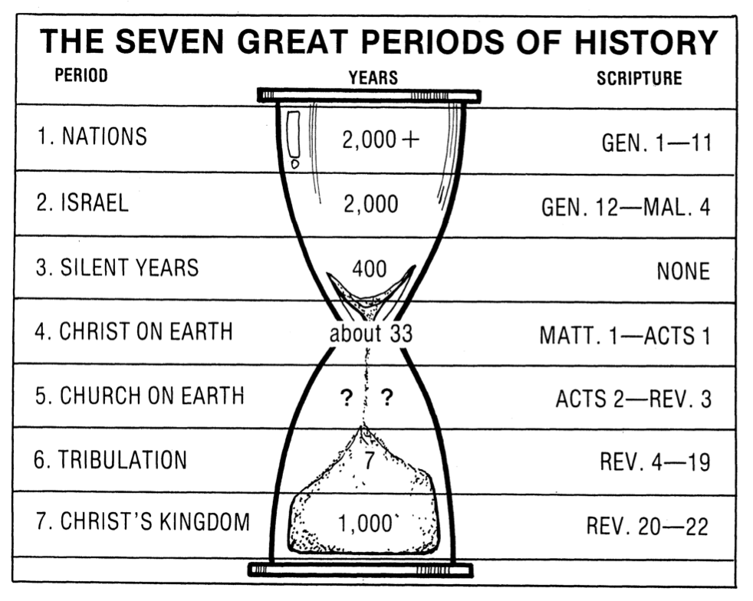
The Seven Great Periods of History
19
PERIOD
YEARS
SCRIPTURE
NATIONS
2000+
GENESIS 1–11
ISRAEL
2000
GENESIS 12–MALACHI 4
SILENT YEARS
400
NONE
CHRIST ON EARTH
About 33
MATTHEW 1–ACTS 1
CHURCH ON EARTH
?
?
ACTS 2-REVELATION 3
TRIBULATION
7
REVELATION 4–19
CHRIST'S KINGDOM
1000
REVELATION 20–22
Terry Hall, Bible Panorama, 157
Notes:
History can be seen as depicted on an hourglass where time funnels into the most significant short period about 33-37 years long when God became man. It will funnel back into his reign for 1000 years and finally into the eternal state!
_______________
Common-124
OS-00-Intro & Biblical Theology-21

Slide 24
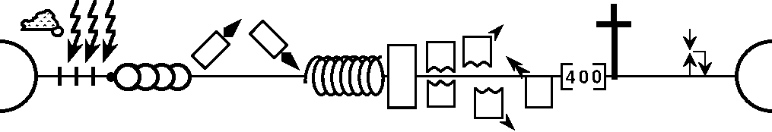
World History Detailed
--------------------------------------------------- 1 & 2 Chronicles ----------------------------------------------------------------
Genesis
1–11
Genesis
12–50
Deuteronomy
1 Samuel
Leviticus
2 Samuel
Nehemiah
Numbers
1 Kings
2 Kings
Exodus
Joshua
Judges
Ruth
Ezra
Esther
NATIONS
ISRAEL
P • G • H • R
Eternity
Flood
S • D • S
2nd Coming
Fall
Babel
1st Coming
Eternity
J (R) & I (J)
Abraham
Isaac
Joseph
Creation
Jacob
Joshua
J (B) & I (A)
Moses
Cycles
Z • E • N
1000
400
2000+
Exodus
Beginnings
Conquests
Patriarchs
Kingdom
Judges
Silent Years
Church
United Kingdom
Divided Kingdom
Restoration
Captivity
Max Anders, Dallas Theological Seminary
Notes:
The OT book of Chronicles was divided into two parts that cover thousands of years from creation through the Post-Exilic era.
S • D • S = Saul • David • Solomon
J(R) = Judah (Rehoboam)
I(J) = Israel (Jeroboam)
J(B) = Judah (Babylon conquered them)
I(A) = Judah (Assyria conquered them)
Z • E • N = Zerubbabel • Ezra • Nehemiah (post-exilic leaders during the time of Buddha!)
P • G • H • R = Persia • Greece • Hasmoneans • Romans
___________
Common-126
OS-00-Intro & Biblical Theology-24, 38
OS-13-1 Chron-47

Slide 25
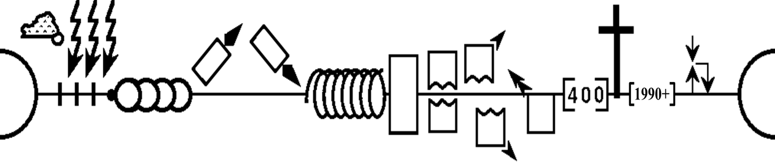
World History Summarized
Creation
Fall
Promise
Gospel
Mission
New
Creation

Slide 26
MAJOR PERIODS OF OLD TESTAMENT HISTORY
00H-Major_Periods_OT-Tanner-1p.pdf at PaulTanner.org

Slide 27
The Old Testament
00B-OT Overview Chart-Tanner-1p.pdf at PaulTanner.org

Slide 28
God's Program of Blessing
00C-Program of Blessing-Tanner-1p.pdf at PaulTanner.org

Slide 29
Geographical Orientation to the Ancient Near East
00D-Sess02_Geographical_Supp-ANE_Map-1p.pdf at PaulTanner.org

Slide 30
KEY EVENTS OF THE OLD TESTAMENT
00I-Key Events Chart 1-Abraham-to-Exodus-1p.pdf at PaulTanner.org

Slide 31
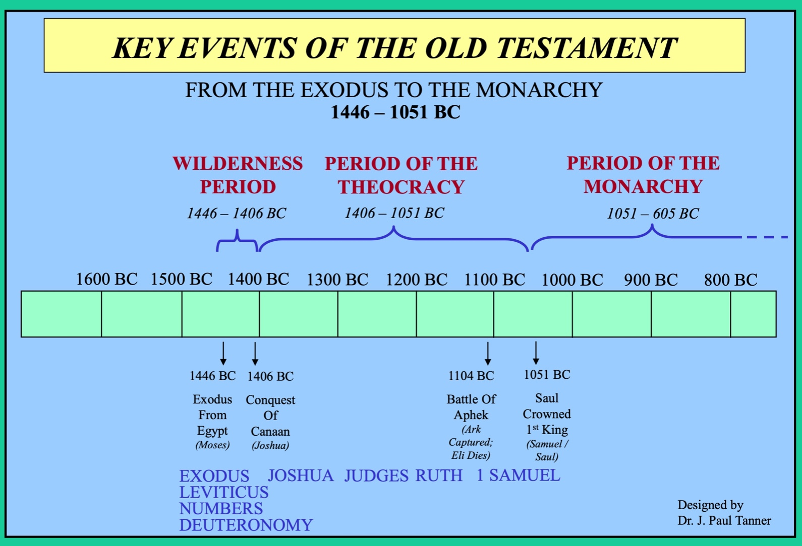
KEY EVENTS OF THE OLD TESTAMENT
00J-Key Events Chart 2-Exodus-to-Monarchy-Tanner-1p-ed2.pdf at PaulTanner.org

Slide 32
KEY EVENTS OF THE OLD TESTAMENT
00K=9B=18C-Key Events Chart 3-Monarchy-to-End-Tanner-1p.pdf at PaulTanner.org

Slide 33
The Davidic Covenant: The Main Source of the Messianic Kingdom Hope
00G-Davidic_Covenant_Chart-Tanner-1p.pdf at PaulTanner.org

Slide 34
THE DIVISION OF THE KINGDOM
00R-Kingdom_Division-Tanner-1p.pdf at PaulTanner.org

Slide 35
THE POSTEXILIC PERIOD
00T-Postexilic_Period_Chart-Tanner-1p.pdf at PaulTanner.org

Slide 36






Time Periods of the Prophets
New Heavens & New Earth
Christ’s
Second
Coming to
Reign in
Millennium
Christ’s
First
Coming
to Suffer
Exile & Return
Prophet's Own Time
Adapted significantly from Salem Kirban, Charts on Revelation (1979), 49

Slide 37

Timeline of the Judges
Ibzan, Elon and Abdon
Civil War of Abimelech
Judges 9
JUDGE
Shamgar
(600 Philistines)
Judges 3:31
Jephthah
Deborah & Barak
Joshua
Othniel
Ehud
Gideon
Samson
Eli
Tola
Jair
Samuel
Moabites
Canaanites
Midianites
Ammonites
Philistines
Edomites
OPPRESSION BY
Adapted from John Walton, Chronological and Background Charts of the Old Testament, and “Biblical Judges,” Wikipedia

Slide 38
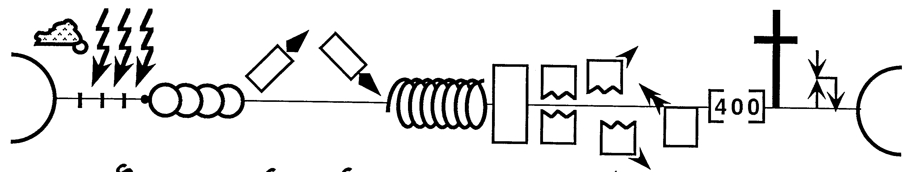
Stages of God's Plan in History
20
I (A) & J (B)
P • G • H • R
2nd Coming
Creation
Abraham
S • D • S
I (J) & J (R)
Z • E • N
1st Coming
Eternity
Eternity
Joseph
Moses
Joshua
Cycles
Flood
Jacob
Fall
Babel
Isaac
1000
Exodus
Judges
Captivity
Church
Patriarchs
Conquests
Kingdom
Beginnings
Restoration
Silent Years
United Kingdom
Divided Kingdom
Max Anders, Dallas Theological Seminary
Notes:
The OT book of Chronicles was divided into two parts that cover thousands of years from creation through the Post-Exilic era.
S • D • S = Saul • David • Solomon
J(R) = Judah (Rehoboam)
I(J) = Israel (Jeroboam)
J(B) = Judah (Babylon conquered them)
I(A) = Judah (Assyria conquered them)
Z • E • N = Zerubbabel • Ezra • Nehemiah (post-exilic leaders during the time of Buddha!)
___________
Common-126
OS-00-Intro & Biblical Theology-24, 38
OS-13-1 Chron-47

Slide 39
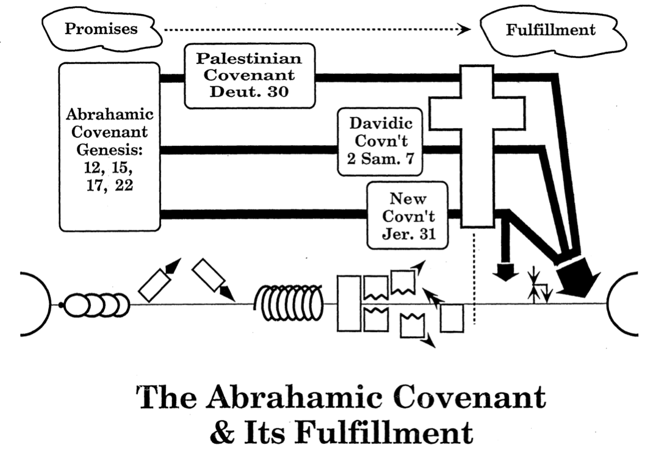
The Abrahamic Covenant
& Its Fulfillment
21
Promises
Fulfillment
Land Covenant
Deut 30
Abrahamic Covenant
Genesis 12, 15, 17, 22
Davidic Covenant
2 Sam 7
New Covenant
Jer 31
Adapted from Max Anders, Dallas Theological Seminary, 1987
Notes:
God has progressively fulfilled his promises given to Abraham. The OT records the Land, Davidic, and New Covenant promises to amplify the land, seed, and blessing promises of Genesis 12:1-3. All three await completion in the Millennium, though Jesus began the New Covenant in the Last Supper (Luke 22:20) and God has brought some of Israel back to the land in fulfillment of Ezekiel 37:1-7.
The land, Davidic, and new covenants follow chronologically from God's promise to Abraham. Scholars hotly debate the extent that each is fulfilled in our present era. This diagram shows that the new covenant is partially fulfilled today prior to the return of Jesus which is marked with the small arrows.
__________________
Common-169
ES-07-Dispensational Premillennialism-66
OS-00-00-Intro_&_Biblical_Theology-111_eng_os_6987_v17—Slide 39
OS-01-Gen4-20-slide 219
OS-23-Isaiah_24-39/Slide 263 on Supplements
OS-23-Isaiah_49-59/Slide 169 on Isaiah 169
OS-23-Isaiah_60-66/Slide 100 on Supplements

Slide 40
Kingdom & Covenants Timeline
22
CH-34a
OS1-22
OS2-337
NS-9g
SA-19
34a
Dr. Rick Griffith • BibleStudyDownloads.org
22
Kingdom Teaching...
Adam rules with God (Gen. 1:26, 28; 2:19)
Satan begins rule as god of this world (Gen. 3:15;
2 Cor. 4:4)
God covenants with Abraham to reestablish man's rule via Israel as a "kingdom of priests" (Gen. 12:1-3; Exod. 19:6)
Israel's failure to witness to nations as a kingdom of priests is judged via exile under foreign rule
Israel rejects Messiah's offer of kingdom (Matt. 12:41-42; 23:37-39)
Jesus extends His kingdom in mystery form to the Church (Matt. 13)
Christ subdues Israel's enemies and nation believes (Rom. 11:26-27)
Christ rules over everything with saints (Eph. 1:9-10; Rev. 20:1-6; 22:5b)
337
9g
Fall of Man (Gen. 3)
Noahic Covenant
19
Genesis 6:18; 9:8-17
Land Covenant
ISRAEL
CHURCH
MESSIANIC KINGDOM
(National Focus)
The "New Man" (Eph. 2:15)
Millennial Eternal
land
Genesis 15:18 (cf. Deut. 30:1-10) promises:
Land from Wadi of Egypt to Euphrates River (Isa. 27:12)
Eternal possession of land (Gen. 17:8) after exile/restoration
Whole world blessed via the land (Isa. 14:1-2)
Israel judged for rejecting Messiah by dispersion away from land for 19 centuries
(AD 70–AD 1948) but now partially restored (Ezek. 37:1-7)
Full restoration (Ezek. 37:8-28) Jerusalem world capital
(Isa. 2:1-5)
New Jerusalem
(Rev. 21–22)
Davidic Covenant
Christ is Head over His Church, which is a spiritual temple (Eph. 2:19-22; 2 Cor. 6:16)
Christ reigns over the world
(Isa. 11)
with saints (Rev. 5:10; 20:4-6)
Christ hands kingdom over to Father (1
Cor. 15:24)
Genesis 12:1-3
2 Samuel 7:12-16 promises:
Sons ("house" never wiped out)
Kingdom (political dynasty)
Throne (right to rule by descendants)
Temple (son to build it)
seed
Abrahamic Covenant
New Covenant
All
things made new!
(Rev. 21:5)
All 5 elements fulfilled in national restoration (Zech. 8)
Jeremiah 31:31-34 promises:
Forgiveness
Indwelling Spirit
New heart, nature, mind
Reunification of Israel and Judah
No need for evangelism
Mosaic Law replaced with first three elements of the New Covenant (Luke 22:20; 2 Cor. 3:6)
blessing
Mosaic Covenant
Law abolished, fulfilled, and replaced at the cross (Rom. 7:1-6;
1 Cor. 9:19-21; Heb. 8:13)
10th Edition
10 Nov 2020
Temporary (Gal. 3:19) and conditional (Deut. 28) to reveal sin (Rom. 7:7) and regulate Israel (Gal. 3:23-25)
Scripture has a dual kingdom-covenant theme. Israel's role from Abraham to Christ expands to include the Church (continuity) yet the Church never replaces the nation as the "new Israel" (discontinuity). Israel will enjoy world prominence after trusting Christ at His second coming.
Notes:
All agree that a partial fulfillment of the covenant to Abraham exists now to the Church in the indwelling Holy Spirit and forgiveness of sins (Jer 31:31-34)—and the ultimate fulfillment will be in the eternal state.
The main area of disagreement relates to the time period from now to eternity. Will there be a literal land, throne, and worldwide blessing to national (ethnic) Israel before the eternal kingdom? This chart shows verses giving a resounding YES to that question in a present partial fulfillment and a future full fulfillment in the normal sense of language in the verses cited. But the messianic kingdom will be in two stages—first in a millennial fulfillment to last 1000 years, but then, after that, the eternal stage in the new Jerusalem after the destruction of our present heavens and earth (Rev 21–22). What an amazing future remains for those who trust Jesus!
____________
Common English-7
CH-02-Nature-103-p34a
OC-10-Chronology-42
OS-00-Intro & Biblical Theology-25 & 90
OS-02-Exodus-276-p22
OS-05-Deut-248-p22
OS-10-2Sam-96-p22
OS-13-1 Chron-46
OS-24-Jeremiah-174-p337
OS-23-Isaiah-97-p337
NS-09-Gal-143-p9g
NS-19-Hebrews-342-p9g
SA-08-Mosaic Law-19-p38a

Slide 41
The Eschatological Significance of the Sabbath
23
529
NS 266k
A visual summary of the ThD dissertation by Richard James Griffith, Dallas Theological Seminary, 1990
Christ’s Second Coming in
2 Phases
Pre-Fall
Pre-Mosaic
Mosaic
Church
Tribulation
Millennial Kingdom
Eternity
Creation
Fall of Man
Mount Sinai
Death of Christ
Rapture
Revelation
Rev 20:1-6
Eternity
6 Days
(Work)
Gen 1
7th Day
(Rest)
Gen 2:1-3
Law Instituted
Exod 20
Law Abolished
Rom 7:1-6
Gal 3:19, 23-29
1 Cor 9:20
2 Cor 3:6-11
Daniel’s 70th Week of 70-Week Prophecy
Dan 9:27
Some Aspects of Law Reinstituted
Ezek 40–48
God’s Work
Work of Creation
Gen 1
Work of Sustaining
John 5:17
Work of Recreation
Rev 21–22
Israel Repeatedly Rejected God’s Offer of the Promised Land Rest…
God’s Rest
Not Resting
Rests from Creative Activity
Gen 2:2-3
Rest Stops by Sin
Rest Linked to Canaan
Gen 12:1-3; 15:18;
Deut 30:1-10
Rejected in Wilderness
Gen 14:23;
Heb 3:9
Rejected in David’s Time
Ps 95:7b-11
Rejected in Messiah
Matt 23:37-39
Rejected in Peter’s Sermon
Acts 3:19-20
Rest Accepted & Reinstituted
Heb 3:7–4:11
Israel’s Sabbath
No Sabbath for Mankind
Israel’s Sabbath Anticipated
Gen 2:3
Sabbath Instituted
Exod 16
Neh 9:13-14
Sign of Mosaic Covenant
Exod 31:13, 17;
Ezek 20:12, 20
Sabbath Abolished
Col 2:16-17
Gal 4:9-10
Rom 14:5
Hos 2:11
Lord’s Day Instituted
Acts 20:7
1 Cor 16:1-2
Rev 1:10
Sabbath Reinstituted
Matt 24:20
Sabbath Reinstituted
Ezek 46:1
Isa 66:23
Transition Begins
Transition Completed
Israel’s National History
Nation Established at Mt Sinai
Exod 19
69 Weeks
（483 years）
444 BC-AD 33
Dan 9:25
Nation Set Aside in
Church Age Gap: “Times of the Gentiles”
Dan 9:26
Luke 21:24
1 Week
(7 Years)
AD ??
Dan 9:27
Nation Repents, Believes in Messiah, Re-established
Ezek 36–39
Kingdom Typology
Kingdom Language
Gen 1
Abrahamic & Land Covenants
Gen 12:1-3; 15:18
Deut 30:1-10
Sabbath Looks Back at Creation & Redemption
Exod 20:8-11
Deut 5:12-15
Sabbath Looks Forward & Typifies Kingdom
Heb 4:9
Lev 23:1-3
Sabbath Typifies in a Dual Sense
Notes:
God worked in six 24-hour days to create the earth, but his rest on Day 7 had no "evening and morning," so he continues to rest from his creative (but not his sustaining) work. Humans entered that rest until the Fall, but since then have repeatedly rejected his offers to enter that rest. Then rest is located in Canaan, so the seventh day Sabbath looked back to creation in Exodus 20 and to redemption from Egypt in Deut 5. Yet Israel repeatedly rejected full entrance into God's Canaan rest—even unto today—through unbelief. But Hebrews 4:9 promises future Canaan rest for all who believe. The Sabbath thus looks forward to the 100-year Canaan rest in a typological sense.
________
OB-25-Feasts-80
OS-00-Intro-41
OS-01-Gen1-3-slide 157
OS-02-Exodus-320
OS-26-Ezek 40-48-slide 23
NS-19-Hebrews-175

Slide 42
Government in Scripture
24
The Bible has many themes (e.g., redemption, community, promise, covenant, God’s glory). However, the overall theme is probably the rule of God or kingdom (see the study on pages 32-33). This government has taken many forms in the past but it will culminate in rule under Messiah in the future, which itself will merge into the eternal state.
Type | Co-Rule | Human | Theocracy | Anarchy | Monarchy | Foreign | Monarchy | Co-Rule
Rulers | God & Unfallen Man | Man & Satan | God | Judges | Kings of Israel & Judah | Pagan Kings & Heads of State | Jesus with Believing Israel & Gentiles | God & Redeemed
Ruler Names | Lord God Adam Eve | Adam Noah Abraham | God via Moses or Joshua | Gideon Samson Samuel | Saul David Zedekiah | Nebuchad-nezzar Cyrus Herod Biden! | Christ | God
Subjects | Animals | All men | Israel | Israel | Israel | Israel & nations | Israel & Gentiles | Angels?
Authority | Fellowship with God | Conscience of each individual | Mosaic Covenant (Law) | Each man’s opinion | Mosaic Covenant & King’s Law | Gentile ruler’s law | New Covenant under Christ | Fellowship with God
Sin | Absent | Degeneration | Controlled | Increased | Mixed | Mixed | Reduced Greatly | Absent
Time | 4143 BC | 4143-1445 BC | 1445-1390 BC | 1390-1043 BC | 1043-586 BC | 586-return of Christ | 1000 years | Eternal state
Scripture | Gen. 1–2 | Gen. 3– Exod. 18 | Exod. 19–Josh. 24 | Judg. 1– 1 Sam. 7 | 1 Sam. 8– 2 Chron. 36 | Dan. 9:26; Luke 21:24 | Isa. 11；Rev. 20:1-6 | Rev. 21–22
Notes:
OS-00-Intro & Biblical Theology-32
OS-02-Exodus-281

Slide 43

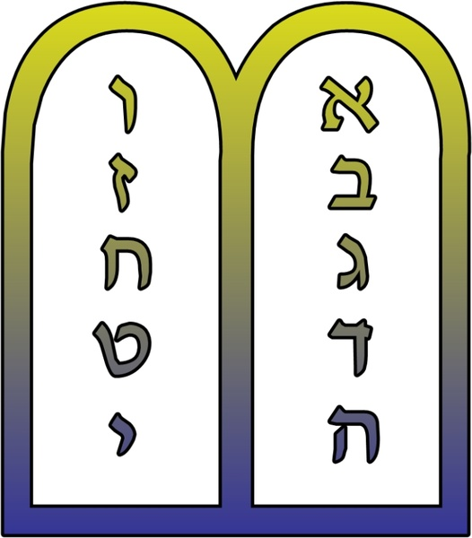
The Bible's Story
25
Matthew
Mark
Luke
John
Genesis
Deuteronomy
Silent Years
Acts
Exodus
Leviticus
Numbers
Joshua
Judges
Ruth
1 Samuel
2 Samuel
1 Kings
2 Kings
1 Chronicles
2 Chronicles
Ezra
Nehemiah
Esther
Isaiah
Haggai
Romans
KEY:
Psalms
1 Corinthians
Job
History
Proverbs
Jeremiah
Zechariah
2 Corinthians
Experience
Lamentations
Malachi
Galatians
Ezekiel
Ephesians
Prophecy
Philippians
Ecclesiastes
Daniel
Colossians
Hosea
1 Thessalonians
Joel
2 Thessalonians
1 Timothy
Amos
2 Timothy
Song
Titus
Obadiah
Jonah
Philemon
Hebrews
Micah
James
Nahum
1 Peter
2 Peter
Habakkuk
1 John
Zephaniah
2 John
3 John
Jude
Adapted from Terry Hall, Bible Panorama, 14
Revelation
Notes:
OS-00-Intro & Biblical Theology-33
Kingdom & Prophets Charts-2

Slide 44
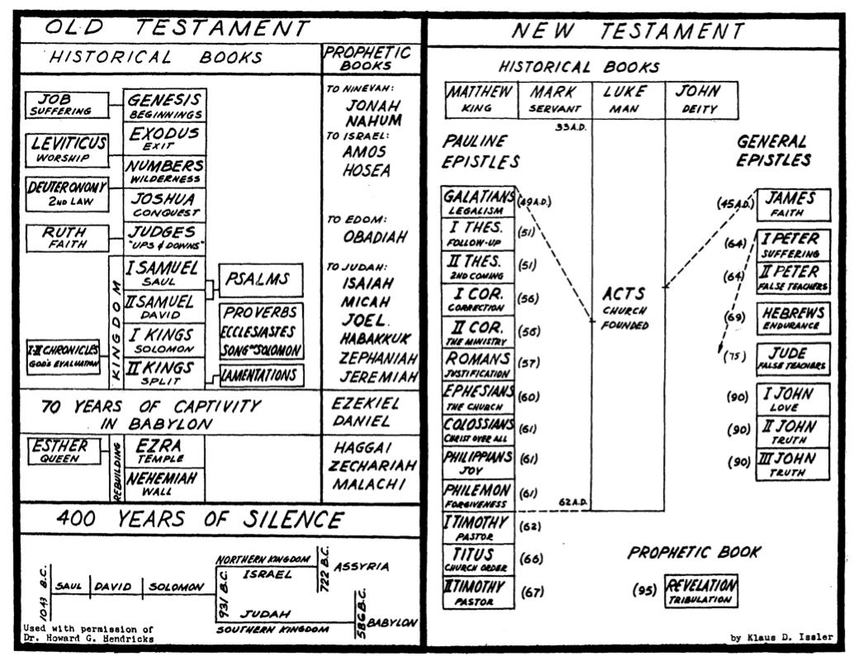
Overview of the OT & NT
26
旧约
Overview of the OT & NT
新约
历史书
先知书
历史书
创世记
起初
去尼尼微：
约拿书
那鸿书
去以色列：
阿摩司书
何西阿书
去以东：
俄巴底亚书
去犹大：
以赛亚书
弥迦书
约珥书
哈巴谷书
西番亚书
耶利米书
马太福音
君王
马可福音
仆人
路加福音
人子
约翰福音
神性
约伯
受苦
利未记
敬拜
出埃及记
离开
保罗书信
普通书信
民数记
旷野
申命记
第二个律法
加拉太书
拘泥法律
约书亚记
攻取
雅各书
信心
路得记
信心
士师记
起起落落
帖撒罗尼迦前书
跟进
彼得前书
受苦
撒母耳记上
扫罗
诗篇
帖撒罗迦
后书
再来
彼得后书
假师傅
使徒行传
教会根基
撒母耳记下
大卫
哥林多前书
连接
箴言
传道书
雅歌
希伯来书
忍耐
王国
哥林多后书
新的事奉
列王记上
所罗门
历代志上下
神的建设
罗马书
称义
犹大书
假师傅
列王记下
分裂
耶利米哀歌
以西结书
但以理书
以弗所书
教会
约翰一书
爱
被掳至巴比伦70 年
歌罗西书
尊主为大
约翰二书
真理
以斯帖
王后
以斯拉记
圣殿
哈该书
撒迦利亚书
玛拉基书
腓立比书
喜乐
约翰三书
真理
重建
尼希米记
城墙
腓利门书
宽恕
静默时期400年
提摩太前书
牧者
预言书
北国
亚述
提多书
教会纪律
以色列
主前722
启示录
患难
扫罗
大卫
所罗门
主前931
提摩太后书
牧者
主前1043
犹大
主前586
南国
巴比伦
Notes:
Translators, please translate the text on the right and then drag it over the English above.

Slide 45
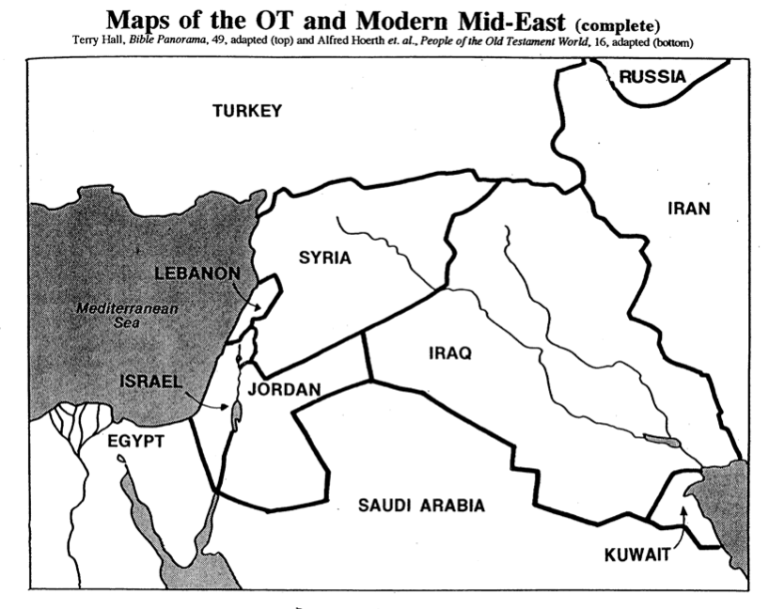
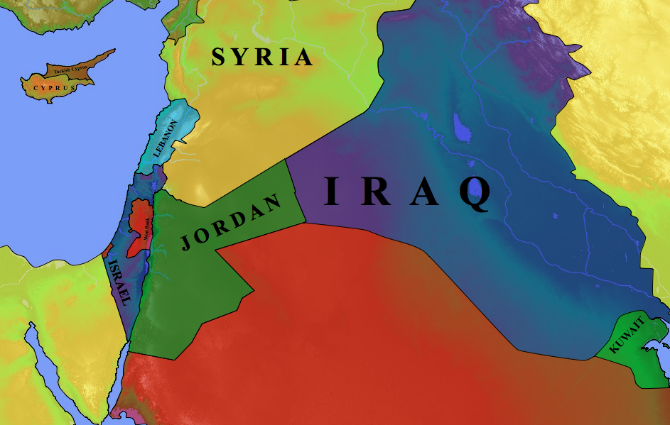
Modern Middle East Nations
27
Terry Hall, Bible Panorama, 49
Turkey
Russia
Syria
Cyprus
Iran
Lebanon
Iraq
Mediterranean Sea
Jordan
Israel
Saudi Arabia
Kuwait
Egypt

Slide 46

The Ancient Near East
28
Fertile Crescent
Iraq
Israel
Egypt

Slide 47
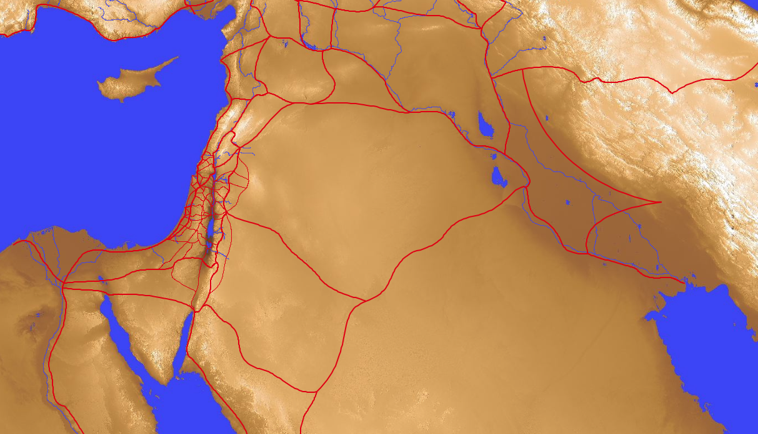
Old Testament Trade Routes & Bodies of Water
28
8
Tigris
7
1
Euphrates
Mediterranean
Sea
4
Sea of Chinnereth
5
Jordan River
6
Salt Sea
2
Nile River
9
Persian
Gulf
3
Red Sea
In your small group…
Name each of the 9 bodies of water
Tell how each got its name
Notes:
Mediterranean: "In the middle" (medi) + "lands" (terrain) = "between two lands" (Europe and Africa)
Nile River: "The name Nile comes from the Greek “neilos”, which means valley. The Ancient Egyptians called the river Ar or Aur (black) because of the colour of the sediment left after the river's annual flood (http://www.primaryhomeworkhelp.co.uk/egypt/nile.htm)
Red Sea: "Like the Yellow Sea, the Red Sea may also be named after a natural process. Seasonal blooms of a bacteria commonly called “sea sawdust” turn the water red. These bacteria, Trichodesmium erythraeum, help process nutrients in the ocean that certain small marine creatures depend upon. But there are other thoughts regarding how the Red Sea, which is an inlet of the Indian Ocean, got its name. Among them is the idea that it borders the “red land,” the name ancient Egyptians used to refer to the Egyptian Desert. Another theory states that the color red signifies “south.” Some Asiatic languages use colors to refer to directions" (http://www.dictionary.com/e/yellow-sea/)
Sea of Chinnereth: harp sea as it is shaped like the ancient harp
Jordan River: "The river's name in Hebrew is יַרְדֵן (Yarden), and it is derived from יָרַד (yarad) meaning "descend" or "flow down" (https://www.behindthename.com/name/jordan).
Salt Sea: sea with highest salt content on earth as it is the lowest spot where water stops and evaporates to make it continually saltier
Euphrates River: "A river named Perath (Hebrew for Euphrates) is one of the four rivers that flow from the Garden of Eden according to Genesis 2:14. This Hebrew word, derived from either the word "stream" or "to break forth," has been translated as Euphrates" (http://www.newworldencyclopedia.org/entry/Euphrates_River)
Tigris River: "From Latin Tigris, from Ancient Greek Τίγρις (Tígris), an alternative form of Τίγρης (Tígrēs), from Old Persian 𐎫𐎡𐎥𐎼𐎠 (Tigrā), from Elamite 𒋾𒅅𒊏 (ti-ig-ra), from Sumerian 𒀀𒇉𒈦𒄘𒃼 (^{ÍD}Idigna, ^{ÍD}Idigina, literally “fast as an arrow”).} (https://en.wiktionary.org/wiki/Tigris#Etymology)
Persian Gulf: named after the land just to the north

Slide 48

Mesopotamia
28
T
Tigris
Mesopotamia
N
Nineveh
E
Euphrates
B
Babylon

Slide 49
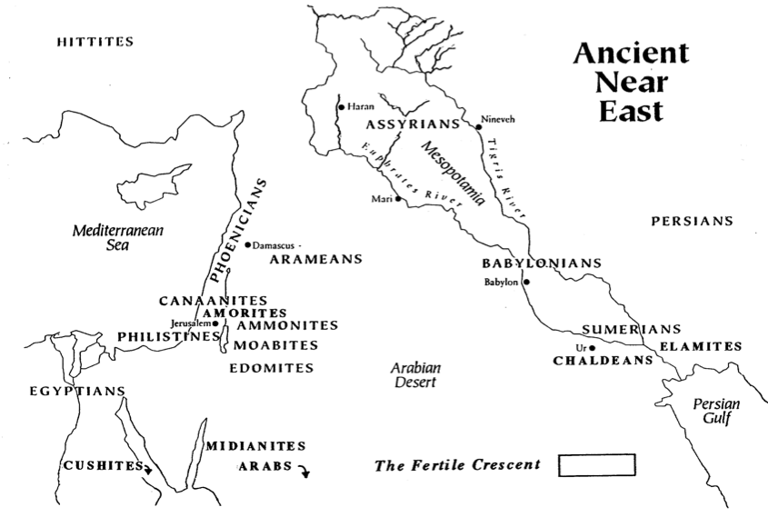
The Ancient Near East
Small Group:
Name the 7 cities
27
HITTITES
3
ASSYRIANS
Tigris
Haran
5
Euphrates
Nineveh
PHOENICIANS
Mesopotamia
2
Damascus
4
Mediterranean
Sea
Mari
PERSIANS
ARAMEANS
CANAANITES
BABYLONIANS
AMORITES
Babylon
6
Jerusalem
1
GILEADITES
SUMERIANS
PHILISTINES
AMMONITES
7
ELAMITES
MOABITES
Ur
EDOMITES
Arabian
Desert
CHALDEANS
EGYPTIANS
MIDIANITES
Persian
Gulf
Fertile Crescent in Green
CUSHITES
ARABS
Alfred Hoerth et. al., Peoples of the Old Testament World, 16

Slide 50

Tribal Boundaries of Israel
"AND"
Naphtali
Dan
Asher
171
Zebulun
Manasseh
Issachar
Joshua 13:1–19:48
"ZIMM"
Manasseh
Gad
"DEB"
Dan
Ephraim
Ammon
Benjamin
Reuben
Judah
"GAMER"
Simeon
Eastern tribes
Moab
Firstborn double portion & kingly tribe
Seven tribal allotments by lot
Neighboring nations related by blood
Edom

Slide 51
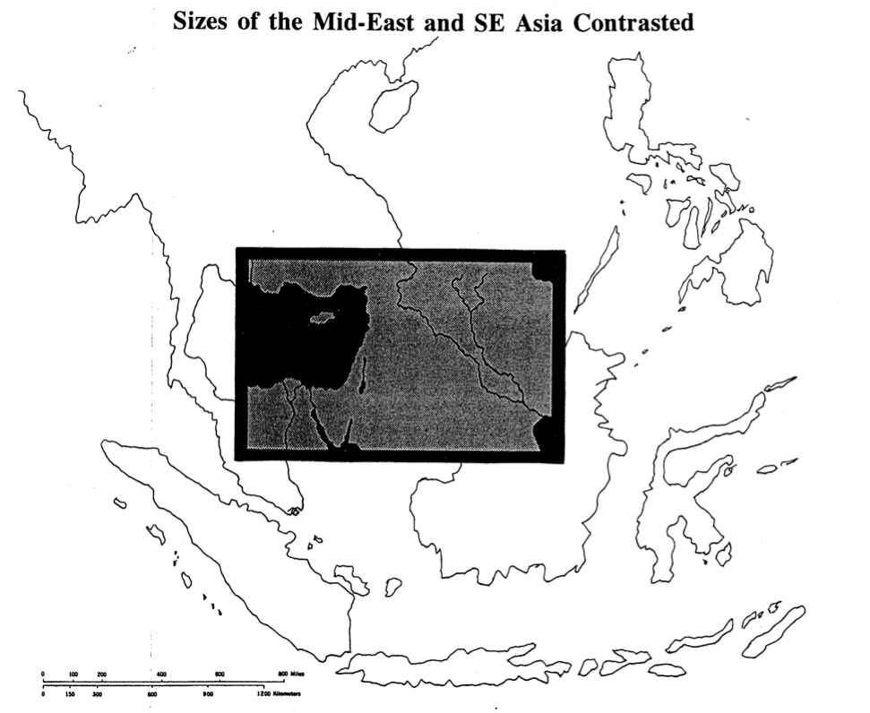
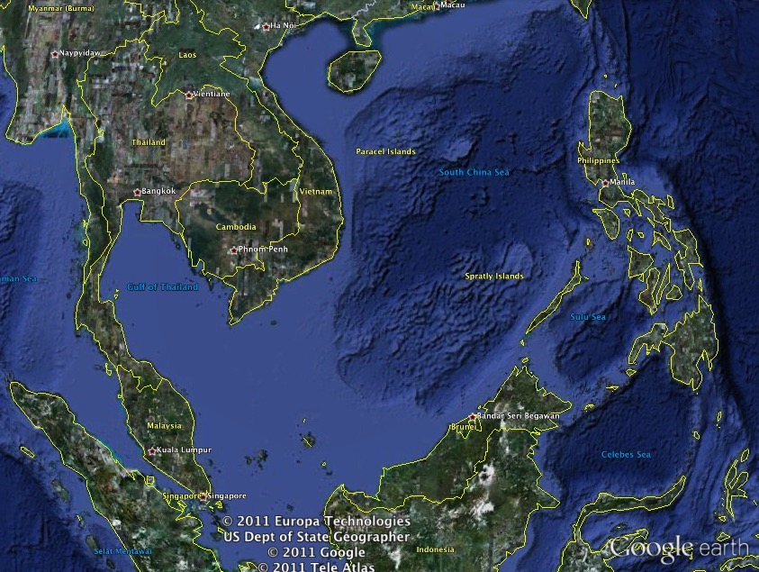
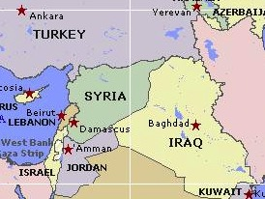
Size of the Mid-East & SE Asia Contrasted
29
安卡拉
埃里温
阿塞拜疆
土耳其
叙利亚
贝鲁特
黎巴嫩
大马色
巴格达
安曼
伊拉克
以色列
约旦
科威特
Notes:
Translators, please translate the text on the right and then drag it over the English above.

Slide 52
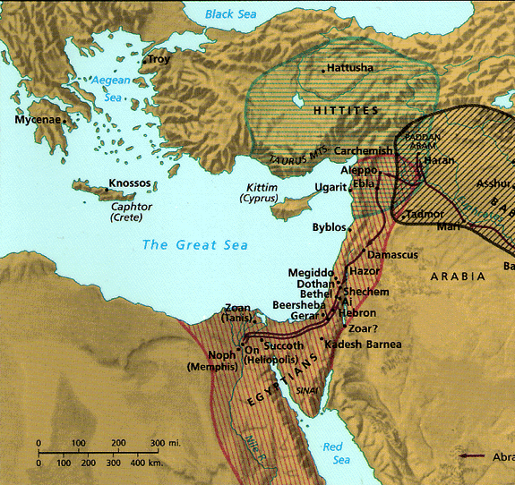
Israel's Strategic Location
28
Thought Question:
How has God placed you in a strategic place for His purposes?
"Thus says the Lord GOD: This is Jerusalem; I have set her in the center of the nations, with countries round about her"
Ezekiel 5:5

Slide 53

Regions of Israel (OT)
19
27
171
Bashan
Galilee
Israel
G
Gilead
A
Ammon
Judah
M
Moab
E
Edom

Slide 54
Topography of Israel
http://www.studylight.org/se/maps/browse.cgi?st=51&pn=11

Slide 55

The Kingdom of God
34
460
The Eternal Kingdom
False Kingdom of Satan
Soteriological Line
Theocratic Kingdom on Earth
Eden | Conscience
Human Government
Patriarchs | Judges | Kings | Prophets | Christ | Grace
Millennium
Israel | Times of Gentiles
Covenants
Abrahamic Covenant
Land Covenant
Davidic Covenant
New Covenant
Dispensations (Tests of Obedience)
Inno-cence | Conscience
Human Government
Promise | Law (Gal. 3:19) | Grace
Millennium
Adapted from J. Dwight Pentecost, Thy Kingdom Come, 323
Notes:
• The Kingdom of God (KOG) is comprehensive in scope over all the universe and lasting from eternity past to eternity future.
• Satan's false kingdom as "god of this world" (2 Cor 4:4) began when he rebelled in heaven and achieved an earthly dominion over Adam and Eve in Eden, but it is not eternal as it will end after the Millennium (Rev 20:10).
• God began to offer salvation through the soteriological line of Eve in his promise of descendants to proclaim salvation until her ultimate descendant (Christ) defeats Satan (Gen 3:15) after the Millennium, when there will be no more need for salvation.
• Through the ages that have come and gone, the Theocratic Kingdom has provided leaders on earth while God Himself remains King over all as God uses Human Government for his purposes through the Millennium.
• Christ's death ended the period of the Law and introduced the period of Grace, though both law and grace are seen in each dispensation, or "administration" (Eph 3:2) of God's rule.
• The KOG through earthly authorities related to Abraham extended through his descendants that became Israel until Zedekiah's reign ended Israel's kings. Since the fall of Israel's monarchy, the "times of the Gentiles" (Luke 21:24) have seen other nations rule over Israel until Jesus begins his rightful reign in the Millennium.
• Jesus thus fulfills the Davidic Covenant, but his reign will progressively extend from his present full authority (Matt 28:18) until he defeats all opposition after the Millennium (Rev 20:7-10).
• This will complete God's promises in the Abrahamic Covenant when the Land and New Covenants also see completion.
• Through each age God enacts various tests of obedience to see whose hearts are fully committed to him.
__________________
Common-499
OS-00-00-Intro_&_Biblical_Theology-111_eng_os_6987_v17—Slide 55
OS-23-Isaiah_24-39/Slide 264 on Supplements
OS-23-Isaiah_49-59/Slide 52 on Isaiah 170
OS-23-Isaiah_60-66/Slide 101 on Supplements

Slide 56
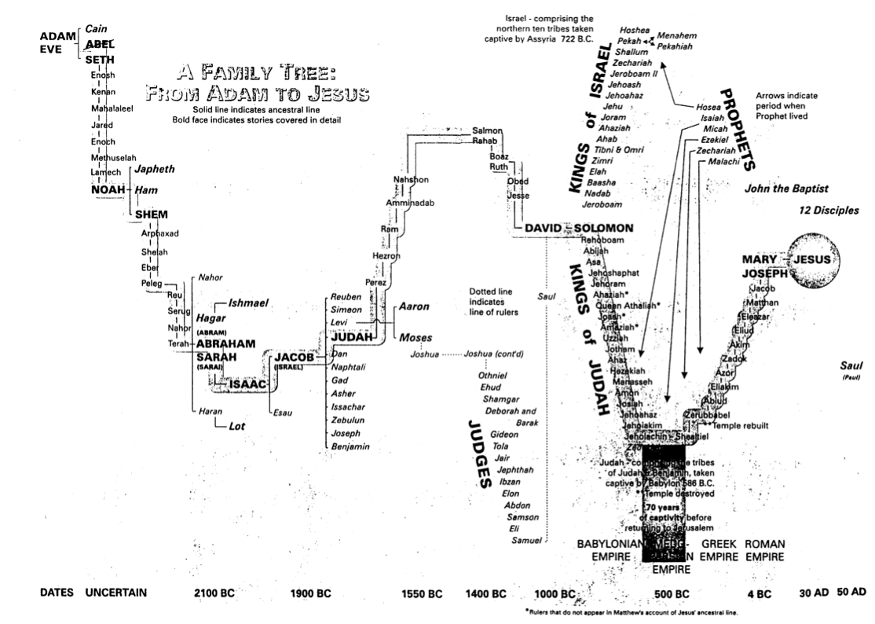
Family Tree from Adam to Jesus
44
John R. Cross, The Stranger on the Road to Emmaus, 174-75

Slide 57
Bible Facts
Chapter
Verse
Longest
Psalm 119
Esther 8:9
Shortest
WHAT?

Slide 58
The longest verse…
ESV Esther 8:9 "The king's scribes were summoned at that time, in the third month, which is the month of Sivan, on the twenty-third day. And an edict was written, according to all that Mordecai commanded concerning the Jews, to the satraps and the governors and the officials of the provinces from India to Ethiopia, 127 provinces, to each province in its own script and to each people in its own language, and also to the Jews in their script and their language."

Slide 59
Bible Facts
Chapter
Verse
Longest
Psalm 119
Esther 8:9
Shortest
Psalm 117
WHAT?

Slide 60
Shortest Chapter
Praise the LORD, all peoples everywhere!
Praise Him, all peoples of the earth!
For He loves us dearly,
and His truth endures!
Praise the LORD!
Psalm 117
WHAT?

Slide 61
English Texts
"Jesus wept'
John 11:35 (NIV)
"Be joyful always"
1 Thessalonians 5:16 (NIV)
WHAT?

Slide 62


Greek Texts
John 11:35 (N26)
1 Thessalonians 5:16 (N26)
WHAT?

Slide 63
Bible Facts
Chapter
Verse
Longest
Psalm 119
Esther 8:9
Shortest
Psalm 117
1 Thess. 5:16
WHAT?

Slide 64

HOW MUCH OF THE BIBLE IS THE OT?
New
Testament
22.8%
77.2%
3 hour
SBC course
Old Testament
3 hour
SBC course
Notes:
OT Survey
00-Intro & Biblical Theology-62
Slide 33

Slide 65
OT English Arrangement
Old Testament
Genesis - Malachi
History (17)
Poetry (5)
Prophecy (17) Major Minor
Christian

Slide 66
OT Hebrew Arrangement
51
Old Testament
Genesis - Nehemiah
Law (5)
Prophets (8) Former Latter
Writings (11)
Masoretic
Notes:
"The Prophetic Books comprise the largest section of the Bible.¹ In Jewish tradition the Prophetic division includes the Former Prophets (Joshua–Kings) and the Latter Prophets (Isaiah, Jeremiah, Ezekiel, and the Twelve). The Former Prophets have much to say about individual prophets but seldom convey messages from them; the Latter Prophets contain much of the prophetic messages but say virtually nothing about them as persons.
Footnote:
¹ The OT was commonly divided into three sections by the Jews: the Law, the Prophets, and the Writings (see Luke 24:44). English Bibles following the Septuagint divide the Prophets into the Historical Books and the Prophetic Books, each of approximate equal length. The Historical and Prophetical Book sections are each of more length than any other segment of the Bible."
_______
Mark F. Rooker, “The Prophetic Books,” in The World and the Word: An Introduction to the Old Testament (Nashville, TN: B&H Academic, 2011), 361.

Slide 67


The Same Old Testament. . .
Just a Different Order!
Jewish:
Law
Prophets
Writings
(24 books)
Christian:
Law
History
Prophets
(39 books)

Slide 68
Literary Forms
Narrative
Editorial
Legal
Discourse
Letter
Poetry
Wisdom
Prophecy
Parables
Visions

Slide 69
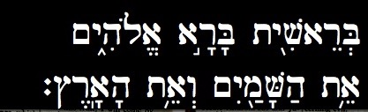
Hebrew
Old Testament
Genesis - Malachi
HEBREW
Genesis 1:1

Slide 70
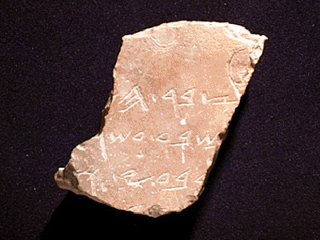
Writing Materials
Some OT writings were originally inscribed on stone, such as the Ten Commandments.
Some

Slide 71
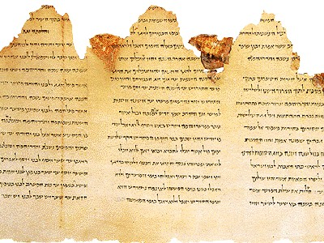
Papyrus
Many original autographs were written on papyrus and copied from older copies onto other papyri.

Slide 72
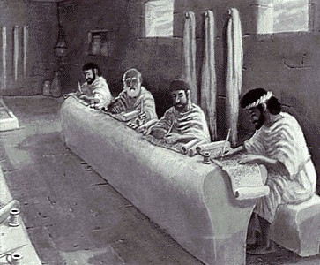
The Essenes
HOW?

Slide 73
"It may be safely said that no other work of antiquity has been so carefully transmitted"
–William Green, General Introduction to the Old Testament (NY: Scribners, 1899), 181
HOW?
Cited by McDowell, Evidence, 56

Slide 74
The Bible is unique as…
The most read
The most translated
The most memorized
The most copied
The most studied
The most debated
The most adored
The most hated
. . . book in human history!

Slide 75
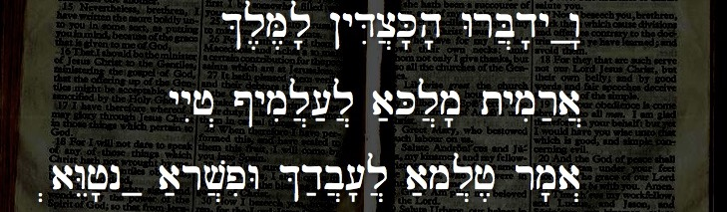
Aramaic
Old Testament
Genesis 31:47; Ezra 4:8-6:18; 7:12-26; Daniel 2:4-7:28; Jeremiah 10:10-11
ARAMAIC
&l,M,l' !yDic]K'h' WrB]d'yÒw"
yyIj> @ymil][;l] a;Kl]m' tymir;a}
.aWEj'nÒ a;rv]piW &d;b]['l] a;ml]j, rm'a>
Daniel 2:4

Slide 76
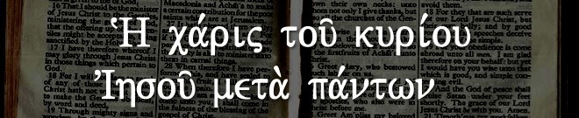
Greek
New Testament
Matthew - Revelation
KOINE GREEK
~H ca,rij tou/ kuri,ou VIhsou/ meta. pa,ntwn
Revelation 22:21

Slide 77
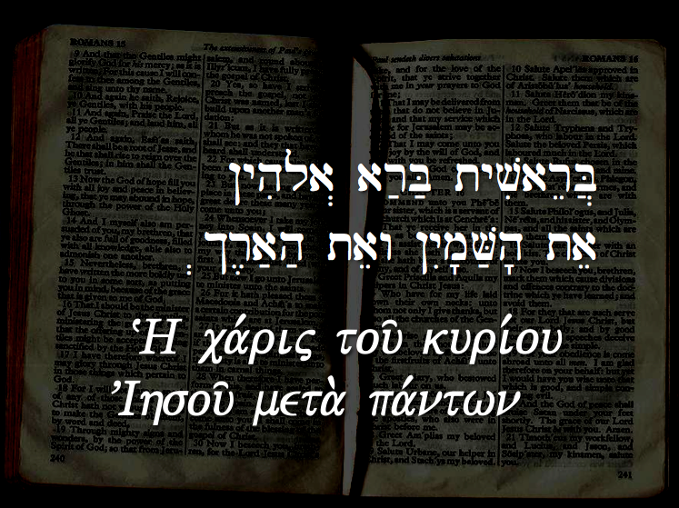
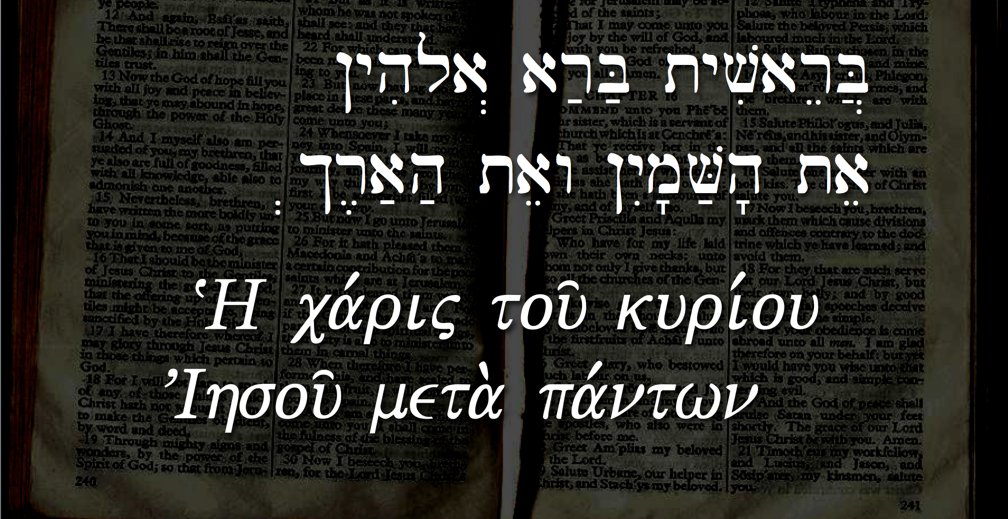
God's Chosen Languages
!yhila> ar;B; tyviareB]
.$r,a;h; taew !yIm'V;h' tae
~H ca,rij tou/ kuri,ou VIhsou/ meta. pa,ntwn

Slide 78
Black

Slide 79

OT Biblical Theology
Dr. Rick Griffith • Jordan Evangelical Theological Seminary • BibleStudyDownloads.org
Notes:
Most of us are good at looking at details. We can evaluate a verse of Scripture or preach a passage. But what about the big picture? So I want to give you a challenge.

Slide 80

What's the Theme of the OT?
54
Write this in one sentence
Notes:
Suppose you were talking to an unbeliever and he asked, "So you are a Bible student? What is the OT about? Please make it simple for me in one sentence."
On the notes section of your phone or on a piece of paper, please write a single sentence to describe the main theme of just the OT.
Now share this with the person next to you—what is your theme? Redemption? Jesus? God? Blessing? Covenants?

Slide 81
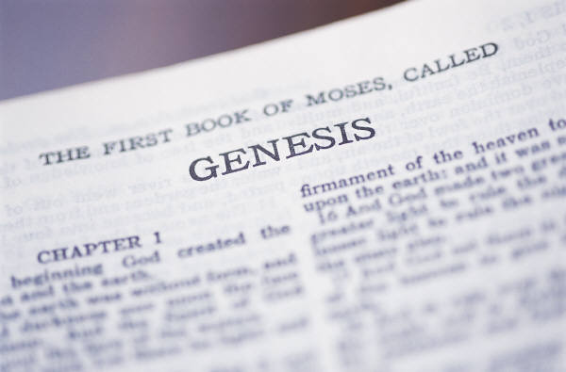
Criteria to Discern the Key OT Theme
54
YES
NO
Text-based
Covers whole OT
Narrow enough to be helpful
Focuses on God as He is the Subject
Not from systematics
Not piecemeal
“Life” is too general a theme to help us
Man is not the subject of the Bible
Notes:
What principles will assure that our theme for the OT and NT is accurate?
• The theme should come out of the text rather than be imposed on the text from systematic theology.
• It should be comprehensive enough to cover all of the OT from Genesis 1 to Malachi 4.
• It should be narrow and specific enough to be helpful (e.g., it is not helpful to say that the Bible talks about “life”).
• Since God is the main subject of the Word, it should focus more on God than man.

Slide 82

Opinions on the Key OT Theme
54-57
Redemption of Man
Notes:
Probably the most common theme presented is the redemption or salvation of man.

Slide 83

Redemption means
“to release from ransom”
Notes:
The idea is freedom from the "prison of sin."

Slide 84

Redemption in the Media
People have an inherent sense that they need redemption
Notes:
Think about most movies. They follow a familiar plot:
1. There is a problem that comes to a crisis point.
2. A Savior figure rises to conquer the problem.
3. Resolution results.

Slide 85


The Focus of History is the Redemption Provided by Christ
Notes:
Scholars often rightfully speak of the process of God redeeming us.

Slide 86

The Centrality of the Cross
WHAT?
1st
A
d
a
m
2nd
A d a m
NAT
ION
TRI
BE
FAMI LY
5 0 0 0
1 2 0
11
Notes:
Human history narrowed down to Jesus Christ and expanded from there. From the "First Adam" came all peoples initially but this narrowed to the nation of Israel, the tribe of Judah, and the line or family of David that brought us, Jesus. Then history expands from the 11 apostles to the 120 at Pentecost to over 5000 that saw the resurrected Jesus, and eventually this "Second Adam" will rule the entire world!

Slide 87
The Centrality of the Cross
55
E
T
E
R
N
I
T
Y
E
T
E
R
N
I
T
Y
But redemption as the KEY OT Theme has these problems:
It is an external structure imposed on the OT from systematic theology.
It focuses too much on man rather than God.
Christ is the central person of the Bible, but the OT focuses on Him as King more than as Savior (the OT rarely notes the salvation of individuals.)
This view also does not include God's program for angels, those not redeemed, and creation as a whole, so it is too restrictive.
The view is not traced in the wisdom books (not supported in Eccles., Prov., etc.).
It neglects the physical (land) aspects prominent in the OT.
Notes:
The person of Christ bridges the OT and the NT.
His redemption is taught some in the OT: Gen 3:15; Leviticus typology; Isa 53; 61:1-4
However, his rule bridges the OT and NT more than his atonement.
• It also has at least six other problems (read).

Slide 88
Opinions on the Key OT Theme
54-57
Redemption of Man
Glory of God
Notes:
Others claim that the key theme of the OT (and the Bible) is the glory of God.

Slide 89

The Glory of God
The Glory of God
Notes:
God certainly wants us to praise him above all else.

Slide 90
The Glory of God
1600 years
40 authors
ONE THEME:
the glory of God
4
3
5
GOSPELS
6
2
PROPHECIES
WRITINGS
ACTS
7
HISTORIES
EPISTLES
1
LAW
8
REVELATION
©2003 TBBMI
7.5.06.
2
15
Notes:
• Every section of the Bible teaches us to glorify God.

Slide 91
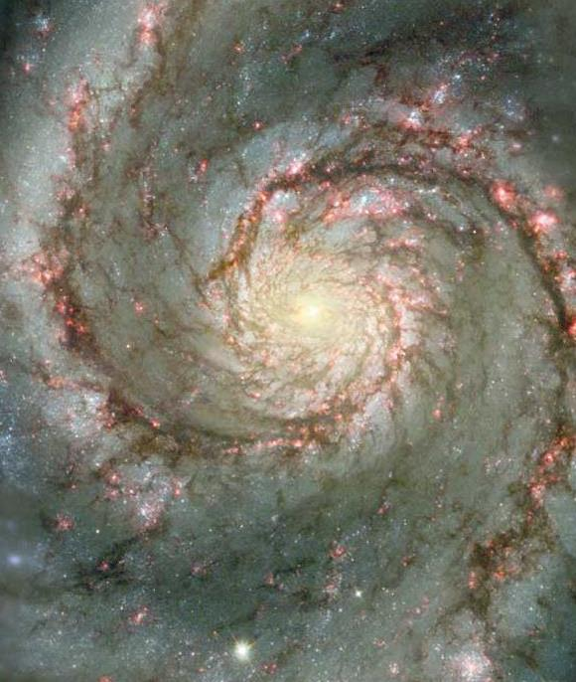

Glory and the Cross
The Glory of God
06-31
40
1
©2003 TBBMI
7.5.06.
Notes:
So the Westminster Catechism tells us that the chief aim of man is to glorify God.
• Jesus prayed in John 17 for God to glorify the Son through the cross so that the Father would be glorified.
And we should glorify God—but exactly how will he do this—and the cross wasn't even needed in Genesis 1–2 so redemption to glorify God wasn't needed then.

Slide 92
Opinions on the Key OT Theme
54-57
Redemption of Man
Glory of God
Sovereignty of God
God
Creation Faith
Deuteronomistic Theology of History
Worship
Promise (Covenant)
Notes:
C. Others say God's sovereignty is the main theme. He is the Big Boss, so just accept it!
D. Still, others say the key idea is simply "God"—but isn't that too broad?
Various other themes are presented that we don't have time to cover (E, F, and G).
H. The Promise Theme emphasizes God's covenants.

Slide 93

Types of Unconditional Covenants
43
Abrahamic
Land
Davidic
New
Land | Seed | Blessing
Physical | Political | Spiritual
Deut. 30:1-10 | 2 Sam. 7:12-16 | Jer. 31:31-34
Notes:
We have already seen how the Abrahamic Covenant is fleshed out further in three other OT covenants.
Covenant is also prominent in the very names of the Old Testament (Old Covenant) and New Testament (New Covenant).
We don’t have these major divisions of the Bible called the Old Kingdom and New Kingdom—or Old Worship and New Worship—or some other designation that highlights a different theme.

Slide 94
Opinions on the Key OT Theme
54-57
Redemption of Man
Glory of God
Sovereignty of God
God
Creation Faith
Deuteronomistic Theology of History
Worship
Promise (Covenant)
No Overall Theme
Rule of God
Kingdom & Covenants
Notes:
I. OT scholar Gerhard Hasel essentially gives up here, throws up his hands, and says that there is no main theme—only many lesser themes.
J. But I think the main theme is the Rule of God shared with man.
K. Or, more completely, God's kingdom expands through his covenants as a secondary theme.

Slide 95

The Lord Reigns 1
The Lord reigns, the Lord reigns,
the Lord reigns let the earth rejoice
let the earth rejoice let the earth rejoice
Let the people be glad;
that our God reigns.
(repeat)
Notes:
Our song, "The Lord Reigns," captures the Kingdom theme well.

Slide 96
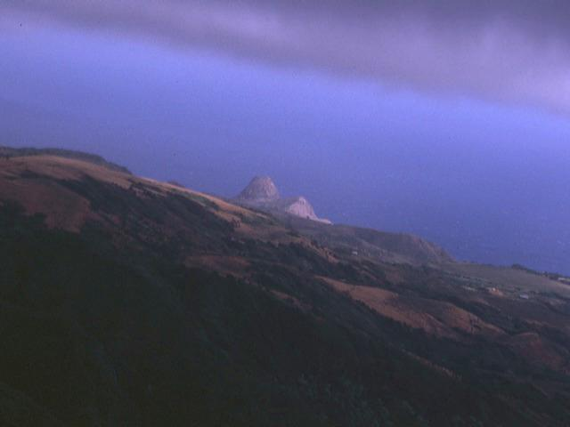
The Lord Reigns 2
The heavens declare His righteousness.
The people see His glory
For You, O Lord, are exalted
over all the earth
over all the earth.
Notes:
All people actually can see God's glory and reign!

Slide 97
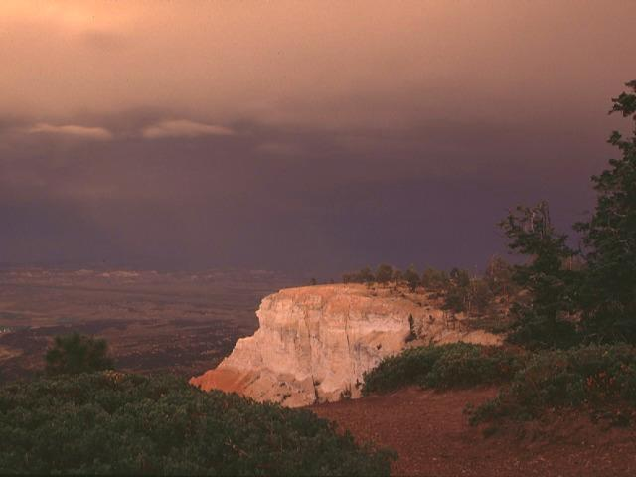
The Lord Reigns 3
The Lord reigns, the Lord reigns,
the Lord reigns let the earth rejoice
let the earth rejoice let the earth rejoice
Let the people be glad;
that our God reigns,
our God reigns,
our God reigns,
our God reigns.
Notes:
Our response should be rejoicing.

Slide 98

Animals
God's Creation…Day 6
"Then God said, 'Let the earth bring forth living creatures after their kind: cattle and creeping things and beasts of the earth after their kind'; and it was so. God made the beasts of the earth after their kind, and the cattle after their kind, and everything that creeps on the ground after its kind; and God saw that it was good" (Gen 1:24-25).
Notes:
But we should do more than just rejoice.
Remember that on Day 6 God made all the land animals.

Slide 99

Man
God's Creation…Day 6
58
"Then God said, 'Let Us make man in Our image, according to Our likeness; and let them rule over the fish of the sea and over the birds of the sky and over the cattle and over all the earth, and over every creeping thing that creeps on the earth'" (Gen 1:26).
Notes:
And he told us to rule over all these land animals along with the fish and birds. People have asked me, "What is God's plan for my life?" I respond, "Have you read the first chapter of the Bible? You are to rule over creation."

Slide 100

Woman
God's Creation…Day 6
"So God created man in his own image
in the image of God he created him
male and female he created them" (Gen 1:27).

Slide 101

Mandate
448
and over the birds of the air
"And God blessed them, and God said to them, 'Be fruitful and multiply, and fill the earth and subdue it;
and have dominion over the fish of the sea
and over every living thing that
moves upon the earth'" (Gen 1:28 NLT).
Notes:
Notice the repetition:
"Subdue" the earth!
"Have dominion" over the fish, the birds, and animals that move on the earth.

Slide 102
An All-Encompassing Theme
33
Genesis 1:26-28
"Then God said, 'Let us make man in our image, in our likeness, and let them rule over the fish … birds … livestock … all the earth, and over all the creatures that move along the ground…' God blessed them and said to them, 'Be fruitful and increase in number; fill the earth and subdue it. Rule over the fish of the sea and the birds of the air and over every living creature that moves on the ground.'"
Revelation 22:5
"There will be no more night. They will not need the light of a lamp or the light of the sun, for the Lord God will give them light. And they will reign for ever and ever."
The Bible's Theme: God extends His rule to man
Command
Covenants
Fulfillment
Notes:
The Kingdom theme goes from the first to the last chapters of the Bible.
• God created us to rule creation
• and we will do that even in the new Jerusalem!
• This means that the overall theme of the Bible is that God shares his rule with us!
• Then God's command
• will finally be fulfilled.
• And the covenants will be his vehicle to accomplish this rule.
God chose believers like us to rule the world!
Throughout Scripture, we see the Kingdom of God as the primary theme from the first to the last chapter. But we also see God establishing covenants or promises, alongside his kingdom rule to enable us to see our eventual rule with him accomplished.
__________
Common-150
BT-01-OT Biblical Theology-24
OS-00-Intro & Biblical Theology-102
OS-01-Gen1-3-slide 100
OS-23-Isaiah_24-39/Slide 265 on Supplements
OS-23-Isaiah_49-59/Slide 171 on Supplements
OS-23-Isaiah_60-66/Slide 103 on Supplements
NS-05-Acts1-2-slide 45
NS-22-Rev20-22-slide

Slide 103
Kingdom & Covenants Timeline
22
CH-34a
OS1-22
OS2-337
NS-9g
SA-19
34a
Dr. Rick Griffith • BibleStudyDownloads.org
22
Kingdom Teaching...
Adam rules with God (Gen. 1:26, 28; 2:19)
Satan begins rule as god of this world (Gen. 3:15;
2 Cor. 4:4)
God covenants with Abraham to reestablish man's rule via Israel as a "kingdom of priests" (Gen. 12:1-3; Exod. 19:6)
Israel's failure to witness to nations as a kingdom of priests is judged via exile under foreign rule
Israel rejects Messiah's offer of kingdom (Matt. 12:41-42; 23:37-39)
Jesus extends His kingdom in mystery form to the Church (Matt. 13)
Christ subdues Israel's enemies and nation believes (Rom. 11:26-27)
Christ rules over everything with saints (Eph. 1:9-10; Rev. 20:1-6; 22:5b)
337
9g
Fall of Man (Gen. 3)
Noahic Covenant
19
Genesis 6:18; 9:8-17
Land Covenant
ISRAEL
CHURCH
MESSIANIC KINGDOM
(National Focus)
The "New Man" (Eph. 2:15)
Millennial Eternal
land
Genesis 15:18 (cf. Deut. 30:1-10) promises:
Land from Wadi of Egypt to Euphrates River (Isa. 27:12)
Eternal possession of land (Gen. 17:8) after exile/restoration
Whole world blessed via the land (Isa. 14:1-2)
Israel judged for rejecting Messiah by dispersion away from land for 19 centuries
(AD 70–AD 1948) but now partially restored (Ezek. 37:1-7)
Full restoration (Ezek. 37:8-28) Jerusalem world capital
(Isa. 2:1-5)
New Jerusalem
(Rev. 21–22)
Davidic Covenant
Christ is Head over His Church, which is a spiritual temple (Eph. 2:19-22; 2 Cor. 6:16)
Christ reigns over the world
(Isa. 11)
with saints (Rev. 5:10; 20:4-6)
Christ hands kingdom over to Father (1
Cor. 15:24)
Genesis 12:1-3
2 Samuel 7:12-16 promises:
Sons ("house" never wiped out)
Kingdom (political dynasty)
Throne (right to rule by descendants)
Temple (son to build it)
seed
Abrahamic Covenant
New Covenant
All
things made new!
(Rev. 21:5)
All 5 elements fulfilled in national restoration (Zech. 8)
Jeremiah 31:31-34 promises:
Forgiveness
Indwelling Spirit
New heart, nature, mind
Reunification of Israel and Judah
No need for evangelism
Mosaic Law replaced with first three elements of the New Covenant (Luke 22:20; 2 Cor. 3:6)
blessing
Mosaic Covenant
Law abolished, fulfilled, and replaced at the cross (Rom. 7:1-6;
1 Cor. 9:19-21; Heb. 8:13)
11th Edition
29 Jan 2023
Temporary (Gal. 3:19) and conditional (Deut. 28) to reveal sin (Rom. 7:7) and regulate Israel (Gal. 3:23-25)
Scripture has a dual kingdom-covenant theme. Israel's role from Abraham to Christ expands to include the Church (continuity) yet the Church never replaces the nation as the "new Israel" (discontinuity). Israel will enjoy world prominence after trusting Christ at His second coming.
Notes:
This complicated chart combines the two themes of Kingdom and Covenants. God's kingdom rule extends to humanity across the ages at the top. But the major part shows the unfolding of the Abrahamic Covenant in its land, Davidic, and New Covenant promises—partially fulfilled in the present, but fully completed in the Messianic Kingdom. This will happen in the Millennial Age and especially in the Eternal State.
• This chart also shows that the Old (Mosaic) Covenant was replaced by the New Covenant.
All agree that a partial fulfillment of the covenant to Abraham exists now to the Church in the indwelling Holy Spirit and forgiveness of sins (Jer 31:31-34)—and the ultimate fulfillment will be in the eternal state.
The main area of disagreement relates to the time period from now to eternity. Will there be a literal land, throne, and worldwide blessing to national (ethnic) Israel before the eternal kingdom? This chart shows verses giving a resounding YES to that question in a present partial fulfillment and a future full fulfillment in the normal sense of language in the verses cited. But the messianic kingdom will be in two stages—first in a millennial fulfillment to last 1000 years, but then, after that, the eternal stage in the new Jerusalem after the destruction of our present heavens and earth (Rev 21–22). What an amazing future remains for those who trust Jesus!
____________
Common English-84
BT-01-OT Biblical Theology-25
CH-02-Nature-103-p34a
OC-10-Chronology-42
OS-00-Intro & Biblical Theology-25 & 90
OS-02-Exodus-267-p22
OS-05-Deut-279, 300
OS-10-2Sam-96-p22
OS-12-Kings & Prophets Charts-25
OS-13-1 Chron-46
OS-23-Isaiah-97-p337
OS-24-Jeremiah-174-p337
OS-23-Isaiah-97-p337
OS-28-Hosea-49
OS-31-Obadiah-164
05-Acts1-2-slide 45
NS-09-Gal-143-p9g
NS-19-Hebrews-342-p9g
SA-08-Mosaic Law-19-p38a

Slide 104

My View of the OT's Theme
33
The Old Testament narrates
God's restoring man to participate in His kingdom rule for His own glory
mandated in Eden but lost in the Fall
and accomplished by redeeming man
through Israel as a kingdom of priests
and ultimately through the Messiah,
who will reign as Savior and King
to fulfill the Abrahamic Covenant
Notes:
• The OT is a story more than a poetic description.
• This part in yellow italics is the main part of the main theme!
• Most descriptions of the overall theme lack kingdom ideas. But this one includes the problem
• the solution (redemption)
• the covenant nation of Israel
• the Messiah as King
• (not just Savior),
• and the Abrahamic Covenant.
__________
Common-152
BT-01-OT Biblical Theology-26
OS-00-Intro & Biblical Theolgy-104
OS-01-Gen1-3-slide 100?
OS-23-Isaiah_24-39/Slide 266 on Supplements
OS-23-Isaiah_49-59/Slide 172 on Supplements
OS-23-Isaiah_60-66/Slide 103 on Supplements
NS-05-Acts1-2-slide 45?
NS-22-Rev20-22-slide ?

Slide 105
My View of the NT's Theme
58
The New Testament narrates
God's restoring man to participate in His kingdom rule for His own glory
proclaimed by the Church
that salvation is by grace alone
though faith alone
in Christ alone
who will reign as Saviour and King
to fulfill the Abrahamic Covenant
to the glory of God alone
Notes:
The key NT theme should match or complete the OT one, right?
• Like the OT, the NT narrates—it is a story also.
• The kingdom of God is noted hundreds of times
• The means of proclamation is the Church
• The message is the same as in the OT, that is, grace
• This grace is received by faith and not works
• Christ is the only object of our salvation faith
• His salvation will result in his rule
• This will complete the Davidic aspect of the Abrahamic Covenant
• And God will receive the glory for it all
__________
Common English-87
BT-01-OT Biblical Theology-27

Slide 106
My View of the Bible's Theme
58
The Bible narrates
God's restoring man to participate in His kingdom rule for His own glory
though Israel bringing forth the Messiah
so that the Church may proclaim
that salvation is in Christ alone
who will reign as Saviour and King
to fulfill the Abrahamic Covenant
to the glory of God alone
Notes:
So, now we can give the theme of the entire Bible!
• The whole book is a story—God's story—History, or "His story"
• God sharing his rule is the key theme
• Israel had the key role to bring us Jesus
• Jesus brings the Church to preach Him
• The Bible's message is to trust Jesus
• Why? There is no other Redeemer or Ultimate Ruler
• No one else fulfills all the promises to Abraham
• No one else will glorify God like Jesus
__________
Common English-88
BT-01-OT Biblical Theology-28

Slide 107
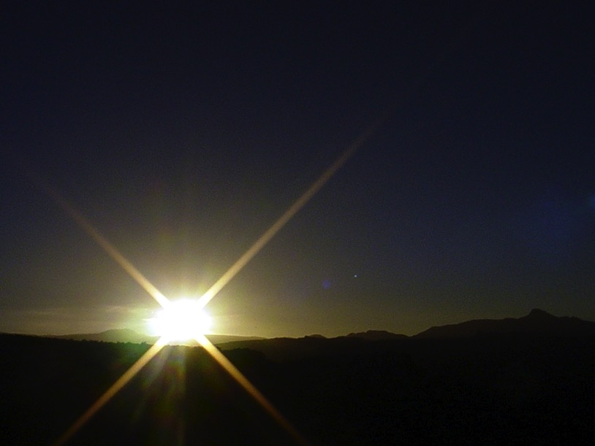


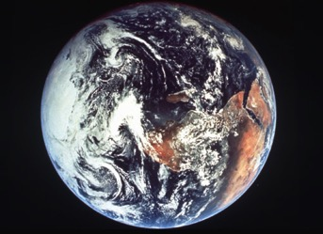
The Bible's Chiasm
446
Repeated Patterns in Reverse Order
Christ's Redemption
Christ's Rule
Man's Rule Lost at
Fall
Man's
Rule Restored at Millennium
Creation
New Creation
Notes:
We need to know who we are—more accurately, who God says we are—our future identity.
This is shown in the overall structure of the Bible in a chiasm—a literary pattern where earlier content is repeated in reverse order:
• Creation in Genesis 1–2 • is repeated In the Restored, New Creation in Rev 21–22
• Man was created to rule over the fish, birds, and land animals (Gen. 1:28) but he gave over his rule over to the god of this world, Satan (2 Cor. 4:4)
• But this rule will be restored during the 1000-year reign of the saints (Rev. 20:4-6)
• Christ is the central Person of history, • both as Lamb (Redeemer) • and as Lion (Ruler of all creation in the line of David)
________________
BE-17-Esther-76
OC-17-Genesis Authorship-14
OS-01-Genesis1-3-slide 243
OS-17-Esther-17, 145
NS-27-Rev20-22-slide 206

Slide 108
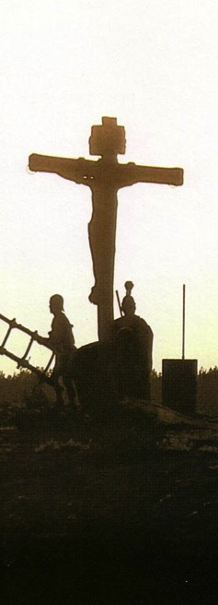
Salvation in All Ages:
The Centrality of the Cross
B.C.
Looked forward to the
Cross of Christ
A.D.
Look
back at the
Cross of Christ
Notes:
It helped me see the centrality of the cross—how people before Jesus believed by looking toward the cross while those of us after Jesus look back at the cross. In other words…
The grounds of salvation has always been the death of Christ—for believers before and after the cross.
____________________
Common English-78
BE-03-Leviticus-73
OB-37-Sacrifices-19
OB-38-Salvation-4
OS-03-Leviticus-73
NS-09-Galatians-16, 50
NS-20-James-32
SA-03-Biblical Terminology-10
SA-15-Inheritance-26

Slide 109
A Dispensational Timeline
OT Survey page 437
Great White
Throne
(Rev 20:11-14)
Rapture
(1 Thess 4:13-18)
2nd Advent
(Zech 14:3-5)
Day of the LORD
Church Age
Tribulation
(Zech 14:1-2)
Millennium
(Zech 14:6-21)
Gog & Magog
(Armageddon)
(Ezek 38–39)
Gog and Magog
Revisited
(Rev 20:7-10)
Notes:
109
OS-23-Isaiah 1-12-Slide 87
OS-26-Ezekiel 1-39-Slide 247
OS-39-Zechariah-158, 168, 184
NS-22-Rev

Slide 110
Black

Slide 111


OT Survey link at BibleStudyDownloads.org
Get this presentation for free!
Notes:
OT Survey (os)

