Slide 1
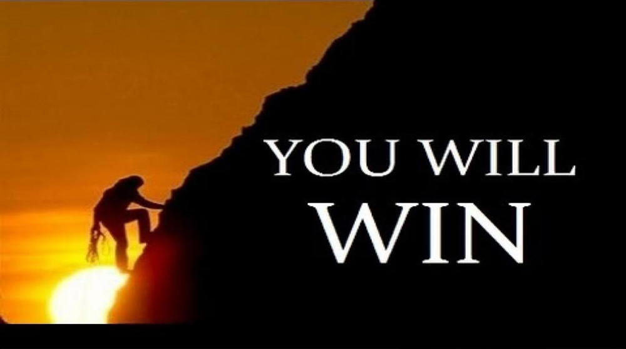
Be Encouraged
Book of Zechariah
Dr. Rick Griffith, Crossroads International Church Singapore
BibleStudyDownloads.org

Slide 2
Discouragement.

Slide 3
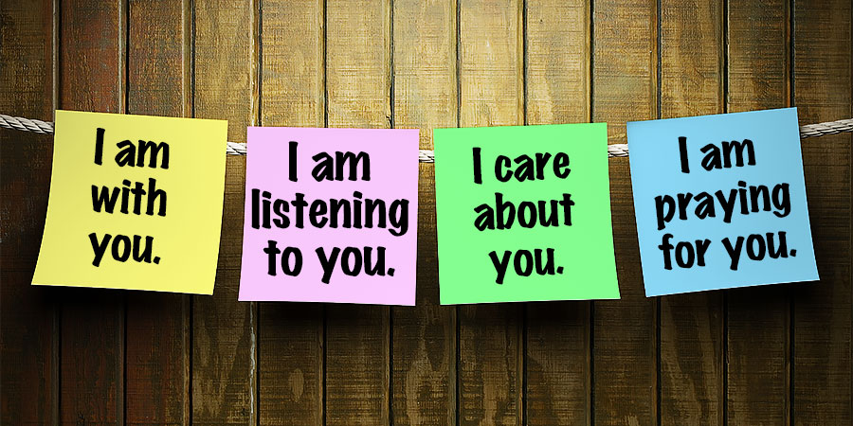
We all need encouragement

Slide 4
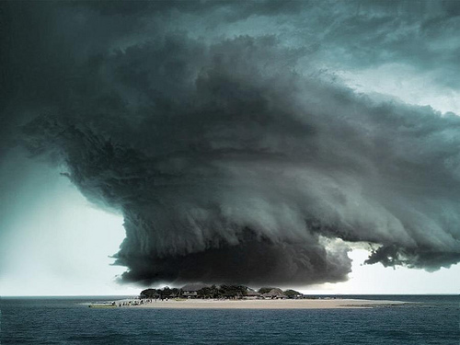
Discouragement.

Slide 5
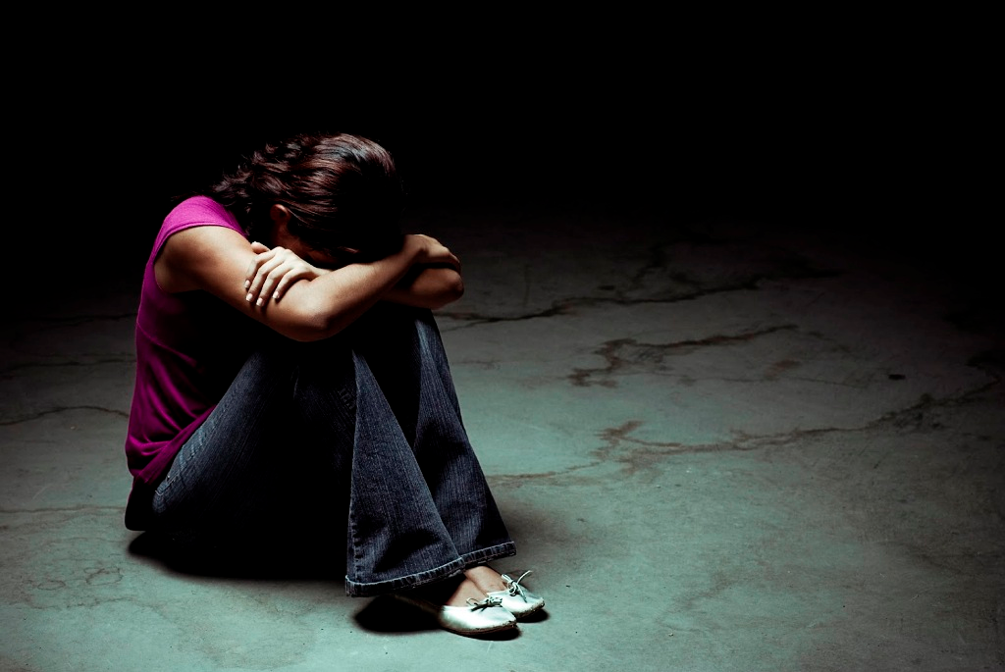
Discouragement.

Slide 6

Discouragement especially happens with work.

Slide 7

Discouragement while serving Jesus is real.

Slide 8

http://www.lawrencewilson.com/stop-saying-1700-pastors-leave-the-ministry-every-month/
Stop saying
"1,700 Pastors Leave the Ministry Every Month"
REALLY?

Slide 9
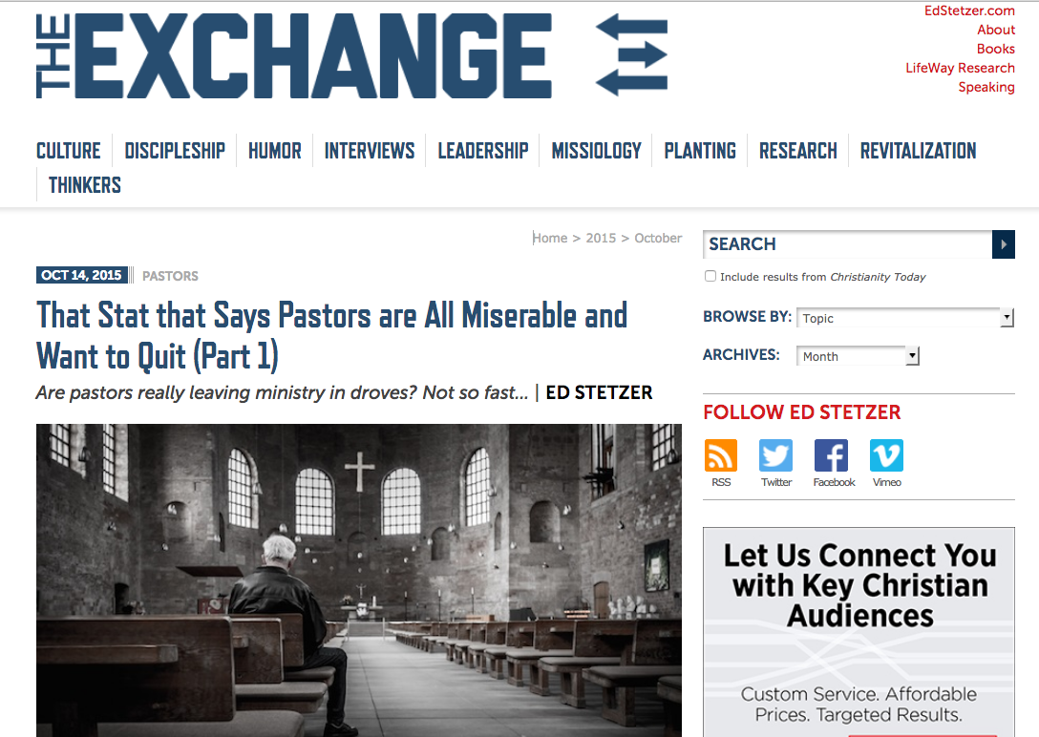
http://www.christianitytoday.com/edstetzer/2015/october/that-stat-that-says-pastors-are-all-miserable-and-want-to-q.html
Are All Pastors Miserable and Want to Quit?

Slide 10
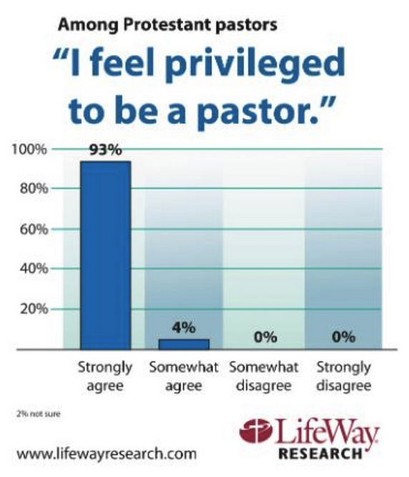
http://lifewayresearch.com/2015/09/01/despite-stresses-few-pastors-give-up-on-ministry/
Are All Pastors Miserable and Want to Quit?

Slide 11
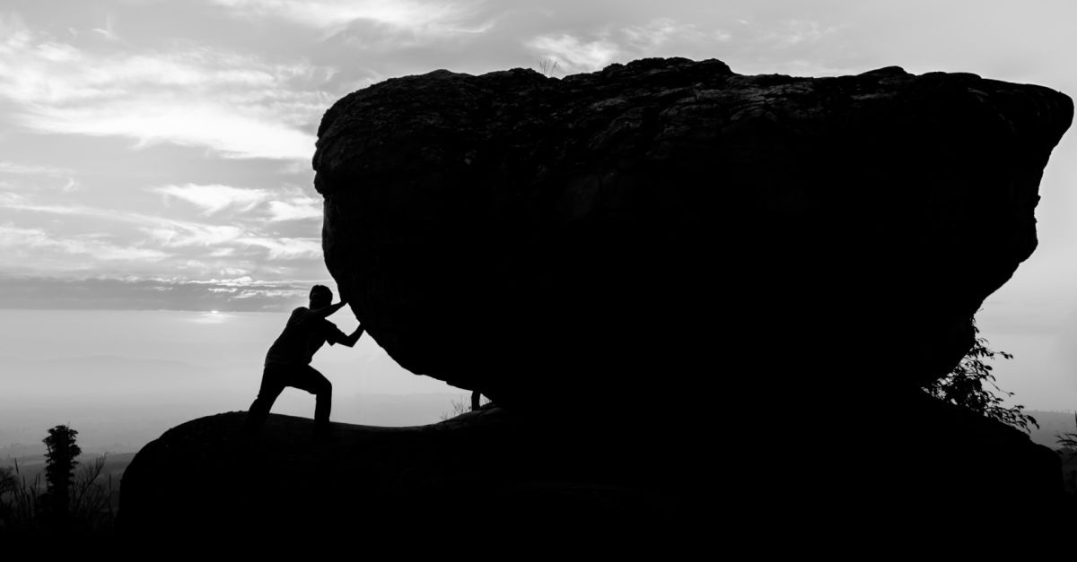
How can you be encouraged in your service for Christ?

Slide 12
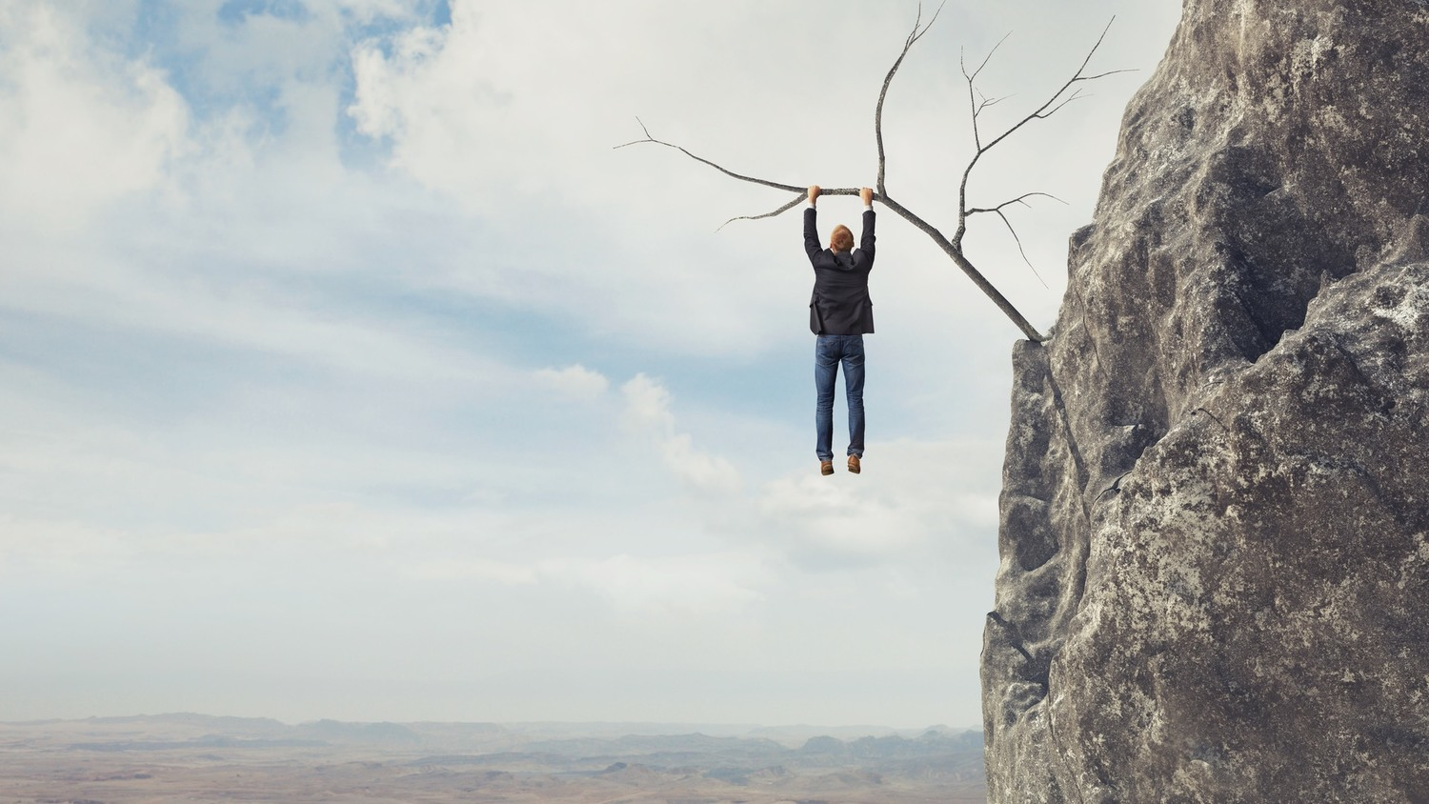
Background:
Judah hanging on a limb

Slide 13

Be Encouraged

Slide 14
The Postexilic Era
560
The Postexilic Era
Prophets:
Haggai
Zechariah
Malachi
605
586
539
536
520
516
483-473
444-425
Others:
Zerubbabel
Esther
Ezra
Nehemiah
Temple work

Slide 15
Dates in Zechariah
Begins Preaching
Night Visions Joshua Crowned
Oct/Nov
1:1-6
2/15
1:7-6:15
Prophecy #1
Rebuilding Resumes
Prophecy #2
Prophecies #3-4
Dates in Haggai
8/29
1:1
9/21
1:15
10/17
2:1
12/18
2:10, 18, 20
Aug
Sep
Oct
Nov
Dec
520 BC
519 BC

Slide 16
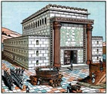
Book Chart
Rebuild Temple for Messiah
God's Covenant Faithfulness |  |  | Future Messianic Rule
Chapters 1–6 |  |  | Chapters 7–14
"The word of the LORD came to Zechariah…" (1:1) |  |  | "The word of the LORD came to Zechariah…" (7:1)
Visions of the Covenant |  |  | Visions of the Messiah
 |  |  |  | Two Burdens
Command to Repent 1:1-6 | Eight Covenantal Visions 1:7–6:8 | Joshua's Symbolic Coronation 6:9-15 | Four Restoration Messages 7–8 | Rejected at First Advent 9–11 | Received at Second Advent 12–14
"The word of the LORD came to Zechariah" | "Then I looked up—and there before me" | "The word of the LORD came to me" | "The word of the LORD came to me" | "The burden of the word of the LORD" (NASB) | "The burden of the word of the LORD" (NASB)
Pictures |  |  | Problems | Predictions
Israel's Fortune |  |  | Israel's Fasting | Israel's Future
While Building the Temple 520-518 BC (1:1; 7:1) |  |  |  | After Building the Temple 480-470 BC (9:13?)
Jerusalem
649
Rebuild Temple for Messiah

Slide 17
Slides on
Zechariah 1

Slide 18
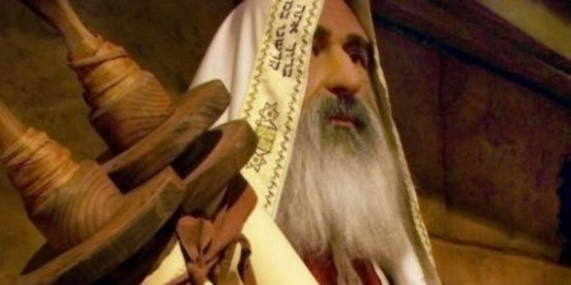
"In November of the second year of King Darius's reign, the LORD gave this message to the prophet Zechariah son of Berekiah and grandson of Iddo" (Zech 1:1 NLT).

Slide 19
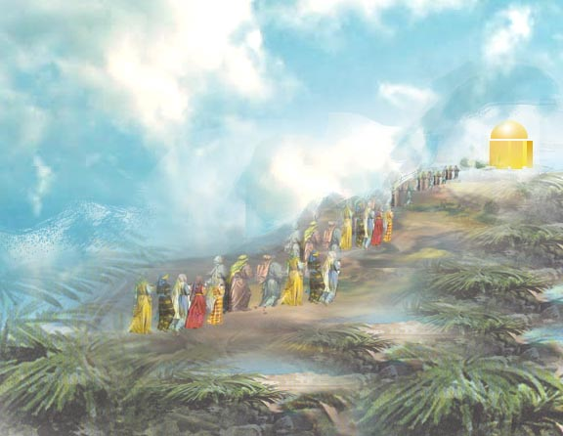

Meaning
650
hy"r>k;z>
"Yahweh has remembered" (Hebrew)
hy"r>k;z>

Slide 20
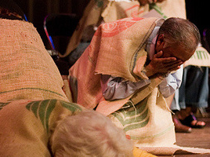
"I, the LORD, was very angry with your ancestors. ³Therefore, say to the people, 'This is what the LORD of Heaven's Armies says: Return to me, and I will return to you, says the LORD of Heaven's Armies'"
(Zech 1:2-3 NLT).

Slide 21
"Don't be like your ancestors who would not listen or pay attention when the earlier prophets said to them, 'This is what the LORD of Heaven's Armies says: Turn from your evil ways, and stop all your evil practices'"
(Zech 1:4 NLT).

Slide 22
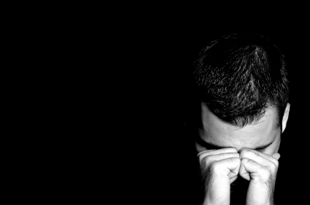
"Where are your ancestors now? They and the prophets are long dead. ⁶But everything I said through my servants the prophets happened to your ancestors, just as I said"
(Zech 1:5-6a NLT).

Slide 23
"As a result, they repented and said, 'We have received what we deserved from the LORD of Heaven's Armies. He has done what he said he would do'"
(Zech 1:6b NLT).

Slide 24
How can you be encouraged in your service for Christ?
2 ways

Slide 25
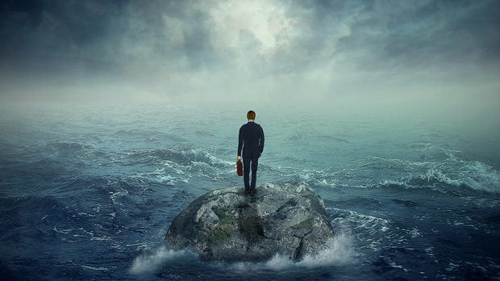
I. See your privileged position (Zech 1–6).

Slide 26
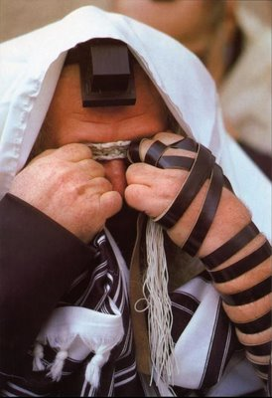
Even today Jews pray every day for the temple rebuilding
Israel's privileged position should result in temple rebuilding
(Chs. 1–6)

Slide 27
Book Chart
Rebuild Temple for Messiah
God's Covenant Faithfulness |  |  | Future Messianic Rule
Chapters 1–6 |  |  | Chapters 7–14
"The word of the LORD came to Zechariah…" (1:1) |  |  | "The word of the LORD came to Zechariah…" (7:1)
Visions of the Covenant |  |  | Visions of the Messiah
 |  |  |  | Two Burdens
Command to Repent 1:1-6 | Eight Covenantal Visions 1:7–6:8 | Joshua's Symbolic Coronation 6:9-15 | Four Restoration Messages 7–8 | Rejected at First Advent 9–11 | Received at Second Advent 12–14
"The word of the LORD came to Zechariah" | "Then I looked up—and there before me" | "The word of the LORD came to me" | "The word of the LORD came to me" | "The burden of the word of the LORD" (NASB) | "The burden of the word of the LORD" (NASB)
Pictures |  |  | Problems | Predictions
Israel's Fortune |  |  | Israel's Fasting | Israel's Future
While Building the Temple 520-518 BC (1:1; 7:1) |  |  |  | After Building the Temple 480-470 BC (9:13?)
Jerusalem
649
Rebuild Temple for Messiah

Slide 28
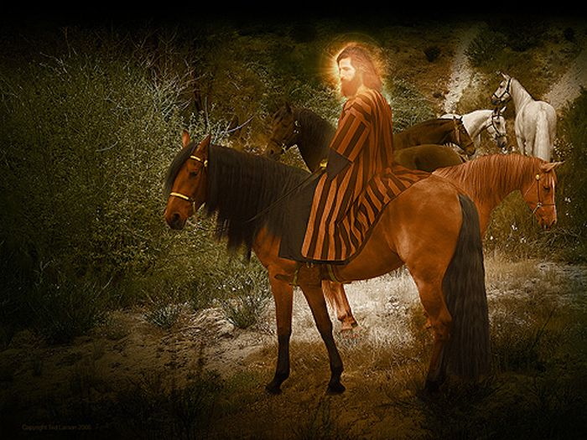
Vision 1: Red-Horse Rider among the Myrtles (Zech 1:7-17)
"Three months later, on February 15, the LORD sent another message to the prophet Zechariah son of Berekiah and grandson of Iddo. ⁸In a vision during the night, I saw a man sitting on a red horse that was standing among some myrtle trees in a small valley. Behind him were riders on red, brown, and white horses. ⁹I asked the angel who was talking with me, 'My lord, what do these horses mean?' 'I will show you,' the angel replied" (1:7-9 NLT).

Slide 29
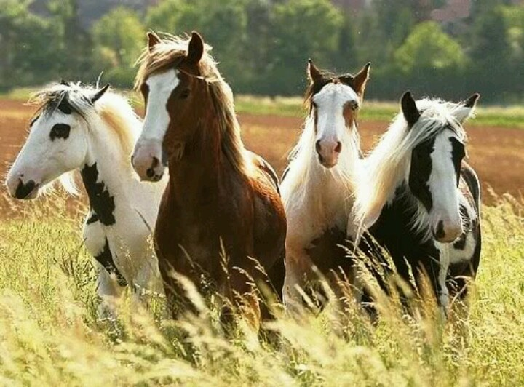
"The rider standing among the myrtle trees then explained, 'They are the ones the LORD has sent out to patrol the earth'" (1:10 NLT).

Slide 30
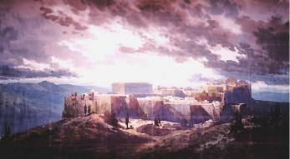
"Then the angel said to me, 'Shout this message for all to hear: "This is what the LORD of Heaven's Armies says: My love for Jerusalem and Mount Zion is passionate and strong. ¹⁵But I am very angry with the other nations that are now enjoying peace and security. I was only a little angry with my people, but the nations inflicted harm on them far beyond my intentions" ' " (1:14-15 NLT).

Slide 31
Vision 1: Red-Horse Rider among the Myrtles (Zech 1:7-17)
God's anger against the nations and blessing on restored Israel
Bible Knowledge Commentary, 1:1549

Slide 32
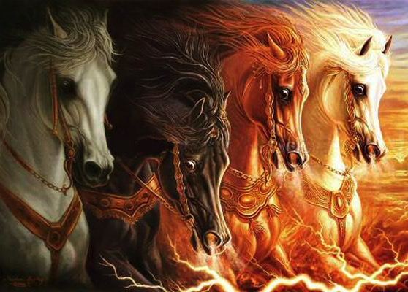
Zechariah 1:8 expands in Revelation 6:1-4

Slide 33
1:16 "My temple will be rebuilt!"
650

Slide 34
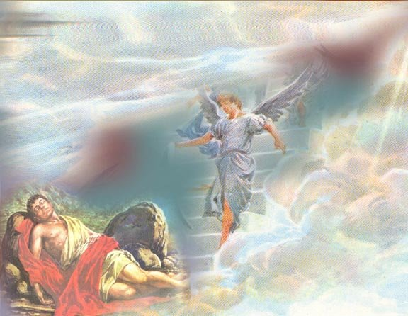
Eight Covenantal Visions
653
Vision | Text | Meaning
Red-Horse Rider among the Myrtles | 1:7-17 | God's anger against the nations and blessing on restored Israel
Four Horns and Four Craftsmen | 1:18-21 | God's judgment on the nations that afflict Israel
Surveyor with a Measuring Line | Zech. 2 | God's future blessing on restored Israel
Cleansing and Crowning of Joshua the High Priest | Zech. 3 | Israel's future cleansing from sin and reinstatement as a priestly nation
Golden Lampstand and Two Olive Trees | Zech. 4 | Israel as the light to the nations under Messiah, the King-Priest
Flying Scroll | 5:1-4 | Severity and totality of divine judgment on individual Israelites
Woman in the Ephah | 5:5-11 | Removal of national Israel's sin of rebellion against God
Four Chariots | 6:1-8 | Divine judgment on Gentile nations
Bible Knowledge Commentary, 1:1549

Slide 35
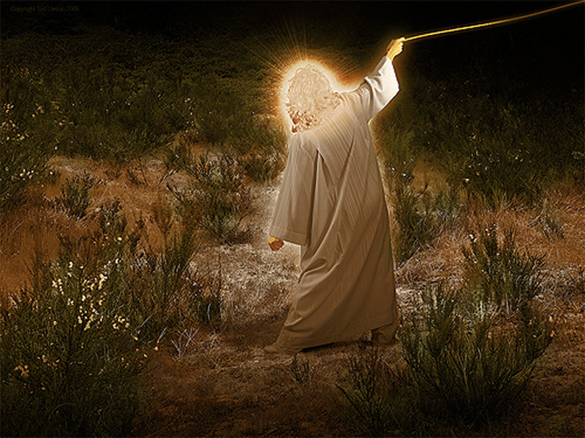
Vision 2: Four Horns and
Four Craftsmen (Zech 1:18-21)
God's judgment on the nations
that afflict Israel
Bible Knowledge Commentary, 1:1549

Slide 36
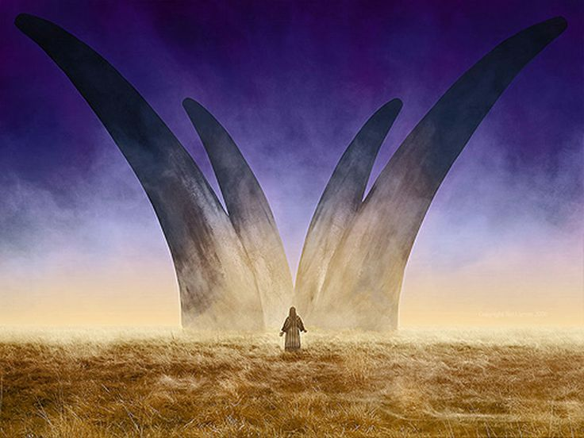
Zechariah's Second Vision:
The Horns and the Smiths (Craftsmen) in Zechariah 1:18-21
"Then I looked up and saw four animal horns. ^{19'}What are these?' I asked the angel who was talking with me. He replied, 'These horns represent the nations that scattered Judah, Israel, and Jerusalem'" (Zech 1:18-19 NLT).

Slide 37
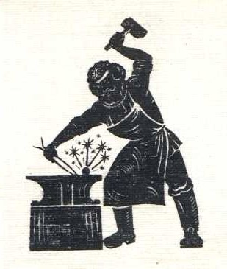
"Then the LORD showed me four blacksmiths. ²¹'What are these men coming to do?' I asked. The angel replied, 'These four horns—these nations—scattered and humbled Judah. Now these blacksmiths have come to terrify those nations and throw them down and destroy them'"
(Zech 1:20-21 NLT).

Slide 38
Slides on
Zechariah 2

Slide 39
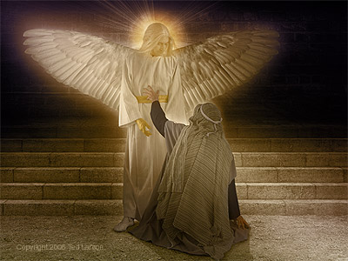
Vision 3: Surveyor with a Measuring Line (Zech 2)
God's future blessing on restored Israel
Bible Knowledge Commentary, 1:1549

Slide 40
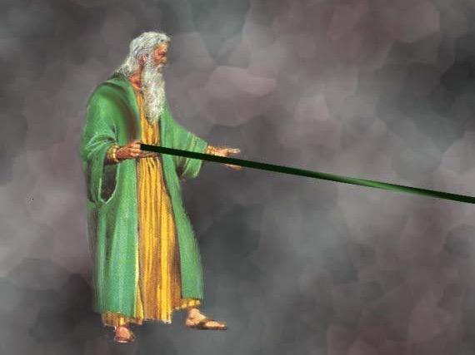
A Measuring Rod for Jerusalem (Zech. 2:1-2 NLT)
"When I looked again, I saw a man with a measuring line in his hand. ²'Where are you going?' I asked. He replied,
'I am going to measure Jerusalem, to see how wide and how long it is.'"

Slide 41

Jerusalem Population (2002)
East = Arabs
West = Jews

Slide 42
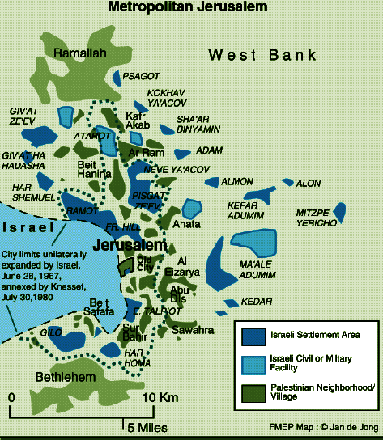
Jerusalem (2002)
Foundation for Middle East Peace
(March 2002)

Slide 43
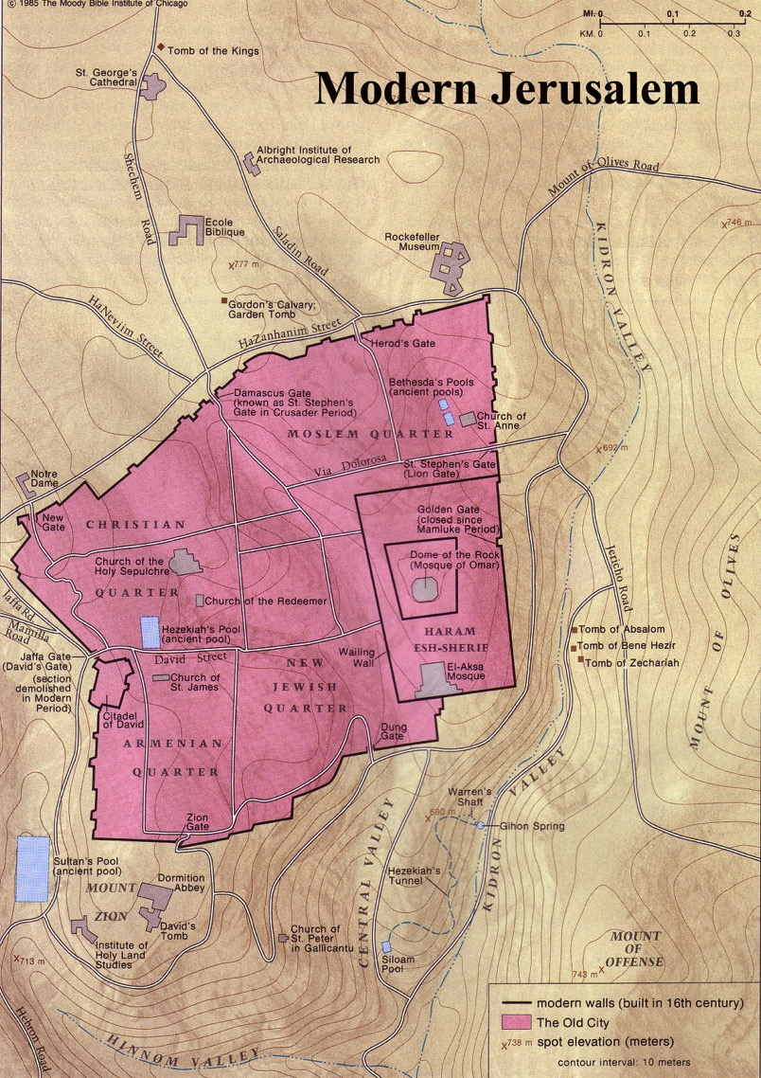
The Old City Today

Slide 44

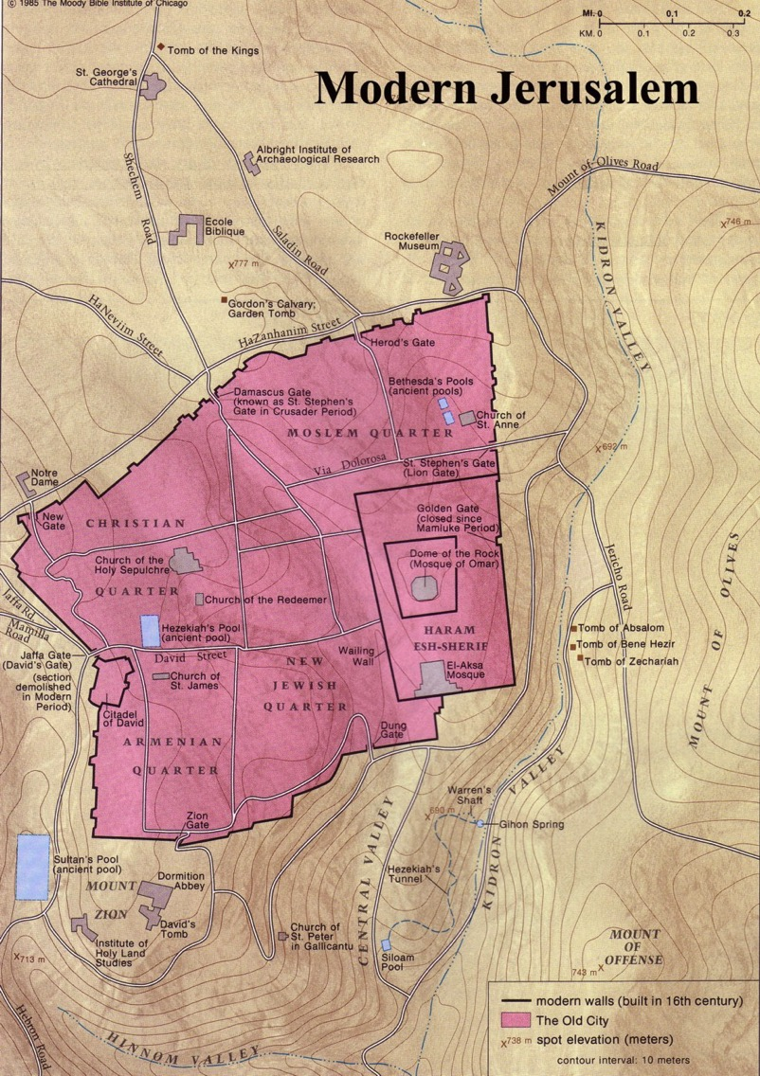

Modern Jerusalem: "Many will live outside the city walls" (Zech. 2:4)

Slide 45
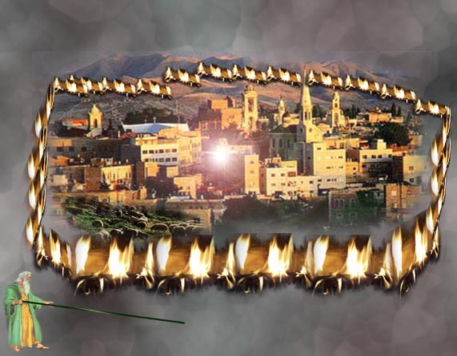
The Wall of Fire (Zech. 2:3-5 NLT)
649
"Then the angel who was with me went to meet a second angel who was coming toward him. ⁴The other angel said, 'Hurry, and say to that young man, 'Jerusalem will someday be so full of people and livestock that there won't be room enough for everyone! Many will live outside the city walls. ⁵Then I, myself, will be a protective wall of fire around Jerusalem, says the LORD. And I will be the glory inside the city!'"

Slide 46
Slides on
Zechariah 3

Slide 47
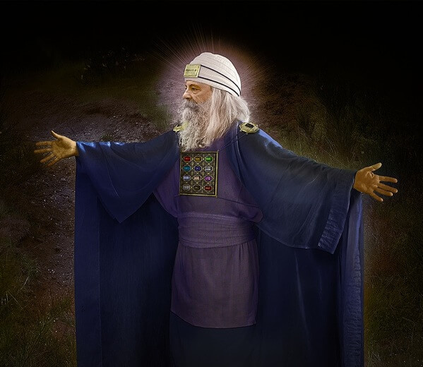
Vision 4: Cleansing and Crowning of Joshua the High Priest (Zech 3)
Israel's future cleansing from sin and reinstatement as a priestly nation
Bible Knowledge Commentary, 1:1549

Slide 48
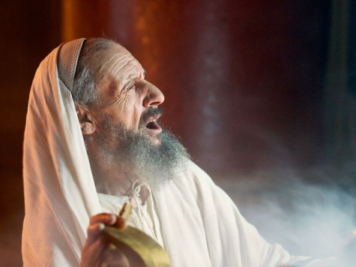
"Then the angel showed me Joshua the high priest standing before the angel of the LORD. The Accuser, Satan, was there at the angel's right hand, making accusations against Joshua. ²And the LORD said to Satan, 'I, the LORD, reject your accusations, Satan. Yes, the LORD, who has chosen Jerusalem, rebukes you. This man is like a burning stick that has been snatched from the fire'" (Zech 3:1-2 NLT).

Slide 49
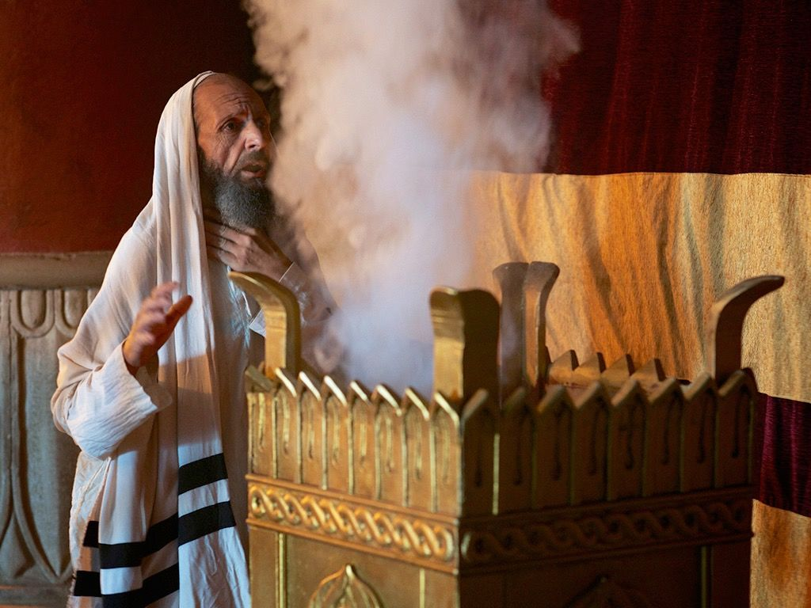
"Joshua's clothing was filthy as he stood there before the angel. ⁴So the angel said to the others standing there, 'Take off his filthy clothes.' And turning to Joshua he said, 'See, I have taken away your sins, and now I am giving you these fine new clothes'" (Zech 3:3-4 NLT).

Slide 50
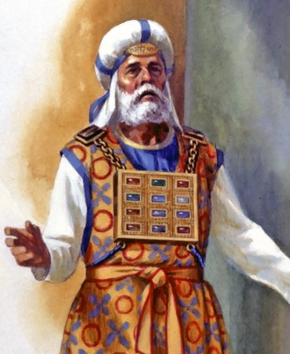
"Then I said, 'They should also place a clean turban on his head.' So they put a clean priestly turban on his head and dressed him in new clothes while the angel of the LORD stood by'"
(Zech 3:5 NLT).

Slide 51
Vision 4: Cleansing and Crowning of Joshua the High Priest (Zech 3)
Israel's future cleansing from sin and reinstatement as a priestly nation
Bible Knowledge Commentary, 1:1549

Slide 52
Slides on
Zechariah 4

Slide 53
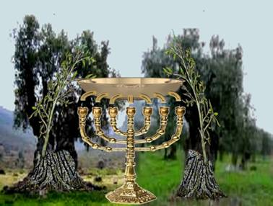
The Lamp & Olive Trees (Zech. 4:1-14)
"Then the angel who had been talking with me returned and woke me, as though I had been asleep. ²'What do you see now?' he asked" (Zech 4:1-2a NLT).

Slide 54
"'I see a solid gold lampstand with a bowl of oil on top of it. Around the bowl are seven lamps, each having seven spouts with wicks" (Zech 4:2a NLT).

Slide 55
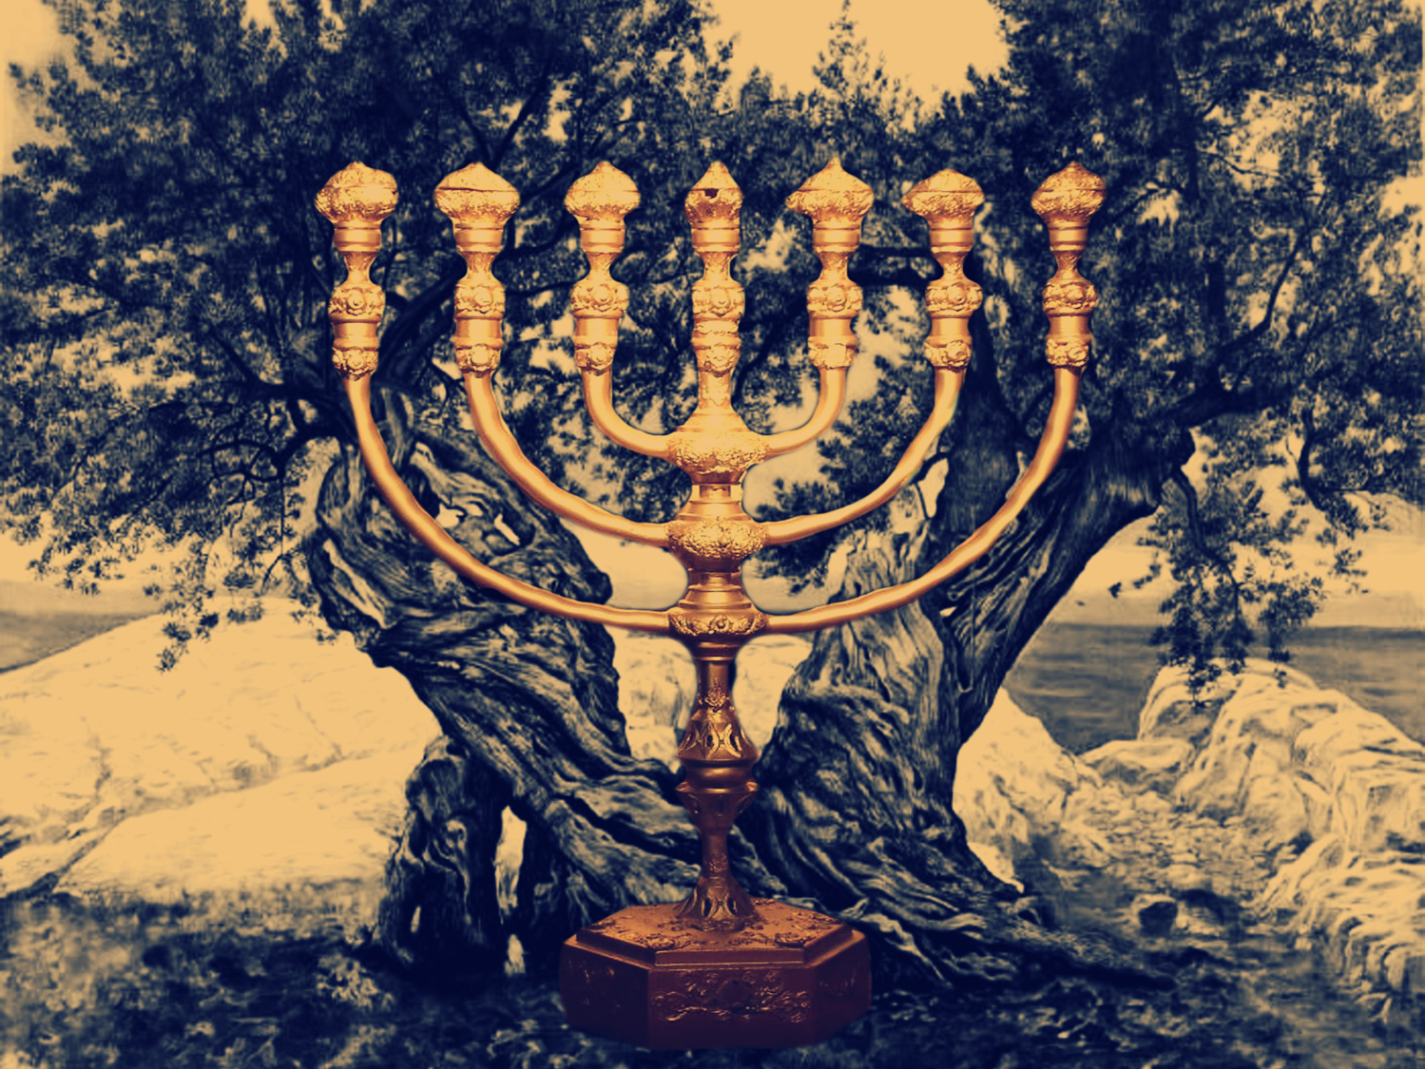
Vision 5: Golden Lampstand and Two Olive Trees (Zech 4)
Israel as the light to the nations under Messiah, the King-Priest
Bible Knowledge Commentary, 1:1549

Slide 56
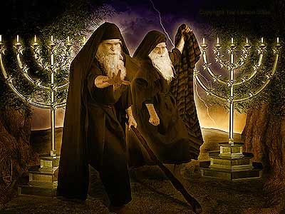
The Two Olive Trees (Rev. 11:4)
330

Slide 57
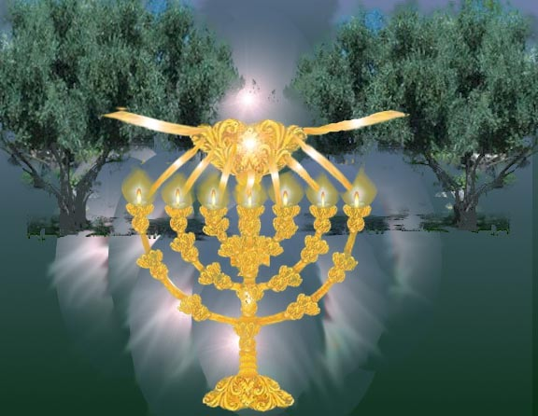
The Lamp & Olive Trees (Zech. 4:1-14)
"'Zerubbabel is the one who laid the foundation of this Temple, and he will complete it. Then you will know that the LORD of Heaven's Armies has sent me. ¹⁰Do not despise these small beginnings, for the LORD rejoices to see the work begin, to see the plumb line in Zerubbabel's hand.' (The seven lamps represent the eyes of the LORD that search all around the world.)" (Zech. 4:9-10 NLT)

Slide 58
Slides on
Zechariah 5

Slide 59
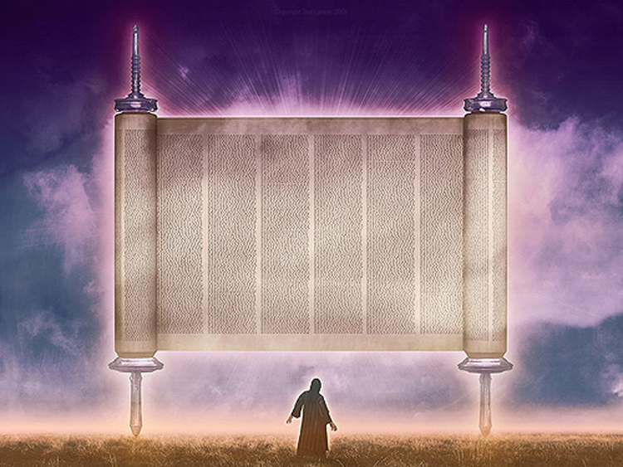
Vision 6: The Flying Scroll (Zech 5:1-4)
Severity and totality of divine judgment on individual Israelites
Bible Knowledge Commentary, 1:1549

Slide 60
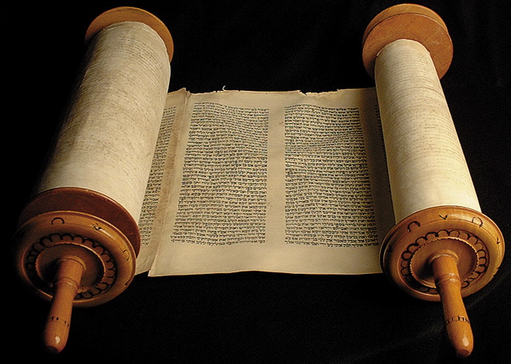
5:1-4 Flying Scroll

Slide 61
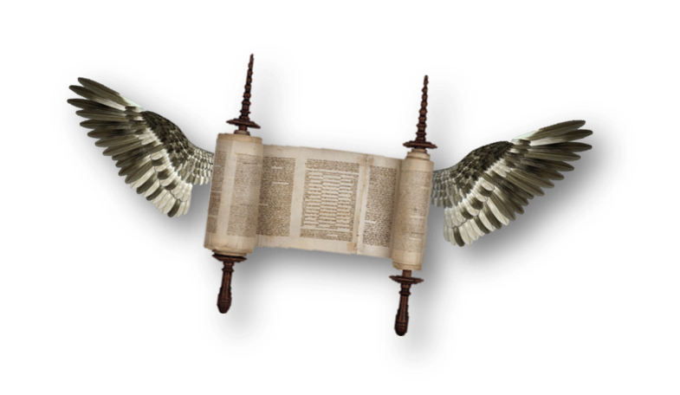
"I looked up again and saw a scroll flying through the air. ²'What do you see?' the angel asked. 'I see a flying scroll,' I replied. 'It appears to be about 30 feet long and 15 feet wide'" (Zech 5:1-2 NLT).

Slide 62
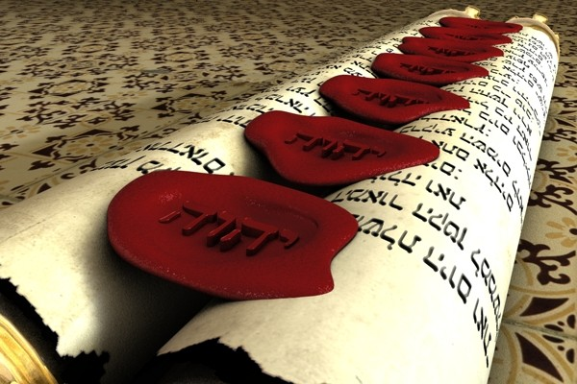
"Then he said to me, 'This scroll contains the curse that is going out over the entire land. One side of the scroll says that those who steal will be banished from the land; the other side says that those who swear falsely will be banished from the land'"
(Zech 5:3 NLT).

Slide 63
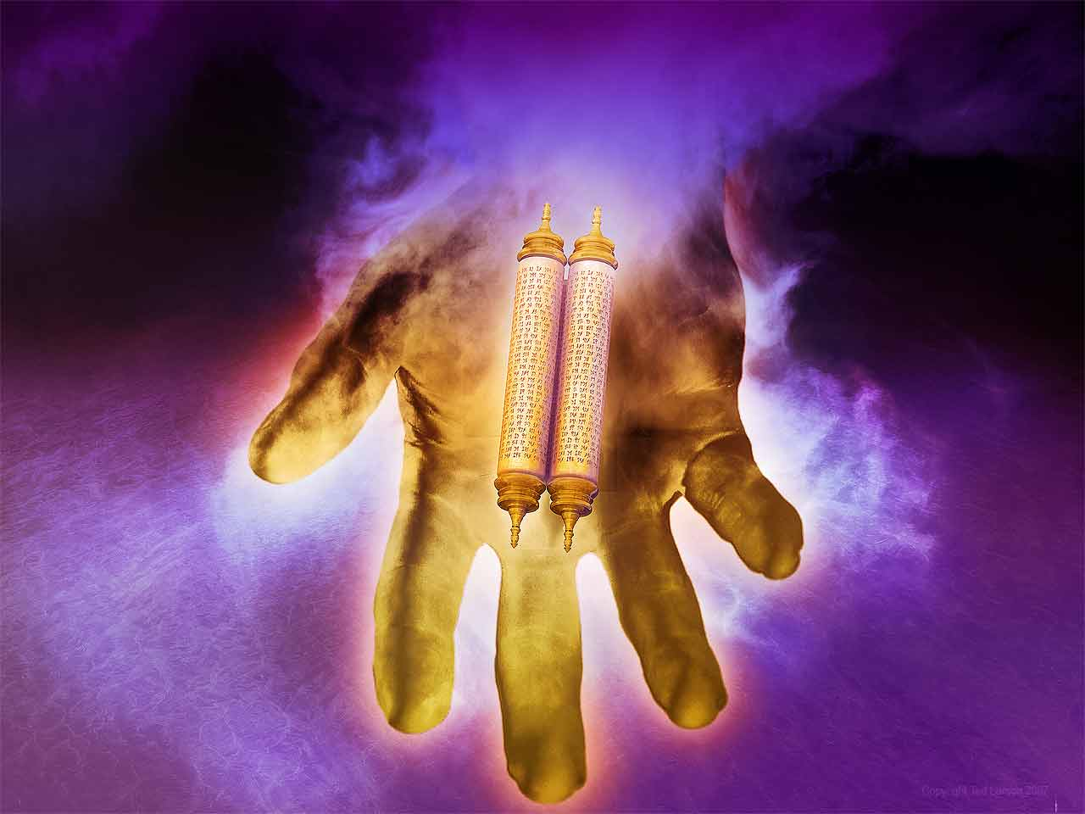
"And this is what the LORD of Heaven's Armies says: I am sending this curse into the house of every thief and into the house of everyone who swears falsely using my name. And my curse will remain in that house and completely destroy it—even its timbers and stones" (Zech 5:4 NLT).

Slide 64
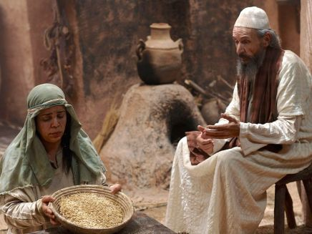
Baskets were very familiar to Zechariah

Slide 65
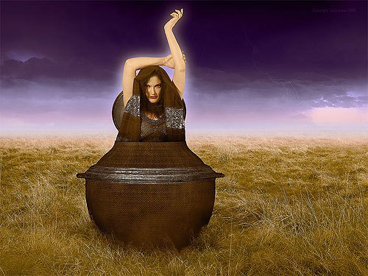
Vision 7: Woman in the Ephah
(Zech 5:5-11)
Removal of national Israel's sin of rebellion against God
Bible Knowledge Commentary, 1:1549

Slide 66
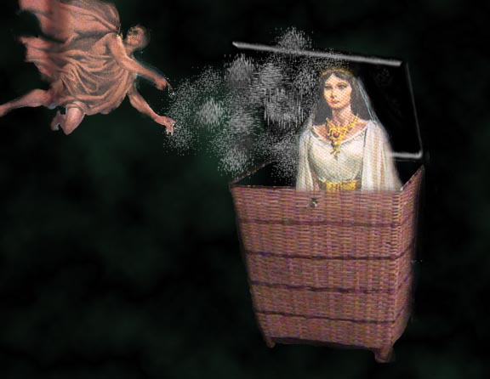
5:5-8 Woman in Basket
"Then the angel who was talking with me came forward and said, 'Look up and see what's coming.' ⁶'What is it?' I asked. He replied, 'It is a basket for measuring grain, and it's filled with the sins of everyone throughout the land.' ⁷Then the heavy lead cover was lifted off the basket, and there was a woman sitting inside it"
(Zech 5:5-7 NLT).

Slide 67
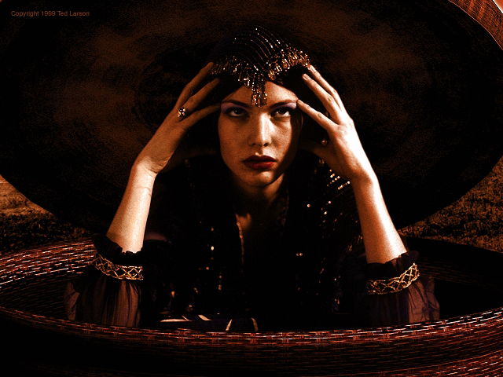
"The angel said, 'The woman's name is Wickedness,' and he pushed her back into the basket and closed the heavy lid again"
(Zech 5:8 NLT).

Slide 68
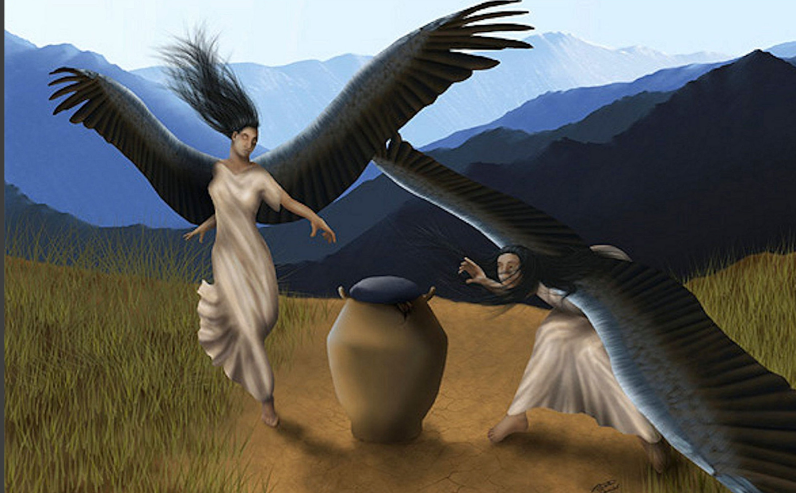
"The angel said, 'The woman's name is Wickedness,' and he pushed her back into the basket and closed the heavy lid again"
(Zech 5:8 NLT).

Slide 69
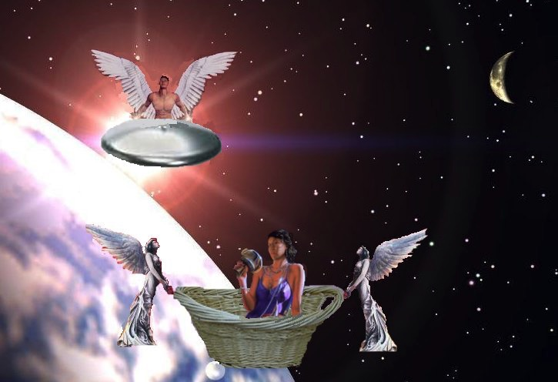
5:9-11 Woman in Basket
^{9 "}Then I looked up and saw two women flying toward us, gliding on the wind. They had wings like a stork, and they picked up the basket and flew into the sky. ¹⁰ 'Where are they taking the basket?' I asked the angel. ¹¹ He replied, 'To the land of Babylonia, where they will build a temple for the basket. And when the temple is ready, they will set the basket there on its pedestal'" (Zech 5:9-11 NLT).

Slide 70
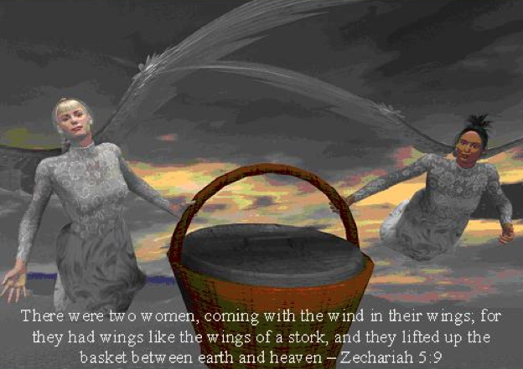
5:5-8 Woman in Basket
"Then I looked up and saw two women flying toward us, gliding on the wind. They had wings like a stork, and they picked up the basket and flew into the sky"
(Zech 5:9 NLT).

Slide 71

Wickedness sometimes appears in the imagery of women.
Zechariah 5:9 is one of two places that mention female supernatural beings.

Slide 72
Slides on
Zechariah 6

Slide 73
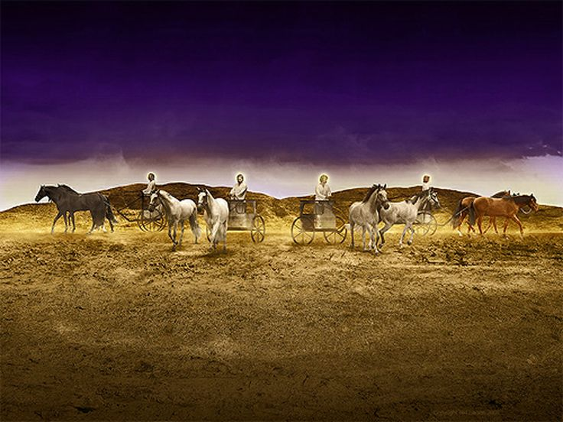
Vision 8: The Four Chariots (Zech 6:1-8)
"Then I looked up again and saw four chariots coming from between two bronze mountains. ²The first chariot was pulled by red horses, the second by black horses, ³the third by white horses, and the fourth by powerful dappled-gray horses."
"⁴'And what are these, my lord?' I asked the angel who was talking with me" (Zech 6:1-4 NLT).
Bible Knowledge Commentary, 1:1549

Slide 74

6:1-8 Chariots
"The angel replied, 'These are the four spirits of heaven who stand before the LORD of all the earth. They are going out to do his work.
649
South
West
⁶The chariot with black horses is going north, the chariot with white horses is going west, and the chariot with dappled-gray horses is going south'"
(Zech 6:5-6 NLT).
North

Slide 75

Vision 8: The Four Chariots (Zech 6:1-8)
Divine judgment on Gentile nations
Bible Knowledge Commentary, 1:1549

Slide 76

The Night Visions Reviewed
  red-horse rider among the myrtles 1:7-17
  four horns & the four craftsmen 1:18-21
  surveyor with the measuring line 2:1-13
  cleansing & crowning of Joshua 3:1-10
  gold lampstand & the two olive trees 4:1-14
  flying scroll 5:1-4
  woman in the ephah 5:5-11
  four chariots 6:1-8

Slide 77

God also encourages us to serve him by revealing our identity in Christ.

Slide 78

Our Identity in Christ

Slide 79
How can you be encouraged in your service for Christ?
2 ways

Slide 80
I. See your privileged position (Zech 1–6).

Slide 81

II. See your glorious future (Zech 7–14).

Slide 82
Slides on
Zechariah 7

Slide 83


The Postexilic Era
295-296
The Postexilic Era
Temple work
Haggai
"On December 7 of the fourth year of King Darius's reign, another message came to Zechariah from the LORD"
(Zech 7:1 NLT).
Prophets:
Zechariah
605
586
539
536
520
516
Others:
Zerubbabel
Persian Kings:
Cyrus
Darius
Notes:
This was King Darius's second year, in 520 BC (1:1)

Slide 84

"The people of Bethel had sent Sharezer and Regemmelech, along with their attendants, to seek the LORD's favor. ³They were to ask this question of the prophets and the priests at the Temple of the LORD of Heaven's Armies: 'Should we continue to mourn and fast each summer on the anniversary of the Temple's destruction, as we have done for so many years?'"
(Zech 7:2-3 NLT).

Slide 85
"The LORD of Heaven's Armies sent me this message in reply: ⁵'Say to all your people and your priests, "During these seventy years of exile, when you fasted and mourned in the summer and in early autumn, was it really for me that you were fasting? ⁶And even now in your holy festivals, aren't you eating and drinking just to please yourselves?"'"
(7:4-6 NLT).

Slide 86
Book Chart
Rebuild Temple for Messiah
God's Covenant Faithfulness |  |  | Future Messianic Rule
Chapters 1–6 |  |  | Chapters 7–14
"The word of the LORD came to Zechariah…" (1:1) |  |  | "The word of the LORD came to Zechariah…" (7:1)
Visions of the Covenant |  |  | Visions of the Messiah
 |  |  |  | Two Burdens
Command to Repent 1:1-6 | Eight Covenantal Visions 1:7–6:8 | Joshua's Symbolic Coronation 6:9-15 | Four Restoration Messages 7–8 | Rejected at First Advent 9–11 | Received at Second Advent 12–14
"The word of the LORD came to Zechariah" | "Then I looked up—and there before me" | "The word of the LORD came to me" | "The word of the LORD came to me" | "The burden of the word of the LORD" (NASB) | "The burden of the word of the LORD" (NASB)
Pictures |  |  | Problems | Predictions
Israel's Fortune |  |  | Israel's Fasting | Israel's Future
While Building the Temple 520-518 BC (1:1; 7:1) |  |  |  | After Building the Temple 480-470 BC (9:13?)
Jerusalem
649

Slide 87
7:1–8:23 Fasts in Zechariah
657
Text | Month/Day | Fast Commemorates: | Scripture
8:19d | 10/10 | Nebuchadnezzar Began Jerusalem Siege (15 January 588) | Jer. 39:1; 52:4; 2 Kings 25:1
8:19a | 4/9 | Jerusalem Destroyed (18 July 586) | Jer. 39:2; 52:6; 2 Kings 25:3
7:3, 5 8:19b | 5/10 | Jerusalem & Temple Burned (15-18 August 586) | Jer. 52:12-13; 2 Kings 25:8
7:5 8:19c | 7/3 | Gedaliah Slain (9 October 586) | Jer. 41:1-3 2 Kings 25:25-26
Adapted from a Dallas Theological Seminary Class Handout

Slide 88
Slides on
Zechariah 8

Slide 89

"Then another message came to me from the LORD of Heaven's Armies: 'This is what the LORD of Heaven's Armies says: My love for Mount Zion is passionate and strong; I am consumed with passion for Jerusalem!"
(Zech 8:1-2 NLT).

Slide 90
Key Verse
649
"This is what the LORD says, 'I will return to Zion and dwell in Jerusalem. Then Jerusalem will be called The City of Truth, and the mountain of the LORD Almighty will be called The Holy Mountain'" (Zechariah 8:3).
Zechariah

Slide 91

Jews will be sought out
649
"This is what the LORD of Heaven's Armies says: In those days ten men from different nations and languages of the world will clutch at the sleeve of one Jew. And they will say, 'Please let us walk with you, for we have heard that God is with you'" (Zech. 8:23 NLT).

Slide 92

"All Israel will be saved" (Rom. 11:25-27)
NTS 155w
²⁵I do not want you to be ignorant of this mystery, brothers, so that you may not be conceited: Israel has experienced a hardening in part until the full number of the Gentiles has come in.
²⁶And so all Israel will be saved, as it is written:
"The deliverer will come from Zion; he will turn godlessness away from Jacob.
²⁷And this is my covenant with them when I take away their sins."

Slide 93

Zech-a-Cry-Ah
= Key Word

Slide 94
Slides on
Zechariah 9

Slide 95
Key Word
649
343
Messiah
Zechariah

Slide 96

Zechariah Kingdom Statement
343
Judah must rebuild the temple (6:9-15) for blessing in the Messiah's kingdom.

Slide 97

Barry Huddleston, The Acrostic Summarized Bible (Grand Rapids: Baker, 1992)
Zechariah
1 Meaning of Zechariah's vision
2 Examination with measuring line
3 Satan and the Branch
4 Seven lampstands of gold
5 Interpreting the flying scroll
6 Act of crowning Joshua
7 Hearts become like flint
8 Security comes to Jerusalem
9 Return of the Messiah
10 Ephraim and Judah restored
11 Teaching about wicked shepherds
12 Understanding whom they pierced
13 Refining of God's remnant
14 New kingdom ushered in

Slide 98

Judgments
Hamath
"This is the message from the LORD against the land of Aram and the city of Damascus, for the eyes of humanity, including all the tribes of Israel, are on the LORD. ²Doom is certain for Hamath, near Damascus, and for the cities of Tyre and Sidon, though they are so clever. ³Tyre has built a strong fortress and has made silver and gold as plentiful as dust in the streets! ⁴But now the LORD will strip away Tyre's possessions and hurl its fortifications into the sea, and it will be burned to the ground."
Damascus
Sidon
Tyre
Aram
Israel
Zechariah 9:1-4 NLT

Slide 99
Book Chart
Rebuild Temple for Messiah
God's Covenant Faithfulness |  |  | Future Messianic Rule
Chapters 1–6 |  |  | Chapters 7–14
"The word of the LORD came to Zechariah…" (1:1) |  |  | "The word of the LORD came to Zechariah…" (7:1)
Visions of the Covenant |  |  | Visions of the Messiah
 |  |  |  | Two Burdens
Command to Repent 1:1-6 | Eight Covenantal Visions 1:7–6:8 | Joshua's Symbolic Coronation 6:9-15 | Four Restoration Messages 7–8 | Rejected at First Advent 9–11 | Received at Second Advent 12–14
"The word of the LORD came to Zechariah" | "Then I looked up—and there before me" | "The word of the LORD came to me" | "The word of the LORD came to me" | "The burden of the word of the LORD" (NASB) | "The burden of the word of the LORD" (NASB)
Pictures |  |  | Problems | Predictions
Israel's Fortune |  |  | Israel's Fasting | Israel's Future
While Building the Temple 520-518 BC (1:1; 7:1) |  |  |  | After Building the Temple 480-470 BC (9:13?)
Jerusalem
649

Slide 100

Triumphal Entry
Zech. 9:9

Slide 101
Slides on
Zechariah 10

Slide 102

"Ask the LORD for rain in the spring, for he makes the storm clouds. And he will send showers of rain so every field becomes a lush pasture. ²Household gods give worthless advice, fortune-tellers predict only lies, and interpreters of dreams pronounce falsehoods that give no comfort. So my people are wandering like lost sheep; they are attacked because they have no shepherd" (Zech 10:1-2 NLT).

Slide 103
Slides on
Zechariah 11

Slide 104
Judgments
"Open your doors, Lebanon,
so that fire may devour your cedar forests.
²Weep, you cypress trees, for all the ruined cedars;
the most majestic ones have fallen.
Weep, you oaks of Bashan,
for the thick forests have been cut down.
³Listen to the wailing of the shepherds,
for their rich pastures are destroyed.
Hear the young lions roaring,
for their thickets in the Jordan Valley are ruined."
Sidon
Lebanon
Tyre
Bashan
Israel
Zechariah 11:1-3 NLT

Slide 105
Slides on
Zechariah 12

Slide 106
"This message concerning the fate of Israel came from the LORD: 'This message is from the LORD, who stretched out the heavens, laid the foundations of the earth, and formed the human spirit. ²I will make Jerusalem like an intoxicating drink that makes the nearby nations stagger when they send their armies to besiege Jerusalem and Judah'"
(Zech 12:1-2 NLT).

Slide 107
Book Chart
Rebuild Temple for Messiah
God's Covenant Faithfulness |  |  | Future Messianic Rule
Chapters 1–6 |  |  | Chapters 7–14
"The word of the LORD came to Zechariah…" (1:1) |  |  | "The word of the LORD came to Zechariah…" (7:1)
Visions of the Covenant |  |  | Visions of the Messiah
 |  |  |  | Two Burdens
Command to Repent 1:1-6 | Eight Covenantal Visions 1:7–6:8 | Joshua's Symbolic Coronation 6:9-15 | Four Restoration Messages 7–8 | Rejected at First Advent 9–11 | Received at Second Advent 12–14
"The word of the LORD came to Zechariah" | "Then I looked up—and there before me" | "The word of the LORD came to me" | "The word of the LORD came to me" | "The burden of the word of the LORD" (NASB) | "The burden of the word of the LORD" (NASB)
Pictures |  |  | Problems | Predictions
Israel's Fortune |  |  | Israel's Fasting | Israel's Future
While Building the Temple 520-518 BC (1:1; 7:1) |  |  |  | After Building the Temple 480-470 BC (9:13?)
Jerusalem
649

Slide 108

The Repentance of Israel
"Then I will pour out a spirit of grace and prayer on the family of David and on the people of Jerusalem. They will look on me whom they have pierced and mourn for him as for an only son. They will grieve bitterly for him as for a firstborn son who has died"
(Zech. 12:10 NLT).

Slide 109

Tribulation Results
"They will look on the one they have pierced…"
(Zech. 12:1-10; esp. v. 10)
"The Redeemer will come to Zion, to those in Jacob who repent of their sins" (Isa. 59:20)
"The deliverer will come from Zion; he will turn godlessness away from David"
(Rom. 11:26b)
"And so all Israel will be saved" (Rom. 11:26a)

Slide 110

"Look!
He comes with the clouds of heaven.
And everyone will see him— even those who pierced him.
And all the nations of the world will mourn for him. Yes! Amen!"
Rev. 1:7 NLT
cf. Zech. 12:10

Slide 111
Amillennialism
473
Second Coming
Spiritual reign of Christ
Tribulations
Church Age
Eternal Kingdom
Judgment
Notes:
111

Slide 112
Premillennialism
473
Second Coming
Second Advent
=
Tribulation
Millennium
Church Age
Eternal Kingdom
7 years
1000 years
Judgment
Judgment
Notes:
112

Slide 113
A Dispensational Timeline
437
Great
White
Throne
(Rev. 20:11-14)
Rapture
(1 Thess. 4:13-18)
2nd Advent
(Zech. 14:3-5)
Day of the LORD
Church Age
Tribulation
(Zech. 14:1-2)
Millennium
(Zech. 14:6-21)
Gog & Magog
(Armageddon)
(Ezek. 38–39)
Gog and Magog
Revisited
(Rev. 20:7-10)
Notes:
113

Slide 114
Slides on
Zechariah 13

Slide 115

"On that day a fountain will be opened for the dynasty of David and for the people of Jerusalem, a fountain to cleanse them from all their sins and impurity" (Zech 13:1 NLT).

Slide 116

"'And on that day,' says the LORD of Heaven's Armies, 'I will erase idol worship throughout the land, so that even the names of the idols will be forgotten. I will remove from the land both the false prophets and the spirit of impurity that came with them'" (Zech 13:2 NLT).

Slide 117

"'Awake, O sword, against my shepherd, the man who is my partner,' says the LORD of Heaven's Armies. 'Strike down the shepherd, and the sheep will be scattered, and I will turn against the lambs. ⁸Two-thirds of the people in the land will be cut off and die,' says the LORD. 'But one-third will be left in the land'"
(Zech 13:7-8 NLT).

Slide 118

"I will bring that group through the fire and make them pure.
I will refine them like silver and purify them like gold.
They will call on my name, and I will answer them.
I will say, 'These are my people,' and they will say, 'The LORD is our God'"
(Zech 13:9 NLT).

Slide 119
Slides on
Zechariah 14

Slide 120
Jerusalem Population (2002)
East = Arabs
West = Jews

Slide 121

The Plundering
"Watch, for the day of the LORD is coming when your possessions will be plundered right in front of you!"
(Zech. 14:1).

Slide 122


The Attack
"I will gather all the nations to fight against Jerusalem. The city will be taken, the houses looted, and the women raped. Half the population will be taken into captivity, and the rest will be left among the ruins of the city" (Zech. 14:2 NLT).

Slide 123
A Dispensational Timeline
437
Great
White
Throne
(Rev. 20:11-14)
Rapture
(1 Thess. 4:13-18)
2nd Advent
(Zech. 14:3-5)
Day of the LORD
Church Age
Tribulation
(Zech. 14:1-2)
Millennium
(Zech. 14:6-21)
Gog & Magog
(Armageddon)
(Ezek. 38–39)
Gog and Magog
Revisited
(Rev. 20:7-10)
Notes:
123

Slide 124

Christ's Return
"Then the LORD will go out to fight against those nations, as he has fought in times past"
(Zech. 14:3 NLT).

Slide 125

The Second Coming
"On that day, his feet will stand on the Mount of Olives east of Jerusalem"
(Zech. 14:4).

Slide 126






The Spirit Leaves & Returns
656
Ezek. 8:4; 9:3; 10:4; 10:18-19; 11:23
Luke 19:37; 24:50; Acts 1:10
Acts 1:11; Zech. 14:4; Ezek. 43:1-5

Slide 127

The Second Coming
"On that day, his feet will stand on the Mount of Olives east of Jerusalem…"
(Zech. 14:4a).

Slide 128

The Second Coming
"…And the Mount of Olives will split apart, making a wide valley running from east to west. Half the mountain will move toward the north and half toward the south"
(Zech. 14:4b NLT).

Slide 129
The Second Coming
"You will flee through this valley, for it will reach across to Azal. Yes, you will flee as you did from the earthquake in the days of King Uzziah of Judah. Then the LORD my God will come, and all his holy ones with him"
(Zech. 14:5 NLT).

Slide 130

The Second Coming
"On that day the sources of light will no longer shine, ⁷yet there will be continuous day! Only the LORD knows how this could happen. There will be no normal day and night, for at evening time it will still be light" (Zech. 14:6-7 NLT).

Slide 131

Living Water!
"On that day life-giving waters will flow out from Jerusalem, half toward the Dead Sea and half toward the Mediterranean, flowing continuously in both summer and winter" (Zech. 14:8 NLT).

Slide 132

The Second Coming
"And the LORD will be king over all the earth.
On that day there will be one LORD—
his name alone will be worshiped"
(Zech. 14:9 NLT).

Slide 133

Jerusalem Repopulated
655
¹⁰ All the land from Geba, north of Judah, to Rimmon, south of Jerusalem, will become one vast plain. But Jerusalem will be raised up in its original place and will be inhabited all the way from the Benjamin Gate over to the site of the old gate, then to the Corner Gate, and from the Tower of Hananel to the king's winepresses. ¹¹ And Jerusalem will be filled, safe at last, never again to be cursed and destroyed"
(Zech. 14:10-11 NLT).
Tower of Hananel
Tower of 100
Mount of Olives
Sheep Gate
Fish Gate
Inspection Gate
Jeshanah (Old Gate?)
East Gate
Broad Wall
Horse Gate
Tower of the Ovens?
Wall of Ophel
Great Projecting Tower
Valley Gate
Water Gate
Dung Gate
The Angle
Pool of Shelah (Siloam)
Fountain Gate

Slide 134

The Second Coming
"And the LORD will send a plague on all the nations that fought against Jerusalem. Their people will become like walking corpses, their flesh rotting away. Their eyes will rot in their sockets, and their tongues will rot in their mouths"
(Zech. 14:12 NLT).

Slide 135

The Second Coming
"On that day they will be terrified, stricken by the LORD with great panic. They will fight their neighbors hand to hand. ¹⁴Judah, too, will be fighting at Jerusalem. The wealth of all the neighboring nations will be captured—great quantities of gold and silver and fine clothing"
(Zech. 14:13-14 NLT).

Slide 136

The Second Coming
"This same plague will strike the horses, mules, camels, donkeys, and all the other animals in the enemy camps"
(Zech. 14:15 NLT).

Slide 137
A Dispensational Timeline
437
Great
White
Throne
(Rev. 20:11-14)
Rapture
(1 Thess. 4:13-18)
2nd Advent
(Zech. 14:3-5)
Day of the LORD
Church Age
Tribulation
(Zech. 14:1-2)
Millennium
(Zech. 14:6-21)
Gog & Magog
(Armageddon)
(Ezek. 38–39)
Gog and Magog
Revisited
(Rev. 20:7-10)
Notes:
137

Slide 138

Millennial Worship
"In the end, the enemies of Jerusalem who survive the plague will go up to Jerusalem each year to worship the King... and to celebrate the Festival of Shelters. ¹⁷Any nation in the world that refuses to come to Jerusalem to worship the King... will have no rain. ¹⁸If the people of Egypt refuse to attend the festival, the LORD will punish them with the same plague that he sends on the other nations who refuse to go. ¹⁹Egypt and the other nations will all be punished if they don't go to celebrate the Festival of Shelters"
(Zech. 14:16-19 NLT).

Slide 139


Millennial Holiness
^{20 "}On that day even the harness bells of the horses will be inscribed with these words: Holy to the LORD. And the cooking pots in the Temple of the LORD will be as sacred as the basins used beside the altar.
²¹ In fact, every cooking pot in Jerusalem and Judah will be holy to the LORD... All who come to worship will be free to use any of these pots to boil their sacrifices. And on that day there will no longer be traders [Heb. Canaanites] in the Temple of the LORD of Heaven's Armies."
(Zech. 14:20-21 NLT)

Slide 140

Zechariah
Summary Statement
649
346
Zechariah prepares Judah for the Messiah by encouraging the nation to respond to its privileged covenant position among the nations by rebuilding the temple in light of future blessings when the Messiah rules in the kingdom.

Slide 141

Millennial Jerusalem
106
"The law will go out from Zion,
the word of the LORD from Jerusalem"
––Isaiah 2:3

Slide 142

We also will rule with Israel after Christ's return.
Notes:
Christians who abandon Jesus will not reign with him after he returns.

Slide 143

Do you need encouragement today?

Slide 144

Main Idea
The way to fight discouragement is to...
see who you are
and where you are going.

Slide 145
I. See your privileged position (Zech 1–6).

Slide 146
II. See your glorious future (Zech 7–14).

Slide 147
Questions to Ponder
How can you better understand your exalted position in Christ?
————————
How can you better serve Christ now in light of your rule with him at his return?

Slide 148
Black

Slide 149


OT Preaching link at BibleStudyDownloads.org
Get this presentation and script for free!

