Slide 1
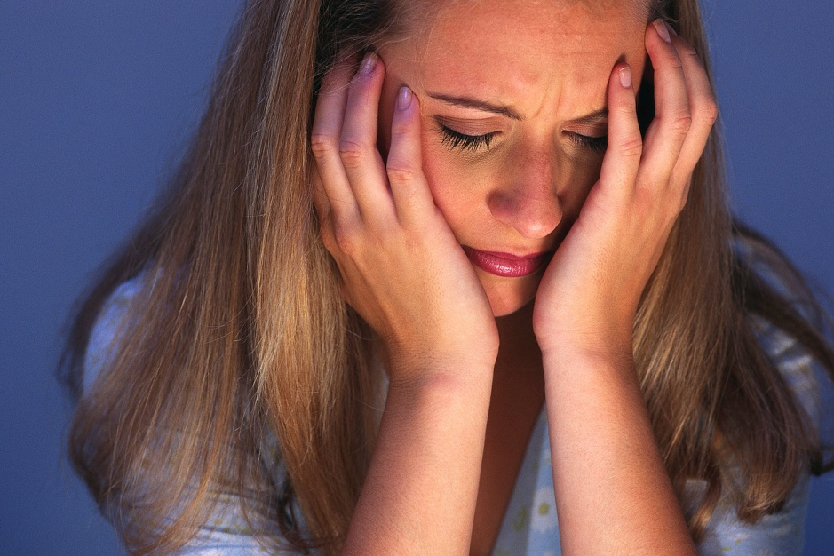
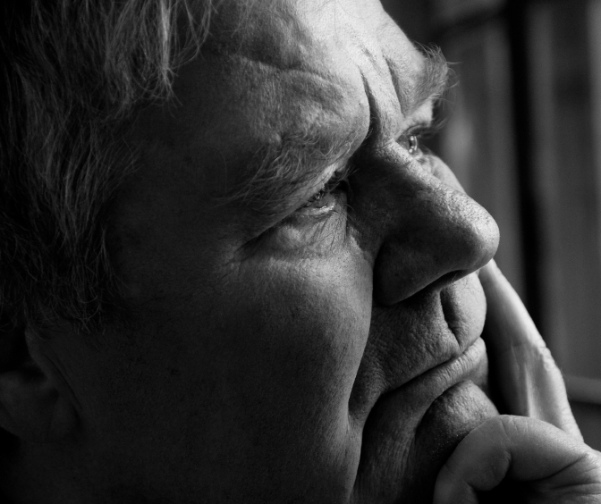
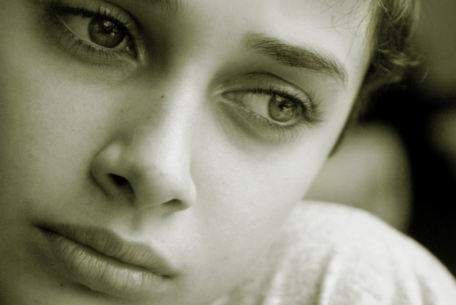
RUTH 1
Overcoming Bad Decisions
Dr Scott Wooddell Eastridge Park Christian Church, Mesquite, Texas Uploaded by Dr. Rick Griffith • Jordan Evangelical Theological Seminary Files in many languages for free download at BibleStudyDownloads.org

Slide 2
RUTH 1
When we make bad decisions, how can we get back on track?

Slide 3
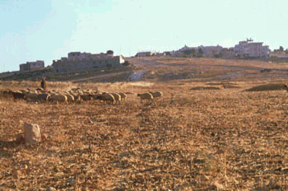
1. MAN’S CALAMITY (vs. 1-5)
“In the days when the Judges ruled, there was a famine in the land, and a man from Bethlehem in Judah, together with his wife and two sons, went to live for a while in the country of Moab” (v. 1).
WHEN: In the days when the Judges ruled.
WHERE: The City of Bethlehem and the country of Moab.
WHO: Elimelech, Naomi, Mahlon and Kilion.

Slide 4
2. GOD’S OPPORTUNITY (vs. 6-22)
“When she heard in Moab that the Lord had come to the aid of His people by providing food for them, Naomi and her daughters-in-law prepared to return home from there” (v. 6).
“So Naomi returned from Moab accompanied by Ruth the Moabitess, her daughter-in-law, arriving in Bethlehem as the barley harvest was beginning” (v. 22).

Slide 5
TAKE HOME TRUTH
When we return to the place where God can bless us, He returns blessings to us.

Slide 6
Black

Slide 7
OT Preaching link at BibleStudyDownloads.org
Get this presentation for free!
Notes:
OT Preaching (op)

