Slide 1
Am I Important?
A Meditation on Psalm 8
Peter Lin • Crossroads International Church Singapore • CICFamily.com Uploaded by Dr. Rick Griffith • Jordan Evangelical Theological Seminary Files in many languages for free download at BibleStudyDownloads.org

Slide 2
Psalm 8 - 3 looks at significance
V1/3 Look at the stars –
God’s greatness
our smallness
V4 Look at ourselves –
God’s remembrance
our significance
V5/8 Look at the cross
God’s care
our importance

Slide 3
1. Look - Stars
8:1 O LORD, our Lord, how majestic is your name in all the earth! You have set your glory above the heavens.

Slide 4
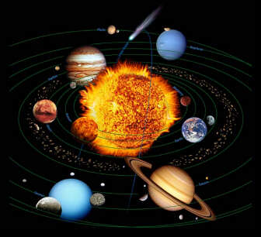

Slide 6
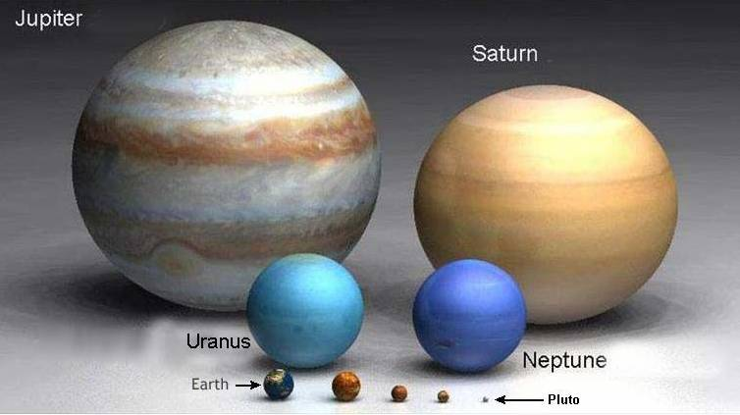

Slide 9
Notes:
Antares is the 15th brightest star in the sk y. It is more than 1000 light years away.

Slide 10
1. Look - Stars
8:1 O LORD, our Lord, how majestic is your name in all the earth! You have set your glory above the heavens.
Majesty = addir = POWER
“When I look at the heavens, the work of your fingers”

Slide 11
When you see the stars, remember A God of majestic POWER

Slide 12
2. Look - You
The smallness of me
“When I look at the heavens, the work of your fingers…
what is man that you are mindful of him?” Ps 8:3-4a
Mindful = ZAKA = God promises to remember

Slide 13
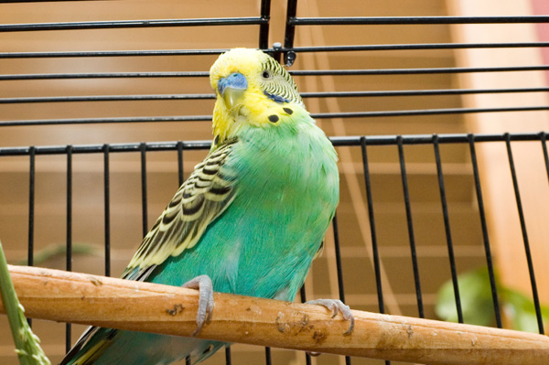

Slide 14
Mt 10:29 Are not 2 sparrows sold for a penny? Yet not one of them fall to the ground apart from your father.
31You are of much more value than many sparrows.
30Even the hairs of your head are numbered

Slide 15
2. LOOK - YOU
Significance is based not on
what you do
but who cares for you
Let every star reminds you of GOD’s addir
Let every bird reminds you
of His mindfulness
Let every hair reminds you
of His Zaka
promise to remember

Slide 16
3. Look at the Cross
V.4
“Or the son of man that you should care for him?”
Care = Paqad
Paqad = God visit to deliver and bless

Slide 17
3. Look - Cross
Ps 8:5-6; Hebrew 2:7-8
⁵You made him a little lower than the heavenly beings
and crowned him with glory and honor.
⁶You made him ruler over the works of your hands;
you put everything under his feet:

Slide 18
33. Look – Cross (Heb 2:9-10)
⁹But we see Jesus, who was made a little lower than the angels, now crowned with glory and honor because he suffered death, so that by the grace of God he might taste death for everyone.
Who would you sacrifice your children for?

Slide 19
Conclusion: Look outward and praise
How you see yourself dictates your journey to significance?
A change:
Look away from yourself
Look at God and see it from his perspective

Slide 20
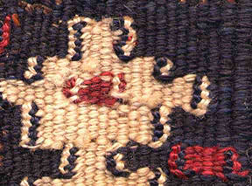
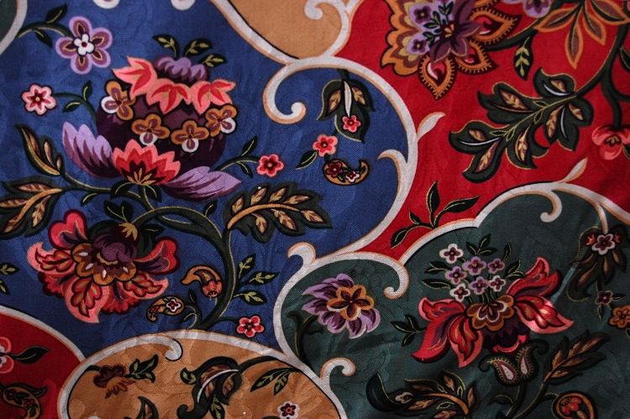
We see under the tapestry
God sees above the tapestry

Slide 21
A challenge:
Look at the stars and remember….
Addir
Look at your hairs and know …
Zaka
Look at the cross and worship …
Pakad
-

Slide 22
Black

Slide 23
OT Preaching link at BibleStudyDownloads.org
Get this presentation for free!

