Slide 1
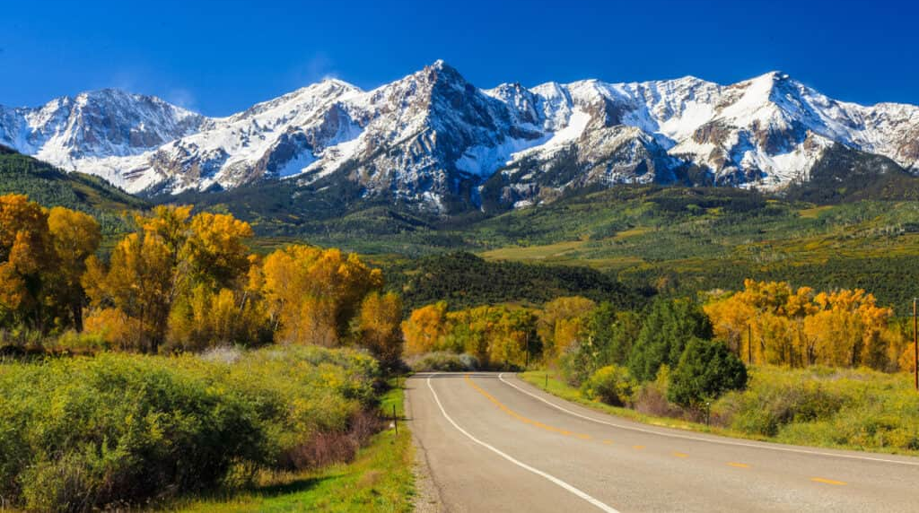
Psalm 37
A Call to Confidence in God’s Ways!
Summer in the
psalms
Preached by Dan Bridges at Amman International Church Singapore • AmmanChurch.com Uploaded by Dr. Rick Griffith • Jordan Evangelical Theological Seminary Files in many languages for free download at BibleStudyDownloads.org

Slide 2
Old City and Kidron Valley from north
“Don’t worry about the wicked or envy those who do wrong.”
Psalm 37:1
Why would we envy
the wicked???

Slide 3
Old City and Kidron Valley from north
We envy the wicked because…
We often do not see them as wicked – who are they?
(The wicked are people who are living their lives apart from God.)
They have what we think we want!

Slide 4
Old City and Kidron Valley from north
What Do We Want???
Love / Acceptance
Financial Security
(Money, Own house, car, etc.)
To feel significant
To feel / appear competent
Successful ministry
Power or position

Slide 5
Music Stars
Politicians
Sports Stars
Actors
What are the voices in our society saying?
Influencers
Actresses

Slide 6
What are the voices in our society saying?
Music Stars
Politicians
Life is all about “ME”!
Satisfaction is found in the pursuit of _____
Love, humility and meekness are weak
Christians are bigots
(Creation, Marriage, Gender, Moral Issues)
Christians are naïve and foolish
Sports Stars
Actors
Influencers
If we are not careful, we end up believing these lies!
Actresses

Slide 7
What are the voices in our society saying?
Music Stars
Politicians
Life is all about “ME”!
Satisfaction is found in the pursuit of _____
Love, humility and meekness are weak
Christians are bigots
(Creation, Marriage, Gender, Moral Issues)
Christians are naïve and foolish
Sports Stars
Actors
Influencers
We can end up believing we are a weak minority!
Actresses

Slide 8
Psalm 37 is a call to confidence in God’s ways!

Slide 9
Old City and Kidron Valley from north
Psalm 37… Two Ways
1. Pursuing Satisfaction
Apart from God
“Don’t worry about the wicked
or envy those who do wrong.”
Psalm 37:1

Slide 10
Old City and Kidron Valley from north
Psalm 37… Two Ways
2. Trusting God to Satisfy Us
“Delight yourself
In the Lord and he will give you the desires of your heart.”
Psalm 37:4

Slide 11
Three reasons why trusting in God is the only path to true satisfaction.
God gives you what your really want (vss 1-15).
God gives you what you really need (vss 16-26).
God gives the best long-term results (vss 27-40).

Slide 12
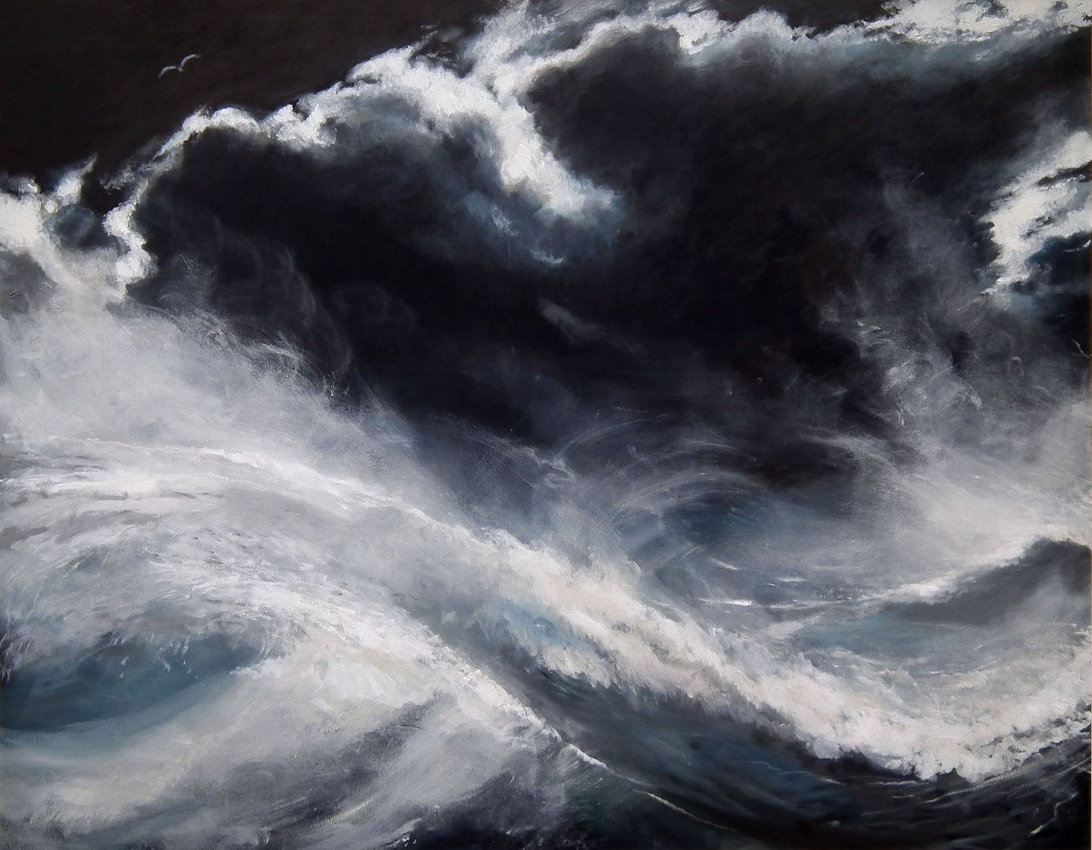
Why Secular Paths Don’t Work…
¹ Fret not yourself because of evildoers;
be not envious of wrongdoers!
² For they will soon fade like the grass
and wither like the green herb.
⁷ …fret not yourself over the one who prospers in his way, over the man who carries out evil devices!
⁹ …For the evildoers shall be cut off,
¹⁰ In just a little while, the wicked will be no more;
though you look carefully at his place, he will not be there.

Slide 13
Why Secular Paths Don’t Work…
¹ Fret not yourself because of evildoers;
be not envious of wrongdoers!
² For they will soon fade like the grass
and wither like the green herb.
⁷ …fret not yourself over the one who prospers in his way, over the man who carries out evil devices!
⁹ …For the evildoers shall be cut off,
¹⁰ In just a little while, the wicked will be no more;
though you look carefully at his place, he will not be there.
The satisfaction is temporary

Slide 14
Why Secular Paths Don’t Work…
¹. Fret not yourself because of evildoers;
be not envious of wrongdoers!
² For they will soon fade like the grass
and wither like the green herb.
⁷ …fret not yourself over the one who prospers in his way, over the man who carries out evil devices!
⁹ …For the evildoers shall be cut off,
¹⁰ In just a little while, the wicked will be no more;
though you look carefully at his place, he will not be there.
Life itself is temporary

Slide 15
Why Secular Paths Don’t Work…
¹² The wicked plots against the righteous
and gnashes his teeth at him,
¹³ but the Lord laughs at the wicked,
for he sees that his day is coming.
¹⁴ The wicked draw the sword and bend their bows
to bring down the poor and needy,
to slay those whose way is upright;
¹⁵ their sword shall enter their own heart,
and their bows shall be broken.
This life is opposed by God

Slide 16
Why God’s Paths Do Work…
When we focus on God, we will desire (and receive) what truly satisfies us.
³ Trust in the Lord, and do good;
dwell in the land and befriend faithfulness.
⁴ Delight yourself in the Lord,
and he will give you the desires of your heart.

Slide 17
Why God’s Paths Do Work…
When we are patient and wait for God, he gives us legitimate things that everyone is chasing after.
⁵ Commit your way to the Lord;
trust in him, and he will act.
⁶ He will bring forth your righteousness as the light,
and your justice as the noonday.
⁷ Be still before the Lord and wait patiently for him;
¹¹ …But the meek shall inherit the land
and delight themselves in abundant peace.

Slide 18
Three reasons why trusting in God is the only path to true satisfaction.
God gives you what your really want (vss 1-15).
God gives you what you really need (vss 16-26).
God gives the best long-term results (vss 27-40).

Slide 19
God Gives You What You Really Need…
¹⁶ Better is the little that the righteous has
than the abundance of many wicked.
¹⁸ …The Lord knows the days of the blameless,
and their heritage will remain forever;
¹⁹ they are not put to shame in evil times;
in the days of famine they have abundance.

Slide 20
God Gives You What You Really Need…
Even if the righteous have less, they actually have more because they have God as their provider – even when times are difficult.
¹⁶ Better is the little that the righteous has
than the abundance of many wicked.
¹⁸ …The Lord knows the days of the blameless,
and their heritage will remain forever;
¹⁹ they are not put to shame in evil times;
in the days of famine they have abundance.

Slide 21
God Gives You What You Really Need…
²¹ …The wicked borrows but does not pay back,
but the righteous is generous and gives;
²⁵ …I have been young, and now am old,
yet I have not seen the righteous forsaken
or his children begging for bread.
²⁶ He is ever lending generously,
and his children become a blessing.

Slide 22
God Gives You What You Really Need…
²¹ …The wicked borrows but does not pay back,
but the righteous is generous and gives;
²⁵ …I have been young, and now am old,
yet I have not seen the righteous forsaken
or his children begging for bread.
²⁶ He is ever lending generously,
and his children become a blessing.
Not only does God provide what we need, but he provides for others through us.

Slide 23
God Gives You What You Really Need…
²¹ …The wicked borrows but does not pay back,
but the righteous is generous and gives;
²⁵ …I have been young, and now am old,
yet I have not seen the righteous forsaken
or his children begging for bread.
²⁶ He is ever lending generously,
and his children become a blessing.
The path to having what we need is giving it away!

Slide 24
Three reasons why trusting in God is the only path to true satisfaction.
God gives you what your really want (vss 1-15).
God gives you what you really need (vss 16-26).
God gives the best long-term results (vss 27-40).

Slide 25
God Gives the Best Long-Term Results…
²⁷ Turn away from evil and do good;
so shall you dwell forever.
²⁸ For the Lord loves justice;
he will not forsake his saints.
They are preserved forever,
but the children of the wicked shall be cut off.
²⁹ The righteous shall inherit the land
and dwell upon it forever.

Slide 26
God Gives the Best Long-Term Results…
²⁷ Turn away from evil and do good;
so shall you dwell forever.
²⁸ For the Lord loves justice;
he will not forsake his saints.
They are preserved forever,
but the children of the wicked shall be cut off.
²⁹ The righteous shall inherit the land
and dwell upon it forever.
What God gives us is forever!

Slide 27
God Gives the Best Long-Term Results…
²⁷ Turn away from evil and do good;
so shall you dwell forever.
²⁸ For the Lord loves justice;
he will not forsake his saints.
They are preserved forever,
but the children of the wicked shall be cut off.
²⁹ The righteous shall inherit the land
and dwell upon it forever.
The righteous will receive in the end what the wicked wanted!

Slide 28
God Gives the Best Long-Term Results…
³⁰ The mouth of the righteous utters wisdom,
and his tongue speaks justice.
³¹ The law of his God is in his heart;
his steps do not slip.
³² The wicked watches for the righteous
and seeks to put him to death.
³³ The Lord will not abandon him to his power
or let him be condemned when he is brought to trial.

Slide 29
God Gives the Best Long-Term Results…
³⁰ The mouth of the righteous utters wisdom,
and his tongue speaks justice.
³¹ The law of his God is in his heart;
his steps do not slip.
³² The wicked watches for the righteous
and seeks to put him to death.
³³ The Lord will not abandon him to his power
or let him be condemned when he is brought to trial.
Literally:
To Murmer or Meditate

Slide 30
God Gives the Best Long-Term Results…
³⁰ The mouth of the righteous utters wisdom,
and his tongue speaks justice.
³¹ The law of his God is in his heart;
his steps do not slip.
³² The wicked watches for the righteous
and seeks to put him to death.
³³ The Lord will not abandon him to his power
or let him be condemned when he is brought to trial.
Righteous person loves God’s Word and meditates on it!

Slide 31
God Gives the Best Long-Term Results…
³⁰ The mouth of the righteous utters wisdom,
and his tongue speaks justice.
³¹ The law of his God is in his heart;
his steps do not slip.
³² The wicked watches for the righteous
and seeks to put him to death.
³³ The Lord will not abandon him to his power
or let him be condemned when he is brought to trial.
Long-term stability and protection by God

Slide 32
God Gives the Best Long-Term Results…
³⁴ Wait for the Lord and keep his way,
and he will exalt you to inherit the land;
you will look on when the wicked are cut off.
Who inherits the land in Psalm 37?
9: Those who wait for the Lord
11: The meek
22: Those blessed by the Lord
29: The righteous
34: Those who wait for the Lord and keep his ways

Slide 33
God Gives the Best Long-Term Results…
³⁵ I have seen a wicked, ruthless man,
spreading himself like a green laurel tree.
³⁶ But he passed away, and behold, he was no more;
though I sought him, he could not be found.
³⁷ Mark the blameless and behold the upright,
for there is a future for the man of peace.
³⁸ But transgressors shall be altogether destroyed;
the future of the wicked shall be cut off.

Slide 34
God Gives the Best Long-Term Results…
³⁵ I have seen a wicked, ruthless man,
spreading himself like a green laurel tree.
³⁶ But he passed away, and behold, he was no more;
though I sought him, he could not be found.
³⁷ Mark the blameless and behold the upright,
for there is a future for the man of peace.
³⁸ But transgressors shall be altogether destroyed;
the future of the wicked shall be cut off.
No future for those pursuing the secular way

Slide 35
God Gives the Best Long-Term Results…
³⁵ I have seen a wicked, ruthless man,
spreading himself like a green laurel tree.
³⁶ But he passed away, and behold, he was no more;
though I sought him, he could not be found.
³⁷ Mark the blameless and behold the upright,
for there is a future for the man of peace.
³⁸ But transgressors shall be altogether destroyed;
the future of the wicked shall be cut off.
God wants us to look at real life examples of righteous people and how their lives have worked out!

Slide 36
God Gives the Best Long-Term Results…
³⁵ I have seen a wicked, ruthless man,
spreading himself like a green laurel tree.
³⁶ But he passed away, and behold, he was no more;
though I sought him, he could not be found.
³⁷ Mark the blameless and behold the upright,
for there is a future for the man of peace.
³⁸ But transgressors shall be altogether destroyed;
the future of the wicked shall be cut off.
There is a secure future for those who live God’s way.

Slide 37
God Gives the Best Long-Term Results…
³⁹ The salvation of the righteous is from the Lord;
he is their stronghold in the time of trouble.
⁴⁰ The Lord helps them and delivers them;
he delivers them from the wicked and saves them,
because they take refuge in him.
God protects us – Our well-being is secure.

Slide 38
Three reasons why trusting in God is the only path to true satisfaction.
God gives you what your really want (vss 1-15).
God gives you what you really need (vss 16-26).
God gives the best long-term results (vss 27-40).

Slide 39
Applications
How do you see yourself when you’re around secular people?
Weak minority?
Apologetic?
Confident you’re on the winning team!

Slide 40
Applications
How do you see yourself when you’re around secular people?
How confident are you that only God’s ways give true satisfaction?
Are you pursuing your desires by trusting in God or in secular ways?

Slide 41
Wanting to Feel Loved and Accepted
God’s Way Secular Way
Trust
Focus
Commitment
Timing
Behavior
God
Delighting in God,
Depending on God
Pursue relationships
to love
Waiting is OK
Patient, Selfless
Self – All depends on me
How I “feel”; Meeting
the “love need”
Pursue relationships to
get love
Now / ASAP
Self-focused, angry, manipulative

Slide 42
Desire to have a Successful Ministry
God’s Way Secular Way
Trust
Focus
Commitment
Timing
Behavior
God
Delighting in God,
Depending on God
Obeying God even
if it doesn’t feel OK
Waiting is OK
Patient, Selfless
Self – All depends on me
How I feel about myself
& my performance
“Right” activities,
Visibility, Bragging
Now / ASAP
Ministry centers around self, Need attention

Slide 43
In every area of life, we have to decide between God’s way and the world’s way.
What need or desire do you find yourself focusing on?
Love / Acceptance
Financial Security
(Money, Own house, car, etc.)
To feel significant
To feel / appear competent
Successful ministry
Power or position
Regardless of the desire or need, the only path to true satisfaction is depending on and waiting for God!

Slide 45
OT Preaching link at BibleStudyDownloads.org
Get this presentation and notes for free!
Notes:
OT Preaching (op)

