Slide 1
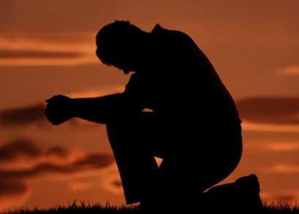
God's Faithfulness—Psalm 32
Manik Corea • Crossroads International Church Singapore • CICFamily.com Uploaded by Dr. Rick Griffith • Jordan Evangelical Theological Seminary Files in many languages for free download at BibleStudyDownloads.org

Slide 2
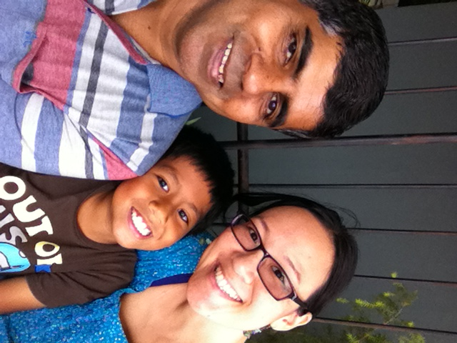
The Coreas in Bangkok

Slide 3
Ministry highlights
8 years and counting in Thailand
A NAMS base community since Sep 2012
Vision to plant disciple-making congregations wherever God opens doors.

Slide 4
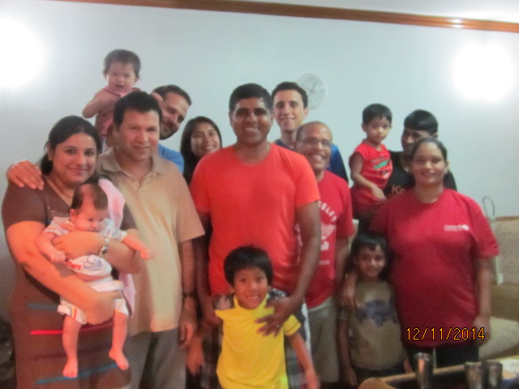
Snapshots
From one disciple-making cell to 3 cells, and other outreach groups or relationships
English Club outreach with our Thai partner church, Khlong Toey Church

Slide 5
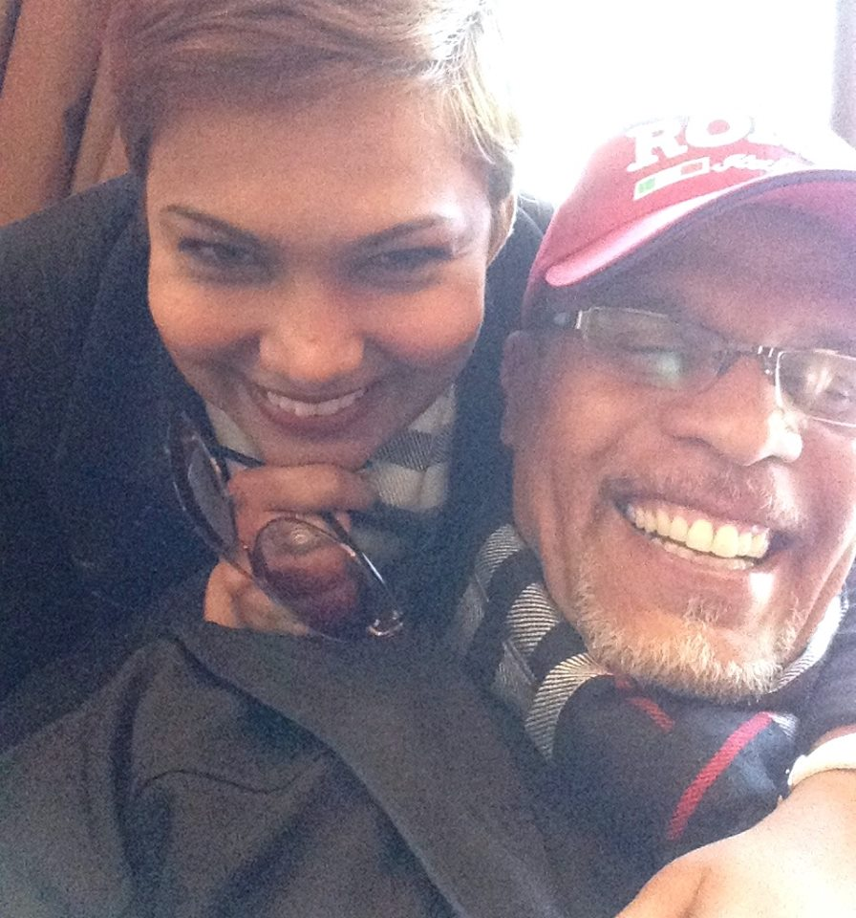
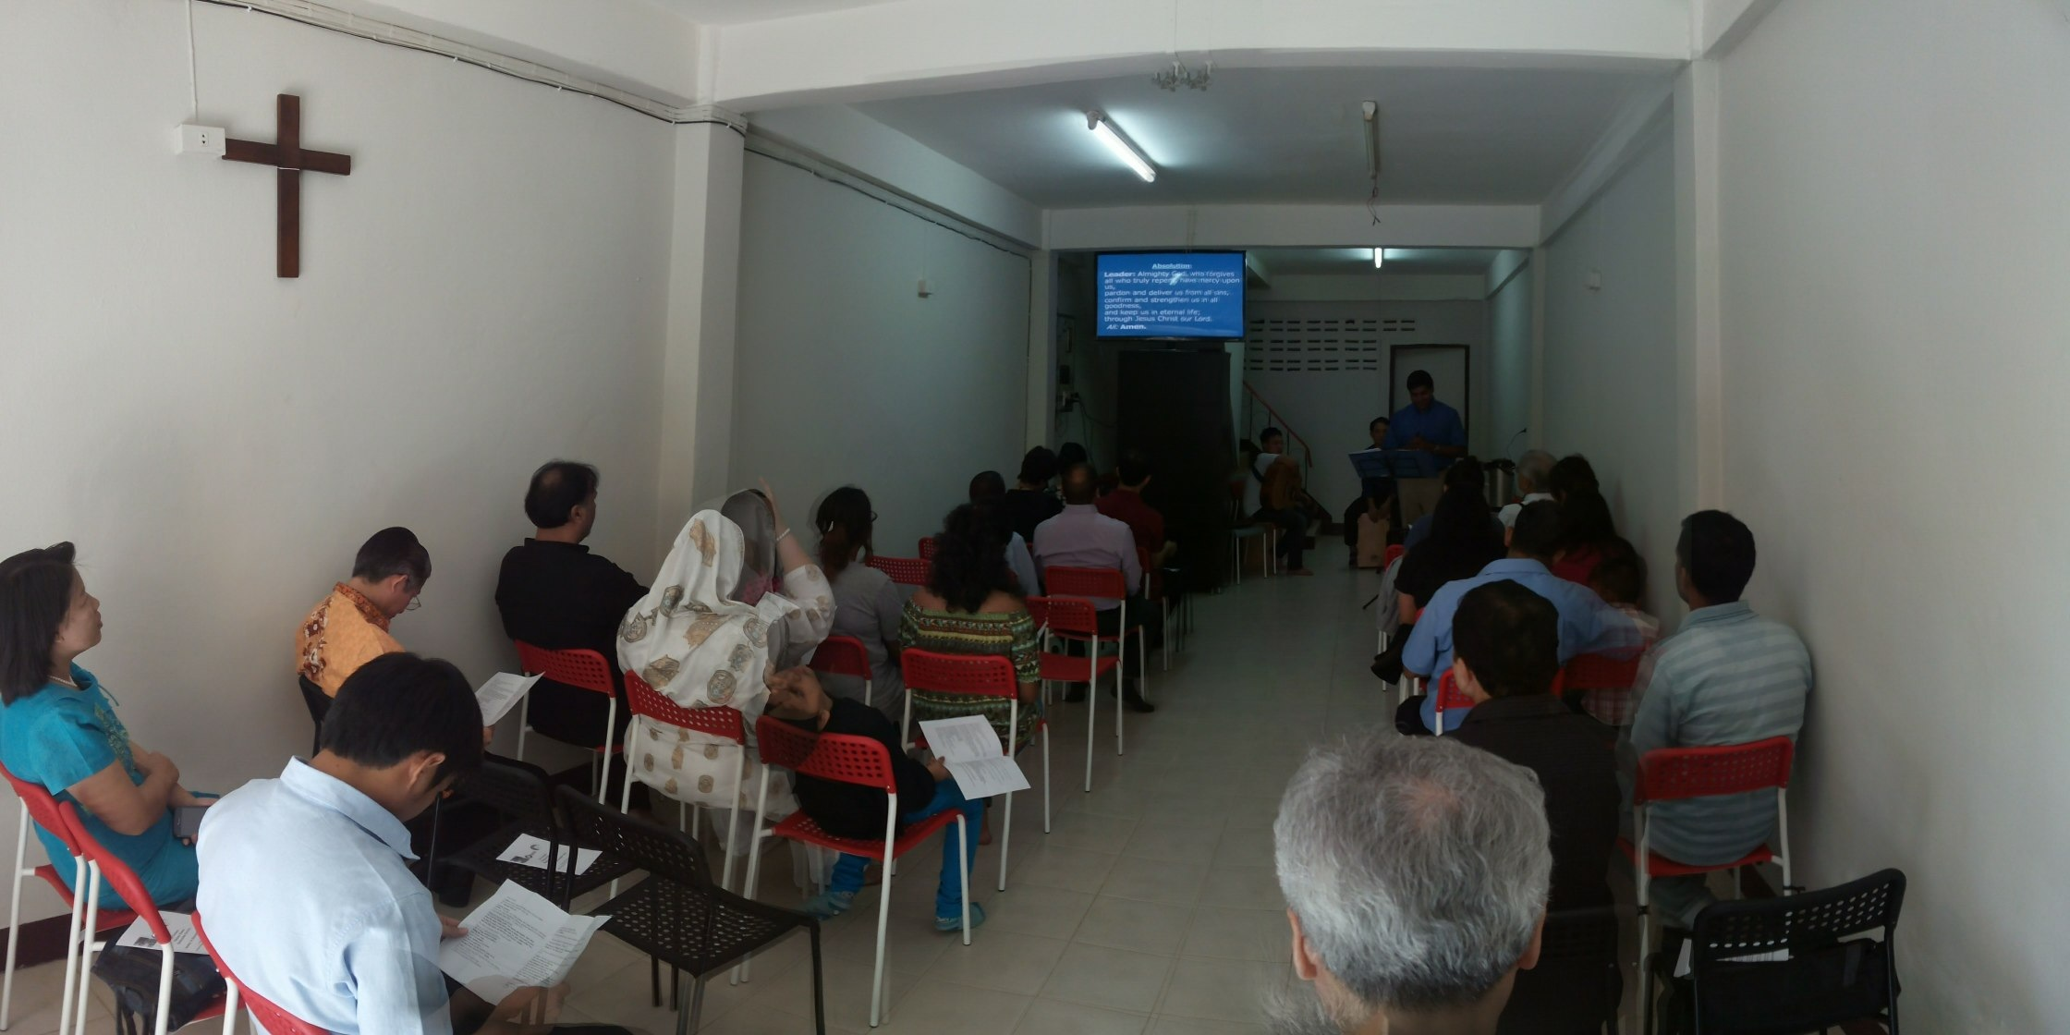
Snapshots
Warrens leading a new work in Salaya, on outskirts of Bangkok.
All Nations Mission House as a place of prayer, training and mission.

Slide 6
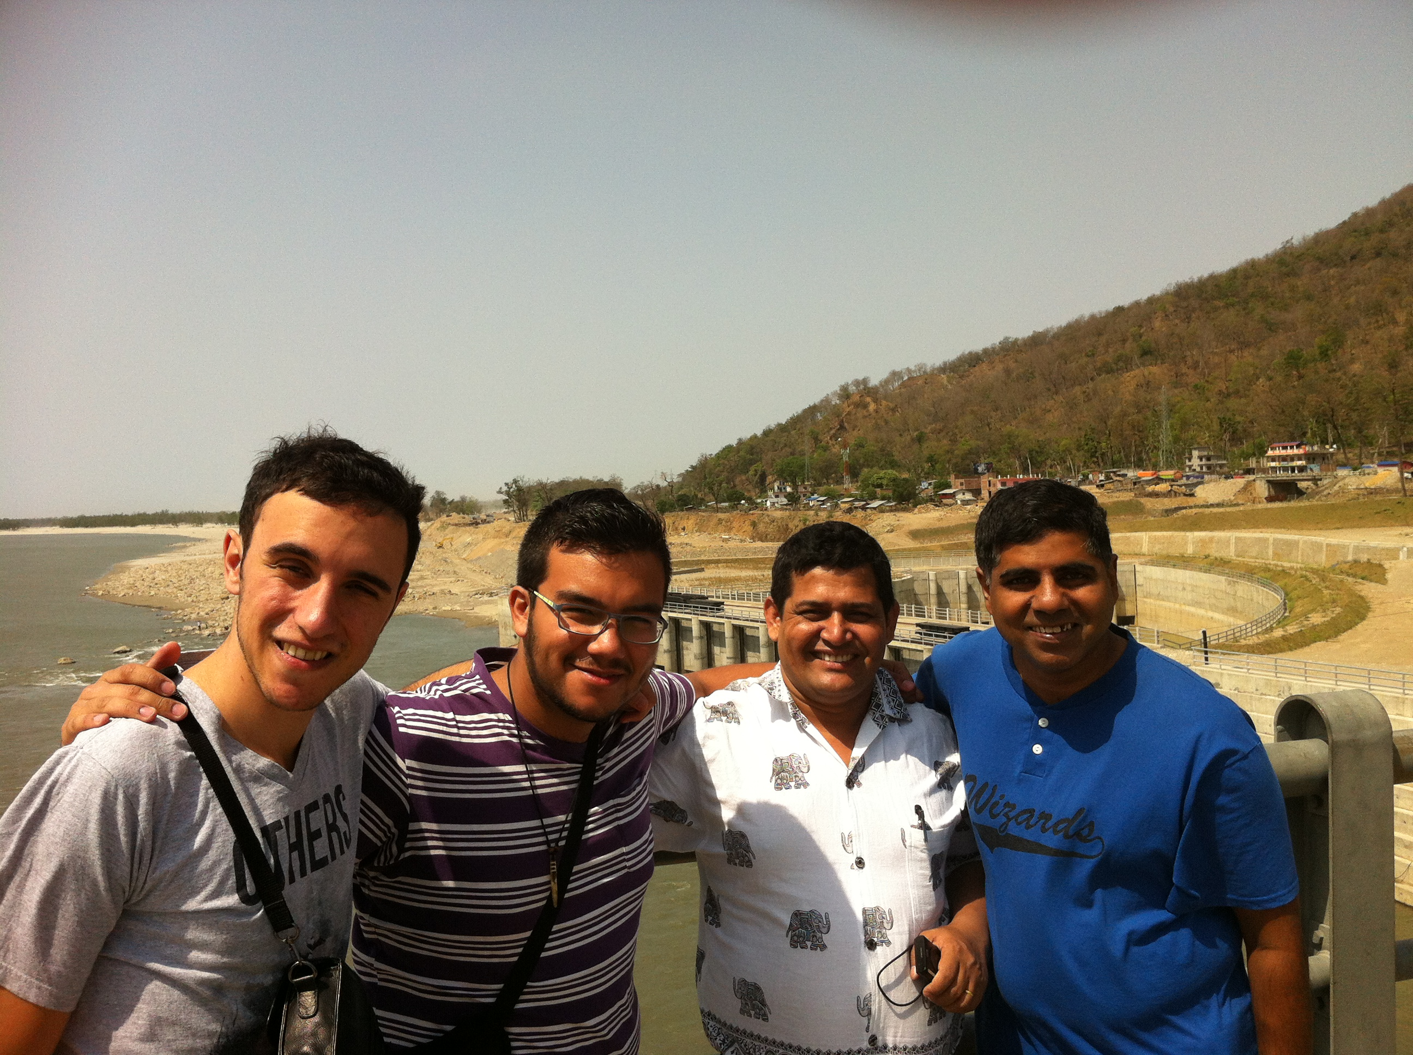
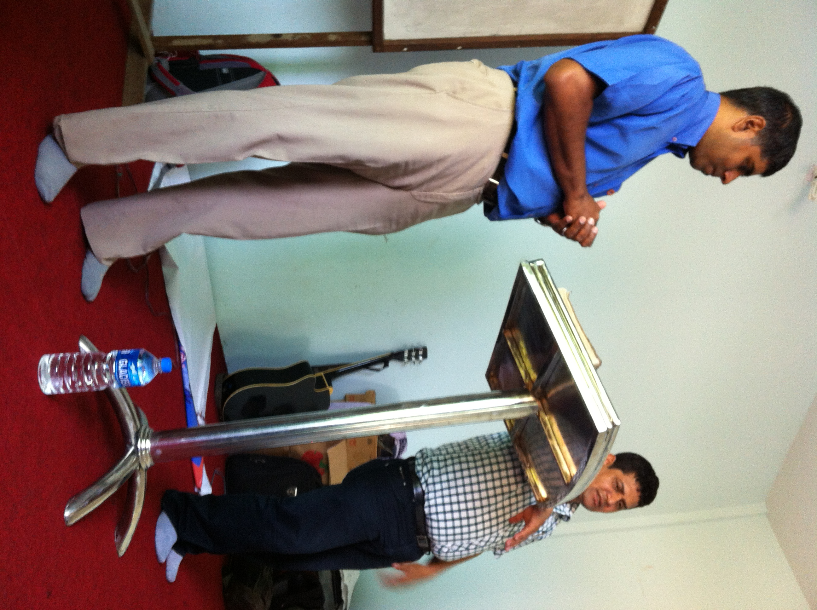
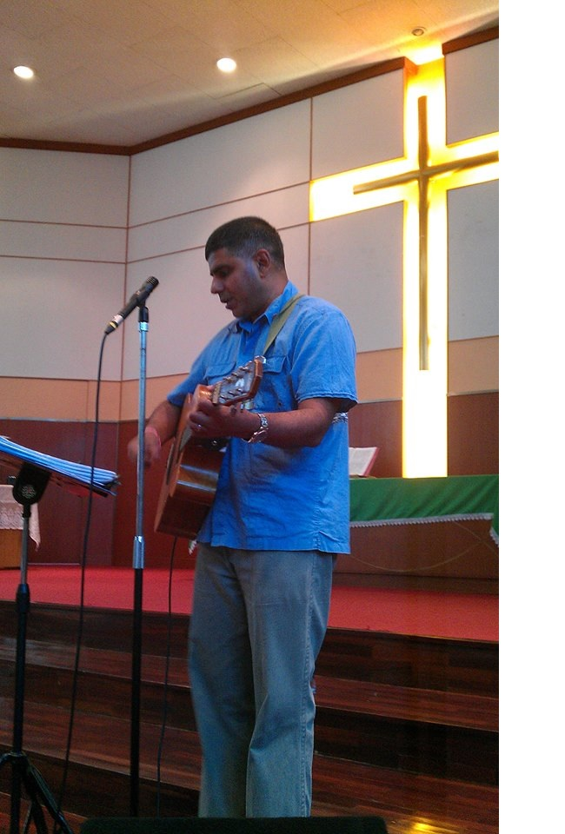
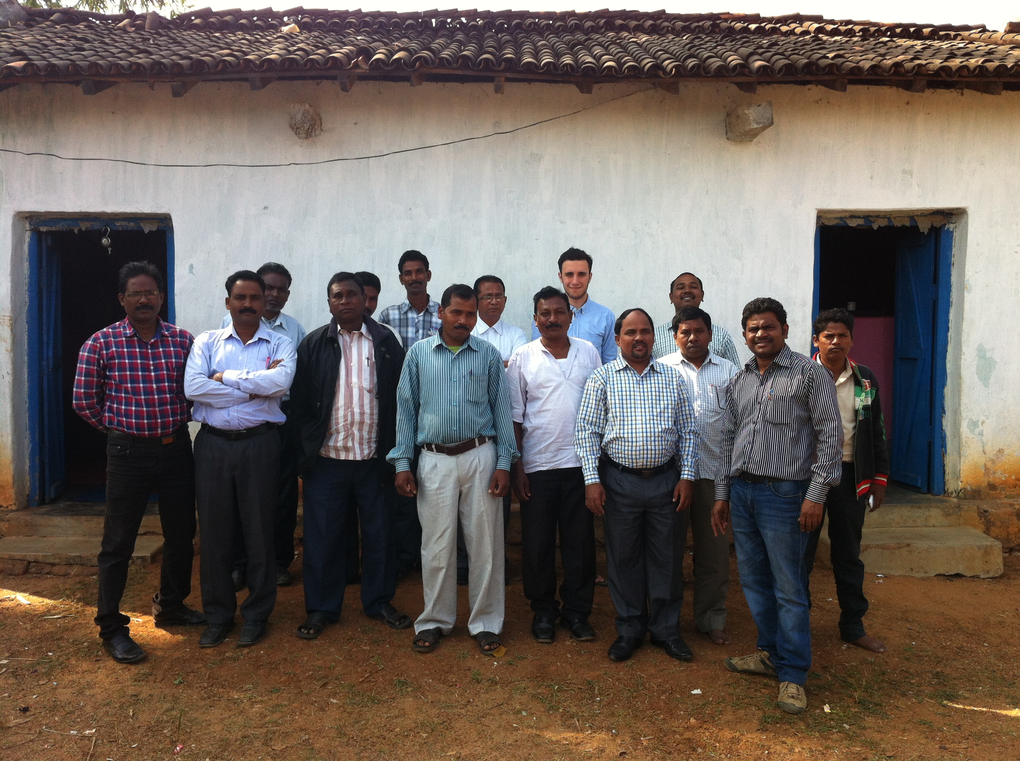
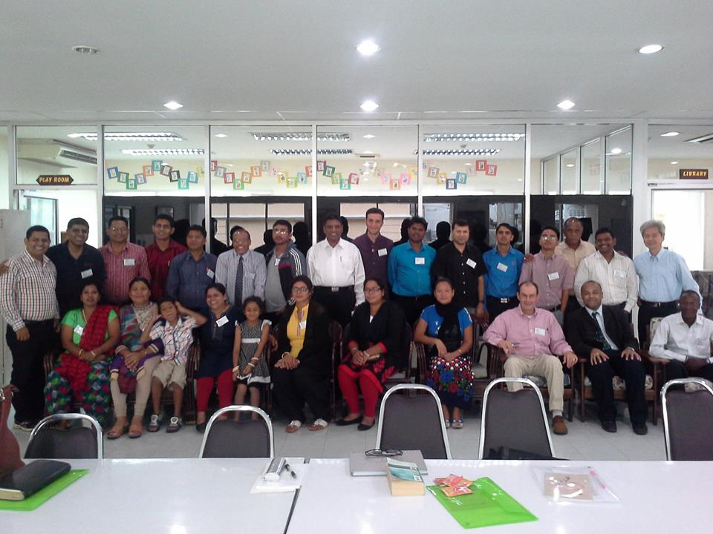
Snapshots - Regional
NAMS Nepal – Mission in May 2015. Now an on going relationship.
New opportunities in Myanmar and India

Slide 7
Reading from Psalm 32

Slide 8
Psalm 32
Of David. A maskil.
¹ Blessed is the one whose transgressions are forgiven, whose sins are covered. ² Blessed is the one whose sin the Lord does not count against them and in whose spirit is no deceit.
³ When I kept silent, my bones wasted away through my groaning all day long. ⁴ For day and night your hand was heavy on me; my strength was sapped as in the heat of summer.
⁵ Then I acknowledged my sin to you and did not cover up my iniquity. I said, ‘I will confess my transgressions to the Lord.’ And you forgave the guilt of my sin.

Slide 9
Psalm 32
⁶ Therefore let all the faithful pray to you while you may be found; surely the rising of the mighty waters will not reach them. ⁷ You are my hiding-place; you will protect me from trouble and surround me with songs of deliverance.
⁸ I will instruct you and teach you in the way you should go; I will counsel you with my loving eye on you. ⁹ Do not be like the horse or the mule, which have no understanding but must be controlled by bit and bridle or they will not come to you. ¹⁰ Many are the woes of the wicked, but the Lord’s unfailing love surrounds the one who trusts in him.
¹¹ Rejoice in the Lord and be glad, you righteous; sing, all you who are upright in heart!

Slide 10
A maskil - a teaching Psalm
Main theme: God's love is an all inclusive package of forgiveness, preservation and instruction.

Slide 11
Psalm 32
Of David. A maskil.
¹ Blessed is the one whose transgressions are forgiven, whose sins are covered. ² Blessed is the one whose sin the Lord does not count against them and in whose spirit is no deceit.
³ When I kept silent, my bones wasted away through my groaning all day long. ⁴ For day and night your hand was heavy on me; my strength was sapped as in the heat of summer.
⁵ Then I acknowledged my sin to you and did not cover up my iniquity. I said, ‘I will confess my transgressions to the Lord.’ And you forgave the guilt of my sin.

Slide 12
Psalm 132
3 Sections
1st section (vs 1-5) – Confess your sins
‘How happy is the one’ – vs 1
You will never know the freedom from sin till you’ve felt the burden of your guilt.
Verse 5 is pivotal – ‘I said’ vs ‘I kept silent’ in vs 3

Slide 13
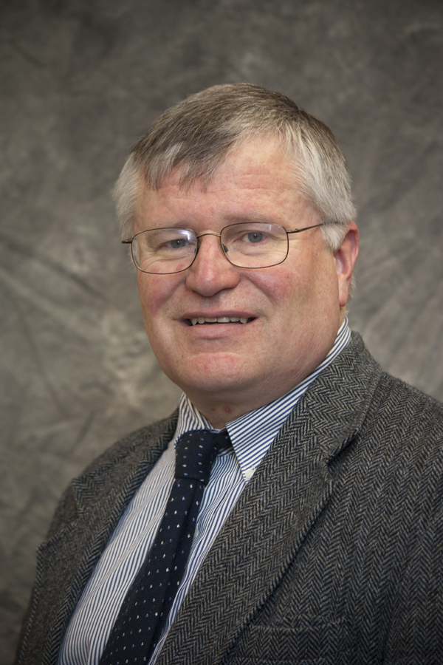
Gene Veith
"It is hard to proclaim the forgiveness of sins to people who believe that, since morality is relative, they have no sins to forgive.”

Slide 14
Psalm 132
3 particular words for forgiveness
Vs 1- ‘forgiven’ נָשָׂא- nasa' – lit. to bear up, to lift, to take away, carry off
Vs 1 - ‘covered’ כָּסָה kacah – lit. to cover over, take out of sight
Vs 2 – ‘not counted’ - חָשַׁב chashab - lit. Not charged, not accounted.
FORGIVENESS = FREEDOM

Slide 15
Psalm 32
⁶ Therefore let all the faithful pray to you while you may be found; surely the rising of the mighty waters will not reach them. ⁷ You are my hiding-place; you will protect me from trouble and surround me with songs of
deliverance.

Slide 16
Psalm 132
2nd section (vs 6-7) – Trusts God’s provision
God is our consummate refuge.
Psalm 46:1 ‘God is our refuge and strength – a very present help in trouble.’ (KJV)

Slide 17
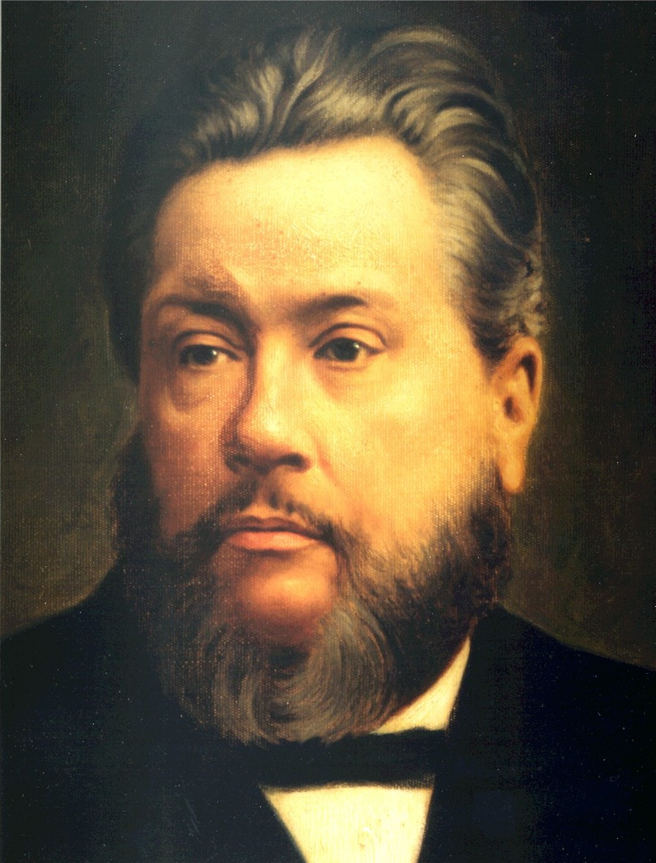
C.H. Spurgeon
‘A help that is not present when we need it is of small value. The anchor which is left at home is of no use to the seaman in the hour of storm; the money which he used to have is of no worth to the debtor when a writ is out against him……
He is more than "present," He is very present. More present than the nearest friend can be, for He is in us in our trouble; more present than we are to ourselves, for sometimes we lack presence of mind. He is always present, effectually present, sympathetically present, altogether present.’

Slide 18
Psalm 132
3rd section (vs 8-11) – Obey God’s instructions.

Slide 19
Psalm 32
⁸ I will instruct you and teach you in the way you should go; I will counsel you with my loving eye on you. ⁹ Do not be like the horse or the mule, which have no understanding but must be controlled by bit and bridle or they will not come to you. ¹⁰ Many are the woes of the wicked, but the Lord’s unfailing love surrounds the one who trusts in him.
¹¹ Rejoice in the Lord and be glad, you righteous; sing, all you who are upright in heart!

Slide 20
Psalm 132
3rd section (vs 8-11) – Obey God’s instructions.
God breaks in – the promise of divine guidance (see also Psalms 16:7, 73:24).
Vs 11 – all these result in the righteous being joyful and blessed.

Slide 21
A.W.Tozer
“With the goodness of God to desire our highest welfare, the wisdom of God to plan it, and the power of God to achieve it, what do we lack? Surely we are the most favoured of all creatures.”

Slide 22
The Gate of the Year Minne Louise Haskins — 1908
I said to the man who stood at the gate of the year,
"Give me a light that I may tread safely into the unknown."
And he replied,
"Go into the darkness and put your hand into the hand of God. That shall be to you better than light and safer than a known way."

Slide 23
Black

Slide 24
OT Preaching link at BibleStudyDownloads.org
Get this presentation for free!

