Slide 1
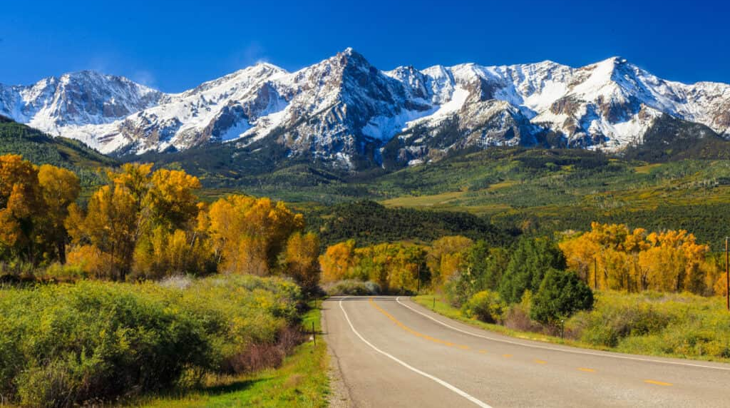
Psalm 25
Guidance – Our Great Need!
Summer in the
psalms
Preached by Dan Bridges at Amman International Church Singapore • AmmanChurch.com Uploaded by Dr. Rick Griffith • Jordan Evangelical Theological Seminary Files in many languages for free download at BibleStudyDownloads.org

Slide 2
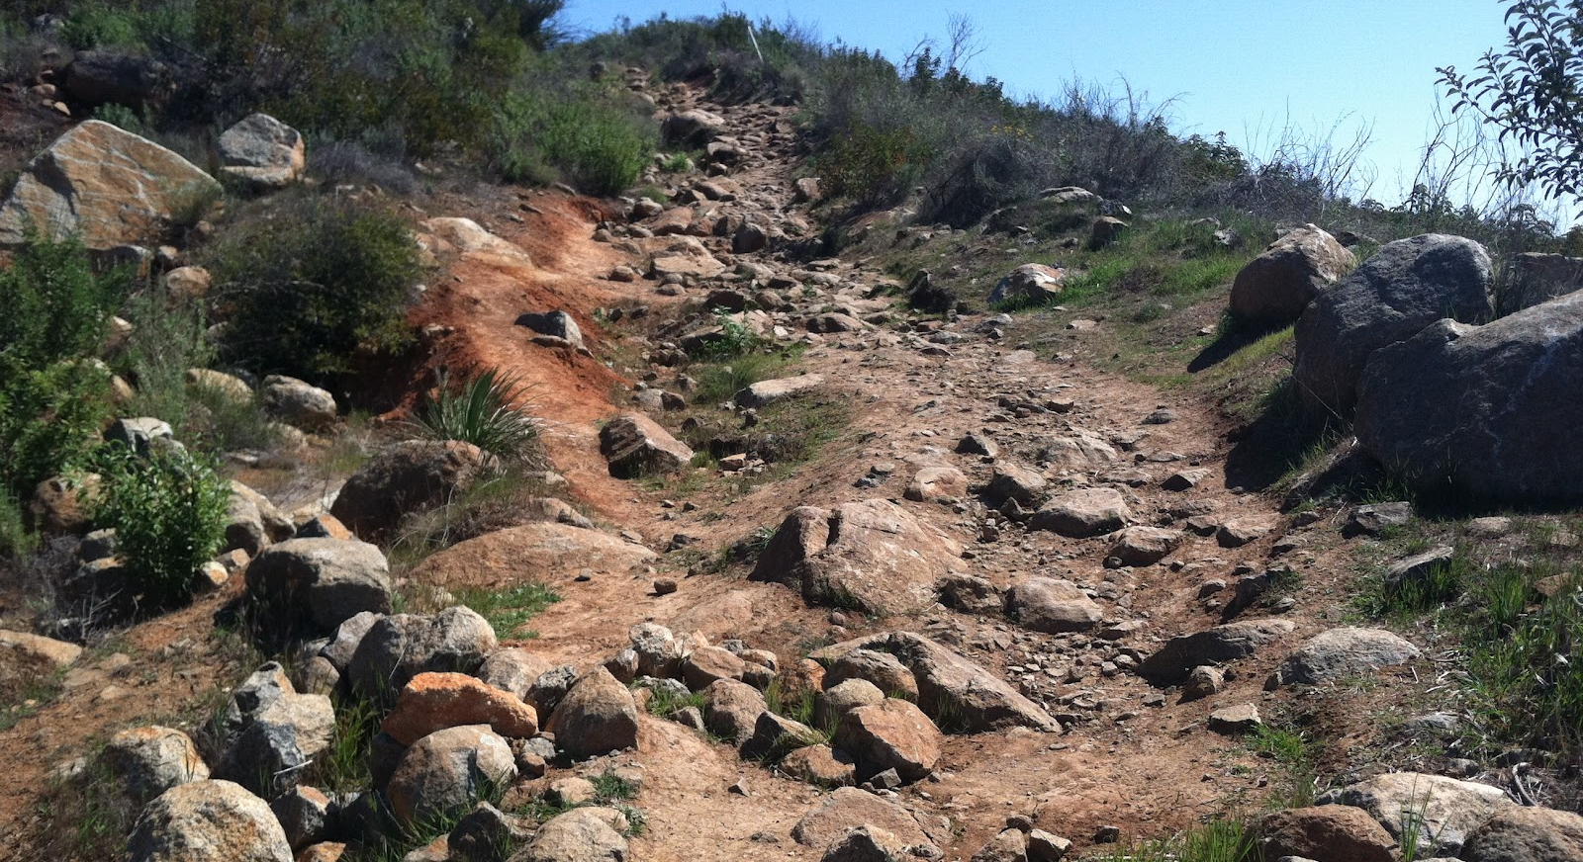
Old City and Kidron Valley from north
4 Show me your ways, Lord,
teach me your paths.
5 Guide me in your truth and teach me,
for you are God my Savior,
and my hope is in you all day long.
Psalm 25:4-5 (NIV)

Slide 3
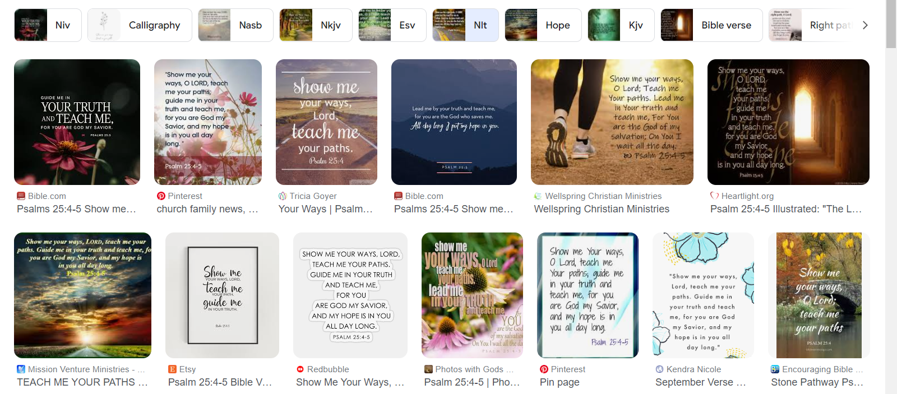
Psalm 25:4-5 – An Iconic Passage
“Show me your ways, Lord,
teach me your paths.
Guide me in your truth and teach me,
for you are God my Savior,
and my hope is in you all day long.”

Slide 4
Old City and Kidron Valley from north
Psalm 25 – David’s Prayer for Guidance
Overall Observations:
Acrostic Psalm
Prayer – mixed with meditations
No clear structure, but repeated themes
Major themes – David’s needs, God’s guidance, Prayers for forgiveness

Slide 5
Old City and Kidron Valley from north
Psalm 25 – David’s Prayer for Guidance
David’s Situation
God’s Guidance – David’s Great Need
Principles of How God Guides

Slide 6
Old City and Kidron Valley from north
1 To you, O Lord, I lift up my soul.
2 O my God, in you I trust;
let me not be put to shame;
let not my enemies exult over me.
3 Indeed, none who wait for you shall
be put to shame;
they shall be ashamed who are
wantonly treacherous.

Slide 7
Old City and Kidron Valley from north
16 Turn to me and be gracious to me,
for I am lonely and afflicted.
17 The troubles of my heart are enlarged;
bring me out of my distresses.
18 Consider my affliction and my trouble,
and forgive all my sins.

Slide 8
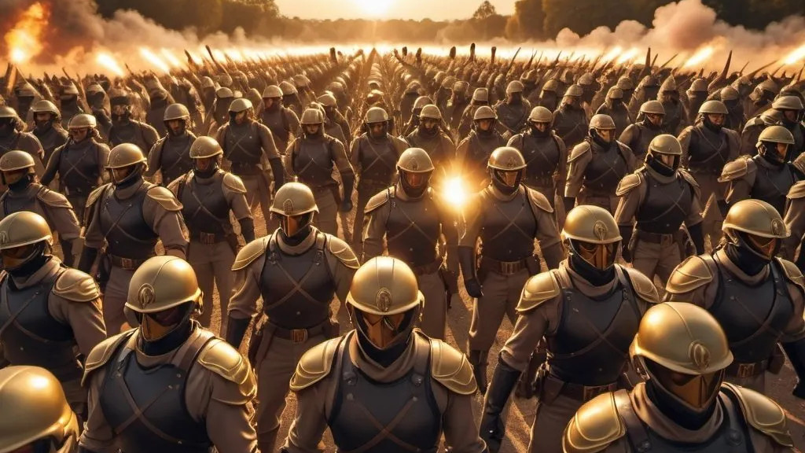
Old City and Kidron Valley from north
19 Consider how many are my foes,
and with what violent hatred they hate me.
20 Oh, guard my soul, and deliver me!
Let me not be put to shame, for I take refuge in you.
21 May integrity and uprightness preserve me,
for I wait for you.
22 Redeem Israel, O God,
out of all his troubles.

Slide 9
Old City and Kidron Valley from north
David’s Situation:
Fear of his enemies (2, 19)
Loneliness (16)
Troubled in his heart (17)
Distressed & Afflicted (16-18)
So, in response to all of this, how did he pray?

Slide 10
Old City and Kidron Valley from north
Psalm 25 – David’s Prayer for Guidance
David’s Situation
God’s Guidance – David’s Great Need
Principles of How God Guides

Slide 11
Old City and Kidron Valley from north
Why the focus on shame?
1 To you, O Lord, I lift up my soul.
2 O my God, in you I trust;
let me not be put to shame;
let not my enemies exult over me.
3 Indeed, none who wait for you shall
be put to shame;
they shall be ashamed who are
wantonly treacherous.
“put to shame” here means to be disappointed or let down.

Slide 12
Old City and Kidron Valley from north
1 To you, O Lord, I lift up my soul.
2 O my God, in you I trust;
let me not be put to shame;
let not my enemies exult over me.
3 Indeed, none who wait for you shall
be put to shame;
they shall be ashamed who are
wantonly treacherous.
“put to shame” here means to be disappointed or let down.
David is saying,
“I choose to trust in God and his ways.
If I do this, he will never let me down!”

Slide 13
Old City and Kidron Valley from north
Why focus on God’s guidance rather than his difficulties?
4 Make me to know your ways, O Lord;
teach me your paths.
5 Lead me in your truth and teach me,
for you are the God of my salvation;
for you I wait all the day long.

Slide 14
Old City and Kidron Valley from north
Because David chose to trust in God and God’s ways for protection and help, he saw God’s guidance as a greater need than deliverance!

Slide 15
Old City and Kidron Valley from north
To you, O Lord, I lift up my soul.
O my God, in you I trust;
let me not be put to shame;
let not my enemies exult over me.
Indeed, none who wait for you shall be put to shame;
they shall be ashamed who are wantonly treacherous.
Make me to know your ways, O Lord;
teach me your paths.
Lead me in your truth and teach me,
for you are the God of my salvation;
for you I wait all the day long.
Remember your mercy, O Lord, and your steadfast love,
for they have been from of old.
Remember not the sins of my youth or my transgressions;
according to your steadfast love remember me,
for the sake of your goodness, O Lord!
Good and upright is the Lord;
therefore he instructs sinners in the way.
He leads the humble in what is right,
and teaches the humble his way.
All the paths of the Lord are steadfast love and faithfulness,
for those who keep his covenant and his testimonies
For your name's sake, O Lord,
pardon my guilt, for it is great.
Who is the man who fears the Lord?
Him will he instruct in the way that he should choose.
His soul shall abide in well-being,
and his offspring shall inherit the land.
The friendship of the Lord is for those who fear him,
and he makes known to them his covenant.
My eyes are ever toward the Lord,
for he will pluck my feet out of the net.
Turn to me and be gracious to me,
for I am lonely and afflicted.
The troubles of my heart are enlarged;
bring me out of my distresses.
Consider my affliction and my trouble,
and forgive all my sins.
Consider how many are my foes,
and with what violent hatred they hate me.
Oh, guard my soul, and deliver me!
Let me not be put to shame, for I take refuge in you.
May integrity and uprightness preserve me,
for I wait for you.
Redeem Israel, O God, out of all his troubles.
Focus on his difficulties

Slide 16
Old City and Kidron Valley from north
To you, O Lord, I lift up my soul.
O my God, in you I trust;
let me not be put to shame;
let not my enemies exult over me.
Indeed, none who wait for you shall be put to shame;
they shall be ashamed who are wantonly treacherous.
Make me to know your ways, O Lord;
teach me your paths.
Lead me in your truth and teach me,
for you are the God of my salvation;
for you I wait all the day long.
Remember your mercy, O Lord, and your steadfast love,
for they have been from of old.
Remember not the sins of my youth or my transgressions;
according to your steadfast love remember me,
for the sake of your goodness, O Lord!
Good and upright is the Lord;
therefore he instructs sinners in the way.
He leads the humble in what is right,
and teaches the humble his way.
All the paths of the Lord are steadfast love and faithfulness,
for those who keep his covenant and his testimonies
For your name's sake, O Lord,
pardon my guilt, for it is great.
Who is the man who fears the Lord?
Him will he instruct in the way that he should choose.
His soul shall abide in well-being,
and his offspring shall inherit the land.
The friendship of the Lord is for those who fear him,
and he makes known to them his covenant.
My eyes are ever toward the Lord,
for he will pluck my feet out of the net.
Turn to me and be gracious to me,
for I am lonely and afflicted.
The troubles of my heart are enlarged;
bring me out of my distresses.
Consider my affliction and my trouble,
and forgive all my sins.
Consider how many are my foes,
and with what violent hatred they hate me.
Oh, guard my soul, and deliver me!
Let me not be put to shame, for I take refuge in you.
May integrity and uprightness preserve me,
for I wait for you.
Redeem Israel, O God, out of all his troubles.
Focus on God’s Guidance

Slide 17
Old City and Kidron Valley from north
To you, O Lord, I lift up my soul.
O my God, in you I trust;
let me not be put to shame;
let not my enemies exult over me.
Indeed, none who wait for you shall be put to shame;
they shall be ashamed who are wantonly treacherous.
Make me to know your ways, O Lord;
teach me your paths.
Lead me in your truth and teach me,
for you are the God of my salvation;
for you I wait all the day long.
Remember your mercy, O Lord, and your steadfast love,
for they have been from of old.
Remember not the sins of my youth or my transgressions;
according to your steadfast love remember me,
for the sake of your goodness, O Lord!
Good and upright is the Lord;
therefore he instructs sinners in the way.
He leads the humble in what is right,
and teaches the humble his way.
All the paths of the Lord are steadfast love and faithfulness,
for those who keep his covenant and his testimonies
For your name's sake, O Lord,
pardon my guilt, for it is great.
Who is the man who fears the Lord?
Him will he instruct in the way that he should choose.
His soul shall abide in well-being,
and his offspring shall inherit the land.
The friendship of the Lord is for those who fear him,
and he makes known to them his covenant.
My eyes are ever toward the Lord,
for he will pluck my feet out of the net.
Turn to me and be gracious to me,
for I am lonely and afflicted.
The troubles of my heart are enlarged;
bring me out of my distresses.
Consider my affliction and my trouble,
and forgive all my sins.
Consider how many are my foes,
and with what violent hatred they hate me.
Oh, guard my soul, and deliver me!
Let me not be put to shame, for I take refuge in you.
May integrity and uprightness preserve me,
for I wait for you.
Redeem Israel, O God, out of all his troubles.
Focus on forgiveness

Slide 18
Old City and Kidron Valley from north
To you, O Lord, I lift up my soul.
O my God, in you I trust;
let me not be put to shame;
let not my enemies exult over me.
Indeed, none who wait for you shall be put to shame;
they shall be ashamed who are wantonly treacherous.
Make me to know your ways, O Lord;
teach me your paths.
Lead me in your truth and teach me,
for you are the God of my salvation;
for you I wait all the day long.
Remember your mercy, O Lord, and your steadfast love,
for they have been from of old.
Remember not the sins of my youth or my transgressions;
according to your steadfast love remember me,
for the sake of your goodness, O Lord!
Good and upright is the Lord;
therefore he instructs sinners in the way.
He leads the humble in what is right,
and teaches the humble his way.
All the paths of the Lord are steadfast love and faithfulness,
for those who keep his covenant and his testimonies
For your name's sake, O Lord,
pardon my guilt, for it is great.
Who is the man who fears the Lord?
Him will he instruct in the way that he should choose.
His soul shall abide in well-being,
and his offspring shall inherit the land.
The friendship of the Lord is for those who fear him,
and he makes known to them his covenant.
My eyes are ever toward the Lord,
for he will pluck my feet out of the net.
Turn to me and be gracious to me,
for I am lonely and afflicted.
The troubles of my heart are enlarged;
bring me out of my distresses.
Consider my affliction and my trouble,
and forgive all my sins.
Consider how many are my foes,
and with what violent hatred they hate me.
Oh, guard my soul, and deliver me!
Let me not be put to shame, for I take refuge in you.
May integrity and uprightness preserve me,
for I wait for you.
Redeem Israel, O God, out of all his troubles.
Difficulties
Guidance or Forgiveness

Slide 19
Old City and Kidron Valley from north
David believed that God could and would save him, but his biggest need was God’s wisdom and teaching to know how to proceed.
4 Make me to know your ways, O Lord;
teach me your paths.
5 Lead me in your truth and teach me,
for you are the God of my salvation;
for you I wait all the day long.

Slide 20
Old City and Kidron Valley from north
Psalm 25 – David’s Prayer for Guidance
David’s Situation
God’s Guidance – David’s Great Need
Principles of How God Guides

Slide 21
Old City and Kidron Valley from north
Principles of God’s Guidance:
Ask for it
4 Make me to know your ways, O Lord;
teach me your paths.
5 Lead me in your truth and teach me,
for you are the God of my salvation;
for you I wait all the day long.

Slide 22
Old City and Kidron Valley from north
Principles of God’s Guidance:
Ask for it
Be willing to wait for it
4 Make me to know your ways, O Lord;
teach me your paths.
5 Lead me in your truth and teach me,
for you are the God of my salvation;
for you I wait all the day long.

Slide 23
Old City and Kidron Valley from north
Principles of God’s Guidance:
Ask for it
Be willing to wait for it
Admit our unworthiness
6 Remember your mercy, O Lord, and your steadfast love,
for they have been from of old.
7 Remember not the sins of my youth or my transgressions;
according to your steadfast love remember me,
for the sake of your goodness, O Lord!

Slide 24
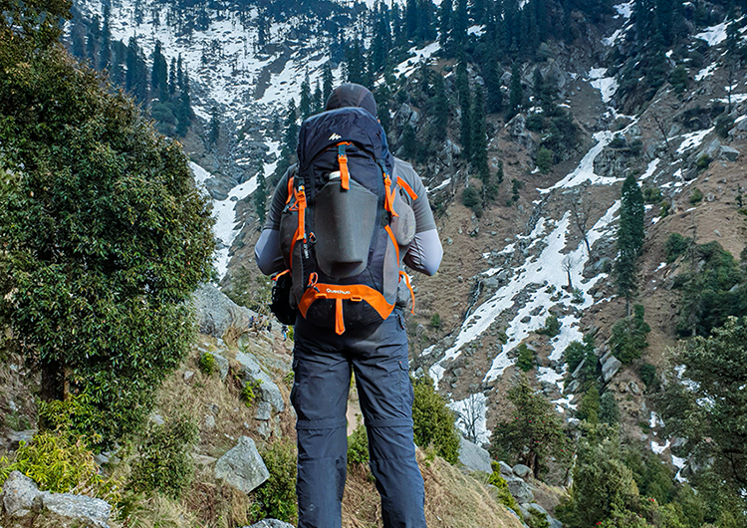
Old City and Kidron Valley from north
Principles of God’s Guidance:
Be willing to wait for it
Admit our unworthiness
God gives it to sinners
8 Good and upright is the Lord;
therefore he instructs sinners in the way.
9 He leads the humble in what is right,
and teaches the humble his way.

Slide 25
Old City and Kidron Valley from north
Principles of God’s Guidance:
Admit our unworthiness
God gives it to sinners
Humble, teachable heart
8 Good and upright is the Lord;
therefore he instructs sinners in the way.
9 He leads the humble in what is right,
and teaches the humble his way.

Slide 26
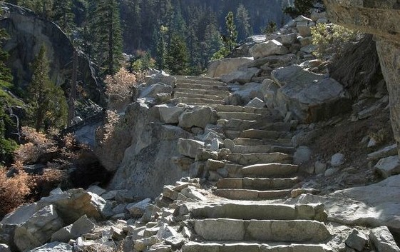
Old City and Kidron Valley from north
Principles of God’s Guidance:
God gives it to sinners
Humble, teachable heart
Readiness to accept/obey
10 All the paths of the Lord are steadfast love and faithfulness,
for those who keep his covenant and his testimonies.

Slide 27
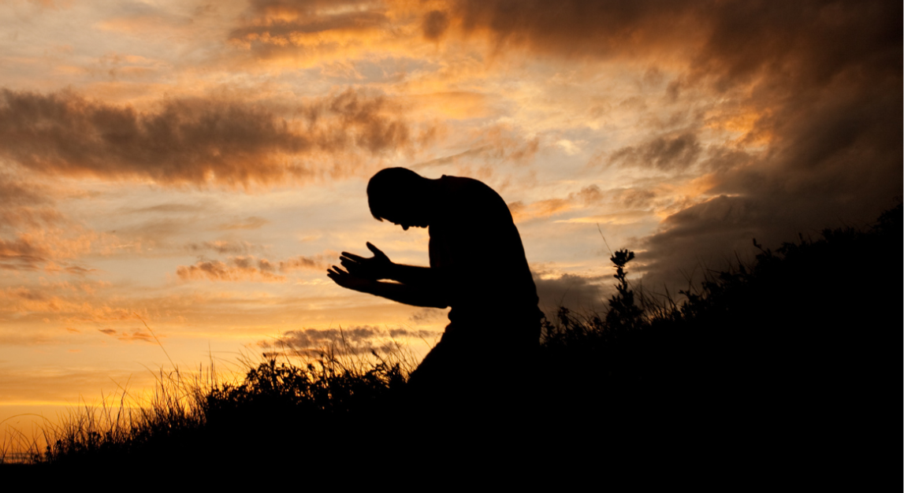
Old City and Kidron Valley from north
Principles of God’s Guidance:
Humble, teachable heart
Readiness to accept/obey
Fear the Lord
11 For your name's sake, O Lord,
pardon my guilt, for it is great.
12 Who is the man who fears the Lord?
Him will he instruct in the way that he should choose.

Slide 28
Old City and Kidron Valley from north
The most important factor in receiving God’s guidance is not technique, but attitude and character!
Ask for it
Be willing to wait for it
Admit our unworthiness
God gives it to sinners
Humble, teachable heart
Readiness to accept/obey
Fear the Lord

Slide 29
Old City and Kidron Valley from north
So how can we expect God to guide us?
What will that look like?
Ask for it
Be willing to wait for it
Admit our unworthiness
God gives it to sinners
Humble, teachable heart
Readiness to accept/obey
Fear the Lord

Slide 30
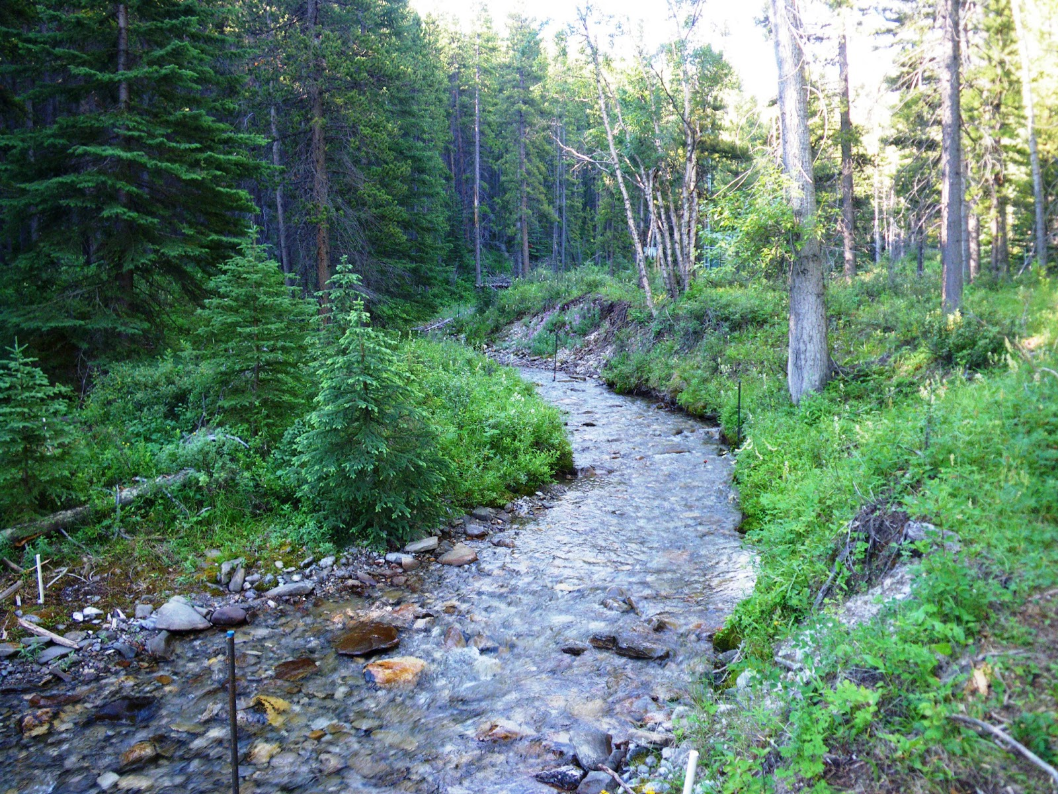
Old City and Kidron Valley from north
13 His soul shall abide in well-being,
and his offspring shall inherit the land.
14 The friendship of the Lord is for those who fear him,
and he makes known to them his covenant.
15 My eyes are ever toward the Lord,
for he will pluck my feet out of the net.
ESV: The friendship of the LORD is for those who fear him
NASB: The secret of the LORD is for those who fear Him
NIV: The LORD confides in those who fear him
NLT: The LORD is a friend to those who fear him

Slide 31
Old City and Kidron Valley from north
sôḏ - Secrets shared only with
most intimate and trusted
people
ESV: The friendship of the LORD is for those who fear him
NASB: The secret of the LORD is for those who fear Him
NIV: The LORD confides in those who fear him
NLT: The LORD is a friend to those who fear him

Slide 32
Old City and Kidron Valley from north
13 His soul shall abide in well-being,
and his offspring shall inherit the land.
14 The friendship of the Lord is for those who fear him,
and he makes known to them his covenant.
15 My eyes are ever toward the Lord,
for he will pluck my feet out of the net.
God’s guides us in the context of our relationship with him!

Slide 33
Old City and Kidron Valley from north
As we pursue a relationship with him, God shows us:
Wrong motives (fear, getting rid of pain, selfish interests)
Principles from His Word that apply (sins I’m clinging to, applicable parts of God’s character, purposes of God in the world)
Needed details of his leading (through circumstances, other people and our own hearts)

Slide 34
Old City and Kidron Valley from north
How will you handle your difficulties?
Will you choose to say,
“I choose to trust in God and his ways.
If I do this, he will never let me down!”
“All the paths of the Lord are steadfast love
and faithfulness.”
Will you choose to seek guidance before deliverance?
Will you choose to seek guidance by pursuing holiness and Christ-like character?

Slide 35
Old City and Kidron Valley from north
13 His soul shall abide in well-being,
and his offspring shall inherit the land.
14 The friendship of the Lord is for those who fear him,
and he makes known to them his covenant.
15 My eyes are ever toward the Lord,
for he will pluck my feet out of the net.
God’s guides us in the context of our relationship with him!

Slide 37
OT Preaching link at BibleStudyDownloads.org
Get this presentation and notes for free!
Notes:
OT Preaching (op)

