Slide 1

Trusting God
Trusting God as My Shepherd
Preached by Dan Bridges Amman International Church, Jordan (AmmanChurch.org) Uploaded by Dr. Rick Griffith • Jordan Evangelical Theological Seminary Files in many languages for free download at BibleStudyDownloads.org

Slide 2
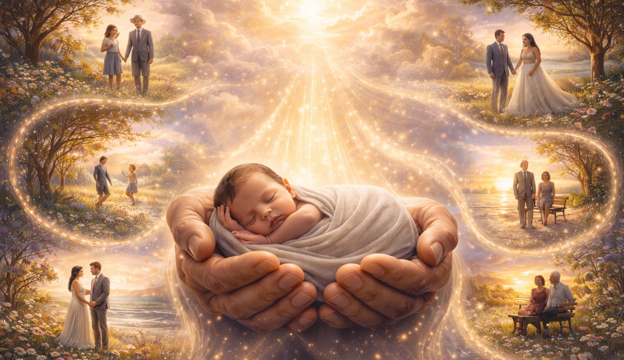
How can I be confident of finding the path God has for me?
“…in your book were written, every one of them, the days that were formed for me, when as yet there was none of them.”
Psalm 139:16

Slide 3
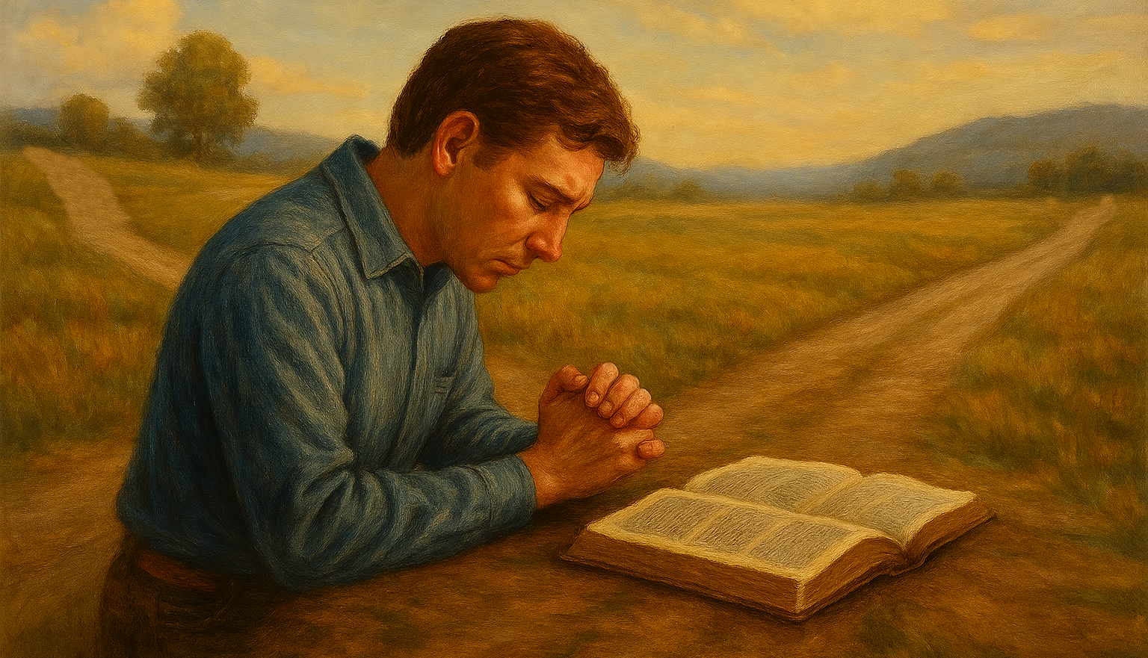
Life is full of decisions!
How can we trust God to guide us?

Slide 4



What if I miss God’s will – either by sinful choices or mistake?

Slide 5
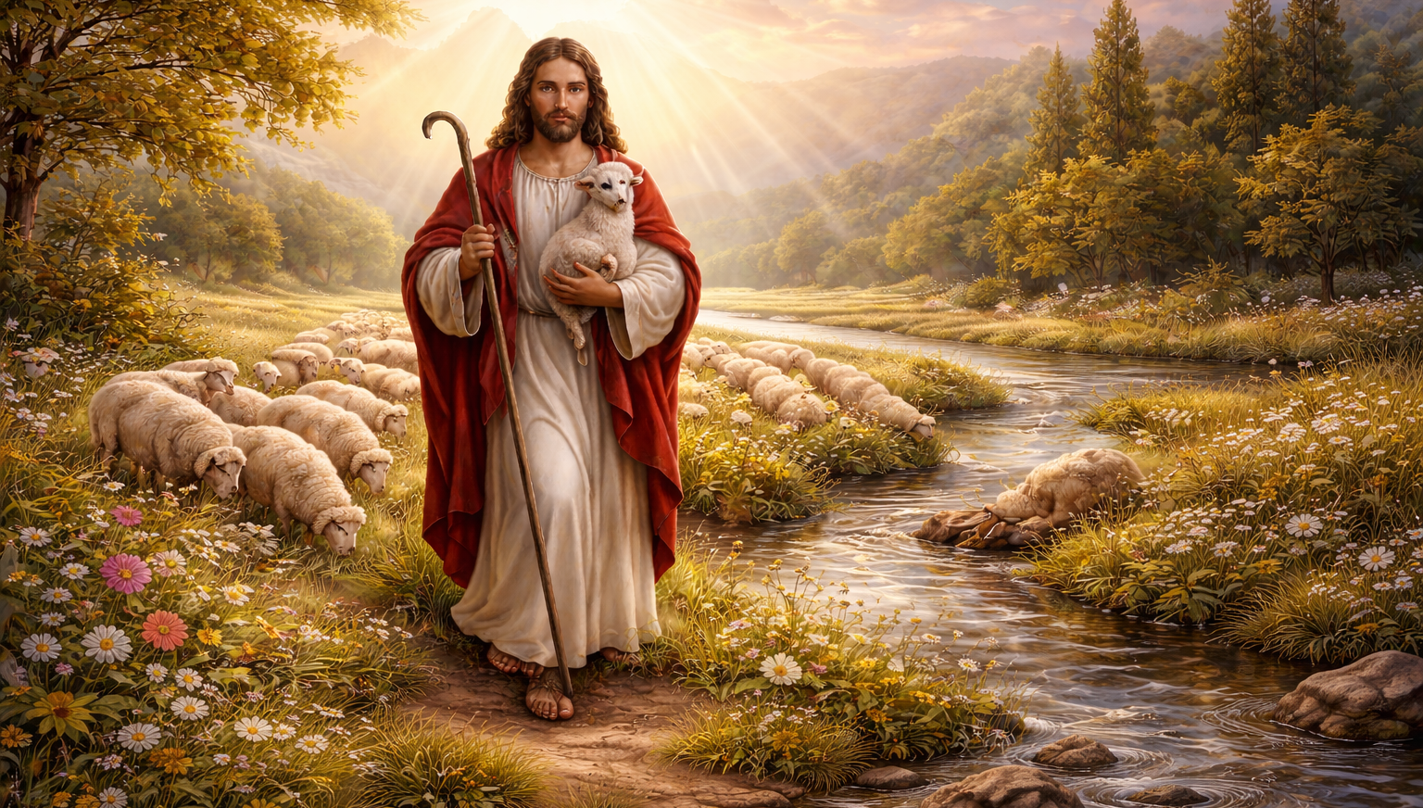
“The LORD is my shepherd…” Psalm 23:1
What, exactly, does it mean that,
“The LORD is my Shepherd”?

Slide 6
Trusting God as My Shepherd
God’s Role as My Shepherd
Embracing God's Guidance
What if I Mess Up?

Slide 7
“The LORD is my shepherd; I shall not want.
He makes me lie down in green pastures.
He leads me beside still waters.
He restores my soul.
He leads me in paths of righteousness
for his name's sake.” Psalm 23:1-3

Slide 8
“Sheep require, more than any other class of livestock, endless attention and meticulous care!”
Phillip Keller – A Shepherd Looks at Psalm 23
“The LORD is my shepherd; I shall not want.” Psalm 23:1

Slide 9
Recognize who this is…
Yahweh, the creator of the universe!
“The LORD is my shepherd; I shall not want.” Psalm 23:1

Slide 10
To “want” is to lack.
Do we trust that He knows and will provide what we need?
“The LORD is my shepherd; I shall not want.” Psalm 23:1

Slide 11
“Contentment should be the hallmark of the one who has put his affairs in the hands of God.”
Phillip Keller – A Shepherd Looks at Psalm 23
“The LORD is my shepherd; I shall not want.” Psalm 23:1

Slide 12
Green pastures are a place of rest and nourishment.
“He makes me lie down in green pastures.
He leads me beside still waters.
He restores my soul.” Psalm 23:2

Slide 13
What enables sheep to lie down and rest?
They must be free from fear and anxiety…
The presence of the shepherd gives this!
“He makes me lie down in green pastures.
He leads me beside still waters.
He restores my soul.” Psalm 23:2

Slide 14
“In peace I will both lie down and sleep; for you alone, O LORD, make me dwell in safety.”
Psalm 4:8
“He makes me lie down in green pastures.
He leads me beside still waters.
He restores my soul.” Psalm 23:2

Slide 15
When sheep are thirsty, they will drink from anywhere – even places that make them sick!
“He makes me lie down in green pastures.
He leads me beside still waters.
He restores my soul.” Psalm 23:2

Slide 16
The shepherd alone knows where the still, clean, pure water is to be found!
“If anyone thirsts, let him come to me and drink.”
John 7:38
“He makes me lie down in green pastures.
He leads me beside still waters.
He restores my soul.” Psalm 23:2

Slide 17
Why do we need him to “restore our souls”?
“He makes me lie down in green pastures.
He leads me beside still waters.
He restores my soul.” Psalm 23:2

Slide 18
“Why are you cast down, O my soul,
and why are you in turmoil within me?”
Psalm 42:5
“He makes me lie down in green pastures.
He leads me beside still waters.
He restores my soul.” Psalm 23:2

Slide 19
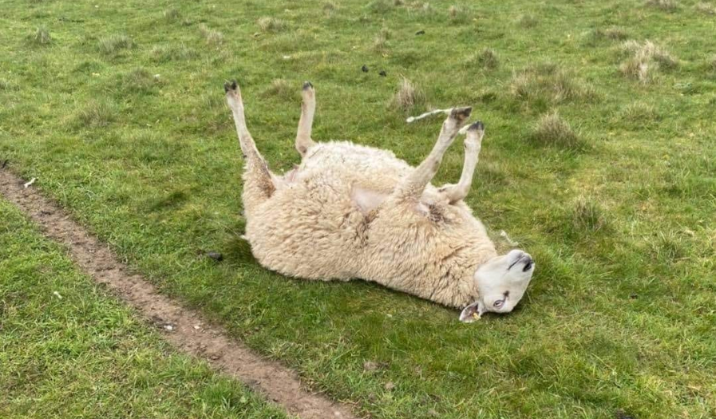
“Cast Down” Sheep!
“Why are you cast down, O my soul,
and why are you in turmoil within me?” Psalm 42:5

Slide 20
“Cast Down” Sheep!
A good shepherd always knows when one of the sheep is missing… then they go in search of the missing one!

Slide 21
God loves to restore our souls!
“He makes me lie down in green pastures.
He leads me beside still waters.
He restores my soul.” Psalm 23:2

Slide 22
What does it look like in life to lie down in green pastures, to satisfy my thirst in Jesus, to be restored by Him?
“He makes me lie down in green pastures.
He leads me beside still waters.
He restores my soul.” Psalm 23:2

Slide 23
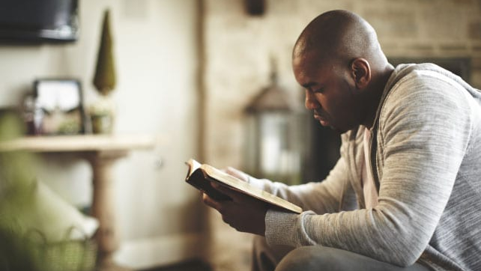
“He makes me lie down in green pastures.
He leads me beside still waters.
He restores my soul.” Psalm 23:2

Slide 24
“He leads me in paths of righteousness
for his name's sake.” Psalm 23:3

Slide 25
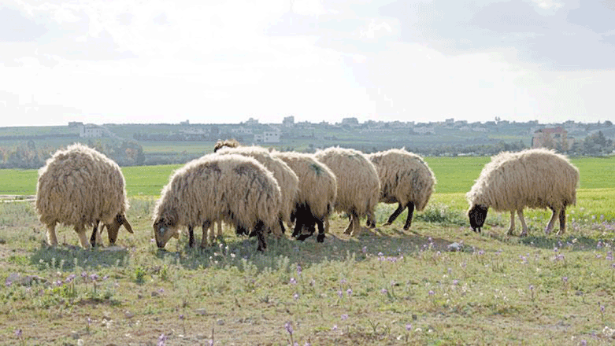
Left to themselves, sheep will graze the same ground until it’s ruined and follow the same paths until they become huge gullies. To survive, they need to be led!

Slide 26
We, like sheep, like to cling to ways and habits that are familiar – often to our own harm!

Slide 27
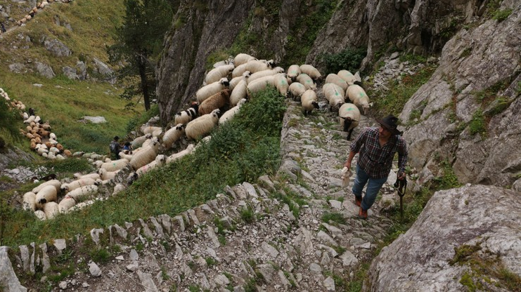
A good shepherd constantly changes grazing locations – he knows where his flock will thrive!

Slide 28
What does it look like to follow Jesus as our shepherd in real life?
It looks like obedience!

Slide 29
Who is the initiator in this relationship?
“The LORD is my shepherd; I shall not want.
He makes me lie down in green pastures.
He leads me beside still waters.
He restores my soul.
He leads me in paths of righteousness
for his name's sake.” Psalm 23:1-3

Slide 30
Who is the initiator in this relationship?
“The LORD is my shepherd; I shall not want.
He makes me lie down in green pastures.
He leads me beside still waters.
He restores my soul.
He leads me in paths of righteousness
for his name's sake.” Psalm 23:1-3

Slide 31
But we still need to respond!
“The LORD is my shepherd; I shall not want.
He makes me lie down in green pastures.
He leads me beside still waters.
He restores my soul.
He leads me in paths of righteousness
for his name's sake.” Psalm 23:1-3

Slide 32
Trusting God as My Shepherd
God’s Role as My Shepherd
Embracing God's Guidance
What if I Mess Up?

Slide 33
How does God, as my shepherd, guide me through life?

Slide 34
God’s Job… My Job
“The king's heart is a stream of water in the hand of the Lord; he turns it wherever he will.” Proverbs 21:1

Slide 35
God’s Job… My Job
“The king's heart is a stream of water in the hand of the Lord; he turns it wherever he will.” Proverbs 21:1
God guides the hearts of all to work out his sovereign will in the world.

Slide 36
God’s Job… My Job
“Trust in the LORD, and do good;
dwell in the land and befriend faithfulness.
Delight yourself in the LORD,
and he will give you the desires of your heart.” Psalm 37:3-4

Slide 37
God’s Job… My Job
“Trust in the LORD, and do good;
dwell in the land and befriend faithfulness.
Delight yourself in the LORD,
and he will give you the desires of your heart.” Psalm 37:3-4
Satisfying our thirst in Him! (Psalm 23:2)
God guides as we live faithfully and delight in Him in our current situation

Slide 38
God’s Job… My Job
“Trust in the LORD with all your heart,
and do not lean on your own understanding.
In all your ways acknowledge him,
and he will make straight your paths.”
Proverbs 3:5-6

Slide 39
God’s Job… My Job
“Trust in the LORD with all your heart,
and do not lean on your own understanding.
In all your ways acknowledge him,
and he will make straight your paths.”
Proverbs 3:5-6
Letting him lead us! (Psalm 23:3)
God guides as we obey and live in his ways rather than what seems best to us.

Slide 40
“Delight yourself in the LORD,
and he will give you the desires of your heart.”
“In all your ways acknowledge him,
and he will make straight your paths.”
Story of getting my first job…

Slide 41
Characteristics of God’s Guidance:
He guides us in his sovereignty
He calls us to delight in Him!
He asks us to obey and be faithful where we are before he leads us to the next thing
His solutions are in his time and often require waiting – trusting!

Slide 42
“‘Ah, stubborn children,’ declares the LORD,
‘who carry out a plan, but not mine,
and who make an alliance, but not of my Spirit,
that they may add sin to sin;
who set out to go down to Egypt,
without asking for my direction,
to take refuge in the protection of Pharaoh
and to seek shelter in the shadow of Egypt!’”
Isaiah 30:1-2
When we are afraid God won’t meet our needs, we are tempted to provide our own solutions…

Slide 43
Characteristics of God’s Guidance:
He guides us in his sovereignty
He calls us to delight in Him!
He asks us to obey and be faithful where we are before he leads us to the next thing
His solutions are in his time and often require waiting – trusting!

Slide 44
Trusting God as My Shepherd
God’s Role as My Shepherd
Embracing God's Guidance
What if I Mess Up?

Slide 45
What if I miss God’s will – either by sinful choices or mistake?

Slide 46
The Bible is full of examples of God redeeming even these situations!

Slide 47
Jacob:
Known as a deceiver
Weak faith - For many years he only referred to God as “the God of my fathers”
Deceived his father and brother and had to run for his life
Result:
God used him to establish the 12 tribes of Israel!

Slide 48
David:
Committed adultery with Bathsheba
Killed Bathsheba’s husband
Result:
Solomon – the wisest king ever and writer of part of the Bible was the son of Bathsheba!

Slide 49
These people had to live with the difficult consequences of their choices and situations.
But, at the same time, God redeemed the situations and used them to accomplish his sovereign purposes!

Slide 50
Trusting God as My Shepherd
God’s Role as My Shepherd
Embracing God's Guidance
What if I Mess Up?

Slide 51
Many religions give us rules to follow…
Only Christianity gives us a Shepherd who will walk with us and lead us through life!
“The LORD is my shepherd; I shall not want.” Psalm 23:1

Slide 52
“I will walk among you and will be your God and you will be my people.”
Leviticus 26:12
“The LORD is my shepherd; I shall not want.” Psalm 23:1

Slide 53
How does the LORD become my shepherd?
The LORD cannot be my Shepherd
until he is first my Savior!
“The LORD is my shepherd; I shall not want.” Psalm 23:1
“I am the good shepherd. The good shepherd lays down his life for the sheep.” John 10:11

Slide 54
In what areas of life do you especially need him to be your shepherd now?
“When the shepherd has brought out all his own, he goes before them, and the sheep follow him, for they know his voice.” John 10:4

Slide 55
Prayer:
“Lord, I don’t know how to handle this situation. But you are my shepherd. I trust you to lead me. Help me to hear your voice and then to obey!”
“When the shepherd has brought out all his own, he goes before them, and the sheep follow him, for they know his voice.” John 10:4

Slide 56
Sermon by Dan Bridges
Amman International Church (AIC)
Amman, Jordan
This and most other AIC sermons can be found on the church website:
ammanchurch.org

Slide 57
Black

Slide 58


OT Preaching link at BibleStudyDownloads.org
Get this presentation and script for free!
Notes:
OT Preaching (op)

