Slide 1
Manik

Slide 2
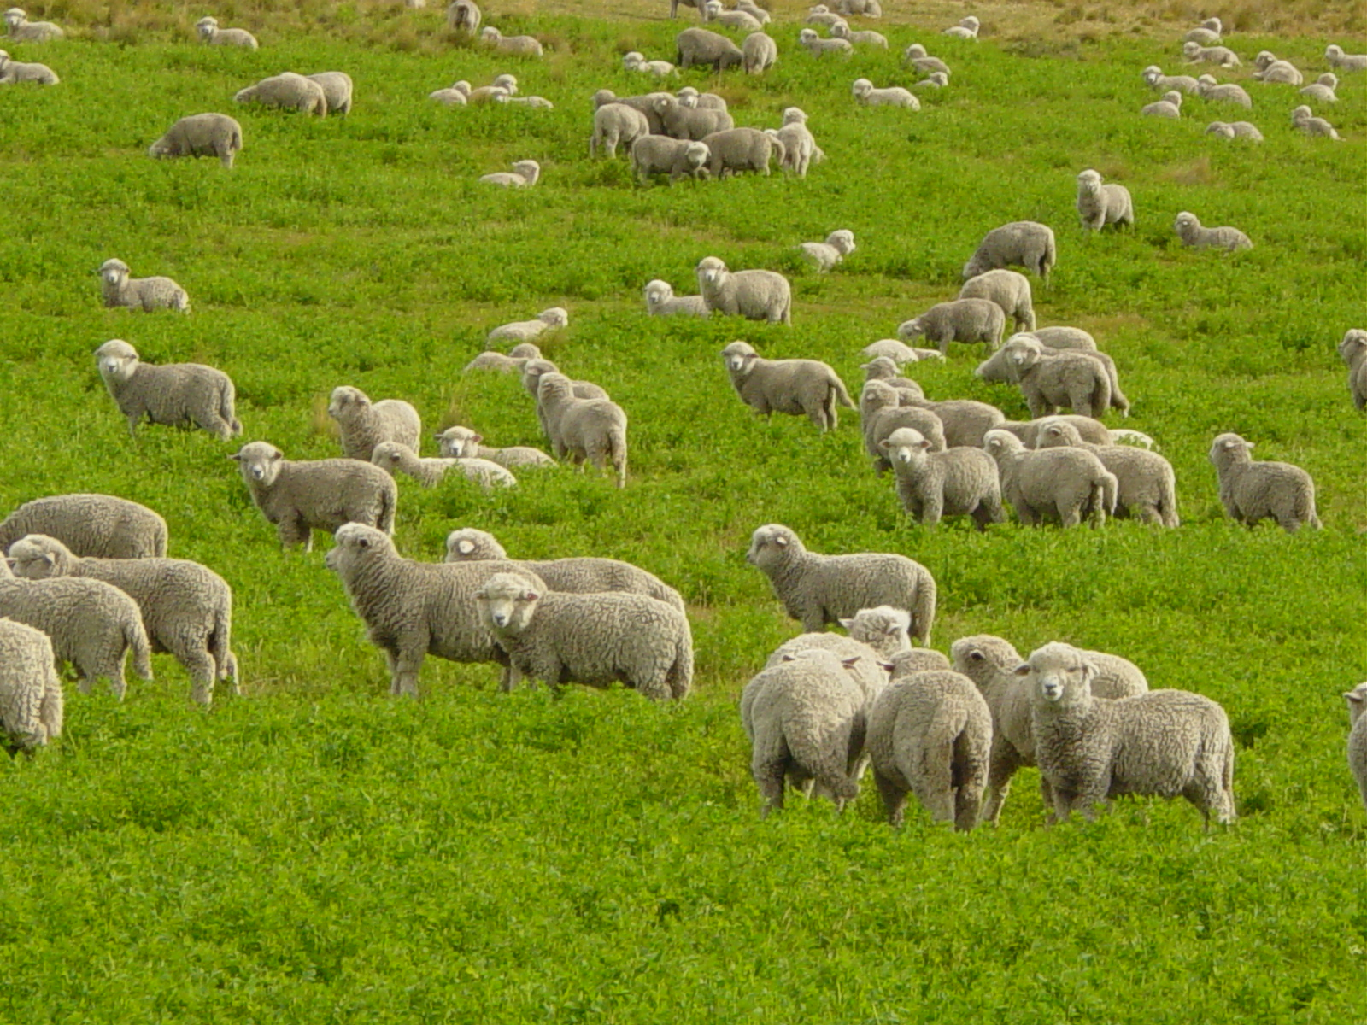
Our Shepherd Leads Us
Psalm 23
Manik Corea, Crossroads International Church cicfamily.com & biblestudydownloads.com

Slide 3
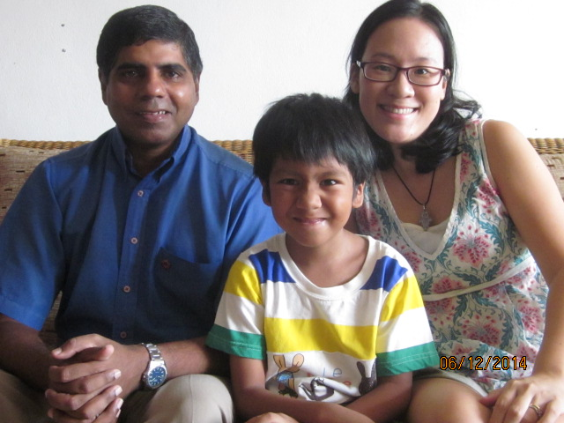
THE COREAS in Bangkok

Slide 4
All Nations Bangkok
Brief snapshots:
7th year in Thailand
Working for NAMS – regional base for South-
East Asia
Begun All Nations as our first base in Sept.
2012 (We’ve been supported by CIC since).
Our Vision:
Plant worshipping communities of missionary disciples, meeting regularly in cells and congregations, seeking to transform their communities for Christ.

Slide 5
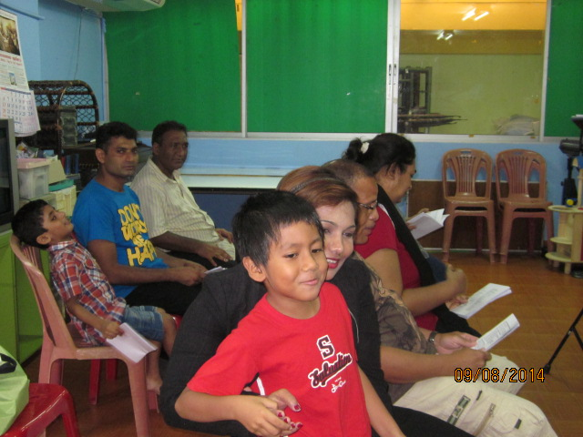
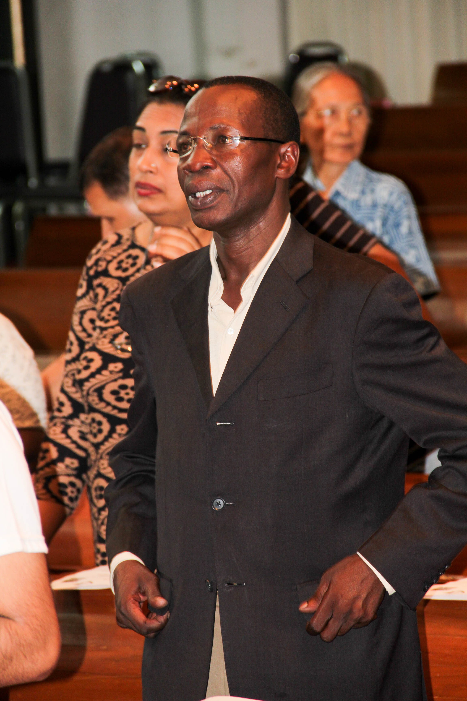
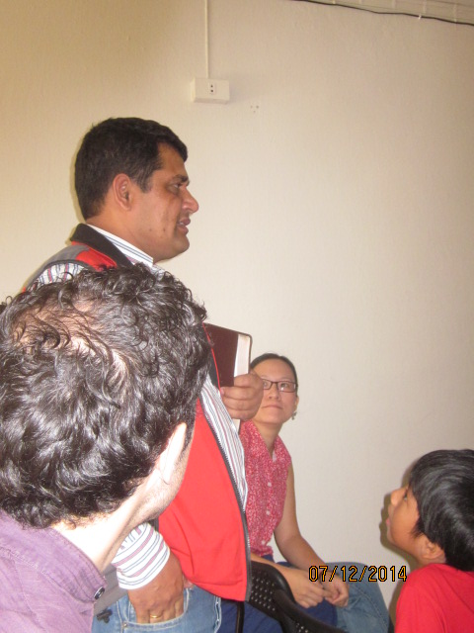
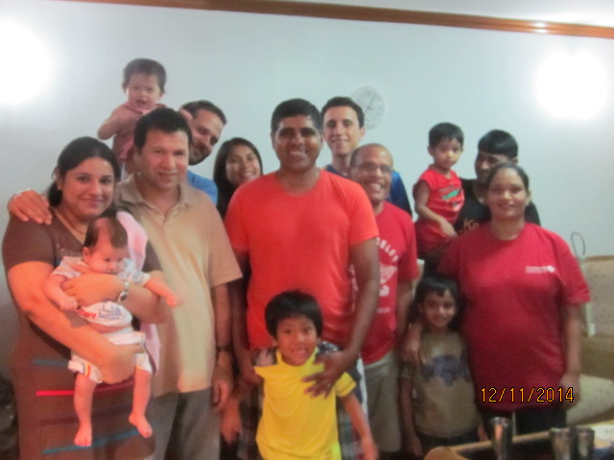
TO DATE
Disciple-making groups

Slide 6
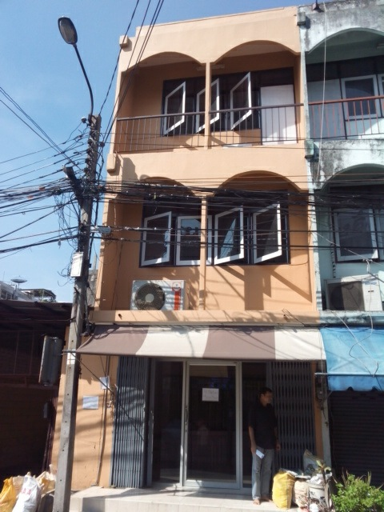
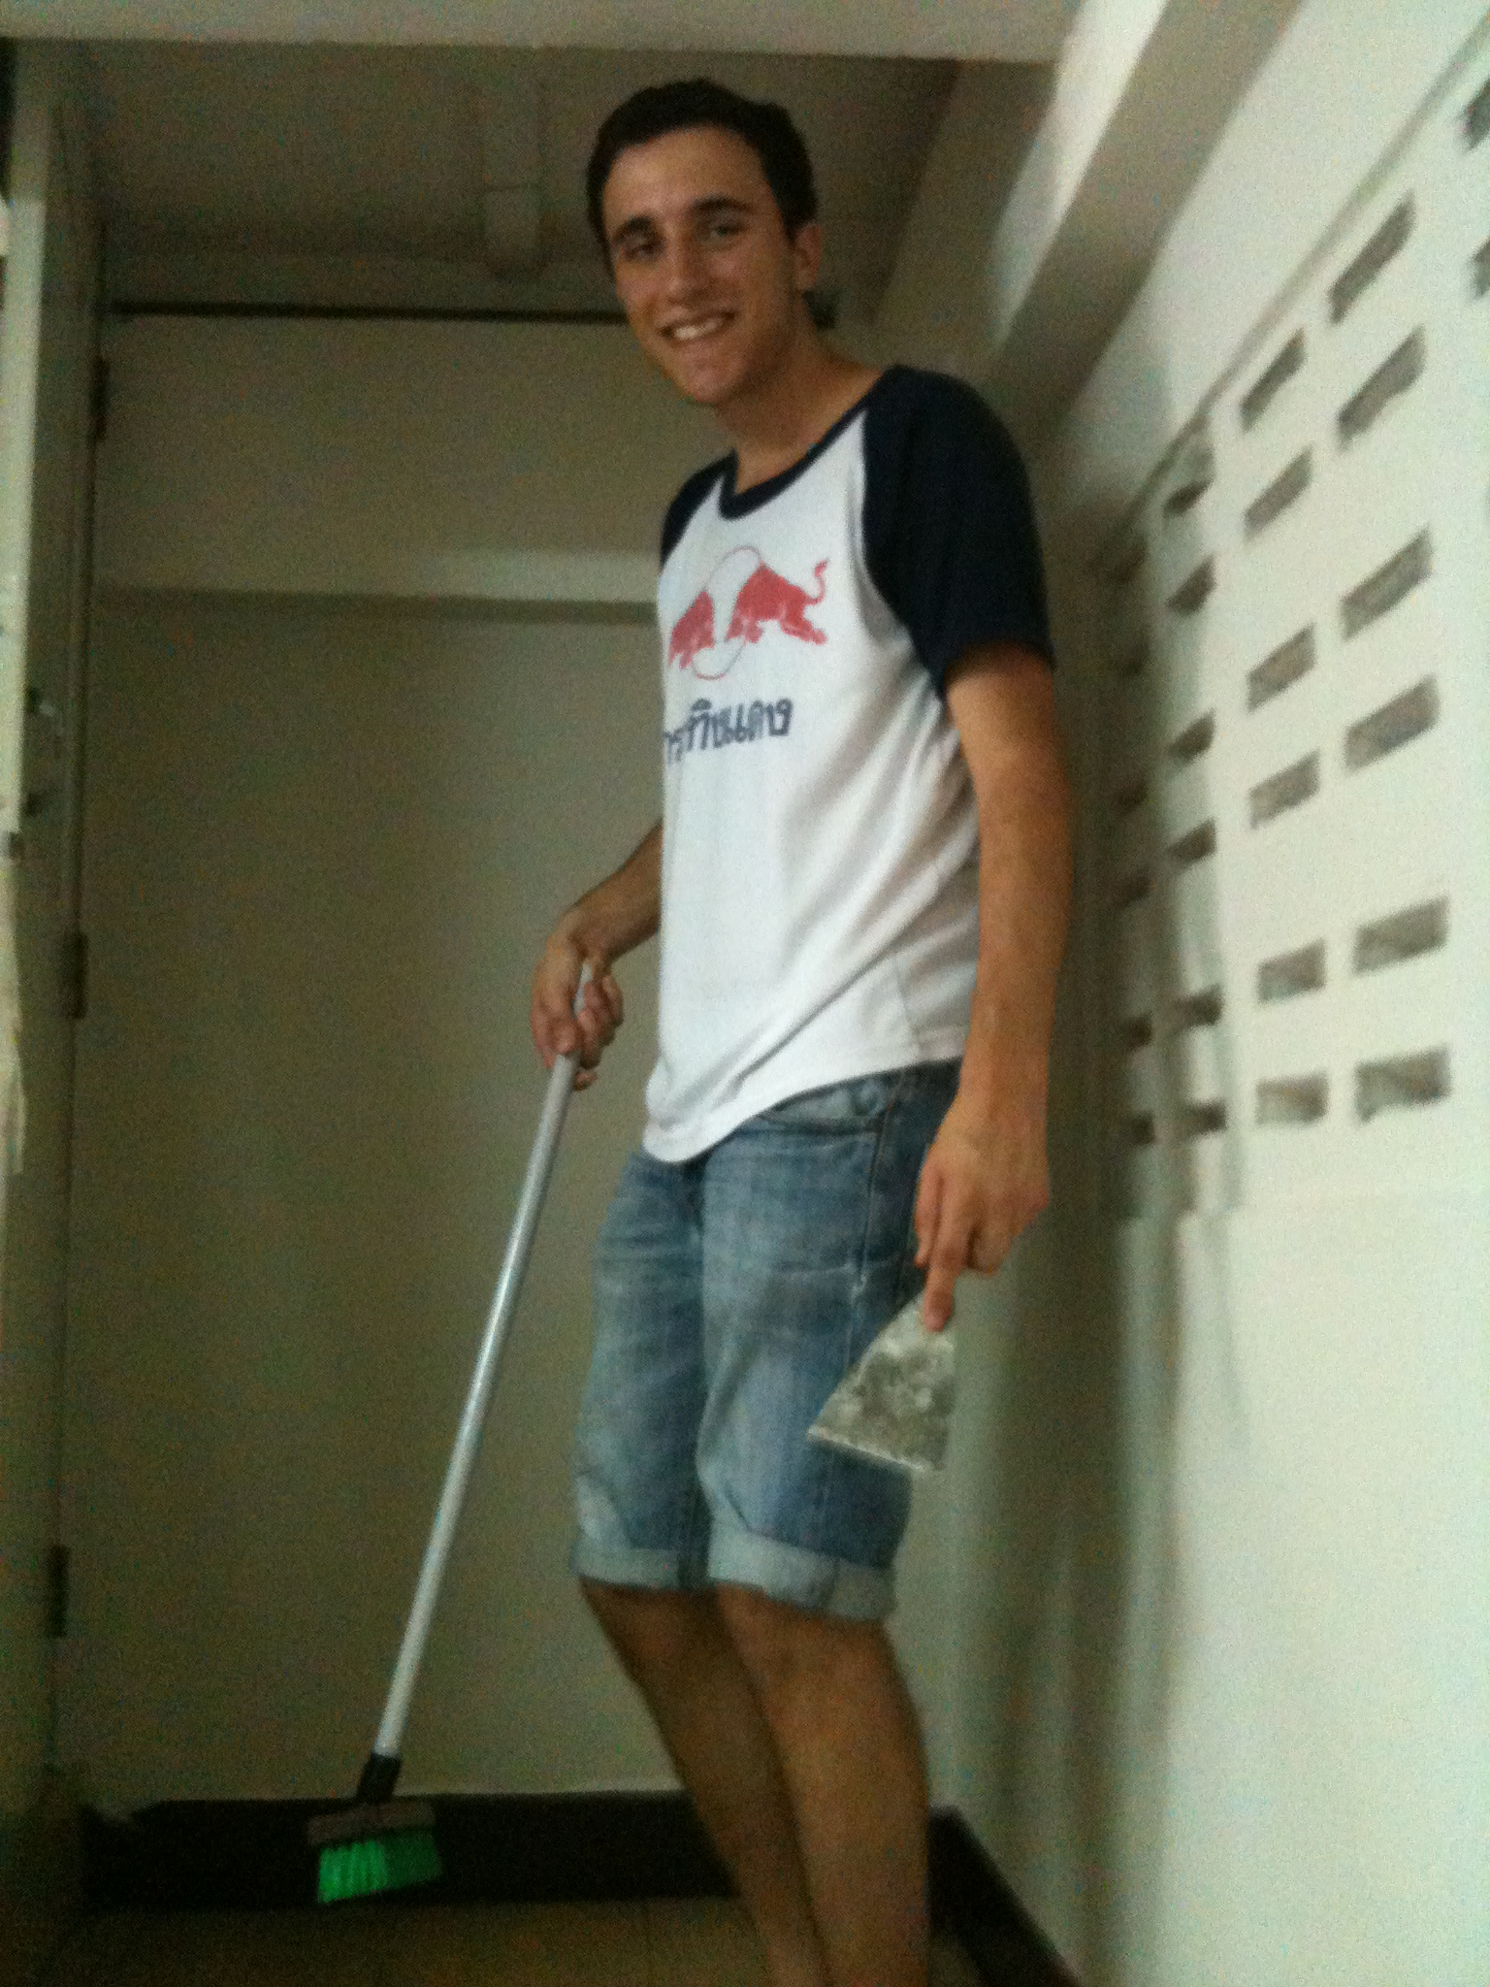
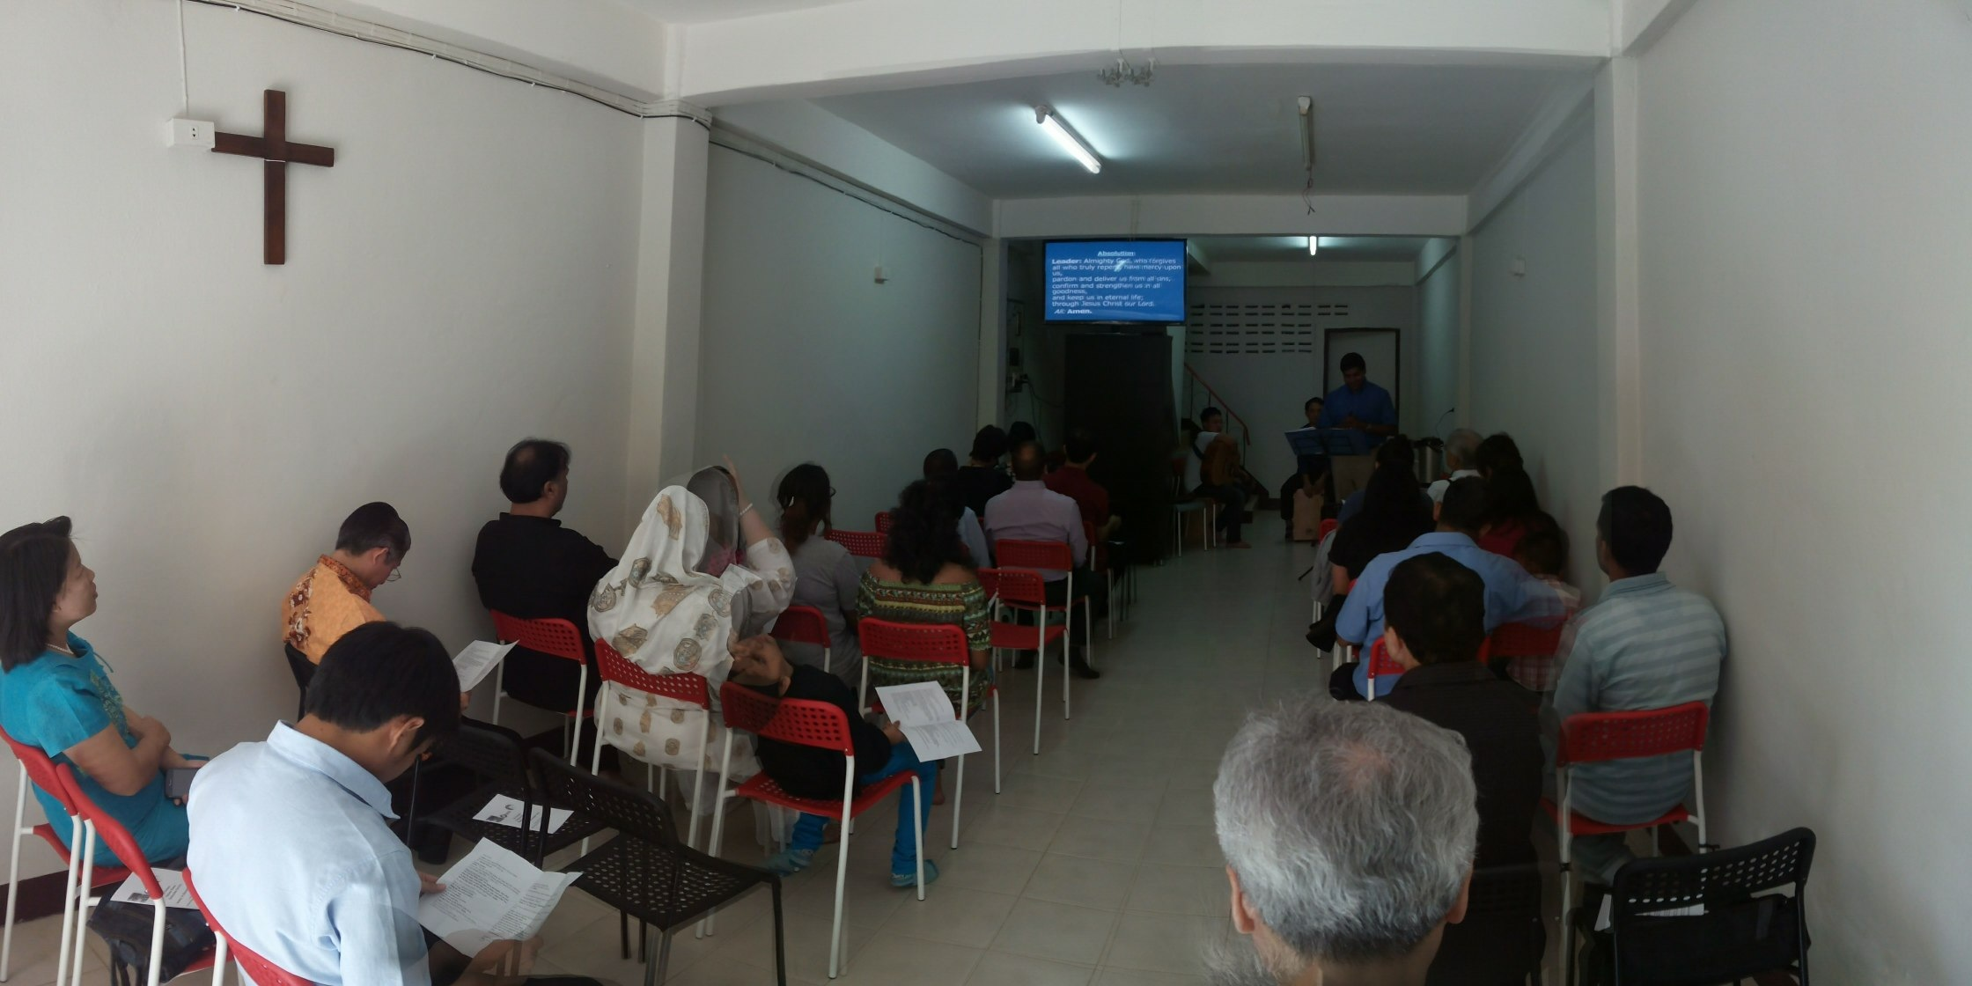
TO DATE
- Mission House
Missionary Intern
Isaac Lasky from England

Slide 7
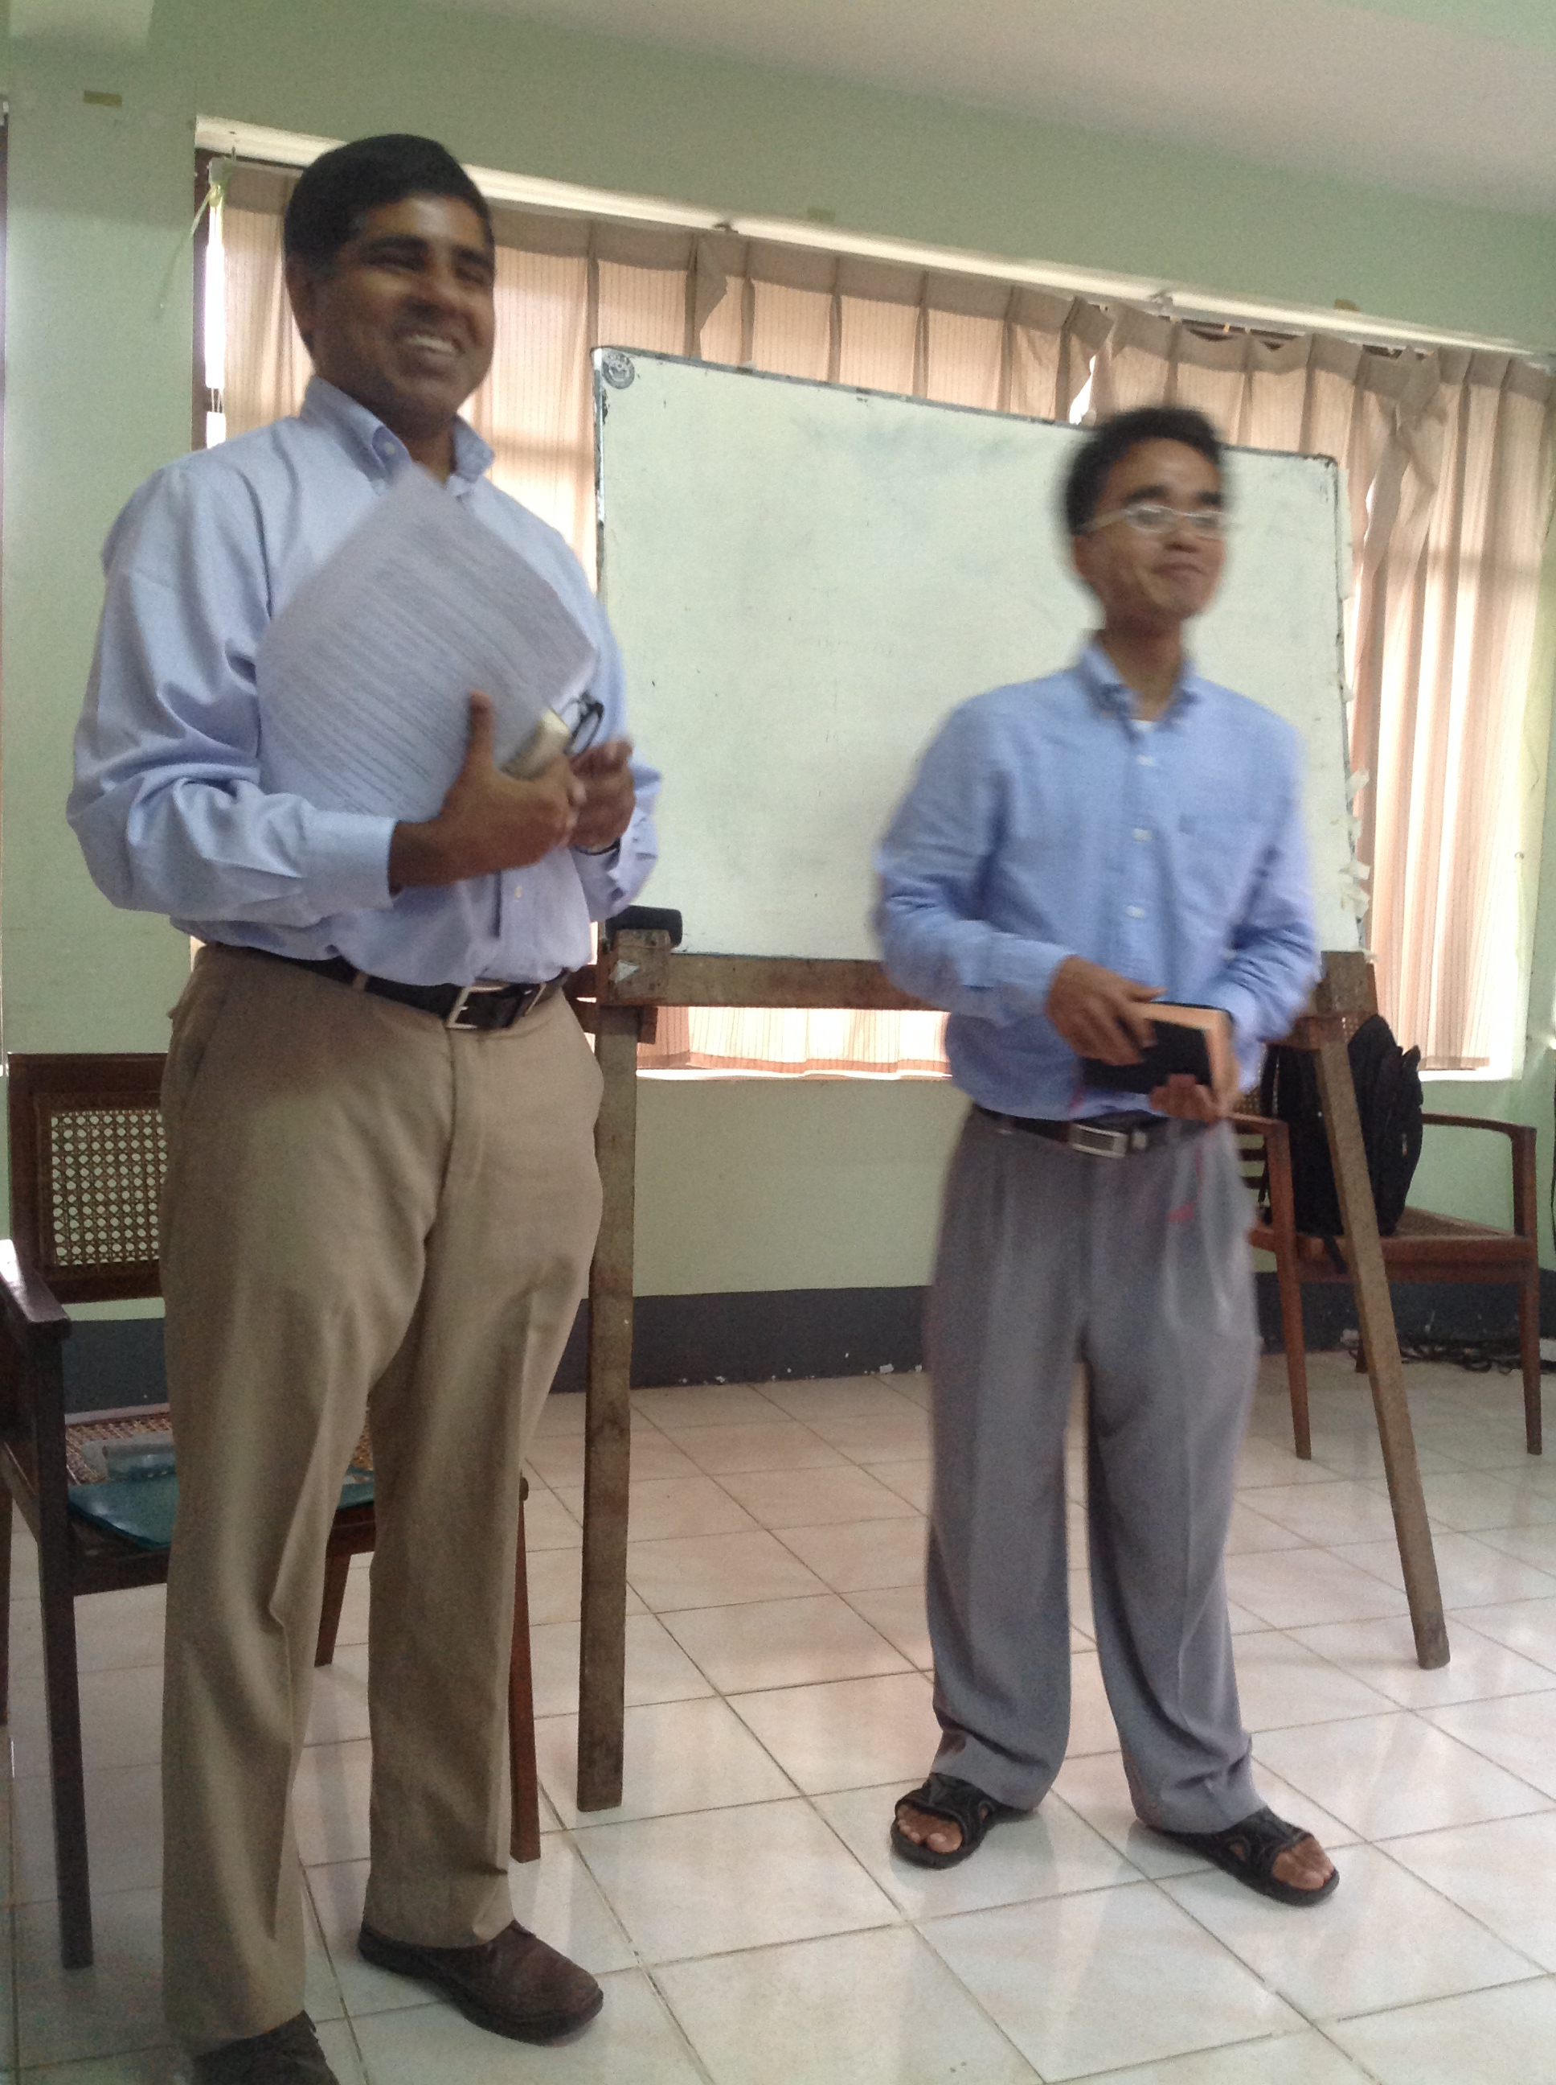
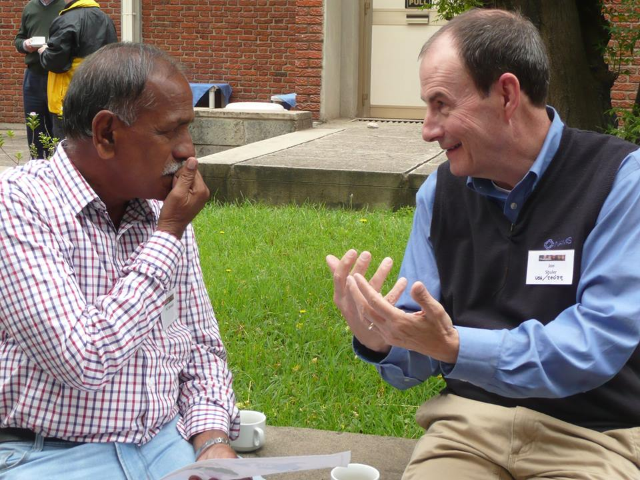
TO DATE
Regional work
NEPAL
INDIA
MYANMAR

Slide 9
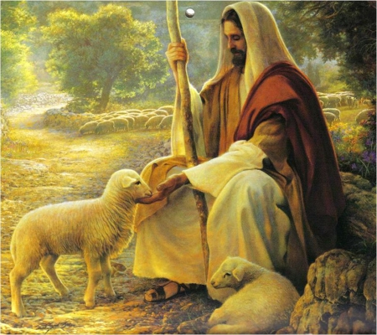
Sermon by Manik Corea
Psalm 23
- The Good Shepherd

Slide 10
Scripture Reading: Psalm 23
¹ The Lord is my shepherd, I lack nothing. ² He makes me lie down in green pastures, He leads me beside quiet waters, ³ He restores my soul. He guides me along the right paths for His name’s sake. ⁴ Even though I walk through the valley of the shadow of
death I will fear no evil, for You are with me;

Slide 11
Scripture Reading: Psalm 23
Your rod and Your staff, they comfort me.
⁵ You prepare a table before me in the presence of my enemies. You anoint my head with oil; my cup overflows.
⁶ Surely your goodness and love will follow
me all the days of my life, and I will dwell in the house of the Lord for ever.

Slide 12
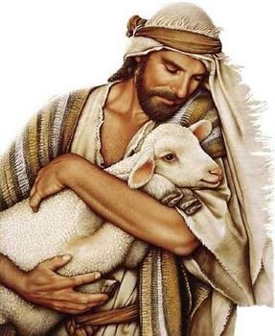
Psalm 23
Vs 1: The Lord is personal
Jesus knows His sheep (John 10:3-4, 14)

Slide 13
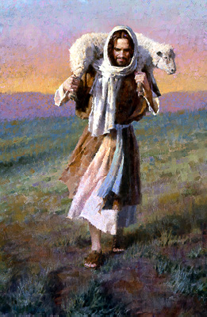
Psalm 23
Vs 2: The Lord is provider

Slide 14
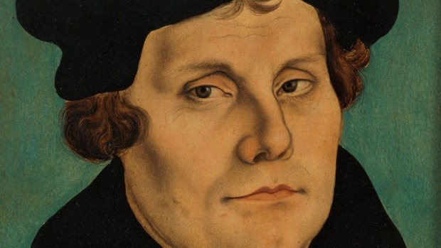
Martin Luther said...
'Good morning theologians. You wake and sing. But I, old fool, know less than you and worry over everything, instead of simply trusting in the heavenly Father's care.'

Slide 15
Psalm 23
Vs 2: The Lord is provider
To worry is to question God's provision (Matthew 6:25-34).

Slide 16
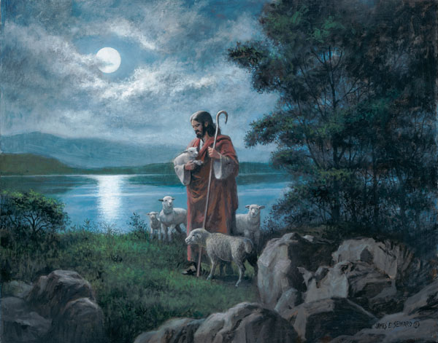
Psalm 23
Vs 3: The Lord is restorer
‘He guides me…along right paths’
Lit. in Hebrew:
‘paths that are right and good in God’s sight’
Sheep need to be rescued first, and then led onto the right paths. It is all for God's sake and glory!

Slide 17
Psalm 23
Vs 4: The Lord is comforter and guide
Trials have a purpose (Romans 5:4)
He never leave us (Deuteronomy 31:6) – The rod and staff of the Shepherd guide and protect.
God’s Word and His Spirit are our guide, comfort, protection and strength.

Slide 18
Don’t look down or around – look up!

Slide 19
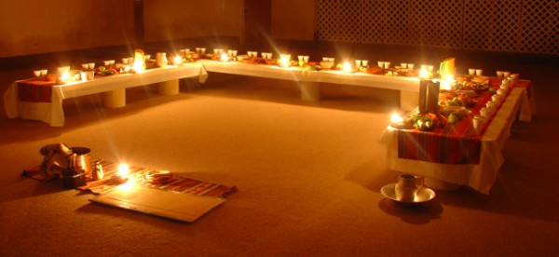
Psalm 23
Vs 5: The Lord is exalter
God has blessed us with overflowing abundance.

Slide 20
Psalm 23
Vs 6: The Lord is our home
God's love and goodness are constant throughout our life and into eternity.
Lit. ‘God’s constant, strong love’

Slide 21
Psalm 23
Application:
1) We need to trust God's ways and timing

Slide 22
“He brought me here. He will keep me here. He will make this trial a blessing. He will bring me out again. Therefore, I am here by God’s appointment, in His keeping, under His training, for His time.”
(Andrew Murray)

Slide 23
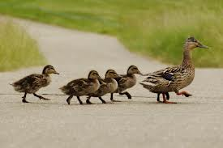
Psalm 23
Application:
1) We need to trust God's ways and timing
2) We need to follow and obey Him on his paths, because they lead us home to Him.

Slide 24
THANK YOU FOR LISTENING! MAY WE KNOW THE LORD AS SHEPHERD OF OUR LIVES ALWAYS!

Slide 25
Black

Slide 26
OT Sermons link at biblestudydownloads.com
Get this presentation for free!

