Slide 1
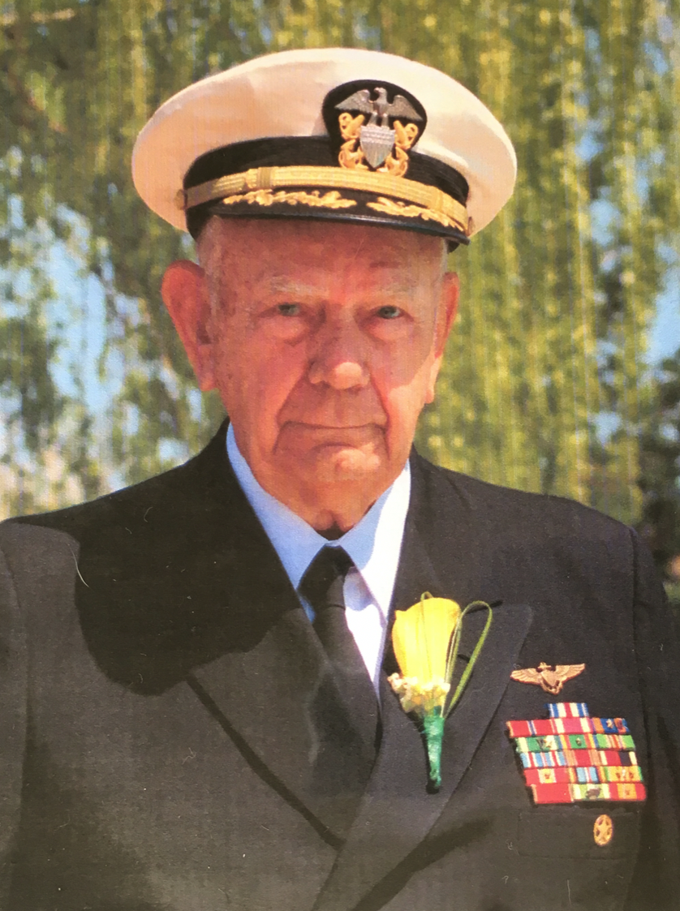
Harold "Hal" Francis Griffith
27 Dec 1925 -29 Jan 2018
Psalm 23
Dr. Rick Griffith • Crossroads International Church Singapore CICFamily.com & BibleStudyDownloads.org

Slide 2
Welcome

Slide 3
Eulogy

Slide 4
Prayer

Slide 5
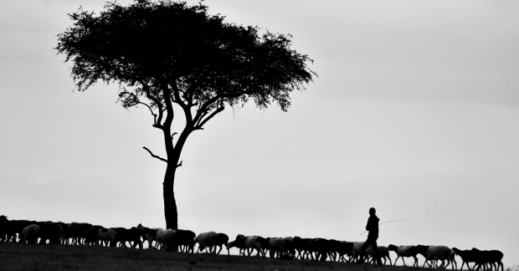
Psalm 23

Slide 6
Early Years

Slide 7
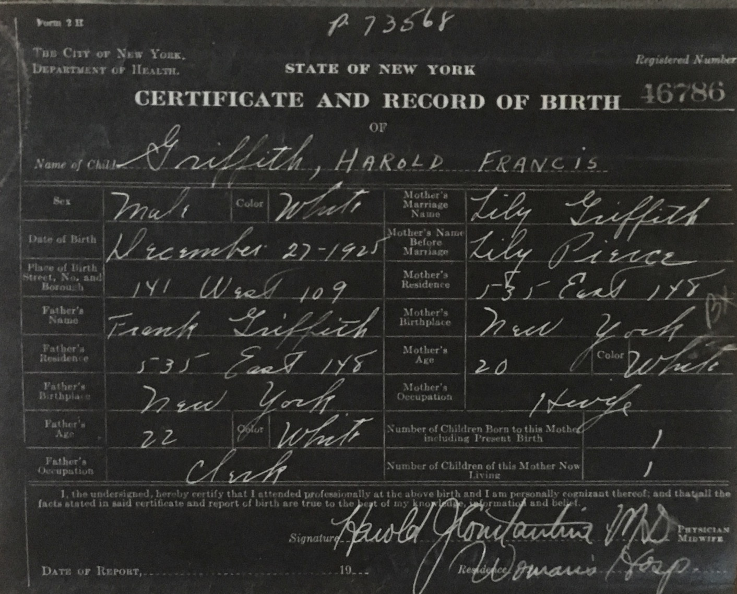
Title
Notes:
Dad felt like he needed a Shepherd—for his start in life was something few of us could imagine. I saw his birth certificate for the first time this week. It is hand-written in cursive, and under “name,” all it reads is, “Griffith.” No first name. No middle name. Just “Griffith.” But next to it is written in ALL CAPS the words “Harold Francis.” For his first 17 years he was known as “Harry Frank.” Harry was his grandpa and Frank was his father.

Slide 8
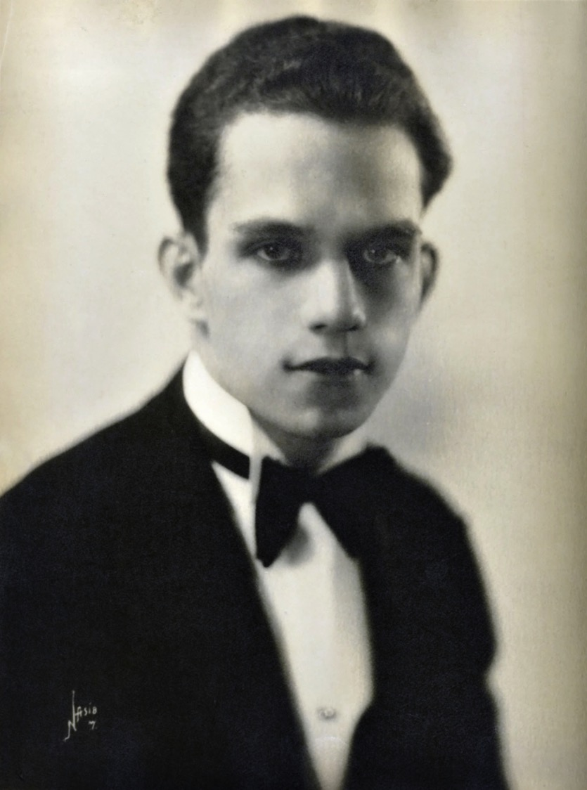
Title
Notes:
Frank was his father.

Slide 9
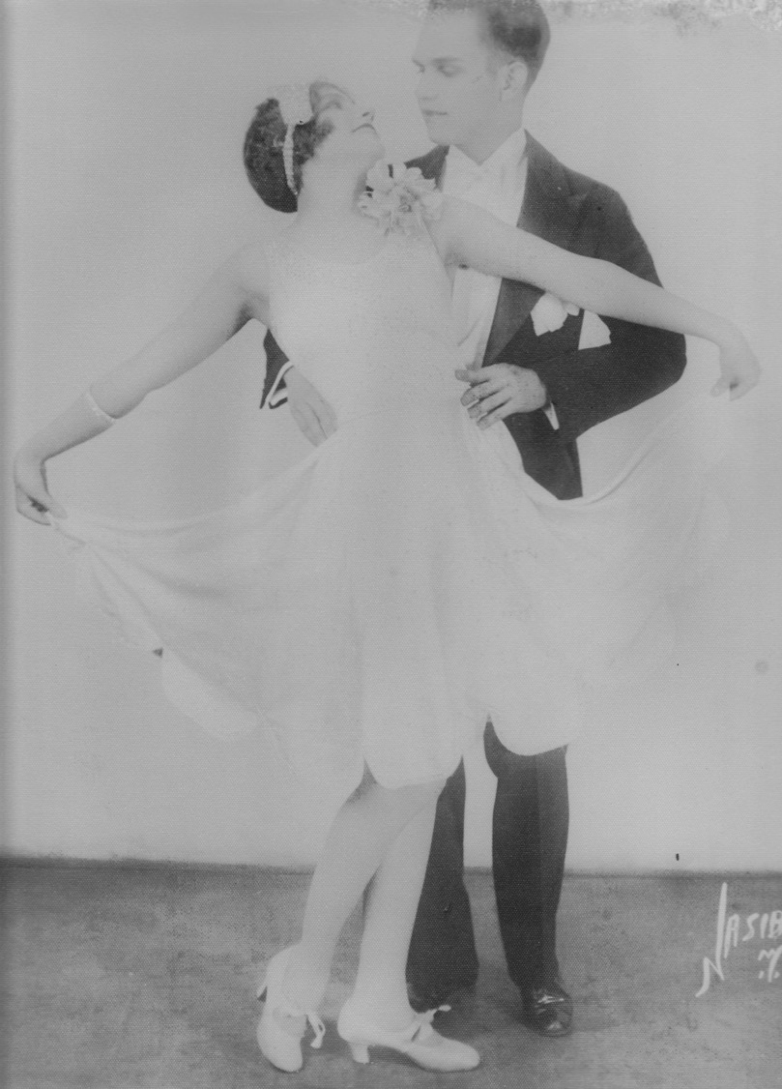
Title
Notes:
Yet both of his parents—famous dancers in the mid 20s, believe it or not—dropped him off at his maternal grandparents home as a baby and they went on tour to the Caribbean.

Slide 10
Title
Notes:
So, at age 17, upon entering the Navy, he had to look up his birth certificate. There he found no first or middle name! So he had the unusual privilege—if you call it that—to name himself. He decided to keep the same H.F. initials, choosing Harold Francis.

Slide 11
Black

Slide 12
How does God show his goodness to you?

Slide 13
God Provides

Slide 14
Black

Slide 15
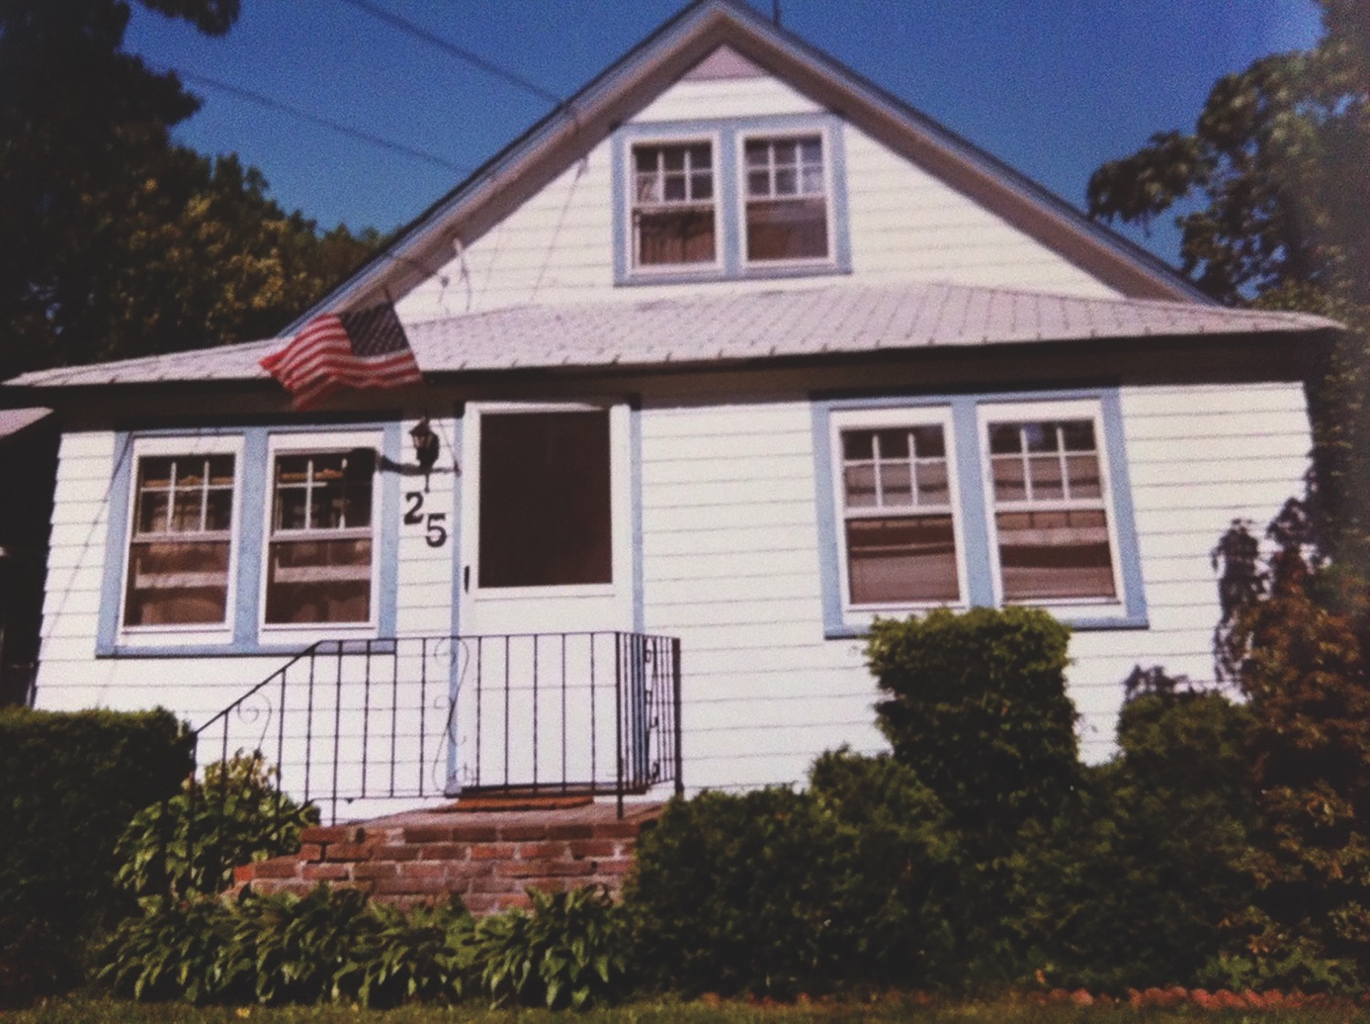
Title
Notes:
Text

Slide 16
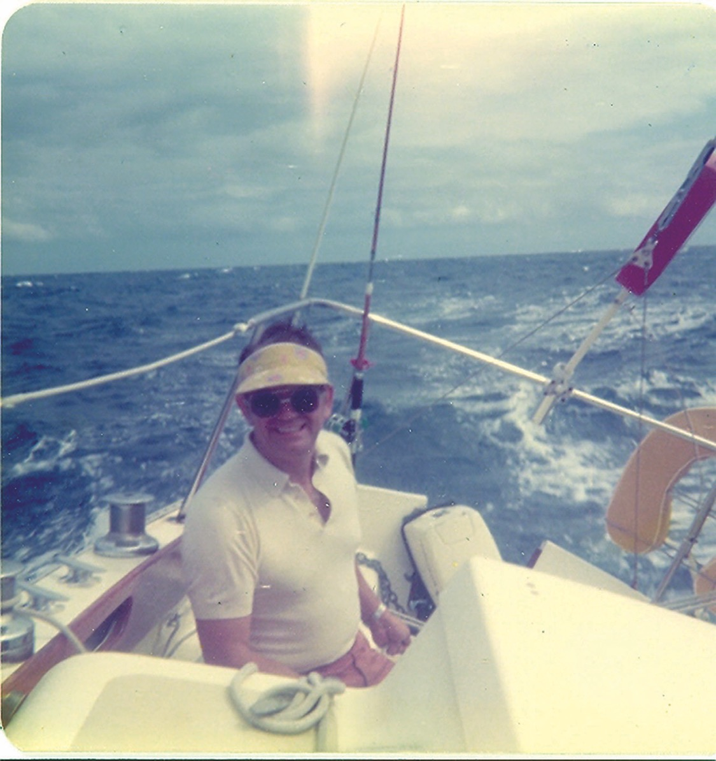
Title
Notes:
Text

Slide 17
God Protects

Slide 18
Black

Slide 19
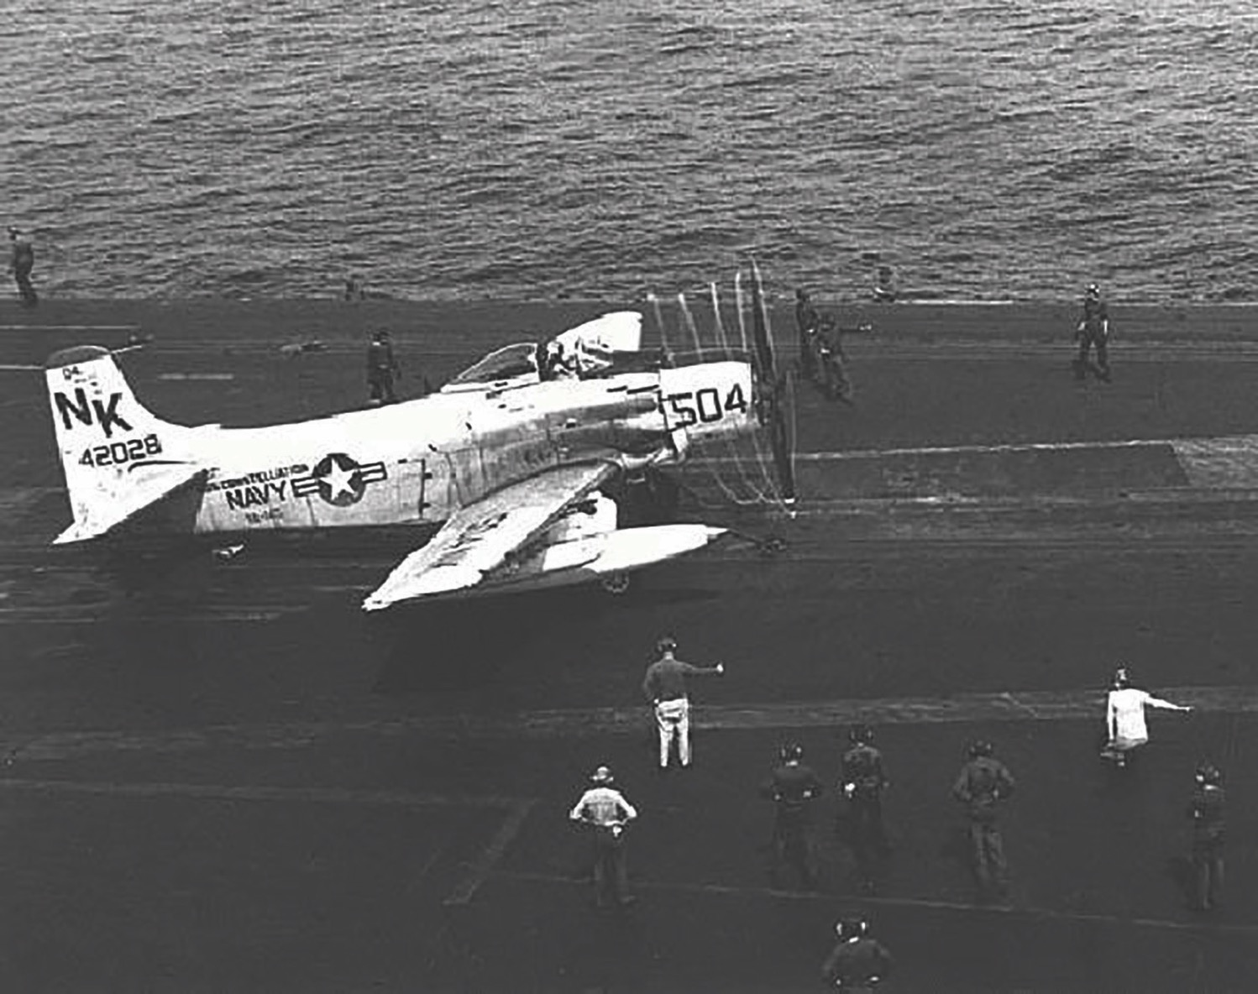
Title
Notes:
Dad flew the A-1 Skyraider that had the most powerful engine ever on a propeller fighter—so strong that when taking off from a carrier that the pilot had to immediately jerk the plane to the right or else the power of the propeller would flip the plane upside down into the sea. He had an amazing 660 carrier landings!

Slide 20
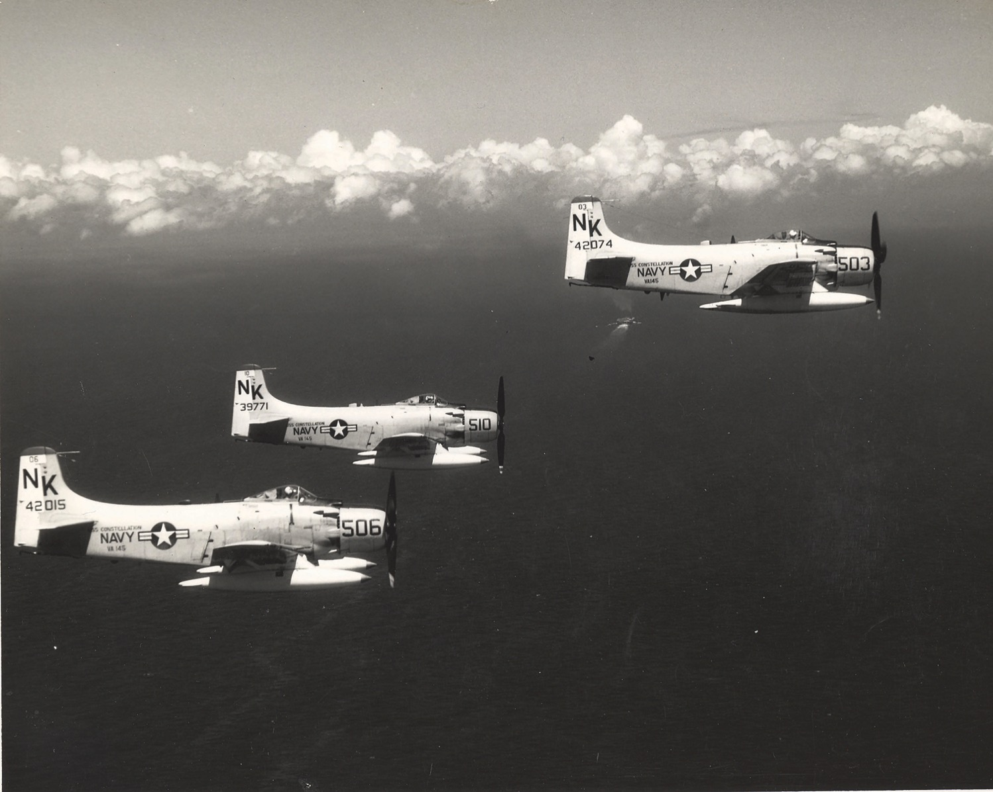
Title
Notes:
He also flew and incredible 186 combat missions destroying supply bridges and boats in a barrage of anti-aircraft fire.

Slide 21
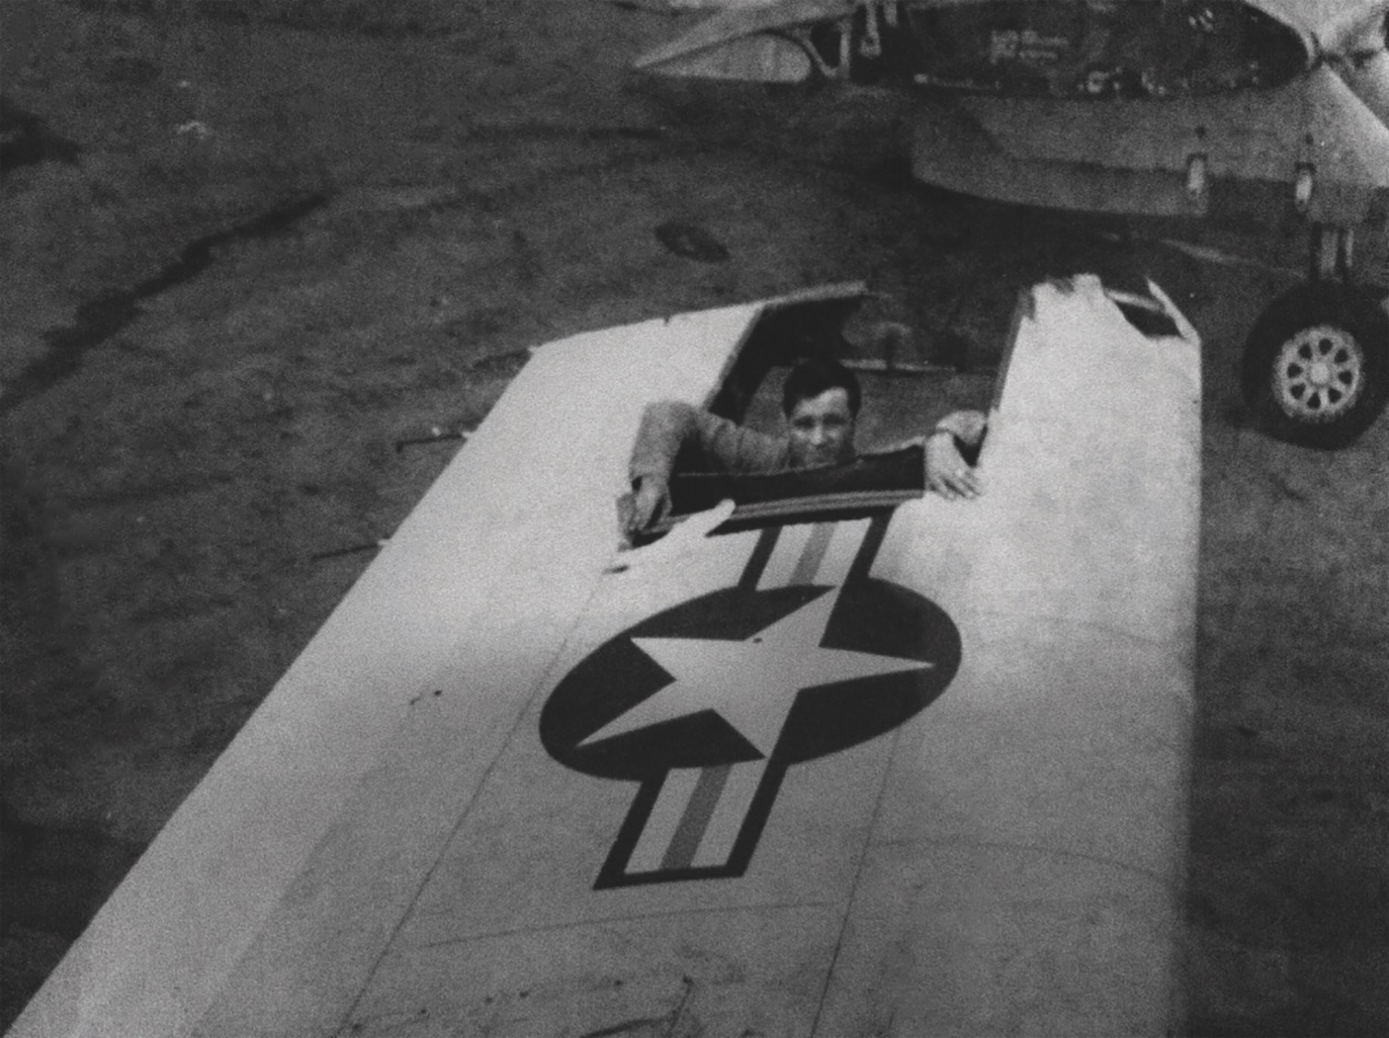
Title
Notes:
Once the left wing of his plane was so shot up that he could only steer right and not make it back to the carrier to land so he flew to a friendly airbase instead. He looped and looped to eventually land safely.

Slide 22
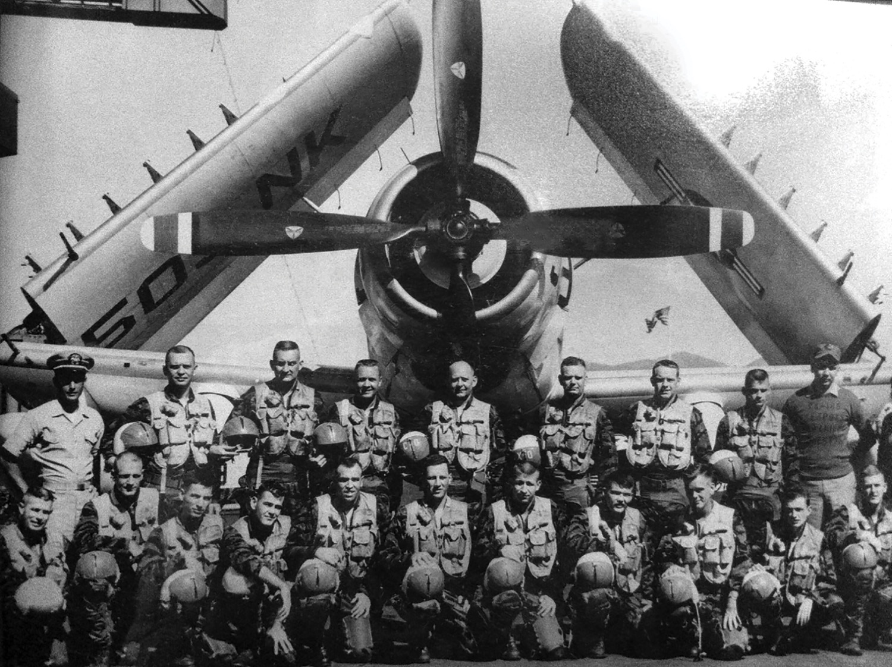
Title
Notes:
I asked him how he could see over 50 of his fellow pilots die but he was spared. He didn’t attribute this to his astonishing flying ability—though he was one of the best pilots. He clearly noted that God himself watched over him “in the presence of mine enemies.”

Slide 23
We Worship

Slide 24
Black

Slide 25
An Amazing Life

Slide 26
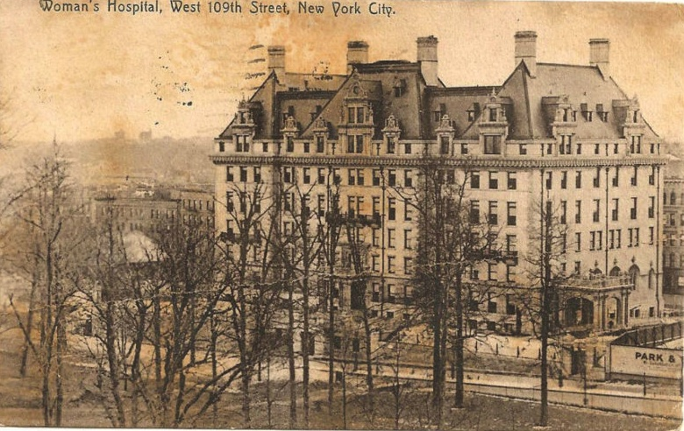
Title
Notes:
Text

Slide 27
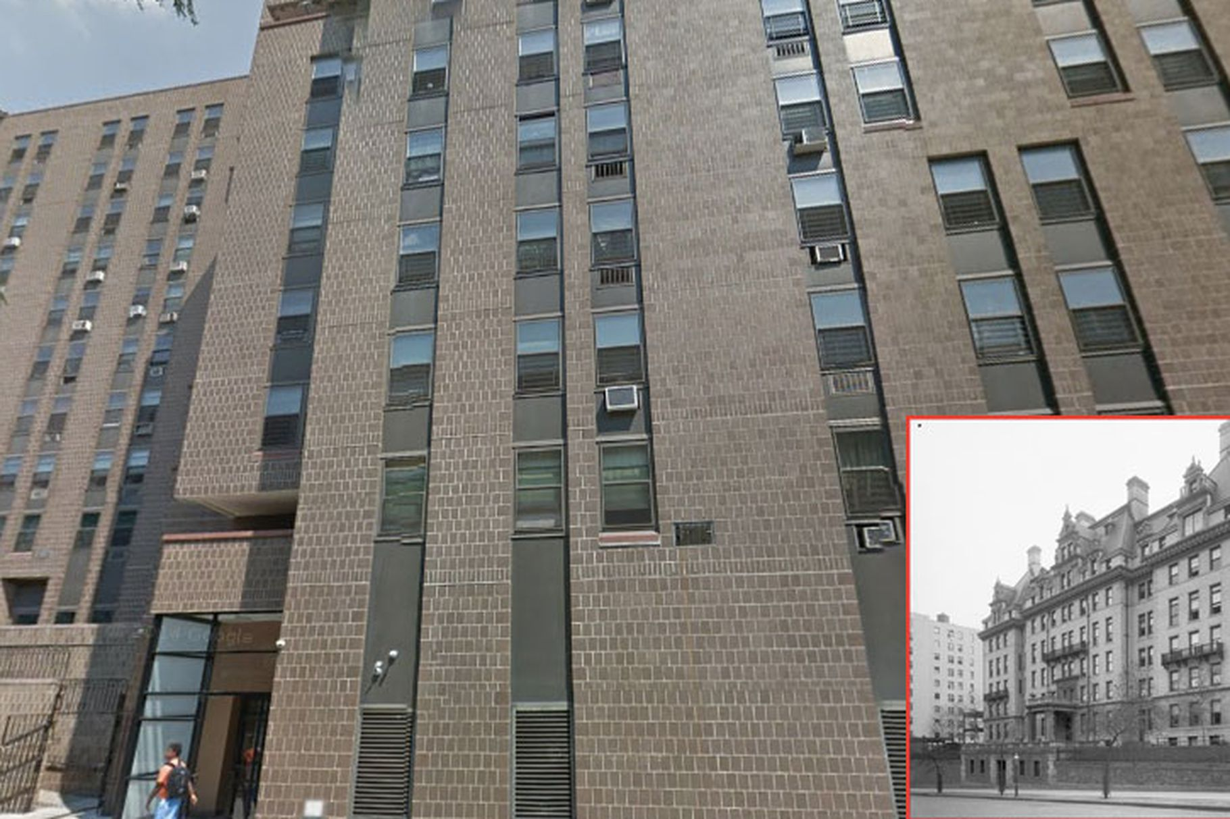
Title
Notes:
Text

Slide 28
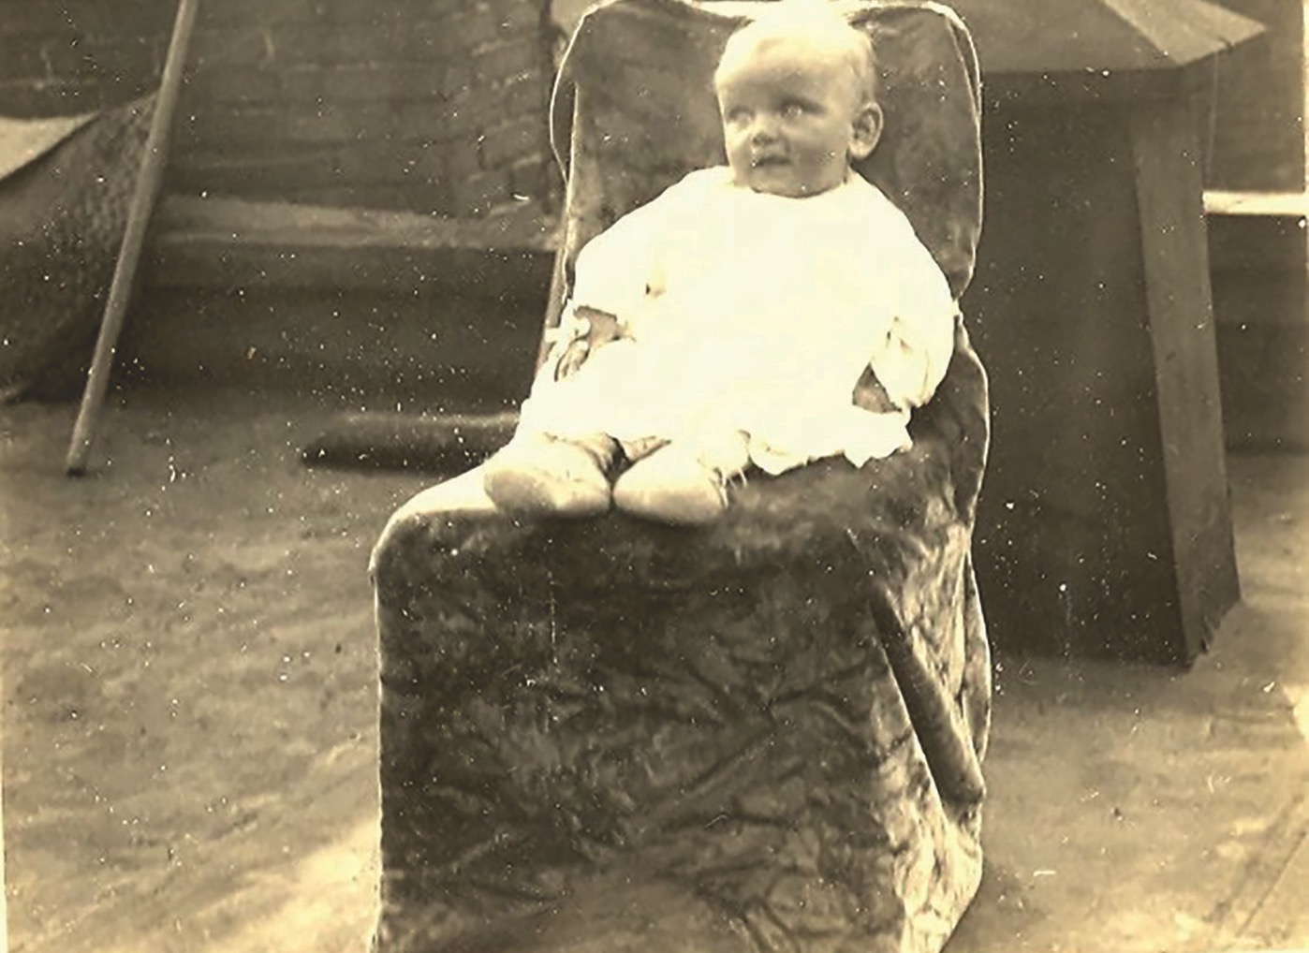
Title
Notes:
Text

Slide 29
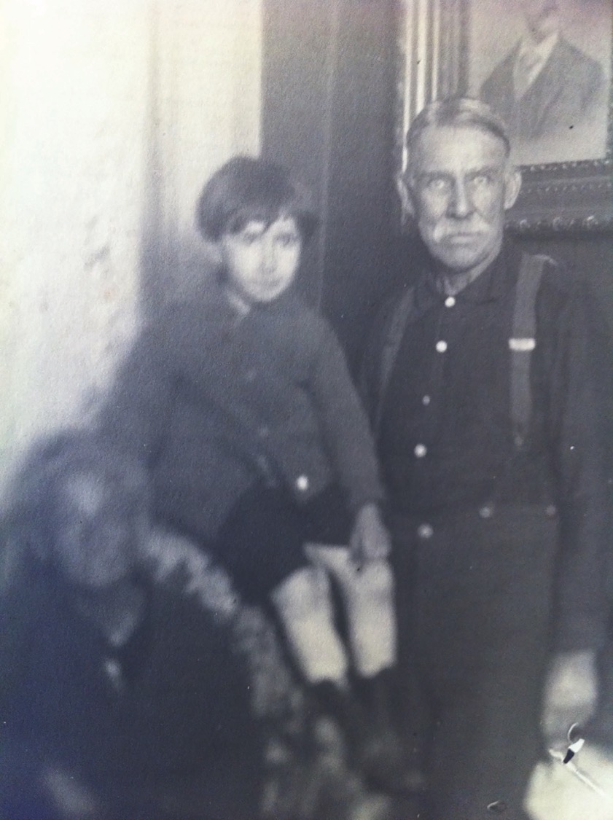
Title
Notes:
Text

Slide 30
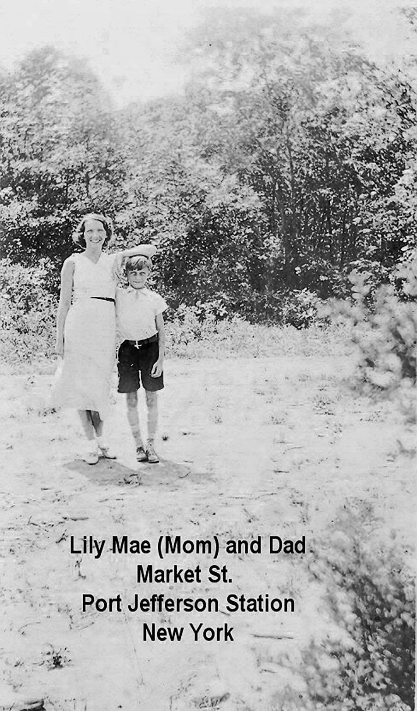
Title
Notes:
Text

Slide 31
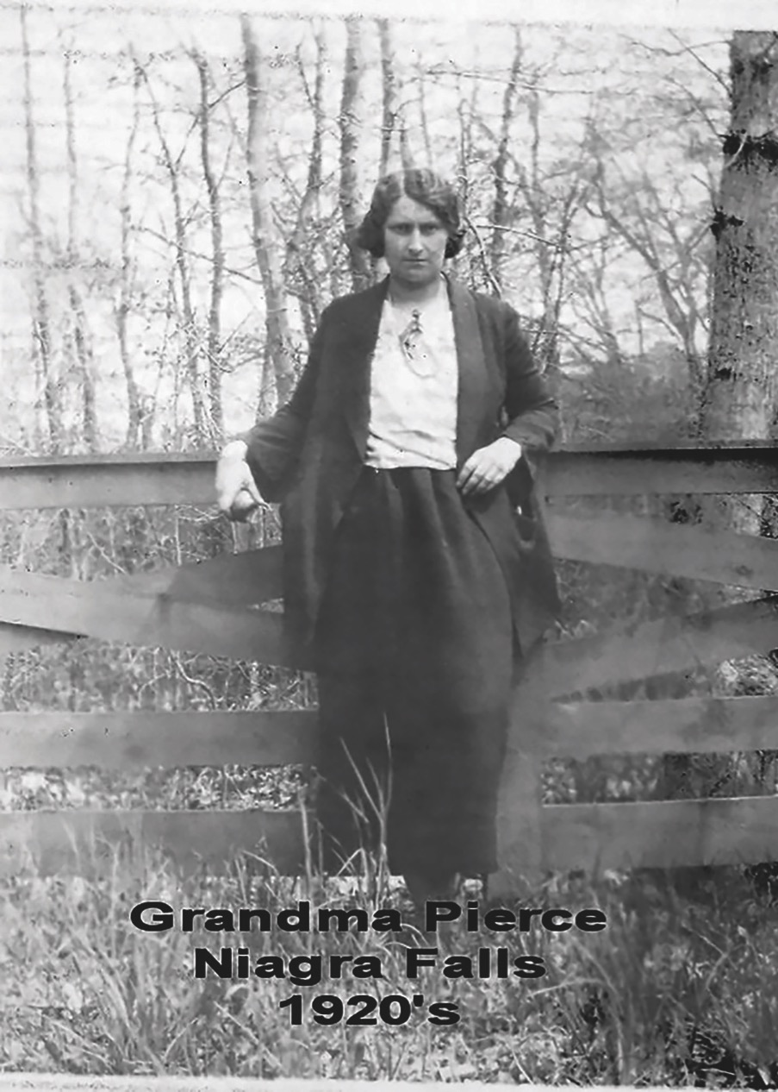
Title
Notes:
Text

Slide 32
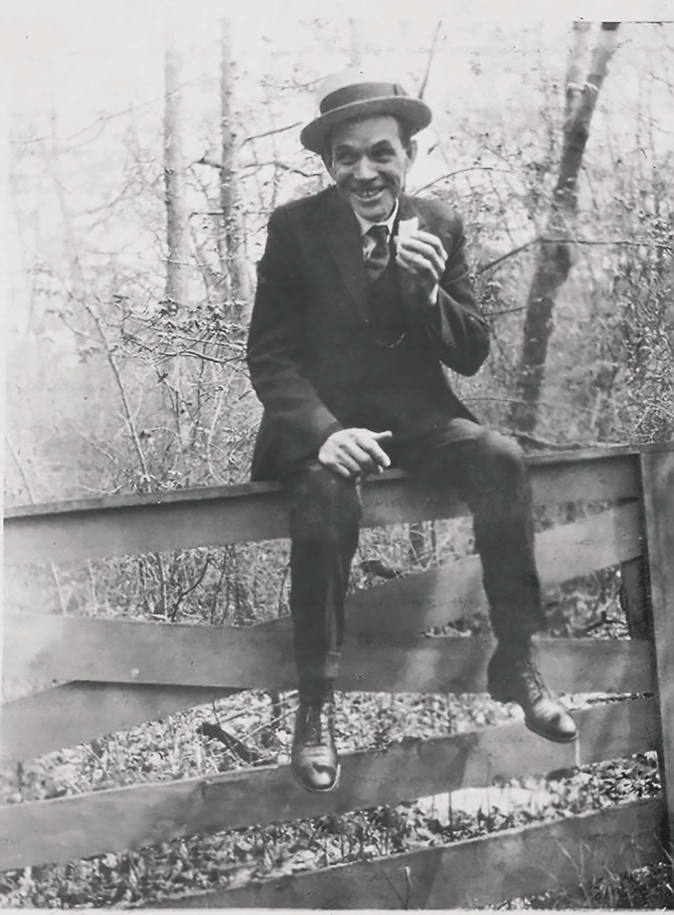
Title
Notes:
Text

Slide 33
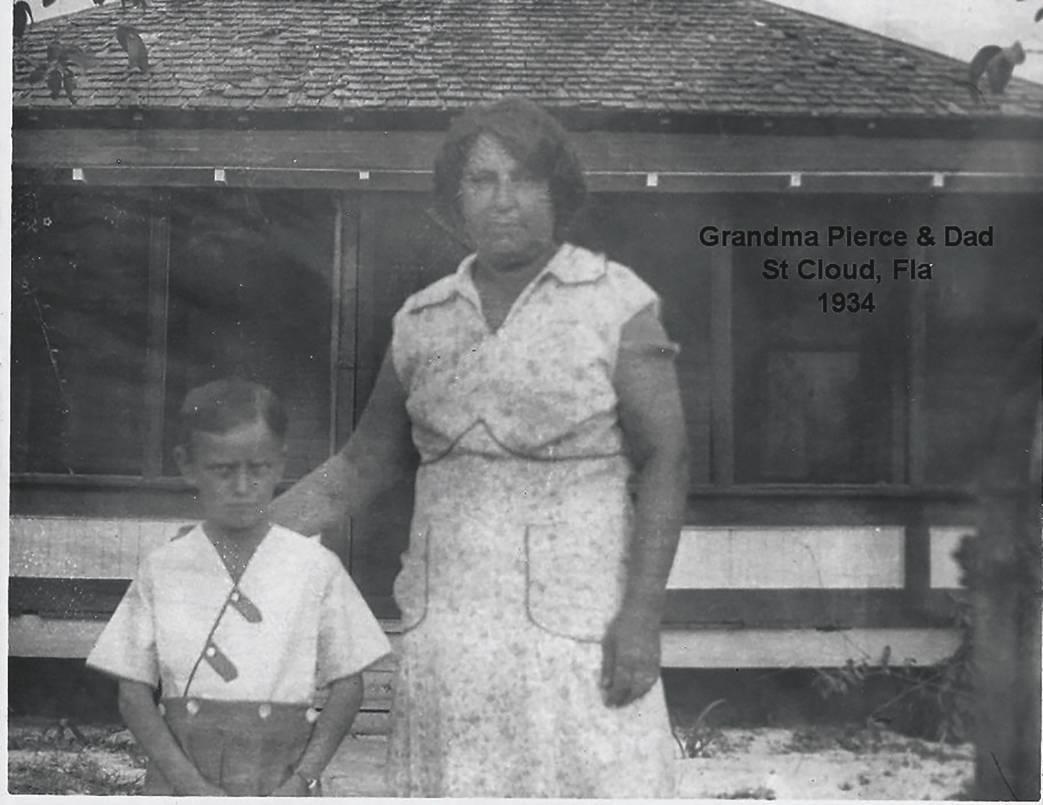
Title
Notes:
Text

Slide 34
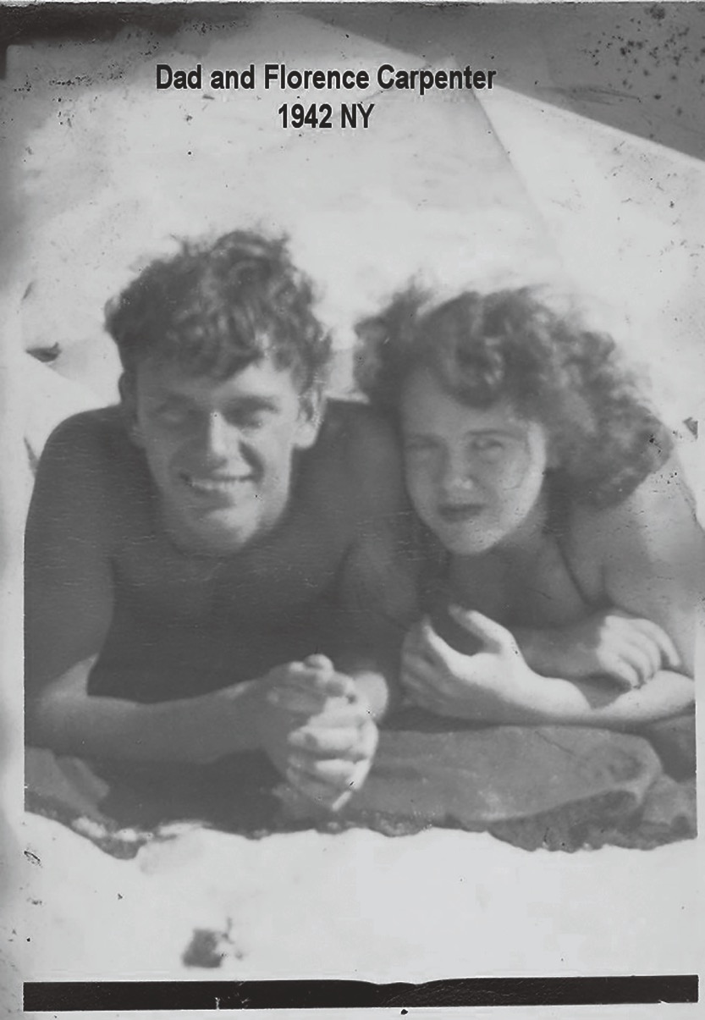
Title
Notes:
Text

Slide 35
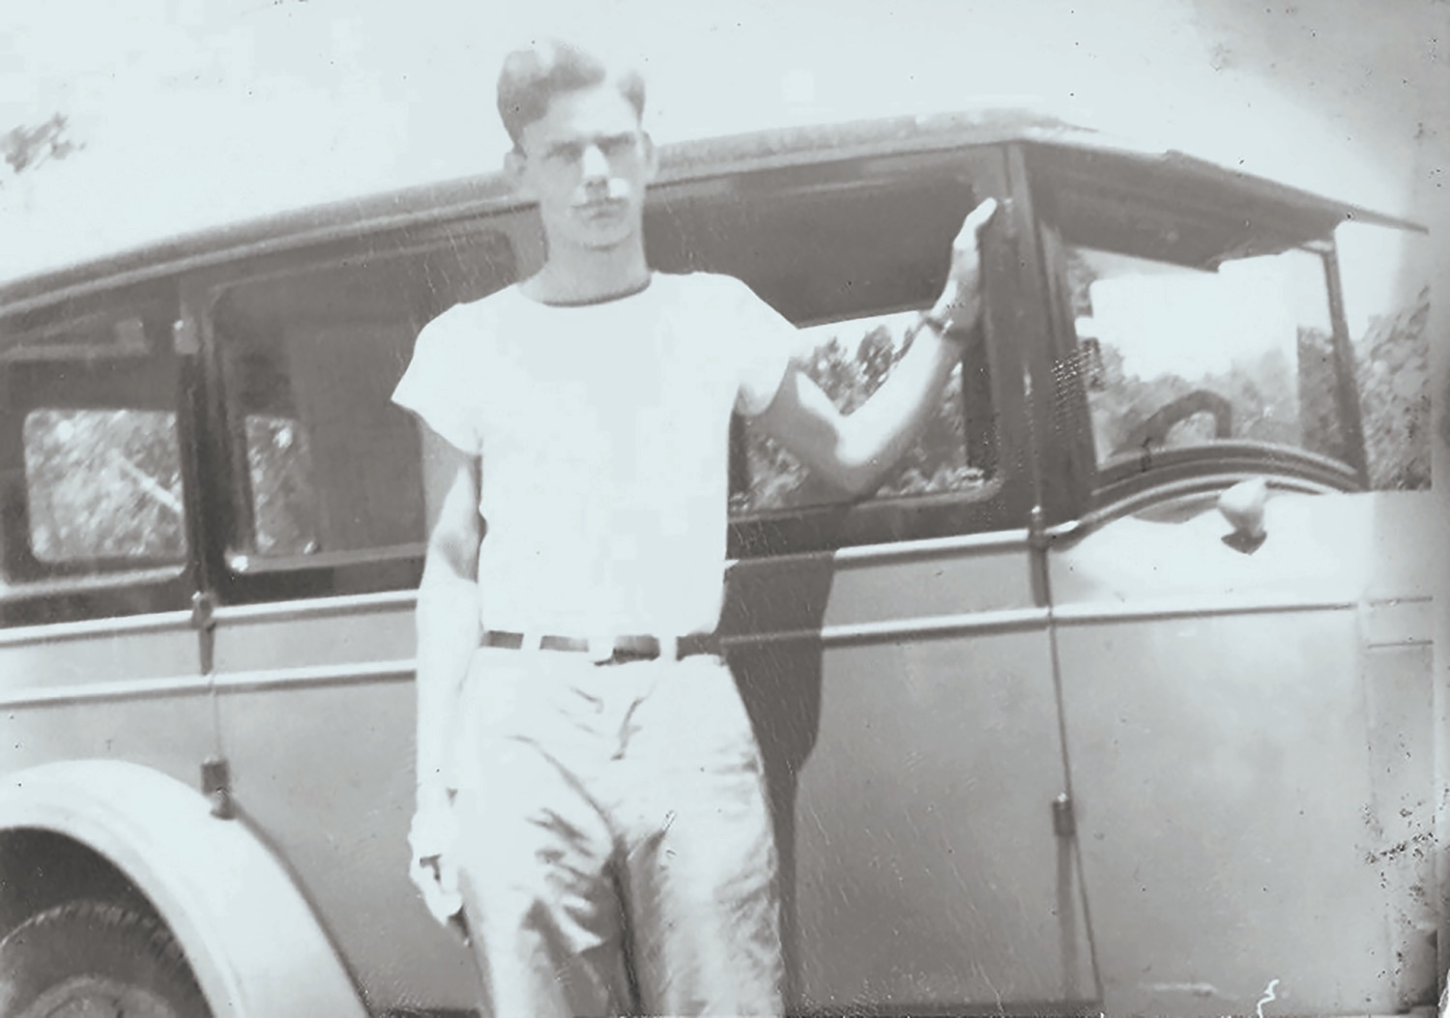
Title
Notes:
Text

Slide 36
Navy

Slide 37
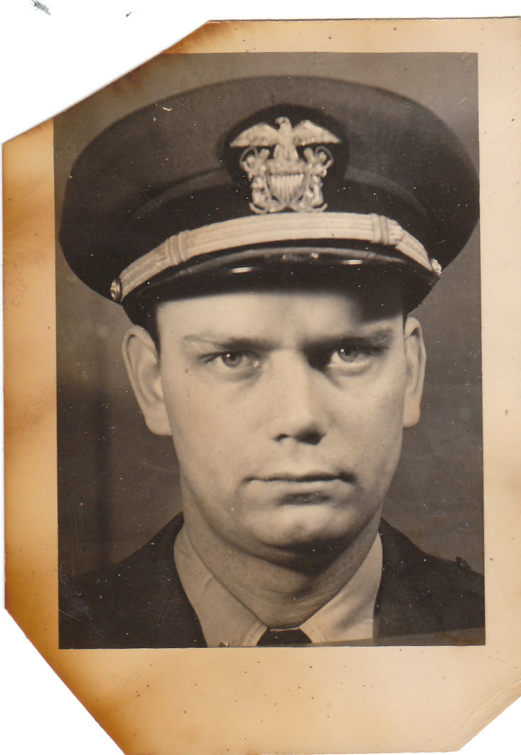
Title
Notes:
Text

Slide 38
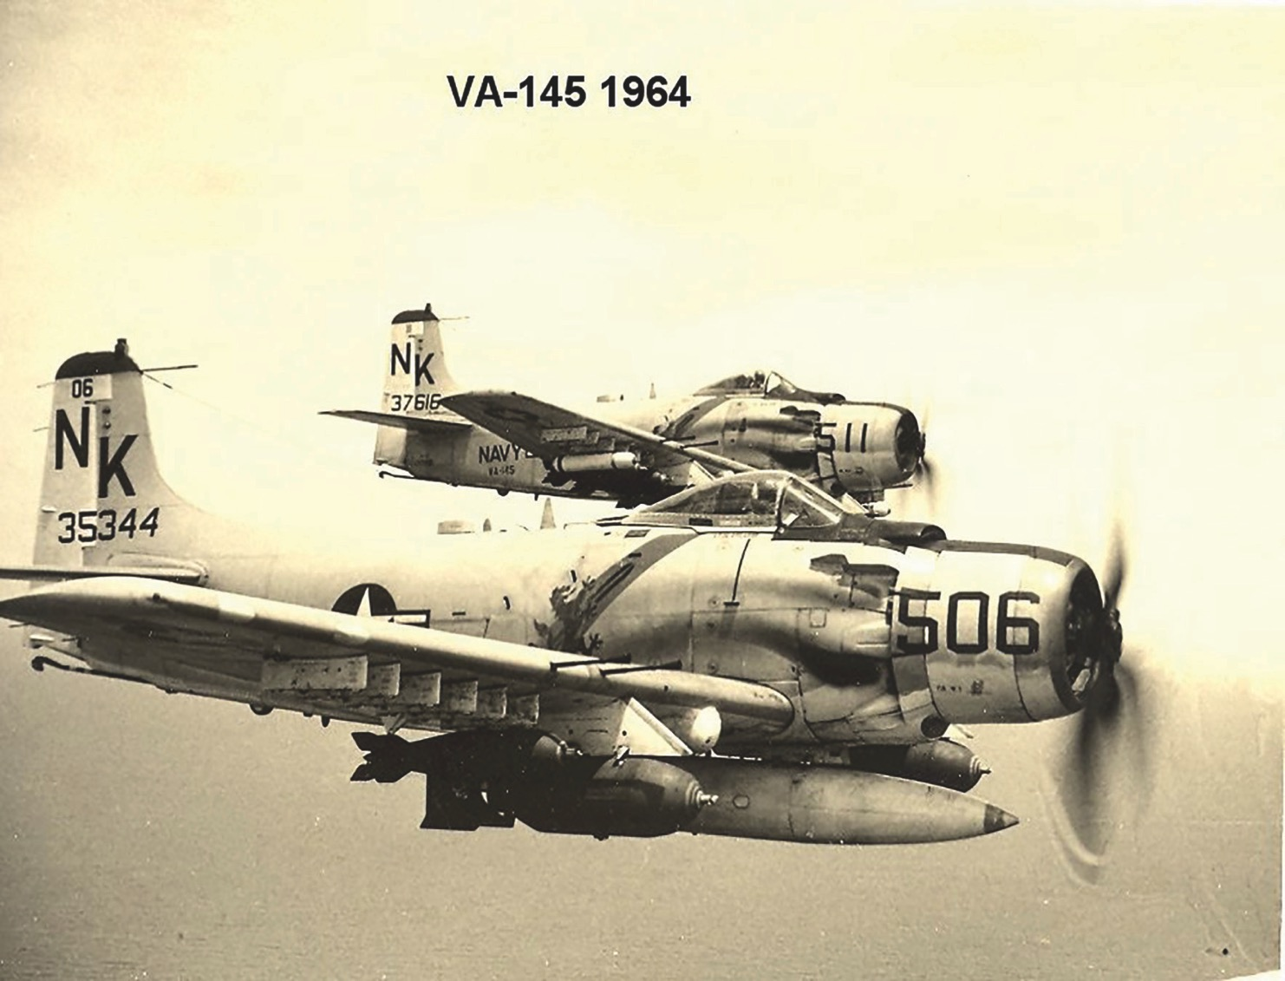
Title
Notes:
Text

Slide 39
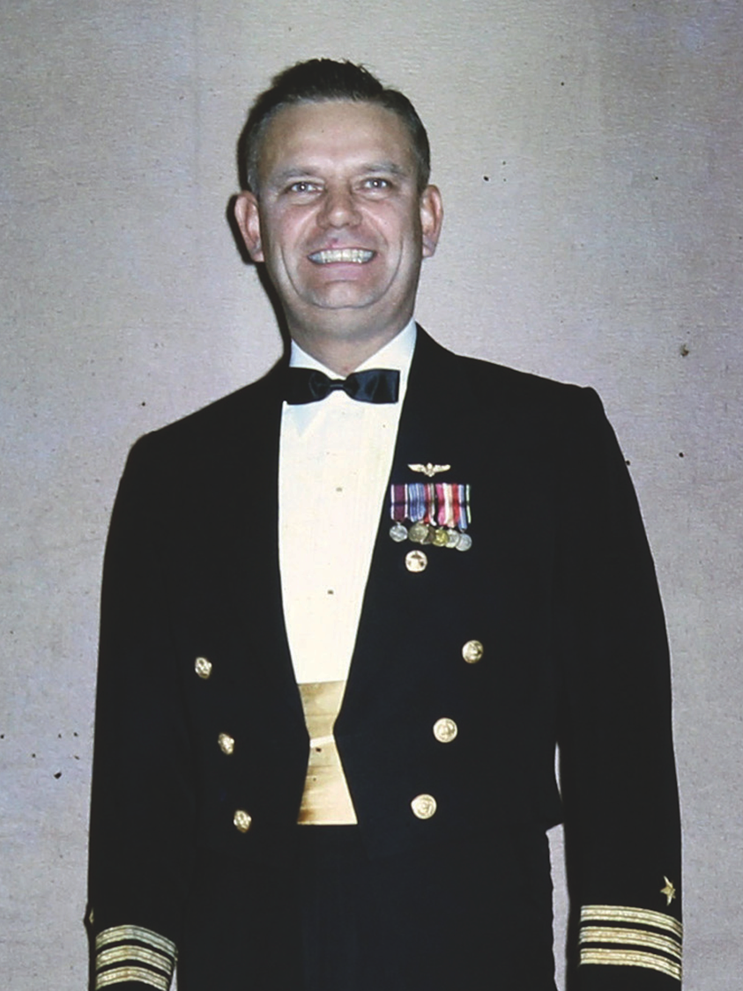
Title
Notes:
Text

Slide 40
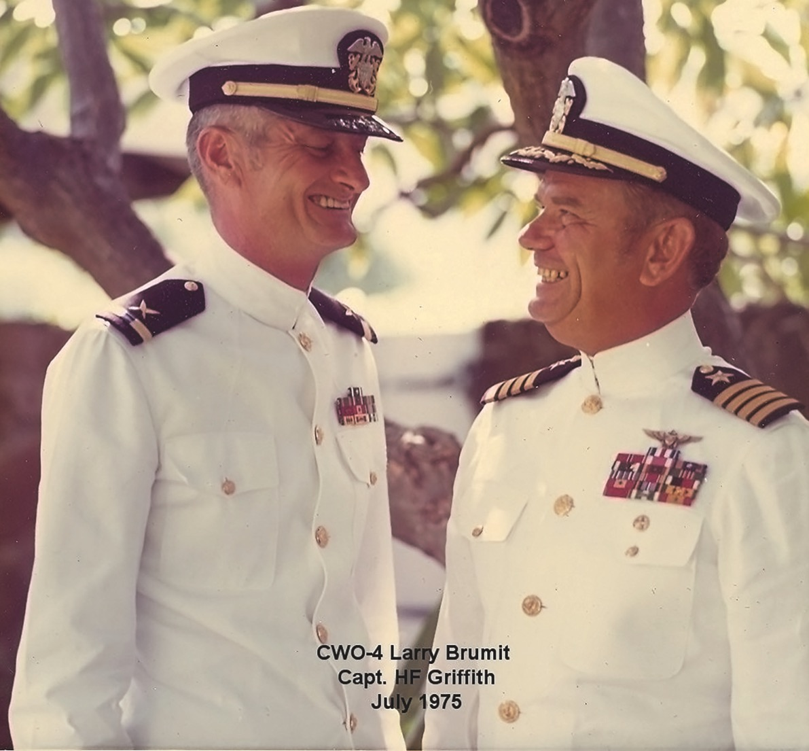
Captain (1968)
Notes:
Text

Slide 41
Family

Slide 42
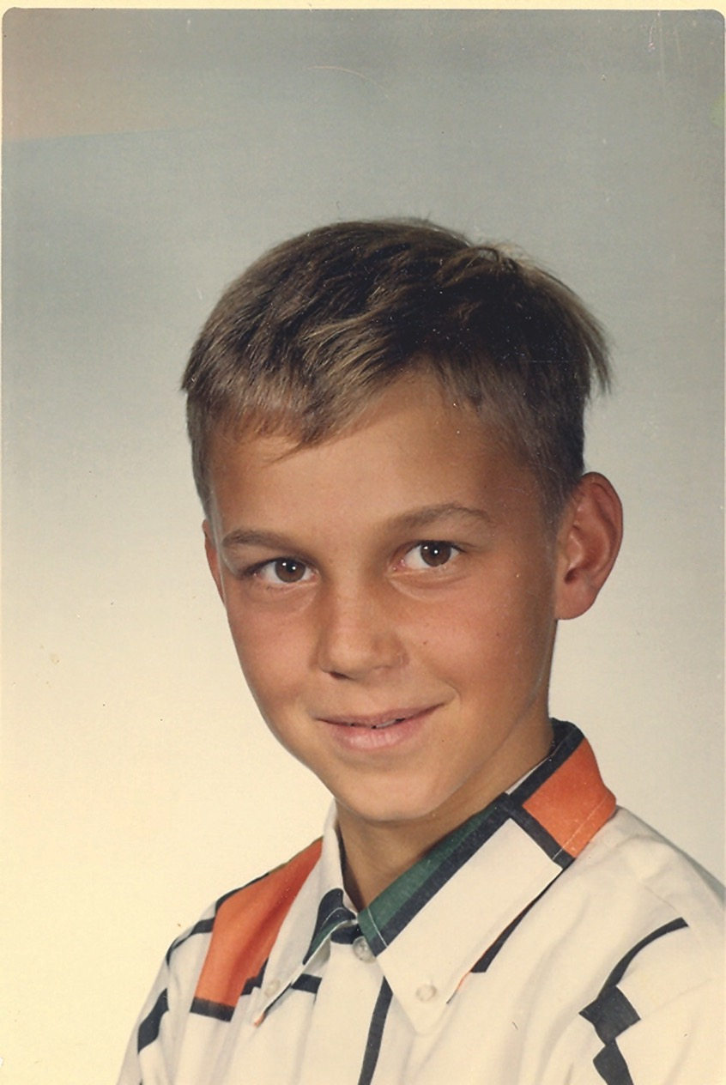
Title
Notes:
Text

Slide 43
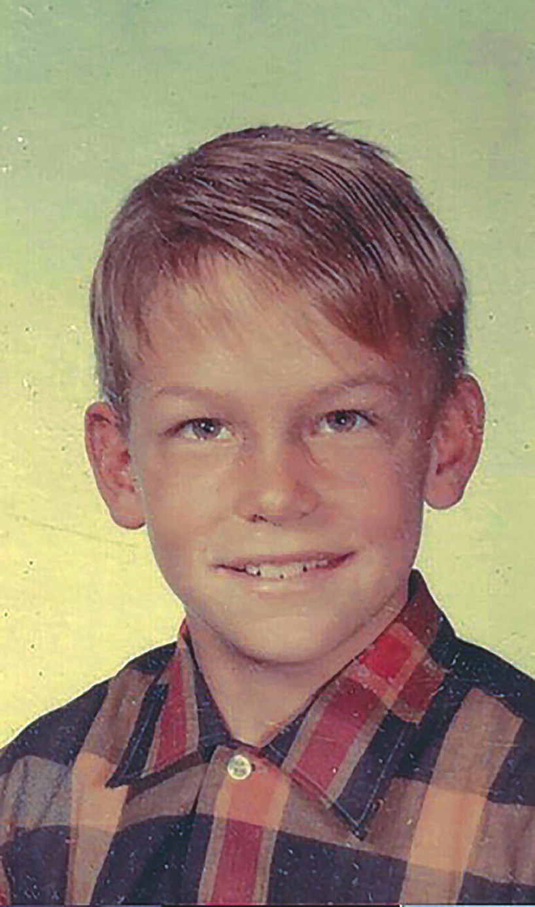
Title
Notes:
Text

Slide 44
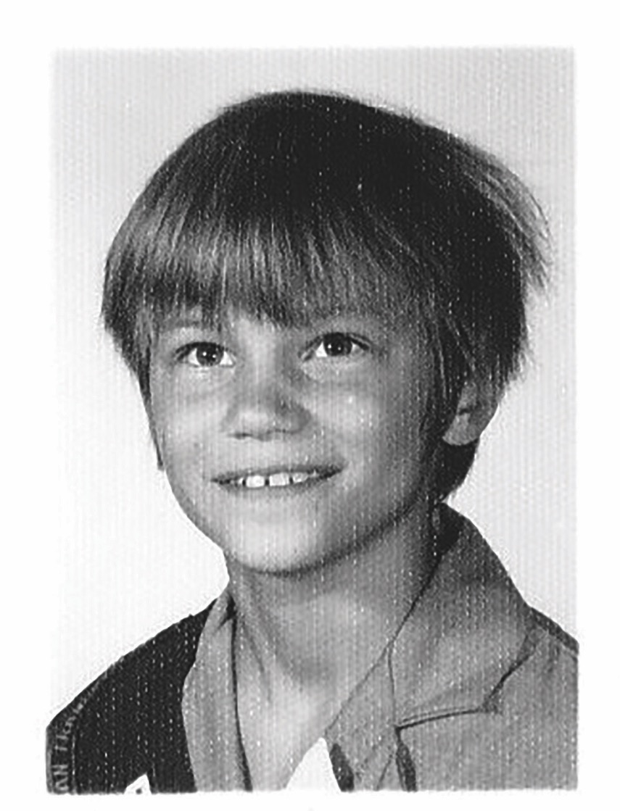
Title
Notes:
Text

Slide 45
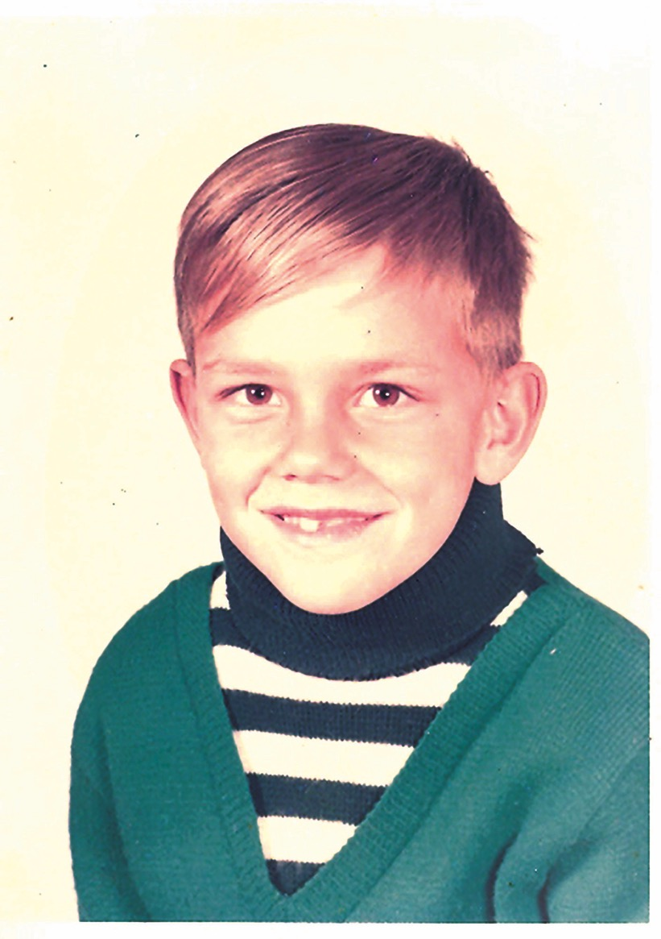
Title
Notes:
Text

Slide 46
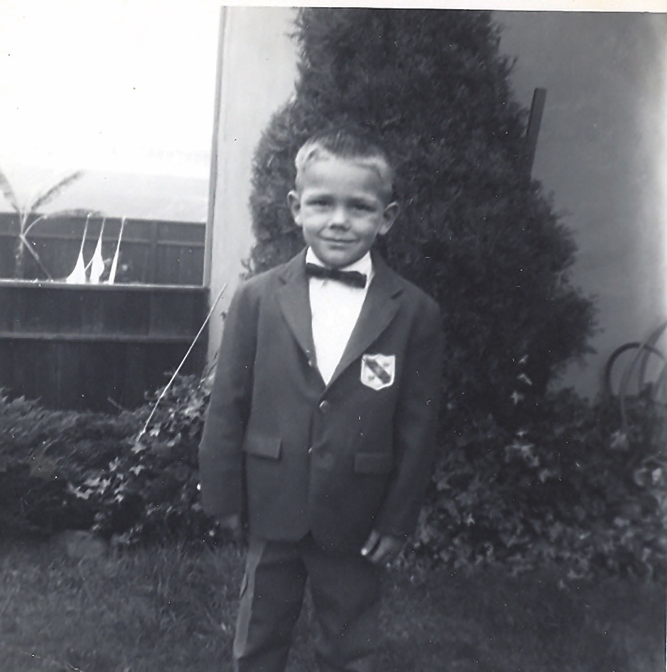
Title
Notes:
Text

Slide 47
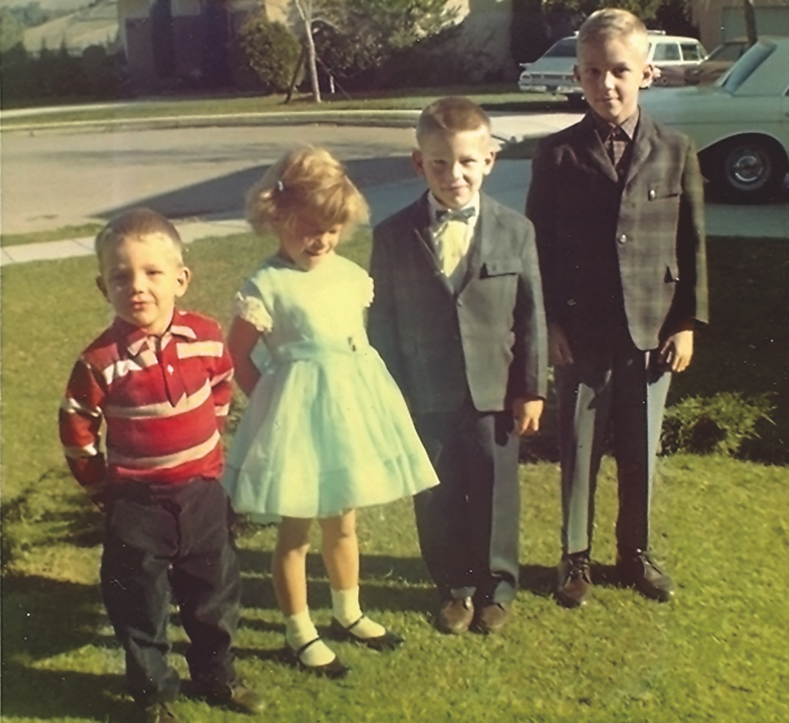
Title
Notes:
Text

Slide 48
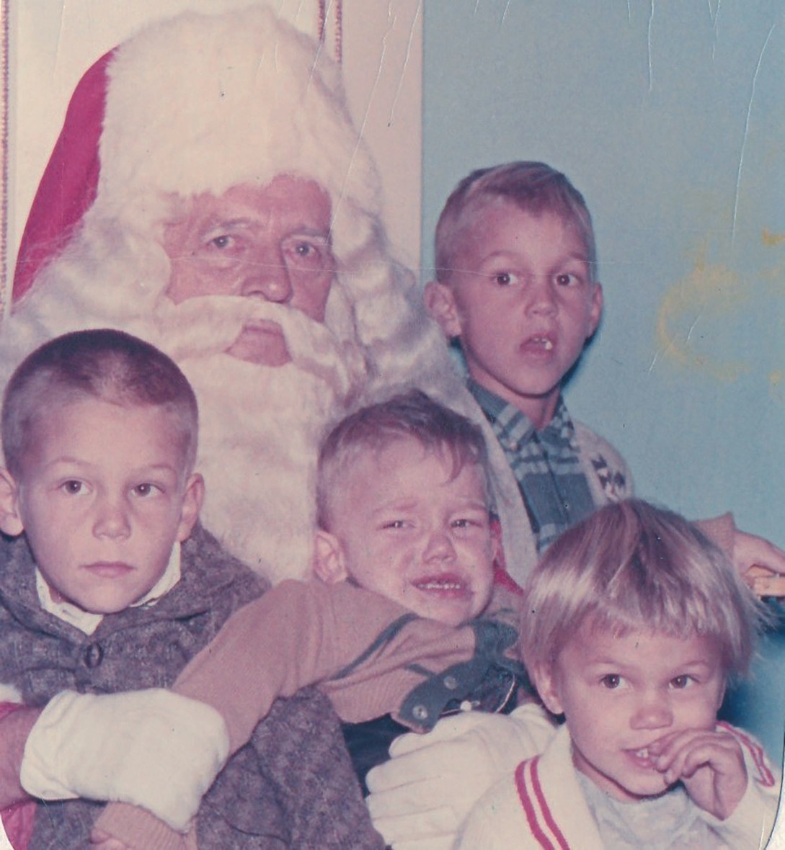
1964
Notes:
Text

Slide 49
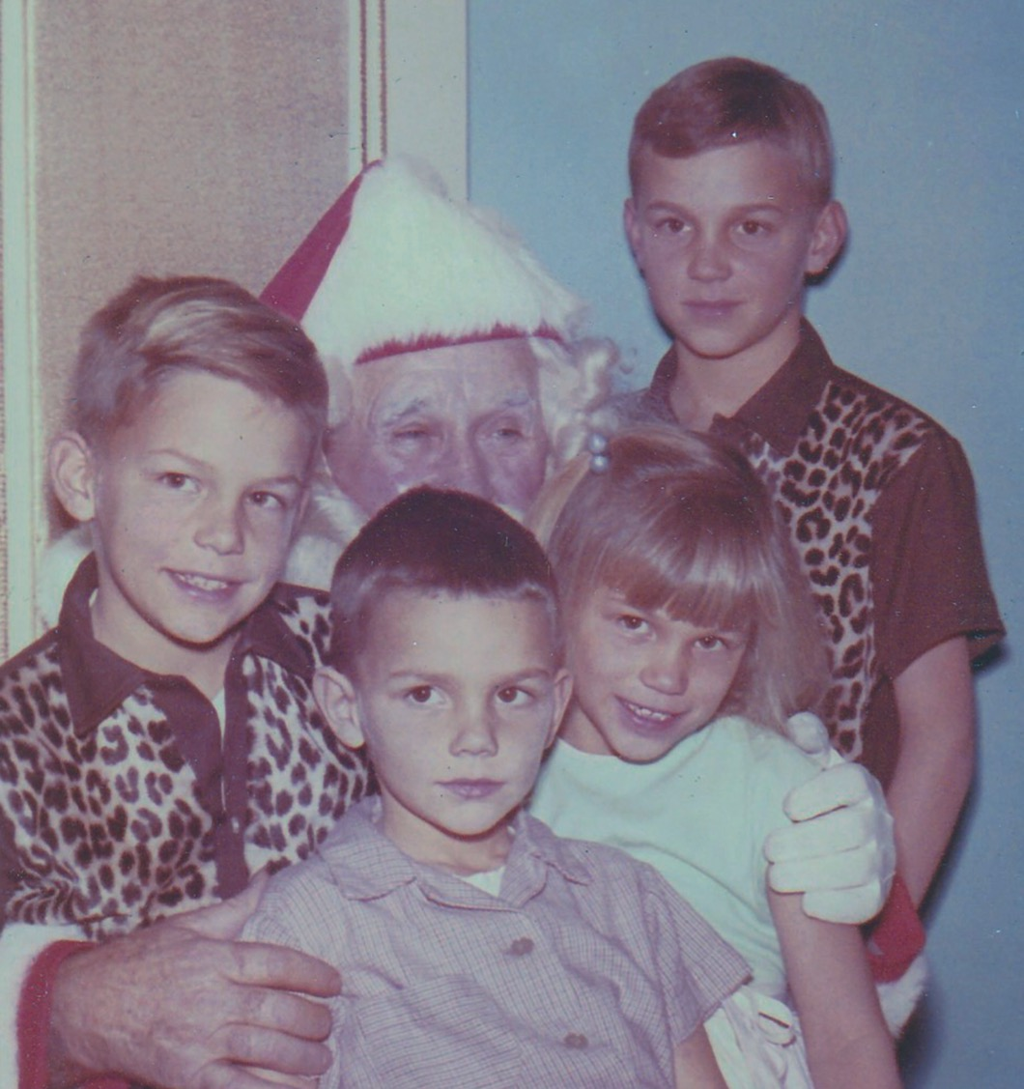
1967
Notes:
Text

Slide 50
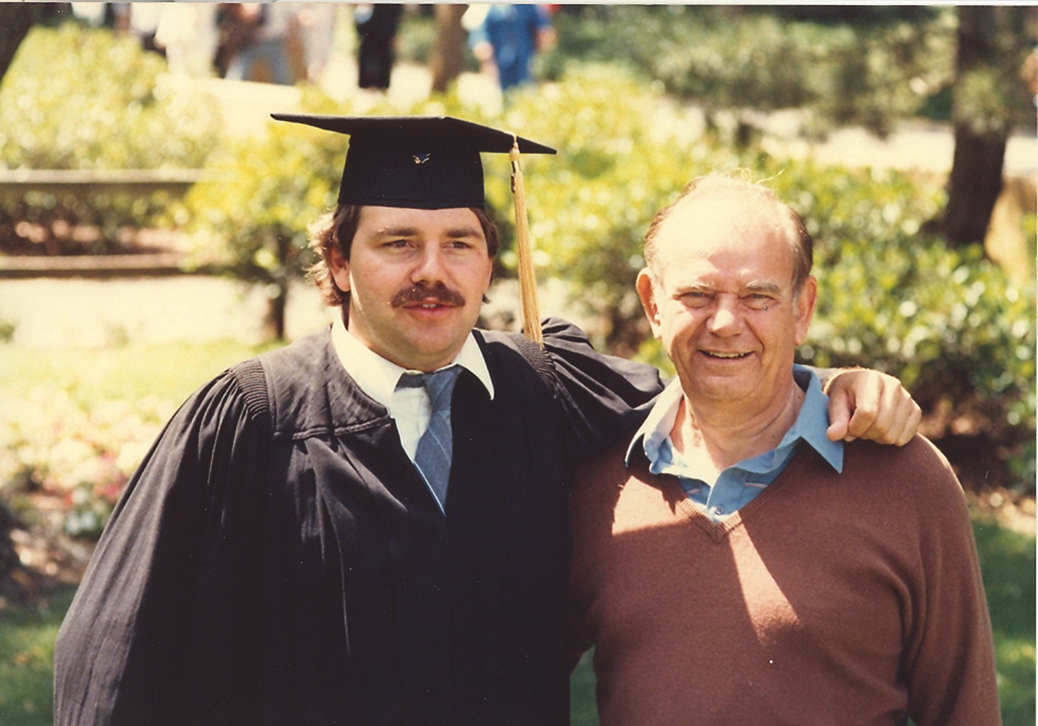
Title
Notes:
Text

Slide 51
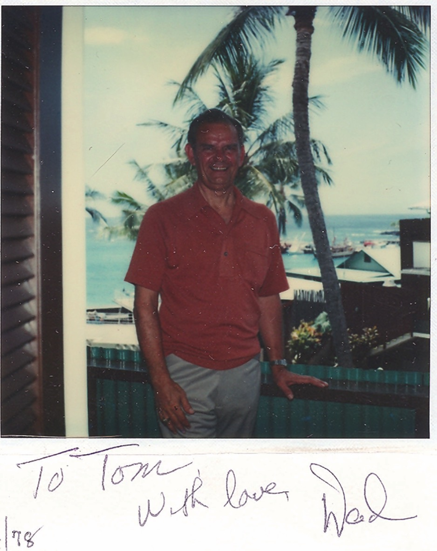
Title
Notes:
Text

Slide 52
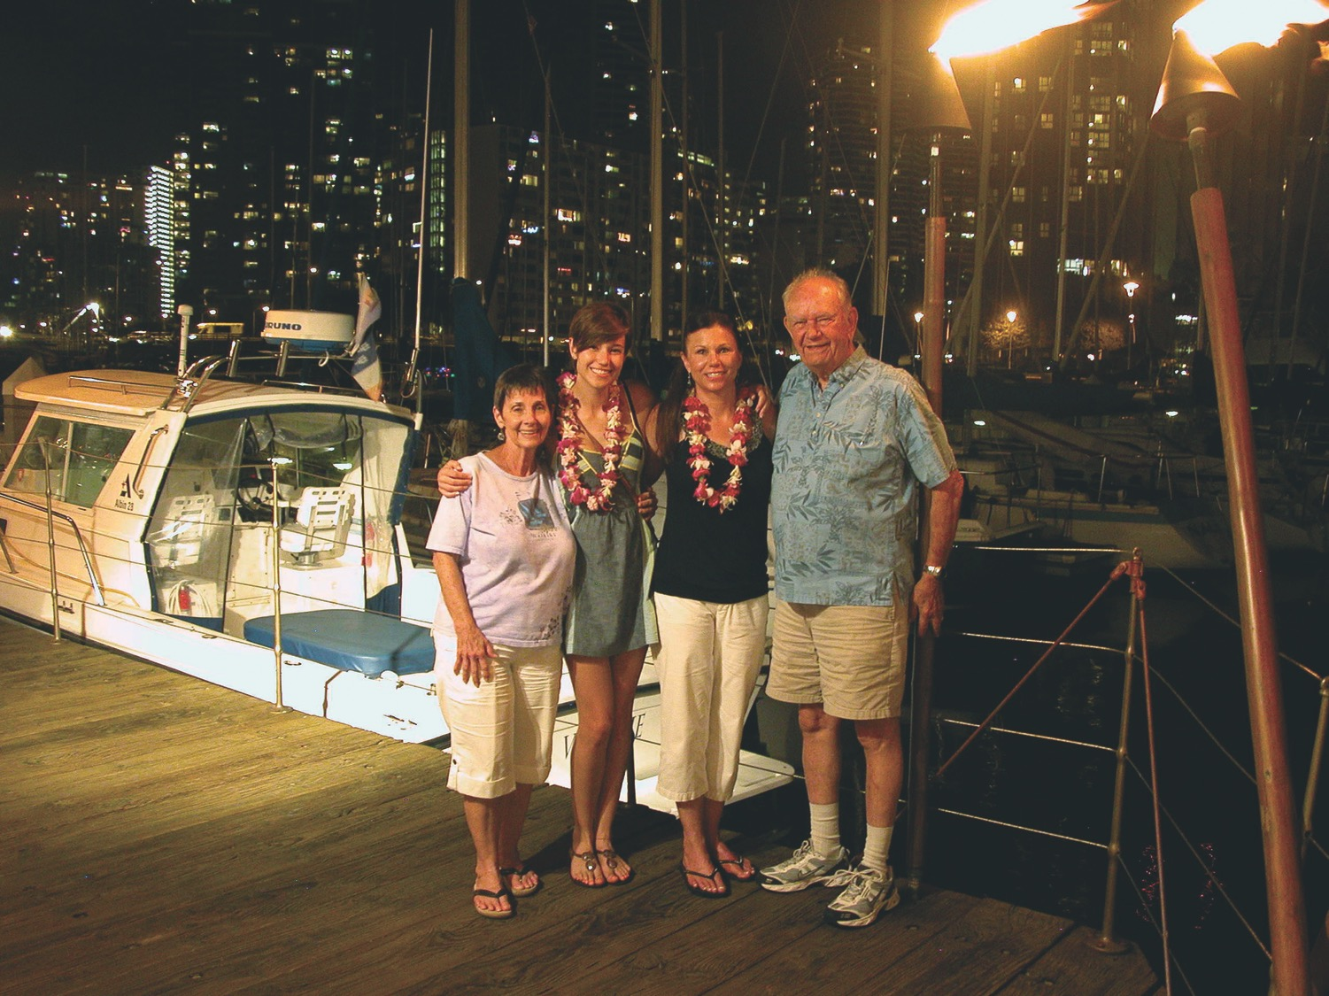
Title
Notes:
Text

Slide 53
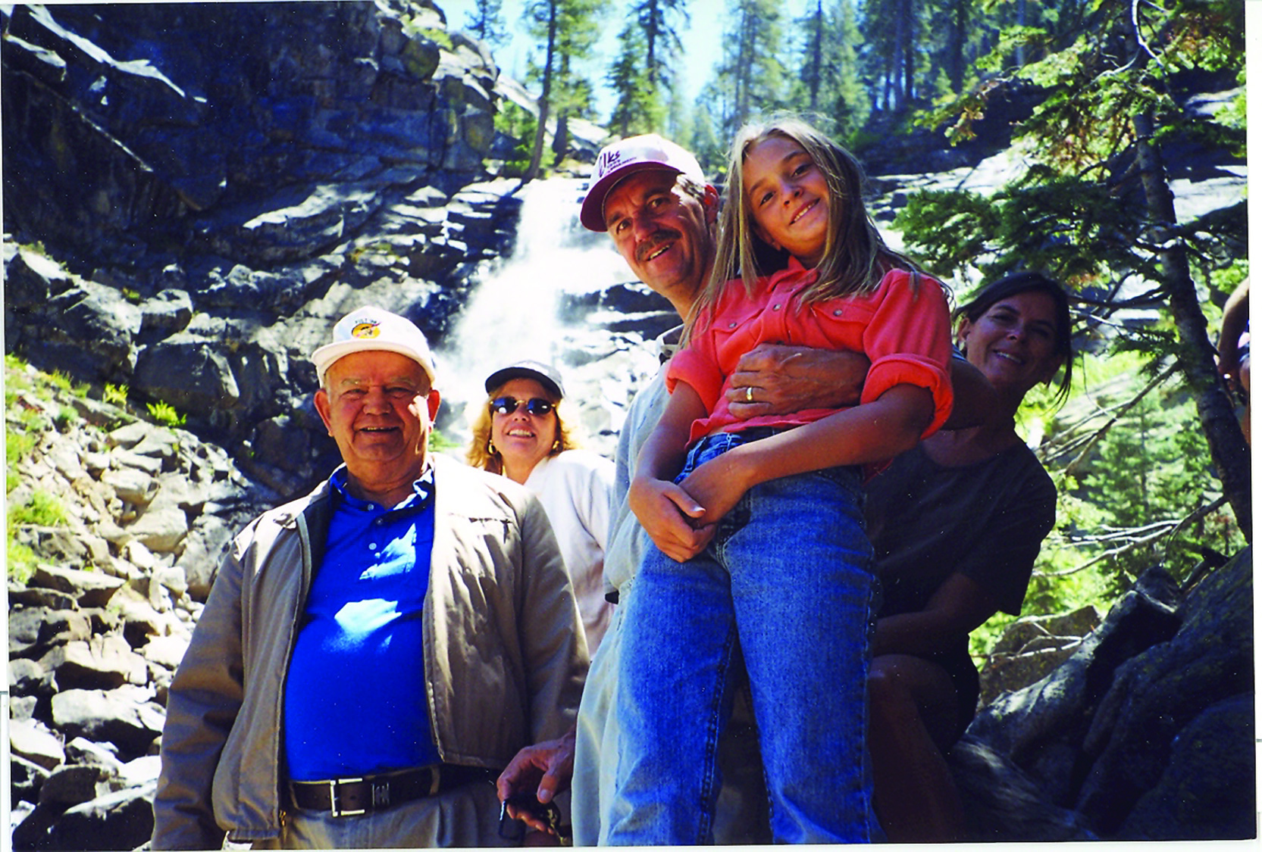
Title
Notes:
Text

Slide 54
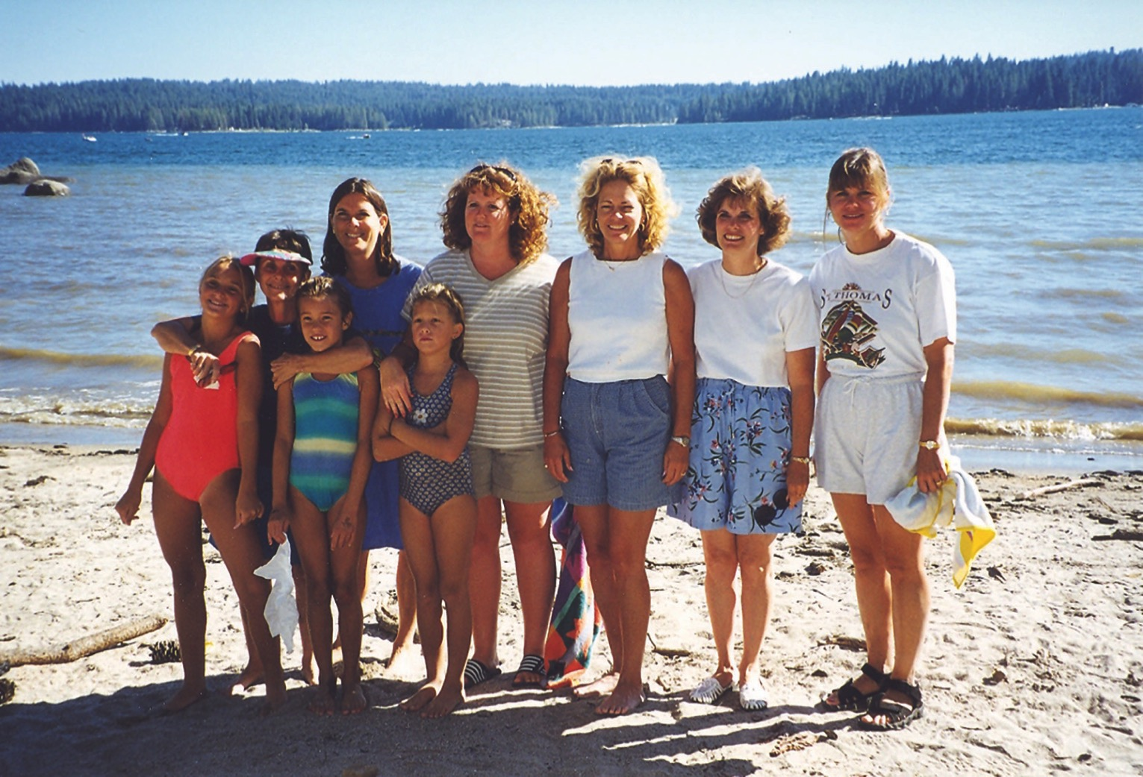
Title
Notes:
Text

Slide 55
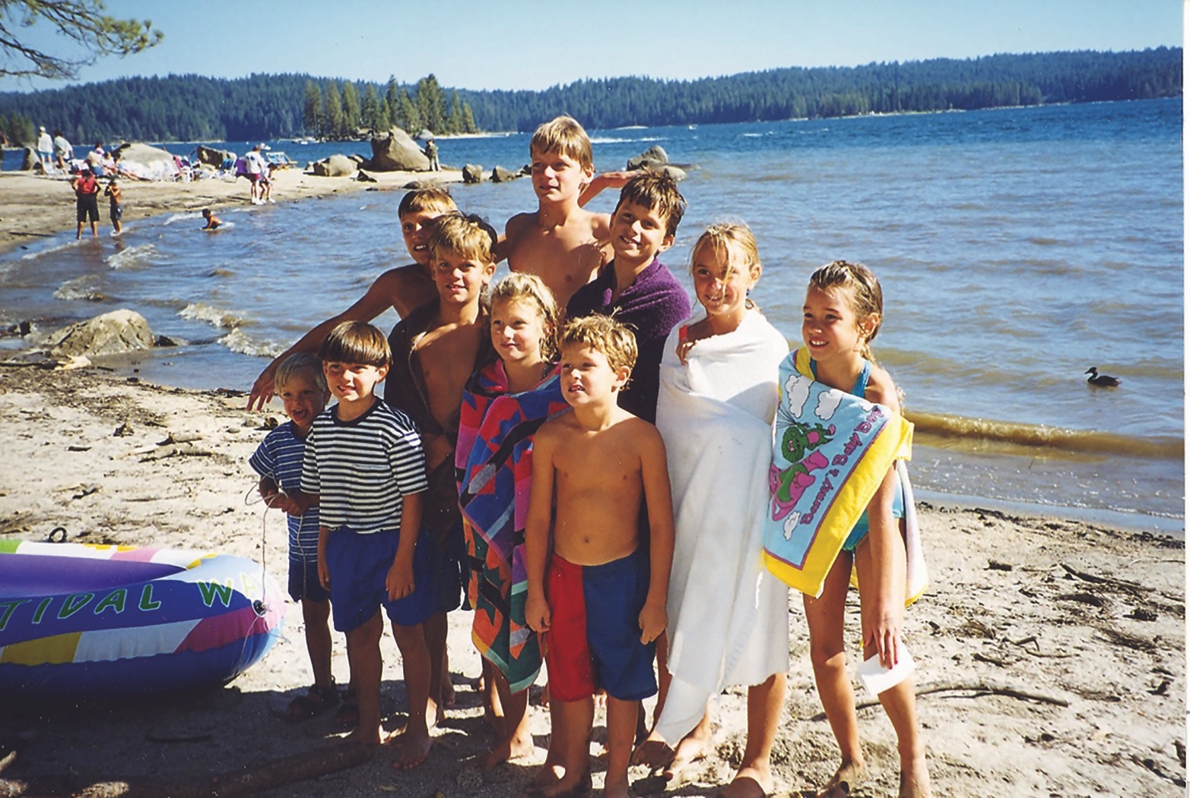
Title
Notes:
Text

Slide 56
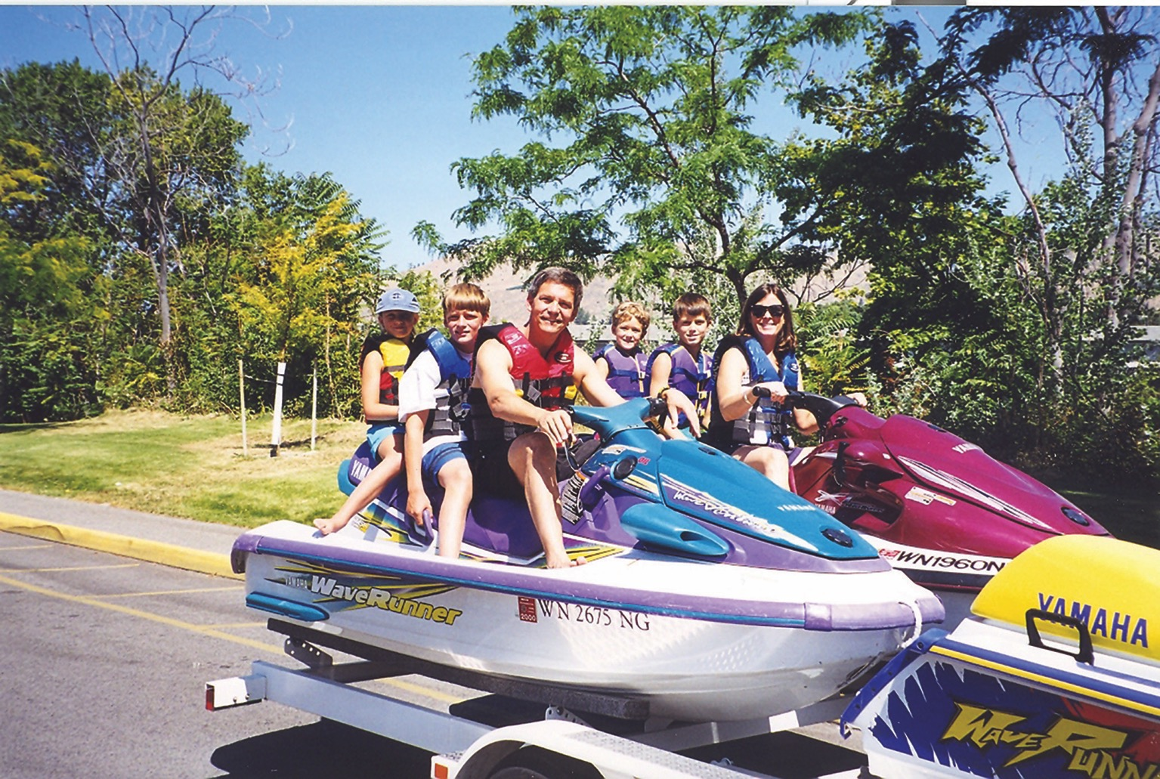
Title
Notes:
Text

Slide 57
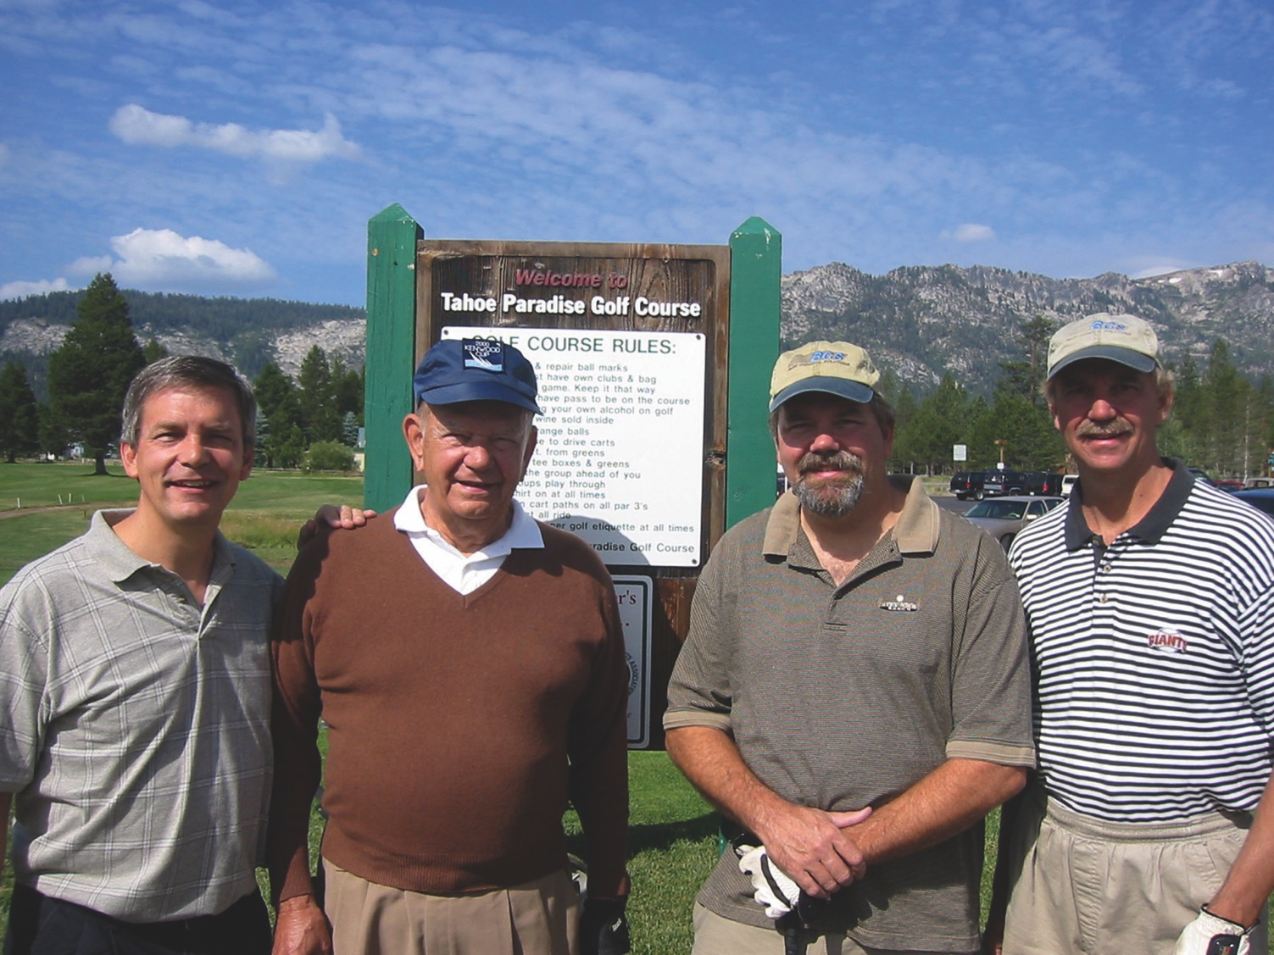
Title
Notes:
Text

Slide 58
Carolynn

Slide 59
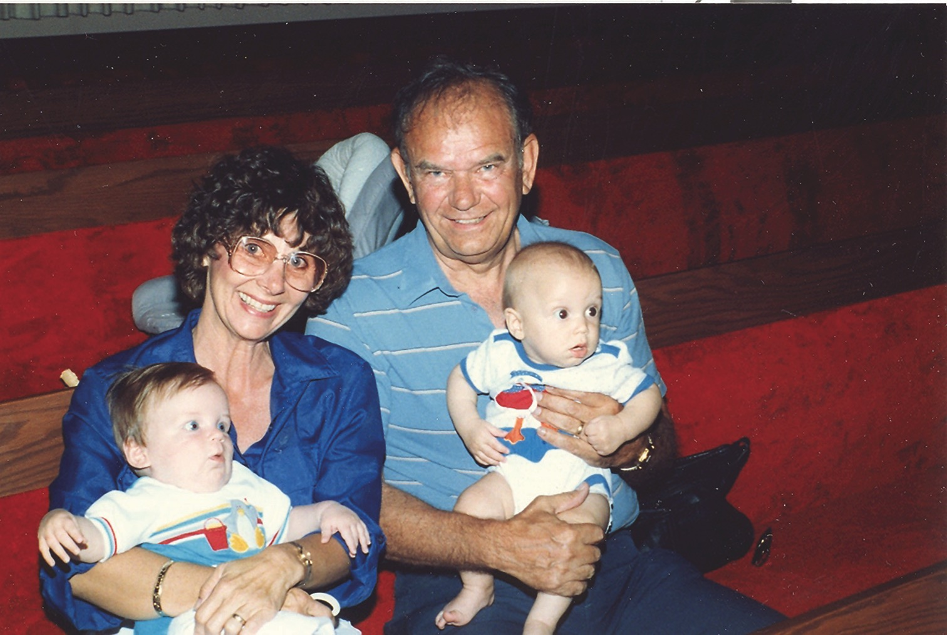
Title
Notes:
Text

Slide 60
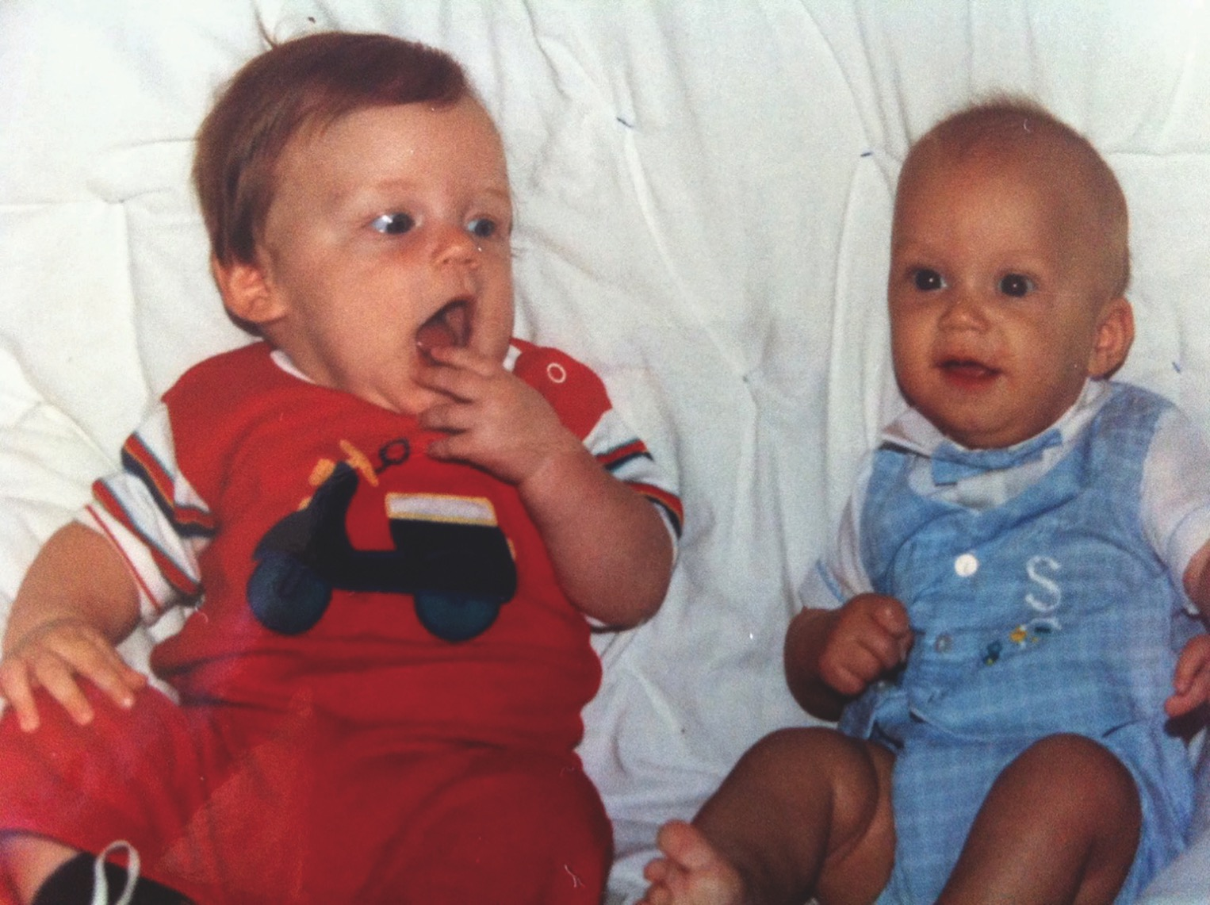
Title
Notes:
Text

Slide 61
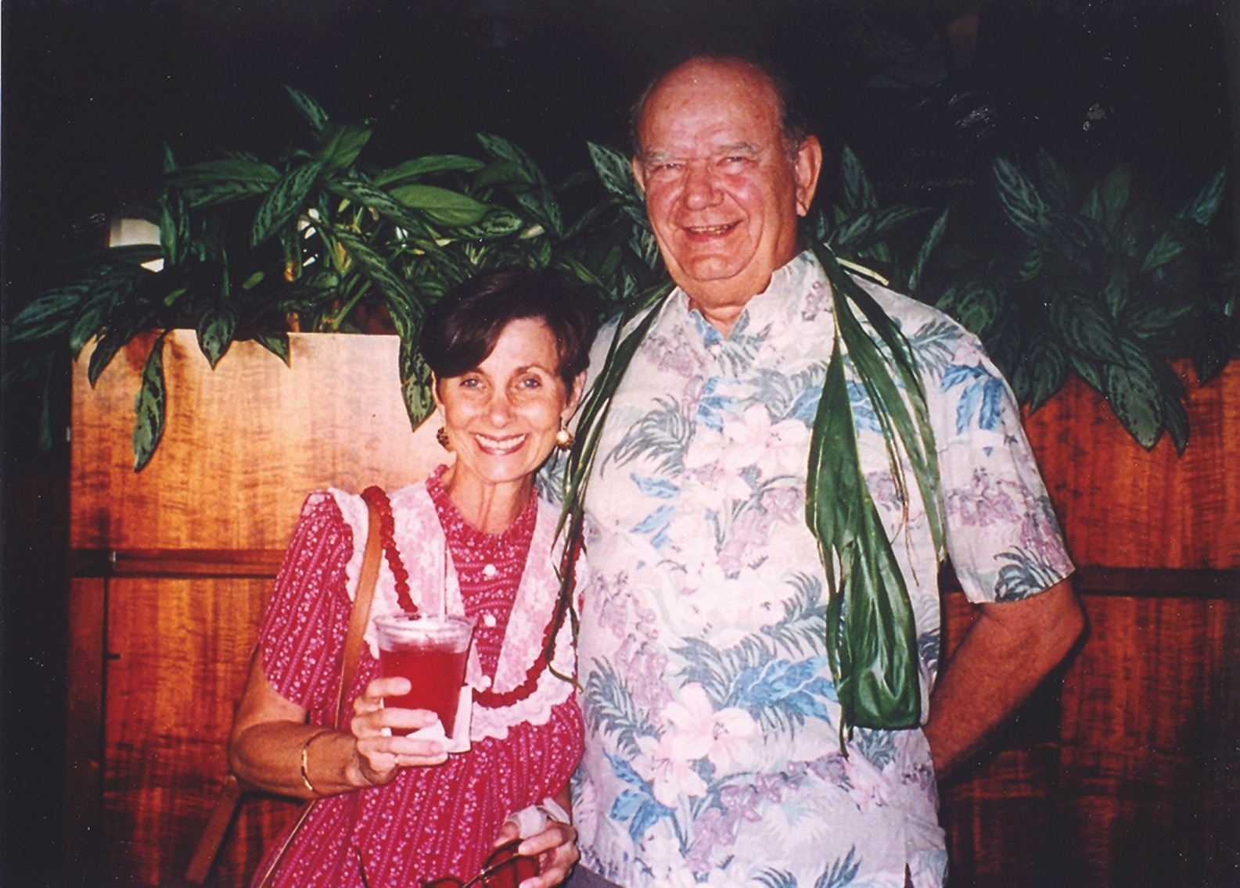
Title
Notes:
Text

Slide 62
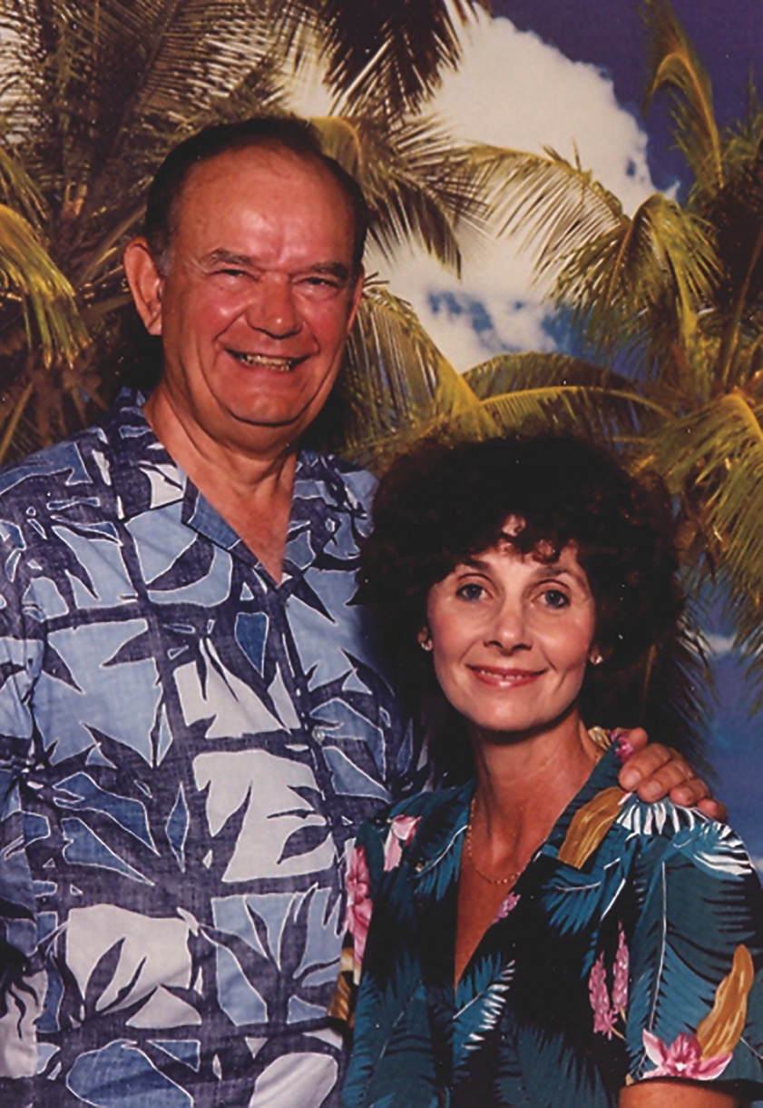
Title
Notes:
Text

Slide 63
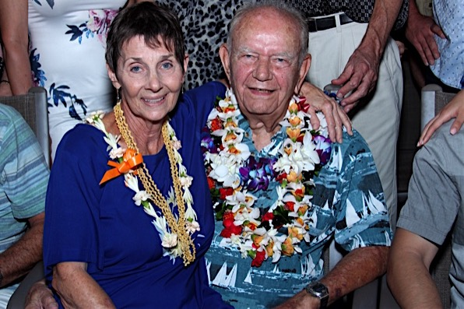
Title
Notes:
Text

Slide 64
Nalu

Slide 65
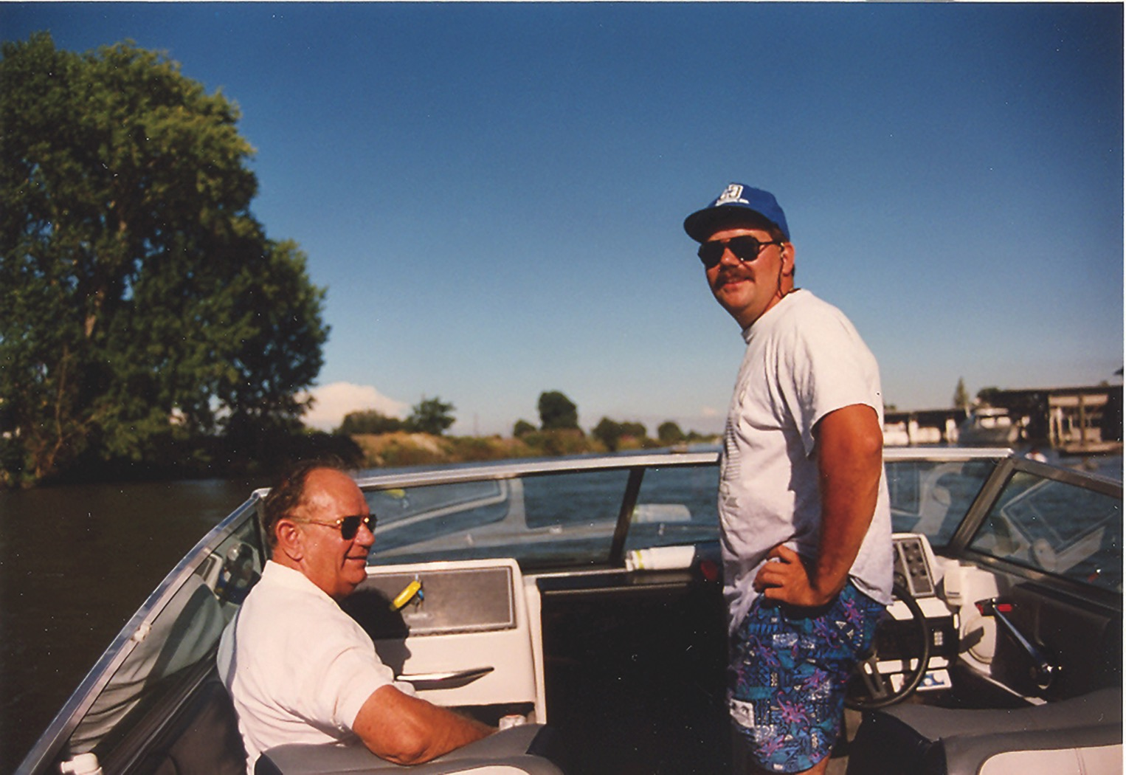
Title
Notes:
Text

Slide 66
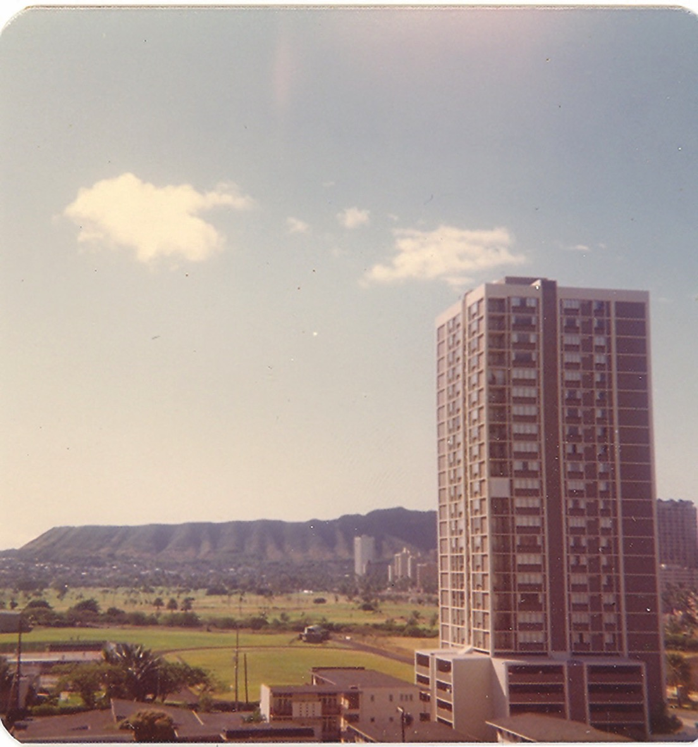
Title
Notes:
Text

Slide 67
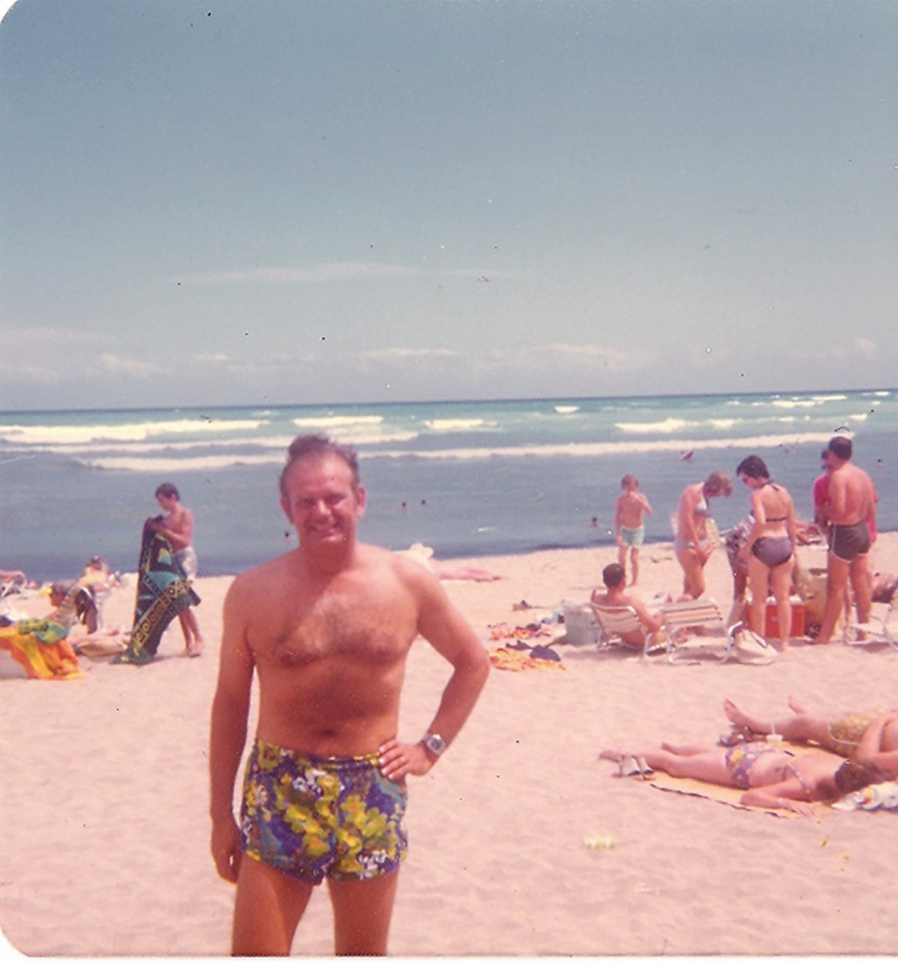
Title
Notes:
Text

Slide 68
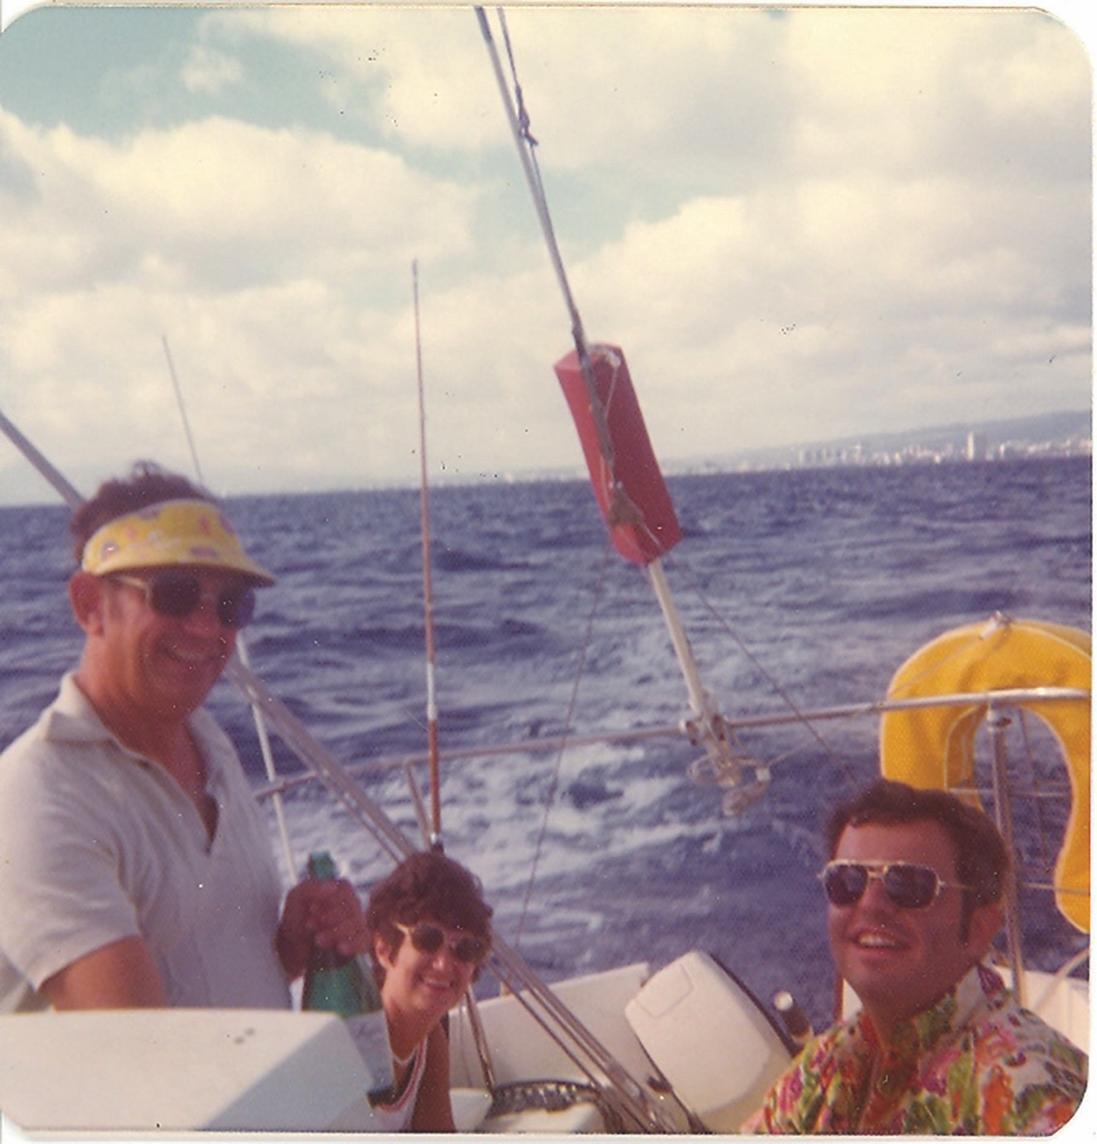
Title
Notes:
Text

Slide 69
Title
Notes:
Text

Slide 70
Legacy

Slide 71
Title
Notes:
Text

Slide 72
Title
Notes:
Text

Slide 73
Title
Notes:
Text

Slide 74
Title
Notes:
Text

Slide 75
Title
Notes:
Text

Slide 76
Title
Notes:
Text

Slide 77
Title
Notes:
Text

Slide 78
Title
Notes:
Text

Slide 79
Title
Notes:
Text

Slide 80
Title
Notes:
Text

Slide 81
Title
Notes:
Text

Slide 82
WW2 Veteran Funeral Poem by Mac McGovern

Slide 83
Military Funeral Honors

Slide 84
Tuesday, March 6
11 AM
Hawaii State Veterans Cemetery, Kaneohe
Notes:
Text

Slide 85
Reflections

Slide 86
Stephen

Slide 87
Final Flight

Slide 88
Title
Notes:
Text

Slide 89
Title
Notes:
Text

Slide 90
Title
Notes:
Text

Slide 91
Title
Notes:
Text

Slide 92
Title
Notes:
Text

Slide 93
Carolynn

Slide 94
Other Reflections

Slide 95
Title
Notes:
Text

Slide 96
Prayer

Slide 97
Title
Notes:
Text

Slide 98
Black

Slide 99
OT Preaching link at BibleStudyDownloads.org
Get this presentation and script for free!
Notes:
OT Preaching (op)

