Slide 1
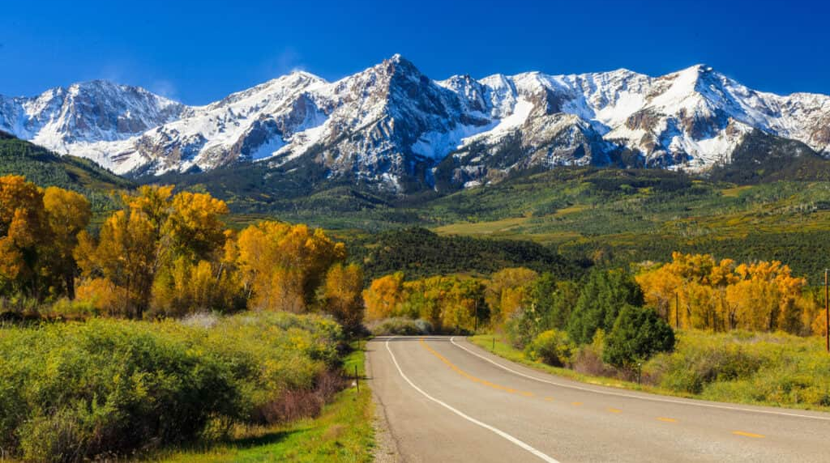
Psalm 19
God is Speaking… Are You Listening?
Summer in the
psalms
Preached by Dan Bridges at Amman International Church Singapore • AmmanChurch.com Uploaded by Dr. Rick Griffith • Jordan Evangelical Theological Seminary Files in many languages for free download at BibleStudyDownloads.org

Slide 2
Old City and Kidron Valley from north
Ever had the experience of talking but not being listened to? Or vice-versa?

Slide 3
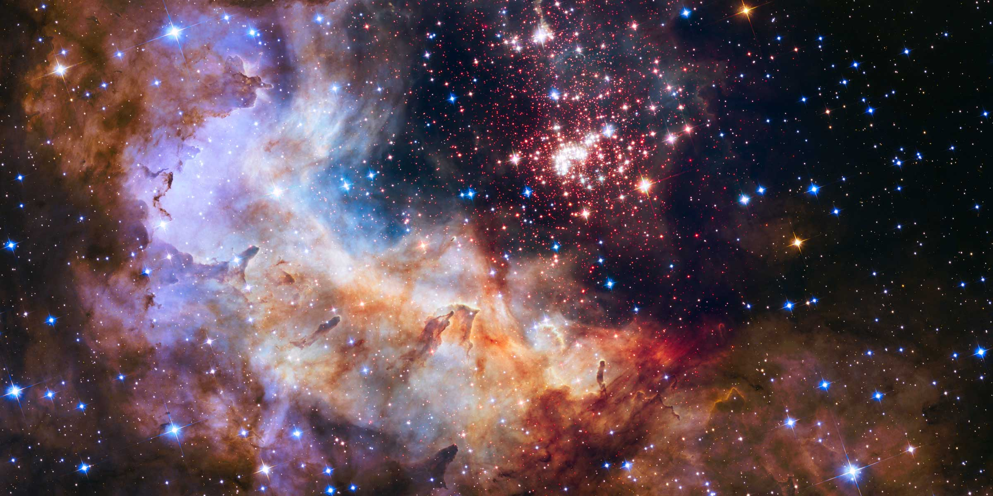
Old City and Kidron Valley from north
Psalm 19
God is constantly speaking to us…
He calls us to listen!

Slide 4
Old City and Kidron Valley from north
Psalm 19
Speaking Through Creation (1-6)
Speaking Through the Word (7-11)
Prayer of Submission (12-14)

Slide 5
Old City and Kidron Valley from north
1 The heavens declare the glory of God,
and the sky above proclaims his handiwork.

Slide 6
Old City and Kidron Valley from north
How do the heavens “declare the glory of God”?
1 The heavens declare the glory of God,
and the sky above proclaims his handiwork.

Slide 7
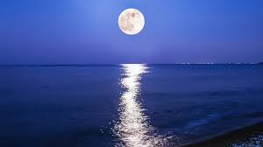
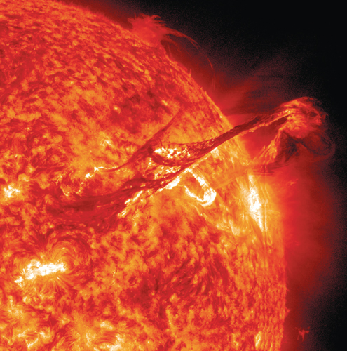
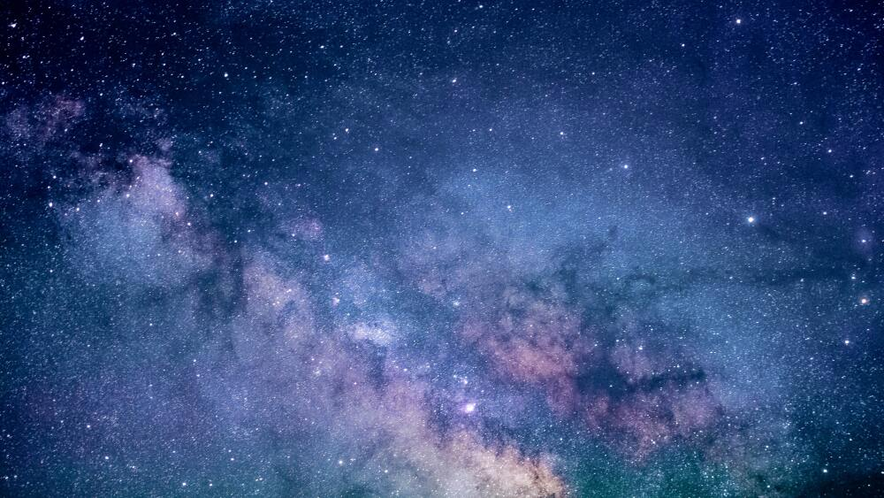
Old City and Kidron Valley from north
What do these tell us about God?

Slide 8
Old City and Kidron Valley from north
How do the heavens “declare the glory of God”?
They tell us about the nature of God… His
Creativity
Power
Wisdom
Attention to Detail
Divine Nature
1 The heavens declare the glory of God,
and the sky above proclaims his handiwork.

Slide 9
Old City and Kidron Valley from north
They are constantly speaking… To what purpose?
To minister to us!
2 Day to day pours out speech,
and night to night reveals knowledge.

Slide 10
Old City and Kidron Valley from north
If we are “listening”, how does God minister to us through his creation?
He fills our hearts with his greatness.
He gives us hope, happiness and humility.
He heals and refreshes our souls.

Slide 11
Old City and Kidron Valley from north
NASB:
“There is no speech, nor are there words; Their voice is not heard.”
3 There is no speech, nor are there words,
whose voice is not heard.
4 Their voice goes out through all the earth,
and their words to the end of the world.

Slide 12
Old City and Kidron Valley from north
This
“General Revelation”
is available to all people at all places at all times.
3 There is no speech, nor are there words,
whose voice is not heard.
4 Their voice goes out through all the earth,
and their words to the end of the world.

Slide 13
Old City and Kidron Valley from north
Everyone is accountable for this revelation:
19 For what can be known about God is plain to them, because God has shown it to them.
20 For his invisible attributes, namely, his eternal power and divine nature, have been clearly perceived, ever since the creation of the world, in the things that have been made. So they are without excuse.
Romans 1:19-20

Slide 14
Old City and Kidron Valley from north
David’s Meditation:
What does the sun’s movement communicate about God?
Why focus on the sun?
Most obvious object in the heavens
Worshipped by many as a god
4 In them he has set a tent for the sun,
5 which comes out like a bridegroom leaving his chamber,
and, like a strong man, runs its course with joy.
6 Its rising is from the end of the heavens,
and its circuit to the end of them,
and there is nothing hidden from its heat.

Slide 15
Old City and Kidron Valley from north
David’s Meditation:
What does the sun’s movement communicate about God?
4 In them he has set a tent for the sun,
5 which comes out like a bridegroom leaving his chamber,
and, like a strong man, runs its course with joy.
6 Its rising is from the end of the heavens,
and its circuit to the end of them,
and there is nothing hidden from its heat.
Sunrise – The joy and anticipation of a bridegroom
(God of Joy and Beauty!)

Slide 16
Old City and Kidron Valley from north
David’s Meditation:
What does the sun’s movement communicate about God?
Sun’s journey across the sky – Strength of a runner
(God of Power & Strength!)
4 In them he has set a tent for the sun,
5 which comes out like a bridegroom leaving his chamber,
and, like a strong man, runs its course with joy.
6 Its rising is from the end of the heavens,
and its circuit to the end of them,
and there is nothing hidden from its heat.

Slide 17
Old City and Kidron Valley from north
David’s Meditation:
What does the sun’s movement communicate about God?
Scope of sun’s influence
(God of completeness!)
4 In them he has set a tent for the sun,
5 which comes out like a bridegroom leaving his chamber,
and, like a strong man, runs its course with joy.
6 Its rising is from the end of the heavens,
and its circuit to the end of them,
and there is nothing hidden from its heat.

Slide 18
Old City and Kidron Valley from north
Psalm 19:1-6
Why start the Psalm with God speaking through his creation?
David is worshipping!
David is listening to God!

Slide 19
Old City and Kidron Valley from north
Psalm 19
Speaking Through Creation (1-6)
Speaking Through the Word (7-11)
Prayer of Submission (12-14)

Slide 20
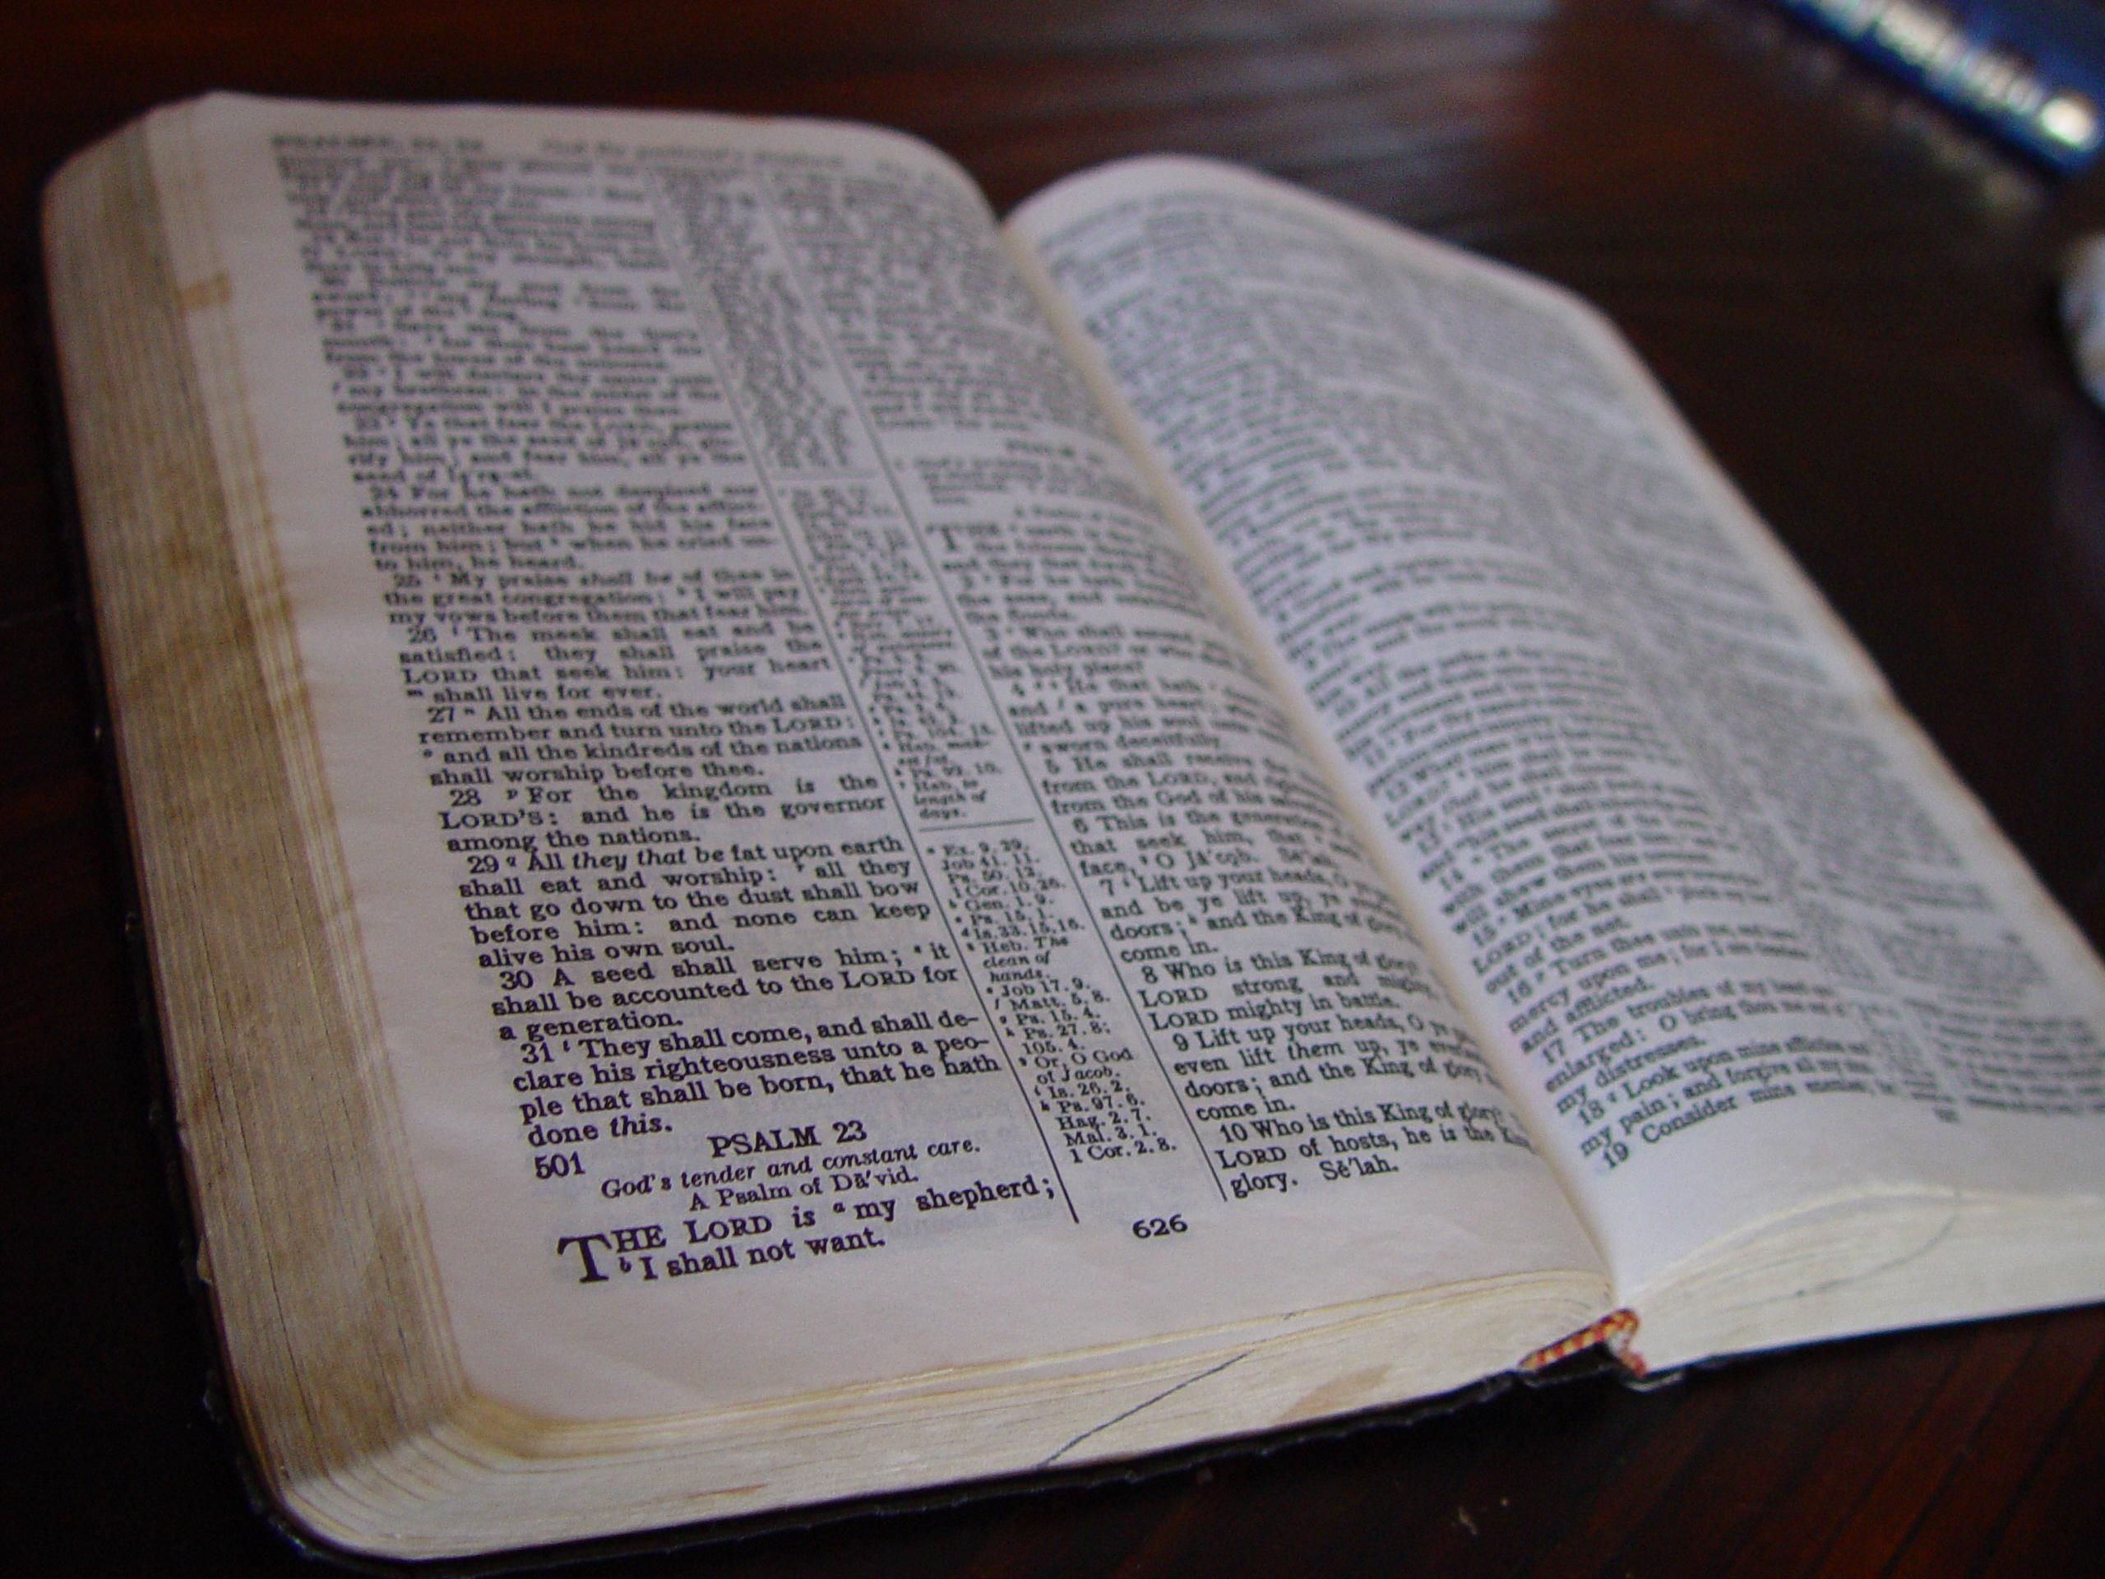
Old City and Kidron Valley from north
Psalm 19:7-11
Special Revelation (God’s Word)
If God’s glory / goodness to man is revealed in creation, how much more is it revealed in his Word!

Slide 21
Old City and Kidron Valley from north
7 The law of the LORD is perfect,
reviving the soul;
the testimony of the LORD is sure,
making wise the simple;
8 the precepts of the LORD are right,
rejoicing the heart;
the commandment of the LORD is pure,
enlightening the eyes;
9 the fear of the LORD is clean,
enduring forever;
the rules of the LORD are true,
and righteous altogether.

Slide 22
Old City and Kidron Valley from north
7 The law of the LORD is perfect,
reviving the soul;
the testimony of the LORD is sure,
making wise the simple;
8 the precepts of the LORD are right,
rejoicing the heart;
the commandment of the LORD is pure,
enlightening the eyes;
9 the fear of the LORD is clean,
enduring forever;
the rules of the LORD are true,
and righteous altogether.
Six times
“… of the LORD”
The Bible is God’s Word!
Do we really see it as the words of the God of the Universe?

Slide 23
Old City and Kidron Valley from north
7 The law of the LORD is perfect,
reviving the soul;
the testimony of the LORD is sure,
making wise the simple;
8 the precepts of the LORD are right,
rejoicing the heart;
the commandment of the LORD is pure,
enlightening the eyes;
9 the fear of the LORD is clean,
enduring forever;
the rules of the LORD are true,
and righteous altogether.
Six times
“… of the LORD”
How does this compare with anything else we can read or watch?

Slide 24
Old City and Kidron Valley from north
7 The law of the LORD is perfect,
reviving the soul;
the testimony of the LORD is sure,
making wise the simple;
8 the precepts of the LORD are right,
rejoicing the heart;
the commandment of the LORD is pure,
enlightening the eyes;
9 the fear of the LORD is clean,
enduring forever;
the rules of the LORD are true,
and righteous altogether.
Six Adjectives

Slide 25
Old City and Kidron Valley from north
7 The law of the LORD is perfect,
reviving the soul;
the testimony of the LORD is sure,
making wise the simple;
8 the precepts of the LORD are right,
rejoicing the heart;
the commandment of the LORD is pure,
enlightening the eyes;
9 the fear of the LORD is clean,
enduring forever;
the rules of the LORD are true,
and righteous altogether.
Sure: Stable foundation
Right: Always correct
True: Always reliable
This tests our faith!

Slide 26
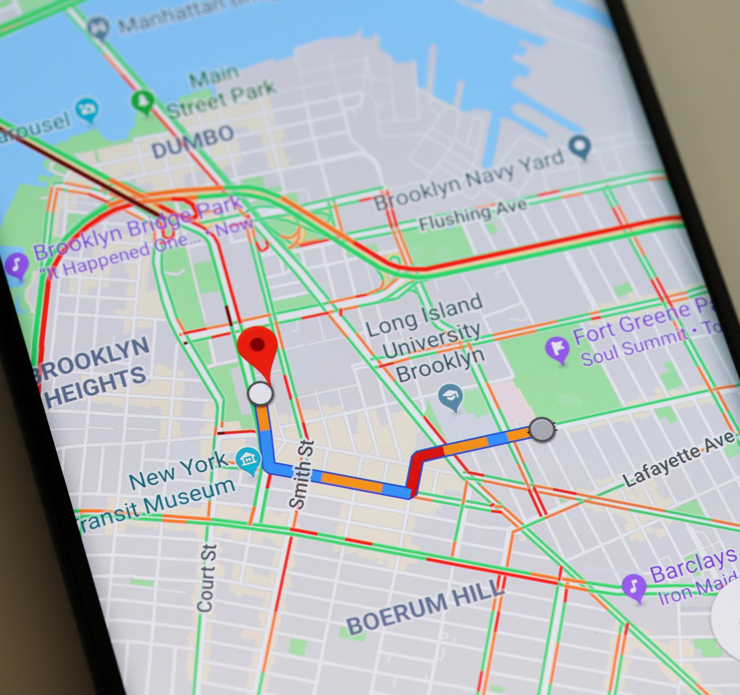
Old City and Kidron Valley from north
Do you trust your maps app?
Do you follow it even when you don’t understand why it’s sending you a certain way?

Slide 27
Old City and Kidron Valley from north
How much more should we trust the Word of the creator of the universe who loves us!

Slide 28
Old City and Kidron Valley from north
7 The law of the LORD is perfect,
reviving the soul;
the testimony of the LORD is sure,
making wise the simple;
8 the precepts of the LORD are right,
rejoicing the heart;
the commandment of the LORD is pure,
enlightening the eyes;
9 the fear of the LORD is clean,
enduring forever;
the rules of the LORD are true,
and righteous altogether.
Sure: Stable foundation
Right: Always correct
True: Always reliable
This tests our faith!

Slide 29
Old City and Kidron Valley from north
7 The law of the Lord is perfect,
reviving the soul;
the testimony of the Lord is sure,
making wise the simple;
8 the precepts of the Lord are right,
rejoicing the heart;
the commandment of the Lord is pure,
enlightening the eyes;
9 the fear of the Lord is clean,
enduring forever;
the rules of the Lord are true,
and righteous altogether.
Four Effects
Life
Wisdom
Joy

Slide 30
Old City and Kidron Valley from north
7 The law of the Lord is perfect,
reviving the soul;
the testimony of the Lord is sure,
making wise the simple;
8 the precepts of the Lord are right,
rejoicing the heart;
the commandment of the Lord is pure,
enlightening the eyes;
9 the fear of the Lord is clean,
enduring forever;
the rules of the Lord are true,
and righteous altogether.
Four Effects
Life
shoob – to return; to refresh or restore to its
former state
“He restores my soul” Psalm 23:3
“Restore to me the joy of your salvation,
and uphold me with a willing spirit.
Then I will teach transgressors your ways,
and sinners will return to you.” Psalm 51:12-13

Slide 31
Old City and Kidron Valley from north
7 The law of the Lord is perfect,
reviving the soul;
the testimony of the Lord is sure,
making wise the simple;
8 the precepts of the Lord are right,
rejoicing the heart;
the commandment of the Lord is pure,
enlightening the eyes;
9 the fear of the Lord is clean,
enduring forever;
the rules of the Lord are true,
and righteous altogether.
Four Effects
Wisdom
What is biblical wisdom?
The ability to make good choices based on the reality of God and eternity… For example,
Where do we store up treasure?
Whose glory should we live for?
How do we live safely and securely?

Slide 32
Old City and Kidron Valley from north
7 The law of the Lord is perfect,
reviving the soul;
the testimony of the Lord is sure,
making wise the simple;
8 the precepts of the Lord are right,
rejoicing the heart;
the commandment of the Lord is pure,
enlightening the eyes;
9 the fear of the Lord is clean,
enduring forever;
the rules of the Lord are true,
and righteous altogether.
Four Effects
Joy
Genuine, heartfelt joy!
“Therefore my heart is glad, and my whole being rejoices… in your presence there is fullness of joy…”
Psalm 16:9,11

Slide 33
Old City and Kidron Valley from north
7 The law of the Lord is perfect,
reviving the soul;
the testimony of the Lord is sure,
making wise the simple;
8 the precepts of the Lord are right,
rejoicing the heart;
the commandment of the Lord is pure,
enlightening the eyes;
9 the fear of the Lord is clean,
enduring forever;
the rules of the Lord are true,
and righteous altogether.
Four Effects
Life
Wisdom
Is this your experience?
Have you seen God’s Word revive you,
give you wisdom and produce joy?
Joy

Slide 34
Old City and Kidron Valley from north
7 The law of the Lord is perfect,
reviving the soul;
the testimony of the Lord is sure,
making wise the simple;
8 the precepts of the Lord are right,
rejoicing the heart;
the commandment of the Lord is pure,
enlightening the eyes;
9 the fear of the Lord is clean,
enduring forever;
the rules of the Lord are true,
and righteous altogether.
Four Effects
Life
Wisdom
Do you desire the Bible?
Or do you read out of a sense of duty?
Joy

Slide 35
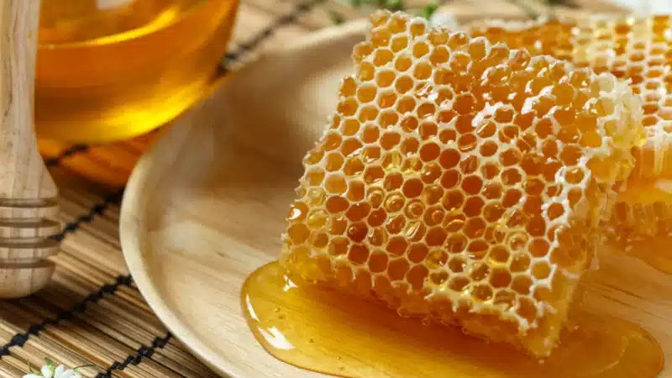
Old City and Kidron Valley from north
10 More to be desired are they than gold,
even much fine gold;
sweeter also than honey
and drippings of the honeycomb.
11 Moreover, by them is your servant warned;
in keeping them there is great reward.

Slide 36
Old City and Kidron Valley from north
10 More to be desired are they than gold,
even much fine gold;
sweeter also than honey
and drippings of the honeycomb.
11 Moreover, by them is your servant warned;
in keeping them there is great reward.
Value of God’s Word

Slide 37
Old City and Kidron Valley from north
10 More to be desired are they than gold,
even much fine gold;
sweeter also than honey
and drippings of the honeycomb.
11 Moreover, by them is your servant warned;
in keeping them there is great reward.
Joy found in God’s Word!

Slide 38
Old City and Kidron Valley from north
Purpose of the Word is to change our lives…
10 More to be desired are they than gold,
even much fine gold;
sweeter also than honey
and drippings of the honeycomb.
11 Moreover, by them is your servant warned;
in keeping them there is great reward.

Slide 39
Old City and Kidron Valley from north
Psalm 19:7-11
Questions to ask ourselves in view of this:
What is the importance of God’s Word in my life relative to other things I read or watch?
Am I in the Bible directly, or am I more dependent on what others say about the Bible (sermons, commentaries, books about the Bible, etc.)?
Is my life being changed by the Bible?

Slide 40
Old City and Kidron Valley from north
Psalm 19
Speaking Through Creation (1-6)
Speaking Through the Word (7-11)
Prayer of Submission (12-14)

Slide 41
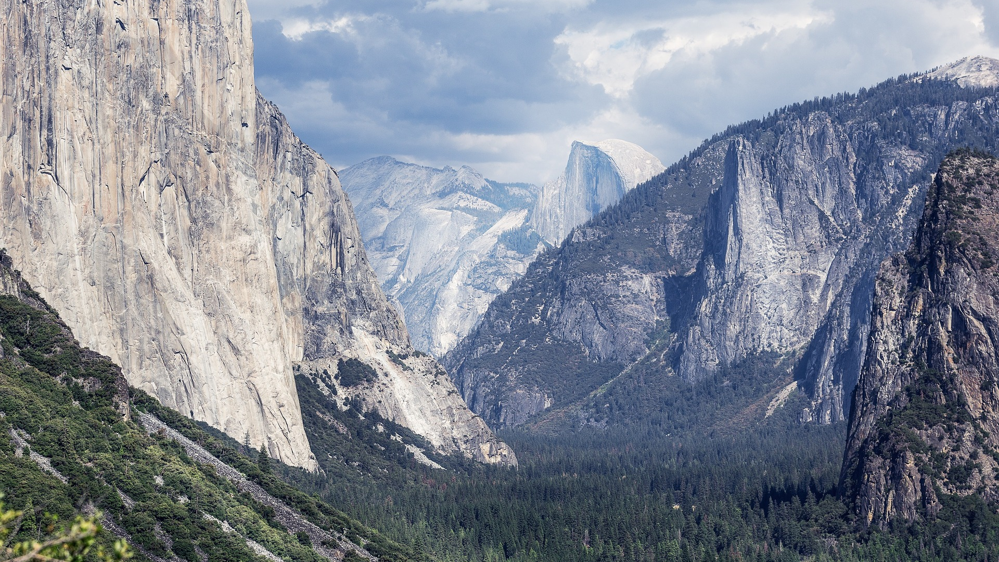
Old City and Kidron Valley from north
David’s Prayer (12-14):
12 Who can discern his errors?
Declare me innocent from hidden faults.
13 Keep back your servant also from presumptuous sins;
let them not have dominion over me!
Then I shall be blameless,
and innocent of great transgression.

Slide 42
Old City and Kidron Valley from north
David’s Prayer (12-14):
Sins we are not aware of…
12 Who can discern his errors?
Declare me innocent from hidden faults.
13 Keep back your servant also from presumptuous sins;
let them not have dominion over me!
Then I shall be blameless,
and innocent of great transgression.

Slide 43
Old City and Kidron Valley from north
David’s Prayer (12-14):
Sins we are aware of but do anyway!
12 Who can discern his errors?
Declare me innocent from hidden faults.
13 Keep back your servant also from presumptuous sins;
let them not have dominion over me!
Then I shall be blameless,
and innocent of great transgression.

Slide 44
Old City and Kidron Valley from north
David’s Prayer (12-14):
14 Let the words of my mouth
and the meditation of my heart
be acceptable in your sight,
O Lord, my rock and my redeemer.

Slide 45
Old City and Kidron Valley from north
Psalm 19
God is constantly speaking to us…
He calls us to listen!

Slide 46
Old City and Kidron Valley from north
David’s Prayer (12-14):
14 Let the words of my mouth
and the meditation of my heart
be acceptable in your sight,
O Lord, my rock and my redeemer.

Slide 48
OT Preaching link at BibleStudyDownloads.org
Get this presentation and notes for free!
Notes:
OT Preaching (op)

