Slide 1
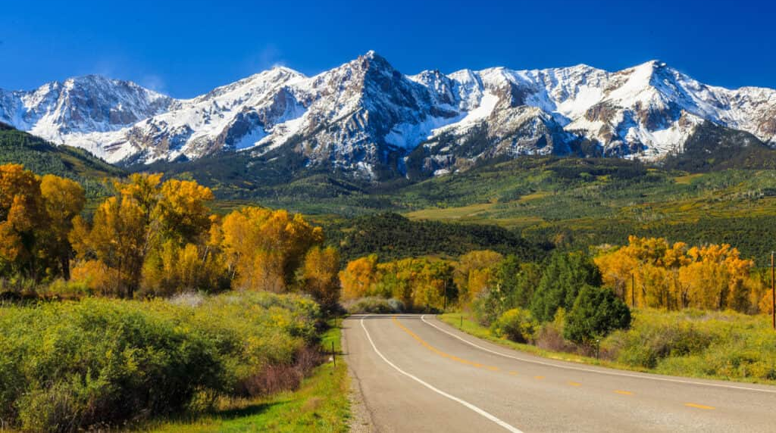
Summer in the
psalms
Psalm 16
The Path to True Joy!
Preached by Dan Bridges at Amman International Church Singapore • AmmanChurch.com Uploaded by Dr. Rick Griffith • Jordan Evangelical Theological Seminary Files in many languages for free download at BibleStudyDownloads.org

Slide 2
Old City and Kidron Valley from north
How do you feel about a command to always rejoice?
16 Rejoice always, 17 pray without ceasing, 18 give thanks in all circumstances; for this is the will of God in Christ Jesus for you.
1 Thessalonians 5:16-18

Slide 3
Old City and Kidron Valley from north
How can we experience this?
You make known to me the path of life;
in your presence there is fullness of joy;
at your right hand are pleasures forevermore.
Psalm 16:11

Slide 4
Old City and Kidron Valley from north
Why are these people so joyful?

Slide 5
Old City and Kidron Valley from north
Biblical joy comes when our hearts are captivated by someone greater than our circumstances!
What if one of them lost their job the next day?

Slide 6
Old City and Kidron Valley from north
The Path to True Joy!
True joy, regardless of circumstances, happens only when we are satisfied in God!

Slide 7
Old City and Kidron Valley from north
Psalm 16 – The Path to True Joy!
1 Preserve me, O God…
(Verses 1b – 8: How David experienced God)
9 Therefore my heart is glad, and my whole being rejoices…
11 …in your presence there is fullness of joy;
at your right hand are pleasures forevermore.

Slide 8
Old City and Kidron Valley from north
Psalm 16 – The Path to True Joy!
David’s Experience of God (1-8)
Result in David’s Life (9-10)
Life Principle Stated (11)

Slide 9
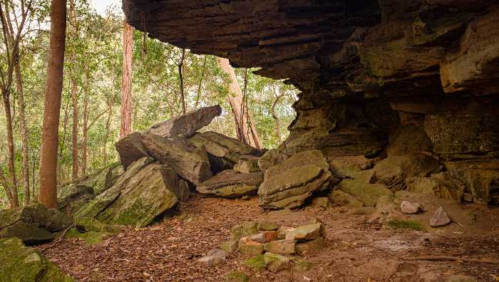
Old City and Kidron Valley from north
1 Preserve me, O God, for in you I take refuge.

Slide 10
Old City and Kidron Valley from north
Things we seek protection from:
People-Related:
Enemies
Difficult Relationships
Physical harm, Crime
Life Situations:
Singleness, Loneliness
Childlessness
Embarrasment
Health-Related:
Sickness, Disabilities
Death
Circumstances:
Natural Disasters
Econ Collapse / Poverty
Spiritual-Related:
Sin, other gods
Hell
Where do you go for refuge from these?

Slide 11
Old City and Kidron Valley from north
Adonai – Master, Sovereign
1 Preserve me, O God, for in you I take refuge.
2 I say to the LORD, “You are my Lord;
I have no good apart from you.”

Slide 12
Old City and Kidron Valley from north
Treating God as his highest treasure
1 Preserve me, O God, for in you I take refuge.
2 I say to the LORD, “You are my Lord;
I have no good apart from you.”

Slide 13
Old City and Kidron Valley from north
3 As for the saints in the land, they are the excellent ones, in whom is all my delight.

Slide 14
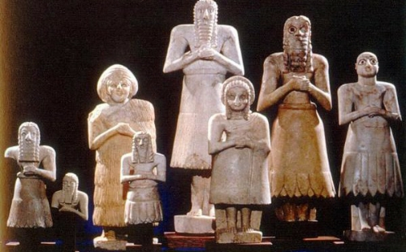
Old City and Kidron Valley from north
4 The sorrows of those who run after another god shall multiply;
their drink offerings of blood I will not pour out
or take their names on my lips.

Slide 15
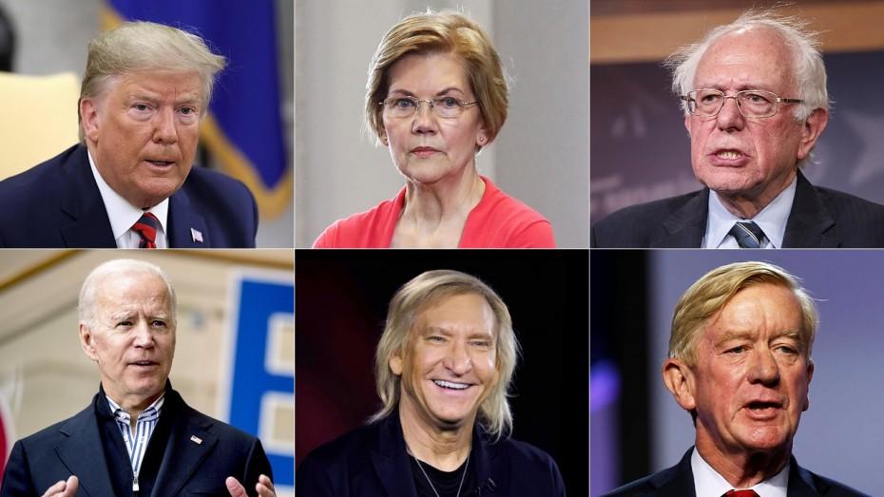
Music Stars
Politicians
Sports Stars
Actors
Who do you delight in?
Influencers
Actresses

Slide 16
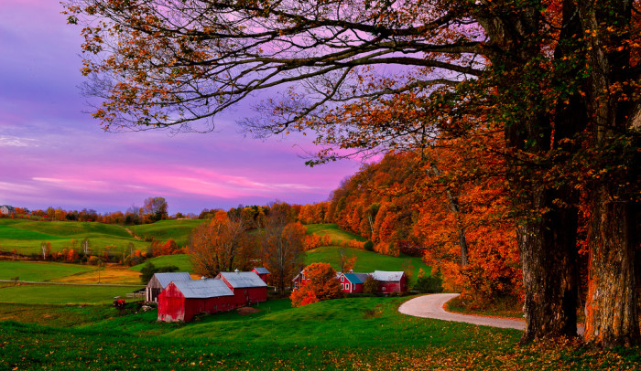
Old City and Kidron Valley from north
5 The Lord is the portion of my inheritance
and my cup;
you hold my lot.
6 The lines have fallen for me in pleasant places;
indeed, I have a beautiful inheritance.

Slide 17
Old City and Kidron Valley from north
5 The Lord is the portion of my inheritance
and my cup;
you hold my lot.
6 The lines have fallen for me in pleasant places;
indeed, I have a beautiful inheritance.
Language of
Old Testament
Tribal Inheritance

Slide 18
Old City and Kidron Valley from north
5 The Lord is the portion of my inheritance
and my cup;
you hold my lot.
6 The lines have fallen for me in pleasant places;
indeed, I have a beautiful inheritance.
And the Lord said to Aaron, “You shall have no inheritance in their land, neither shall you have any portion among them. I am your portion and your inheritance among the people of Israel.”
Numbers 18:20

Slide 19
Old City and Kidron Valley from north
5 The Lord is the portion of my inheritance
and my cup;
you hold my lot.
6 The lines have fallen for me in pleasant places;
indeed, I have a beautiful inheritance.
Cup – a symbol of God’s generosity and how he satisfies
“my cup overflows” Psalm 23:5

Slide 20
Old City and Kidron Valley from north
5 The Lord is the portion of my inheritance
and my cup;
you hold my lot.
6 The lines have fallen for me in pleasant places;
indeed, I have a beautiful inheritance.

Slide 21
Old City and Kidron Valley from north
You shall inherit the land by lot according to your clans. To a large tribe you shall give a large inheritance, and to a small tribe you shall give a small inheritance. Wherever the lot falls for anyone, that shall be his. According to the tribes of your fathers you shall inherit.
Numbers 33:54
The lot is cast into the lap,
but its every decision is from the Lord.
Proverbs 16:33

Slide 22
Old City and Kidron Valley from north
5 The Lord is the portion of my inheritance
and my cup;
you hold my lot.
6 The lines have fallen for me in pleasant places;
indeed, I have a beautiful inheritance.
Lot – a symbol of God’s sovereignty over his life

Slide 23
Old City and Kidron Valley from north
5 The Lord is the portion of my inheritance
and my cup;
you hold my lot.
6 The lines have fallen for me in pleasant places;
indeed, I have a beautiful inheritance.
A choice to be content in the lot in life God has assigned to him

Slide 24
Old City and Kidron Valley from north
5 The Lord is the portion of my inheritance
and my cup;
you hold my lot.
6 The lines have fallen for me in pleasant places;
indeed, I have a beautiful inheritance.
A beautiful inheritance because he has God himself!

Slide 25
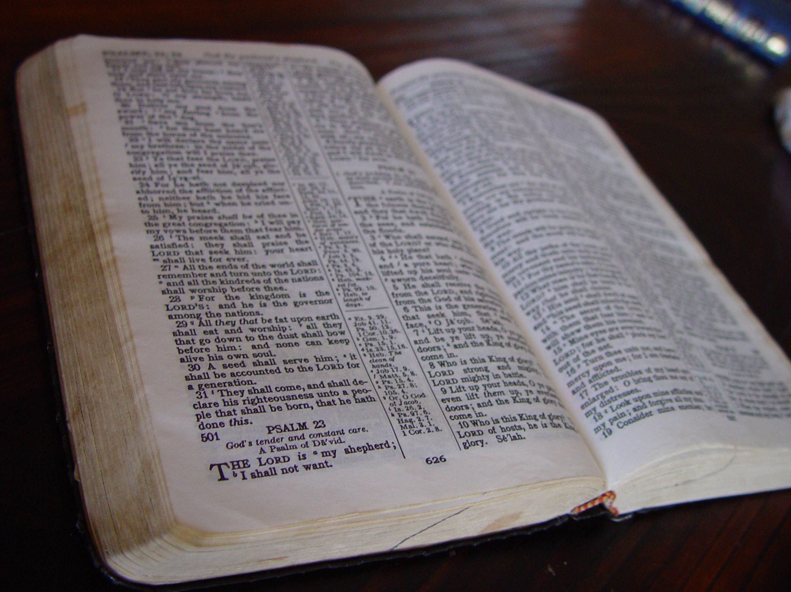
Old City and Kidron Valley from north
David was immersed in his relationship with God – Word & Prayer
7 I bless the Lord who gives me counsel;
in the night also my heart instructs me.

Slide 26
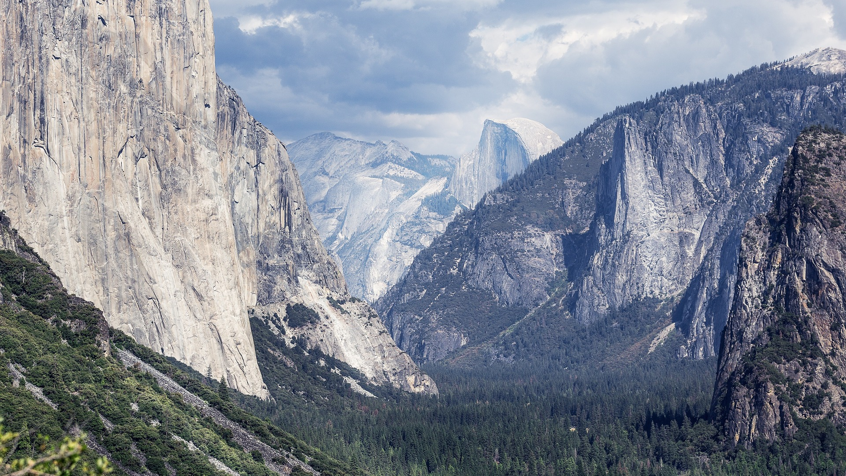
Old City and Kidron Valley from north
David had developed habits of remembering God.
8 I have set the Lord always before me;
because he is at my right hand,
I shall not be shaken.

Slide 27
Old City and Kidron Valley from north
As a result of reflecting on who God was to him, David could now make this declaration!
8 I have set the Lord always before me;
because he is at my right hand,
I shall not be shaken.

Slide 28
Old City and Kidron Valley from north
Psalm 16 – The Path to True Joy!
David’s Experience of God (1-8)
Result in David’s Life (9-10)
Life Principle Stated (11)

Slide 29
Old City and Kidron Valley from north
9 Therefore my heart is glad, and my whole being rejoices; my flesh also dwells secure.
10 For you will not abandon my soul to Sheol,
or let your holy one see corruption.

Slide 30
Old City and Kidron Valley from north
Genuine emotional response of joy!
9 Therefore my heart is glad, and my whole being rejoices; my flesh also dwells secure.
10 For you will not abandon my soul to Sheol,
or let your holy one see corruption.

Slide 31
Old City and Kidron Valley from north
Genuine sense of security!
9 Therefore my heart is glad, and my whole being rejoices; my flesh also dwells secure.
10 For you will not abandon my soul to Sheol,
or let your holy one see corruption.

Slide 32
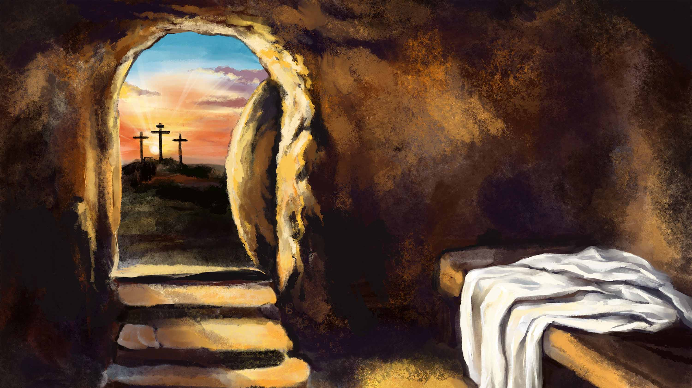
Old City and Kidron Valley from north
2 Samuel 7 – The Davidic Covenant
David knew he would die
David knew that one of his offspring would reign forever
9 Therefore my heart is glad, and my whole being rejoices; my flesh also dwells secure.
10 For you will not abandon my soul to Sheol,
or let your holy one see corruption.

Slide 33
Old City and Kidron Valley from north
To David, this seems to have been an assurance of being in God’s presence even after death
Ultimately, it was about resurrection of the Messiah
9 Therefore my heart is glad, and my whole being rejoices; my flesh also dwells secure.
10 For you will not abandon my soul to Sheol,
or let your holy one see corruption.

Slide 34
Old City and Kidron Valley from north
Quotation of Psalm 16:8-11… Then…
29 “Brothers, I may say to you with confidence about the patriarch David that he both died and was buried, and his tomb is with us to this day. 30 Being therefore a prophet, and knowing that God had sworn with an oath to him that he would set one of his descendants on his throne, 31 he foresaw and spoke about the resurrection of the Christ, that he was not abandoned to Hades, nor did his flesh see corruption.”
Acts 2:29-31

Slide 35
Old City and Kidron Valley from north
Because Jesus conquered death, satisfaction in God begins in this life, but goes into eternity!
9 Therefore my heart is glad, and my whole being rejoices; my flesh also dwells secure.
10 For you will not abandon my soul to Sheol,
or let your holy one see corruption.

Slide 36
Old City and Kidron Valley from north
Effect of Verses 1-8 on David’s Life:
Genuine emotional joy and security
Confidence that his relationship with God even bridged death
9 Therefore my heart is glad, and my whole being rejoices; my flesh also dwells secure.
10 For you will not abandon my soul to Sheol,
or let your holy one see corruption.

Slide 37
Old City and Kidron Valley from north
Psalm 16 – The Path to True Joy!
David’s Experience of God (1-8)
Result in David’s Life (9-10)
Life Principle Stated (11)

Slide 38
Old City and Kidron Valley from north
How can we experience this?
Only by being satisfied in God!
You make known to me the path of life;
in your presence there is fullness of joy;
at your right hand are pleasures forevermore.
Psalm 16:11

Slide 39
Old City and Kidron Valley from north
How can we be satisfied in God?
By taking refuge in him
By giving him authority in our lives
By treasuring him above all else
(Would you choose him as your inheritance
above everything else in life?)
By setting him always before us
(Immersion in Word and Prayer)

Slide 40
Old City and Kidron Valley from north
The Path to True Joy!
True joy, regardless of circumstances, happens only when we are satisfied in God!

Slide 42
OT Preaching link at BibleStudyDownloads.org
Get this presentation for free!
Notes:
OT Preaching (op)

