Slide 1

Who Knows My Heart?
Psalm 139
Preached by Troy Josey
Amman International Church, Jordan (AmmanChurch.org)
Uploaded by Dr. Rick Griffith • Jordan Evangelical Theological Seminary
Files in many languages for free download at BibleStudyDownloads.org

Slide 2

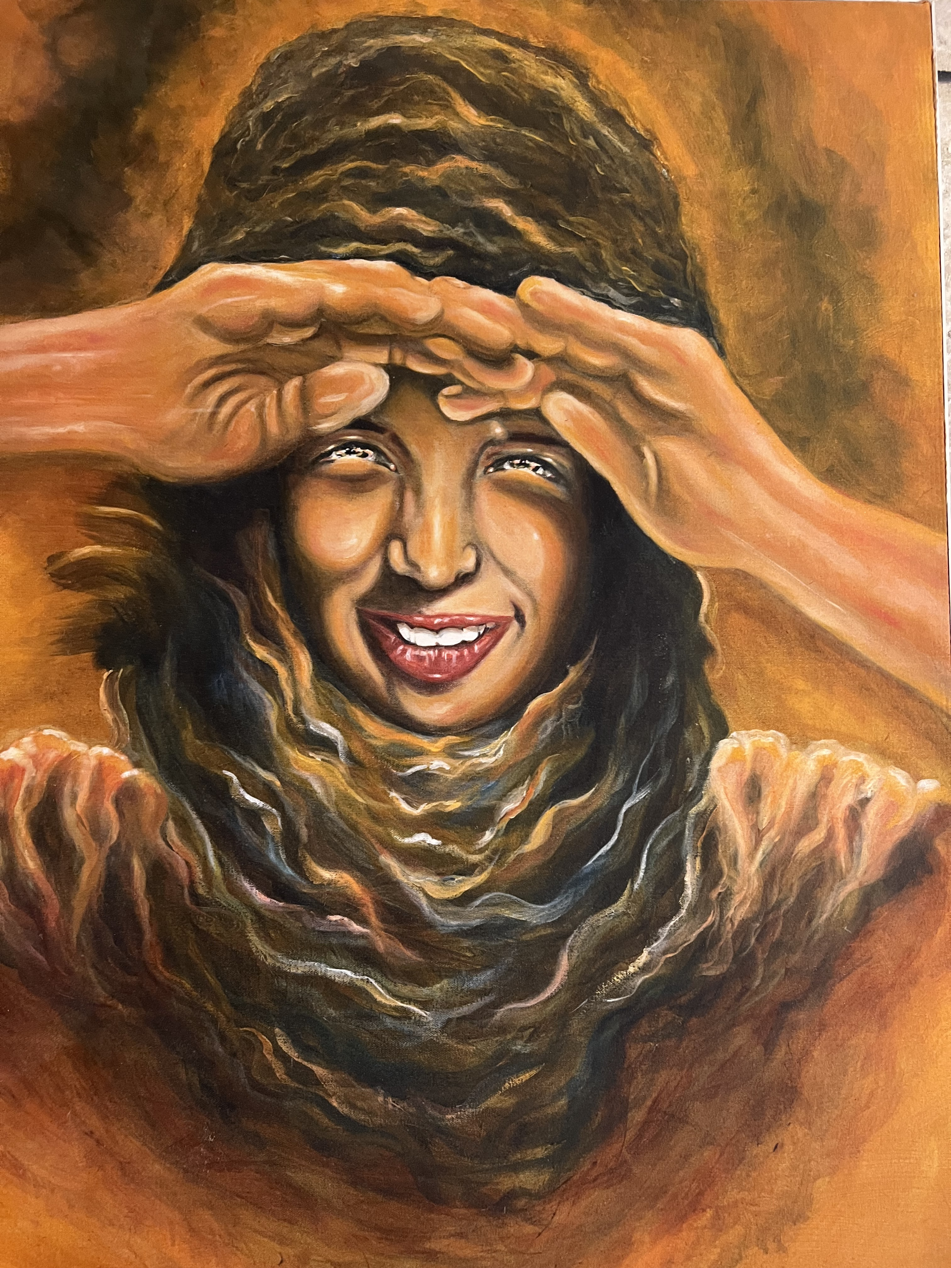
The God Who Sees
“You are a God of seeing; truly here I have seen him who looks after me”
(Genesis 16:13)
God sees the thoughts and intentions of our hearts.

Slide 3
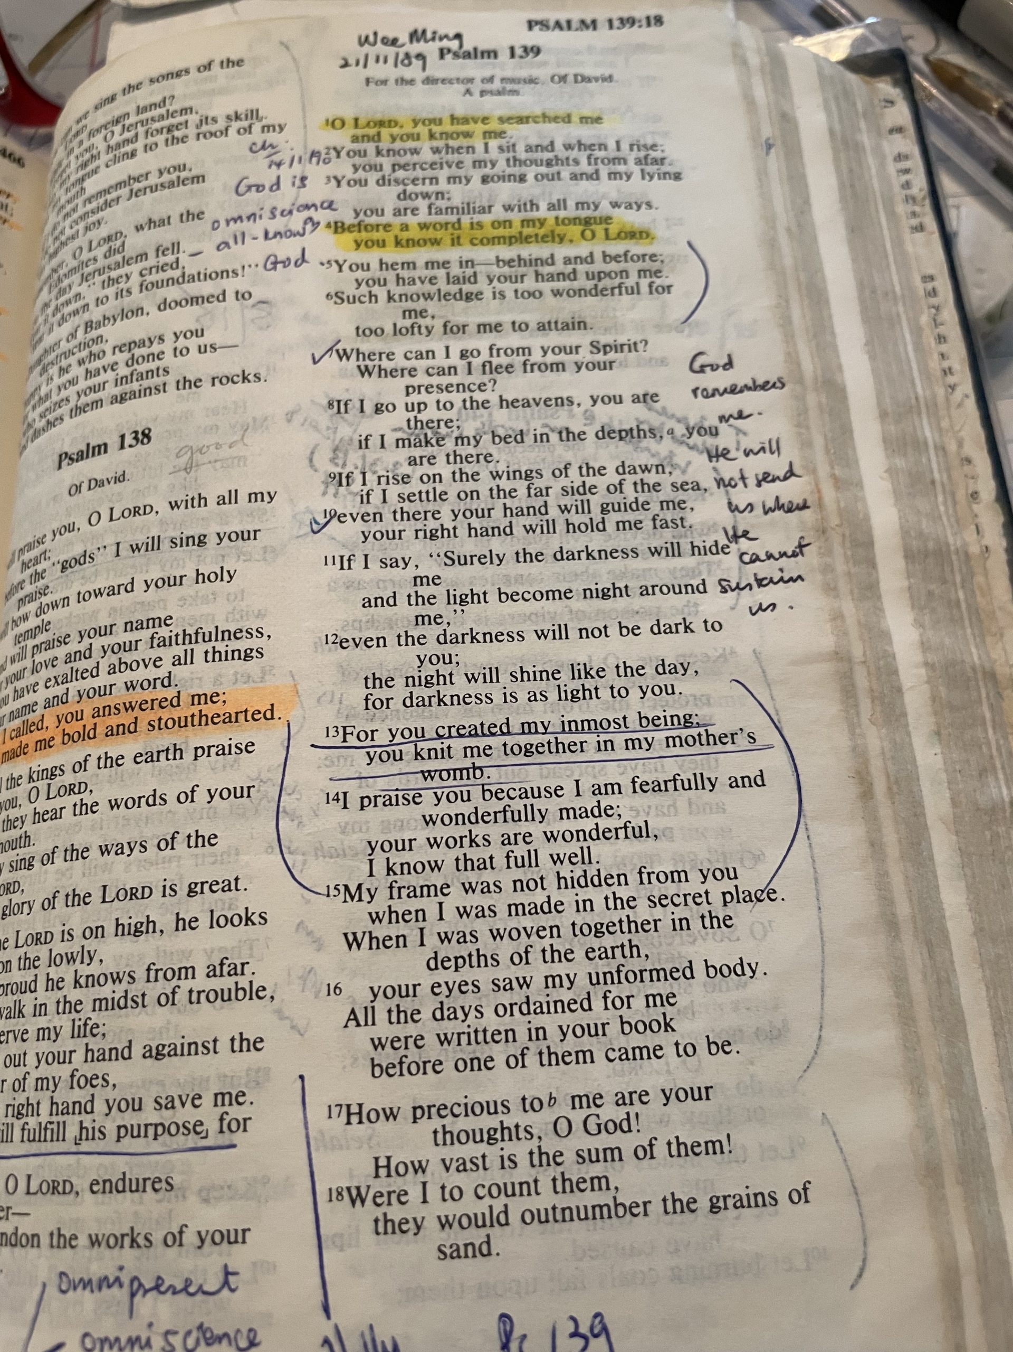

1. God Knows Me (vv. 1–6)
¹O Lord, you have searched me and known me!
² You know when I sit down and when I rise up;
you discern my thoughts from afar.
³ You search out my path and my lying down
and are acquainted with all my ways.
⁴ Even before a word is on my tongue,
behold, O Lord, you know it altogether.
⁵ You hem me in, behind and before,
and lay your hand upon me.
⁶ Such knowledge is too wonderful for me;
it is high; I cannot attain it.
Psalm 139:1-6

Slide 4

1. God Knows Me (vv. 1–6): Intimate Knowledge
Relational, Not Just Intellectual
In Hebrew thought, being known goes far beyond intellectual observation. It signifies deep, relational intimacy.
YADA
God intimately knows the burdens you carry, the unexpressed grief, your silent struggles, and the spiritual battles fought within your soul.
Hebrew: "To Know"

Slide 5
1. God Knows Me (vv. 1–6)
God has full knowledge of our actions, thoughts, motives, and words.
He sees the good intentions and our desire to honor him. But he also sees the sin and deception in our hearts (cf. Jeremiah 17:9).
He knows our deepest failures, yet in Christ, He never rejects us. There is nothing you can do to make God love you less! His love is perfect in Christ Jesus.
    1 Samuel 16:7 — "Man looks on the outward appearance,
    but the Lord looks on the heart.”

Slide 6
1. God Knows Me (vv. 1–6): Consider the following questions
When you realize God knows your deepest thoughts, is your initial reaction relief or fear?
Do you view God’s all-seeing eye as a surveillance camera waiting to catch you, or as a loving Father guarding your life?
If God knows every word before it hits your tongue, does that truth make you retreat into silence, or draw near in honest prayer?
Where in your life are you saying "everything is fine" to God, while internally drowning in chaos?
What are you still trying to hide from the God who already saw it happen, knows why you did it, and holds you anyway?
Are you spending more energy managing your reputation before people than resting in your standing before God?
Is your self-worth built on your performance and others' approval, or on the fact that the Creator of the universe knows your name and heart?
When your hidden motives or failures come to light, do you double down on self-justification, or do you run to the God who exposed it to heal it?

Slide 7

2. God Is With Me (Psalm 139:7-12)
⁷ Where shall I go from your Spirit?
Or where shall I flee from your presence?
⁸ If I ascend to heaven, you are there!
If I make my bed in Sheol, you are there!
⁹ If I take the wings of the morning
and dwell in the uttermost parts of the sea,
¹⁰ even there your hand shall lead me,
and your right hand shall hold me.
¹¹ If I say, “Surely the darkness shall cover me,
and the light about me be night,”
¹² even the darkness is not dark to you;
the night is bright as the day,
for darkness is as light with you.
Psalm 139:7-12

Slide 8






2. God Is With Me (Psalm 139:7-12): Hiding
Adam & Eve
Jonah
Hagar
Attempted to conceal their shame among the trees, yet God sought them out with compassionate mercy.
Fled from God's assignment into the deep ocean, only to find God meeting him in his lowest moment.
Escaped harsh oppression in the barren desert, discovering the Lord as the God who sees her pain.

Slide 9

2. God Is With Me (Psalm 139:7-12)
Our Natural Reflex
The Transforming Reality
Like Hagar, Adam, and Jonah, our instinct in pain, guilt, or fear is to flee and hide. We erect social and religious barriers to protect our reputation and save face.
When we realize God knows us completely—and loves us regardless of our sin—we stop hiding. Unmasking our hearts before Him opens the door to genuine inner healing.

Slide 10
2. God Is With Me (Psalm 139:7-12)
Whether in heaven, Sheol, or the uttermost parts of the sea, God's hand leads and holds us securely.
Light and darkness are alike to God.
“We assume that because God does not feel near or close or intimate, he must not be. But God’s presence is not based on our feelings. It is based on his character and person. God knows his people and pursues his people. He did not leave Adam and Eve in their shame, Hagar in the wilderness, or Jonah in the belly of the fish.”

Slide 11
2. God is with Me (vv. 7-12): Consider the following questions
When trouble or pain hits, is your default instinct to move toward God in prayer, or to flee into isolation and distraction?
Are you currently sitting in a season of "Sheol" or darkness, assuming God has abandoned you simply because you cannot feel Him?
For those far from home or family: Are you looking to your location and circumstances for security, or to the God who is holding you right here?
What is the "darkness" in your life right now that you need to stop hiding and allow God to illuminate with His presence?

Slide 12


3. God Made Me (Psalm 139:13–18)
¹³ For you formed my inward parts;
you knitted me together in my mother's womb.
¹⁴ I praise you, for I am fearfully and wonderfully made.
Wonderful are your works;
my soul knows it very well.
¹⁵ My frame was not hidden from you,
when I was being made in secret,
intricately woven in the depths of the earth.
¹⁶ Your eyes saw my unformed substance;
in your book were written, every one of them,
the days that were formed for me,
when as yet there was none of them.
¹⁷ How precious to me are your thoughts, O God!
How vast is the sum of them!
¹⁸ If I would count them, they are more than the sand.
I awake, and I am still with you.
Psalm 139:13-18

Slide 13
3. God Made Me (Psalm 139:13–18)
Divine Workmanship
Your life, body, and days are not accidents. The Creator of the universe personally fashioned you in His image and authored your story before a single day came to be.

Slide 14
“
"I praise you, for I am fearfully and wonderfully made. Wonderful are your works; my soul knows it very well."
— PSALM 139:14

Slide 15
3. God Made Me (Psalm 139:13–18)
Consider the following questions
Who defines your worth: the God who created you, or the people around you?
Who holds your future: are you trying to control tomorrow, or trusting the God who wrote your story?
What fills your mind: thoughts of fear and shame, or thoughts of God’s deep love for you?
How does this change your daily life: are you living like God’s purposeful masterpiece, or just trying to survive?

Slide 16
4. God Changes Me (Psalm 139:19-24)
¹⁹ Oh that you would slay the wicked, O God!
O men of blood, depart from me!
²⁰ They speak against you with malicious intent;
your enemies take your name in vain.
²¹ Do I not hate those who hate you, O Lord?
And do I not loathe those who rise up against you?
²² I hate them with complete hatred;
I count them my enemies.
²³ Search me, O God, and know my heart!
Try me and know my thoughts!
²⁴ And see if there be any grievous way in me,
and lead me in the way everlasting!
Psalm 139:19-24

Slide 17
4. God Changes Me (Psalm 139:19-24)
Imprecatory Psalms: 5:10, 10:15, 28:4, 31:17-18, 35:4-6, 40:14-15, 58:6-11, 69:22-28, 109:6-15, 140:9-10
“But there may come a point when wickedness is so persistent and high-handed and God-despising that the time of redemption is past and there only remain irremediable wickedness and judgment. For example, Jesus speaks of unforgivable sin (Matthew 12:32) and John says there is sin that is “unto death” and adds, “I do not say that one should pray for this” (1 John 5:16). And Paul says, “If anyone does not love the Lord, let him be accursed” (1 Corinthians 16:22). This imprecation is like the Psalms, and assumes that there comes a point of such extended, hardened, high-handed lovelessness toward God that it may be appropriate to call down anathema on it.”
John Piper

Slide 18
4. God Changes Me (Psalm139:19–24)
Righteous Zeal
Humble Surrender
David expresses intense abhorrence for evil (vv. 19–22). Recognizing God's holy character makes the stark reality of sin and injustice unbearable.
Instead of self-righteously judging others, David invites God to examine his own heart: "Search me, O God, and know my heart... and lead me in the way everlasting!"

Slide 19

Conclusion
God knows me.
God is with me.
God made me.
God changes me.
"Search me, O God, and know my heart! Try me and know my thoughts! And see if there be any grievous way in me, and lead me in the way everlasting!"
— Psalm 139:23–24

Slide 20


Image Sources
https://share.google/rpqHQXnatD1bACrfL
Source: https://word-of-prayer.com/psalm-139/
https://static.vecteezy.com/system/resources/previews/043/405/469/non_2x/night-sky-with-stars-dark-blue-universe-shiny-abstract-cosmos-galaxy-illustration-with-sparkles-and-starlight-celestial-winter-cosmic-background-vector.jpg
Source: www.vecteezy.com
https://img.freepik.com/premium-photo/sun-is-shining-through-trees-creating-warm-peaceful-atmosphere-light-is-filtering-through-leaves-casting-golden-glow-forest-floor-scene-is-serene-calming_715671-25792.jpg
Source: www.magnific.com

Slide 21
Black

Slide 22
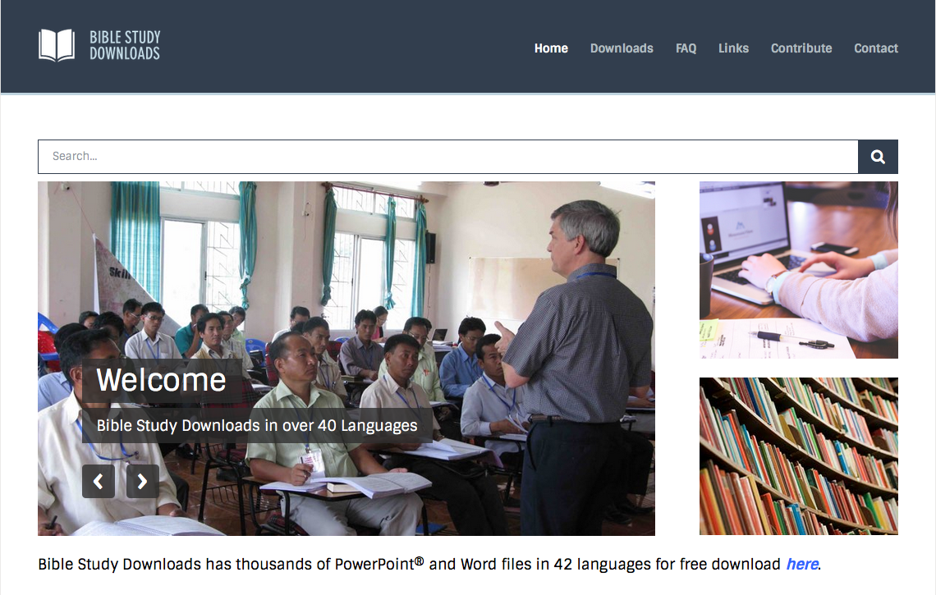
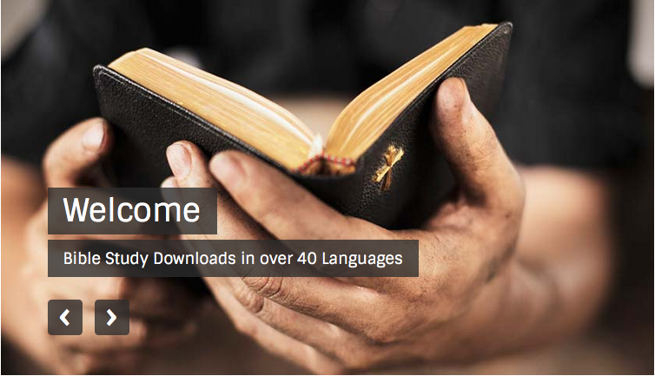
OT Preaching link at BibleStudyDownloads.org
Get this presentation for free!
Notes:
OT Preaching (op)

