Slide 1

Complain Not
Numbers 14
Dr. Rick Griffith • Jordan Evangelical Theological Seminary
BibleStudyDownloads.org

Slide 2

Syllabus Shock
Notes:
Syllabus shock is real.
We are now starting our second week of classes, when we all have God’s will for our lives.

Slide 3

Syllabus Shock
Notes:
You can even find on the Internet “Five Steps to Avoid Syllabus Shock.”
How have you responded to getting all of your assignments at the beginning of the semester last week?
Some of us are grateful for the work.
Others of us wonder how we will ever manage.
Yet it is God’s will for you to be here. So…

Slide 4

How should we respond to God's will?
Notes:
How should we respond to God’s will?
What is the best way to handle the Lord's plan? (Restatement)

Slide 5
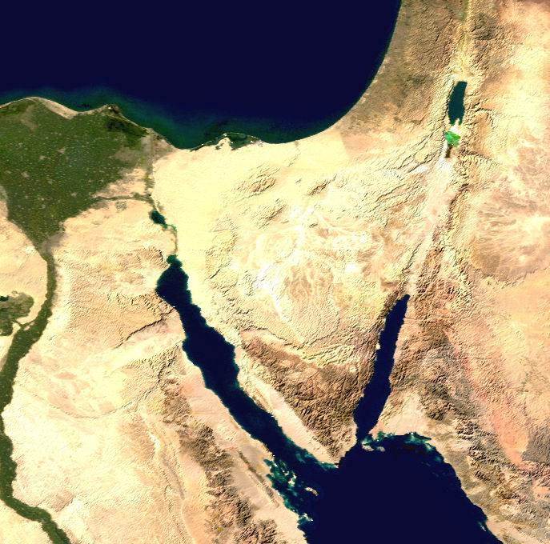
Map Preceding Numbers
• Zoan
• Rameses
Kadesh- Barnea
GOSHEN
• Marah
• Elim
Desert of Sin
Midian
• Rephidim
Mt. Sinai
Route of the Exodus
Notes:
God’s syllabus for Israel was to bring them from Egypt to Canaan.
God promised the Land to Abraham 600 years earlier (Gen 15:18; 17:8).
• God brought them out of Egypt to give them their land (Exod 12).

Slide 6

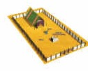
Putting it together…
142
N
W
E
Benjamin
Dan
Asher
S
Naphtali
Gershonites
Manasseh
Merarites
Ephraim
Kohathites
Judah
Moses & Aaron and sons
Issachar
Gad
Simeon
Zebulun
Reuben
Numbers 4
Notes:
God gave them a mobile worship system for the wilderness (Exod 40—Leviticus).

Slide 7
The Marching Line
142
Furniture
Tabernacle
Dan
Ephraim
Reuben
Judah
Asher
Simeon
Issachar
ARK
Merarites
Manasseh
Kohathites
Gershonites
Naphtali
Benjamin
Gad
Zebulun
Numbers 2; 10:11-28
Notes:
God organized the people for the march toward the land (Num 2, 10).
God showed them how to be holy or sanctified en route to the Land (Num 5:1–10:10).

Slide 8
Numbers 1–12 Map
• Zoan
• Rameses
Kadesh- barnea
GOSHEN
• Marah
• Elim
Desert of Sin
• Rephidim
Mt. Sinai
Route of the Journey
Notes:
God brought them from Sinai to Kadesh at the border of the Land (10:11–12:16).

Slide 9
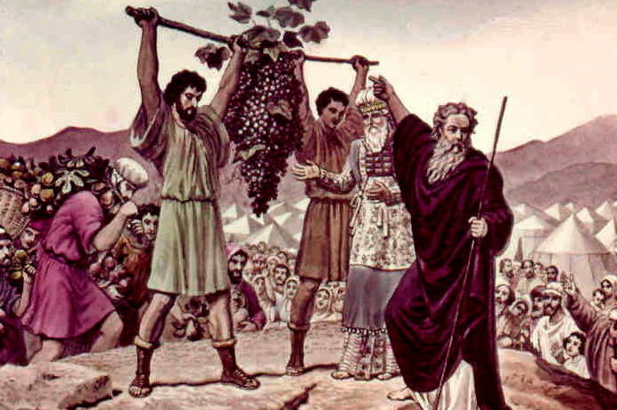
The Spies Return
Numbers 13
Notes:
They sent spies who returned 40 days later. Despite the bountiful grapes… (Num 13:31-33).

Slide 10
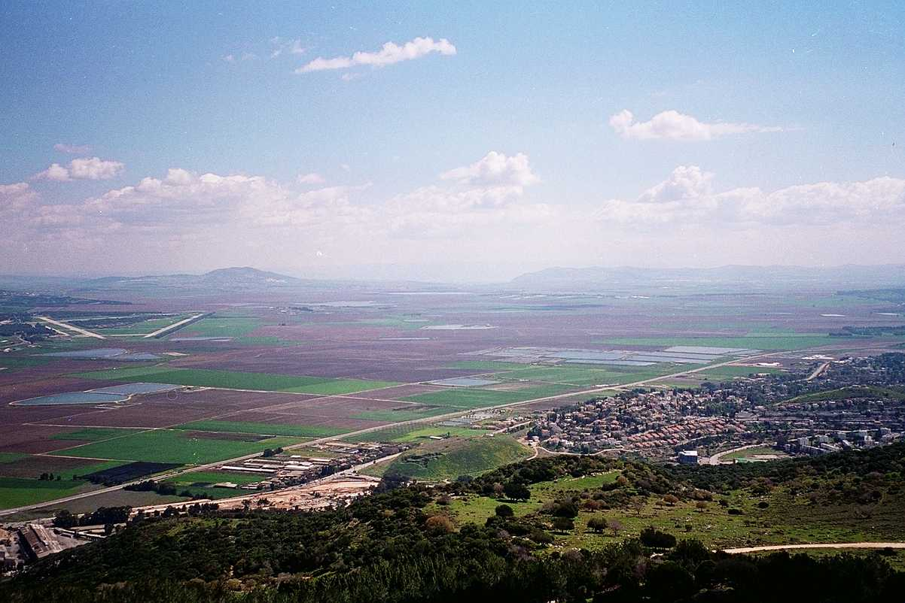
The Majority Report
G
ood
iants
rasshoppers
Numbers 13:26-33
Notes:
The majority report said that the land was good, but the giants made them feel like grasshoppers.

Slide 11
The Minority Report
G
OD
Numbers 13:26-33
Notes:
The minority report focused on God!

Slide 12
Where we're going
DON'T COMPLAIN
PRAY INSTEAD
BE WARNED
Notes:
Let’s see how the people responded, how Moses responded, and how God responded. We will see that the people complained—so we shouldn't complain.
• We should pray instead, like Moses.
• And follow God's warning.

Slide 13
How should we respond to God's will?
Notes:
So, back to our main question for today. How should we respond to God's will? First, let's see what NOT to do…

Slide 14

1. Don't complain!
Notes:
Accept God’s plan without grumbling.

Slide 15
Numbers 14:1-12
Notes:
The people’s response to God’s command to take the land was one of complaining.
Follow along as Eyad reads verses 1-12.
Num. 14:1 Then the whole community began weeping aloud, and they cried all night. ² Their voices rose in a great chorus of protest against Moses and Aaron. “If only we had died in Egypt, or even here in the wilderness!” they complained. ³ “Why is the LORD taking us to this country only to have us die in battle? Our wives and our little ones will be carried off as plunder! Wouldn’t it be better for us to return to Egypt?” ⁴ Then they plotted among themselves, “Let’s choose a new leader and go back to Egypt!”
Num. 14:5 Then Moses and Aaron fell face down on the ground before the whole community of Israel. ⁶ Two of the men who had explored the land, Joshua son of Nun and Caleb son of Jephunneh, tore their clothing. ⁷ They said to all the people of Israel, “The land we traveled through and explored is a wonderful land! ⁸ And if the LORD is pleased with us, he will bring us safely into that land and give it to us. It is a rich land flowing with milk and honey. ⁹ Do not rebel against the LORD, and don’t be afraid of the people of the land. They are only helpless prey to us! They have no protection, but the LORD is with us! Don’t be afraid of them!”
Num. 14:10 But the whole community began to talk about stoning Joshua and Caleb. Then the glorious presence of the LORD appeared to all the Israelites at the Tabernacle. ¹¹ And the LORD said to Moses, “How long will these people treat me with contempt? Will they never believe me, even after all the miraculous signs I have done among them? ¹² I will disown them and destroy them with a plague. Then I will make you into a nation greater and mightier than they are!”

Slide 16

Numbers
135
Preparation to Occupy the Land
Preparing the
Old Generation
Postponement
for Unbelief
Preparing the
New Generation
1:1–10:10
10:11–25:18
26–36
God's Faithfulness
Israel's Faithlessness
God's Faithfulness
God's Blessings
God's Discipline
God's Blessings
Israel's Commitment
Israel's Complaining
Israel's Commitment
Order
Disorder
Reorder
Mount Sinai
Wilderness
Moab
20 Days
38 Years, 3 Months, 10 Days
ca. 5 Months
Organization
(1–4)
Sanctification (5:1–10:10)
To Kadesh (10:11–
12:16)
Kadesh Sin
(13–14)
Wilder-ness (15–19)
To Moab (20–21)
Moab
Sin
(22–25)
Provision for Land (26–27)
Offerings & Vows (28–30)
Final Preparations (31–36)
Notes:
In Numbers, we see Israel's commitment in both the first and last sections. But in the middle, we see Israel's complaining.
_________
The first and third believing sections are parallel with the climactic middle section of unbelief.
________
OS-03-Numbers-10, 57, 109, 151, 172, 188, 219, 225, 232

Slide 17
Grumbling in the Wilderness
Paul N. Benware, Survey of the Old Testament, 68
157a
SCRIPTURE
ISRAEL'S COMPLAINT
MOSES' RESPONSE
GOD'S RESPONSE
Exod. 14:11
Pharaoh's army
Encouraged Israel
to trust God
Delivered Israel
Exod. 15:24
Bitter water
Cried out to God
"Healed" the water
Exod. 16:2
Lack of food
Rebuked Israel
Supplied manna
Exod. 17:2
Lack of water
Prayed to the Lord
Water from the rock
Num. 11:1
God providing food
Anger & prayer
Judgment
Num. 14:2
Moses' leadership
Pled with Israel, prayed to God
Judgment
Num. 16:2
Moses' leadership
Rebuked & prayed
Judgment
Num. 16:41
Moses
Prayed
Judgment
Num. 20:2
Moses & lack of water
Rebuked Israel
Struck rock
Supplied water
Num. 21:4
Moses & manna
No response
Judgment
Notes:
One account shows ten times Israel complained and the responses from Moses and God.

Slide 18

Are you a complainer?
Notes:
We often complain instead of obeying God’s will.

Slide 19

Are you a complainer?
Notes:
Men are often as good at complaining as women.

Slide 20

"Do everything without complaining and arguing"
(Phil 2:14)
Notes:
Yet Philippians 2:14 commands us to do ALL things without complaining and arguing.

Slide 21
Philippians 4:13
I can do
EVERYTHING
through HIM
who gives me
STRENGTH
Notes:
Philippians 4:13 promises strength. You can mimic Jesus by not complaining at all!
(Instead of complaining, how else should we respond to God’s will?)

Slide 22
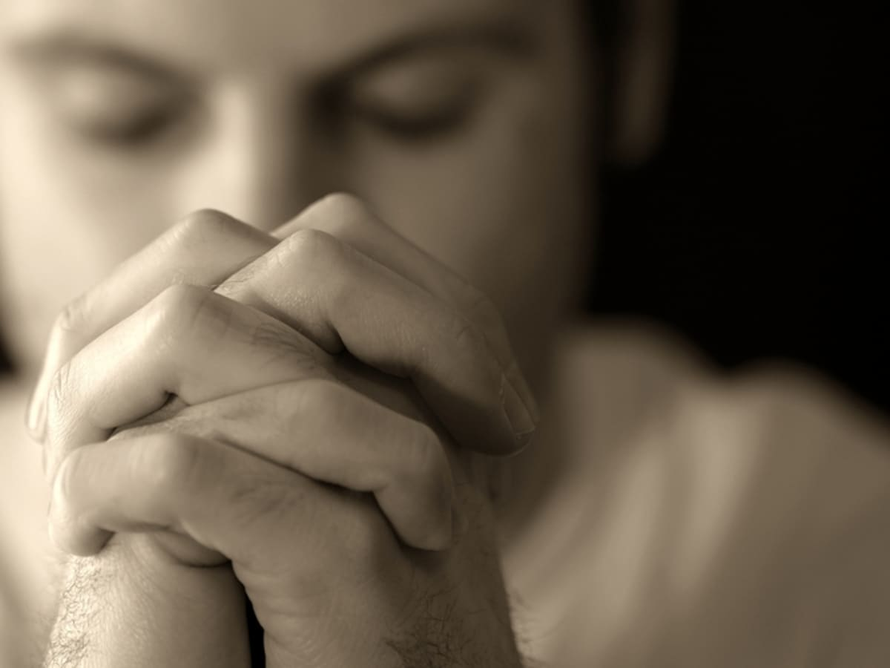
2. Pray instead of complaining (13-19).
Notes:
Intercession: Moses’ response to Israel’s complaining was to pray for them (13-19).
Moses prayed based on God’s power (13).
Moses prayed based on God’s presence (14-16).
Moses prayed based on God’s pardon (17-19).
____________
Num. 14:13 But Moses objected. “What will the Egyptians think when they hear about it?” he asked the LORD. “They know full well the power you displayed in rescuing your people from Egypt. ¹⁴ Now if you destroy them, the Egyptians will send a report to the inhabitants of this land, who have already heard that you live among your people. They know, LORD, that you have appeared to your people face to face and that your pillar of cloud hovers over them. They know that you go before them in the pillar of cloud by day and the pillar of fire by night. ¹⁵ Now if you slaughter all these people with a single blow, the nations that have heard of your fame will say, ¹⁶ ‘The LORD was not able to bring them into the land he swore to give them, so he killed them in the wilderness.’
Num. 14:17 “Please, Lord, prove that your power is as great as you have claimed. For you said, ¹⁸ ‘The LORD is slow to anger and filled with unfailing love, forgiving every kind of sin and rebellion. But he does not excuse the guilty. He lays the sins of the parents upon their children; the entire family is affected—even children in the third and fourth generations.’ ¹⁹ In keeping with your magnificent, unfailing love, please pardon the sins of this people, just as you have forgiven them ever since they left Egypt.”

Slide 23
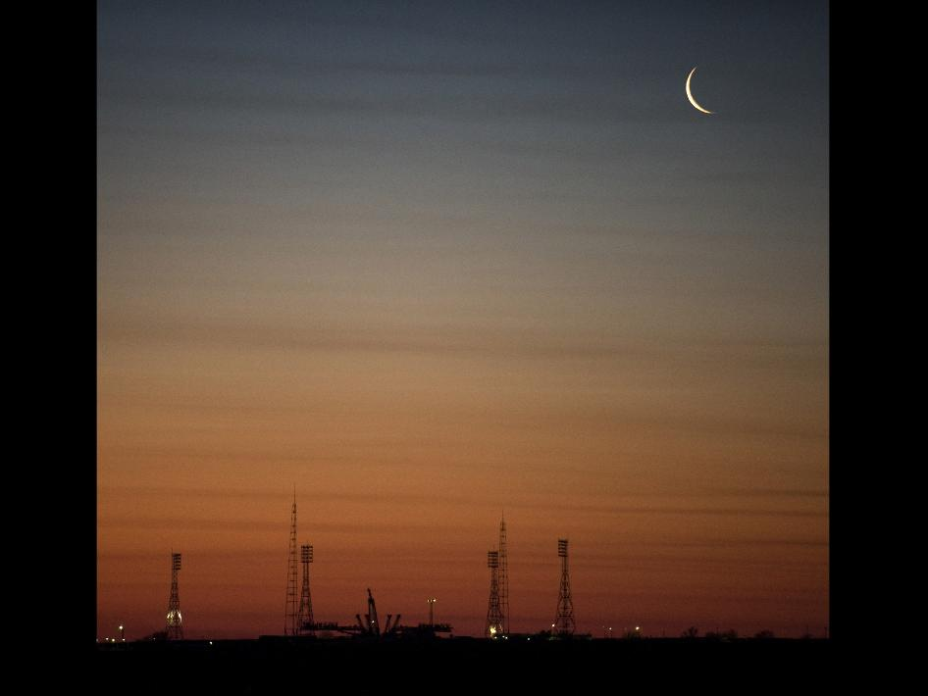
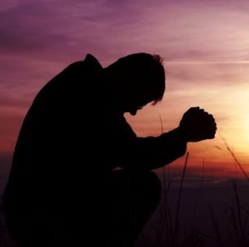
The Gaze-Glance Principle
Seeking God's Hand
God
Elton & Shirley Gillam, The Restoration of Biblical Prayer (Greely, CO: Chambers College Press, 2009), 33
Glance
Our Request
Gaze
Notes:
The Gaze-Glance Principle helps us focus on God rather than our problems. Follow the Gaze-Glance Principle. This is a straightforward, biblical approach to seeking guidance.
• When a struggle enters our lives, we usually gaze at this request.
• We only have occasional glances at God for His help. We ask him to remove the problem because we are only seeking His hand. We're only seeking what He can give us.
_______________
Download their book free at https://biblestudydownloads.org/files/eng/py/08-Restoration_of_Biblical_Prayer_(Elton_and_Shirley_Gillam)-281pp_eng_py_v1.pdf.
______________
Common-536
OS-19-Psalms-219
OS-23-Isa40-42—slide 79
NS-20-James1-2—slide 128
NS-27-Rev20-22-slide 359

Slide 24

The Gaze-Glance Principle
Seeking God's Face
God
Elton & Shirley Gillam, The Restoration of Biblical Prayer (Greely, CO: Chambers College Press, 2009), 33
Gaze
Our Request
Glance
Notes:
But the Bible tells us to shift our focus.
• We should gaze at God.
• Then only glance at our request. This is seeking His face instead of seeking His hand. When and if He removes the problem becomes His business, so we don't end up resenting Him.
Where has your focus been concerning the issue that concerns you?
• Have you been gazing at God or gazing at your problem?
• Have you been seeking God's face or seeking God's hand?
(What if we complain instead of pray? How does God respond when we refuse His will?)
___________________
Download their book free at https://biblestudydownloads.org/files/eng/py/08-Restoration_of_Biblical_Prayer_(Elton_and_Shirley_Gillam)-281pp_eng_py_v1.pdf.
________________
Common-537
OP-Numbers14—slide 23
OS-19-Psalms-220
OS-23-Isa40-42—slide 80
NS-20-James1-2—slide 129
NS-27-Rev20-22-slide 360

Slide 25
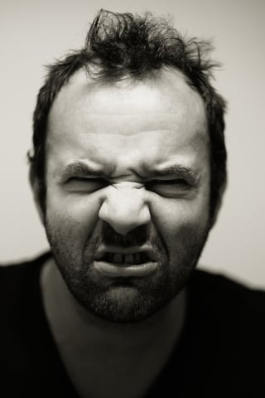
3. God shortens the lives of complainers (20-45).
Notes:
Grumbling takes a severe toll on us.
__________
Num. 14:20 Then the LORD said, “I will pardon them as you have requested. ²¹ But as surely as I live, and as surely as the earth is filled with the LORD’s glory, ²² not one of these people will ever enter that land. They have all seen my glorious presence and the miraculous signs I performed both in Egypt and in the wilderness, but again and again they have tested me by refusing to listen to my voice. ²³ They will never even see the land I swore to give their ancestors. None of those who have treated me with contempt will ever see it. ²⁴ But my servant Caleb has a different attitude than the others have. He has remained loyal to me, so I will bring him into the land he explored. His descendants will possess their full share of that land. ²⁵ Now turn around, and don’t go on toward the land where the Amalekites and Canaanites live. Tomorrow you must set out for the wilderness in the direction of the Red Sea.”
Num. 14:26 Then the LORD said to Moses and Aaron, ²⁷ “How long must I put up with this wicked community and its complaints about me? Yes, I have heard the complaints the Israelites are making against me. ²⁸ Now tell them this: ‘As surely as I live, declares the LORD, I will do to you the very things I heard you say. ²⁹ You will all drop dead in this wilderness! Because you complained against me, every one of you who is twenty years old or older and was included in the registration will die. ³⁰ You will not enter and occupy the land I swore to give you. The only exceptions will be Caleb son of Jephunneh and Joshua son of Nun.
Num. 14:31 “‘You said your children would be carried off as plunder. Well, I will bring them safely into the land, and they will enjoy what you have despised. ³² But as for you, you will drop dead in this wilderness. ³³ And your children will be like shepherds, wandering in the wilderness for forty years. In this way, they will pay for your faithlessness, until the last of you lies dead in the wilderness.
Num. 14:34 “‘Because your men explored the land for forty days, you must wander in the wilderness for forty years—a year for each day, suffering the consequences of your sins. Then you will discover what it is like to have me for an enemy.’ ³⁵ I, the LORD, have spoken! I will certainly do these things to every member of the community who has conspired against me. They will be destroyed here in this wilderness, and here they will die!”
Num. 14:36 The ten men Moses had sent to explore the land—the ones who incited rebellion against the LORD with their bad report— ³⁷ were struck dead with a plague before the LORD. ³⁸ Of the twelve who had explored the land, only Joshua and Caleb remained alive.
Num. 14:39 When Moses reported the LORD’s words to all the Israelites, the people were filled with grief. ⁴⁰ Then they got up early the next morning and went to the top of the range of hills. “Let’s go,” they said. “We realize that we have sinned, but now we are ready to enter the land the LORD has promised us.”
Num. 14:41 But Moses said, “Why are you now disobeying the LORD’s orders to return to the wilderness? It won’t work. ⁴² Do not go up into the land now. You will only be crushed by your enemies because the LORD is not with you. ⁴³ When you face the Amalekites and Canaanites in battle, you will be slaughtered. The LORD will abandon you because you have abandoned the LORD.”
Num. 14:44 But the people defiantly pushed ahead toward the hill country, even though neither Moses nor the Ark of the LORD’s Covenant left the camp. ⁴⁵ Then the Amalekites and the Canaanites who lived in those hills came down and attacked them and chased them back as far as Hormah.

Slide 26

OT Discipline
Notes:
Death: God’s response to Israel’s unbelief to enter Canaan was for them to die in the desert (20-45).
__________
Num. 14:20 Then the LORD said, “I will pardon them as you have requested. ²¹ But as surely as I live, and as surely as the earth is filled with the LORD’s glory, ²² not one of these people will ever enter that land. They have all seen my glorious presence and the miraculous signs I performed both in Egypt and in the wilderness, but again and again they have tested me by refusing to listen to my voice. ²³ They will never even see the land I swore to give their ancestors. None of those who have treated me with contempt will ever see it. ²⁴ But my servant Caleb has a different attitude than the others have. He has remained loyal to me, so I will bring him into the land he explored. His descendants will possess their full share of that land. ²⁵ Now turn around, and don’t go on toward the land where the Amalekites and Canaanites live. Tomorrow you must set out for the wilderness in the direction of the Red Sea.”
Num. 14:26 Then the LORD said to Moses and Aaron, ²⁷ “How long must I put up with this wicked community and its complaints about me? Yes, I have heard the complaints the Israelites are making against me. ²⁸ Now tell them this: ‘As surely as I live, declares the LORD, I will do to you the very things I heard you say. ²⁹ You will all drop dead in this wilderness! Because you complained against me, every one of you who is twenty years old or older and was included in the registration will die. ³⁰ You will not enter and occupy the land I swore to give you. The only exceptions will be Caleb son of Jephunneh and Joshua son of Nun.
Num. 14:31 “‘You said your children would be carried off as plunder. Well, I will bring them safely into the land, and they will enjoy what you have despised. ³² But as for you, you will drop dead in this wilderness. ³³ And your children will be like shepherds, wandering in the wilderness for forty years. In this way, they will pay for your faithlessness, until the last of you lies dead in the wilderness.
Num. 14:34 “‘Because your men explored the land for forty days, you must wander in the wilderness for forty years—a year for each day, suffering the consequences of your sins. Then you will discover what it is like to have me for an enemy.’ ³⁵ I, the LORD, have spoken! I will certainly do these things to every member of the community who has conspired against me. They will be destroyed here in this wilderness, and here they will die!”
Num. 14:36 The ten men Moses had sent to explore the land—the ones who incited rebellion against the LORD with their bad report— ³⁷ were struck dead with a plague before the LORD. ³⁸ Of the twelve who had explored the land, only Joshua and Caleb remained alive.
Num. 14:39 When Moses reported the LORD’s words to all the Israelites, the people were filled with grief. ⁴⁰ Then they got up early the next morning and went to the top of the range of hills. “Let’s go,” they said. “We realize that we have sinned, but now we are ready to enter the land the LORD has promised us.”
Num. 14:41 But Moses said, “Why are you now disobeying the LORD’s orders to return to the wilderness? It won’t work. ⁴² Do not go up into the land now. You will only be crushed by your enemies because the LORD is not with you. ⁴³ When you face the Amalekites and Canaanites in battle, you will be slaughtered. The LORD will abandon you because you have abandoned the LORD.”
Num. 14:44 But the people defiantly pushed ahead toward the hill country, even though neither Moses nor the Ark of the LORD’s Covenant left the camp. ⁴⁵ Then the Amalekites and the Canaanites who lived in those hills came down and attacked them and chased them back as far as Hormah.

Slide 27
God's Report
Num. 13:26-14:9
DRESSING
THE
STAGE
Here's the situation:
MS
TWELVE SPIES: TWO REPORTS
10 SPIES: A MAJORITY OPINION
LAND OF MILK AND HONEY!
GIANTS IN THE LAND!
GO BACK TO EGYPT!
2 SPIES: A MINORITY OPINION
LAND OF MILK AND HONEY!
GIANTS IN THE LAND!
GOD IS WITH US!
N(A)
TRIP CANCELLED!
H
SG
C
ER
B
J
MN
MOSES
DS
Exodus
Sinai
E
M - C - C
Kadesh Barnea
KB
U
40
MS
PG
SO...LET'S GO!!!!!
RS
Handbook pg. 26-29
21
Notes:
God forgave them (20).
But God judged them with death for over 40 years in the wilderness (21-35).

Slide 28

Key Verses
135
Discipline–"Not one of the men who saw my glory and the miraculous signs I performed in Egypt and in the desert but who disobeyed me these ten times—not one of them will ever see the land I promised on oath to their forefathers…" (God to Israel in Num. 14:22-23)

Slide 29
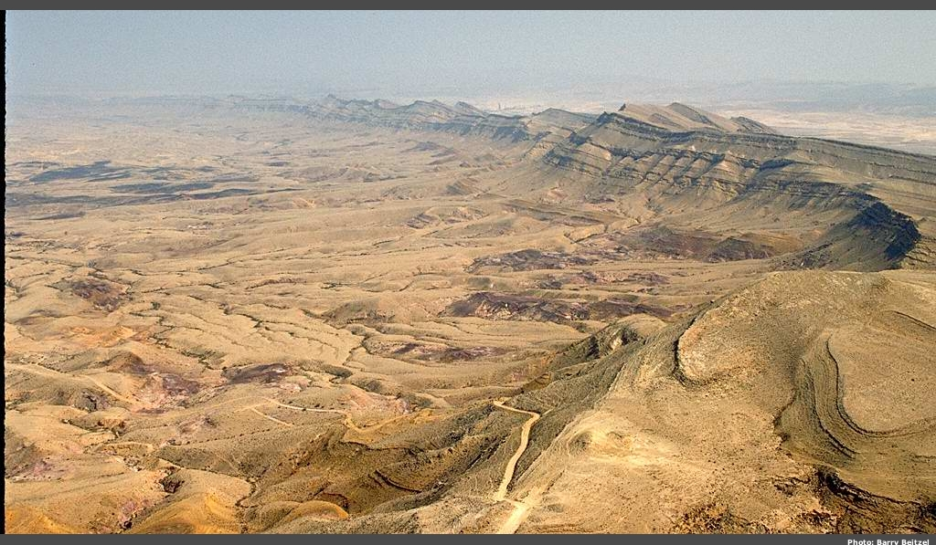
Wilderness of Zin
Notes:
God judged the disbelieving spies with immediate death (36-38).

Slide 30
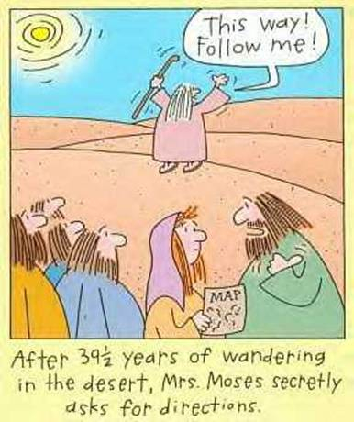
No Directions
This way!
Follow me!
After 39½ years of wandering in the desert, Mrs. Moses secretly asks for directions.
Notes:
God judged those who refused his discipline by defeat in battle (39-45).

Slide 31
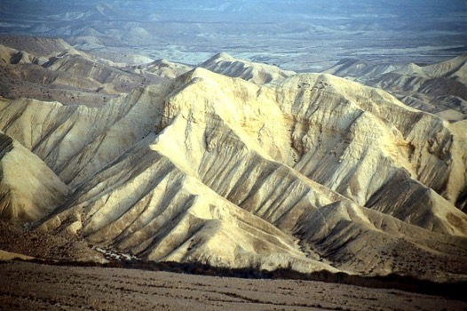
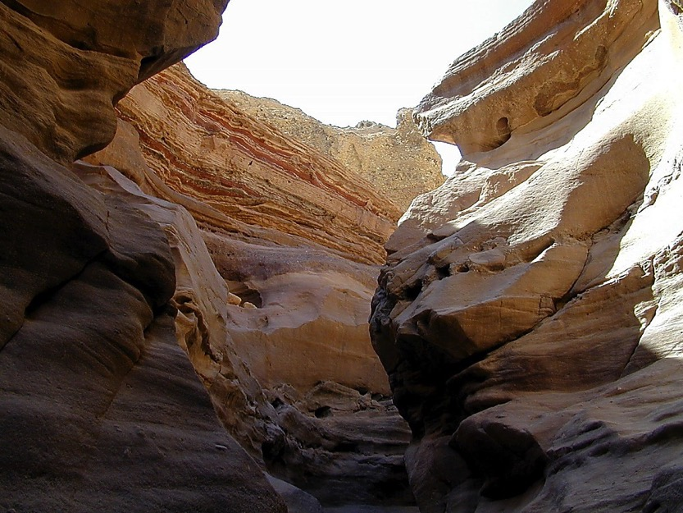
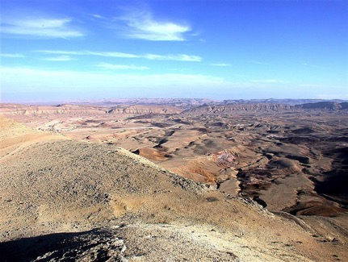
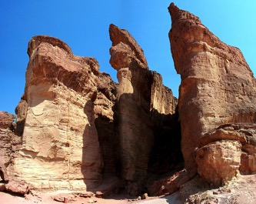
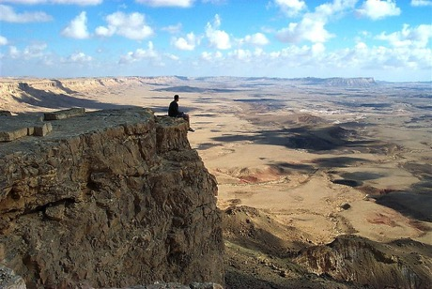
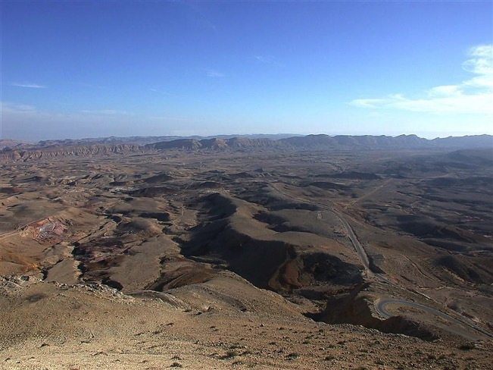
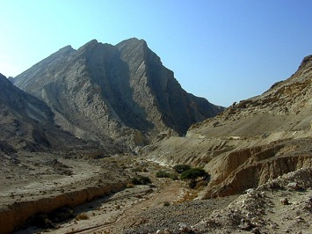
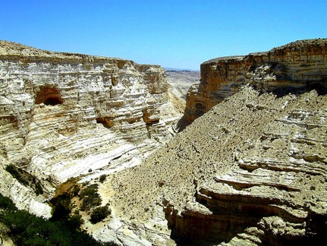
Divine Discipline
Num. 32:49; 34:1
DRESSING
THE
STAGE
YOU MEAN…
40 YEARS? OUT HERE?
MOSES
Exodus
Sinai
M - C - C
Kadesh Barnea
40
40
Handbook pg. 26-29
24
Notes:
Few complainers live very long.

Slide 32

How Complaining is Killing You
(and What to Do Instead)
Always complaining about things not going your way? Here is why you should stop.
https://www.inc.com/neil-patel/how-complaining-is-killing-you-and-what-to-do-instead.html
Notes:
Many studies show that negative people die earlier.
_______________
https://www.inc.com/neil-patel/how-complaining-is-killing-you-and-what-to-do-instead.html

Slide 33
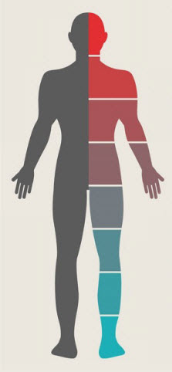
Complaining Harms Your Body
Whenever we complain about something from the past, our bodies react as though we were reliving the experience.
Our heart rate and blood pressure rise, and our brains release the stress hormones adrenaline and cortisol, triggering our fight-or-flight response. Our muscle tissue goes into a tense state of hyper-readiness, and non-essential systems like digestion go on temporary shutdown.
https://www.inc.com/neil-patel/how-complaining-is-killing-you-and-what-to-do-instead.html
Notes:
Complaining is bad for your health.

Slide 34
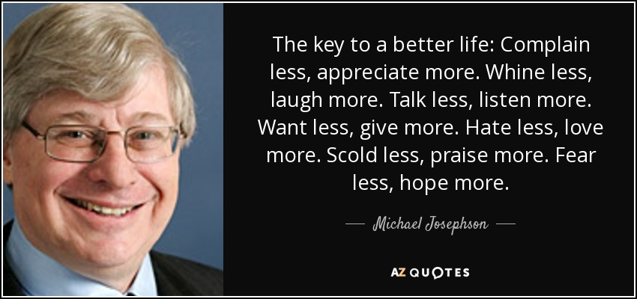
—Michael Josephson–
The key to a better life:
Complain less, appreciate more.
Talk less, listen more.
Want less, give more.
Hate less, love more.
Scold less, praise more.
Fear less, hope more.

Slide 35
How should we respond to God's will?

Slide 36

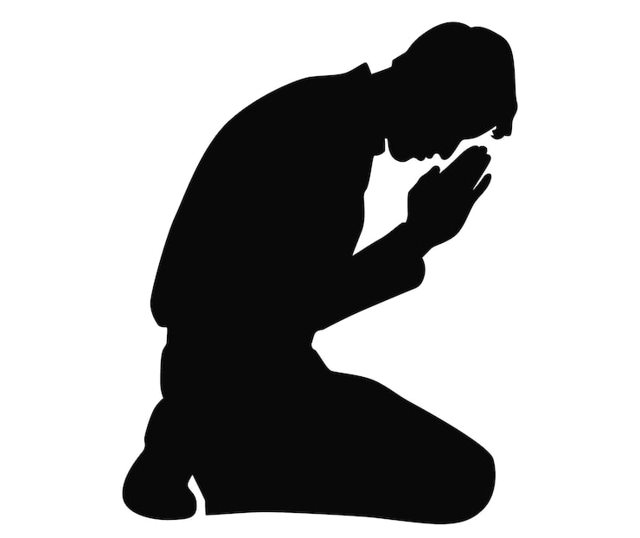
Main Idea
Instead of complaining,
pray like Moses
Notes:
Don’t grumble—intercede instead! (Restatement)

Slide 37
1. Don't complain!
Notes:
Accept God’s plan without grumbling.

Slide 38
2. Pray instead of complaining (13-19).
Notes:
Intercession: Moses’ response to Israel’s complaining was to pray for them (13-19).
Moses prayed based on God’s power (13).
Moses prayed based on God’s presence (14-16).
Moses prayed based on God’s pardon (17-19).

Slide 39
3. God shortens the lives of complainers (20-45).
Notes:
Grumbling takes a severe toll on us.

Slide 40
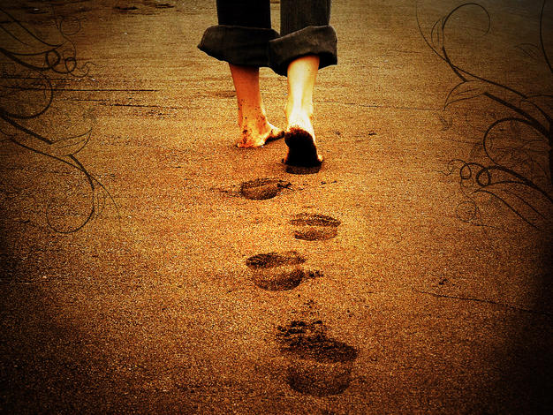
How to Be Prepared
135
Realize that God has given you everything you need to do His will, but disobedience deserves discipline.
God will get His will done either through you or despite you.
Are you characterized by commitment or complaining?
Notes:
How can we be prepared to truly follow God’s will?

Slide 41
Black
Notes:
What are you complaining about now?
How can you pray instead?

Slide 42


OT Preaching link at biblestudydownloads.org
Get this presentation and script for free!

