Slide 1
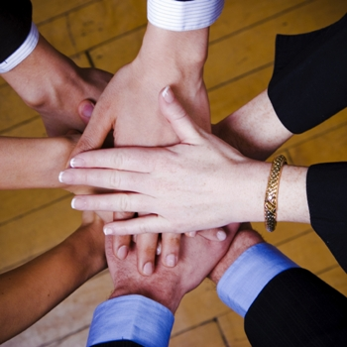
Be Diligent
Nehemiah
Dr. Rick Griffith • Crossroads International Church Singapore
CICFamily.com • BibleStudyDownloads.org

Slide 2
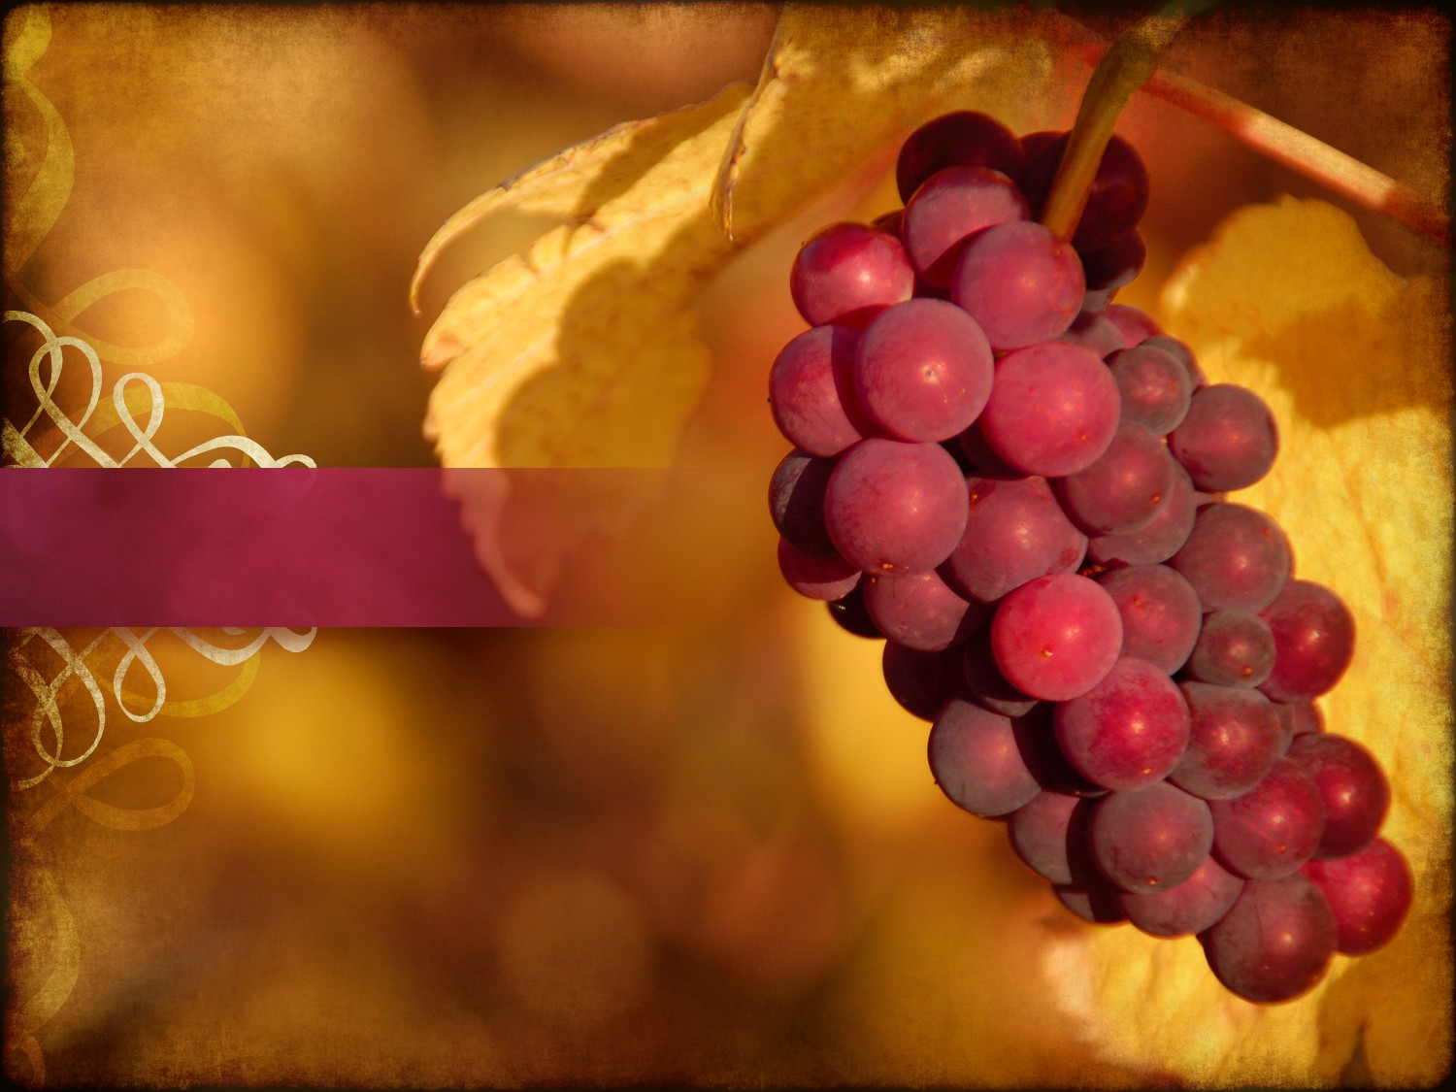
How much have others done for you?
Notes:
It's easy to take for granted what others do for us.

Slide 3
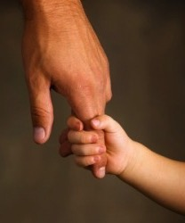
Are you grateful for what is done for you?
Notes:
How do you respond to people who serve you?
• How often do you say thanks?
• How often do you use the sandwich principle?
How do you respond to God who restores you?
• Has God restored your life?
• How would you respond if someone asked you what the Lord has done for you?
• Think of the ways God has restored you (examples from my life—broken family, no school for sons, no inheritance, etc.).

Slide 4
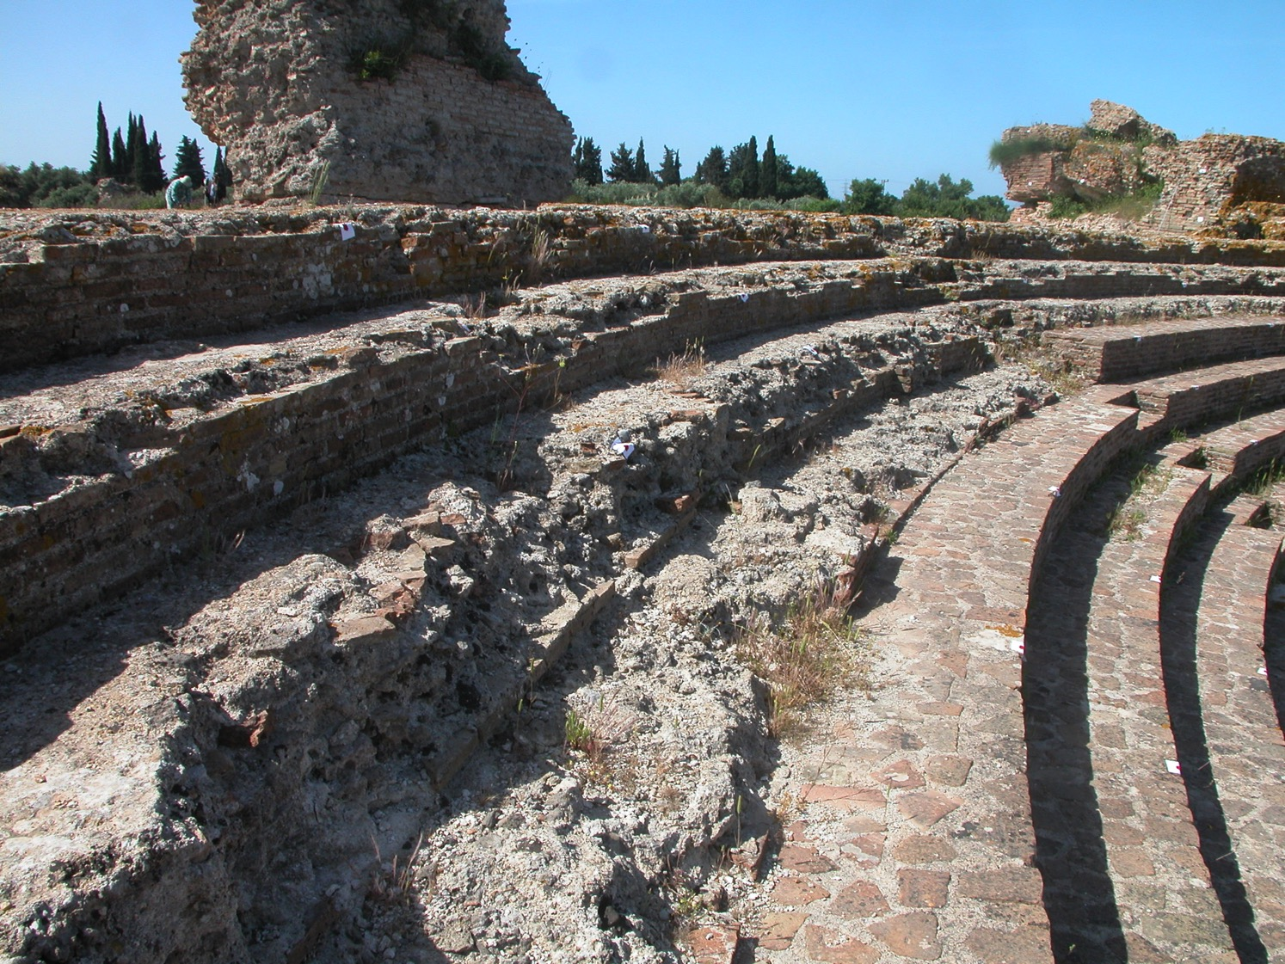
How should you respond to God's faithfulness to restore you?
Notes:
What would be the right way to say thanks to the LORD for all he has done for you?

Slide 5

Sin
JUDGMENT
IDOLATRY
WRATH
D A N I E L
E Z E K I E L
PUNISHMENT
SIN
DISOBEDIENCE

Slide 6
JUDAH IS PRESERVED!
^{DRESSING THE STAGE}
^{Isaiah 9:6-7}
^{Summing up…}
^{MS}
^{N(A)}
^{H}
^{SG}
^{C}
^{ER}
^{B}
^{J}
^{MN}
^{DS}
^{E}
^{KB}
^{WHY?}
^{U}
^{MS}
Because Messiah was long prophesied to appear through the tribe of Judah.
^{PG}
^{RS}
^{Handbook pg. 37-38}
⁵⁷
⁸
Notes:
Summing up this time of ROYALTY…
Remember again that crucial difference when the NORTHERN and the SOUTHERN Kingdoms fell. Recall that
//// the NORTHERN Kingdom, Israel, is attacked by Assyria,
//// taken away into captivity and , through time,
//// absorbed into other societies.
But JUDAH, the SOUTHERN KINGDOM and its people…
//// conquered by Babylon under Nebuchadnezzar…
//// is taken over to Babylon for a TEMPORARY captivity. But Judah is destined to continue to play center stage in the long future history of THE LAND.
//// JUDAH IS PRESERVED and eventually returned to The Land.
////` Why?
//// Because the expected Messiah...long prophesied...was destined by the Old Testament prophets to appear through the tribal line of JUDAH.

Slide 7
Neh. 3
7
ZERUBBABEL…returns to begin rebuilding the Temple.
ZERUBBABEL
CAPTIVITY
EZRA…returns to teach the Law of the Lord.
EZRA
70 YEARS
Z-E-N
3 TREKS
100 YEARS / 50,000
Z - E - N
THREE DIPLOMAT PRIESTS
CAPTIVITY
NEHEMIAH
70 Years
NEHEMIAH…returns as the great Old Testament leader and rebuilder of the city's gates and its walls.
3 Treks
100 Years / 50,000
Z - E - N
Handbook pg. 37-38
66
3
Notes:
ZERUBBABEL is remembered because of his crucial role in beginning the rebuilding of the actual Temple structure, small though it was…
//// EZRA...the great priest who went to Jerusalem to teach the law of the Lord to the returned people...
//// While NEHEMIAH, that famed Old Testament administrator and leader, returned to rebuild the city's gates and walls. In an astonishingly short time, he and his men rebuilt Jerusalem's crucial defenses.
//// These three great men…Z-E-N….Zerubbabel, Ezra and Nehemiah…the diplomat-priests…were at the center of Judah's return, carefully guiding the development of an exiled nation now back in its homeland.

Slide 8
Ezra's Correlation with Esther
289
Restoring the Temple and People
Temple
Book of Esther (58 YEAR GAP)
People
Zerubbabel
Ezra
Ezra 1–6
Ezra 7–10
50,000 Return
5,000 Return
Survival
Revival
Working
Worshipping
538-516 BC (22 Years)
458-457 BC (1 Year)
External Opposition: Samaritans
Internal Opposition: Intermarriage
Return
1–2
Rebuilding
3–6
Return
7–8
Restoration
9–10
Decree
1
Returnees
2
Begins
3
Opposed
4:1–6:12
Ends
6:13-22
Qualifications
& Provisions
7
Returnees
& Protection
8
Inter- marriage
& Lament
9
Divorces
Carried Out
10

Slide 9
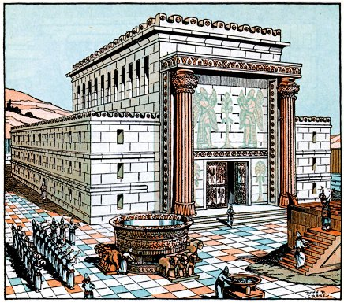
God rebuilt the temple (Ezra 6:15)
Notes:
9
The temple had been rebuilt a century earlier under Zerubbabel.

Slide 10
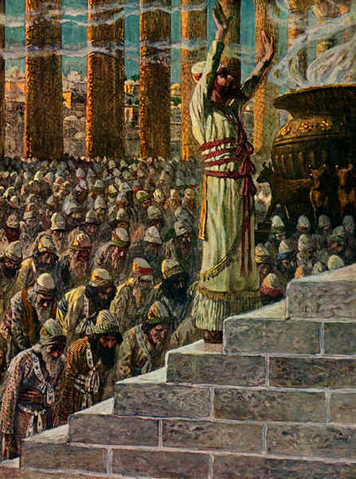
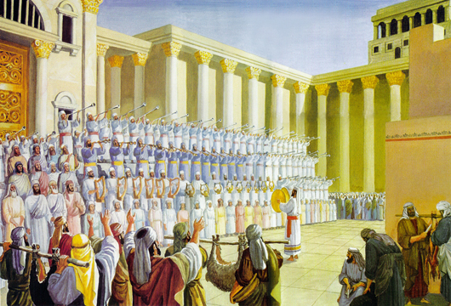
In 520 BC returning Jews celebrated the temple completion
Notes:
10
They then had a huge ceremony in Ezra 6:16.

Slide 11
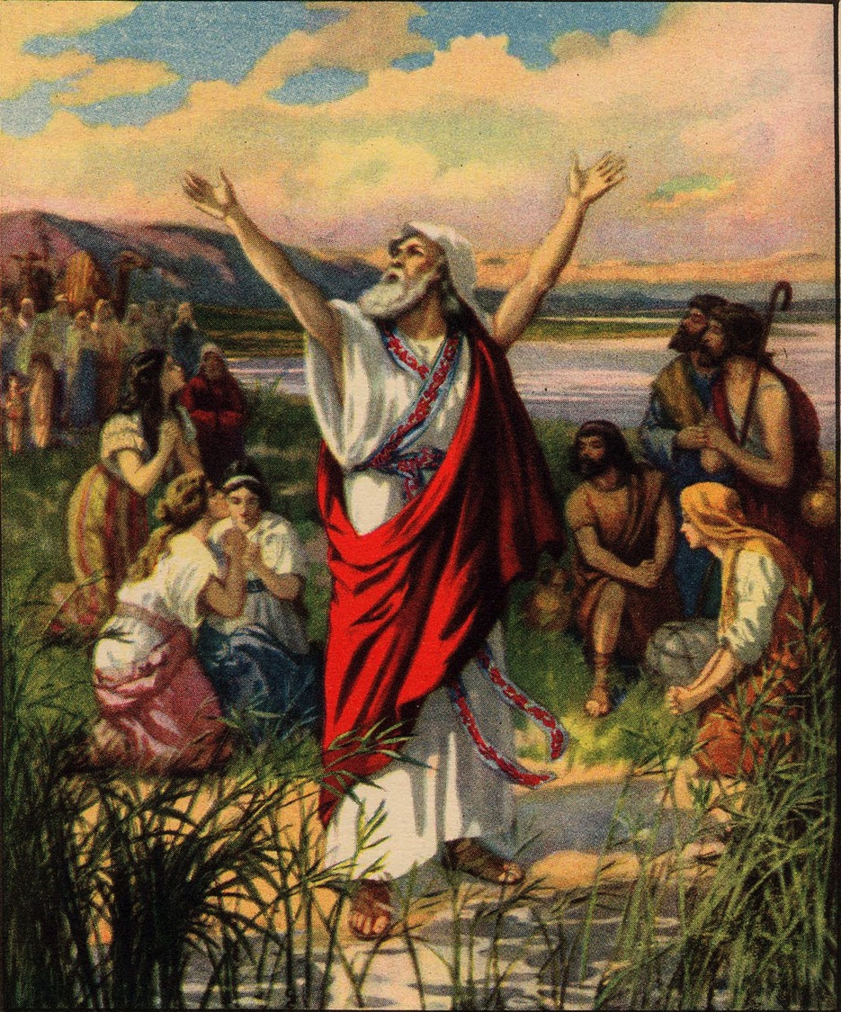
Ezra restored the people in an amazing revival (Ezra 8).
Notes:
Six decades later Ezra himself restored the people in an amazing revival (Ezra 8).

Slide 12
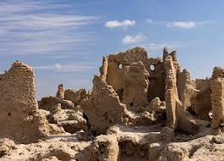
The Three "Rs" (1:3)
Remnant Small
Reproached Jews
Ruined Walls
Notes:
Yet the people were still a…
Remnant: Few Jews had returned to the land.
Reproached: The same pagans of Ezra’s account threatened them on every side.
—But yet they also had intermarried with these pagans!
—They still didn't follow the Sabbath—the sign of their covenant with God.
Ruins: They still had a broken down wall around the city.

Slide 13
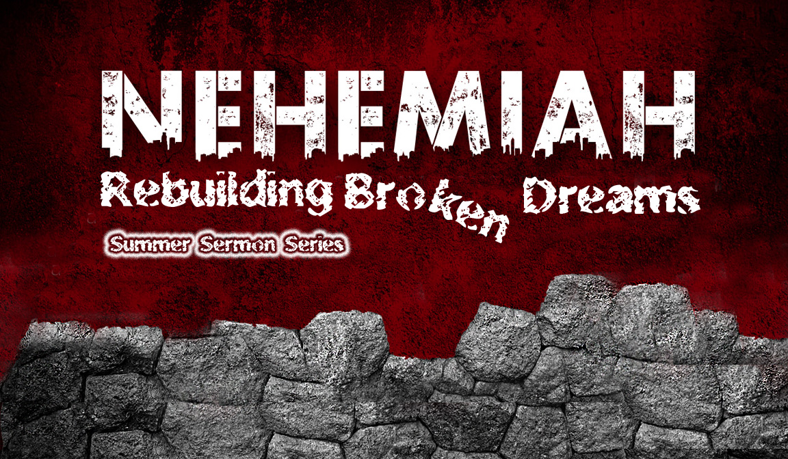
Listen to the Sermon Series
July-October 2013
Notes:
So God raised up Nehemiah to restore the walls. We had a whole sermon series no this 2013 if you want to listen to the whole book on the website.

Slide 14
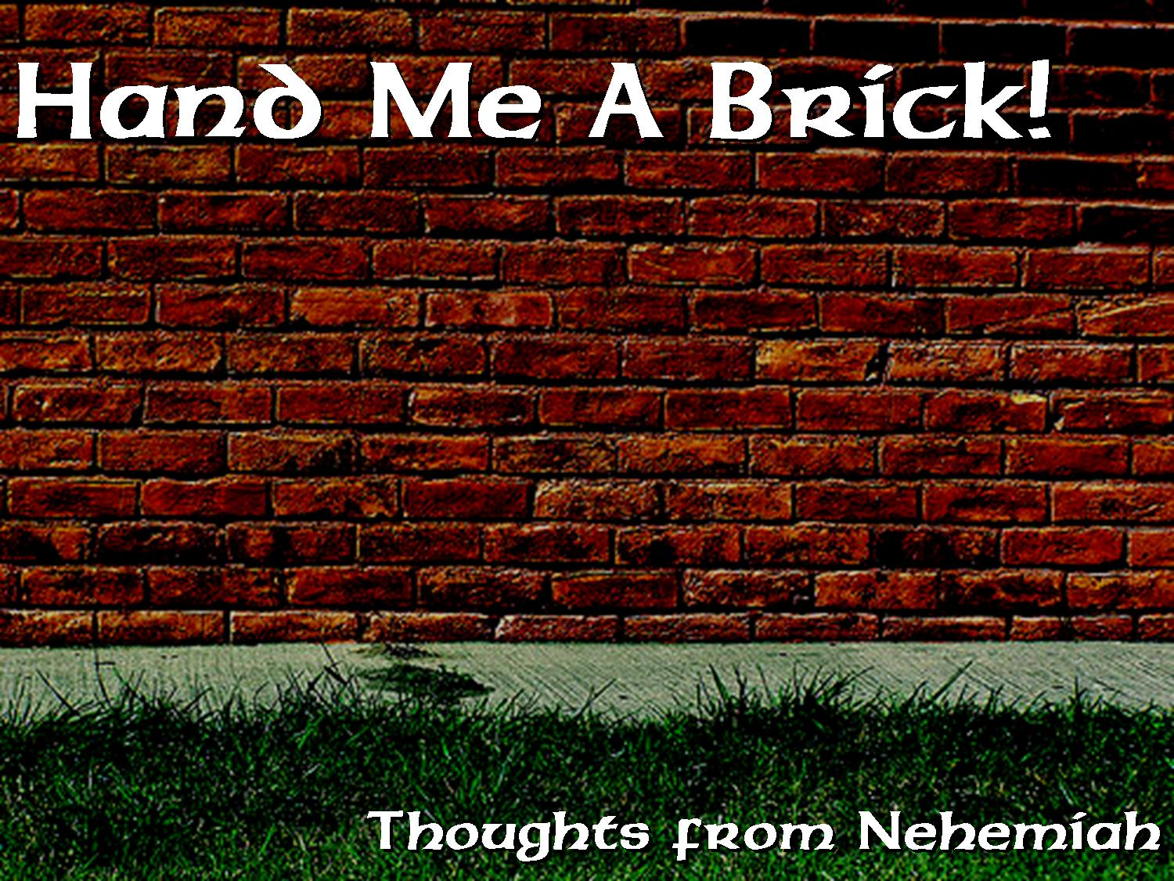
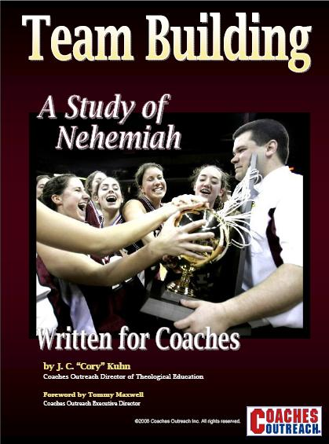
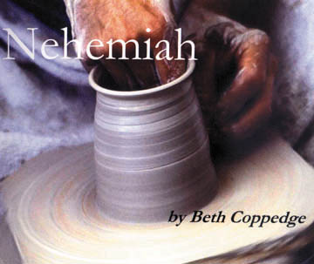
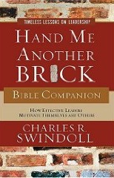
Books on Nehemiah
Notes:
Too often teaching on this book focuses on Nehemiah—even team building for coaches!

Slide 15

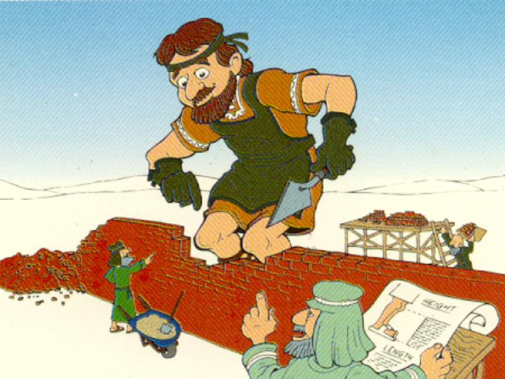
Our Key Word
Nehemiah:
Walls
Walk Through The Bible ©1989
Notes:
Knee-High-My-A was a very tall man!
Well, maybe not physically, but spiritually he had great stature!

Slide 16
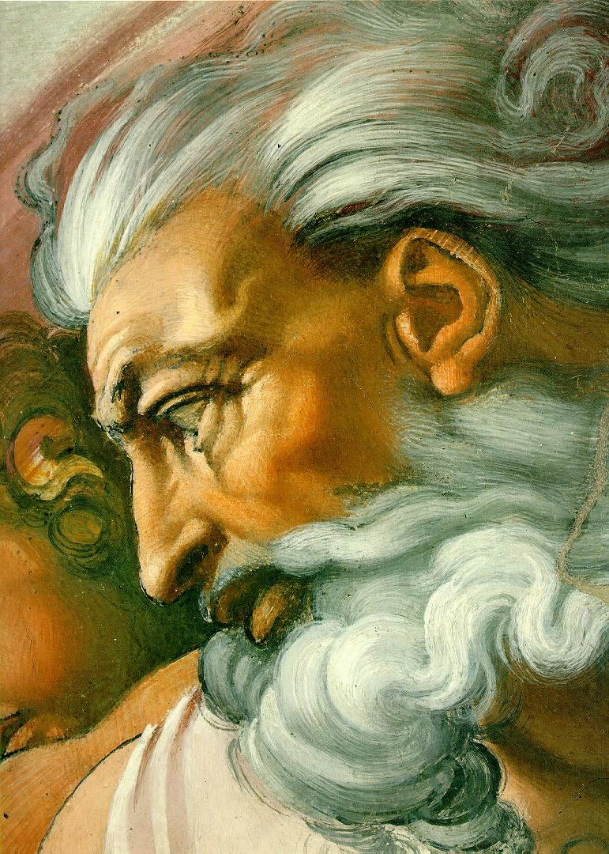
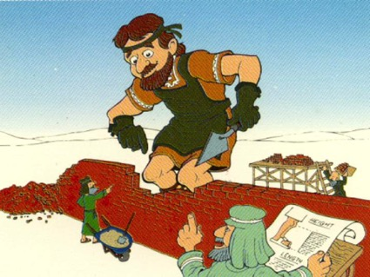
The Real Hero of the Book
Or
God?
Nehemiah?

Slide 17
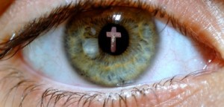
Focus on God
Focus on
He was called “the God of heaven” (4b).
He was “the great and awesome God who keeps his covenant of love…” (5).
God listens to prayer (6, 11a).
God graciously gave commands, decrees, and laws through Moses (7).
God promised not only exile but also return (8-9).
God redeemed this remnant by His great strength (10)
Notes:
Too often we focus on Nehemiah in the book instead of the real hero—God!
Even Nehemiah himself focuses on God.

Slide 18
Nehemiah
299
Restoring the Walls and People
Walls
People
Chapters 1–7
Chapters 8–13
Construction
Instruction
Political
Spiritual
Return
1–2
Rebuilding
3–7
Renewal
8–10
Reforms
11–13
Persia Prayer
1
Jerusalem Inspection
2
Dele- gation
3
Opposed / Finished
4–6
Organ-ized
7
Convic-tion
8
Confes- sion
9
Cove-nant
10
Resettle- ment & Dedication
11–12
Sabbath & Inter-marriage Reforms
13
-----52 days (6:15)----
445-433 BC
13:6a
425 BC?
420 BC?
13:6b
Notes:
Through Nehemiah God was the one to restore Jerusalem's walls and people.

Slide 19
How should you respond to God's faithfulness to restore you?
Notes:
What would be the right way to say thanks to the LORD for all he has done for you?

Slide 20
Two Responses to God's Restoration
Diligent Response #1
Diligent Response #2
then

Slide 21
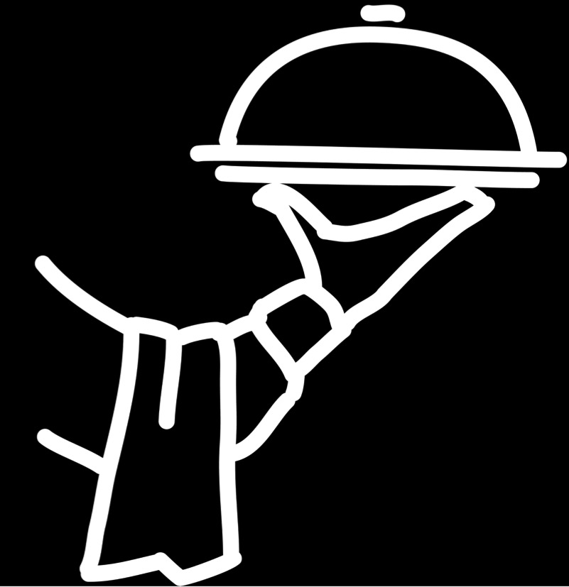
I. Serve God diligently
(Neh 1–7).
Notes:
Faithful divine help should lead to faithful human help.

Slide 22
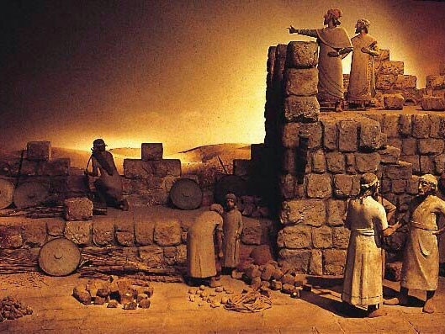
The remnant responded to God's faithful restoration of Jerusalem's wall under Nehemiah by diligent service (Neh 1–7).
Notes:
The natural reaction to seeing God's loyal hand is to work for him.

Slide 23
Slides on
Nehemiah 1
Notes:
God enabled Nehemiah to prepare to rebuild the wall to reestablish temple worship in Jerusalem (Neh 1–2).

Slide 24
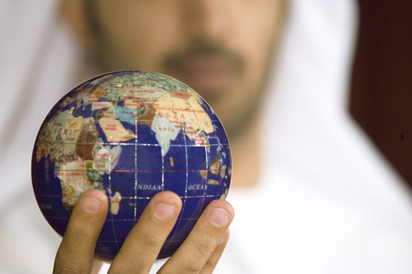
How can you know if God wants you to do a certain task?

Slide 25
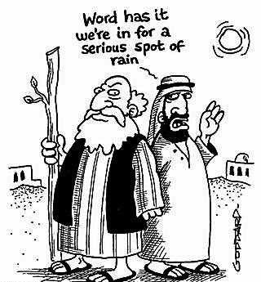
God gives us the information we need to do His will (1:1-3).
Word has it we're in for a serious spot of rain

Slide 26
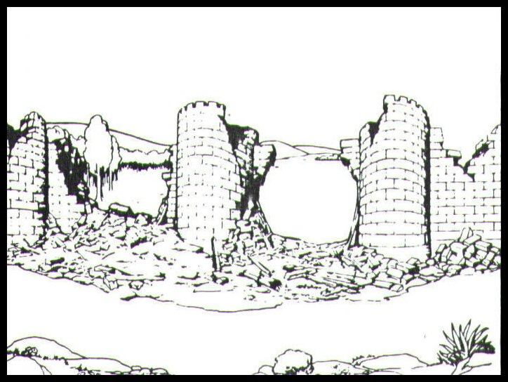
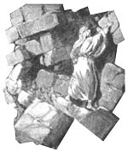
God informed Nehemiah of Jerusalem's sad state without a wall (1:1-3).

Slide 27
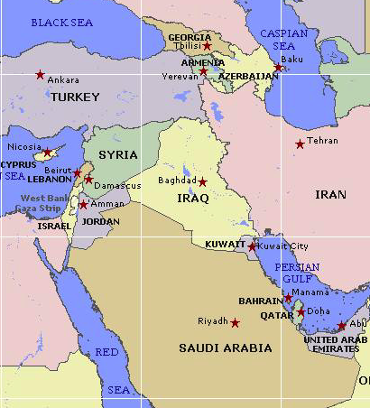

Borders of the Land Promised to Abraham
44
Genesis 15:18
On that day the LORD made a covenant with Abram, saying, “To your offspring I give this land, from the river of Egypt to the great river, the river Euphrates” (ESV)
Notes:
27

Slide 28
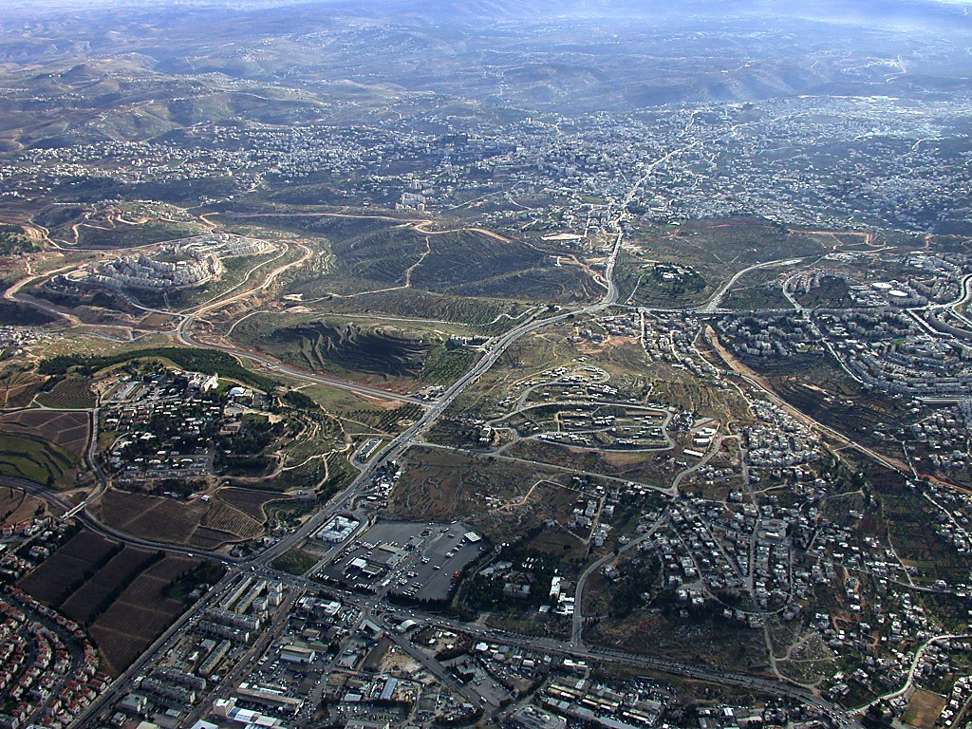
Bethlehem aerial from north
Herodium
Bethlehem
Church of Nativity
Rachel's Tomb
Har Homa
Tantur
Mar Elias
Ramat Rahel
Bethlehem aerial from north near Jerusalem
Notes:
28
Bethlehem in the Old Testament
Bethlehem was the home of Micah's Levite priest (Jud 17:1-13).
Ruth harvested in the fields of Boaz in Bethlehem.
Three generations after Ruth, David was born in Bethlehem (Ruth was David's great-grandmother).
David was anointed king in Bethlehem (1 Sam 16:1-13), but he chose not to make this city his capital.
Bethlehem was the home of Joab, Abishai, and Asahel. Asahel was buried here (2 Sam 2:32).
Bethlehem was also the home of Elhanan, one of David's mighty men (2 Sam 23:24; 1 Chr 11:26).
Rehoboam fortified Bethlehem (2 Chr 11:6).
Many Jews fled to Bethlehem after Gedaliah was killed (Jer 41:17).
The city was rebuilt after the return from Babylonian exile (Ezra 2:21; Neh 7:25).
Bethlehem was named as the place of the Messiah's birth (Micah 5:2; John 7:42).

Slide 29
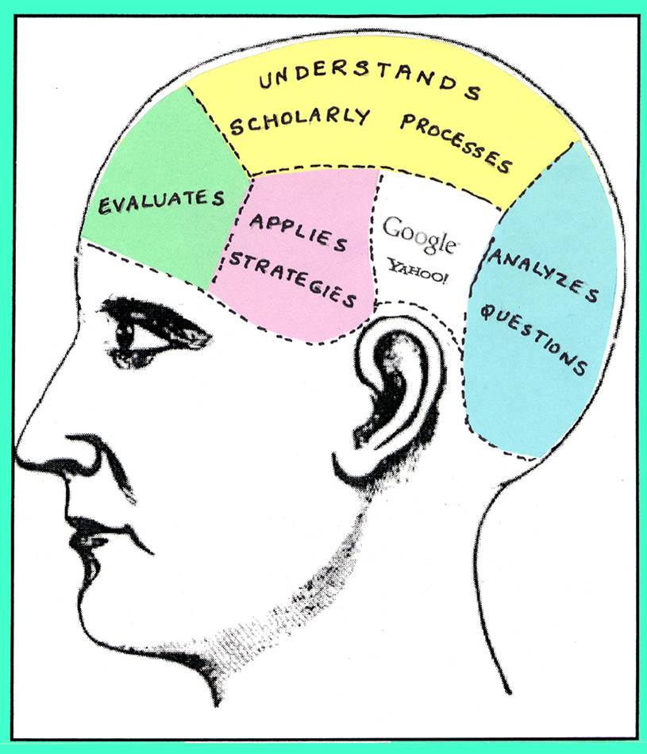

God also informs us how to serve Him.

Slide 30

God gives us the vision we need to do His will (1:4-11a).

Slide 31
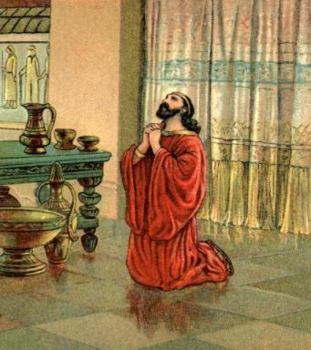
An ordinary day…
Notes:
It's interesting how this day in Nehemiah's life likely began as did any other—he got up, did his job, etc.—but he was open to God giving him a vision that day that would change his life and the life of Israel through him forever

Slide 32
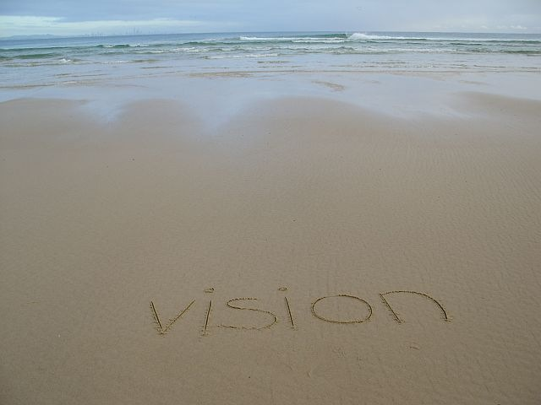
God also gives us a vision to serve Him. What's on your heart today?
Notes:
Diligence is true dilgence if you don't get paid for it. Here is where church is quite different from work as volunteer ministry really tests our motivation.

Slide 33
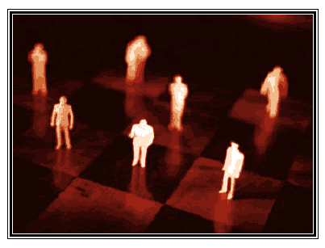
God gives us the position we need to do His will (1:11b).

Slide 34
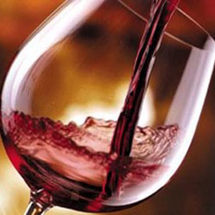
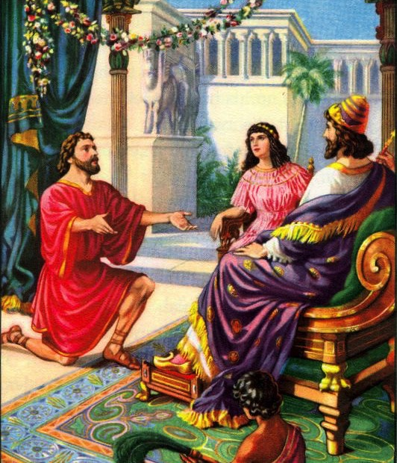
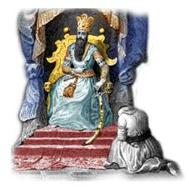
The Cupbearer
Warren Wiersbe…
Notes:
Wiersbe notes, “A cupbearer was much more than our modern 'butler' (see Gen. 40). It was a position of great responsibility and privilege. At each meal, he tested the king's wine to make sure it wasn't poisoned. A man who stood that close to the king in public had to be handsome, cultured, knowledgeable in court procedures, and able to converse with the king and advise him if asked (see 41:1–13). Because he had access to the king, the cupbearer was a man of great influence, which he could use for good or for evil.”
• “That Nehemiah, a Jew, held such an important position in the palace speaks well of his character and ability (Dan. 1:1–4). For nearly a century, the Jewish remnant had been back in their own land, and Nehemiah could have joined them; but he chose to remain in the palace. It turned out that God had a work for him to do there that he could not have accomplished elsewhere. God put Nehemiah in Susa just as He had put Esther there a generation before, and just as He had put Joseph in Egypt and Daniel in Babylon. When God wants to accomplish a work, He always prepares His workers and puts them in the right places at the right time.”
Ibid.

Slide 35
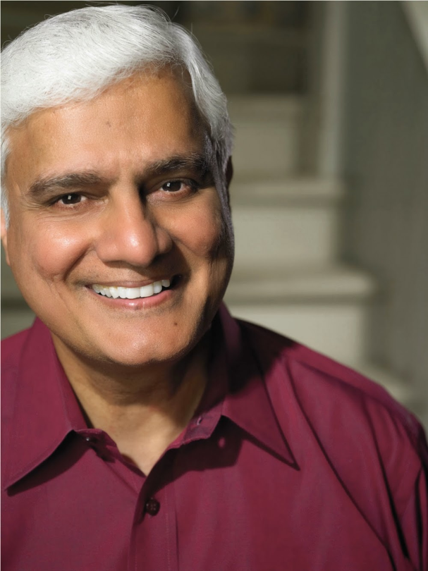
Secular Work?
"We are all priests before God, there is no such distinction as 'secular or sacred.' In fact, the opposite of sacred is not secular; the opposite of sacred is profane. In short, no follower of Christ does secular work. We all have a sacred calling."
–– Ravi Zacharias ––
Notes:
Was Nehemiah in secular work? After all, he worked for the king. Ravi Zacharias notes…
The Grand Weaver: How God Shapes Us Through the Events of Our Lives

Slide 36
How can you know if God wants you to do a certain task?

Slide 37
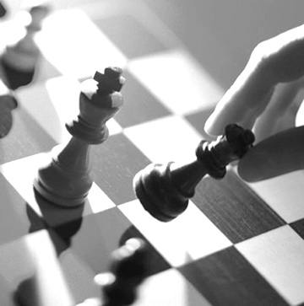

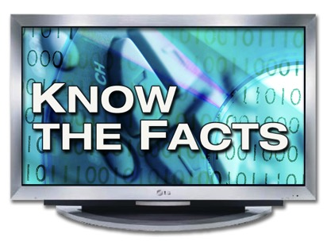
Key Idea of Nehemiah 1
God gives you the
information, vision, & position
KNOW THE FACTS
vision
you need to do His will.

Slide 38

What knowledge, faith, and place of influence has God given you?
What does God want you to do with it?
Notes:
What knowledge, faith, and place of influence has He given you? What does God want you to do with it? What burden has the Lord placed on your heart? Soul care? How can we help you achieve this vision so you have all you need to do His will

Slide 39
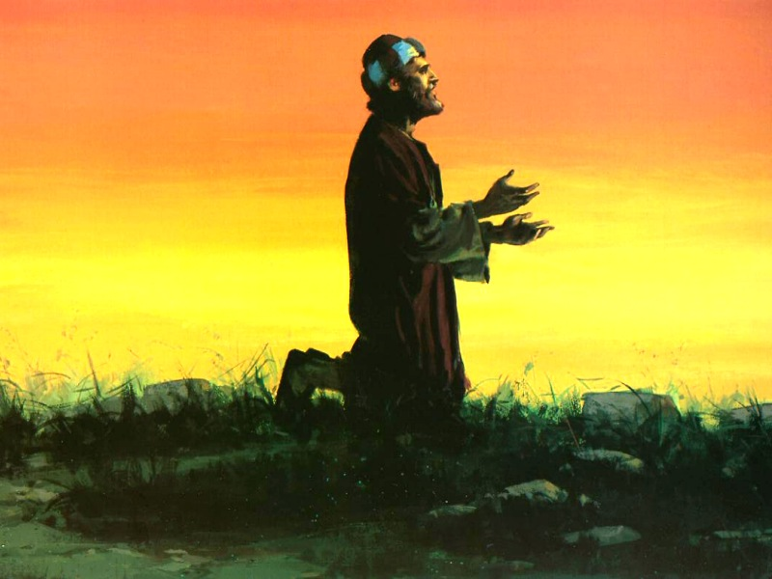
Prayer and vision
Notes:
So Gof gave Nehemiah the heart to do his will, and the man responded.

Slide 40
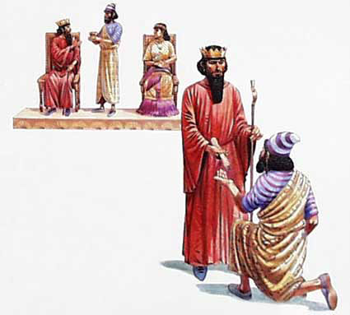
King's Help Granted
Notes:
Then God opened the doors that he needed.

Slide 41
Slides on
Nehemiah 2
Notes:
In Jerusalem, Nehemiah prepared to reconstruct the wall by inspecting the project, encouraging the people, and rebuffing his critics (2:9-20).

Slide 42
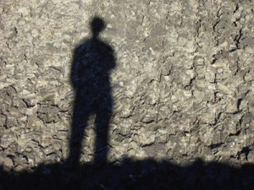
Nehemiah 2:11-20
Restoring God's Honor

Slide 43
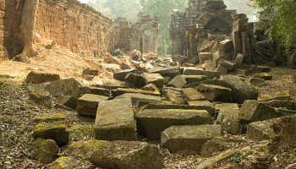
Temple But No Walls

Slide 44
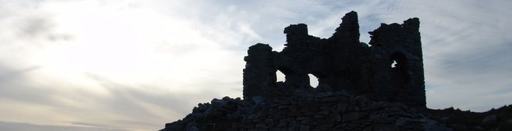
Nehemiah 1:1–2:10 Summary
God reproached!

Slide 45
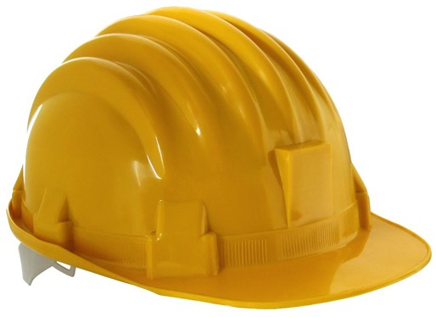
The Cupbearer
Willing to be a foreman
Notes:
Nehemiah was a man of the marble-floored palace—but he willingly became a man of the dirt.

Slide 46
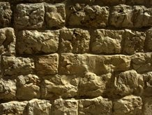
How does God restore us?
(3 ways in Neh 2)

Slide 47
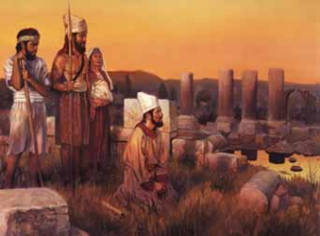
1. God informs us of our sad state of affairs (2:11-15).

Slide 48
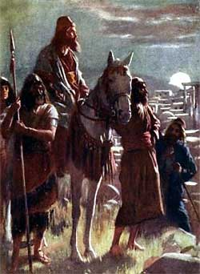
“I went to Jerusalem, and after staying there three days ¹²I set out during the night with a few men. I had not told anyone what my God had put in my heart to do for Jerusalem. There were no mounts with me except the one I was riding on” (2:11-12 NIV).

Slide 49
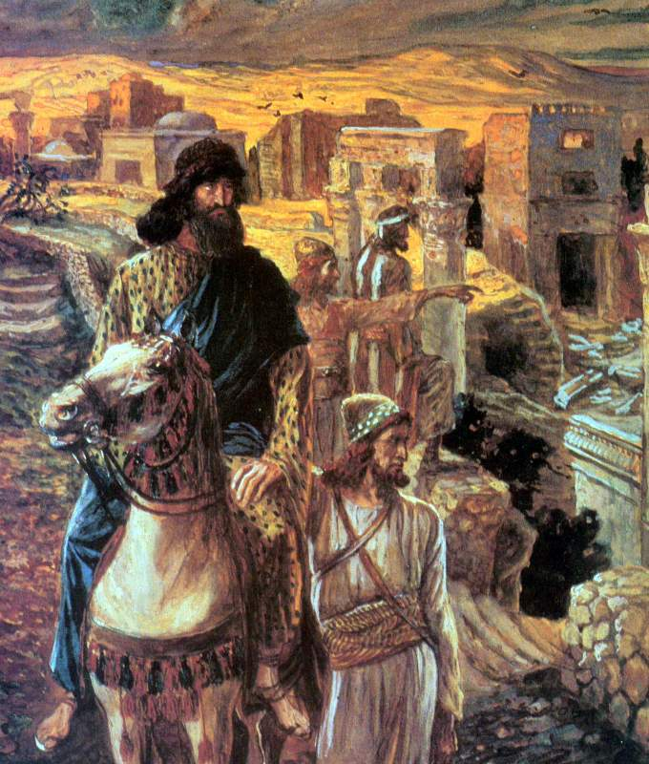
”By night I went out through the Valley Gate toward the Jackal Well and the Dung Gate, examining the walls of Jerusalem, which had been broken down, and its gates, which had been destroyed by fire” (2:13 NIV).

Slide 50
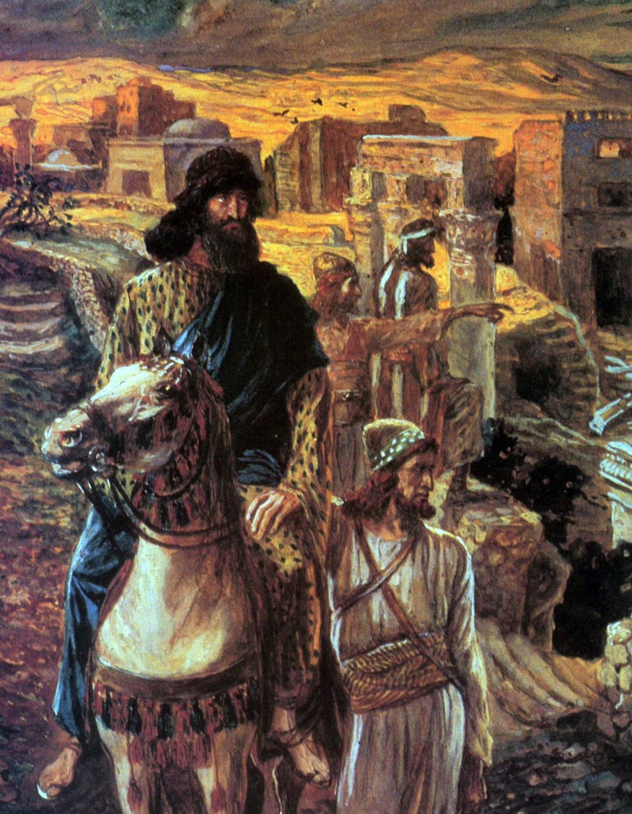
Nehemiah wisely investigated the situation before getting started
Notes:
50

Slide 51
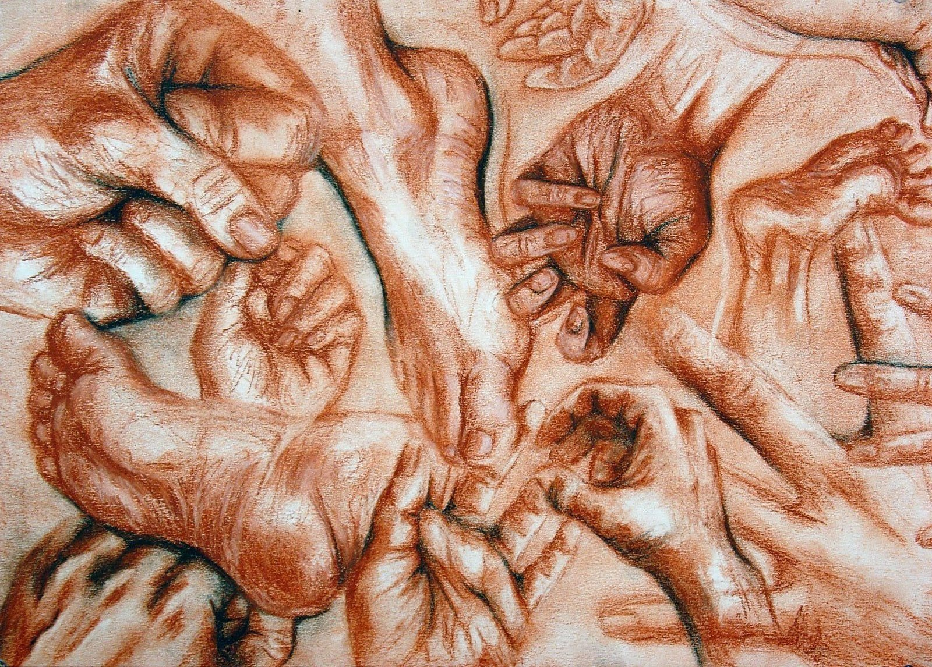
2. God rallies us to honor his name once again (2:16-18).
HANDS & FEET

Slide 52
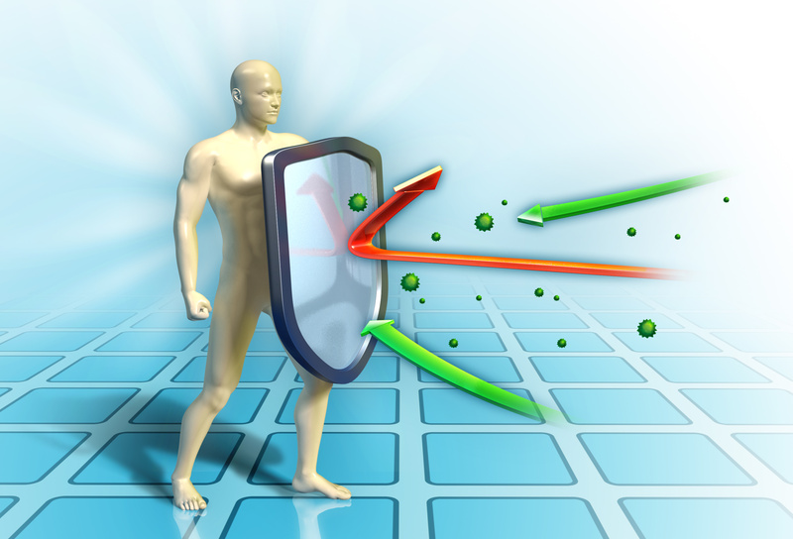
3. God defends us against potential setbacks (2:19-20).

Slide 53
Slides on
Nehemiah 3
Notes:
Nehemiah wisely delegated the rebuilding project to workers who constructed the wall near their homes as incentive to do quality work (Neh 3).

Slide 54
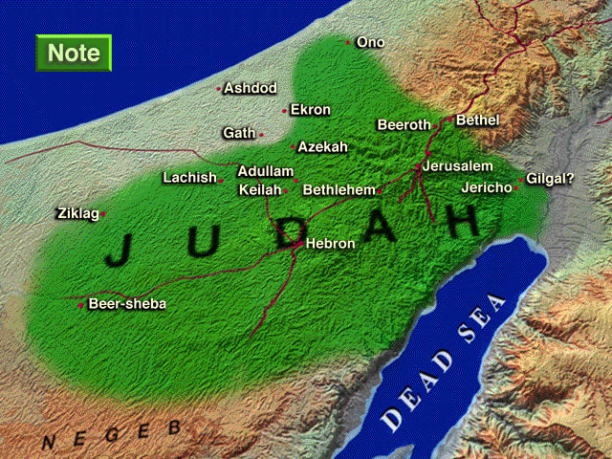

Enemies in Nehemiah's Time
Sanballat
the Samaritan
Tobiah
the Ammonite
NEHEMIAH
Geshom
the Arab
Notes:
54

Slide 55

How does God help us serve Him when we're opposed?

Slide 56

1. God helps us to be sensible to overcome opposition.
A. Nehemiah 3 makes sense…
• Geographic: They worked at the right spots on the wall

Slide 57

Wall-to-Wall Workers (Neh. 3:1-2)
304
Tower of Hananel
Tower of 100
Mount of Olives
¹Then Eliashib the high priest and the other priests started to rebuild at the Sheep Gate. They dedicated it and set up its doors, building the wall as far as the Tower of the Hundred, which they dedicated, and the Tower of Hananel. ²People from the town of Jericho worked next to them, and beyond them was Zaccur son of Imri.
Sheep Gate
Notes:
57

Slide 58

The Sheep Gate
North of the temple, it connected the Sheep Pool to the temple complex.
(looking west)
Notes:
58

Slide 59
Opposing Quotes on Work
Wiersbe notes, “When it comes to the work of the Lord, there is no place for spectators or self-appointed advisors and critics; but there is always room for workers.”
British humorist Jerome K. Jerome said,
“I like work, it fascinates me. I can sit and look at it for hours.”
Notes:
59

Slide 60
1. God helps us to be sensible to overcome opposition
A. Nehemiah 3 makes sense…
• Geographic: They worked at the right spots on the wall
• Communal
• Inconvenient
• Complete
• Reasonable

Slide 61

B. God calls us to serve him in sensible ways to protect His church

Slide 62

Play your own instrument

Slide 63
1. God helps us to be sensible to overcome opposition.

Slide 64

2. God helps us to be united to overcome opposition.

Slide 65

A. God united all kinds of Jews to work as common laborers

Slide 66
A. God united all kinds of Jews to work as common laborers
    Priests (1, 22, 28)
    Goldsmiths (8a, 31, 32)
    Perfumer (8b)
    Political leaders (9, 15, 16, 17, 18, 19)
    Women & men (12)
    Levites (17)
    Merchants (32)
    Even people from outside the city (2, 5, 7)

Slide 67

Bound sticks
Notes:
A young boy wanted to show his strength in front of the class by breaking a bunch of 20 small, thin sticks tied together. He tried hard to break these sticks tied together, but even after several attempts he failed. He gave up. Then the teacher called him and told him to untie the bunch of sticks and break them one by one. The boy found it very easy to break them. It wasn't that difficult after all. Once the bunch of sticks was untied the sticks lost their strength. “United we stand, divided we fall.”

Slide 68

The Main Idea of Nehemiah 3
God fights opposition through a sensible plan that includes us all.
Notes:
This passage helps to show how God gives a sensible and united plan to accomplish His will through us. God worked his will through many people and he still does today. He is a God of order. He works in the same way today to see our church grow for His glory.

Slide 69
Slides on
Nehemiah 4
Notes:
External opposition came from Sanballat and Tobiah who sought to stop the work by ridicule, threat of attack, and discouragement (Neh 4).

Slide 70

Opposition to Building the Wall

Slide 71

Ridicule: "Even a fox would break down that wall!" (4:3)

Slide 72

Main Idea of Nehemiah 4
Respond to external discouragement and danger with
• God-dependent prayer,
• God-informed planning, and
• God-empowered action.

Slide 73
Slides on
Nehemiah 5
Notes:
Internal opposition came from greedy Jews who abused their countrymen in contrast to Nehemiah's selfless service as governor (Neh 5).

Slide 74




Do you help the poor?

Slide 75

How should we help the poor?

Slide 76

"Let's build that wall!"

Slide 77

Chapter 5
Internal Problems Right at Home

Slide 78

Prayer
We can focus too much on Nehemiah as a construction manager.
But he was also a man of prayer.
In Nehemiah 5 we also see that he responds to the cry of the poor.
Do we?
Compassion

Slide 79

1. Nehemiah helped the poor by fighting greed in others and in his own life (5:1-19).

Slide 80

A. The problem: A famine enabled wealthy Jews to take advantage of poorer Jews (5:1-5).

Slide 81

B. The solution: Nehemiah fought greed with both public rebuke and personal example (5:6-19).

Slide 82

2. Help the poor by fighting greed.

Slide 83

Be generous yourself.

Slide 84
Nehemiah's Example
Nehemiah used personal resources instead of demanding more from the people.
The cries of the poor impacted the way he did his job and how he leveraged the roles and resources that God had given him.
He understood that God cares for the poor and called him (and calls us) to respond with compassion and action.

Slide 85

Dozens of Inexpensive Courses in English, Chinese, Vietnamese, etc.
Notes:
INTERVIEWER: And Susan, what ministries has the Lord granted you?
SUSAN: I have been teaching the wives of leaders at SBC. These 5 women come from 5 different nations!
SUSAN: I also lead the woman's Bible study at our church

Slide 86
How should we help the poor?

Slide 87

Main Idea
Replace greed
with generosity

Slide 88
How can you help the poor?

Slide 89



We have to choose to hear their cries and respond
or ignore their need.

Slide 90



Missions Giving
21%

Slide 91



What one way can you be generous?

Slide 92
Slides on
Nehemiah 6
Notes:
External opposition came from Sanballat, Tobiah, and Geshem who tried compromise, blackmail, treachery, and intimidation by false prophets (6:1-14).

Slide 93

Guarding the Work of God's Hand
Nehemiah 6:15–7:3

Slide 94

Do you have your guard up when things are going well?
How should we respond when God gives us victory?
Elijah
Abraham
Moses

Slide 95

Nehemiah's External Opposition
Sanballat
the Samaritan
NEHEMIAH
Tobiah
the Ammonite
Geshom
the Arab
Notes:
95
^{18�} Then I told them about how the gracious hand of God had been on me, and about my conversation with the king.
They replied at once, “Yes, let's rebuild the wall!” So they began the good work.
^{19�} But when Sanballat, Tobiah, and Geshem the Arab heard of our plan, they scoffed contemptuously. “What are you doing? Are you rebelling against the king?” they asked.
^{20�} I replied, “The God of heaven will help us succeed. We, his servants, will start rebuilding this wall. But you have no share, legal right, or historic claim in Jerusalem.”
Tyndale House Publishers., Holy Bible : New Living Translation., 2nd ed. (Wheaton, Ill.: Tyndale House Publishers, 2004), Ne 2:18.
Map Has Settlements of the Persian Province of Judah According to Ezra and Nehemiah (Logos Libronix Bible Maps, Mac edition, 2008)

Slide 96

Finally Finished!
"So on October 2 the wall was finished—just fifty-two days after we had begun. 16 When our enemies and the surrounding nations heard about it, they were frightened and humiliated. They realized this work had been done with the help of our God"
(6:15-16 NLT).

Slide 97

Responses to God's Work
Oppose it
Guard it

Slide 98

I. Expect some to oppose God's work (6:17-19).

Slide 99

To every action there is always an equal and opposite reaction
––Isaac Newton

Slide 100

Opposition to Building the Wall

Slide 101
Tower of Hananel
Tower of 100
Mount of Olives
Sheep Gate
Fish Gate
Inspection Gate
Jeshanah (Old Gate?)
East Gate
Broad Wall
Horse Gate
Tower of the Ovens?
Wall of Ophel
Great Projecting Tower
Valley Gate
Water Gate
Dung Gate
The Angle
Pool of Shelah (Siloam)
Fountain Gate
Notes:
101
Despite internal opposition from Tobiah’s relatives, the wall took only 52 days, discouraging the enemies as they saw God clearly at work (6:15-19).

Slide 102

Nehemiah 6:17-19
The work of God is opposed—again!
  Tobiah has powerful political partners (17-18)
  Tobiah has insidious inside informers (19a)
  Tobiah has sent scary statements (19b)

Slide 103

Are you opposed?

Slide 104

Jesus promised family opposition
³⁴"Don't imagine that I came to bring peace to the earth!
I came not to bring peace, but a sword.
³⁵I have come to set
a man against his father,
a daughter against her mother,
and a daughter-in-law against her mother-in-law.
³⁶Your enemies will be right in your own household!" (Matt. 10:34-36 NLT)

Slide 105

"Me? Be a Christian at work?"

Slide 106



Opposing Our Church
Notes:
Our church has certainly been opposed over the years in a variety of ways. The same tools have been used as in Nehemiah—tools like ridicule, discouragement, financial challenges, and even attempts to close us down.

Slide 107
1. Expect some to oppose God's work (6:17-19).

Slide 108
Slides on
Nehemiah 7
Notes:
Nehemiah organized Jerusalem by posting guards and using the returnee list from century earlier to encourage the Jews to repopulate the city (Neh 7).

Slide 109

2. Guard God's work (7:1-3).

Slide 110

Nehemiah responded to threats by guarding the city (7:1-3).

Slide 111

Some guarded the gates and others guarded their homes

Slide 112

The Main Idea of Nehemiah 6:15–7:3
Guard God's work!

Slide 113
How should you respond to God's faithfulness to restore you?
Notes:
What would be the right way to say thanks to the LORD for all he has done for you?

Slide 114
I. Serve God diligently
(Neh 1–7).
Notes:
Faithful divine help should lead to faithful human help.

Slide 115

II. Worship God diligently
(Neh 8–13).
Notes:
The natural reaction to seeing God's loyal hand is to revere him.

Slide 116
Slides on
Nehemiah 8
Notes:
Conviction: Ezra's reading of the Pentateuch and Levite exposition urged all to celebrate the Feast of Tabernacles and begin a revival based on God’s Word (Neh 8).

Slide 117

Reading the Law Brought Revival (Neh. 8:8, 18; 9:3)

Slide 118
Slides on
Nehemiah 9
Notes:
Confession: Everyone gathered again 24 days later to fast, listen to the Law of Moses, worship, confess sin, and obey a written covenant (Neh 9).

Slide 119

Community Renewal
Nehemiah 8–10
Nehemiah 10
Nehemiah 9
Nehemiah 8
COVENANT
CONFESSION
CONVICTION

Slide 120
Slides on
Nehemiah 10
Notes:
Covenant: Nehemiah publicized those who agreed to follow the covenant as a written record of the people's commitment to obey (Neh 10).

Slide 121



Commitment
Notes:
A list of the priests, Levites, and leaders of the people who signed the covenant reminded them of their agreement to obey the Law (10:1-27).

Slide 122
Covenant Renewal
Notes:
122
Nehemiah recorded the covenant stipulations of submission to the Word, no intermarriage, Sabbath observance, and financial support (10:28-39).

Slide 123
1. Leaders must lead in commitment to God (9:38–10:27).
Community Renewal
Nehemiah 8–10
Nehemiah 10
COVENANT
I. Leaders

Slide 124




Leaders must lead…
How should our church renew our commitment to God?
…and followers must follow
Crossroads International Church

Slide 125
Slides on
Nehemiah 11
Notes:
They obeyed the covenant by resettling Jerusalem, dedicating the walls, and supporting the temple (Neh 11–13).
The people obeyed the plan for 10% of the nation to resettle Jerusalem to protect the city and temple from attack to show their commitment to the temple (11:1–12:26).

Slide 126

Key Idea of Nehemiah 11
Make your commitment to God practical by following His individual plan for you!

Slide 127
Slides on
Nehemiah 12
Notes:
The wall dedication by Levites, two choirs, and contributions for the temple service once again show their commitment to God’s house (12:27-47).

Slide 128
Overview
299
Building the Walls – Building the People
Walls
People
Chapters 1—7
Chapters 8—13
Construction
Instruction
Political
Spiritual
Return
1—2
Rebuilding
3—7
Renewal
8—10
Reforms
11—13
Persia Prayer
1
Jerusalem Inspection
2
Dele- gation
3
Opposed / Finished
4—6
Organ-ized
7
Convic- tion
8
Confes- sion
9
Cove- nant
10
Resettle- ment & Dedication
11—12
Sabbath & Inter-marriage Reforms
13
-----52 days (6:15)----
445-433 BC
13:6a
425 BC?
420 BC?
13:6b

Slide 129
Walls Outlined
(Neh 2–3, 12)
304
Tower of Hananel
Tower of 100
Mount of Olives
Sheep Gate
Fish Gate
Inspection Gate
Jeshanah (Old Gate)
East Gate
Horse Gate
Broad Wall
Wall of Ophel
Tower of the Ovens
Great Projecting Tower
Walls Today (since 1500s)
Valley Gate
Temple Mount Today
Water Gate
Inspection (Neh 2)
Walls Built (Neh 3)
The Angle
Procession (Neh 12:27-43)
Dung Gate
Pool of Shelah (Siloam)
Fountain Gate
Notes:
Nehemiah highlights the importance of borders and security. Can you imagine a country without border control? Singapore rightly checks everyone who wants to come in, while my country argues over the 1000 people EACH DAY that sneak in illegally!
Building the wall was certainly something to celebrate!
The two processions on top of the wall proceeded from the west in opposite directions. One group went south and around to the temple. Nehemiah followed the group proceeding north to the temple. What a celebration it was! This project that took 150 years was finally done (586-444 BC)!

Slide 130


Slide 131
Slides on
Nehemiah 13
Notes:
Nehemiah forbade foreigners from the temple, supported temple workers, corrected Sabbath abuses, and prohibited intermarriage to force covenant faithfulness (Neh 13).

Slide 132

Leadership?
294
Do Ezra and Nehemiah teach us proper leadership style?
If so, then whom should you follow?
Intermarriage led Ezra to pull out his own hair (Ezra 9:13)
Intermarriage led Nehemiah to pull out others' hair (Neh. 13:25)!

Slide 133

Ezra
Who?

Slide 134

Whose hair?
Who?
Nehemiah

Slide 135
How should you respond to God's faithfulness to restore you?
Notes:
What would be the right way to say thanks to the LORD for all he has done for you?

Slide 136

Main Idea
Our restoring God deserves diligent
service and worship.
Notes:
The LORD works so much for us! Shouldn't we work for him? Shouldn't we honor him?

Slide 137
I. Serve God diligently
(Neh 1–7).
Notes:
Faithful divine help should lead to faithful human help.

Slide 138
II. Worship God diligently
(Neh 8–13).
Notes:
The natural reaction to seeing God's loyal hand is to revere him.

Slide 139

What would your life look like if you more fully grasped God's restoring hand in your own experience?
Notes:
What would change for you if you saw Jesus clearly?

Slide 140
How can I serve God diligently?
Notes:
If you served diligently…
Maybe you would do the PPT for this church.
You might even help with our website.
You would get serious about being a member.

Slide 141
How can I worship God diligently?
Notes:
If you worshipped diligently…
Perhaps you would play bass in our worship team!
You would sing the first song with us in our services.

Slide 142

20 Verses on Diligence
(Each group or individual read aloud)

Slide 143

All
The soul of the sluggard craves and gets nothing,
while the soul of the diligent is richly supplied.
Proverbs 13:4

Slide 144

Women
And let us not grow weary of doing good,
for in due season we will reap,
if we do not give up.
Galatians 6:9

Slide 145

Men
Whatever your hand finds to do, do it with your might
Ecclesiastes 9:10

Slide 146

All
The hand of the diligent will rule,
while the slothful will be put to forced labor.
Proverbs 12:24

Slide 147

Teacher
The plans of the diligent lead surely to abundance,
but everyone who is hasty comes to poverty
Proverbs 21:5

Slide 148

Women
Keep your heart with all vigilance,
for from it flow the springs of life.
Proverbs 4:23

Slide 149

Men
In all toil there is profit, but mere talk tends only to poverty.
Proverbs 14:23

Slide 150

Young Men
Keep hold of instruction;
do not let go, guard her,
for she is your life.
Proverbs 4:13

Slide 151

Students
But as you excel in everything –
in faith, in speech, in knowledge, in all earnestness,
and in our love for you –
see that you excel in this act of grace also.
2 Corinthians 8:7

Slide 152

Left Side
Blessed is the man who remains steadfast under trial,
for when he has stood the test
he will receive the crown of life,
which God has promised to those who love him
James 1:12

Slide 153

Women
Whoever is slothful will not roast his game,
but the diligent man will get precious wealth.
Proverbs 12:27

Slide 154

Leader
Go to the ant, O Sluggard;
consider her ways, and be wise.
Without having any chief, officer, or ruler,
she prepares her bread in
summer and gathers her food in harvest.
Proverbs 6:6-8

Slide 155

Right Side
A slack hand causes poverty,
but the hand of the diligent makes rich.
Proverbs 10:4

Slide 156

Mothers
Whatever you do,
work heartily, as for the Lord and not for men,
Colossians 3:23

Slide 157

Fathers
I press on toward the goal
for the prize of the upward call of God in Christ Jesus
Philippians 3:14

Slide 158

Women
Do not be conformed to this world,
but be transformed by the renewal of your mind,
that by testing you may discern what is the will of God, what is good and acceptable and perfect.
Romans 12:2

Slide 159

Back Row
Therefore, brothers,
be all the more diligent to confirm your calling and election,
for if you practice these qualities you will never fall.
2 Peter 1:10

Slide 160

Young Women
Set your minds on things that are above,
not on things that are on earth.
Colossians 3:2

Slide 161

Young Men
Therefore, beloved, since you are waiting for these,
be diligent to be found by Him without spot or blemish, and at peace.
2 Peter 3:14

Slide 162

Everyone
For this very reason,
make every effort to supplement
your faith with virtue,
and virtue with knowledge,
and knowledge with self-control,
and self- control with steadfastness,
and steadfastness with godliness,
and godliness with brotherly affection,
and brotherly affection with love.
2 Peter 1:5-7

Slide 163
Black

Slide 164


OT Preaching link at BibleStudyDownloads.org
Get this presentation and script for free!

