Slide 1
Living Above Reproach
Nehemiah 6:1-14
Lewis Winkler
Rick Griffith, Crossroads International Church www.biblestudydownloads.com

Slide 2
By Way of Review:
Nehemiah was burdened by God to help rebuild the wall around Jerusalem.
He was given favor by the king to return to Jerusalem and start the work.
He trusted God in the midst of much opposition and many challenges both external and internal.
As a result, the work began and proceeded.

Slide 3
Past Challenges Overcome:
Obtaining permission to begin the rebuilding process
Obtaining the necessary protection and resources to rebuild
Organizing and motivating a disorganized and discouraged people
Encouraging the builders in the face of ridicule and discouragement from foreigners
Protecting the builders from threats of bodily harm and death from these same foreigners
Reversing unjust oppression of poor Jews by fellow Jews

Slide 4
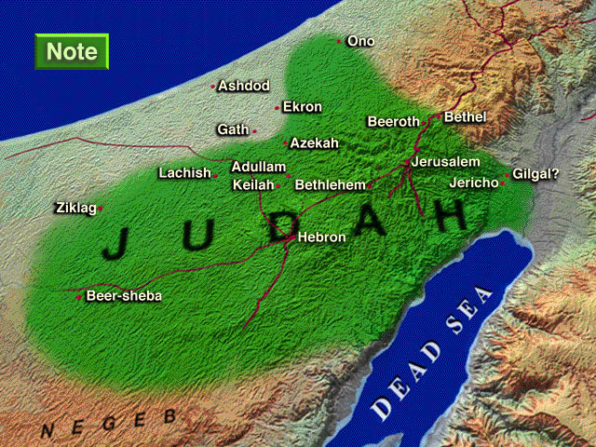
Enemies in Nehemiah's Time
Sanballat the Samaritan
Tobiah the Ammonite
NEHEMIAH
Geshom the Arab
Notes:
4
Map Has Settlements of the Persian Province of Judah According to Ezra and Nehemiah (Logos Libronix Bible Maps, Mac edition, 2008)

Slide 5
The First Challenge to Living above Reproach:
Dangerous Diversion (1-4)

Slide 6
The Plain of Ono

Slide 7
Nehemiah's First Response:
Continued Concentration (3-4)

Slide 8
Some Food for Thought:
What is God calling you to do at this stage in your life?
What people and/or things are distracting you from fulfilling that divine calling?
How will you trust God to help you avoid and eliminate those distractions?

Slide 9
The Second Challenge to Living above Reproach:
Dishonest Defamation (5-7)

Slide 10
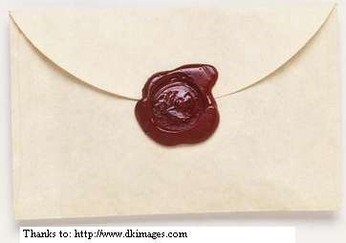
An “Open Letter”

Slide 11
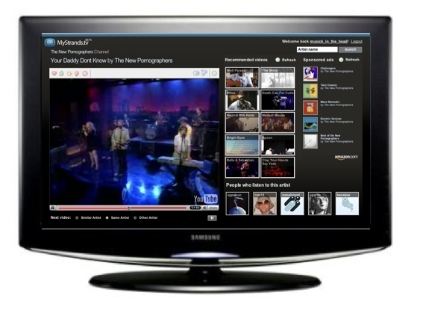
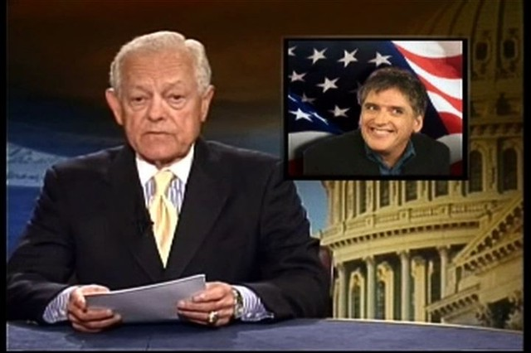
“It has been reported that Nehemiah plans to rebel against the King.”
REBEL LEADER?
Nehemiah

Slide 12
Nehemiah's Second Response:
Courageous Candor (8-9)
The rumor wouldn't stick!

Slide 13
But I prayed, “Now strengthen my hands.”

Slide 14
Some Food for Thought:
Have you ever been defamed and slandered?
Was there any truth to the accusation?

Slide 15
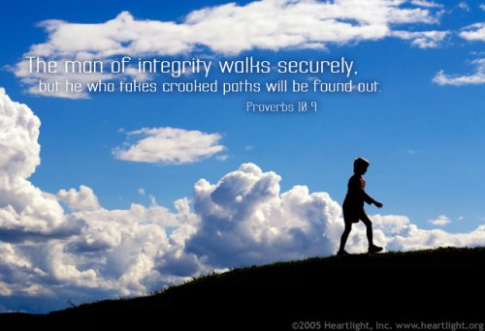

Slide 16
Some Food for Thought:
If you have been slandered unjustly, how did you respond to the challenge?
What might you do differently in light of Nehemiah's example?

Slide 17
Some More Food for Thought:
Have you ever defamed or slandered someone else?
Have you ever passed on a rumor about someone else to others?

Slide 18
The Third Challenge to Living above Reproach:
Deceitful Deception (10)

Slide 19
Nehemiah's Third Response:
Confident Clarity (11-14)

Slide 20
“But you [Aaron] and your sons with you shall attend to your priesthood for everything concerning the altar and inside the veil, and you are to perform service. I am giving you the priesthood as a bestowed service, the outsider who comes near shall be put to death.”
—Numbers 18:7

Slide 21
“Remember, O my God, because of what they have done . . . .”

Slide 22
Some Food for Thought:
Have you ever been encouraged to do something by someone you trusted or thought was godly that you knew was wrong?
What did you do and what might you do differently in light of Nehemiah's example?

Slide 23
Conclusion and Application
Main Idea:
When faced with challenges to your personal integrity, live above reproach by responding with God-centered concentration, courage, and clarity.

Slide 24
Conclusion and Application
Assess your personal life and honestly ask: Is my life truly above reproach?
If not, what specific area or areas of your life might others use against you?
How might Nehemiah's example help you become a person of greater integrity?

Slide 25
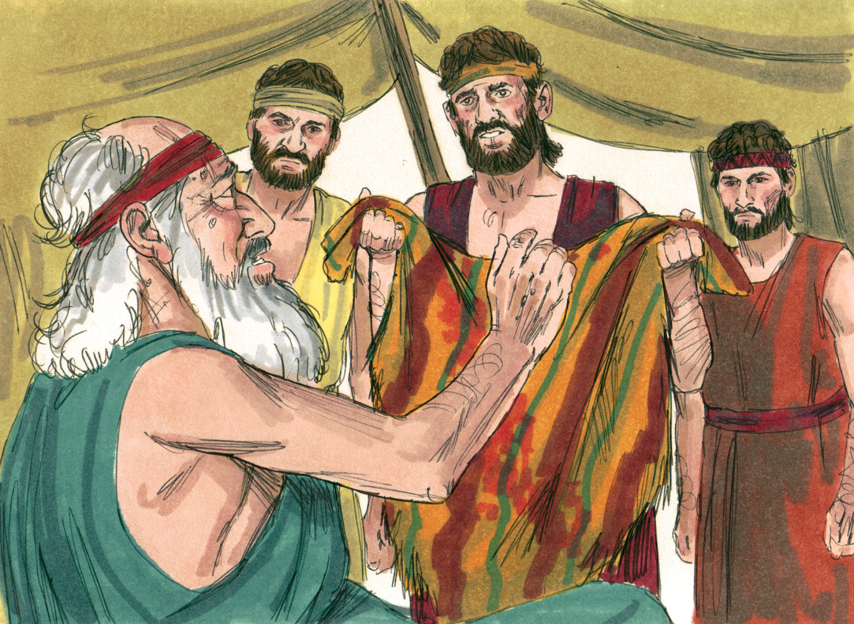
The Story of Joseph's Brothers: Genesis 37, 42-44

Slide 26
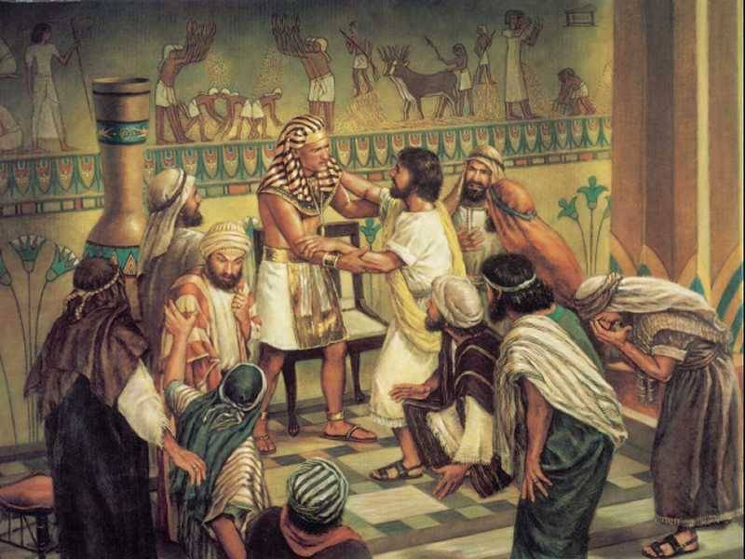
The Story of Joseph's Brothers: Genesis 37, 42-44

