Slide 1
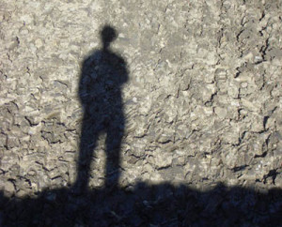
Nehemiah 2:11-20
Restoring God's Honor
Rick Griffith, Crossroads International Church www.biblestudydownloads.com

Slide 2
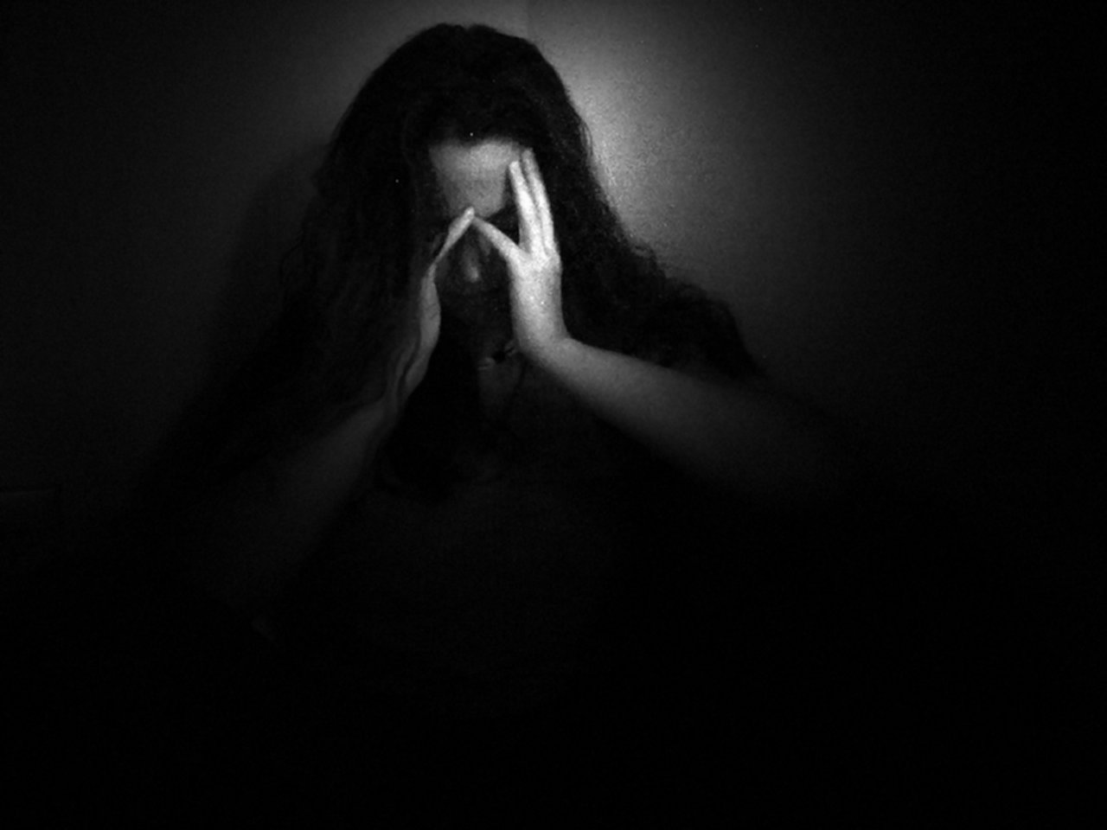
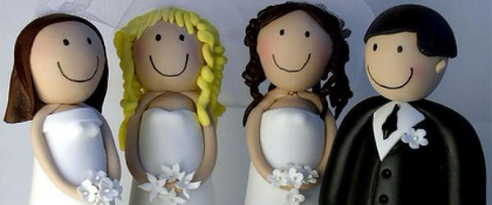
God Dishonored
OMG
"Jesus"
Marriage
Pastors

Slide 3
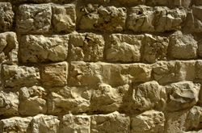
Our Need
How does God restore us?

Slide 4
Our Present Sermon Series
July-October 2013

Slide 5
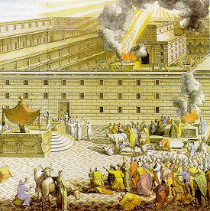
The Postexilic Era
560
The Postexilic Era
Temple work
Prophets:
Haggai
Zechariah
Malachi
605
586
539
536
520
516
483-473
444-425
72 years
Others:
Zerubbabel
Esther
Ezra
Nehemiah
Persian Kings:
Cyrus
Darius
Xerxes
Artaxerxes

Slide 6
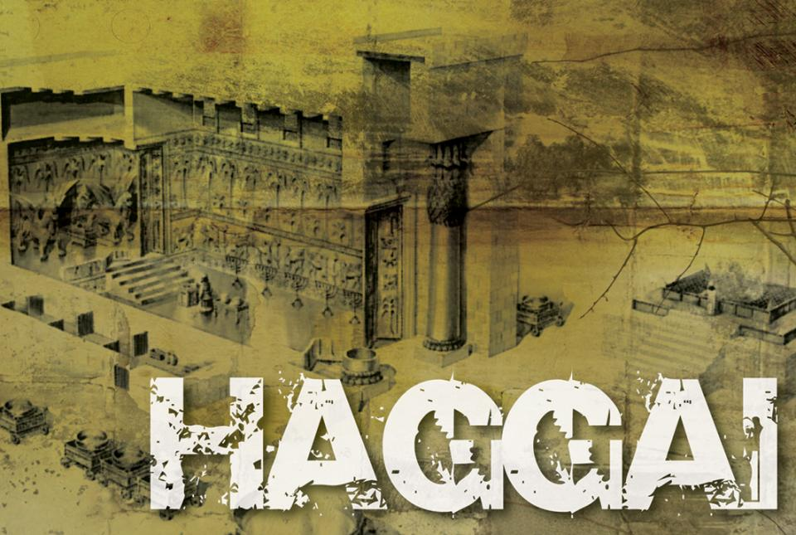
Temple But No Walls

Slide 7
Nehemiah 1:1–2:10 Summary
God reproached!
Notes:
^{4�} When I heard this, I sat down and wept. In fact, for days I mourned, fasted, and prayed to the God of heaven. ^{5�} Then I said,
“O Lord, God of heaven, the great and awesome God who keeps his covenant of unfailing love with those who love him and obey his commands, ^{6�} listen to my prayer! Look down and see me praying night and day for your people Israel. I confess that we have sinned against you. Yes, even my own family and I have sinned! ^{7�} We have sinned terribly by not obeying the commands, decrees, and regulations that you gave us through your servant Moses.
^{8�} “Please remember what you told your servant Moses: 'If you are unfaithful to me, I will scatter you among the nations. ^{9�} But if you return to me and obey my commands and live by them, then even if you are exiled to the ends of the earth, I will bring you back to the place I have chosen for my name to be honored.'
^{10�} “The people you rescued by your great power and strong hand are your servants. ^{11�} O Lord, please hear my prayer! Listen to the prayers of those of us who delight in honoring you. Please grant me success today by making the king favorable to me.* Put it into his heart to be kind to me.”

Slide 8
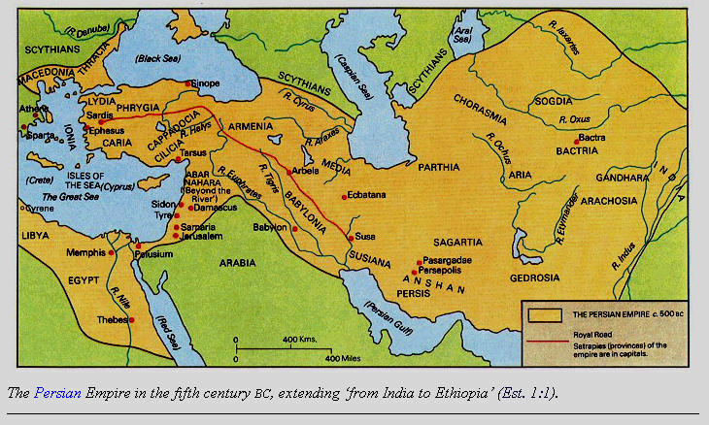
The Persian Empire
^{Susa}
The boundaries of the empire that Cyrus II initiated
and Darius I consolidated stretched from Greece to India

Slide 9
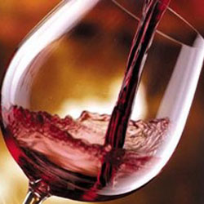
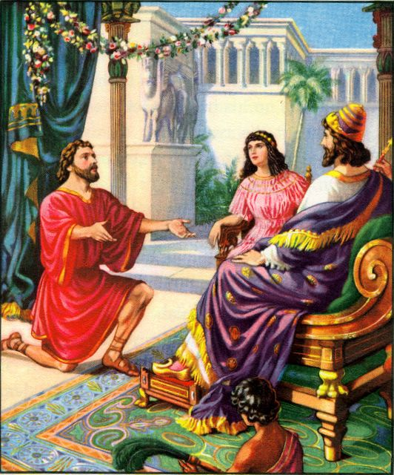
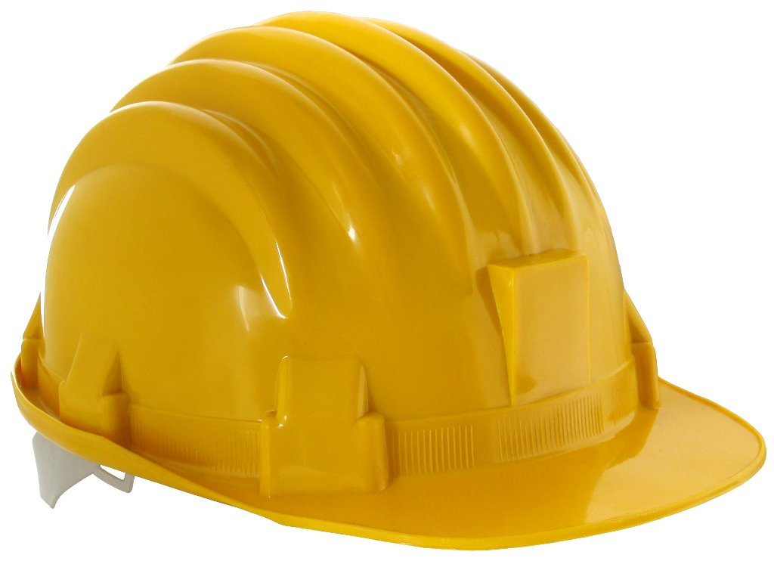
The Cupbearer
Willing to be a foreman
Notes:
IWiersbe also notes, “A cupbearer was much more than our modern 'butler' (see Gen. 40). It was a position of great responsibility and privilege. At each meal, he tested the king's wine to make sure it wasn't poisoned. A man who stood that close to the king in public had to be handsome, cultured, knowledgeable in court procedures, and able to converse with the king and advise him if asked (see 41:1–13). Because he had access to the king, the cupbearer was a man of great influence, which he could use for good or for evil.” “That Nehemiah, a Jew, held such an important position in the palace speaks well of his character and ability (Dan. 1:1–4). For nearly a century, the Jewish remnant had been back in their own land, and Nehemiah could have joined them; but he chose to remain in the palace. It turned out that God had a work for him to do there that he could not have accomplished elsewhere. God put Nehemiah in Susa just as He had put Esther there a generation before, and just as He had put Joseph in Egypt and Daniel in Babylon. When God wants to accomplish a work, He always prepares His workers and puts them in the right places at the right time.”
Ibid.

Slide 10
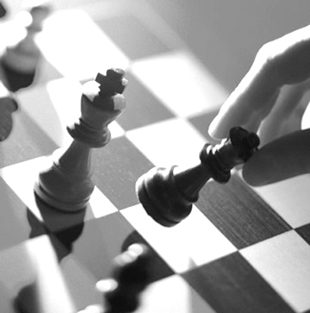
Key Idea of Nehemiah 1
God gives you the
information, vision, & position
KNOW THE FACTS
vision
you need to do His will.

Slide 11
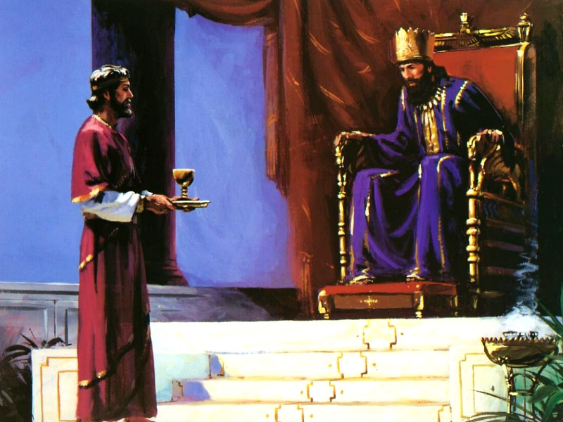
Nehemiah 2:1-10 Key Idea
God gives us a burden to make unconventional requests.

Slide 12
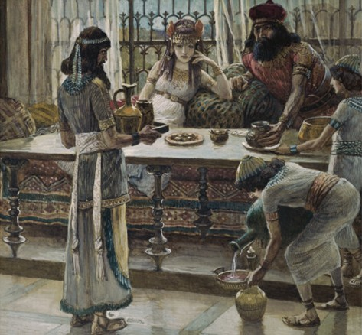
Nehemiah 2:1-10 Key Idea
God also prepares others to grant our requests.

Slide 13
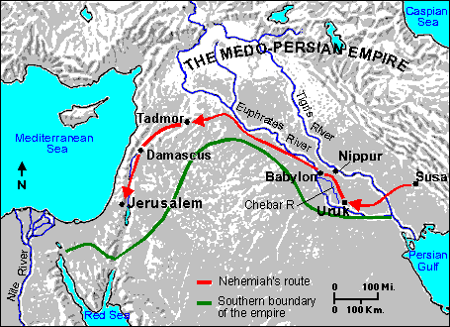
Nehemiah's Journey

Slide 14
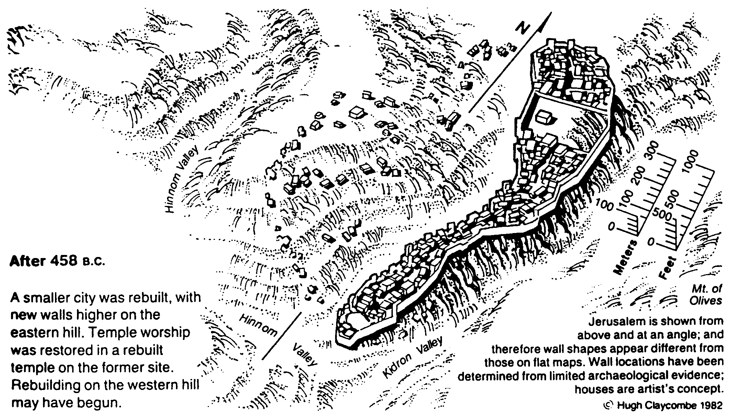
Jerusalem of the Returning Exiles
Bible Visual Resource Book, 99; Gene Getz, Nehemiah,” in Bible Knowledge Commentary, 1:679

Slide 15
How does God restore us?
(3 ways)

Slide 16
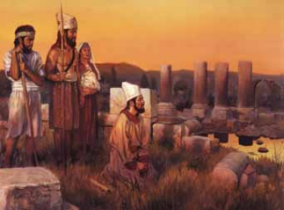
I. God informs us of our sad state of affairs (2:11-15).

Slide 17
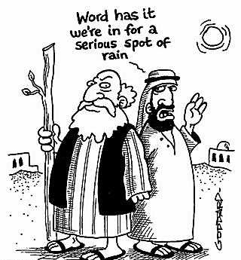
God gives us the information we need to do His will (1:1-3).
Word has it we're in for a serious spot of rain

Slide 18
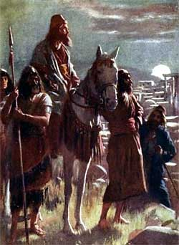
¹¹I went to Jerusalem, and after staying there three days ¹²I set out during the night with a few men. I had not told anyone what my God had put in my heart to do for Jerusalem. There were no mounts with me except the one I was riding on.

Slide 19
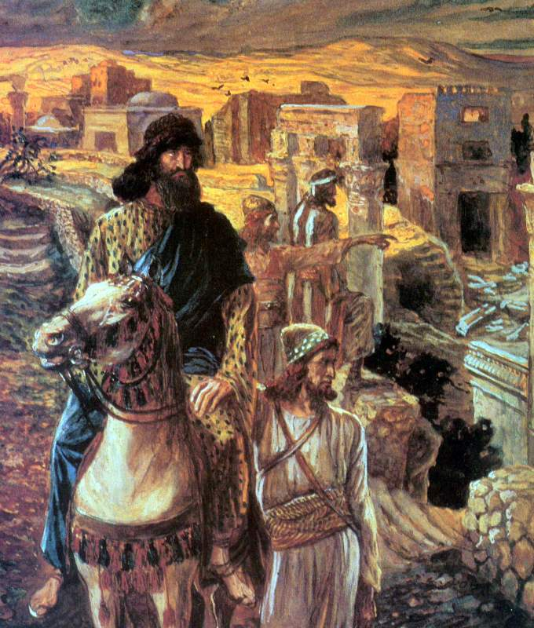
¹³By night I went out through the Valley Gate toward the Jackal Well and the Dung Gate, examining the walls of Jerusalem, which had been broken down, and its gates, which had been destroyed by fire.

Slide 20
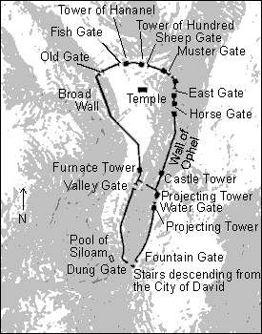
Surveying the wall at night
¹⁴Then I moved on toward the Fountain Gate and the King's Pool, but there was not enough room for my mount to get through; ¹⁵so I went up the valley by night, examining the wall. Finally, I turned back and reentered through the Valley Gate.

Slide 21
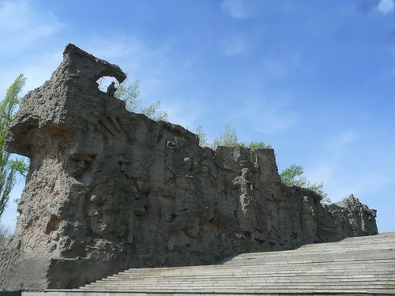
God is beginning to restore us by showing us our true situation at Crossroads
Revolving door
Busy folks
Part-time
Separations

Slide 22
I. God informs us of our sad state of affairs (2:11-15).

Slide 23
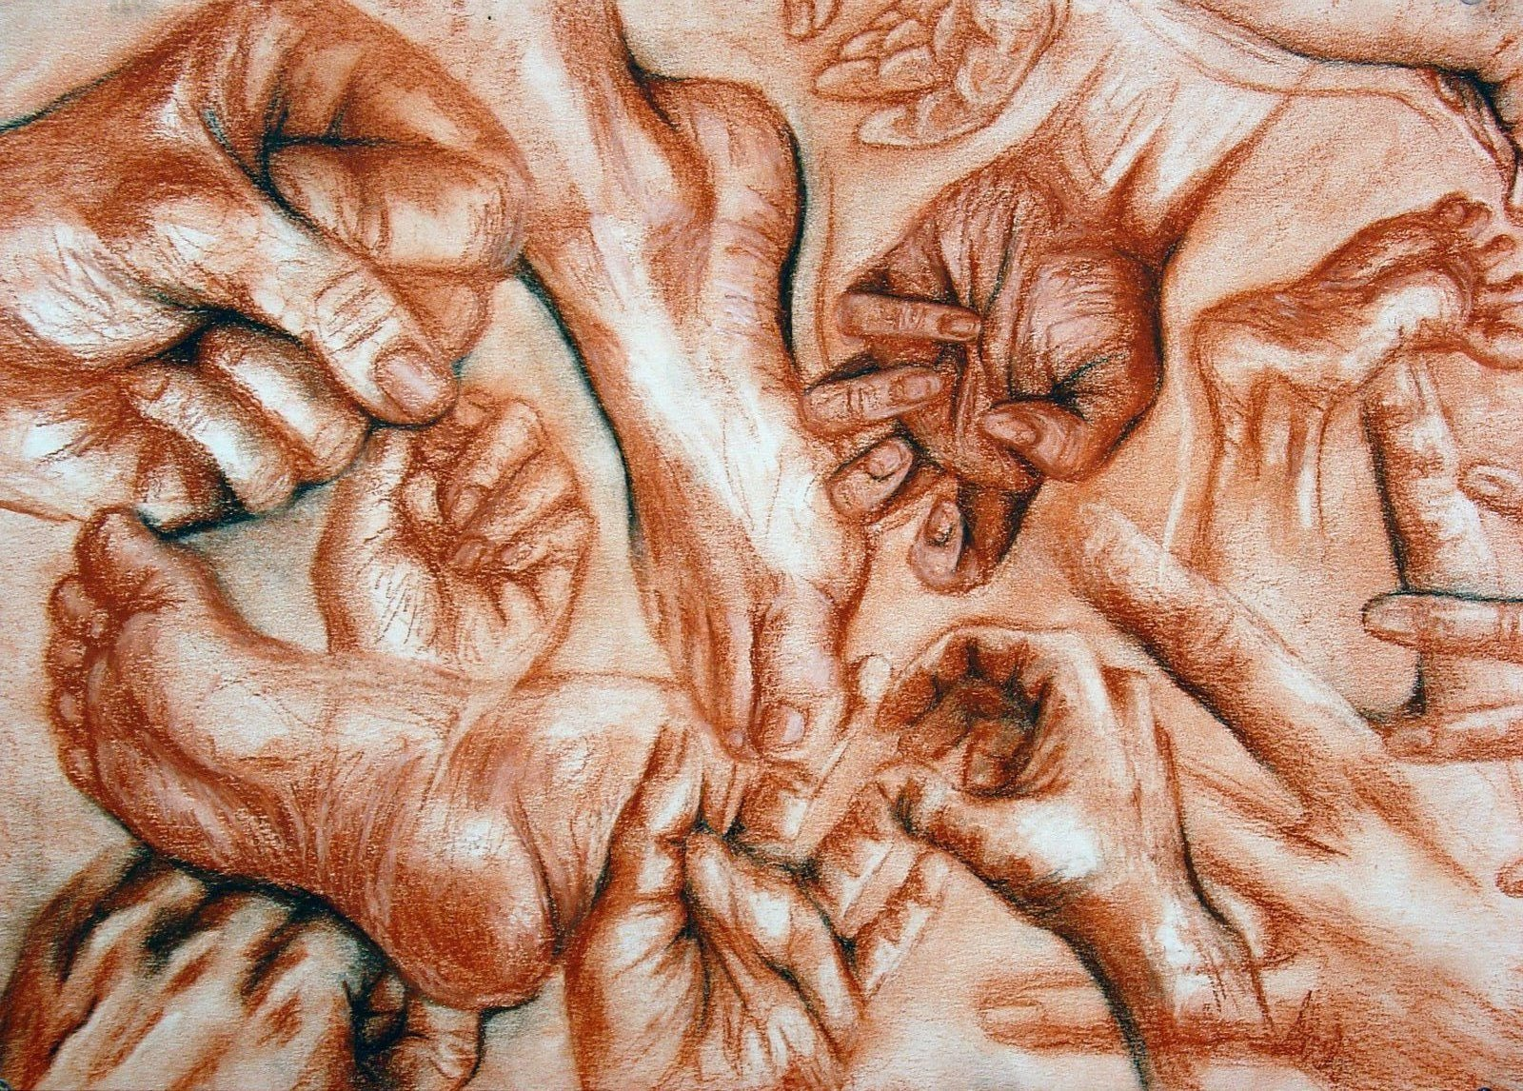
II. God rallies us to honor his name once again (2:16-18).
HANDS & FEET

Slide 24
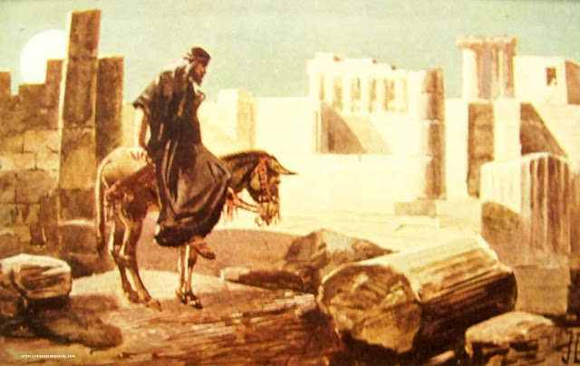
¹⁶The officials did not know where I had gone or what I was doing, because as yet I had said nothing to the Jews or the priests or nobles or officials or any others who would be doing the work.

Slide 25
¹⁷Then I said to them, "You see the trouble we are in: Jerusalem lies in ruins, and its gates have been burned with fire. Come, let us rebuild the wall of Jerusalem, and we will no longer be in disgrace." ¹⁸I also told them about the gracious hand of my God upon me and what the king had said to me. They replied, "Let us start rebuilding." So they began this good work.

Slide 26
God is raising up new leaders among us to honor him
Lewis––central home group
Leland––Man2Man director
David—Worship (+Athan+Singpu)
Susan—Ladies Bible Study
Linda—Retreat (+Sénéchals)
Valentin—treasurer
Kim, Chanchan, Yaopei—kids
Notes:
What knowledge, faith, and place of influence has He given you? What does God want you to do with it? What burden has the Lord placed on your heart? Soul care? How can we help you achieve this vision so you have all you need to do His will

Slide 27
I. God informs us of our sad state of affairs (2:11-15).

Slide 28
II. God rallies us to honor his name once again (2:16-18).
HANDS & FEET

Slide 29
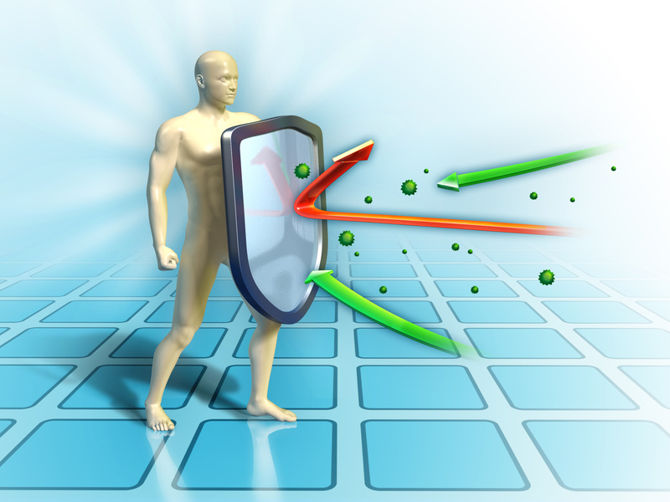
III. God defends us against potential setbacks (2:19-20).

Slide 30
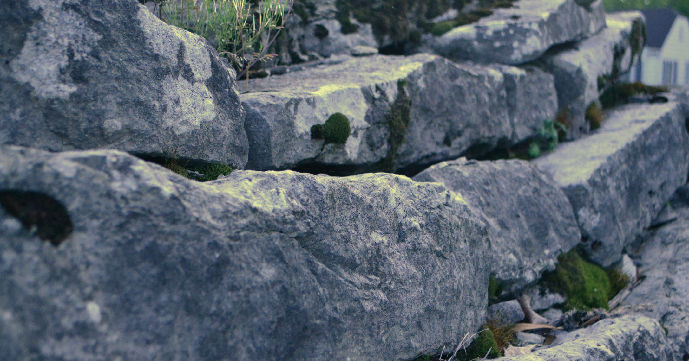
¹⁹But when Sanballat the Horonite, Tobiah the Ammonite official and Geshem the Arab heard about it, they mocked and ridiculed us. "What is this you are doing?" they asked. "Are you rebelling against the king?

Slide 31
²⁰I answered them by saying, "The God of heaven will give us success. We his servants will start rebuilding, but as for you, you have no share in Jerusalem or any claim or historic right to it."

Slide 32
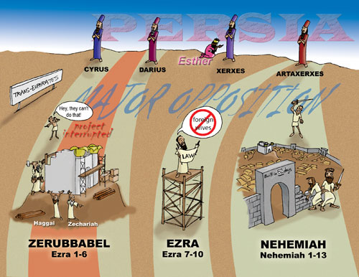
The Historical Context of Opposition

Slide 33
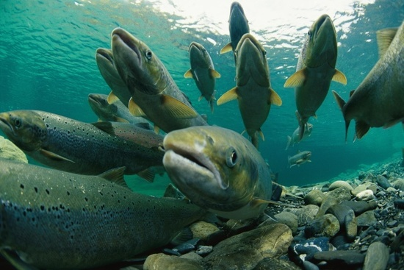
Salmon Seek to Spawn
Notes:
Play Life Cycle of Salmon (Discovery Channel)
http://www.youtube.com/watch?v=5DqjsWsY8-g

Slide 34
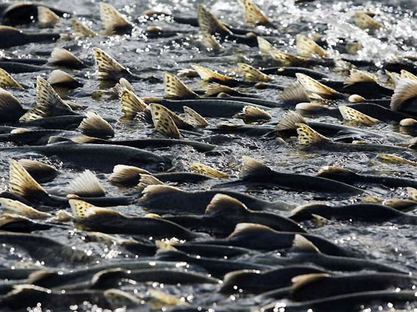
Millions start the journey
Notes:
Many have started the journey with us at our church…

Slide 35
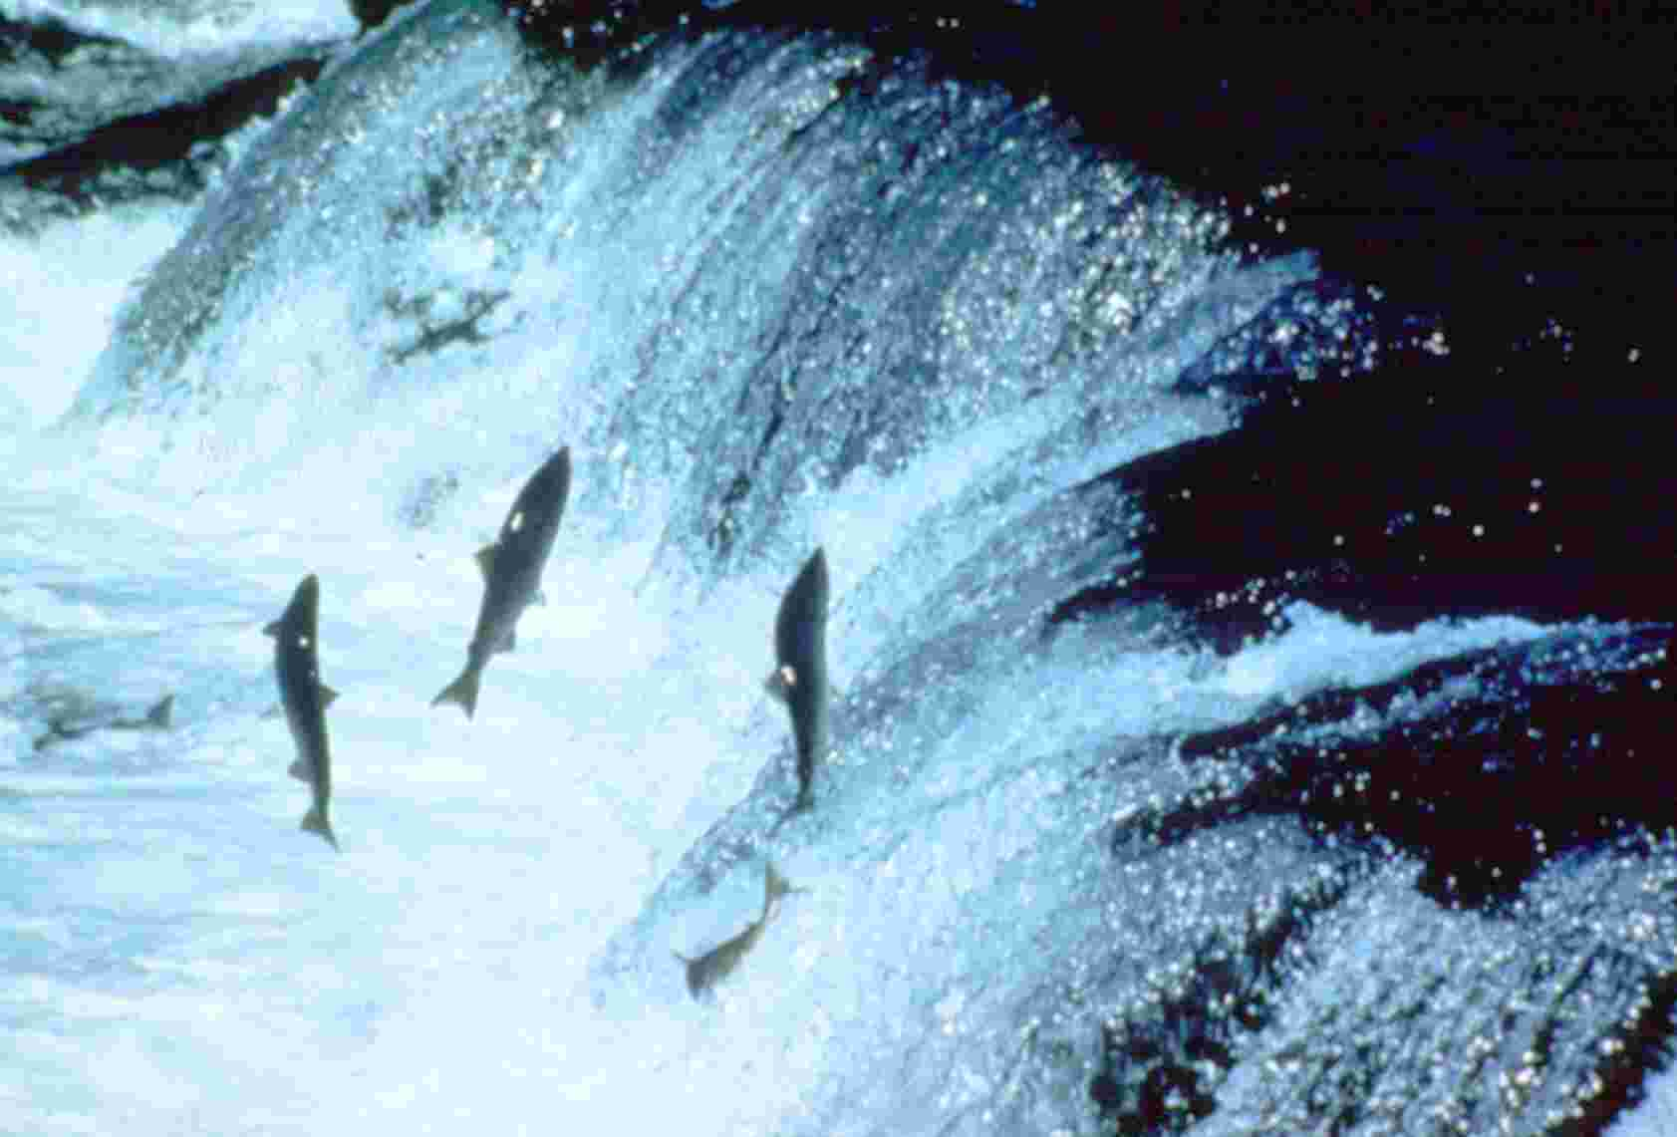
Upstream swim
Notes:
But establishing a church is no small task––an upstream swim!

Slide 36
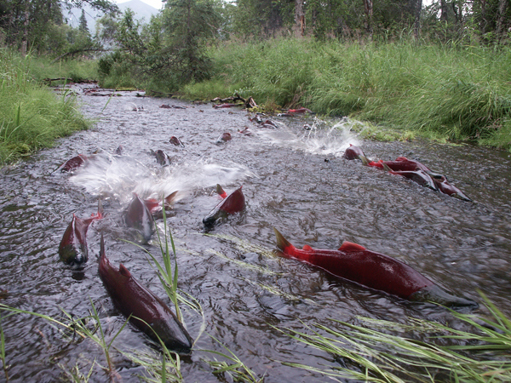
Shallow waters
Notes:
Sometimes we come across lean times financially and in personnel and morale

Slide 37
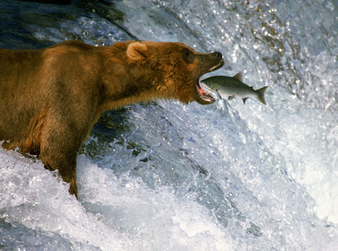
Predators
Notes:
Our enemies sometimes snatch members who leave as they marry outside the faith or become disillusioned

Slide 38
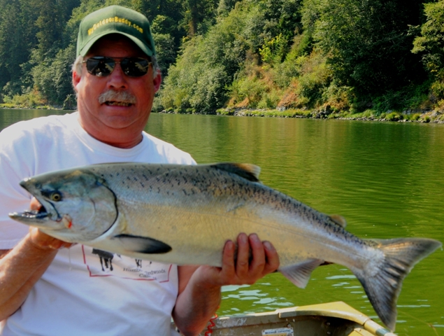
Predators
Notes:
Often those predators are well-meaning people

Slide 39
Does God lay out the red carpet for us?
Ah, no…
Notes:
Where did we get the idea that God lays out the red carpet for us?

Slide 40
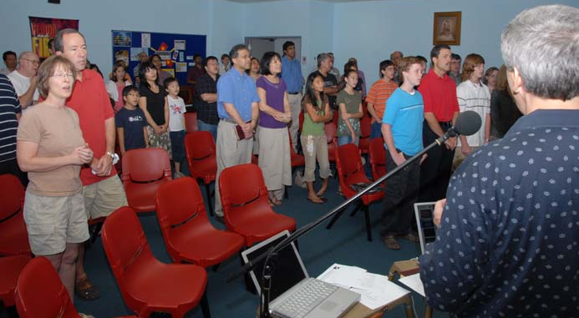
First Worship Service 19 November 2006

Slide 41
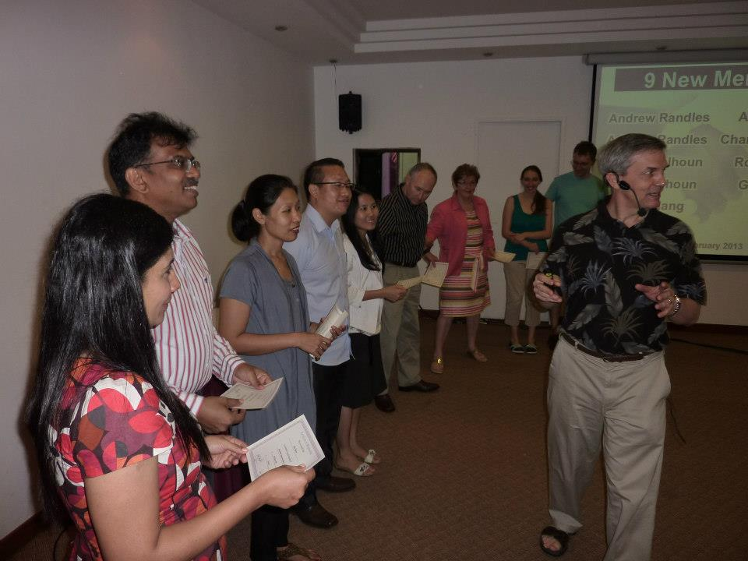
9 New Members on 24 Feb 2013

Slide 42
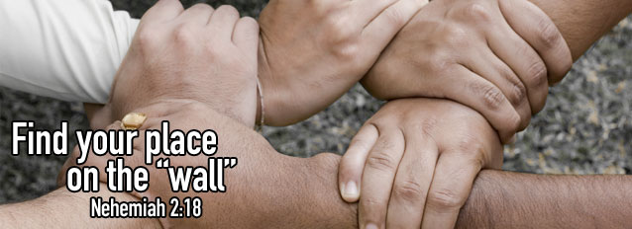
Find Your Place
These 16 began attending in 2013…
Leland and Linda, Robert & Geeta, Athan & Chanchan, Samuel & Eunice, Brad & Veronica, Christina, Kim, Amos, Yaopei, Doris, David

Slide 43
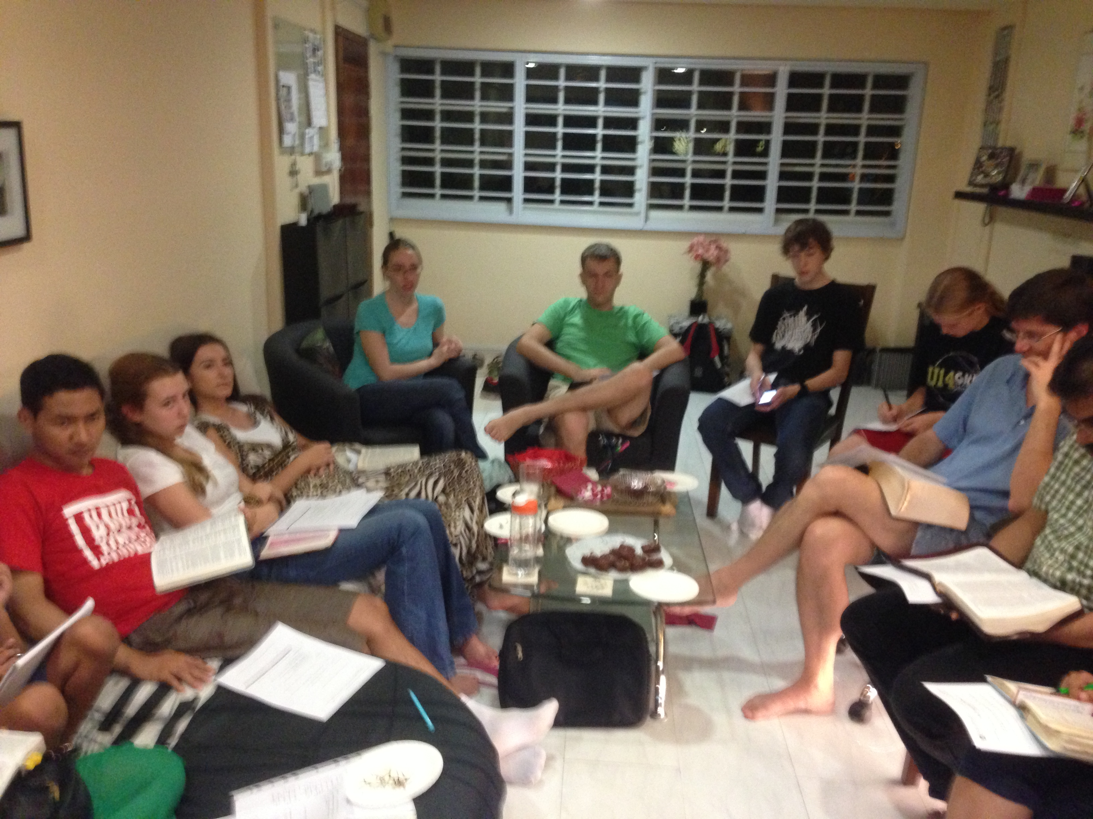
Home Group THIS Friday 7:30 PM!

Slide 44
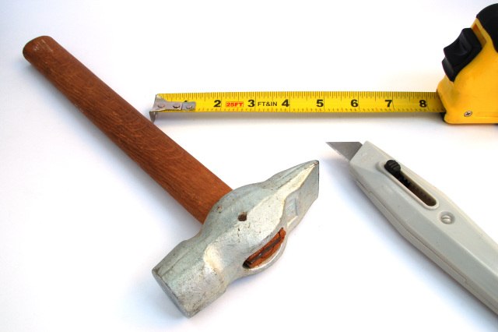
God provides all we need to honor Him (Main Idea)

Slide 45
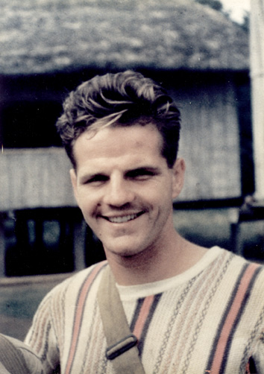
"The world has yet to see what God can do with a man fully surrendered" – Jim Elliot –

Slide 46
How does God restore us?
He informs • rallies • defends us

Slide 47
What tools has God given you to restore our church?

