Slide 1
Be Patient
Nahum
Dr. Rick Griffith • Crossroads International Church Singapore
BibleStudyDownloads.org

Slide 2
Sequels
Notes:
Sequels are great as they finish stories that we’ve heard.
Hollywood has us hooked—a movie always ends without a real ending, which makes you want to see what happens next, right? So it continues into parts 2 and then 3.
• The Bourne series has three movies. Ice Age had a sequel in Ice Age 2, followed by a sequel-to-the-sequel in Ice Age 3. The same was true for the Star Wars Trilogy, Jaws, and many others

Slide 3
Major Messages, Minor Prophets
God’s Old Message for Our New Day
Notes:
In recent weeks, we have covered five of the 12 Minor Prophets.

Slide 4
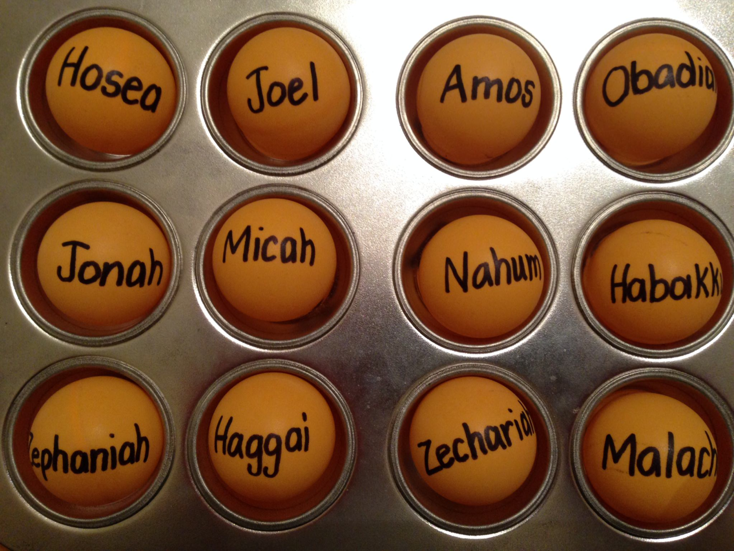
Be...
Loyal
Just
Humble
Caring
Generous
Notes:
So far we have seen 5 “Be” titles:
• Humble—Obadiah taught us not to be proud like the Edomites. Instead, be humble.
• Caring—Jonah warned that God cared for Nineveh, so we also should be caring.
• Just—Amos said that God was just, so we should be just.
• Loyal—Hosea was a great example of God’s loyalty to Israel, so we should be loyal to him.
• Generous—Micah defended the poor as God does, so we also should be generous.

Slide 5
The Nineveh Metropolis
602
Rehoboth Ir
Size of Singapore
Nineveh Proper
The Great City of Nineveh
Resen
Calah
Genesis 10:11-12
0
kilometers
20
Notes:
That second study was on Jonah. Nineveh was the super-city of antiquity, composed of four cities combined (cf. Gen. 10:11-12).
____________
There's a problem here regarding the three-day's journey (cf. OTS, 602). Nineveh's inner wall was less than eight miles, so the diameter of the city was only two miles—hardly a three-day journey. One day's journey in the open was usually 15-20 miles (Hannah, BKC, 1:1463).
But this isn't really a problem in either of two ways:
"The great city of Nineveh" (1:2; 3:2; cf. 4:11) almost surely included three other towns in the vicinity as well. Four cities (Nineveh, Rehoboth Ir, Calah, and Resen) are mentioned in Genesis 10:11-12 as "the great city" and they still exist today with different names (Kouyunjik, Khorsbad, Nimroud, and Karamles). This can be observed on this map by Austin Henry Layard, Nineveh and Its Remains, 2:40.
If we superimpose a map of Singapore over it, we can see that walking through Nineveh would be like walking in Singapore from the far north in Yishun to Harbourfront in the south. That could take 3 days easily—especially when stopping to preach along the way.
5

Slide 6
Jonah God's Reluctant Prophet
Notes:
Jonah at first was the reluctant prophet

Slide 7
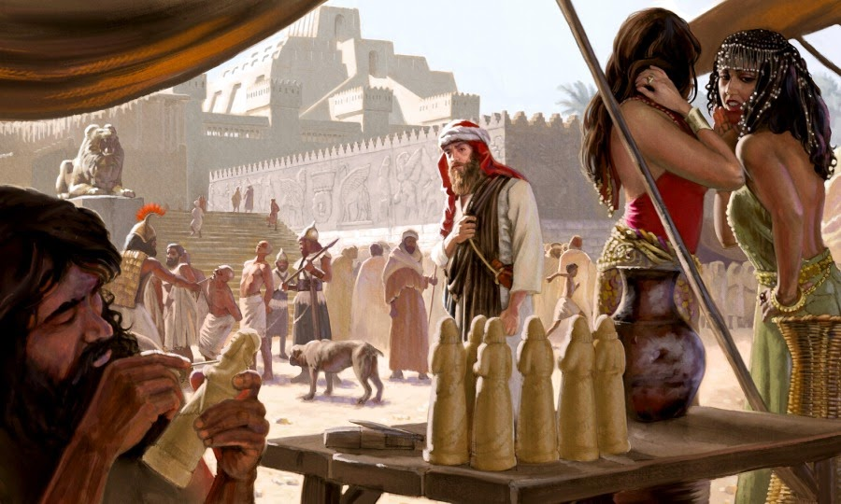
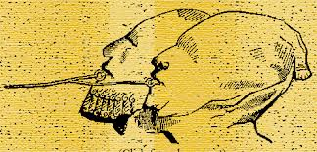
Jonah Wicked Nineveh
Notes:
You can't blame him, in that Nineveh was the epitome of idolaty, immorality, injustice, and torture!

Slide 8
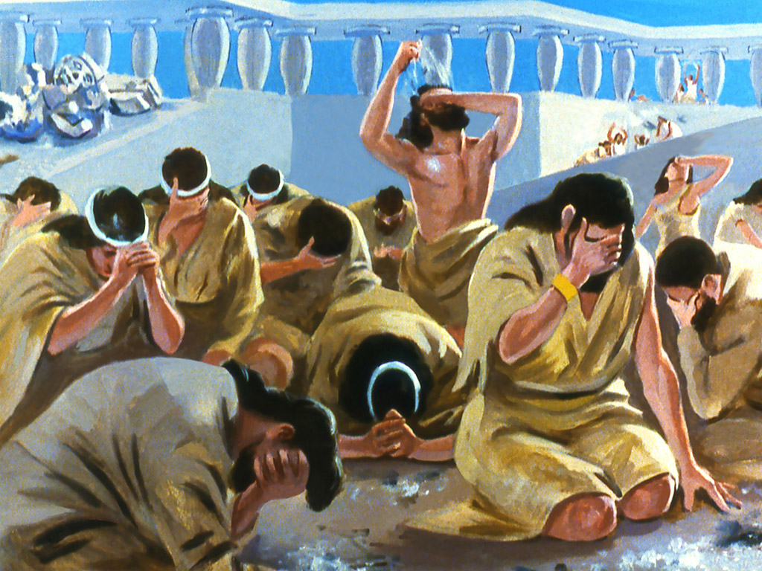
Jonah Amazing Repentance of Nineveh
Notes:
When we studied Jonah we saw at the end that Nineveh repented, God relented…

Slide 9
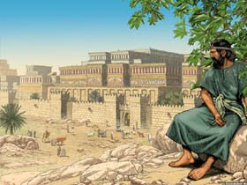
Jonah Waiting for Judgment
So what happened afterwards?
Notes:
…and Jonah resented! So whatever happened to Jonah and Nineveh?
We left Jonah pouting—but what ever happened to him? Well, we just don’t know! The Bible doesn’t say.

Slide 10
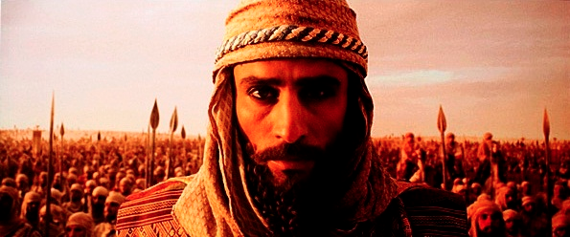
A Prophetic Word for a Day of Military Might
Notes:
But what happened to Nineveh? The Bible does tell us where the city was at spiritually 100 years later—

Slide 11
Placing the Prophets
342
Placing the Prophets
Key Dates
931
Obadiah
722
Jonah
Amos
Hosea
Isaiah
Micah
Nahum
586
Notes:
Four other prophets had preached but…

Slide 12
The Assyrian Threat
Assyrian Expansion
Nineveh
Mediterranean
Sea
Syria
Israel
Judah
Persian
Gulf
Egypt
Notes:
Nineveh repented 100 years earlier under Jonah, but then went back to its sin.
Assyrians invaded Israel 60 years earlier and scattered the people.
Then they destroyed 46 towns of Judah—all but Jerusalem!

Slide 13
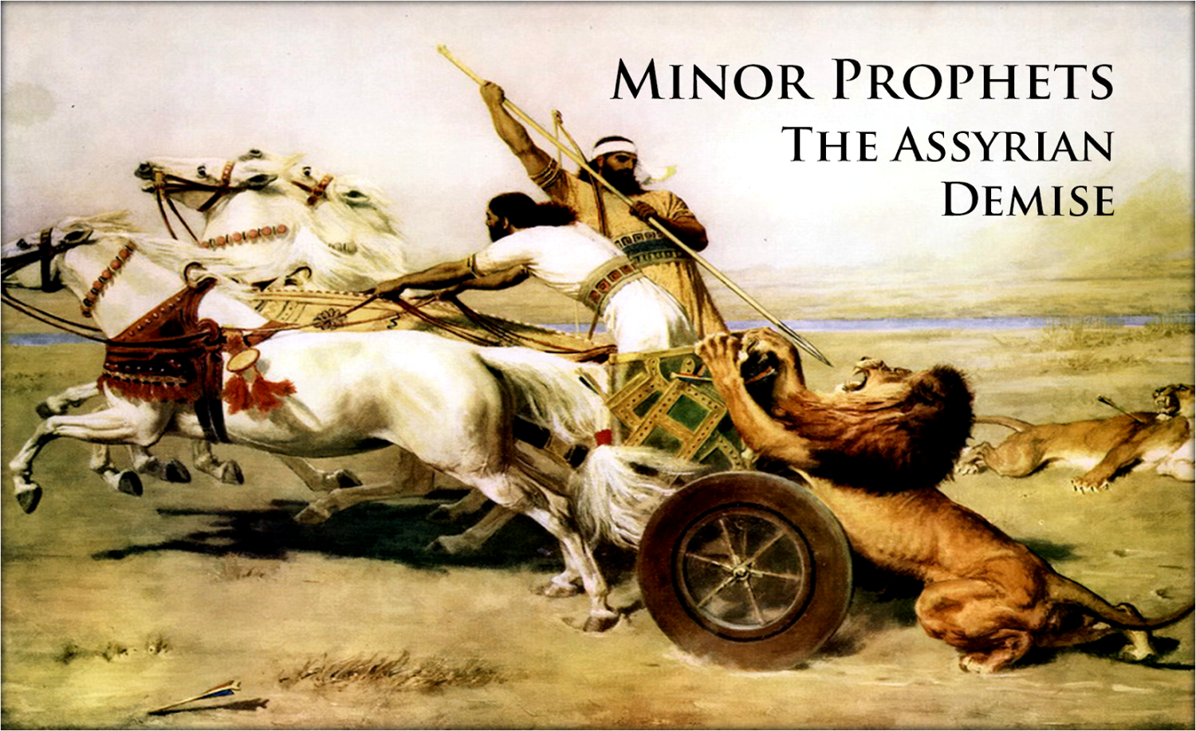
What would God do with short-lived repentance?
Notes:
Would God do anything about this? What happens when repentance is short-lived?

Slide 14
The Incredible Patience of God
Notes:
Today we will study the incredible patience of God, which is the title of a book by Charles Stanley.

Slide 15
What mistake do we too often make about God’s patience?
Notes:
We’ll answer this question: what mistake do we too often make about God’s patience?

Slide 16
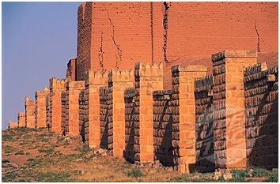
The Sequel to Jonah
Notes:
Our text is the sequel to Jonah called Nahum. It tells us Nineveh’s fate.

Slide 17
100 Years Later…
ASSYRIA
Tiglath-Pilesar
Assyria Strong
Jonah 760
Nahum 660
Nineveh's Fall 612
Israel's Fall 722
1100
900
850
800
750
700
650
600
Nineveh's Relapse
Notes:
Nineveh was weak in Jonah’s time, but then grew incredibly strong 100 years later once again. But how strong? What was next on God’s calendar?

Slide 18
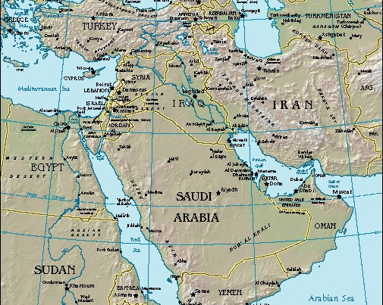
Nahum
Nineveh
Today's Study:
I. Nineveh's Future
II. Our Future
Notes:
Today we will see what would happen to Nineveh, then what will happen in our future too.
And what is that fate? Nahum tells us that…

Slide 19
Barry Huddleston, The Acrostic Summarized Bible (Grand Rapids: Baker, 1992)
I. God would destroy Nineveh but save Judah (Nahum 1–3).
1 God’s character and judgment
2 Overthrow of Nineveh imminent
3 Details of Nineveh’s judgment
Nahum
Notes:
The capital of Assyria would have capital punishment for its capital crimes, yet the southern kingdom of Israel could gain comfort from this as the LORD would preserve them.

Slide 20
Book Chart
621
Nahum: Nineveh's Destruction
Certain |  |  |  | Detailed |  | Justified
Nahum 1 |  |  |  | Nahum 2 |  | Nahum 3
Destruction Decreed |  |  |  | Destruction Described |  | Destruction Deserved
Verdict of Vengeance |  |  |  | Vision of Vengeance |  | Vindication of Vengeance
What God Will Do |  |  |  | How God Will Do It |  | Why God Will Do It
God's Anger |  |  |  | God's Actions |  | God's Accusations
God's Predictions for Judah |  |  |  | God's Power for Judah |  | God's Justice for Judah
Title 1:1 | God's Attributes 1:2-8 | Plotting Against God 1:9-11 | Destruction is Judah's Deliverance 1:12-15 | Battling vs. Judah's Splendor 2:1-2 | Destruction & Despoiling 2:3-13 | Destruction for Cruelty 3:1-7 | Drunk When Destroyed 3:3-11 | Burned With Fire 3:12-19
In Judah Against Assyria's Capital, Nineveh
c. 660 BC
Notes:
Nineveh’s judgment is certain, so Judah could feel secure (Ch. 1).

Slide 21
Slides on Nahum 1
Notes:
God’s attributes assure Judah (1:2-8).

Slide 22
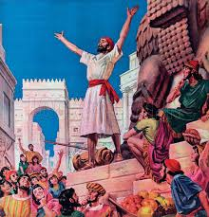
Nahum 1:1 (NLT)
623
"This message concerning Nineveh came as a vision to Nahum, who lived in Elkosh"

Slide 23
God is Just: Nahum 1:2-3
623
"The LORD is a jealous God, filled with vengeance and rage. He takes revenge on all who oppose him and continues to rage against his enemies!
³The LORD is slow to get angry, but his power is great, and he never lets the guilty go unpunished. He displays his power in the whirlwind and the storm. The billowing clouds are the dust beneath his feet" (NLT).
Notes:
God is just—so Nineveh won’t go unpunished (1:2-3).

Slide 24
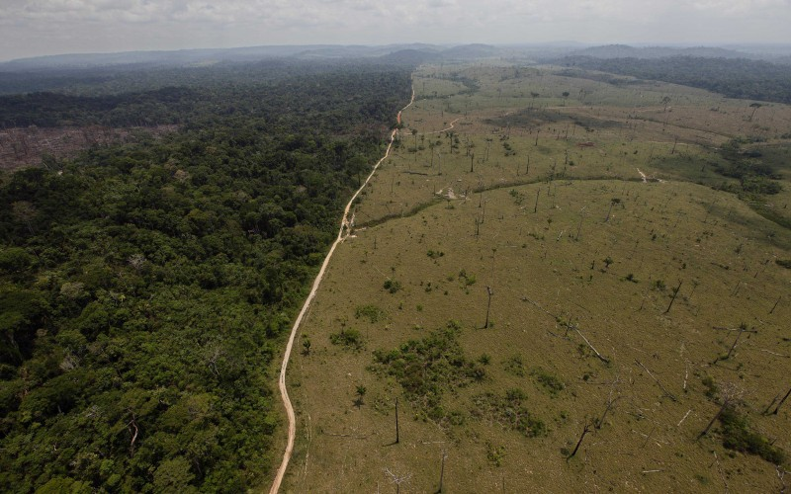
God is All Powerful: Nahum 1:4
623
"At his command the oceans dry up,
and the rivers disappear.
The lush pastures of Bashan and Carmel fade,
and the green forests of Lebanon wither" (NLT).
Notes:
God is all-powerful—so he can handle Nineveh (1:4-6).

Slide 25
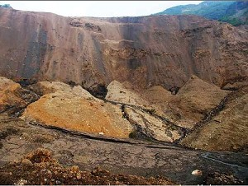
God is All Powerful: Nahum 1:5-6
623
"In his presence the mountains quake,
and the hills melt away;
the earth trembles,
and its people are destroyed.
⁶Who can stand before his fierce anger?
Who can survive his burning fury?
His rage blazes forth like fire,
and the mountains crumble to dust in his presence" (NLT).
Notes:
God is all-powerful—so he can handle Nineveh (1:4-6).

Slide 26
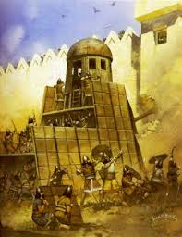
God is Good: Nahum 1:7
623
"The LORD is good, a strong refuge when trouble comes. He is close to those who trust in him" (NLT).
Notes:
God is good—so he will be loyal to Judah (1:7-8).

Slide 27
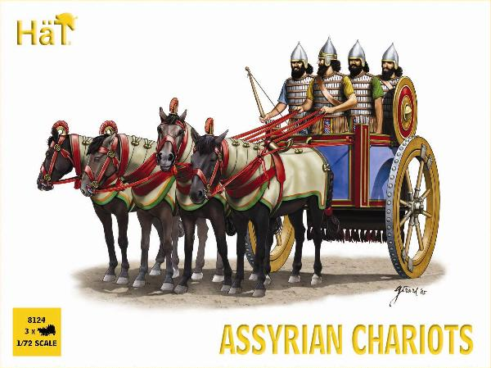
Assyrian Chariots

Slide 28
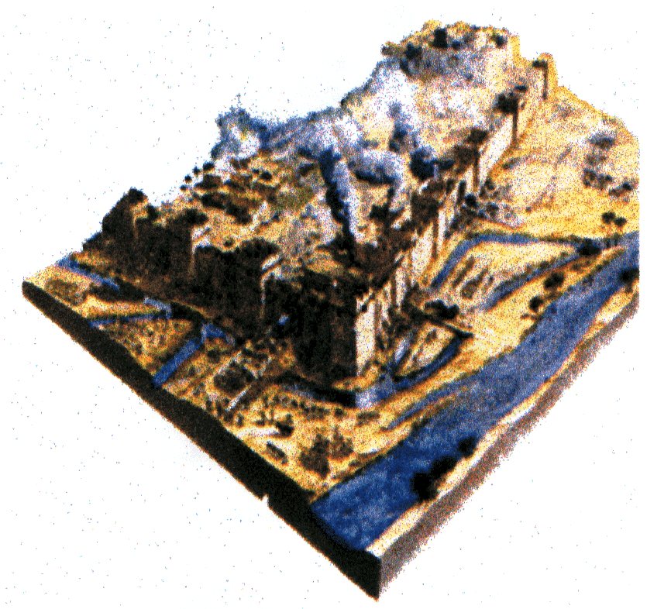
God is Good: Nahum 1:8
623
"But he will sweep away his enemies in an overwhelming flood. He will pursue his foes into the darkness of night" (NLT).

Slide 29
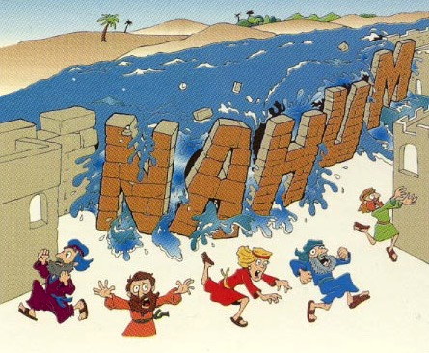
"Flood"
Nahum
Nahum 1:8
Walk Through The Bible ©1989

Slide 30
"Why are you scheming against the LORD? He will destroy you with one blow; he won’t need to strike twice! ¹⁰His enemies, tangled like thornbushes and staggering like drunks, will be burned up like dry stubble in a field" (Nahum 1:9-10 NLT).
Notes:
Nineveh will plot against God the last time (1:9-11).

Slide 31
Nahum's Prophecies Happened
625
Nahum's Prophecies | Historical Fulfillments
"From you, O Nineveh, has one come forth who plots evil against the LORD and counsels wickedness…” (1:11-12) | Sennacherib made arrogant threats in 701 BC against Judah and Jerusalem (cf. 2 Kings 18–19).
"Now I will break their yoke from your neck and tear your shackles away” (1:13) | Judah's service to Assyria ended at Nineveh's demise (2 Kings 18:14; 2 Chron. 33:11).
Hobart E. Freeman, An Introduction to the Old Testament Prophets (Chicago: Moody Press, 1977).

Slide 32
Nahum's Prophecies Happened
625
Nahum's Prophecies | Historical Fulfillments
12. Nineveh's destruction would be final (1:9,14) | 12. Many cities of the ancient Near East were rebuilt after being destroyed (e.g., Samaria, Jerusalem, Babylon) but not Nineveh.
Elliott E. Johnson, “Nahum,” in The Bible Knowledge Commentary (Colorado Springs: SP Pub., 1985), 1:1495.
Notes:
1:9 "Whatever they plot against the LORD
he will bring to an end;
trouble will not come a second time" (NIV)
1:14 "And this is what the LORD says concerning the Assyrians in Nineveh:
“You will have no more children to carry on your name.
I will destroy all the idols in the temples of your gods.
I am preparing a grave for you
because you are despicable!” (NLT)

Slide 33
Nahum's Prophecies Happened
625
Nahum's Prophecies | Historical Fulfillments
11. Nineveh’s images and idols would be destroyed (1:14). | 11. The statue of the goddess Ishtar lay headless in the debris of Nineveh’s ruins (“The British Museum Excavations on the Temple of Ishtar at Nineveh, 1930-1,” Annals of Archaeology and Anthropology 19, pp. 55-56).
Elliott E. Johnson, “Nahum,” in The Bible Knowledge Commentary (Colorado Springs: SP Pub., 1985), 1:1495.
Notes:
1:14 "And this is what the LORD says concerning the Assyrians in Nineveh:
“You will have no more children to carry on your name.
I will destroy all the idols in the temples of your gods.
I am preparing a grave for you
because you are despicable!” (NLT)

Slide 34
"Look! A messenger is coming over the mountains with good news! He is bringing a message of peace. Celebrate your festivals, O people of Judah, and fulfill all your vows, for your wicked enemies will never invade your land again. They will be completely destroyed!" (Nahum 1:15 NLT).
Notes:
Nineveh's destruction will bring peace to Judah (1:12-15).

Slide 35
Theology of Nahum
God as Sovereign King
God rules the universe. He controls both nature and nations, judging them and using them as instruments of judgment by His will. Not even mighty Assyria, earth's superpower in Nahum's day, could withstand the LORD's judgment. The LORD would destroy Nineveh's idols (1:14), showing His sovereignty over the Assyrian gods.

Slide 36
Theology of Nahum
God as Warrior
The LORD is Divine Warrior par excellence. The book begins with a terrifying portrayal of the angry, avenging warrior in a storm frightening all of nature with His battle cry (1:2-6). In these verses, Nahum used many of the same words used by Assyrian kings to describe their prowess and exploits in battle. This emphasized that the LORD, not Assyria's king, was the most powerful warrior. The "LORD Almighty," or "LORD of Armies," personally announced He would defeat Nineveh (2:13; 3:5).

Slide 37
Book Chart
621
Nahum: Nineveh's Destruction
Certain |  |  |  | Detailed |  | Justified
Nahum 1 |  |  |  | Nahum 2 |  | Nahum 3
Destruction Decreed |  |  |  | Destruction Described |  | Destruction Deserved
Verdict of Vengeance |  |  |  | Vision of Vengeance |  | Vindication of Vengeance
What God Will Do |  |  |  | How God Will Do It |  | Why God Will Do It
God's Anger |  |  |  | God's Actions |  | God's Accusations
God's Predictions for Judah |  |  |  | God's Power for Judah |  | God's Justice for Judah
Title 1:1 | God's Attributes 1:2-8 | Plotting Against God 1:9-11 | Destruction is Judah's Deliverance 1:12-15 | Battling vs. Judah's Splendor 2:1-2 | Destruction & Despoiling 2:3-13 | Destruction for Cruelty 3:1-7 | Drunk When Destroyed 3:3-11 | Burned With Fire 3:12-19
In Judah Against Assyria's Capital, Nineveh
c. 660 BC
Notes:
Nineveh’s judgment is detailed to show Judah that God will protect them (Ch. 2).

Slide 38
Slides on Nahum 2

Slide 39
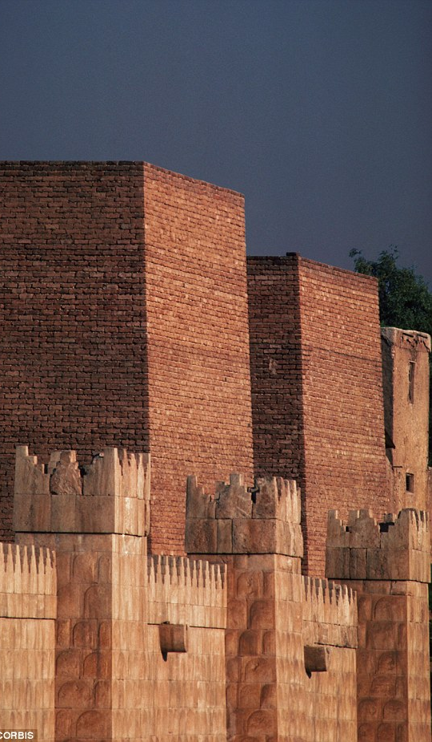
"Your enemy is coming to crush you, Nineveh. Man the ramparts! Watch the roads! Prepare your defenses! Call out your forces! ²Even though the destroyer has destroyed Judah, the LORD will restore its honor. Israel’s vine has been stripped of branches, but he will restore its splendor" (Nahum 2:1-2 NLT).
Notes:
Attacked: Nineveh should prepare for battle because God considers Judah's splendor a “done deal” (2:1-2).

Slide 40
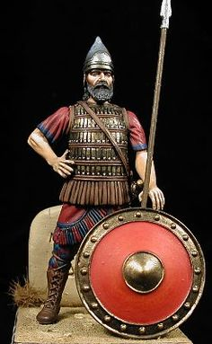
"Shields flash red in the sunlight! See the scarlet uniforms of the valiant troops! Watch as their glittering chariots move into position, with a forest of spears waving above them. ⁴The chariots race recklessly along the streets and rush wildly through the squares. They flash like firelight and move as swiftly as lightning" (Nahum 2:3-4 NLT).
Notes:
Defeated: The destruction of the city graphically visualizes God's power over the puny Assyrians (2:3-8).
"2:3-4. Nahum spoke of the equipment and speed of the “attacker” (v. 1) and his soldiers and chariots. His in the first line of verse 3 probably refers not to the defending Assyrian king but to the unidentified “attacker.” The shields of the Medes and Babylonians were red either from blood, or from red-dyed leather over the wooden shields, or by being covered with copper. The warriors’ scarlet- colored attire (cf. “red” in Ezek. 23:14) would make them awesome in appearance. (Xenophon wrote about the Persians in Cyrus’ army being dressed in scarlet, Cyropaedia 6. 4. 1.) The metal on the chariots glistened in the sun, as the soldiers’ wooden spears were brandished (swung) in their wild attack" (Johnson, "Nahum," BKC).

Slide 41
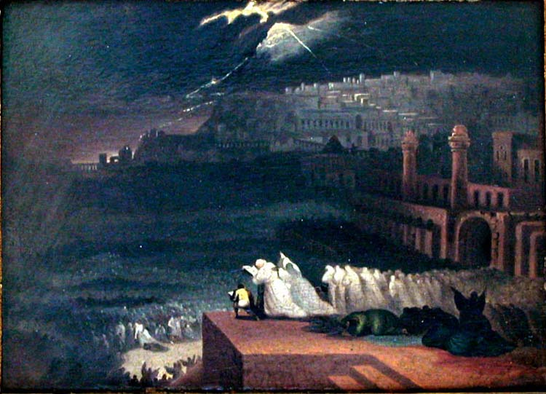
Nahum 2:5-6 (NLT)
623
"The king shouts to his officers; they stumble in their haste, rushing to the walls to set up their defenses.
⁶The river gates have been torn open!
The palace is about to collapse!"
Notes:
Defeated: The destruction of the city graphically visualizes God's power over the puny Assyrians (2:3-8).

Slide 42
Nahum's Prophecies Happened
625
Nahum's Prophecies | Historical Fulfillments
9. When Nineveh would be captured its people would try to escape (2:8): "Nineveh is like a leaking water reservoir! The people are slipping away. 'Stop, stop!' someone shouts, but no one even looks back" (NLT). | 9. “Sardanapalus [another name for King Sin-shar-ishkun] sent away his three sons and two daughters with much treasure into Paphlagonia, to the governor of Kattos, the most loyal of his subjects” (Diodorus, Bibliotheca Historica 2.26.8).
Elliott E. Johnson, “Nahum,” in The Bible Knowledge Commentary (Colorado Springs: SP Pub., 1985), 1:1495.

Slide 43
Nahum's Prophecies Happened
625
Nahum's Prophecies | Historical Fulfillments
5. Nineveh would be destroyed by a flood (1:8; 2:6, 8) | 5. Nineveh weakened by an unusually heavy & long flood of the Tigris. This carried away a huge section of the rampart around the city, allowing the enemy in. Terrifying thunder (presumably with a storm) accompanied the capture (Diodorus, Bibliotheca Historica 2.26.9; 2.27.13; Xenophon, Anabasis 3.4.12).
Elliott E. Johnson, “Nahum,” in The Bible Knowledge Commentary (Colorado Springs: SP Pub., 1985), 1:1495.

Slide 44
Nineveh's Water System Destroyed
637
"And He will stretch out His hand against the north and destroy Assyria, and He will make Nineveh a desolation, parched like the wilderness" (Zeph. 2:13)
The prophesied destruction of Nineveh (Zeph. 2:13), the capital of Assyria in what is now Iraq, fell in 612 BC into the hands of the neighboring Babylonians, with the whole empire taken by 605 BC. The prediction that God would leave Nineveh "dry as a desert" is remarkable in view of the fame of the city's great irrigation system.

Slide 45
Nahum's Prophecies Happened
625
Nahum's Prophecies | Historical Fulfillments
8. Plundering and pillaging would accompany the overthrow of the city (2:9-10). | 8. According to the Babylonian Chronicle, “Great quantities of spoil from the city, beyond counting, they carried off. The city [they turned] into a mound and ruin heap” (Luckenbill, Ancient Records of Assyria and Babylonia, 2:420).
Elliott E. Johnson, “Nahum,” in The Bible Knowledge Commentary (Colorado Springs: SP Pub., 1985), 1:1495.
Notes:
Pillaged: The plundering of the city shows how God will humble the proud city (2:9-10).

Slide 46
Chiastic Structure of Nahum
a Yahweh, like a terrible force of nature, avenges his enemies (1:2-10)
b Yahweh will destroy Nineveh but restore Judah (1:11-15)
c Vivid description of the attack upon Nineveh (2:1-10)
d CENTER: Lament over fall of Nineveh (2:11-13)
c' Vivid description of the looting of Nineveh (3:1-7)
b' Nineveh will be destroyed: it is vulnerable, like Thebes (3:8-13)
a' Nineveh, likened to a force of nature, will be destroyed (3:14-19)
Adapted from David A. Dorsey, The Literary Structure of the Old Testament: A Commentary on Genesis – Malachi (Grand Rapids: Baker, 1999)
Dorsey reveals that the placement of the eulogy over the "lion's den" in the book's highlighted central position reinforces the sense of certainty of Nineveh's fall.

Slide 47
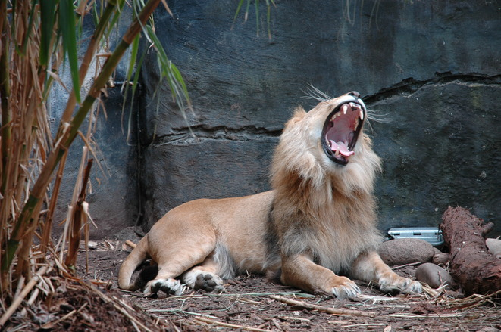
Lion Imagery (2:11-13)
Notes:
Illustrated: God would destroy the powerful Ninevites like destroying a fearless lion in its den (2:11-13).

Slide 48
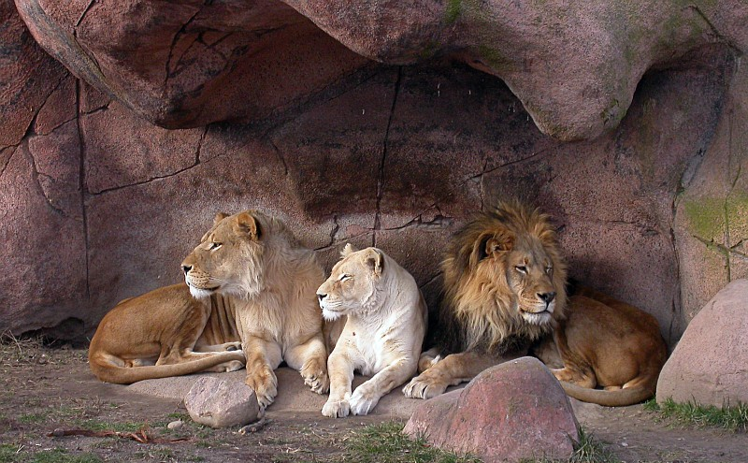
Nahum 2:11-13 (NLT)
623
"Where now is that great Nineveh,
that den filled with young lions?
It was a place where people—like lions and their cubs—
walked freely and without fear."

Slide 49
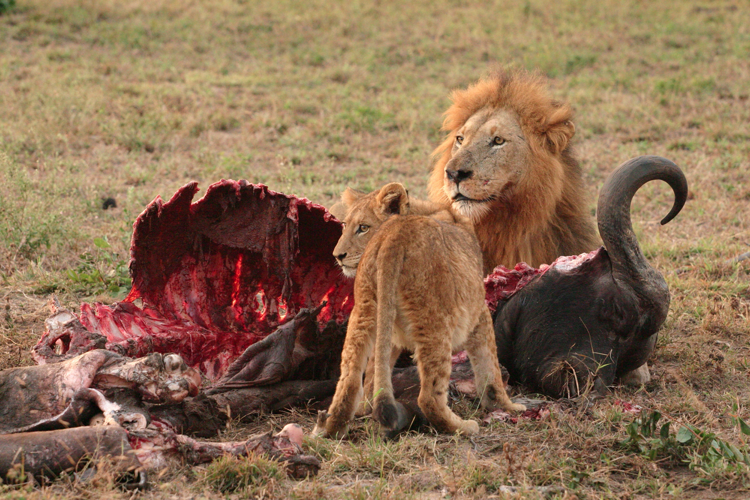
Nahum 2:12 (NLT)
623
"The lion tore up meat for his cubs
and strangled prey for his mate.
He filled his den with prey,
his caverns with his plunder."

Slide 50
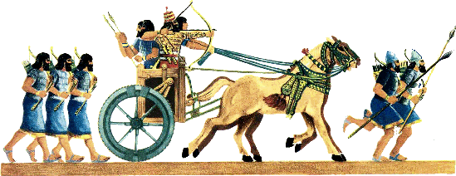
Nahum 2:13 (NLT)
"'I am your enemy!'
says the LORD of Heaven's Armies.
'Your chariots will soon go up in smoke.
Your young men will be killed in battle.
Never again will you plunder conquered nations.
The voices of your proud messengers will be heard no more'" (2:13).
623

Slide 51
Nahum's Prophecies Happened
625
Nahum's Prophecies | Historical Fulfillments
6. Nineveh would be destroyed by fire (1:10; 2:13; 3:15). | 6. Archaeological excavations at Nineveh have revealed chard wood, charcoal, and ashes. “… about 2 inches thick...” (R. Campbell Thomson and R. W. Hutchinson, A Century of Exploration at Nineveh. London: Luzac, pp. 45, 77).
Elliott E. Johnson, “Nahum,” in The Bible Knowledge Commentary (Colorado Springs: SP Pub., 1985), 1:1495.

Slide 52
Book Chart
621
Nahum: Nineveh's Destruction
Certain |  |  |  | Detailed |  | Justified
Nahum 1 |  |  |  | Nahum 2 |  | Nahum 3
Destruction Decreed |  |  |  | Destruction Described |  | Destruction Deserved
Verdict of Vengeance |  |  |  | Vision of Vengeance |  | Vindication of Vengeance
What God Will Do |  |  |  | How God Will Do It |  | Why God Will Do It
God's Anger |  |  |  | God's Actions |  | God's Accusations
God's Predictions for Judah |  |  |  | God's Power for Judah |  | God's Justice for Judah
Title 1:1 | God's Attributes 1:2-8 | Plotting Against God 1:9-11 | Destruction is Judah's Deliverance 1:12-15 | Battling vs. Judah's Splendor 2:1-2 | Destruction & Despoiling 2:3-13 | Destruction for Cruelty 3:1-7 | Drunk When Destroyed 3:3-11 | Burned With Fire 3:12-19
In Judah Against Assyria's Capital, Nineveh
c. 660 BC
Notes:
Nineveh’s judgment is justified because God's justice had to punish them (Ch. 3).

Slide 53
Slides on Nahum 3

Slide 54
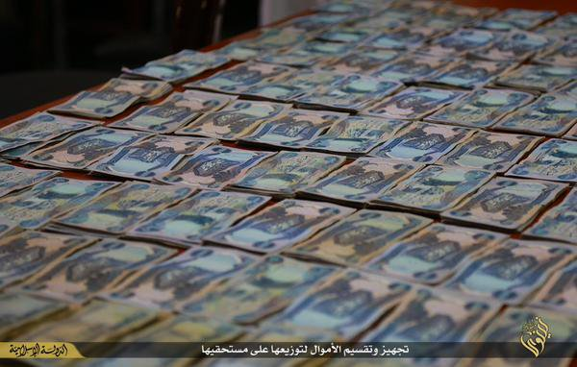
Nahum 3:1 (NLT)
623
"What sorrow awaits Nineveh, the city of murder and lies!
She is crammed with wealth and is never without victims"
Notes:
Nineveh’s bloodshed, lying and greed humiliated enemies (3:1-4).

Slide 55
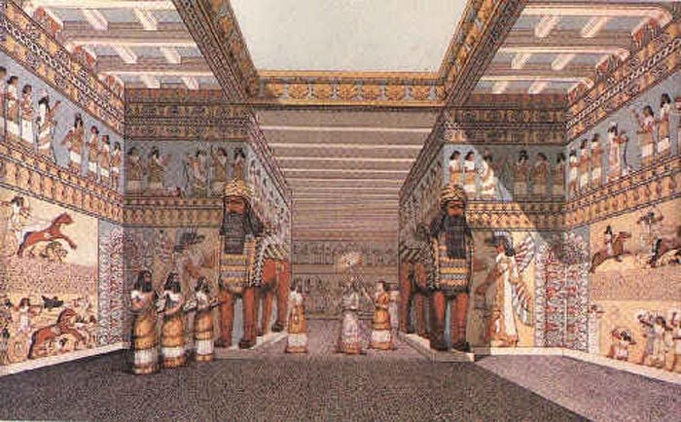
Nineveh Interior of Sennacherib's Palace

Slide 56
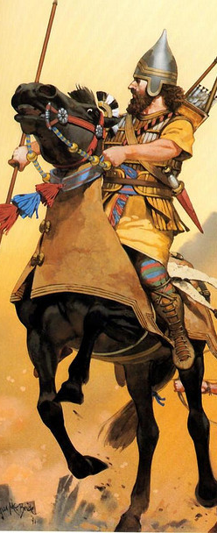
"Hear the crack of whips, the rumble of wheels! Horses’ hooves pound, and chariots clatter wildly. ³See the flashing swords and glittering spears as the charioteers charge past! There are countless casualties, heaps of bodies—so many bodies that people stumble over them" (Nahum 3:2-3 NLT).

Slide 57
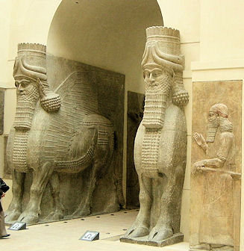
Llamsu Guarded Nineveh's Gates
British Museum

Slide 58
Nahum's Prophecies Happened
625
Nahum's Prophecies | Historical Fulfillments
7. The city’s capture would be attended by a great massacre of people (3:3). | 7. “In two battles fought on the plain before the city the rebels defeated the Assyrians… So great was the multitude of the slain that the flowing stream, mingled with their blood, changed its color for a considerable distance” (Diodorus, Bibliotheca Historica 2.26.6-7).
Elliott E. Johnson, “Nahum,” in The Bible Knowledge Commentary (Colorado Springs: SP Pub., 1985), 1:1495.

Slide 59
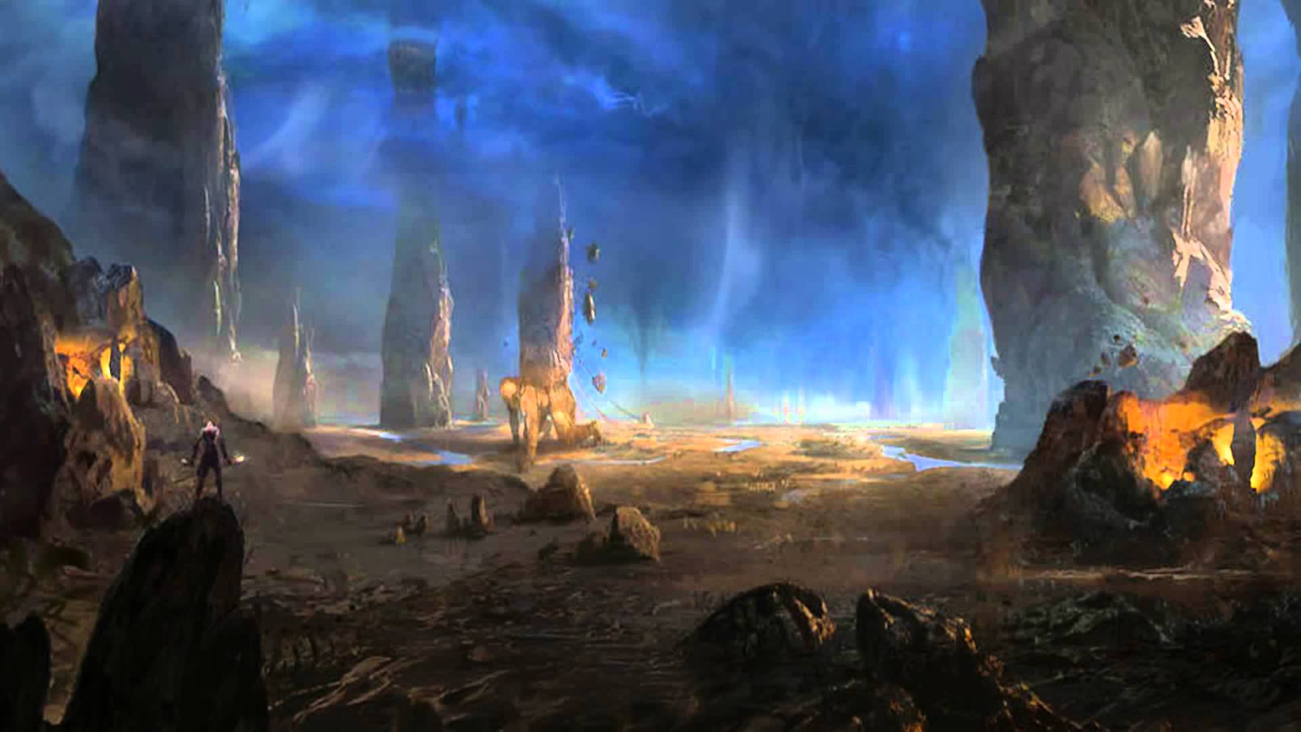
Nahum 3:4 (NLT)
623
"All this because Nineveh,
the beautiful and faithless city,
mistress of deadly charms,
enticed the nations with her beauty.
She taught them all her magic,
enchanting people everywhere."

Slide 60
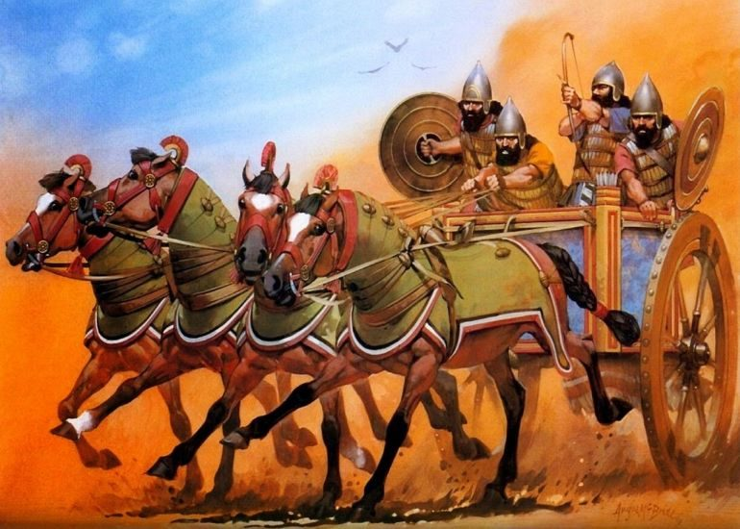
Assyrian Chariots Humbled (3:5-7)
Notes:
The Babylonians will publicly humiliate Nineveh (3:5-7).
3:5-7 Shame
“I am your enemy!”
says the Lord of Heaven’s Armies.
“And now I will lift your skirts
and show all the earth your nakedness and shame.
⁶ I will cover you with filth
and show the world how vile you really are.
⁷ All who see you will shrink back and say,
‘Nineveh lies in ruins.
Where are the mourners?’
Does anyone regret your destruction?”

Slide 61
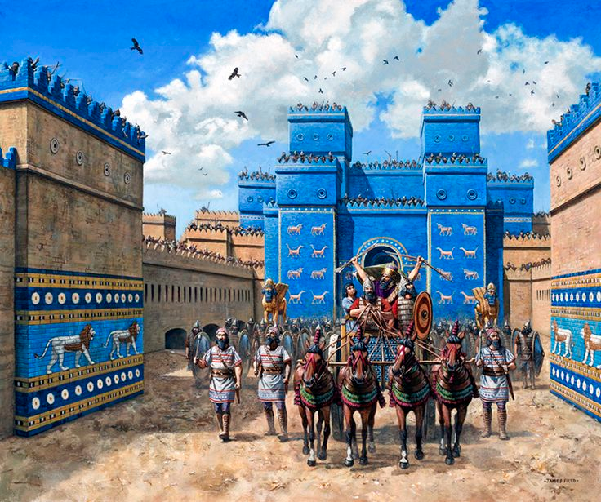
Ishtar Gate of the Conquering Babylonians

Slide 62
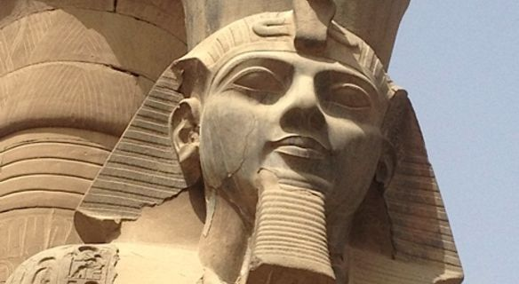
The Benefit of Egyptian Chronology
Notes:
Nineveh will be drunk when destroyed and will go into hiding for its cruel treatment of Thebes in Egypt in 663 BC (3:8-11).

Slide 63
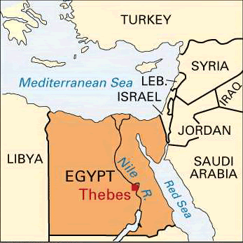
Fall of Thebes (663 BC)
Nahum 3:8-10
Notes:
"Are you any better than the city of Thebes,
situated on the Nile River, surrounded by water?
She was protected by the river on all sides,
walled in by water" (NLT).

Slide 64
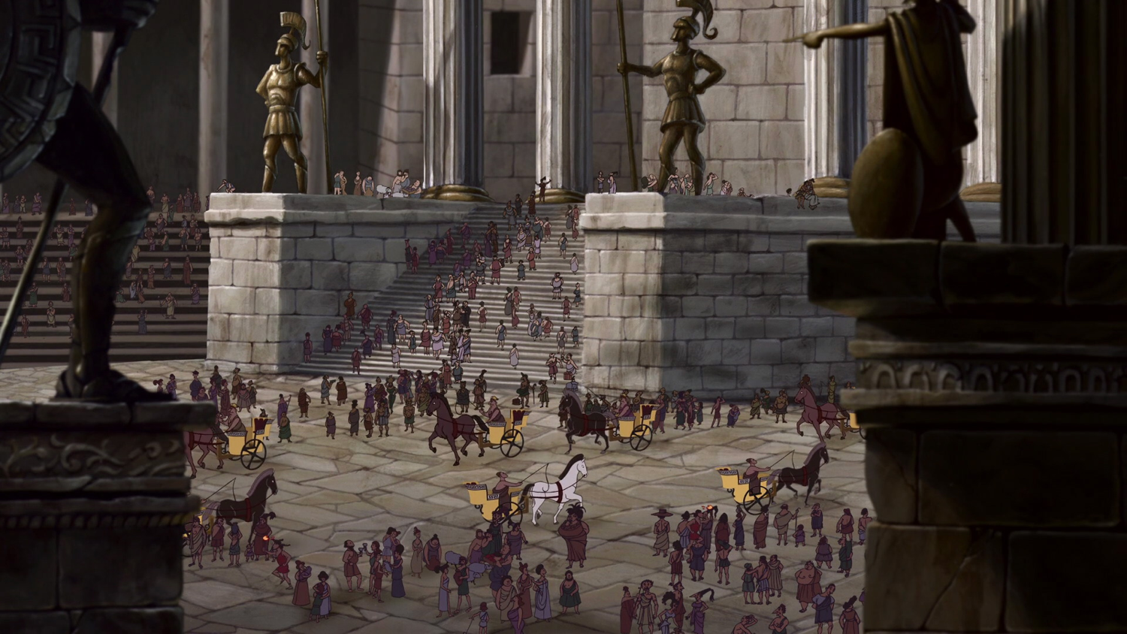
Fall of Thebes (663 BC)
Notes:
⁹ Ethiopia and the land of Egypt
gave unlimited assistance.
The nations of Put and Libya
were among her allies" (NLT).

Slide 65
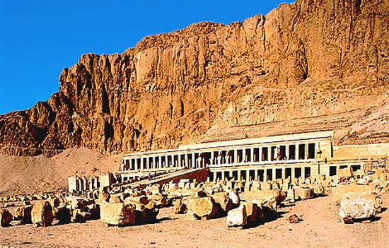
Fall of Thebes (663 BC)
Notes:
¹⁰ Yet Thebes fell,
and her people were led away as captives.
Her babies were dashed to death
against the stones of the streets.
Soldiers threw dice to get Egyptian officers as servants.
All their leaders were bound in chains" (NLT).

Slide 66
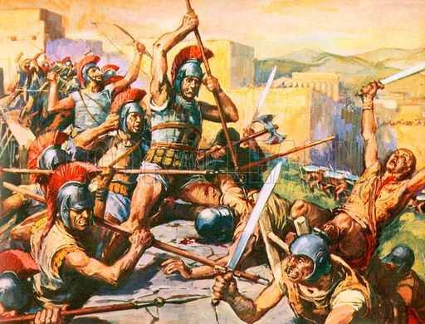
Thebes Conquered again by Alexander in 335 BC

Slide 67
Nahum's Prophecies Happened
625
Nahum's Prophecies | Historical Fulfillments
1. The Assyrian fortresses surrounding the city would be easily captured (3:12) | According to the Babylonian Chronicle the fortified towns in Nineveh’s environs begin to fall in 614 BC, including Tabris, present-day Sharis-Khan, a few miles northwest of Nineveh.
Elliott E. Johnson, “Nahum,” in The Bible Knowledge Commentary (Colorado Springs: SP Pub., 1985), 1:1495.

Slide 68
Nahum's Prophecies Happened
625
Nahum's Prophecies | Historical Fulfillments
2. The besieged Ninevites would prepare bricks and mortar for emergency defense walls (3:12). | 2. A. T. Olmstead reported: “To the south of the gate, the moat is still filled with fragments of stone and of mud bricks from the walls, heaped up when they were breached” (History of Assyria, Chicago: University of Chicago Press, 1951, p. 637).
Elliott E. Johnson, “Nahum,” in The Bible Knowledge Commentary (Colorado Springs: SP Pub., 1985), 1:1495.

Slide 69
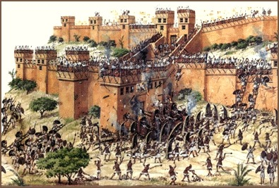
Nineveh Destroyed by Flood (3:14) & Fire (3:12)

Slide 70
Nahum's Prophecies Happened
625
Nahum's Prophecies | Historical Fulfillments
3. The city gates would be destroyed (3:13). | 3. Olmstead noted: “The main attack was directed from the northwest and the brunt fell upon the Hatami gate at this corner… Within the gates are traces of the counter wall raised by the inhabitants in their last extremity” (History of Assyria, Chicago: University of Chicago Press, 1951, p. 637).
Elliott E. Johnson, “Nahum,” in The Bible Knowledge Commentary (Colorado Springs: SP Pub., 1985), 1:1495.

Slide 71
Nahum's Prophecies Happened
625
Nahum's Prophecies | Historical Fulfillments
4. In the final hours of the attack the Ninevites would be drunk (1:10; 3:11) | 4. After the Assyrians had repulsed the enemy's attack, they got drunk and feasted, and as a result were surprised by the Medes and the city was taken. (Diodorus, Bibliotheca Historica 2.26.4).
Elliott E. Johnson, “Nahum,” in The Bible Knowledge Commentary (Colorado Springs: SP Pub., 1985), 1:1495.

Slide 72
Nahum's Prophecies Happened
625
Nahum's Prophecies | Historical Fulfillments
10. The Ninevites officers would weaken and flee (3:17). | 10. The Babylonian Chronicle states that “[the army] of Assyria deserted [lit., ran away before] the king” (Luckenbill, Ancient Records of Assyria and Babylonia, 2:420).
Elliott E. Johnson, “Nahum,” in The Bible Knowledge Commentary (Colorado Springs: SP Pub., 1985), 1:1495.

Slide 73
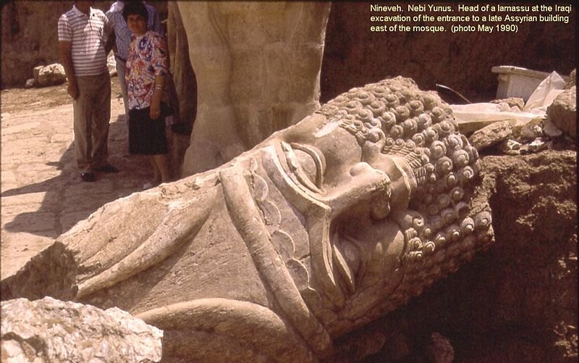
Nahum 3:19 Final Verse (NLT)
623
"There is no healing for your wound; your injury is fatal.
All who hear of your destruction will clap their hands for joy.
Where can anyone be found who has not suffered from your continual cruelty?"

Slide 74
II. God will judge the wicked and deliver the righteous in the future too.
Be patient.
Notes:
The LORD is watching over your future, including his promise to punish all who reject him.

Slide 75
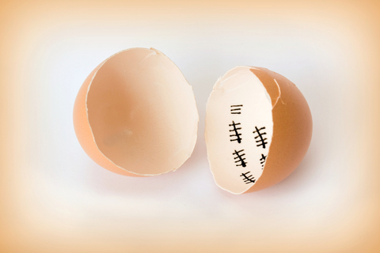
Be patient.
Notes:
God is a God of holiness who must judge sin—so just be patient.

Slide 76
And more patient.

Slide 77
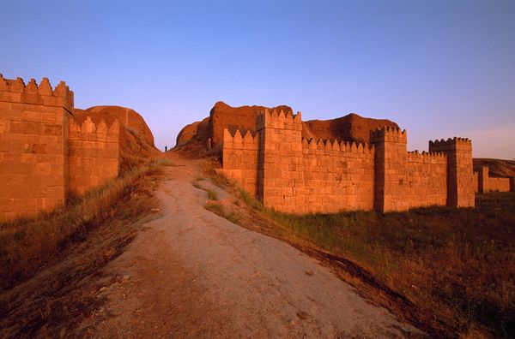
Some Nineveh Walls Remained

Slide 78
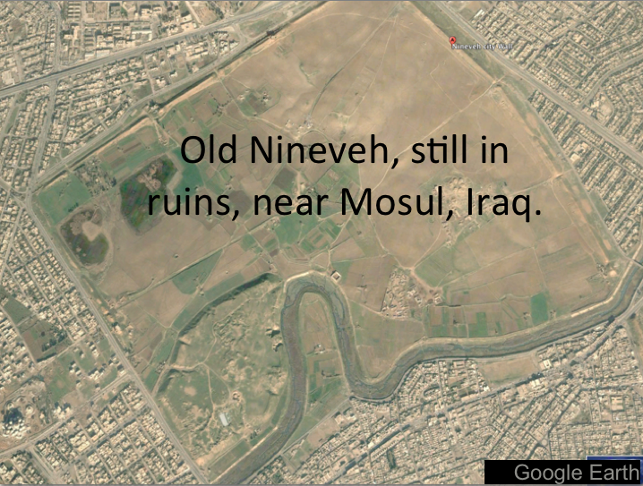
Modern Map
Mosul, Iraq, surrounds Nineveh’s ancient ruins

Slide 79
Nineveh ISIS captured Modern-Day Mosul

Slide 80
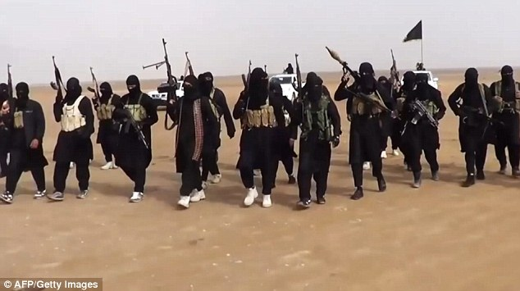
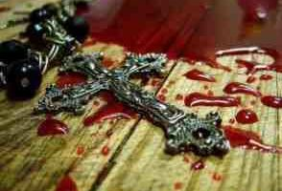
Nineveh ISIS forced out 200,000 Christians

Slide 81
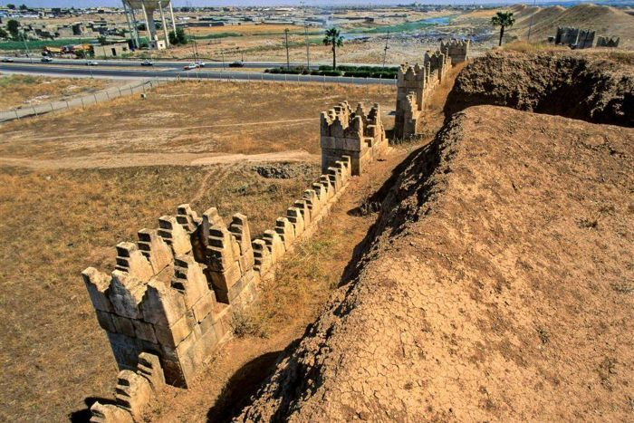
Nineveh Walls destroyed by ISIS in 2015
Notes:
January 2015 before ISIS invasion

Slide 82
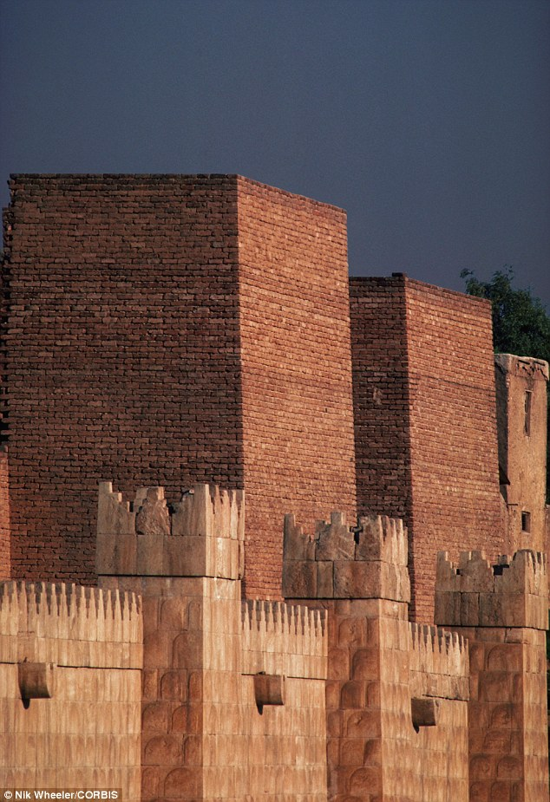
Nineveh Walls destroyed by ISIS in 2015
Notes:
January 2015
Ancient: Ruins at the ancient Assyrian city of Nineveh, which Islamic State militants have vowed to destroy when the Iraqi army comes to try to liberate Mosul, Iraq's second largest city Read more: http://www.dailymail.co.uk/news/article-2900530/ISIS-plan-destroy-walls-Nineveh-capital-Assyrian-Empire-one-important-archaeological-sites-Iraq.html#ixzz4LcEZWyuW Follow us: @MailOnline on Twitter | DailyMail on Facebook
Over the past month the Islamic State has seized hundreds of Assyrian relics from Mosul's cultural museum as well as destroyed Assyrian monuments in the city, which it claims 'distort Islam', AINSA reported.
Assyrians believe themselves to be Iraq's original indigenous people, with a documented history stretching back to 4750 BC. They now comprise 95 per cent of the country's Christian population.
Nearly 200,000 were forced to flee their homes around the Nineveh plain last summer as Islamic State made its lightning advance across Iraq.
Most now live as refugees in Iraq's Kurdish areas.
Read more: http://www.dailymail.co.uk/news/article-2900530/ISIS-plan-destroy-walls-Nineveh-capital-Assyrian-Empire-one-important-archaeological-sites-Iraq.html#ixzz4LcEENuP2 Follow us: @MailOnline on Twitter | DailyMail on Facebook

Slide 83
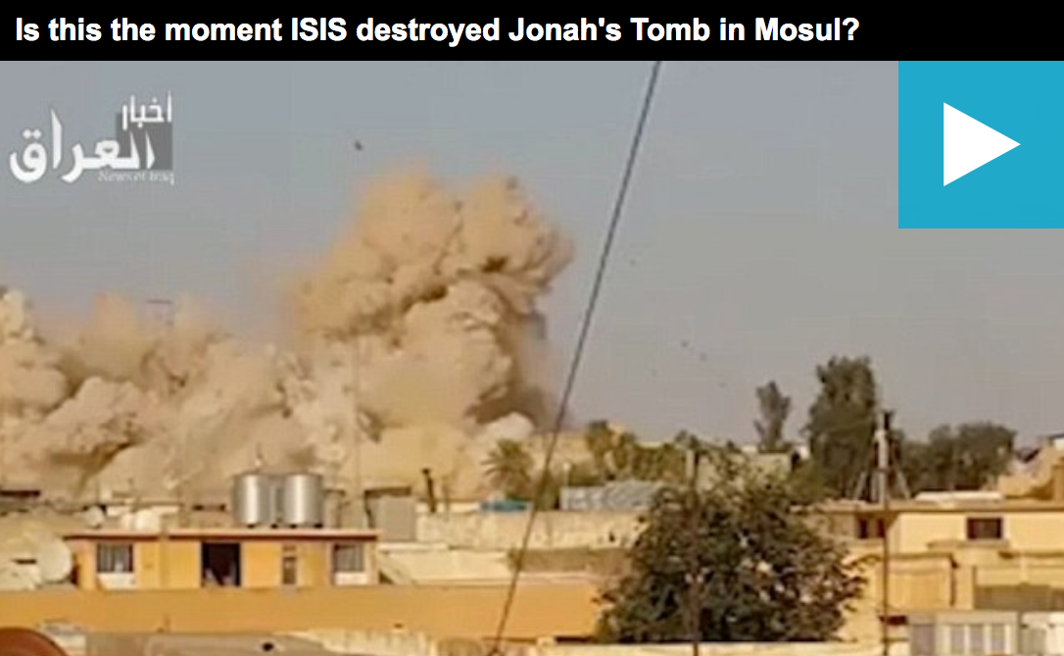
Nineveh Jonah’s Tomb Destroyed by ISIS

Slide 84
The Recapture of Mosul (2017)
Hey, ISIS!
Remember us?
We’re back!
Support the NPU

Slide 85
Oprah Winfrey
Notes:
Lakeside Church in Houston, Texas, is the largest church in the USA with 40,000 attending. The pastor, Joel Osteen, is often featured on the cover of Success magazine.

Slide 86
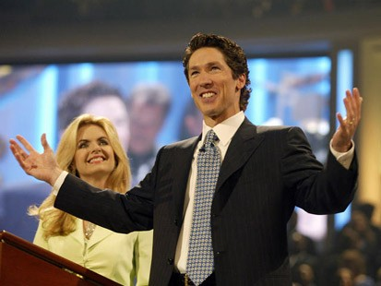
Joel Osteen
No preaching on sin
Led in prayer at gay "wedding"
Notes:
One key rule in the pulpit there is: you cannot talk about sin or judgment.

Slide 87
Motivational Speaking
Magical prayers, feel good messages, have it your way theology; surely this is too awesome to be what Paul warned us about
http://www.conservativecut.com/blog/?tag=false-teacher
Notes:
http://www.conservativecut.com/blog/?tag=false-teacher

Slide 88
The Judgment of God
Notes:
But at CIC we are not afraid to talk about what God warns us about—and judgment is all over the face of the Bible.
God told Ezekiel that he must warn the people—and if he didn’t, then their blood was on his head (cf. Ezek. 33:1-9)!
Hey, I don’t want your blood on my head, so we preach the full gospel here, including God’s wrath!
Who really wants the mamby-pamby God that does not hold people accountable?
Do you have respect for parents that do not discipline their children?
Do you respect governments that let people get away with murder?
Then why do we have a problem with God being a God of justice?

Slide 89
We have a tremendous future ahead of us in Christ (Rev. 20:1-6).
Second Coming
Second Advent
=
Tribulation
Millennium
Church Age
Eternal Kingdom
7 years
1000 years
Judgment
Judgment
Notes:
89

Slide 90
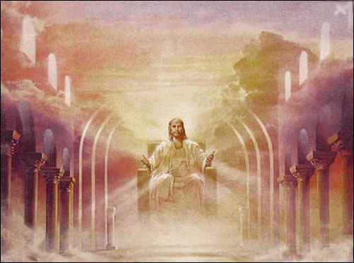
A Literal, Political Kingdom
"Jesus replied, 'I assure you that when the world is made new and the Son of Man sits upon his glorious throne, you who have been my followers will also sit on twelve thrones, judging the twelve tribes of Israel'" (Matt. 19:28 NLT)

Slide 91
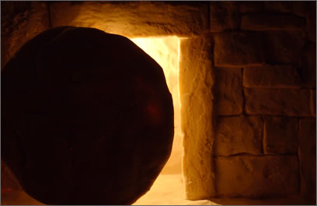
Our Future
Jesus will bring worldwide truth, peace, prosperity, holiness and protection

Slide 92
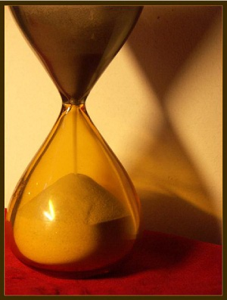
Main Idea
Don’t mistake the patience of God as the impotence of God.

Slide 93
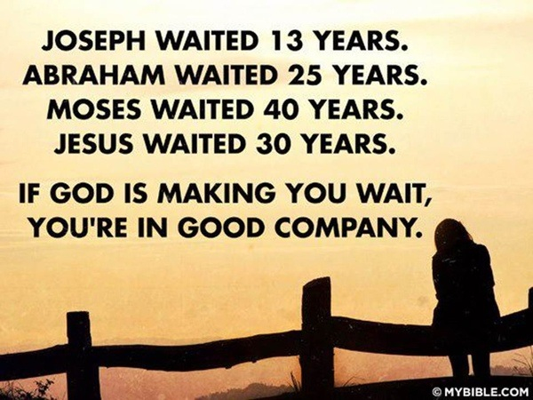
Wait. It's biblical.
Notes:
But don’t let your impatience make you think God can’t resolve things. This issue isn’t that God can’t solve issues. It’s that he is more patient than you give him credit for. He had many people through history have to wait (Joseph 13 years, Abraham 25 years, Moses 40 years, Jesus 30 years).

Slide 94
Barry Huddleston, The Acrostic Summarized Bible (Grand Rapids: Baker, 1992)
I. God would destroy Nineveh but save Judah (Nahum 1–3).
1 God’s character and judgment
2 Overthrow of Nineveh imminent
3 Details of Nineveh’s judgment
Nahum
Notes:
The capital of Assyria would have capital punishment for its capital crimes, yet the southern kingdom of Israel could gain comfort from this as the LORD would preserve them.

Slide 95
II. God will judge the wicked and deliver the righteous in the future too.
Be patient.
Notes:
The LORD is watching over your future, including his promise to punish all who reject him.

Slide 96
Key Verse
621
"The LORD is slow to anger and great in power; he will not leave the guilty unpunished" (Nahum 1:3a).
Nahum
Notes:
Are you heading the wrong direction—towards judgment?
Once an older man was very offended by the preacher Vance Havner. He complained, “Pastor, you are rubbing the cat the wrong way!” Havner replied, “Well, then turn the cat around!”
Are you offended by what I’ve said today? I’ve only warned you as part of my responsibility before God. It’s your responsibility to turn around and come towards God instead of away from him.

Slide 97
What are you waiting for?
God's 3 answers to your prayers:
Yes.
Not yet.
I have something better in mind.

Slide 98
Black

Slide 99
OT Sermons link at BibleStudyDownloads.org
Get this presentation and script for free!

