Slide 1
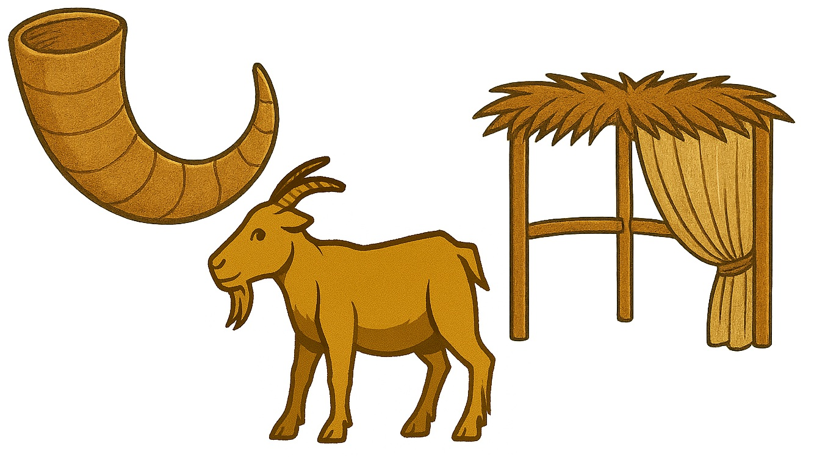
The Fall Feasts
Leviticus 23:23-44
Matthew Lyle
at Crossroads International Church Singapore • CICFamily.com
Uploaded by Dr. Rick Griffith • Jordan Evangelical Theological Seminary
Files in many languages for free download at BibleStudyDownloads.org
11

Slide 2

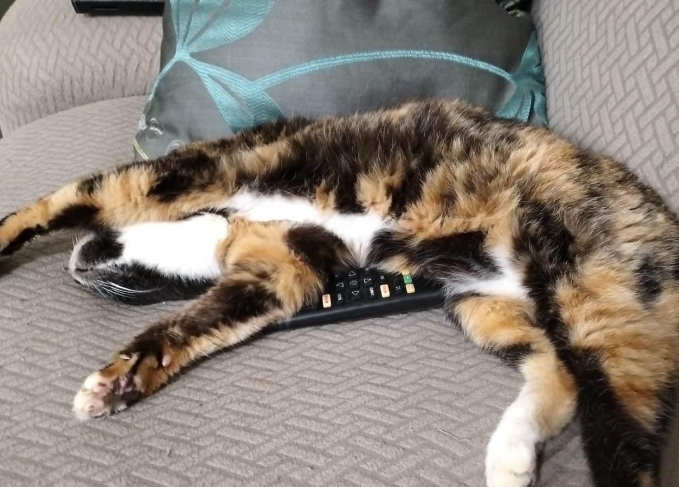
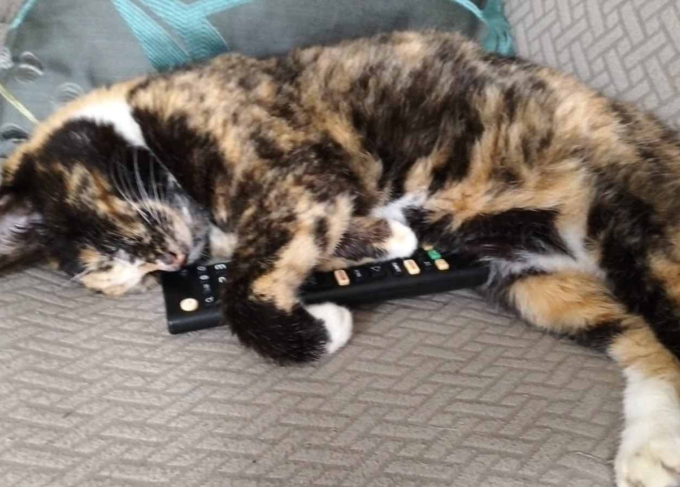

Slide 3








Slide 4
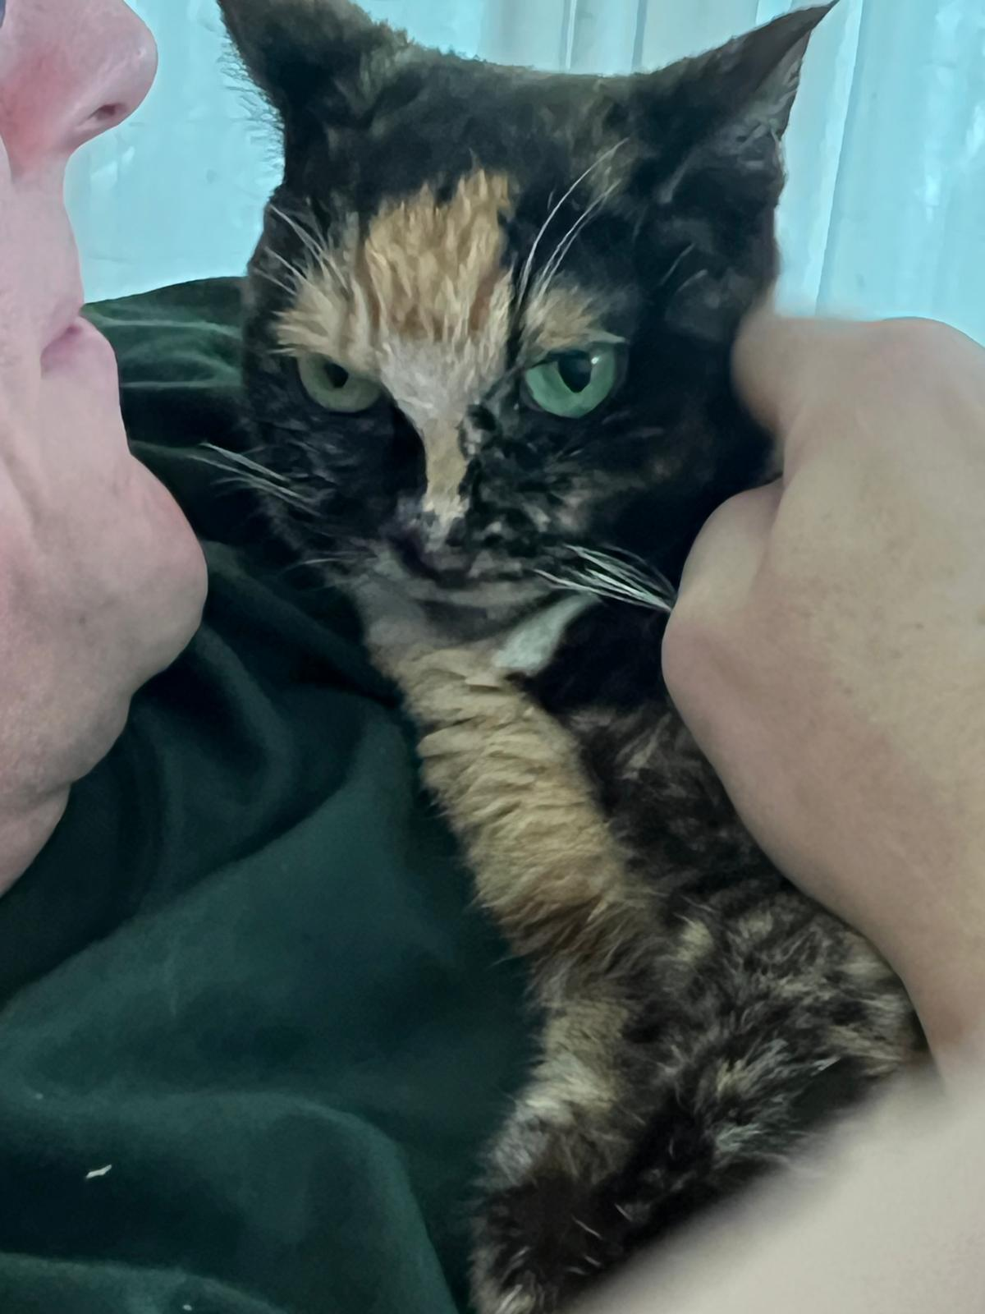
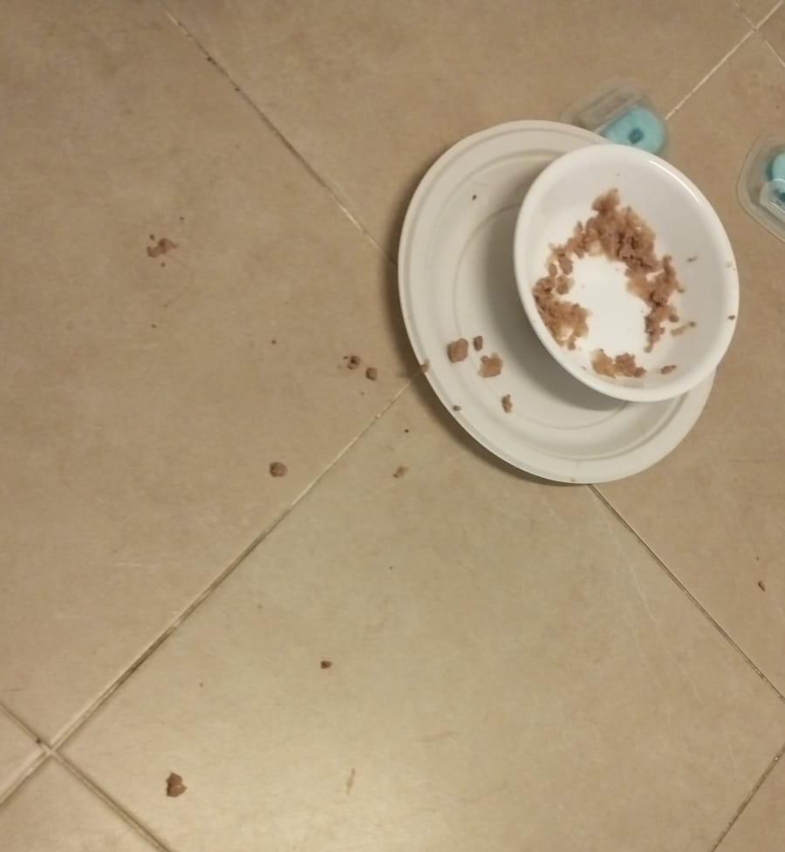

Slide 5
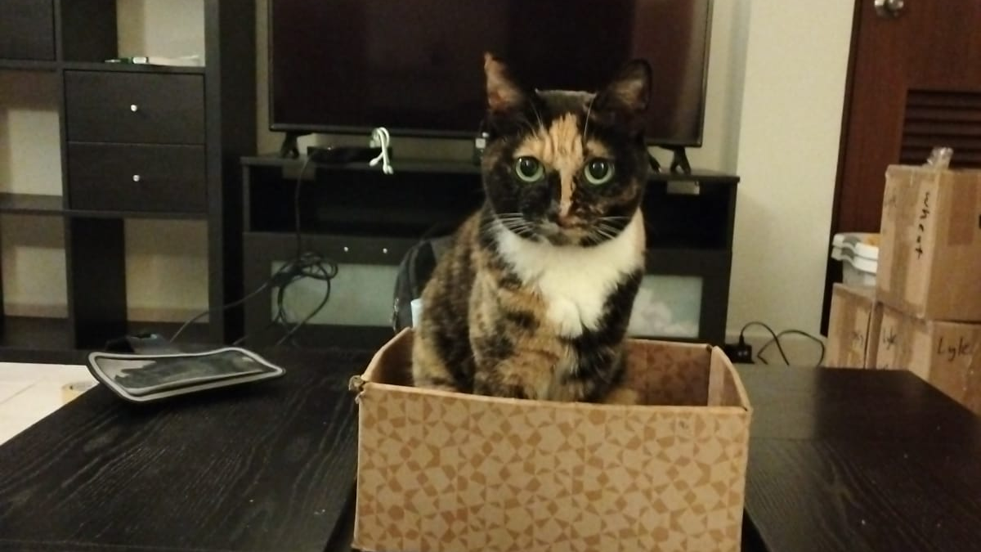

Slide 7
Isaiah 11 ⁶ The wolf will live with the lamb,
the leopard will lie down with the goat,
the calf and the lion and the yearling together;
and a little child will lead them.
⁷ The cow will feed with the bear,
their young will lie down together,
and the lion will eat straw like the ox.
⁸ The infant will play near the cobra’s den,
and the young child will put its hand into the viper’s nest.
⁹ They will neither harm nor destroy
on all my holy mountain,
for the earth will be filled with the knowledge of the Lord
as the waters cover the sea.
6

Slide 8
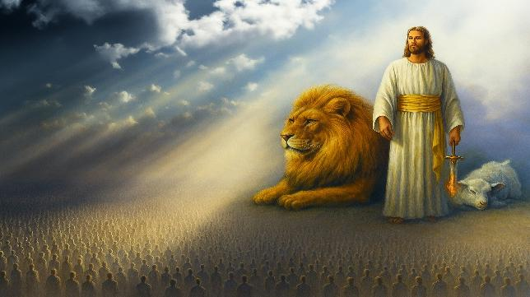
Millennial Kingdom
7

Slide 9

The Spring Feasts
Leviticus 23:1-22
8

Slide 10







Sabbath => Rest & Gathering
Passover => Deliverance
Unleavened Bread => Purity
Firstfruits => Trust
Feast of Weeks => Generosity
9

Slide 11
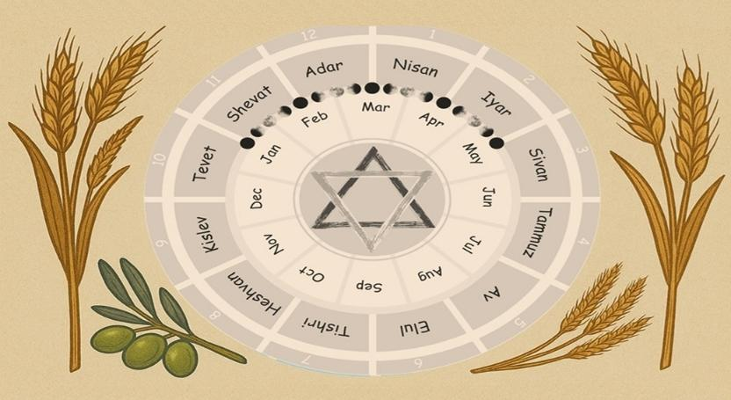
God’s Checklist of Remembrance
Leviticus 23
God’s Calendar of Redemption
Leviticus 23
10

Slide 12
The Fall Feasts
Leviticus 23:23-44
11

Slide 13
²³ And the Lord spoke to Moses, saying, ²⁴ “Speak to the people of Israel, saying, In the seventh month, on the first day of the month, you shall observe a day of solemn rest, a memorial proclaimed with blast of trumpets, a holy convocation. ²⁵ You shall not do any ordinary work, and you shall present a food offering to the Lord.”
12

Slide 14
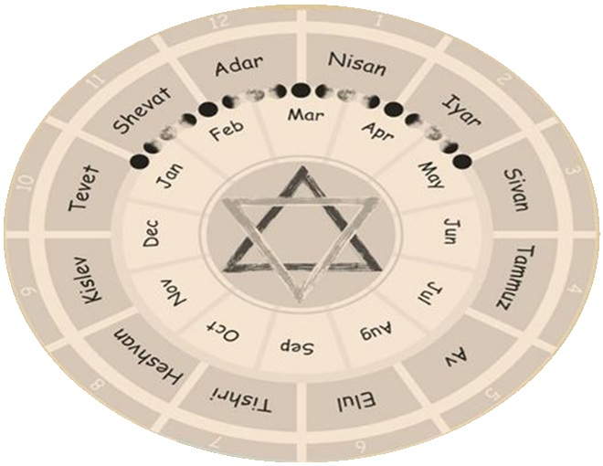
SPRING
FEASTS
FALL
FEASTS
13

Slide 15
²³ And the Lord spoke to Moses, saying, ²⁴ “Speak to the people of Israel, saying, In the seventh month, on the first day of the month, you shall observe a day of solemn rest, a memorial proclaimed with blast of trumpets, a holy convocation. ²⁵ You shall not do any ordinary work, and you shall present a food offering to the Lord.”
14

Slide 16
Exodus 19: Israel at Mt. Sinai

Slide 17
¹⁶ On the morning of the third day there were thunders and lightnings and a thick cloud on the mountain and a very loud trumpet blast, so that all the people in the camp trembled.

Slide 18
¹⁷ Then Moses brought the people out of the camp to meet God, and they took their stand at the foot of the mountain. ¹⁸ Now Mount Sinai was wrapped in smoke because the Lord had descended on it in fire. The smoke of it went up like the smoke of a kiln, and the whole mountain trembled greatly.

Slide 19
¹⁹ And as the sound of the trumpet grew louder and louder, Moses spoke, and God answered him in thunder. ²⁰ The Lord came down on Mount Sinai, to the top of the mountain.

Slide 20
Exodus 19 is the first time the people as a whole directly experience God’s presence and voice, fulfilling God's promise to make Himself known not just through Moses, but to the nation.
Exodus 19
שׁוֹפָר (shofar)
Ram’s horn, trumpet (object)
Explicit – shofar
Signaled God’s Presence
Leviticus 23:24
תְּרוּעָה (teru‘ah)
Blast/shout (sound)
Implied – shofar
Call to remembrance

Slide 21



Experience God’s Presence

Slide 22

Today, the Feast of Trumpets is called Rosh Hashanah marks the beginning of the civil year, according to the teachings of Judaism, and is the traditional anniversary of the creation of Adam and Eve

Slide 23
²⁶ And the Lord spoke to Moses, saying, ²⁷ “Now on the tenth day of this seventh month is the Day of Atonement. It shall be for you a time of holy convocation, and you shall afflict yourselves and present a food offering to the Lord. ²⁸ And you shall not do any work on that very day, for it is a Day of Atonement, to make atonement for you before the Lord your God.

Slide 24
²⁹ For whoever is not afflicted on that very day shall be cut off from his people. ³⁰ And whoever does any work on that very day, that person I will destroy from among his people. ³¹ You shall not do any work. It is a statute forever throughout your generations in all your dwelling places. ³² It shall be to you a Sabbath of solemn rest, and you shall afflict yourselves. On the ninth day of the month beginning at evening, from evening to evening shall you keep your Sabbath.”

Slide 25
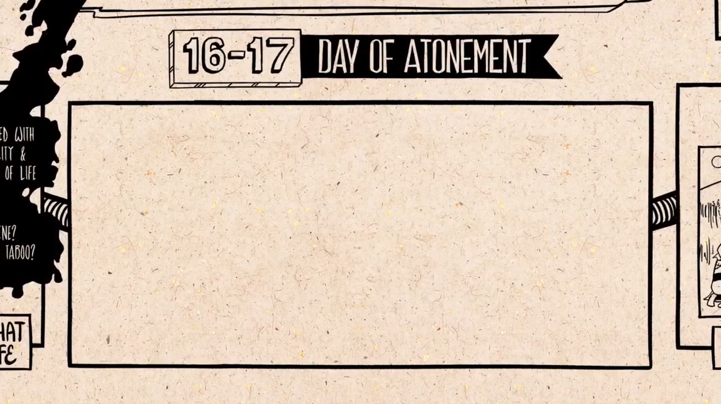

Slide 26
Holy convocation (gather)
No work
Offering
Afflict yourselves

Slide 27
Lev 23 Sabbath + Feasts | Gather | Work | Offering
Sabbath | Yes | Yes | Yes
Passover | No | No | Yes
Unleavened Bread (1st Day) | Yes | Yes | Yes
Unleavened Bread (7th Day) | Yes | Yes | Yes
Feast of Weeks (Pentecost) | Yes | Yes | Yes
Feast of Trumpets | Yes | Yes | Yes
Day of Atonement | Yes | Yes | Yes
Feast of Booths (1st Day) | Yes | Yes | Yes
Feast of Booths (8th Day) | Yes | Yes | Yes

Slide 28
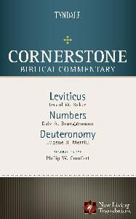
Lev 23 Sabbath + Feasts | Afflict Yourselves
Sabbath | No
Passover | No
Unleavened Bread (1st Day) | No
Unleavened Bread (7th Day) | No
Feast of Weeks (Pentecost) | No
Feast of Trumpets | No
Day of Atonement | Yes
Feast of Booths (1st Day) | No
Feast of Booths (8th Day) | No
The self-denial of food and other elements of life such as sexual intimacy (cf. Num 30:13; Ps 35:13; Isa 58:3, 5)

Slide 29
²⁹ For whoever is not afflicted on that very day shall be cut off from his people.
Verse | Offense | Reason for Being “Cut Off”
Gen 17:14 | Not circumcised | Covenant violation
Exo 30:33 | Misusing sacred anointing oil | Treating holy things as common
Exo 30:38 | Making the sacred incense as perfume | Profaning sacred worship
Lev 7:20–21 | Eating peace offering while unclean | Violating ritual purity
Lev 7:25 | Eating sacrificial fat | Disrespecting God’s portion
Lev 7:27 | Eating blood | Defiling the sacred life-blood
Lev 17:9 | Sacrificing outside the tabernacle | Rejecting God’s ordained worship
Lev 19:8 | Eating a holy offering improperly | Disregarding holiness
Num 9:13 | Failing to keep the Passover | Neglecting God’s appointed time

Slide 30
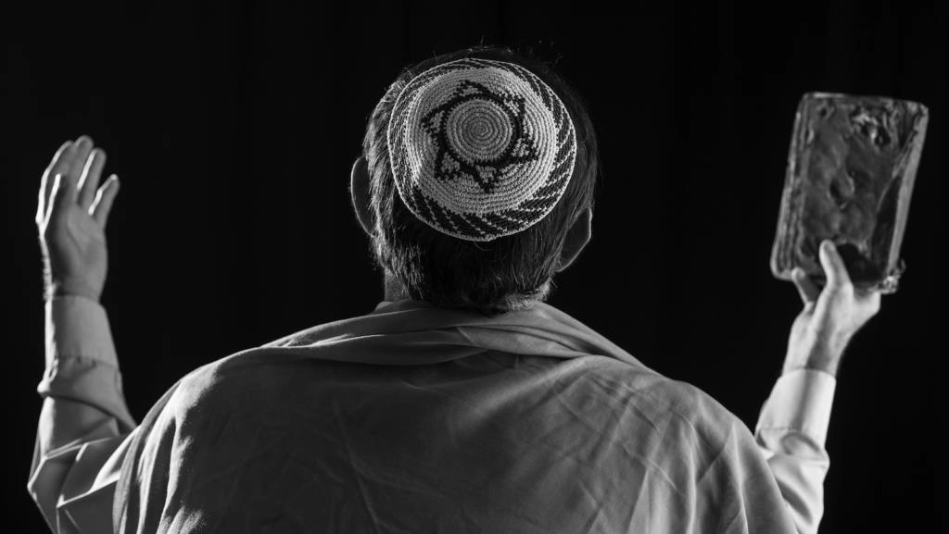
Yōm Kippūr is the holiest day of the year in Judaism.

Slide 31

https://bibleproject.com/videos/leviticus/
https://www.youtube.com/@bibleproject

Slide 32
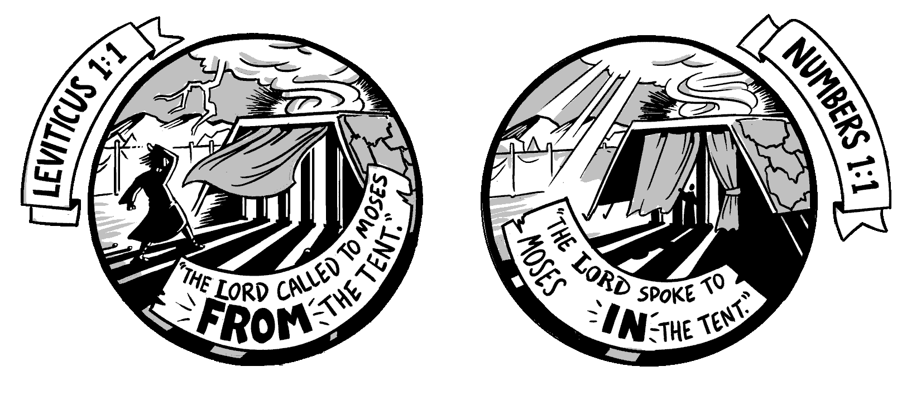
"How can Israel, in their sin and selfishness,
be reconciled to a holy God?

Slide 33
Experience God’s Presence
Escape God’s Punishment

Slide 34
Experience God’s Presence
Escape God’s Punishment
Enjoy God’s Provision

Slide 35
³³ And the Lord spoke to Moses, saying, ³⁴ “Speak to the people of Israel, saying, On the fifteenth day of this seventh month and for seven days is the Feast of Booths to the Lord. ³⁵ On the first day shall be a holy convocation; you shall not do any ordinary work. ³⁶ For seven days you shall present food offerings to the Lord. . . .

Slide 36
⁴² You shall dwell in booths for seven days. All native Israelites shall dwell in booths, ⁴³ that your generations may know that I made the people of Israel dwell in booths when I brought them out of the land of Egypt: I am the Lord your God.”
⁴⁴ Thus Moses declared to the people of Israel the appointed feasts of the Lord.

Slide 37
⁴² You shall dwell in booths for seven days. All native Israelites shall dwell in booths, ⁴³ that your generations may know that I made the people of Israel dwell in booths when I brought them out of the land of Egypt: I am the Lord your God.”
⁴⁴ Thus Moses declared to the people of Israel the appointed feasts of the Lord.

Slide 38
Enjoy God’s Provision
1. Daily Provision of Food
Manna – Bread from heaven (Exodus 16:4, 31–35)
Quail – Meat when they complained of hunger (Exodus 16:12–13; Numbers 11:31–32)
Water from the rock – At Horeb and again at Meribah (Exodus 17:6; Numbers 20:11)

Slide 39
Enjoy God’s Provision
2. Preservation of Clothing and Health
Clothes did not wear out (Deuteronomy 8:4; 29:5)
Feet did not swell – A sign of divine protection and health (Deuteronomy 8:4; Nehemiah 9:21)

Slide 40
Enjoy God’s Provision
3. Guidance and Protection
Pillar of cloud by day – Led them and gave shade (Exodus 13:21–22; Numbers 9:15–23)
Pillar of fire by night – Gave light and direction (same passages)
Angel of the Lord – Went before them (Exodus 23:20–23)

Slide 41
Enjoy God’s Provision
4. Victory Over Enemies
Defeated attacking nations like the Amalekites, Sihon king of the Amorites, Og king of Bashan (Exodus 17; Numbers 21)
Protection from curses – God turned Balaam’s curse into blessing (Numbers 22–24; Deuteronomy 23:5)

Slide 42
Enjoy God’s Provision
5. The Law and Covenant
Ten Commandments and Torah – Given at Mount Sinai (Exodus 20; Deuteronomy 5)
The Tabernacle – God's dwelling among them (Exodus 25–40)
Priesthood and sacrifices – For atonement and worship (Leviticus)

Slide 43
Enjoy God’s Provision
6. Order and Structure
Tribal organization – Camp arrangement and leadership (Numbers 2–4)
Judges and elders – To help govern (Exodus 18; Numbers 11)

Slide 44
Enjoy God’s Provision
7. Mercy and Forgiveness
Despite rebellion, idolatry, and complaining, God:
Did not destroy them completely (Exodus 32–34)
Continued to dwell with them through the Tabernacle
Renewed the covenant multiple times (Deuteronomy 9–10)

Slide 45
Experience God’s Presence
1 Cor 15:52 in a moment, in the twinkling of an eye, at the last trumpet. For the trumpet will sound, and the dead will be raised imperishable, and we shall be changed.
1 Thess 4:16 For the Lord himself will descend from heaven with a cry of command, with the voice of an archangel, and with the sound of the trumpet of God. And the dead in Christ will rise first.

Slide 46
Escape God’s Punishment
Rom 3:25 God presented Christ as a sacrifice of atonement, through the shedding of his blood—to be received by faith.
1 John 2:2 He is the atoning sacrifice for our sins, and not only for ours but also for the sins of the whole world.
1 John 4:10 This is love: not that we loved God, but that he loved us and sent his Son as an atoning sacrifice for our sins.

Slide 47
Enjoy God’s Provision
1. Spiritual Food and Drink
  Jesus, the Bread of Life (John 6:35)
  Living Water through the Spirit (John 4:14; 7:38–39)
2. Sustaining Grace
  God's grace is sufficient in weakness (2 Corinthians 12:9)
  Renewed strength for the journey (Isaiah 40:31; Philippians 4:13)

Slide 48
Enjoy God’s Provision
3. Divine Guidance
  The Holy Spirit leads us into all truth (John 16:13; Romans 8:14)
4. Victory Over the Enemy
  Spiritual armor for battle (Ephesians 6:10–18)
  Christ’s triumph over sin and death (Colossians 2:15)

Slide 49
Enjoy God’s Provision
5. A New Covenant
  Jesus mediates a better covenant (Heb 8:6)
  The law written on our hearts (Heb 10:16)
6. The Church Community
  The body of Christ for support and order (Romans 12:4–5; 1 Cor 12)
  Gifts and leadership for building up (Eph 4:11–16)

Slide 50
Enjoy God’s Provision
7. Mercy and Forgiveness
  Continual access to grace and forgiveness through Christ (1 John 1:9; Hebrews 4:16)
  No condemnation in Christ (Romans 8:1)

Slide 51
Experience God’s Presence
Escape God’s Punishment
Enjoy God’s Provision

Slide 52
Black

Slide 53


OT Preaching link at BibleStudyDownloads.org
Get this presentation and script for free!
Notes:
OT Preaching (op)

