Slide 1
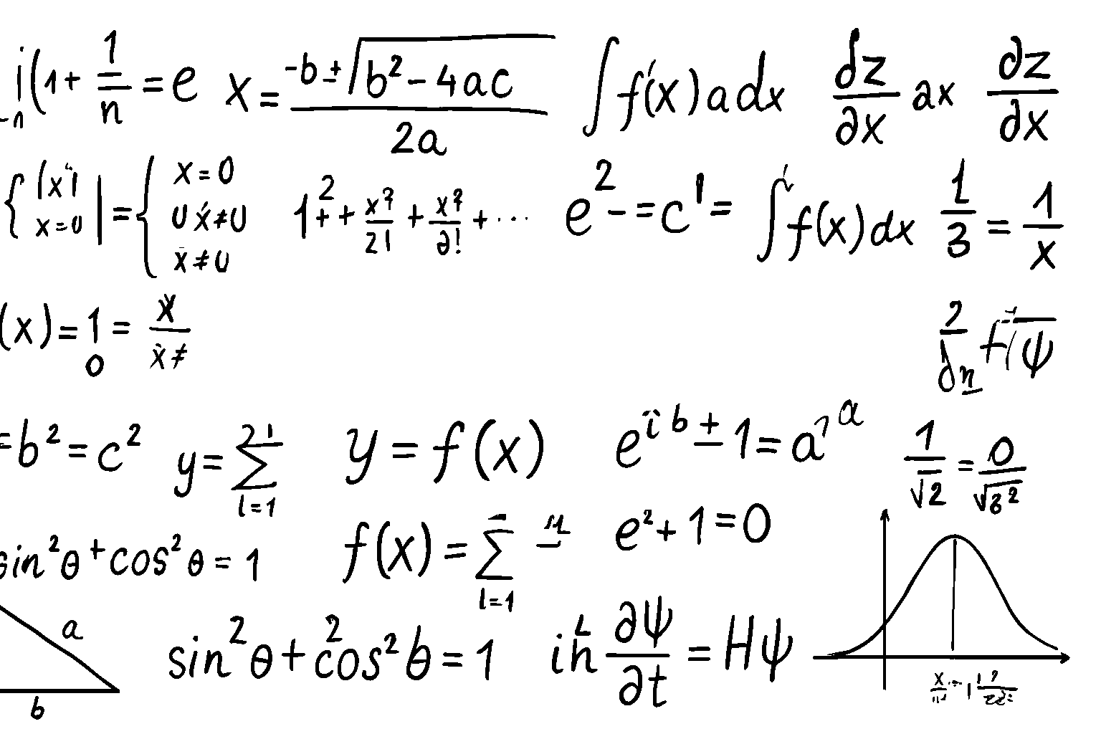
The Spring Feasts
Leviticus 23:1-22
Matthew Lyle
at Crossroads International Church Singapore • CICFamily.com
Uploaded by Dr. Rick Griffith • Jordan Evangelical Theological Seminary
Files in many languages for free download at BibleStudyDownloads.org
4

Slide 2


Slide 3
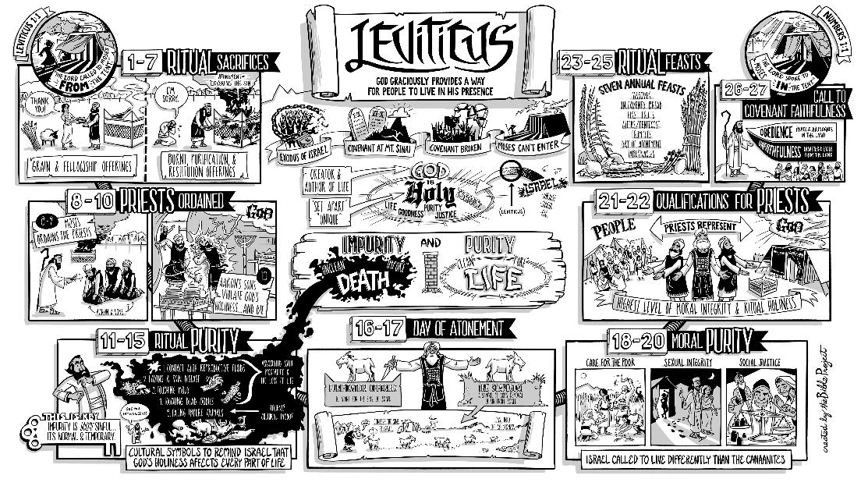

Slide 4
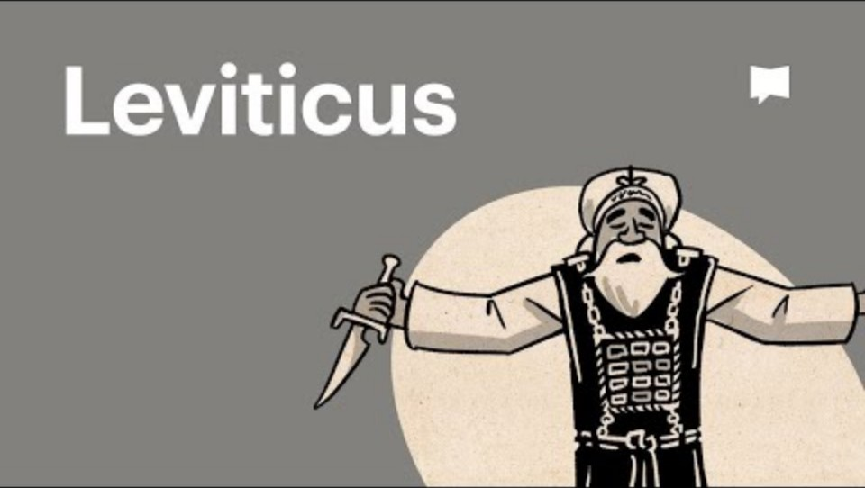

Slide 5
Leviticus 23
4

Slide 6
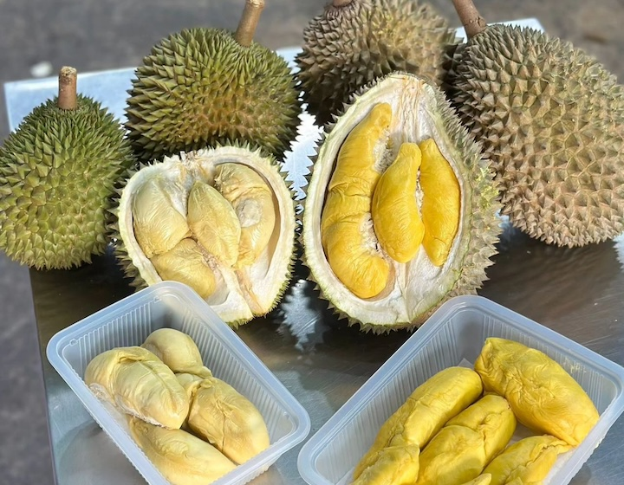
5

Slide 7
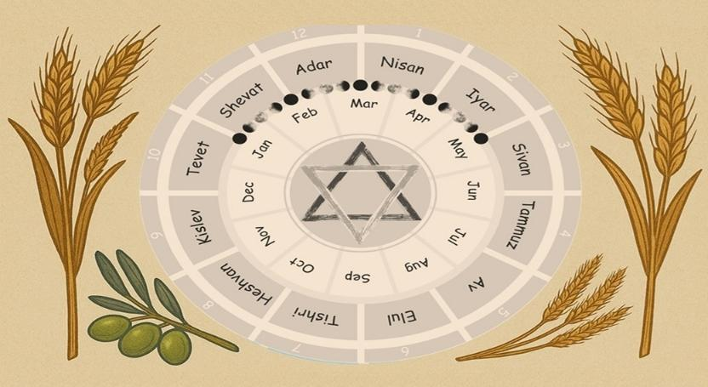
God's Calendar of Redemption
Leviticus 23
6

Slide 8
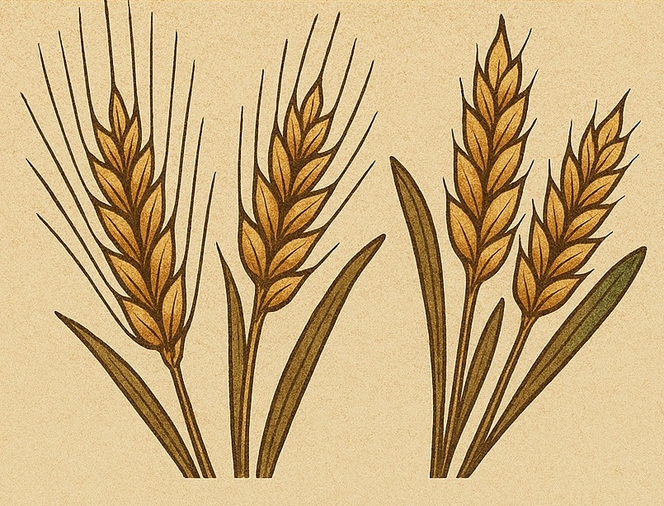
The Spring Feasts
Leviticus 23:1-22
7

Slide 9
Leviticus Ch 23 ¹ The Lord spoke to Moses, saying, ² “Speak to the people of Israel and say to them, These are the appointed feasts of the Lord that you shall proclaim as holy convocations; they are my appointed feasts.
³ “Six days shall work be done, but on the seventh day is a Sabbath of solemn rest, a holy convocation. You shall do no work. It is a Sabbath to the Lord in all your dwelling places.
8

Slide 10
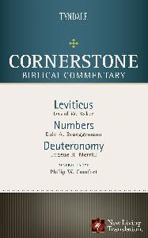
The Sabbath was to be marked by completely stopping all work and the people assembling together
Baker, D. W. (1996)
9
Notes:
). Leviticus. In P. W. Comfort (Ed.), Cornerstone Biblical Commentary: Leviticus, Numbers, Deuteronomy (Vol. 2, p. 167). Tyndale House Publishers.

Slide 11
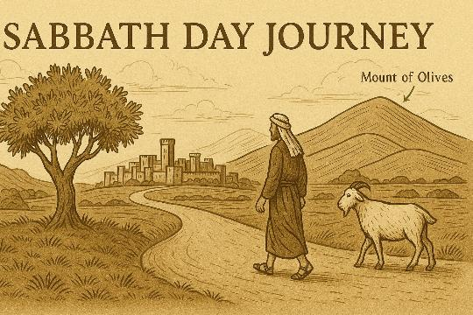
10

Slide 12
⁴ “These are the appointed feasts of the Lord, the holy convocations, which you shall proclaim at the time appointed for them. ⁵ In the first month, on the fourteenth day of the month at twilight, is the Lord's Passover.
11

Slide 13

Deliverance
12

Slide 14
⁶ And on the fifteenth day of the same month is the Feast of Unleavened Bread to the Lord; for seven days you shall eat unleavened bread. ⁷ On the first day you shall have a holy convocation; you shall not do any ordinary work. ⁸ But you shall present a food offering to the Lord for seven days. On the seventh day is a holy convocation; you shall not do any ordinary work.”
13

Slide 15

Purity
14

Slide 16
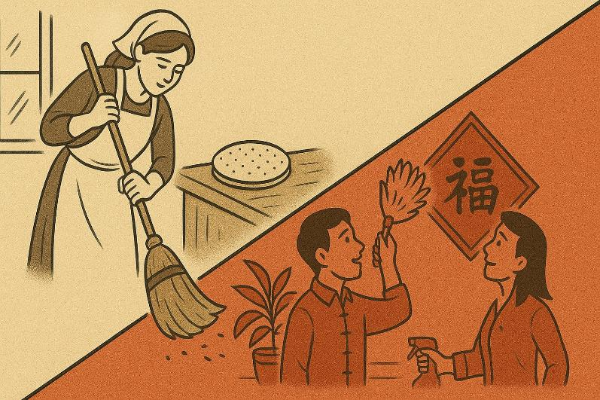
15

Slide 17
⁹ And the Lord spoke to Moses, saying, ¹⁰ “Speak to the people of Israel and say to them, When you come into the land that I give you and reap its harvest, you shall bring the sheaf of the firstfruits of your harvest to the priest, ¹¹ and he shall wave the sheaf before the Lord, so that you may be accepted. On the day after the Sabbath the priest shall wave it. ¹² And on the day when you wave the sheaf, you shall offer a male lamb a year old without blemish as a burnt offering to the Lord. ¹³ And the grain offering with it shall be two tenths of an ephah of fine flour mixed with oil, a food offering to the Lord with a pleasing aroma, and the drink offering with it shall be of wine, a fourth of a hin. ¹⁴ And you shall eat neither bread nor grain parched or fresh until this same day, until you have brought the offering of your God: it is a statute forever throughout your generations in all your dwellings.
16

Slide 18
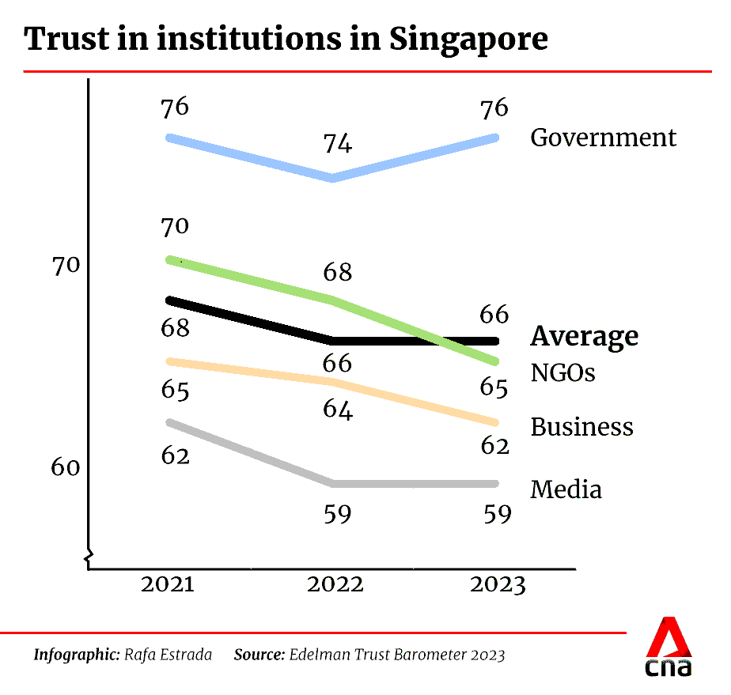
17
Notes:
https://www.channelnewsasia.com/singapore/edelman-trust-barometer-2023-government-business-polarisation-inequality-3345571

Slide 19

Trust
18

Slide 20
¹⁵ “You shall count seven full weeks from the day after the Sabbath, from the day that you brought the sheaf of the wave offering. ¹⁶ You shall count fifty days to the day after the seventh Sabbath. Then you shall present a grain offering of new grain to the Lord. ¹⁷ You shall bring from your dwelling places two loaves of bread to be waved, made of two tenths of an ephah. They shall be of fine flour, and they shall be baked with leaven, as firstfruits to the Lord. ”
Verses 18–22 describe additional offerings (lambs, a bull, rams, a sin offering, and peace offerings) and command the people to leave grain for the poor and foreigner — showing that trust in God's provision should overflow into generosity.
19

Slide 21

Generosity
20

Slide 22
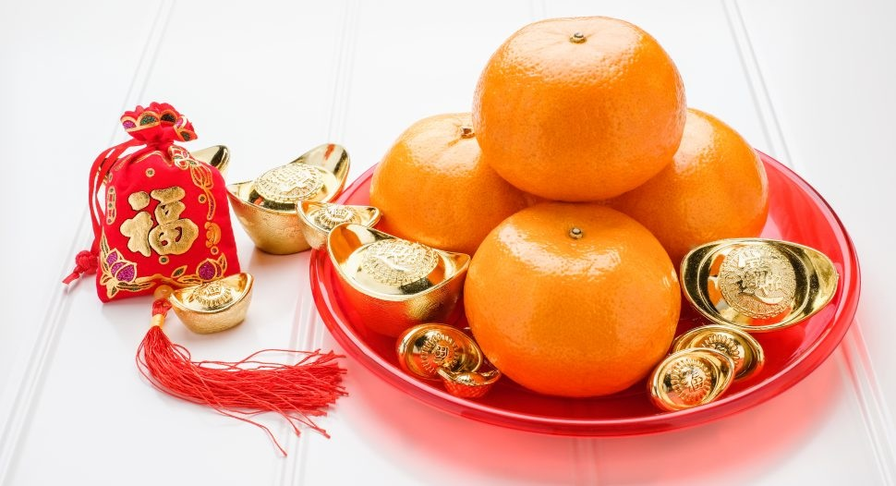
21

Slide 23
The Spring Feasts
Leviticus 23:1-22
22

Slide 24
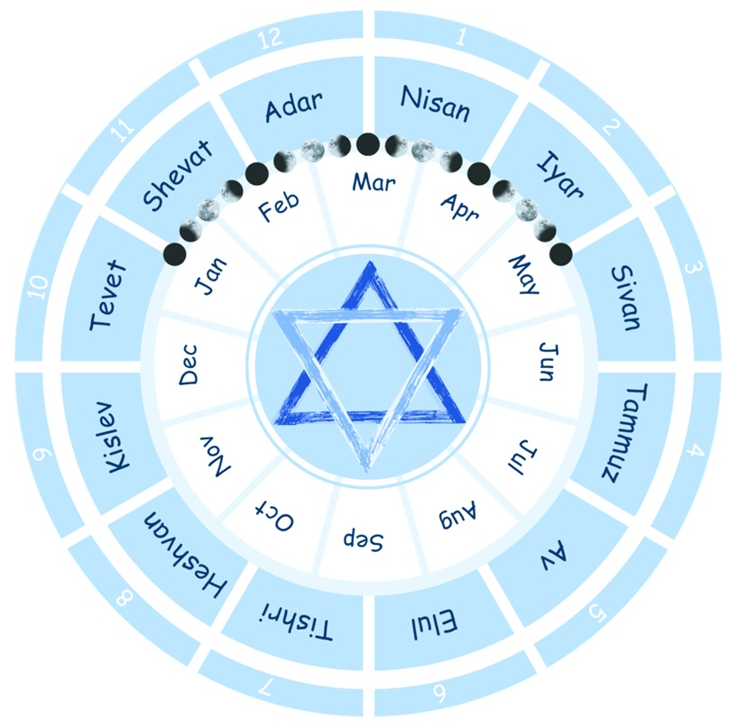
23
Notes:
https://shivat-zion.com/news/hebrew-calendar-is-the-official-calendar-of-israel/

Slide 25

lunar drift
~ -11 days
~ -11 days
leap month
~ +30 days
Lunar New Year:
2025
Jan 29
2026
2027
24
Feb 17
Feb 6

Slide 26
God's Calendar of Redemption
Leviticus 23
25

Slide 27

Sabbath => Rest & Gathering
Passover => Deliverance
Unleavened Bread => Purity
Firstfruits => Trust
Feast of Weeks => Generosity
26

Slide 28
Old Testament Practice | New Testament Fulfillment
Sabbath — Rest from work, gathering together | Rest in Christ's finished work (Hebrews 4:9-10) and gathering on the first day to celebrate the Resurrection (Acts 20:7; Hebrews 10:24-25)
27

Slide 29
Old Testament Practice | New Testament Fulfillment
Passover — Deliverance from Egypt through the blood of the lamb | Christ our Passover Lamb, sacrificed to deliver us from sin and death (1 Corinthians 5:7)
28

Slide 30
Old Testament Practice | New Testament Fulfillment
Unleavened Bread — Purity; removing leaven, leaving behind Egypt | Call to holiness and sincerity; leaving the old life of sin (1 Corinthians 5:8)
29

Slide 31
Old Testament Practice | New Testament Fulfillment
Firstfruits — Trust, offering the first of the barley harvest in trust | Christ as the firstfruits of resurrection, guaranteeing our future hope (1 Corinthians 15:20)
30

Slide 32
Old Testament Practice | New Testament Fulfillment
Feast of Weeks (Pentecost) — Gratitude and generosity at wheat harvest | The outpouring of the Holy Spirit at Pentecost, empowering a generous, Spirit-filled community (Acts 2:1-4)
31

Slide 33
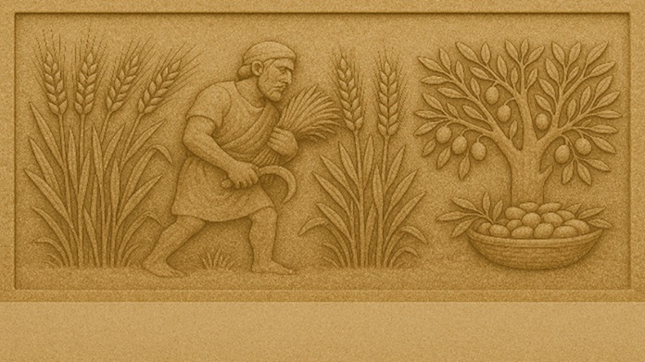
32

Slide 34
Black

Slide 35


OT Preaching link at BibleStudyDownloads.org
Get this presentation and script for free!
Notes:
OT Preaching (op)

