Slide 1
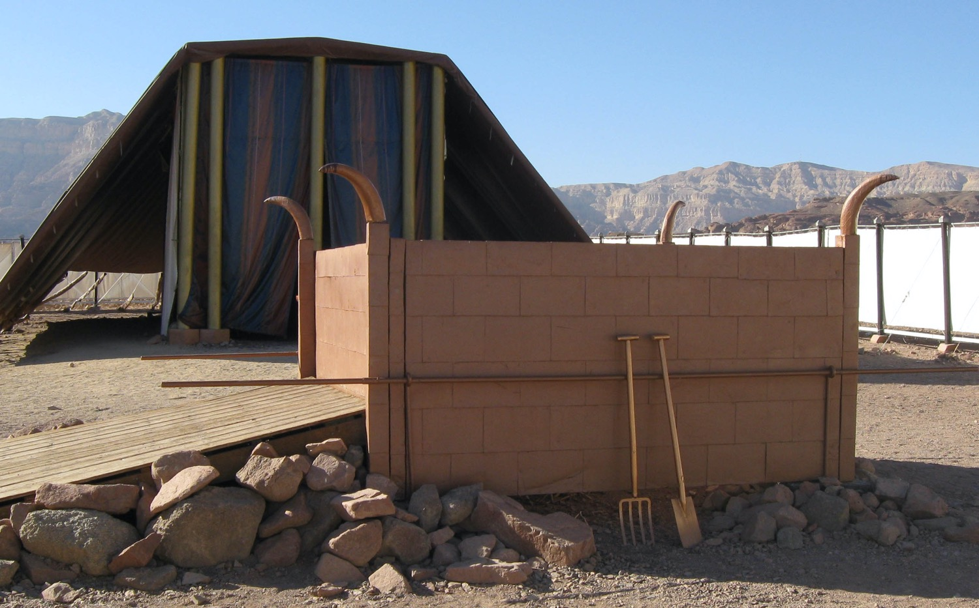
Five Offerings We Bring
Leviticus 1:1–6:7
Dr. Rick Griffith • Crossroads International Church Singapore
Singapore Bible College • CICFamily.com • BibleStudyDownloads.org

Slide 2
Do Christians always act like Christians?
Notes:
Tell your answer to this question to the person next to you.

Slide 3

Even leaders like us cleansed of our sins sometimes get out of fellowship with the Lord.
So what should we do?

Slide 4

NT Forgiveness of Sin
121b
Pipe = Relationship with God (never changing)
Sin
Clog = Fellowship with God (hindered by sin)
Notes:
• Our relationship with God can be compared to a pipe.
• Occasionally the pipe gets a clog—like sin.
• This hinders our fellowship with God.
Do we still have a relationship with God when we sin? Yes!
Sin does not hinder our relationship with God but our fellowship with Him.
• But how do you unclog the pipe?
_________
OB-38-Salvation-11
OS-03-Leviticus-72, 130
OS-04-Numbers-30

Slide 5

So how do you personally sustain your walk with God?
Promises?
Bible reading?
Prayer?
Something else?
Notes:
• Some people make promises to God that they will go wherever he wants them to go.
• Others vow that they will never miss a day of Bible reading the rest of their life.
• Still others promise daily prayer.
• How do you sustain your walk with God? What should you do?

Slide 6

How can you maintain fellowship with your holy God?

Slide 7
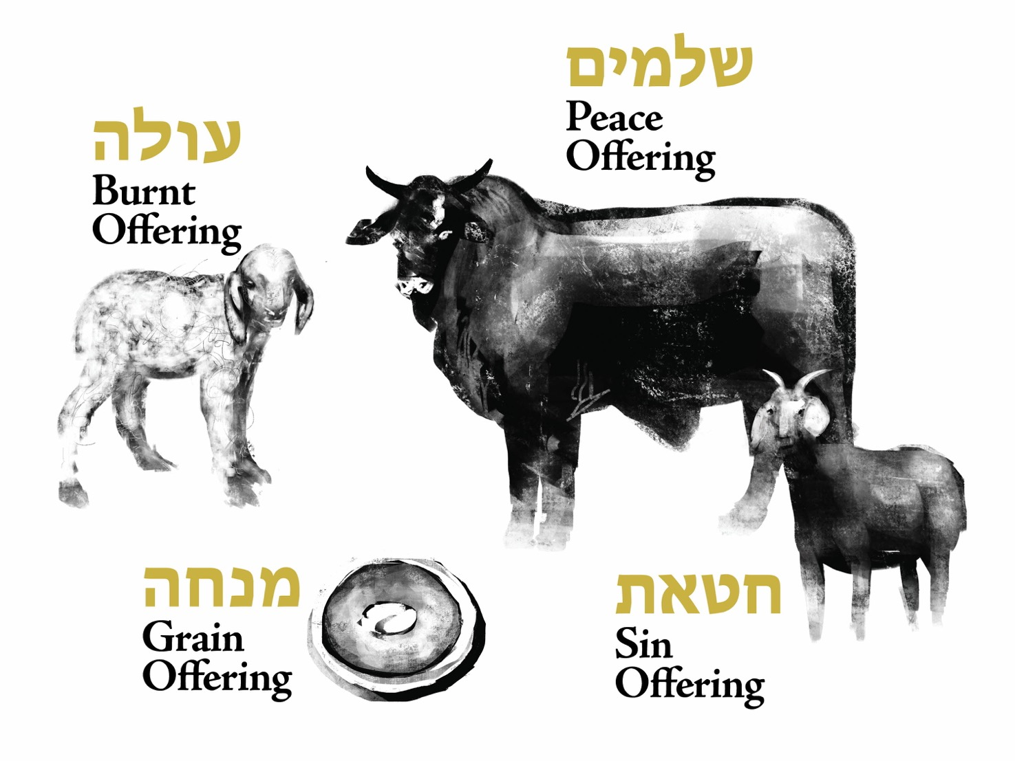
Offerings (Lev 1–7)
Fellowship
Burnt
Grain
Sin & Guilt
Notes:
We can gain insight today from studying the various offerings in the OT book of Leviticus.
How?
OT sacrifices did not establish a relationship with God but rather they restored fellowship with God for Israelites .

Slide 8
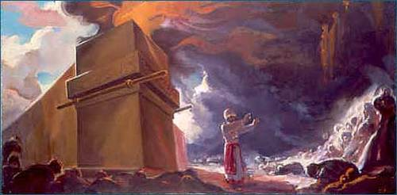
Background
Notes:
Israel already had a relationship with God—the new nation just needed to know how to sustain their fellowship with God.

Slide 9



The Passover Lamb
Notes:
A year earlier, each Israelite had been saved from death by faith in an innocent lamb.

Slide 10

Passover Protection
"The blood will be a sign for you on the houses where you are; and when I see the blood, I will pass over you. No destructive plague will touch you when I strike Egypt."
Exodus 12:13 (NIV)
Notes:
They shed the Passover lamb’s blood and put it on their doorposts.

Slide 11
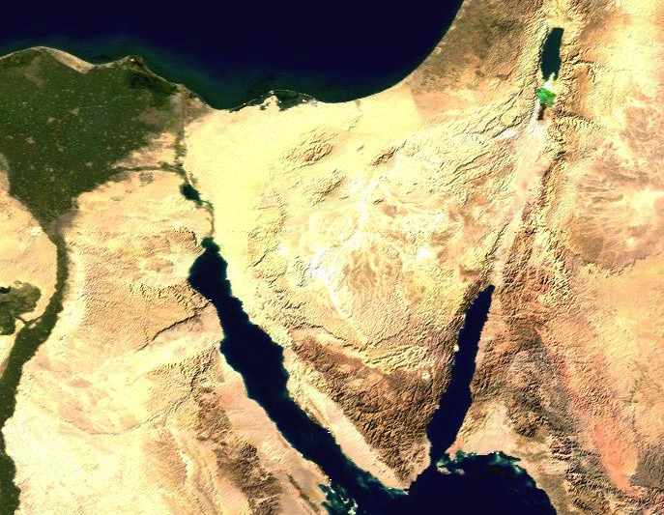
Route of the Exodus
107
111a
123
Canaan
Goshen
Desert of Sin
Marah
Elim
Midian
Mt. Sinai
Notes:
Then God miraculously parted the Sea and led his people out of Egypt—a picture of salvation for the believers since each of those redeemed had been saved from death by the Passover lamb’s blood. In other words, they had a personal relationship with God.

Slide 12
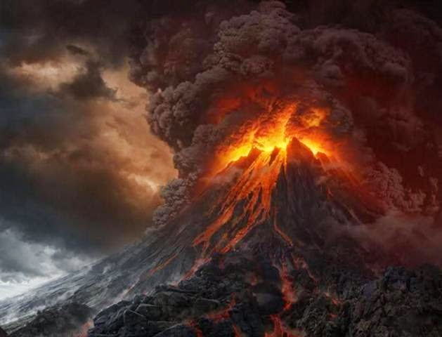
Mount Sinai
Notes:
Israel invited God’s presence at Mt. Sinai and God was pleased to dwell with them (Exodus 39:34).
Despite God’s awesome holiness at Sinai, they had come into a relationship with God though the Passover lamb at the Exodus.

Slide 13
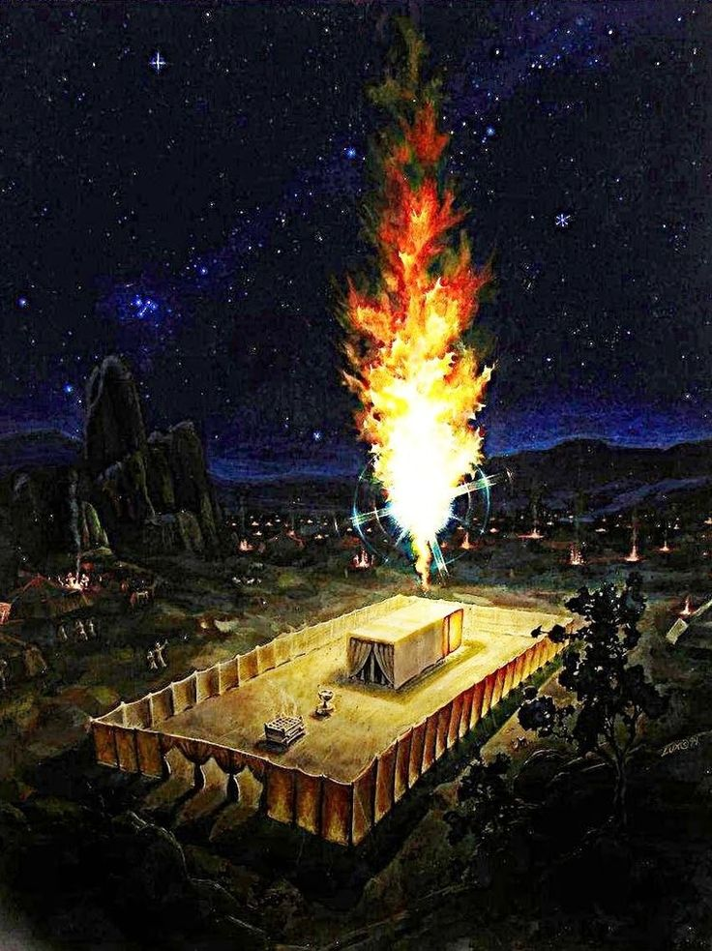
Background
Notes:
Now they stand there at the tabernacle wondering how long this will last. How could they experience God’s blessing, guidance and reality continually?

Slide 14
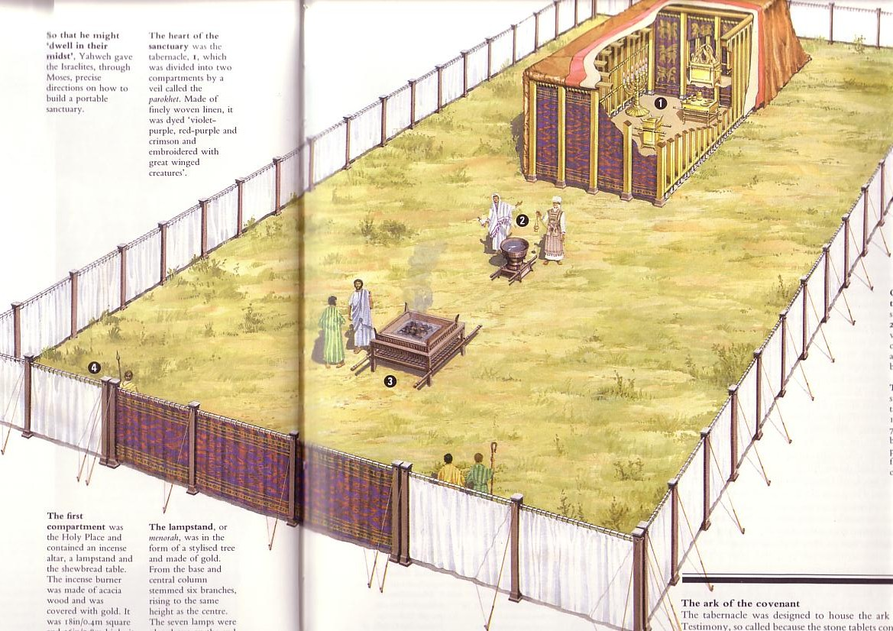
Circumstances When Leviticus Was Written
123
Israel has a new tabernacle built in the book of Exodus.
But they don‘t know how to use it.
So Moses wrote Leviticus to explain the worship and walk of the new nation.
Notes:
The tabernacle was finished but now they needed to know what to do with it!

Slide 15
How can you maintain fellowship with your holy God?
Two Ways
Leviticus 1:1–6:7
Notes:
(So what is the first way to maintain fellowship with your holy God?)

Slide 16

I. Do what is not required—extra acts of worship.
Notes:
Do things that are voluntary to honor the Lord—especially when life is so busy that we don’t do anything optional.

Slide 17
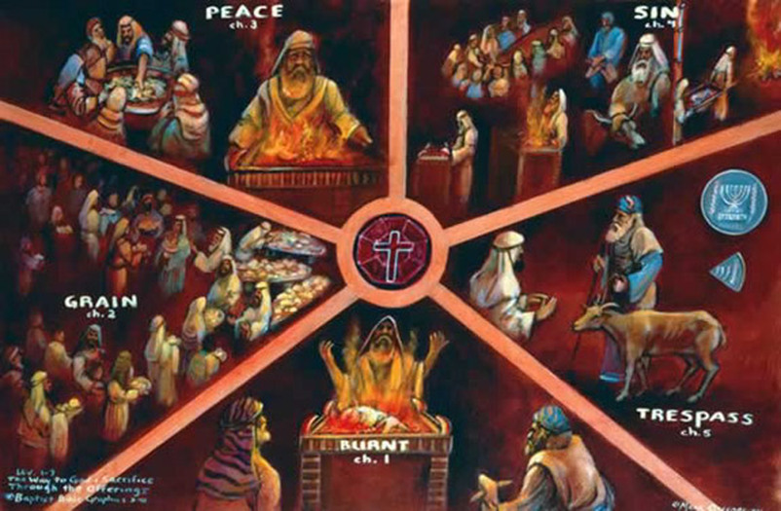
Offerings (Lev 1–7)
Fellowship
Sin
I. Do what is not required —extra acts of worship.
Grain
Guilt
Burnt
Notes:
Israel could continue to enjoy God’s presence by three sacrifices for consecration when in fellowship (Lev 1–3).
We also should express our love to God in new ways.

Slide 18
Slides on
Leviticus 1

Slide 19
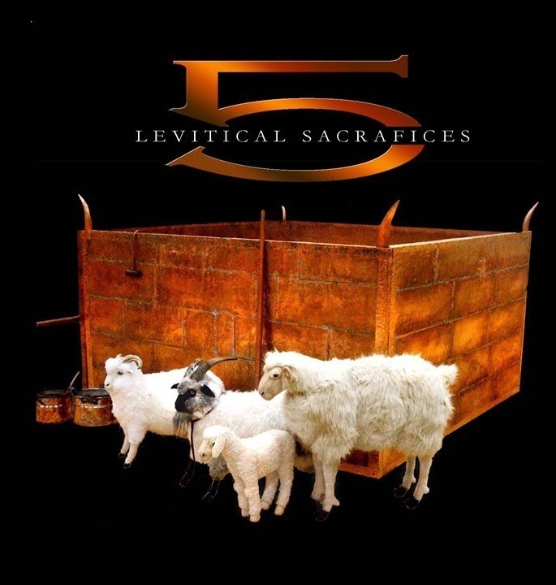
“All I am Belongs to God”
Burnt Offering
Lev 1:3-17
Notes:
The burnt offering was a voluntary sacrifice that totally consumed the animal to draw near to God in total dedication (Lev 1).

Slide 20
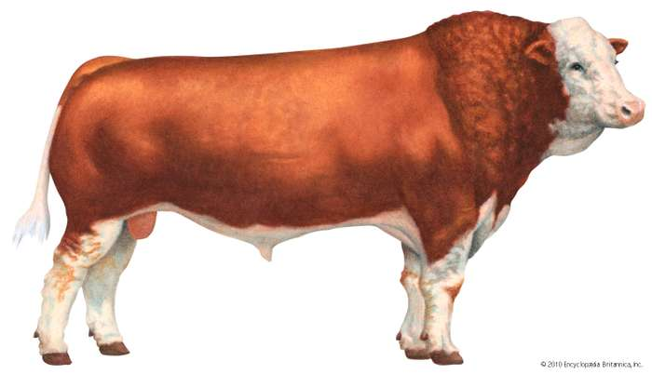
Offerings (Lev 1–7)
Burnt Offering
Notes:
The burnt offering begins with instructions to offer a bull. Wow, what an expensive gift to God! This would be several months or even a year or more wages for people!

Slide 21
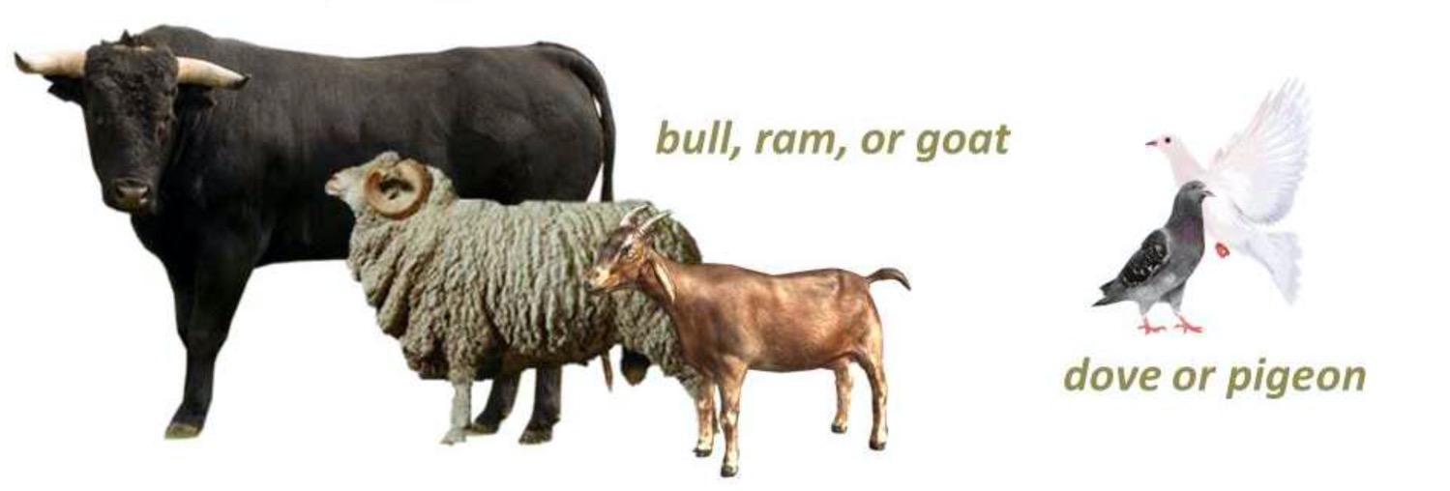
Offerings (Lev 1–7)
Burnt Offering
bull, ram or goat
dove or pigeon
Notes:
But notice that God allowed various types of animals for the same offering.
“1:2. This verse forms a transition to the law of the burnt offering by referring to an offering (NA;b√r∂q, “that which is brought” to God—a general term covering all sacrifice) from either the herd (i.e., a bull, vv. 3-9) or the flock (i.e., a sheep or goat, vv. 10-13). With the addition of birds (vv. 14-17), this provides the formal outline of the law of burnt offering (see also 6:8-13), the animals of the offering being listed in a descending order of value” (BKC).
God allowed expensive offerings (bulls) for the wealthy, moderate animals for the middle class (lambs, goats), and the poor could offer as simple an animal as a bird. Likewise, he instituted the tithe because he made sure that even the poorest person could live on 90% of his income.

Slide 22
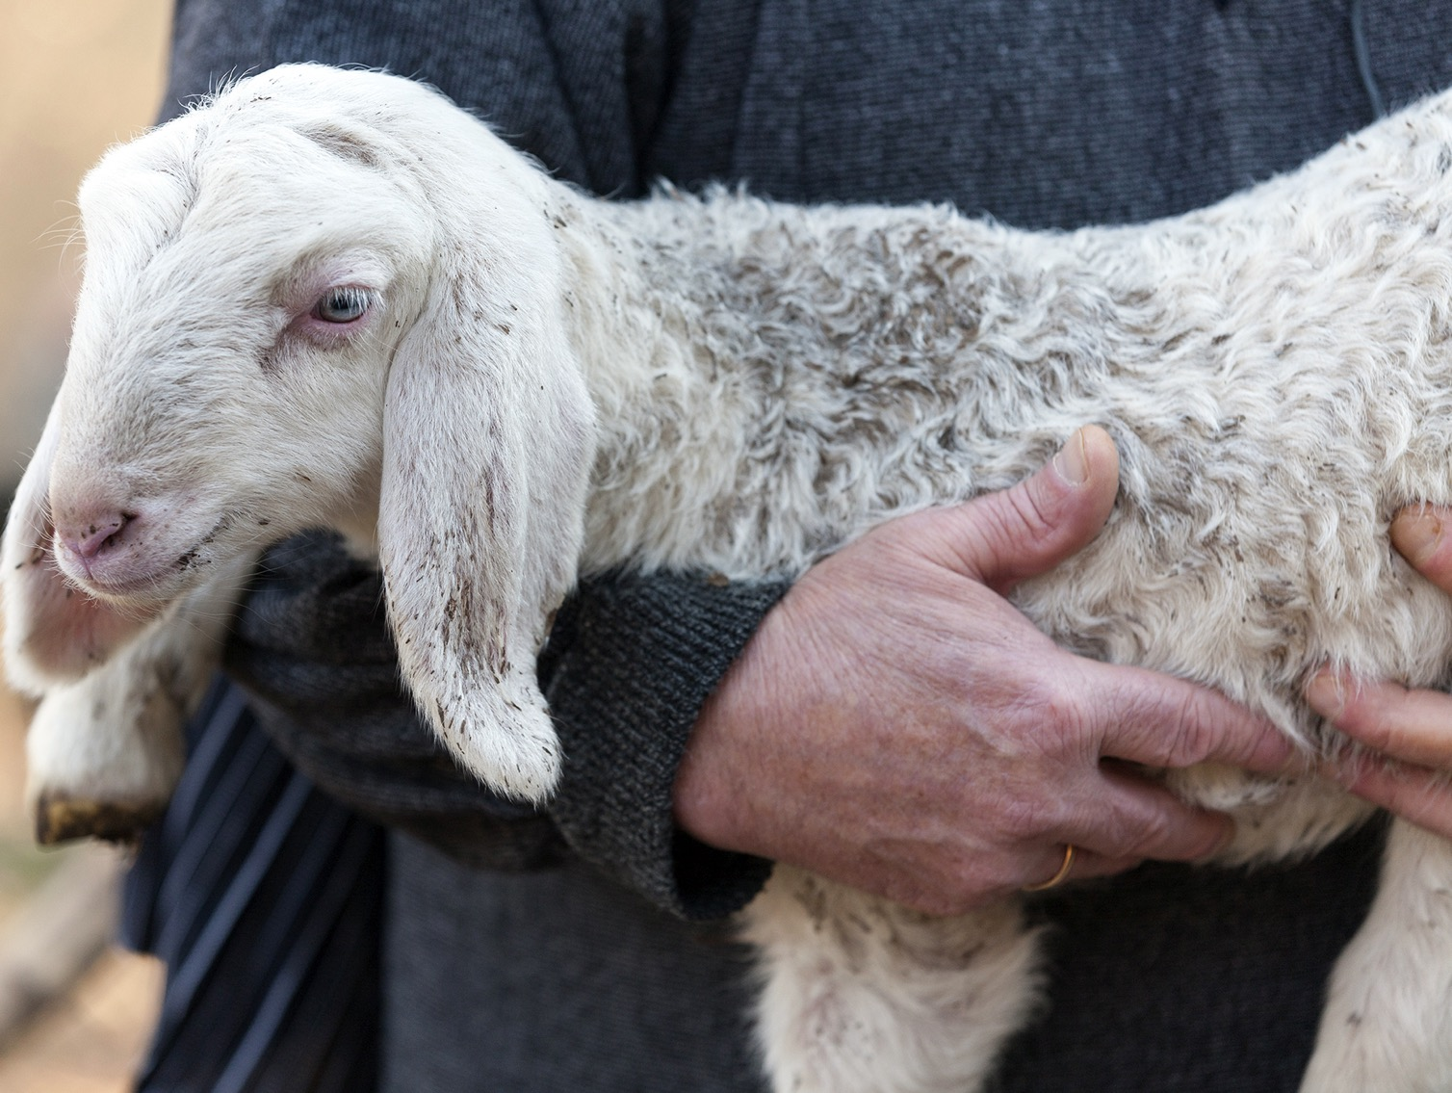
A Perfect Sacrifice
Notes:
But one thing that characterized all of these offerings is that they must be perfect animals without defect—just like our Lord Jesus Christ.

Slide 23
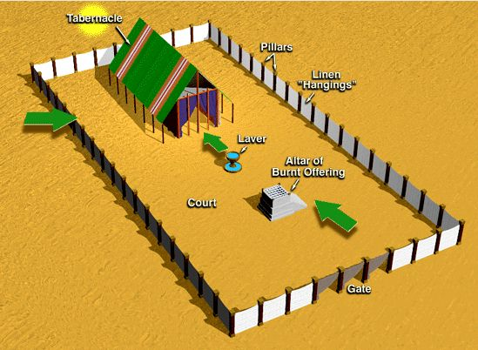
The Tabernacle & Courtyard
Tabernacle
Pillars
Linen "Hangings"
Laver
Altar of Burnt Offering
Court
Gate
Notes:
The process was also clearly given.

Slide 24
Offering Rituals in Lev. 1–5
128
The worshipper presents his offering.
He lays his hand(s) upon the victim, and possibly confesses his sin.
3. The worshipper slaughters the offering.

Slide 25
Offering Rituals in Lev. 1–5
128
4. The priest collects the blood in a basin and dashes it against the NE and SW corners of the altar in such a way that all four sides are spattered. The remainder of the blood is then poured out at the base of the altar.

Slide 26
Offering Rituals in Lev. 1–5
128
5. A portion of the sacrifice is burned.
R. T. Beckwith, New Bible Dictionary, 1962
Notes:
But for a burnt offering, the ENTIRE sacrifice was burned.

Slide 27
Offering Rituals in Lev. 1–5
128
6. Any remaining portions of the sacrifice were eaten in a sacrificial meal, either by the priests and worshippers (fellowship-offering), or by the priests and their families, or by the priests alone.
R. T. Beckwith, New Bible Dictionary, 1962

Slide 28
Slides on
Leviticus 2

Slide 29
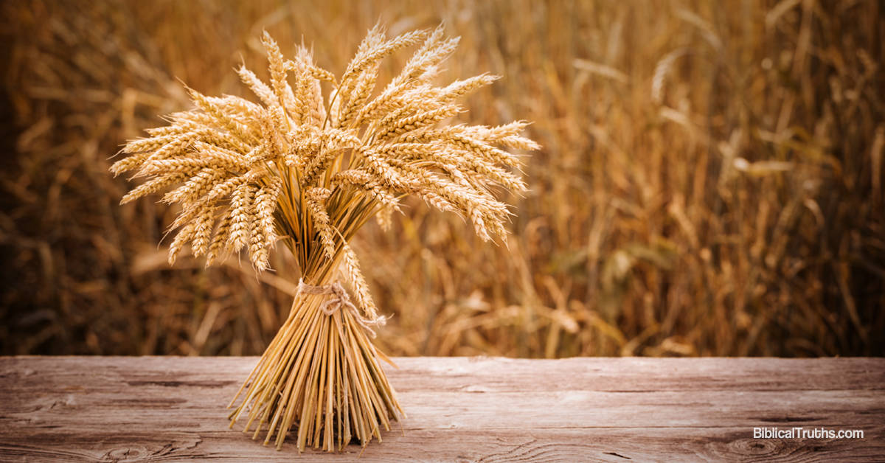
Grain Offering (Lev 2)
Notes:
The staple of our diet comes from grain.

Slide 30
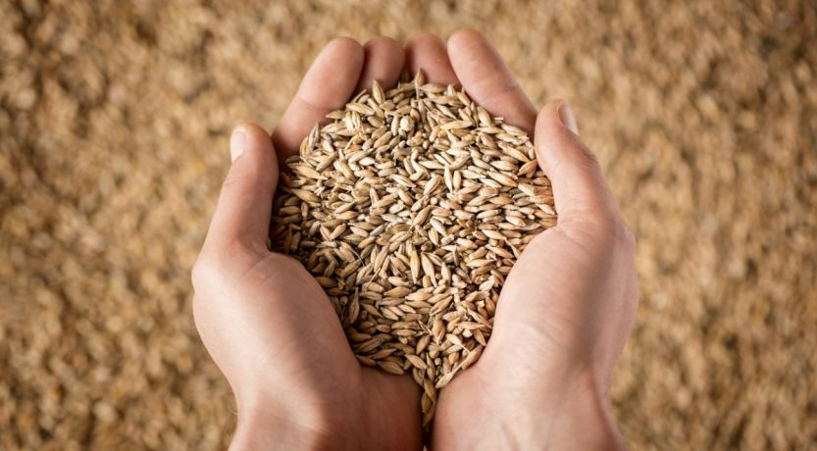
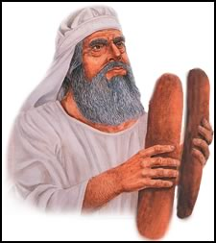
Grain Offering (Lev 2)
Notes:
When God provided grain, Israelites could offer some back to God to say thank you.

Slide 31
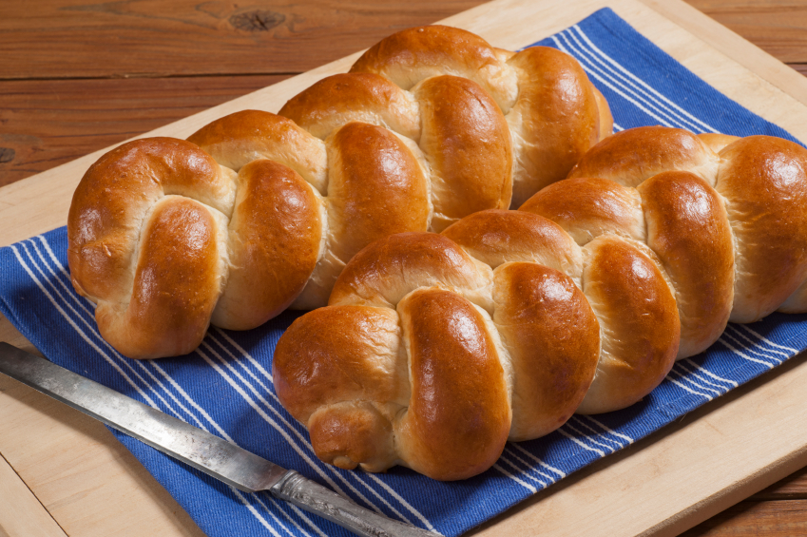
Grain Offering (Lev 2)
Notes:
Sometimes grain could be in the form of baked loaves.

Slide 32
Old Testament Sacrifices
128
NAME
OT TEXTS
ELEMENTS
PURPOSE
BURNT OFFERING
Lev 1
6:8-13
8:18-21
16:24
Perfect bull, ram or male bird (dove or young pigeon for poor); wholly consumed
Voluntary act of worship; atone for unintentional sin in general; expression of surrender to God
GRAIN OFFERING
Lev 2
6:14-23
Grain, flour, olive oil, incense, bread, with salt & burnt or fellowship offering
Voluntary act of worship; recognition of God's goodness and provisions; devotion to God
The Bible Visual Resource Book, 29
Notes:
The grain offering was a voluntary act of worship in recognition of God's goodness and provisions. It symbolized our devotion to God in response to his goodness to us.

Slide 33
Slides on
Leviticus 3

Slide 34
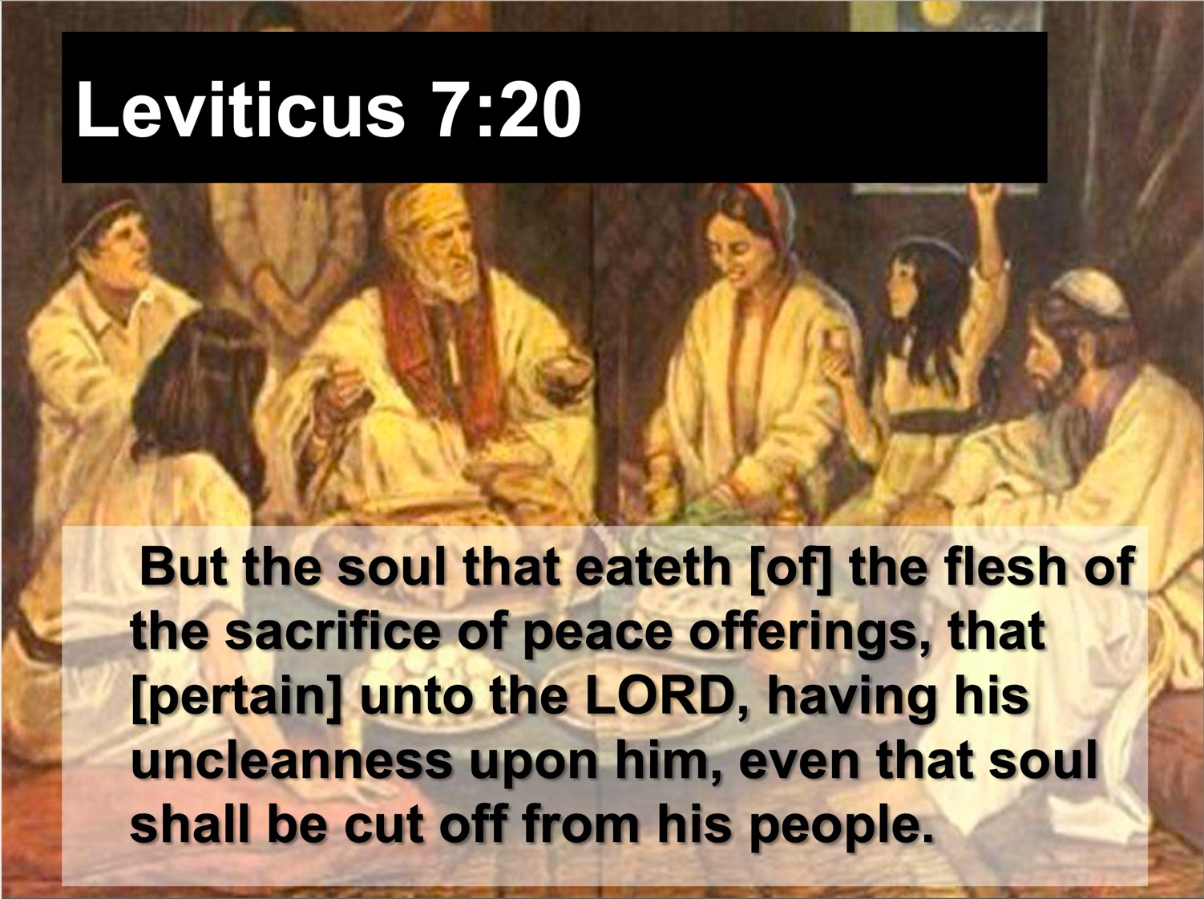
Fellowship Offering (Lev 3)
“The meat of the peace offering of thanksgiving must be eaten on the same day it is offered. None of it may be saved for the next morning” (Lev 7:15 NLT)
Notes:
“The distinctiveness of the fellowship offering was in the communal meal which the worshiper and his family ate before the Lord (cf. 7:15). It was essentially a voluntary act in which the worshiper accepted the meat from God as a token of His covenant faithfulness and gave God acknowledgment or thankful praise for His past blessings bestowed, whether in answer to prayer, or granted unexpectedly, or the normal blessings [1:180] such as a good harvest” )” (Lindsey, BKC, 1:179-80).

Slide 35
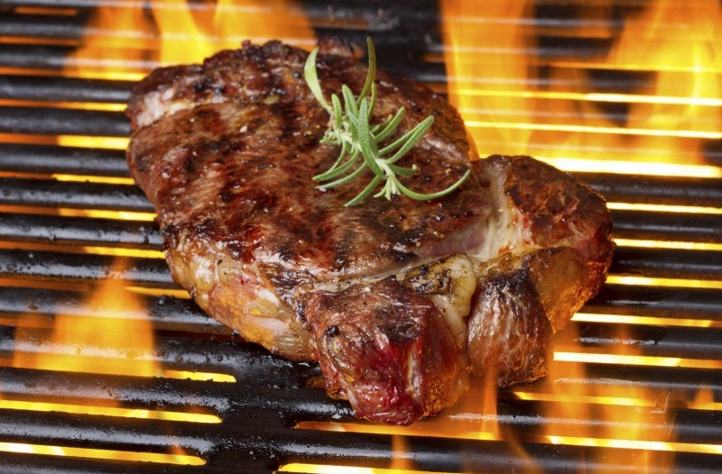
Why “an aroma pleasing to the LORD” (Lev. 1:9, 17; 2:2, 9, 12; 3:5, 16; 4:31)?
Notes:
Why are these offerings called “an aroma pleasing to the LORD” (Lev. 1:9, 17; 2:2, 9, 12; 3:5, 16; 4:31)?
• Simply put, God likes BBQ!
More seriously, the Lord is pleased to see his people follow his ways. All obedience is like a sweet fragrance to God—especially sacrifices that express our love for him or restore our fellowship with him

Slide 36
We also should express our love to God in ways he does not specifically command.
Notes:
Do things that are voluntary to honor the Lord—especially when life is so busy that we don’t do anything optional.

Slide 37
Romans 12
154e
Righteousness is applied in transformed living

Slide 38

Righteousness in Romans
145
Theme | Needed | Provided | Imparted | Proved | Applied | Dissem-inated
Intro 1:1-17 | Condem-nation 1:18– 3:20 | Justifi-cation 3:21– 5:21 | Sanctifi-cation 6–8 | Election 9–11 | Trans-form-ation 12:1– 15:13 | Propa-gation 15:14– 16:27
Start | Sin | Salva-tion | Set Apart | Sove-reignty | Service | Send

Slide 39

Romans 12:1
154e
"Offer your body as a
living sacrifice…”
Notes:
Offering our bodies continually is our counterpart to the whole burnt offering (Rom 12:1)—but staying alive on the altar is challenging.

Slide 40


ROMANS 12:2
BE TRANSFORMED
BY THE RENEWING OF YOUR MIND

Slide 41
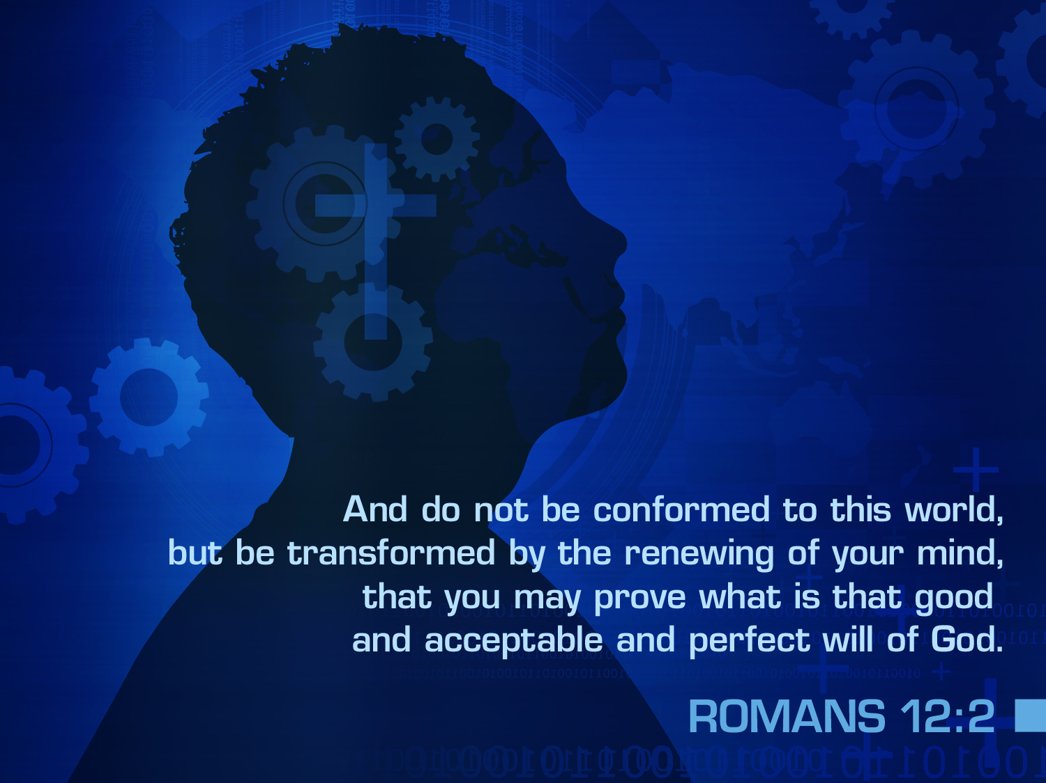

ROMANS 12:2
And do not be conformed to this world,
but be transformed by the renewing of your mind,
that you may prove what is that good
and acceptable and perfect will of God.

Slide 42
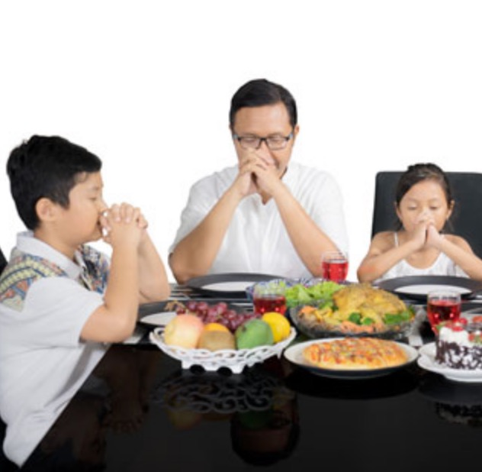
Grain Offering = Giving Thanks
Notes:
Thanking God for our food parallels the grain offering.

Slide 43

Body Life (Rom. 12)
154e
Notes:
Community worship is also a fantastic privilege! Don’t look at church as a burden but as a blessing. That’s why the fellowship offering is also called the peace offering. “The typology of the fellowship offering pictures the fellowship that the New Testament believer has with God and with other believers on the basis of Christ’s death on the cross (1 John 1:3). This is one phase of Christ’s ‘making peace through His blood, shed on the cross’ (Col. 1:20). In fact, ‘He Himself is our peace’ (Eph. 2:14)” (Lindsey, BKC, 1:180).

Slide 44
Old Testament Sacrifices
128
NAME
OT TEXTS
ELEMENTS
PURPOSE
FELLOWSHIP OFFERING
Lev 3
7:11-34
Perfect goat or sheep; variety of breads
Voluntary; thanksgiving with group meal
SIN
OFFERING
Lev 4:1–5:13 6:24-30
8:14-17
16:3-22
Perfect bull, goat, or lamb; dove/pigeon (poor); 1/10 ephah fine flour for very poor
Mandatory; atoned for unintentional sin; confession, forgiveness & cleansing
GUILT OFFERING
Lev 5:14–6:7
7:1-6
Perfect ram or lamb
Mandatory to atone for unintentional sin; pay 20% fine
The Bible Visual Resource Book, 29
Notes:
Peace and fellowship were experienced in a group meal.

Slide 45
I. Do what is not required—extra acts of worship.
Notes:
Do things that are voluntary to honor the Lord—especially when life is so busy that we don’t do anything optional.

Slide 46
Offerings (Lev 1–7)
Fellowship
Sin
I. Do what is not required —extra acts of worship.
Grain
Guilt
Burnt
Notes:
Israel could continue to enjoy God’s presence by three sacrifices for consecration when in fellowship (Lev 1–3).
We also should express our love to God in ways he does not specifically command.

Slide 47
Offerings in Leviticus 1–7
128
Whole burnt offering
Grain offering
Fellowship offering
Sin offering
Guilt offering
Consecration
Voluntary
Cleansing
Obligatory
Notes:
• So the first group of three offerings tell us to do what is not required—
• extra acts of worship from consecration to God.
• But now we will see another group, so what is the difference between this group of sacrifices? Why have two different groups of offerings? The first three simply expressed thanks and worship of God.
• But now the last two enabled worshippers to confess their sin in a very tangible way.
• Sacrifices of consecration were voluntary.
• But sacrifices of cleansing were obligatory.
So what is the second way to maintain fellowship with your holy God? These last two offerings teach us to…

Slide 48
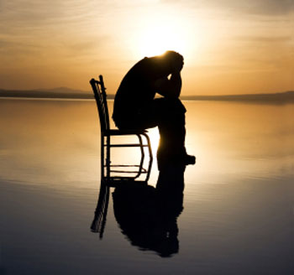
II. Do what is required
—confession of sin.
Notes:
Do things that are compulsory to restore our walk the Lord.

Slide 49
Offerings (Lev 1–7)
Fellowship
Sin
II. Do what is required
—confession of sin.
Grain
Guilt
Burnt
Notes:
Do things that are compulsory to restore our walk the Lord (Lev 4:1-6:7).
Israel could continue to enjoy God’s presence by sacrifices for cleansing when out of fellowship (4:1–6:7).
Give priority to take time to agree with God about your own sin.

Slide 50
Slides on
Leviticus 4

Slide 51
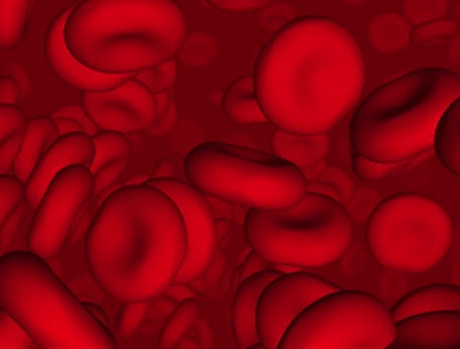
Why did God institute the sacrificial system?
Did the blood actually forgive sin?
Notes:
Did these sacrifices forgive sin in the sense that they established a relationship with God?

Slide 52
Did blood sacrifices save Israelites under the Law?
BLOOD
Notes:
The answer is NO, for Israel was already a saved community.

Slide 53
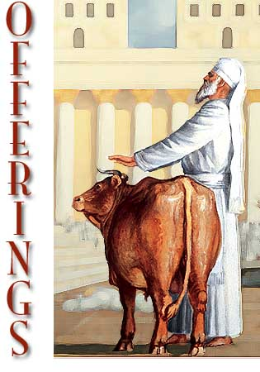
Sacrifices forgave sin
"Through this process, the priest will purify the people, making them right with the LORD, and
they will be forgiven"
(4:20 NLT; cf. 4:26, 31, 35).
Notes:
They only needed to know how to maintain their fellowship with a holy God.

Slide 54
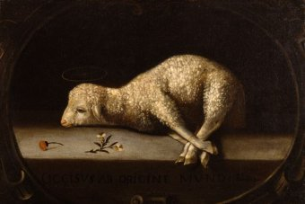
God forgave Israelites through the blood of offerings
(Lev 4:1–5:13; 6:24-30).
Notes:
Jews restored their fellowship with the Lord through sin and guilt sacrifices.

Slide 55
Slides on
Leviticus 5

Slide 56
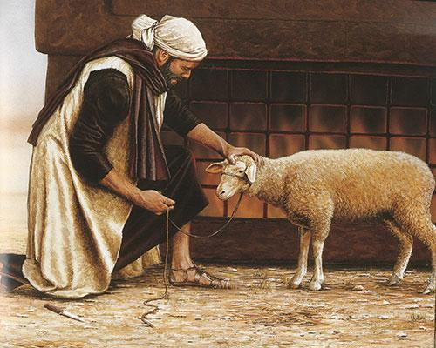
The blood and restitution of the guilt offering forgave unintentional sin
(5:14–6:7; 7:1-10).
+20%
Notes:
The guilt (trespass) offering was an obligatory sacrifice to make restitution for withholding proper due from God or man (5:14–6:7).
• It required an additional 20% restitution for doing wrong to someone else.

Slide 57
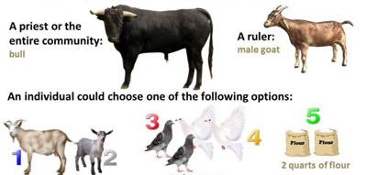
Guilt Offerings
WHY: Atone for accidental sins
WHAT: Depends on who the offender is
A priest or the entire community:
A ruler:
bull
male goat
Other individuals could choose one of the following:
1 female goat or
1 female lamb
2 pigeons or doves
2 quarts of flour
Notes:
God made covering one’s guilt possible no matter his social status!

Slide 58

OT Forgiveness of Sin
121b
Pipe = Relationship with God (never changing)
Sin
Clog = Fellowship with God (hindered by sin)
Sacrifices = Confession of Sin (sin forgiven to restore fellowship but relationship was never threatened)
Notes:
OS-04-Num-29
OP-02-Lev-28
NS-23-1Jn-58
Do we still have a relationship with God when we sin? Yes!
Sin does not hinder our relationship with God but our fellowship with Him.
OT sacrifices did not establish a relationship with God but rather they restored their fellowship with God

Slide 59
NT Forgiveness of Sin
121b
"If we confess our sins,
He is faithful and righteous to forgive us our sins and to cleanse us from all unrighteousness"
(1 John 1:9 NAU)
Pipe = Relationship with God (never changing)
Sin
Clog = Fellowship with God (hindered by sin)
Christ's Sacrifice = The Basis for Confession of Sin (sin is forgiven to restore fellowship but relationship has never been never threatened)
Notes:
Our relationship with God can be compared to a pipe.
Occasionally the pipe gets a clog—like sin—that hinders our fellowship with God.
Do we still have a relationship with God when we sin? Yes!
Sin does not hinder our relationship with God but our fellowship with Him.
_________
OB-38-Salvation-11
OS-03-Leviticus-56, 72, 130
OS-04-Numbers-30
NS-23-1Jn-59

Slide 60
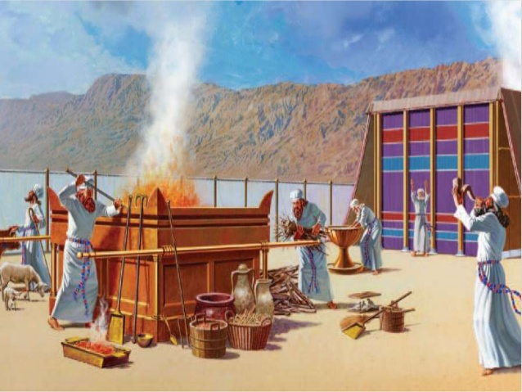
III. Main Point
Notes:
Imagine every sin costing you a month’s pay—would you sin less?

Slide 61
How can you maintain fellowship with your holy God?
Two Ways
Leviticus 1:1–6:7
Notes:
We began with this simple question.
We saw two ways it is answered.

Slide 62

Main Idea
Worship God & confess your sin.
Notes:
Reverence Him and agree when you fail [restatement].

Slide 63
I. Do what is not required—extra acts of worship.
Notes:
Do things that are voluntary to honor the Lord—especially when life is so busy that we don’t do anything optional.

Slide 64
II. Do what is required
—confession of sin.
Notes:
Do things that are compulsory to restore our walk the Lord.

Slide 65
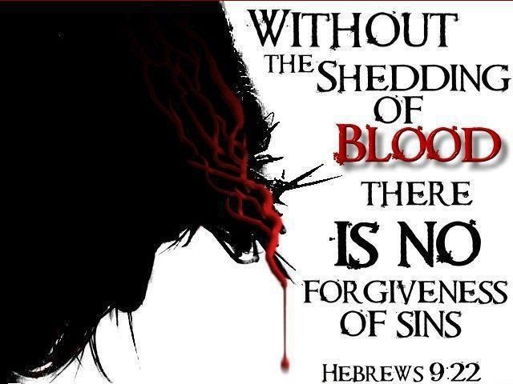
Without the shedding of
BLOOD there is no forgiveness of sins
Hebrews 9:22
Notes:
Christ made the way for us.
Without the shedding of blood there is no forgiveness.

Slide 66

"This is my body…"
Notes:
We celebrate forgiveness at the Lord’s Supper.

Slide 67

“I did not get here by myself.”
Notes:
Admit, like a turtle on a fencepost, “I didn’t get here by myself.”

Slide 68

What practice in your life must you confess and purge?
Follow peace with all men, and holiness, without which no man shall see the Lord.
Hebrews 12:14 KJV
Notes:
What issue do you need to address with God now?
Telling the Lord that you love him?
Neglecting community?
Resisting his promptings?

Slide 69
Black

Slide 70


OT Preaching link at BibleStudyDownloads.org
Get this presentation and script for free!

