Slide 1
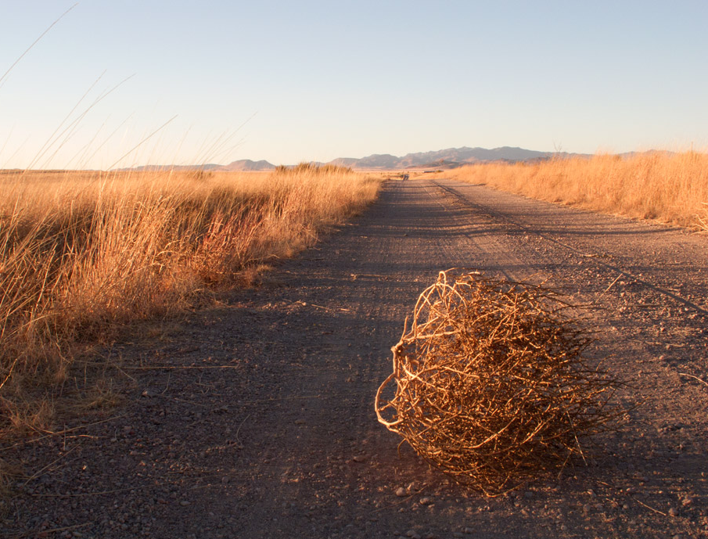
Abimelech
A Thornbush Rules the Trees
Judges 8:33–9:57
Dr. Rick Griffith, Crossroads International Church Singapore
BibleStudyDownloads.org

Slide 2

Both Running
Notes:
The US presidential election is in five weeks and has everyone perplexed how the people must choose between two unpopular candidates.

Slide 3
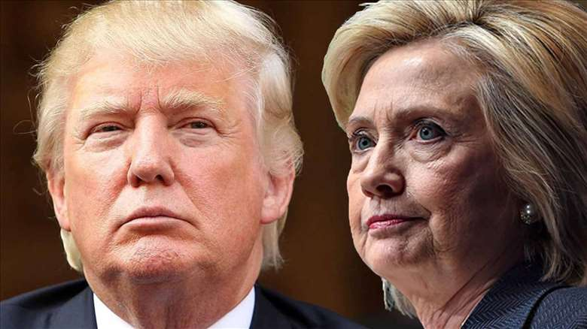
Both Disliked
Notes:
Like the days of the judges, the two candidates have a higher disapproval rating than approval rating! How did that happen?

Slide 4

Both Not Trusted
Notes:
How can the people elect those whom they despise?

Slide 5
Why is it that we often have choices of leaders, but none of these choices is desirable?
Why don't we have better leaders ?

Slide 6
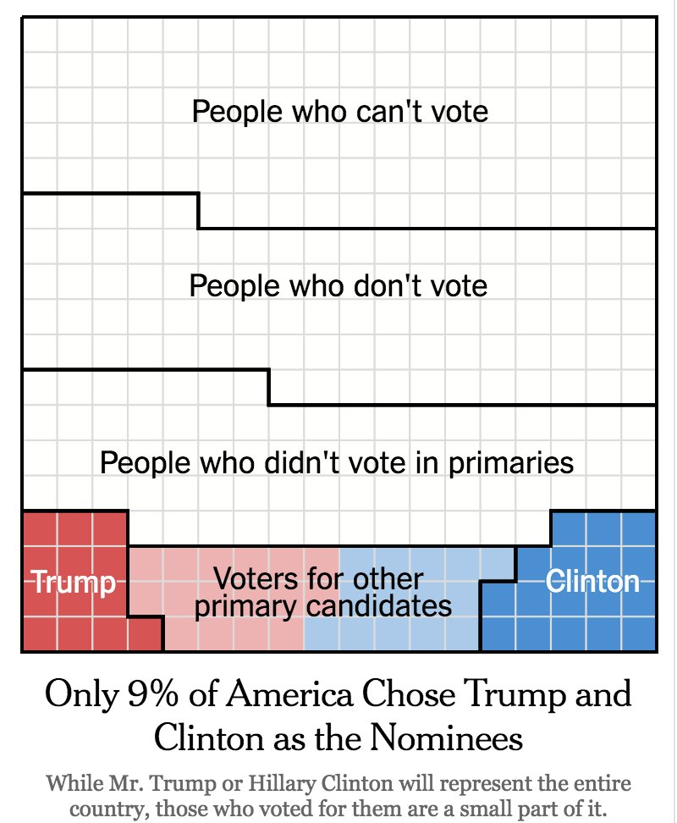
Need
Notes:
Well, apathy and division rules. These two candidates were chosen from the votes of only 9% of the electorate!

Slide 7
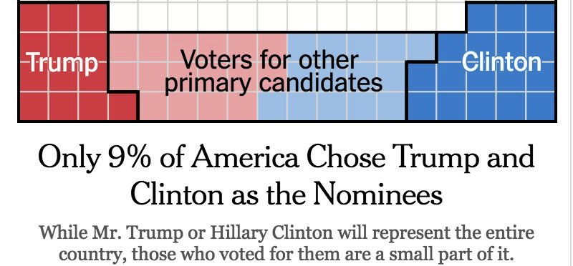
Need

Slide 8
Leaders will never be better than the people who select them. The moral decline in the US as a whole now shows up in the undesirable options to choose from for president.
Notes:
READ ABOVE
This leads us to the key point of our text today that I want to share upfront. So here's the…

Slide 9
Main Idea
All people deserve their leader.
Notes:
You got a leader? That's because you chose him or her. Of course, this applies only when you have a choice. In some cases, others take over without our voice.

Slide 10
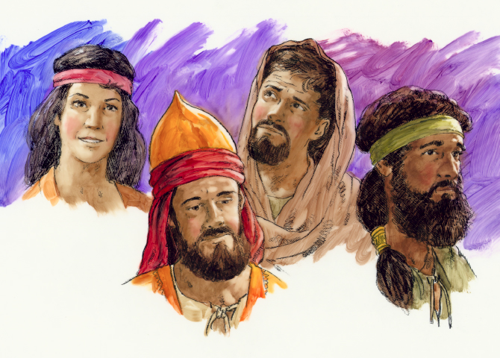
Judges
Judges
Notes:
We have been seeing in our study of Judges that Israel worshipped idols, so it had idolaters to choose from as leaders.

Slide 11

Band-Aids on a Gunshot Wound
Lessons from Judges
Notes:
Our series is called "Band-Aids on a Gunshot Wound." That means you have serious problems but not serious solutions to address them!

Slide 12
Everyone worships.
Notes:
Of course, here is the corollary point: Everyone worships.
PLAY VIDEO

Slide 13
Key Verse
172
"In those days Israel had no king;
everyone did as he saw fit
(what was right in his own eyes)"
(Judges 17:6; 21:25)
Judges
Notes:
We all worship something, but Israel had the basic problem of worshipping the wrong God as seen in the theme verse in 21:25.

Slide 14
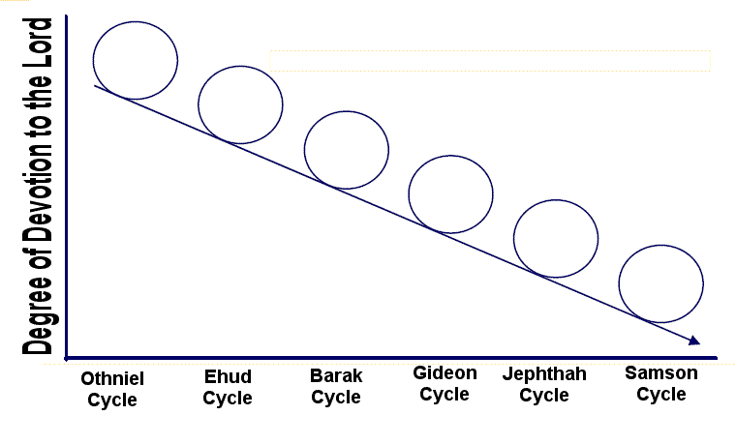
Downward Spiral of the Cycles
Degree of Devotion to the Lord
Othniel
Cycle
Ehud
Cycle
Barak
Cycle
Gideon
Cycle
Jephthah
Cycle
Samson
Cycle
Notes:
This led to a downward spiral of leaders and other nations oppressing them, but in today's text we'll see it even got worse with civil war—a self-inflicted "gunshot wound," if you will.

Slide 15
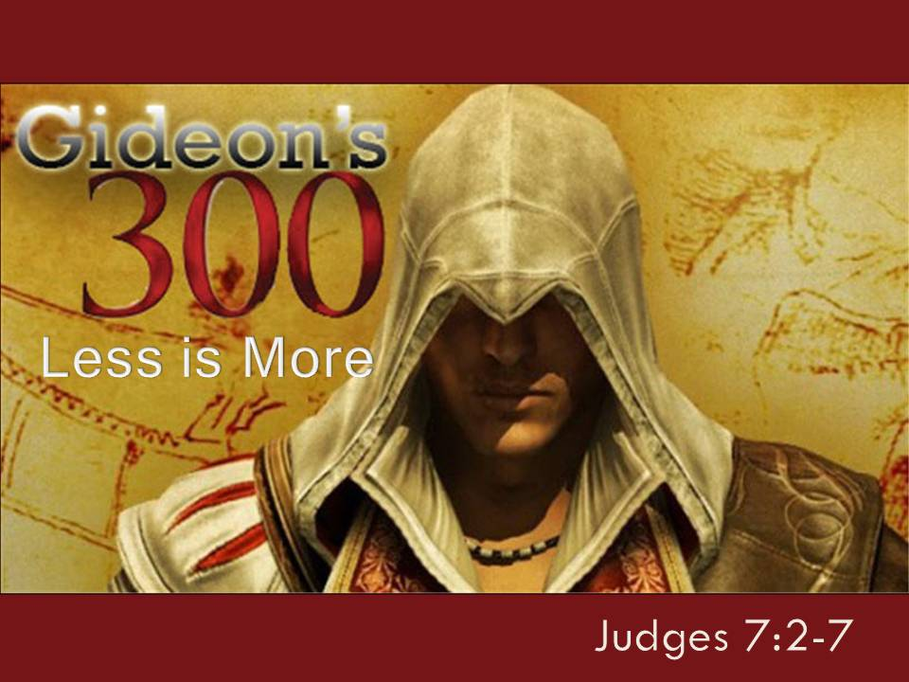
"Scripture" (6: NLT).
Notes:
Last week we saw that Gideon won a fantastic victory for Israel that brought 40 years of peace. With 300 men he defeated 135,000 Midianites and Eastern peoples.

Slide 16
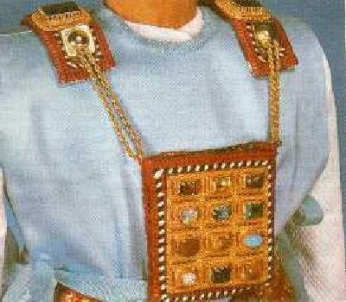
God judged Gideon for foolishly making an ephod that the people worshipped (8:22-27).
Notes:
However, those 40 years of glory also had some cracks in the armor when Gideon tortured some who opposed him, made an ephod that the people worshipped, as well as him giving birth though his concubine to a son named Abimelech.

Slide 17

The Gideon Cycle
174
"Thus Midian was subdued before the Israelites and did not raise its head again. During Gideon's lifetime, the land enjoyed peace forty years" (8:28 NIV).
1 Sin
2 Servitude
5 Silence
3 Supplication
4 Salvation
Notes:
Nevertheless, Israel was ushered into an entire generation without war.

Slide 18
Today's Preview
Israel's Self-Inflicted Crisis
(Judges 8:33–9:57)
Some Lessons for Us
Notes:
Today let's see how this leadership crisis was actually caused by the people themselves, and then draw some principles from this to live by.
The familiar cycle in Judges begins with Cycle 5 where…

Slide 19
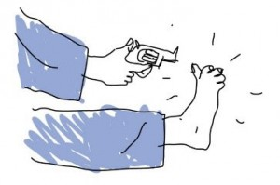
I. Israel's five-fold sin pattern was self-inflicted (8:33–9:57).
Notes:
The people couldn't blame anyone else beside themselves for their woes.

Slide 20
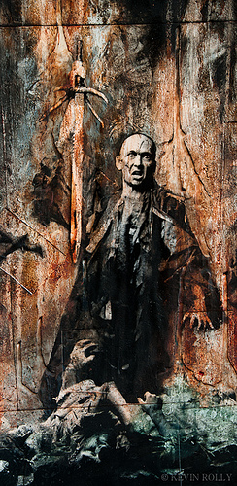
Abimelech introduced (8:29-32)
Notes:
Israel's sin pattern got even worse than the earlier ones:
Sin: Israel sinned against the LORD by worshipping the Baals (8:33-35).
The essence of the sin was sexual, which starts in last weeks' text of 8:29-32.

Slide 21
The four cycles in the book of Judges so far should have clued us into all-familiar patterns of sin. Simply stated, the one thing we learn from sin is that we don't learn from sin! We see others sin and suffer terrible consequences, but then we do the same without learning from their mistakes.

Slide 22
Redefining Sexual Immorality and Fornication
Fling
Affair
One night stand
Mistress
Failure
Affront
One night fall
Adulteress
"Concubine"
Notes:
One such area of sin is sexual relationships apart from marriage. We used to call this "sexual immorality" or "fornication," but that sounds too sinful. So now we call it a "fling" or an "affair" or a "one night stand." It would be better to call these a "failure" or an "affront" or a "one night fall." Instead of the nice-sounding "mistress" we actually have the not-so-nice sounding "adulteress."
In the days of the judges, women with whom men committed sexual immorality were called concubines. The BKC calls the concubine "a secondary wife who might live with her own family and be visited occasionally by her husband." Basically, they gave sexual pleasure without commitment. Of course, in a day with no real birth control, there was the possibility of pregnancy as a result. Such was the case in today's text.

Slide 23

Q&A
Was polygamy OK?
Was concubinage OK?
Notes:
1. Was it OK for Gideon to marry so many wives that he had 70 sons (8:30)?
The text doesn't say this as something God either approved or disapproved. This is simply a statement of fact.
Of course, wherever we find polygamy in the Bible, we find a host of other problems, such as jealousy, idolatry, and murder. Today's text is no exception!
2. Was it OK for Gideon to have a concubine (8:31)?
Now this is different than the rather bland statement about the many wives. We see this in the fact that the woman's name isn't noted, as well as her being from the town of ill repute called Shechem.
All this sets the reader up to expect nothing good to come about from the son of this unnamed concubine—and we aren't disappointed! Actually, we are disappointed, but at least we're expecting to be disappointed!

Slide 24
The Abimelech Cycle
174
1 Sin
"As soon as Gideon died, the Israelites prostituted themselves by worshiping the images of Baal, making Baal-berith their god. ³⁴They forgot the LORD their God, who had rescued them from all their enemies surrounding them. ³⁵Nor did they show any loyalty to the family of Jerub-baal (that is, Gideon), despite all the good he had done for Israel" (8:33-35 NLT).
Notes:
The sin associated with sex was idolatry (sin cycle of 8:33-35).
Baal worship was sexual at it core.

Slide 25
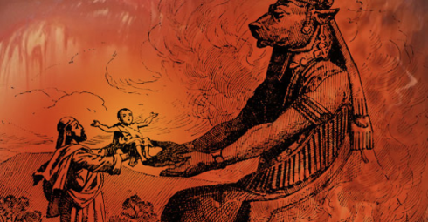
Baal Worship
Notes:
Years after Gideon "Jezebel had instituted Baal worship as the State religion in Israel. Baal was considered the God of weather and fertility and it was believed that the hot summers and lack of rain meant Baal was displeased and needed to be resurrected from the underworld to provide rain. Baal could be appeased in three ways: Unrestrained sexual immorality, child sacrifice and pantheism or the worship of creation over the creator where the environment is more important than people.
One of the consequences of this activity was unexpected pregnancies but that's not a problem for Baal as he will accept any child as a sacrifice. The arms and lap of Baal were lit with fire and the babies were placed in the fire as the drums were playing to drown out the cries of the child. The larger issue is not that the culture worshipped Baal but that God's people had also become loyal to Baal while attempting to worship Yahweh as well."
21st Century Baal Worship
By markivey
https://markivey.org/author/markivey/
Accessed 24 Sep 2016

Slide 26
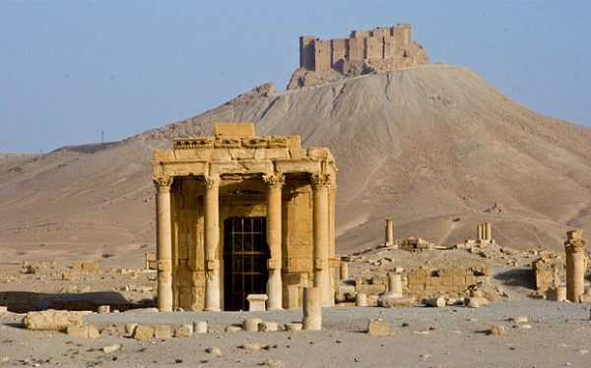
Baal Altar in Palmyra, Syria
Notes:
Baal's altar in Syria stood all the way until 2015.

Slide 27
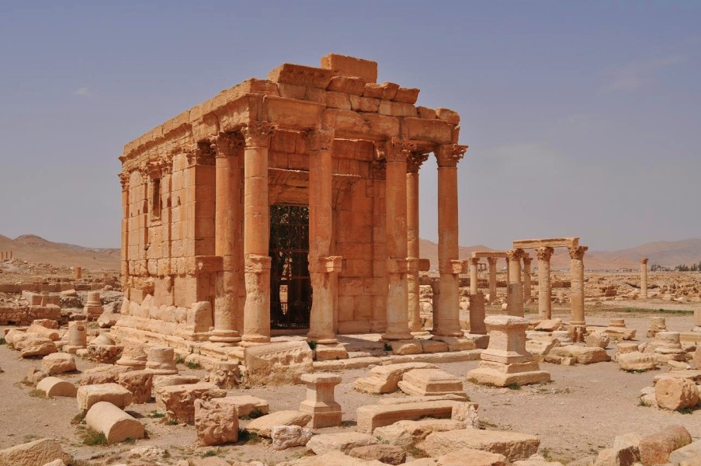
Baal Altar in Palmyra, Syria
Notes:
More about that later…

Slide 28
The Abimelech Cycle
174
1 Sin
2 Servitude
Israel's idolatry led to the fellow Israelite Abimelech terrorizing the land (9:1-49)

Slide 29
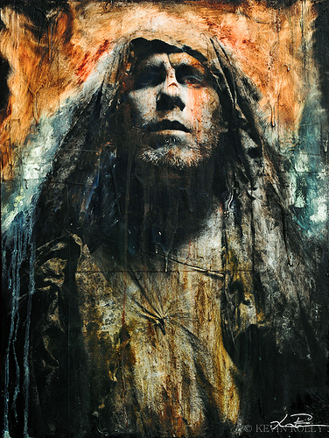
Gideon refused to be king: "I will not rule over you, nor will my son rule over you. The LORD will rule over you"
(8:23).
Notes:
After his great victory, the people had asked Gideon to be their king (8:22), but he refused, saying, "I will not rule over you, nor will my son rule over you. The LORD will rule over you" (8:23). He doesn't say which son he was talking about!

Slide 30
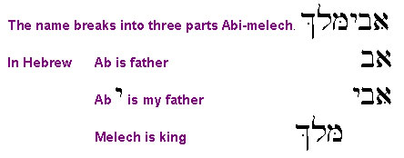
Abimelech
= “My father is king”
Notes:
So none of his 70 sons ruled. However, the one illegitimate son he named Abimelech, which, ironically, means
• "My father is king"! Gibeon began well, but in his latter years, Gideon blew it and wanted to be called king. How sad.

Slide 31
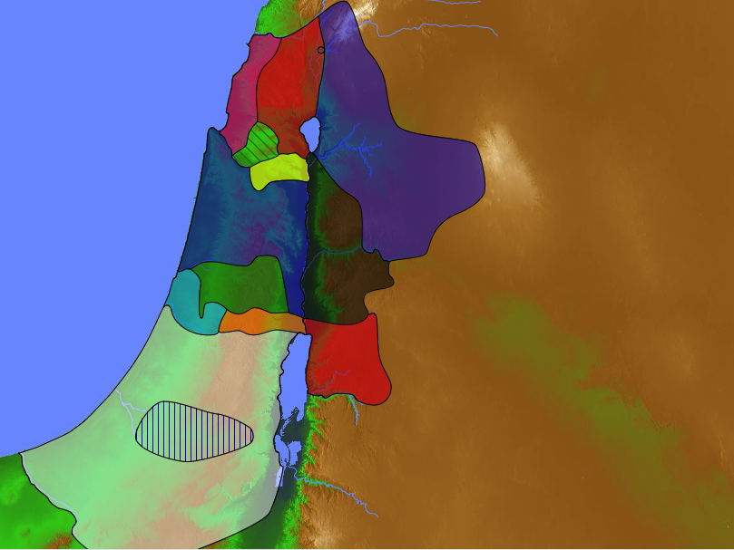
Abimelech revealed the sad state of the people as a whole in the north of Israel.
Naphtali
180a
Asher
Zebulun
Manasseh
Issachar
Manasseh
Abimelech
Gad
Ephraim
Dan
Benjamin
Reuben
Judah
Simeon
Notes:
He sought power (READ 9:1-2). What was Shechem noted for (9:1)?

Slide 32
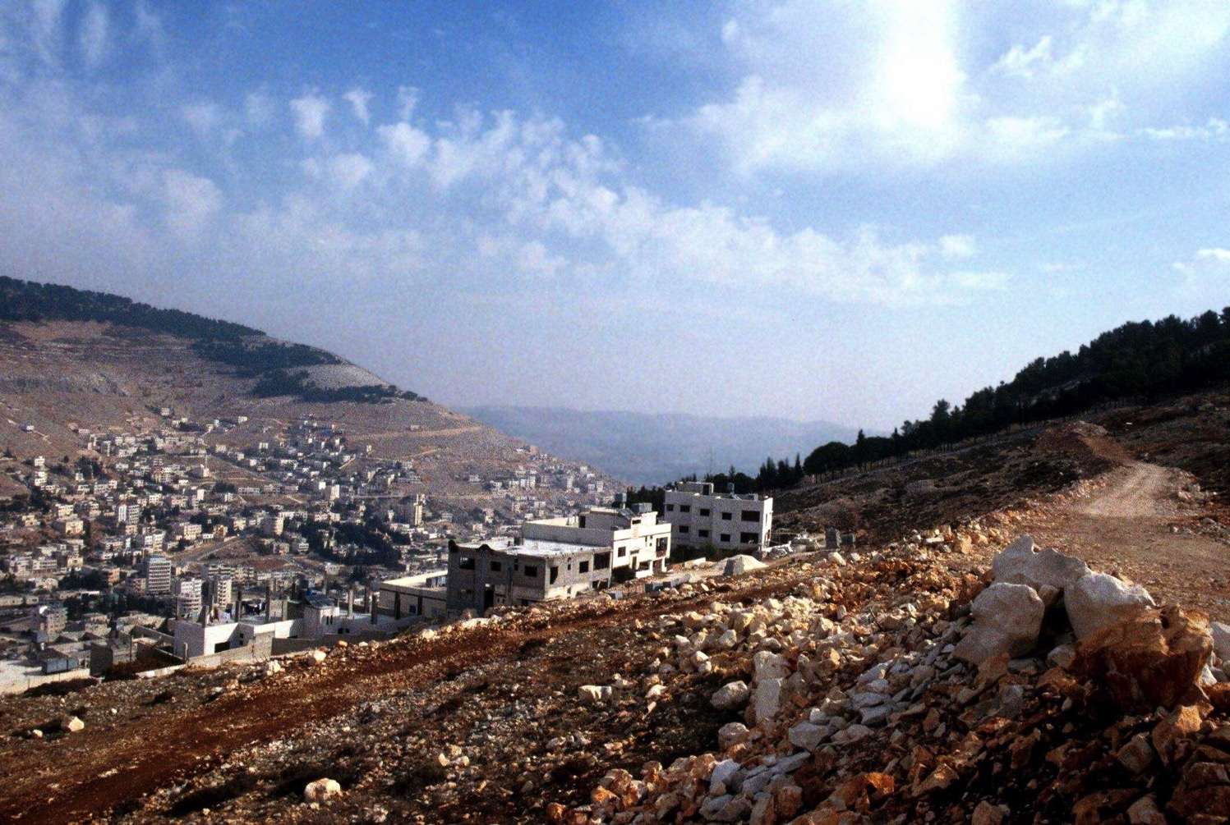
Mount Gerizim Looking East (Deut. 27:9-13)
Shechem
Mount Ebal (cursing)
Mount Gerizim (blessing)
Notes:
Way back in Deuteronomy 27:9-13 we read, "Then Moses and the Levitical priests addressed all Israel as follows: 'O Israel, be quiet and listen! Today you have become the people of the Lord your God. ¹⁰ So you must obey the Lord your God by keeping all these commands and decrees that I am giving you today.' ¹¹ That same day Moses also gave this charge to the people: ¹² 'When you cross the Jordan River, the tribes of Simeon, Levi, Judah, Issachar, Joseph, and Benjamin must stand on Mount Gerizim to proclaim a blessing over the people. ¹³ And the tribes of Reuben, Gad, Asher, Zebulun, Dan, and Naphtali must stand on Mount Ebal to proclaim a curse'" (Deut. 27:11-13).

Slide 33
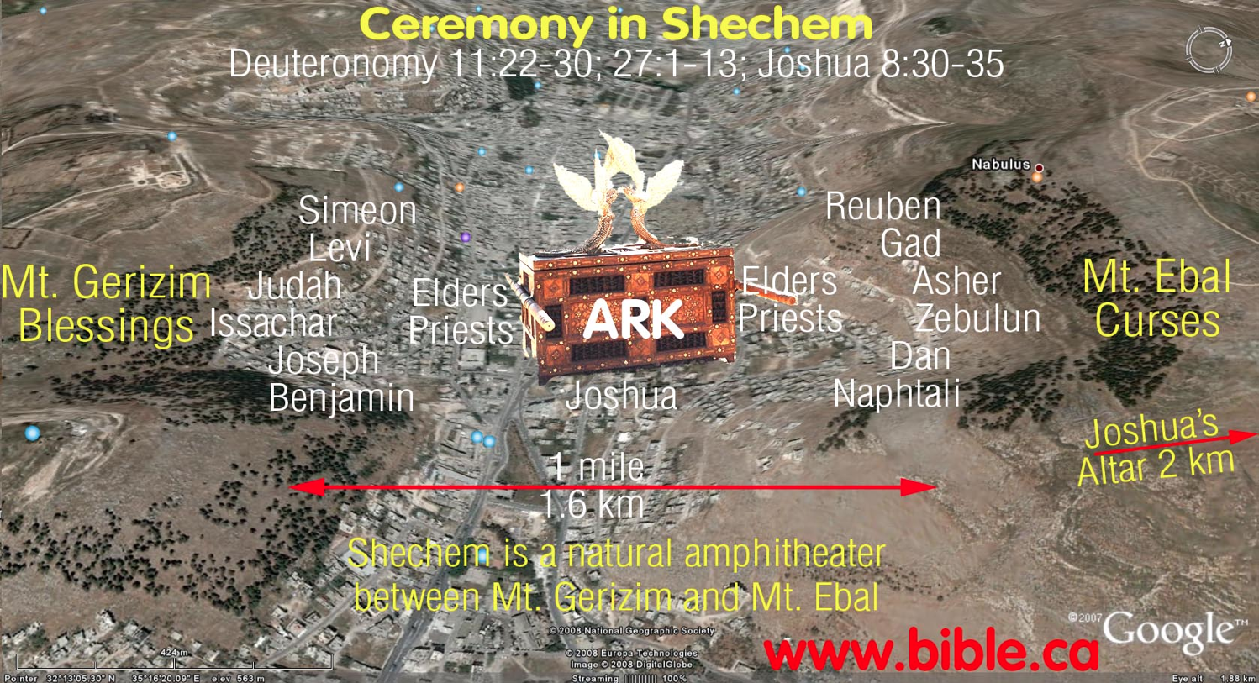
Shechem
Notes:
"The city of Shechem had been a significant religious center since the time of Abraham (Gen. 12:6-7). It was located in the narrow valley between the prominent hills of Gerizim and Ebal, the site of the recitation under Joshua of the blessings and cursings of the Law (Josh. 8:30-35) [Vol. 1, p. 397] and of the further covenant renewal ceremony before Joshua's death (Josh. 24:1-28)" (BKC, 396-97).

Slide 34
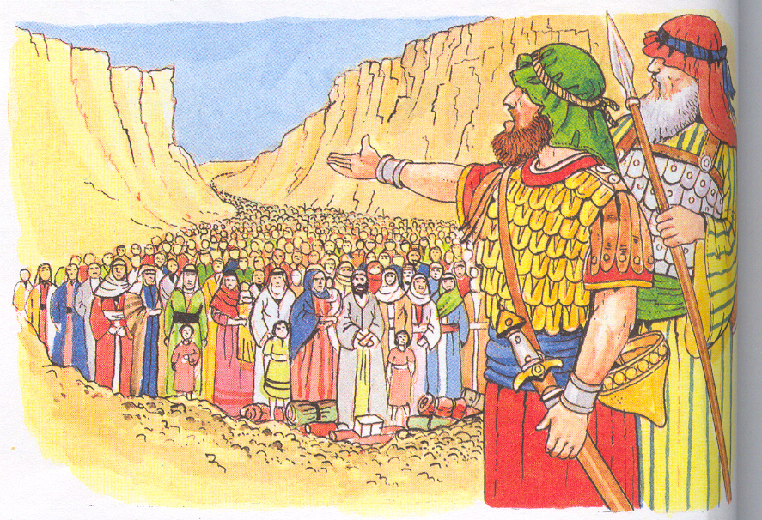
Joshua 24
Shechem
JOSHUA'S LAST
SPEECH
Notes:
Joshua claimed at this crossroads that he and his family would serve the LORD.
BKC says, "Shechem was situated on a strategic crossroads of the latitudinal route ascending from the coastal highway in the west and descending to Adam, on the Jordan River, and the longitudinal route along the central ridge from Jerusalem in the south to the northern accesses to the Jezreel Valley" (BKC, 397).

Slide 35
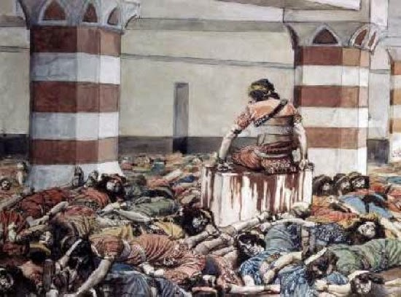
Abimelech gained power (9:3-5)
Notes:
Why did the people of Shechem want such a scoundrel as a leader (9:3)?
The people saw that Abimelech was from their city and that settled it for them. What kind of reputation he had was irrelevant. What kind of experience he had didn't matter either. Was he honorable? No one investigated.
In fact, the first actions of Abimelech showed his true colors. He couldn't raise a real army because he lived respectably and earned their trust, so they raided their temple to pay "reckless adventurers" (read scoundrels) to kill Abimelech's own brothers!
Basically, the people of Shechem couldn't get a leader any better than them.

Slide 36
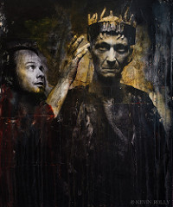
Abimelech crowned king (9:6)

Slide 37
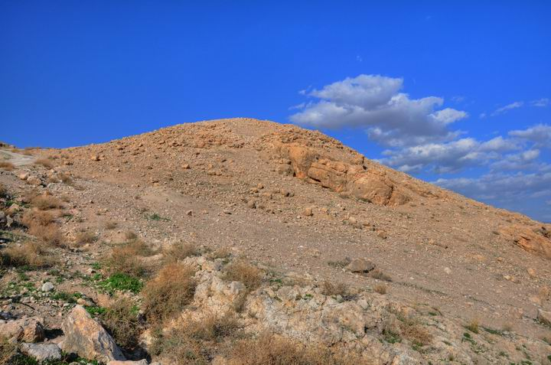
He was challenged by Jotham (9:7-21).

Slide 38
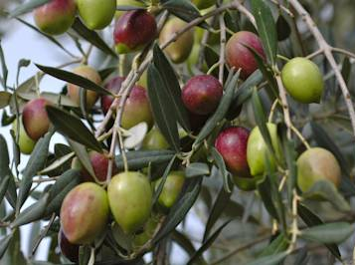
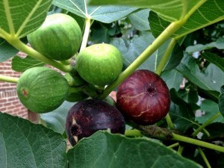
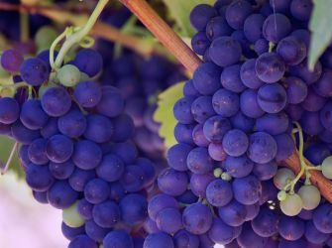
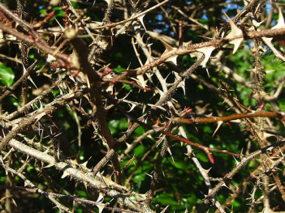
Who should rule?
Olive tree?
Fig tree?
Vine?
Thornbush?
Notes:
What's the point of Jotham's parable about the various types of trees ruling over the other trees (9:7-15)?
Each of these trees was too busy doing its job to take on a leadership role.
The point is this: Only someone without a worthy work will want to rule over scoundrels. "The major point of Jotham's parable was that only worthless people seek to lord it over others, for worthy individuals are too busy in useful tasks to seek such places of authority" (BKC).

Slide 39
"And the thornbush replied to the trees,
'If you truly want to make me your king, come and take shelter in my shade'"
(9:15a NLT).

Slide 40
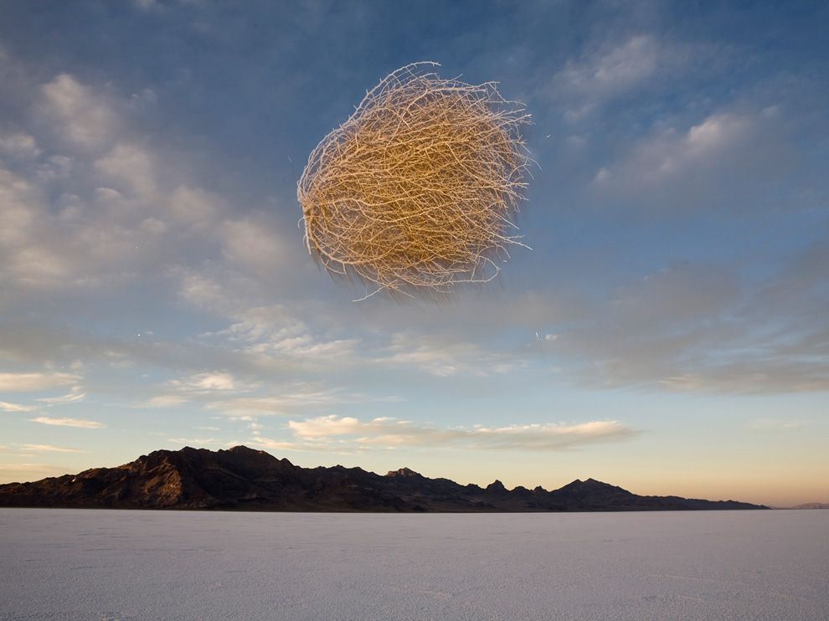
The problem? Tumbleweeds fly.

Slide 41
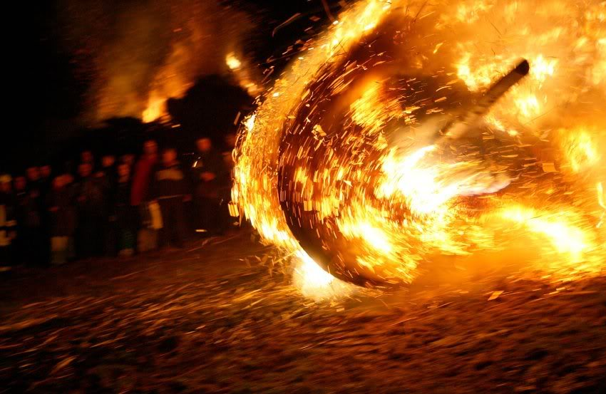
"If [you don't want to make me your king], let fire come out from me and devour the cedars of Lebanon"
(9:15b NLT).
Notes:
"Jotham employed extreme irony in this statement, for the puny thornbush at the foot of other trees scarcely casts a shadow. The threat of fire coming out of the thornbush, however, was real for farmers feared the wildfires that could spread quickly through the dried tinder of thornbushes" (BKC).

Slide 42
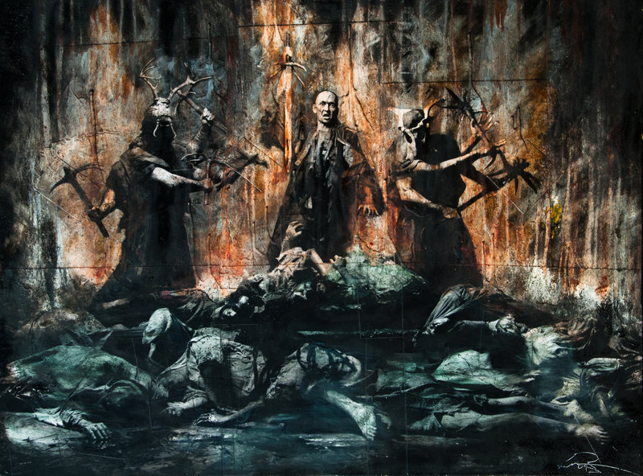
Abimelech terrorized his own people (9:22-55)

Slide 43
The Abimelech Cycle
174
"But when the people of Israel cried out to the Lord for help…" (3:9a, etc ABSENT).
1 Sin
2 Servitude
3 Supplication
Notes:
Israel never requested God for deliverance from Abimelech (Absent).

Slide 44
The Abimelech Cycle
174
1 Sin
2 Servitude
An unnamed woman in Thebez—though not called a judge—delivered Israel from Abimelech by killing him with a millstone (9:50-57).
3 Supplication
4 Salvation

Slide 45
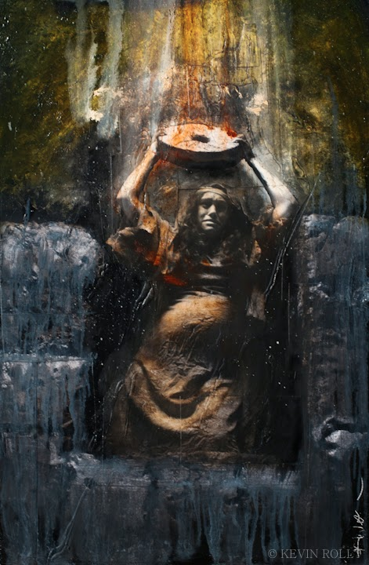
Where are the men?

Slide 46
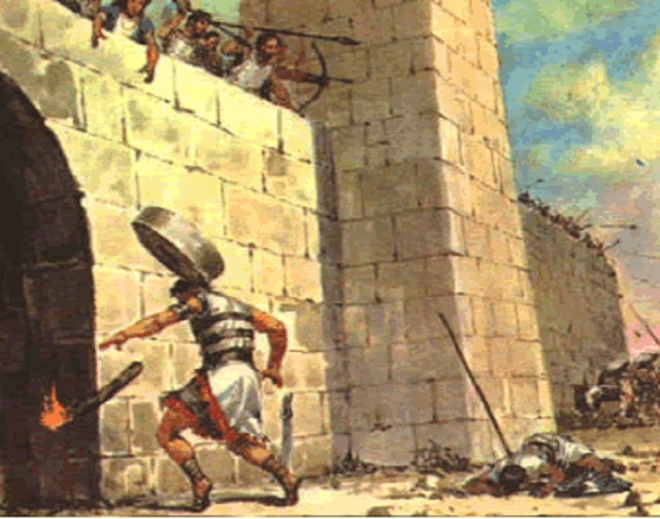
Abimelech's End (9:54-55)

Slide 47
The Abimelech Cycle
174
No peace noted.
1 Sin
2 Servitude
5 Silence
3 Supplication
4 Salvation
Notes:
What resulted from Abimelech's rule (9:22-57)?
In a word, his rule led to destruction. No cities were built, the population didn't increase but only people were murdered. No one learned piety from the king, and no prosperity came.
It also led to justice. Ultimately God caused Abimelech to come to a sad end due to the murder of his brothers. The city of Shechem also paid for their wickedness (9:57).
As we will see in the coming weeks, when people reject God, things can only get worse instead of better.
(So what is the key lesson for us here? What's the main idea?)

Slide 48
Main Idea
All people deserve their leader.
Notes:
Sometimes we get conquered, true…
but when we choose our own leader, we choose one like us.

Slide 49

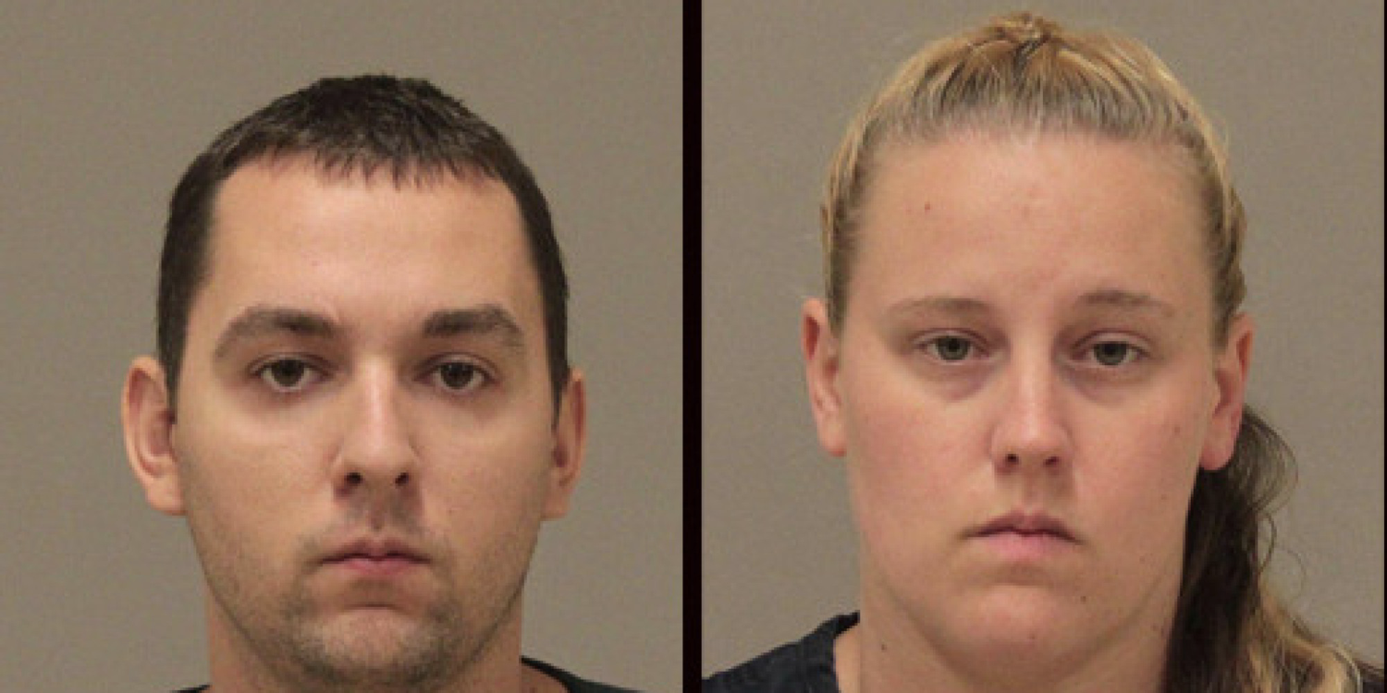
Every couple deserves each other.
Notes:
Every couple deserves each other.
My professor who taught me how to counsel others told me he had one basic rule for marriage counseling: "Every couple deserves each other." You may think you deserve a better spouse than you got, but your spouse may then be thinking the same thing! Since you both went into the marriage willingly, you both did the best you could. You deserve each other.
The same applies to the selection of leaders. Wicked people don't deserve a great, godly leader, so they don't choose one. If they have one, they soon throw him out due to their own wickedness.
The problem during the time of the judges wasn't that they didn't have good leaders. Their problem wasn't that their leaders got worse as time went on. It's true that the leaders got worse, but that was the result, not the cause. The issue was the people, who chose to serve idols over the living and true God.
So here is the main idea of this passage: "Every people deserves its leaders." The followers always warrant the leaders they get. Godless people choose godless leaders. Righteous people earn the privilege of being headed by godly people.

Slide 50

A leadership crisis begins with a followership crisis.

Slide 51
The Modern Cycle
174
1 Sin
We sin against the LORD by worshipping anything and anyone but Jesus (8:33-35).
Notes:
Sin: We sin against the LORD by worshipping anything and anyone but Jesus (8:33-35).

Slide 52
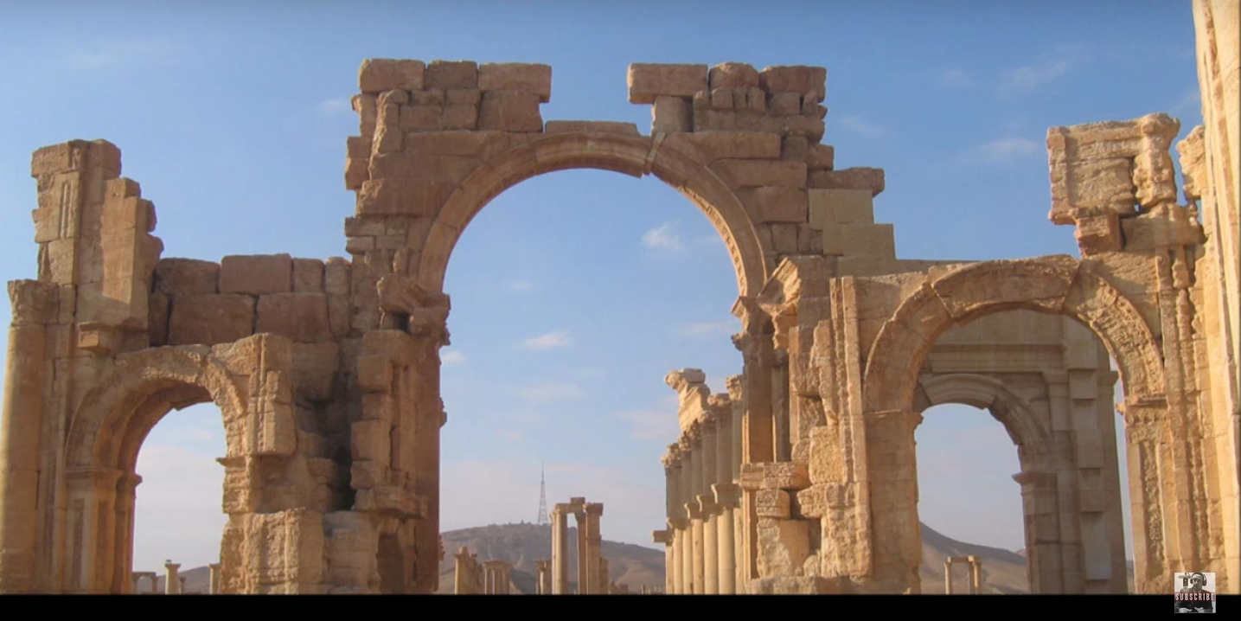
Baal Altar in Palmyra, Syria

Slide 53
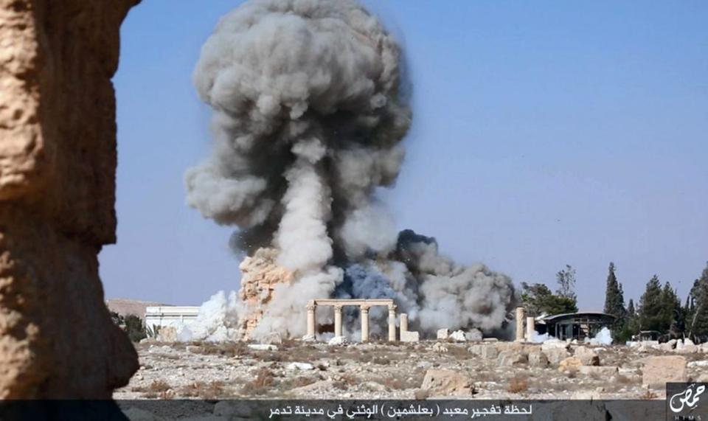
Baal Altar in Palmyra, Syria Destroyed by ISIS in October 2015

Slide 54
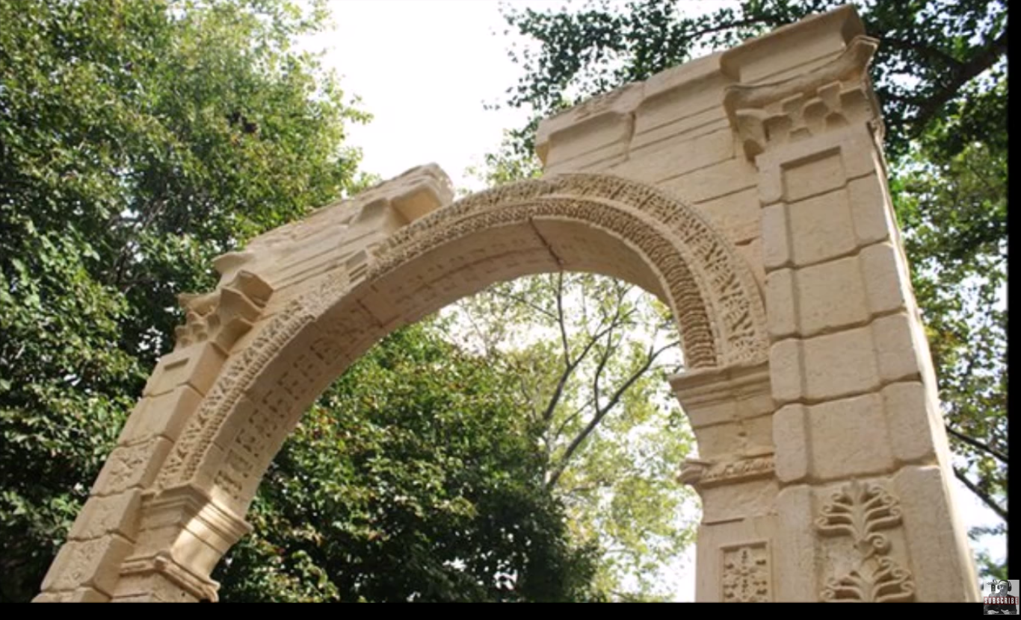
Baal Altar in New York City Dedicated 19 Sep 2016
Notes:
I noted earlier that years after Gideon, Baal worship was officially adopted in Israel. One author notes,
"Lest we think this has no relevance to us today, remember that several media outlets recently carried the report of arches to Baal being built in New York and London. Because there was such a strong backlash from the Christian community, those projects were placed on hold. However, one needs to read the fine print that said 1000 of these Baal arch/temples were scheduled to be constructed around the world. It is clear we are surrounded by 21st century Baal worship. Unrestrained, legalized, sexual immorality, abortion and extreme environmentalism called climate change is nothing more than Baal worship under a new name called progressivism.
Remember though, that God never allows the spirit of Baal to reign without being confronted by the spirit of Elijah. As God raised up a passionate follower of God in the Old Testament, He is raising up people in the body of Christ who have no other desire but to see the honor of Jesus in the land. Get ready: A fresh confrontational, powerful and corrective grace is coming to true believers to tear down the altars of men and rebuild the altars of God!"
21st Century Baal Worship
By markivey
https://markivey.org/author/markivey/
Accessed 24 Sep 2016

Slide 55
The Modern Cycle
174
1 Sin
2 Servitude
Servitude: Our idolatry leads to bad leaders from among us (9:1-49).

Slide 56
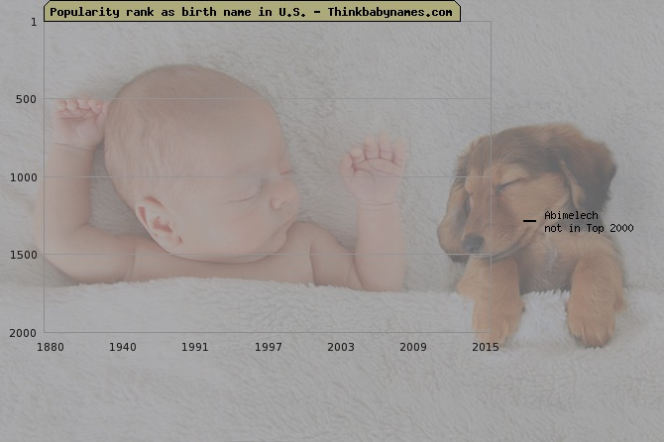
Abimelech
Popularity rank as birth name in U.S. — Thinkbabynames.com

Slide 57
The Modern Cycle
174
1 Sin
2 Servitude
We must not neglect to ask God for deliverance (Absent).
3 Supplication
Notes:
Supplication: We must not neglect to ask God for deliverance (Absent).

Slide 58
The Modern Cycle
174
1 Sin
2 Servitude
God always answers prayer of repentance by giving us salvation in Jesus (9:50-57).
3 Supplication
4 Salvation
Notes:
Salvation: God always answers prayer of repentance by giving us salvation in Jesus (9:50-57).

Slide 59
The Modern Cycle
174
Life still has struggles but life in Christ always has God’s peace as well (Absent).
1 Sin
2 Servitude
5 Silence
3 Supplication
4 Salvation
Notes:
Silence: Life still has struggles but life in Christ always have God's peace as well (Absent).
(Why don't we have better leaders? Because we don't first have better followers.)

Slide 60

All people deserve their leader.
MAIN IDEA

Slide 61
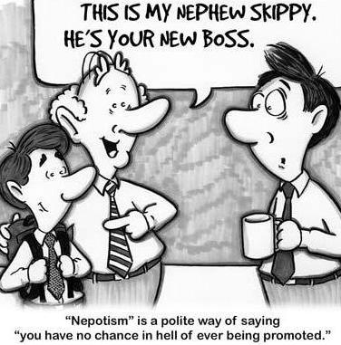
Nephew
This is my nephew, Skippy.
He's your new boss.
Notes:
We need to make God our leader rather than show favoritism based on family ties. But how can we do that? How can we follow God better?

Slide 62

How can you be a better follower?
First follow Jesus.
Then develop godly qualities.

Slide 63
Black

Slide 64


OT Sermons link at BibleStudyDownloads.org
Get this presentation and script for free!

