Slide 1
VICTORY NEEDED?
Joshua 5:13-6:27

Slide 2
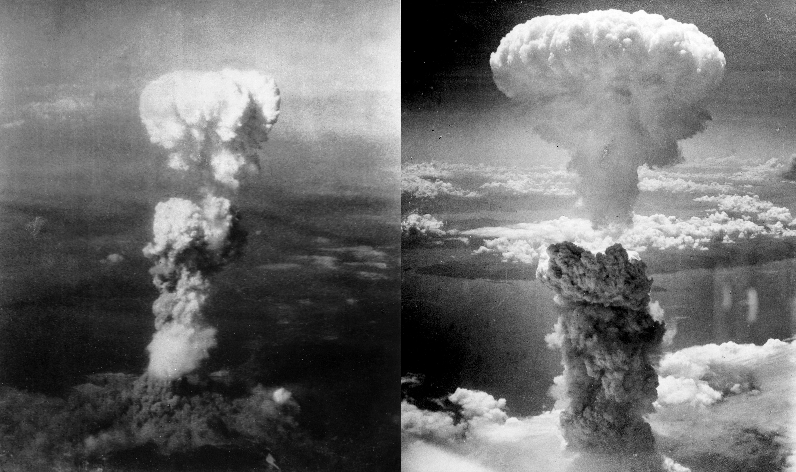
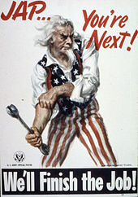
World War II
Japan’s attack on Pearl Harbour
US declared war on Japan.
Atomic bombs: Little Boy & Fat Man
Hiroshima & Nagasaki destroyed

Slide 3
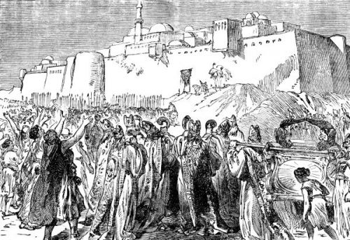
Battle of Jericho
Home?
Food?
Own Inheritance?
Joshua as commander?
Win or lose?

Slide 4
OUR BATTLES

Slide 5
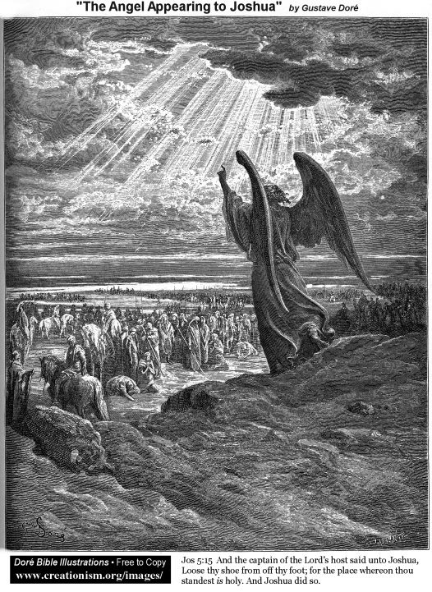
GOD IS WITH US
“…so the Lord was with Joshua,
and his fame spread throughout the land”

Slide 6
Jeremiah 30:17
“…But I will restore you to health
and heal your wounds…”

Slide 7
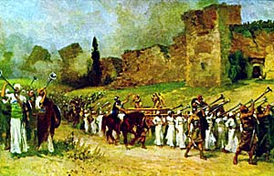

Slide 9
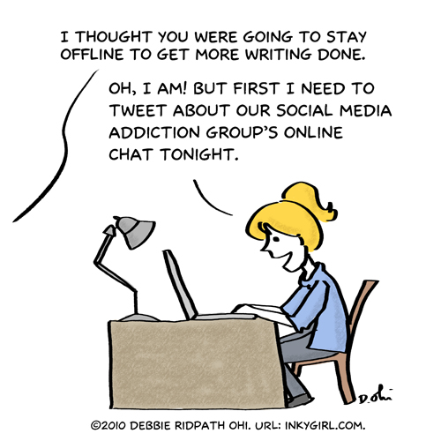

Slide 10
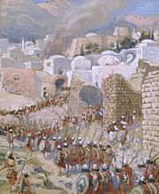
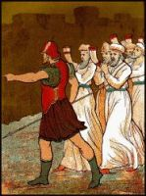
OBEY GOD FULLY

Slide 11
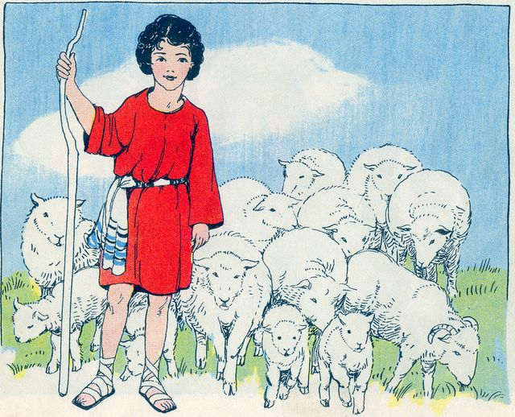

Slide 12
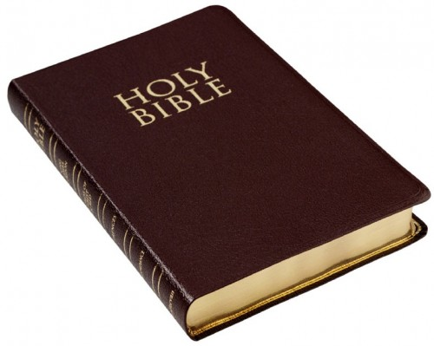
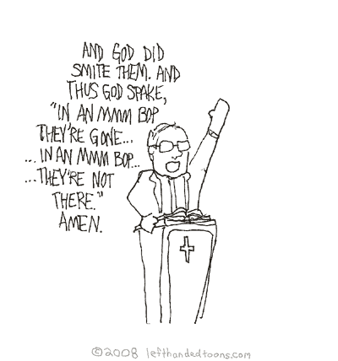
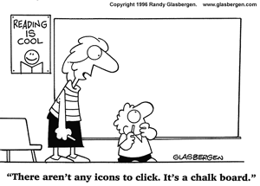

Slide 13
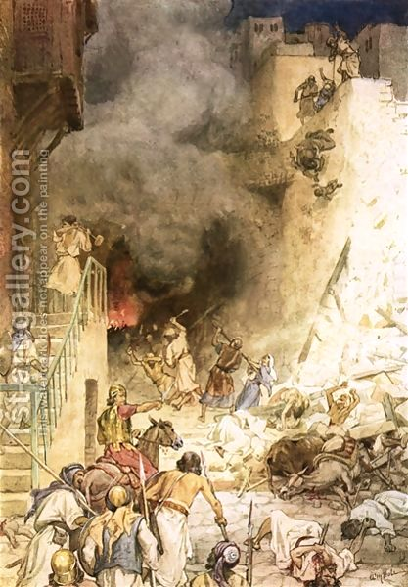
God expects full obedience

Slide 14
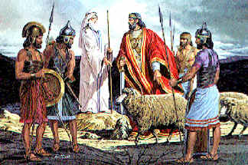

Slide 15
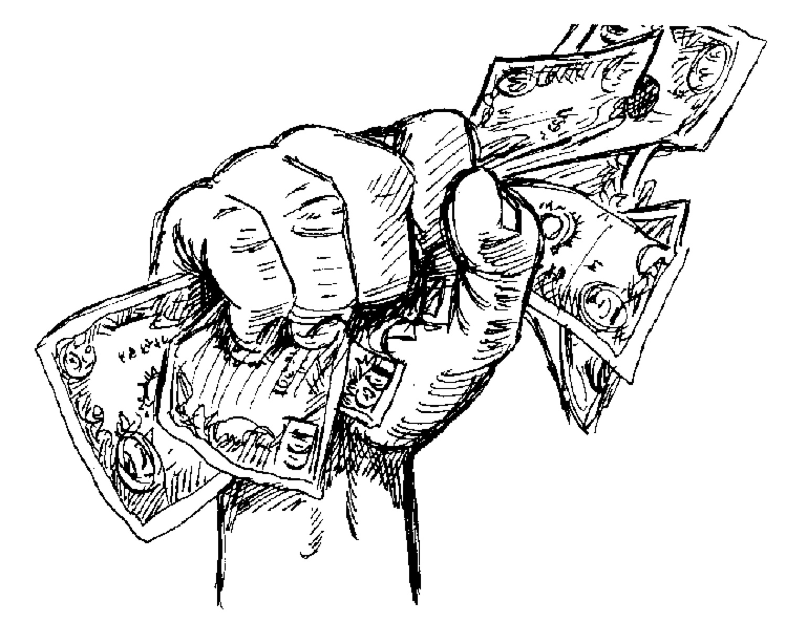

Slide 16
VICTORY NEEDED?
FULL OBEDIENCE
IS KEY

Slide 17
I know Who goes before me
I know Who stands behind
The God of angel armies
Is always by my side
The One who reigns forever
He is a friend of mine
The God of angel armies
Is always by my side.
Nothing formed against me shall stand
You hold the whole world in Your hands
I’m holding on to Your promises
You are faithful, You are faithful
Who shall I Fear (God of Angel Armies)
by Chris Tomlin

