Slide 1
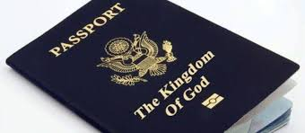

A Refugee’s Faithful Faith
Joshua 2 (1-14, 18-19)
Matthew Lyle
at Crossroads International Church Singapore • CICFamily.com
Uploaded by Dr. Rick Griffith • Jordan Evangelical Theological Seminary
Files in many languages for free download at BibleStudyDownloads.org

Slide 2
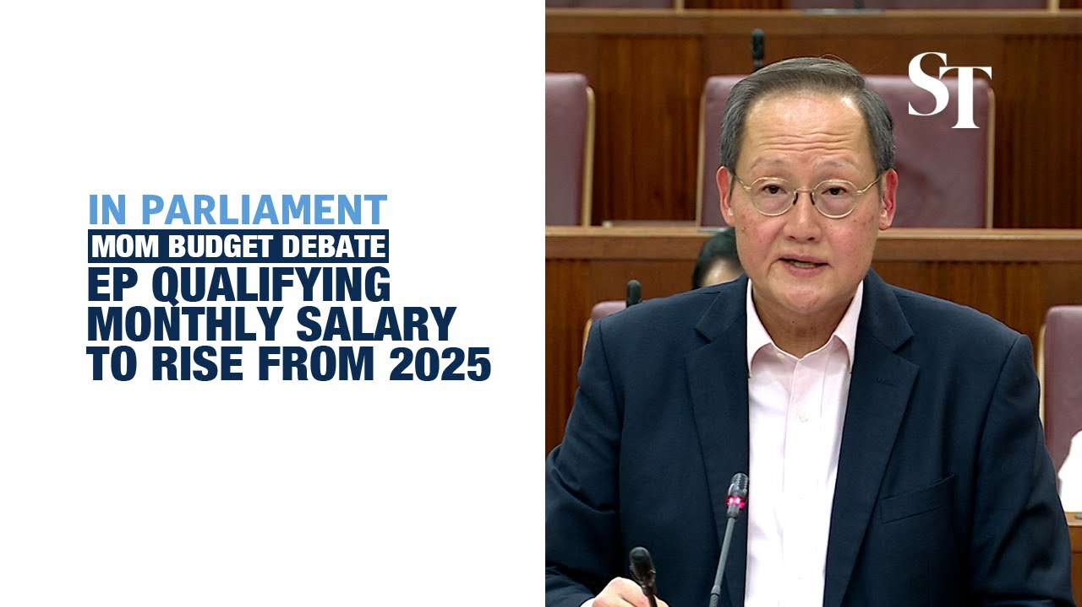
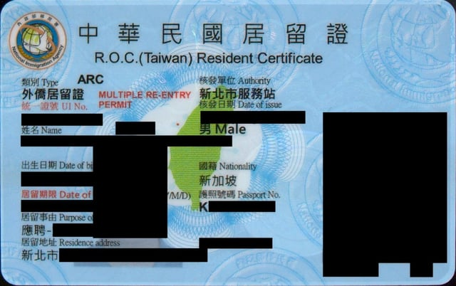


Slide 3
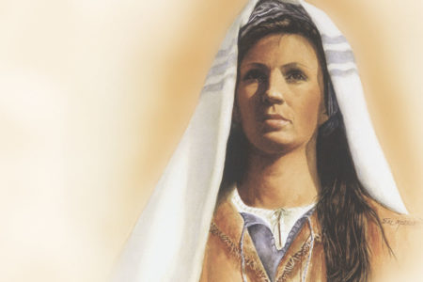
Application to God’s Kingdom
Prostitute
→ Canaanite prostitute

Slide 4
The Conditions for Citizenship in God’s Kingdom – hopelessness and submission
… and said to the men, “I know that the LORD has given you the land, and that the fear of you has fallen upon us, and that all the inhabitants of the land melt away before you. ¹⁰ For we have heard how the LORD dried up the water of the Red Sea before you when you came out of Egypt, and what you did to the two kings of the Amorites who were beyond the Jordan, to Sihon and Og, whom you devoted to destruction. ¹¹ And as soon as we heard it, our hearts melted, and there was no spirit left in any man because of you, for the LORD your God, he is God in the heavens above and on the earth beneath. ¹² Now then, please swear to me by the LORD that, as I have dealt kindly with you, you also will deal kindly with my father’s house, and give me a sure sign ¹³ that you will save alive my father and mother, my brothers and sisters, and all who belong to them, and deliver our lives from death.” Joshua 2:9-12

Slide 5
The Conditions for Citizenship in God’s Kingdom – hopelessness and submission
The Basis for Citizenship in God’s Kingdom

Slide 6

The Conditions for Citizenship in God’s Kingdom – hopelessness and submission
The Basis for Citizenship in God’s Kingdom – God’s mercy and grace
Behold, when we come into the land, you shall tie this scarlet cord in the window through which you let us down, and you shall gather into your house your father and mother, your brothers, and all your father’s household. Joshua 2:18

Slide 7
The Conditions for Citizenship in God’s Kingdom – hopelessness and submission
The Basis for Citizenship in God’s Kingdom – God’s mercy and grace
For by grace you have been saved through faith. And this is not your own doing; it is the gift of God, ⁹ not a result of works, so that no one may boast. ¹⁰ For we are his workmanship, created in Christ Jesus for good works, which God prepared beforehand, that we should walk in them. Ephesians 2:8-10
he saved us, not because of works done by us in righteousness, but according to his own mercy, by the washing of regeneration and renewal of the Holy Spirit, ⁶ whom he poured out on us richly through Jesus Christ our Savior, ⁷ so that being justified by his grace we might become heirs according to the hope of eternal life. Titus 3:5-6

Slide 8
The Conditions for Citizenship in God’s Kingdom – hopelessness and submission
The Basis for Citizenship in God’s Kingdom – God’s mercy and grace
The Requirements of Citizenship in God’s Kingdom
For by grace you have been saved through faith. And this is not your own doing; it is the gift of God, ⁹ not a result of works, so that no one may boast. ¹⁰ For we are his workmanship, created in Christ Jesus for good works, which God prepared beforehand, that we should walk in them. Ephesians 2:8-10

Slide 9
The Conditions for Citizenship in God’s Kingdom – hopelessness and submission
The Basis for Citizenship in God’s Kingdom – God’s mercy and grace
The Requirements of Citizenship in God’s Kingdom – live by faith as if ALREADY a citizen
For by grace you have been saved through faith. And this is not your own doing; it is the gift of God, ⁹ not a result of works, so that no one may boast. ¹⁰ For we are his workmanship, created in Christ Jesus for good works, which God prepared beforehand, that we should walk in them. Ephesians 2:8-10

Slide 10
The Conditions for Citizenship in God’s Kingdom – hopelessness and submission
The Basis for Citizenship in God’s Kingdom – God’s mercy and grace
The Requirements of Citizenship in God’s Kingdom – A Faithful Faith
For by grace you have been saved through faith. And this is not your own doing; it is the gift of God, … Ephesians 2:8
And without faith it is impossible to please him, for whoever would draw near to God must believe that he exists and that he rewards those who seek him. - Hebrews 11:6

Slide 11
Prostitute
Canaanite prostitute
Liar, traitor
  and Salmon the father of Boaz by Rahab, and Boaz the father of Obed by Ruth, and Obed the father of Jesse, ⁶ and Jesse the father of David the king. - Matthew 1:5-6
  By faith Rahab the prostitute did not perish with those who were disobedient, because she had given a friendly welcome to the spies. - Hebrews 11:31
  And in the same way was not also Rahab the prostitute justified by works when she received the messengers and sent them out by another way? - James 2:25

Slide 12
And looking intently at the council, Paul said, “Brothers, I have lived my life before God in all good conscience [as a citizen] up to this day.” Acts 23:1
The Lord is not slow to fulfill his promise as some count slowness, but is patient toward you, not wishing that any should perish, but that all should reach repentance. ¹⁰ But the day of the Lord will come like a thief, and then the heavens will pass away with a roar, and the heavenly bodies will be burned up and dissolved, and the earth and the works that are done on it will be exposed.
¹¹ Since all these things are thus to be dissolved, what sort of people ought you to be in lives of holiness and godliness, ¹² waiting for and hastening the coming of the day of God, because of which the heavens will be set on fire and dissolved, and the heavenly bodies will melt as they burn! ¹³ But according to his promise we are waiting for new heavens and a new earth in which righteousness dwells. ¹⁴ Therefore, beloved, since you are waiting for these, be diligent to be found by him without spot or blemish, and at peace. 2 Peter 3:9-14

Slide 13
A Refugee’s Faithful Faith
The Conditions for Citizenship in God’s Kingdom – hopelessness and submission
The Basis for Citizenship in God’s Kingdom – God’s mercy and grace
The Requirements of Citizenship in God’s Kingdom – live by faith as if ALREADY a citizen

Slide 14
Black

Slide 15


OT Preaching link at BibleStudyDownloads.org
Get this presentation and script for free!
Notes:
OT Preaching (op)

