Slide 1

Title Slide
JONAH
Dr. Rick Griffith • Crossroads International Church Singapore
CICFamily.com & BibleStudyDownloads.org
Notes:
1

Slide 2

What’s Most Important?
Notes:
What do you think is the most important thing we do as a church? Worship? Evangelism? Fellowship? Bible study? Prayer? A few weeks ago a man inquiring about our church asked me, “So what is most important to your church? What is unique?” If he had asked you, what would you have said? I told him one word: LOVE!
One of the teachers of religious law was standing there listening to Jesus debate. He realized that Jesus had answered well, so he asked, “Of all the commandments, which is the most important?” Jesus answered…
2

Slide 3

What’s Most Important?
Mark 12:29-31 -- Jesus replied, “The most important commandment is this: ‘Listen, O Israel! The Lord our God is the one and only Lord. ³⁰ And you must love the Lord your God with all your heart, all your soul, all your mind, and all your strength.’
³¹ The second is equally important:
‘Love your neighbor as yourself.’ No other commandment is greater than these.”
Notes:
One of the teachers of religious law was standing there listening to the debate. He realized that Jesus had answered well, so he asked, “Of all the commandments, which is the most important?” Jesus answered…
3

Slide 4

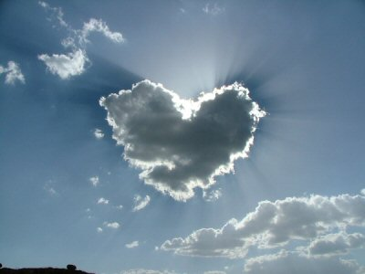


Our Vision is to…
Love God
Love the Church
Love the Nations
Notes:
• Love God
Where it starts—and ends—is in our call to LOVE. As Paul noted, “The greatest of these is love” (1 Cor. 13:13).
What is the most important thing we do as a church? It begins with loving the God who loves us.
• Love Church
Do you genuinely love him? If you don’t, then nothing else you do counts, really.
The second thing He said right after this: to love your neighbor as yourself.
• Love Nations
But who is your neighbor? It starts right here in the body—to love the church—but then it extends from this “close neighbor” to those who are out of the reach of this fellowship where we love the nations. Our leadership is committed to make all that we do revolve around one of these three priorities.
4

Slide 5
Black
Notes:
5

Slide 6
The Setting: Assyrian Might
443
Strong 883-783
Strong 745-626
Weak 790-745
900
850
800
750
70 0
65 0
600
550
500
Jonah

Slide 7
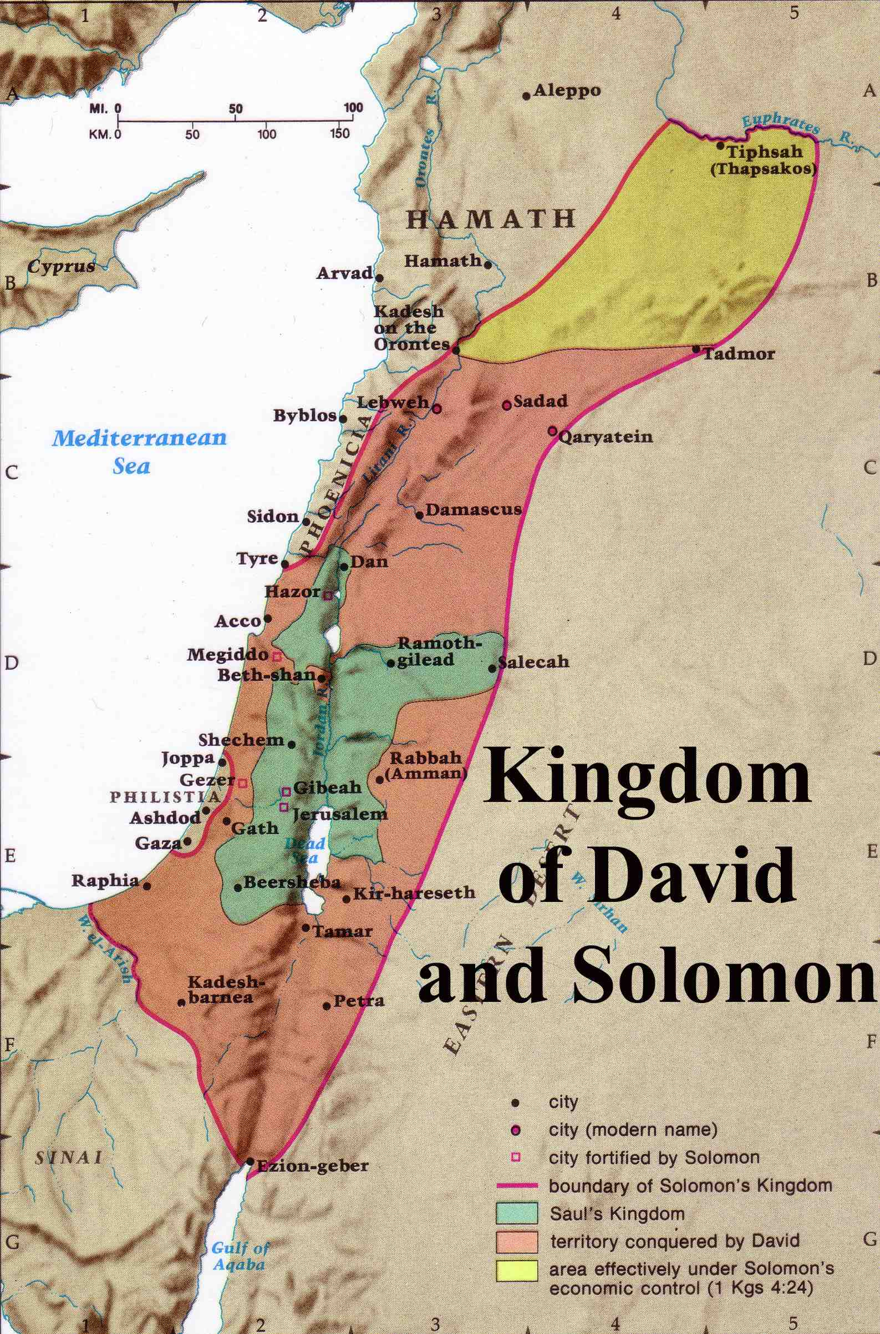
Expansion under Jeroboam II
446
Jeroboam II
“Jeroboam II recovered the territories of Israel between Lebo-hamath and the Dead Sea,* just as the Lord, the God of Israel, had promised through Jonah son of Amittai, the prophet from Gath-hepher.”
(2 Kings 14:25 NLT).
* Hebrew the sea of the Arabah
Jeroboam I (930 BC)
Notes:
7
The boundaries under Jeroboam II went even farther than David and Solomon, who only had tribute sent from Hamath.

Slide 8
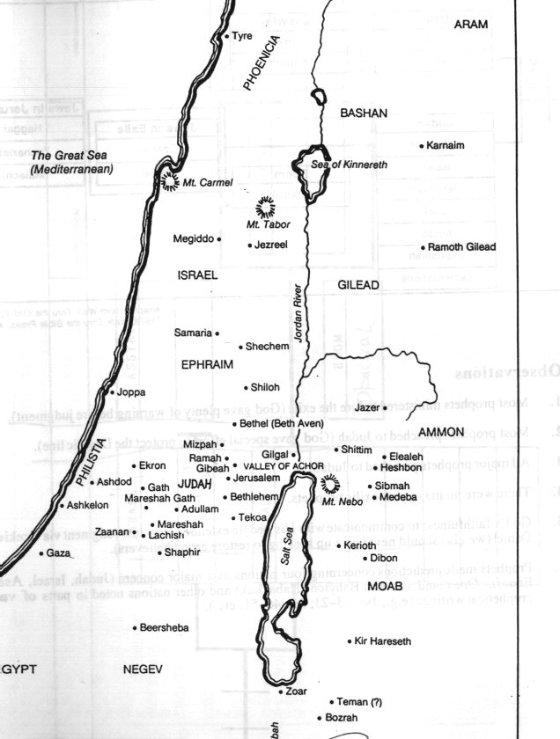

Concerning Whom Did the Prophets Minister?
446
Assyria
Jonah
Nahum
Hosea
Babylon & Persia
Amos
Ezekiel
Daniel
Habakkuk
Micah
Isaiah
Zephaniah
Jeremiah
Joel
Haggai
Zechariah
Malachi
Obadiah
Edom
Notes:
8
Jonah was the man of the hour for the PAP—the Prophets Action Party. In fact, he was the PM (Prophet Minister). At the height of his career, God called him to tell the Al-Queda of his day how much God hated their wickedness.

Slide 9
“Go! No! So Row!”
Jonah 1
Notes:
9

Slide 10
Jonah 1: Go!
604
God commands His people to tell the wicked how much He hates their sin (1-2).
Notes:
10

Slide 11
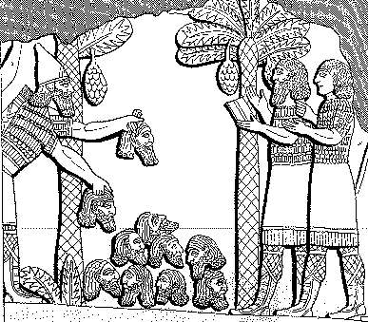
Assyrian Brutality
Assyrian
614
Brutality
“A pyramid of heads I reared in front of his city. Their youths and their maidens I burnt up in the flames.”
Shalmaneser, 859-824 BC
= 80 years before Jonah, in
Luckenbill, Ancient Records of Assyria and Babylonia, 1:213
Notes:
11

Slide 12

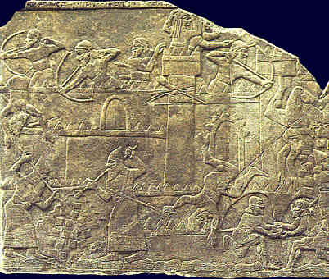
Siege & Attack
614
Siege & Attack!
See H. Hunt, “Sixth Century Siege Warfare,” Biblical Illustrator (Fall ‘96): 43-45
Notes:
12

Slide 13
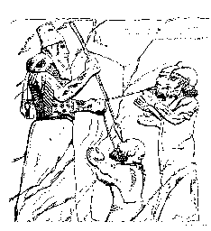

Treatment of Captured Kings
614
“I pierced his chin with my keen hand dagger. Through his jaw… I passed a rope, put a dog chain upon him and made him occupy a kennel”
Ashurbanipal, 669-626 BC
= 100 years after Jonah, in
Luckenbill, Ancient Records of
Assyria & Babylonia, 2:319
Notes:
13

Slide 14
Esarhaddon’s Ego (660 BC)
614
“I am powerful, I am all powerful,
I am a hero, I am gigantic, I am colossal, I am honored, I am magnified, I am without equal among all kings, the chosen one of Asshur, Nabu, and Marduk!”
Luckenbill, Ancient Records of Assyria and Babylonia, 2:226

Slide 15
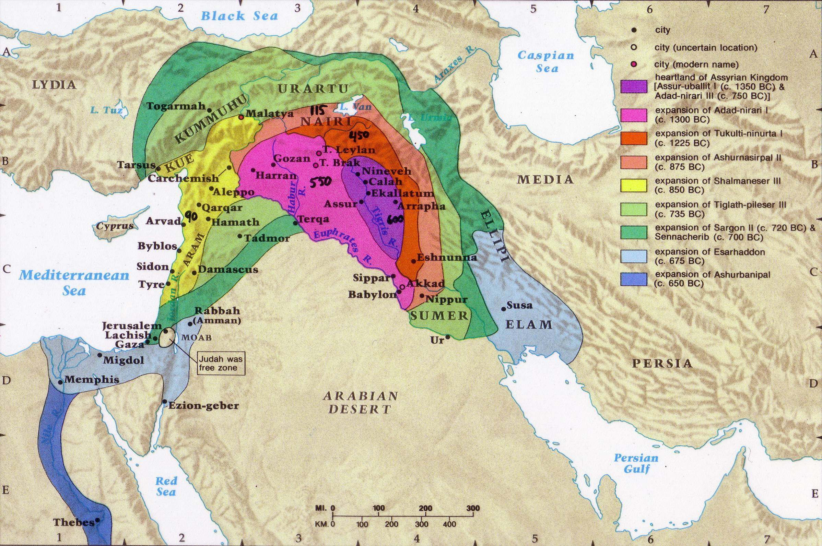
Assyrian Expansion
607
Notes:
15

Slide 16
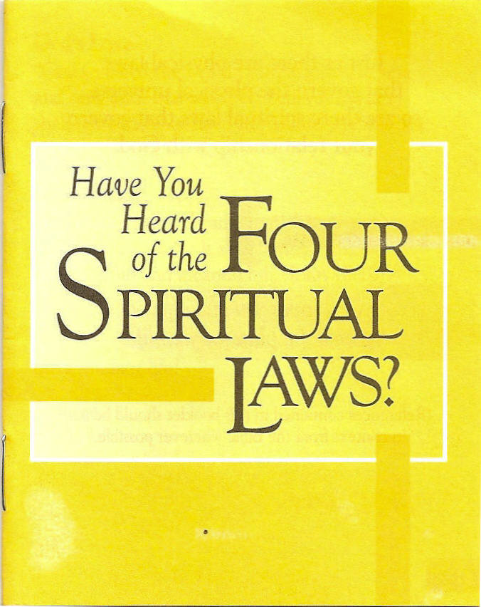
God loves you and offers a wonderful plan for your life?
Notes:
16
Not exactly Law #1: God loves you and has a wonderful plan for your life

Slide 17
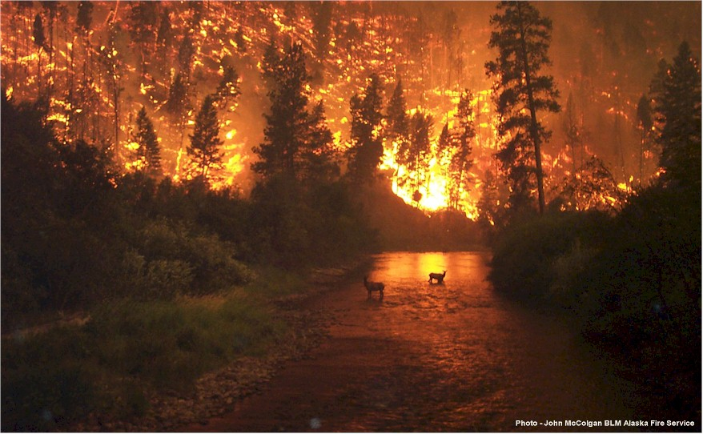
What a Message…
Jonah’s Message…
“Nineveh’s bad and God’s mad!
You better turn or you’re gonna burn!”

Slide 18

Israel’s Strategic Location

Slide 19
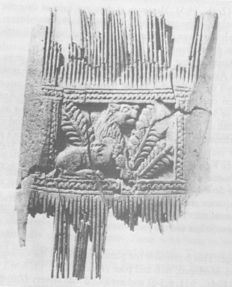
Ivory Comb
Ivory comb from Megiddo, representative of the wealth and luxury assailed by Amos (3:15; 6:4)
--Oriental Institute, University of Chicago
Notes:
19

Slide 20
Summary of Jonah’s Time
600
Circumstances Summary
Date: During the reign of Jeroboam II of Israel
(2 Kings 14:25; 758 BC)
Setting:
1. Assyria in temporary decline due to
internal dissension
2. Israel’s borders expanded tremendously
3. A narrow, nationalistic focus in Israel,
which enjoyed its prosperity
Notes:
20

Slide 21
Black
Notes:
21

Slide 22
Jonah 1: Go! No!
God commands His people to tell the wicked how much He hates their sin (1-2).
God’s people often don’t want to tell bad people that they’re bad (3).
Notes:
22

Slide 23
Where would Jonah go?
Tarshish
Nineveh
Gath-Hepher
Joppa

Slide 24
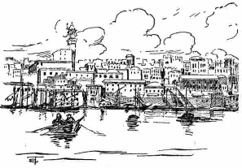
Joppa was an important seaport
Going down to Joppa was the way to get out of Israel by ship—unlike Peter 800 years later
Notes:
24

Slide 25
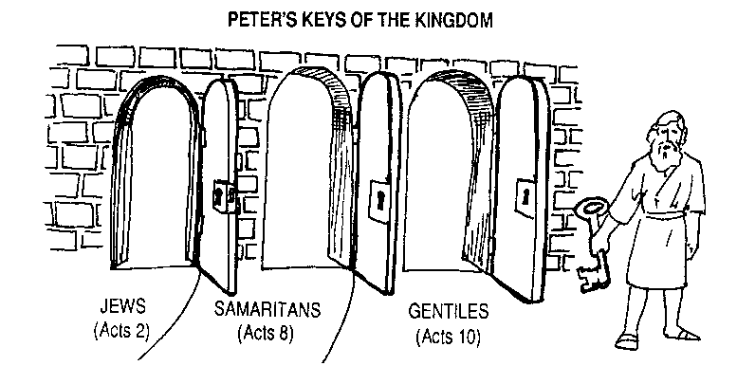
Q: How did God overcome the prejudice in the Church at Jerusalem?
A: Gradually
AD 33
AD 35
AD 40
Notes:
25

Slide 26
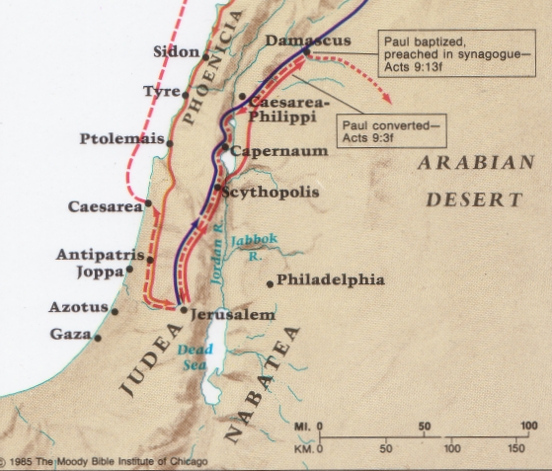
Peter was not like Jonah at Joppa
Caesarea
Joppa
Notes:
26

Slide 27
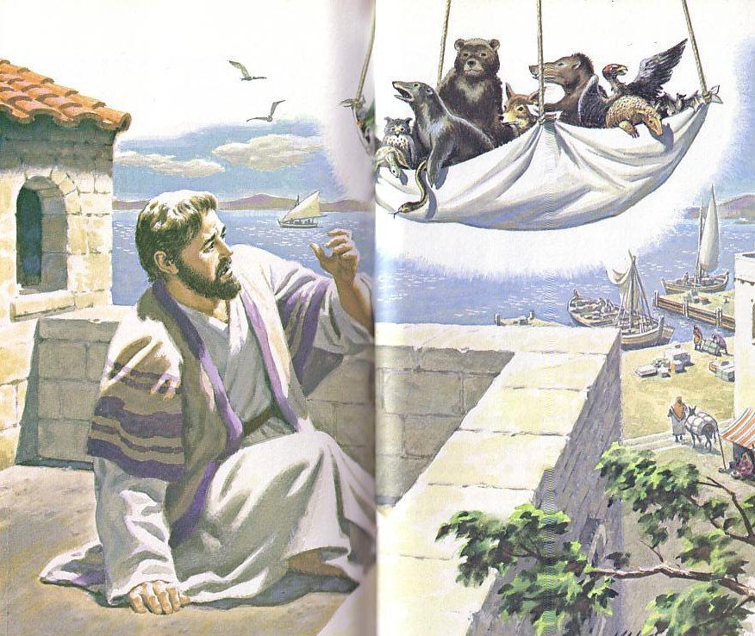
“Get up, Peter! Kill and eat!”
Notes:
27

Slide 28
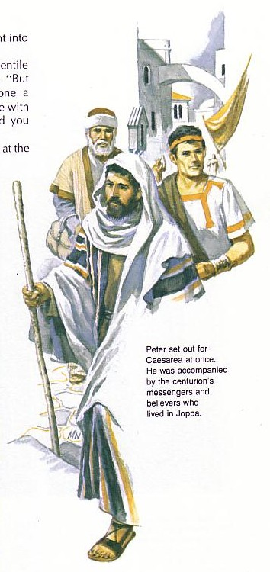
“What’s God going to do to these unclean men?”
Peter must have wondered why God wanted him to go with the servants of Cornelius
Notes:
28

Slide 29
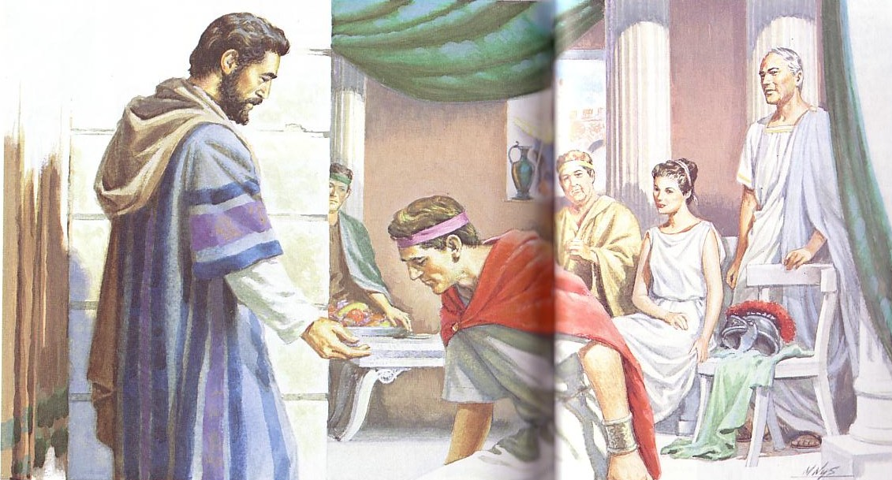
Cornelius bows to Peter
Notes:
29

Slide 30
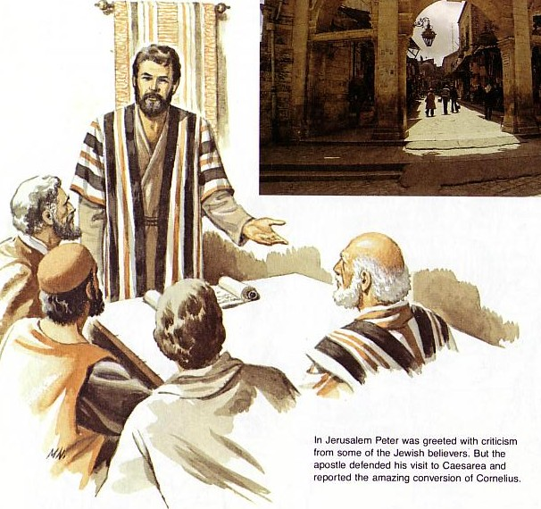
Peter defends his lack of prejudice
Notes:
30

Slide 31
Black
Notes:
31
Israel became naval-gazing, arrogant, and sinful (a mission field herself!)
We also disobey God by avoiding witnessing for Him (in break room, airplane seat, to neighbor or family member)

Slide 32
Jonah 1: Go! No! So Row!
God commands His people to tell the wicked how much He hates their sin (1-2).
God’s people often don’t want to tell bad people that they’re bad (3).
Neglecting evangelism brings consequences (4-16).
Notes:
32

Slide 33
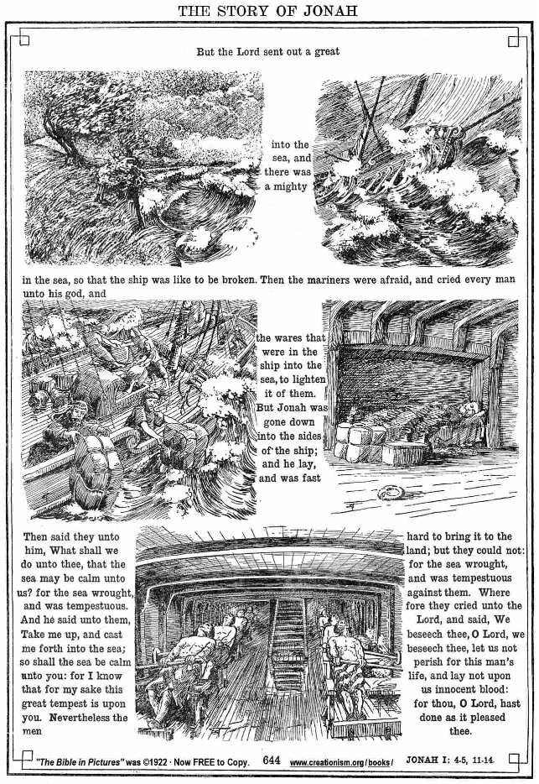
Raging Sea
Notes:
33
⁴ But the Lord hurled a powerful wind over the sea, causing a violent storm that threatened to break the ship apart. NLT

Slide 34

Ship Threatened to Break
Notes:
34
The Hebrew reads that the ship itself threatened to break up!

Slide 35

Cargo Overboard
Notes:
35
⁵ Fearing for their lives, the desperate sailors shouted to their gods for help and threw the cargo overboard to lighten the ship. NTL
The Bible in Pictures, drawn in 1922 but free to copy at www.creationism.org/books/

Slide 36

Jonah Sleeping
Notes:
36
But all this time Jonah was sound asleep down in the hold. ⁶ So the captain went down after him. “How can you sleep at a time like this?” he shouted. “Get up and pray to your god! Maybe he will pay attention to us and spare our lives.”
NLT, Jon 1:5-6.
The Bible in Pictures, drawn in 1922 but free to copy at www.creationism.org/books/

Slide 37

Black
⁷ Then the crew cast lots to see which of them had offended the gods and caused the terrible storm. When they did this, the lots identified Jonah as the culprit.
⁸ “Why has this awful storm come down on us?” they demanded. “Who are you? What is your line of work? What country are you from? What is your nationality?”
⁹ Jonah answered, “I am a Hebrew, and
I worship the Lord, the God of heaven, who made the sea and the land” (1:7-9 NLT).
Notes:
37

Slide 38
Black
Notes:
38
¹⁰ The sailors were terrified when they heard this, for he had already told them he was running away from the Lord. “Oh, why did you do it?” they groaned. ¹¹ And since the storm was getting worse all the time, they asked him, “What should we do to you to stop this storm?”
¹² “Throw me into the sea,” Jonah said, “and it will become calm again. I know that this terrible storm is all my fault.” (1:10-12 NLT)

Slide 39

Sailors Rowing
Notes:
39
¹³ Instead, the sailors rowed even harder to get the ship to the land. But the stormy sea was too violent for them, and they couldn’t make it (1:13 NLT).
The Bible in Pictures, drawn in 1922 but free to copy at www.creationism.org/books/

Slide 40
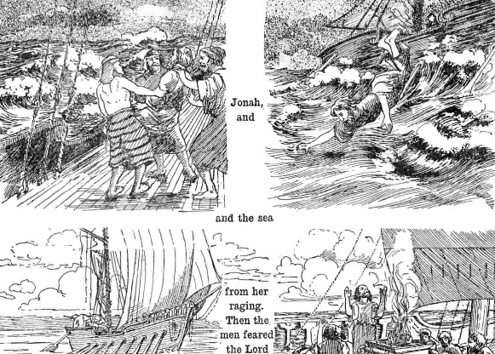
Jonah Overboard
Notes:
40
¹⁴ Then they cried out to the Lord, Jonah’s God. “O Lord,” they pleaded, “don’t make us die for this man’s sin. And don’t hold us responsible for his death. O Lord, you have sent this storm upon him for your own good reasons.”
¹⁵ Then the sailors picked Jonah up and threw him into the raging sea, and the storm stopped at once! ¹⁶ The sailors were awestruck by the Lord’s great power, and they offered him a sacrifice and vowed to serve him (Jon 1:14-16 NLT).

Slide 41
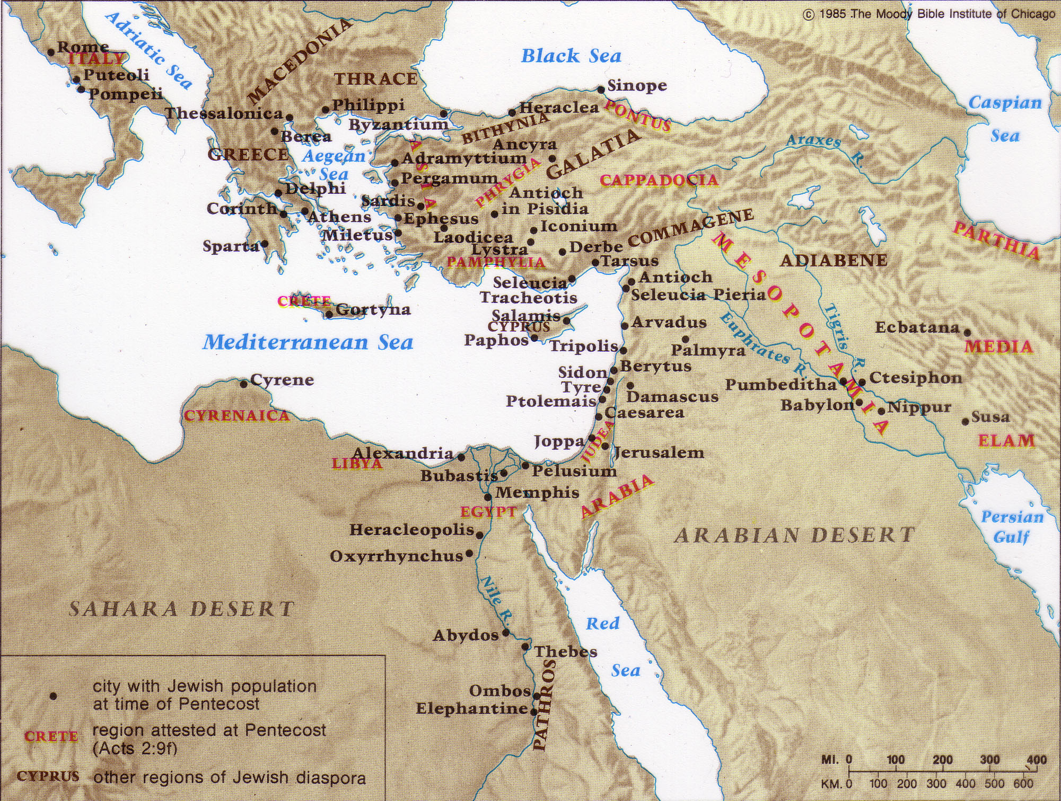
The Jewish Diaspora
40,000 Jews in Rome alone!
83%
17%
Notes:
41

Slide 42
Main Idea of Jonah 1
Neglecting evangelism brings consequences
God still uses means today to show us His seriousness about evangelism
Notes:
42

Slide 43
God often used invasions of His people to convert the invaders!
Periods of Christian Expansion
Period 1
Period 2
Period 3
Period 4
Period 5
Ends of
Earth
Romans
Barbarians
Vikings
Saracens
0
400
800
1200
1600
2000
Ralph Winter, The World Christian Movement

Slide 44
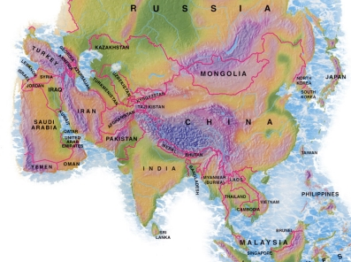
4.89 million people
1.68 million foreigners!
Notes:
44

Slide 45
Our Vision is to…
Love God
Love the Church
Love the Nations

Slide 46

Mercedes-Benz
Notes:
46
One Mercedes-Benz commercial shows their car colliding with a cement wall during a safety test. Someone then asks the company spokesman why they do not enforce their patent on the Mercedes-Benz energy-absorbing body, a design evidently copied by other companies because of its success. He replies matter-of-factly, “Because some things in life are too important not to share.”
How true. That also includes the gospel of salvation, which saves people from far more than auto collisions.
Jim Beranek, Leadership magazine

Slide 47
Black
Notes:
47

Slide 48

Jonah 1 Small Group Questions
Can you share an example of how God got your attention when you disobeyed in evangelism?
2. Do other people sometimes suffer for our disobedience? How?
3. Why do you sometimes disobey God’s Word by refusing to share your faith?
4. What practical steps can you take to change?

Slide 49
Black

Slide 50


OT Preaching link at BibleStudyDownloads.org
Get this presentation and script for free!
Notes:
OT Preaching (op)

