Slide 1
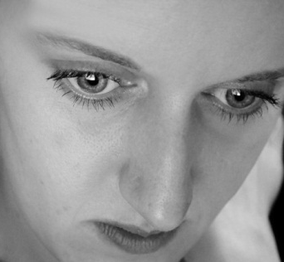
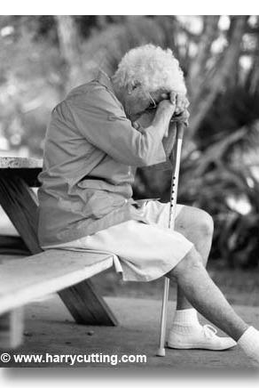
JOB 4-14
Working Through Suffering
Dr Scott Wooddell Eastridge Park Christian Church, Mesquite, Texas Uploaded by Dr. Rick Griffith • Jordan Evangelical Theological Seminary Files in many languages for free download at BibleStudyDownloads.org
COMFORTIG OTHERS

Slide 2
JOB 4-14
How do we work through the suffering in this world?
COMFORTIG OTHERS

Slide 3
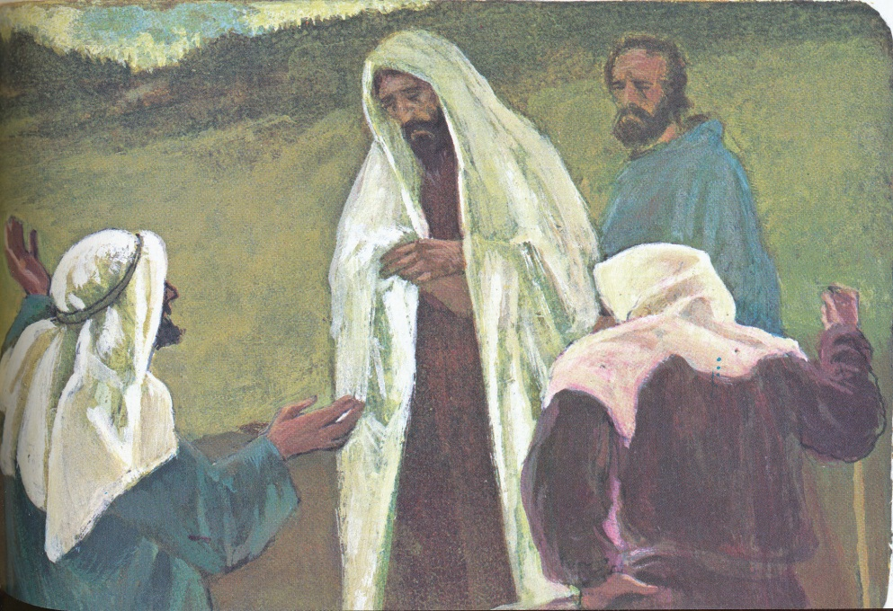
1. THE MISERABLE COMFORT OF WELL-MEANING FRIENDS
ELIPHAZ THE PRAGMATIST
“Consider now; who, being innocent, has ever perished? Where were the upright ever destroyed? I have observed, those who plow evil and those who sow trouble reap it.”
(Job 4:7-8)
“But if it were I, I would appeal to God. I would lay my cause before Him.”
(Job 5:7)

Slide 4
1. THE MISERABLE COMFORT OF WELL-MEANING FRIENDS
BILDAD THE TRADITIONALIST
“When your children sinned against Him, He gave them over to the penalty of their sin.”
“But if you will look to God and plead with the Almighty, if you are pure and upright, even now He will rouse Himself on your behalf and restore you to your rightful place.” (Job 8:4-5)

Slide 5
1. THE MISERABLE COMFORT OF WELL-MEANING FRIENDS
ZOPHAR THE LEGALIST
“Oh, how I wish that God would speak, that He would open His lips against you and disclose to you the secrets of wisdom, for true wisdom has two sides. Know this; God has even forgotten some of your sins.” (Job 11:5-6)

Slide 6
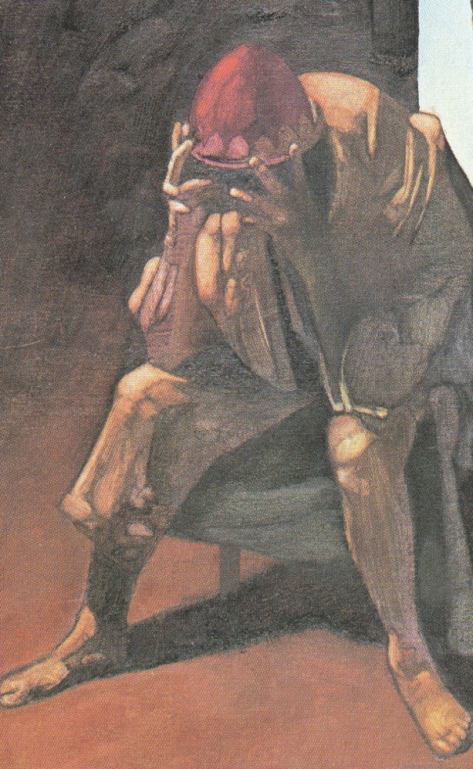
1. THE MISERABLE COMFORT OF WELL-MEANING FRIENDS
GOD’S VIEW OF JOB’S THREE FRIENDS.
“After the Lord had said these things to Job, He said to Eliphaz the Temanite, ‘I am angry with you and your two friends because you have not spoken of me what is right as my servant Job has.’” (Job 42:7)
JOB’S VIEW OF HIS THREE FRIENDS
“I have heard many things like these, miserable comforters are you all.” (Job 16:2)

Slide 7
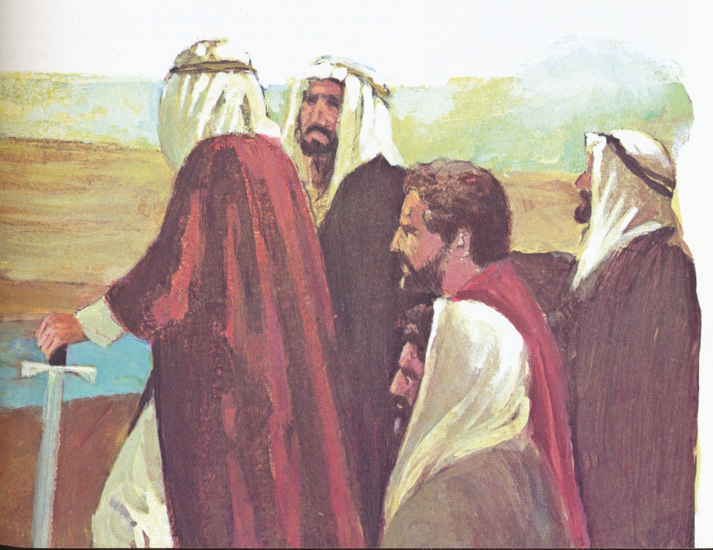
2. THE WONDERFUL COMFORT OF THE LORD
“Praise be to the God and Father of our Lord Jesus Christ, the Father of compassion and the God of all comfort, who comforts us in all our troubles, so that we can comfort those in any trouble with the comfort we ourselves have received from God.” (2 Cor. 1:3-4)

Slide 8
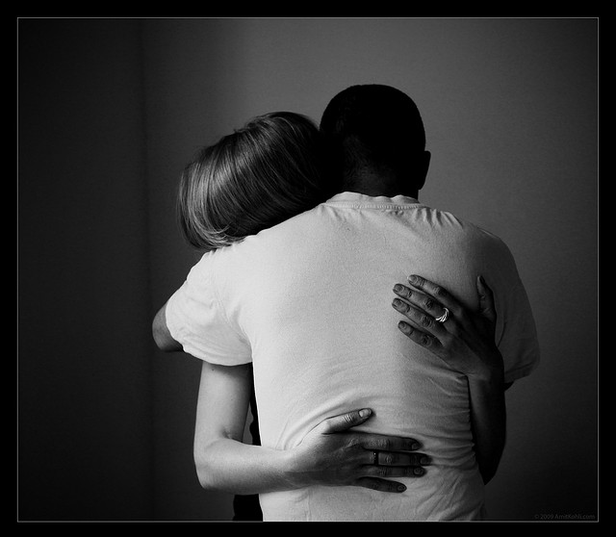
TAKE HOME TRUTH
Comfort comes, not from fixing their problem, but from feeling their pain

Slide 9
Black

Slide 10
OT Preaching link at BibleStudyDownloads.org
Get this presentation for free!
Notes:
OT Preaching (op)

