Slide 1
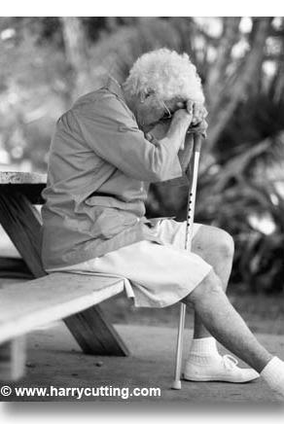
JOB 38-41
Comfort Without Answers
Dr Scott Wooddell Eastridge Park Christian Church, Mesquite, Texas Uploaded by Dr. Rick Griffith • Jordan Evangelical Theological Seminary Files in many languages for free download at BibleStudyDownloads.org
JOB 38-41

Slide 2
JOB 38-41
Where do we find comfort when there are no answers?
JOB 38-41

Slide 3
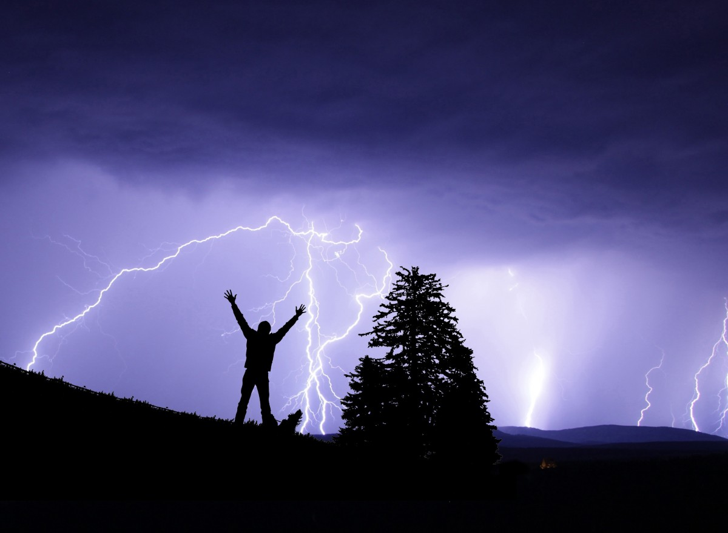
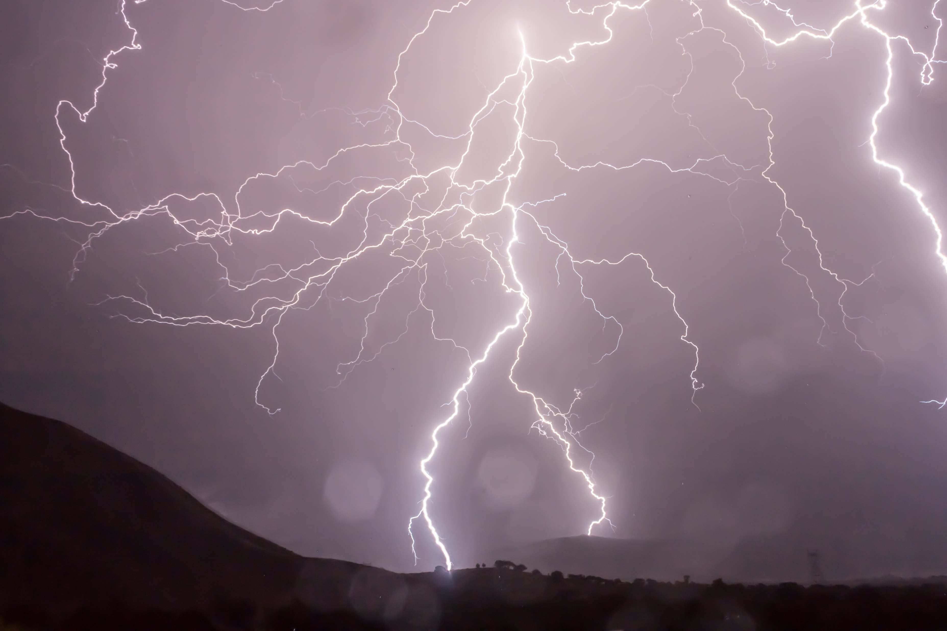
1. GOD’S QUESTIONS UNDERSCORE HIS POWER
“Then the Lord answered Job out of the storm. He said, ‘Who is this that darkens my counsel with words without knowledge? Brace yourself like a man; I will question you, and you shall answer me.’” (Job 38:1-3)

Slide 4
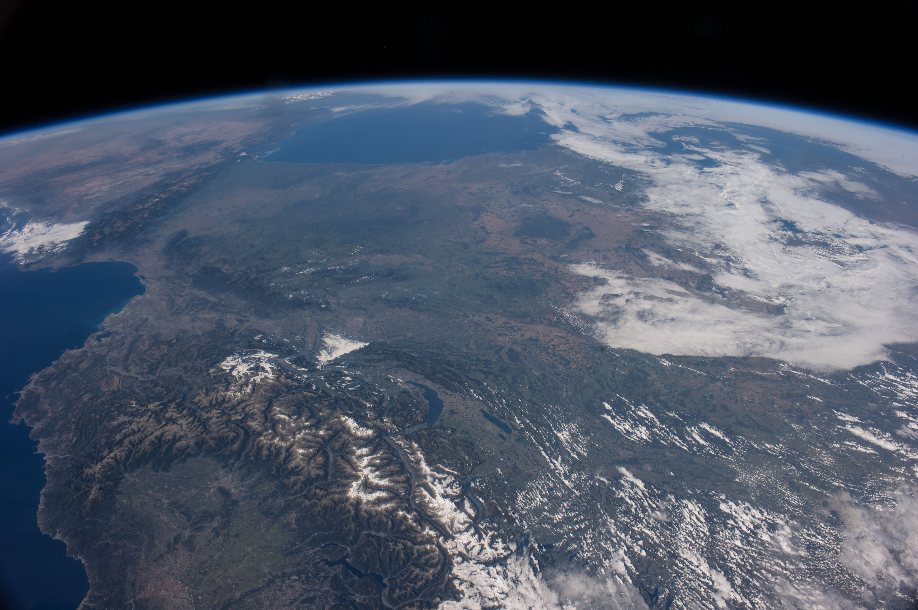
1. GOD’S QUESTIONS UNDERSCORE HIS POWER
“Where were you when I laid the earth’s foundation? Tell me, if you understand. Who marked off its dimensions? Surely you know! Who stretched a measuring line across it? On what were its footings set, or who laid its cornerstone – while the morning stars sang together, and all the angels shouted for joy?” (Job 38:4-7)
“Have you ever given orders to the morning, or shown the dawn to its place?” (Job 38:12)
This Photo by Unknown Author is licensed under CC BY-NC

Slide 5
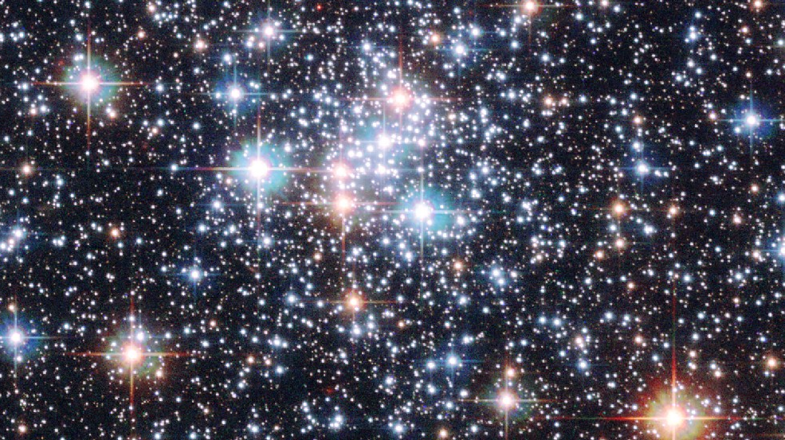
1. GOD’S QUESTIONS UNDERSCORE HIS POWER
“Can you bind the beautiful Pleiades? Can you loose the cords of Orion? Can you bring forth the constellations in their seasons, or lead out the Bear with its cubs? Do you know the laws of the heavens? Can you set up God’s dominion over the earth?” (Job 38:31-33)
“He determines the number of the stars, and He calls them each by name.” (Psalm 147:4)

Slide 6
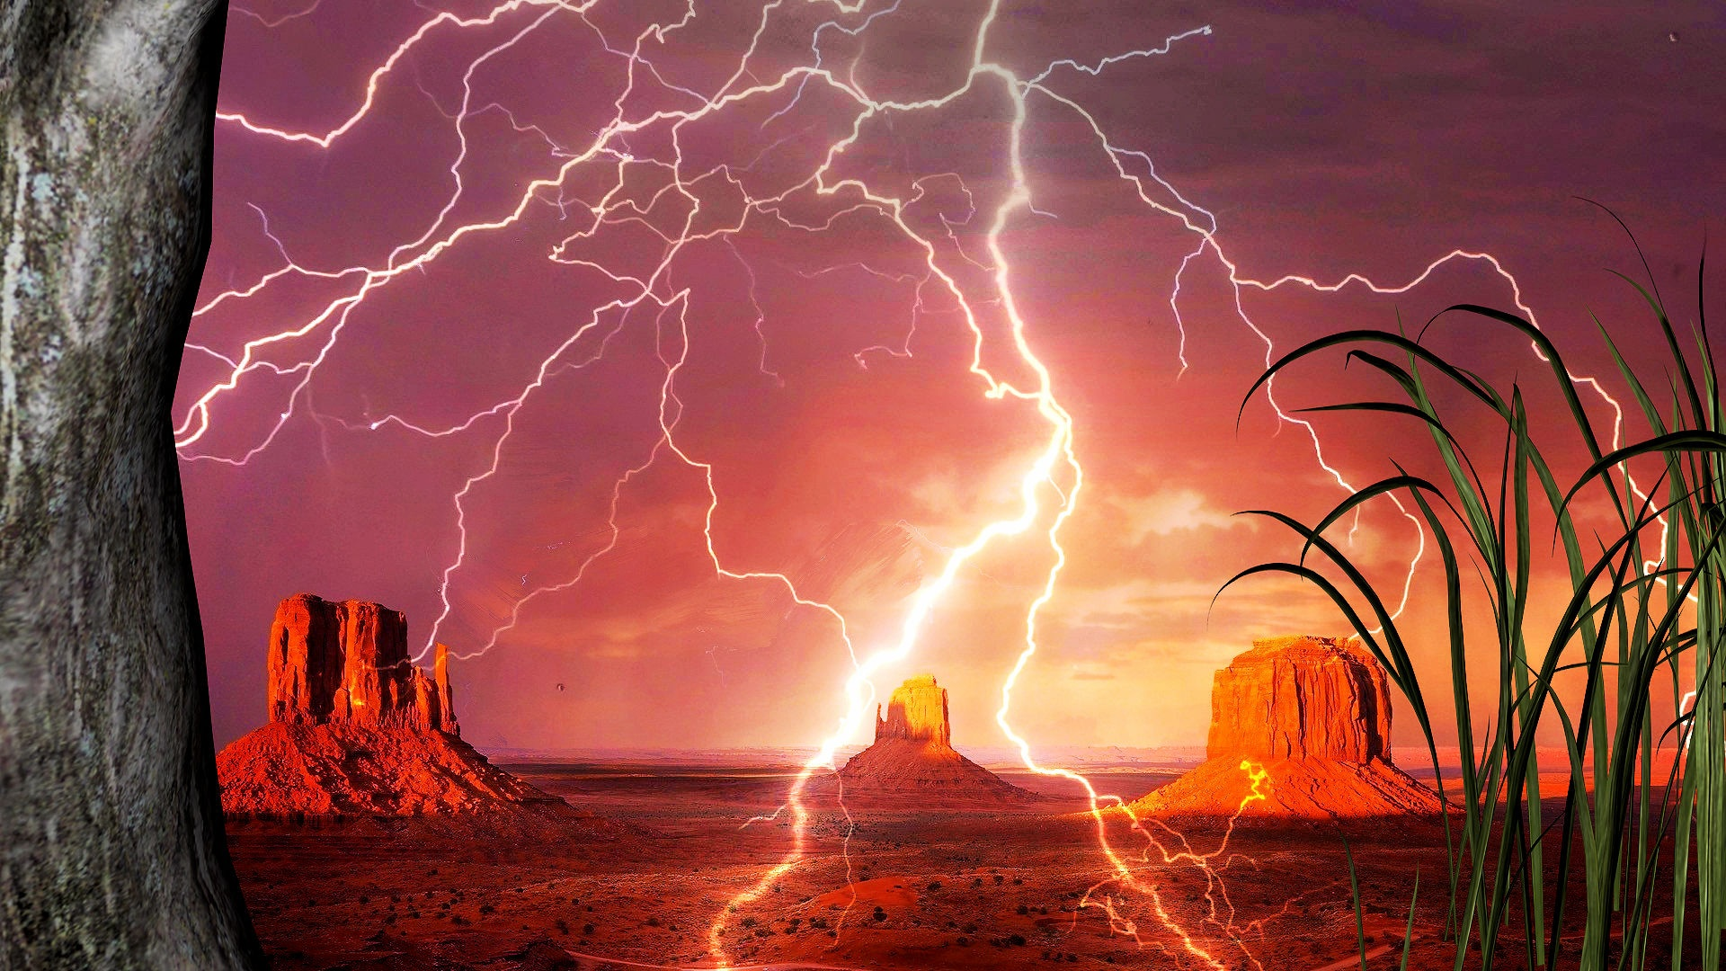
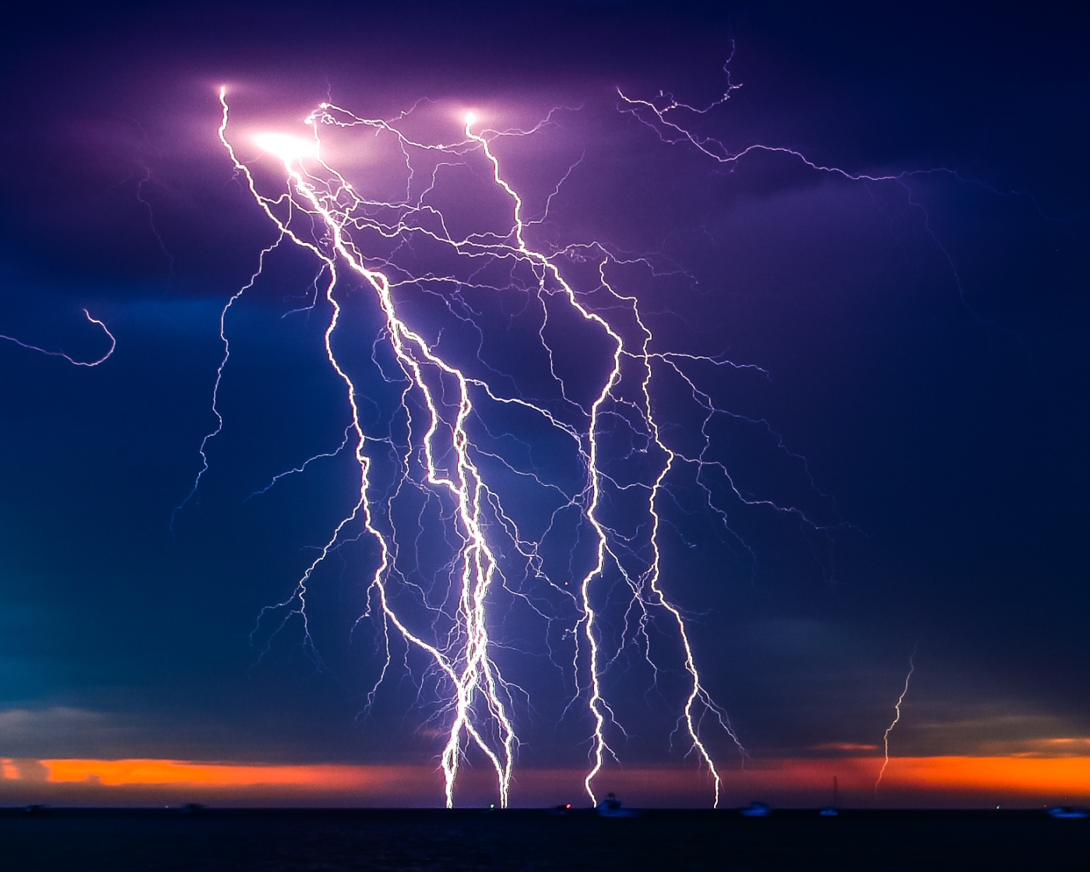
1. GOD’S QUESTIONS UNDERSCORE HIS POWER
“Can you raise your voice to the clouds and cover yourself with a flood of water?” (Job 38:34)
“Do you send the lightning bolts on their way? Do they report to you, ‘Here we are?’” (Job 38:35)

Slide 7
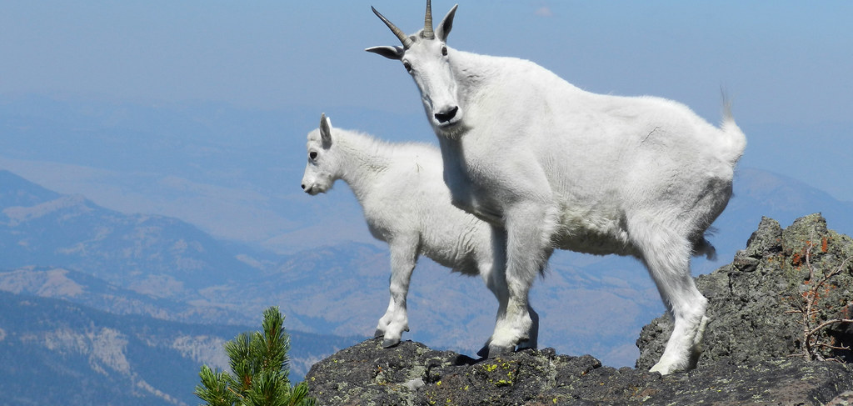
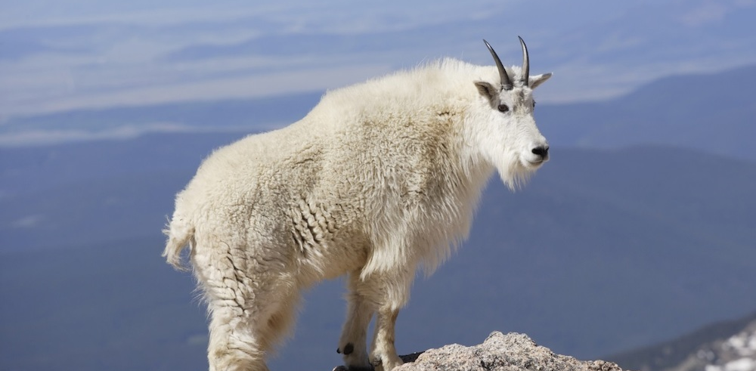
2. GOD’S QUESTIONS UNDERSCORE HIS COMPASSION
“Do you know when the mountain goats give birth?” “Do you watch when the doe bears her fawn?” (Job 39:1)
“Do you count the months till they bear? Do you know the time they give birth? They crouch down and bring forth their young; their labor pains are ended. Their young thrive
and grow strong in the
wilds…” (Job 39:2-4)

Slide 8
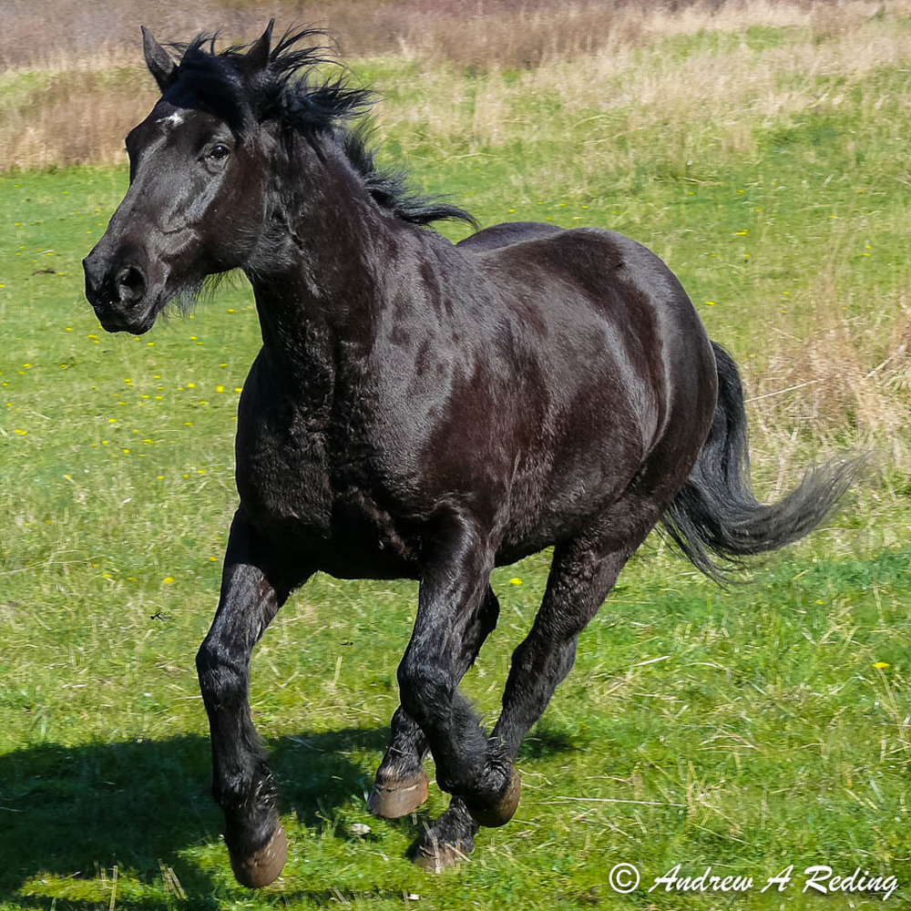
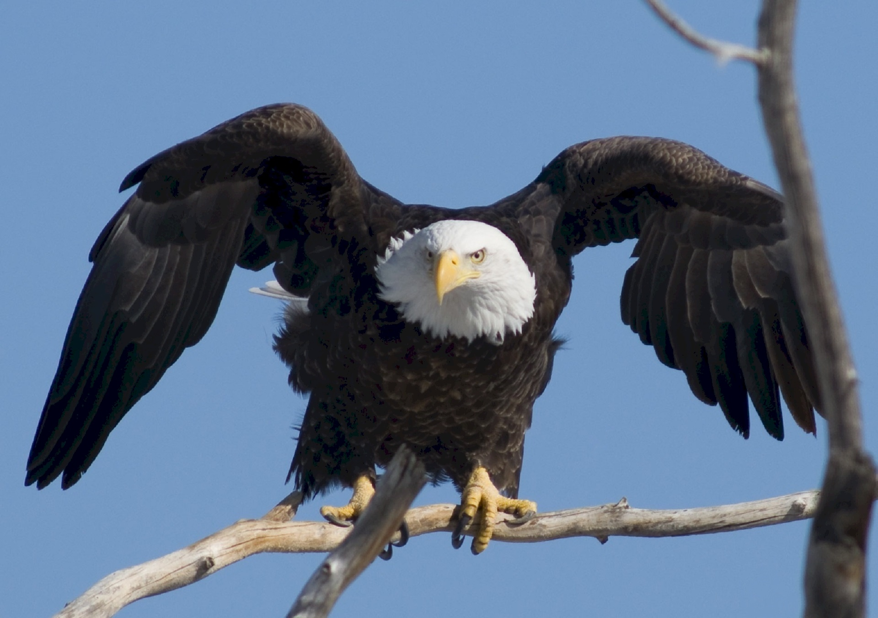
2. GOD’S QUESTIONS UNDERSCORE HIS COMPASSION
“Do you give the horse his strength or clothe his neck with a flowing mane?” (Job 39:19)
“Does the eagle sore at your command and build his nest on high? He dwells on a cliff and stays there at night; a rocky crag is his stronghold.” (Job 39:27)

Slide 9
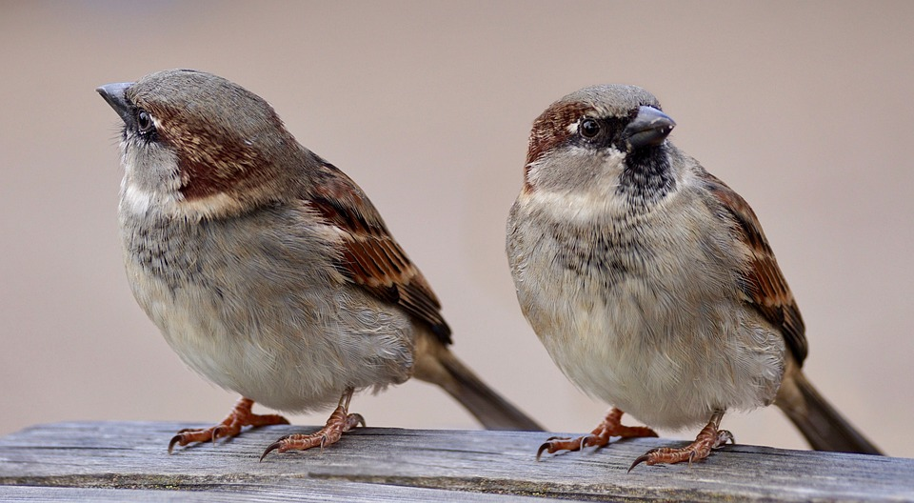
2. GOD’S QUESTIONS UNDERSCORE HIS COMPASSION
“Are not two sparrows sold for a penny? Yet not one of them will fall to the ground apart from the will of your Father. Even the very hairs of your head are all numbered. So do not be afraid; you are worth more than many sparrows.” (Matthew 10:29-30)

Slide 10
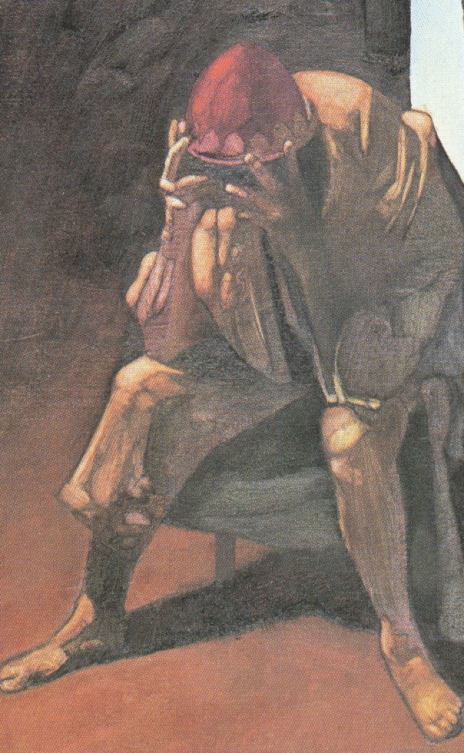
2. GOD’S QUESTIONS UNDERSCORE HIS COMPASSION
“The Lord said to Job, ‘Will the one who contends with the Almighty correct Him? Let him who accuses God answer Him!’” (Job 40:1-2)
“Then Job answered the Lord; ‘I am unworthy, how can I reply to you? I put my hand over my mouth. I spoke once but I have no answer; twice, but I will say no more.’” (Job 40:3-5)

Slide 11
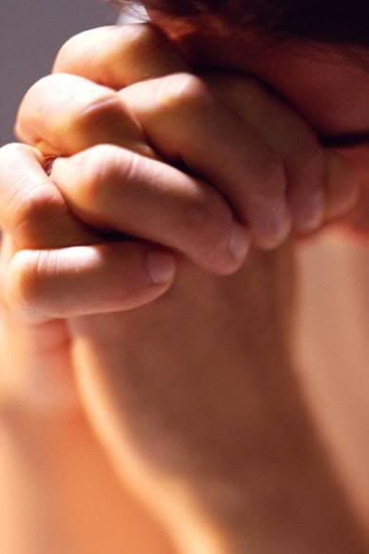
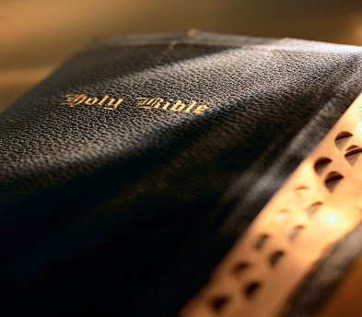
TAKE HOME TRUTH
Comfort comes, not from knowing why things happen, but from trusting who is governing the things that happen.

Slide 12
Black

Slide 13
OT Preaching link at BibleStudyDownloads.org
Get this presentation for free!
Notes:
OT Preaching (op)

