Slide 1
JOB 2
Handling Adversity

Slide 2
JOB 2
How should we respond to the adversities of life?

Slide 3
1. SATAN IS OUR NEMESIS IN ADVERSITY
“On another day, the angels came to present themselves before the Lord, and Satan also came with them to present himself before Him.”
“And the Lord said to Satan, ‘Have you considered my servant Job? There is no one on earth like him. He is blameless and upright, a man who fears God and shuns evil. And he still maintains his integrity, though you incited me against him to ruin him without any reason.’” (Job 2:2-3)
“The Lord said to Satan, ‘Very well then, he is in your hands; but you must spare his life.’” (Job 2:6)

Slide 4
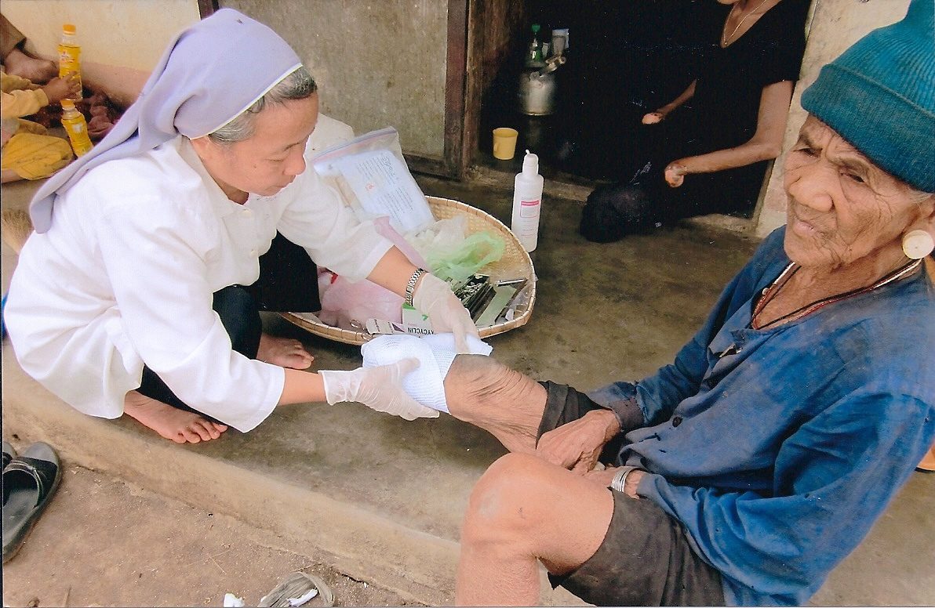
2. JOB IS OUR EXAMPLE IN ADVERSITY
“His wife said to him, ‘Are you still holding on to your integrity? Curse God and die!’”
“He replied, ‘You are talking like a foolish woman. Shall we accept good from God, and not trouble?’ In all this, Job did not sin in what he said,” (Job 2:9-10)

Slide 5
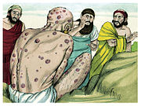
3. FRIENDS ARE OUR COMFORT IN ADVERSITY
“When they saw him from a distance, they could hardly recognize him; they began to weep aloud, and they tore their robes and sprinkled dust on their heads. Then they sat on the ground with him for seven days and seven nights. No one said a word to him because they saw how great his suffering was.” (Job 2:12-13)

Slide 6
WHAT DO WE LEARN FROM JOB?
Godly people are the most sorely tested.
Both prosperity and adversity pass through the Lord’s hands.
Suffering forces us to decided how we will respond.

Slide 7
TAKE HOME TRUTH
We trust the Lord when life is at its worst, because eternity will prove that His plan is best.

Slide 8
Black

Slide 9
OT Preaching link at BibleStudyDownloads.org
Get this presentation for free!
Notes:
OT Preaching (op)

