Slide 1
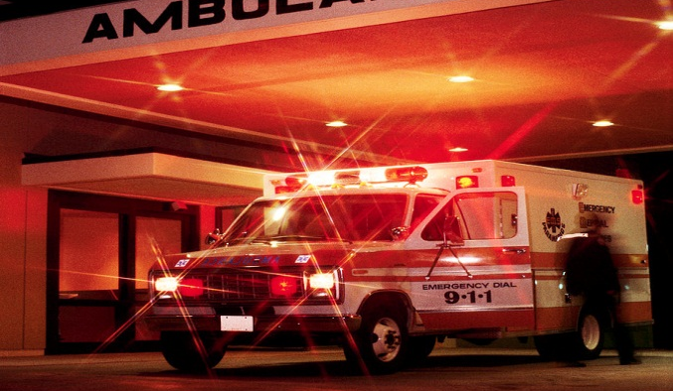
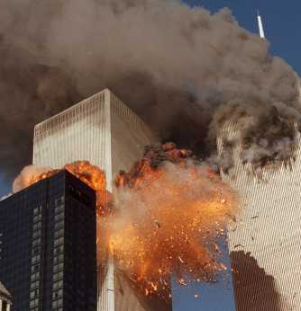
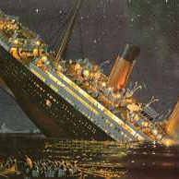
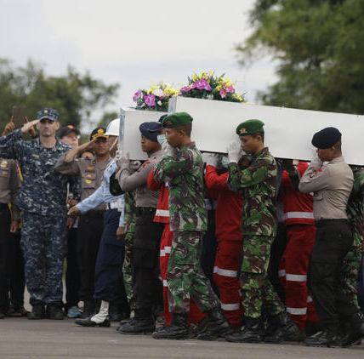
JOB 1
Handling Adversity
Dr Scott Wooddell Eastridge Park Christian Church, Mesquite, Texas Uploaded by Dr. Rick Griffith • Jordan Evangelical Theological Seminary Files in many languages for free download at BibleStudyDownloads.org

Slide 2
JOB 1
How do we respond to the adversities of life?

Slide 3
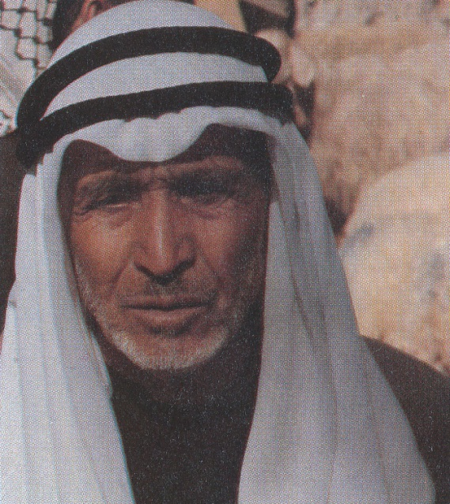
SCENE ONE – GOD BLESSES THE RIGHTEOUS
“In the land of Uz there lived a man whose name was Job. This man was blameless and upright; he feared God and shunned evil.” (Job 1:1)
Job was a righteous man.
Job was a family man.
Job was a prosperous man.
Job was a spiritual man.

Slide 4
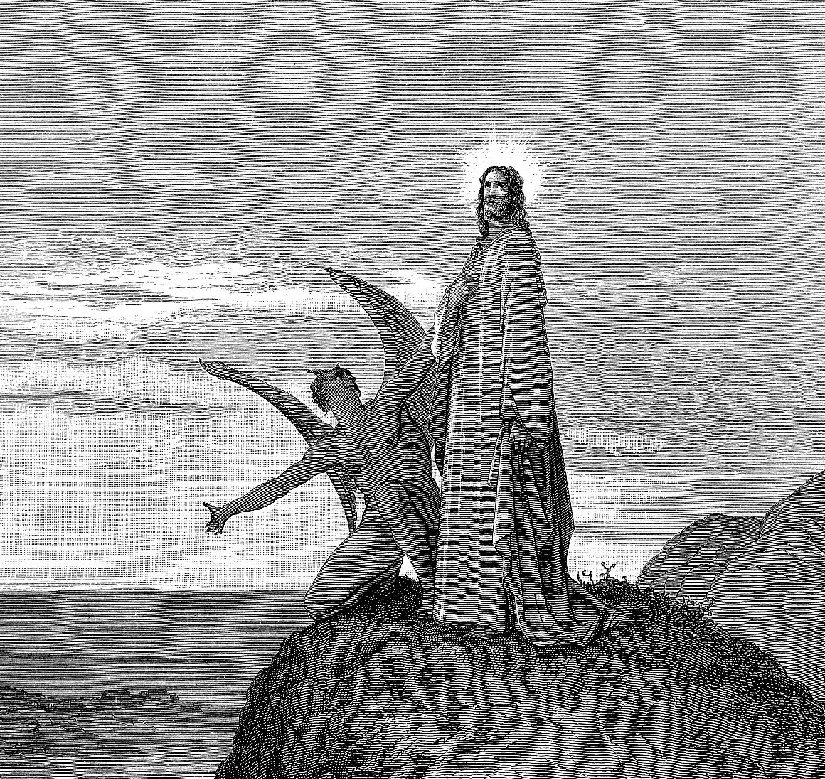
SCENE TWO - GOD PRAISES THE RIGHTEOUS
“One day the angels came to present themselves before the Lord, and Satan also came with them. The Lord said to Satan, ‘Where have you come from?’ Satan answered the Lord, ‘From roaming through the earth and going back and forth in it.’”
“Then the Lord said to Satan, ‘Have you considered my servant Job? There is no one on the earth like him; he is blameless and upright, a man who fears God and shuns evil.’” (Job 1:6-8)

Slide 5
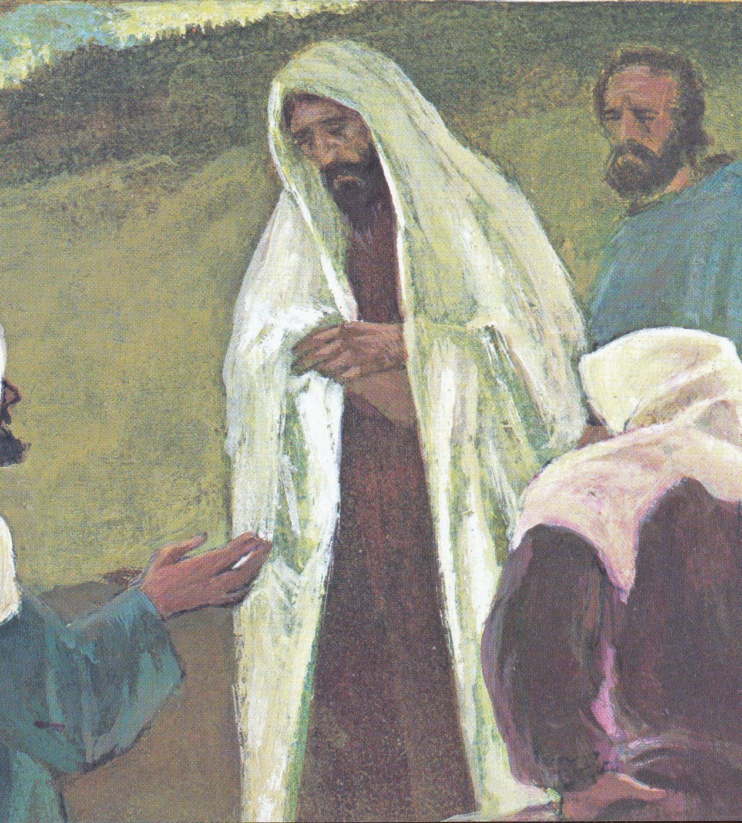
SCENE THREE – GOD TESTS THE RIGHTEOUS
The Sabeans steal Job’s livestock and kill his servants.
Fire from the sky burns up Job’s sheep and servants.
The Chaldeans steal Job’s camels and kill his servants.
A storm kills Job’s children.

Slide 6
SCENE THREE – GOD TESTS THE RIGHTEOUS
“At this, Job got up and tore his robe and shaved his head. Then he fell to the ground in worship and said, ‘Naked I came from my Mother’s womb, and naked I will depart. The Lord gave and the Lord has taken away; may the name of the Lord be praised.’”
(Job 1:20-21)

Slide 7
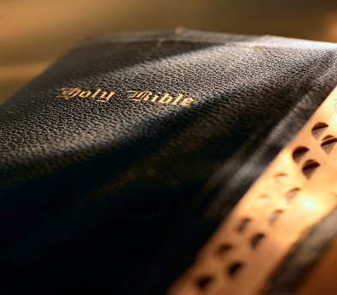
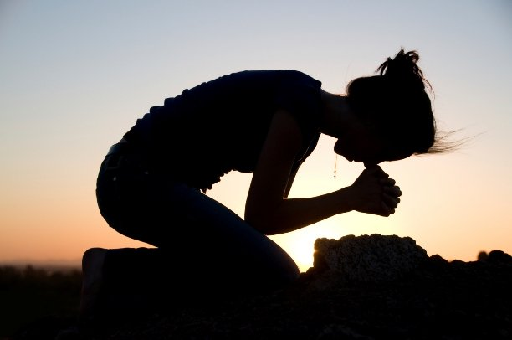
TAKE HOME TRUTH
When life treats us unfairly, we trust God’s grace fully.

Slide 8
Black

Slide 9
OT Preaching link at BibleStudyDownloads.org
Get this presentation for free!
Notes:
OT Preaching (op)

