Slide 1

Be Submissive
Job
Dr. Rick Griffith • Crossroads International Church Singapore
CICFamily.com • BibleStudyDownloads.org

Slide 2
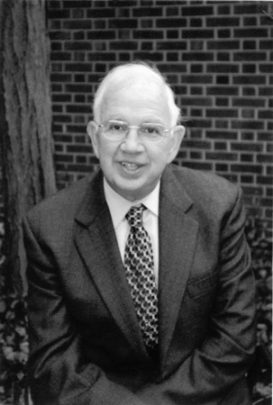
Rabbi Harold Kushner
Notes:
Rabbi Kushner was a Jewish rabbi who cared for his congregation. His people had the same kinds of issues we all face––

Slide 3
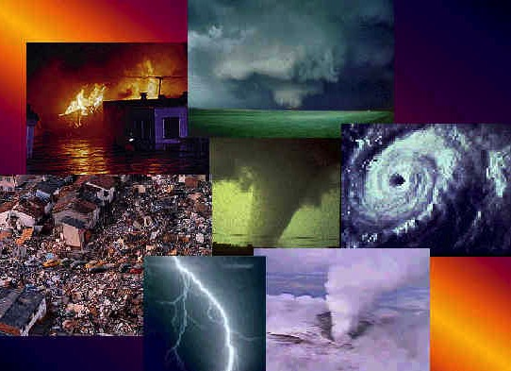

When
BAD
Things Happen to
GOOD
People
Small Group: Do you agree with this title?
Notes:
—natural disasters, sickness, divorce, death, problems with children, etc. In 1981 this led him to write the book When Bad Things Happen to Good People.
Random House says of this book, "When Harold Kushner's three-year-old son was diagnosed with a degenerative disease and that he would only live until his early teens, he was faced with one of life's most difficult questions: Why, God? Years later, Rabbi Kushner wrote this straightforward, elegant contemplation of the doubts and fears that arise when tragedy strikes. Kushner shares his wisdom as a rabbi, a parent, a reader, and a human being. Often imitated but never superseded, When Bad Things Happen to Good People is a classic that offers clear thinking and consolation in times of sorrow."
So what is his "clear thinking"? His thesis is that God is doing all He can to help people, but he can only do so much! Try to understand that God could solve your problem if he was only able to do it.
Let's not get duped into thinking that He is just not able to help you!

Slide 4
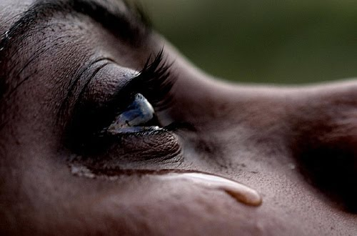
What righteous suffering have you experienced or are experiencing now?
Notes:
Think about how pain may hit you despite your innocence.
What righteous suffering have you experienced in the past?
What issue are you going through now though it is undeserved?

Slide 5
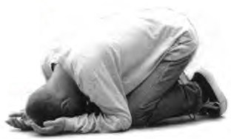
What is the proper response to righeous suffering?
Notes:
How should we act when we can't figure out seemingly undeserved difficulty?

Slide 6
The Rule of Job's Day
SIN
SUFFERING
GODLINESS
BLESSING
Notes:
In Job’s day the common belief was that suffering was always caused by sin but godliness that led to blessing. Therefore, the right response to suffering was simply to repent from sin. But is that the proper response to righteous suffering?

Slide 7
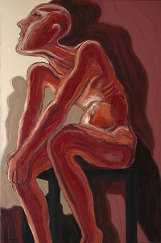
Prevailing Theology of Retribution
"The house of the wicked will be destroyed,
but the tent of the godly will flourish"
(Prov. 14:11 NLT)
"Those who fear the LORD are secure;
he will be a refuge for their children"
(Prov. 14:26 NLT)
Really?
Always?

Slide 8
JOB IN A NUTSHELL
SETTING
DEBATE
RESOLUTION
Notes:
Today we’ll see three steps to answer this question: the setting, the debate and the resolution to this problem of righteous suffering.

Slide 9

I. The Setting: Suffering sometimes hits when we haven’t done anything wrong
(Job 1–2).
Notes:
We haven’t deserved it, but at times pain comes nonetheless.

Slide 10
Slides on
Job 1
Notes:
The setting regarding God's sovereignty over righteous suffering was where Job, unaware of Satan’s plot, innocently suffered great losses (Job 1–2).

Slide 11
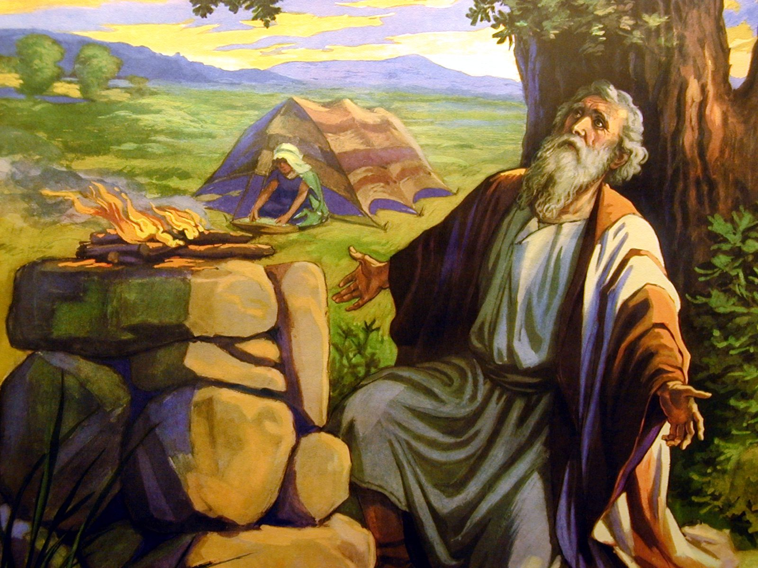
The Description of Job (1:1-5)
Scene 1
Notes:
God blessed Job's character of righteousness with great possessions to show his sovereign blessing on his life (1:1-5).
____________
Job by Bonnat from Wikipedia

Slide 12

Did Job really exist?
358
No (e.g., Tremper Longman) | Yes (e.g., Rick Griffith)
It is only a thought experiment | Why not a real experiment? Job is parallel to the real men Noah & Daniel (Ezek 14:14, 20)
It is written in stylistic poetry | Why can’t Job have real poetic dialogue (cf. Song)? Many societies do this.
Job had seven sons and three daughters | Job could have actually had the ideal number of children.
Job is one of the last books of the OT— at least in its final form | What textual support shows that Job a late date? It has unity (cp. Job 1 & Job 42).
Ha Satan (“The Accuser”) in Hebrew is not a definite name as it has the article (“the”) | Portuguese has a definite article in names; Satan is the Accuser (Rev 12:10).
Notes:
Longman arguments given 19 Aug 2019 seminar, Singapore Bible College

Slide 13
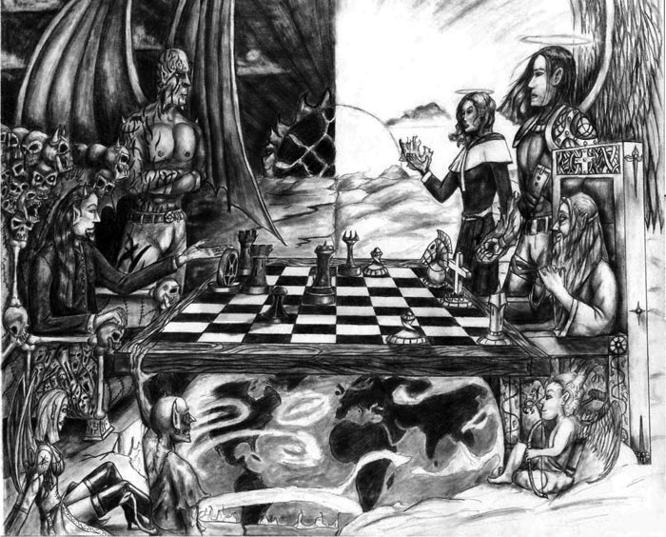
Chess
Scene 2
Notes:
Satan assaulted Job twice but he remained true to God as background for his friends' accusations against his character (1:6–2:10).

Slide 14
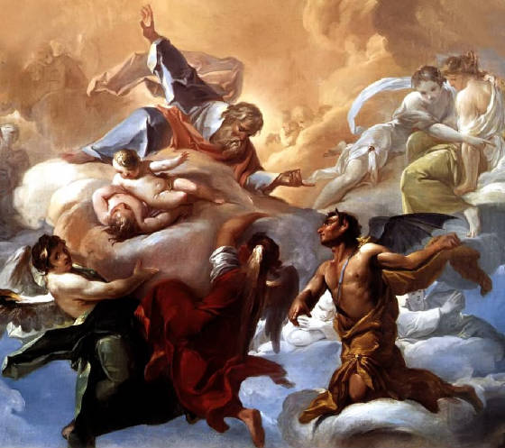
The Description of Satan (1:6-12)
Scene 3
Notes:
Satan's first assault against Job under God's sovereign limitations takes all his possessions and children, but Job responds righteously (1:6-22).
Scene 2 (Heaven): Satan’s limitations are contrasted with God’s sovereignty as he tests Job, as Satan attributes his righteousness to material blessing (1:6-12).
_______
Job by Bonnat from Wikipedia

Slide 15
Satan's Attacks in Job 1
???
 | 1 | 2 | 3 | 4
Attacker | Sabeans (1:14-15) | Fire of God (1:16) | Chaldeans (1:17) | Wind (1:18-19)
Animals Killed | 1000 oxen 500 donkeys | 7000 sheep | 3000 camels | —
People Killed | Many servants | Many servants | Many servants | 7 sons 3 daughters
Interchange | Man | God | Man | God
Satan waited until a day of celebration (1:13)
Satan didn't challenge God's limitations
Notes:
Scene 3 (Uz): Satan responds to God's permission by taking all of Job's possessions and children, but is rebuked by Job's righteous response (1:13-22).

Slide 16
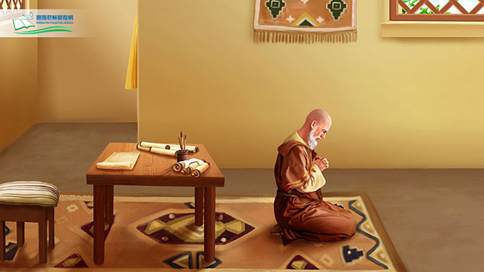
"The LORD gave, the LORD took away. Blessed be his name" (1:21b).

Slide 17
Slides on
Job 2
Notes:
Satan's second assault against Job under God's sovereign limitations takes his health, but again Job responds righteously (2:1-10).

Slide 18
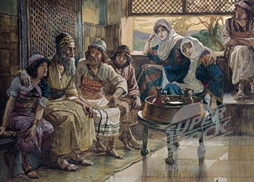
Outline
II. (Job 3–41) Job & 4 friends unsuccessfully dialogue regarding the reason for his suffering, but God declares that this question should not be asked because of His incomprehensibility & sovereignty.
360
Job 4–31 has 3 cycles of controversy. (Eliphaz begins each series & Zophar does not speak in the last series.)
First Cycle
Eliphaz
4–5
è
Job
6–7
Bildad
8
è
Job
9–10
Zophar
11
è
Job
12–14
Second Circle
Eliphaz
15
è
Job
16–17
Bildad
18
è
Job
19
Zophar
20
è
Job
21
Third Cycle
Eliphaz
22
è
Job
23–24
Bildad
25
è
Job
26–31
Irving L. Jensen, Job: A Self-Study Guide, 28

Slide 19
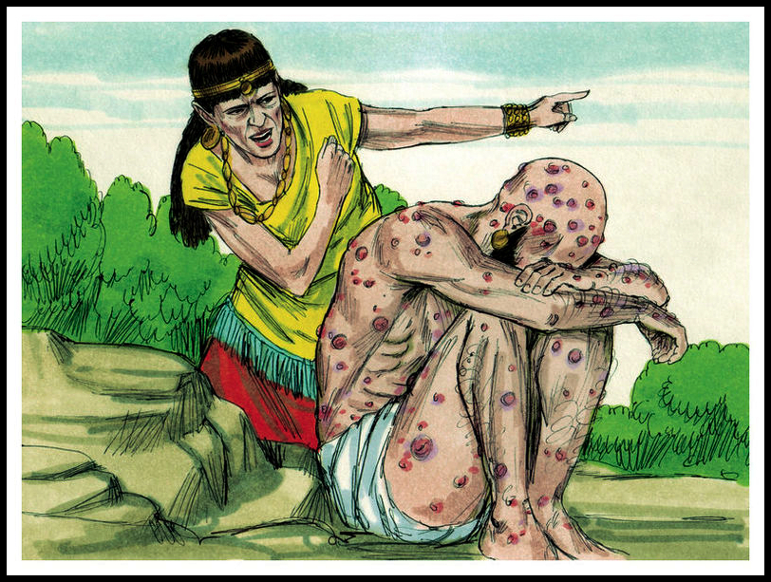
Job's Wife: "Curse God and die!" (2:9)
Scene 5
Notes:
Scene 5 (Uz): Satan responds to God's permission by hurting Job with sores and a merciless wife, yet Job again responds righteously (2:7-10).

Slide 20
Five Responses to Suffering
374
Huang Sabin, SBC, adapted
PERSON
RESPONSE
SOLUTION
MODERN
EQUIVALENT
ANSWER
1. Job's Wife
Curse God & die (2:9)
Suicide
Young people
Unacceptable
2. Three "friends"
Suffering is from sin (4:7-8)
Repentance
"Name it,
claim it"
Not always
applicable
3. Job
God's not fair & doesn't care (19:7)
Complain
Most mourners
Unbiblical
^{NLT} Job 2:9 His wife said to him, "Are you still trying to maintain your integrity? Curse God and die."
4 Elihu
Trials are for teaching (33:14-19)
Endure
Most preachers
Inadequate
5. GOD
Not 'Why?" but "Who?" (38-42)
Worship
None
Unpopular

Slide 21
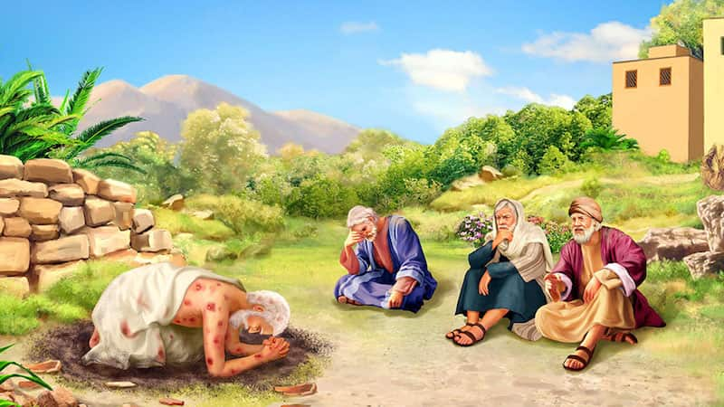
"Then they sat on the ground with him for seven days and nights. No one said a word to Job, for they saw that his suffering was too great for words" (2:13 NLT).
Notes:
Eliphaz the Temanite, Bildad the Shuhite, and Zophar the Naamathite, sat in silence with Job for a week in the custom of the day so Job could first express his grief (2:11-13).

Slide 22

Are you experienceing righeous suffering?
Notes:
Maybe you also are living right but experiencing pain.
Many times suffering comes from sin (break the law, hurt people you love).
But perhaps you have done nothing to deserve your suffering (living for others, loving God and people).

Slide 23
What is the proper response to righeous suffering?
Notes:
How should we act when we can't figure out seemingly undeserved difficulty?

Slide 24
I. The Setting: Suffering sometimes hits when we haven’t done anything wrong
(Job 1–2).
Notes:
We haven’t deserved it, but at times pain comes nonetheless.

Slide 25
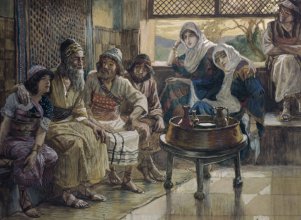
What is our typical response to righteous suffering?

Slide 26

II. The Debate: We struggle with righteous suffering until God shares his incomprehensibility
(Job 3–41).
Notes:
Wrestling with the reason for pain is natural until God says he won't tell.

Slide 27
Slides on
Job 3
Notes:
God shut down debate by saying that this reason for righteous suffering shouldn’t be asked due to his incomprehensibility and sovereignty (Job 3–41).

Slide 28
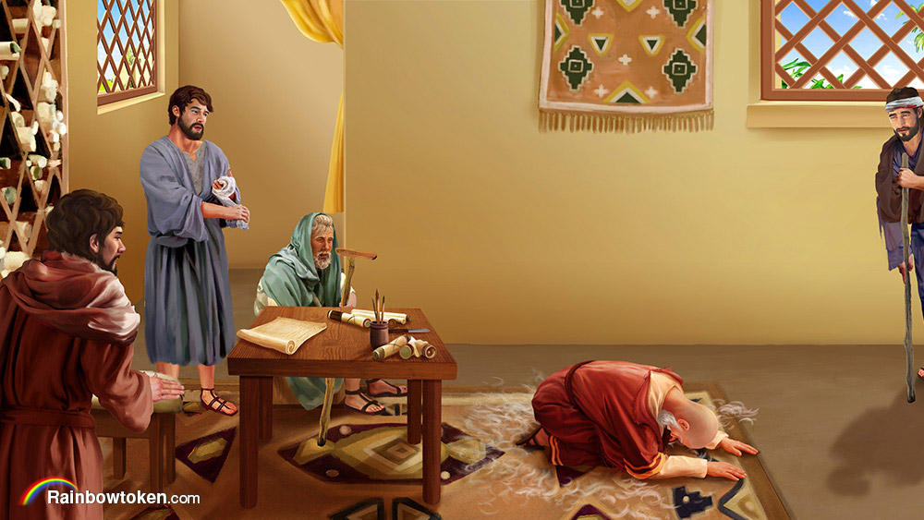
The Debate (Job 3–41)
Notes:
Job and his three friends debated in three cycles the reason for his suffering, each time getting more heated and specific, but not knowing why he suffered (Job 3–26).

Slide 29
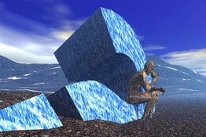
Overview
356

Slide 30
Outline
II. (Job 3–41) Job & 4 friends unsuccessfully dialogue regarding the reason for his suffering, but God declares that this question should not be asked because of His incomprehensibility & sovereignty.
360
Job 4–31 has 3 cycles of controversy. (Eliphaz begins each series & Zophar does not speak in the last series.)
First Cycle
Eliphaz
4–5
è
Job
6–7
Bildad
8
è
Job
9–10
Zophar
11
è
Job
12–14
Second Circle
Eliphaz
15
è
Job
16–17
Bildad
18
è
Job
19
Zophar
20
è
Job
21
Third Cycle
Eliphaz
22
è
Job
23–24
Bildad
25
è
Job
26–31
Irving L. Jensen, Job: A Self-Study Guide, 28

Slide 31
Five Responses to Suffering
374
Huang Sabin, SBC, adapted
PERSON
RESPONSE
SOLUTION
MODERN
EQUIVALENT
ANSWER
1. Job's Wife
Curse God & die (2:9)
Suicide
Young people
Unacceptable
2. Three "friends"
Suffering is from sin (4:7-8)
Repentance
"Name it,
claim it"
Not always
applicable
3. Job
God's not fair & doesn't care (19:7)
Complain
Most mourners
Unbiblical
NIV Job 4:7 "Consider now: Who, being innocent, has ever perished? Where were the upright ever destroyed? ⁸As I have observed, those who plow evil and those who sow trouble reap it."
4 Elihu
Trials are for teaching (33:14-19)
Endure
Most preachers
Inadequate
5. GOD
Not 'Why?" but "Who?" (38-42)
Worship
None
Unpopular

Slide 32
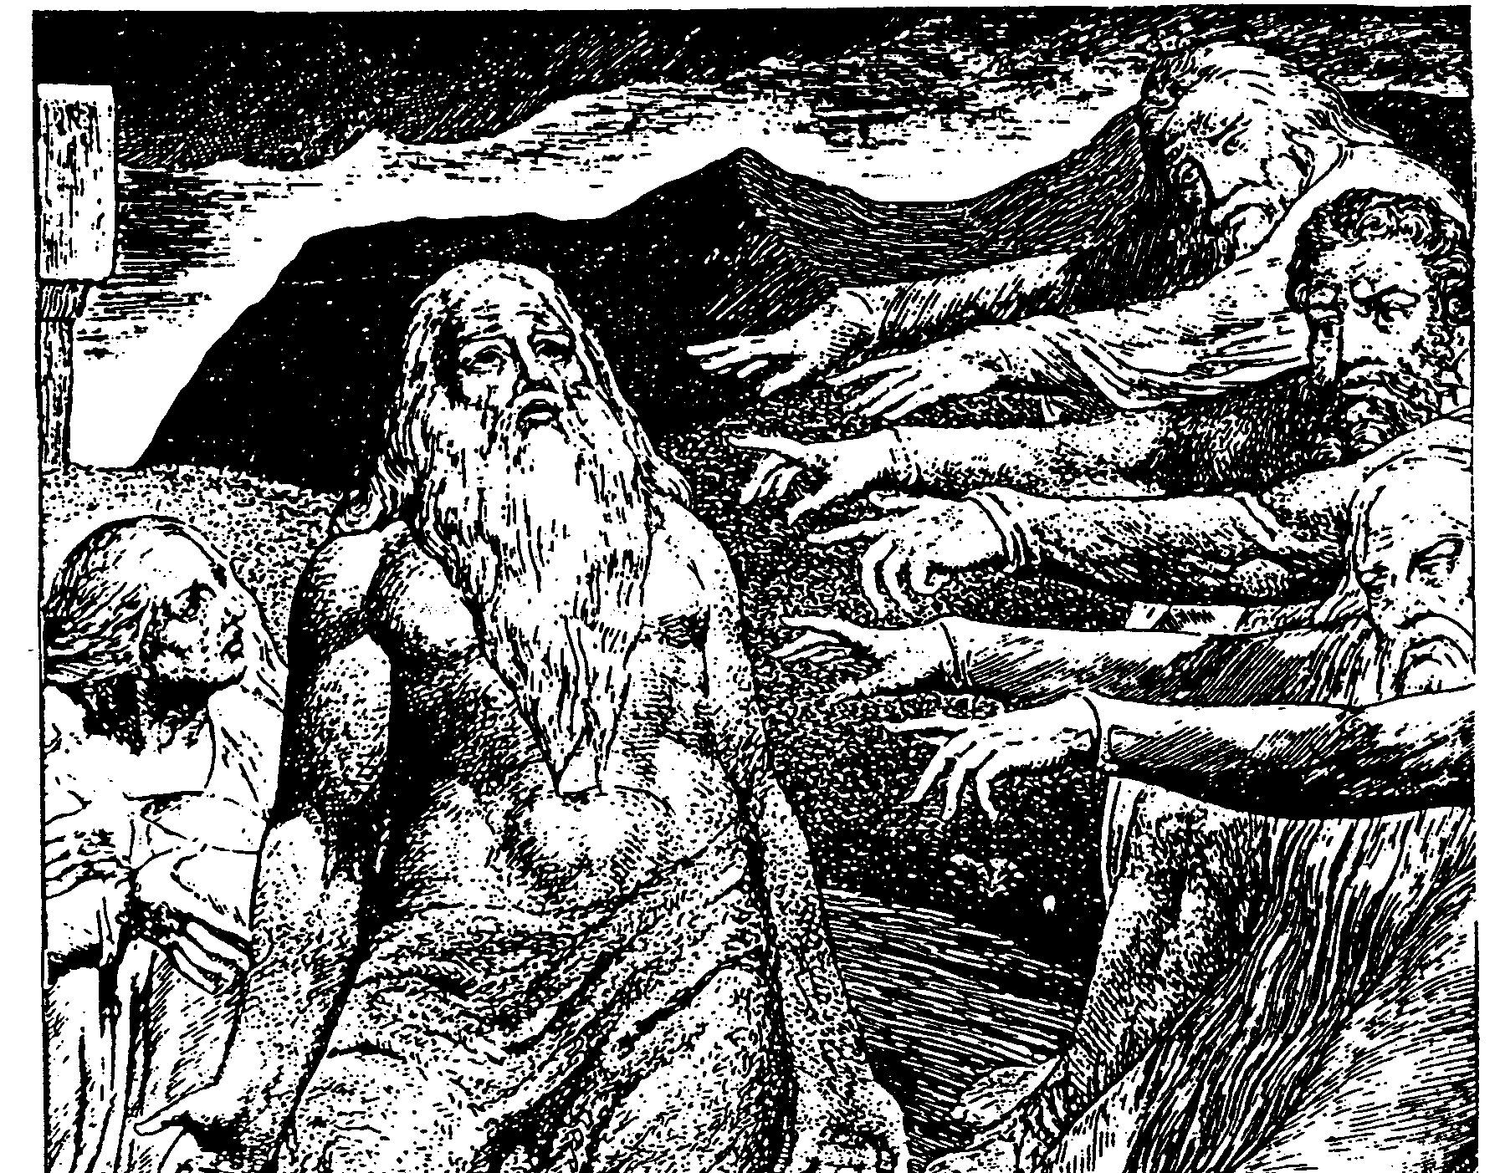
The Cycles of Debate in Job
372

Slide 33
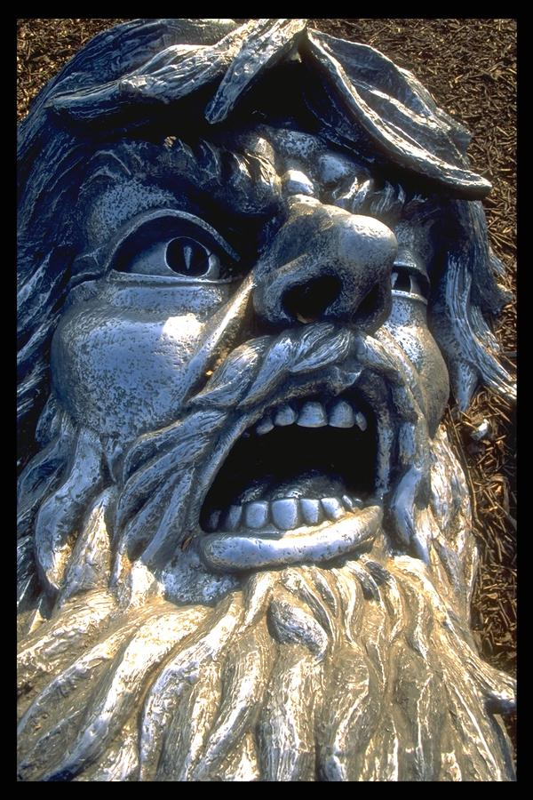
Their Basic Premise
373
Eliphaz
RETRIBUTION
Bildad
You only get what you deserve!
Zophar

Slide 34
Job's Basic Premise
373
Job
I don't deserve
what I got!

Slide 35
Five Responses to Suffering
374
Huang Sabin, SBC, adapted
PERSON
RESPONSE
SOLUTION
MODERN
EQUIVALENT
ANSWER
1. Job's Wife
Curse God & die (2:9)
Suicide
Young people
Unacceptable
2. Three "friends"
Suffering is from sin (4:7-8)
Repentance
"Name it,
claim it"
Not always
applicable
3. Job
God's not fair & doesn't care (19:7)
Complain
Most mourners
Unbiblical
4 Elihu
Trials are for teaching (33:14-19)
Endure
Most preachers
Inadequate
NIV Job 19:7 "Though I cry, 'I've been wronged!' I get no response; though I call for help, there is no justice.' "
5. GOD
Not 'Why?" but "Who?" (38-42)
Worship
None
Unpopular

Slide 36
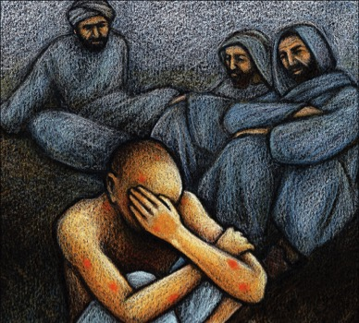
Cycles of Debate
1
2
372
3
Cycle
Tone
Implication
Insinuation
Indictment
Content
General Recommendations
Specific
Advice
Vicious
Accusations
Speakers
Eliphaz
Bildad
Zophar
Eliphaz
Bildad
Zophar
Eliphaz
Bildad
Length
12 chapters
7 chapters
10 chapters
Chapters
3–14
15–21
22–31

Slide 37
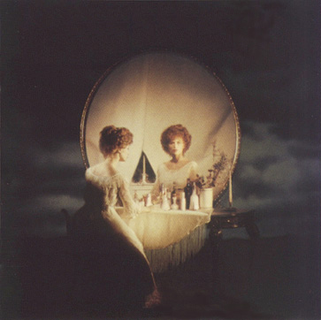
Why do the innocent suffer?
Satan:
Deserved
3 Friends:
Retribution
Elihu:
Discipline

Slide 38
Slides on
Job 32
Notes:
Elihu angrily rebuked Job and his friends saying that God need not reveal the purpose for Job's suffering although He is speaking to Job through his pain (Job 32–37).

Slide 39

Elihu's Addressees (32–37)
367
First speech
To all four (32:6-9)
To the three (32:10-14)
To Job (32:15–33:33)
Second speech
To the three (34:1-15)
To Job (34:16-37)
Third speech
To Job (35:1-3)
To the three (35:4-16)
Fourth speech
To Job (36:1–37:1)
To the three (37:2-13)
To Job (37:14-24)
Adapted at 35:4-16 from Roy B. Zuck, Bible Knowledge Commentary, 1:755

Slide 40
Five Responses to Suffering
374
Huang Sabin, SBC, adapted
PERSON
RESPONSE
SOLUTION
MODERN
EQUIVALENT
ANSWER
1. Job's Wife
Curse God & die (2:9)
Suicide
Young people
Unacceptable
ESV Job 33:14 For God speaks in one way, and in two, though man does not perceive it. ¹⁵In a dream, in a vision of the night. . . ¹⁹Man is also rebuked with pain on his bed and with continual strife in his bones.
2. Three "friends"
Suffering is from sin (4:7-8)
Repentance
"Name it,
claim it"
Not always
applicable
3. Job
God's not fair & doesn't care (19:7)
Complain
Most mourners
Unbiblical
4 Elihu
Trials are for teaching (33:14-19)
Endure
Most preachers
Inadequate
5. GOD
Not 'Why?" but "Who?" (38–42)
Worship
None
Unpopular

Slide 41
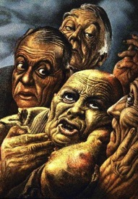
Perspectives of Job's Friends
373
Bruce Wilkinson & Kenneth Boa, Talk Thru the Bible
Eliphaz
Bildad
Zophar
Elihu
Characteristic
Theologian
Historian, legalist
Moralist, dogmatist
Young theologian, intellectual
Relies on
Observation, Experience
Tradition
Assumption
Education
Personality
Considerate
Argumentative
Rude, blunt
Perceptive, some
conceit
Voice
Philosophy
History
Orthodoxy
Logic
Argument
"If you sin, you suffer"
"You must be sinning"
"You are sinning"
"God purifies and
teaches"
Advice to Job
Only the wicked
suffer
The wicked always
suffer
The wicked are
short-lived
Humble yourself
and submit to God
Key Verse
4:8; 5:17
8:8
20:5
37:23
Concept of God
Righteous;
punishes wicked, blesses good
Judge; immovable
lawgiver
Unbending,
merciless
Disciplinarian,
teacher

Slide 42
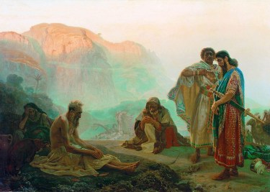
Key Verse
"The Almighty is beyond our reach and exalted in power; in his justice and great righteousness, he does not oppress. Therefore, men revere him, for does he not have regard for all the wise in heart?" (Job 37:23-24)
[Elihu talking] "The Almighty is beyond our reach and exalted in power;
in his justice and great righteousness,
he does not oppress.
²⁴Therefore, men revere him,
for does he not have regard
for all the wise in heart?"
(Job 37:23-24 NIV)
356

Slide 43
Slides on
Job 38
Notes:
The LORD tested Job with unanswerable questions to affirm His incomprehensibility, sovereignty, and omnipotence (Job 38–41).

Slide 44
Why do the innocent suffer?
Satan:
Deserved
3 Friends:
Retribution
Elihu:
Discipline
God:
Incomprehensibility

Slide 45
Job's Mid-Term Exam (38–41)
369
Part 1 (Short Answer, 38:1–40:5): Can you answer even one of my questions?
Part 2 (Essay Questions, 40:6–41:34):
Which of my attributes do you have (40:6-14)?
How are you stronger than Behemoth (40:15-24)?
How are you stronger than Leviathan (41)?
Notes:
Job probably thought God was giving him a FINAL EXAM—but he didn't know that, even though he miserably failed this exam, he would live 140 years after it (42:16).

Slide 46
Five Responses to Suffering
374
Huang Sabin, SBC, adapted
PERSON
RESPONSE
SOLUTION
MODERN
EQUIVALENT
ANSWER
ESV Job 38:1 Then the LORD answered Job out of the whirlwind and said: ²"Who is this that darkens counsel by words without knowledge? ³Dress for action like a man; I will question you, and you make it known to me. ⁴Where were you when I laid the foundation of the earth? Tell me, if you have understanding."
1. Job's Wife
Curse God & die (2:9)
Suicide
Young people
Unacceptable
2. Three "friends"
Suffering is from sin (4:7-8)
Repentance
"Name it,
claim it"
Not always
applicable
3. Job
God's not fair & doesn't care (19:7)
Complain
Most mourners
Unbiblical
4 Elihu
Trials are for teaching (33:14-19)
Endure
Most preachers
Inadequate
5. GOD
Not 'Why?" but "Who?" (38–42)
Worship
None
Unpopular

Slide 47
Slides on
Job 40

Slide 48
Job's Mid-Term Exam (38–41)
369
Part 1 (Short Answer, 38:1–40:5): Can you answer even one of my questions?
Part 2 (Essay Questions, 40:6–41:34):
Which of my attributes do you have (40:6-14)?
How are you stronger than Behemoth (40:15-24)?
How are you stronger than Leviathan (41)?
Notes:
Job probably thought God was giving him a FINAL EXAM—but he didn't know that, even though he miserably failed this exam, he would live 140 years after it (42:16).

Slide 49
Behemoth (Job 40:15-24)
"Look at the behemoth, which I made along with you and which feeds on grass like an ox. ¹⁶What strength he has in his loins, what power in the muscles of his belly! ¹⁷His tail sways like a cedar; the sinews of his thighs are close-knit. ¹⁸His bones are tubes of bronze, his limbs like rods of iron" (40:15-18 NIV).

Slide 50
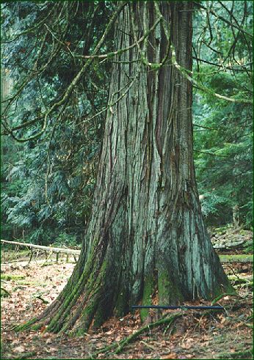
The cedar was the largest tree in the Mid-East
379

Slide 51
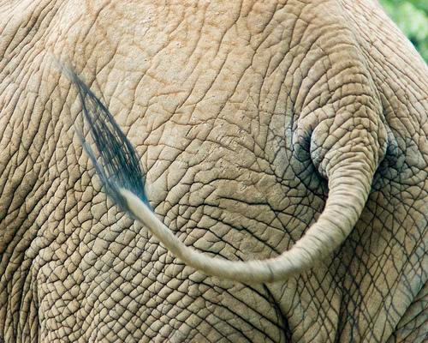
The tail of an elephant is not like a cedar!
379

Slide 52
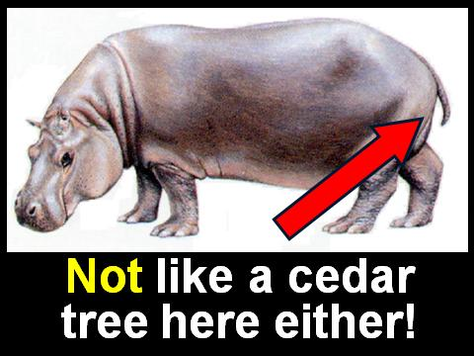
Not like a cedar tree on a hippo either!
379

Slide 53
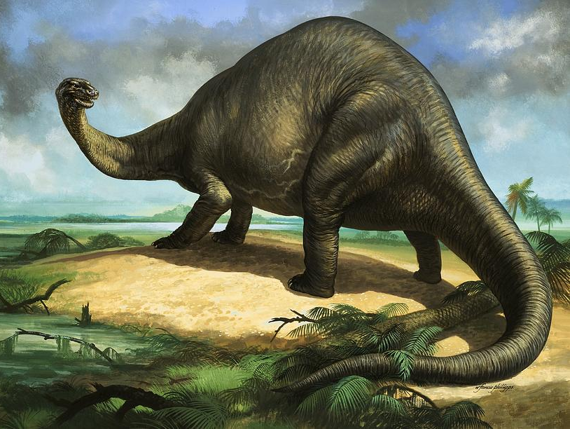
Apatosaurus
379
weighed 35 tons & measured 120 feet!

Slide 54
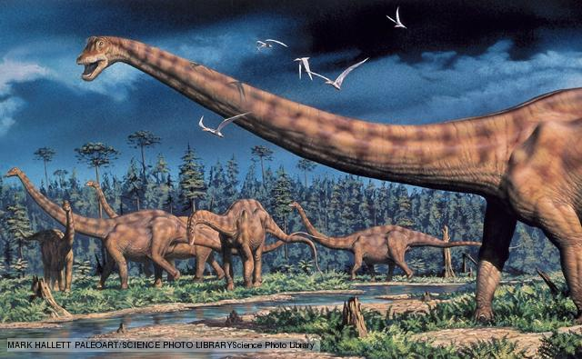
Diplodocus
379
also measured 120 feet!

Slide 55
Slides on
Job 41

Slide 56

What's the Leviathan?
369
379
Job 41

Slide 57
Leviathan (Job 41:1-34)
"Can you pull in the leviathan with a fishhook or tie down his tongue with a rope?
²Can you put a cord through his nose
or pierce his jaw with a hook?
³Will he keep begging you for mercy?
Will he speak to you with gentle words?" (41:1-3 NIV).

Slide 58
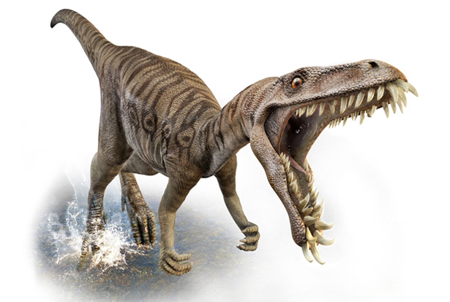
Tyrannosaurus Rex
379

Slide 59
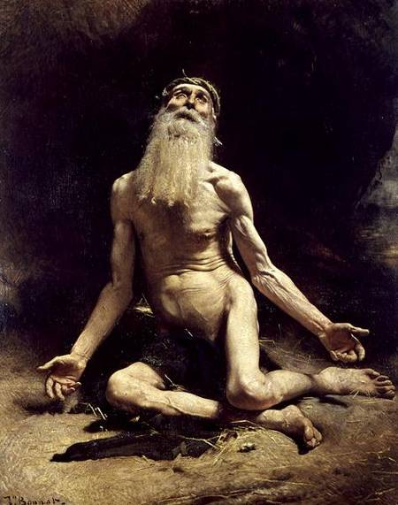
Did God answer Job?
How?
God probably will not reveal why you are suffering—so rest in your ignorance.
Notes:
God probably will not reveal why you are suffering—so rest in your ignorance.
Too often we think that God owes us a reason. He doesn’t owe us anything!
Even if he did tell the reason, we would still struggle with his justice due to our sin.
_____________
Job by Bonnat from Wikipedia

Slide 60
What is the proper response to righeous suffering?
Notes:
How should we act when we can't figure out seemingly undeserved difficulty?

Slide 61
I. The Setting: Suffering sometimes hits when we haven’t done anything wrong
(Job 1–2).
Notes:
We haven’t deserved it, but at times pain comes nonetheless.

Slide 62
II. The Debate: We struggle with righteous suffering until God shares his incomprehensibility
(Job 3–41).
Notes:
Wrestling with the reason for pain is natural until God says he won't tell.

Slide 63

III. The Resolution: Our proper response is to submit to God (Job 42).
Notes:
We should surrender to the Lord rather than fight him.

Slide 64
Slides on
Job 42

Slide 65
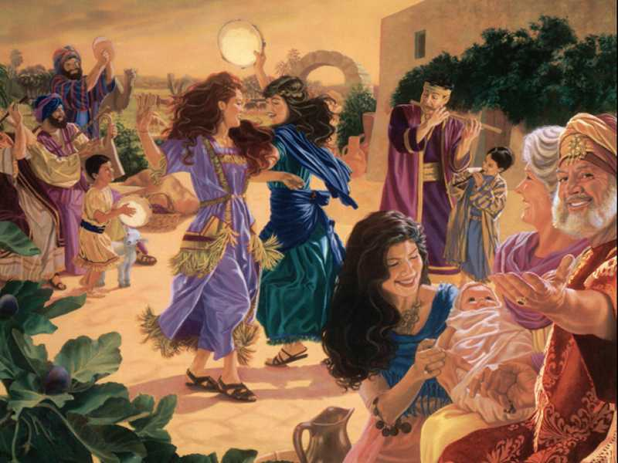
Outline
370
III. Job submits to God for His incomprehensibility and sovereignty, then prays for his friends and has restored possessions, children, and health, thus affirming God's blessing on those who accept His plan (Job 42).
Notes:
The proper response to righteous suffering was Job’s submission to God rather than questioning his incomprehensibility and sovereignty (Job 42).

Slide 66
Contrasts Between Job 1 and Job 42
370
Job 1
Job 42
Description
Blameless & upright, feared God & shunned evil
Blameless yet repentant, feared God & prayed for friends
Sons
7
7
Daughters
3 (ate with brothers at feasts)
3 (more beautiful, got inheritance)
Sheep
7,000
14,000
Camels
3,000
6,000
Yoke of Oxen
500
1,000
Donkeys
500
1,000
Servants
"Large number"
Assumed large
Age
Unstated
Lived another 140 years
Notes:
God blessed Job's obedience with long life, doubling his former wealth, giving him more children and restoring his health, blessing the latter part of his life more than the first (42:10-17).

Slide 67
Don’t strive to know reasons—long to know God instead!
356
Job's suffering, dialogue with others and God, and restoration reveal that the proper response to righteous suffering is submission to God rather than questioning His incomprehensibility and sovereignty.

Slide 68
What is the proper response to righeous suffering?
Notes:
How should we act when we can't figure out seemingly undeserved difficulty?

Slide 69

Main Idea of Job
Submit to God’s incomprehensibility rather than try to figure suffering out.
Notes:
Yield to the LORD by recognizing that he is under no obligation to tell you his purposes in difficulty.

Slide 70
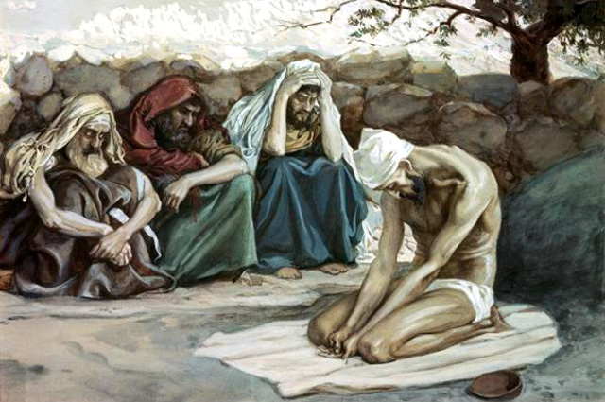

Key Word
Job
356
Incomprehensibility
The problem of suffering
Notes:
James Tissot, "Job and His Three Friends."

Slide 71
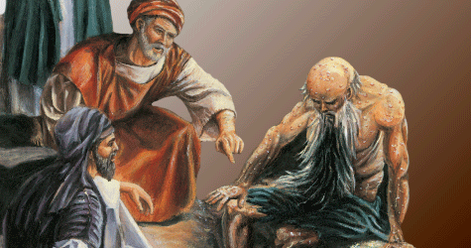
Application
356
APPLICATION
During righteous suffering…
Do not question the reason for your plight.
Submit to God by trusting in God's wisdom.
Notes:
What issue are you going through now?
Is your pain really righteous suffering?
If you need to repent, please go ahead.
If you don’t need to repent, don’t pretend you do.
How are you trying to figure your suffering out?
“If only I knew…” assumes that if you knew right, you would act right.
Are you finding the advice of friends about as helpful as the counsel of Job’s friends?
How can you submit to God by trusting in God’s wisdom?

Slide 72
Don’t try to force God to tell you the things he will not tell.
"The secret things belong to the LORD our God, but the things revealed belong to us and to our children forever, that we may follow all the words of this law"
(Deut 29:29 NIV).
"The LORD our God has secrets known to no one. We are not accountable for them, but we and our children are accountable forever for all that he has revealed to us, so that we may obey all the terms of these instructions”
(Deut 29:29 NLT).

Slide 73

Psalm 46:10
"Be still and know that I am God."
Notes:
Other translations say, "Cease striving…"
Only when we stop to listen will we hear from God.
Only when we hear from God—even hear God's silence—that we will know him as he truly is.
He is God. We are not. This is one of the basic rules of living in his universe.

Slide 74
Black

Slide 75


OT Preaching link at BibleStudyDownloads.org
Get this presentation and script for free!

