Slide 1

Baruch Rebuke
Jeremiah 45
Dr. Rick Griffith • Jordan Evangelical Theological Seminary
BibleStudyDownloads.org

Slide 2
Discouragement.
Notes:
Interest: We are perplexed how to respond to Austin’s rejection—perhaps even discouraged that our colleague has been sent home.

Slide 3

Discouragement.
Notes:
How should we deal with our discouragement with God?
Should we tell God what to do?
Should we beg for mercy from the authorities?
Should we do nothing? Just wait?
Should we ask since James says, “You have not because you ask not?”
Indeed, God can do all things, so maybe we should ask how God deals with us when we are discouraged—even discouraged with him.

Slide 4
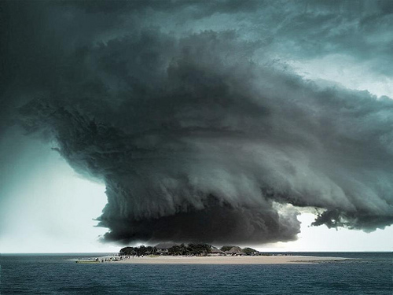
How does God deal with our discouragement with him?
Notes:
In what ways does the Lord respond to us when our complaining about his plan harms us (restatement)?

Slide 5

We all need encouragement
I am with you.
I care about you.
I am praying for you.
I am listening to you.
Notes:
We are often taught that the best way to deal with a discouraged person is to listen, avoid judgment, and let the person vent.

Slide 6
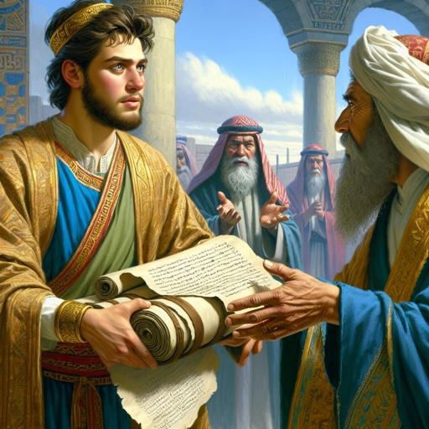
Background
Notes:
But our passage today shows God’s response to a minor character in Jeremiah’s prophecy. In fact, Jeremiah 45 is the shortest chapter but has a lot to teach about how God responds to our discouragement.

Slide 7
Jeremiah Book Chart
474
Deserved Captivity & Undeserved Restoration
Prophetic Call | Judah's Judgment Deserved |  |  |  | Nations' Judgment Deserved |  |  |  | Jerusalem's Fall
Chapter 1 | Chapters 2–45 |  |  |  | Chapters 46–51 |  |  |  | Chapter 52
Commission | Condemnation & Comfort |  |  |  | Condemnation |  |  |  | Captivity
Judgment but God's presence 1 | Pre-Fall 2–38 | Fall 39 | Post-Fall 40–44 | Baruch 45 | Southwest 46–47 | East 48:1–49:22 | North 49:23-33 | Northeast 49:34– 51:64 | Fall 52:1-30 | Rise 52:31-34
Prologue | Ministry |  |  |  |  |  |  |  | Epilogue
Judah |  |  |  |  | Nations |  |  |  | Babylon
c. 627-580 BC
Notes:
Jeremiah arranged his message so that chapters 2–45 prove that Judah’s judgment was deserved.
• This includes a depiction of Jerusalem's Fall in chapter 39.
• It also has a second account of the city's fall in chapter 52.
• Between these, and transitioning between the judgment of Judah and the nations is the short chapter relating to Jeremiah's scribe, Baruch. This chapter (Jeremiah 45) is tucked between this section on deserved judgment (Jer 2–44) and the judgment of the nations (Jer 46–51).
__________
The book is divided into 4 main sections. After the first section in chapter 1 on Jeremiah's call, his person and identity, Jeremiah got down to work very quickly in Chapter 2. Many object lessons run through the 2nd segment where God asks Jeremiah to do unusual things. These give the Judeans an obvious reminder of what they had not done and their failure to return and repent before God. However, buried between this segment in chapters 30-33 is a message of hope in a future restoration, often called Book of Comfort. Embedded here is also the new covenant. After that from chapter 34 onwards are warning after warning against disobedience. But interestingly, chapter 45 records an incident where Barush was encouraged 20 years earlier but is placed here to encourage and show God's sovereignty. This is also a reminder of the encouragement that God gave to Jeremiah in 1:19.. The next segment includes prophecies against the nations that persecuted Judah, many of which where fulfilled while some remain still future. The prophecies end with Babylon, empahsizing how God would very certainly destroy them. This brought hope to the Israelites at that time when they couldn't see beyond their suffering and subjugation. So the reality that future judgment lay ahead for Babylon was also an important encouragement for them to know that their God was a just God.

Slide 8

Background:
Judah hanging on a limb

Slide 9
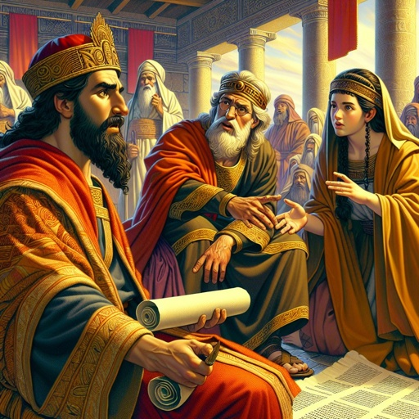
Judah's Evil Kings
Opposed Jeremiah & Baruch
Notes:
Judah’s evil kings had opposed Jeremiah and Baruch, leading to discouragement.

Slide 10
Preview
DISCOUR-AGEMENT
GOD'S RESPONSE
Notes:
Preview: Let’s first see the problem and then God’s solution to discouragement.
Text: Jeremiah 45 reveals both Baruch’s discouragement and God’s response.
(What is the setting of this chapter? What’s the problem?)

Slide 11
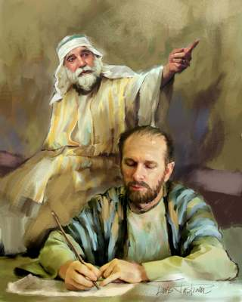
I. Sometimes we are faithful but discouraged (1-3).
Notes:
At times, we do the right thing but have the wrong attitude—we complain.

Slide 12
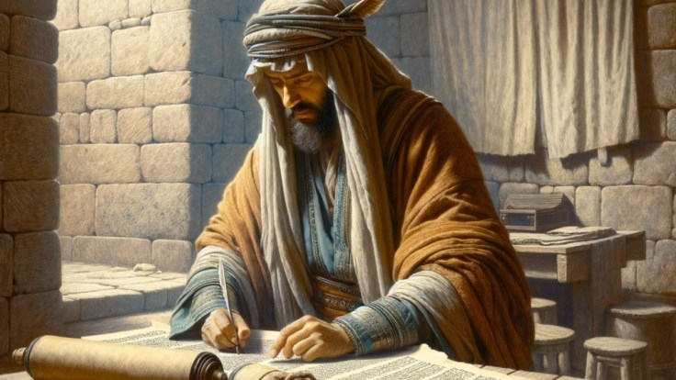
Baruch was faithful but discouraged as Babylon began its invasions (1-3).

Slide 13
"The prophet Jeremiah gave a message to Baruch son of Neriah in the fourth year of the reign of Jehoiakim son of Josiah, after Baruch had written down everything Jeremiah had dictated to him. He said, ²'This is what the LORD, the God of Israel, says to you, Baruch: ³You have said, ‘I am overwhelmed with trouble! Haven’t I had enough pain already? And now the LORD has added more! I am worn out from sighing and can find no rest’"
(Jeremiah 45:1-3 NLT).
Notes:
Baruch faithfully passed on Jeremiah’s prophecies (1).

Slide 14
Josiah's Sons & Prophets
232
342
Daniel
605
Ezekiel
City Fell
Jehoahaz
Josiah
Jehoiakim
Jehoiachin
Zedekiah
609
597
586
(3 mos.)
(11 yrs.)
(3 mos.)
(11 yrs.)
Jeremiah
627
Brief Puppet Kings
Notes:
God spoke through Jeremiah to Baruch in 605 BC when Babylon began invading Judah (1a).
________
Jeremiah was the only prophet to live through the 586 BC fall of Jerusalem. God called him to show God’s compassion even in Judah’s darkest hours. How? Josiah was the last good king, who died in 609. • After him the reigns of his descendants alternated between 3 months• to 11 years • to 3 months • to 11 years once again! • But God spoke to these godless kings through three major prophets. Jeremiah was the only one to preach in Jerusalem until the city fell in 586, • while Daniel was taken to Babylon in 605 • and Ezekiel in 597.

Slide 15
"The prophet Jeremiah gave a message to Baruch son of Neriah in the fourth year of the reign of Jehoiakim son of Josiah, after Baruch had written down everything Jeremiah had dictated to him. He said, ²'This is what the LORD, the God of Israel, says to you, Baruch: ³You have said, ‘I am overwhelmed with trouble! Haven’t I had enough pain already? And now the LORD has added more! I am worn out from sighing and can find no rest’"
(Jeremiah 45:1-3 NLT).
Notes:
Baruch had just finished publicly reading Jeremiah’s warnings of judgment (1b; cf. Jer 36:1-8).

Slide 16
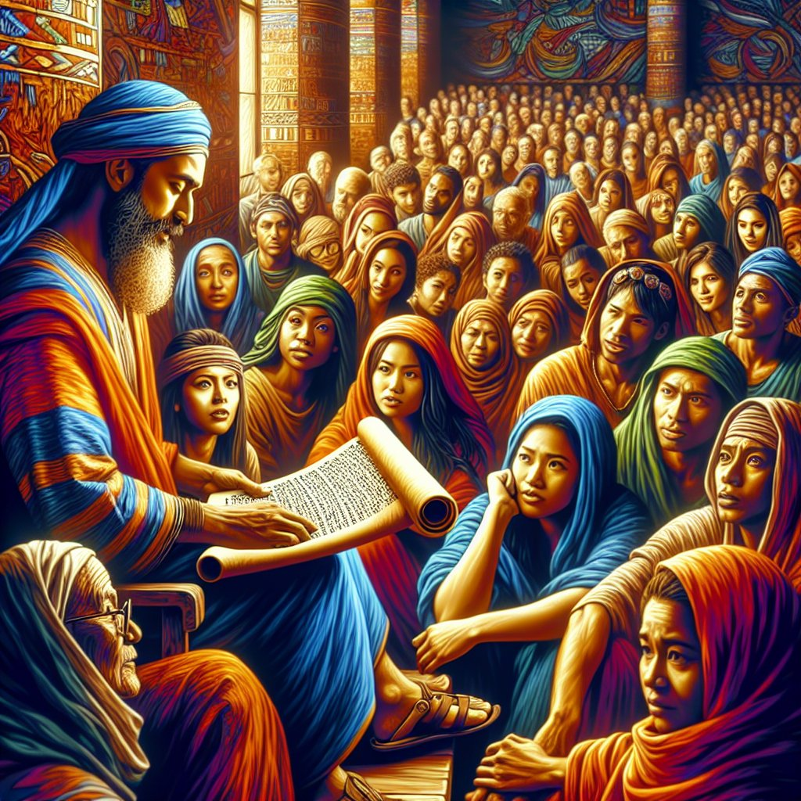
Jeremiah 36:1-8
Notes:
NLT Jer. 36:1 During the fourth year that Jehoiakim son of Josiah was king in Judah, the LORD gave this message to Jeremiah: 2 “Get a scroll, and write down all my messages against Israel, Judah, and the other nations. Begin with the first message back in the days of Josiah, and write down every message, right up to the present time. 3 Perhaps the people of Judah will repent when they hear again all the terrible things I have planned for them. Then I will be able to forgive their sins and wrongdoings.”
Jer. 36:4 So Jeremiah sent for Baruch son of Neriah, and as Jeremiah dictated all the prophecies that the LORD had given him, Baruch wrote them on a scroll. 5 Then Jeremiah said to Baruch, “I am a prisoner here and unable to go to the Temple. 6 So you go to the Temple on the next day of fasting, and read the messages from the LORD that I have had you write on this scroll. Read them so the people who are there from all over Judah will hear them. 7 Perhaps even yet they will turn from their evil ways and ask the LORD’s forgiveness before it is too late. For the LORD has threatened them with his terrible anger.”
Jer. 36:8 Baruch did as Jeremiah told him and read these messages from the LORD to the people at the Temple."

Slide 17
"The prophet Jeremiah gave a message to Baruch son of Neriah in the fourth year of the reign of Jehoiakim son of Josiah, after Baruch had written down everything Jeremiah had dictated to him. He said, ²'This is what the LORD, the God of Israel, says to you, Baruch: ³You have said, ‘I am overwhelmed with trouble! Haven’t I had enough pain already? And now the LORD has added more! I am worn out from sighing and can find no rest’"
(Jeremiah 45:1-3 NLT).
Notes:
God acknowledged Baruch’s discouragement (2-3).

Slide 18
Nebuchadnezzar's Six Deportations to Babylon
492
Size | Date | King of Judah | Number taken | Key Captives | Results/ Comments
1 Minor | 605 BC | Jehoiakim | Few (Dan 1:3) | Daniel, 3 friends & nobility & royalty | Tribute imposed. Egypt powerful.
2 Moderate | 598 BC | Jehoiakim | 3023 (Jer. 52:28) |  | Minor deportation
3 Major | 597 BC | Jehoiachin | 10,000 (2 Kings 24:14) | Jehoiachin, Ezekiel, Mordecai | Neb. deports many; installs Zedekiah
4 Minor | 587 BC | Zedekiah | 832 (Jer. 52:29) |  | Before destruction
5 Major | 586 BC | Zedekiah | ca. 10,400 (2 Kings 25:11) | Zedekiah | Jerusalem & temple destroyed
6 Minor | 582 BC |  | 745 (Jer. 52:30) |  | 4 years after Jerusalem's destruction
Notes:
God was faithful to listen to his complaint—but Baruch had no idea that he was experiencing only the first of SIX deportations!
________
Nebuchadnezzar actually had SIX deportations to Babylon. The 597 BC deportation was the third of the six and the first of 2 major deportations, with 10,000 people deported.
_____________________
OS-12-Kings & Prophets Charts-25
OS-12-2Kings-286
OS-14-2Chron-283
OS-24-Jeremiah-140

Slide 19

Discouragement while serving Jesus is real.
the struggle is real
DISCOURAGEMENT
Notes:
Are you faithful but still discouraged? God is listening.
Are you struggling with Austin’s situation? God cares.
Are you discouraged with some other way that you are serving the Lord but still discouraged? God can handle it.

Slide 20
How does God deal with our discouragement with him?

Slide 21
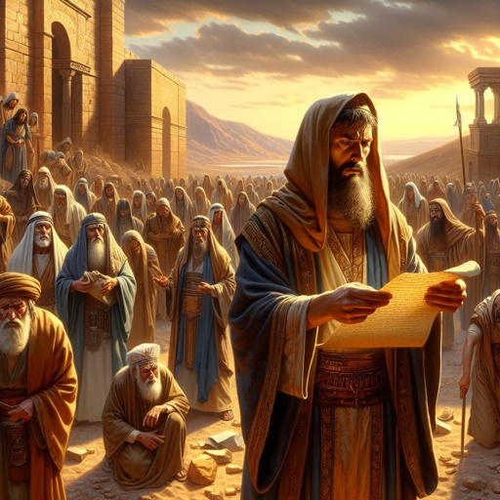
II. God confronts our pride without wavering in his plan (4-5).
Notes:
The Lord expects our humility as He maintains His sovereignty.

Slide 22
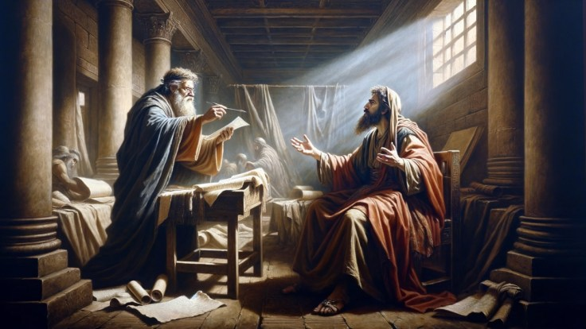
God confronted Baruch’s pride but promised protection despite judgment (4-5).

Slide 23
"Baruch, this is what the LORD says:
‘I will destroy this nation that I built. I will uproot what I planted. ⁵Are you seeking great things for yourself? Don’t do it!
I will bring great disaster upon all these people; but I will give you your life as a reward wherever you go. I, the LORD, have spoken!’"
—Jeremiah 45:4-5 NLT—
Notes:
God reiterated his judgment of the nation (4).
God questioned Baruch’s motives (5a).
God promised protection for Baruch (5b).

Slide 24

Sometimes we seek great things for ourselves instead of for God
Notes:
Sometimes we seek great things for ourselves instead of for God.
Writing prayer letters always challenges my pride. Susan helps.

Slide 25

Motive is Everything
"Ask not what a man does to determine whether his work is sacred or secular. Ask why he does it. The motive is everything. Let a man sanctify the Lord God in his heart and he can thereafter do no secular act" –– A.W. Tozer

Slide 26
How does God deal with our discouragement with him?
Notes:
So, let’s get back to our initial subject…

Slide 27

Main Idea
God sometimes rebukes discouragement to humble us.
Notes:
He surprised me in this passage, as I expected him to say, “Now, Baruch, it’s understandable that you feel this way…” but he answers discouragement with a rebuke!

Slide 28
I. Sometimes we are faithful but discouraged (1-3).
Notes:
At times, we do the right thing but have the wrong attitude—we complain.

Slide 29
II. God confronts our pride without wavering in his plan (4-5).
Notes:
The Lord expects our humility as He maintains His sovereignty.

Slide 30

Are you being faithful like Baruch, yet still discouraged?
In what way should you humble yourself?
Notes:
Confess your pride?
Change your attitude towards gratitude?

Slide 31
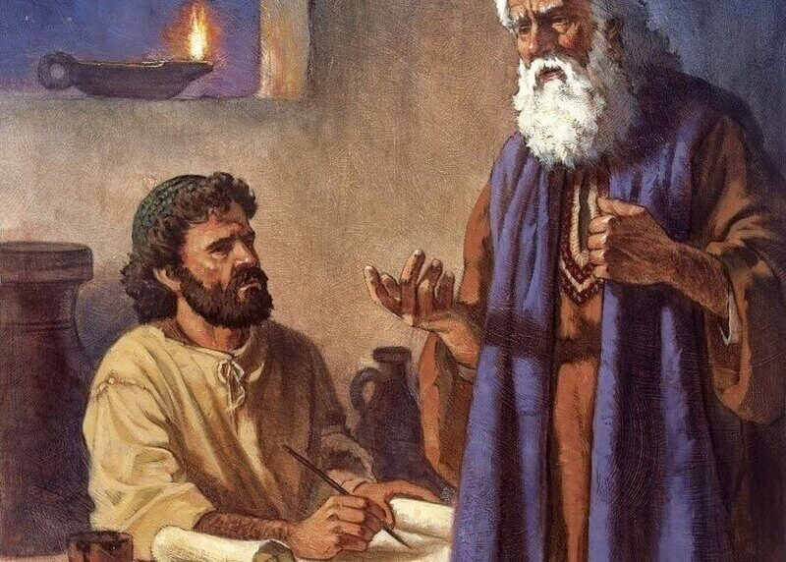
Serve God With Humility
Notes:
Austin’s example is one to serve God with humility.

Slide 32

“At this point, we need the virtues that all of us followers of Christ are pursuing: faith, trust, righteousness, patience, endurance, and worship. We would love to ask the Lord for these things in abundance in our hearts!”
—Austin Surls—
Notes:
One thing that Austin wrote touched me (read)

Slide 33
21 February 2012
Notes:
In 2012, I was trying to be faithful in Singapore, but my employment pass was rejected three times over a period of seven weeks. Susan and I were only three days from having to leave the country on our 21st ministry anniversary! It could have been very discouraging.
Yet the rejection was overturned, and God granted us nine more years.

Slide 34
Are you being faithful like Baruch, yet still discouraged?
In what way should you humble yourself?
Notes:
Confess your pride?
Change your attitude towards gratitude?

Slide 35
Black

Slide 36


OT Preaching link at biblestudydownloads.org
Get this presentation and script for free!

