Slide 1
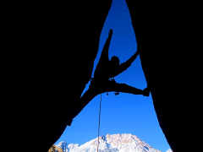
Why You Should Do Crazy Things
Dr. Rick Griffith
Singapore Bible College
Dr. Rick Griffith • Crossroads International Church Singapore
CICFamily.com & BibleStudyDownloads.org

Slide 3
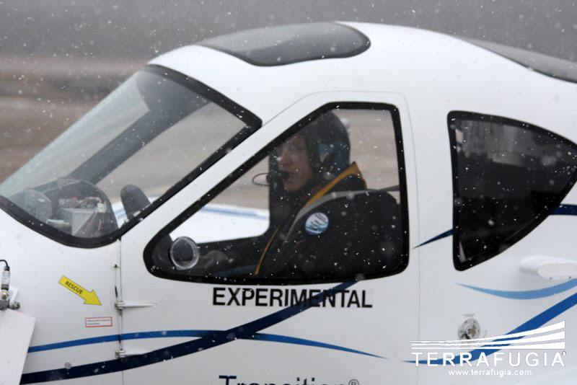
The Car-Plane
Notes:
Every one of us has flown in planes before, but this week I thought I’d share with you a unique one.
Looks like a regular plane, doesn’t it?

Slide 4
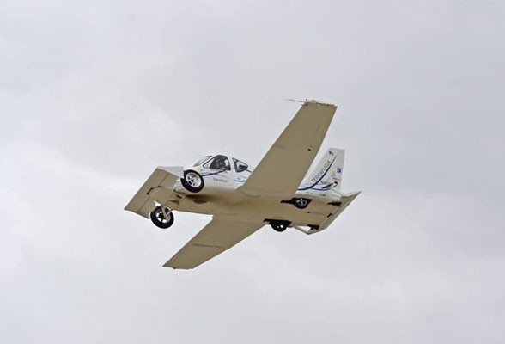
The Car-Plane
Notes:
Introducing the Transition®.
It will fly a distance of 725 kilometers at speeds of 115 miles/hour.

Slide 5
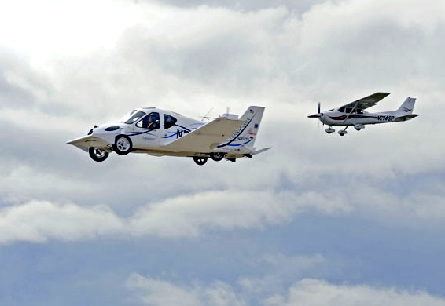
The Car-Plane
Notes:
However, requires a special license to fly AND drive!
Terrafugia has completed flight testing of the Transition POC (Proof of Concept).

Slide 6
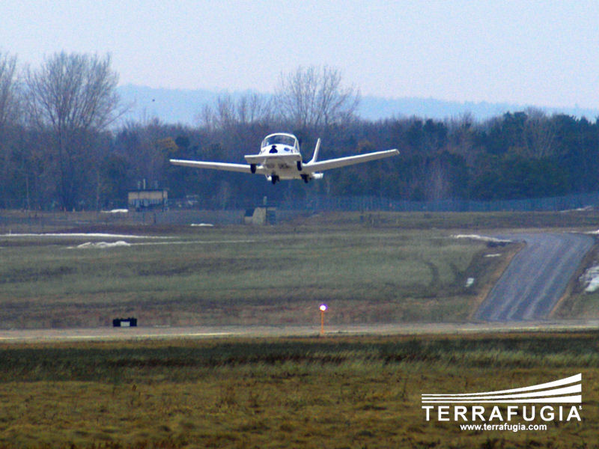
The Car-Plane
Notes:
Drive? Yep!

Slide 7
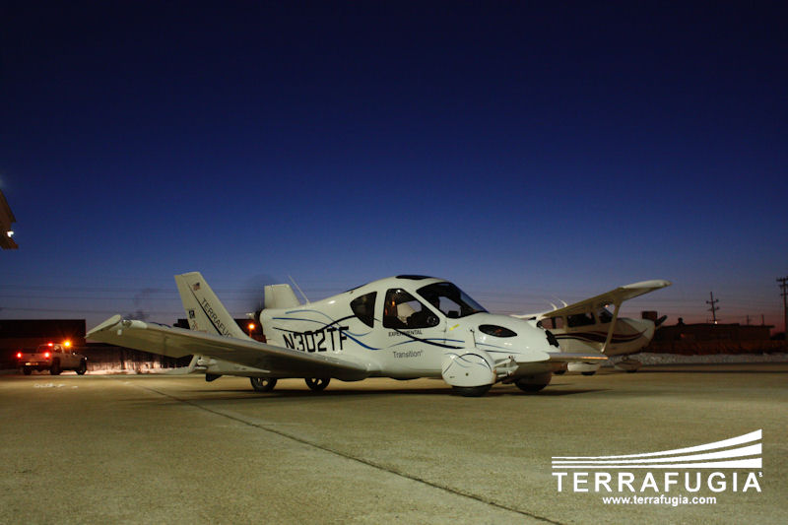
The Car-Plane
Notes:
Simply land at the airport, fold your wings up and drive home.

Slide 8
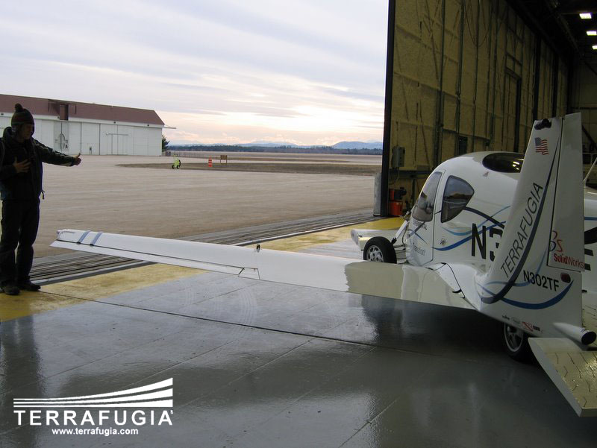
The Car-Plane
Notes:
This way you can by-pass hanger costs at the airport

Slide 9
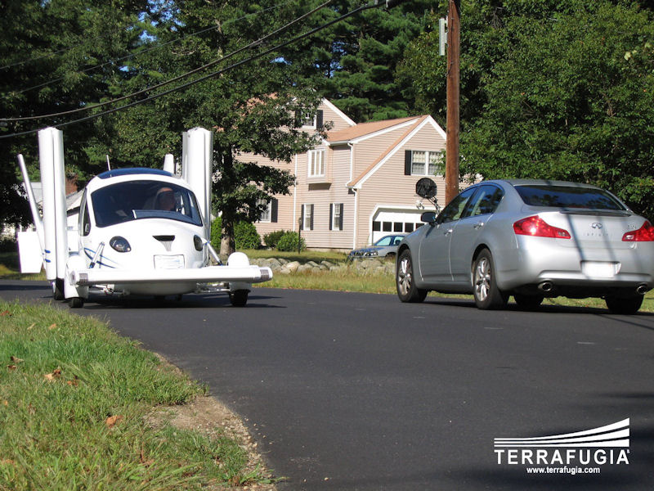
The Car-Plane
Notes:
The time required for the transition from plane to car takes less than 30 seconds.
Vehicle speed 185 km/hour, range is 72.4 km/hr on highways.

Slide 10
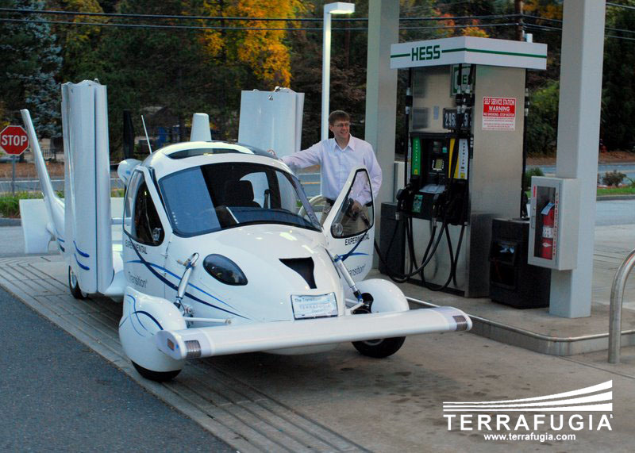
The Car-Plane
Notes:
It is fueled with normal gasoline, so you don’t have to pay those expensive airplane fuel costs!

Slide 11
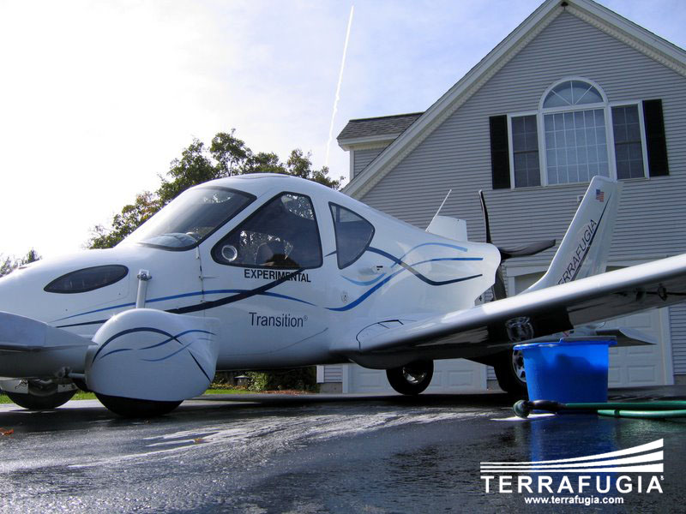
The Car-Plane
Notes:
And why pay others to wash your plane when you can do it cheaper in your own driveway?

Slide 12
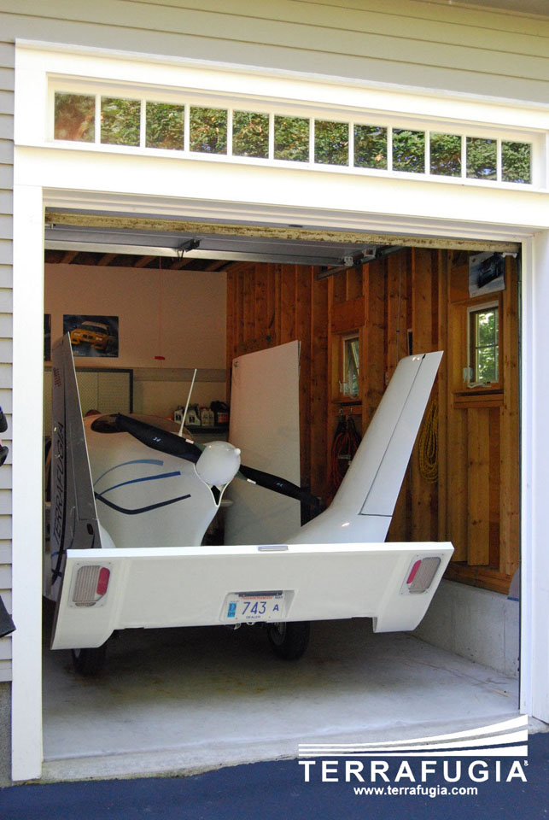
The Car-Plane
Notes:
Lest you think it will save you a lot of money, the price is expected to be around $200,000. Sorry!
The first shipment will be in 2011.

Slide 13
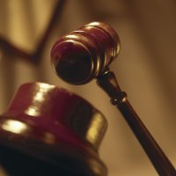

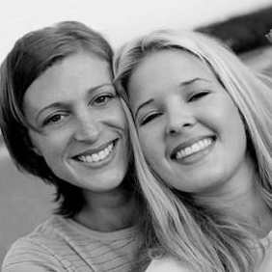
Black
Authorities
Money
Friends

Slide 14
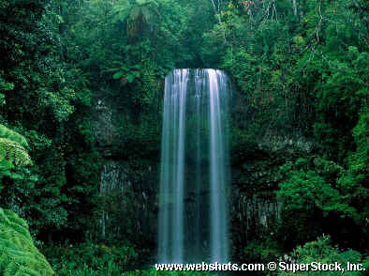
Our Subject…
What should you do
when God asks you to do something
crazy?
Jeremiah 32

Slide 15
Black

Slide 16
The Babylonian Threat
Babylonian Expansion
Mediterranean
Sea
Syria
Babylon
Israel
Judah
586 BC
Persian
Gulf
Egypt

Slide 17
Black

Slide 18
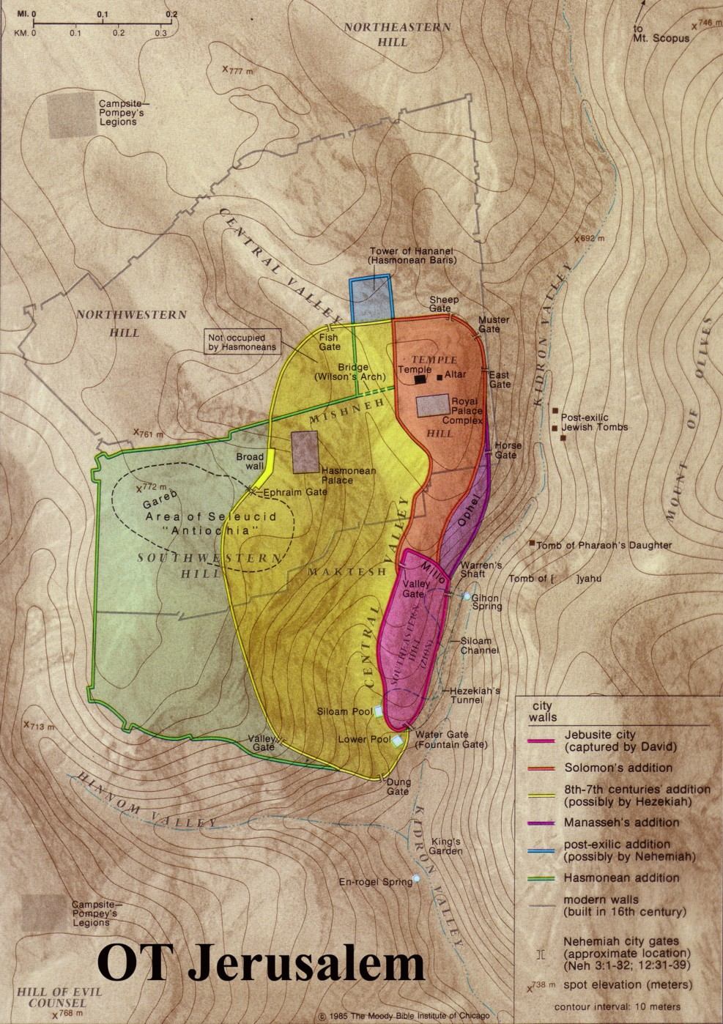
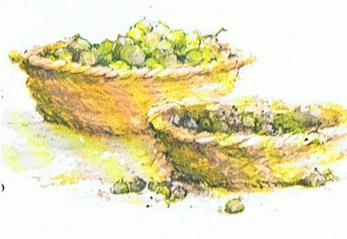
King Zedekiah’s Accusations (32:3-5)
Verse 3:
“Jerusalem Fall?
That’s negative!”
Jews as figs:
Verses 4-5a:
“Me captured?
That’s treason!”
good
bad
Verse 5b:
“Stop fighting?
That’s cowardice”!
Babylonians
Notes:
Jeremiah 24 portrayed all the Jews as two types of figs:
The “bad figs” who refused to submit to God’s discipline by the Babylonians would disobey God by staying in the city and dying
The “good figs” whose lives would be spared would leave the city and surrender to the Babylonians outside!

Slide 19
Black

Slide 20
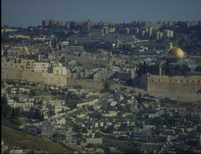
Leviticus 25:25
“If one of your countrymen becomes poor and sells some of his property, his nearest relative is to come and redeem what his countryman has sold”

Slide 21
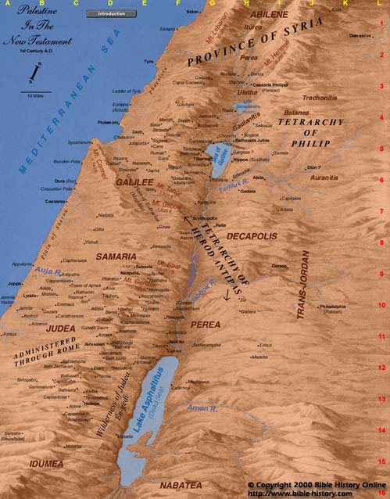
587 BC
Aram
Israel
Anathoth
Jerusalem
Judah

Slide 22
Black

Slide 23

Singapore, January 1942
Your hometown in Kranji
Japanese Occupied in Green
Free Zone in Orange

Slide 24

I. Jeremiah bought a seemingly useless field when God told him to (1-12)

Slide 25
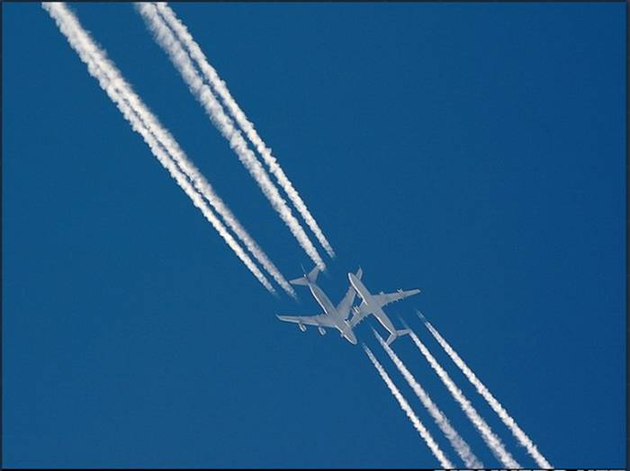
II. When God asks you to do something “crazy…”
do it!

Slide 26
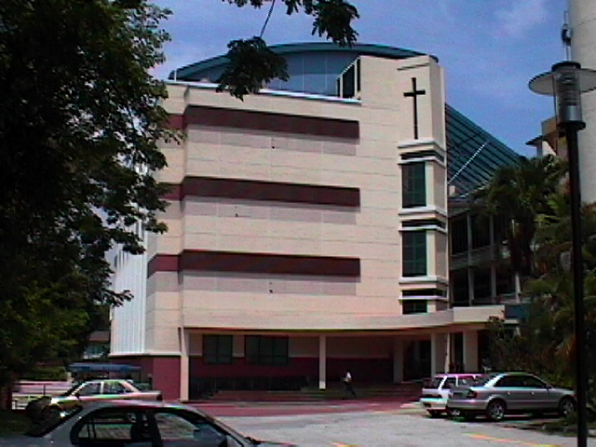

SBC Estimated Cost
Singapore Bible College
Academic Block
Estimated S$8.5 million

Slide 27
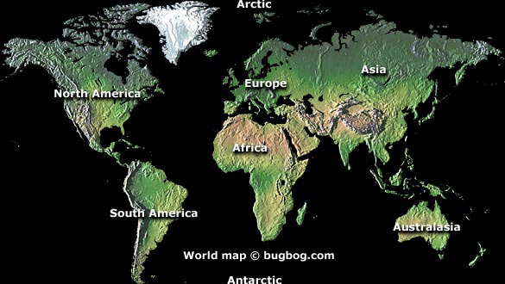
Learn Spanish for Chinese?
圣经...
基要
La Biblia Simpatica?

Slide 28
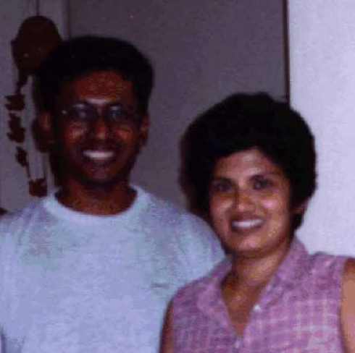
James Kanaganayagam

Slide 29

ICS
• Christian school began in 1993
• 13 students
• S$23,000/mo. lease signed with S$1000

Slide 30
Black

Slide 31
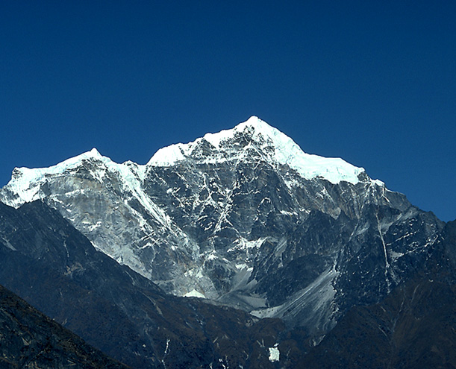
III. Doing crazy things shows you’re fitting into His plans (13-44)

Slide 32
Return from Babylon
Mediterranean
Sea
Syria
Babylon
Israel
Judah
538 BC
Egypt
Persian
Gulf

Slide 33
Black

Slide 34
SBC Actual Cost
Singapore Bible College
Academic Block
Estimated S$8.5 million
Actual S$5.8 million

Slide 35
Spanish was Very Useful
Greek
Hebrew
French
German
La Biblia Simpatica?

Slide 36
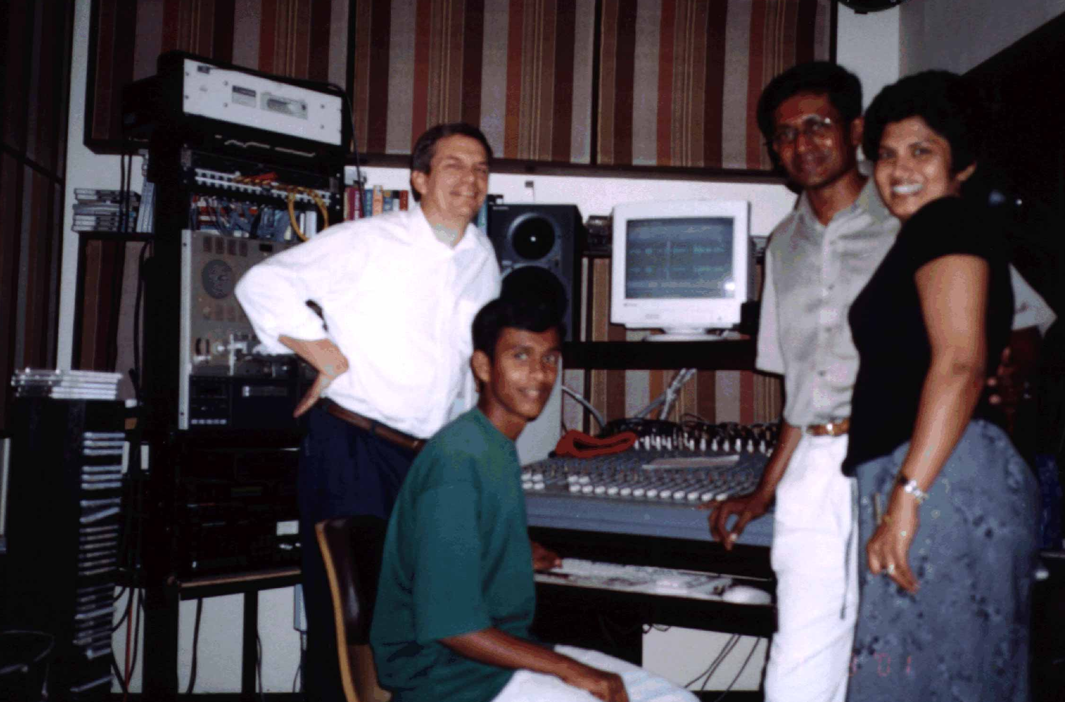
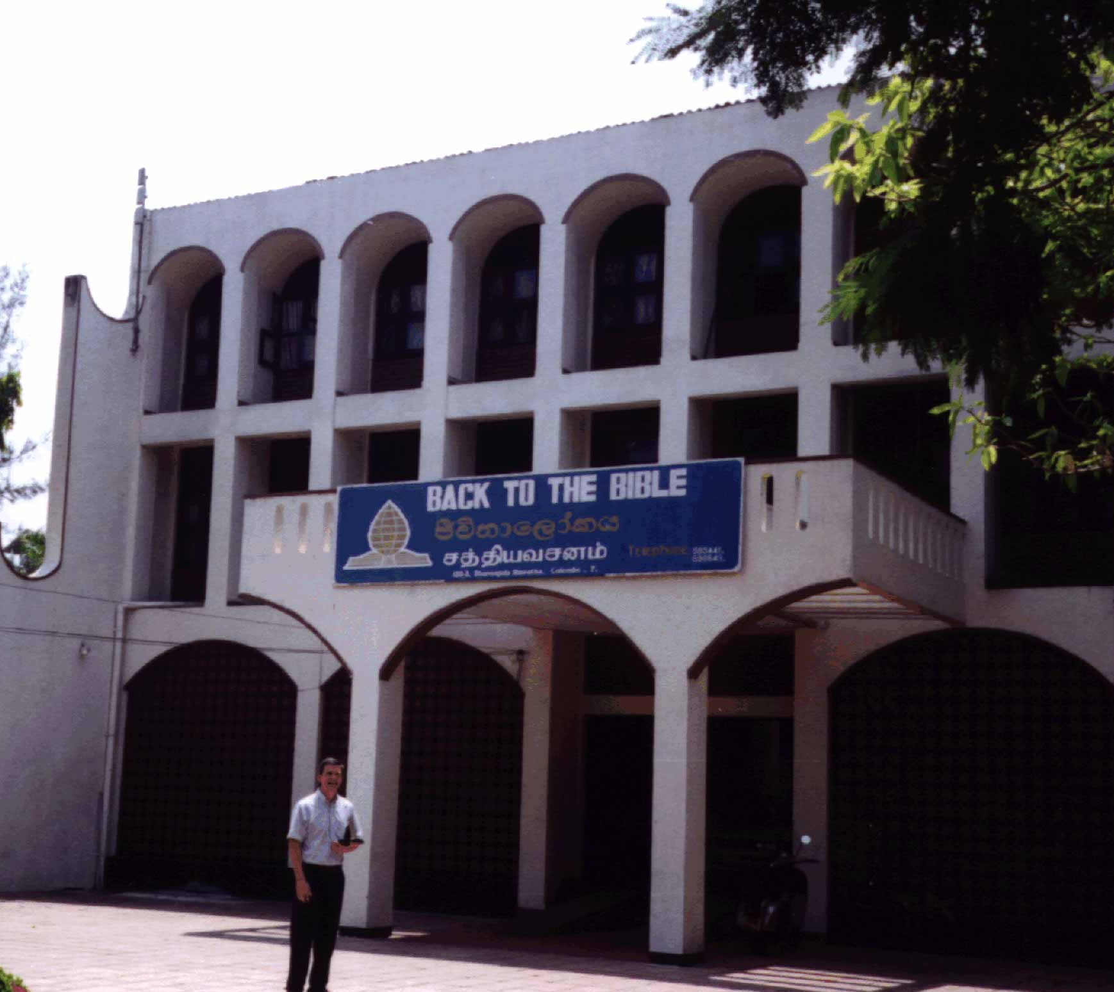
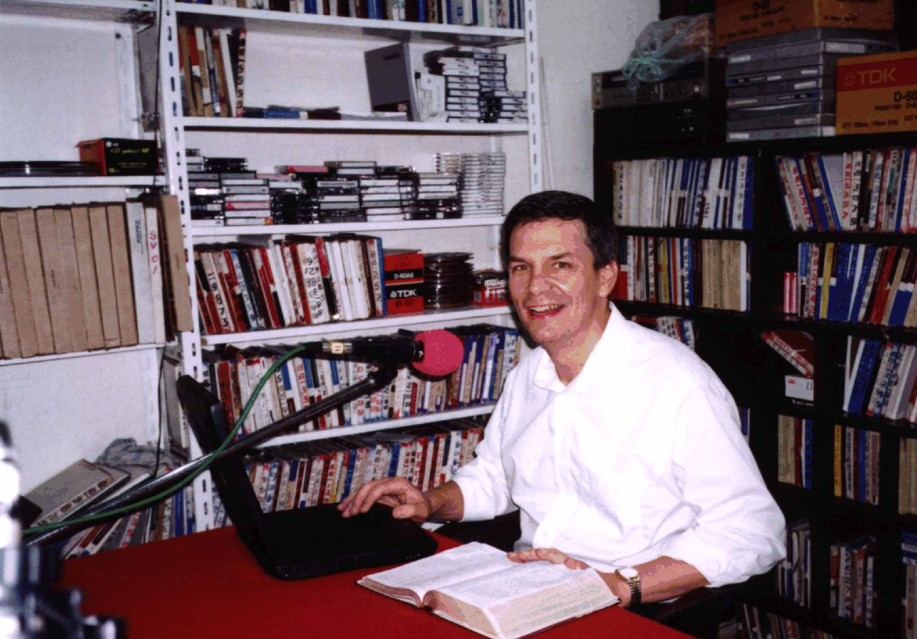
Back to the Bible

Slide 37
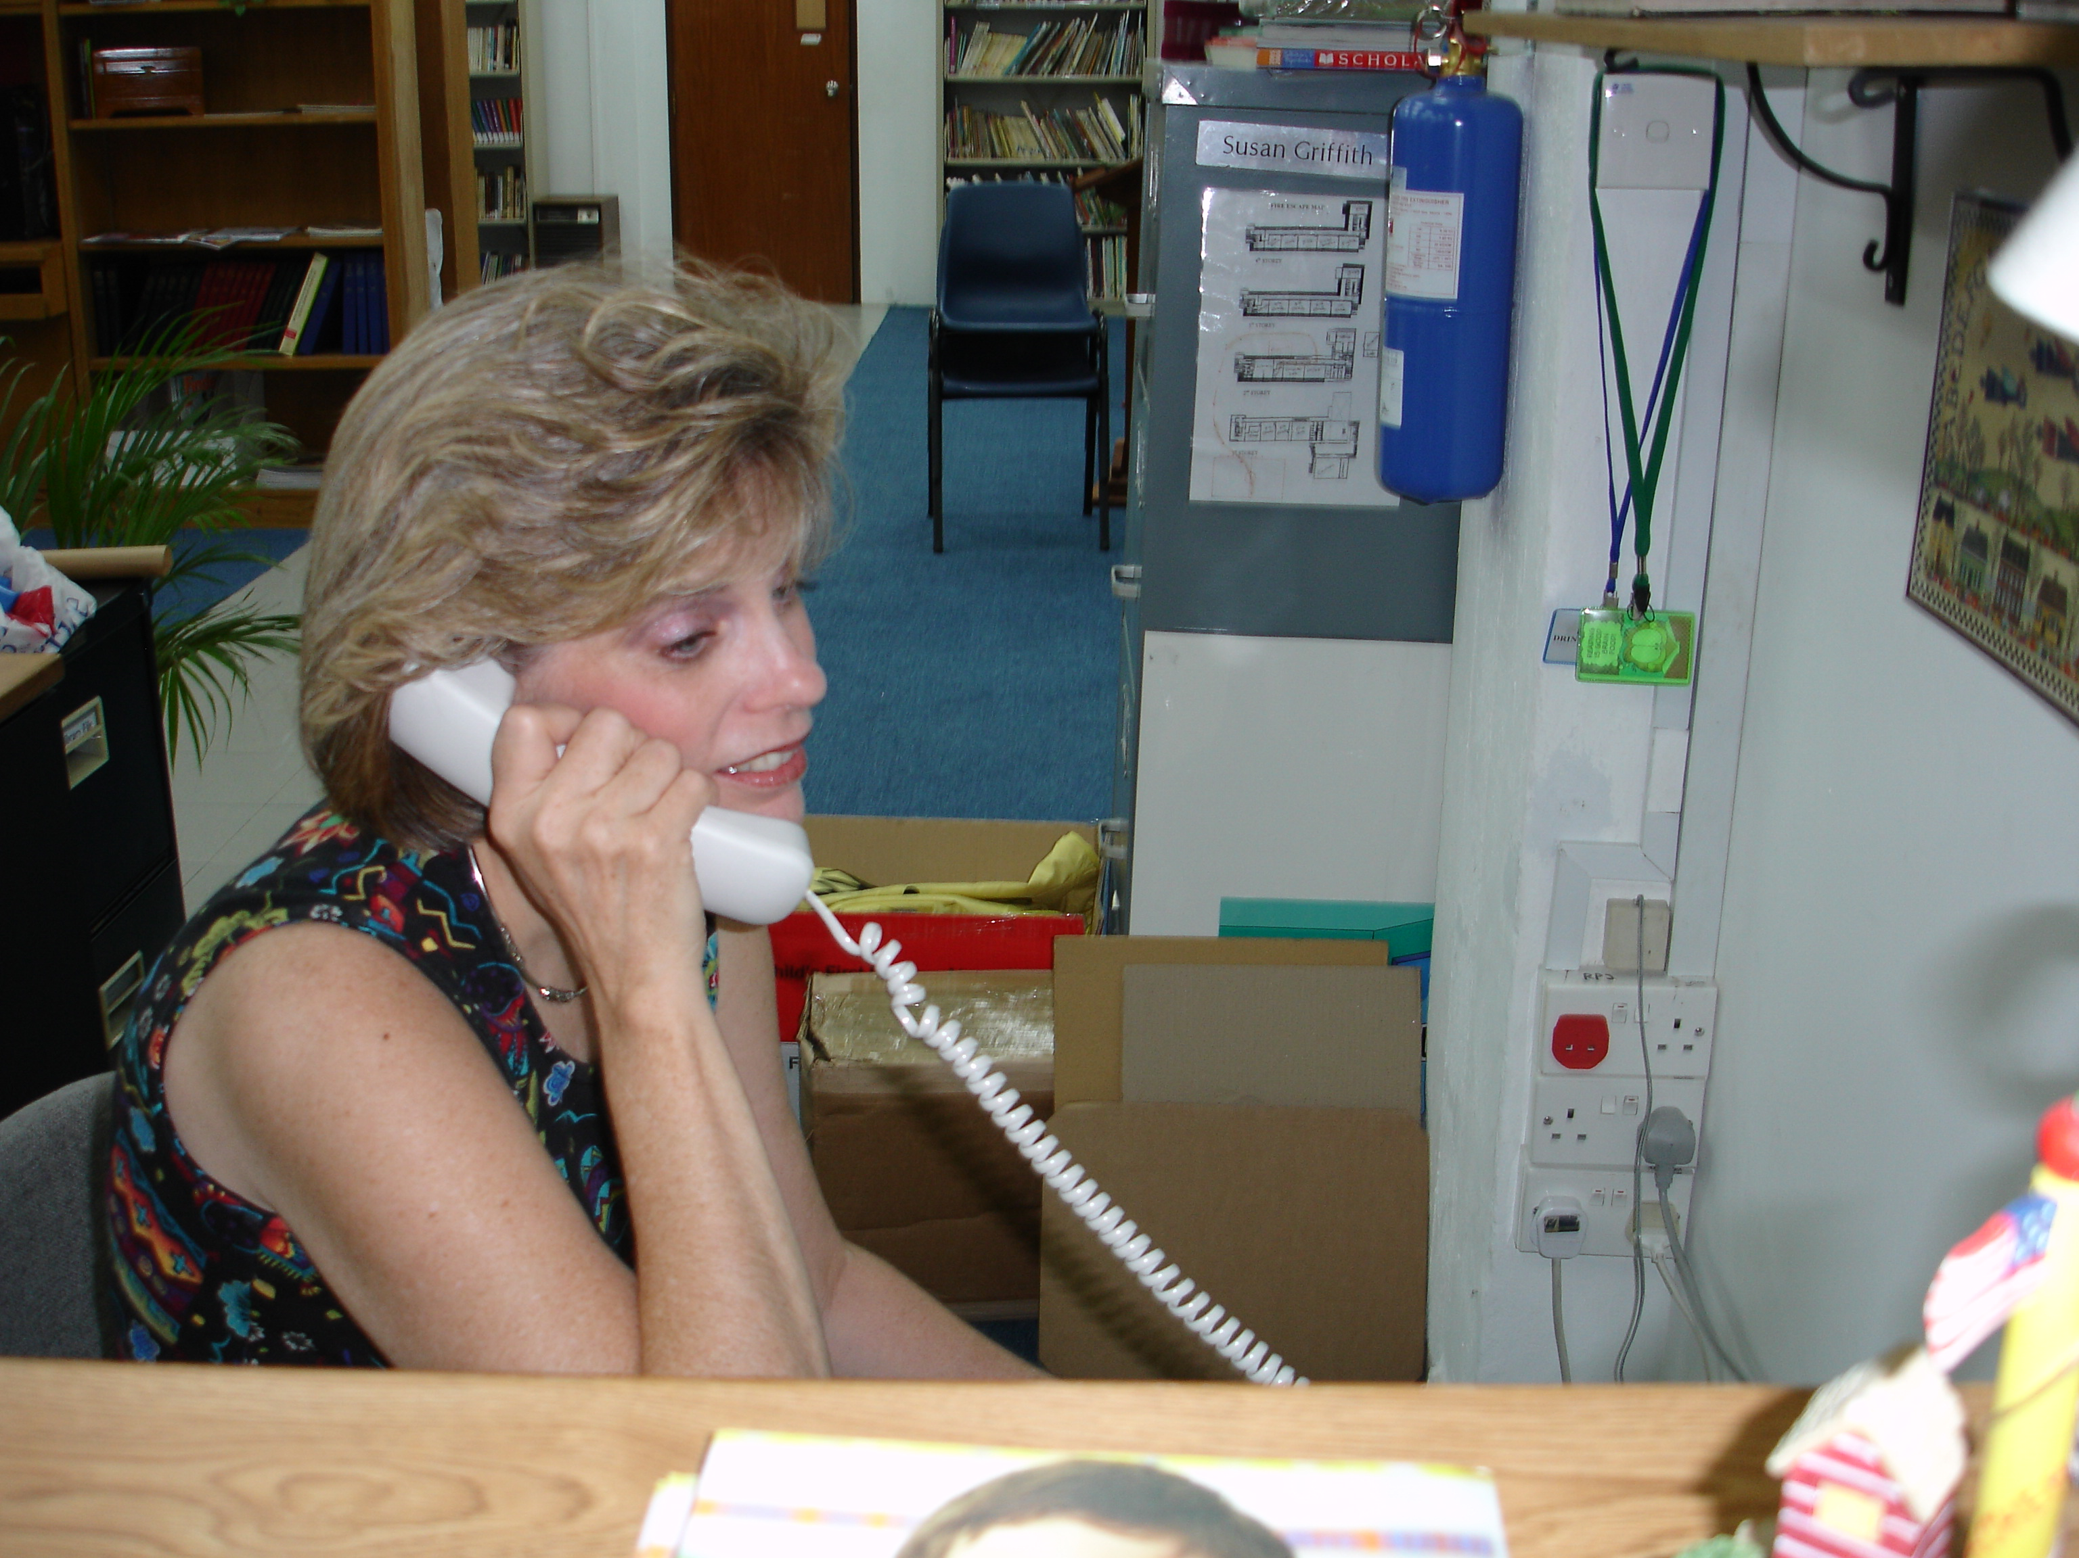
Susan at ICS
• Librarian
• Music teacher
• Art teacher

Slide 38
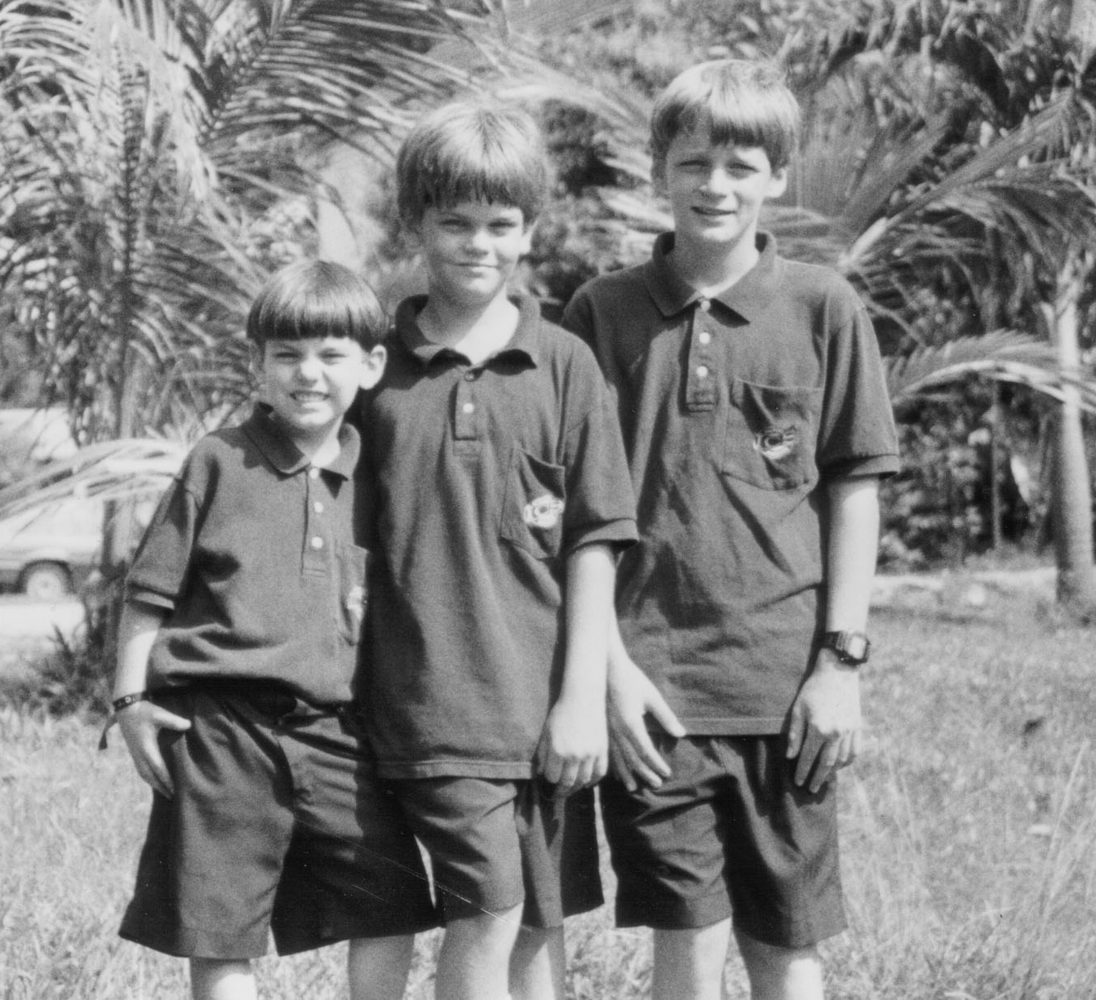
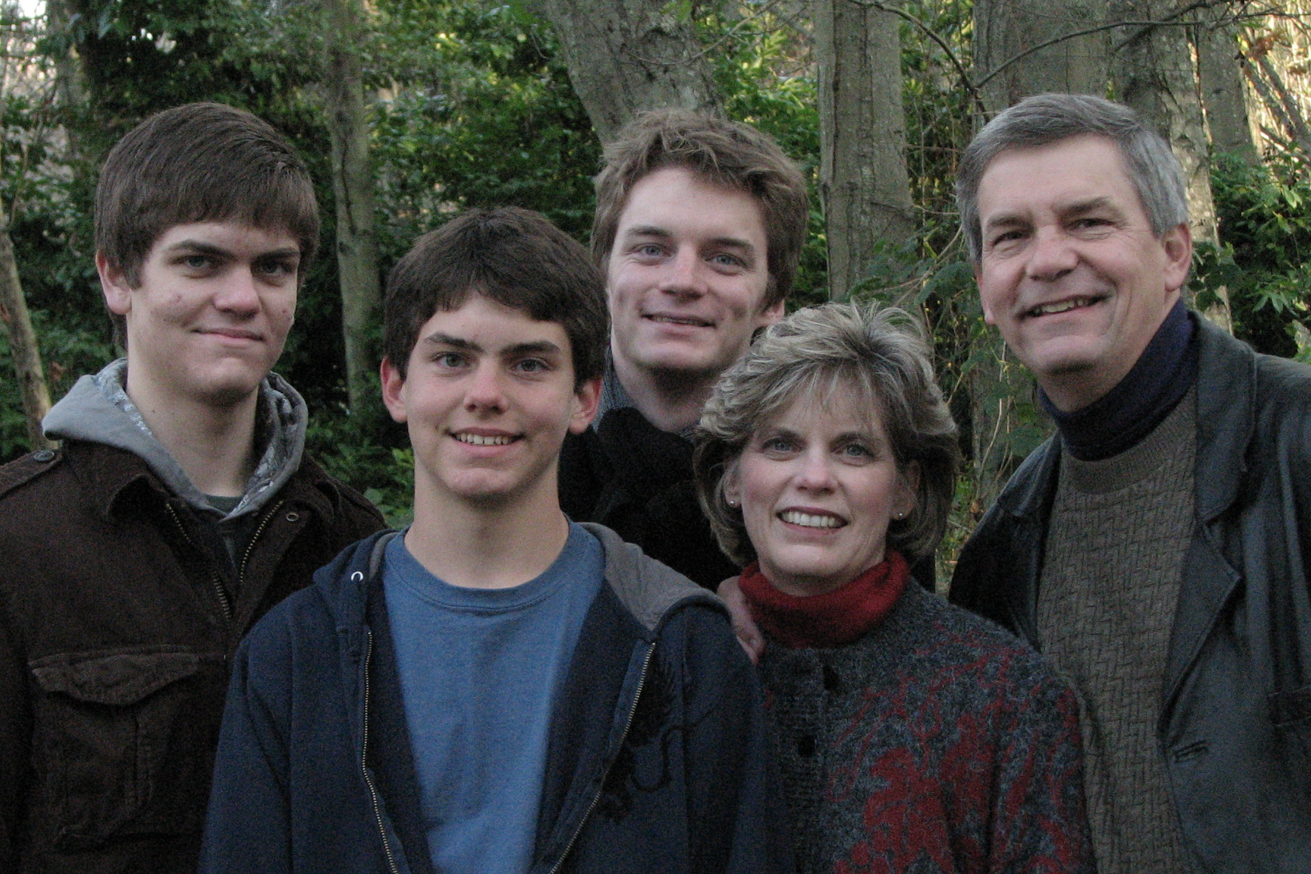
Schooling for 400 + Our Sons

Slide 39
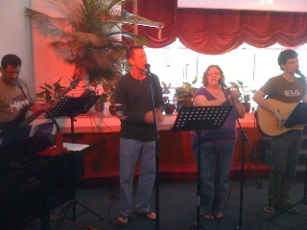
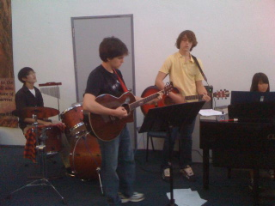

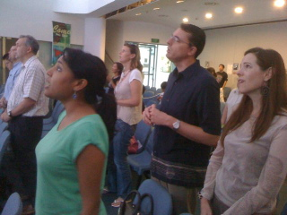
Is it CRAZY to move our services after we’ve all adjusted to being at the Salvation Army the past 3 years?

Slide 40
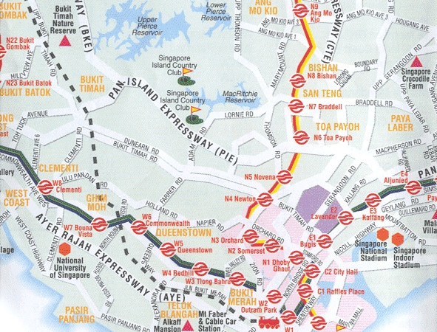

Starting NEXT WEEK!
CIC
Bus 132
Bus 190
SBC
ICS
YMCA
Bus 105
CIS
OFS
ISS
= PIE exits

Slide 41
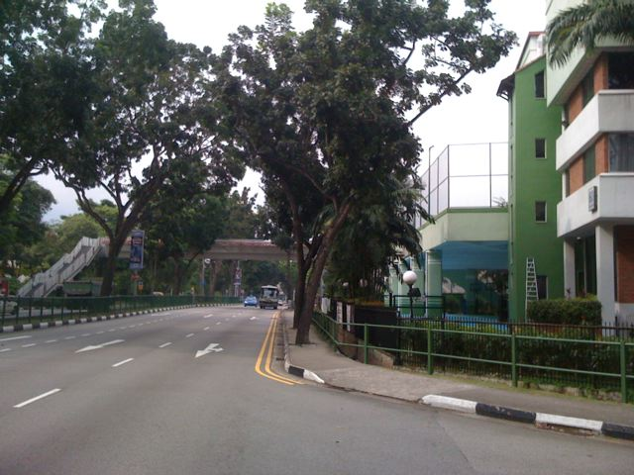
YMCA

Slide 42
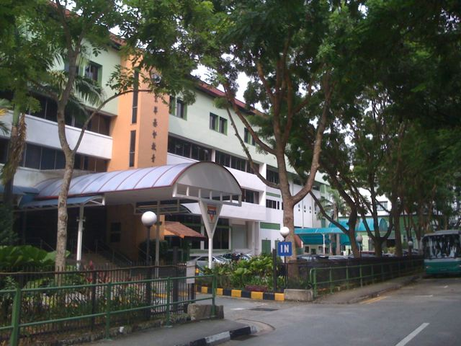
YMCA

Slide 43
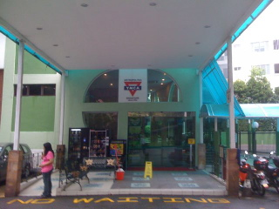
YMCA

Slide 44
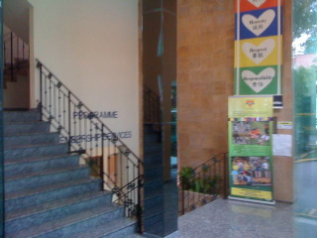
YMCA

Slide 45
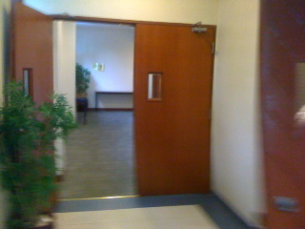
YMCA

Slide 46
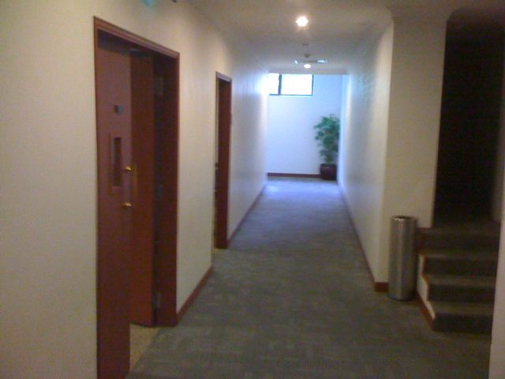
YMCA

Slide 47
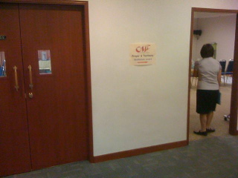
YMCA

Slide 48
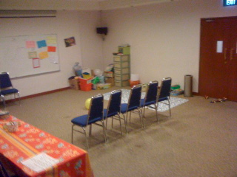
YMCA

Slide 49
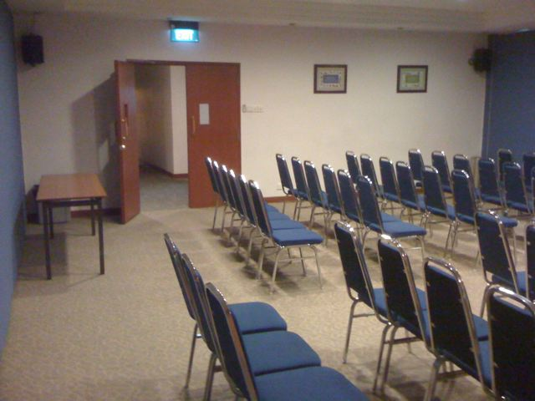
YMCA

Slide 50
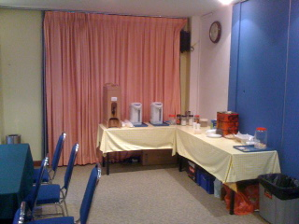
YMCA

Slide 51
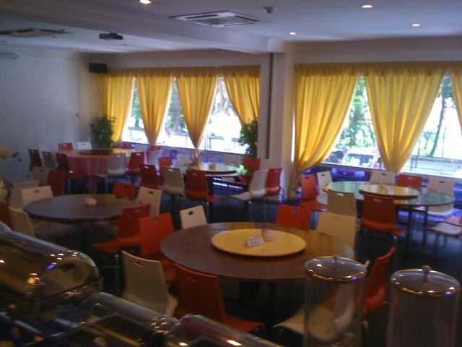
YMCA

Slide 52

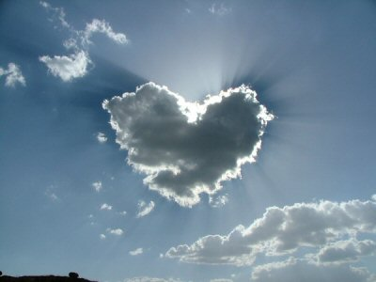
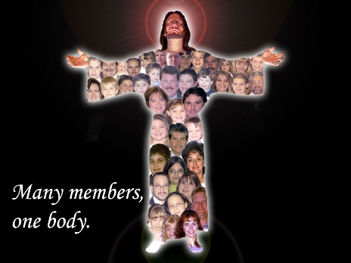

Our Vision is to…
Love God
Love the Church
Love the Nations
Notes:
• Love God
Where it starts—and ends—is in our call to LOVE. As Paul noted, “The greatest of these is love” (1 Cor. 13:13).
What is the most important thing we do as a church? It begins with loving the God who loves us.
• Love Church
Do you genuinely love him? If you don’t, then nothing else you do counts, really.
The second thing He said right after this: to love your neighbor as yourself.
• Love Nations
But who is your neighbor? It starts right here in the body—to love the church—but then it extends from this “close neighbor” to those who are out of the reach of this fellowship where we love the nations. Our leadership is committed to make all that we do revolve around one of these three priorities.
52

Slide 53

When God asks you to do something “crazy,” do it! It shows you’re fitting into His plans.

Slide 54
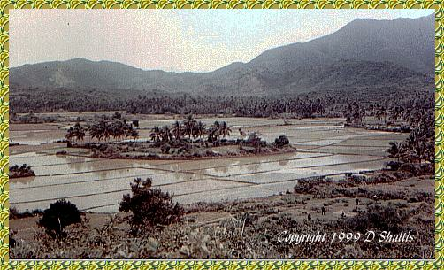
What “field” does God want you to buy?

Slide 55
Black

Slide 56


OT Preaching link at BibleStudyDownloads.org
Get this presentation and script for free!
Notes:
OT Preaching (op)

