Slide 1

Trusting God
Jeremiah 29:11
Trusting in
God’s Love
Preached by Dan Bridges Amman International Church, Jordan (AmmanChurch.org) Uploaded by Dr. Rick Griffith • Jordan Evangelical Theological Seminary Files in many languages for free download at BibleStudyDownloads.org

Slide 2
“Cast all your anxieties on him, because he cares for you.”
1 Peter 5:7
But what about those who have “extra” suffering?
Story of my father…
Notes:
Difficulties in his early life:
Born with crossed eyes, resulting in monocular vision
Childhood illness resulting in deafness in one ear
Childhood poverty
Death of his mother as an early teen
Death of his father at age 20

Slide 3

If God is both all powerful and completely loving, why is there so much suffering, heartache and pain in the world?

Slide 4

God’s Sovereignty
But this truth by itself is not enough…
God is sovereign over
People
Nations
History
Nature
Inanimate Things
Nothing in all of the universe is outside of God’s sovereign control!

Slide 5
Lies that Go Through Our Minds…
It’s often easier to believe in God’s sovereignty than in his love!
If we believe that God is completely sovereign, and yet devastating circumstances sourround us, what lies do we struggle with?
“God may love others, but not me.”
“God doesn’t love as well as I do because I would never do this to my loved ones!”
“God must be mad at me.”
“I must not be good enough for God to really love.”

Slide 6

Three Aspects of Trusting God
Trusting
In God’s Sovereignty
Trusting in
God’s Wisdom
Trusting in
God’s Love

Slide 7
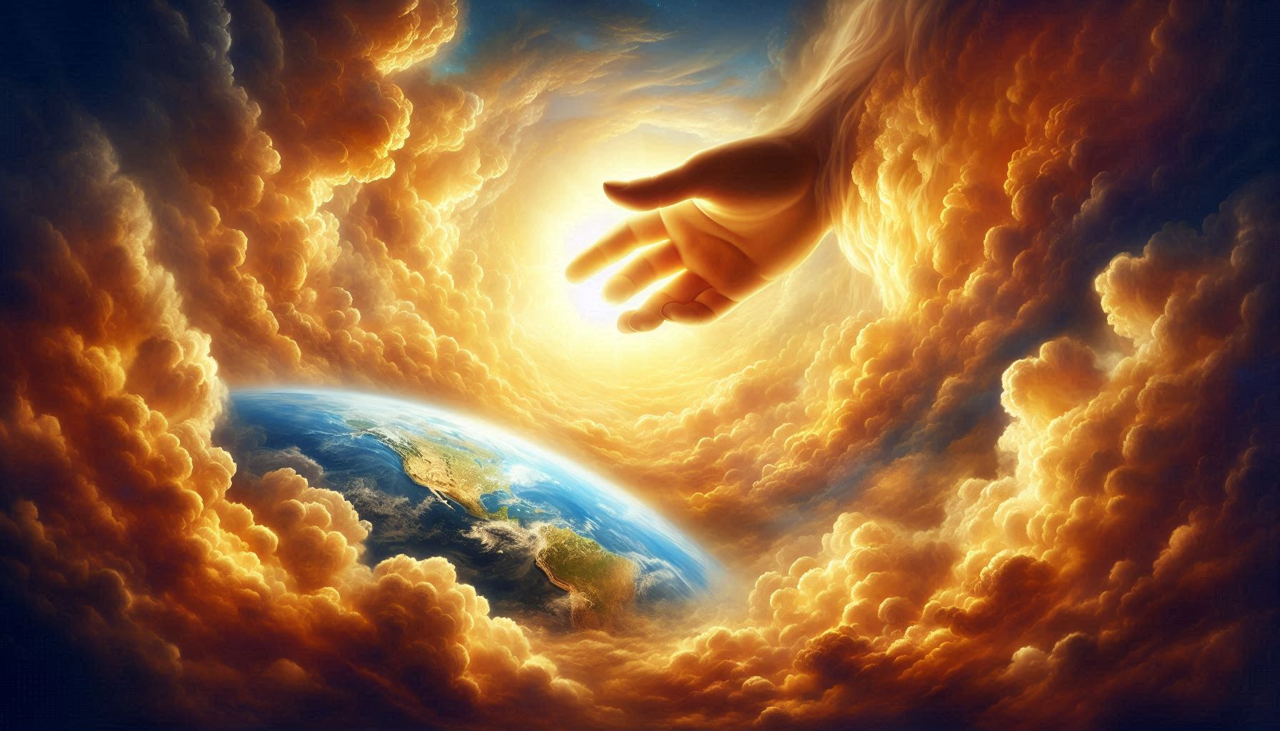
Trusting in God’s Love
God’s Love in the Story of Jeremiah
Describing God’s Love
Applying the Truths About God’s Love

Slide 8

A loving promise!
But what is the context of this promise?
“‘For I know the plans I have for you,’ says the LORD. ‘They are plans for good and not for disaster, to give you a future and a hope.’”
Jeremiah 29:11

Slide 9
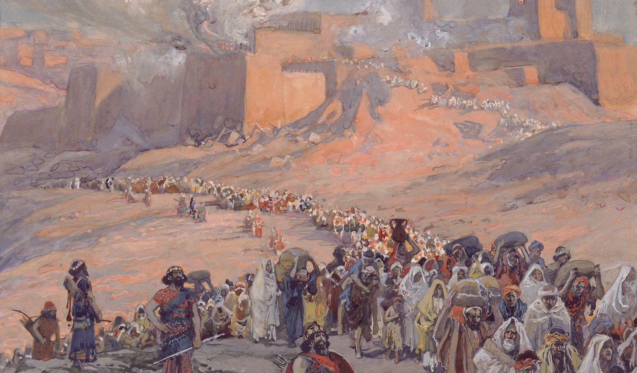
Context of Jeremiah 29:11
Jeremiah experienced three conquests of Jerusalem!
605 BC
597 BC
Jeremiah 29 written after 597 BC
586 BC – Nebuchadnezzar conquered and destroyed Jerusalem
Nebuchadnezzar conquered Jerusalem and took captives into exile
Notes:
mi

Slide 10
Context of Jeremiah 29:11
Jeremiah 28 – False prophets were predicting that God would rescue Jerusalem from Babylon and bring back the exiles within two years.
Jeremiah – speaking for God – said this would not happen.

Slide 11
Context of Jeremiah 29:11
Jeremiah 29 – A letter from Jeremiah to the exiles in Babylon
Jeremiah advised them to “build houses and settle down” – to accept their exile.
They were to wait 70 years before God would bring them home again.
Then comes the promise of 29:11!

Slide 12
Which is the more accurate background for Jeremiah 29:11?
This?
“‘For I know the plans I have for you,’ says the LORD. ‘They are plans for good and not for disaster, to give you a future and a hope.’”
Jeremiah 29:11

Slide 13
“‘For I know the plans I have for you,’ says the LORD. ‘They are plans for good and not for disaster, to give you a future and a hope.’”
Jeremiah 29:11
Or this?

Slide 14
Context of Jeremiah 29:11
Did it feel like God loved them?
God, in his sovereignty, could have rescued them at any time. Why didn’t he?
God, in his love for them, had a higher purpose than their comfort! He was concerned about their eternal good!

Slide 15
Trusting in God’s Love
God’s Love in the Story of Jeremiah
Describing God’s Love
Applying the Truths About God’s Love

Slide 16

Describing God’s Love
Love is an essential part of God’s nature.
“God is light.” (Holy) – 1 John 1:5
“God is love.” – 1 John 4:8
In the same way that God is always holy, he is also always loving!

Slide 17
Describing God’s Love
Love is an essential part of God’s nature.
“The LORD passed before him and proclaimed, “The LORD, the LORD, a God merciful and gracious, slow to anger, and abounding in steadfast love and faithfulness.’” Exodus 34:6
“khesed”
It is God’s nature to be abounding, or overflowing with love!

Slide 18
Describing God’s Love
God’s love is eternal and unchanging.
“The steadfast love of the LORD never ceases; his mercies never come to an end.”
Lamentations 3:22
God will never stop loving – not because we deserve it, but because his nature requires it!

Slide 19
Describing God’s Love
God’s love causes him to show abundant goodness and care to all of his creation.
“The LORD is gracious and merciful, slow to anger and abounding in steadfast love. The LORD is good to all, and his mercy is over all that he has made…
The LORD is righteous in all his ways and kind in all his works.” Psalm 145:8-9,17

Slide 20
Describing God’s Love
The promises about God’s special care and love are available only to his children.
“And we know that for those who love God all things work together for good, for those who are called according to his purpose.” Romans 8:28

Slide 21
Describing God’s Love
The promises about God’s special care and love are available only to his children.
“He does not deal with us according to our sins, nor repay us according to our iniquities. For as high as the heavens are above the earth, so great is his steadfast love toward those who fear him; as far as the east is from the west, so far does he remove our transgressions from us. As a father shows compassion to his children, so the LORD shows compassion to those who fear him.” Psalm 103:10 - 13
Who is it whose sin is removed?

Slide 22
Describing God’s Love
The promises about God’s special care and love are available only to his children.
“He does not deal with us according to our sins, nor repay us according to our iniquities. For as high as the heavens are above the earth, so great is his steadfast love toward those who fear him; as far as the east is from the west, so far does he remove our transgressions from us. As a father shows compassion to his children, so the LORD shows compassion to those who fear him.” Psalm 103:10 - 13

Slide 23
Describing God’s Love
The promises about God’s special care and love are available only to his children.
“He does not deal with us according to our sins, nor repay us according to our iniquities. For as high as the heavens are above the earth, so great is his steadfast love toward those who fear him; as far as the east is from the west, so far does he remove our transgressions from us. As a father shows compassion to his children, so the LORD shows compassion to those who fear him.” Psalm 103:10 - 13

Slide 24
Describing God’s Love
God’s love is most clearly expressed on the cross!
“God shows his love for us in that while we were still sinners, Christ died for us.” Romans 5:8
“God showed how much he loved us by sending his one and only Son into the world so that we might have eternal life through him. This is real love—not that we loved God, but that he loved us and sent his Son as a sacrifice to take away our sins.” 1 John 4:9 (NLT)

Slide 25
Describing God’s Love
God’s love for his children causes him to always work for our eternal good!
“And we know that for those who love God all things work together for good, for those who are called according to his purpose. For those whom he foreknew he also predestined to be conformed to the image of his Son.”
Romans 8:28-29

Slide 26
Trusting in God’s Love
God’s Love in the Story of Jeremiah
Describing God’s Love
Applying the Truths About God’s Love

Slide 27
Lies that Go Through Our Minds…
How can we KNOW and EXPERIENCE that we are in God’s sovereign, loving, caring hands in spite of terrible circumstances?
If we believe that God is completely sovereign, and yet devastating circumstances sourround us, what lies do we struggle with?
“God may love others, but not me.”
“God doesn’t love as well as I do because I would never do this to my loved ones!”
“God must be mad at me.”
“I must not be good enough for God to really love.”
Notes:
mi

Slide 28
Back to Jeremiah!
Jeremiah experienced three conquests of Jerusalem!
605 BC
597 BC
Jeremiah 29 written during this interval
586 BC – Nebuchadnezzar conquered and destroyed Jerusalem
Lamentations written at this time
Nebuchadnezzar conquered Jerusalem and took captives into exile
Notes:
mi

Slide 29
Lessons from Jeremiah
His experience as part of the community:
“In the dust of the streets
lie the young and the old;
my young women and my young men
have fallen by the sword;
you have killed them in the day of your anger,
slaughtering without pity.”
Lamentations 2:21
Notes:
mi

Slide 30
Lessons from Jeremiah
His experience personally:
“He is a bear lying in wait for me, a lion in hiding;
he turned aside my steps and tore me to pieces;
he has made me desolate;
he bent his bow and set me as a target for his arrow.”
Lamentations 3:10-12
Notes:
mi

Slide 31
Lessons from Jeremiah
His experience personally:
“He has made my teeth grind on gravel,
and made me cower in ashes;
my soul is bereft of peace;
I have forgotten what happiness is;
so I say, ‘My endurance has perished;
so has my hope from the LORD.’”
Lamentations 3:16-18
Notes:
mi

Slide 32
Lessons from Jeremiah
His decision to trust in God’s love:
“But this I call to mind, and therefore I have hope:
The steadfast love of the LORD never ceases;
his mercies never come to an end;
they are new every morning; great is your faithfulness.”
Lamentations 3:21-23
Jeremiah chose to see his circumstances through God’s love instead of judging God’s love by his circumstances!
Notes:
mi

Slide 33
Applying the Truths About God’s Love
Decide to see our circumstances through God’s love instead of judging God’s love by our circumstances

Slide 34
Lessons from Romans 8:28 - 39
“And we know that for those who love God all things work together for good, for those who are called according to his purpose. For those whom he foreknew he also predestined to be conformed to the image of his Son.”
Romans 8:28-29
The “good” that God has for us is not our comfort, but for us to become like Christ!
Notes:
mi

Slide 35
Applying the Truths About God’s Love
Decide to see our circumstances through God’s love instead of judging God’s love by our circumstances.
Remember that God is working primarily for our eternal good rather than our present comfort.

Slide 36
Lessons from Romans 8:28 - 39
“Who shall separate us from the love of Christ? Shall tribulation, or distress, or persecution, or famine, or nakedness, or danger, or sword?”
Romans 8:35
As believers, nothing – no matter how bad it is or its cause (even our own sin) –
can separate us from Christ’s love!
Notes:
mi

Slide 37
Applying the Truths About God’s Love
Decide to see our circumstances through God’s love instead of judging God’s love by our circumstances.
Remember that God is working primarily for our eternal good rather than our present comfort.
Believe that, whether we feel it or not, we are still wrapped in God’s loving hands.

Slide 38
Lessons from Romans 8:28 - 39
“For I am sure that neither death nor life, nor angels nor rulers, nor things present nor things to come, nor powers, nor height nor depth, nor anything else in all creation, will be able to separate us from the love of God in Christ Jesus our Lord.”
Romans 8:38-39
God loves us “in Christ” – that is he loves us in the merit of Christ – not our own!
Notes:
mi

Slide 39
Applying the Truths About God’s Love
Decide to see our circumstances through God’s love instead of judging God’s love by our circumstances.
Remember that God is working primarily for our eternal good rather than our present comfort.
Believe that, whether we feel it or not, we are still wrapped in God’s loving hands.
Take confidence that God’s continued love for us is based on Christ’s merit – not ours.

Slide 40
Trusting in God’s Love
God’s Love in the Story of Jeremiah
Describing God’s Love
Applying the Truths About God’s Love

Slide 41
“Cast all your anxieties on him, because he cares for you.”
1 Peter 5:7
But what about those who have “extra” suffering?
The rest of the story of my father…
Notes:
Results of his suffering:
Able to write a book on “Trusting God”
Able to write “God Took Me by the Hand”
Able to write “The Blessing of Humility”

Slide 42
“And we know that for those who love God all things work together for good, for those who are called according to his purpose.”
Romans 8:28

Slide 43
Sermon by Dan Bridges
Amman International Church (AIC)
Amman, Jordan
This and most other AIC sermons can be found on the church website:
ammanchurch.org

Slide 44
Black

Slide 45


OT Preaching link at BibleStudyDownloads.org
Get this presentation for free!
Notes:
OT Preaching (op)

