Slide 1

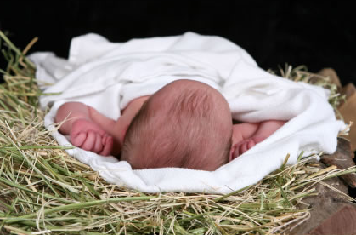
Babies Don't Rule,
Do They?
Isaiah 9:1-7
Isaiah 9:1-7
Rick Griffith • Crossroads International Church • BibleStudyDownloads.org

Slide 2
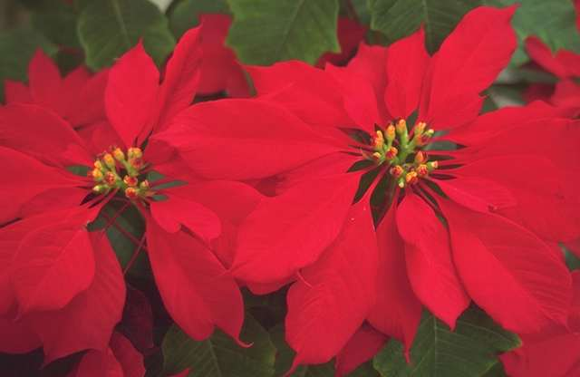
Ah, the Christmas Season…
How 'Ya Doing?
Notes:
How are you doing today? (Has anybody asked you—really asked you?)

Slide 3

Merry Christmas
How 'Ya Doing?
Notes:
It’s Christmas time so everyone is supposed to be upbeat and say, “Blessed Christmas to you” or at least “Merry Christmas.”
But we all know full well that this time is one of the busiest times of the year—and maybe we’re not so merry after all.

Slide 4
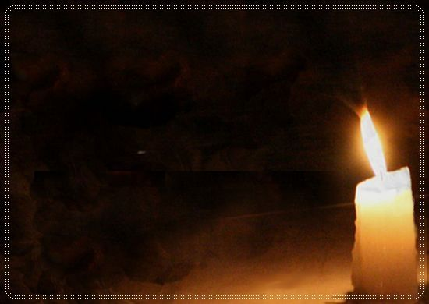
Do you need light in your darkness today?
Notes:
But we all know full well that this time is one of the darkest times of the year—and maybe we’re not so merry after all.
The week that more people die than any other is December 25-Jan 1.
Do you need light in your darkness today?

Slide 5

Need Deliverance?
Notes:
So how are you doing today? Do you need deliverance today?
Do you need to be rescued from seemingly extra doses of stress?
Do you need freedom from the medications that enslave you? Like coffee?
How ‘bout deliverance from concerns about your family—your job—this church?
Anyone here need release from just plain apathy or discouragement?

Slide 6
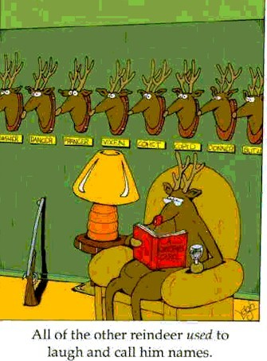
All of the other reindeer used to laugh and call him names.
Notes:
Maybe you relate to Rudolph, whose friends used to laugh & call him names!
The need for deliverance hits in December as much—if not more—than any other time of the year.

Slide 7
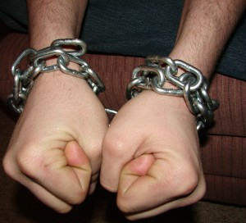

What do you do when you need security?
Notes:
But what do you do when you need security? That’s the question I’ve noted in your sermon outline for today. Where do you find security when life is really insecure? Where do you turn for deliverance in your time of greatest need?

Slide 8
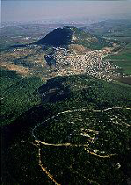
Life in Isaiah's Day
(735 BC)
Notes:
Today we’re going to look at a people that had a whole lot more stress than most of us are experiencing.

Slide 9
The Assyrian Threat
Assyrian Expansion
Nineveh
Mediterranean
Sea
Syria
Israel
Judah
Persian
Gulf
Egypt
Notes:
Let’s journey back to 8th century BC when Isaiah ministered to a stressed out Judah. Isaiah lived during a time of great discouragement and upheaval in Judah:
Assyria was the major threat to the northeast as it expanded its borders.
Syria and Israel stood next in line for destruction. Fearing an Assyrian attack, they asked Judah to join a 12-nation coalition against Assyria.
After Judah refused to join the coalition, Israel joined forces with Syria to fight against Jerusalem (Isa. 7:1-2; 734 BC).
But, rather than trusting the Lord, Ahaz sent a lot of money to Assyria for help (2 Kings 16:7-8).
Assyria essentially said, “Thanks for the money. I was going to conquer them anyway, but I’ll accept pay for it too!” Assyria attacked Damascus in Syria and put King Rezin to death (2 Kings 16:9; 732 BC).
But the “deliverer” Assyria was also the aggressor! This nation had already caused Israel to pay tribute for 9 years (743-734 BC).
Judah had more stress than we do since their very existence was threatened!

Slide 10
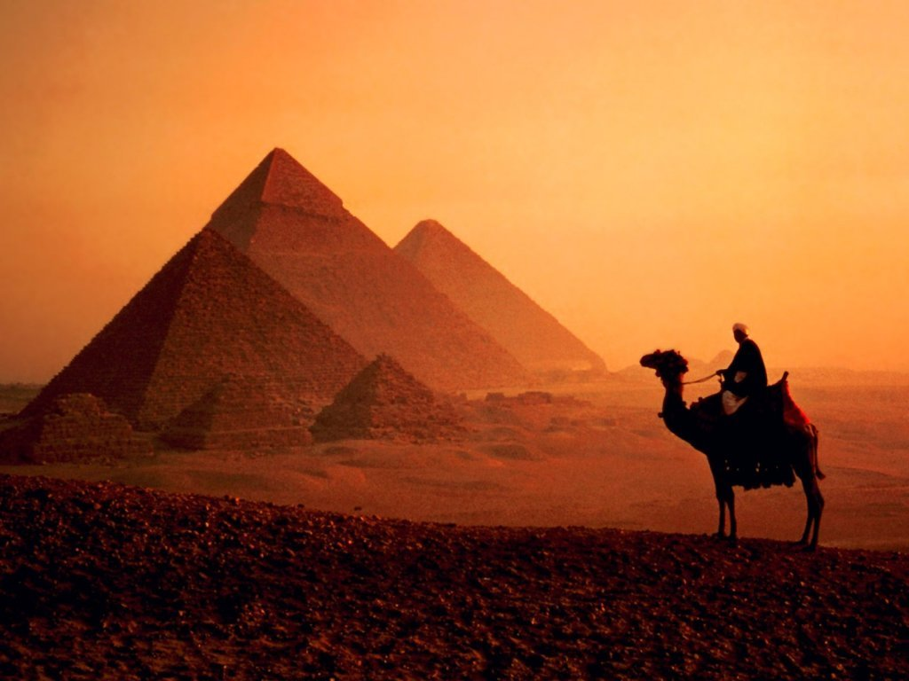
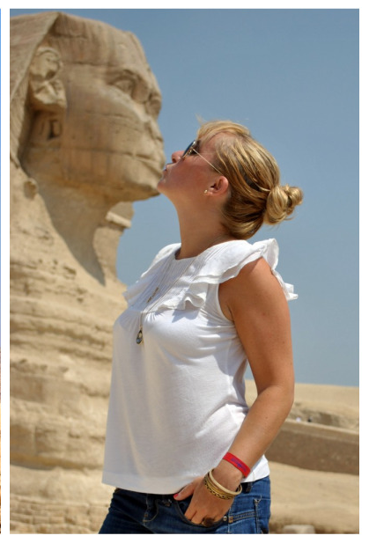
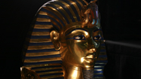
Egypt?
Where to turn?
Notes:
Where to turn?
So the question came, “Who should Judah trust for security?”
• Should Judah look to Egypt and join the 12-nation alliance against Assyria?
• Pharaoh was powerful, so should they kiss up to him?
Or should Judah look to Assyria to protect them from Syria and Israel?

Slide 11
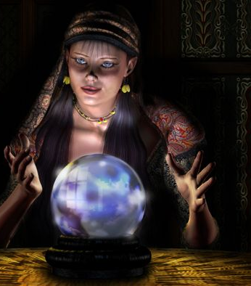
"Someone may say to you, 'Let's ask the mediums and those who consult the spirits of the dead. With their whisperings and mutterings, they will tell us what to do.'
But shouldn't people ask God for guidance? Should the living seek guidance from the dead?"
(Isaiah 8:19 NLT).
Notes:
Who should they rely upon?
Some suggested mediums (read 8:19).

Slide 12
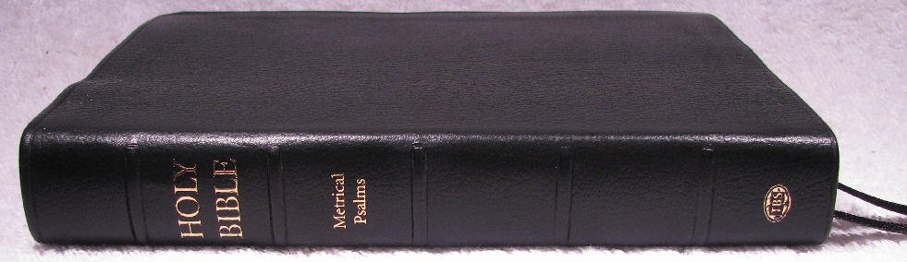
"Look to God's instructions and teachings! People who contradict his word are completely in the dark. ²¹They will go from one place to another, weary and hungry. And because they are hungry, they will rage and curse their king and their God. They will look up to heaven ²²and down at the earth, but wherever they look, there will be trouble and anguish and dark despair. They will be thrown out into the darkness"
(Isaiah 8:20-22 NLT).
Notes:
Other people in Isaiah’s day were looking to the dead for signs [read 8:19-22].
But there’s no security in this!

Slide 13
What do you do when you need security?
Notes:
Rather, to know where to find security, Isaiah 9:1-5 says that…

Slide 14
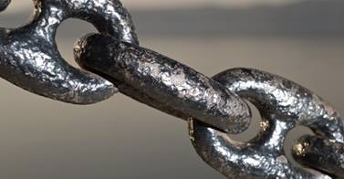
I. Security is often found in the strangest places.
Notes:
[Don’t trust the usual sources of deliverance.]

Slide 15
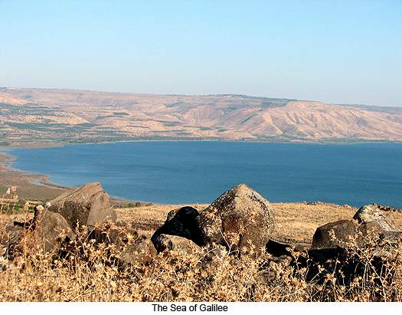
A. Judah shouldn't look to the big powers but to Galilee (9:1-5).

Slide 16
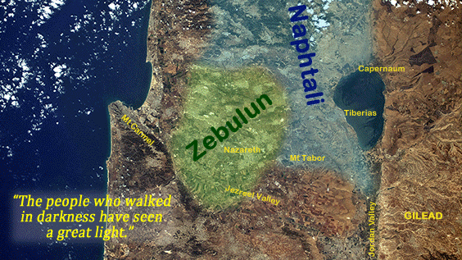
"Nevertheless, that time of darkness and despair will not go on forever. The land of Zebulun and Naphtali will be humbled, but there will be a time in the future when Galilee of the Gentiles, which lies along the road that runs between the Jordan and the sea, will be filled with glory" (Isaiah 9:1 NLT).
Notes:
Instead of the darkness and gloom of those trusting mediums in the previous verses [8:19-22], God promises light and joy in the humiliated Galilee (1-2).

Slide 17
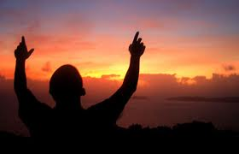
"The people who walk in darkness will see a great light.
For those who live in a land of deep darkness, a light will shine"
(Isaiah 9:2 NLT).

Slide 18
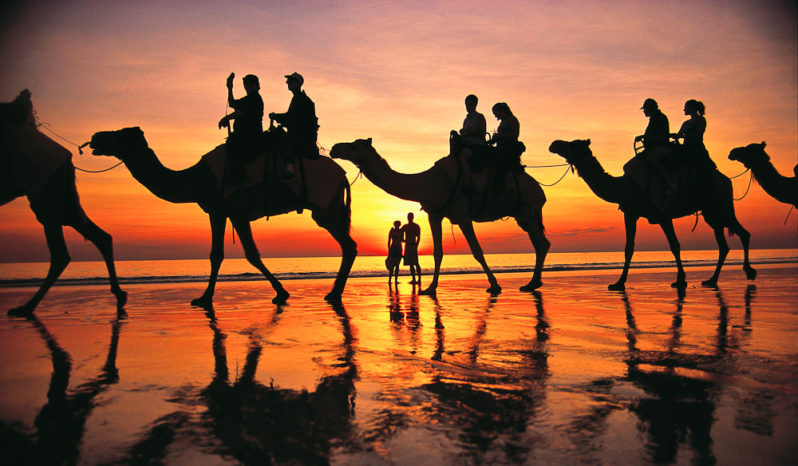
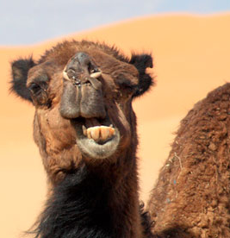
Trampled Galilee Trade Route
Notes:
The typical place Jews looked for deliverance certainly wasn’t Galilee.
Isaiah says in verse 1 that this area of the Jewish tribes of Naphtali and Zebulun was humbled in the past—trampled by caravans and armies as it was on the main trade route.

Slide 19
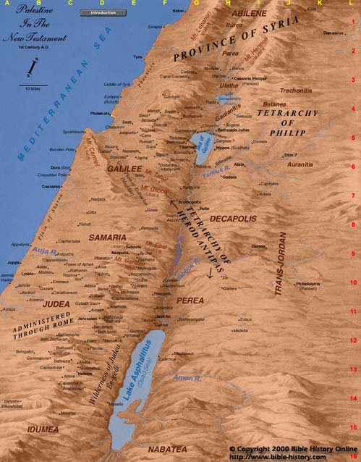
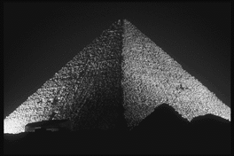
The Way of the Sea
Galilee
Judah
Egypt
Notes:
What is the “way of the sea” (1b)? This is the name of the main highway that connected Egypt and Assyria through Israel, mostly by the Mediterranean Sea. Deliverance surely wouldn’t come from this pagan highway—would it?

Slide 20
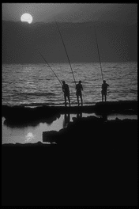
Security? Not in Galilee!
Trampled
Lacked fortresses
Gentile
Notes:
• They thought of security in terms of fortress cities like Jerusalem, Samaria, or the key city of Megiddo—but Galilee had no major fortresses!
• Galilee was the Gentile area of Israel. And of all places, one would never expect to find the Messiah in Nazareth—Nazareth was the headquarters of the Roman garrison in the days of Jesus!
Jews were looking anywhere for security but Galilee! In similar manner, if Singapore (KL) was attacked it would be unlikely to look for deliverance in Geylang (Phuket)!

Slide 21
Deliverance Blessings
Nation enlarged (3a)
"You will enlarge the nation of Israel, and its people will rejoice" (NLT)
Notes:
Yet God’s deliverance in Galilee will result in wonderful blessings (3-5).
• First, the nation will become larger (3a).

Slide 22
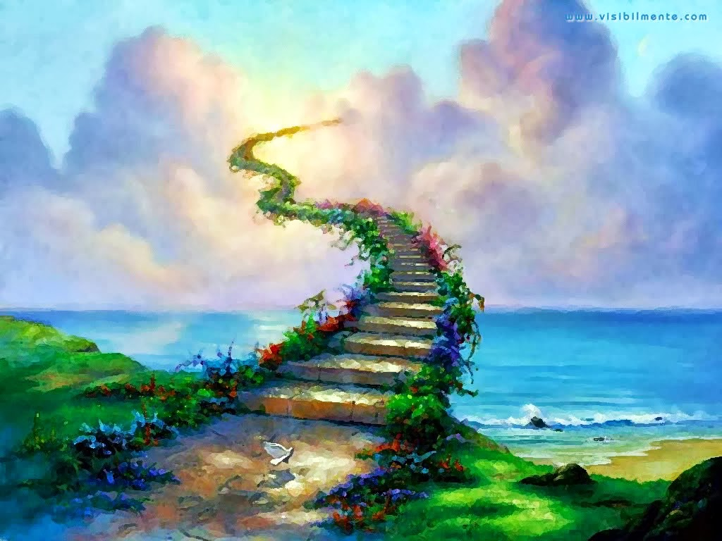
Deliverance Blessings
Notes:
Typically we think that we must go to Heaven for real blessing. However…

Slide 23
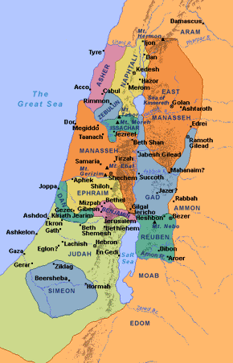

Expansion of Judah
Dan
Asher
Millennial Israel
(Ezek.
47–48)
Naphtali
Divided Kingdom
Manasseh
Ephraim
Israel
Reuben
Judah
Leaders & Temple
Judah
Benjamin
Simeon
Issachar
Zebulun
Gad
Notes:
This is an earthly scene. Ezekiel 47–48 give the future borders of Israel more clearly in fulfillment of this text.

Slide 24
Deliverance Blessings
Nation enlarged (3a)
Joy (3b)
Notes:
Jews will be filled with joy…

Slide 25
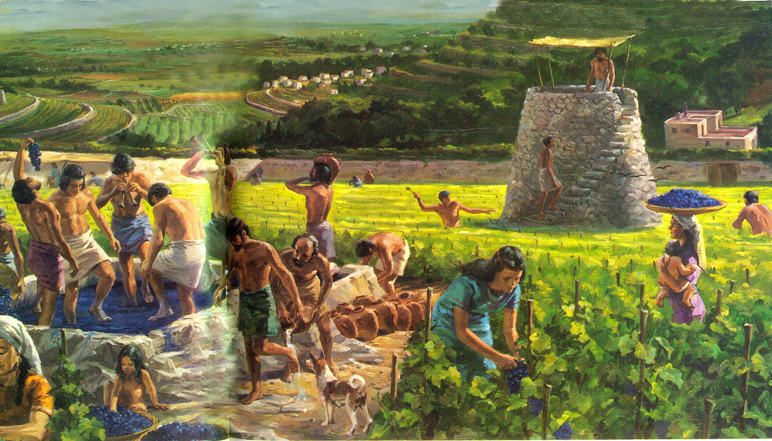
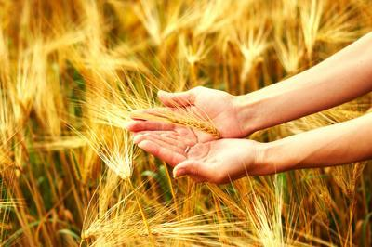

"They will rejoice before you as people rejoice at the harvest…"
(Isa. 9:3b NLT).
Notes:
…like the fun of enjoying the harvest of the crop—like us getting our paycheck!

Slide 26
"They will rejoice… like warriors dividing the plunder"
(Isa. 9:3b NLT).
Notes:
…or like dividing plunder after battle (3b).

Slide 27
Deliverance Blessings
Nation enlarged (3a)
Joy (3b)
No more oppression (4)
Notes:
Other nations will no longer oppress Israel (4)

Slide 28
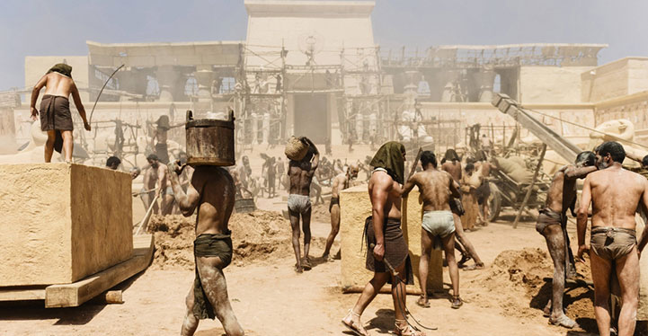
"For you will break the yoke of their slavery and lift the heavy burden from their shoulders" (Isa. 9:4a NLT).
Notes:
Other nations will no longer oppress Israel (4).
Israel was enslaved in Egypt…

Slide 29
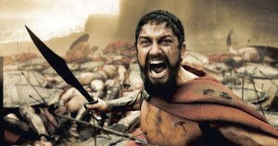
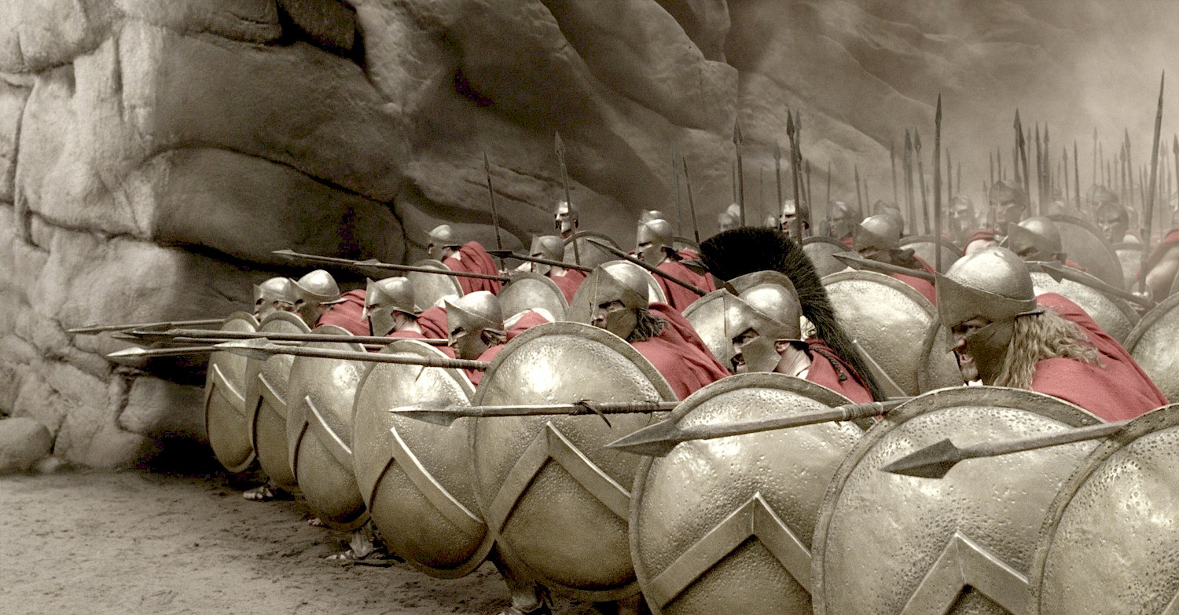
"You will break the oppressor's rod, just as you did when you destroyed the army of Midian"
(Isa. 9:4b NLT).
Gideon
Notes:
But then they will be delivered like Gideon defeated the mighty Midianites!

Slide 30
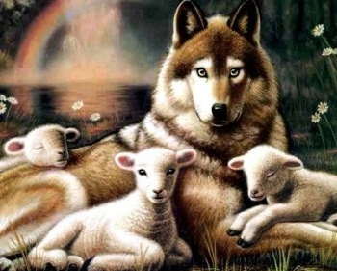
Isaiah 11:6-7
⁶ And the wolf will dwell with the lamb, and the leopard will lie down with the young goat, and the calf and the young lion and the fatling together…
Notes:
30

Slide 31
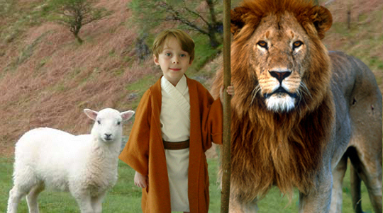
Isaiah 11:6-7
473a
…and a little boy will lead them.
Notes:
31
A little boy will lead a lion!

Slide 32
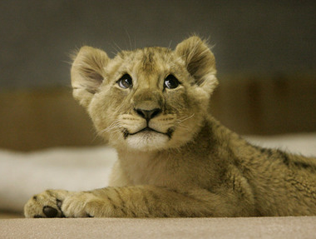
Even lions tamed!
⁷ Also the cow and the bear will graze, their young will lie down together, and the lion will eat straw like the ox.
Notes:
32
Even lions will be tamed!

Slide 33
473a
Incredibly Long Life!
NIV Isaiah 65:20 "Never again will there be in [Jerusalem] an infant who lives but a few days, or an old man who does not live out his years; he who dies at a hundred will be thought a mere youth; he who fails to reach a hundred will be considered accursed."
Notes:
33
Isaiah 65:20 says people over 100 will still be young!

Slide 34

461b
Millennial Jerusalem
"The law will go out from Zion,
the word of the LORD from Jerusalem"
––Isaiah 2:3
Notes:
34
Isaiah 2 notes God’s law coming out of Zion, or Jerusalem.

Slide 35
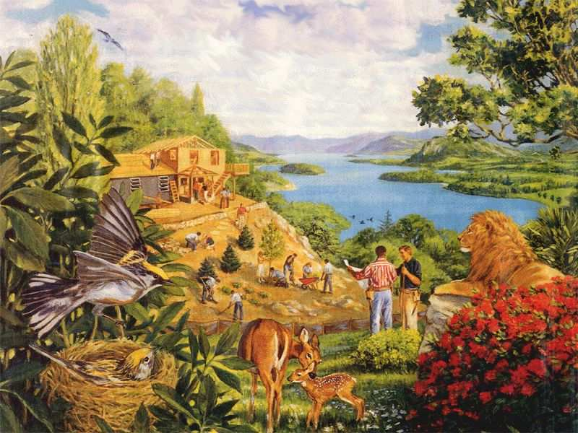
461c
Rebuilding brings…
Notes:
35
Rebuilding of the earth will bring…

Slide 36
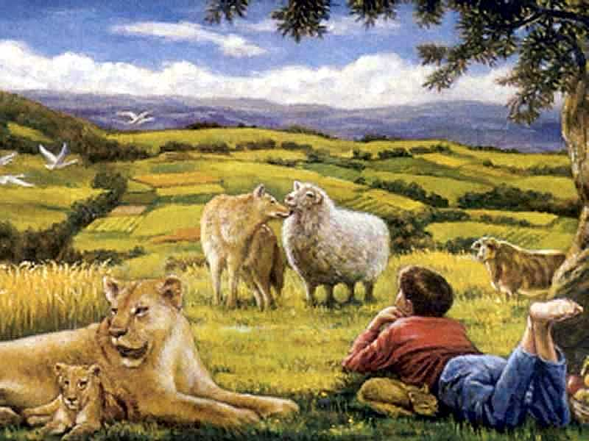
461c
…a totally renewed earth!
Notes:
36
…a totally renewed earth!

Slide 37
Deliverance Blessings
Nation enlarged (3a)
Joy (3b)
No more oppression (4)
Military uniforms gone (5)
Notes:
Military uniforms will be destroyed, as nations won’t need it anymore (5).

Slide 38
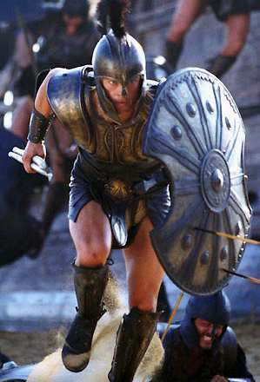
"The boots of the warrior and the uniforms bloodstained by war will all be burned. They will be fuel for the fire"
(Isaiah 9:5 NLT)

Slide 39
"[Jesus] went first to Nazareth, then left there and moved to Capernaum, beside the Sea of Galilee, in the region of Zebulun and Naphtali. ¹⁴This fulfilled what God said through the prophet Isaiah:
Isaiah 9:3-5?
NOT fulfilled yet!
Capernaum
Nazareth
'In the land of Zebulun and of Naphtali,
beside the sea, beyond the Jordan River,
in Galilee where so many Gentiles live'"
(Matt. 4:13-15 NLT)
Notes:
Were verses 1-5 fulfilled in the first century or is the fulfillment yet future?
• Verses 1-2 are quoted in Matthew 4:13-15 as fulfilled by Jesus centering His ministry on the Sea of Galilee in the region of Naphtali and Zebulun. So, at least verses 1-2 were fulfilled which promised a Deliverer from this region.
• Isa. 9:3-5? But verses 3-5 promise Messiah’s yet unfulfilled victory over Judah’s enemies.

Slide 40
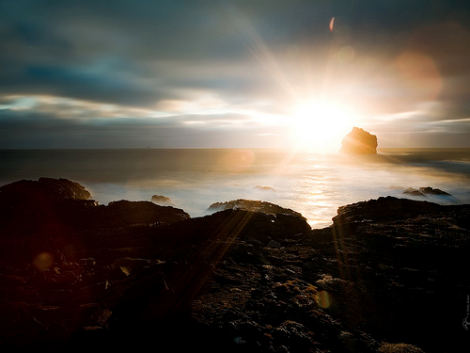
Where's your security?
Government?
Notes:
Yet Israel sought security in the wrong places—alliances, money, etc. Like Israel …
Countries often trust political and military strength which provide little security.

Slide 41
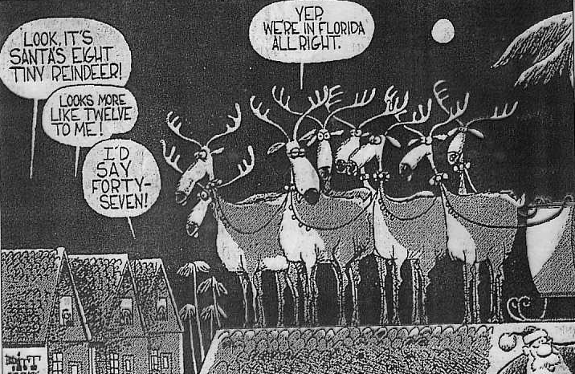
Florida Reindeer
Notes:
Americans have long found security in their democratic system—but the 2000 election complexities showed that democracy is a false hope [read slide].

Slide 42
Where's your security?
Government?
Military?
Allies?
Organization?
Leaders?
Savings?
Notes:
I once heard someone boast, “Singapore’s defenses are so superior it could wipe out both Indonesia and Malaysia!” That’s security in the wrong place!
• As Israel looked to its allies, we too can make the same mistake—but it’s vain.
• Even here at church we can often rest on false sources of security.
• I’m glad to see us organized. But unless we submit to God’s more difficult issues of the heart, we could only have more organized but miserable people!
• Leaders: In our leadership transitions it’s easy to put false hope in what we see—“Well, at least ____ (fill in the blank) is stable.”
But this again is a false sense of security as what we are strong in now can easily be lost or become a cause for disunity.
Even if the church is united, we can stoop to levels of conflict by competing over resources as if we aren’t one family.
• Savings: We can equally trust in our church bank account for security.
In my trips to Mongolia, Vietnam, Nepal, and Sri Lanka in recent years, I’ve noticed something amazing about the church in these poor countries—it’s often stronger than the church in wealthy nations like Singapore and the US.
Sometimes I wonder if it would be better to have no savings at all so that we’d have to fall back on our Real Source of Security!

Slide 43
What do you do when you need security?
Notes:
So if security is found in strange places but these are not our finances or strengths, where do we look? Where is this strange Source of Security? Verse 6-7 tell us…

Slide 44
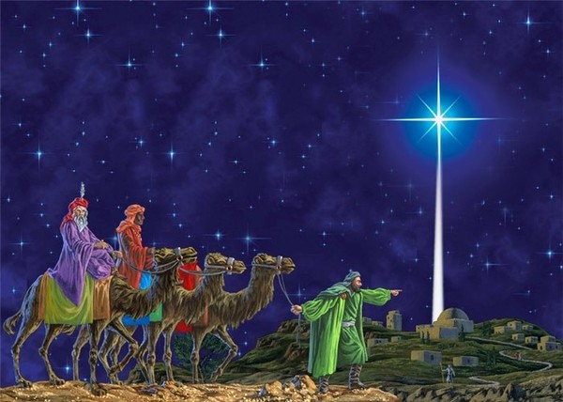
II. When you need security, look to the Child.
Notes:
[Our Ultimate deliverance is in a Baby!]

Slide 45
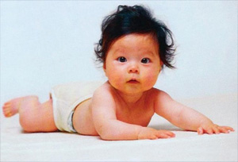
Babies don't rule!
Do they?
Notes:
What would you say if I told you to trust a baby ruler?
Babies don’t rule, do they? Of course not! They drool, but they certainly don’t rule!

Slide 46
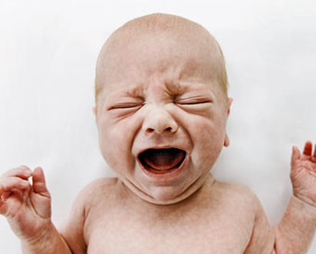
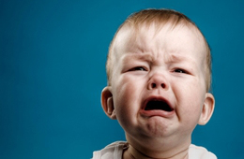
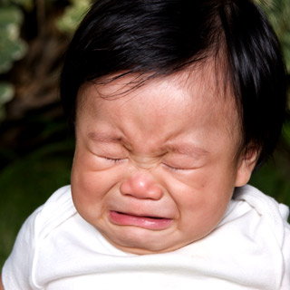
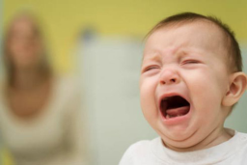
Babies don't rule!
Do they?
Notes:
But you say, “Well, you haven’t been to my house!” Maybe not. But, come to think of it, I’ve had baby boys rule in my own house—three of them!
They decided when to have milk and my wife obliged. (We didn’t like noise!)
Each baby also decided when he wanted his diaper changed—Susan and I jumped to the task before it got any worse.
They each also expressed a number of emotions in a rather “unembarrassing” manner—at least it didn’t embarrass them! Pretty soon we began to see who ruled the house—and some people say children are born without sin! I’m not sure what you call these people, but they sure aren’t called parents!

Slide 47
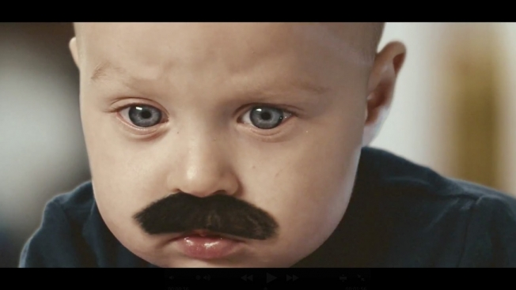
Think ahead…
Notes:
Of course, you know I’m saying this in jest. You have to think of the potential of a baby in the future

Slide 48

Black
Notes:
—just like a cocoon has potential to become a butterfly. This text is about a Baby who is a real ruler…

Slide 49
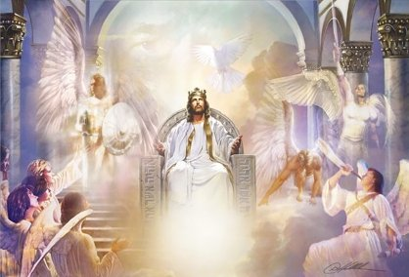
A. The One who will meet all of Israel's needs is a Child who will rule.

Slide 50
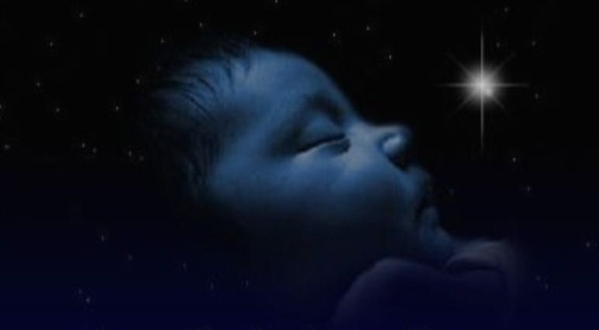
"For a child is born to us, a son is given to us. The government will rest on his shoulders. And he will be called: Wonderful Counselor, Mighty God, Everlasting Father, Prince of Peace"
(Isa. 9:6 NLT)
Notes:
He will be born a child (6a).

Slide 51
How much is a baby worth?
$62,500
-$180,000
$275,000
Notes:
The Nov 2000 Straits Times reported that, “Britain has just published its first set of generational accounts, showing at what ages a person is considered a benefit and a liability to the state.”
A newborn is valued at $62,500; A person at age 30 is worth $275,000, and a 60-year old pensioner is assigned a value of minus $180,000.
To put a dollar figure on a baby seems incredible to me. Certainly my babies were worth far more than $62,500! Yours too!

Slide 52
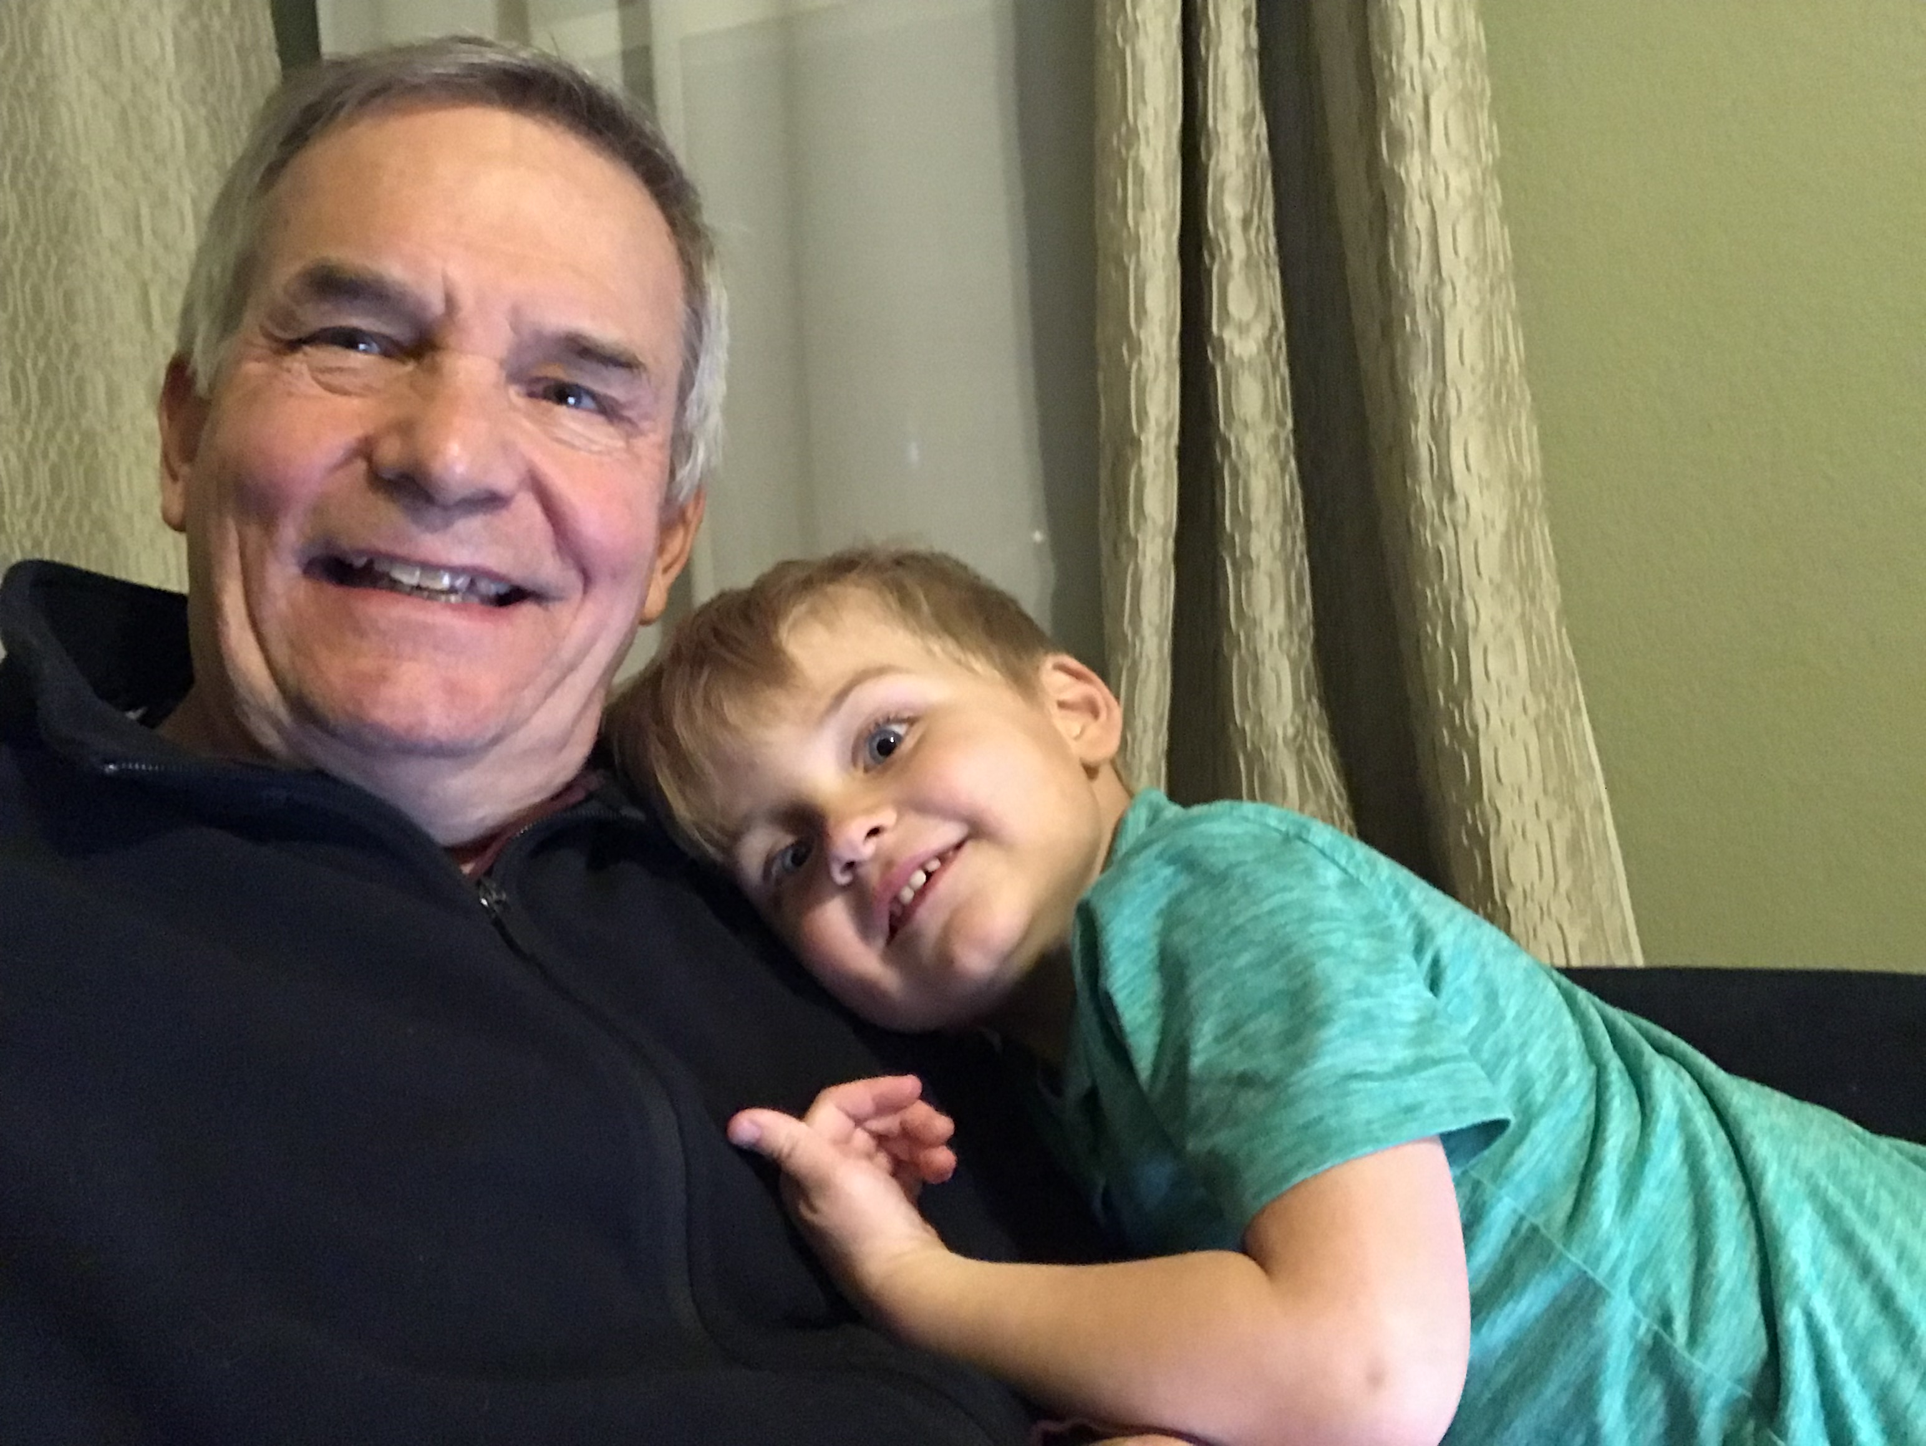
Our Deliverer!
Notes:
A baby is invaluable, but do you look to a baby to deliver you from trouble? Imagine me telling you that an invading army is coming, but don’t worry—Susan and I had a grandson in 2019 named Jesse, the same name as the father of David, the great warrior of old. He will save us.

Slide 53
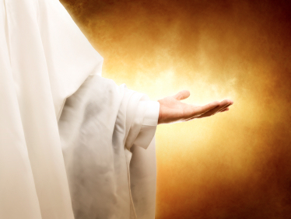
"The government will be on his shoulders"
Notes:
This Child will rule over Israel (6b).
What does it mean that the ‘government will be on his shoulders” (6)? This figuratively refers to the kingly robe to be worn by the Messiah (BKC, 1053).

Slide 54
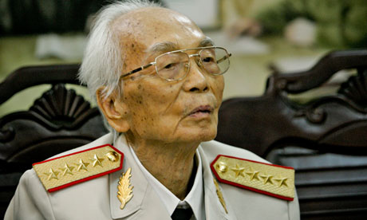
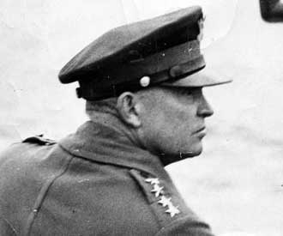
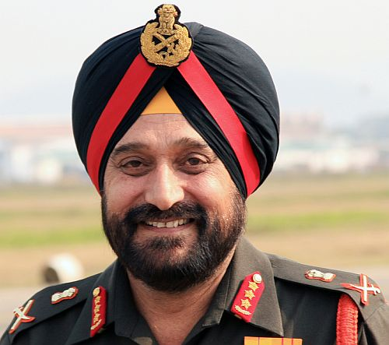
"The government will be on his shoulders"
Notes:
We typically show authority on the shoulders of generals and rulers.

Slide 55
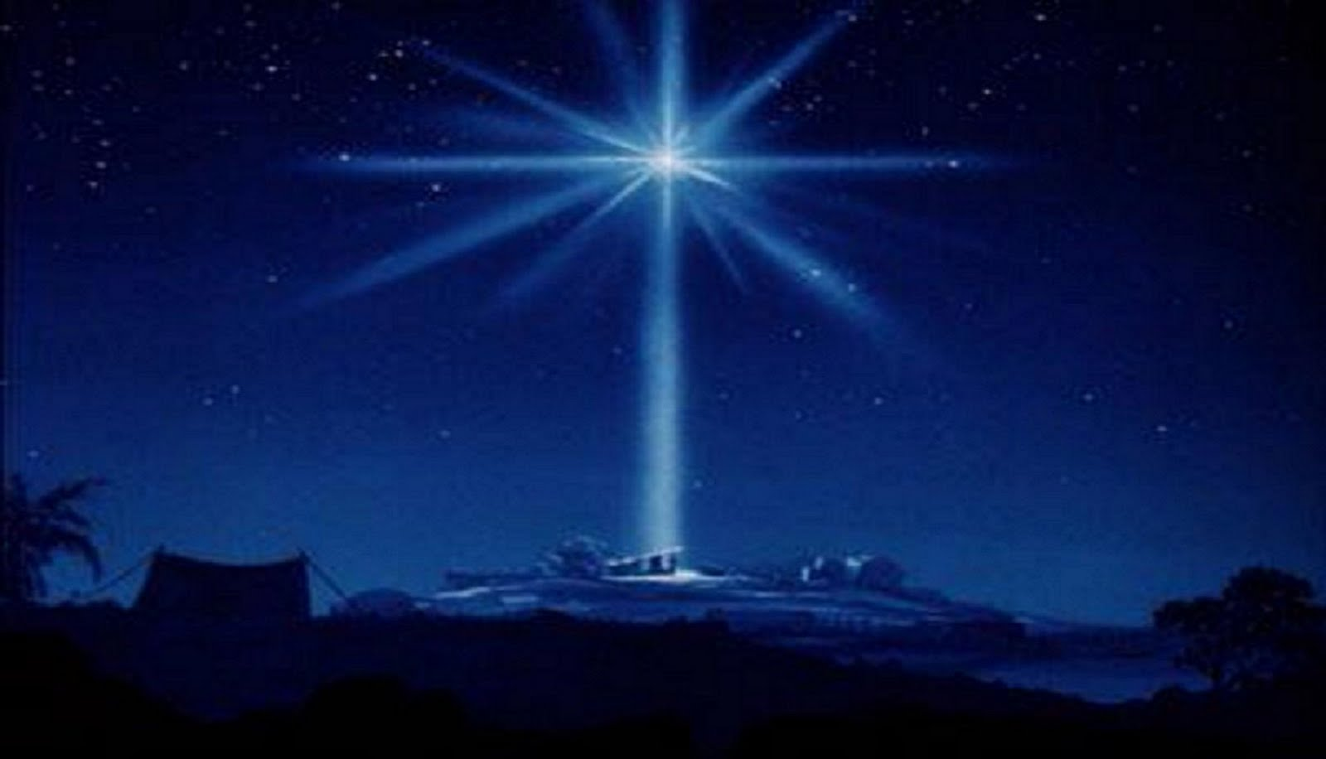
The Son's Kingly Character
Wonderful Counselor
(listened to!)
Mighty God
(Ultimate Power)
Eternal Father
(fatherly rule)
Prince of Peace
(security at last!)
Notes:
Four titles describe this Child’s kingly character (6c-f).
• Wonderful Counselor: Israel (and the world) will finally gladly listen to their leader due to His exceptional authority (6c).
• Listened to: Nowadays Israel hardly listens to its leaders—Barak won by a landslide and was tossed aside. Sharon also won decisively but then had little respect.
But in the kingdom Israel will love to listen to Christ teach God’s ways (2:3).
• Mighty God: The world’s ruler will be none other than God in the flesh (6d)—the Ultimate Power!
• Eternal Father: Christ will rule forever (6e). This refers to…
• His deity,
• His relationship to time, not to other members of the Trinity,
• His “fatherly rule,”
• His eternal kingdom will fulfill the Davidic Covenant where David was promised a descendant who would rule the world forever.
• Prince Peace
• Security
Prince of Peace: Jesus will give us worldwide peace no one else could bring (6f).

Slide 56

The Eastern Gate
Notes:
In fact, Jesus will march into Jerusalem’s Eastern Gate at His return.
This event the Muslims want to prevent so they positioned a Muslim graveyard in front of the gate (good luck!).

Slide 57

Isaiah 9:6
The government will be on His shoulders, and He is able because He has the wisdom to be the Wonderful Counsellor. Their oppressors will be broken and peace enforced because He is the Mighty God who is the Father of Eternity.
Only God's Son is so wonderful that He has the wisdom to rule nations, the power to produce peace and the supreme authority over all eternity. That's why He is called the Prince of Peace.
Notes:
57

Slide 58

What's the significance of the Names "Wonderful" and "Father"?
Wonderful Counsellor
Wonderful is a title of God mentioned in Judges 13:18
Father of Eternity
This name refers to Jesus' supremacy and authority over everything from eternity to eternity.
Notes:
58
Judg. 13:17 Then Manoah [Samson's father] asked the angel of the LORD, "What is your name? For when all this comes true, we want to honor you."
Judg. 13:18 "Why do you ask my name?" the angel of the LORD replied. "It is too wonderful for you to understand."

Slide 59

"His government and its peace will never end. He will rule with fairness and justice from the throne of his ancestor David for all eternity. The passionate commitment of the LORD of Heaven's Armies will make this happen!" (Isa. 9:7 NLT)

Slide 60

Christ's Future Reign
Increasingly stronger (7a)
Righteous (7b)
Eternal (7c)
Divinely empowered (7d)
Notes:
The reign of this Child will unlike any other king (7).
• His reign will increasingly become stronger (7a).
• His reign will fulfill all the promises to David of a righteous kingdom (7b). No more going from good to bad to good to bad leaders!
• His reign will be forever (7c).
Will Christ’s rule be eternal (7)? I thought it would last 1000 years (Rev. 20).
It will—but after a 1000-year reign it will be absorbed into the eternal state.
• His reign will be accomplished by God’s power—not man’s (7d).

Slide 61

So how does this baby relate to me?
Notes:
So, amidst many stresses, God promised Judah a Deliverer as the most unlikely candidate—a Baby! Is our Source of security anywhere else? No, since Jesus is still the Mighty God…

Slide 62

Our security is found only in Christ too!
Notes:
Our security is found only in Christ too.

Slide 63

Many believe the stars direct people's destiny and events on earth.
Notes:
63
Israel sought mediums and the dead, who likely mixed this with astrology. Don’t look to the stars—look to the Son (S-O-N)!
I wonder if the same could be said of you today.
Can someone say of you, “Wow! God is really doing a great work in the life of… blank (fill in the blank with your name).”
Are you known as one who is trusting in the deliverance of Christ Jesus today?
(That’s essentially what this text is about—or, said differently…)

Slide 64


When you need security, look to the Child.
Main Idea:

Slide 65

Poem 1
He was born of a woman…
He was born of a woman…
so we could be born of God

Slide 66

Poem 2
He humbled Himself…
so we could be lifted up

Slide 67

Poem 3
He became a servant…
He became a servant…
so we could be made heirs

Slide 68

Poem 4
He suffered rejection…
He suffered rejection…
The End
so we could be His friends

Slide 69

Poem 5
He denied Himself…
He denied Himself…
so we could freely receive all things

Slide 70

Two Messiahs?
"He will rule with fairness and justice from the throne of his ancestor David for all eternity"
(9:7)
"He was despised and rejected—a man of sorrows, acquainted with deepest grief…"
(53:3)
Notes:
70
More and more among us are doing are freely receiving all things in Him! Jewish scholars before Christ couldn’t reconcile Isaiah's two seemingly contradictory depictions of the Messiah—reigning king and suffering servant. So some thought there existed two Messiahs—one to rule and one to suffer. But I assure you that they are one and the same. Jesus died for you so you can reign with him!

Slide 71
Which one of His titles means the most to you right now (9:6)?
Wonderful Counselor:
"Jesus, I need your counsel."
Mighty God:
"Jesus, I need your power."
Everlasting Father:
"Jesus, I need your rule in my life."
Prince of Peace:
"Jesus, I need your peace."
Notes:
Are you resting in this Child? Remember that His titles affect you in the most personal ways:
Wonderful Counselor means that Christ’s ability to handle your problems is unparalleled! Pray, “Jesus, I need your counsel.”
Mighty God means Christ takes a second seat to no one—He’s God Himself! Pray, “Jesus, I need you to show your power.”
Everlasting Father means that Jesus can provide security in the form of eternal life! Pray, “Jesus, I need your rule over my life.”
Prince of Peace means Jesus can bring peace to us as a church and to you as an individual. Pray, “Jesus, I need your peace.” Are you at peace with the Prince of Peace (evangelistic closing)?

Slide 72
Black

Slide 73


OT Preaching link at BibleStudyDownloads.org
Get this presentation and script for free!
Notes:
OT Preaching (op)

