Slide 1
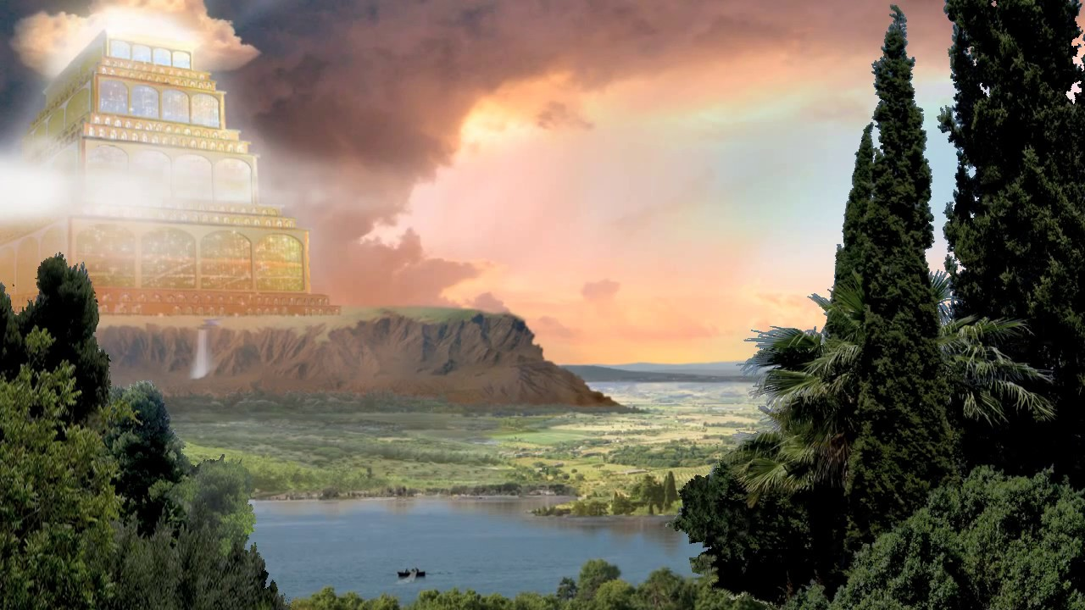
God Answers Isaiah’s Plea
Isaiah 65
Dr Randall Price
World of the Bible Ministries • www.worldofthebible.com
Uploaded by Dr. Rick Griffith • Jordan Evangelical Theological Seminary
Files in many languages for free download at BibleStudyDownloads.org

Slide 2
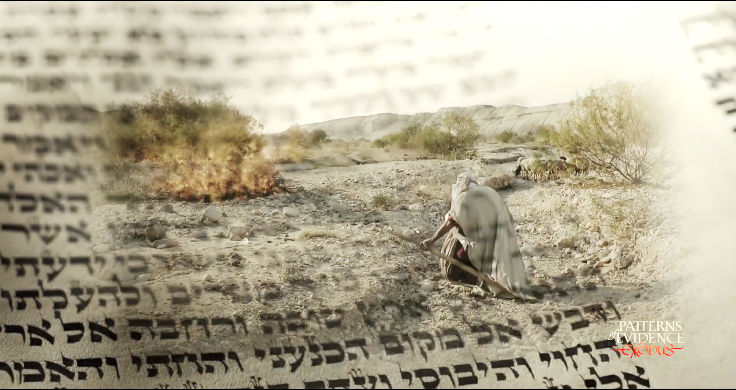
Welcome to
THRU THE BIBLE

Slide 3
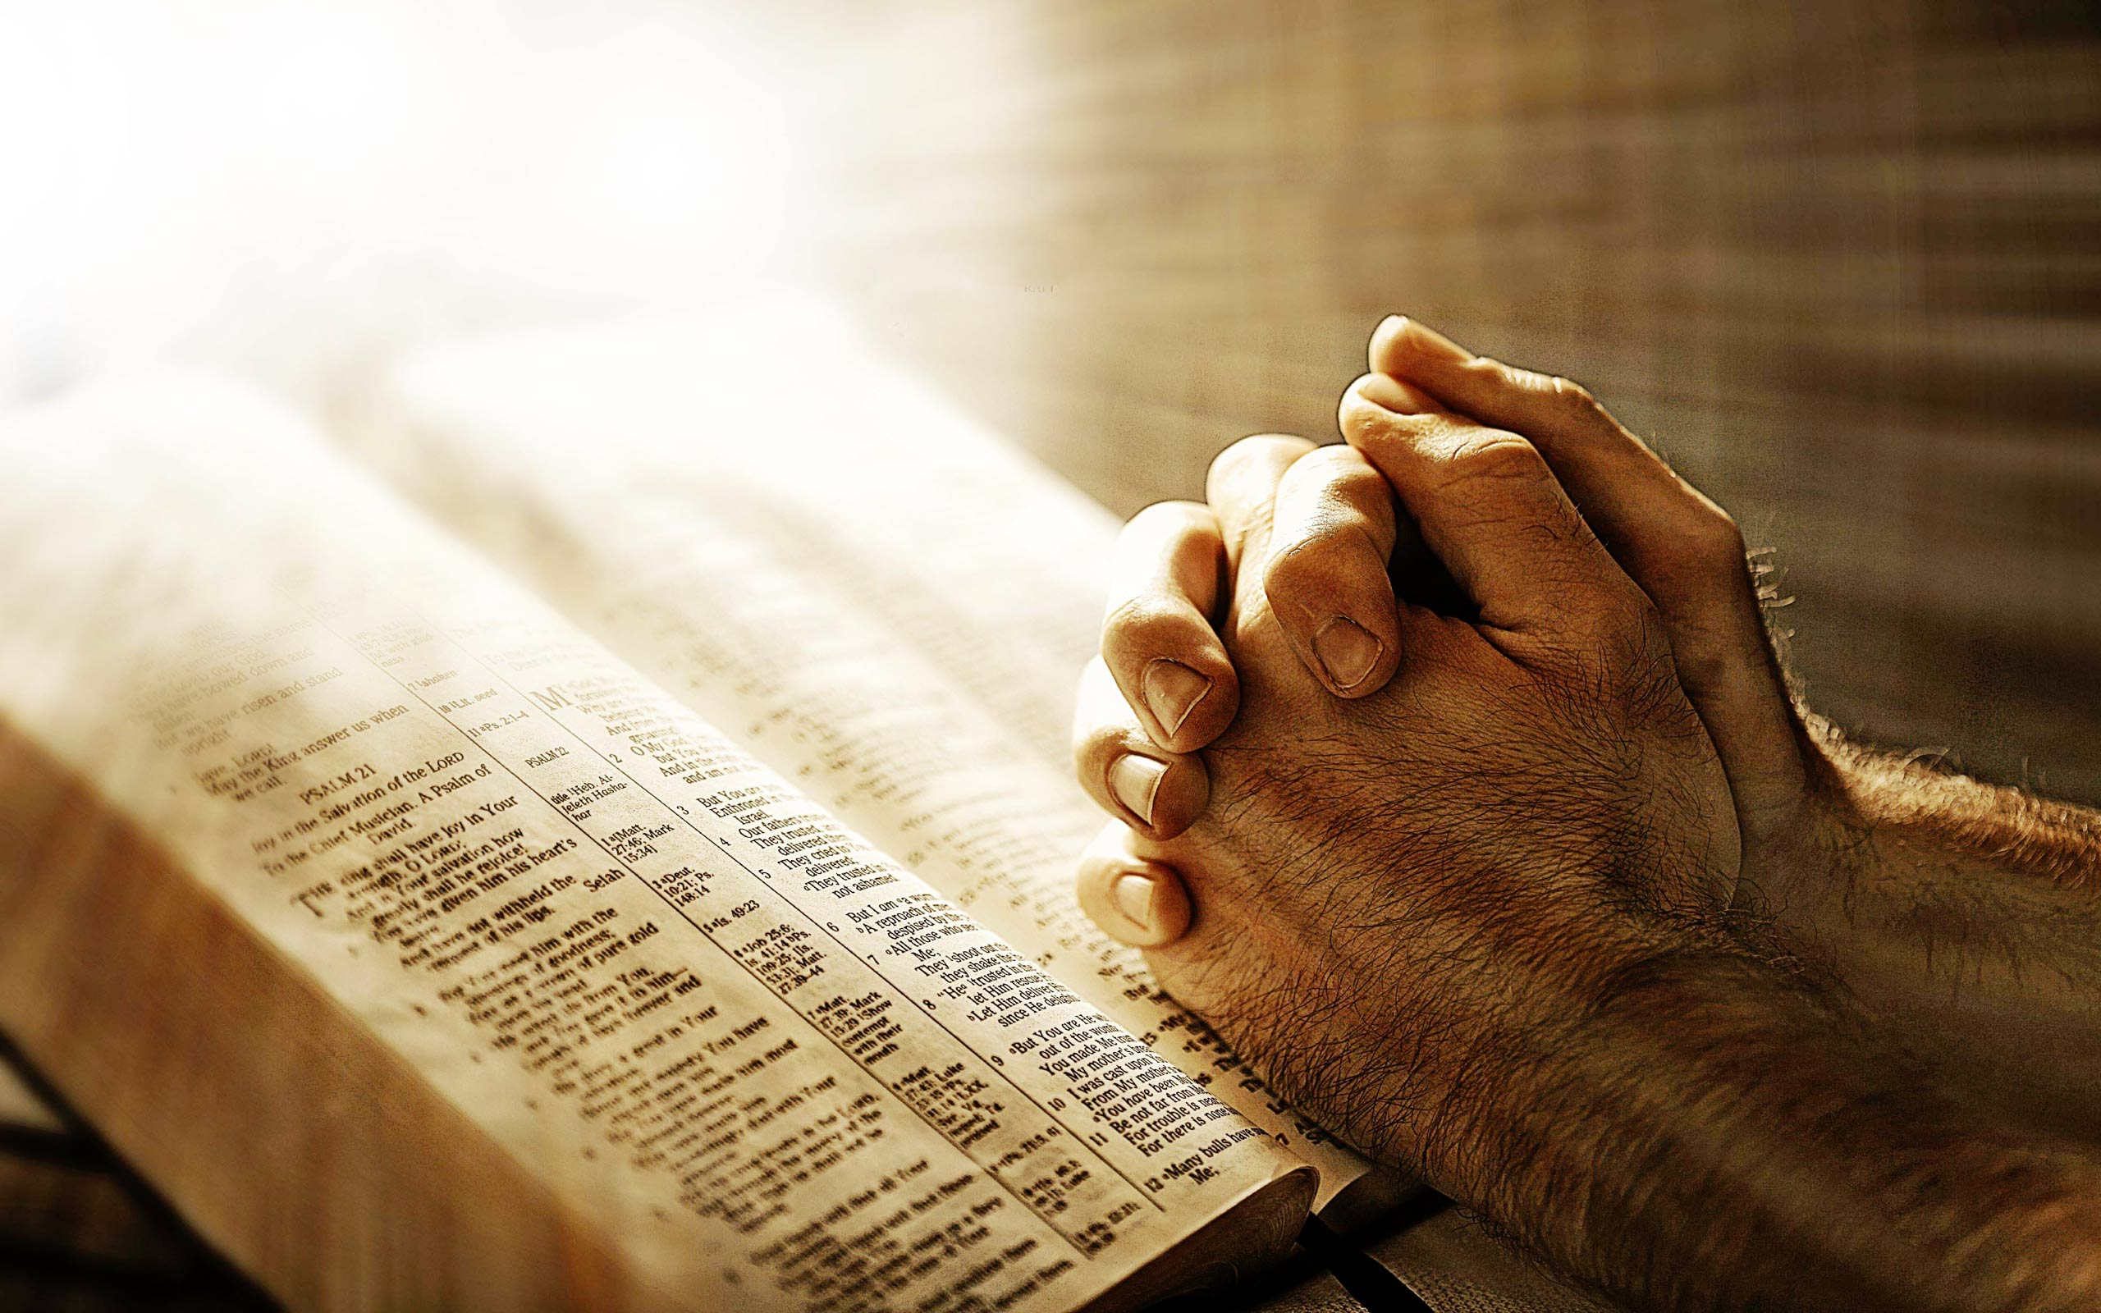
Prayer
Time
“In the morning, O LORD, Thou wilt hear my voice; In the morning I will order my prayer to Thee and eagerly watch.”
Psalm 5:3

Slide 4
God Answers Isaiah’s Plea
Isaiah 65

Slide 5
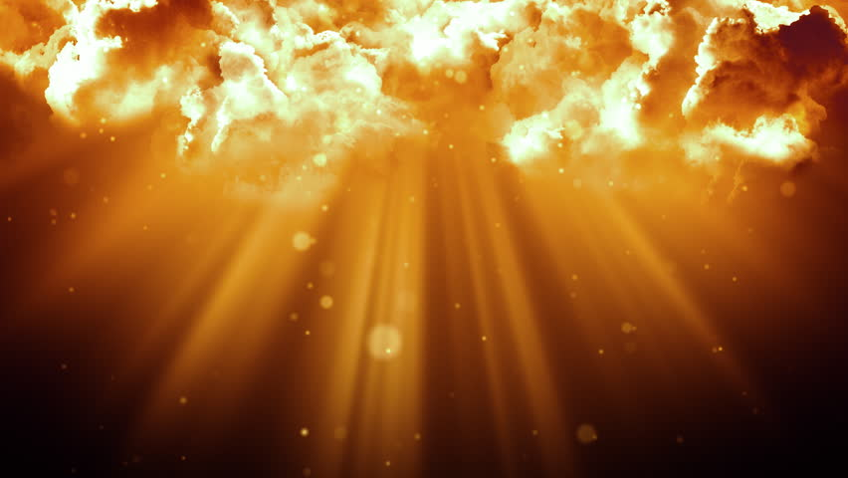
Outline of Isaiah 65
The Problem of an Old Conflict vss. 1-16
A. The Conflict with Rebels and Idolators vss. 1-5
B. The Contrast of Future Destinies vss. 6-16
The Promise of a New Creation vss. 17-25
A. The Creation of the New Jerusalem vss. 17-19a
B. The Characteristics of the Kingdom vss. 19b-25

Slide 6
The Conflict with Rebels and Idolators vss. 1-5
“I permitted Myself to be sought by those who did not ask for Me; I permitted Myself to be found by those who did not seek Me. I said, ‘Here am I, here am I,’ to a nation which did not call on My name.” Isaiah 65:1

Slide 7
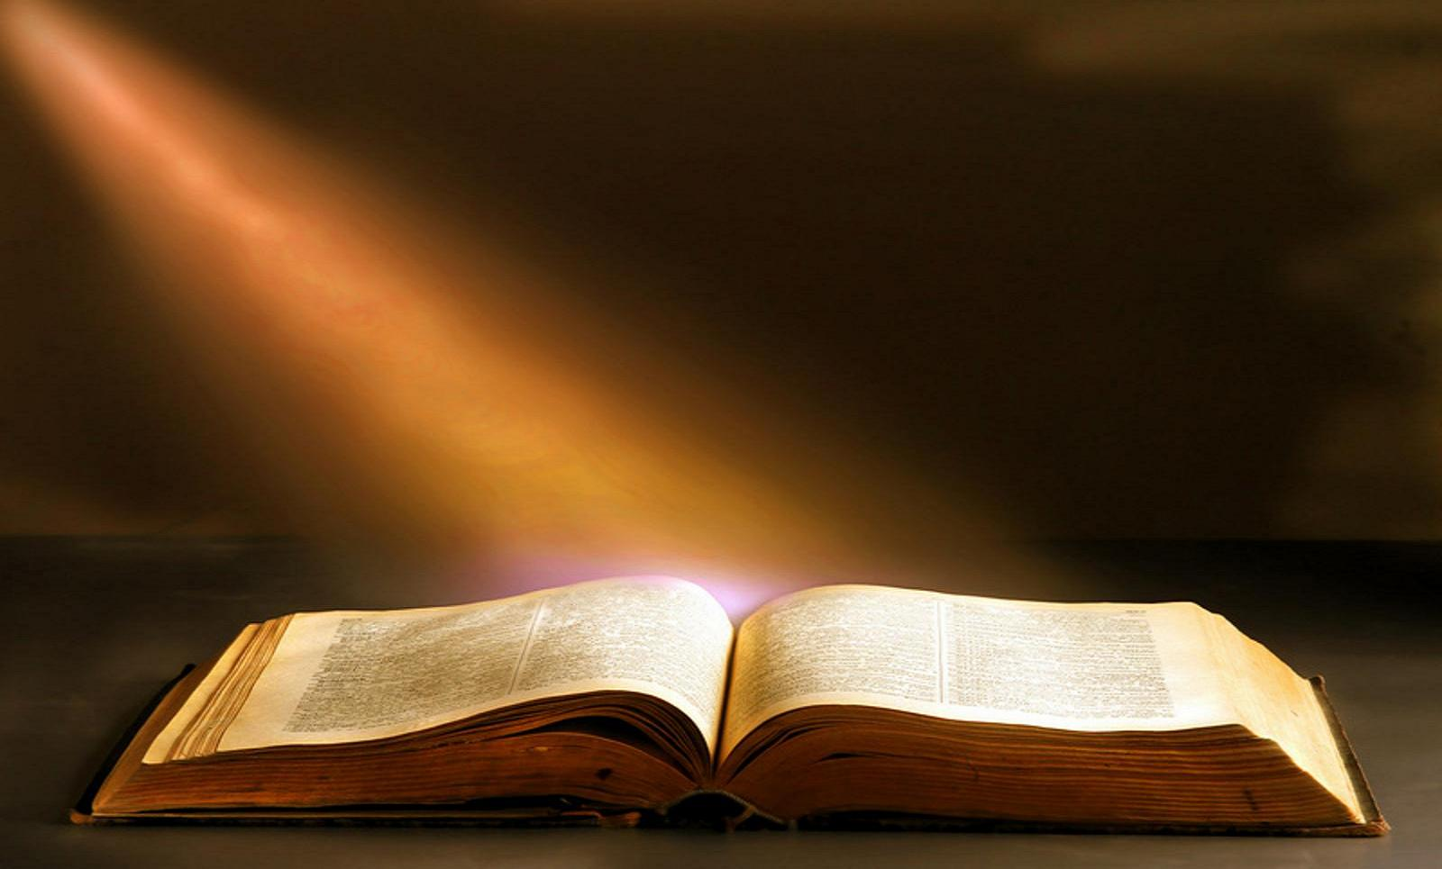
The Apostle Paul understood Isaiah 65:1-2 to apply to the Gentile nations who did not know about God and then to the Nation of Israel who knew about Him but were rebellious (rebellion requires a prior relationship).
To GENTILES (verse 1)
“And Isaiah is very bold and says, ‘I WAS FOUND BY THOSE WHO SOUGHT ME NOT, I BECAME MANIFEST TO THOSE WHO DID NOT ASK FOR ME.’ Romans 10:20
But as for Israel He says, ‘ALL THE DAY LONG I HAVE STRETCHED OUT MY HANDS TO A DISOBEDIENT AND OBSTINATE PEOPLE.’” Romans 10:21
To ISRAEL (verse 2)

Slide 8
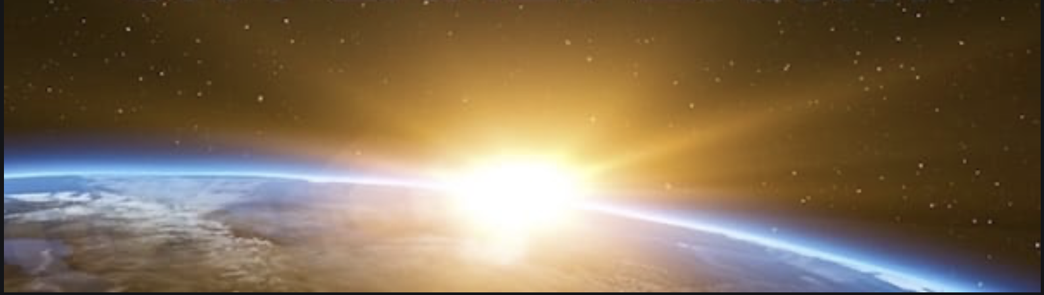
Isaiah has previously predicted that this will take place with the second advent of the Messiah who will bring Israel and the nations under the New Covenant.
“They will not hurt or destroy in all My holy mountain, for the earth will be full of the knowledge of the LORD as the waters cover the sea.” Isaiah 11:9
“I am the LORD, I have called you in righteousness, I will also hold you by the hand and watch over you, and I will appoint you as a covenant to the people, as a light to the nations …” Isaiah 42:6
“Thus He will sprinkle many nations, kings will shut their mouths on account of Him; For what had not been told them they will see, and what they had not heard they will understand.” Isaiah 52:15

Slide 9
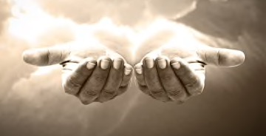
“I have spread out My hands all day long to a rebellious people,
who walk in the way which is not good, following their own thoughts, a people
who continually provoke Me to My face, offering sacrifices in gardens and
burning incense on bricks; Who sit among graves, and spend the night in secret
places; Who eat swine’s flesh, and the broth of unclean meat is in their pots. Who
say, ‘Keep to yourself, do not come near me, For I am holier than you!’” Isaiah 65:2–5a

Slide 10
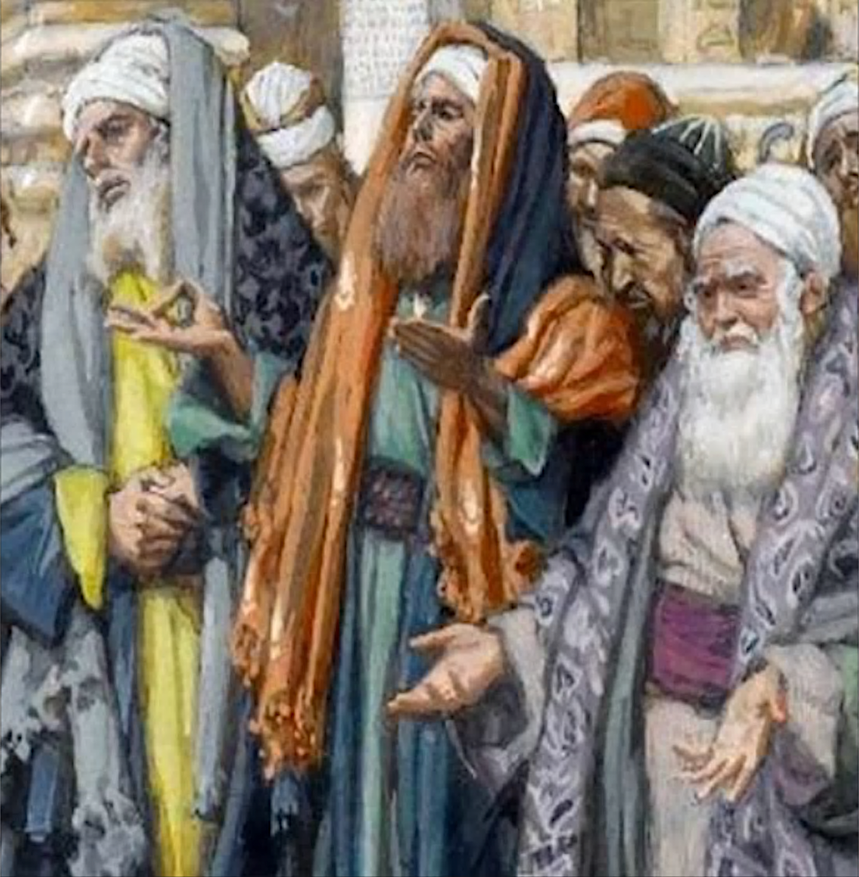
“Now when the Pharisee who had invited Him saw this, he said to himself, ‘If this man were a prophet He would know who and what sort of person this woman is who is touching Him, that she is a sinner’ … And He also told this parable to certain ones who trusted in themselves that they were righteous, and viewed others with contempt: ‘Two men went up into the temple to pray, one a Pharisee, and the other a tax-gatherer. The Pharisee stood and was praying thus to himself, ‘God, I thank Thee that I am not like other people: swindlers, unjust, adulterers, or even like this tax-gatherer. ‘I fast twice a week; I pay tithes of all that I get.’” Luke 7:39; 18:9–12

Slide 11
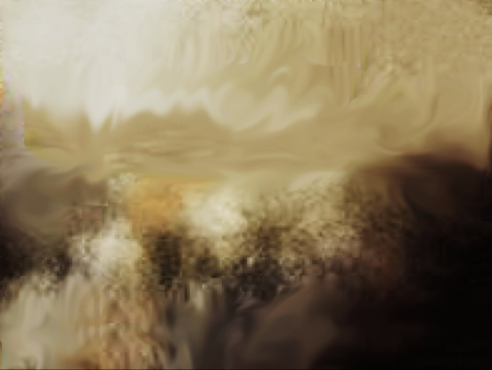
Listing Israel’s Idolatrous Sins
Israel’s Idolatrous Offense Biblical Prohibition
Worship of Ba’al and other fertility deities Exodus 20:3
Sexual Immorality in forests and gardens Isaiah 1:29; 57:5; 66:17
Worship of Astarte, Queen of Heaven Jeremiah 44:17
Necromancy Deut. 18:11; 1 Sam. 28:7-9; Isa. 8:19
Eating forbidden foods Lev. 7:18; 19:7; Isa. 66:17; Ezek. 4:14

Slide 12
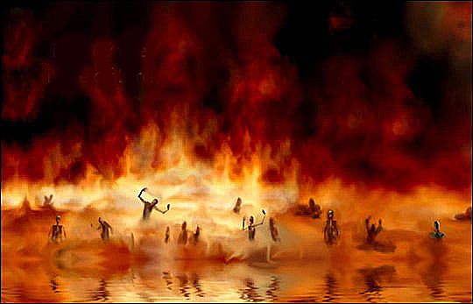
“And I saw a great white throne and Him who sat upon it, from whose presence earth and heaven fled away, and no place was found for them. And I saw the dead, the great and the small, standing before the throne, and books were opened; and another book was opened, which is the book of life; and the dead were judged from the things which were written in the books, according to their deeds … the cowardly and unbelieving and abominable and murderers and immoral persons and sorcerers and idolaters and all liars, their part will be in the lake that burns with fire and brimstone, which is the second death.” Revelation 20:11-12; 21:8

Slide 13
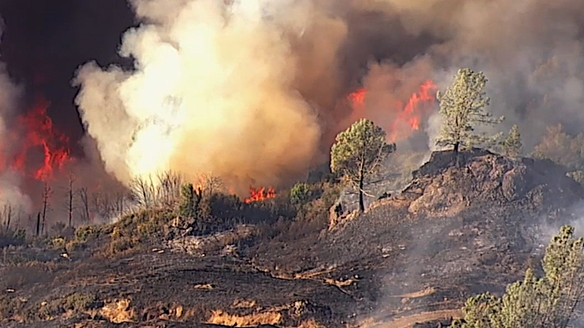
“These are smoke in My nostrils, a fire that burns all the day.” vs. 5b

Slide 14
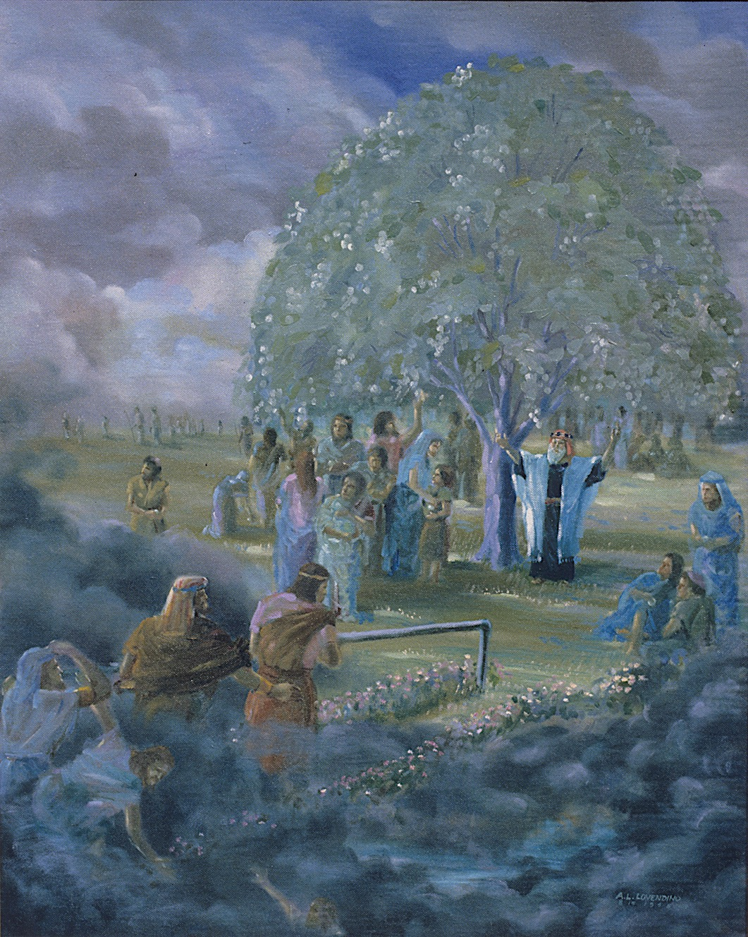
The Contrast of Future Destinies vss. 6-16
‘Behold, it is written before Me, I will not keep silent, but I will repay; I will even repay into their bosom, both their own iniquities and the iniquities of their fathers together,’ says the LORD. Because they have burned incense on the mountains, and scorned Me on the hills, therefore I will measure their former work into their bosom.’” vss. 6–7

Slide 15
God’s Hatred of Paganism
“You shall utterly destroy all the places where the nations whom you shall dispossess serve their gods, on the high mountains and on the hills and under every green tree.” Deuteronomy 12:2
“Then you will know that I am the LORD, when their slain are among their idols around their altars, on every high hill, on all the tops of the mountains, under every green tree, and under every leafy oak — the places where they offered soothing aroma to all their idols.” Ezekiel 6:13

Slide 16
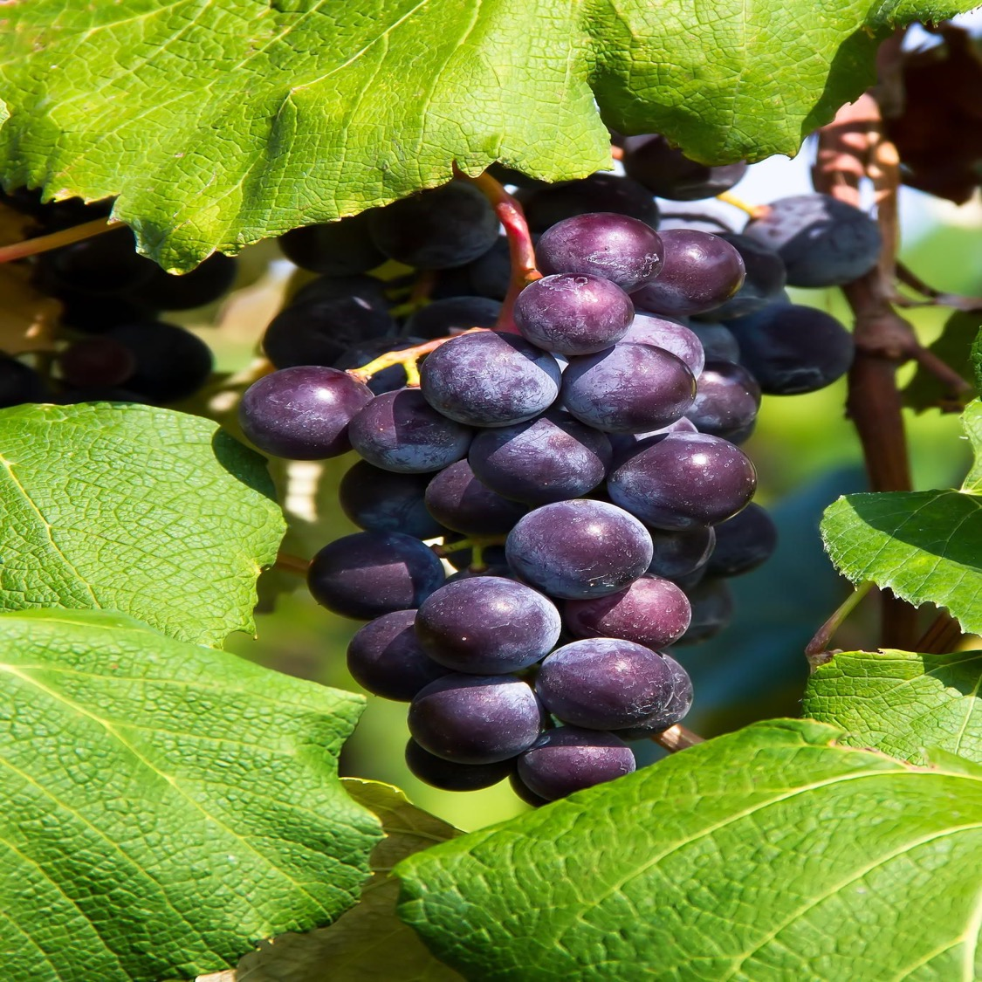
“Thus says the LORD, ‘as the new wine is found in the cluster, and one says, ‘do not destroy it, for there is benefit in it,’ so I will act on behalf of My servants In order not to destroy all of them.
And I will bring forth offspring from Jacob, and an heir of My mountains from Judah; Even My chosen ones shall inherit it, and My servants shall dwell there. And Sharon shall be a pasture land for flocks, and the valley of Achor a resting place for herds, for My people who seek Me.” Isaiah 65:8–10

Slide 17
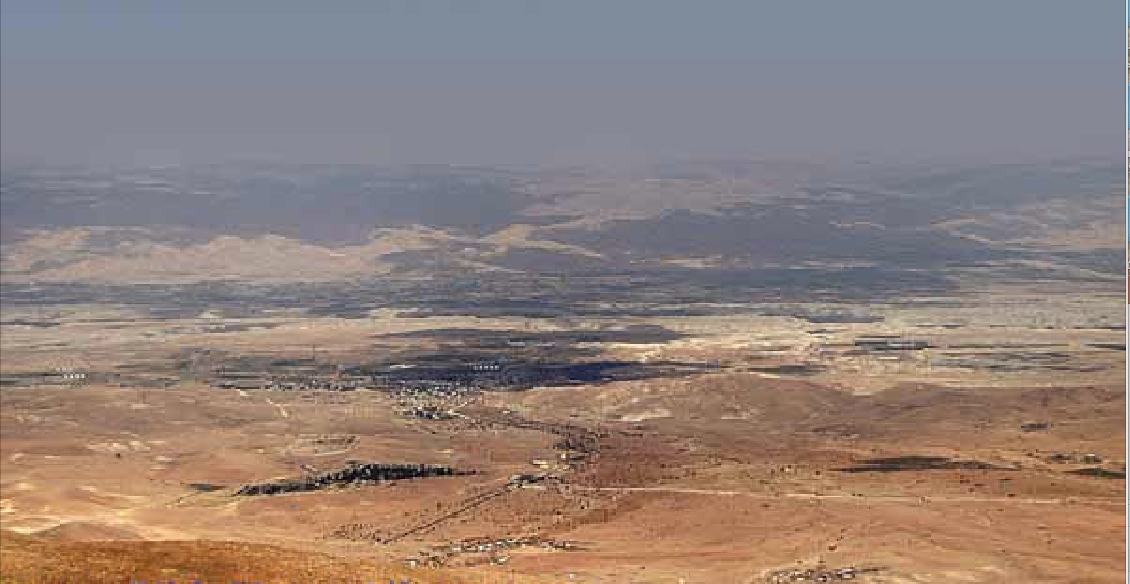
“Then Joshua and all Israel with him, took Achan the son of Zerah, the silver, the mantle, the bar of gold, his sons, his daughters, his oxen, his donkeys, his sheep, his tent and all that belonged to him; and they brought them up to the valley of Achor. And Joshua said, ‘Why have you troubled us? The LORD will trouble you this day.’ And all Israel stoned them with stones; and they burned them with fire after they had stoned them with stones. And they raised over him a great heap of stones that stands to this day, and the LORD turned from the fierceness of His anger. Therefore, the name of that place has been called the valley of Achor (“Disaster”) to this day.” Joshua 7:24–26

Slide 18
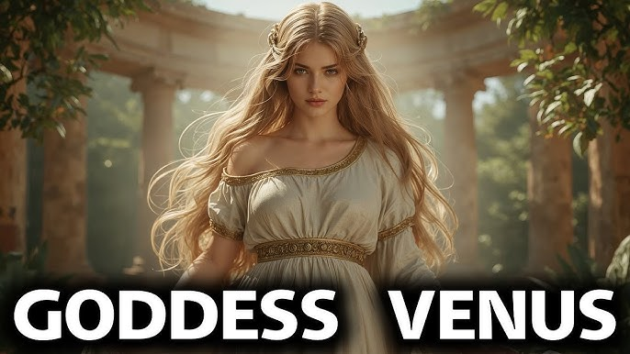
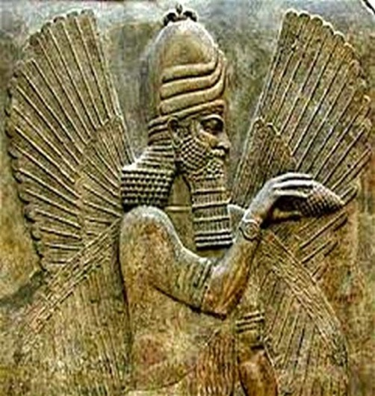
“But you who forsake the LORD, who forget My holy mountain (Temple Mount), who set a table for Fortune (Babylonian god Ba’al Gad = Jupiter), and who fill cups with mixed wine for Destiny (Babylonian god Meni = Venus), I will destine you for the sword, and all of you shall bow down to the slaughter.” Isaiah 65:11–12

Slide 19
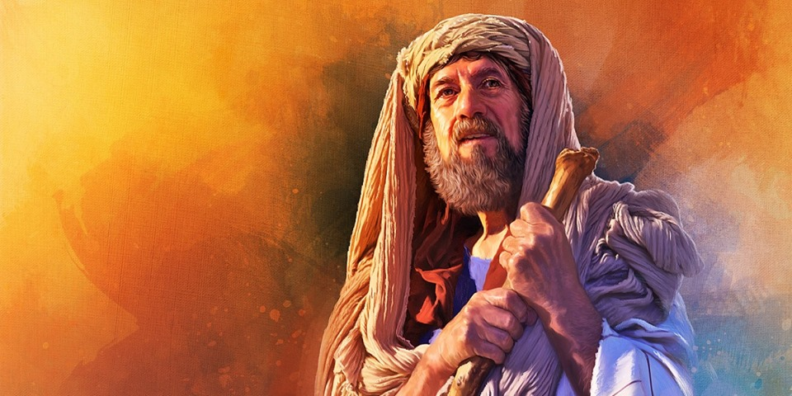
“Because I called, but you did not answer; I spoke, but you did not hear. And you did evil in My sight, and chose that in which I did not delight.” Isaiah 65:12
“Therefore, behold, I am sending you prophets and wise men and scribes; some of them you will kill and crucify, and some of them you will scourge in your synagogues, and persecute from city to city,” Matthew 23:34

Slide 20
The Saints
The Aints
“Therefore, thus says the Lord GOD, ‘Behold, My servants shall eat, but you shall be hungry. Behold, My servants shall drink, but you shall be thirsty. Behold, My servants shall rejoice, but you shall be put to shame. Behold, My servants shall shout joyfully with a glad heart, but you shall cry out with a heavy heart, and you shall wail with a broken spirit. And you will leave your name for a curse to My chosen ones, and the Lord GOD will slay you. But My servants will be called by another name. ” vss. 13–15

Slide 21
The Saints
The Aints
My servants shall eat You shall be hungry
My servants shall drink You shall be thirsty
My servants shall rejoice You shall be ashamed
My servants shall shout joyfully with a glad heart You shall cry out with a heavy heart
My servants will be called by another name Your name will be a curse

Slide 22
“Because he who is blessed in the earth shall be blessed by the God of truth; And he who swears in the earth shall swear by the God of truth; Because the former troubles are forgotten, and because they are hidden from My sight!” Isaiah 65:16

Slide 23
The Creation of the New Jerusalem vss. 17-18
“For behold, I am going to create a new heavens and a new earth; And the former things shall not be remembered or come to mind.” Isaiah 65:17

Slide 24
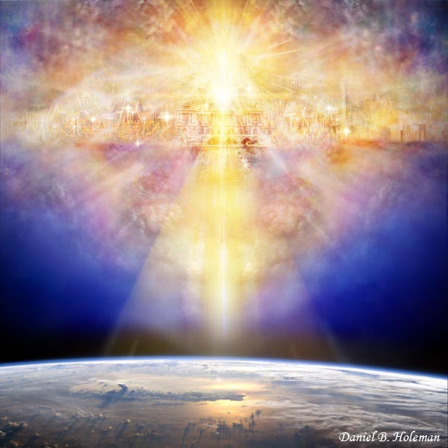
“But be glad and rejoice forever in what I create; For behold, I create Jerusalem for rejoicing, and her people for gladness. I will also rejoice in Jerusalem and be glad in My people.” vss. 18-19a

Slide 25
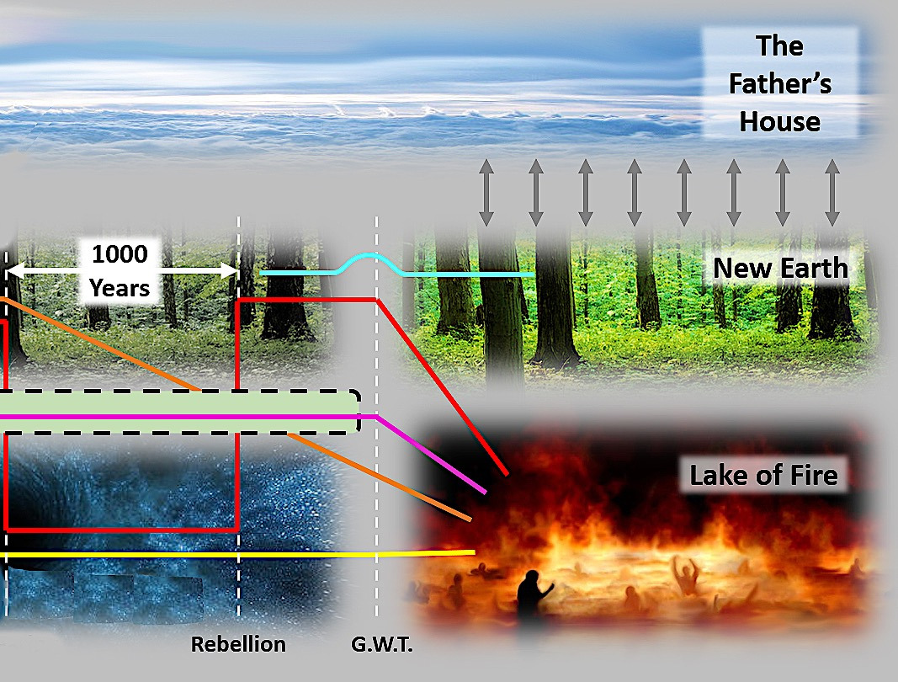

Slide 26
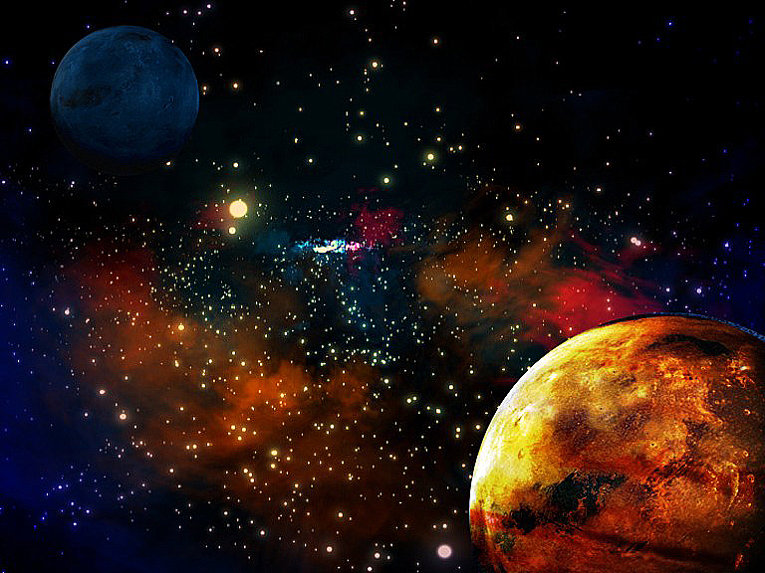
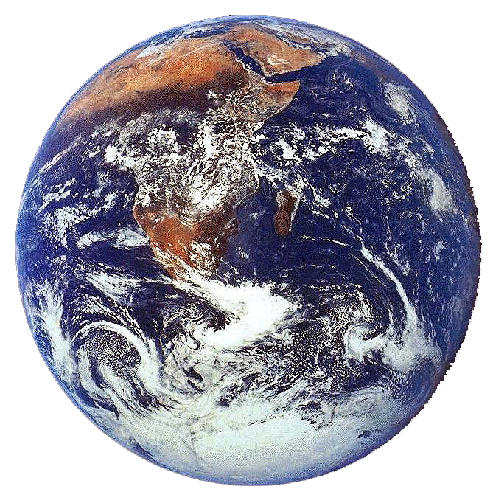
“and he showed me the holy city, Jerusalem, coming down out of heaven from God”
Revelation 21:10

Slide 27

The New Jerusalem
in relation to the U.S.A.

Slide 28
The New Jerusalem is laid out as a square with connecting planes of equal size that apparently form a cube. This has long been recognized as the exact shape of the Holy of Holies, although 240,000 times as big!
The New Jerusalem's dimensions are 1,500 miles equally in every direction, or as one engineer has figured, an area of 2,250,000 square miles. Unlike the limitations of our present cities and our present form, we may be able to inhabit this city equally in all places, from height to depth as well as width to breadth.

Slide 29
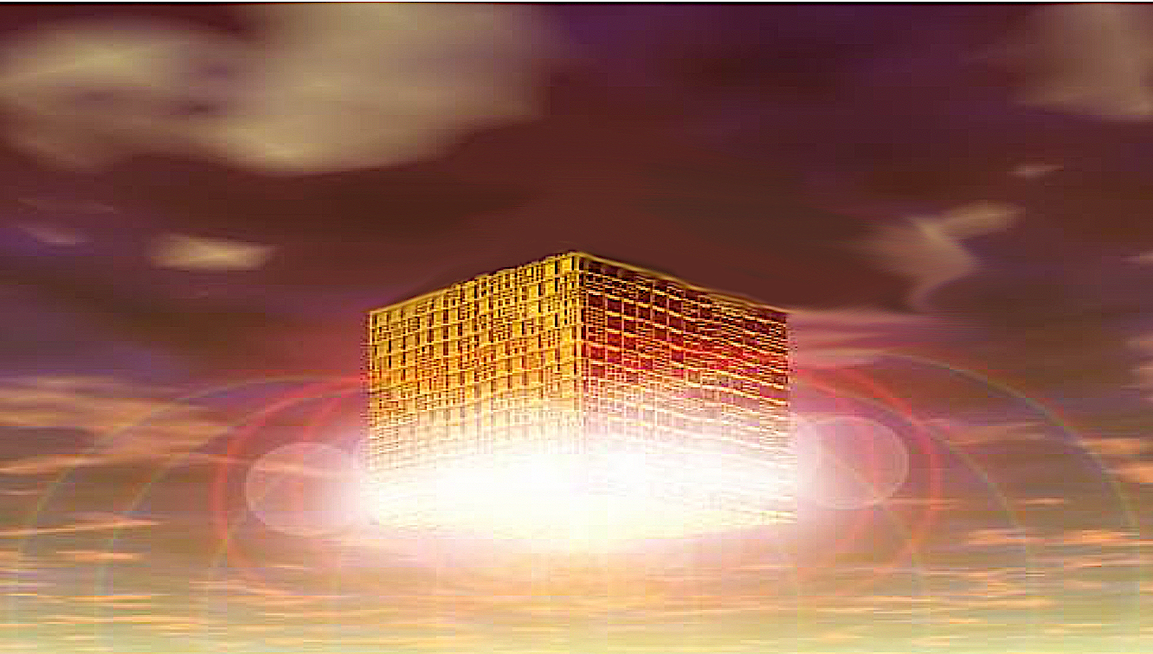
Jesus said: “In my Father’s house are many rooms; if it were not so, I would have told you. I am going there to prepare a place for you. And if I go and prepare a place for you, I will come back and take you to be with me that you also may be where I am.” John 14:1-3
The words “in my Father’s house” indicate that we will not be dwelling in our own “mansions” apart from God, but within His own dwelling place (akin to a modern multiple-family dwelling)
The words “house,” “rooms,” and “a place” suggest a physical place where the physically-resurrected redeemed will f orever live.

Slide 30
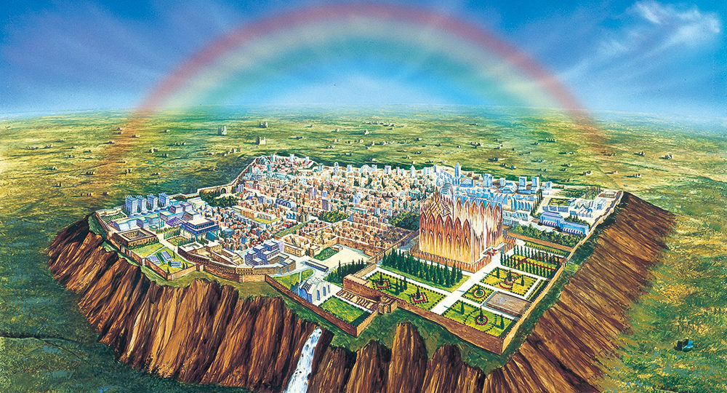
THE SAINTS WILL REIGN (WITH JESUS) ON THE EARTH
“And Thou hast made them to be a kingdom and priests to our God; and they will reign upon the earth.” Revelation 5:10

Slide 31
Perfect Physical Dwelling
Not an ethereal twilight-zone dimension.
We will be physically resurrected (1 Corinthians 15:35-53).
Physically resurrected bodies require a physical place to dwell.
We, in our physically resurrected bodies, will live on a resurrected earth in a resurrected universe.

Slide 32
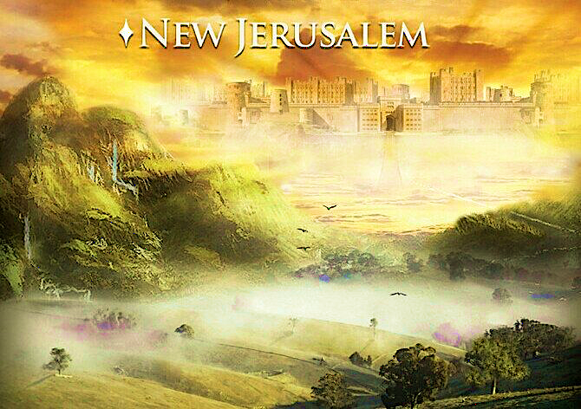
The Characteristics of the Kingdom. vss. 19b-25
“And there will no longer be heard in her the voice of weeping and the sound of crying.” Isaiah 65:19b

Slide 33
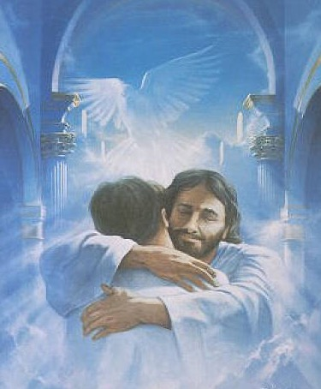
No More Death or Mourning
“He will wipe every tear from their eyes. There will be no more death or mourning or crying or pain, for the old order of things has passed away.” Revelation 21:4
“God will wipe away every tear from their eyes” Isaiah 25:8; Rev. 7:17
  Original Greek: Not tears (generally) but every tear (singular), as if God will wipe away every single tear of every single believer.
  Not a single tear will be upon our faces!
Loved ones not in heaven? “Behold, I will create new heavens and a new earth. The former things will not be remembered, nor will they come to mind.” (Isa. 65:17)

Slide 34
Perfect Relationship with Christian Loved Ones
How do we know we will be reunited?
  “What is our hope, our joy, or the crown in which we will glory in the presence of our Lord Jesus when he comes? Is it not you?” (1 Thessalonians 2:19)
  Reunion in heaven - “Dead in Christ” will rise (1 Thessalonians 4:13-17)
  Will we recognize each other? YES!
  Reunion promised (1 Thessalonians 4:13-17)
  Rich man and Lazarus in the afterlife (Luke 16:19-31)
  David knew he would be reunited with his deceased son in heaven (2 Samuel 12:23)
  Moses and Elijah appeared to Jesus on the Mount of Transfiguration (Matthew 17:1-8)

Slide 35
Our Relationships Will be Utterly Perfect
No sin nature!
No more cross words,
  No more misunderstandings,
  No more neglect shown to people,
  No rivalries,
  No jealousies,
  No competing for someone’s love,
  and no selfishness.

Slide 36

“No longer will there be in it an infant who lives but a few days, or an old man who does not live out his days; For the youth will die at the age of one hundred and the one who does not reach the age of one hundred shall be thought accursed.” Isaiah 65:20

Slide 37
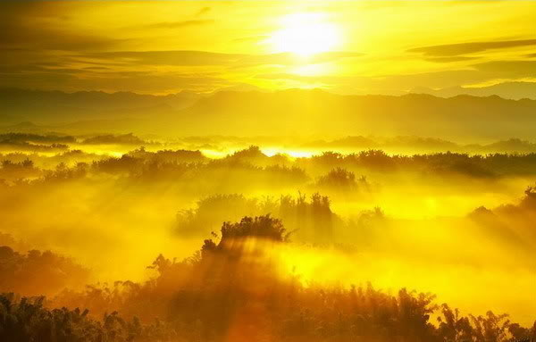
Blessed Rest
The redeemed will rest from their labors: “Blessed are the dead who die in the Lord from now on. ‘Yes,’ says the Spirit, ‘they will rest from their labor.’” Revelation 14:13
  No more deadlines.
  No more overtime.
  Just rest. Sweet serene rest.
“This rest will be absolutely perfect. We shall then have joy without sorrow, and rest without weariness.” - Richard Baxter, The Saints Everlasting Rest

Slide 38
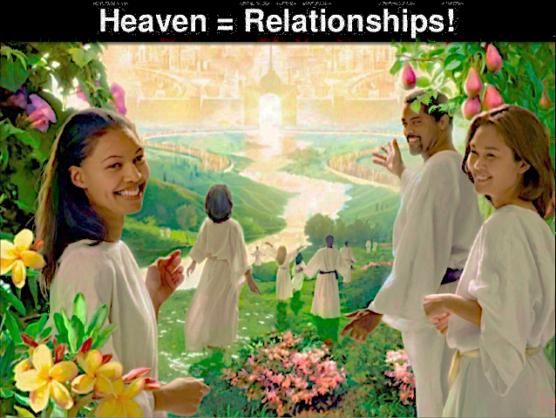
“And they shall build houses and inhabit them; They shall also plant vineyards and eat their fruit.”
“They shall not build, and another inhabit, they shall not plant, and another eat; For as the lifetime of a tree, so shall be the days of My people, and My chosen ones shall wear out the work of their hands.” Isaiah 65:21-22

Slide 39
Blessed Activities
No playing harps on clouds!
No purposeless inactivity.
Meaningful, yet restful, service throughout eternity.
  Not tedious, but joyous.
  Without frustration, without fear of failure, without limitations, and without exhaustion.
Praising and worshiping God and Christ with angels (Rev. 5:11-12)
Learning more about our incomparable God (Eph. 2:7)

Slide 40
“They shall not labor in vain, or bear children for calamity; For they are the offspring of those blessed by the LORD, and their descendants with them.” Isaiah 65:23

Slide 41
Perfect in Every Way
No more curse — perfect restoration.
The throne of God and of the Lamb shall be in it — perfect administration.
God's servants shall serve him — perfect occupation.
God's name shall be on their foreheads — perfect identification.
There shall be no night there; the Lord is the light — perfect illumination.
They shall reign forever and ever with Christ — perfect exultation.
What could be better?

Slide 42
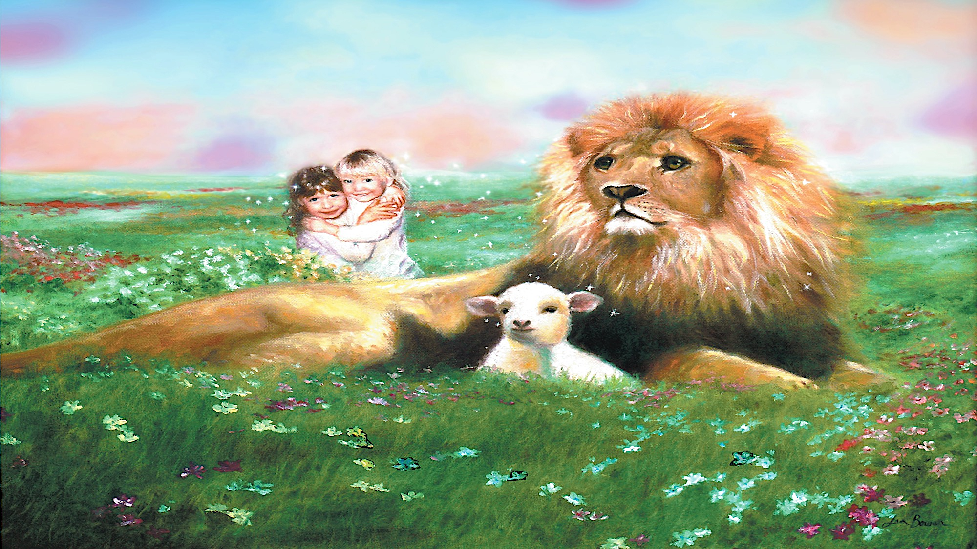
The law of the jungle will change to conform to the rule of the King
“It will also come to pass that before they call, I will answer; and while they are still speaking, I will hear. The wolf and the lamb shall graze together, and the lion shall eat straw like the ox; and dust shall be the serpent’s food. They shall do no evil or harm in all My holy mountain, says the LORD.” Isaiah 65:24–25

Slide 43

Perfect Relationship with God
John declared: “They will see His face” (Revelation 22:4).
The apostle Paul affirmed, “Now we see but a poor reflection as in a mirror; then we shall see face to face. Now I know in part; then I shall know fully, even as I am fully known” (1 Corinthians 13:12).
The psalmist added: “And I … I shall see Your face” (Psalm 17:15).
John also affirmed: “We know that when He appears, we shall be like Him, for we shall see Him as he is.”

Slide 44

Lessons from Isaiah 65
1. God is gracious and just. He extends grace to those who never knew Him and judges those who know His truth but reject Him and follow that which is false (vss. 2-7).
2. God always preserves a believing Remnant in order to carry on His plan, returning to the Promised Land to be blessed and be a blessing (vss. 8-10).
3. God demonstrates His justice in providing for the just and withholding from the unjust (vss. 11-15).
4. God will make life in the Millennial Kingdom so glorious that the past problems of the Tribulation and the scandalous history of mankind is forgotten (vss. 16-25).

Slide 45
Black

Slide 46
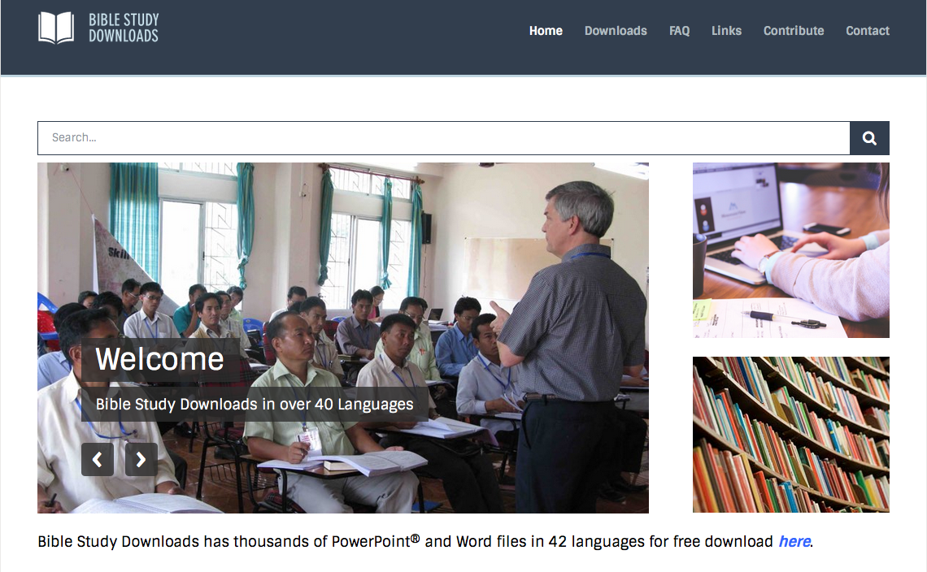

OT Preaching link at BibleStudyDownloads.org
Get this presentation for free!
Notes:
OT Preaching (op)

